Slide 1
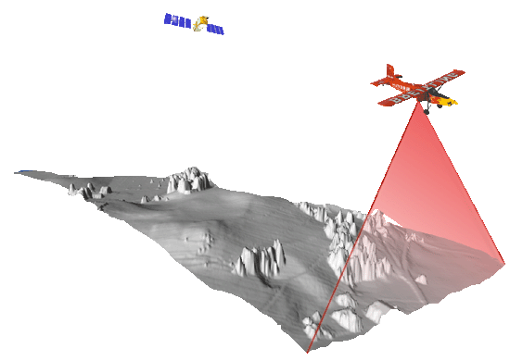



Lidar to inform Nepa
Lidar is an extremely useful tool
that can streamline workflows, save time and money and provide better data to inform natural resource decisions

Slide 2
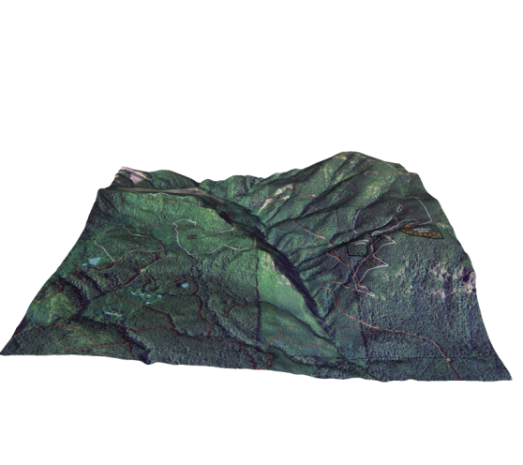
Some of the ways we are using lidar at the Salem blm
Common use products such as; Hillshades, vegetation heights, slope and DEM’s available as mosaics through the state office layer browser for use in ArcMap.
Use “Top points” vegetation height data to get a quick snapshot of stand statistics and use in 3D visualizations.
More precise mapping of existing streams & roads.
Use 3D analyst toolbar & Lidar DEM’s for getting quick profile information related to project planning like; yarding profiles, identifying fish barriers & stream longitudinal and cross-section profiles, testing potential new road locations, and many more……..

Slide 3
More ways we are using lidar Data
Potential Site Tree Height querrying
Quick Line of Sight analysis snapshot
Created a Canopy closure tool (Outputs an estimation of canopy closure)
Created a Trees per acre tool (Outputs an estimation of TPA)
3D visualizations of proposed projects (Using ArcGis Explorer)

Slide 4
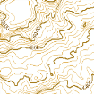








Lidar Mosaics for use in Arcmap or other GIS applications
LiDAR Bare Earth DEM (available in meters or feet)
Bare earth DEM. Elevations are from sea level to ground level, in meters or feet. Values in the ArcMap table of contents will recalculate to show the minimum and maximum in the current extent.
LiDAR Bare Earth Hillshade
Hillshade of bare earth DEM.
LiDAR Bare Earth Shaded Relief
Shaded relief of bare earth DEM.
LiDAR Bare Earth Slope
Percent slope calculate from the bare earth DEM. Slope is unclassified. Values in the ArcMap table of contents will recalculate to show the minimum and maximum in the current extent.
LiDAR Bare Earth Slope Class (20-35-60) (available with or without hillshade)
Percent slope calculated from the bare earth DEM, classified into 4 classes: 0-20%, >20-35%, >35-60%, >60%. Also available draped over bare earth hillshade.
LiDAR Bare Earth Aspect (available with or without hillshade)
Slope aspect in the cardinal directions
Contours (LiDAR)
20’ Contours derived from LiDAR bare earth DEMs.

Slide 5
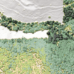
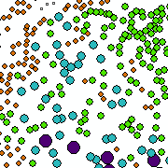





Lidar Mosaics for use in Arcmap (cont)
LiDAR Highest Hit DEM (meters)
First return DEM. Elevations are from sea level to the tops of features, in meters; NOT the height of the features above ground level. Values in the ArcMap table of contents will recalculate to show the minimum and maximum in the current extent.
LiDAR Highest Hit Hillshade
Hillshade of first return DEM.
LiDAR Feature Height (available in meters or feet)
Height, in meters or feet, of features above ground calculated from the bare earth and highest hit DEMs. Values in the ArcMap table of contents will recalculate to show the minimum and maximum in the current extent.
LiDAR Shaded Feature Height (feet) (available in Bright or Green color scheme)
Height, in feet, of features above ground calculated from the bare earth and highest hit DEMs. Values in the ArcMap table of contents will recalculate to show the minimum and maximum in the current extent. Feature Height is draped over the highest hit hillshade. Two color schemes are available: shades of green to dark blue or just in shades of green.
LiDAR Shaded Feature Height Classes (25 foot)
Feature Heights classified into 25’ height bands, draped over the highest hit hillshade.
LiDAR Top Points (available for each resource area)
Feature top points derived from LiDAR. These are peaks in the LiDAR derived feature height surface. In vegetated areas, the points can be used as a proxy for individual tree locations.

Slide 6
Some Limitations on using lidar should be addressed
Limitations:
The ability to pull specific tree species and dbh out of the data is limited (without some advanced processing)
It is very good at depicting the top canopy surface but struggles with mutli-story canopy delineations, (without some advanced processing)
The “Top Points” product is great at relative vegetation heights, but due to possible error with tree lean the inability to parse out multi-story “top points” and the fact that not every tip top of indivitual tree may be detected, there is some error inherent in this data product. (may underestimate the total number of trees in multistory canopy, may overestimate heights in steep ground)
Dense canopy can reduce the resolution of the “ground” DTM or Bare Earth data
Treat the data as a model with these limitations in mind and you will get a much better picture of the landscape, save lots of time and money.

Slide 7
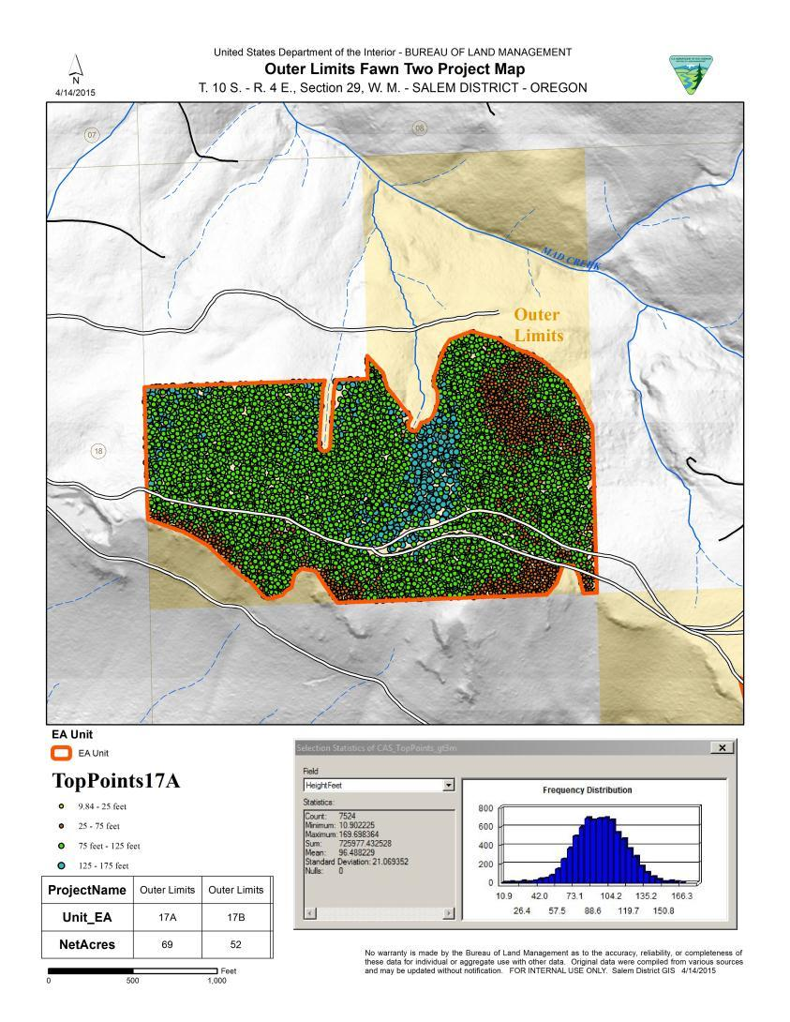
“top points” Quick Stand statistics and visual of tree heights Also gives the ability to query out specific ranges of tree heights also used to create Realistic 3d Visuals in ArcGis explorer

Slide 8
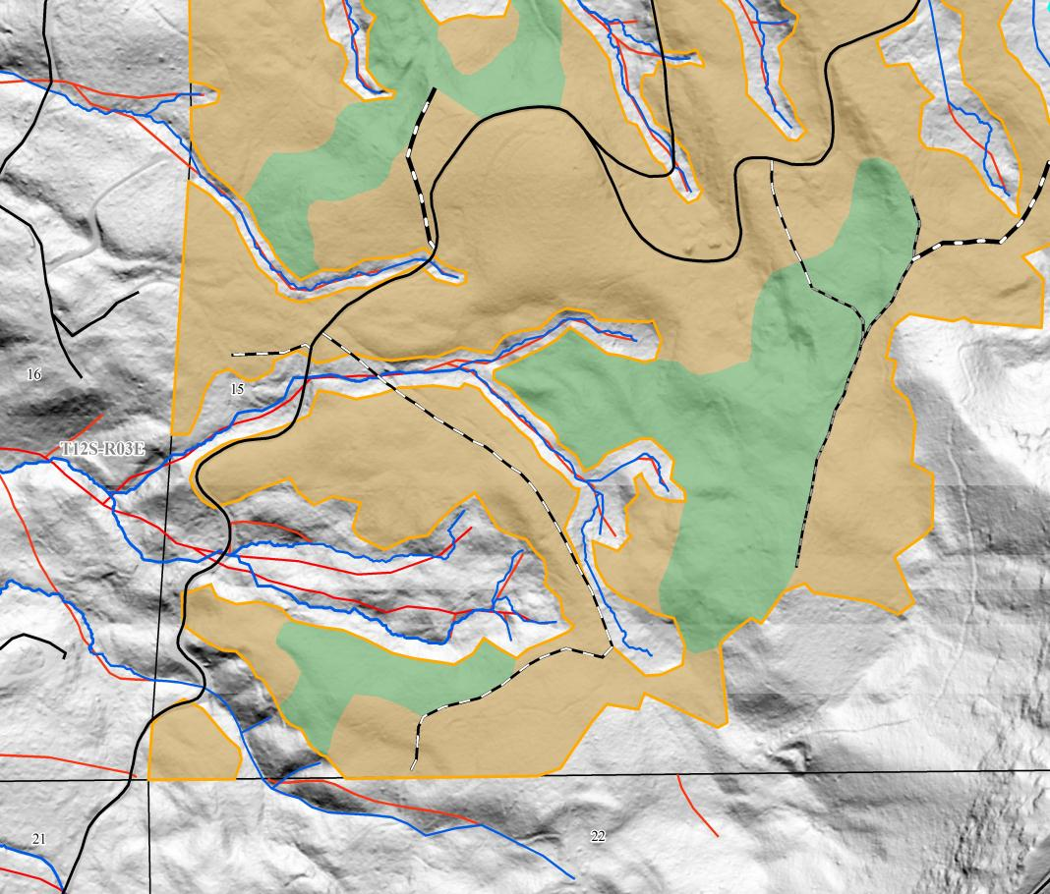
STREAM MODELING (4 ACRE CATCHMENT )
Focused Inception Point Surveys
Accurate Channel Locations (wide floodplanes tricky)
Accurate Stream Buffer
Minimizes “Surprise Streams”

Slide 9
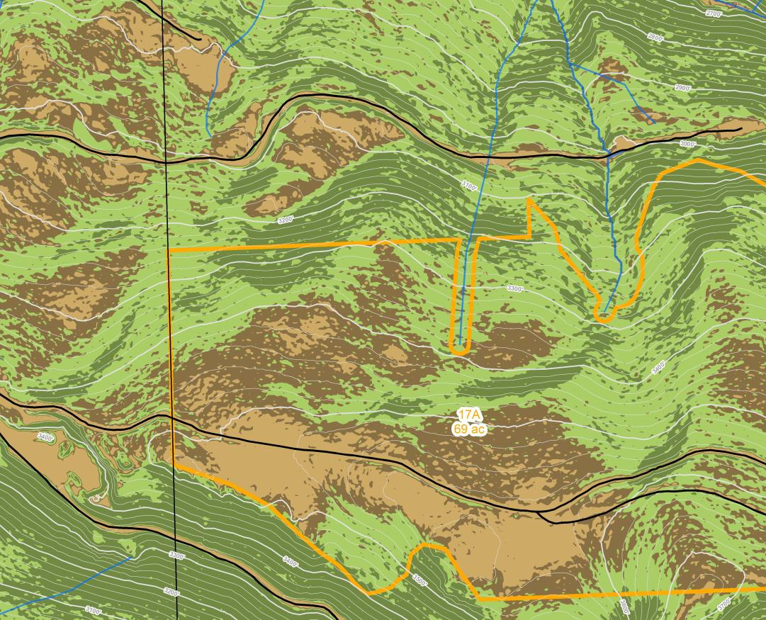
Slope Class / Hillshade / Contours
0-20% (light brown)
Existing Roads
New Rd Construction
Floodplain Mapping*
Adverse Skidding
21-35% (dark brown)
Favorable Skidding
New Rd guide
36-60% (light green)
Skyline Yarding
Rd const. more difficult
>60% (dark green)
Road issues
Stability issues
Sore leg issues

Slide 10
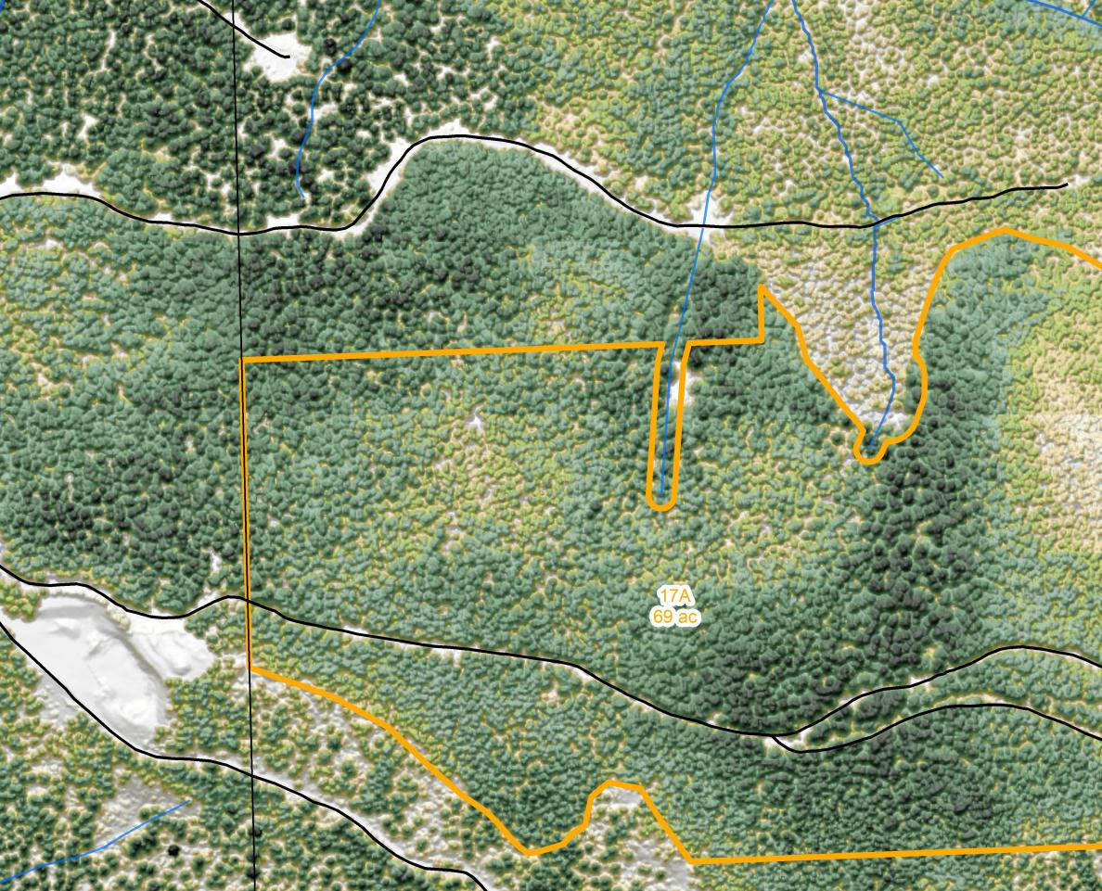
Slope Class / Hillshade / Contours

Slide 11

Slope Class / Hillshade / Contours

Slide 12

Slope Class / Hillshade / Contours

Slide 13
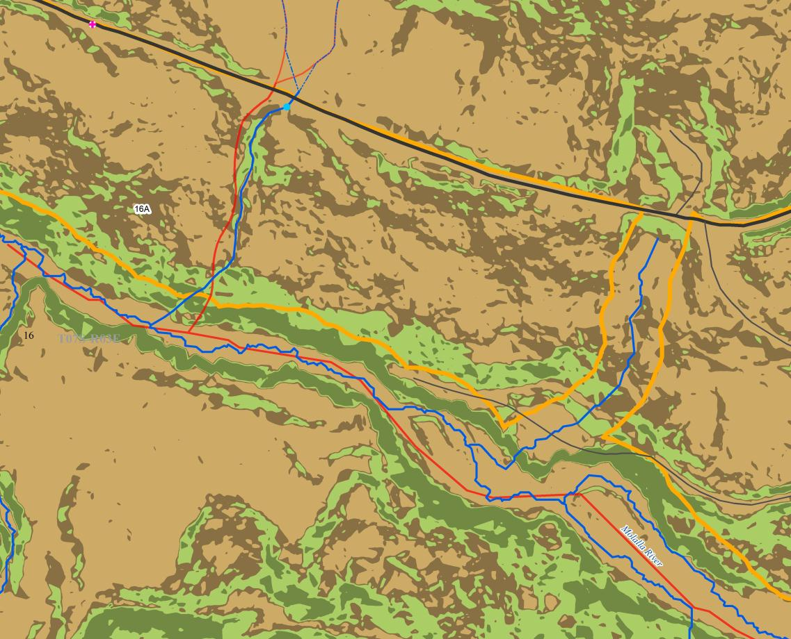
Floodplain Mapping
Wide Floodplains

Slide 14
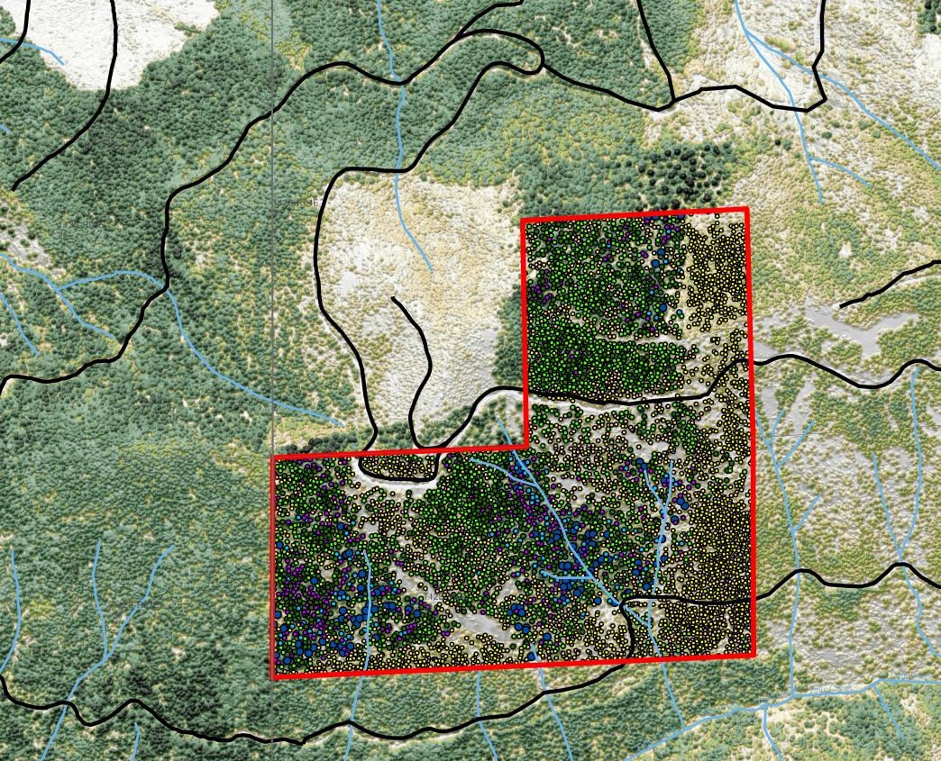
Feature Height / Top Points
Remote Parcel
Proposed for transfer
District Cruiser needed a “Hip Shot” Volume Estimate
Timeline wouldn’t allow a field visit

Slide 15
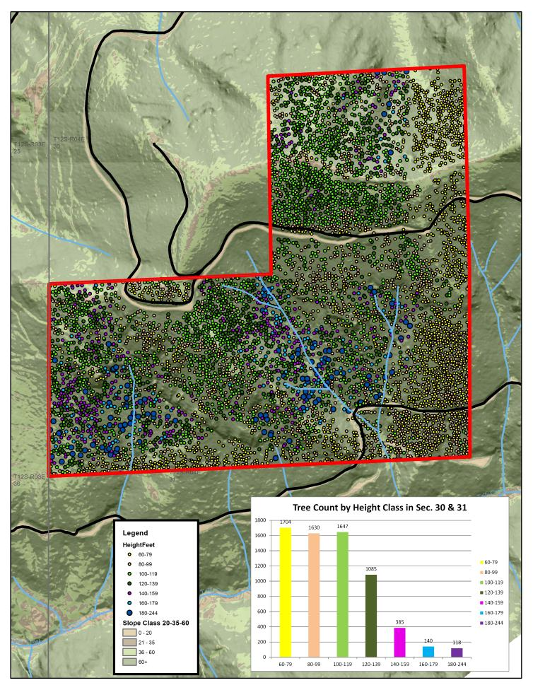
Feature Height / Top Points
Selected Top Points within parcel
Classified Tree Heights from “Top Points”
Exported tree list to MS Excel
Produced tree count by height class table
Overlaid on slopes layer to portray logging difficulty
25 minute turnaround time
Would have taken several days to produce courser data

Slide 16
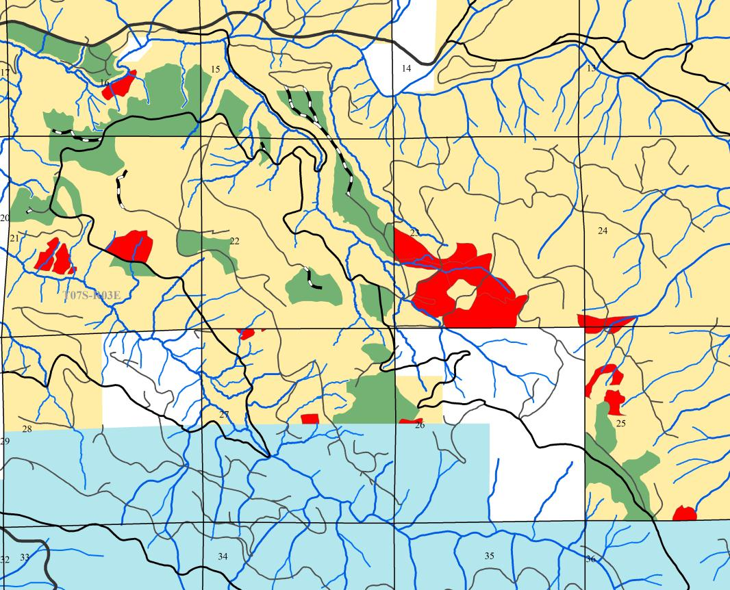
Feature Height / Top Points
200 year Site Tree Query
Harvest Units ~ 500 acres (Green)
Cruised 1 plot / 5ac
~100 trees measured and modeled to 200 yrs
Query Inventory for stands over 200 years (Red)
Select Top Points over 160’ within queried stands

Slide 17
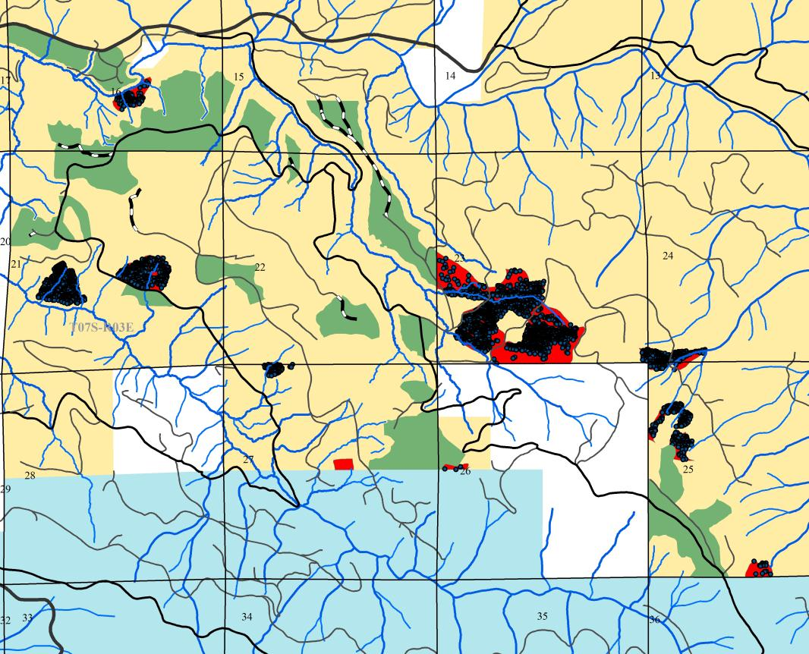
Feature Height / Top Points
200 year Site Tree Query
Returned 3,450 trees
Sample size nearly 3000 trees bigger
No modeling errors possible
Trees within project vicinity

Slide 18
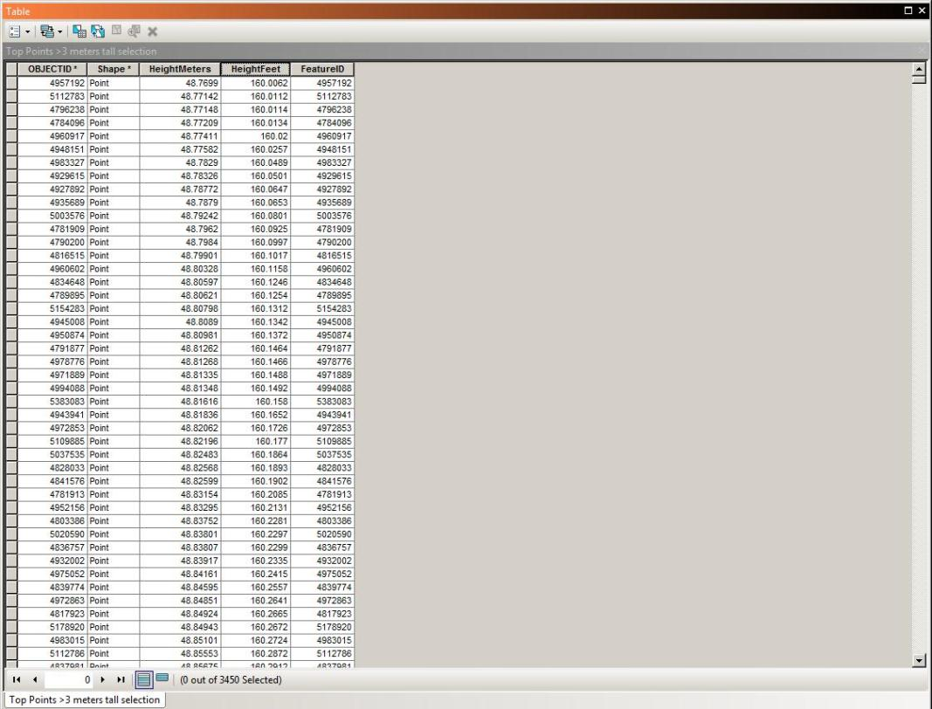
Feature Height / Top Points
200 year Site Tree Query
Returned 3,450 trees
Sample size nearly 3000 trees bigger
No modeling errors possible
Trees within project vicinity

Slide 19
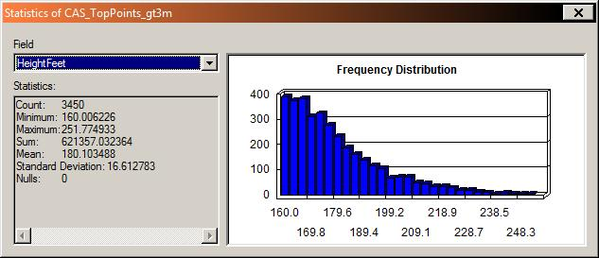
Feature Height / Top Points
200 year Site Tree Query
Height range from 160-252 feet tall
Average Height 180’
Modeled Height 220’
Similar project after cruised showed a 500 MBF difference for every 10 feet of buffer distance
Would be a 2 MMBF volume swing on this sale

Slide 20
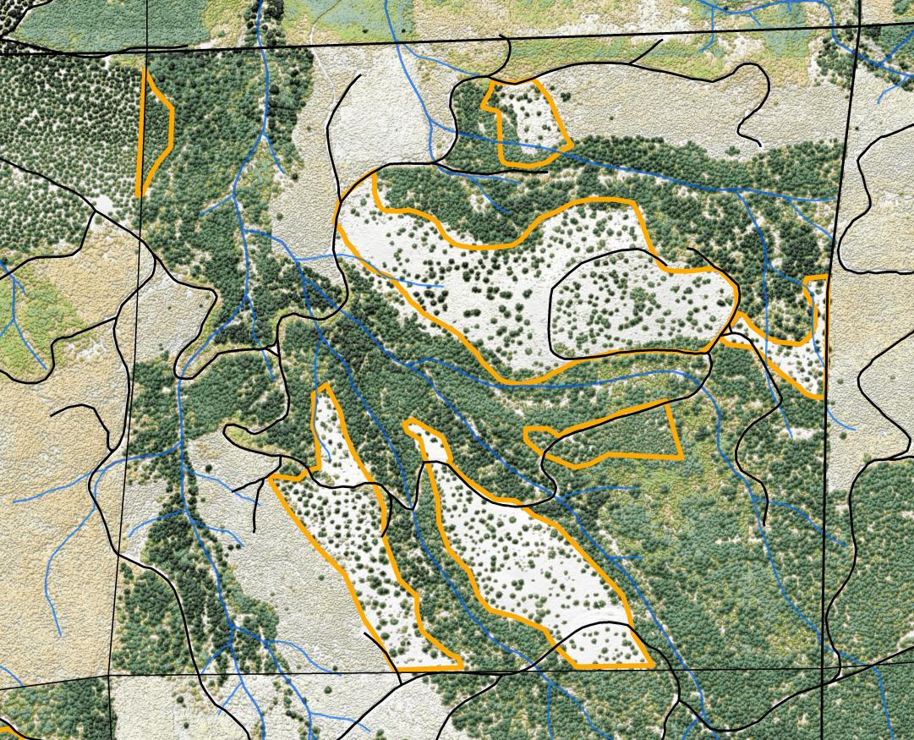
Feature Height / Top Points
Remnant and Wildlife Trees
Post-Harvest Tree Counts
Remnant Tree Location
Could be used to justify Desired Future Condition
Coupled with IR band of High-Res aerial photo, can estimate snag counts.

Slide 21
DEM’s
Select Streams of Interest
Right Click on Streams, Data, Export Data and save to work space
Analysis Tools, Proximity, Buffer: Buffer for desired distance (usually Riparian Reserve).
Data Management Tools, Raster, Raster Processing, Clip:
“Input Raster”=Lidar Bare Earth DEM (meters),
“Output Extent”= Stream Buffer you just created in step 3,
Check the “Use Input Features for Clipping Geometry” box,
Save to your project geodatabase, click “OK”
Spatial Analyst Tools, Distance, Path Distance:
“Input raster or feature source data”= your stream polyline layer created in step 2,
“Output distance raster”= save to your project geodatabase,
leave “Input cost raster” blank,
“Input surface raster”= the DEM raster you created in step 4,
“Maximum distance”= the slope distance of your stream buffer (Riparian Reserves) in meters (since your dem is in meters), click “OK”
Spatial Analyst Tools, Reclass, Reclassify:
“Input raster”= the raster you created in step 5, click on classify: You can classify the slope distances from the stream you are interested in, for example: Method=Manual, Classes=4, Break Values = 9.14399(30ft), 18.28799(60ft), 25.90799(85ft), 67.055954(220ft, or whatever your Riparian Reserve distance was from “Maximum distance” in step 5,
In the “New Values” column you can change these to your distances in feet from the above classes that are in meters (30, 60, 85, and 220, or RR distance),
“Output raster”=save to your project geodatabase.
Conversion Tools, From Raster, Raster to Polygon:
“Input raster”= the raster you created in step 6,
“Field”=Value,
“Output polygon features”=save to your project geodatabase,
check the “Simplify polygons” box, click “OK”

Slide 22
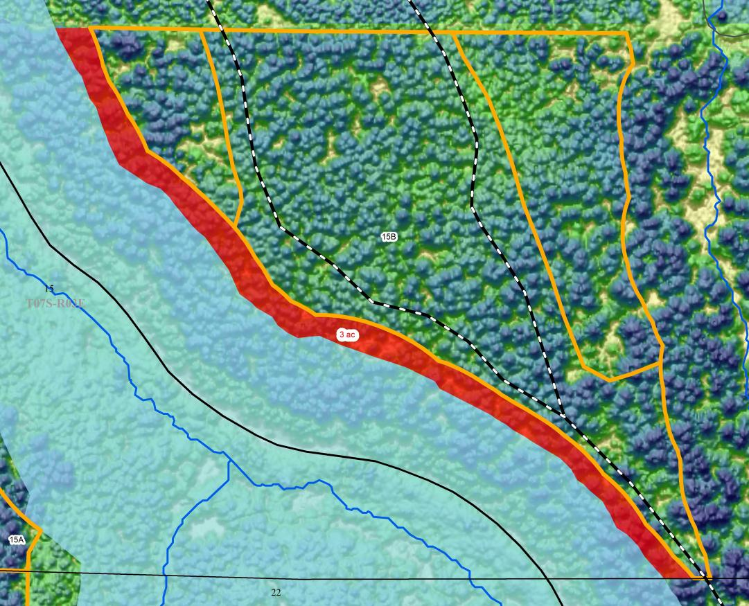
DEM’s
Slope Distance Buffering
Ability to map slope distance buffers vs. horizontal buffers
~75 foot difference in this example = 3 acres on one side of a 15 acre unit
Limits over reporting of roads within Riparians

Slide 23
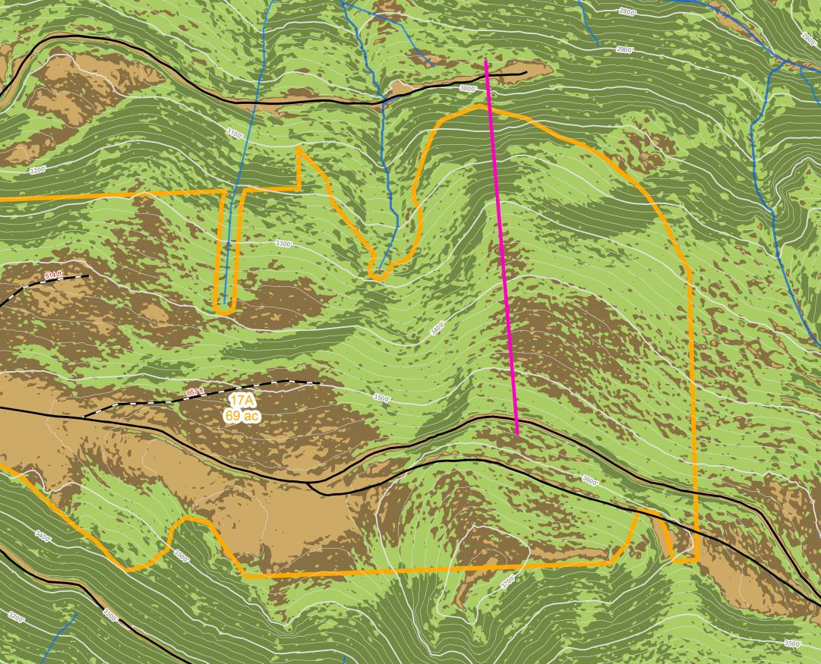
DEM’s
Logging Profiles
Can take days or weeks to collect field data
Can be done in minutes with LiDAR DEM

Slide 24
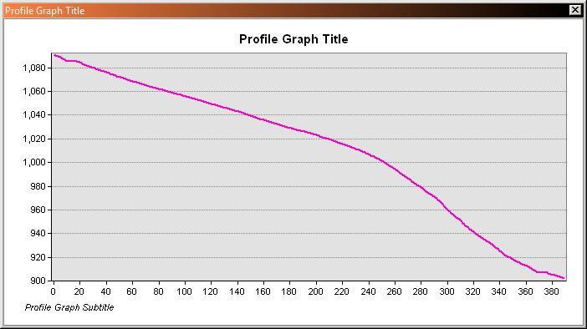
DEM’s
Logging Profiles
Quik profile view with 3D Analyst “interpolate line” tool
Obvious need for a lift tree

Slide 25
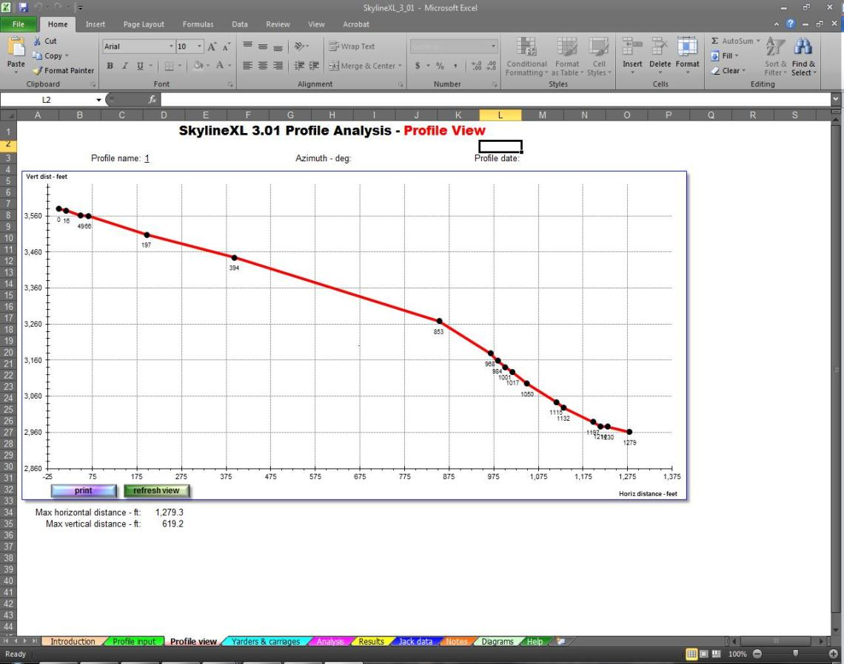
DEM’s
Logging Profiles
Load into SkylineXL
Place Intermediate Support ~ 800’ from landing
Tail to equipment or stump at bottom

Slide 26
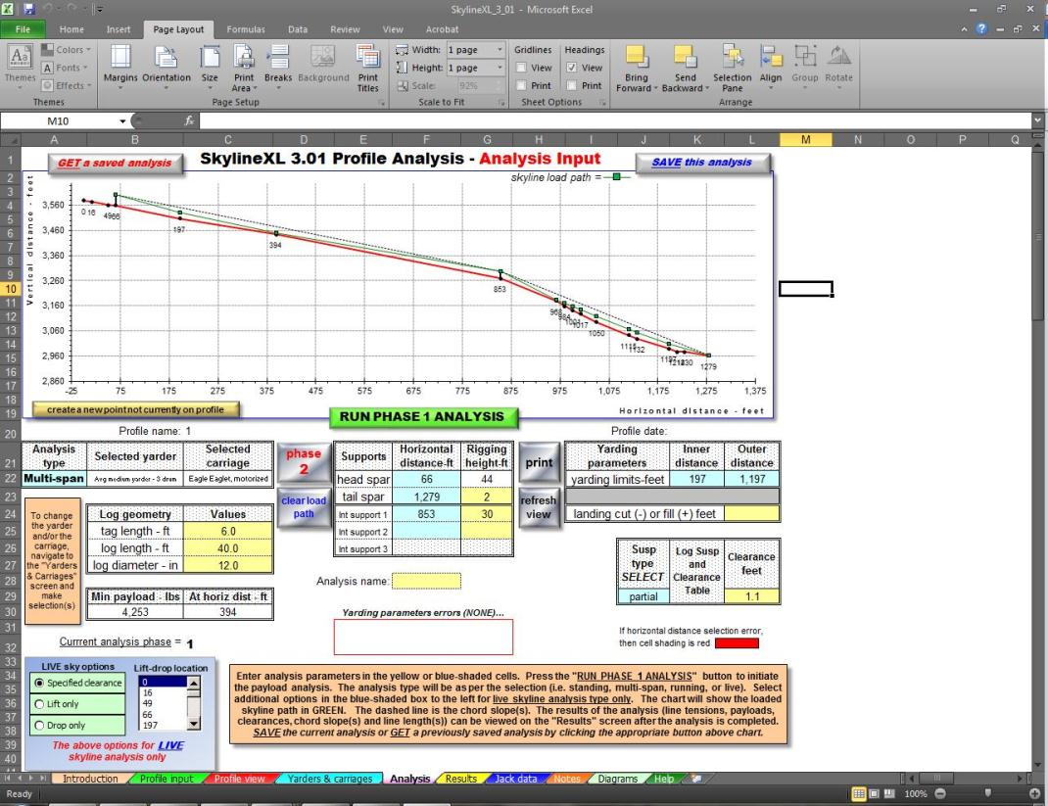
DEM’s
Logging Profiles
30’ tall lift tree needs to be at least 15” dbh DF
~4,200 lb payload
Proves feasiblilty
Check “Feature Height” and “Top Points” for lift tree availability

Slide 27
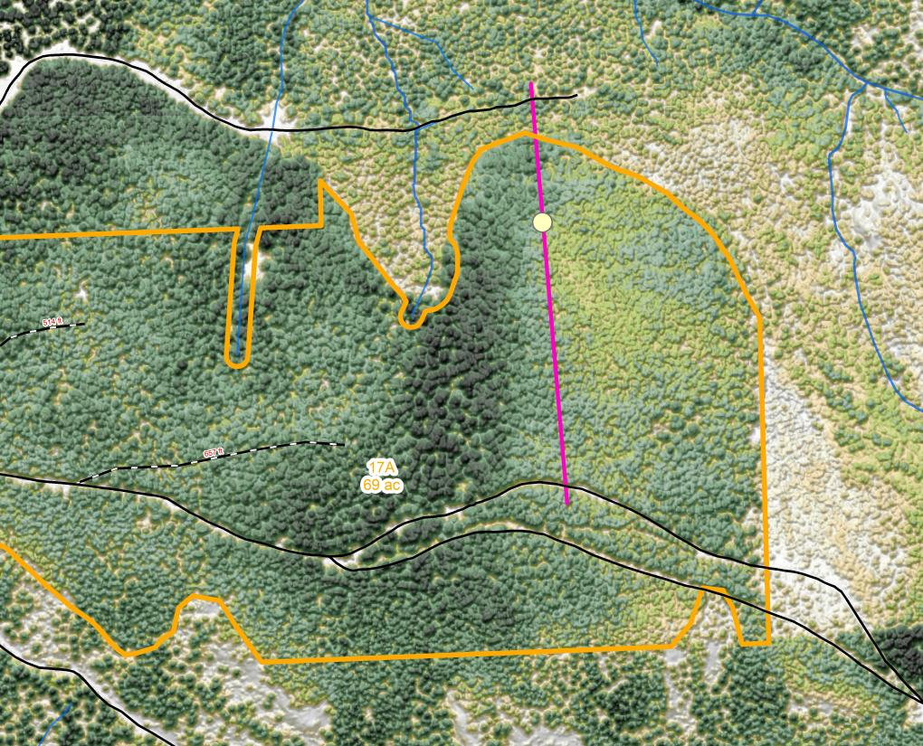
DEM’s
Logging Profiles
Measure out ~ 800’
Trees look pretty small

Slide 28
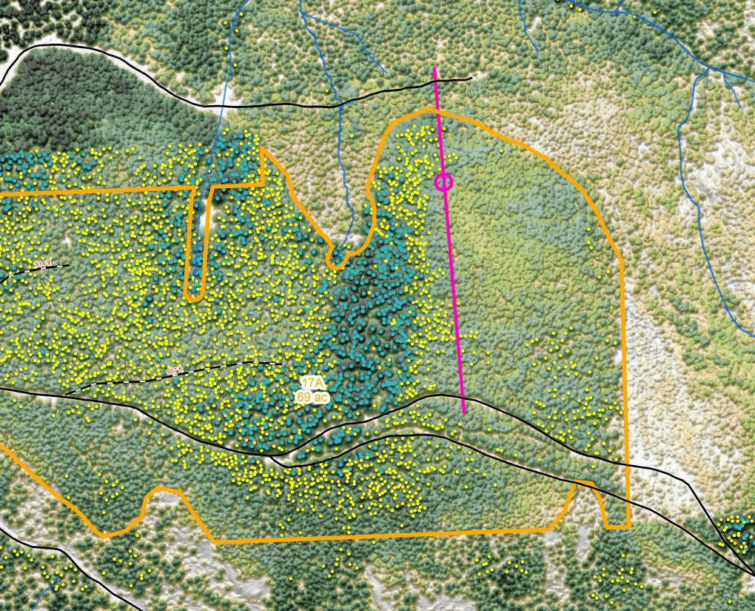
DEM’s
Logging Profiles
Query “Top Points” for trees over 100’ tall
None available on slope break
Log from lower road, build a road from bottom, let trees grow into lift tree size

Slide 29
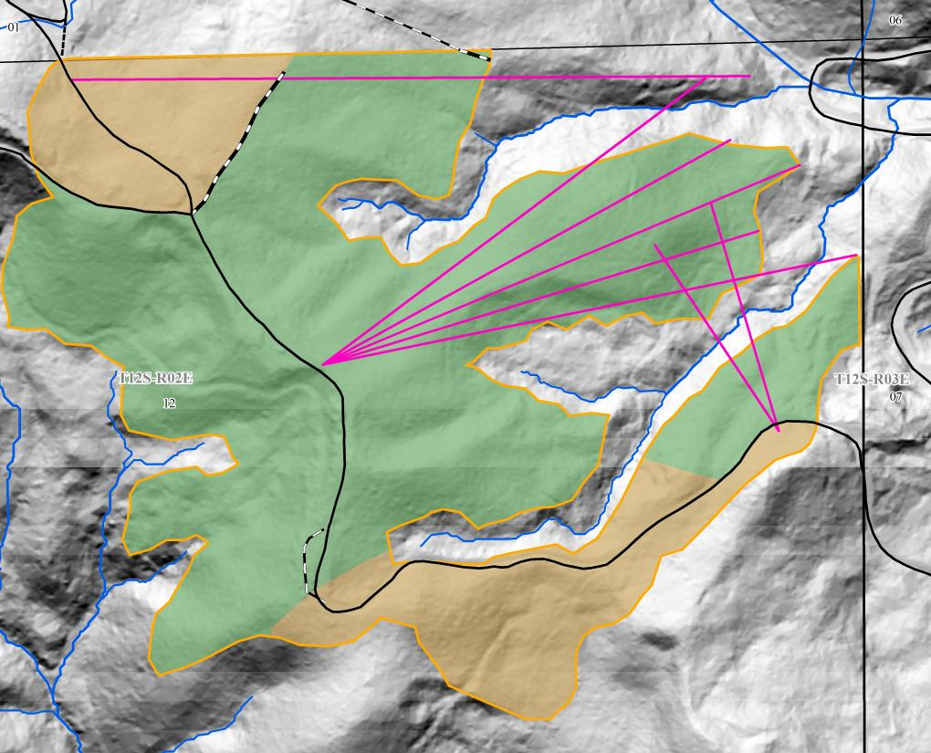
DEM’s
Logging Profiles
Prove full suspension yarding over stream buffers
1700’ yarding w/ int. supports vs. full suspension over stream

Slide 30
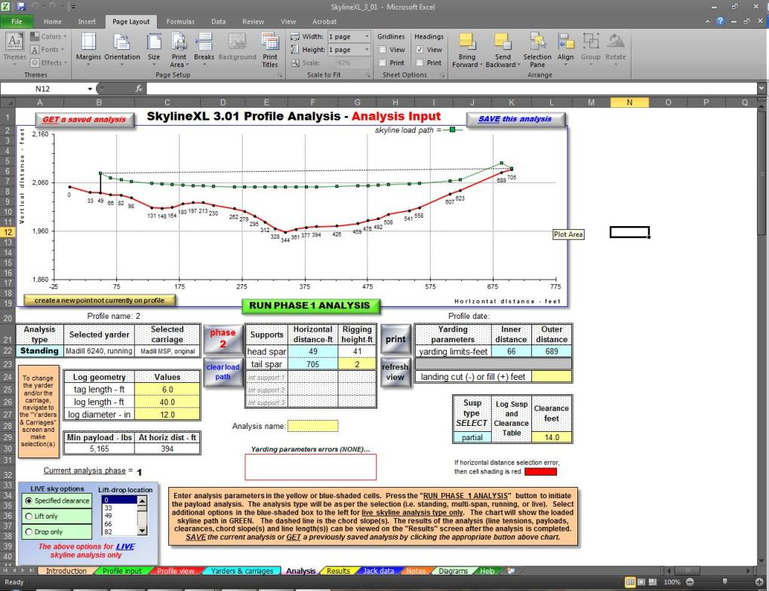
DEM’s
Logging Profiles
Need full suspension from T.P. 264 to 424 (80’)
Analysis showed plenty of lift over stream

Slide 31
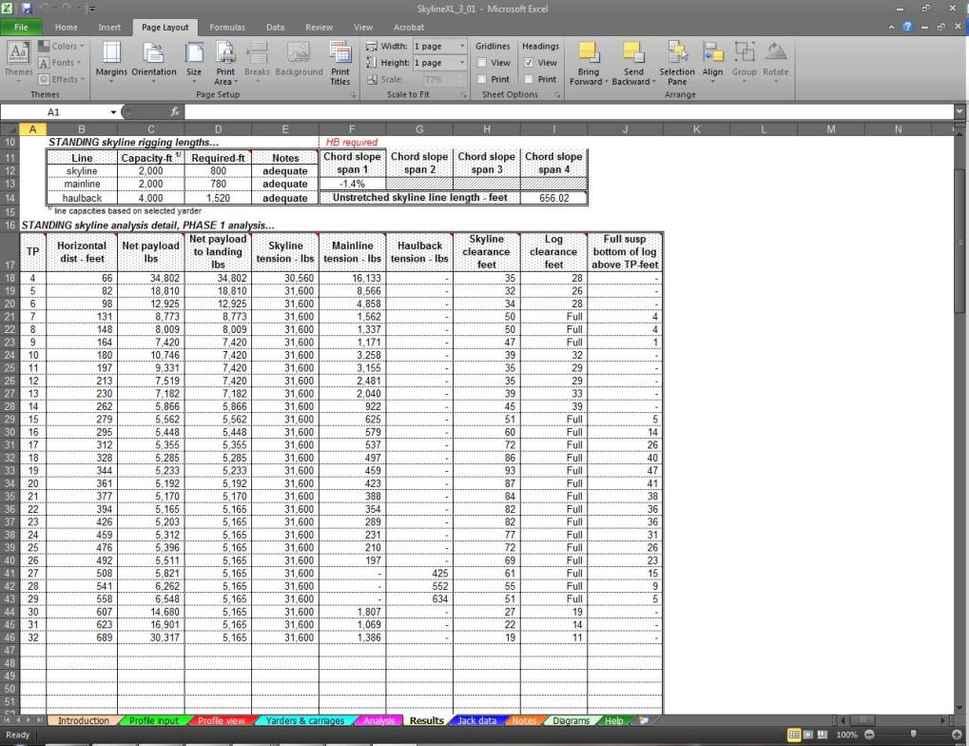
DEM’s
Logging Profiles
Shows full suspension from T.P. 262 to 558
Hydrologist was satisfied and included analysis in their EA report

Slide 32

DEM’s
Logging Profiles
Analyzed all 8 profiles in 30 minutes from office
Field verified guyline anchors, tailholds, and lift trees

Slide 33
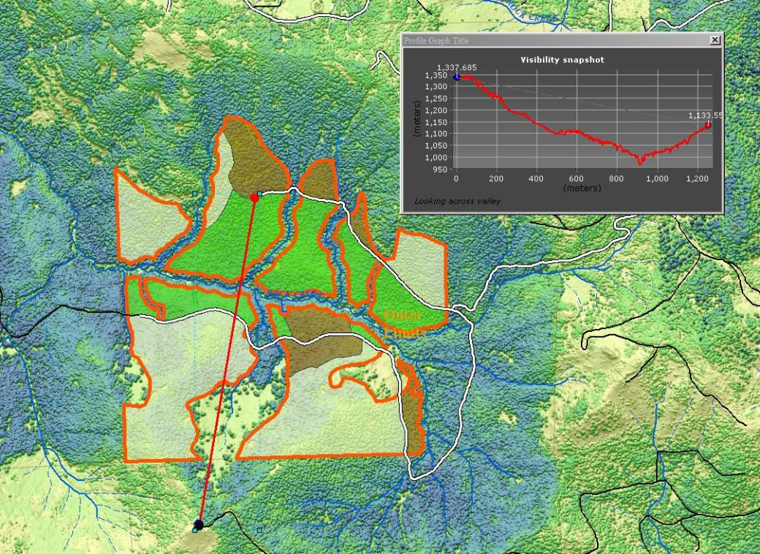
Line of Sight Tool Snapshot
DEM’s (Highest Hit)
Use Lidar highest Hit DEM to show visibility point to point
Interpolates line of sight with green areas being visible and red areas not visible

Slide 34
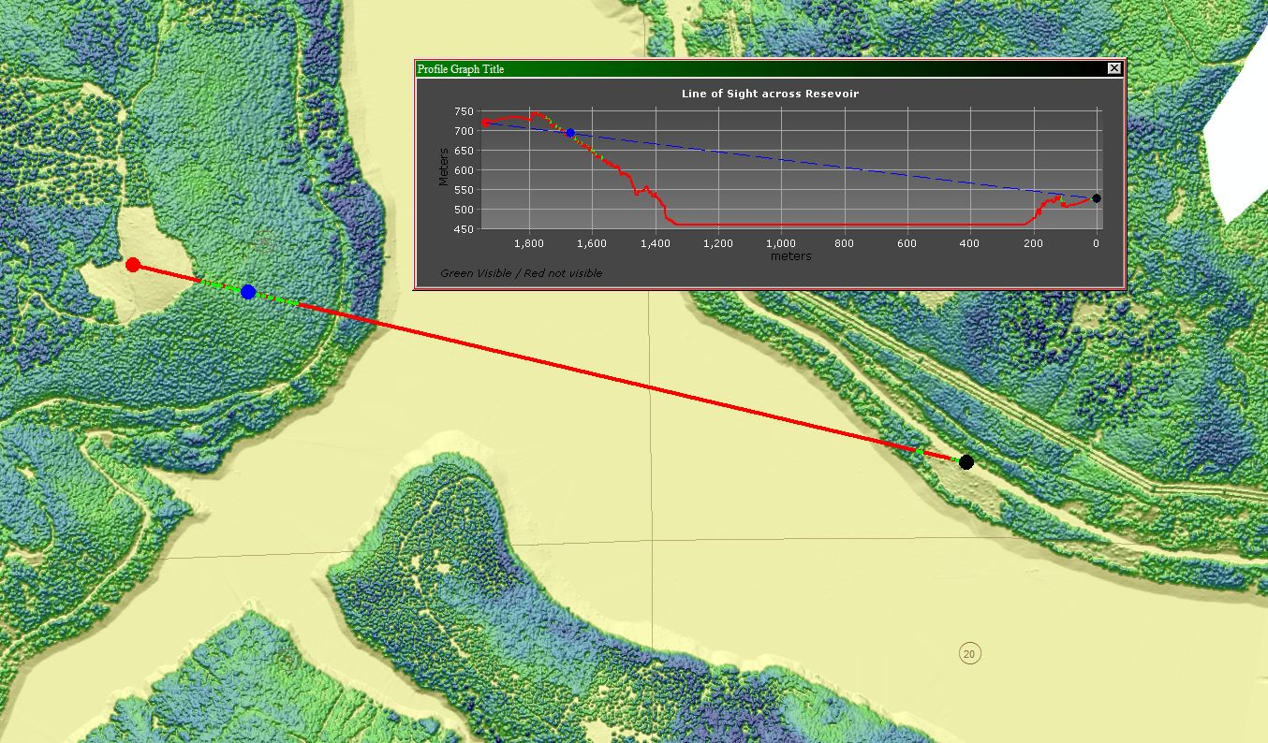
Line of Sight cont…..

Slide 35
A 3D perspective for our data
2D maps are OK…. and are what many of us are used to, and what we generally give to the public…..
But our users and the public often use Google earth at home and sometimes to accomplish work related tasks.
Wouldn’t it be great if we could offer a “Google Earth” –like viewing experience to our users and the public?
Well….. We kind of can…..

Slide 36
Using ArcGIS explorer and LIdar to visualize projects in a 3d environment
Benefits:
Uses our data (with a little processing) to make 3D presentations using live maps.
Tell a story about a project in a 3D environment.
Act as a viewer for almost any of our GIS data in a robust 3D environment.
Some simple analysis and querying capability.
Very flexible platform to add Image, feature and map services, photo overlays, text information & popup data to your map.
The presentation mode lends itself well to creating (Fly-through) type videos.
This program can run from a flash drive once you have it loaded on your local machine, to facilitate presentations, or distribution….

Slide 37

Potential Uses
Create easily understandable 3D visuals for managers that look cool!
Insert 3D screenshots into documents to supplement EA visuals
Have 3D maps available for your IDT meetings (it often helps answer questions)
Create Rich interactive 3D maps for use in public meetings.
With Camtasia, (Or other) screen capture software you can convert these presentations into movie files (mp4 or other) that can be posted on the web, sharepoint, or shared with project partners and/or the public.
I have recently used this process to create videos for Regeneration harvest public meetings, internal IDT meetings and for the Wilderness Area 50th anniversary story map pilot project to make Fly-Through videos.
Here’s some examples……

Slide 38
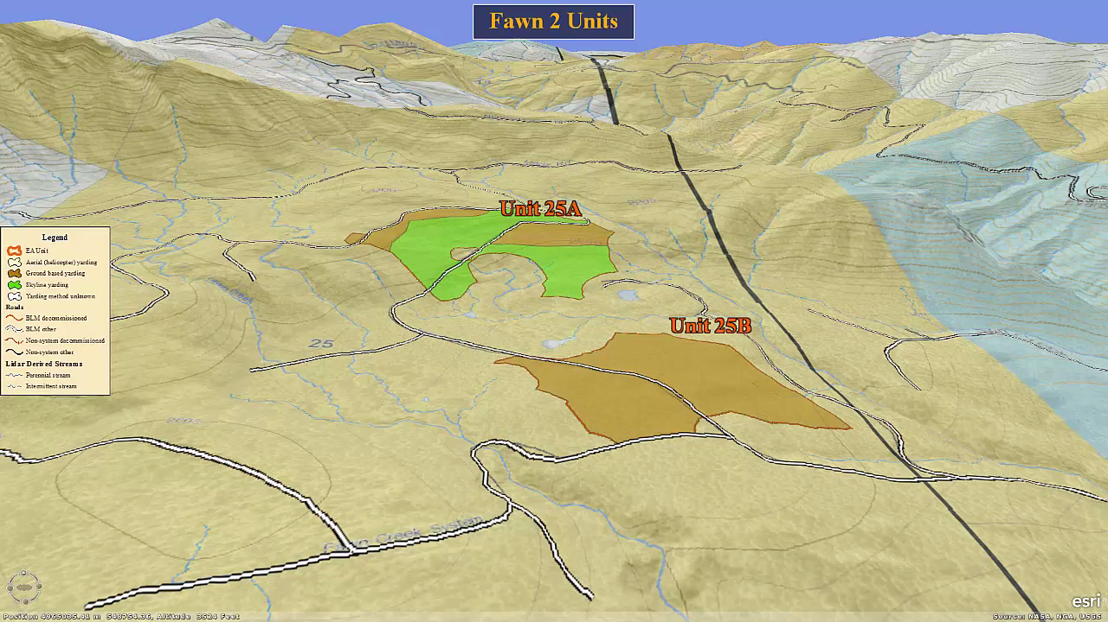
Timber sale Demo

Slide 39
A couple examples of some project map snap shots

Slide 40
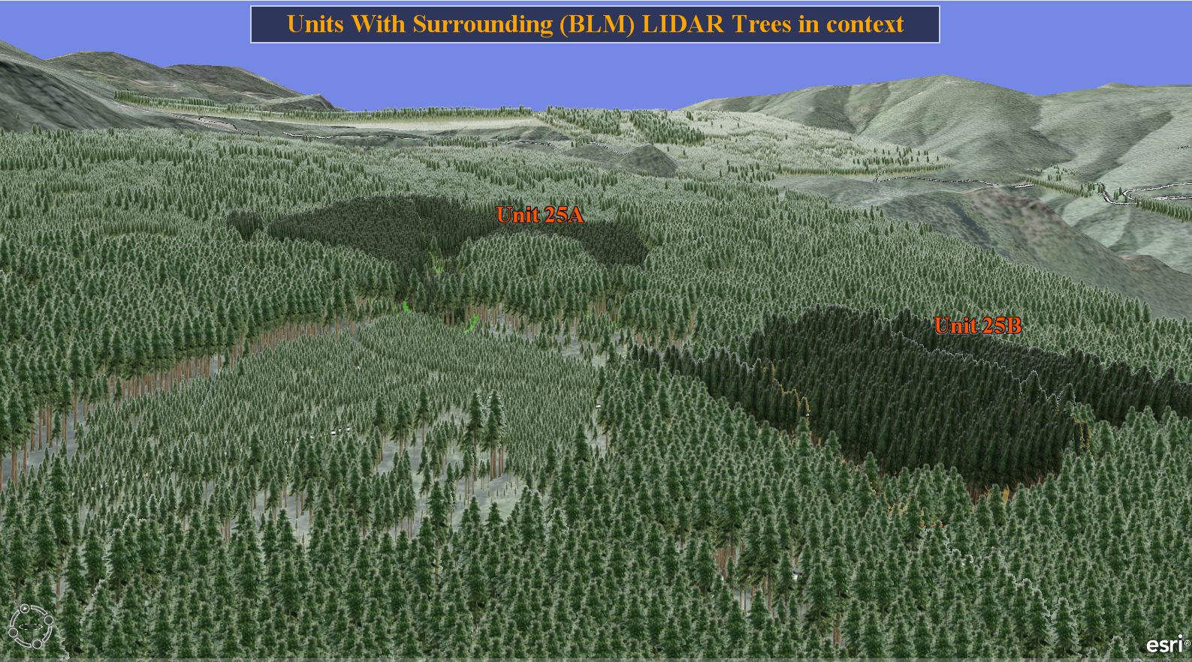

Slide 41
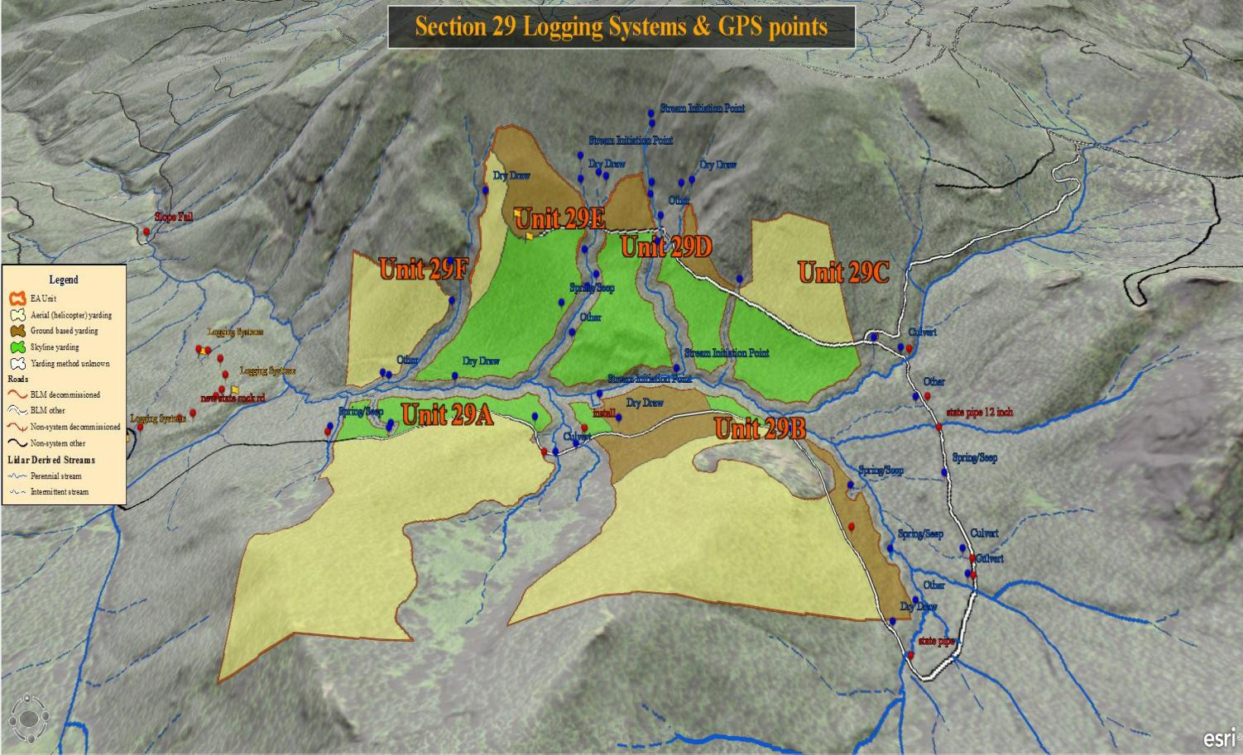

Slide 42

Go To live Demo

Slide 43

Contact your friendly neighborhood SA, and ask them for ArcGIS Explorer……..
Don’t tell them I sent you…….
Just kidding, I’m more than willing to take responsibility

Slide 44


Questions??

