Slide 1
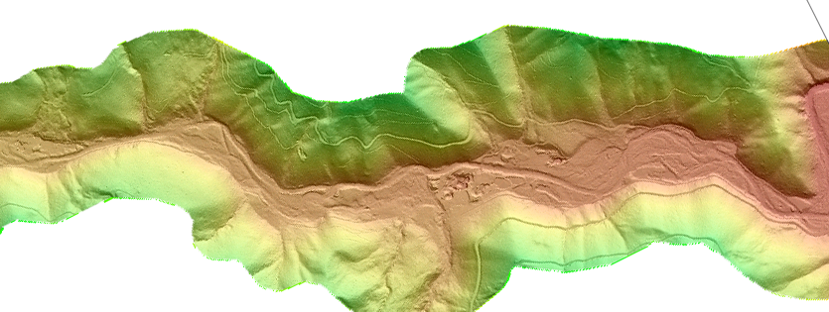
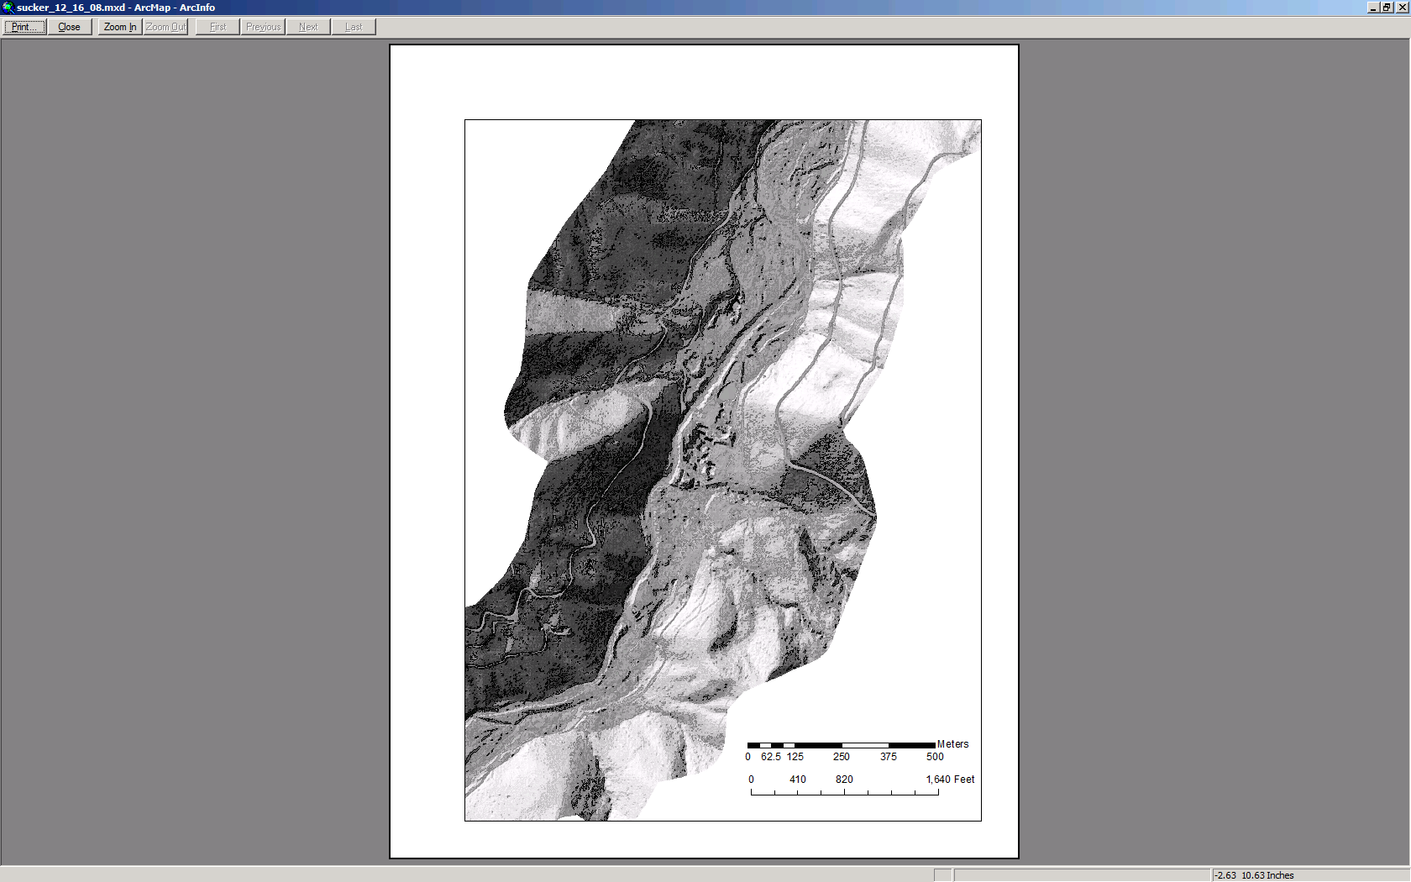
Sucker Creek Design Draft
(Existing Condition)
Poor fisheries habitat
Bridge
Incised channel
Settling ponds
Tailings pile
Disconnected
ponds
Flow Direction
Notes:
Existing condition

Slide 2
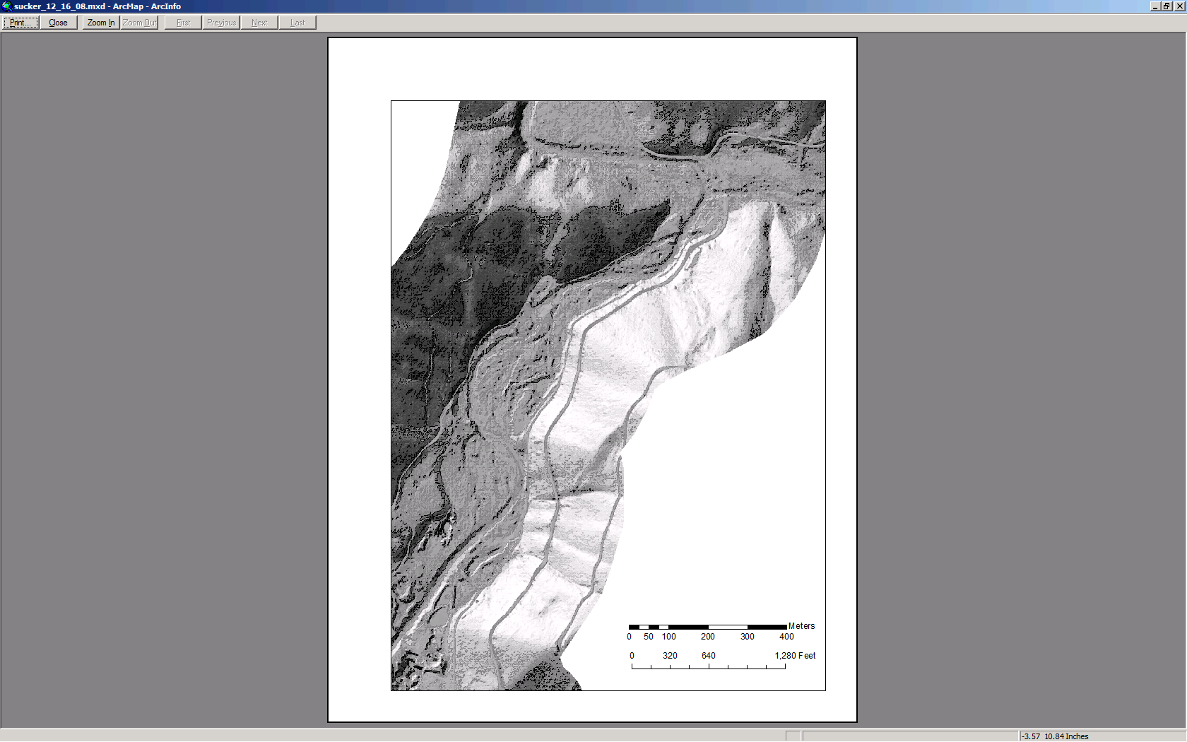
Sucker Creek Conceptual Design-A Draft (channel pattern and layout)
Connect to existing tribs or cold water seeps
Create mid-channel island
Bridge
Side-Channel habitat
(active during higher water)
A
A
Settling ponds
Tailings pile
Channel Reconstruction
Key
Perennial Flow FMF Large Wood Complex
Grade Control Structures Active During higher flows
Island Bar Buddies Constructed Spawning Areas
Bridge
not to scale
Notes:
Notes: 1st island after bridge. Split flow around mid channel bar island. Careful not to let it agrade over time. And not too high to prevent wood and sediment from being transported downstream. Bring one side along valley wall and connect to side tribs for cold refuge, over-wintering habitat, spawning habitat, connection with tribs. Create oxbow lakes and meander scars for habitat. Project area is a depositional zone which is causing channel migration towards valley walls as sediment builds up. This is why we see large meander wavelengths and tight radius of curvatures. Baseflows estimated at 30-40 cfs. A design alternative to allow flow year round is to create smaller side channels, more like islands along mainstem. This could provide an alternative if banks are high or channel is incised.

Slide 3
Cut/Fill Estimations
Bridge
Settling ponds
Tailings pile
Notes:
Reach 1 channel reconstruction volume is estimated to be approx 10% greater than that estimated for the side-channel.

Slide 4
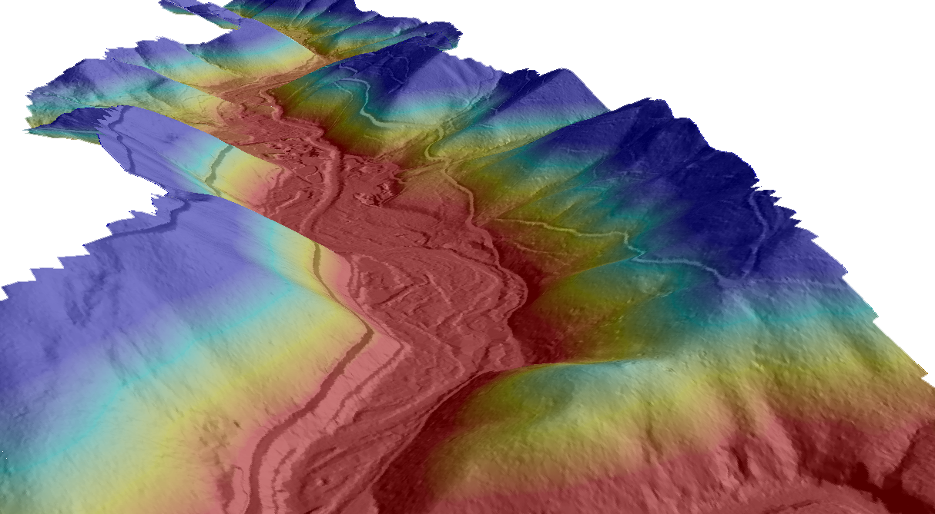
Perspective View
Flow Direction

Slide 5
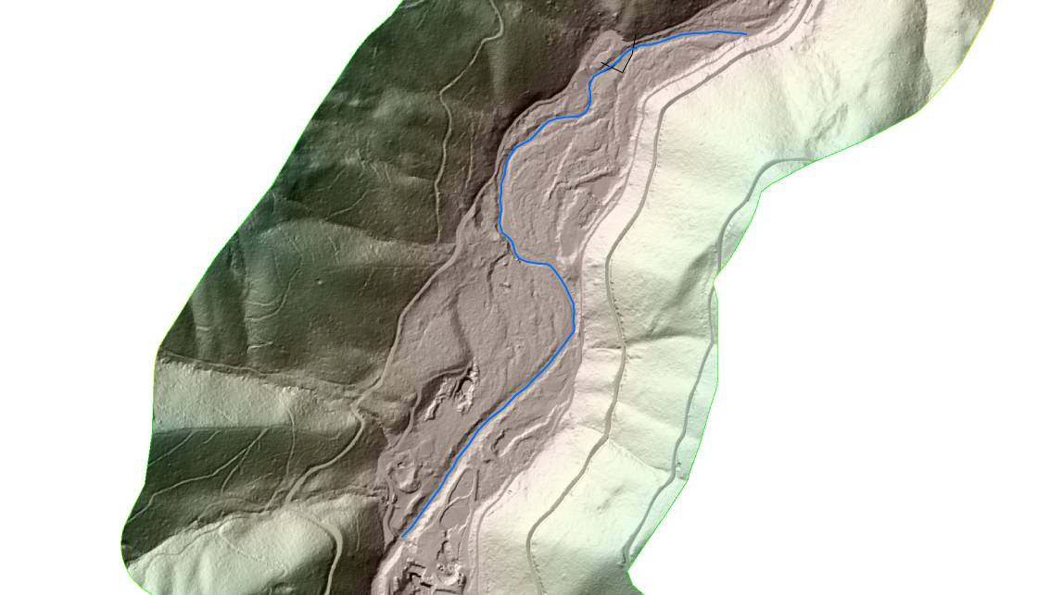
1.5yr Flood (HEC-RAS analysis)
820 cfs

Slide 6
10 yr Flood (HEC-RAS analysis)

Slide 7
100 yr Flood (HEC-RAS analysis)
5,271 cfs

