Slide 1
USING LIDAR TO INFORM NEPA
(KIND OF)
Don Boucher
Rogue River-Siskiyou National Forest

Slide 2
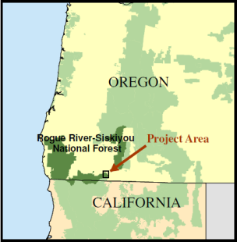
Ashland Watershed

Slide 3
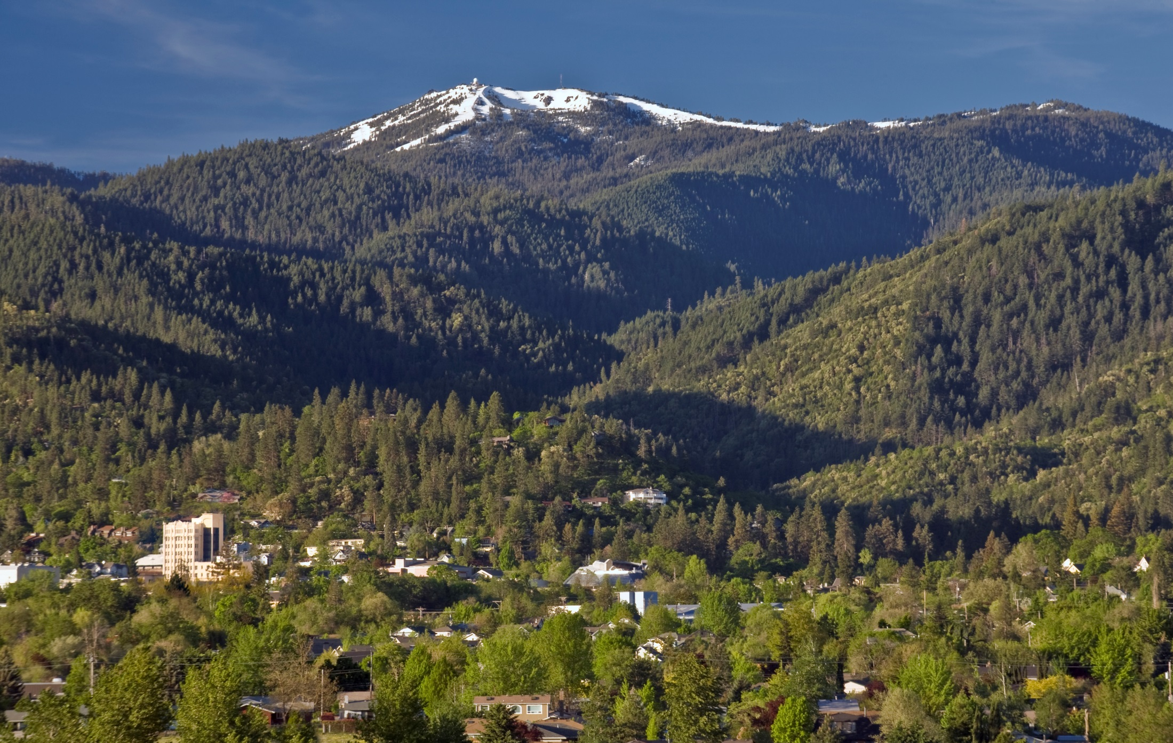



Ashland Forest Resiliency Stewardship Project
Si
Siskiyou Mountains Ranger District
Rogue River-Siskiyou National Forest

Slide 4
Uses of Lidar in Implementation Planning:
Refining road locations
Refined mapping of landslide hazard zones
Predicting legacy tree densities and location
Prioritization of treatment areas
Vegetation data quality

Slide 5
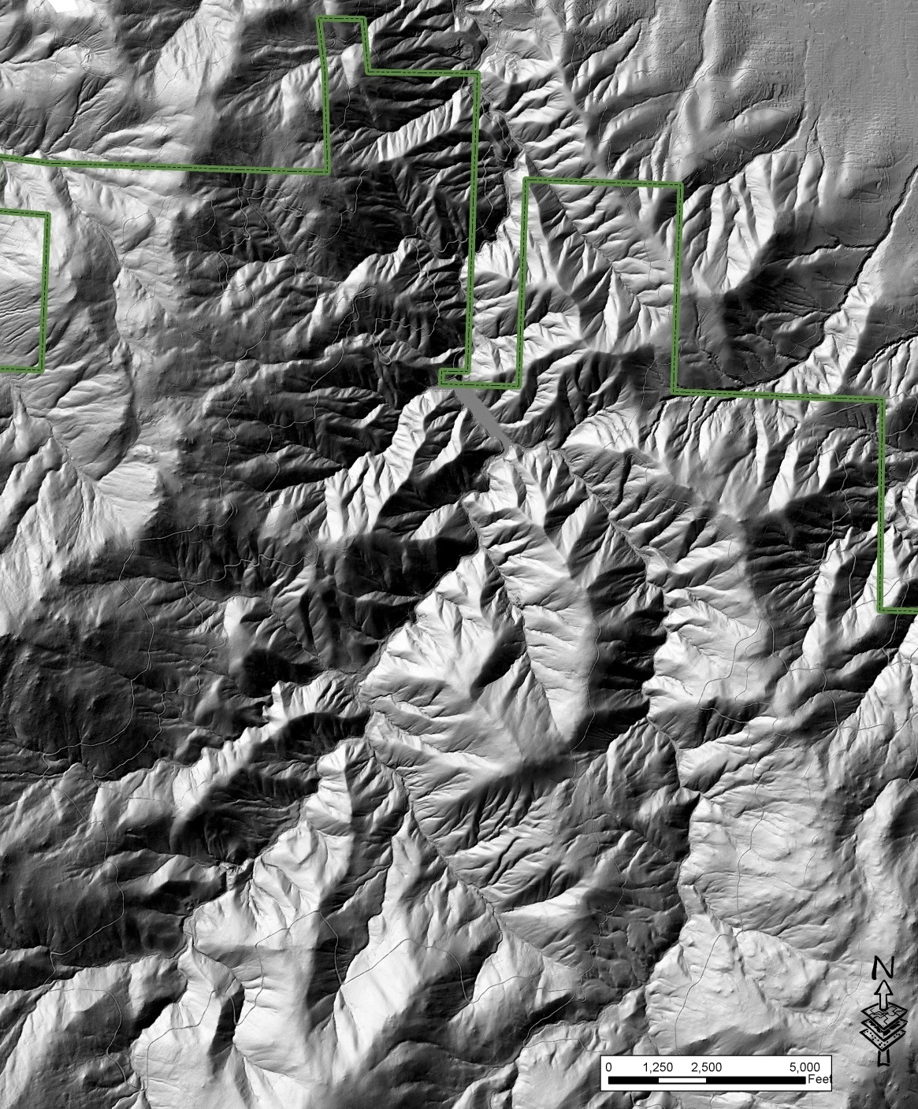
Refining Road Locations

Slide 6
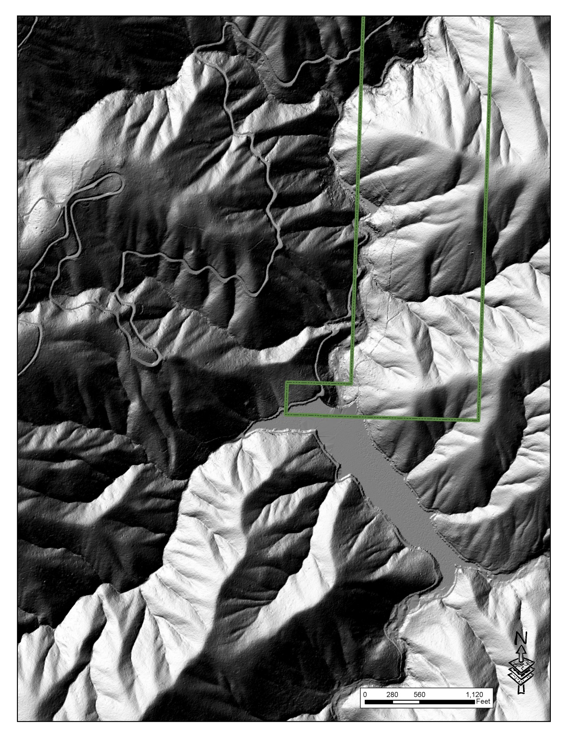

Slide 7
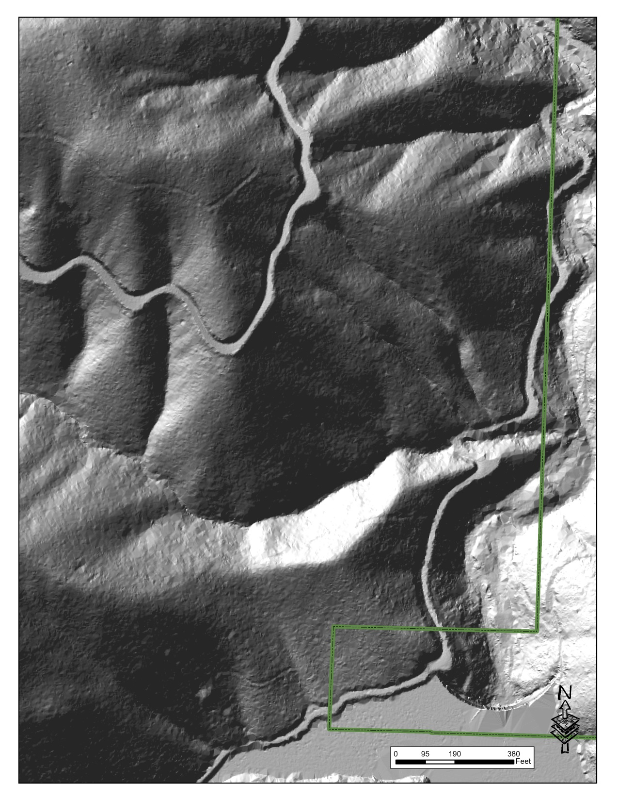

Slide 8
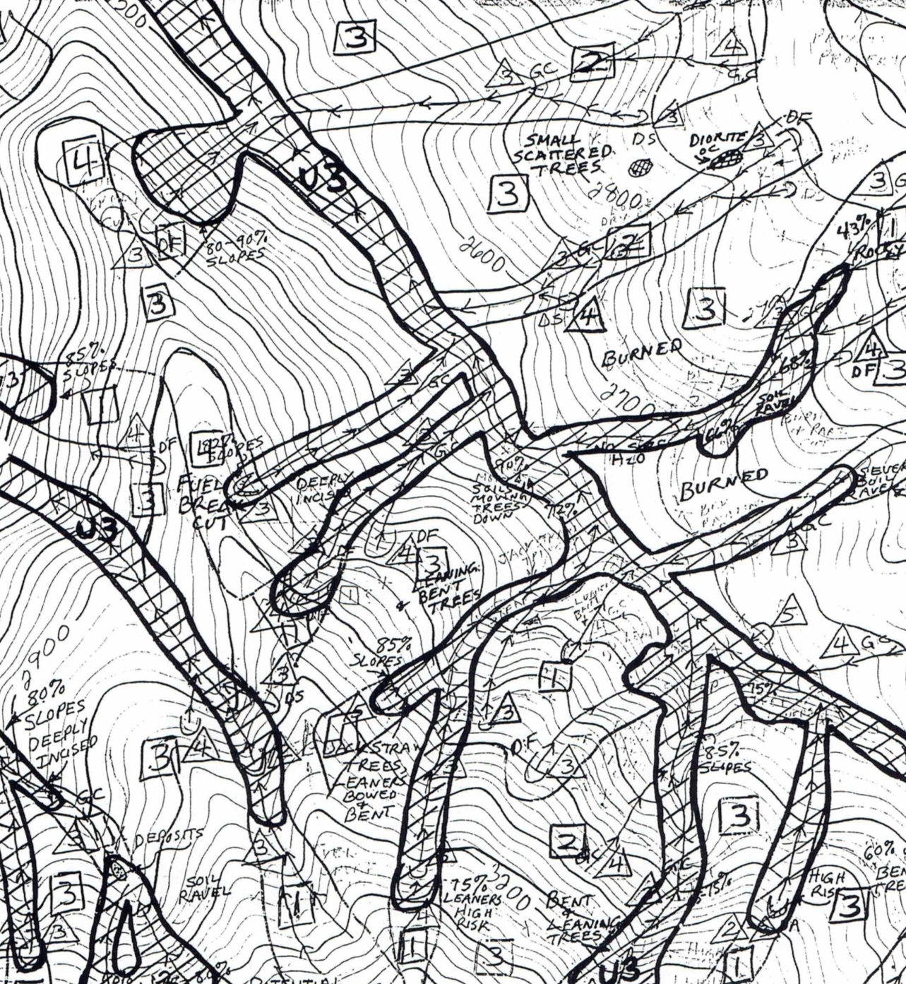
Landslide Hazard Zone Mapping

Slide 9
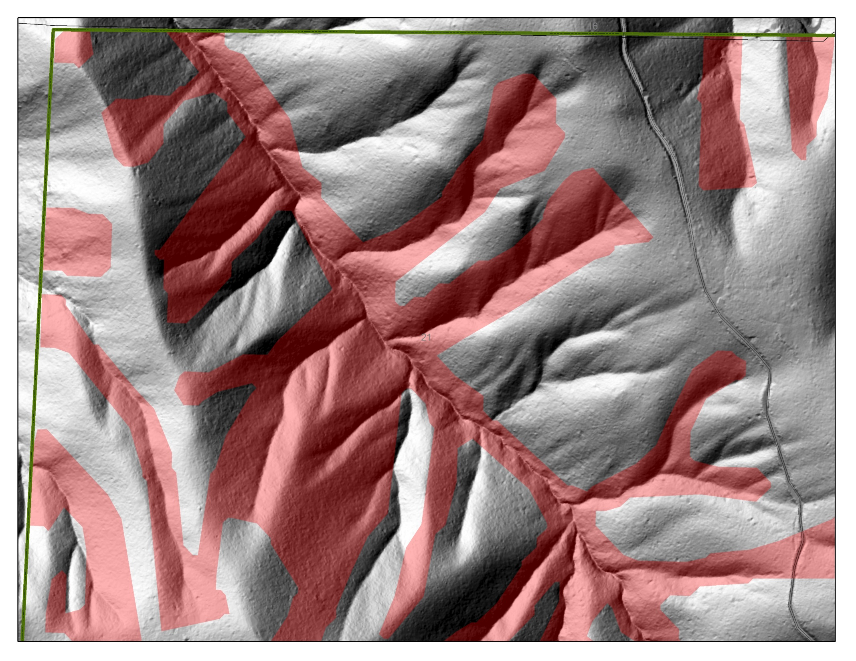

Slide 10
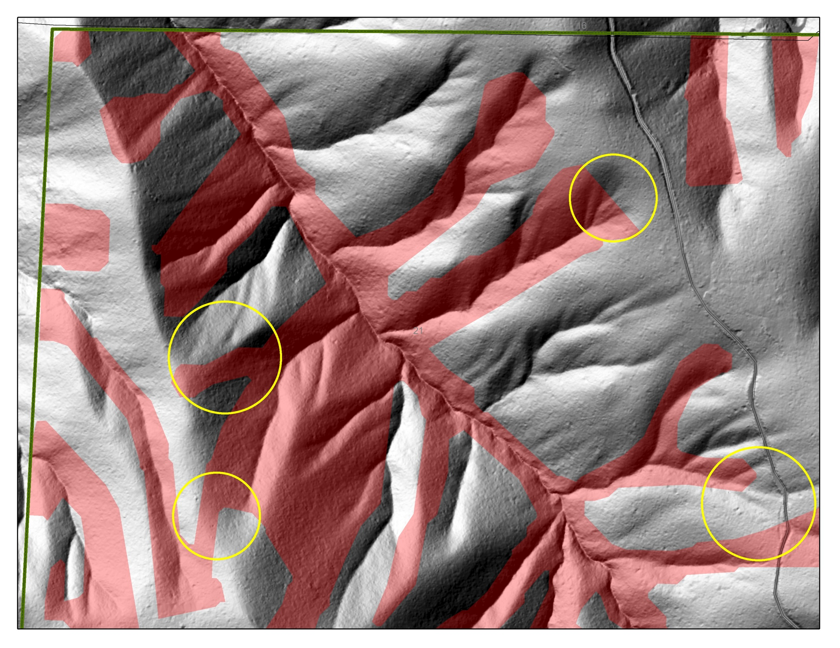

Slide 11
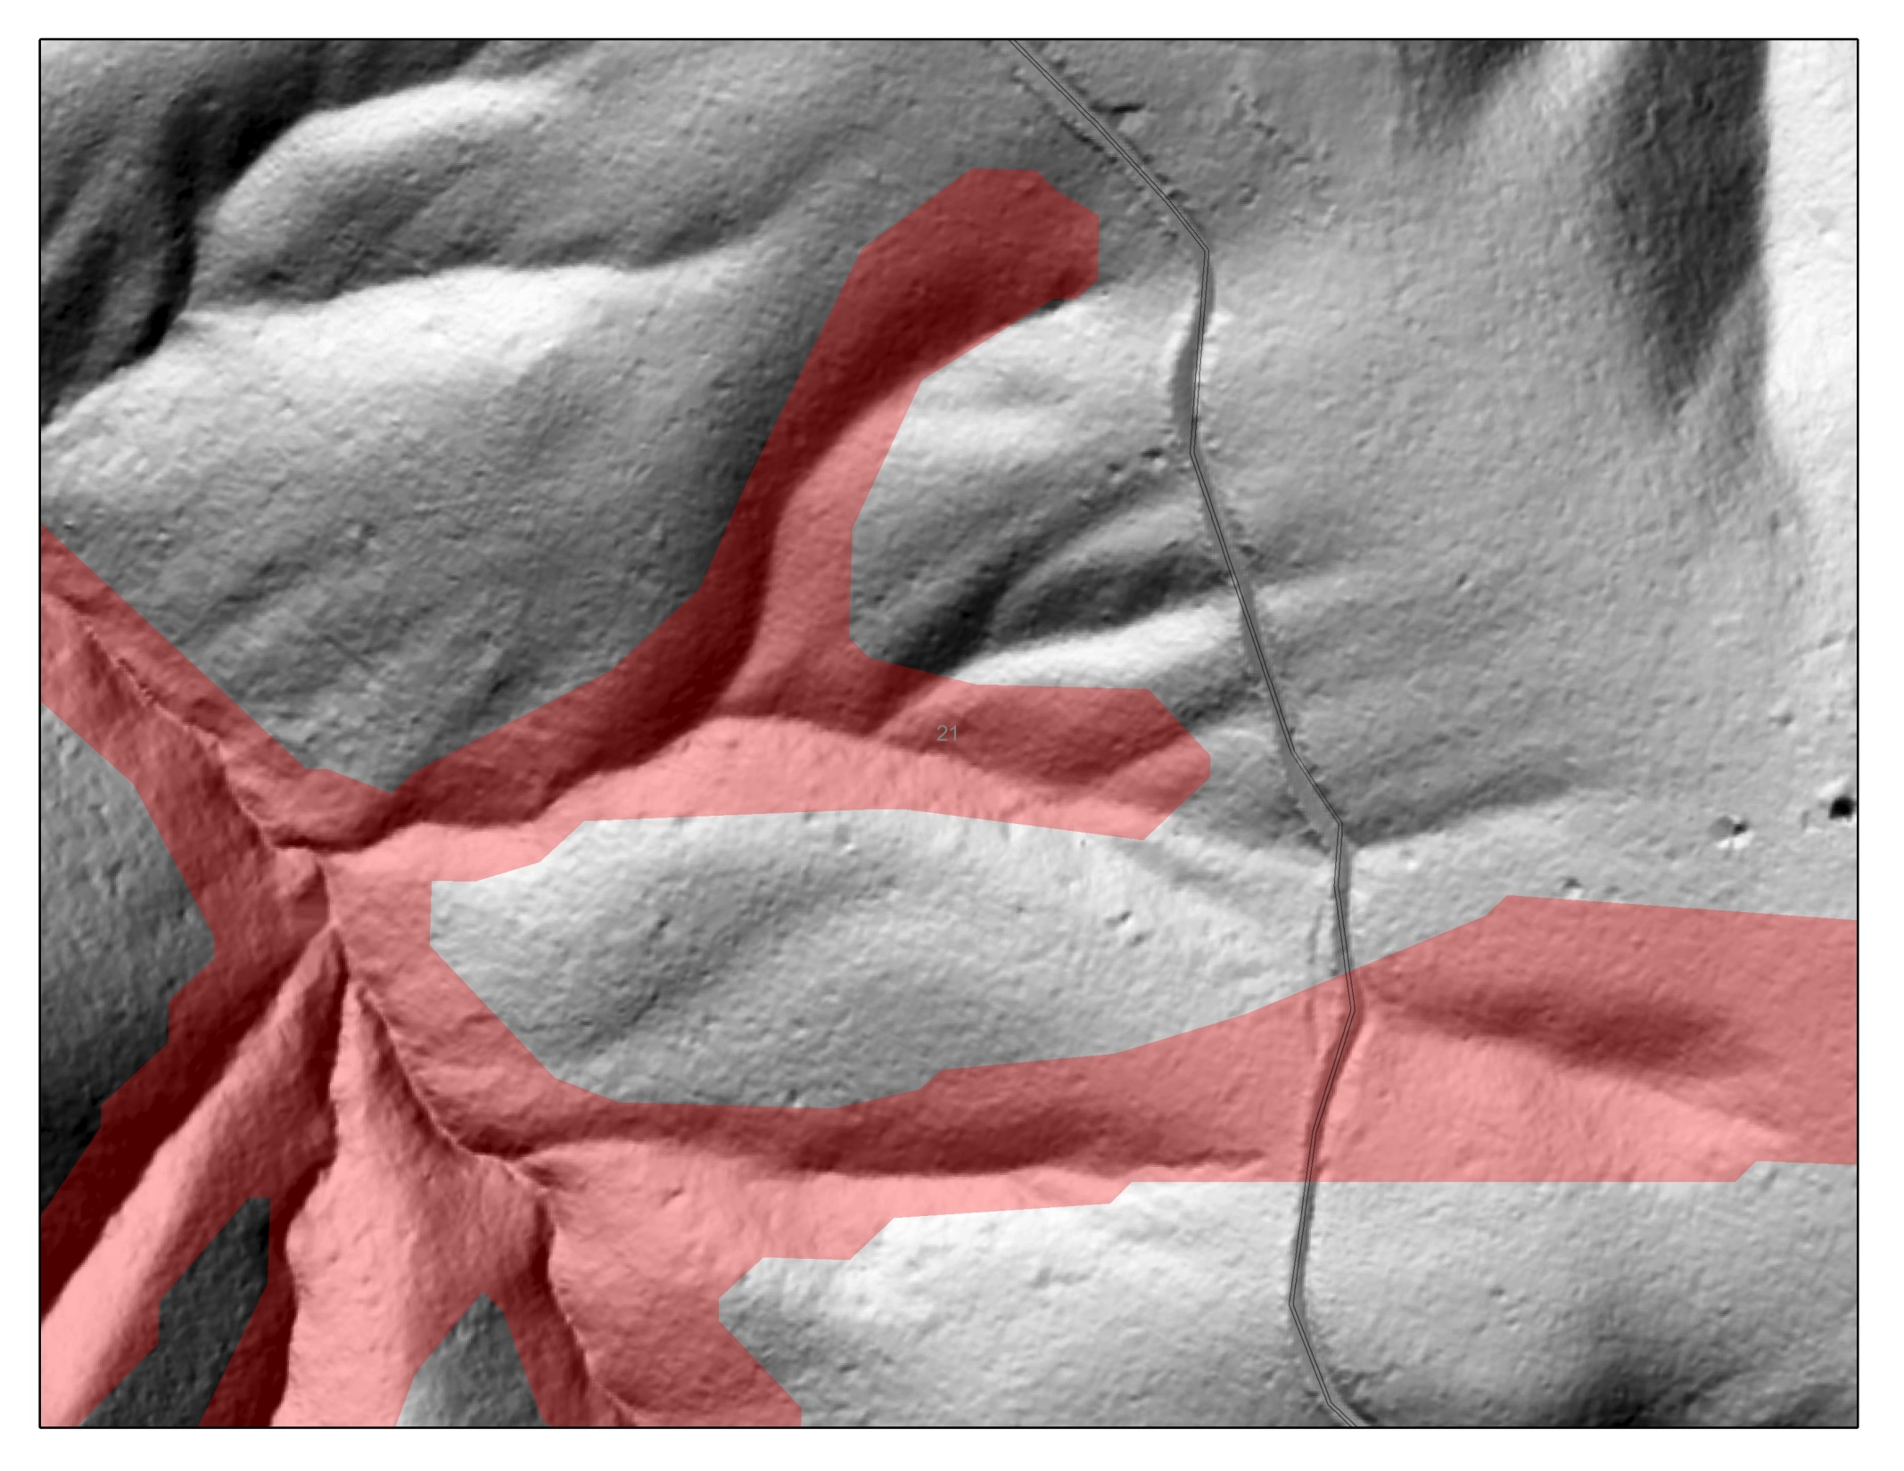

Slide 12


Slide 13
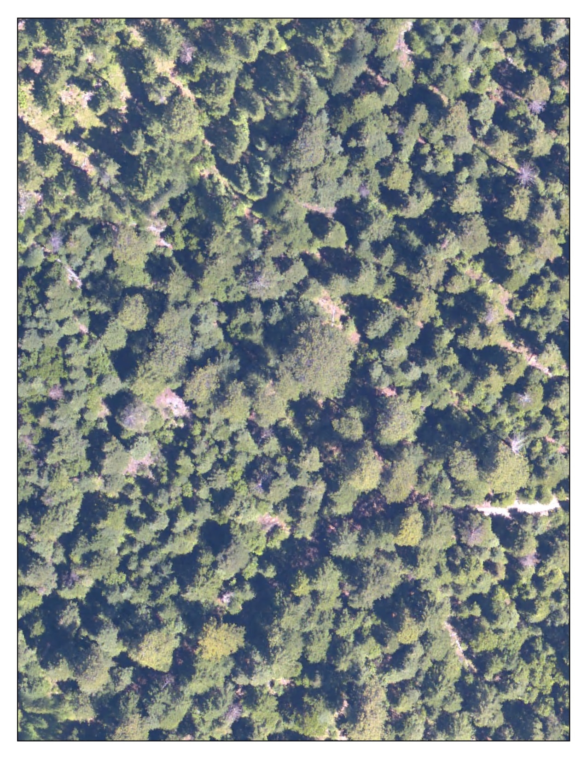
Legacy Tree Prediction

Slide 14
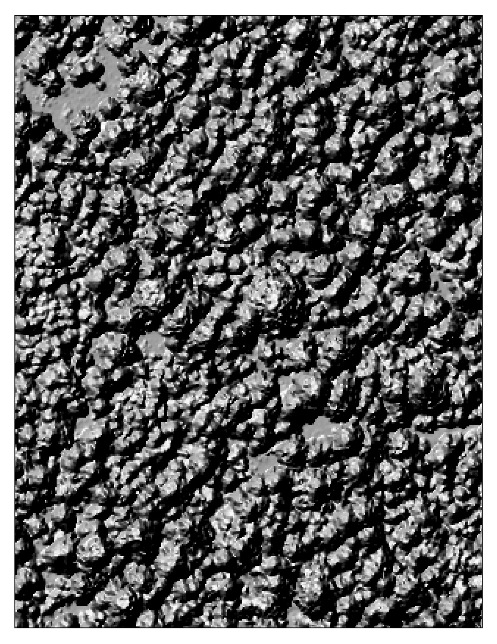

Slide 15
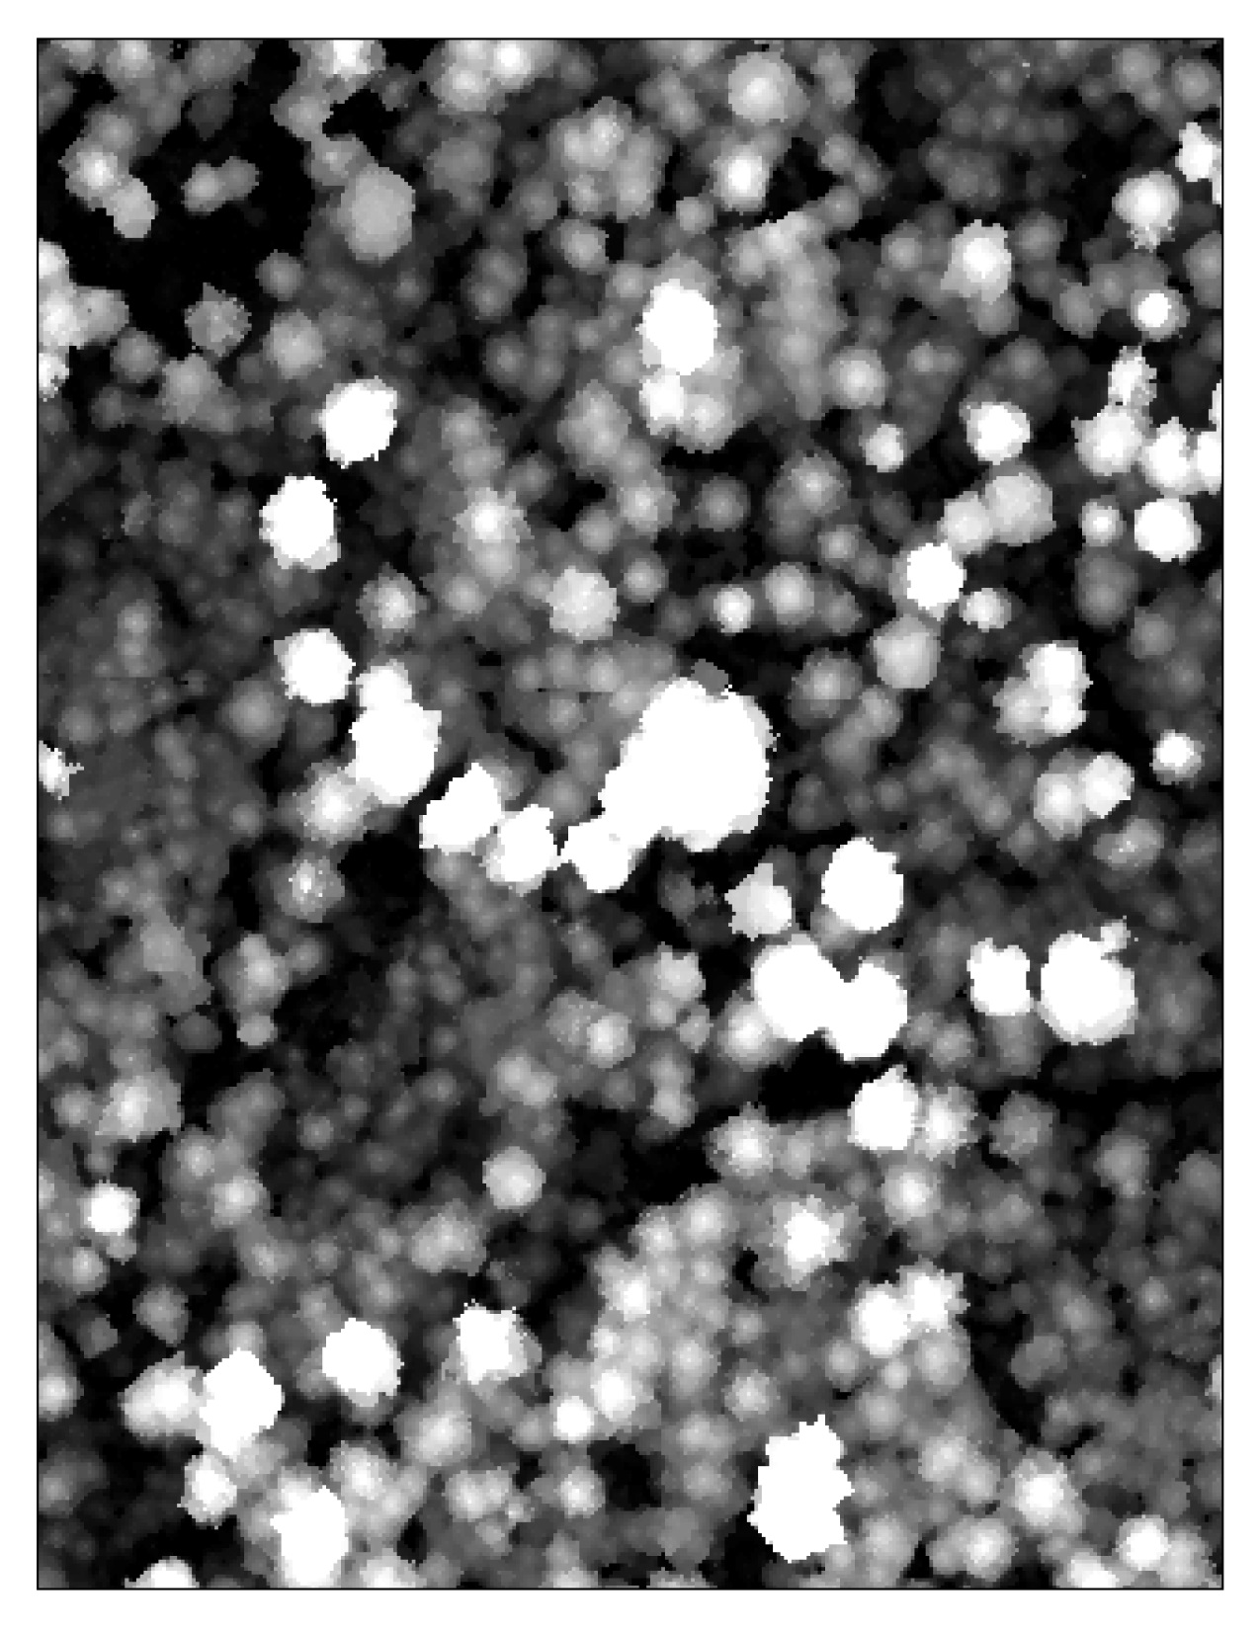

Slide 16
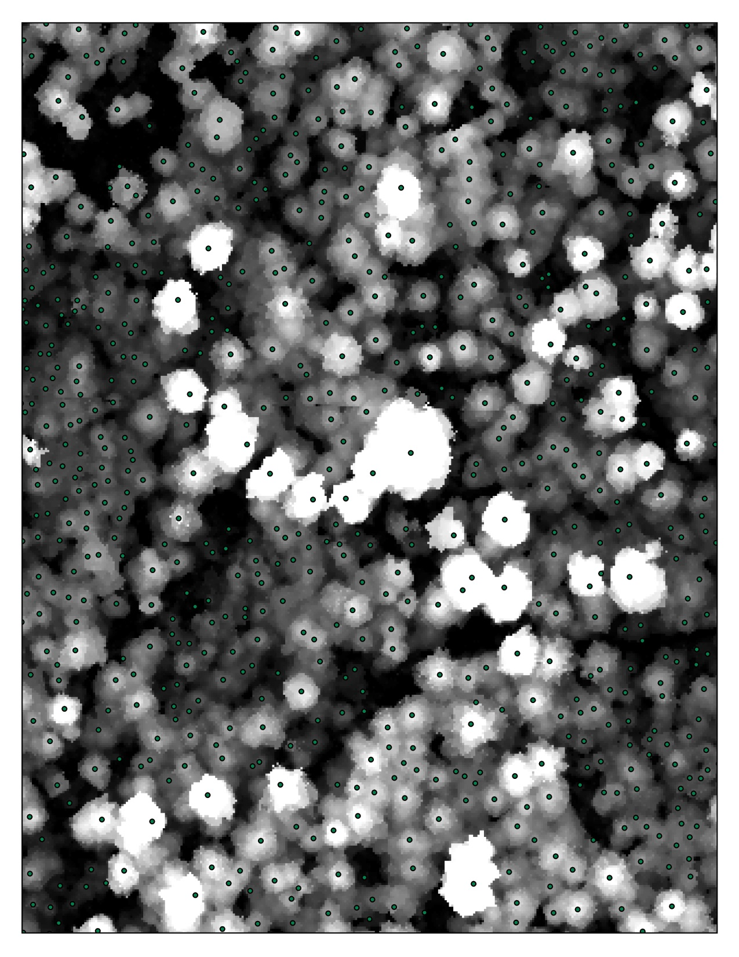

Slide 17
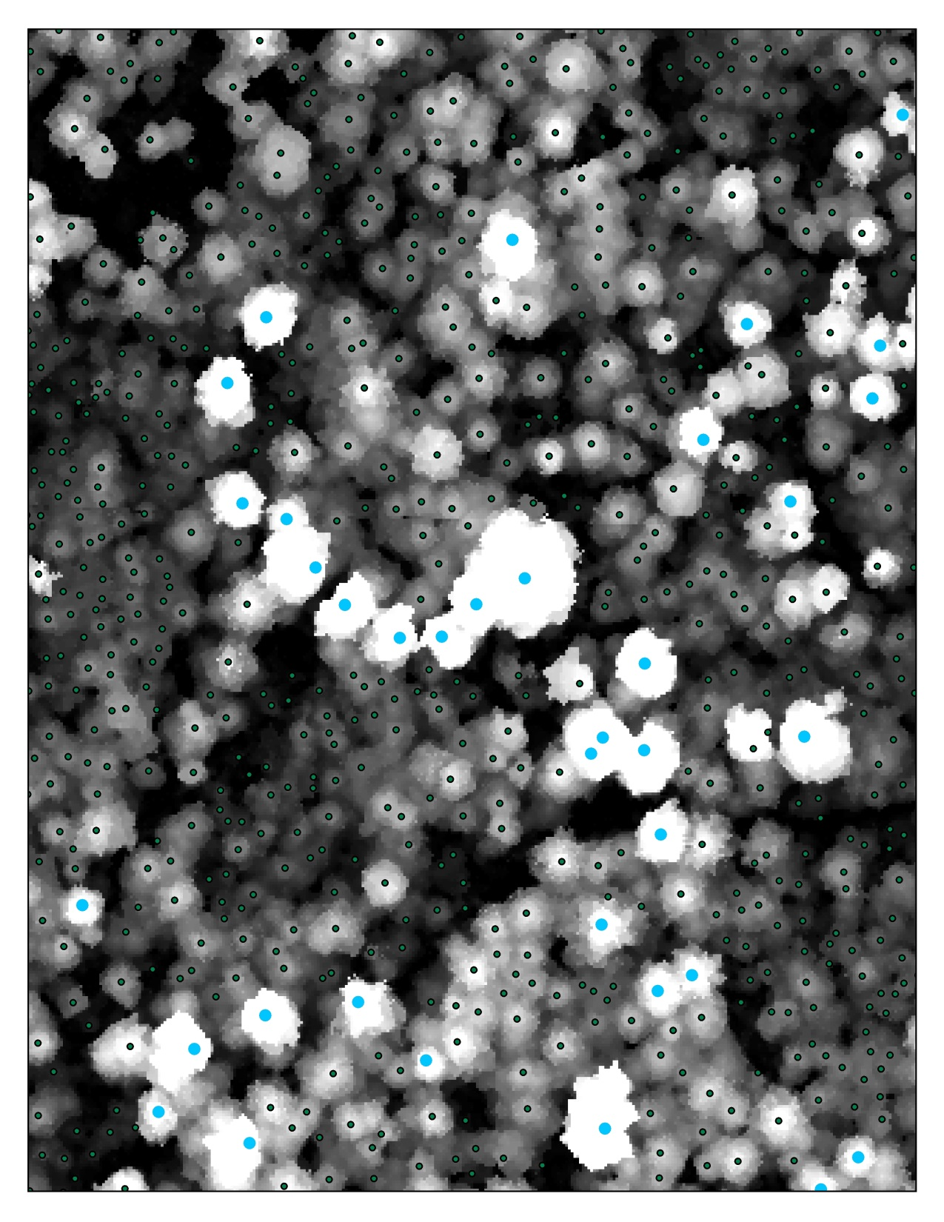

Slide 18
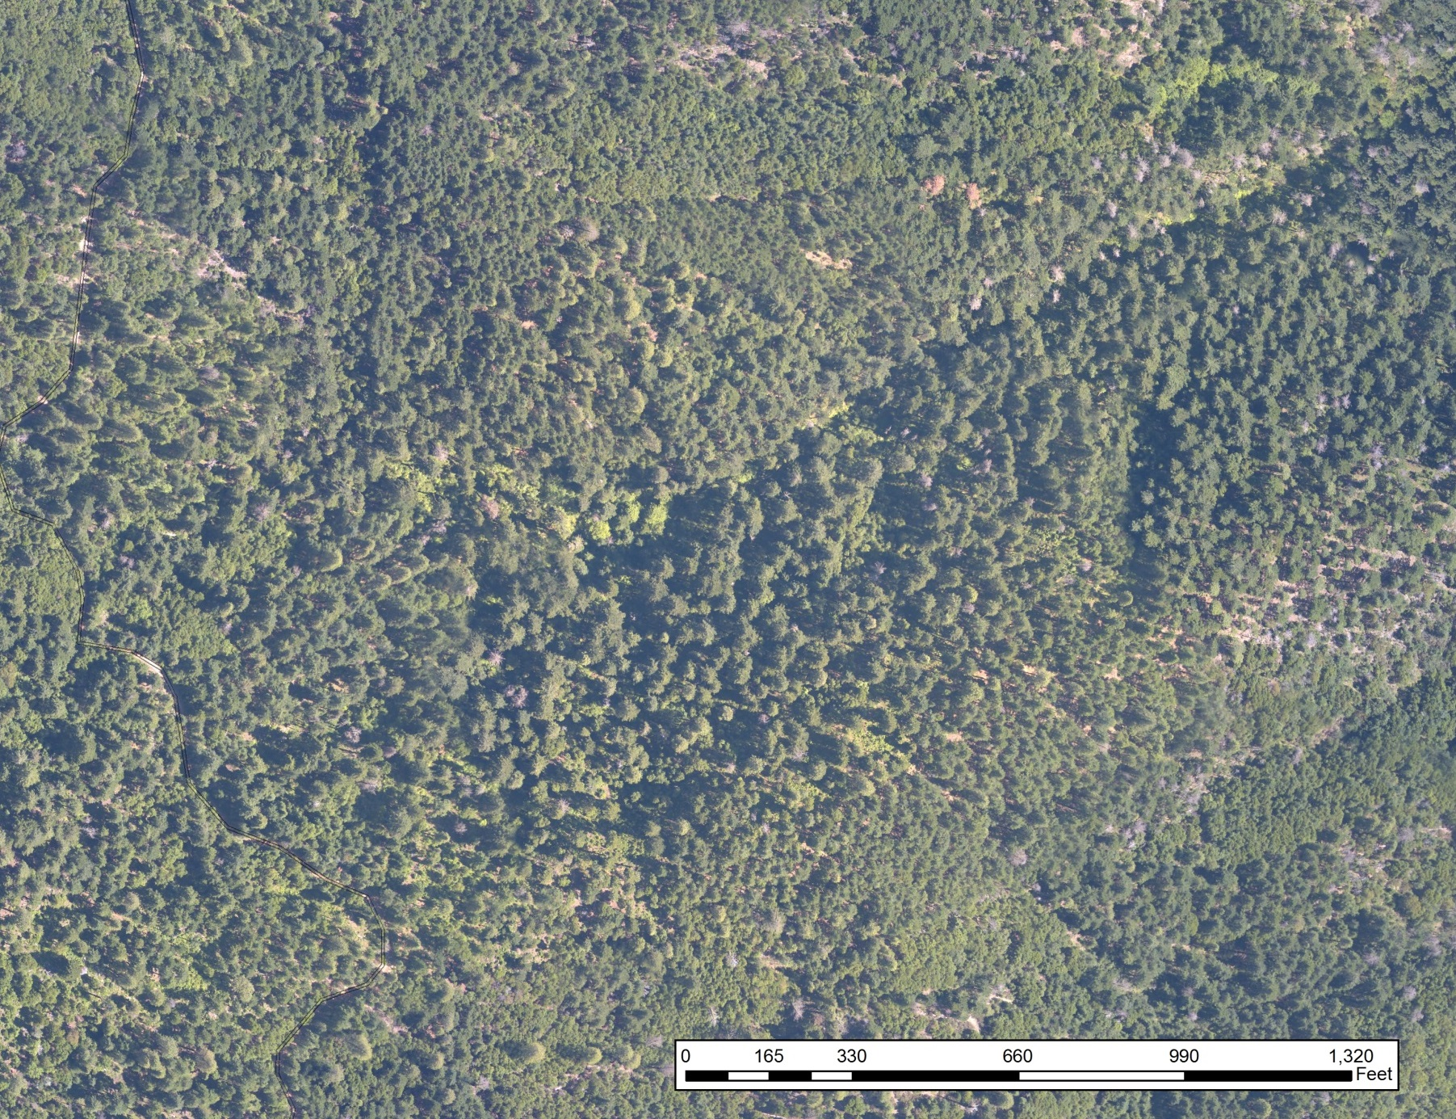
Legacy Tree Prediction

Slide 19
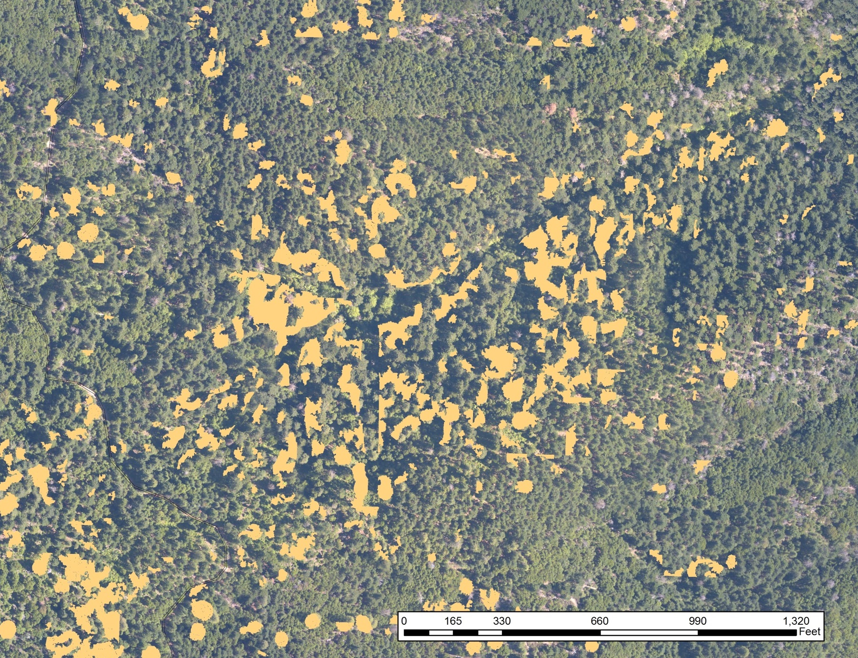
Legacy Tree Prediction

Slide 20
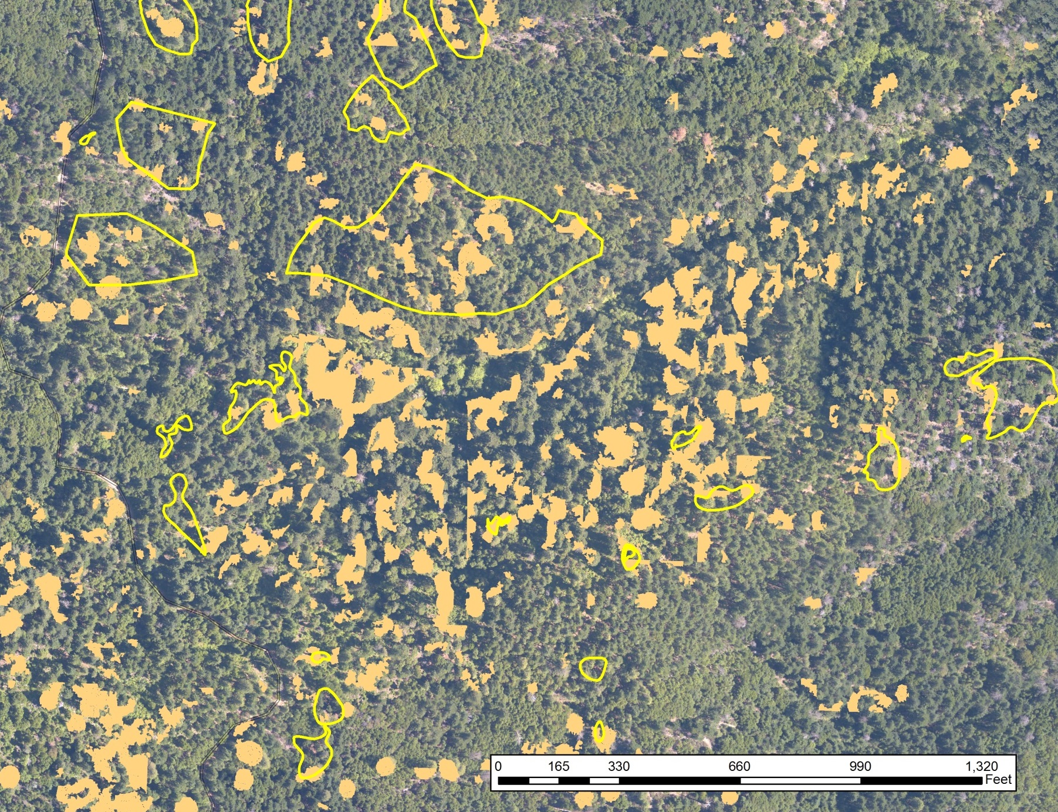
Legacy Tree Prediction

Slide 21
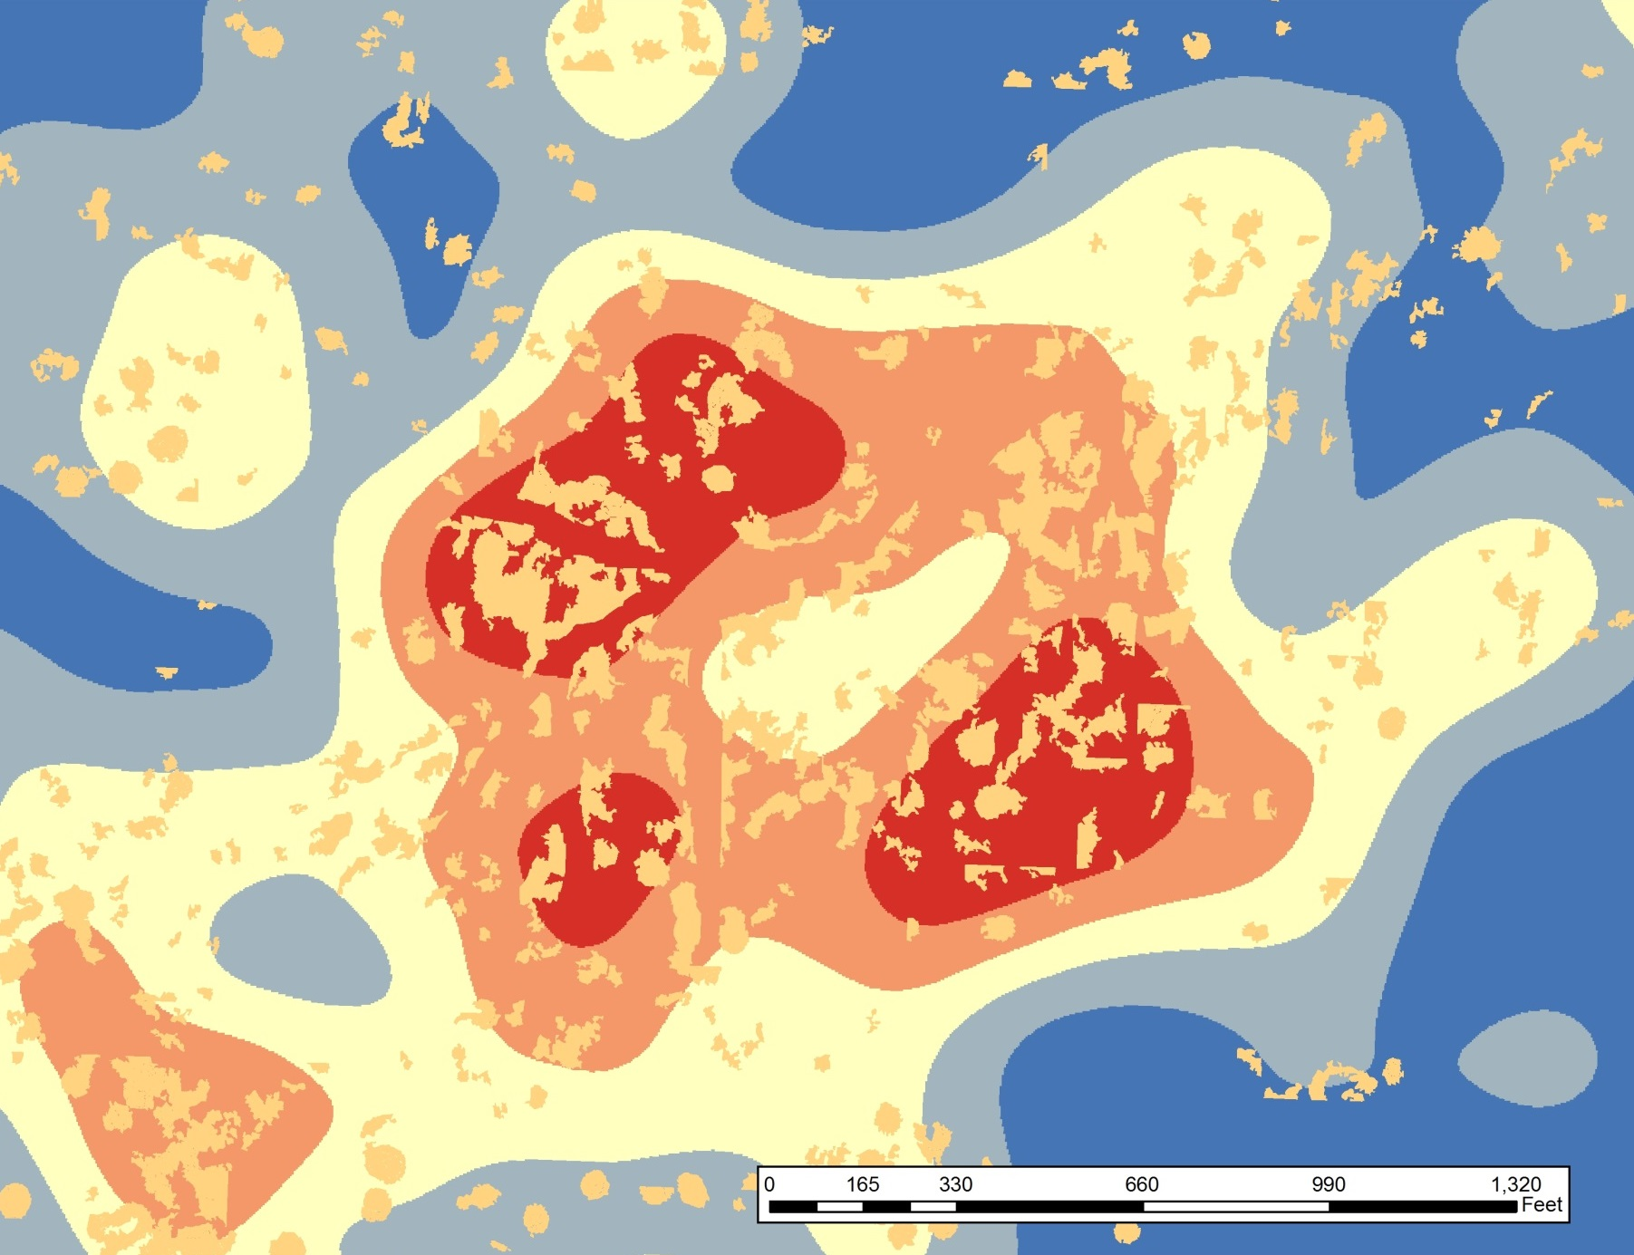
Legacy Tree Prediction

Slide 22
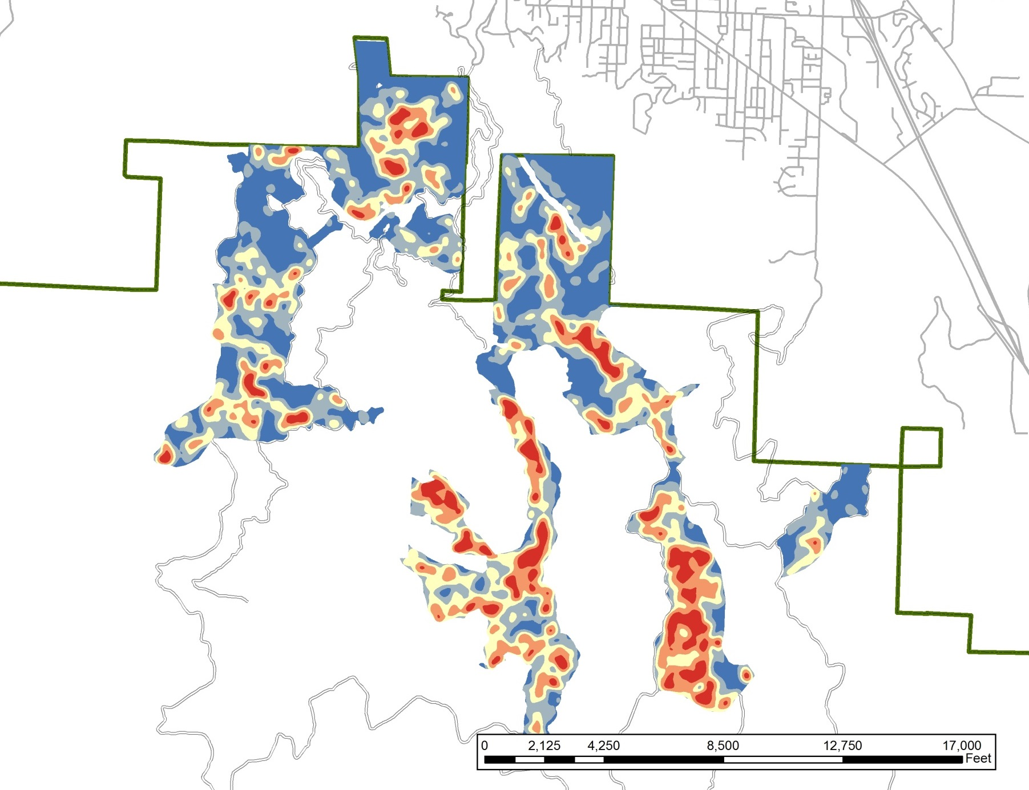
Legacy Tree Prediction

Slide 23
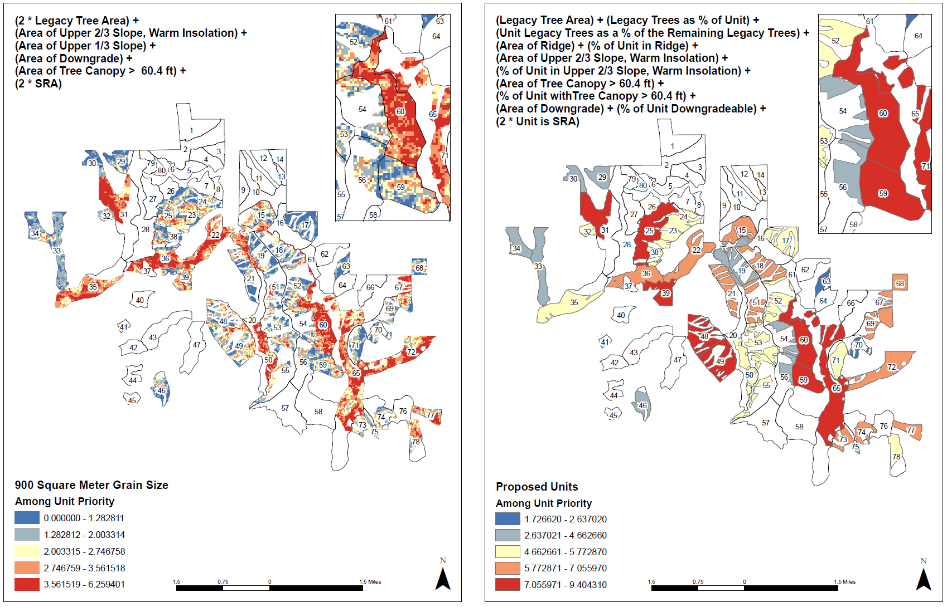
Prioritization of Treatment Areas

Slide 24
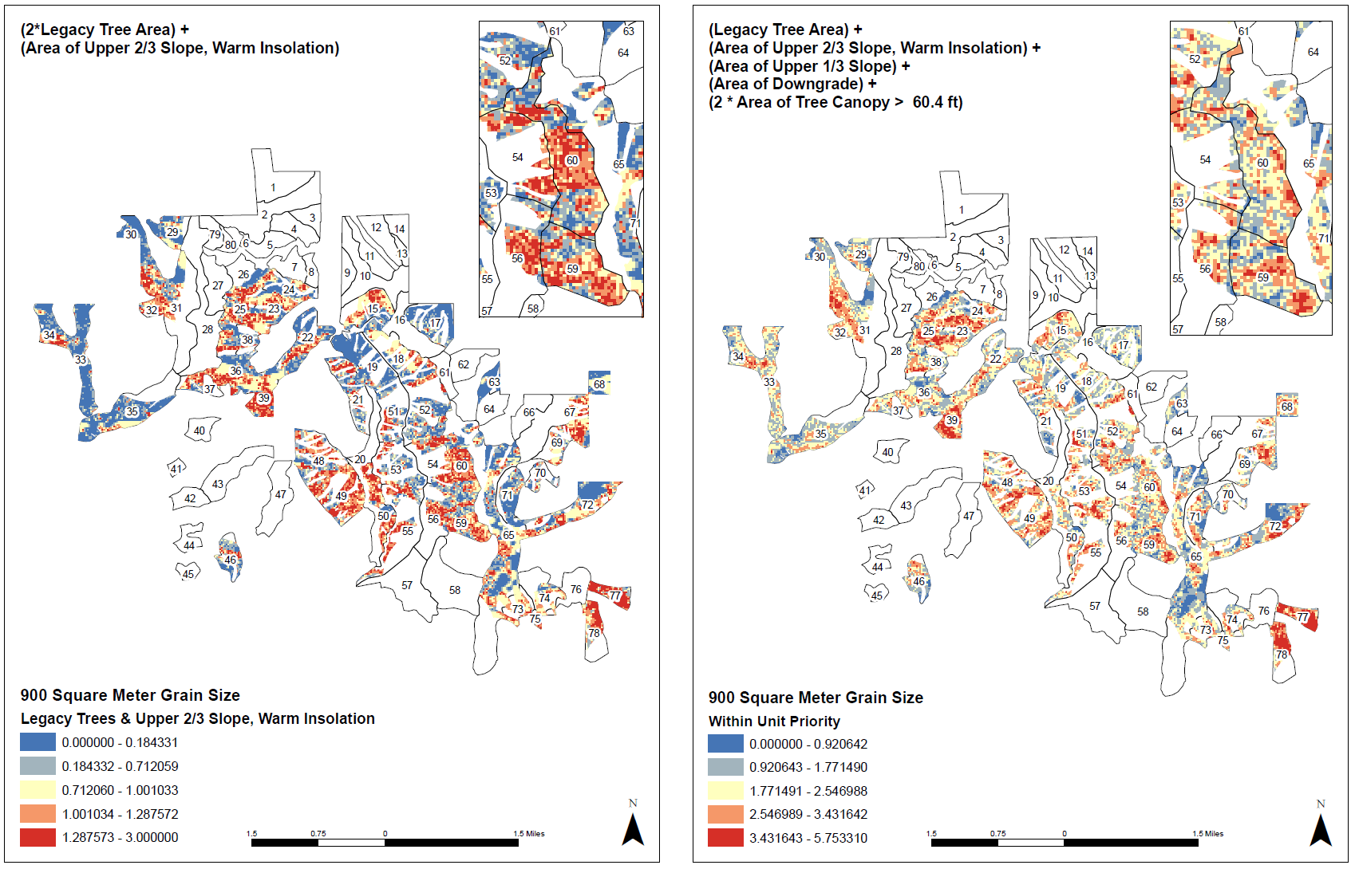
Prioritization of Treatment Areas

Slide 25
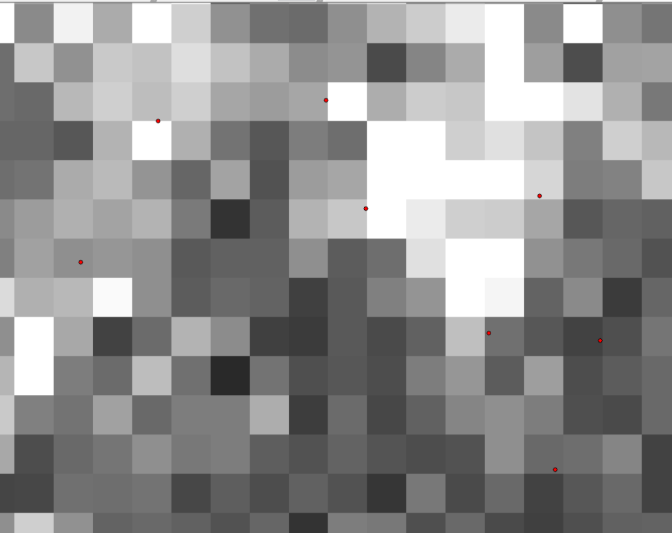
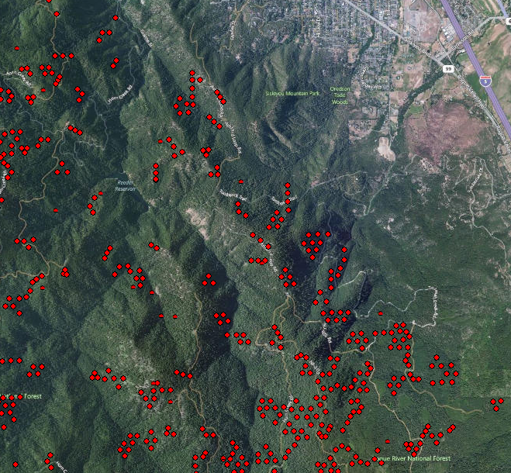
Vegetation Data Quality

Slide 26
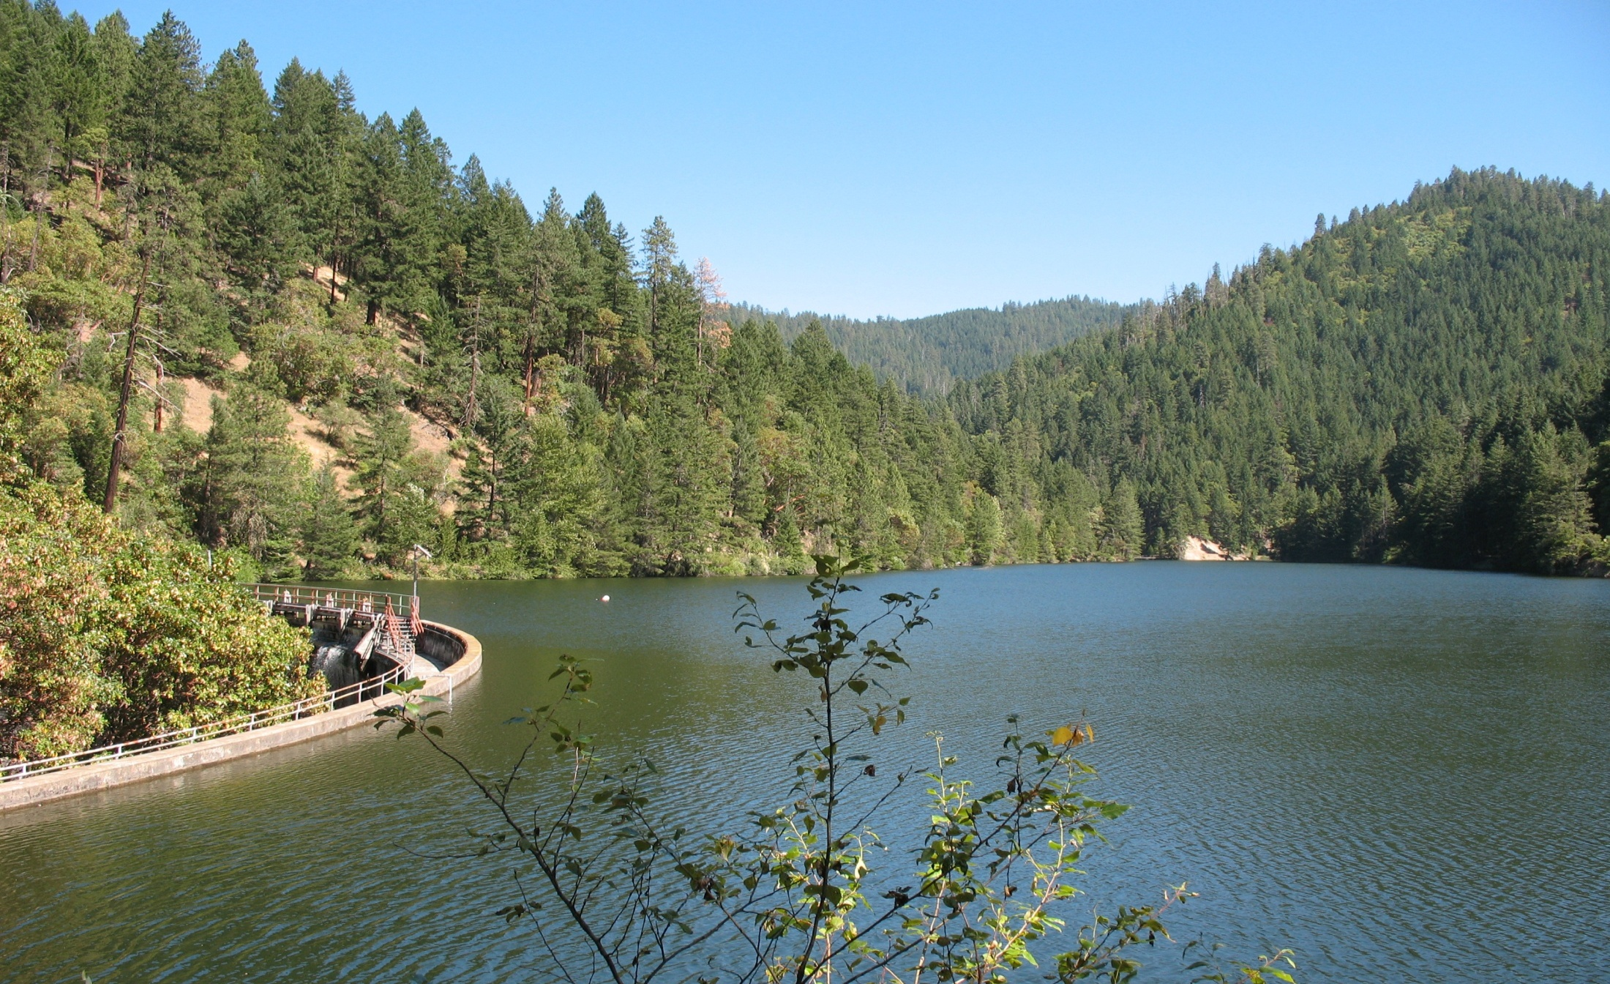
Questions?

