Slide 1
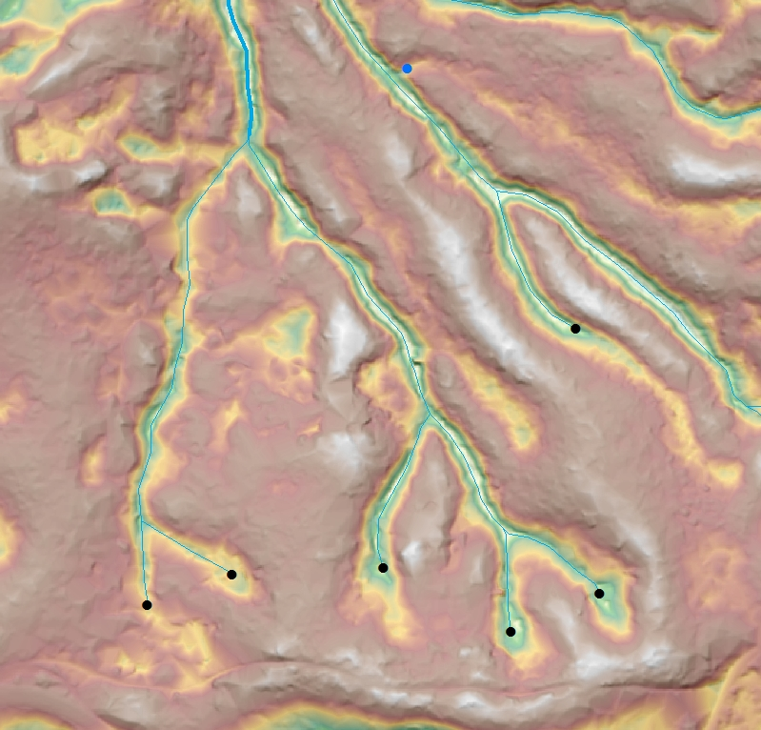
Using LiDAR to Inform NEPA
John Colby – Umpqua Field Office Hydrologist
John Guetterman – GIS Specialist
Coos Bay District BLM

Slide 2
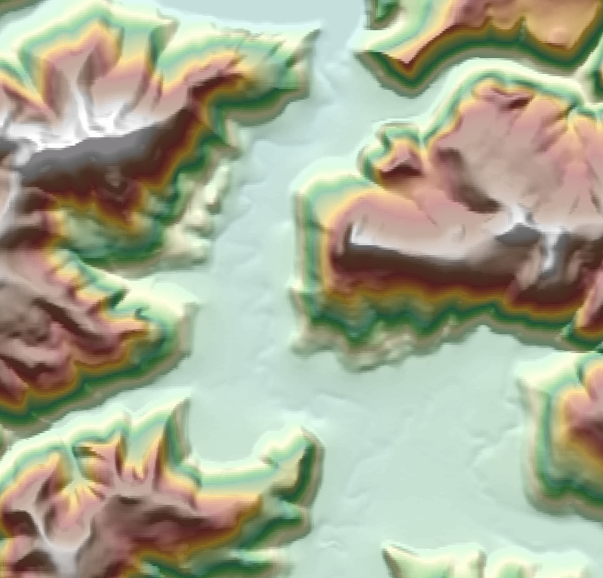

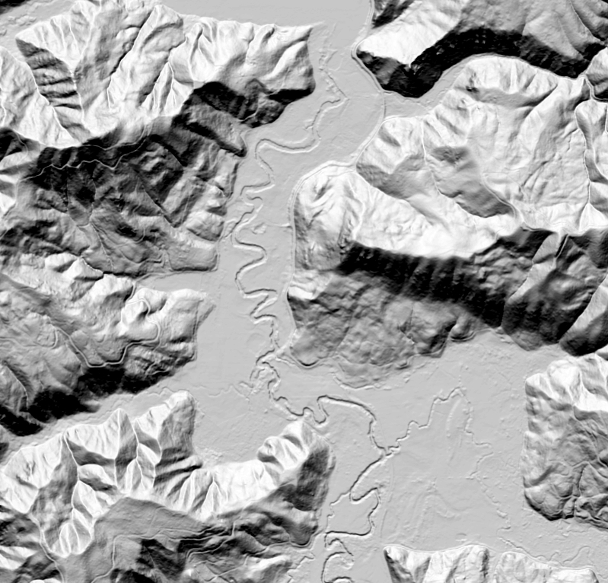
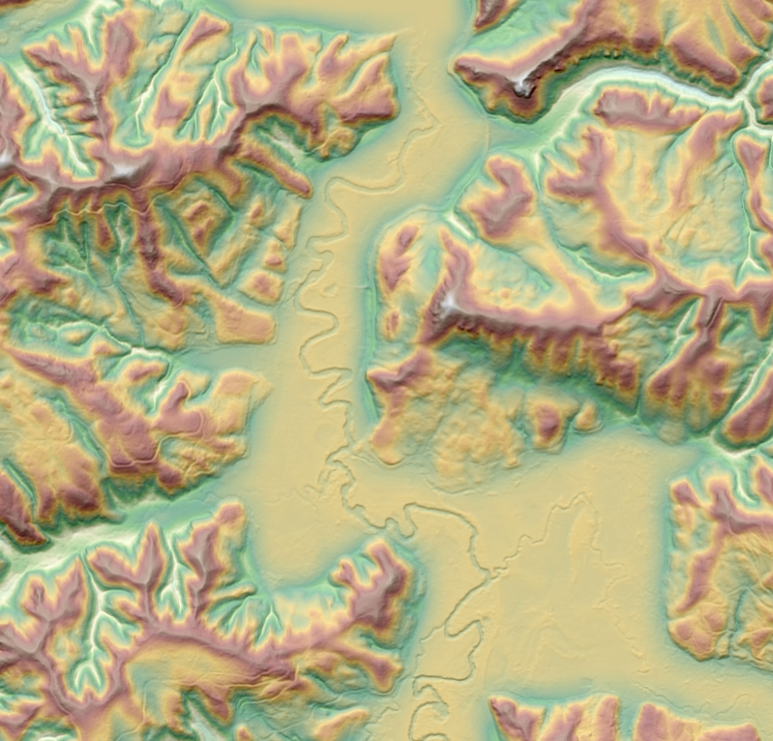
DEM 10m + BLM Hillshade
Hillshade (bare earth)
TPI 30m + Hillshade (bare earth)

Slide 3
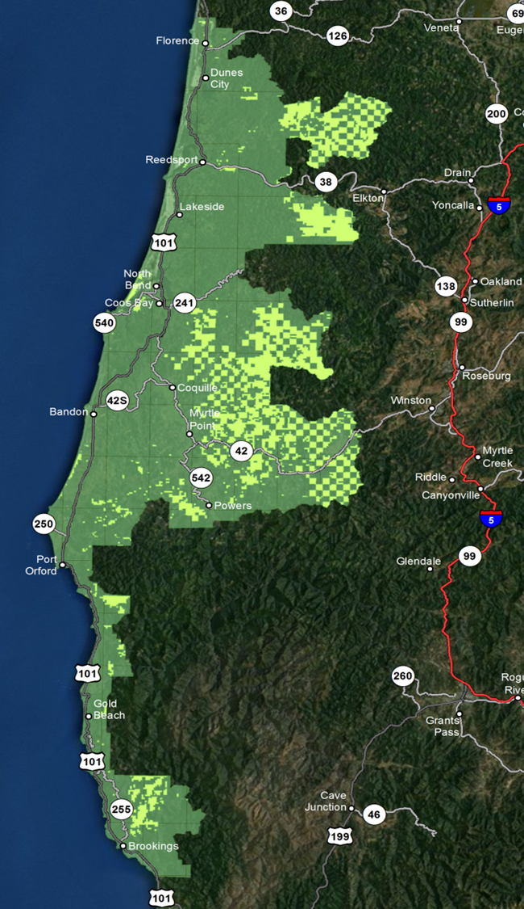
DOGAMI southern Oregon coast study area
Acquisition: 2008 & 2009
Area of interest: 1.6 million acres covering portions of 4 counties
LiDAR Consortium
Led by DOGAMI
CBD BLM 72% coverage or 232,709 acres out of 322,148 total District acres
Cost $175k CBD + $400k OSO
Other partners: USFS, BIA, ODF, State, USACE, private

Slide 4
DOGAMI southern Oregon coast study area
Leaf on
Average pulse density = 8.10 per m²
Average ground density = 0.57 per m²
Basic products
1st return DEM
Bare earth DEM
Point cloud data available from OSO for specific needs

Slide 5
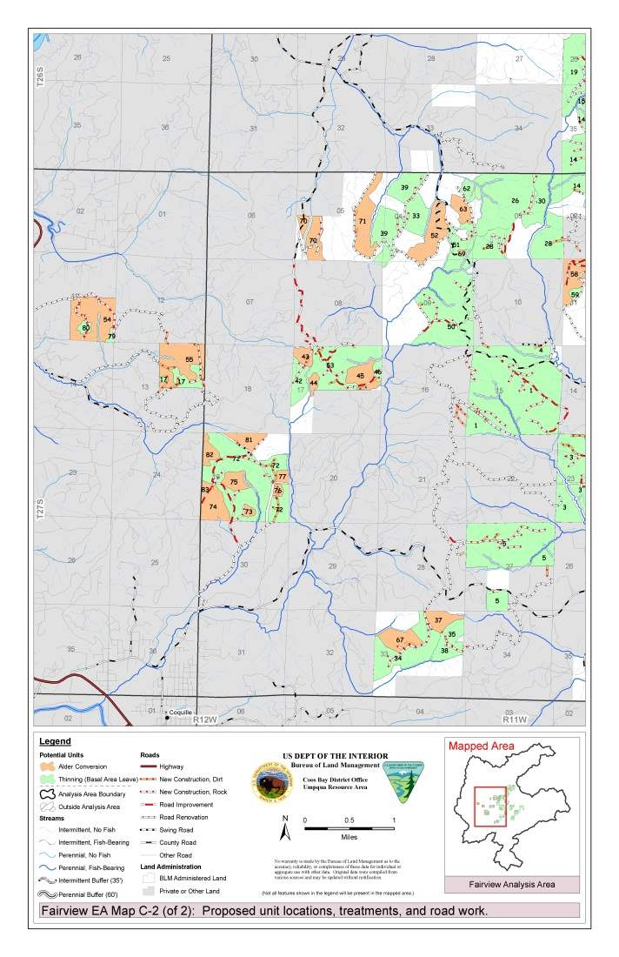
Umpqua Field Office NEPA
EA | Harvest acres | Tree age | No. of units
URSR | 8,963 | 31-80 | 104
Fairview | 7,344 | 40-75 | 83
Soup Cr. | 111 | 67 | 2
Big-Vincent | 6,341 | 34-62 | 31
> 70% of in-unit streams 1st & 2nd order

Slide 6
LiDAR a useful tool
Stream delineation
Stream inception points
Shade duration
LWD source areas

Slide 7
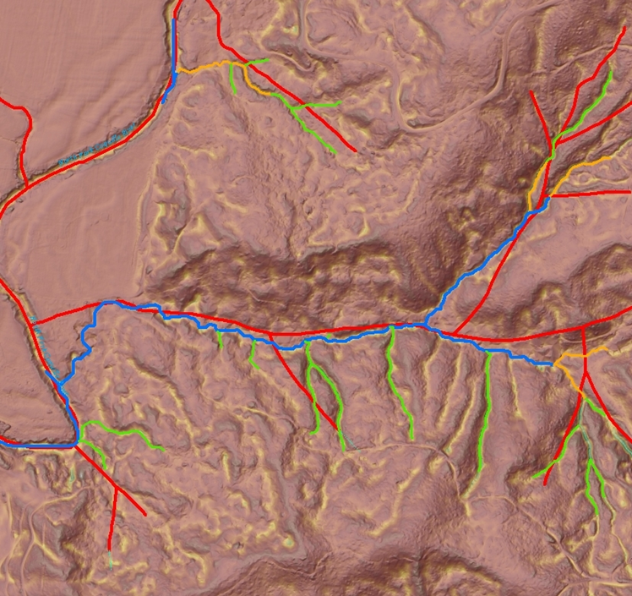
Stream Delineation

Slide 8
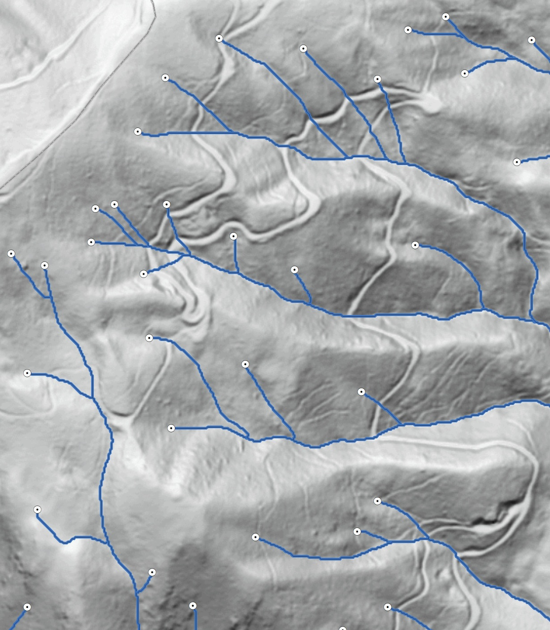
Stream Network Delineation Workflow
Use surface area rather than planimetric area when calculating upslope contributing area with the D-infinity algorithms
Apply Perona-Malik filtering to smooth surface noise while maintaining edges
Incise DEMs to breach depressions at road crossings and other physical obstructions
Fill all other depressions
Estimate channel initiation points using a combination of local curvature and upslope contributing area
Delineate stream network using least-cost path analysis
Courtesy of Craig Ducey, OSO GIS/Remote Sensing Specialist
Draft watershed boundary and stream network delineation
1:8,000

Slide 9
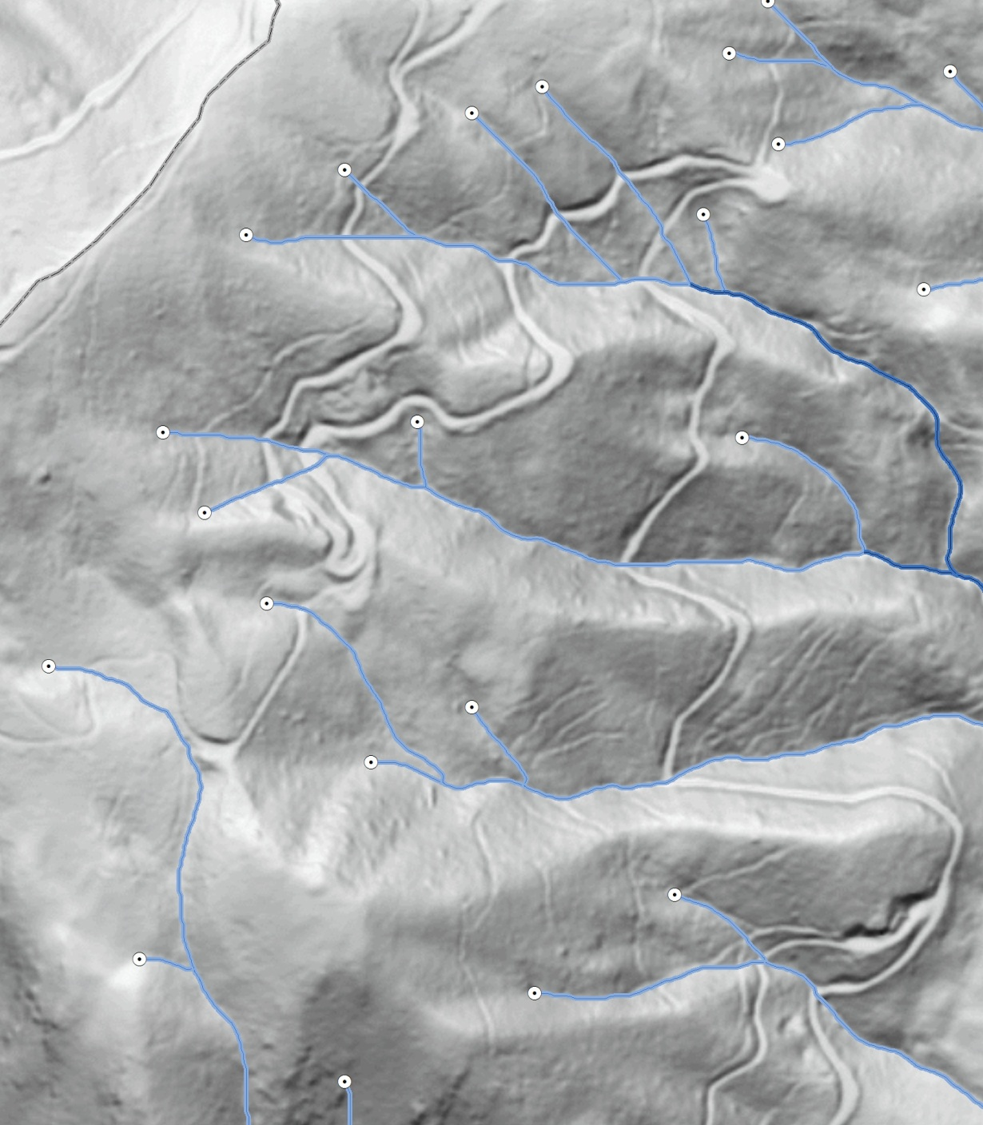
Stream Network Delineation Workflow
Prepare data for NHD steward review
Revise stream network by deleting, adding, or moving channel initiation points
Estimate periodicity using Shreve stream order
Apply minimal smoothing to improve line geometry aesthetics
Migrate attribution and update the NHD corporate dataset
Revise watershed boundaries and update the WBD corporate dataset
Courtesy of Craig Ducey, OSO GIS/Remote Sensing Specialist
Final watershed boundary and stream network delineation
1:8,000

Slide 10
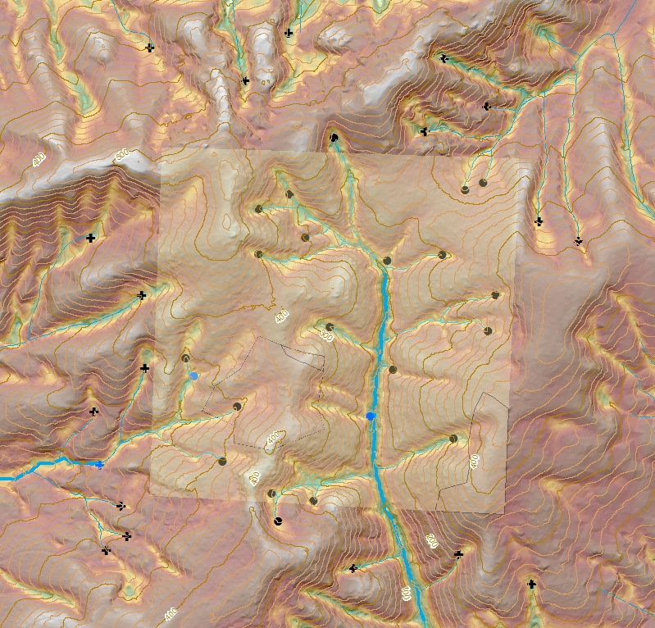
Stream Inception Points - Office
Generate streams with steps from Craig’s earlier work + ESRI tools
Mark inception points
Create paper maps
Load unit boundary and LiDAR streams on GPS

Slide 11
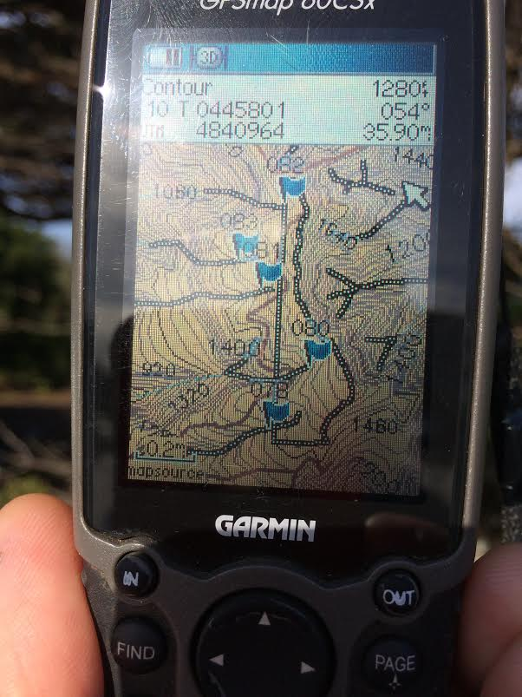
Stream Inception Points - Field
Many hands make light work
Protection of the resource
National Hydrography Dataset (NHD) revisions

Slide 12
Perennial buffer widths
Operational considerations
Unstable ground
Shade
LWD source areas
Hardwoods only
Mixed forest
Pronounced inner gorge

Slide 13
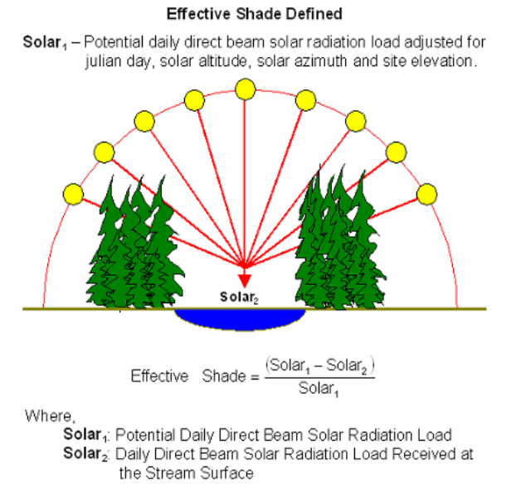
Effective Shade
Daily direct solar radiation blocked from reaching the stream
Function of shade duration and shade quality
ES = 100-53/100 = 47%
12
10
2
12
12
12
12
10
10
8
8
8
4
8
8
Graphic modified from Boyd & Kasper 2003

Slide 14
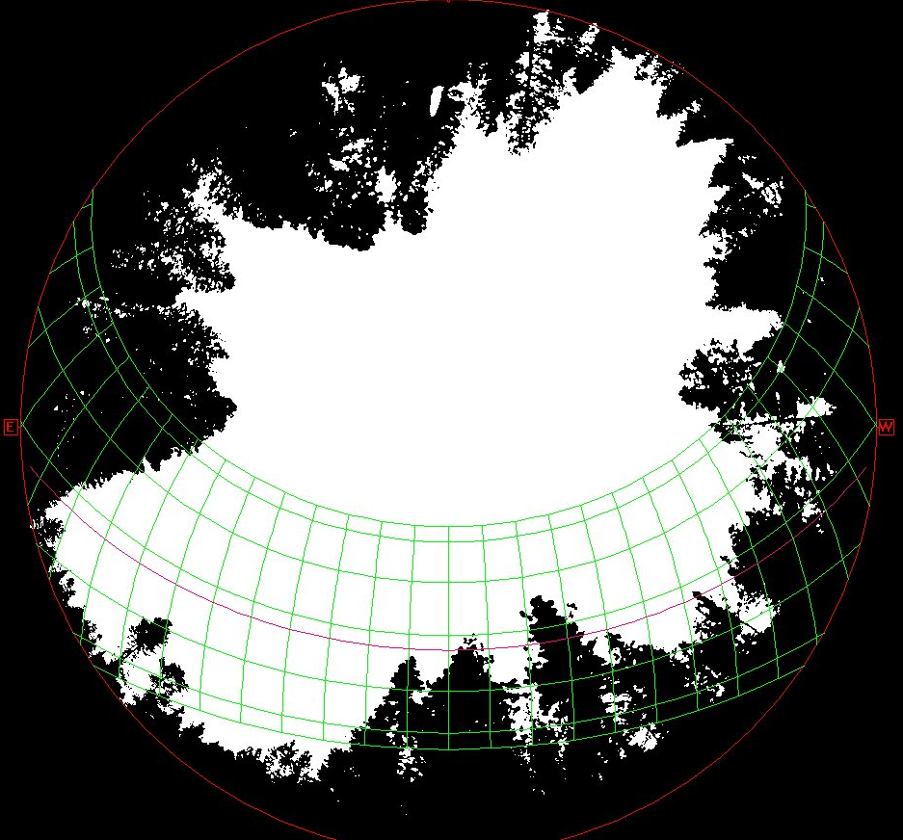
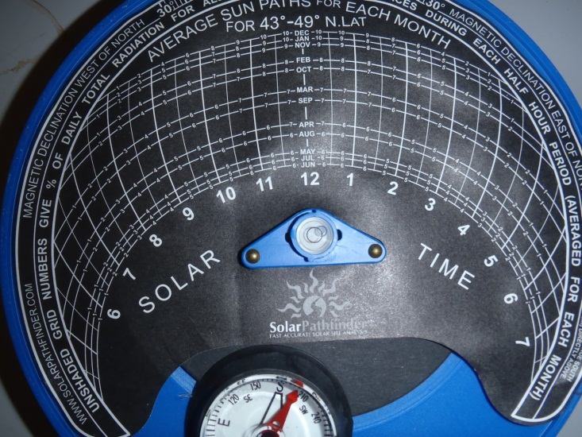
Measuring Effective Shade

Slide 15
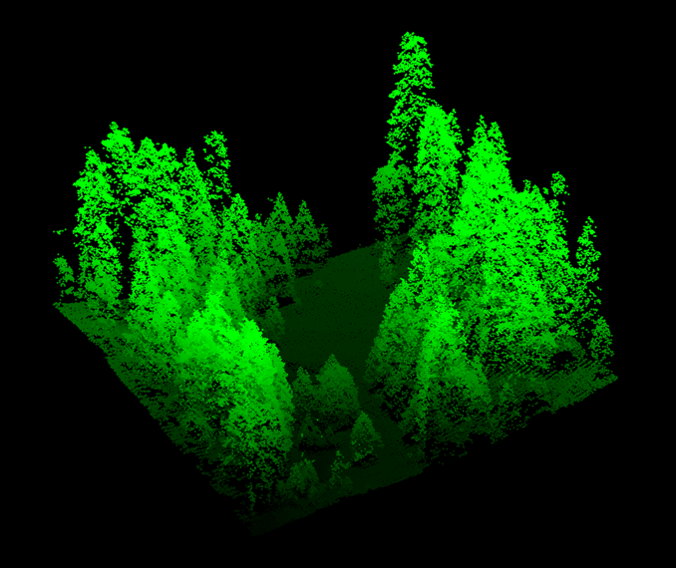
Measuring Effective Shade

Slide 16
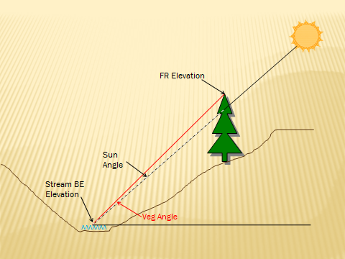
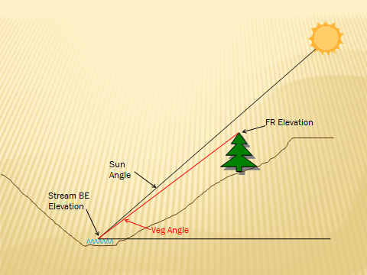
Shade Duration

Slide 17
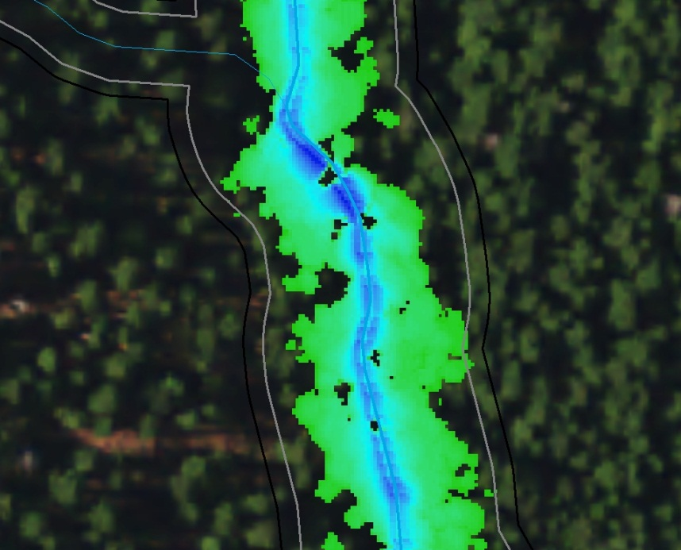
Primary Shade Fairview Unit 13
120’ horizontal
50’ horizontal
100’ horizontal
35’ horizontal

Slide 18
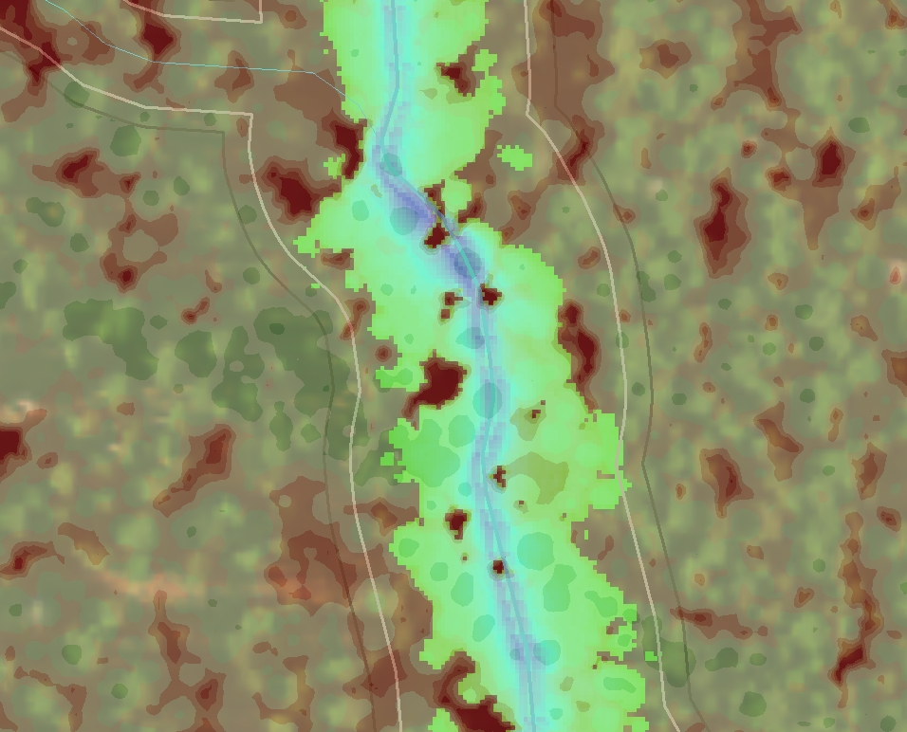
Primary Shade Fairview Unit 13

Slide 19
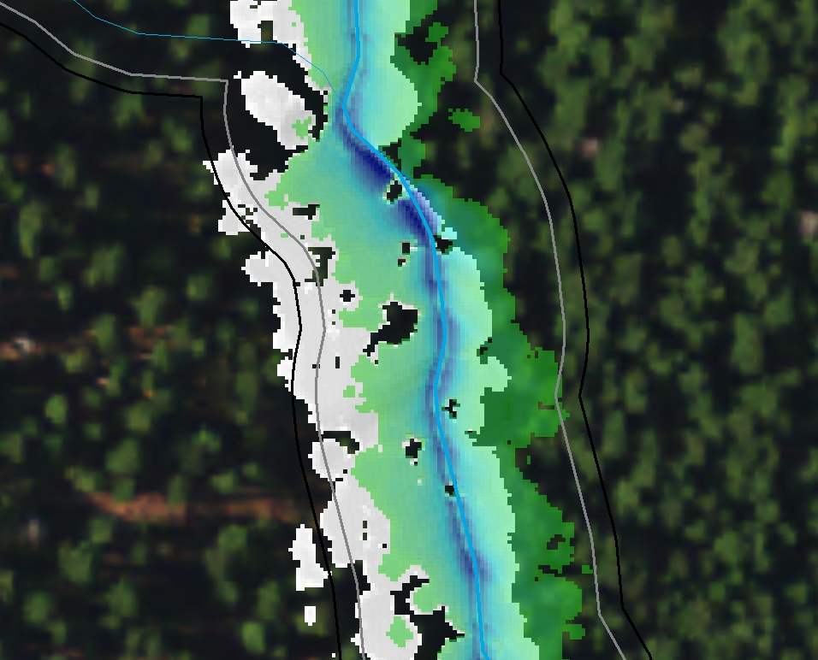
Primary Shade Fairview Unit 13

Slide 20
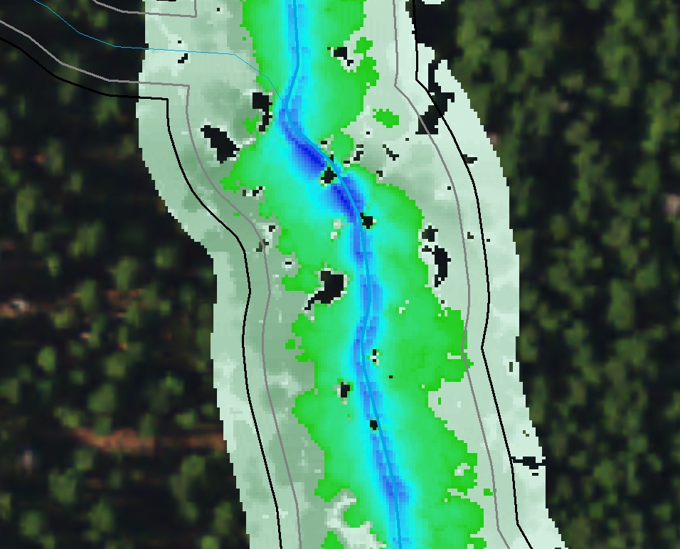
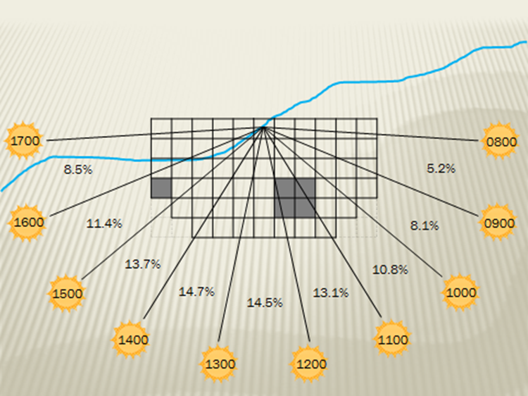
Secondary Shade Fairview Unit 13

Slide 21
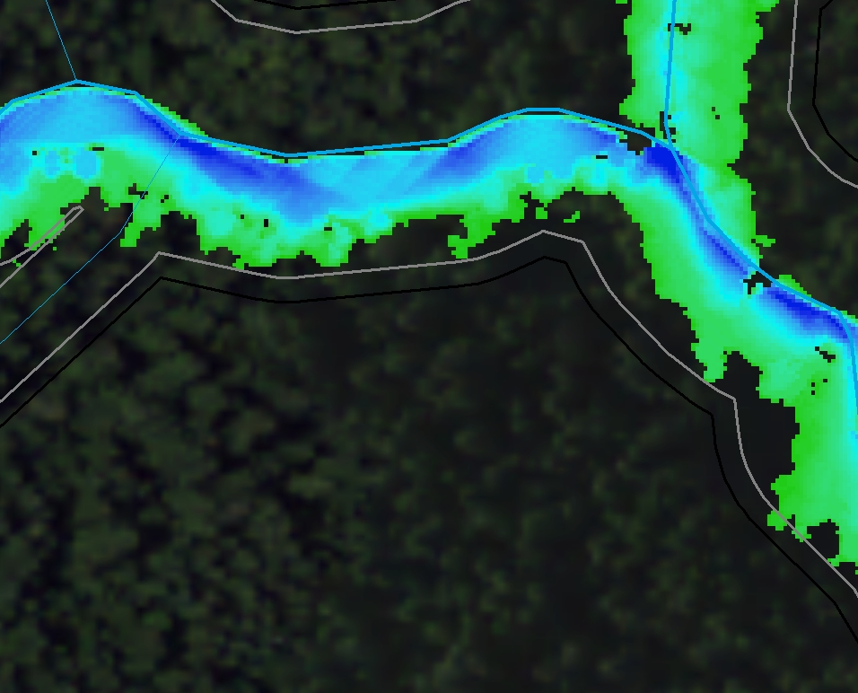
Primary Shade Fairview Unit 1

Slide 22
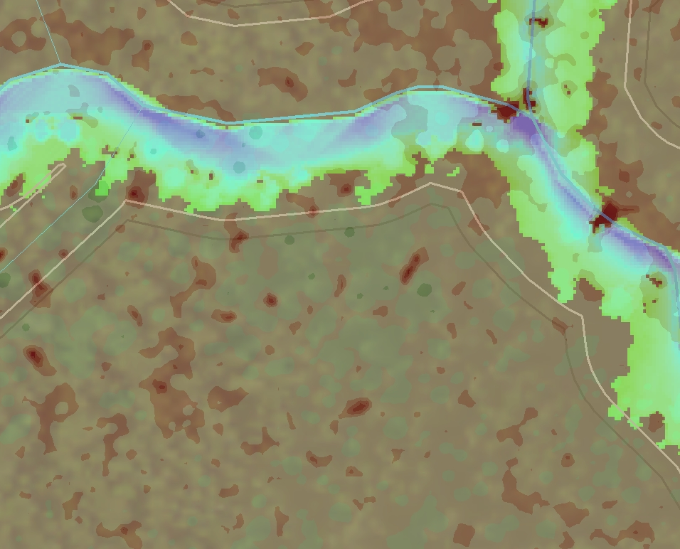
Primary Shade Fairview Unit 1

Slide 23
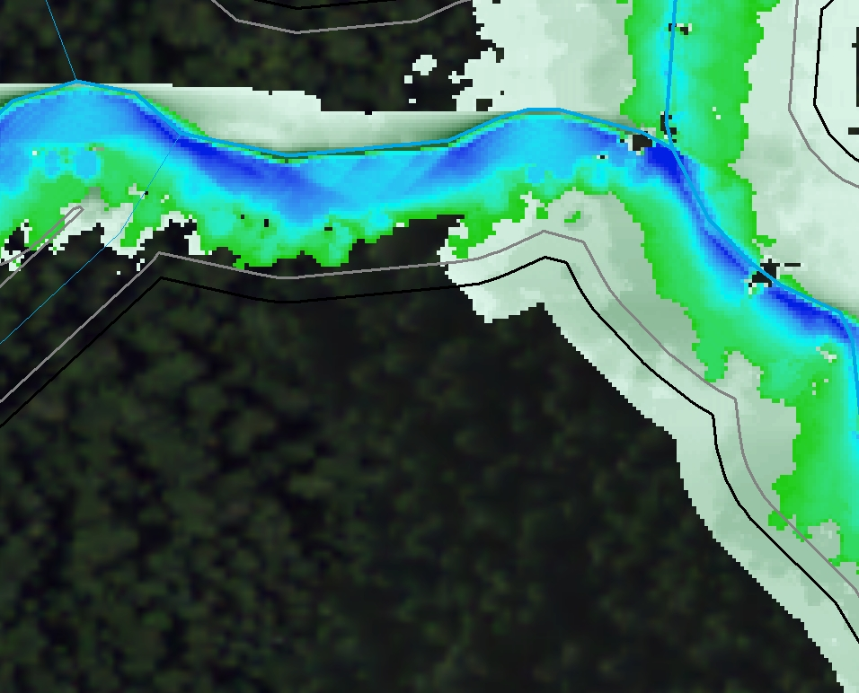
Secondary Shade Fairview Unit 1

Slide 24
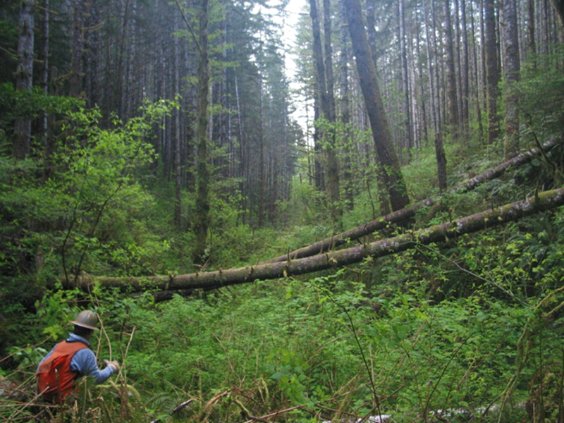
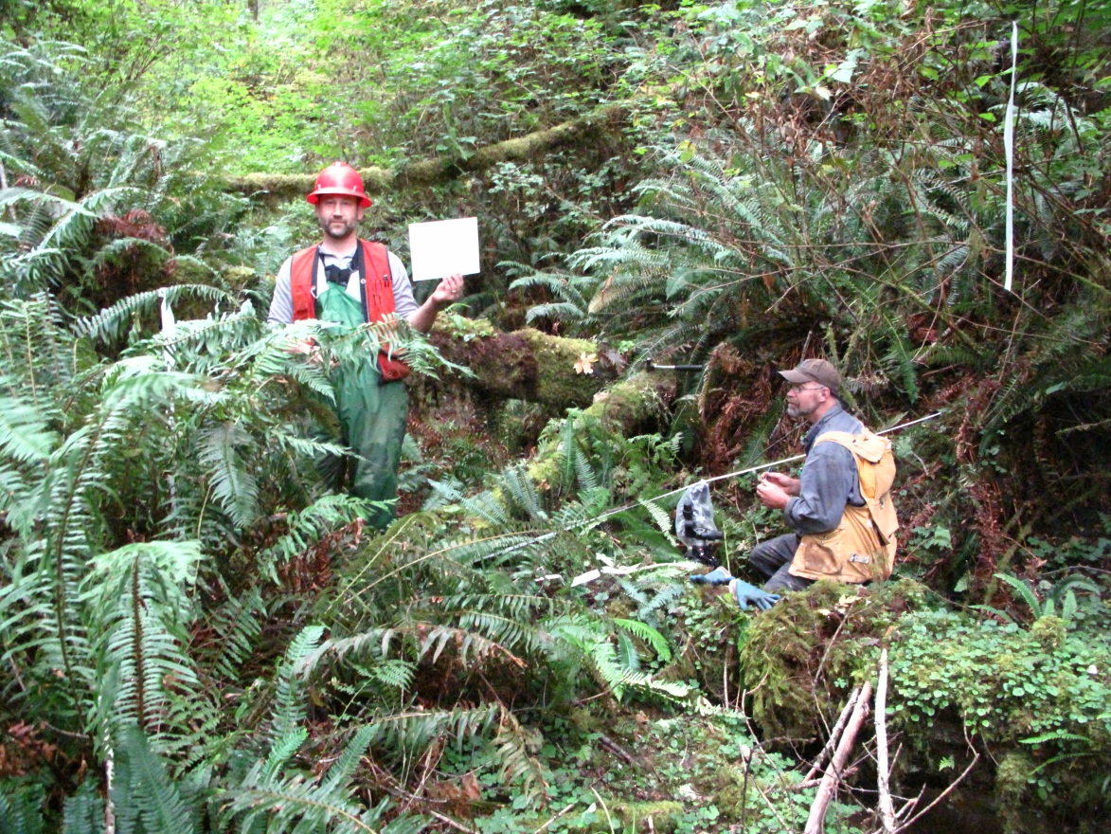
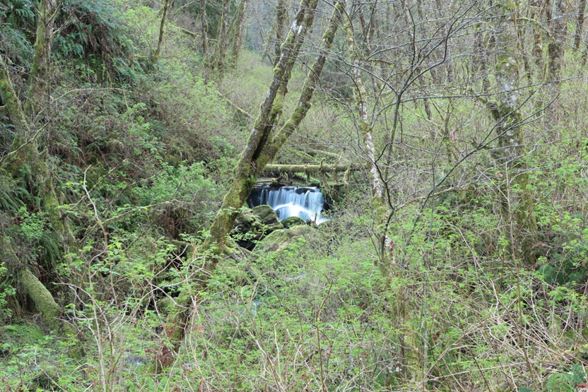
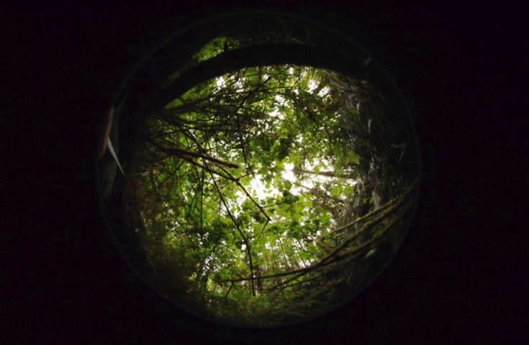
Near Stream Shade
They can’t read your sign.
11 random points / Effective shade 92-97%, average 94%

Slide 25
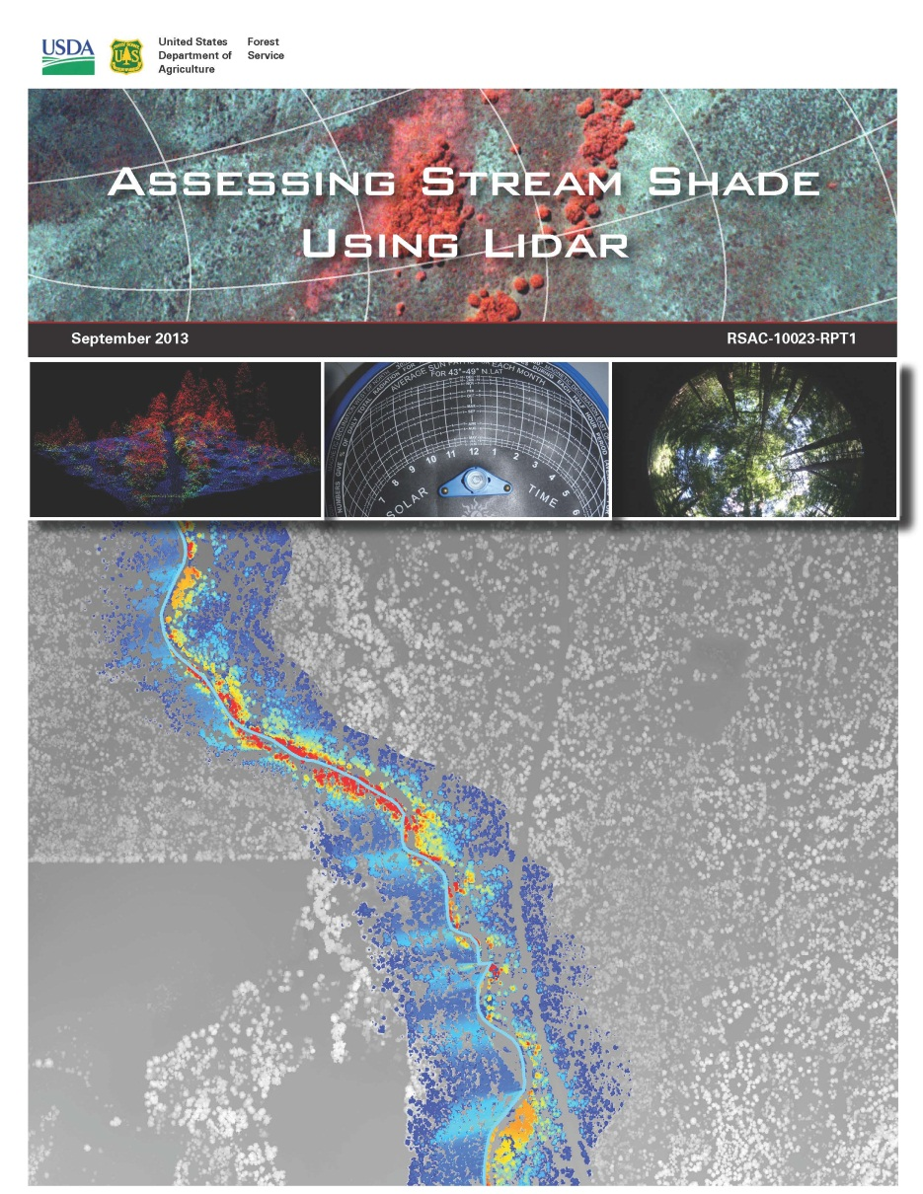
Primary Shade
“At a qualitative level, the primary and secondary shade source layers created by the BLM model could be very useful to land managers… These products can easily be used to identify areas that would benefit from shade management.”

Slide 26
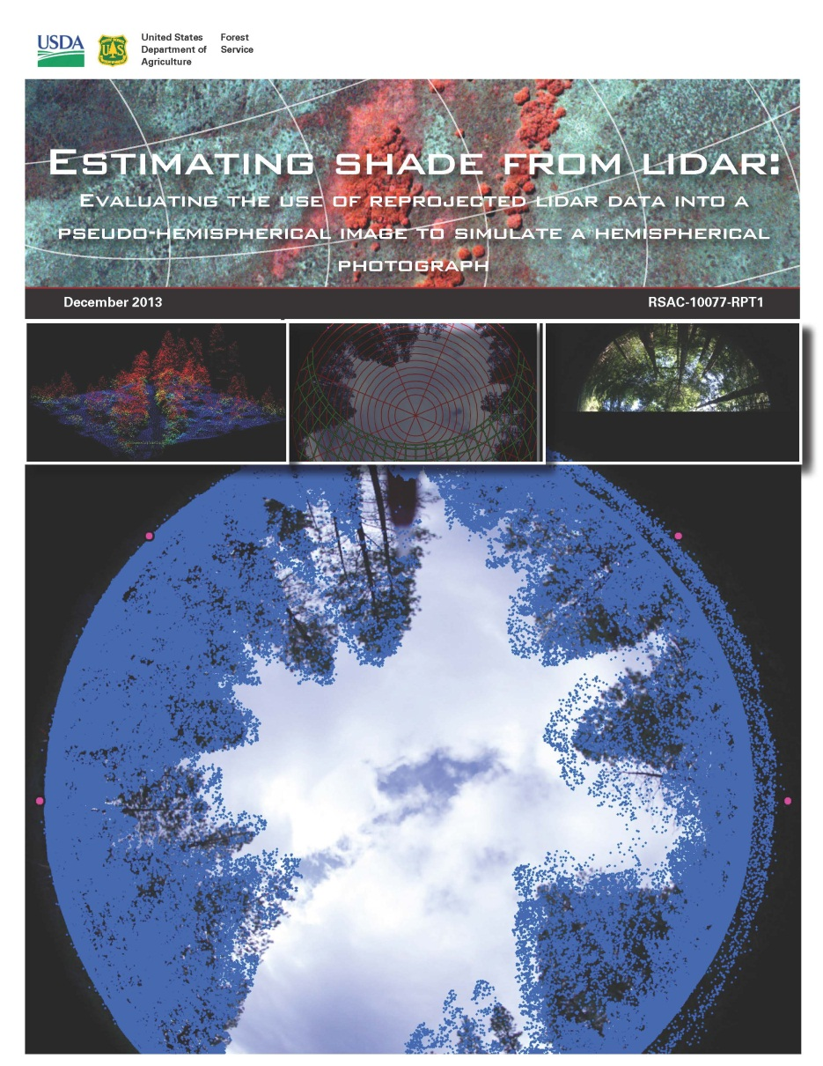
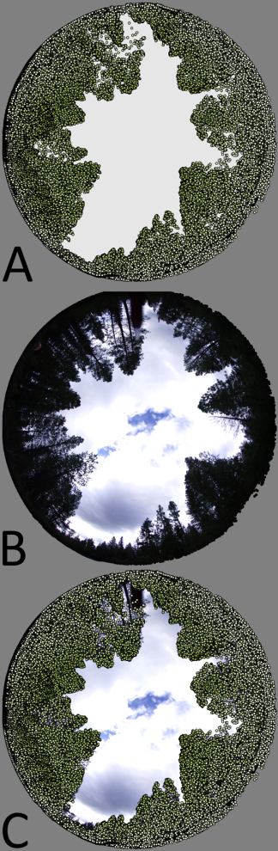
Effective Shade
“Using pseudo-hemispherical images to estimate shade can be a cost effective method for estimating shade anywhere high density LiDAR data is available by reducing the amount of field work necessary to obtain the numerous field hemispherical photographs typically required to describe a stream reach or parcel of land.”

Slide 27
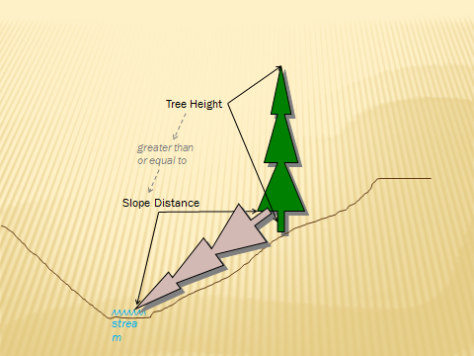
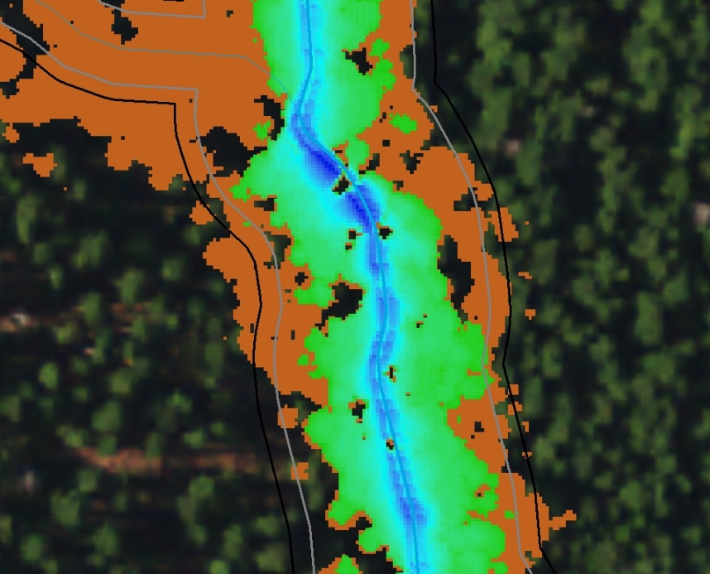
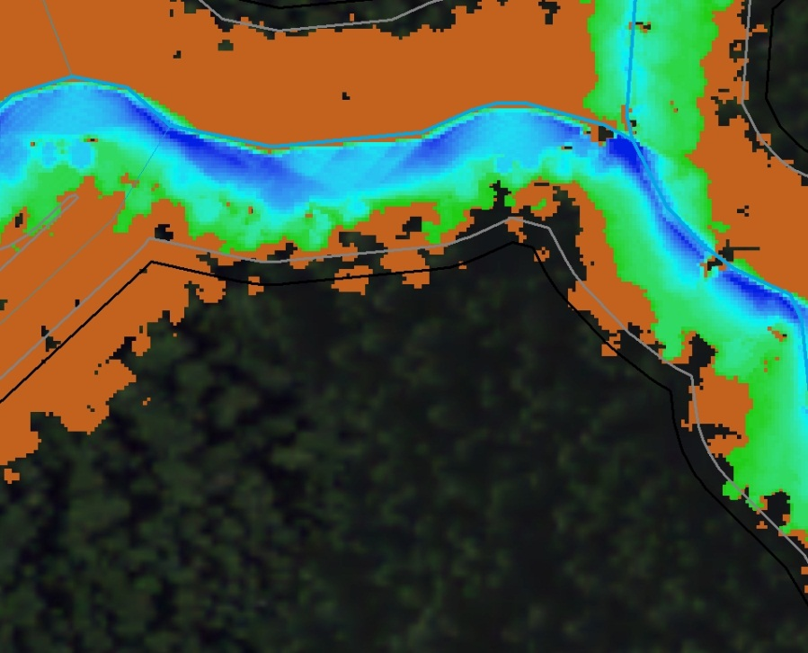
LWD Source Areas

Slide 28
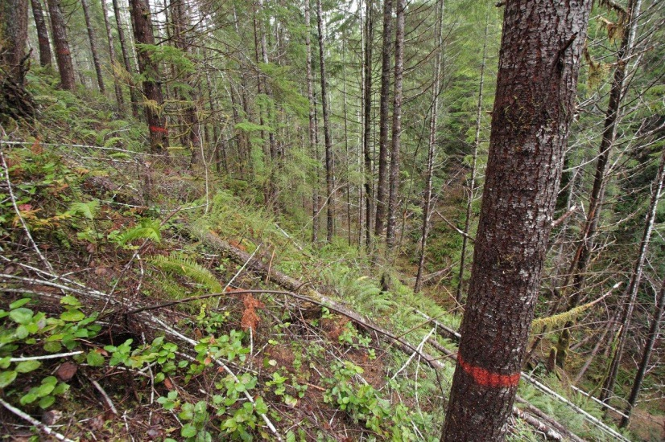
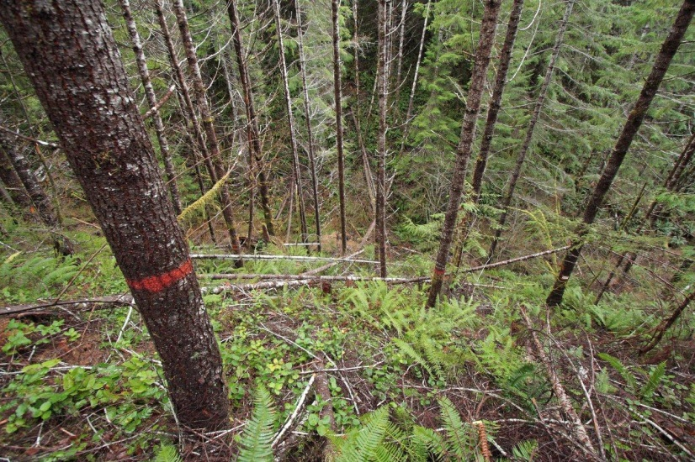
LWD Source Areas

Slide 29
LWD Source Areas
Effective tree height (Robison & Beschta 1990)
20cm (8 in) x 1.5m
20cm x 2m (May & Creswell 2003)
15cm (6 in) x 3m (Foster et al. 2001)
Buffer steeper slopes
40 to >200 year old riparian trees in the PNW more likely to fall towards the channel on steep (>40%) hillslopes (Sobota et al. 2006)
Bole Diameter in Inches at 16-Foot Intervals Up an Average Tree in each DBH Class.
DBH | 16 ft. | 32 ft. | 48 ft. | 64 ft. | 80 ft. | 96 ft. | 112 ft. | 128 ft. | 144 ft. | 160 ft. | 176 ft. | 192 ft. | 208 ft.
12 in. | 10 | 9 | 9 | 6 | 5 | - | - | - | - | - | - | - | -
16 in. | 13 | 12 | 11 | 9 | 8 | 5 | - | - | - | - | - | - | -
20 in. | 16 | 15 | 14 | 12 | 11 | 9 | 6 | - | - | - | - | - | -
24 in. | 19 | 18 | 17 | 15 | 14 | 12 | 10 | 7 | - | - | - | - | -
28 in. | 22 | 21 | 19 | 18 | 16 | 13 | 11 | 7 | - | - | - | - | -
32 in. | 24 | 23 | 22 | 20 | 18 | 16 | 14 | 11 | 8 | - | - | - | -
36 in. | 29 | 28 | 27 | 25 | 24 | 23 | 20 | 18 | 15 | 12 | 9 | - | -
40 in. | 32 | 31 | 30 | 28 | 27 | 25 | 23 | 21 | 19 | 16 | 13 | 10 | -
44 in. | 33 | 32 | 31 | 29 | 28 | 26 | 25 | 23 | 21 | 19 | 16 | 13 | 10
48 in. | 37 | 36 | 34 | 33 | 31 | 29 | 27 | 25 | 23 | 21 | 18 | 15 | 11
Data is based on log taper and board foot tables for Douglas-fir on the Coos Bay District.

Slide 30
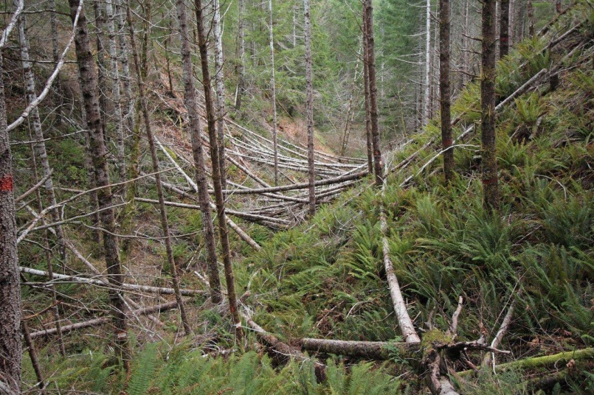
LWD Source Areas

Slide 31
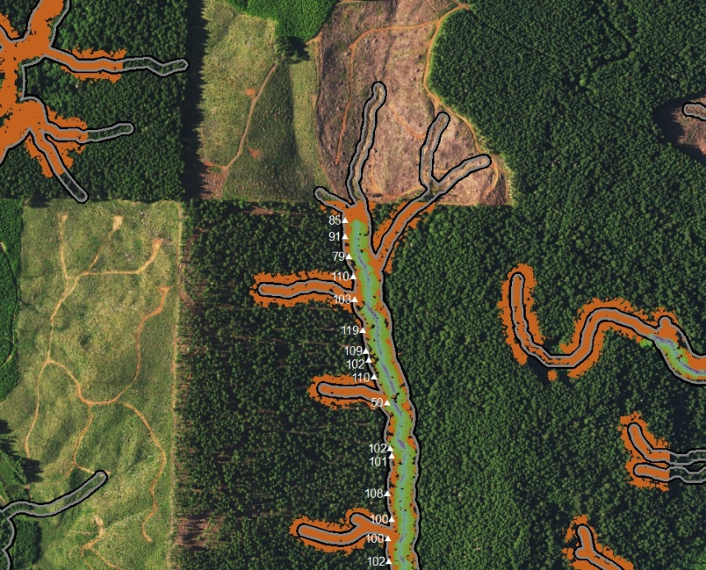
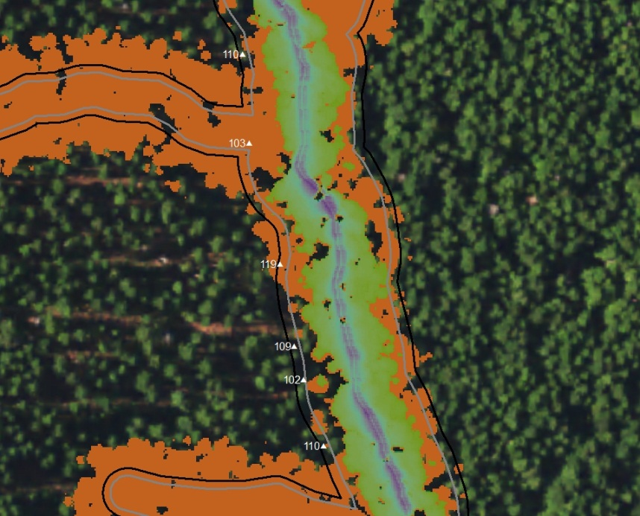
Fairview Unit 13
9/2009
9/2013
Thinning 2/2013 – 2/2014 / 125 tpa to 56 tpa / 23 points, average 104’ horizontal

Slide 32
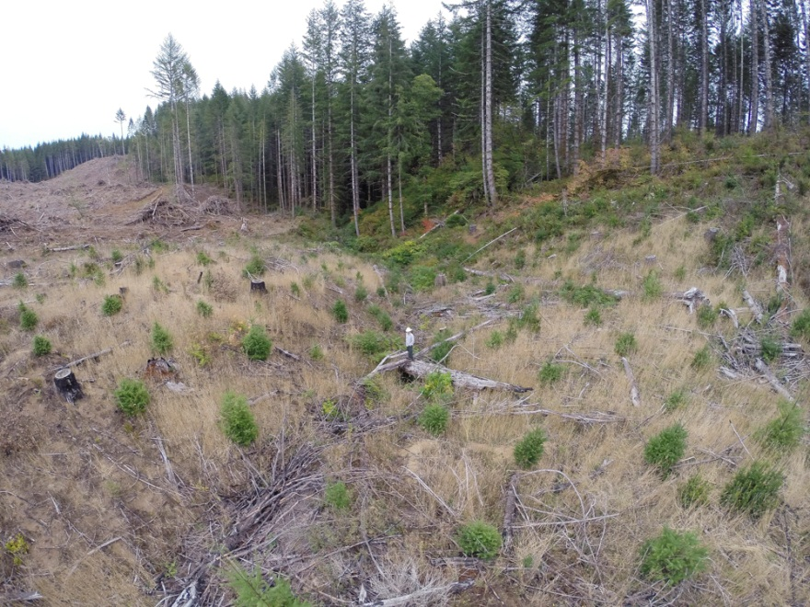
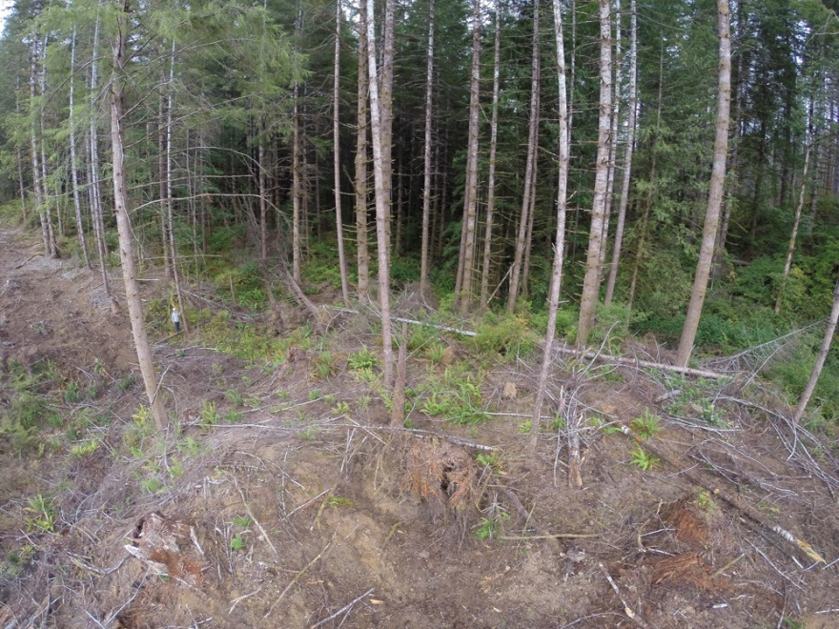
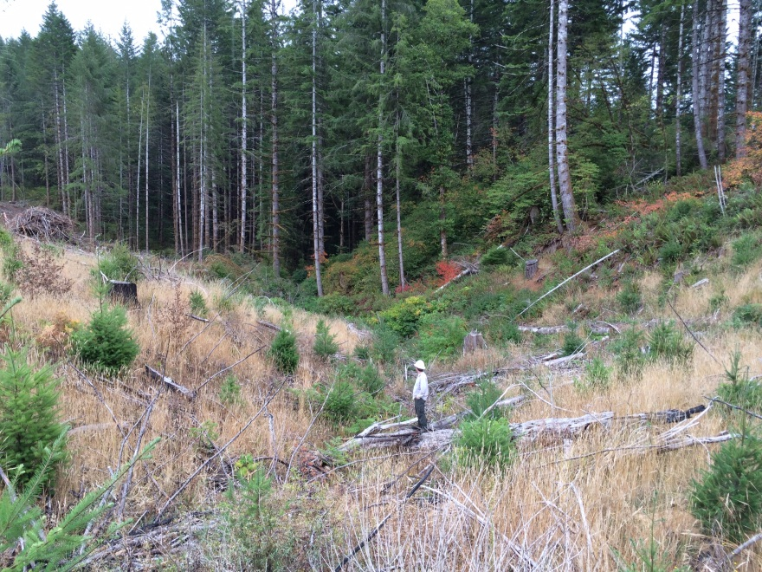
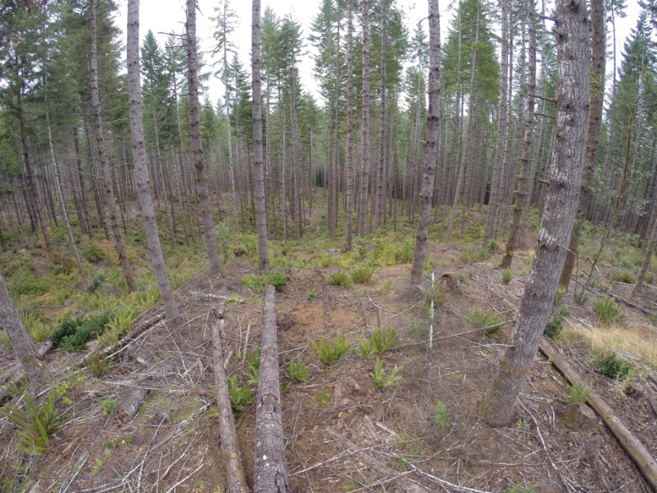
Fairview Unit 13

Slide 33
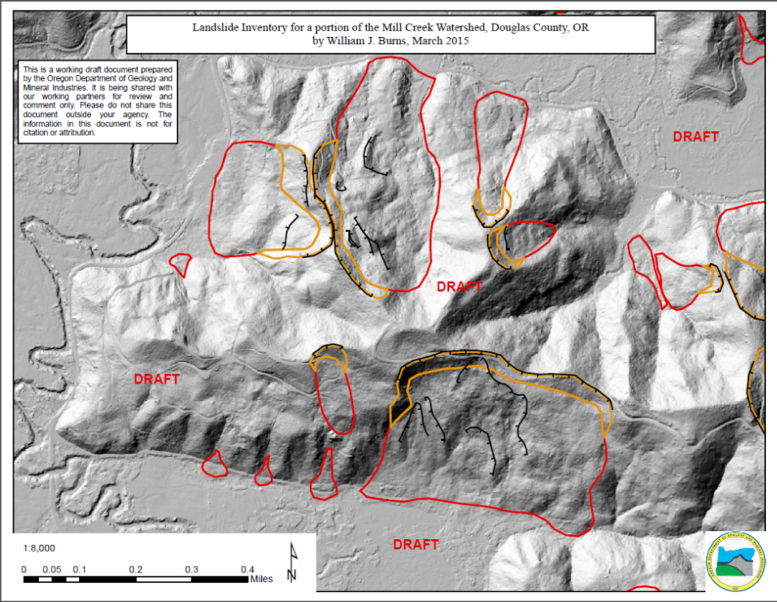
DOGAMI Landslide Agreement
“I don’t want to look at LiDAR anymore. There are too many landslides. I’m going back to the 10m DEM.”

Slide 34
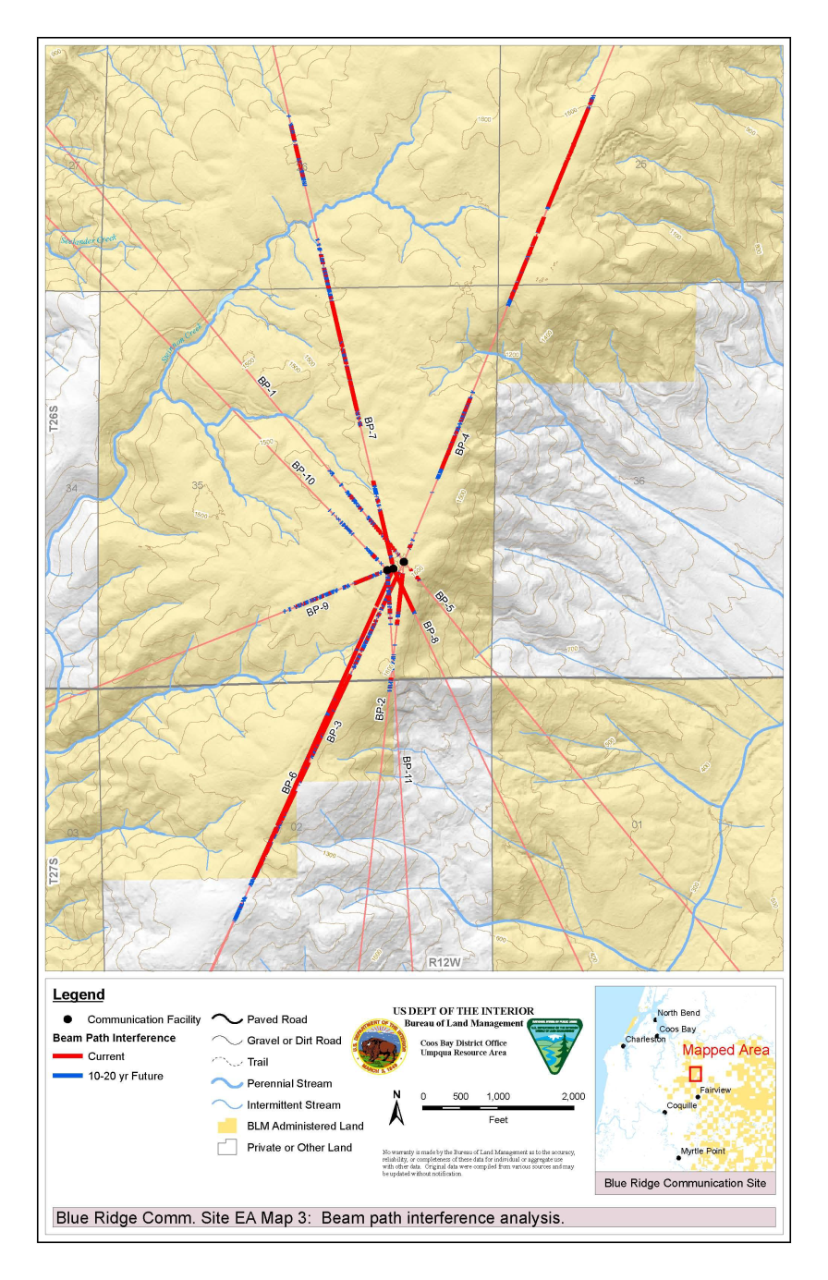
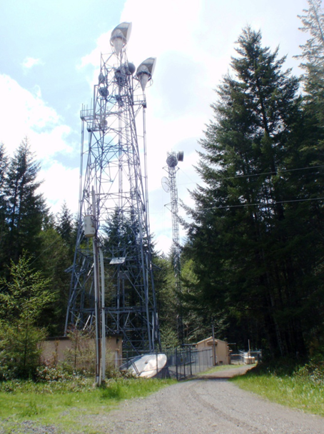
Beam Path Maintenance

Slide 35
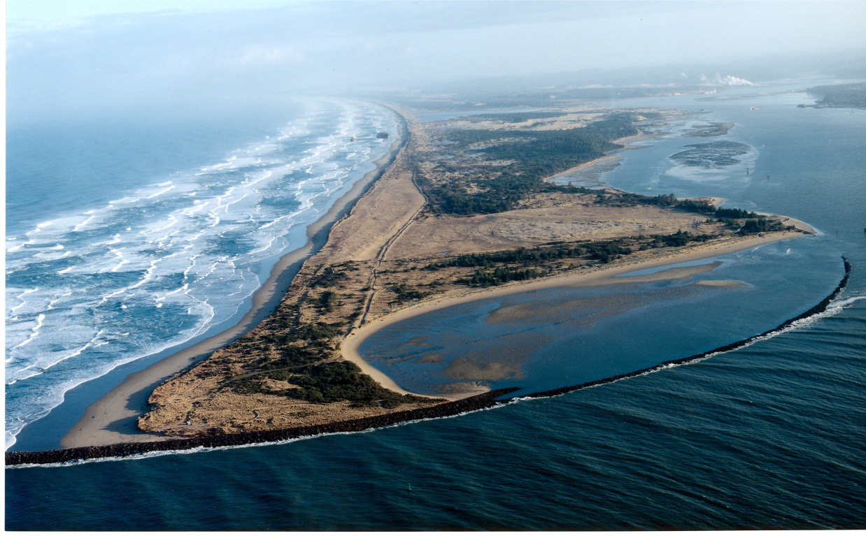
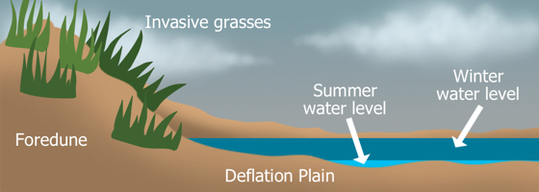
Wetlands – North Spit

Slide 36
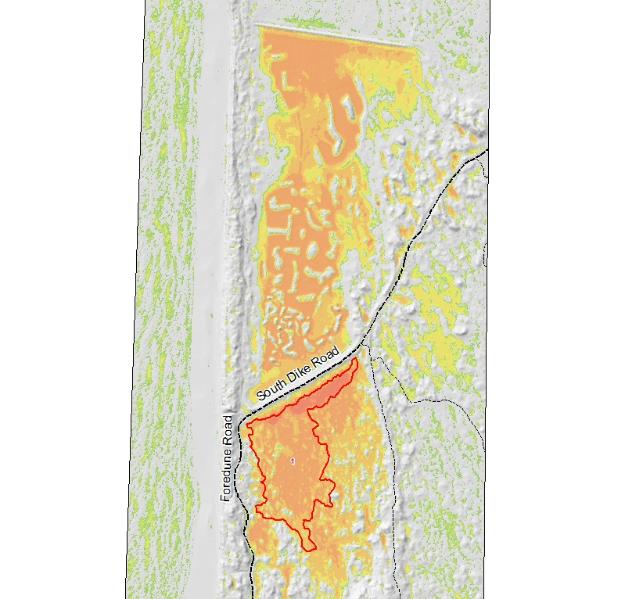
Wetlands – North Spit

Slide 37

Wetlands – Dean Creek EVA

Slide 38

Subsidence
Dikes reduce tidal flooding and sediment deposition
Drying leads to soil oxidation, decomposition, and consolidation
Grazing and haying reduce organic material
Livestock and machinery compact soils
Courtesy of Craig Cornu, South Slough National Estuarine Research Reserve

Slide 39


Wetlands – Dean Creek EVA
TPI 30m + Hillshade (bare earth)

Slide 40

Wetlands – Dean Creek EVA

Slide 41



Hinsdale Garden

Slide 42

Questions?

Slide 43

Stream Profiles

Slide 44



Slide 45



