Slide 1
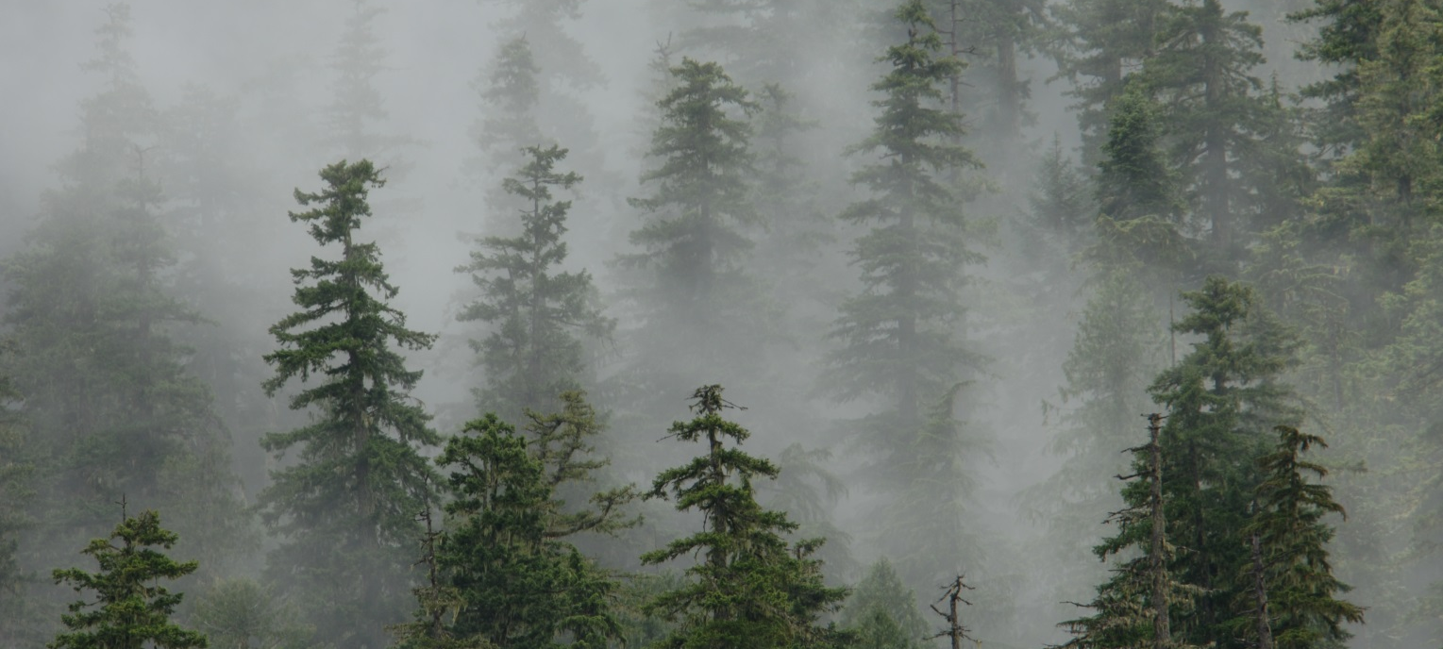
Using LiDAR to Model Forest Wildlife Habitat
3 Applications for Late-Seral Species:
Marbled Murrelet – J. Hagar, USGS
Northern Spotted Owl – S. Ackers, OSU
Red Tree Vole – R. Davis, USFS

Slide 2
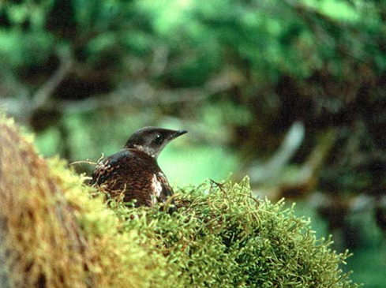
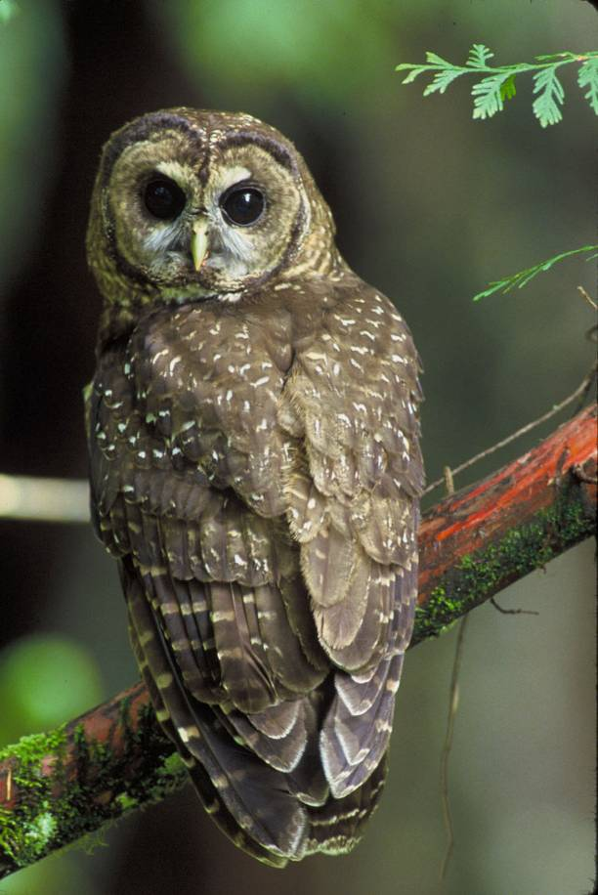
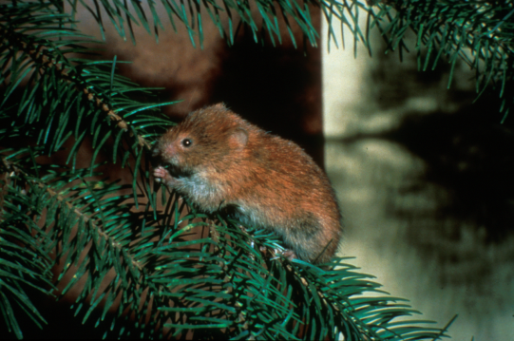
Modeling Habitat for Canopy Associated Species
3D structure difficult to quantify with traditional methods
Especially challenging for species that use late-seral forests
LiDAR – a promising tool for improving habitat models

Slide 3
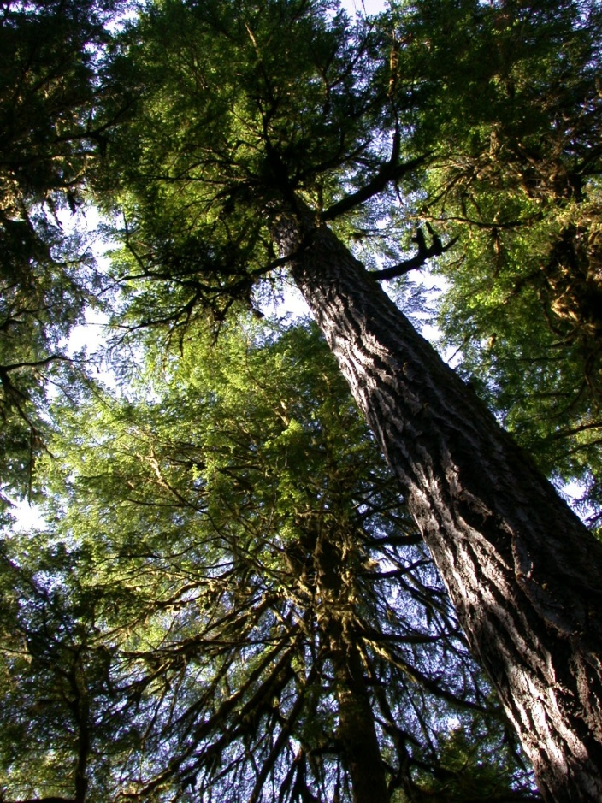
Capabilities of LiDAR
(Wildlife Habitat Modeling Perspective)
Quantifies 3D structure
Describes canopy structure
Continuous variables
Quantifies fine-scale features over broad areas

Slide 4
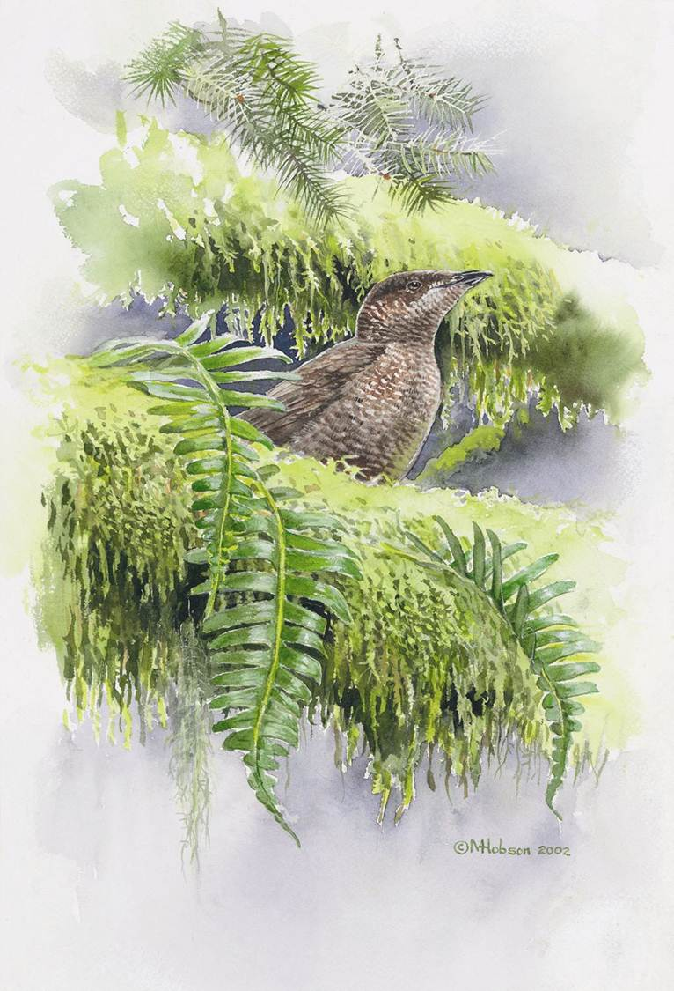
Goals of using LiDAR to model habitat:
Find new variables that describe relevant environmental gradients
Find parsimonious combination of easily interpreted and “multi-use” variables
Not necessarily compatible!

Slide 5
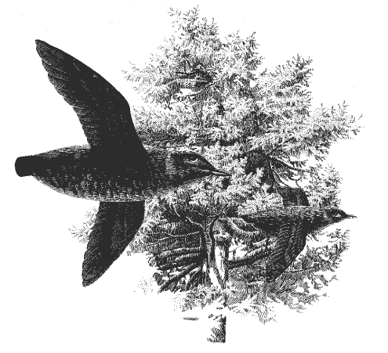
Modeling Marbled Murrelet Habitat Using LiDAR-Derived Canopy Metrics
Finer quantification of canopy structure desired for addressing recovery plan goals
Determine which LiDAR-derived variables are most strongly associated with stand occupancy
Pre-disturbance survey data
Modeling Team: J. Hagar and P. Haggerty (USGS), D. Vesely (Oregon Wildlife Institute), B. Eskelson and S.K. Nelson (OSU)

Slide 6
LiDAR Variables selected for Murrelet habitat model (Hagar et al. 2014 Wildl. Soc. Bull.)
Variable | Occupied | Unoccupied
Maximum of cover above mean height (ALLCVABVMN_max) | greater | less
Maximum of 99th percentile of 1st returns (El_p99_max) | greater | less
Maximum of 10th percentile of 1st returns (El_p10_max) | greater | less
Standard deviation of canopy cover above mode (FRSTCVABVMD_std) | greater | less
Minimum of kurtosis of height distribution (El_kurt_min) | less | greater

Slide 7
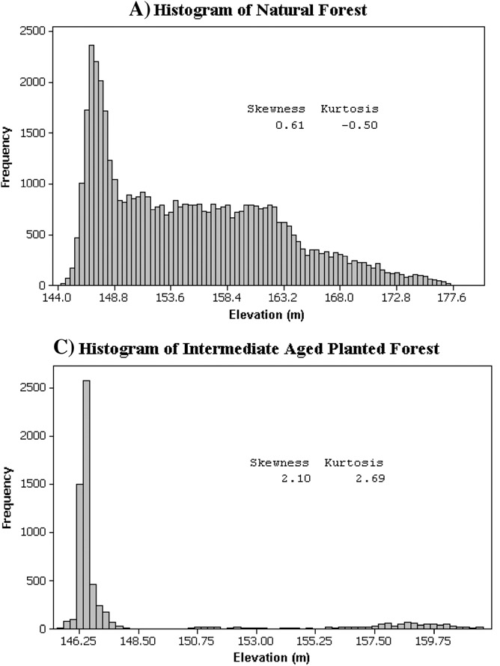
New variable to describe canopy complexity!
FUSION Variable: El_kurt_min
Minimum of kurtosis of height distribution
Interpretation:
Lower kurtosis indicates broader distribution of canopy heights =
*multi-storied*
Antonarakis et al. 2008 Remote Sensing of Environment

Slide 8
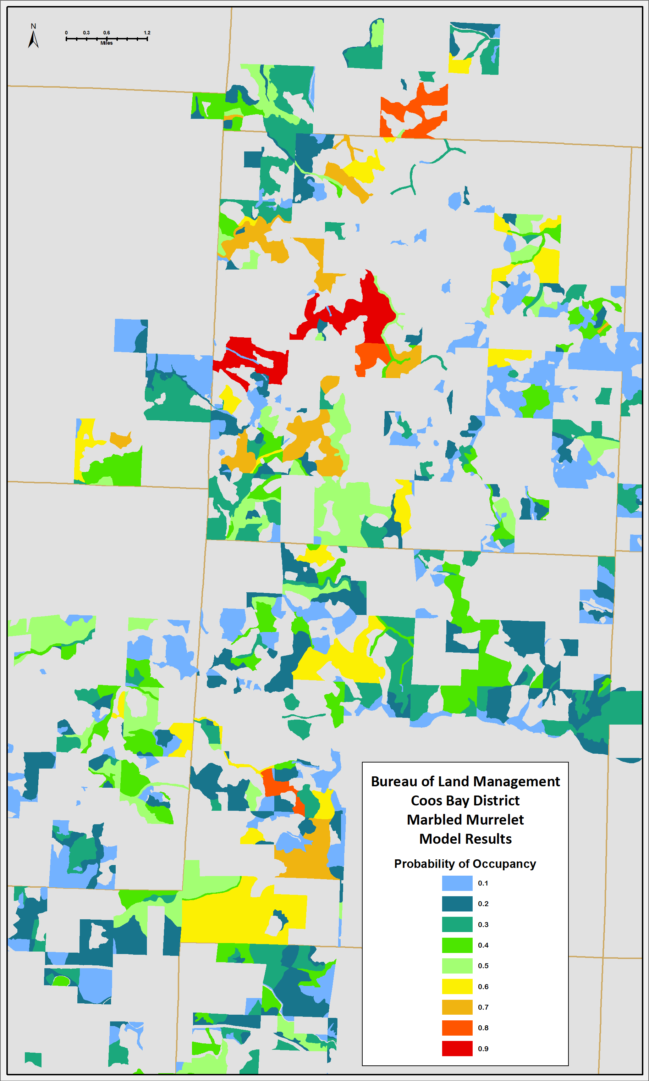
Management Applications of LiDAR Habitat Models
Assess current available habitat
Plan wildlife surveys
Monitoring change
Address Recovery Plan goals
Compare alternative management scenarios

Slide 9
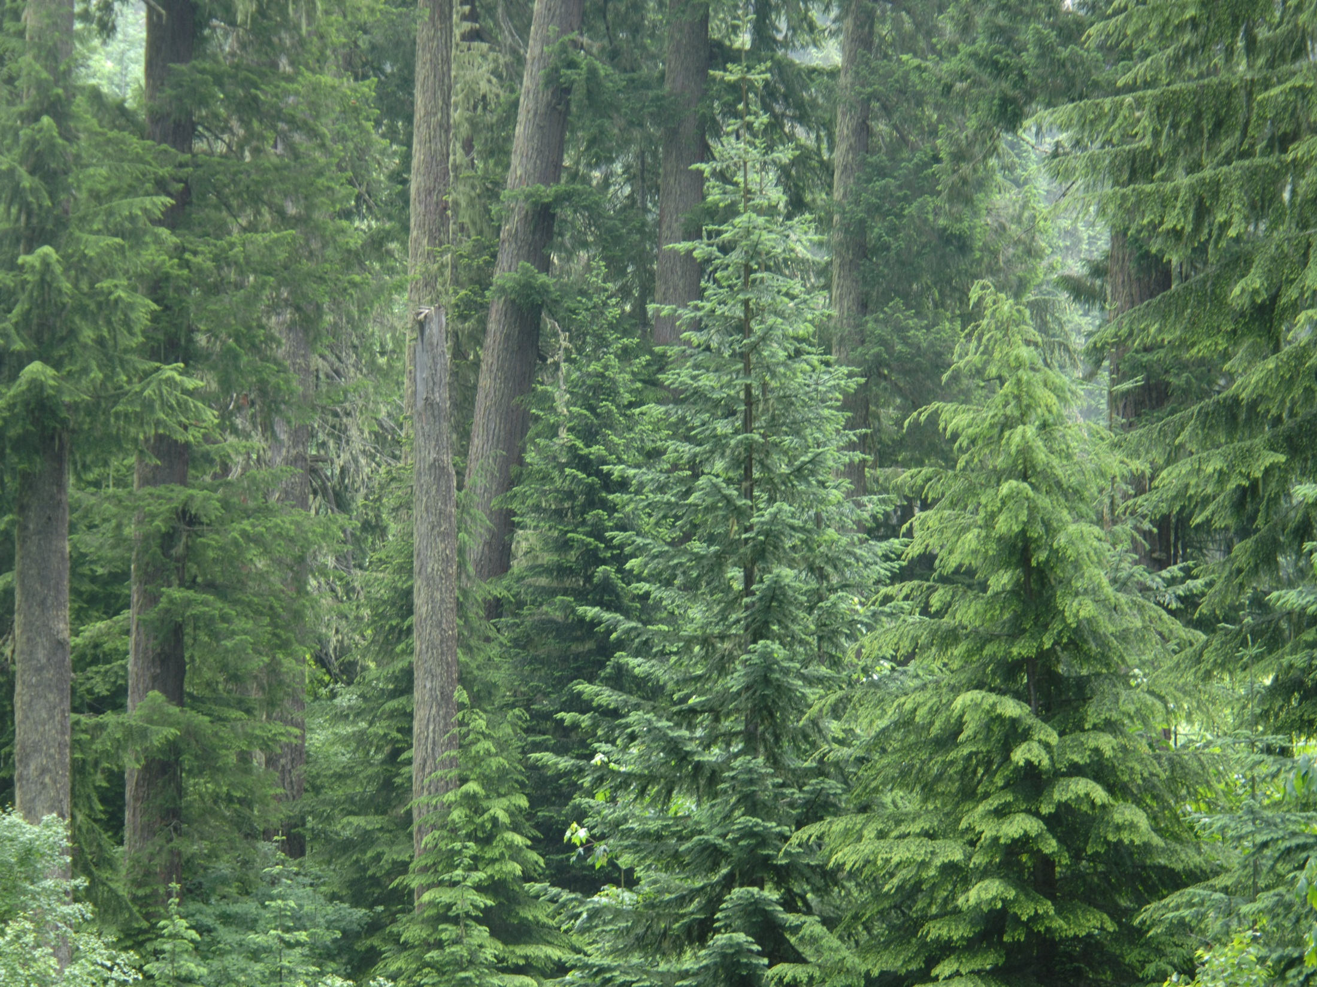

Slide 10



Photo-interpreted, Landsat-based, and Lidar-based Habitat Maps for Northern Spotted Owls (Strix occidentalis caurina)
Steven H. Ackers
Oregon Cooperative Fish and Wildlife Research Unit,
Department of Fisheries and Wildlife, Oregon State University
Raymond J. Davis
U.S. Forest Service, Pacific Northwest Region, Forestry Sciences Lab
Katie M. Dugger
U.S. Geological Survey, Oregon Cooperative Wildlife Research
Unit, Department of Fisheries and Wildlife, Oregon State University
Keith A. Olsen
Department of Forest Ecosystems and Society,
Oregon State University
Ackers, S.H., R.J. Davis, K.A. Olsen, & K.M. Dugger. 2015. The evolution of mapping habitat for northern spotted owls (Strix occidentalis caurina): a comparison of photo-interpreted, Landsat-based, and lidar-based habitat maps. Remote Sensing of Environment 156:361-373.

Slide 11
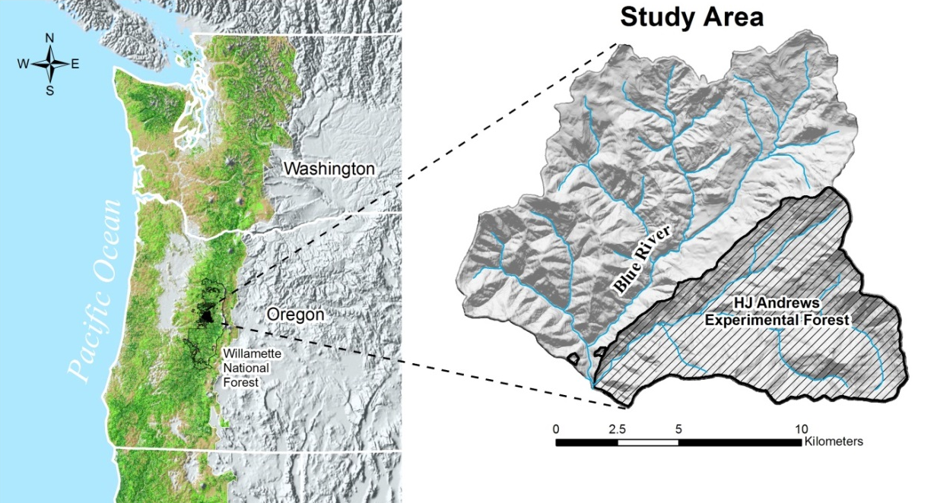
Study area: Blue River Watershed
Approx. 19,000 ha
400 m – 1,600 m
Douglas fir – Western hemlock
Pacific silver fir – Mountain hemlock
Stand age composition
(Cissel et al. 1999. Ecol. Appl. 9:1217-1231)
36% old growth
25% mature (80-200 yrs.)
9% young (40-80 yrs.)
25% clearcut (1950-1994)
5% nonforest

Slide 12
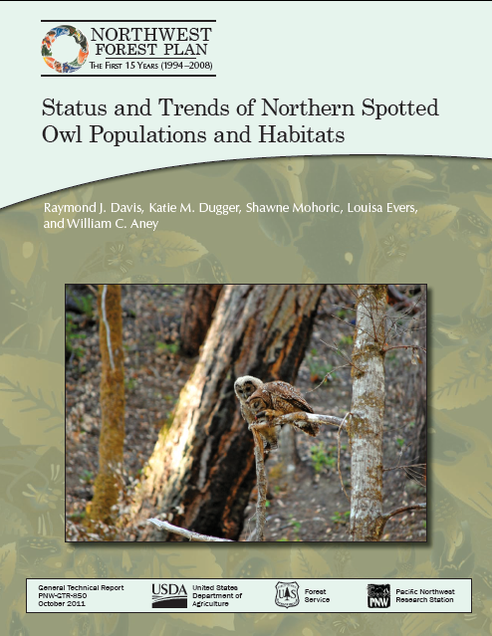
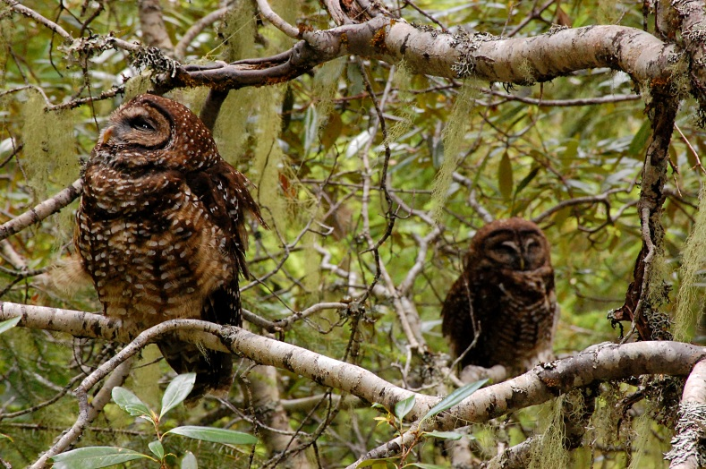
Habitat data sources:
Landsat TM
Gradient Nearest Neighbor imputation
(Ohmann & Gregory 2002. Can. J. For. Res. 32:725-741)
Landsat TM reflectance values, climate data, topography, geology

Plot data (NRI, CVS, FIA, OGS)
⇩
Vegetation structure and composition imputed to all grid cells (30 x 30 m)
15-year spotted owl monitoring report
(Davis et al. 2011)
Density of large conifers
Stand height
Diameter diversity index
(McComb et al. 2002. Forest Science 48:203-216)
Forest Cover
(% of cover in the canopy)
Basal area of subalpine trees
K. Skybak

Slide 13
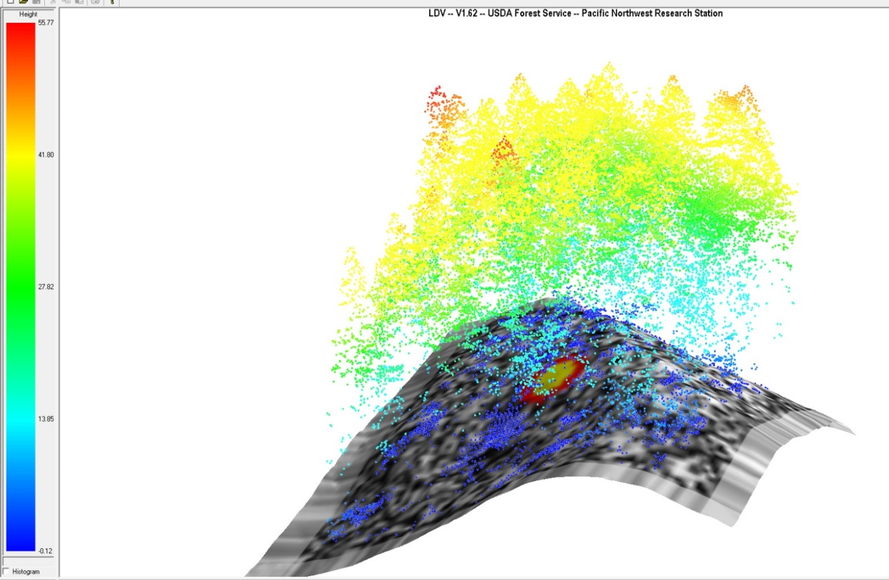
Habitat data sources (cont.):
Discrete-return airborne Lidar (Watershed Sciences Inc.)
Laser pulse density ≥ 9 pulses/m²
Up to 4 returns/pulse
Horizontal accuracy ≤ 30 cm
Vertical accuracy ≤ 15 cm
Canopy and bare Earth maps ± 1 m
Program Fusion (McGaughey 2012)
30 m grid cells (identical to GNN rasters)
Density of large conifers (>76 cm dbh)
Based on local height-diameter relationships (Garmin et al. 1995)
Stand height
Rumple index
(Parker et al. 2004. Ecosystems 7:440-453)
Forest cover (>2 m)
(Young 2011)

Slide 14
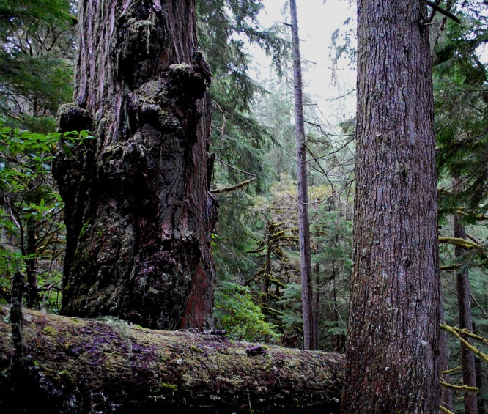
Habitat data sources (cont.):
Willamette National Forest NSO habitat GIS layer
Aerial photo interpretation
Standardized definitions:
Nesting: Any habitat that has known or suspected nesting activity. Mature
forests (70–100+ years) and multi-storied old growth forests ≥200 years old,
average d.b.h. ≥30 in., numerous snags and downed logs.
Roosting/foraging: Any habitat that has known or suspected foraging or
roosting activity. Stands with at least 60% canopy cover. Stand structure not
as clearly defined as for nesting habitat. Can be based on proximity to spotted
owl activity centers or nesting habitat. Usually stands ≥80 years of age,
average d.b.h. ≥18 in.
Dispersal: Stands with at least 40% canopy cover and do
not contain structure to support nesting or foraging.
Usually stands with average d.b.h. ≥11 in.
Unsuitable: Does not meet the above definitions.
U. S. Department of Agriculture, & Forest Service (2007). Definition of spotted owl habitat.
Willamette National Forest. GIS data dictionary/unpublished report on file at Willamette
National Forest, Supervisor's Office, 3106 Pierce Parkway, Suite D, Springfield,
Oregon.

Slide 15
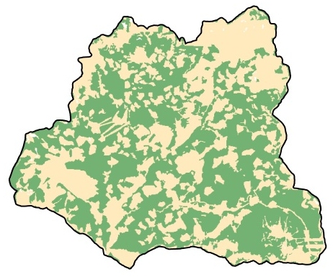
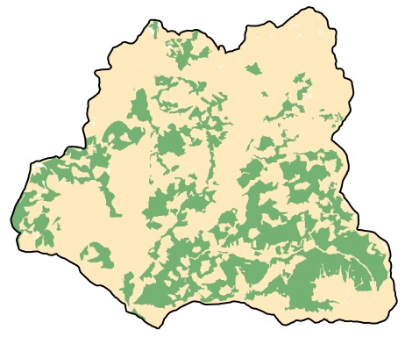
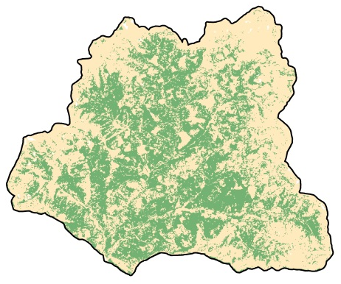
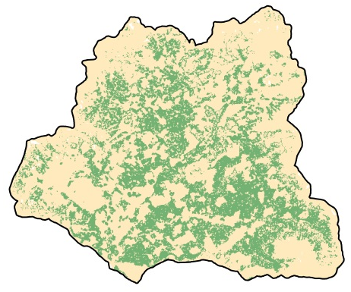
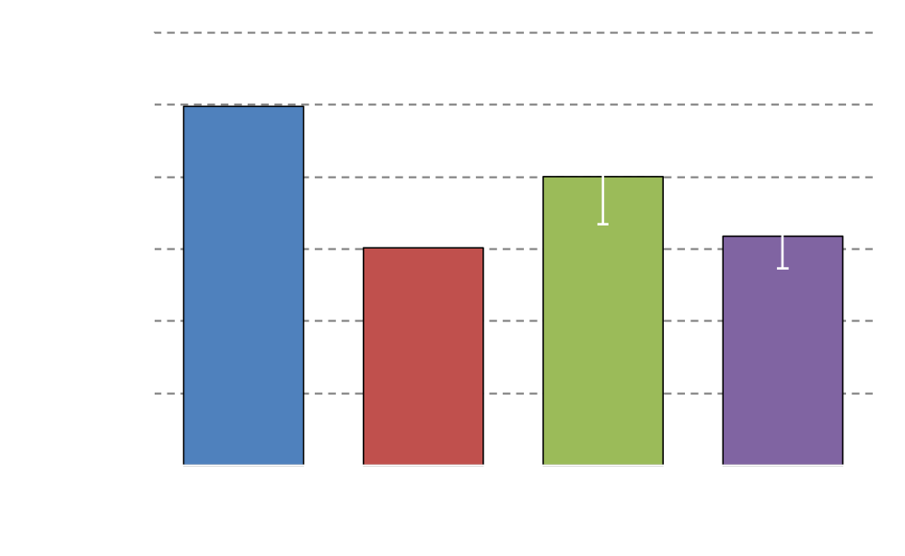
WNF – N-R-F habitat
WNF – nesting habitat
Landsat
Lidar

Slide 16
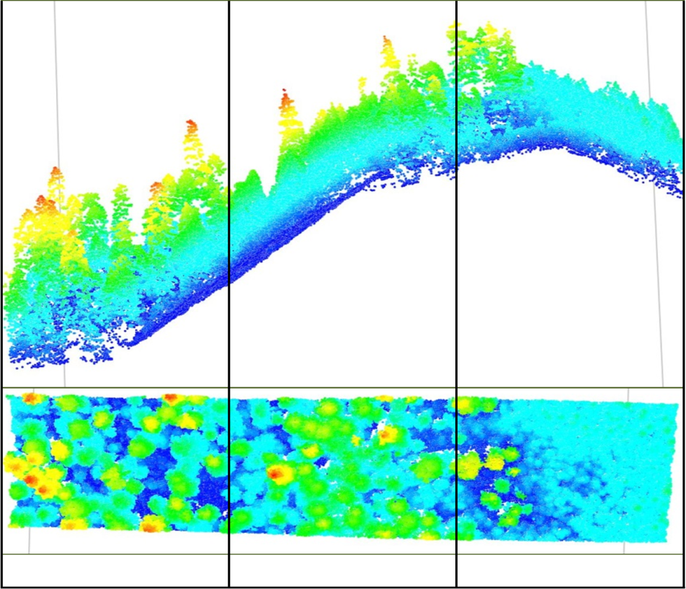

Conclusions
Lidar-based structural measurements produced:
Lower estimated area of suitable habitat
More precise and similar to WNF nesting habitat classification
Well suited for project-level analyses
Landsat/GNN modeling
Habitat area estimate between WNF nesting
and NRF classifications
Currently much greater coverage
Change through time can be evaluated
Well suited for landscape level analyses
Suitable
Marginal
Unsuitable

Slide 17
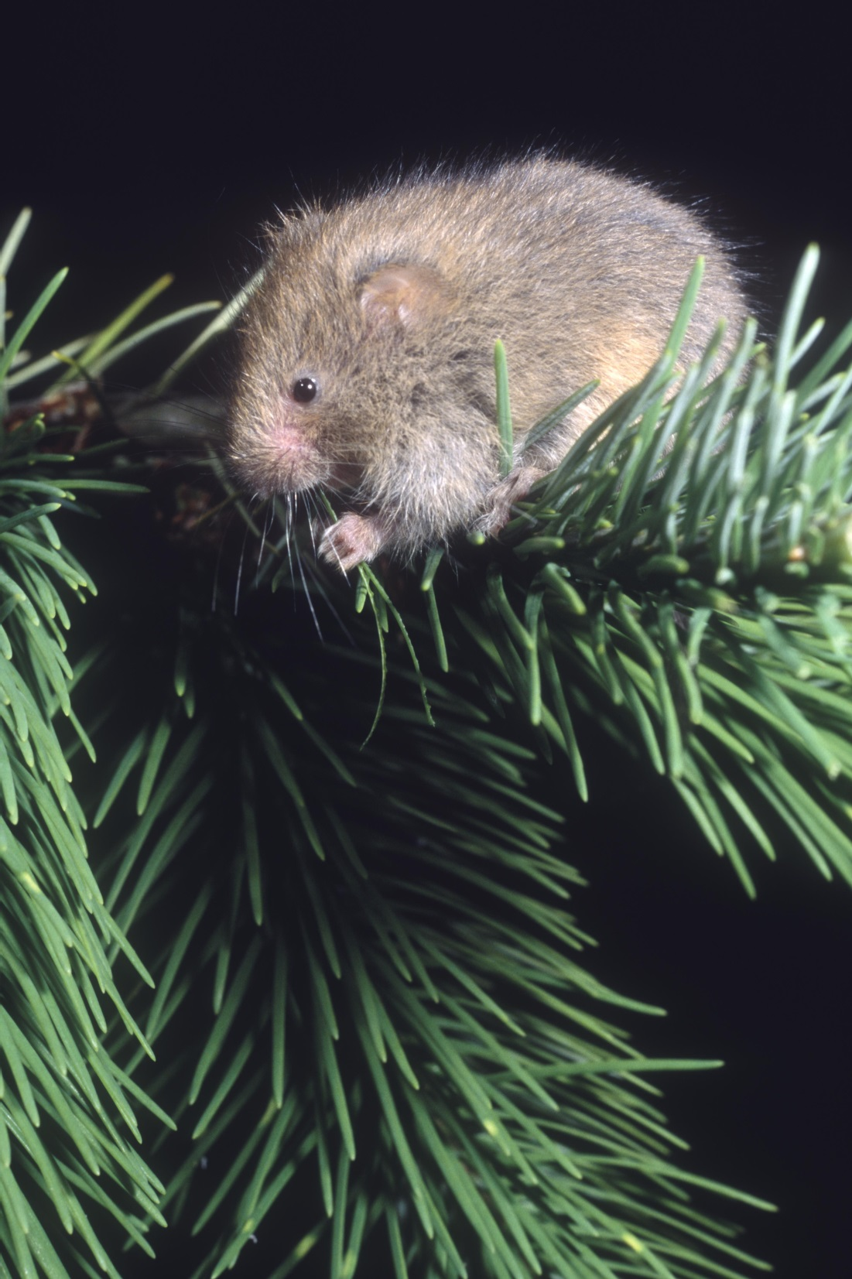
LiDAR and Red Tree Vole Habitat
Step 1 – Making Maps
Use available LiDAR deliverables
Model and map habitat
Based on published paper(s)
Using local presence data
Step 2 – Using Maps
Survey design or in place of surveys
Identification of high (or non-high) priority sites
NEPA analyses and project design
Photo by Bert Gildart

Slide 18
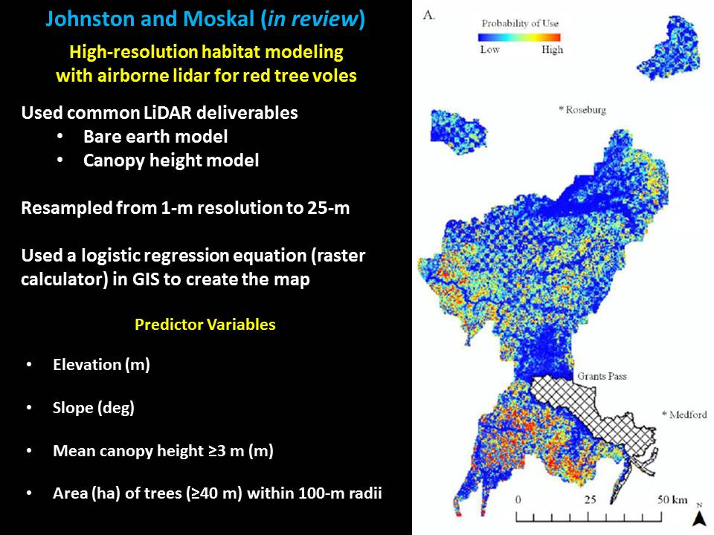

Slide 19
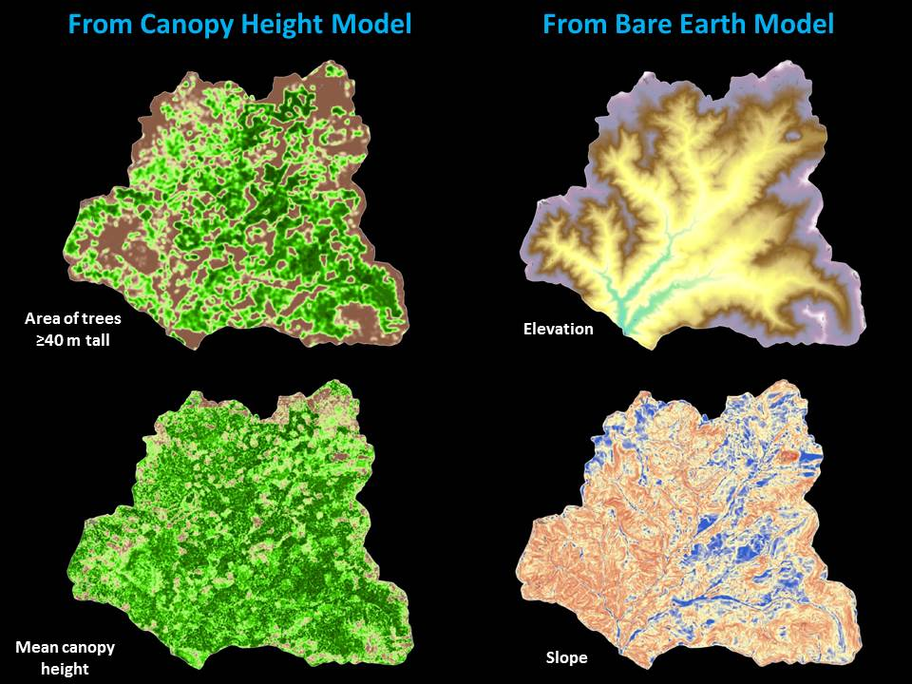

Slide 20
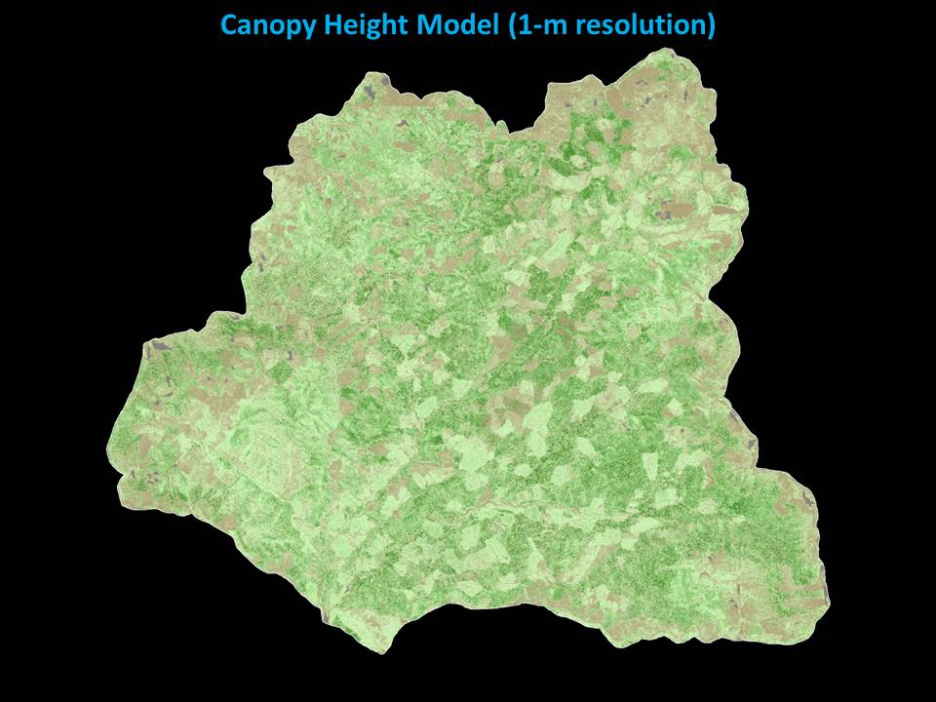

Slide 21
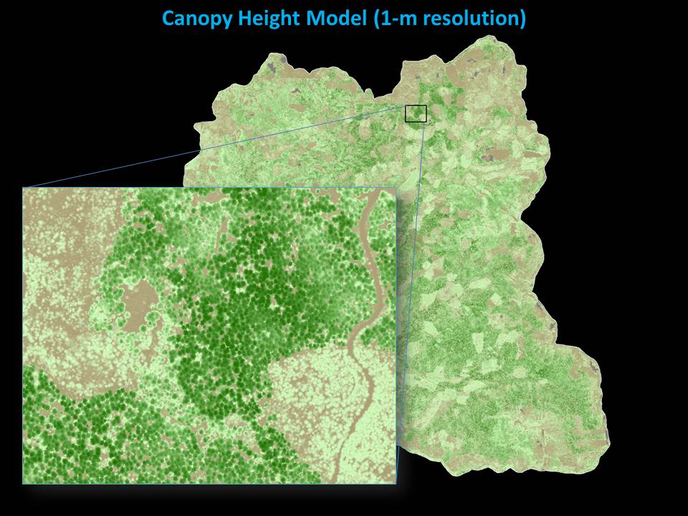

Slide 22
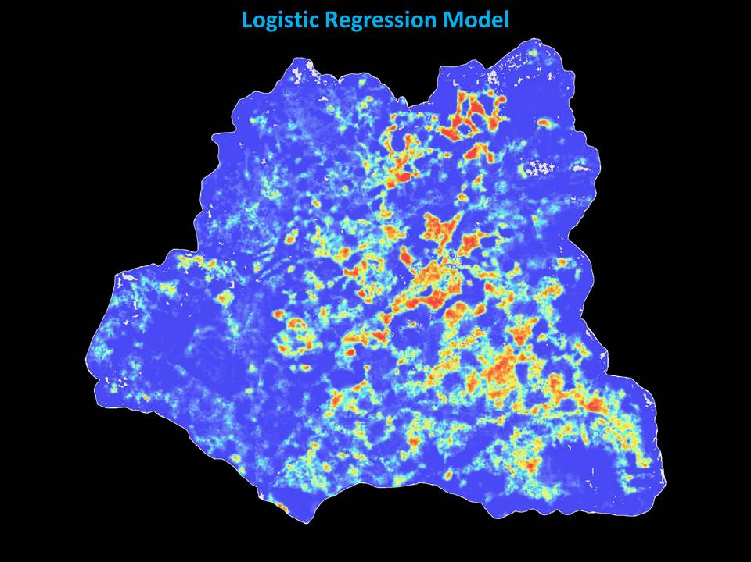

Slide 23


Slide 24
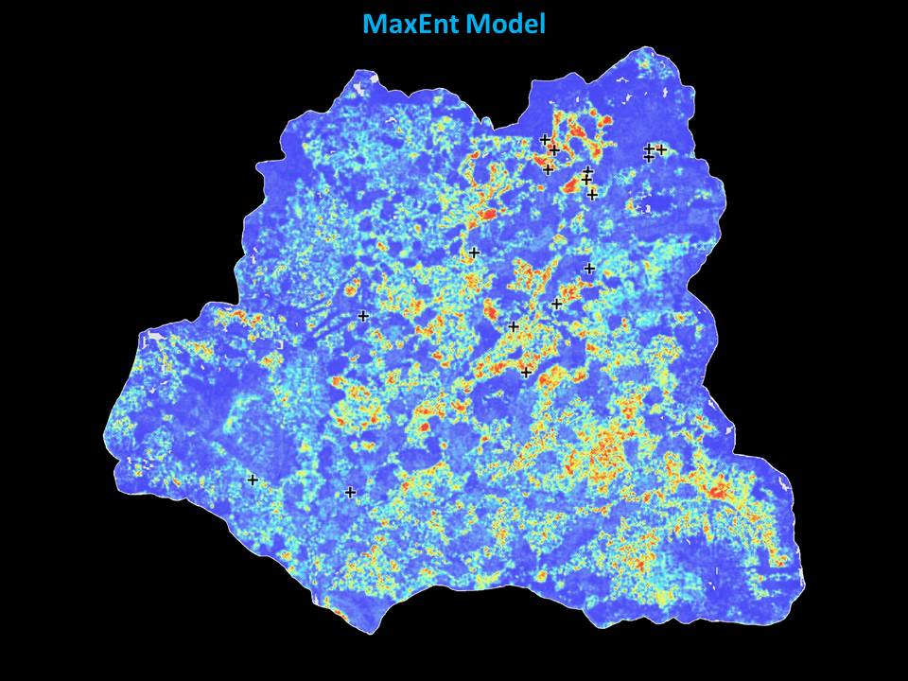

Slide 25
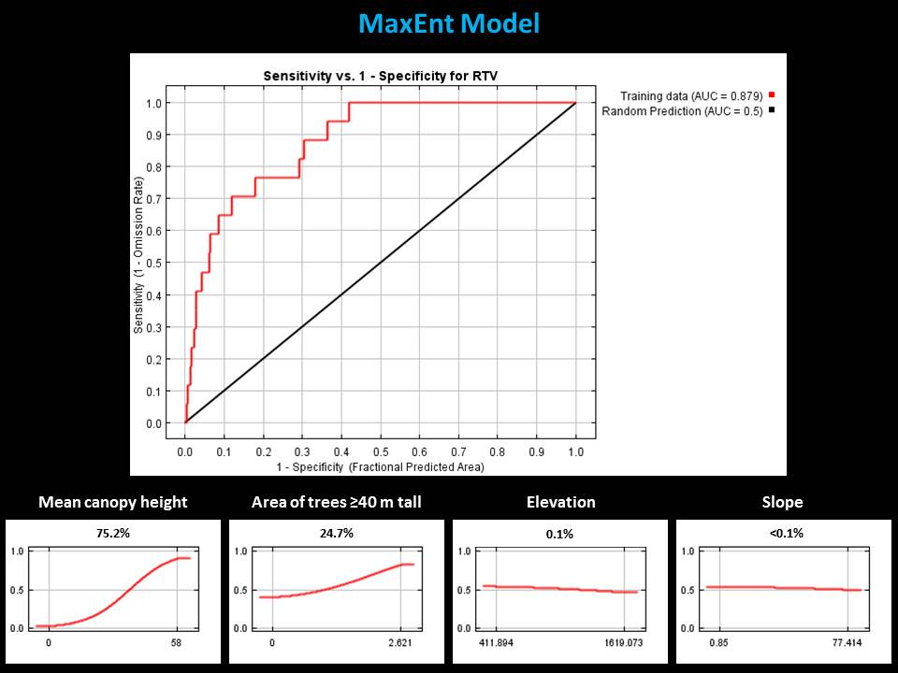

Slide 26
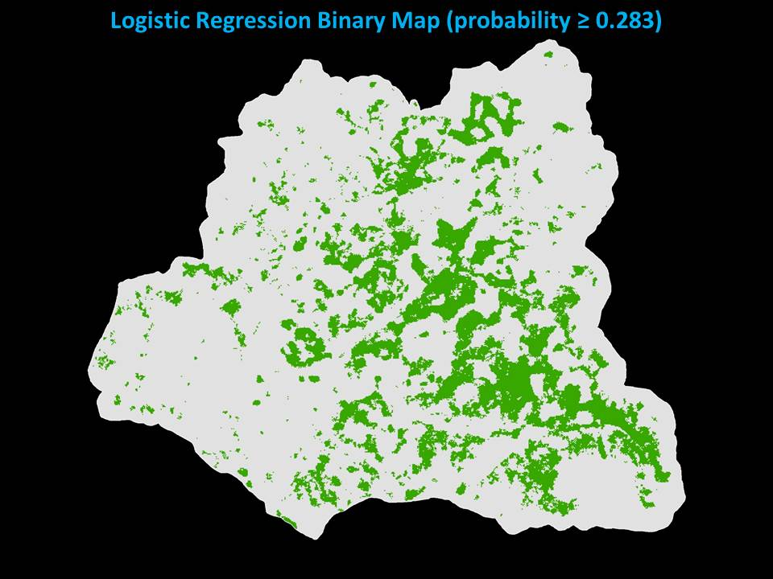

Slide 27
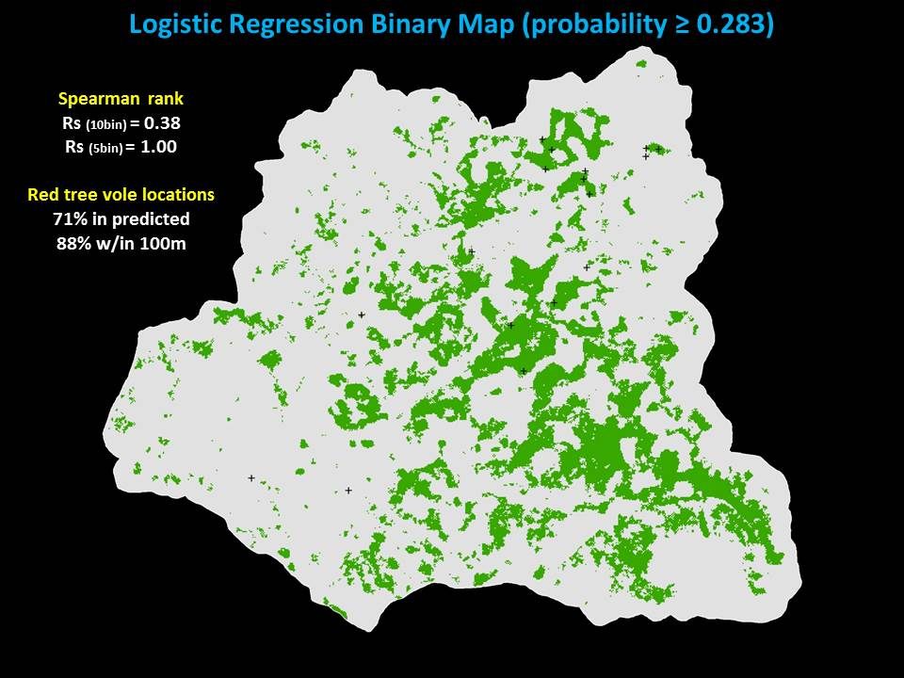

Slide 28
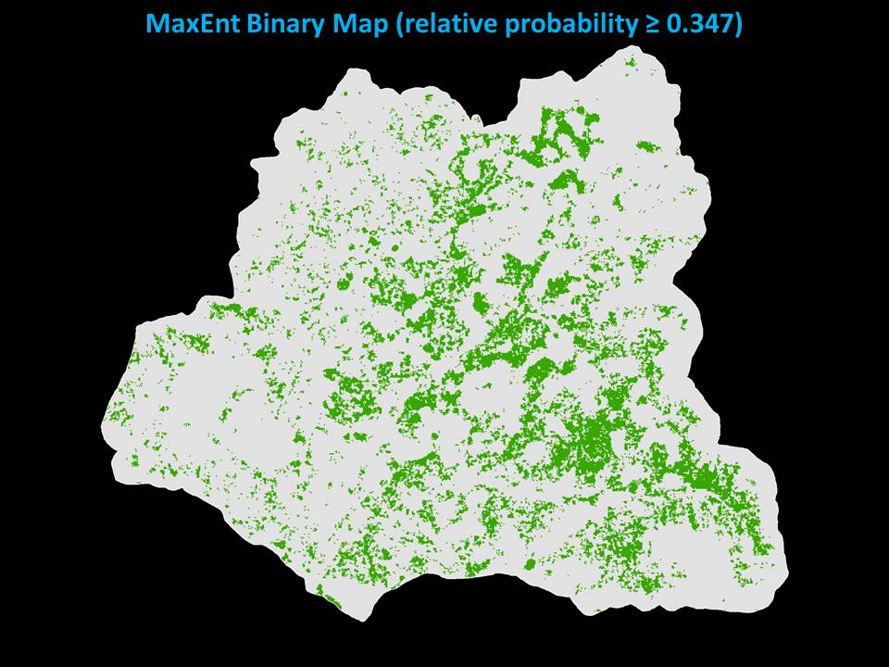

Slide 29
