Slide 1
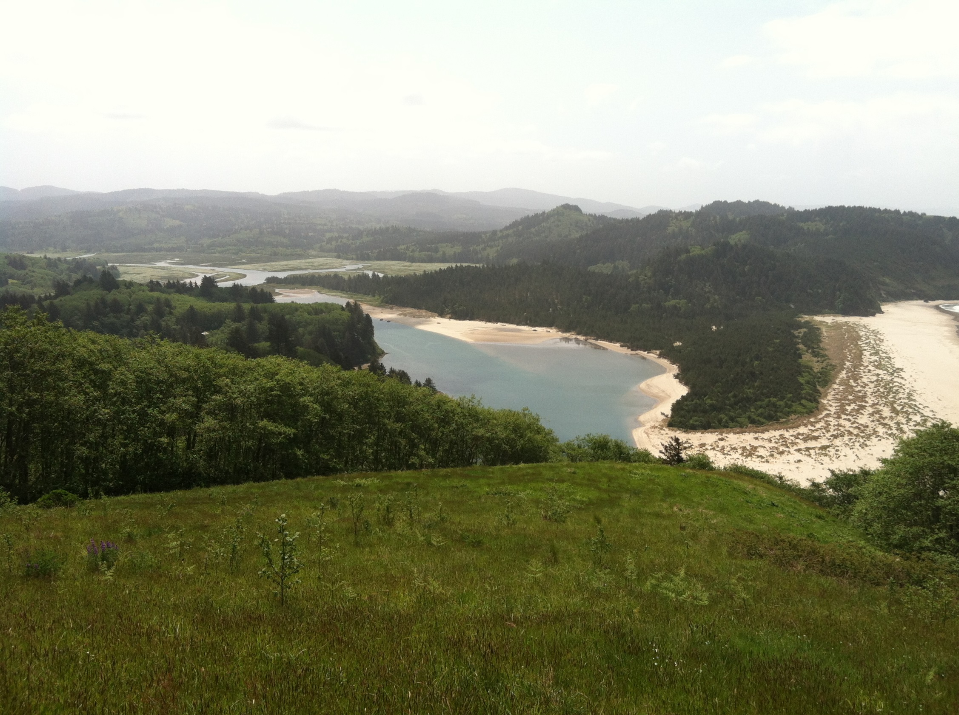

Siuslaw National Forest Restoration Program
Kami S. Ellingson
Hydrologist/Watershed Program Manager
2015 Using LiDAR to inform NEPA

Slide 2
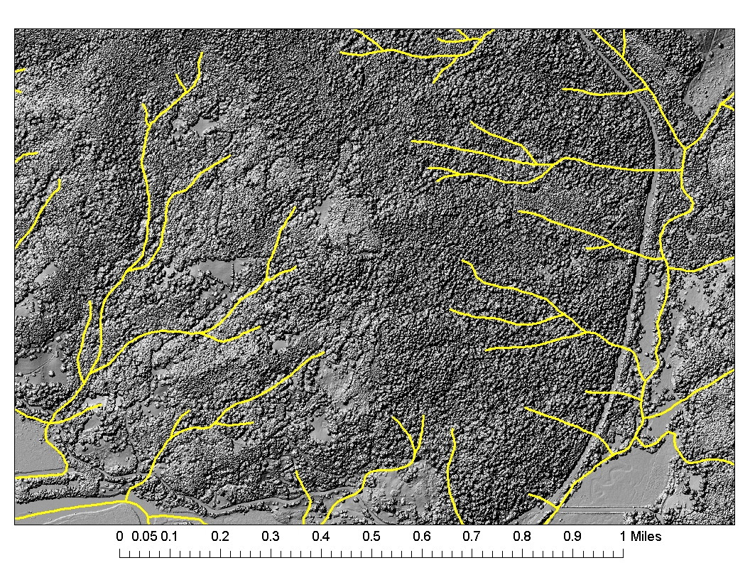
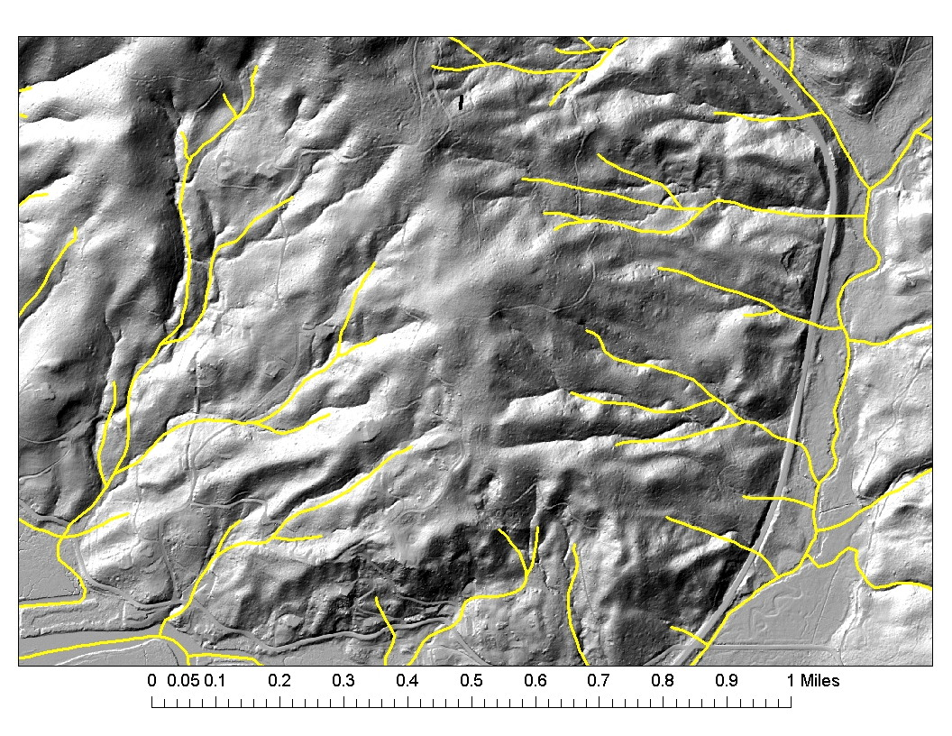
LiDAR Hebo District Stream Layer

Slide 3
LiDAR Hebo District Stream Layer

Slide 4
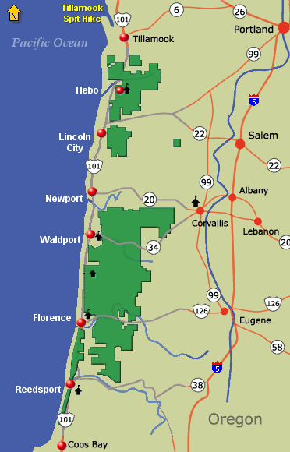
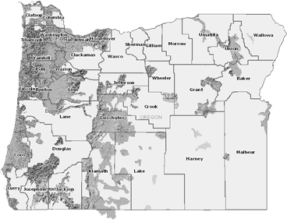

Slide 5
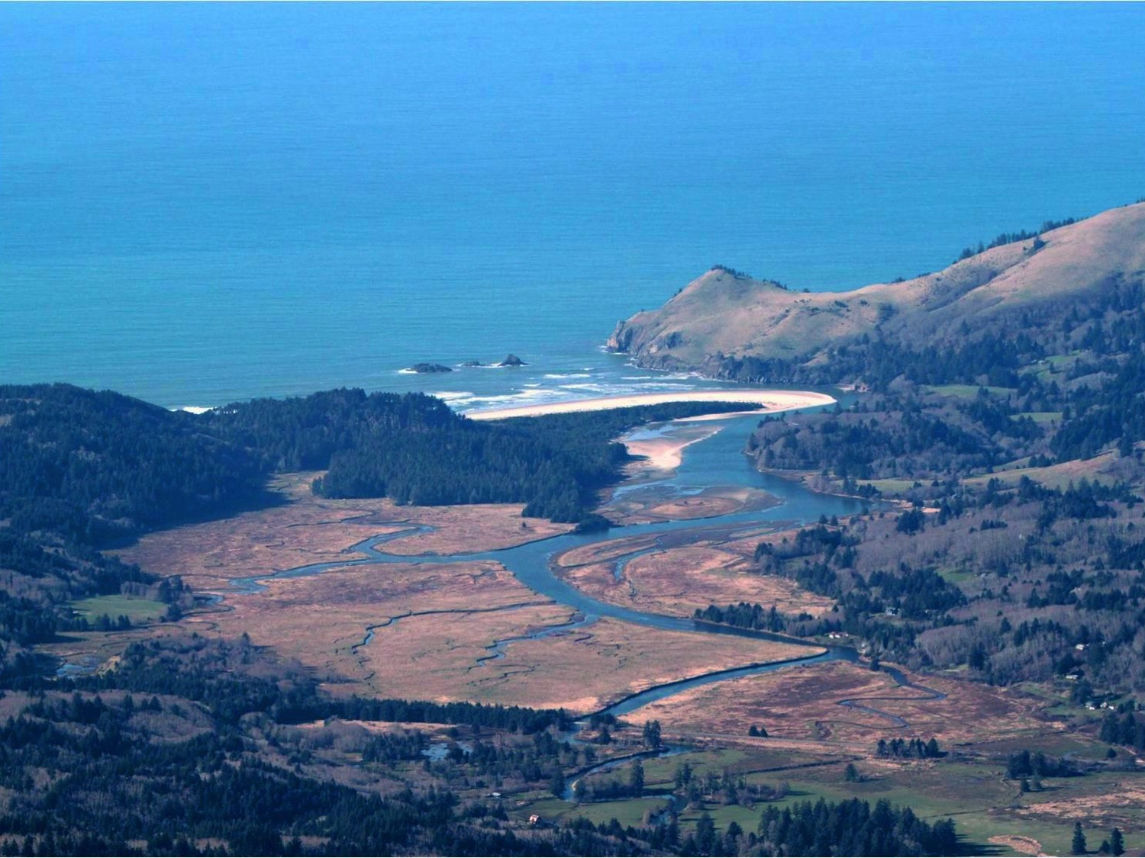
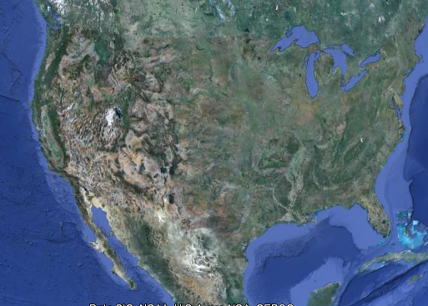
Salmon River Estuary
1974 - Scenic Research Area
1976 - U.N. Biosphere Reserve
1977 - U.S. Forest Service Management
Central Oregon Coast
Notes:
Located on the Central Oregon Coast of the United States1976 – United Nations Biosphere Reserve
1977 – U.S. Forest Service Mgt

Slide 6
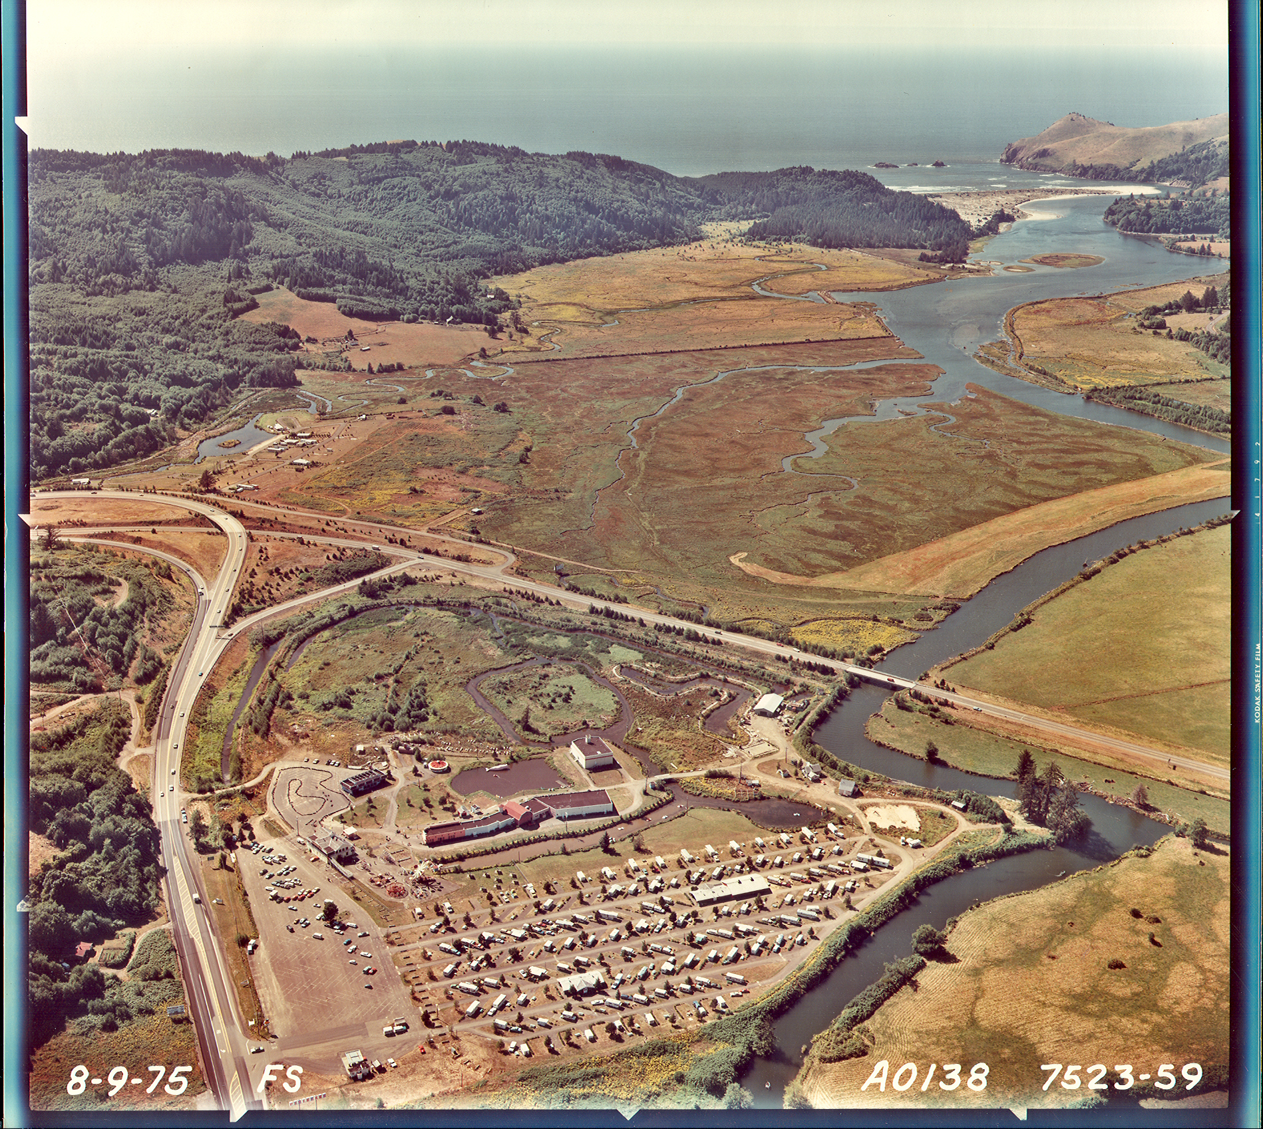
37 Years of Restoration
2012
1987
1978
Reference
Marsh
2009
1996
2010-11
1975 Photo
Notes:
Looking out to sea in this 1975 oblique photo of the estuary, note extensive development. The “reference marsh” is highlighted here. I will briefly take you through the six projects, one by one.

Slide 7
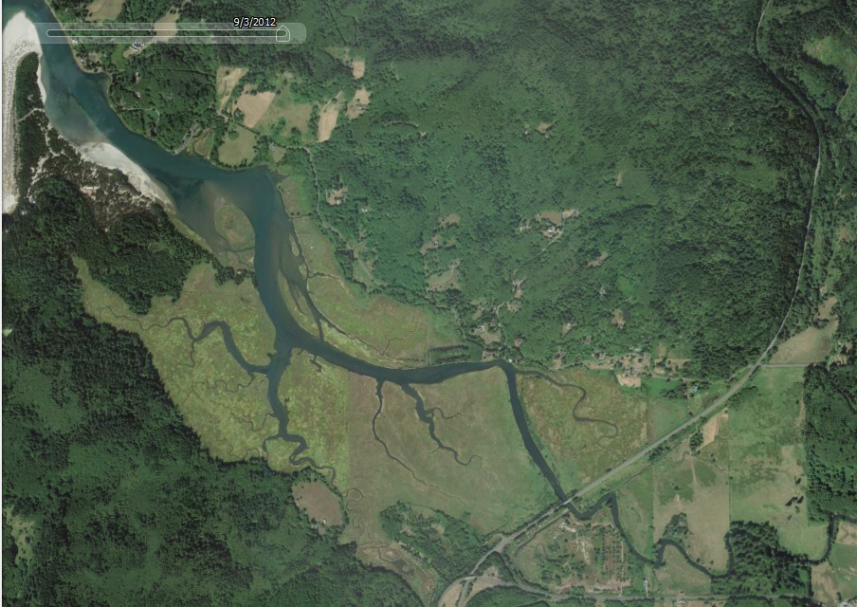
37 Years of Restoration
2012
1978
2014
1987
Reference
1996
2009
2010-11

Slide 8
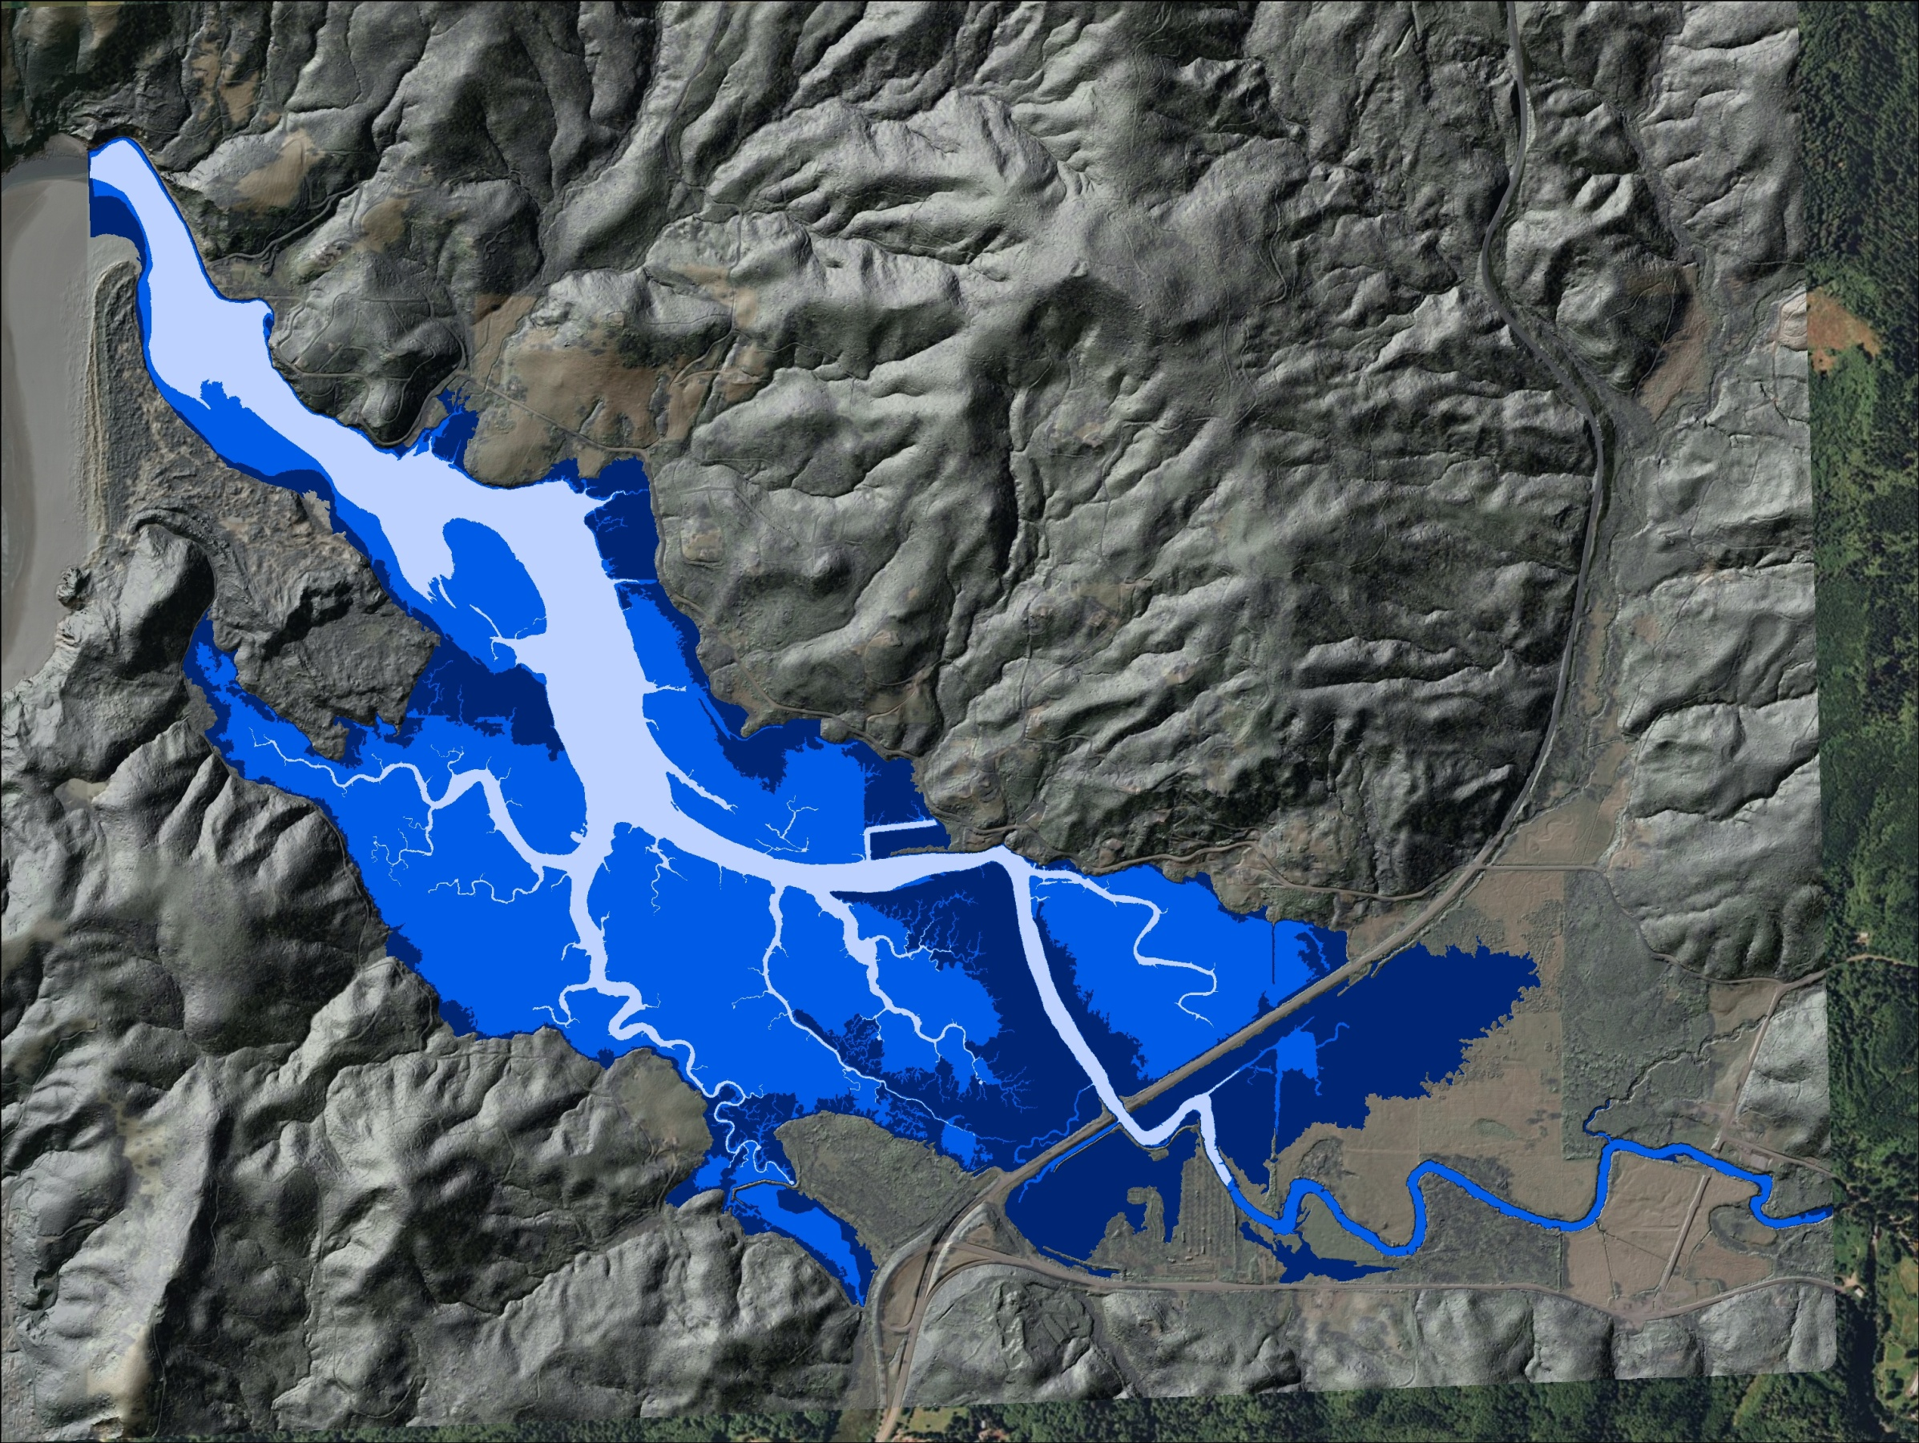
LiDAR as the foundation for restoration

Slide 9
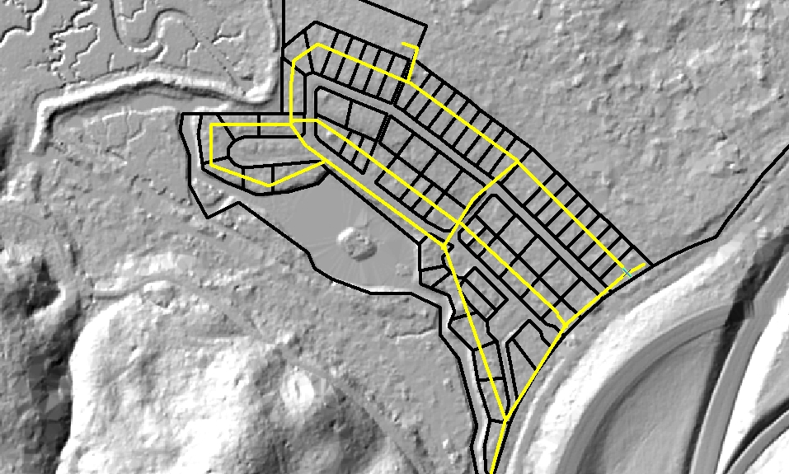
2009 Restoration

Slide 10
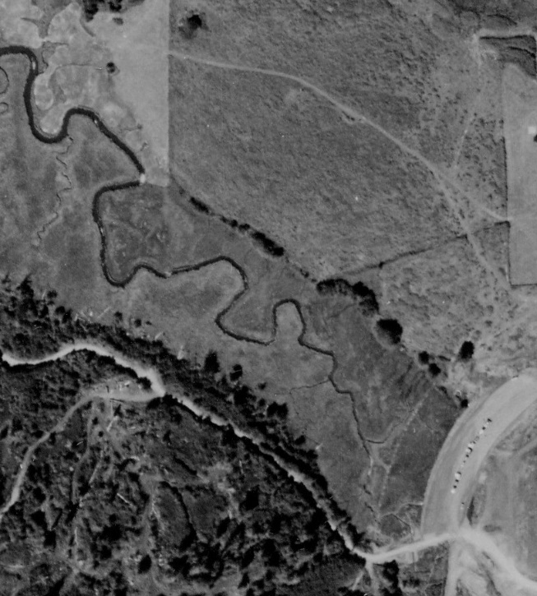
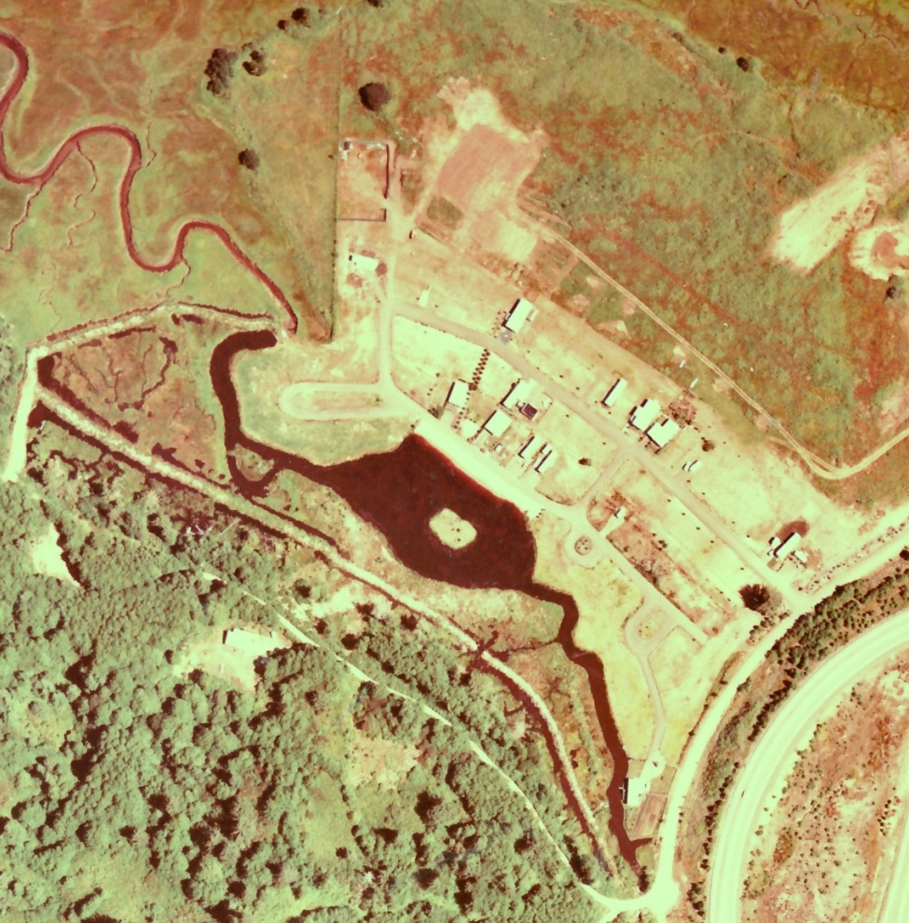
2009 Restoration
1945 Photo
1972 Photo
Pre-Development
Post-Development
Notes:
The 2009 marsh was extremely impacted by development . . .

Slide 11
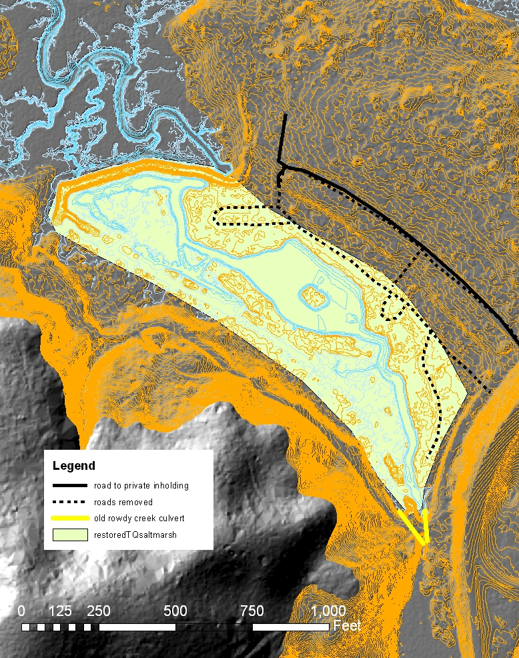
2009 Restoration

Slide 12
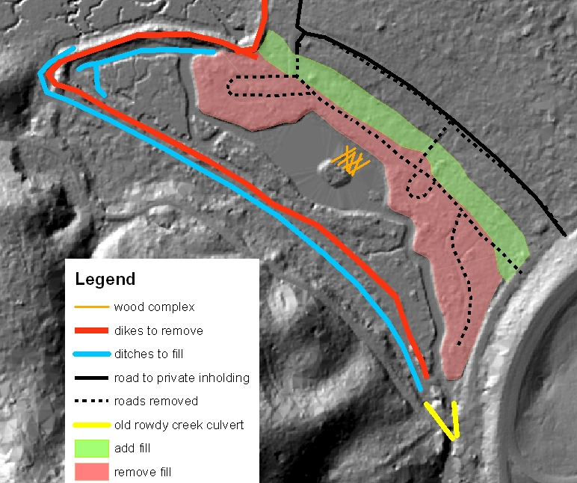
2009 Restoration

Slide 13
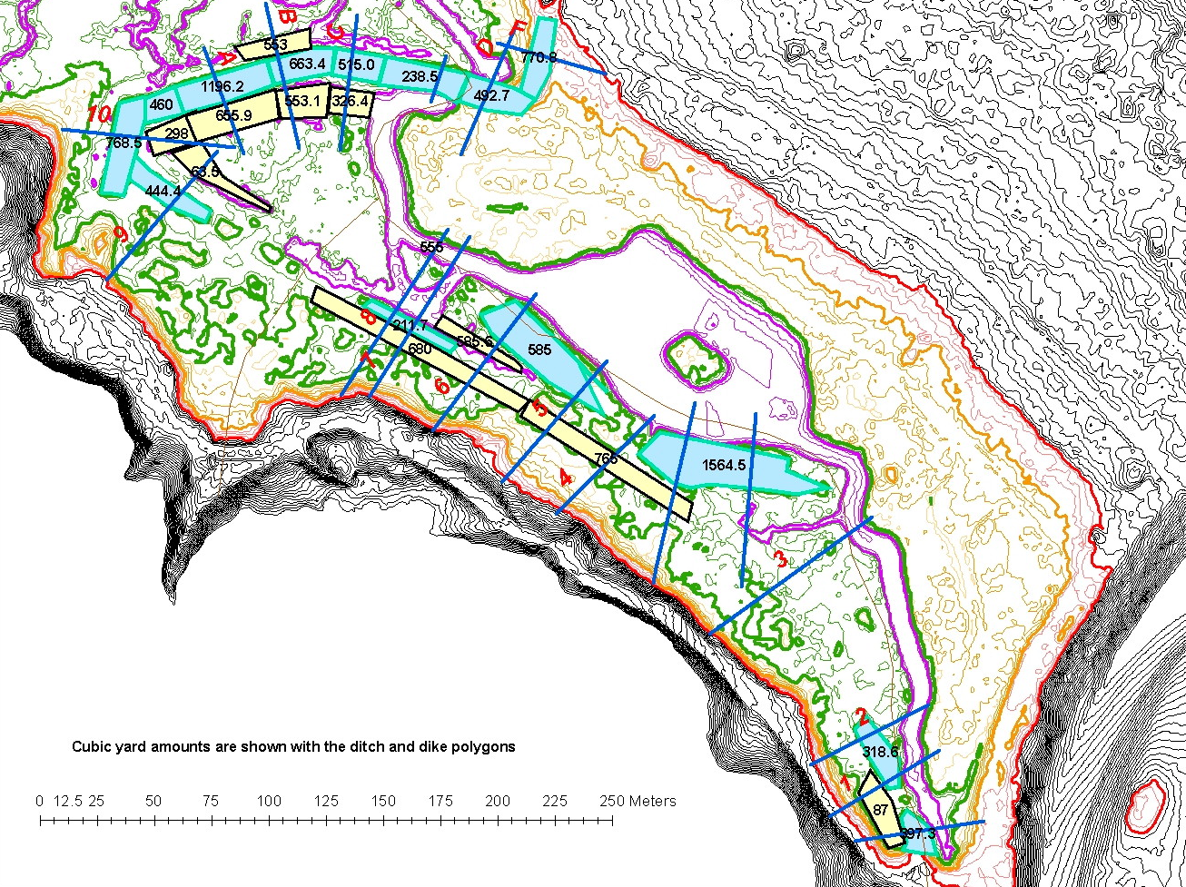
2009 Restoration

Slide 14
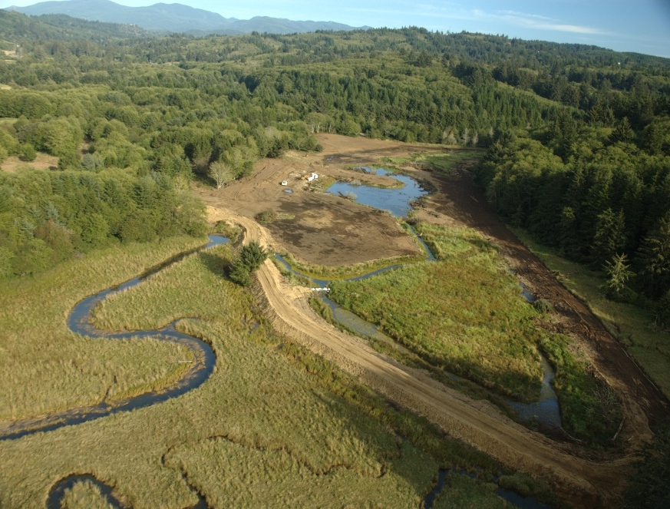
2009 Restoration

Slide 15
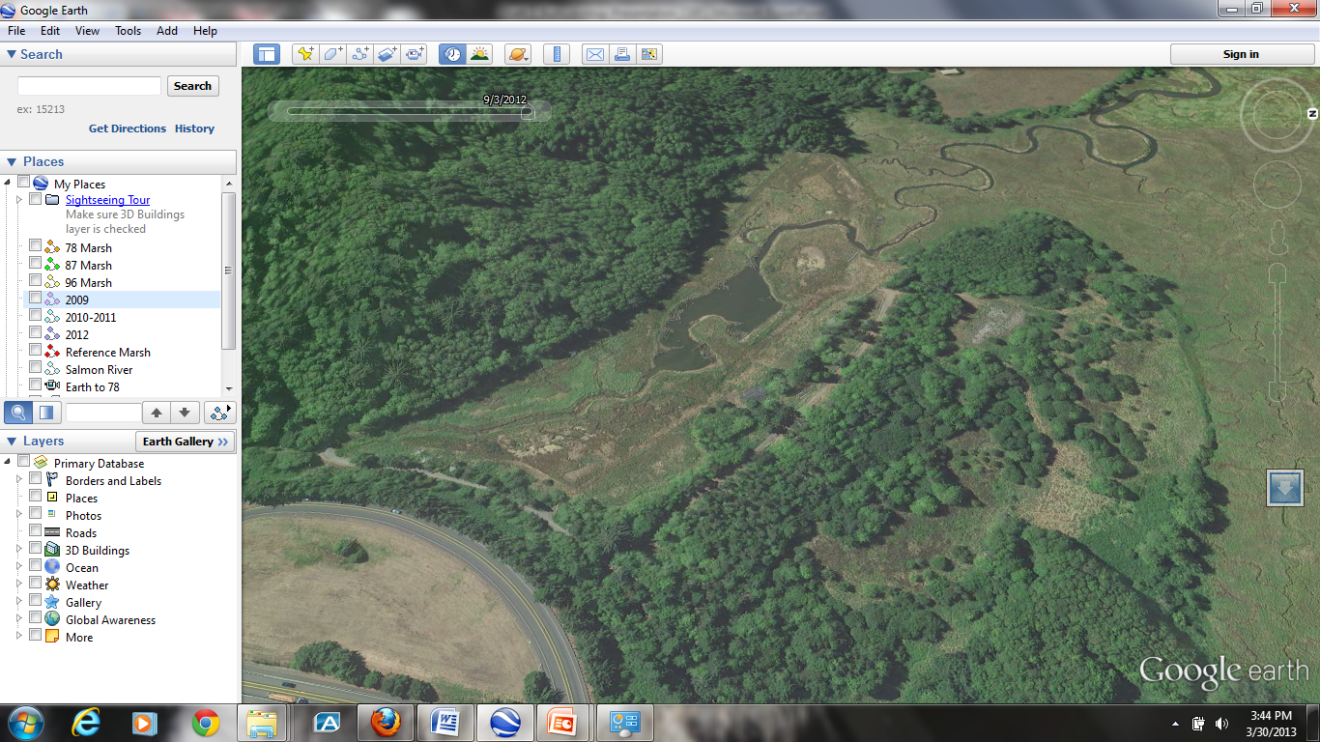
2009 Restoration
1975 Photo
2013 Photo
Project Components
Removed infrastructure
Installed culvert
Rebuilt multiple tidal channels
Revegetated
Project Results
45 acres restored
Fish Passage on Rowdy Creek
Marsh & tidal channels of Rowdy Creek
As-built survey

Slide 16
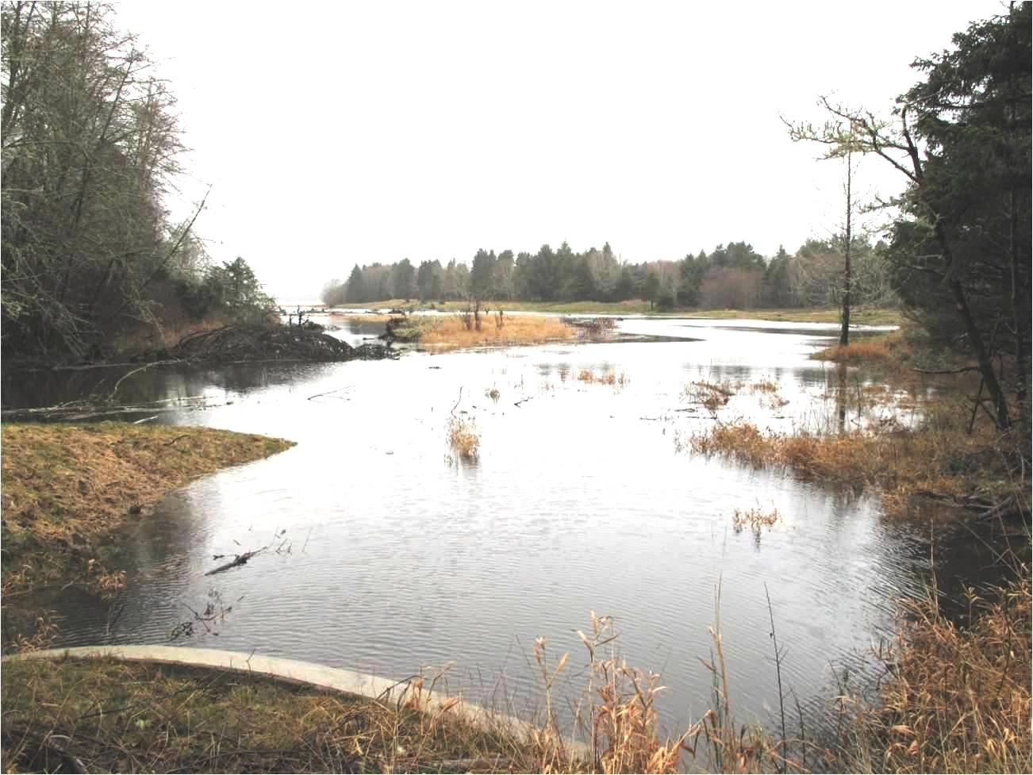
Restored Storage Capacity
2010 Photo
Westwind Stewardship Group

Slide 17
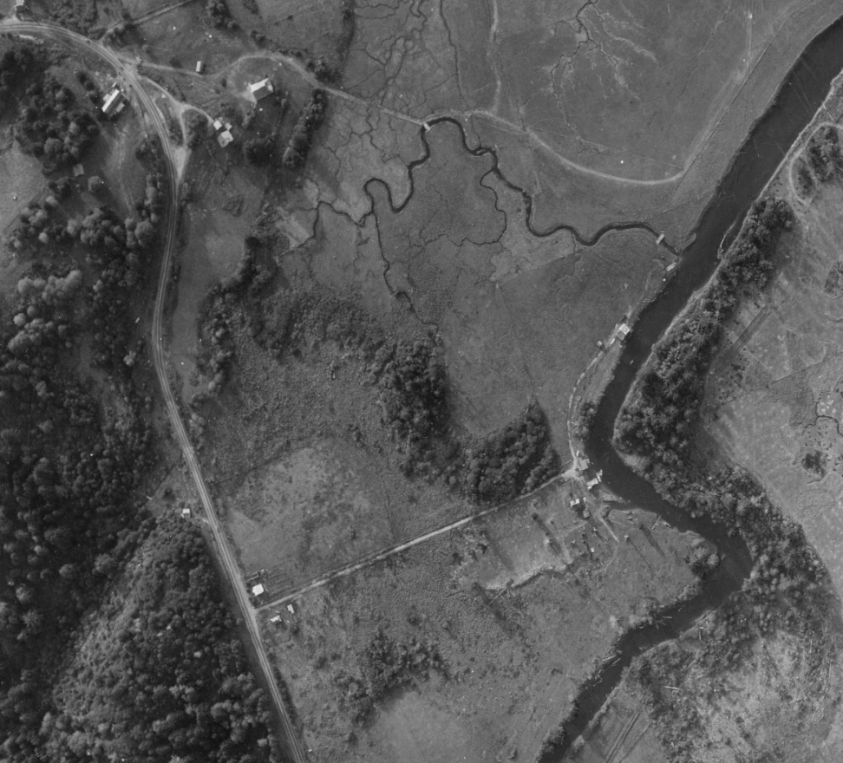
2010 - 2011 Restoration
1945 Photo
1975 Photo
Pre-Development
Post-Development

Slide 18
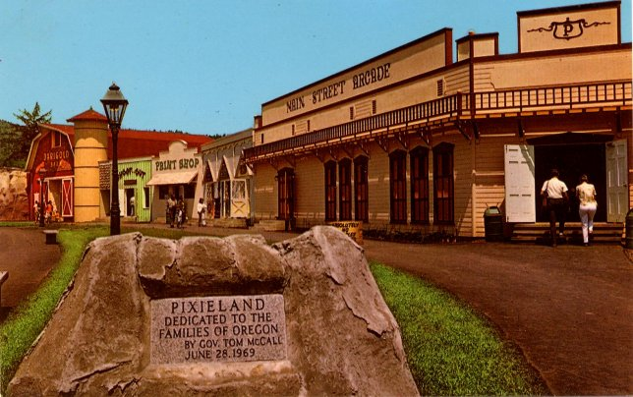
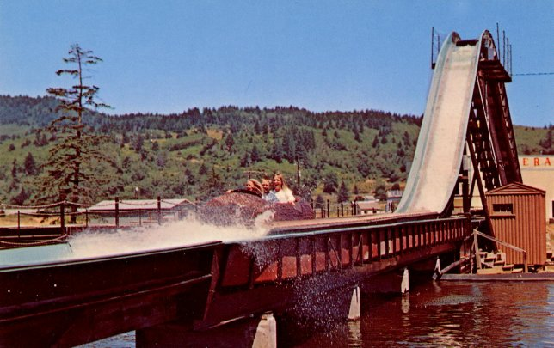
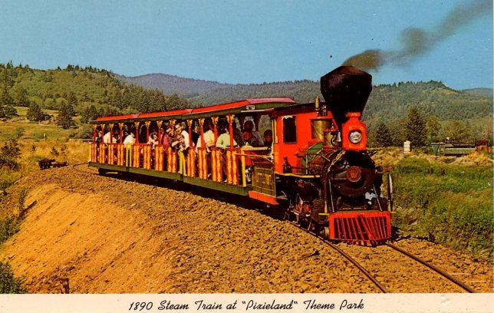
Pixieland Amusement Park
1969-1974
Pdxhistory.com

Slide 19
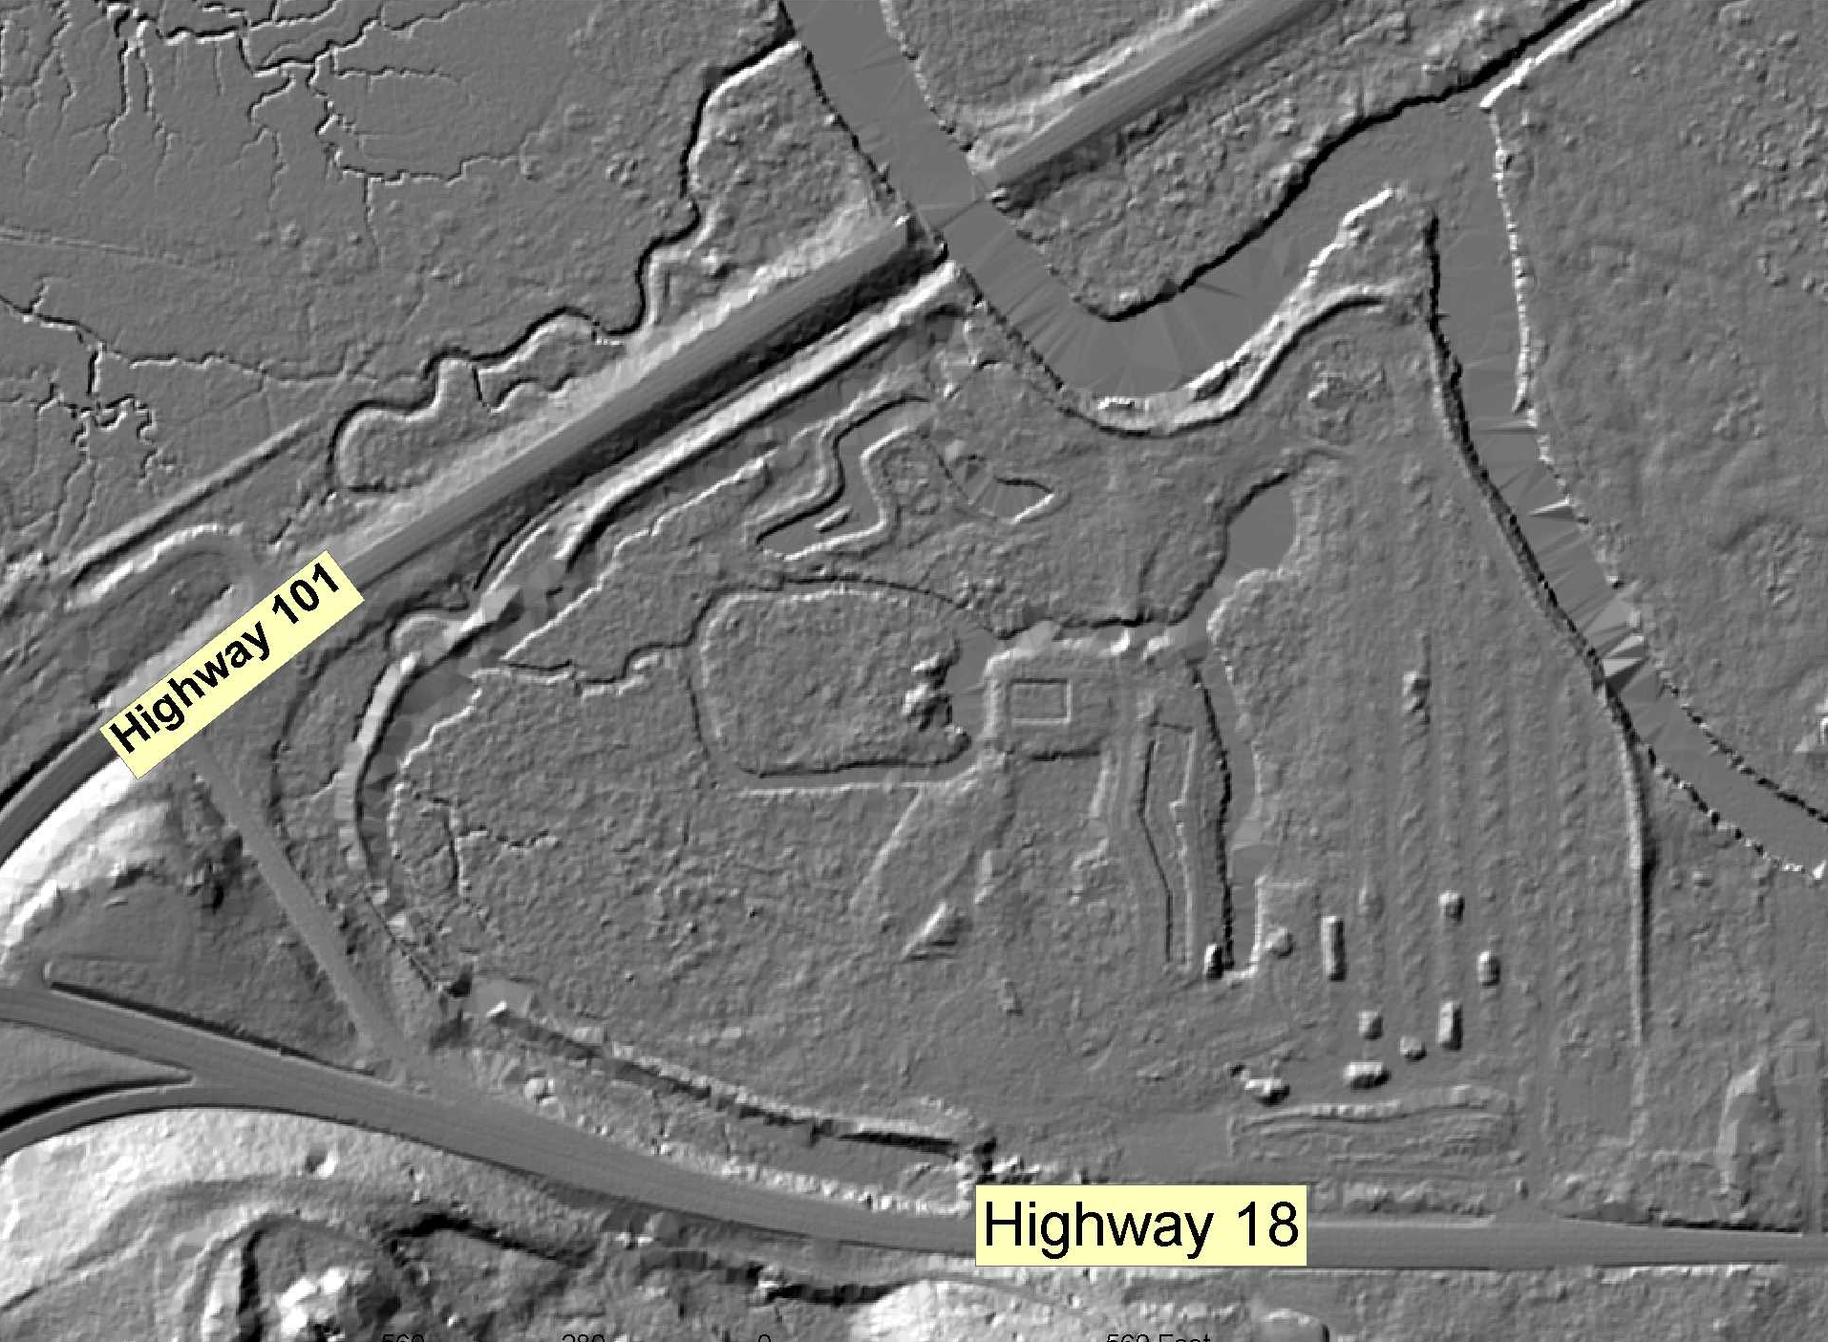
2010 - 2011 Restoration

Slide 20
2010 - 2011 Restoration

Slide 21
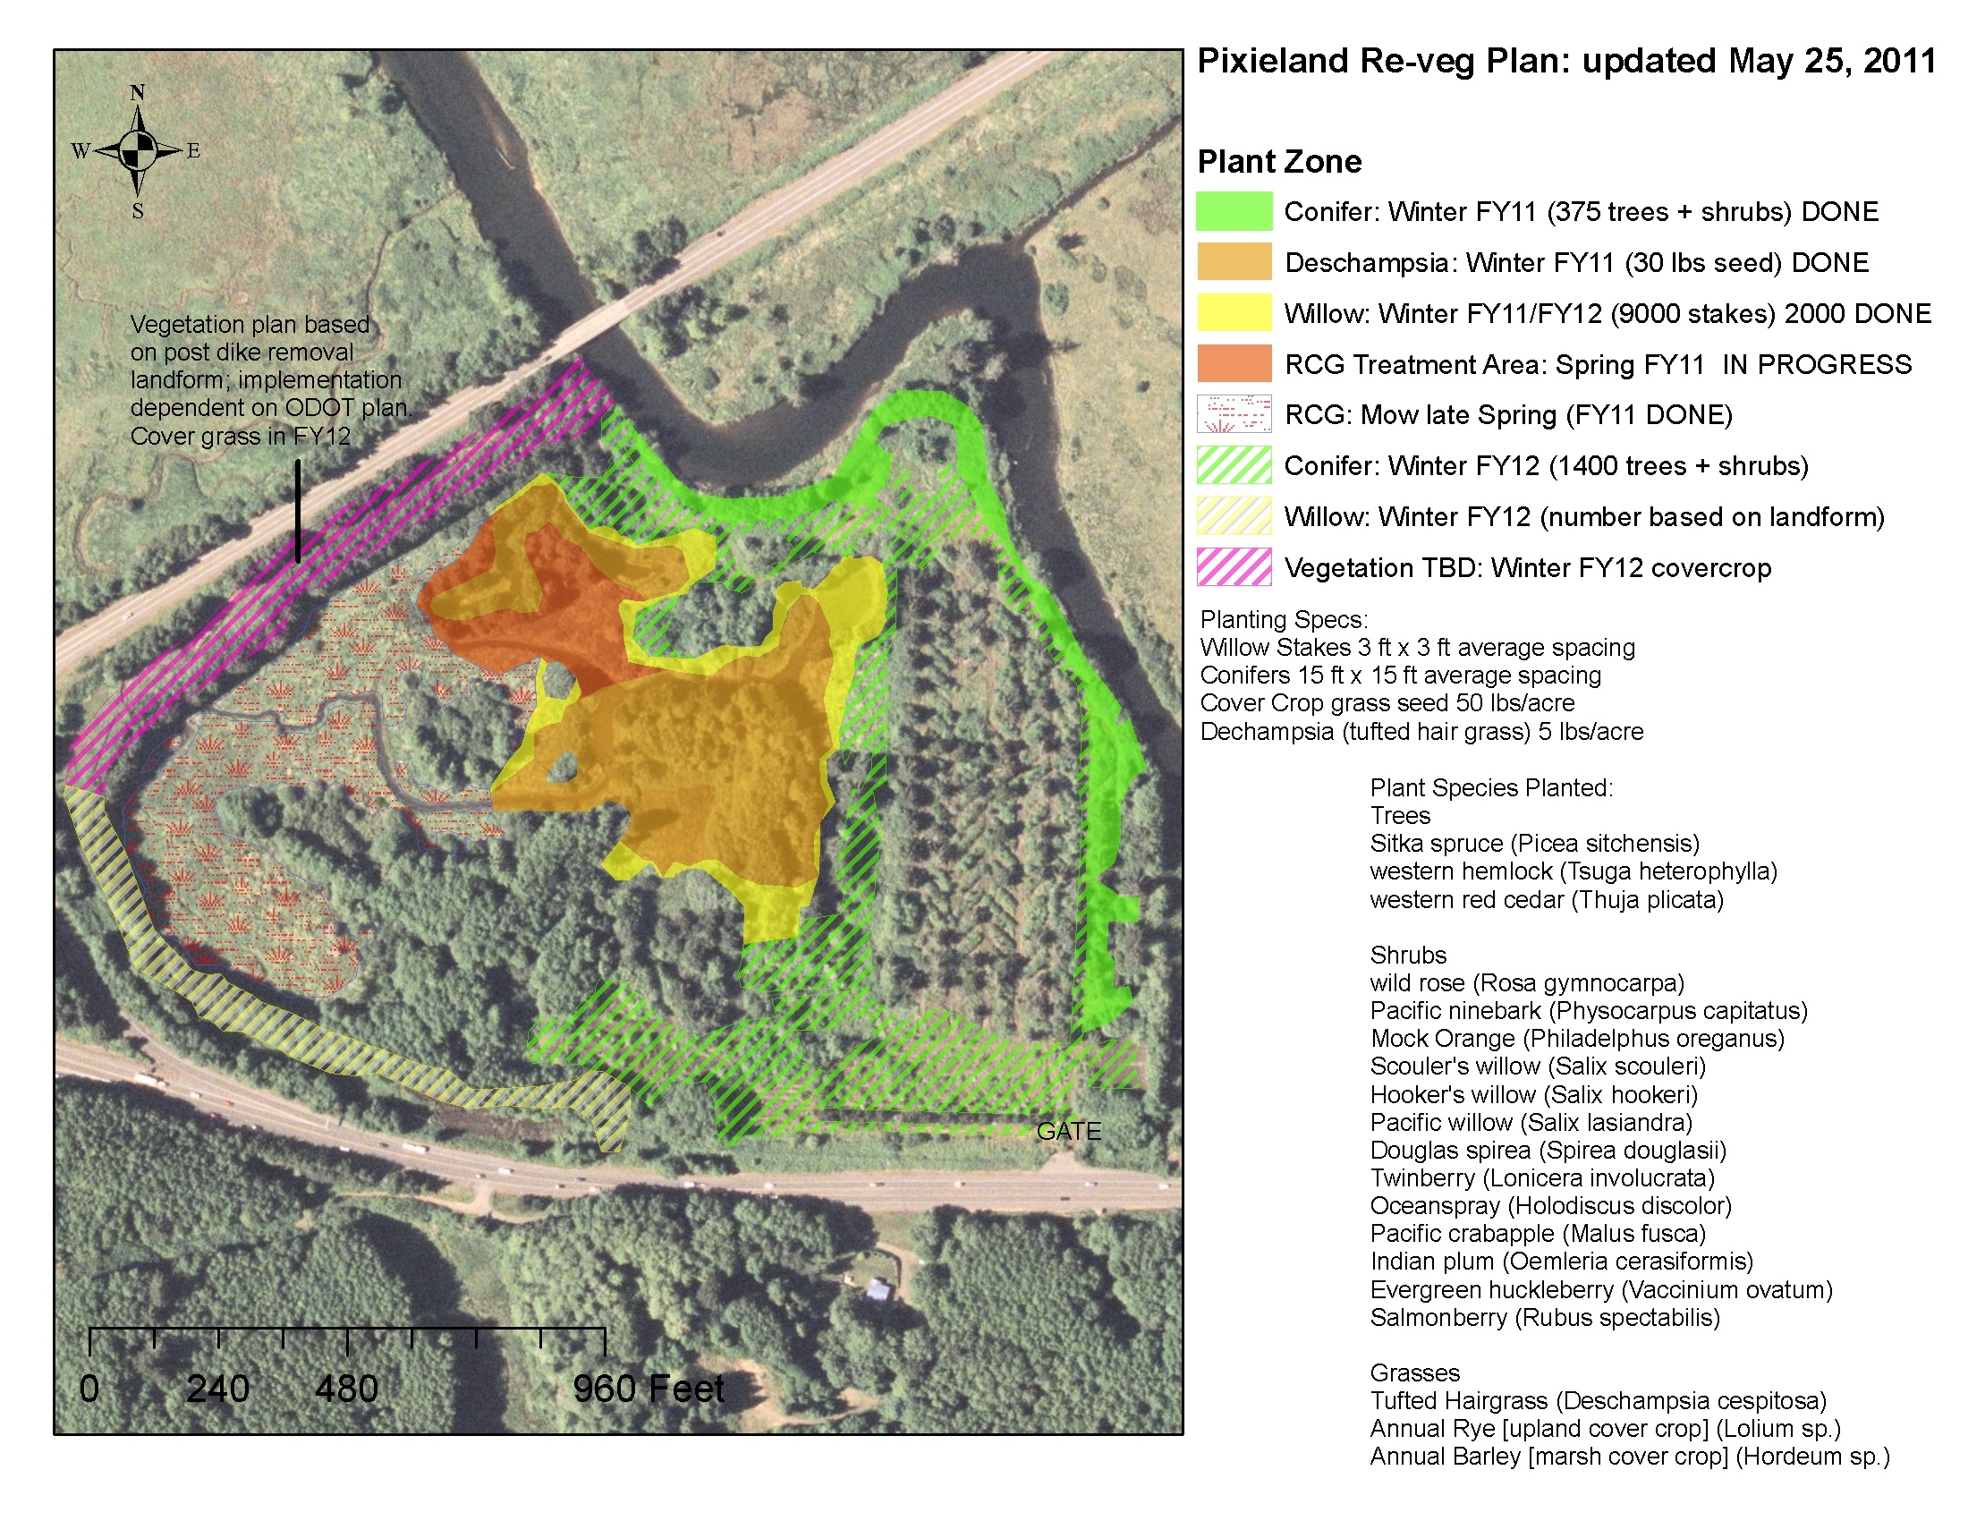
2010 - 2011 Restoration

Slide 22
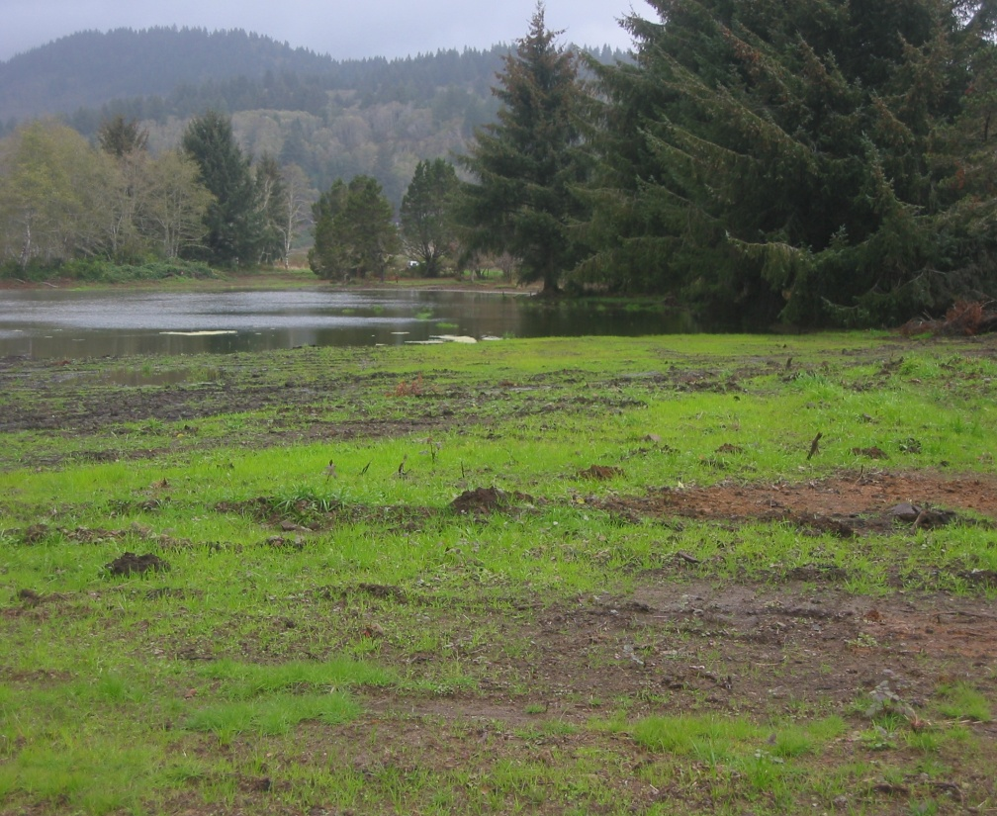
2010-2011 Restoration
Pdxhistory.com
1975 Photo
2012 Photo
Project Components
Removed infrastructure
Filled artificial ponds
Rebuilt multiple tidal channels
Revegetated
Project Results
52 acres restored
Re-established Fraser Creek & tidal marsh
As-built survey

Slide 23
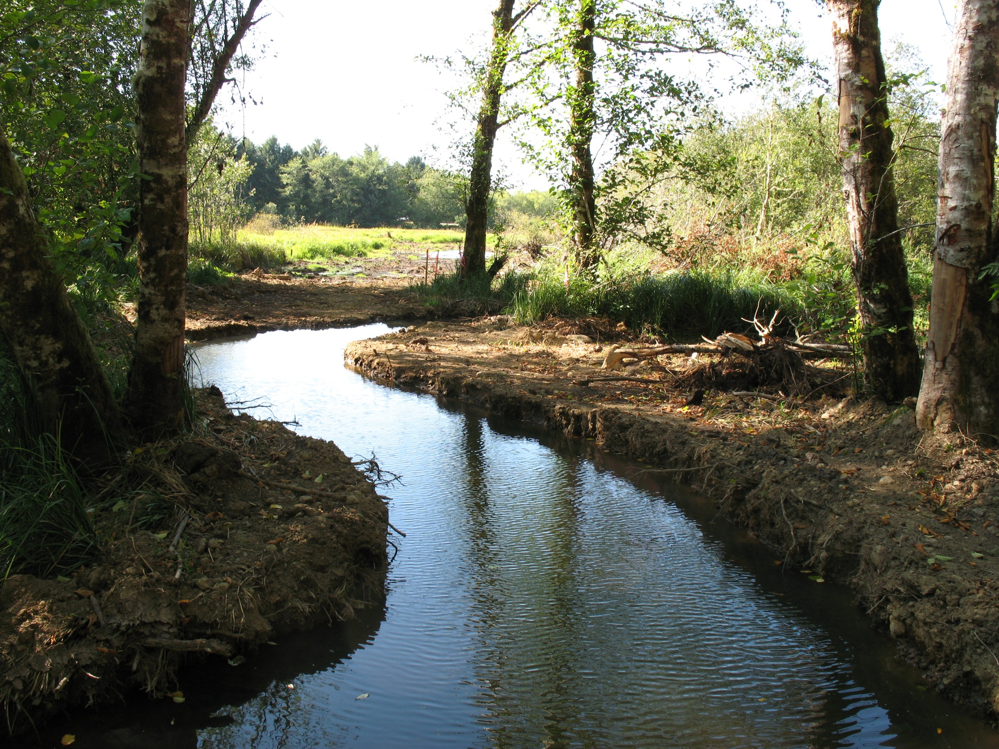
Fraser Creek 7’ Tide

Slide 24
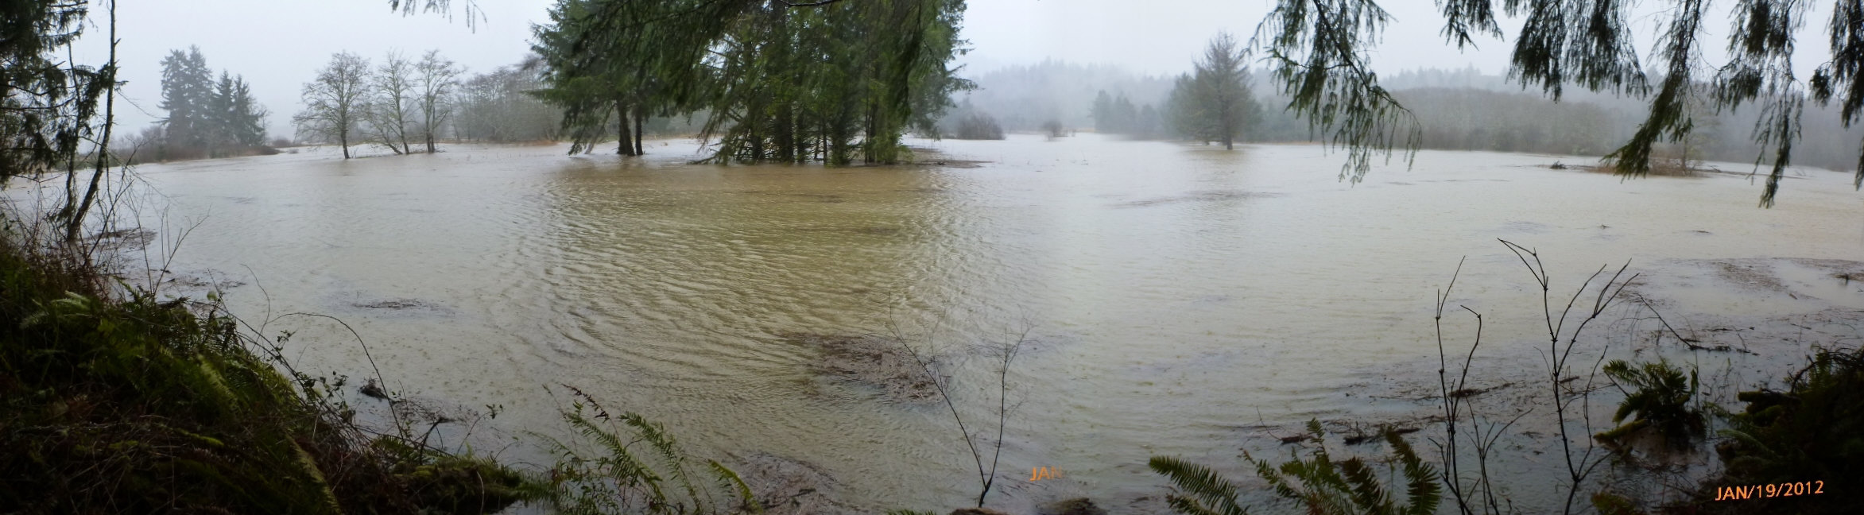
Restored Storage Capacity
2012 Photo

Slide 25
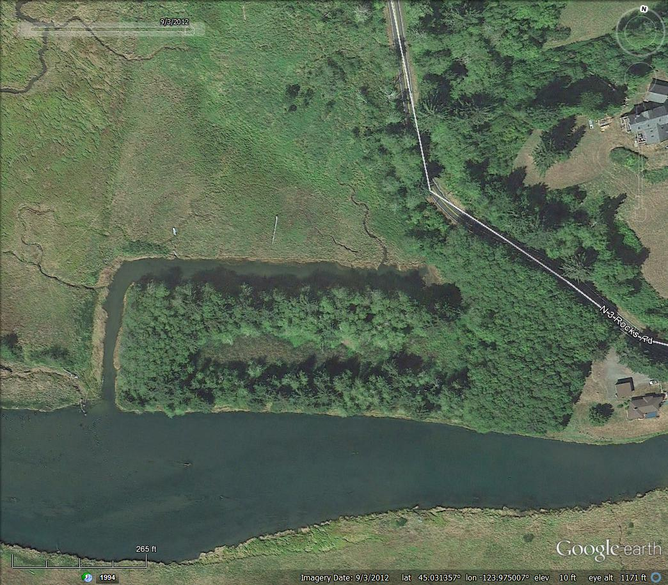
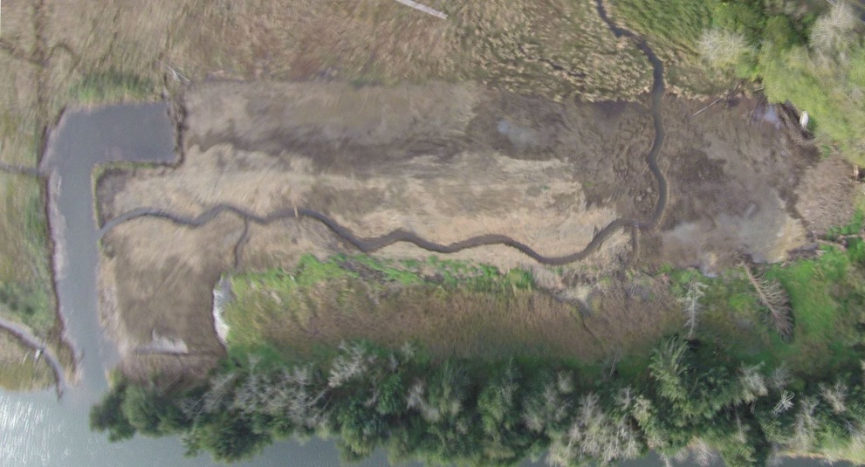
2014 Restoration
Project Components
Fill replaced into L-shaped marina
Native planting & maintenance
Project Results
8 acres restored
Marsh surface & Mink Creek restored
As-built survey
1984 Photo
2014 Photo

Slide 26
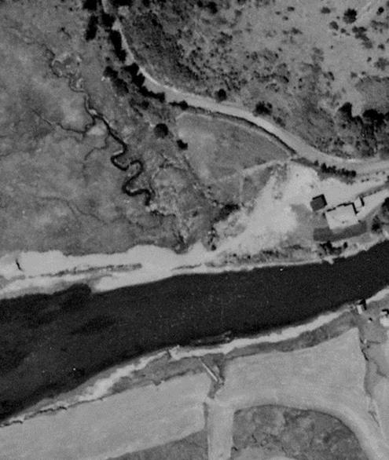
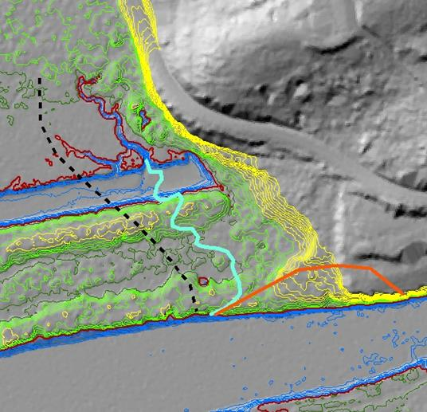
2014 Restoration

Slide 27
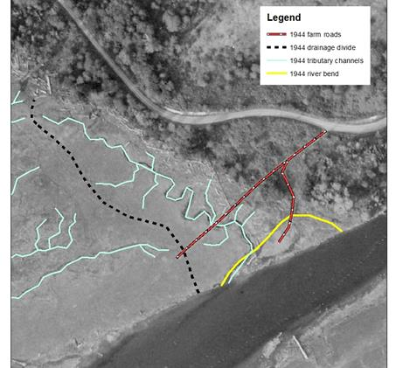
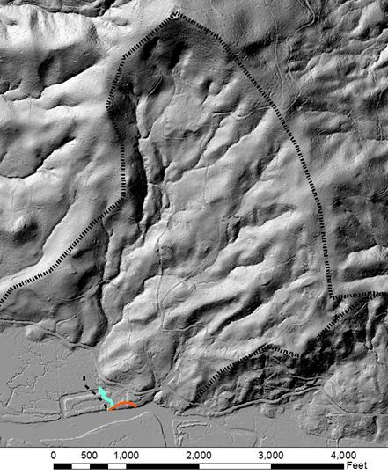
2014 Restoration

Slide 28
Restored Storage Capacity
Overall Results
673 acres restored
Increased storage capacity
2012
1987
1978
2009
2014
Reference Marsh
1996
2010-11

Slide 29
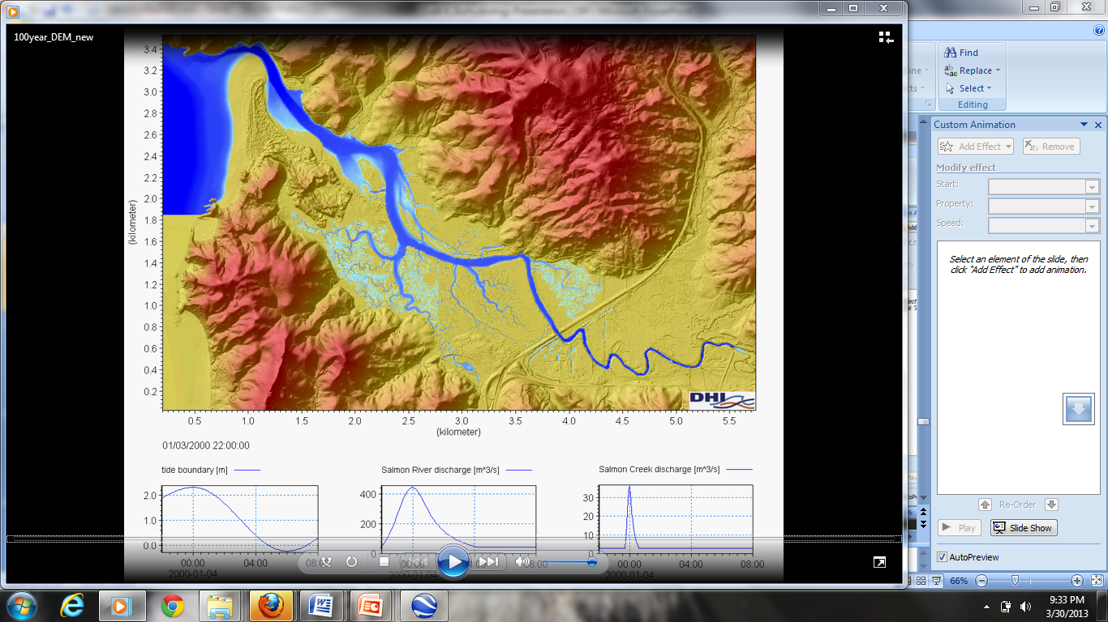
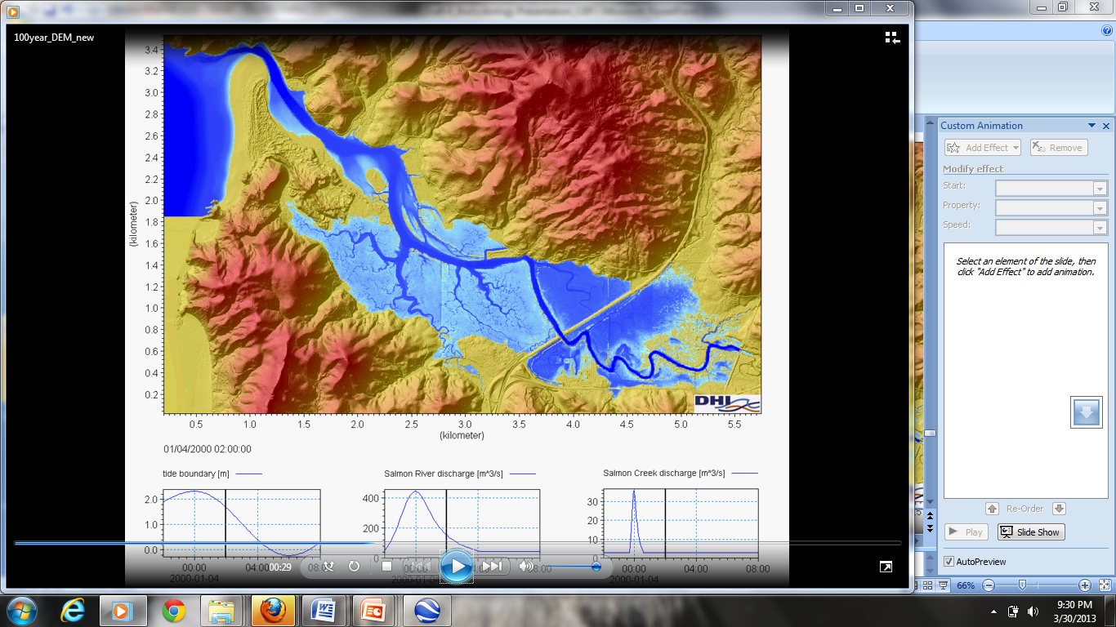
LiDAR as a basis for modeling
Bankful Conditions
100YR
Flood Event
+
8’Tide
Notes:
We looked at the unique role of the state highway in affecting tidal action and flooding

Slide 30
Predicted effects of mean sea-level rise
Current mean high tide
1-m increase
2-m increase

Slide 31
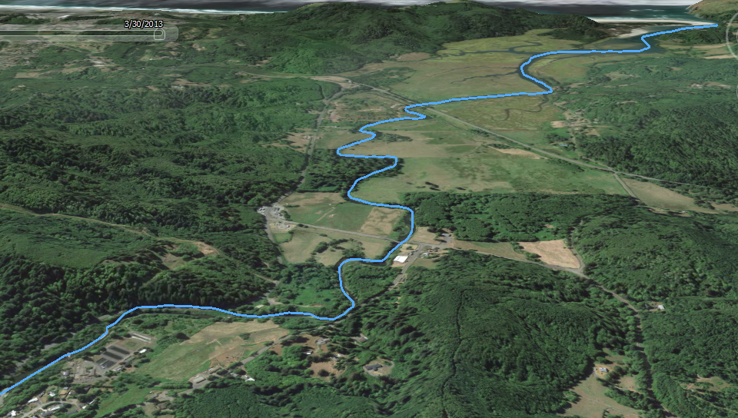
Reduced Flooding
1987
2012
2009
1978
2014
2010-2011
1996
Head
of Tide
Fish Hatchery
Residences
Notes:
There is evidence that the estuary, indeed, does have increased storage capacity. Prior to the removal of the dikes at the 2010-11 Marsh, the fish hatchery depicted here frequently flooded. Significant flooding has not occurred since the removal.

Slide 32
37 Years of Restoration
2012
1978
2014
1987
Reference
1996
2009
2010-11

Slide 33
