Slide 1
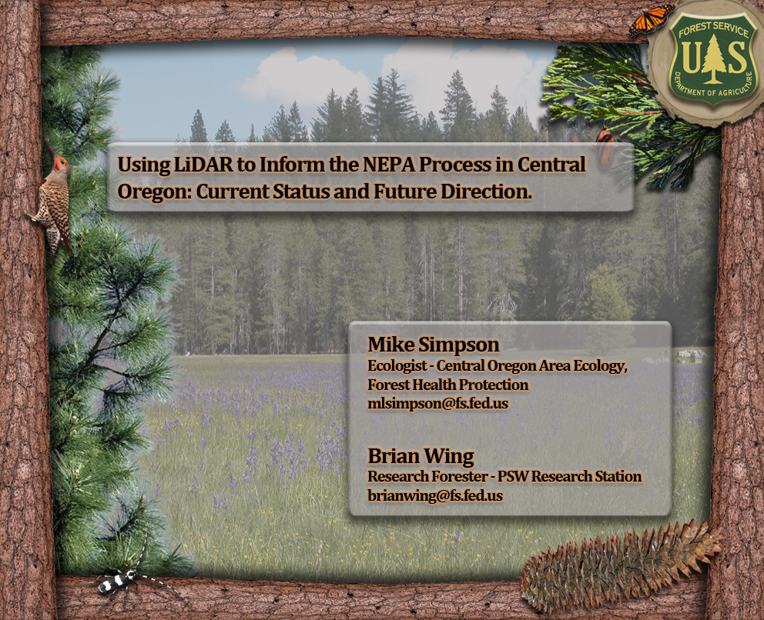

Slide 2
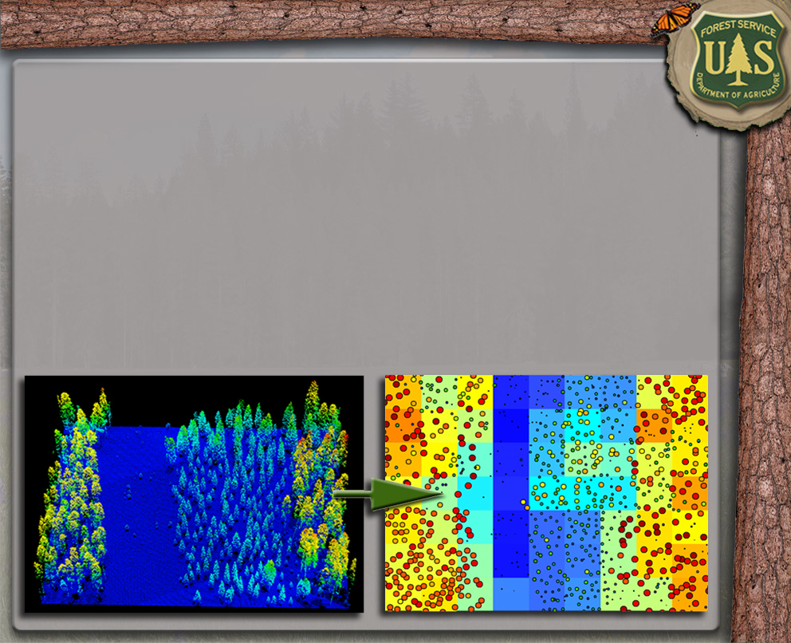
Presentation Outline
DEM Utilization
Individual-Tree Based Products
Creation & Utilization
Plot-Based Products
Creation & Utilization
Future Work

Slide 3
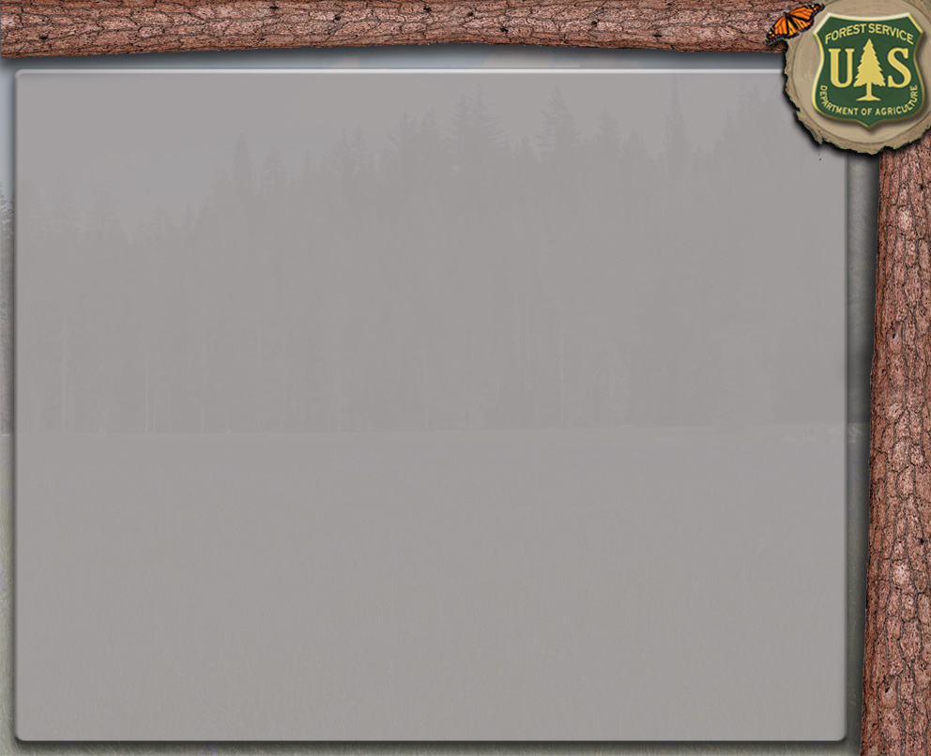
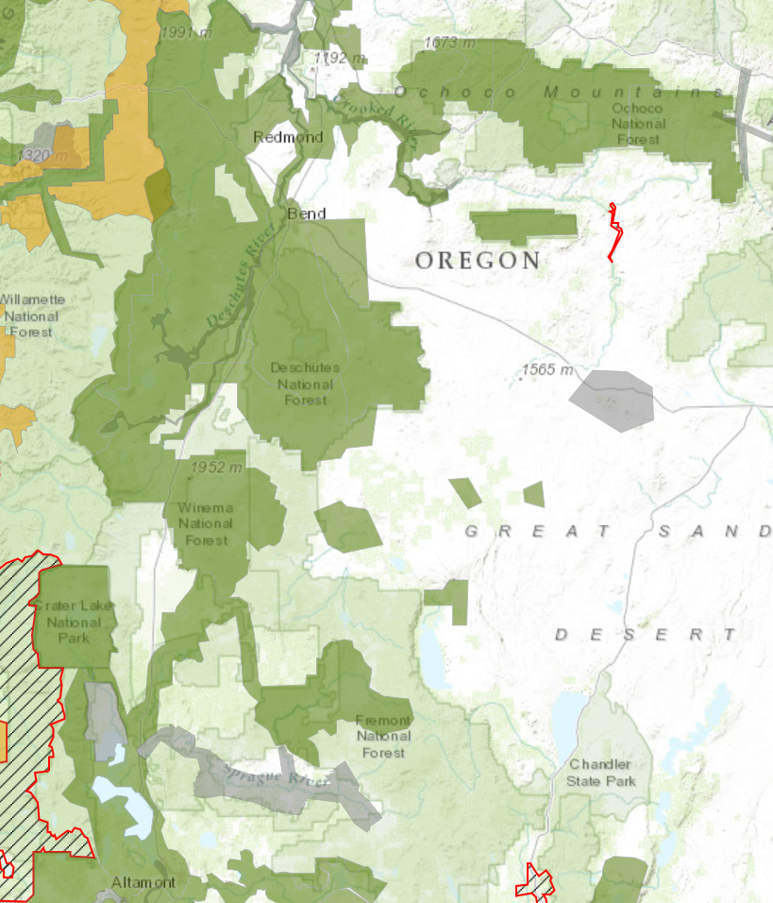
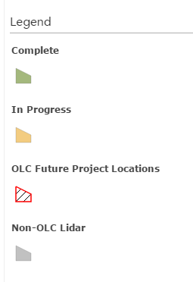
Central Oregon Lidar Acquisition Status 2015
Complete Lidar Cover
Deschutes National Forest
Ochoco National Forest
Crater Lake National Park
Partial Lidar Cover
Fremont-Winema National Forest
Crooked River National Grasslands

Slide 4
Presentation Outline
DEM Utilization
Individual-Tree Based Products
Creation & Utilization
Plot-Based Products
Creation & Utilization
Future Work

Slide 5
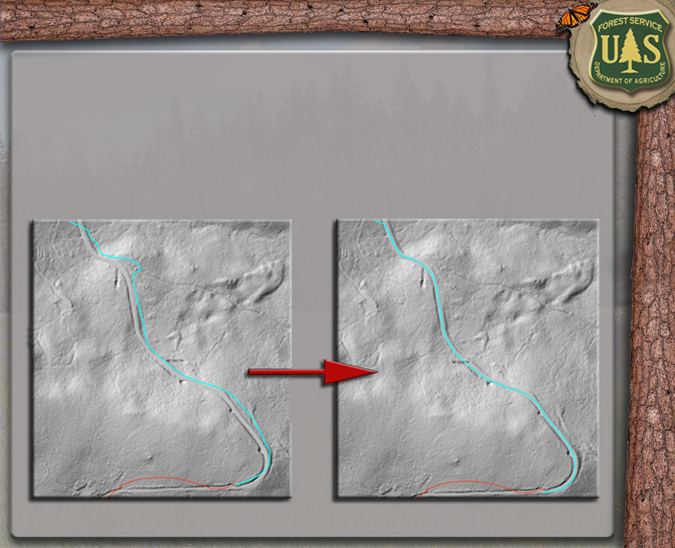
DEM Utilization – Road Correction

Slide 6
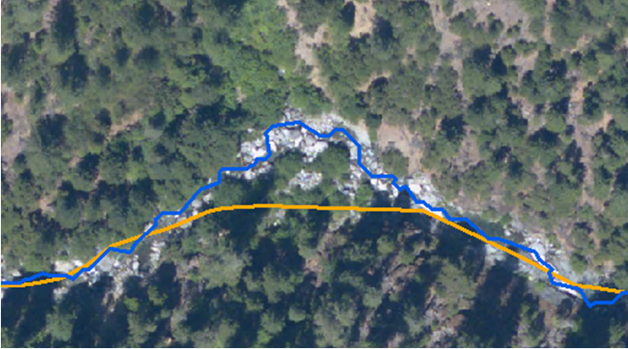
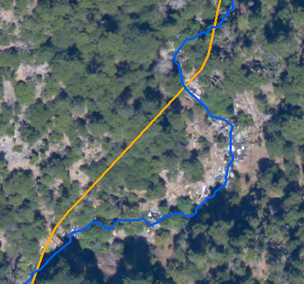
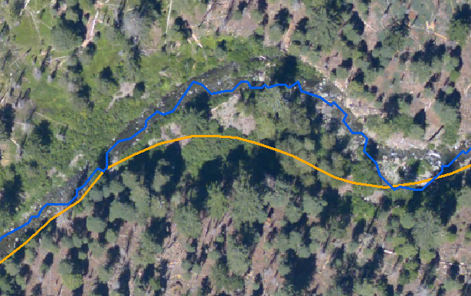
DEM Utilization – Stream Correction
Blue: LiDAR-derived stream channel
Orange: NHD stream layer
Management implication: Greatly improved accuracy for project planning and implementation

Slide 7
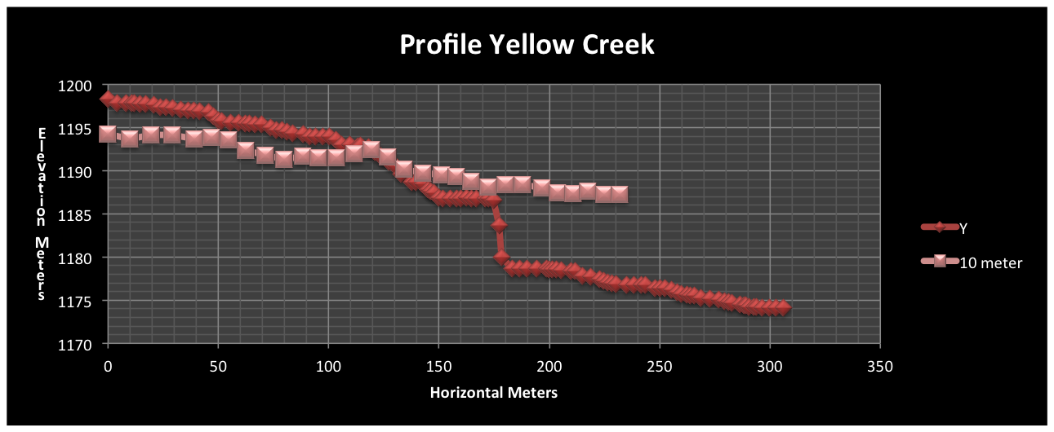
DEM Utilization – Stream Correction
Management implication: Greatly improved accuracy for project planning and implementation

Slide 8
Presentation Outline
DEM Utilization
Individual-Tree Based Products
Creation & Utilization
Plot-Based Products
Creation & Utilization
Future Work

Slide 9
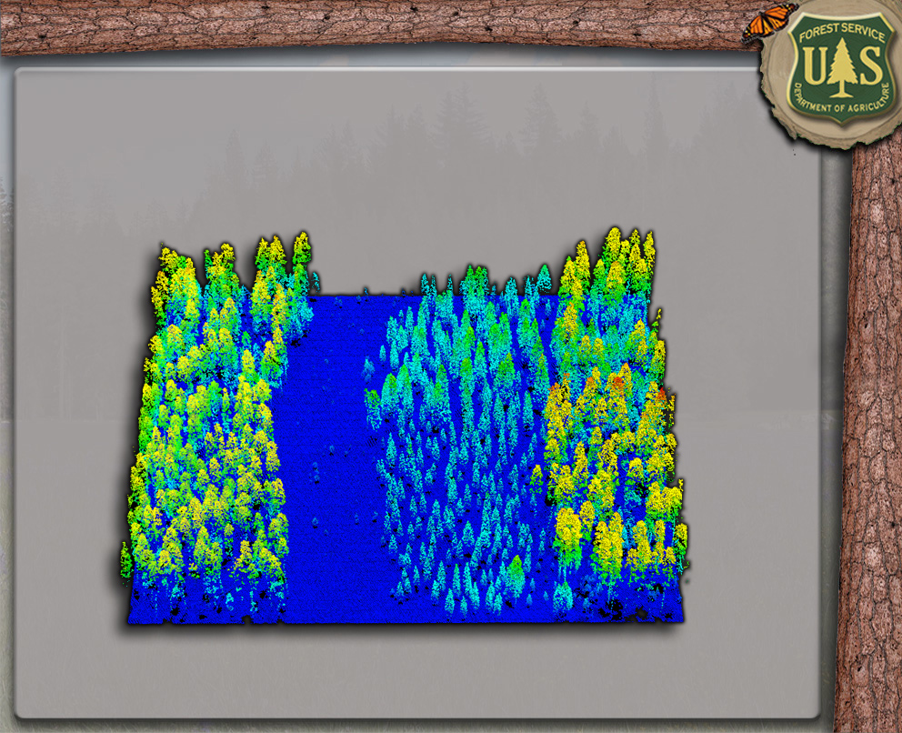
Individual-Tree Product Creation

Slide 10
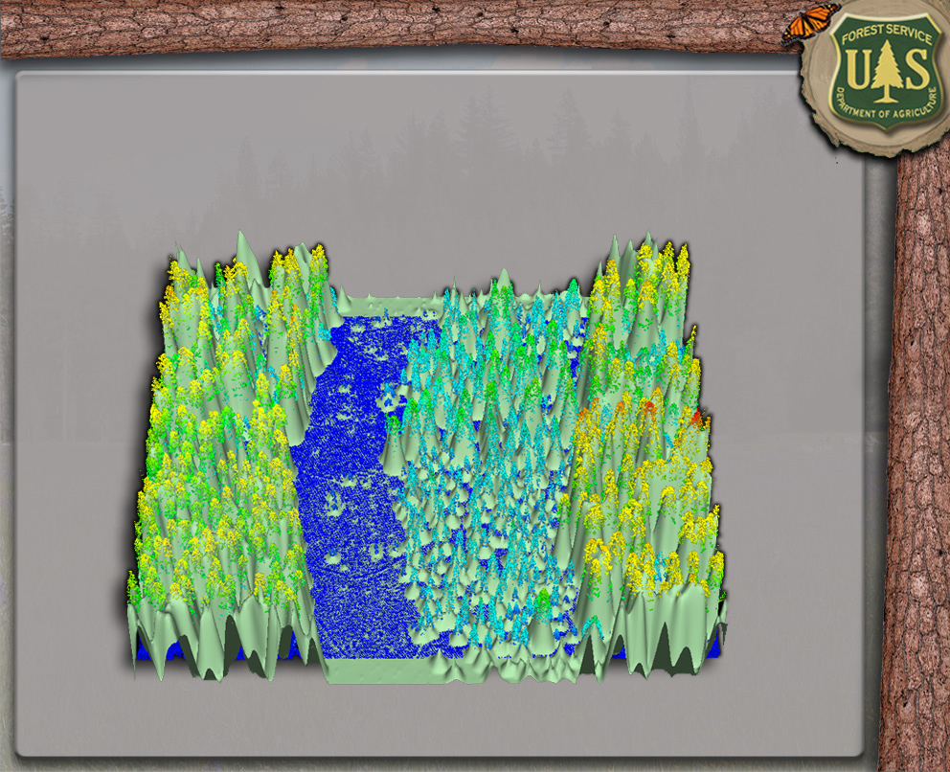
Individual-Tree Product Creation

Slide 11
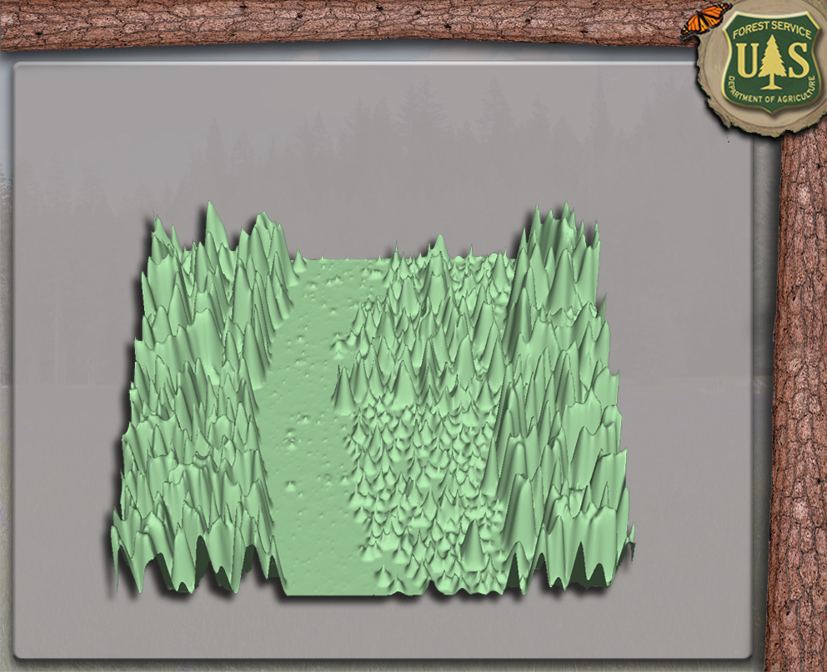
Individual-Tree Product Creation

Slide 12
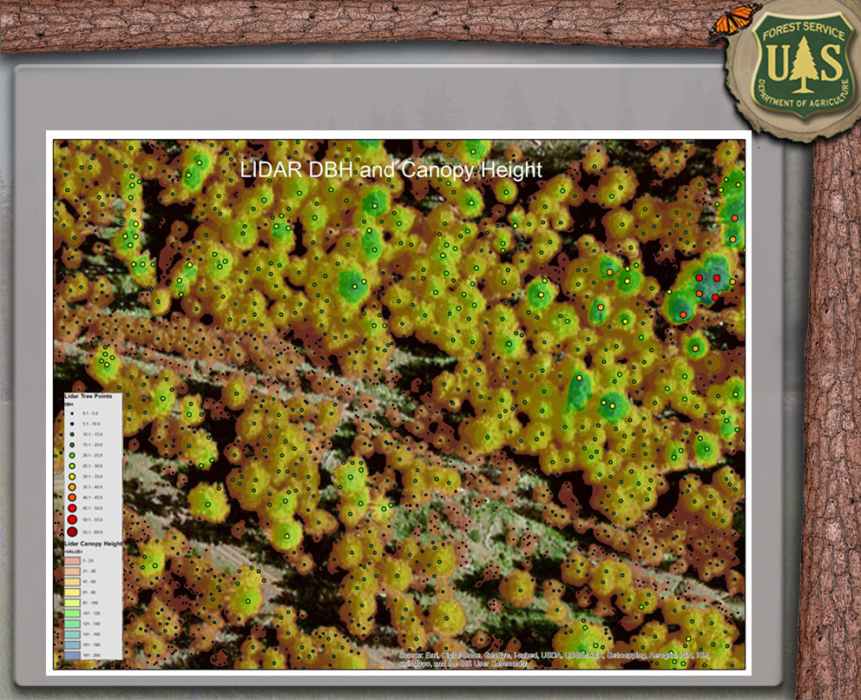
Individual-Tree Product Creation

Slide 13
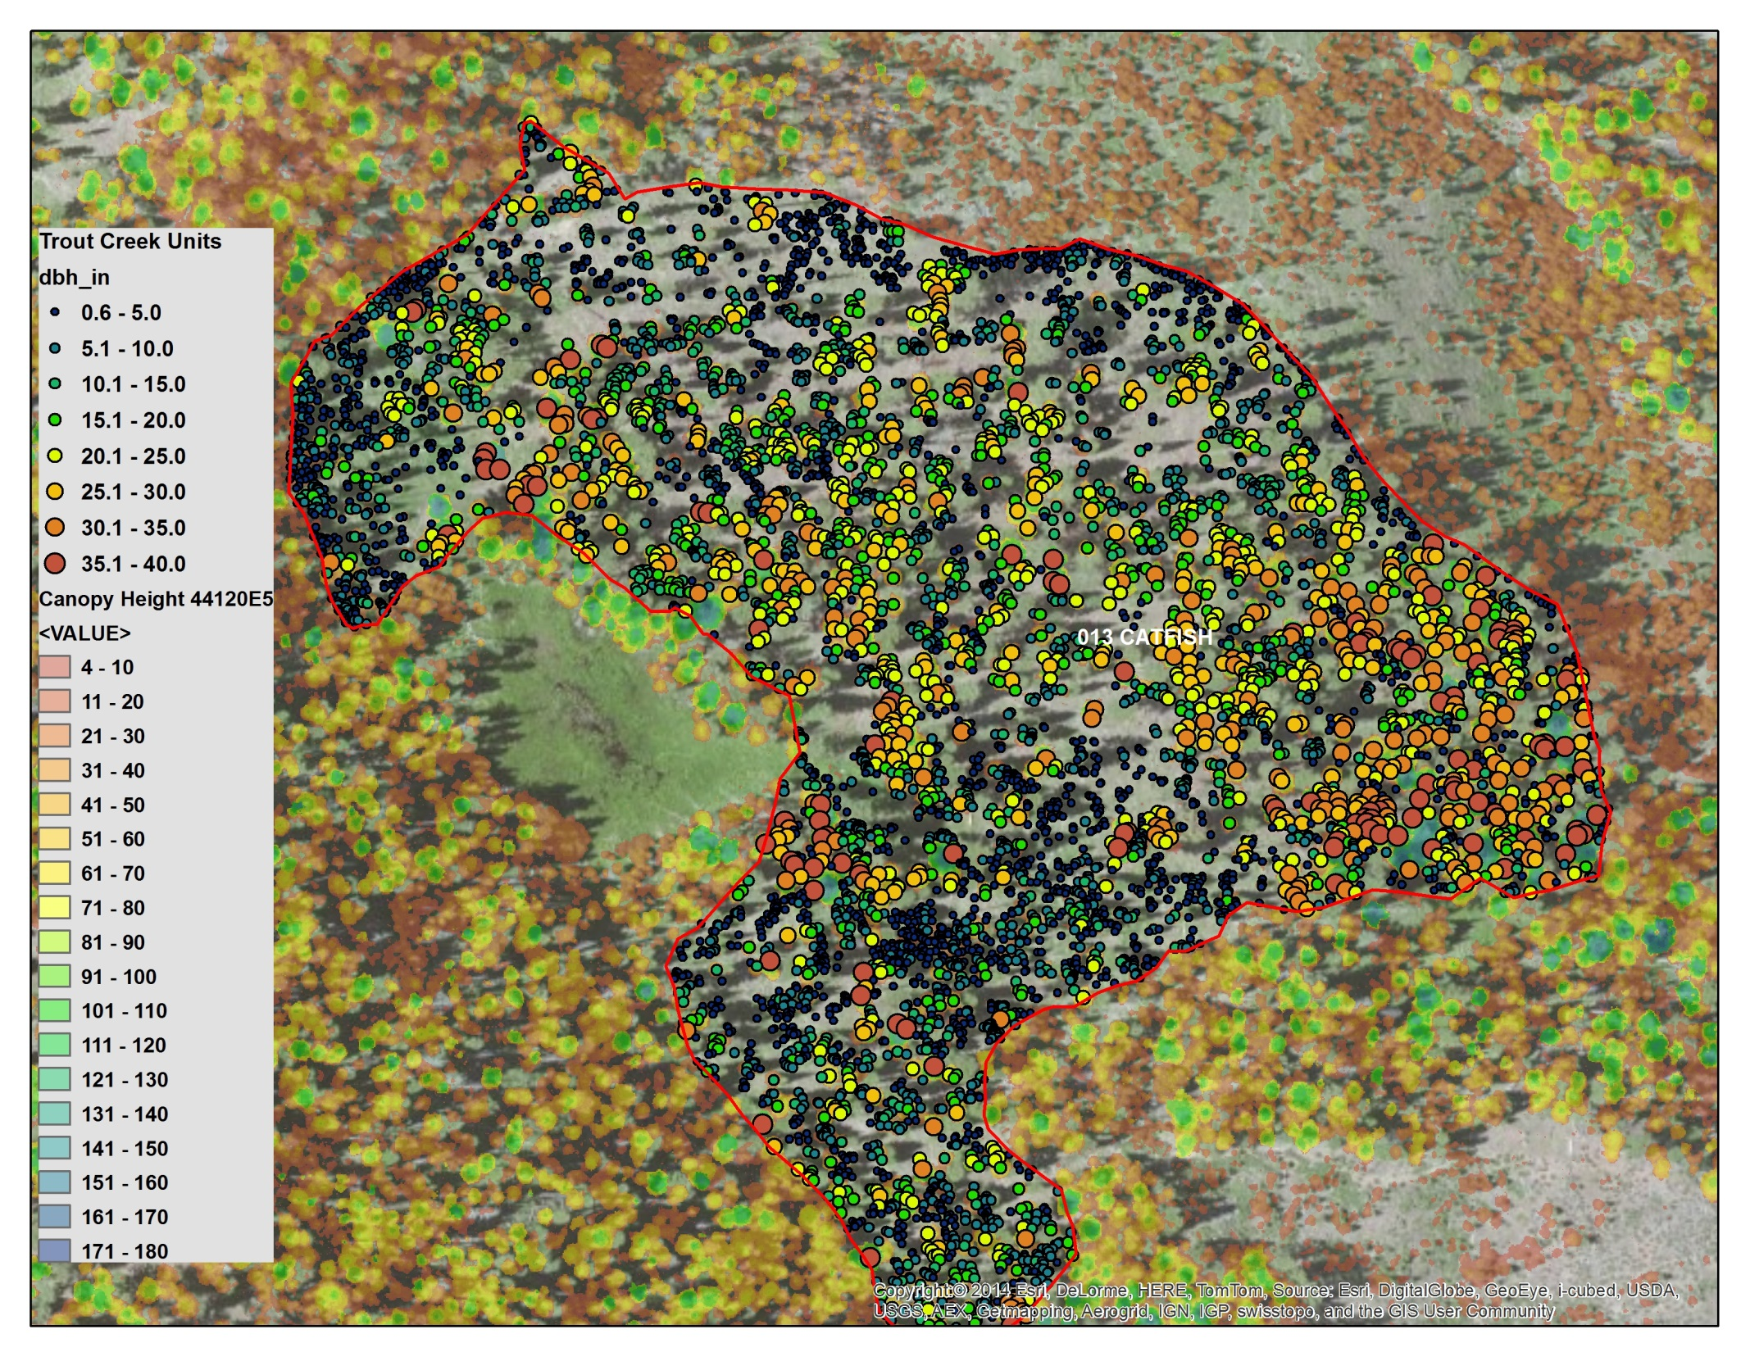

Slide 14
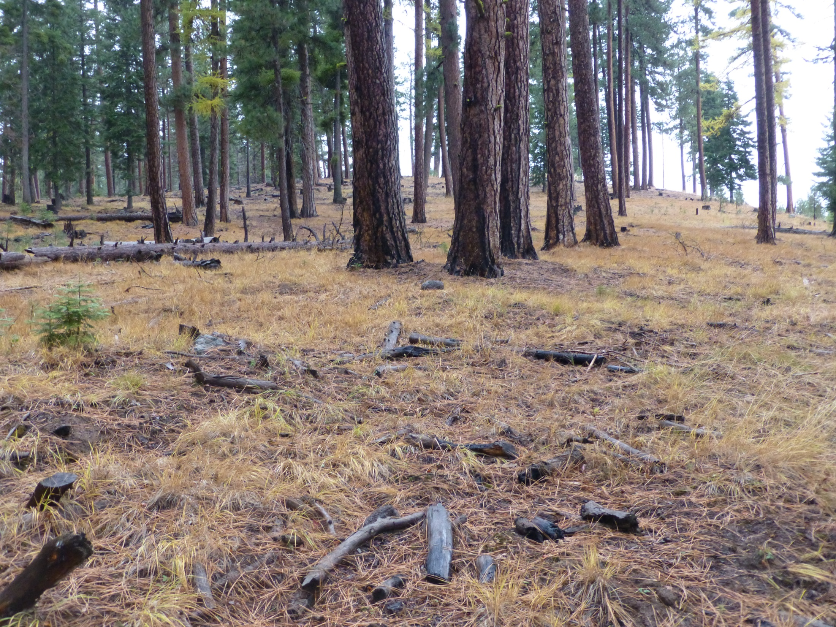
Notes:
Catfish 13 Looking into completed unit from Northeast Corner

Slide 16
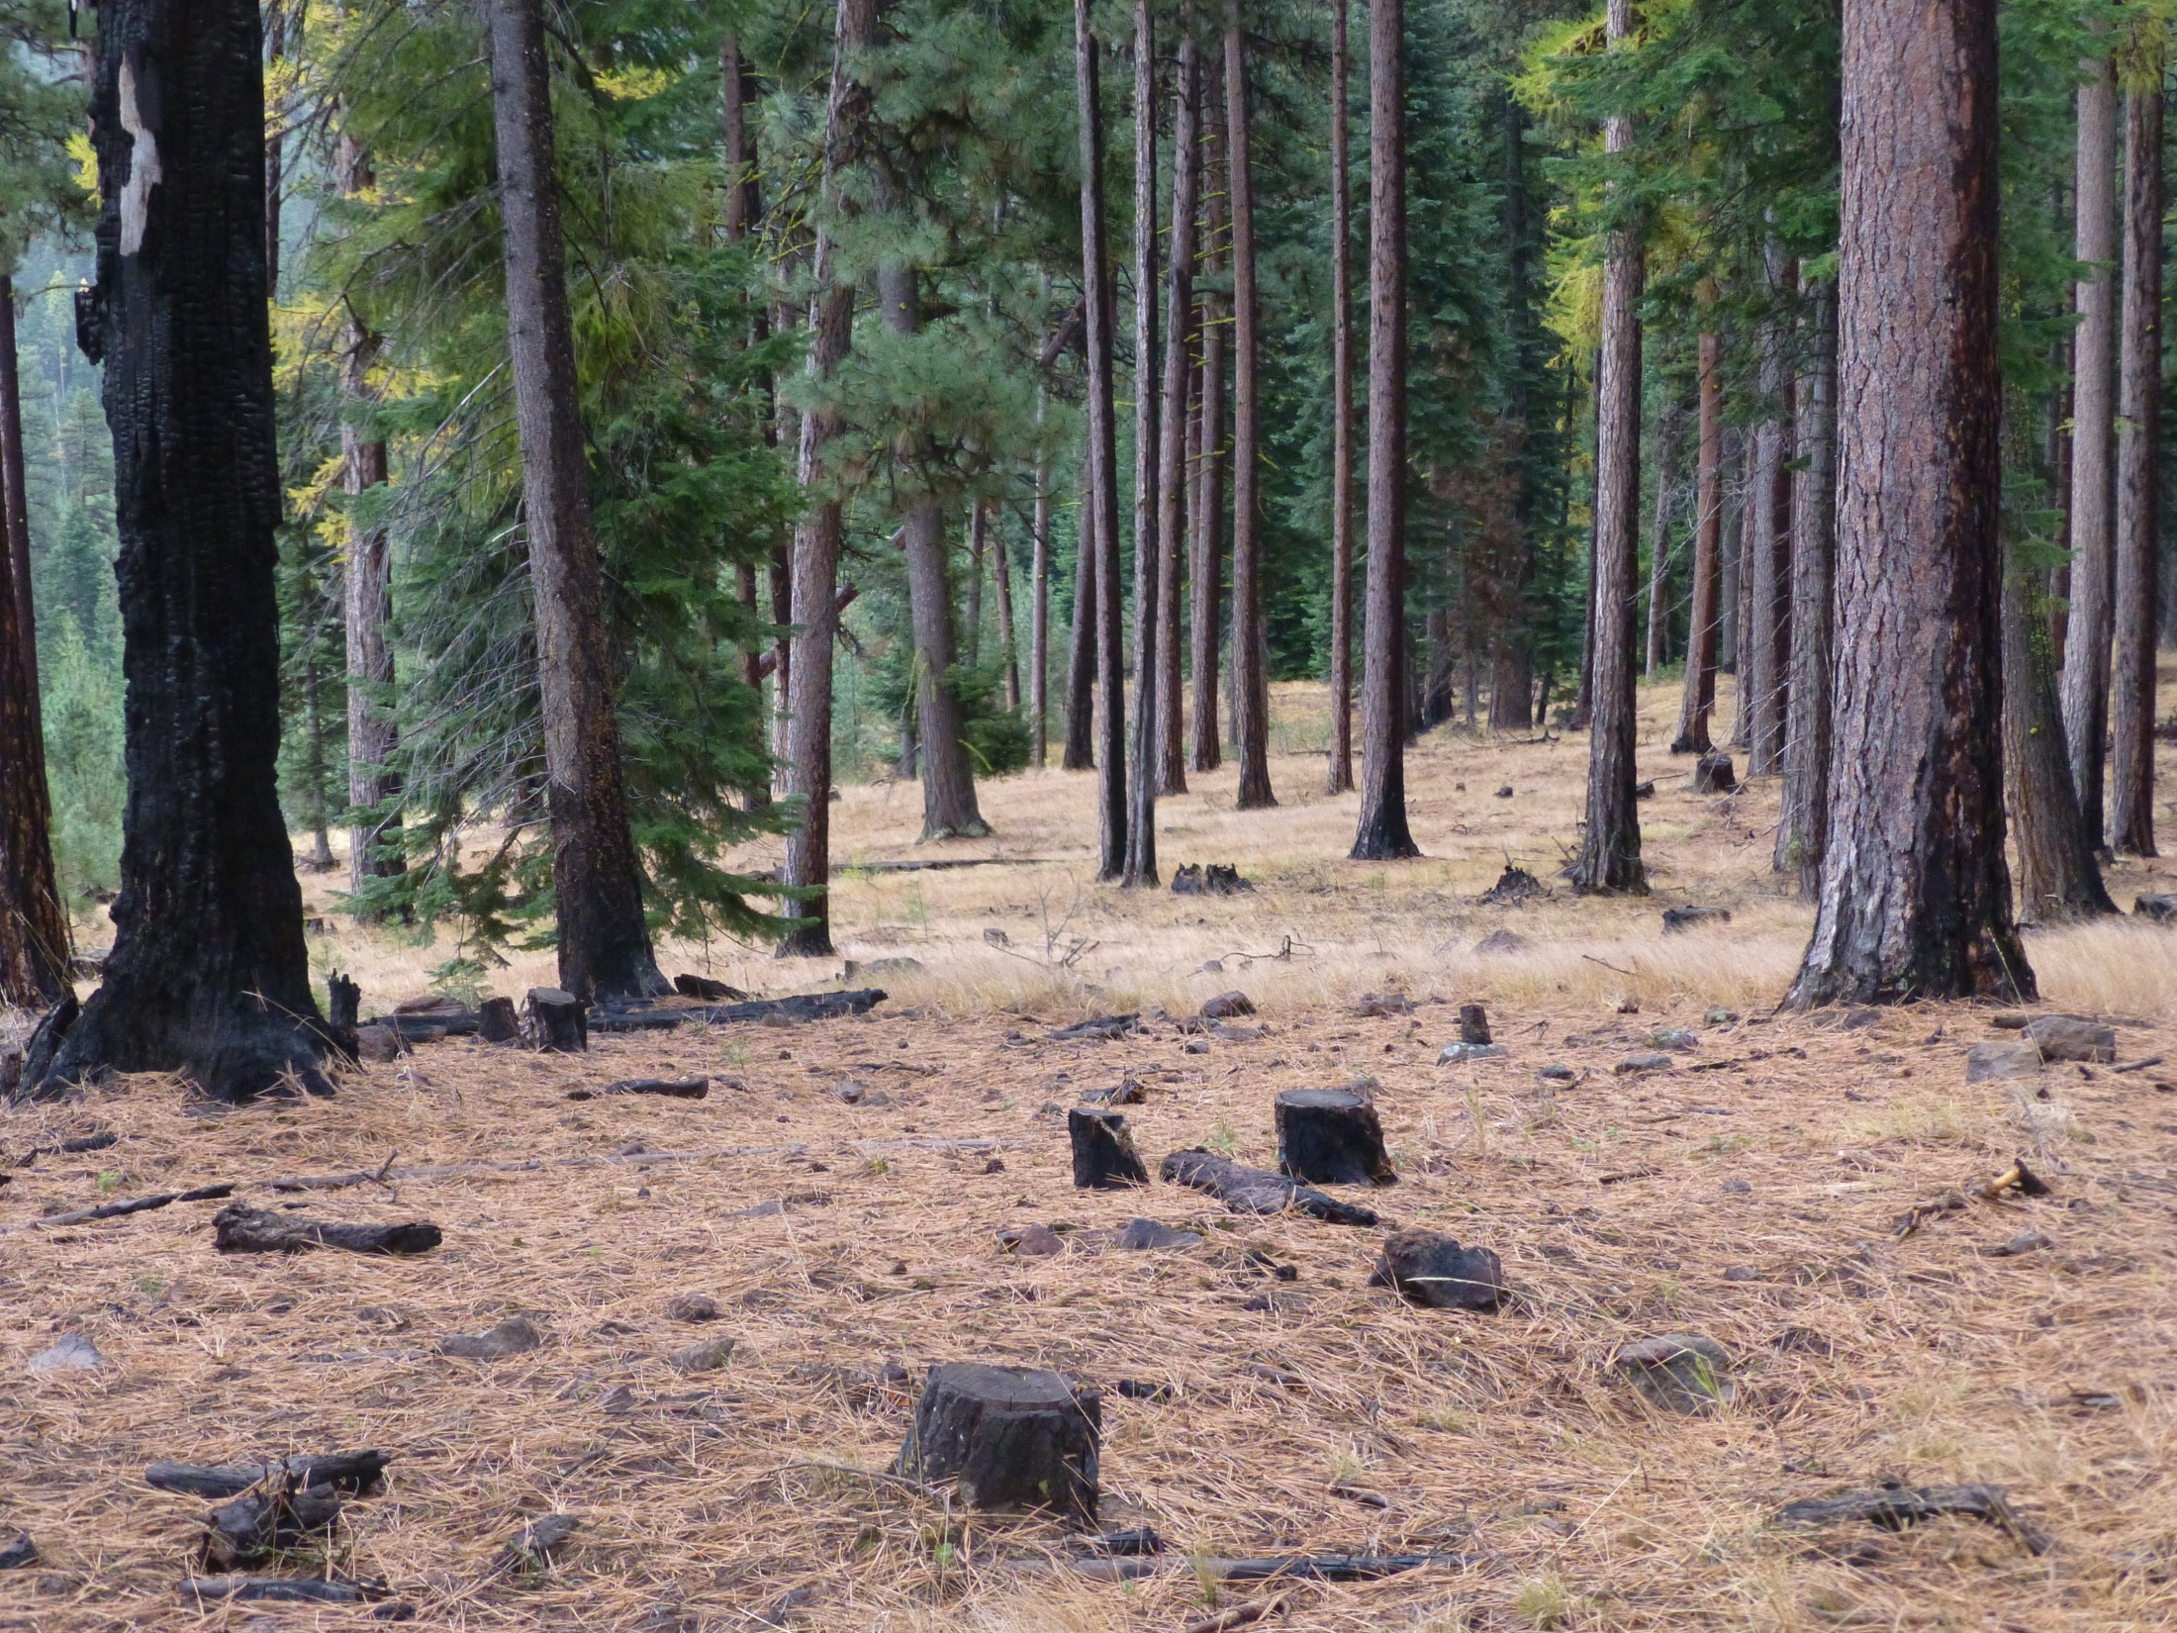
Notes:
Catfish 13 Looking to east from center of unit.

Slide 17
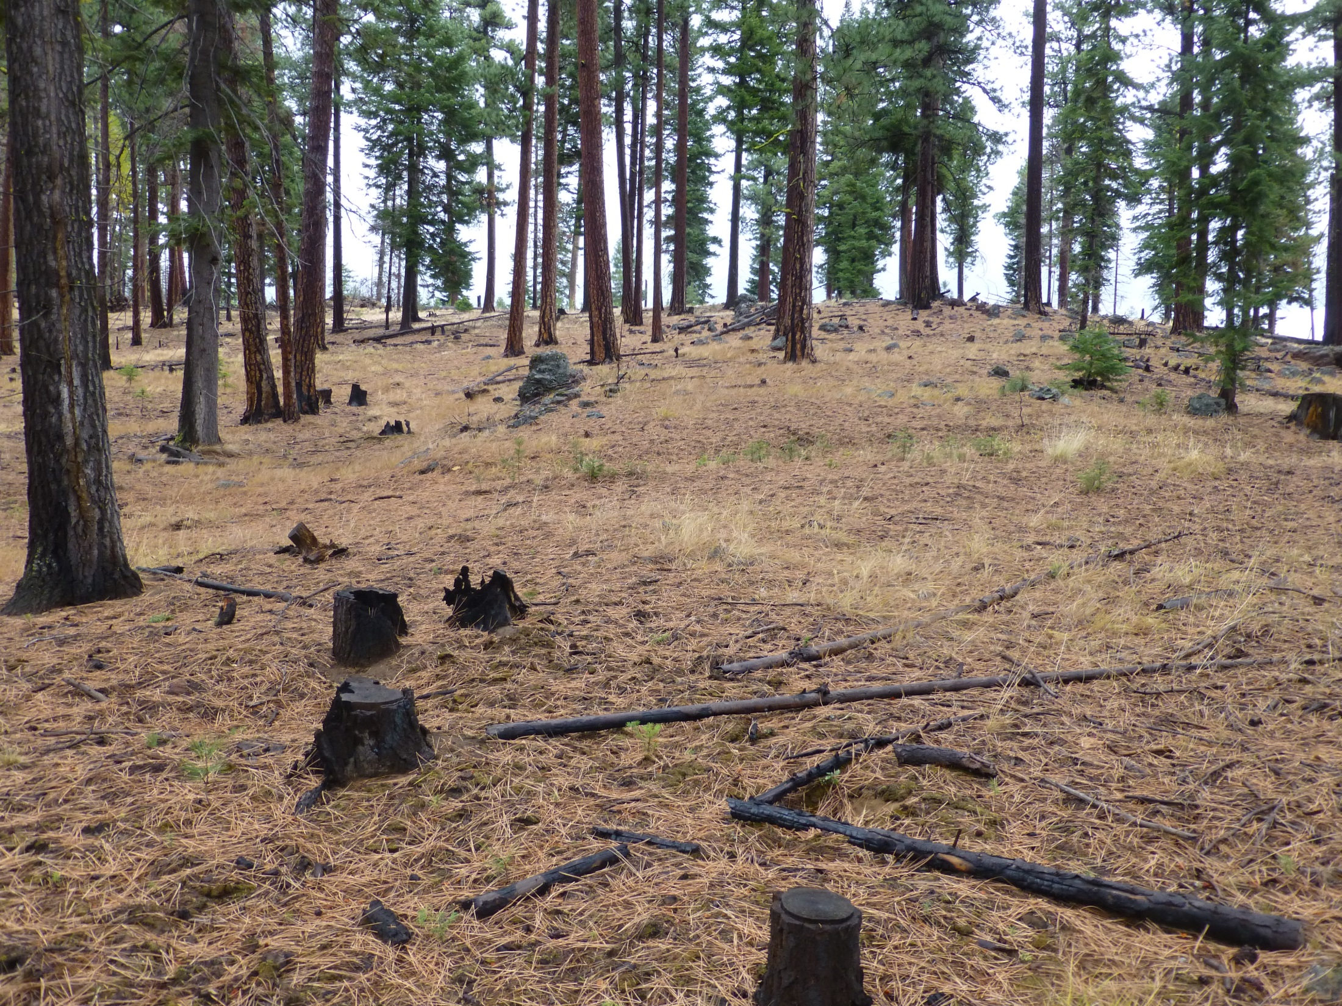

Slide 18
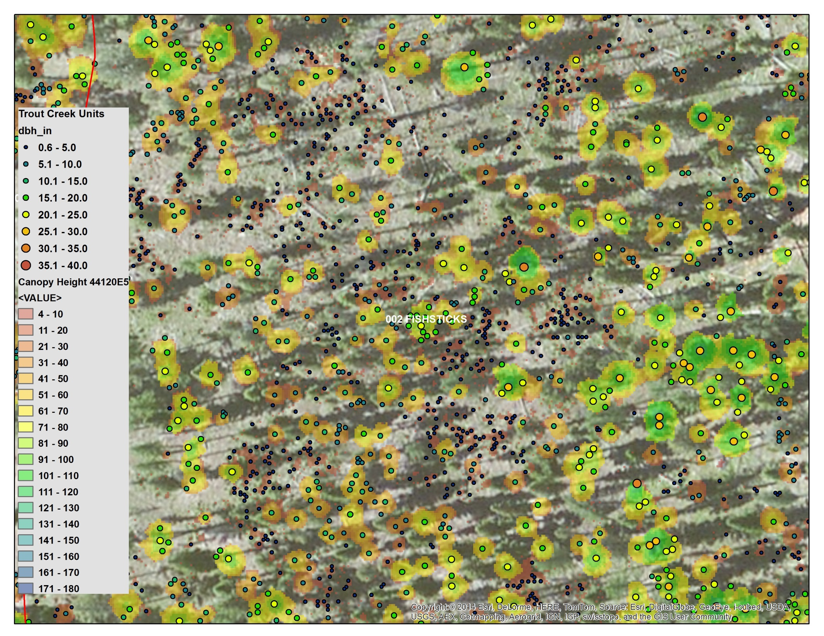

Slide 19
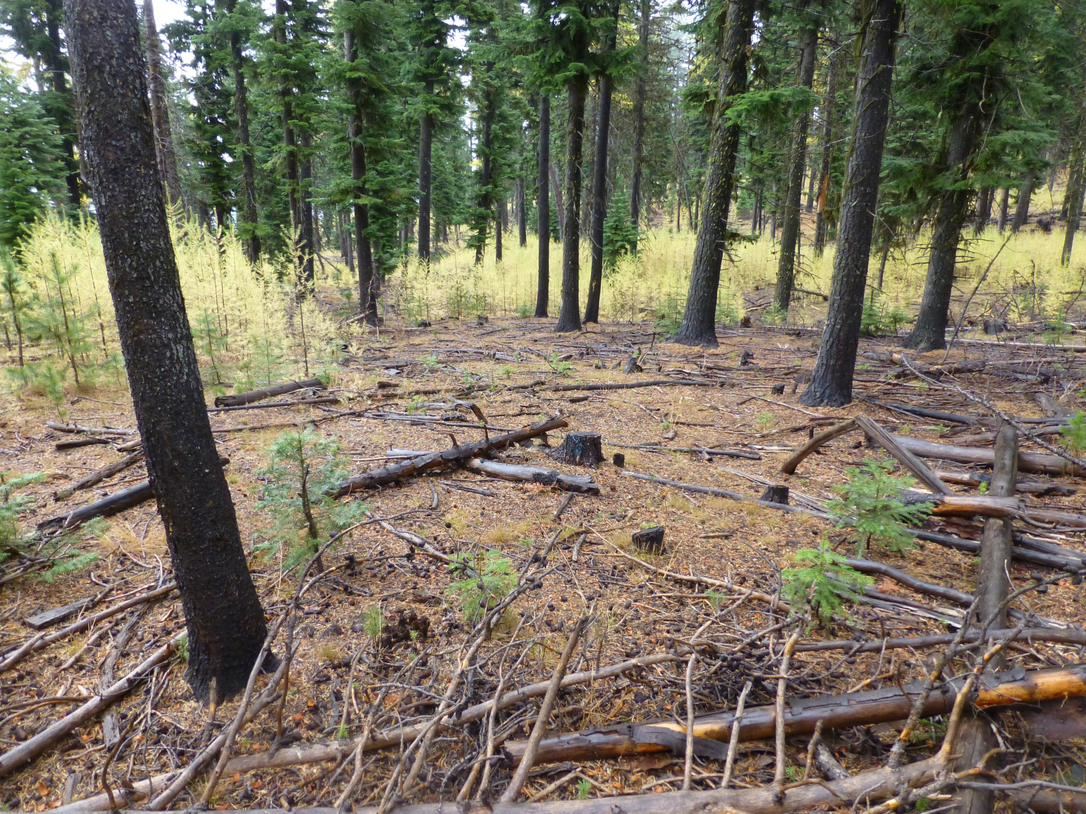
Notes:
Fishsticks 2

Slide 20
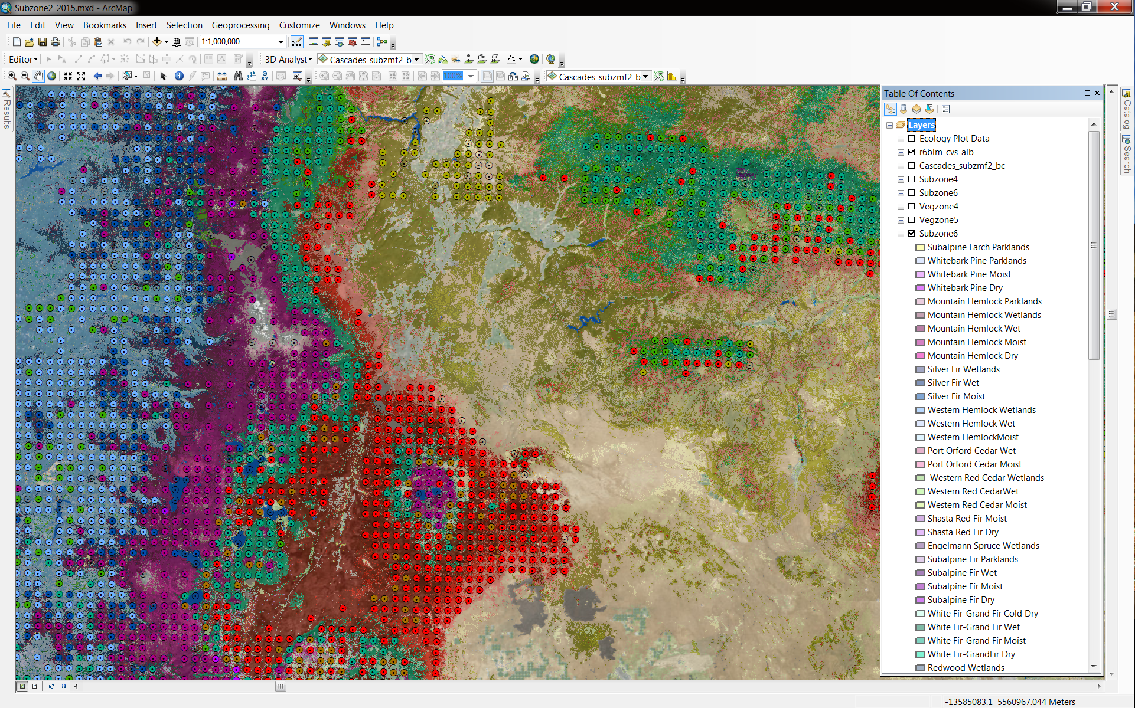

Slide 21
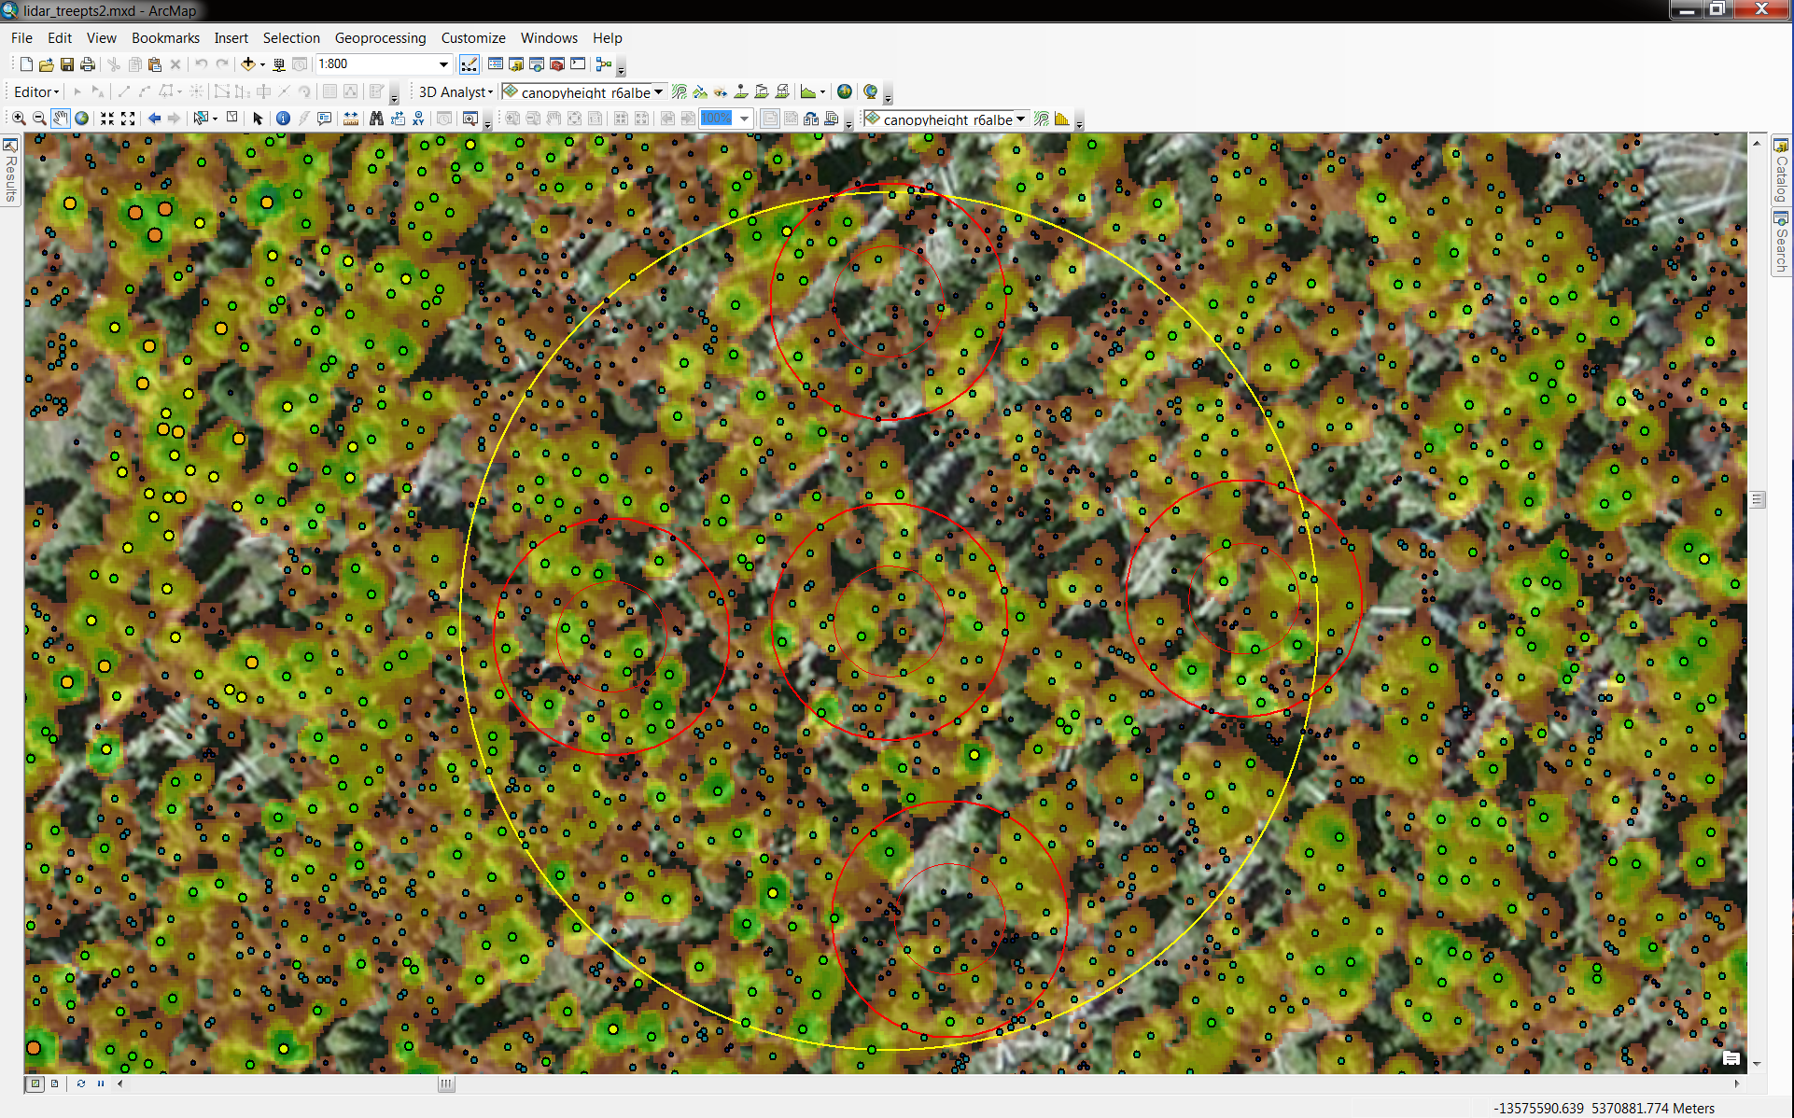

Slide 22
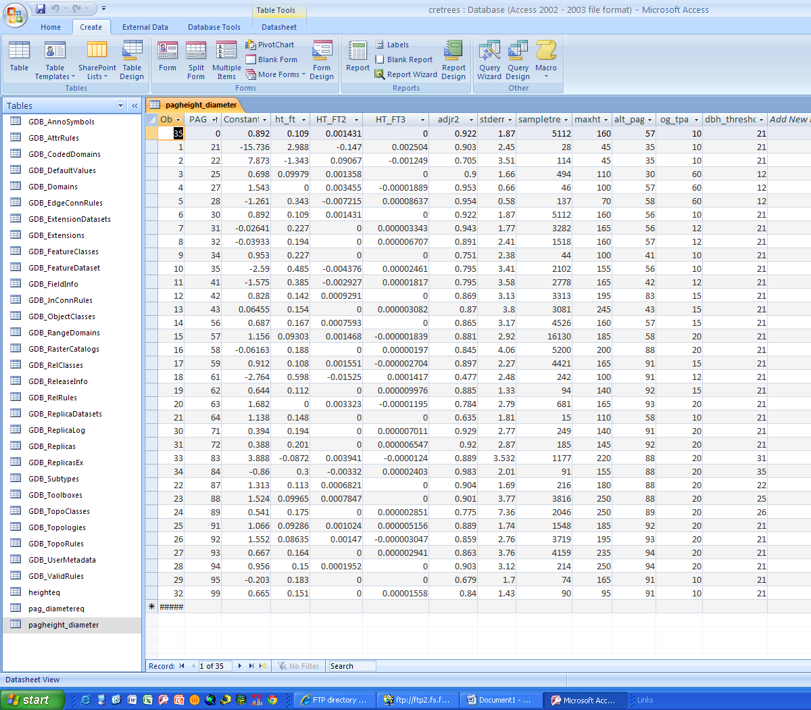

Slide 23
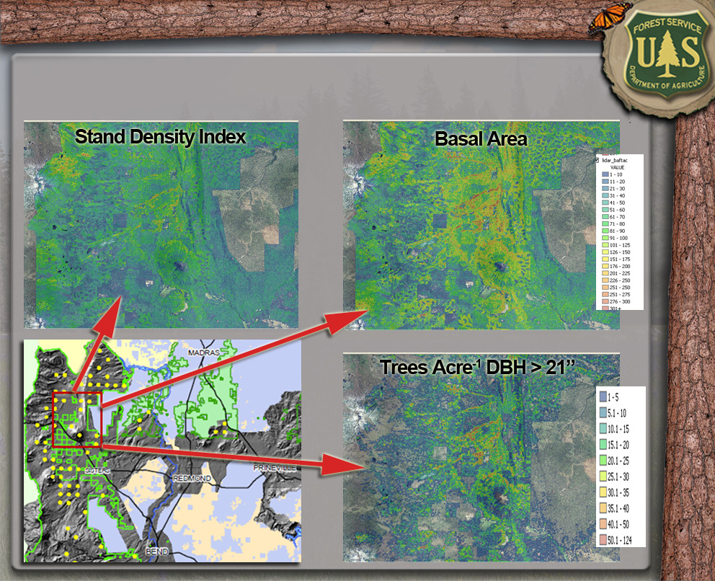
Individual-Tree Product Creation

Slide 24
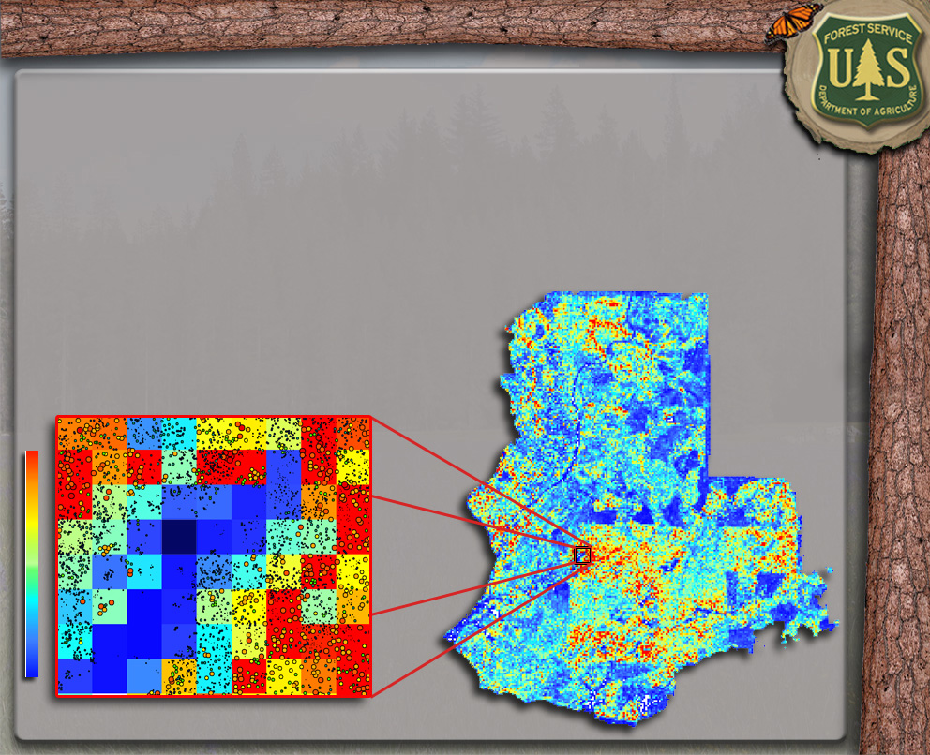
Individual-Tree Product Creation
Basal Area (sqft. acre⁻¹)

Slide 25
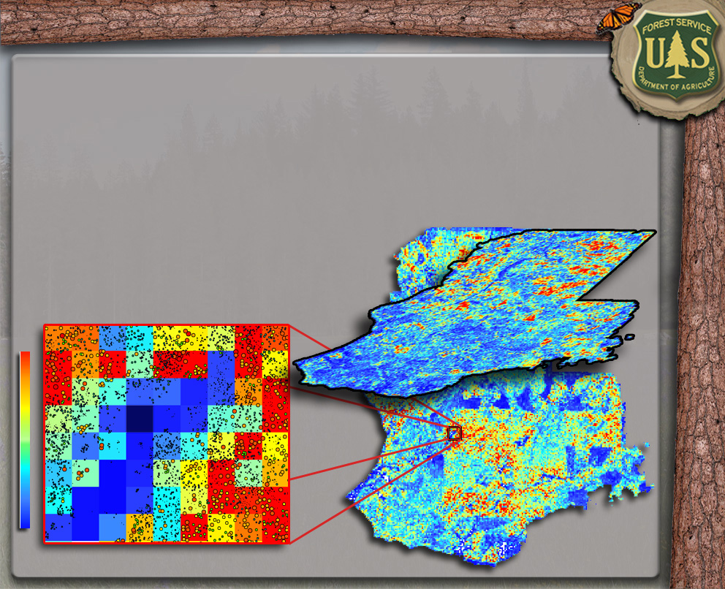
Individual-Tree Product Creation
TPA 0-5” DBH
Basal Area (sqft. acre⁻¹)

Slide 26
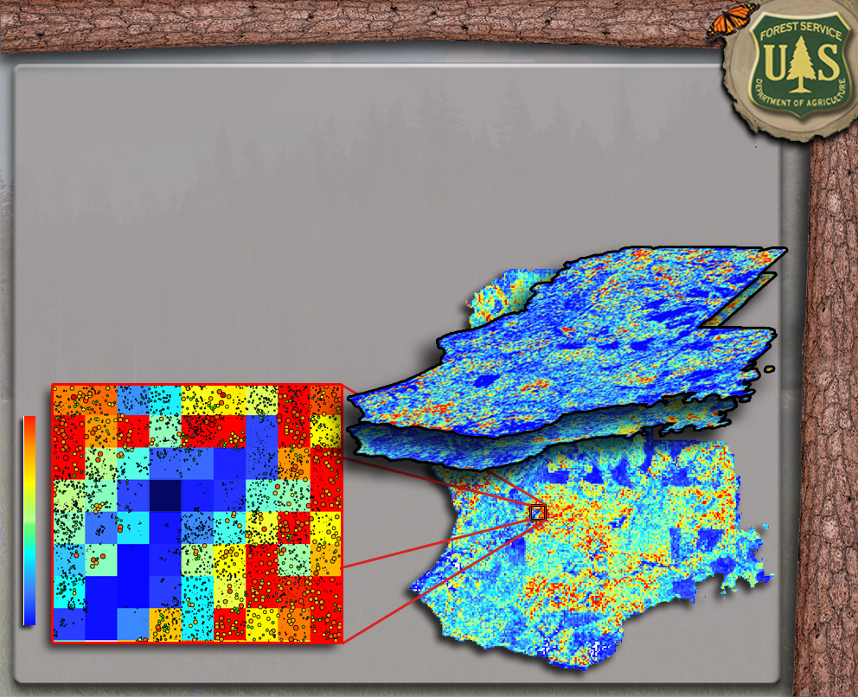
Individual-Tree Product Creation
TPA 5-10” DBH
Basal Area (sqft. acre⁻¹)

Slide 27
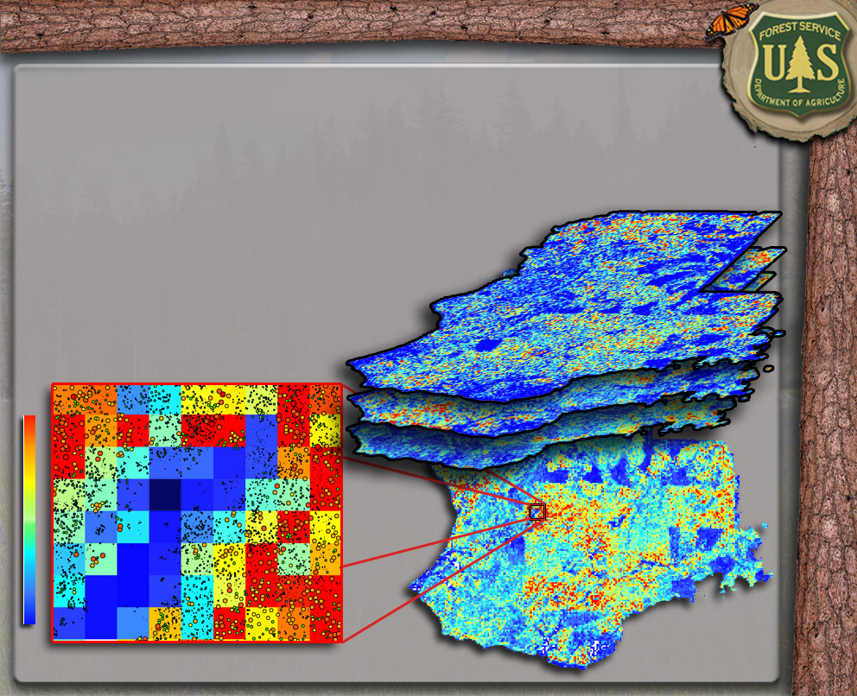
Individual-Tree Product Creation
TPA 10-15” DBH
Basal Area (sqft. acre⁻¹)

Slide 28
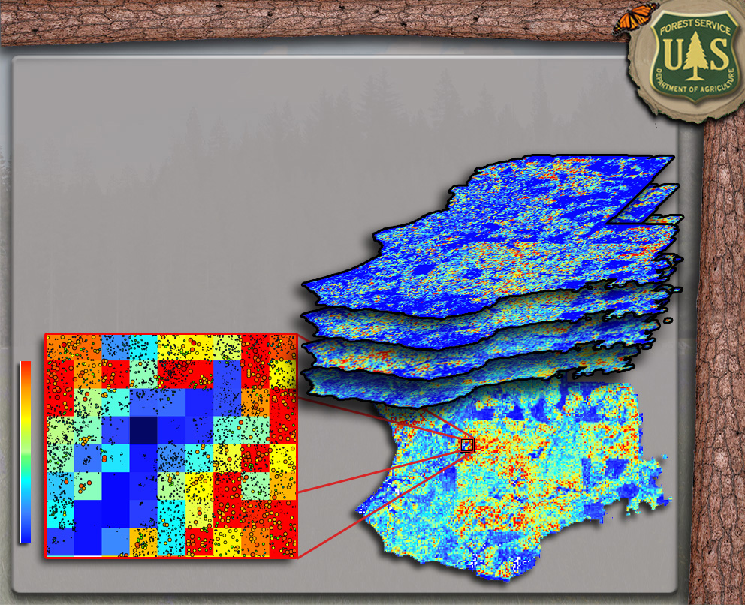
Individual-Tree Product Creation
TPA 15-20” DBH
Basal Area (sqft. acre⁻¹)

Slide 29
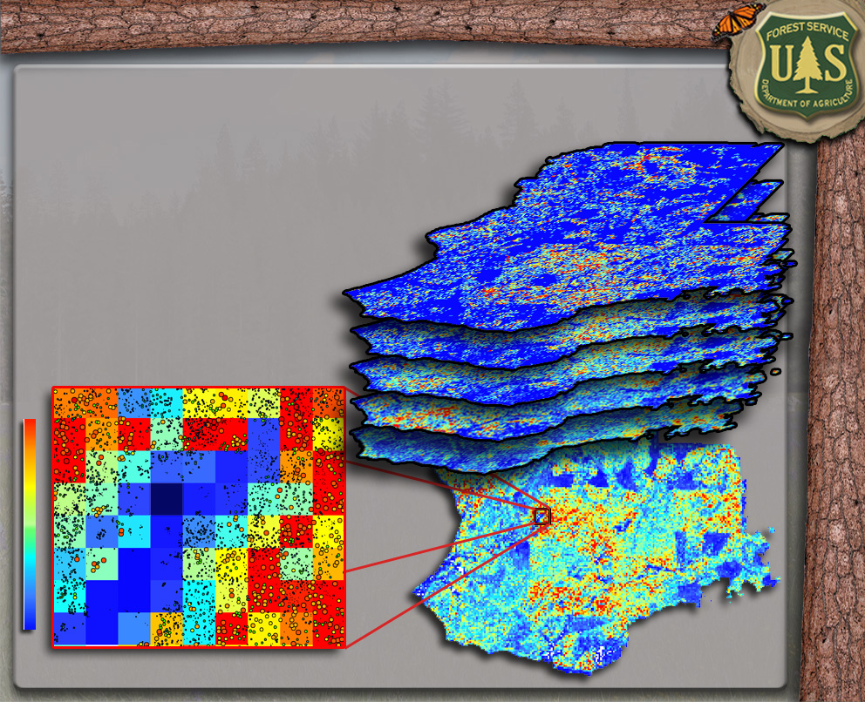
Individual-Tree Product Creation
TPA 20-30” DBH
Basal Area (sqft. acre⁻¹)

Slide 30
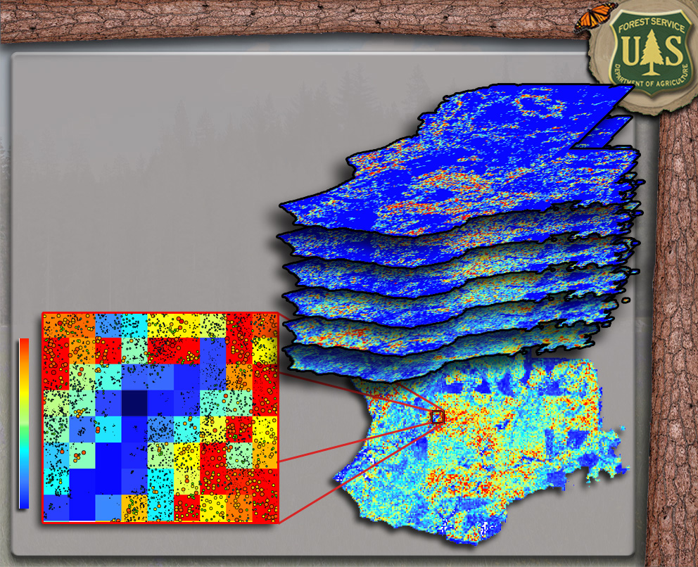
Individual-Tree Product Creation
TPA 30-40” DBH
Basal Area (sqft. acre⁻¹)

Slide 31
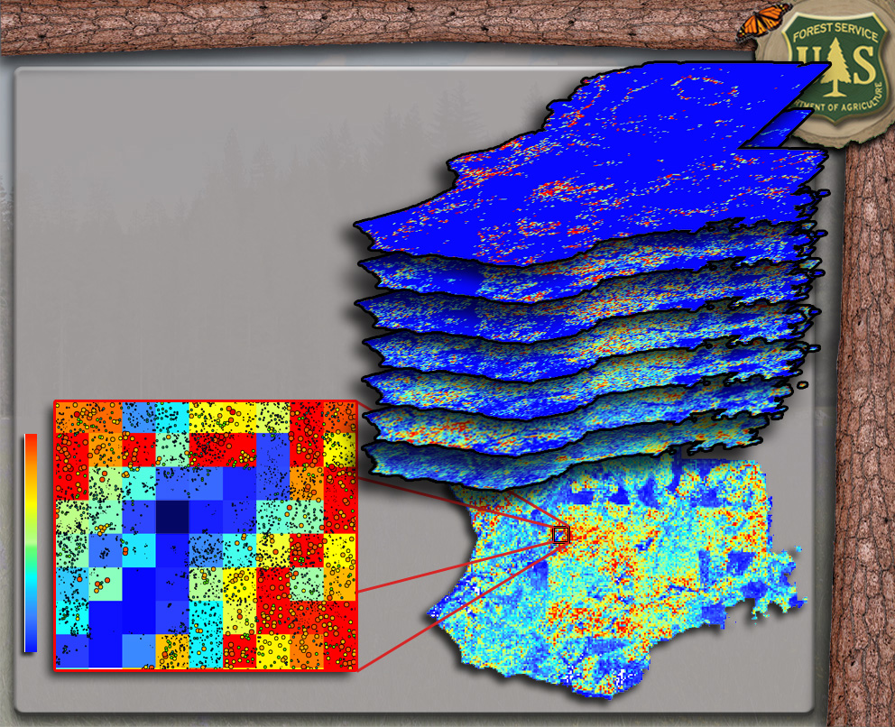
Individual-Tree Product Creation
TPA >=40” DBH
Basal Area (sqft. acre⁻¹)

Slide 32
Individual-Tree Product Uses
Stand Exam Optimization
Unit Boundaries
Primary Forest Inventory Data
Snag Detection & Density
Group Selection Optimization
Basal Area (sqft. acre⁻¹)

Slide 33
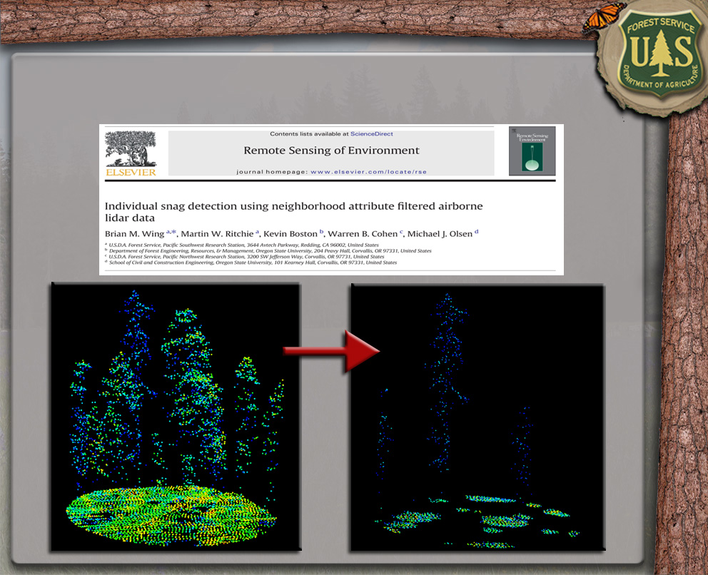
Individual Snag Detection

Slide 34
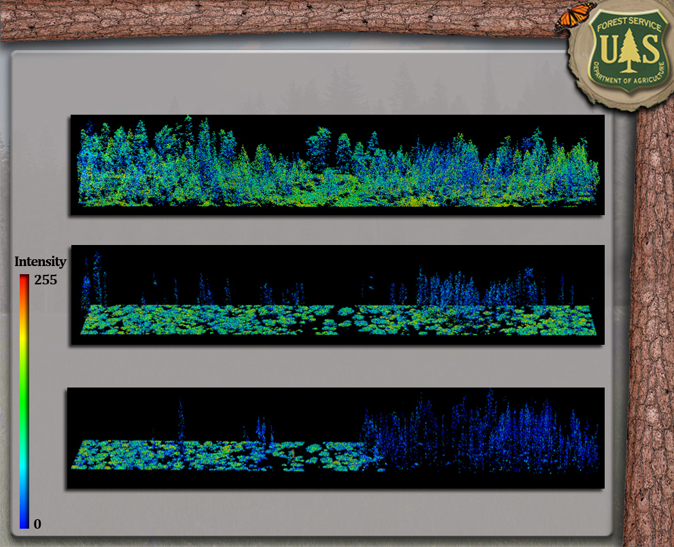
Individual Snag Detection
Pre-Fire
Pre-Fire Snags
Post-Fire Snags

Slide 35
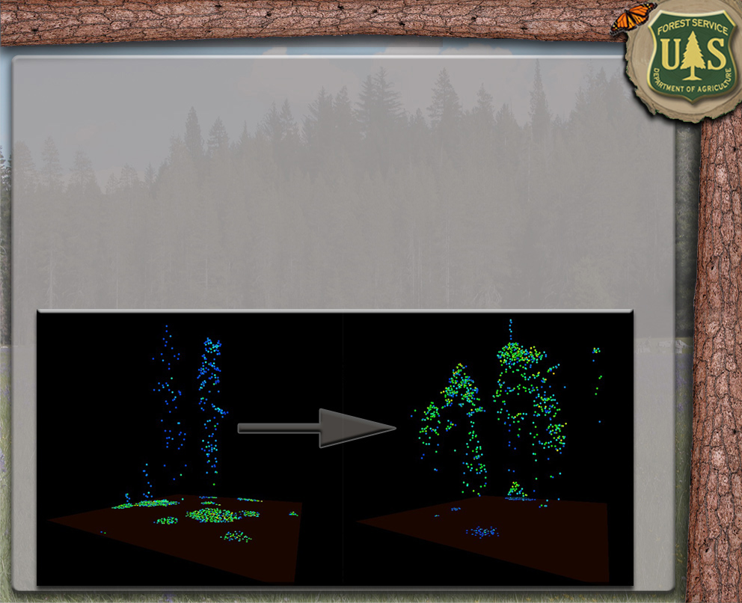
Individual Snag Detection
Attribute Filtered LiDAR Data Improves All LiDAR Analysis Techniques.

Slide 36
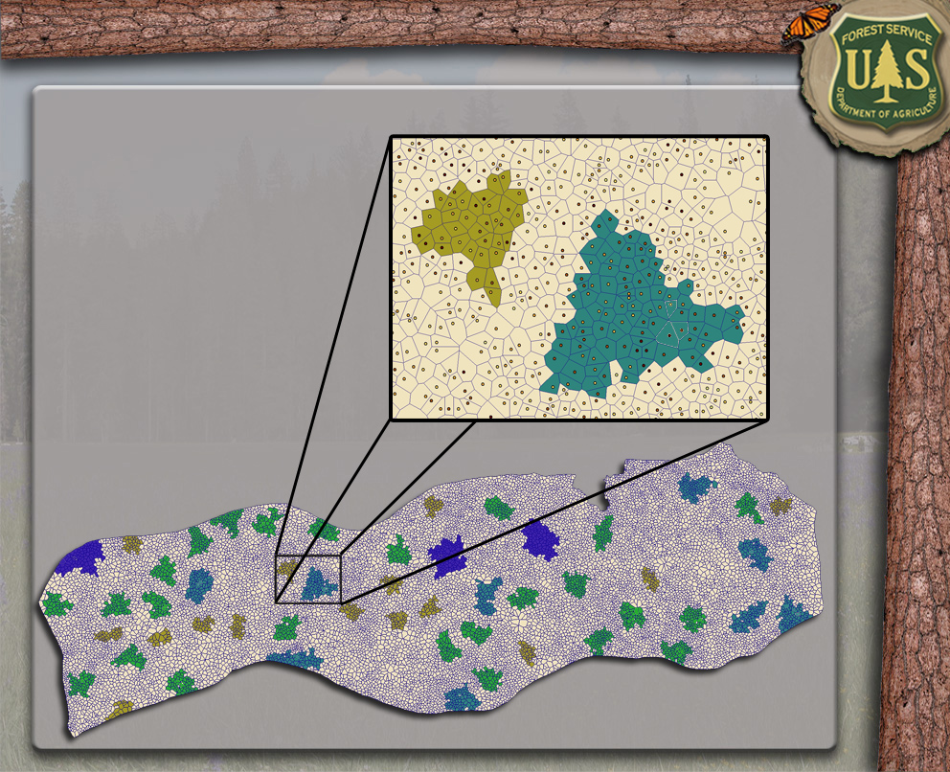
Group Selection Optimization

Slide 37
Presentation Outline
DEM Utilization
Individual-Tree Based Products
Creation & Utilization
Plot-Based Products
Creation & Utilization
Future Work

Slide 38

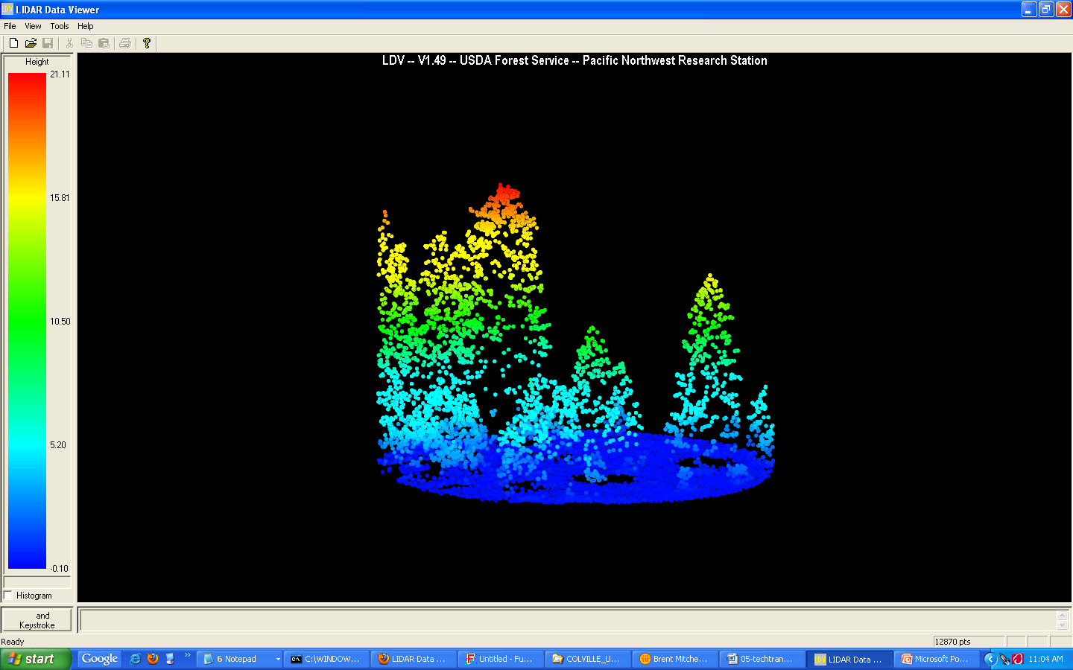
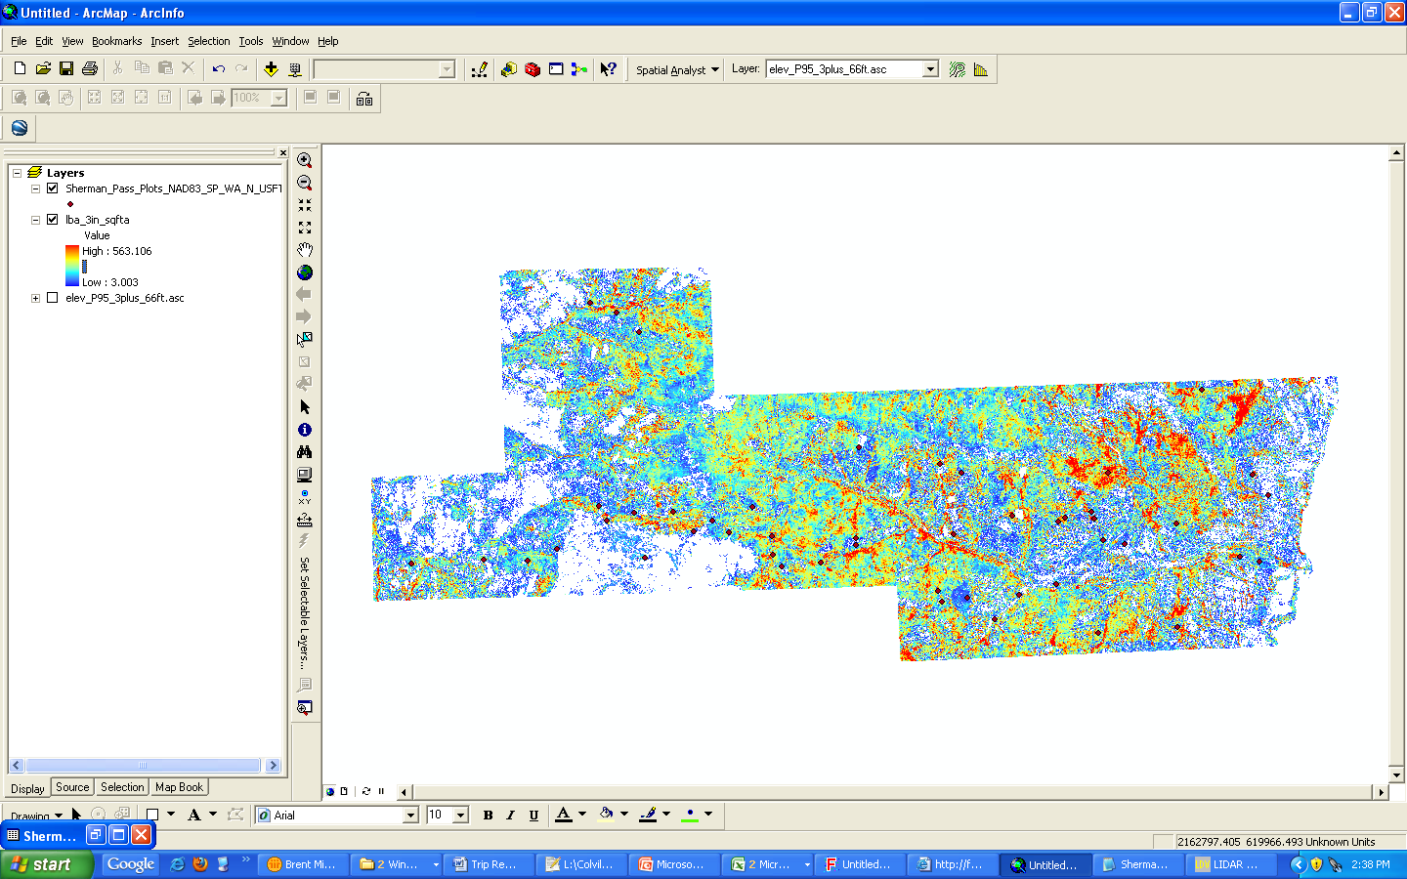
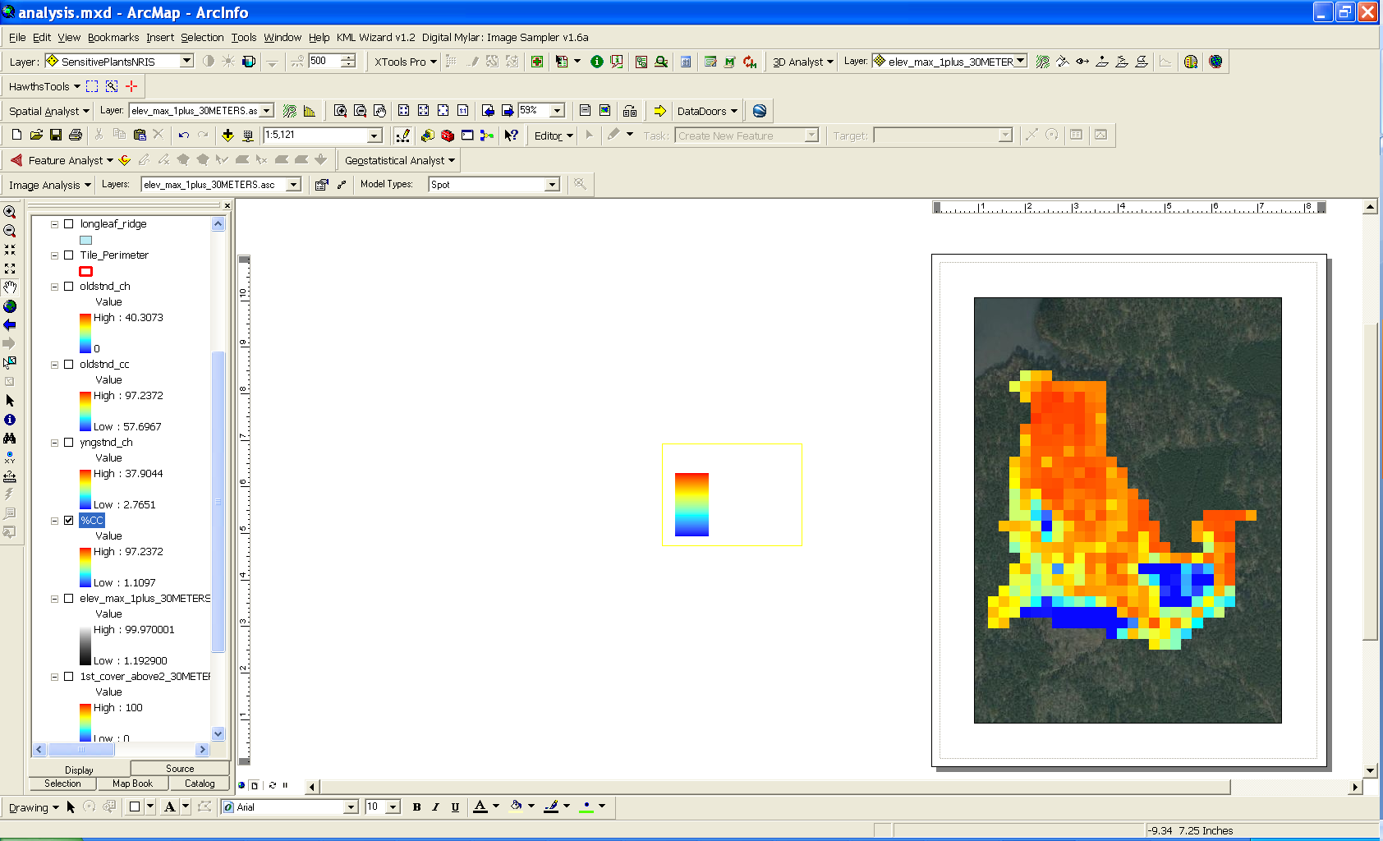
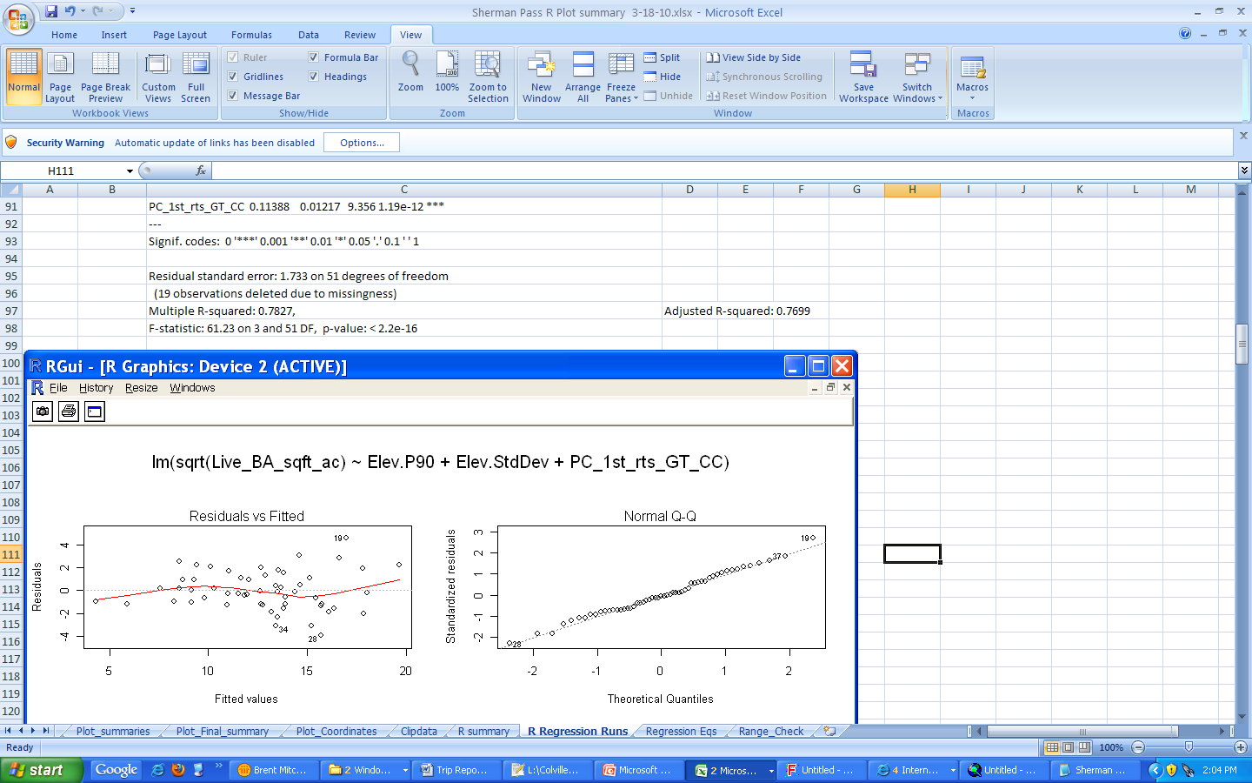
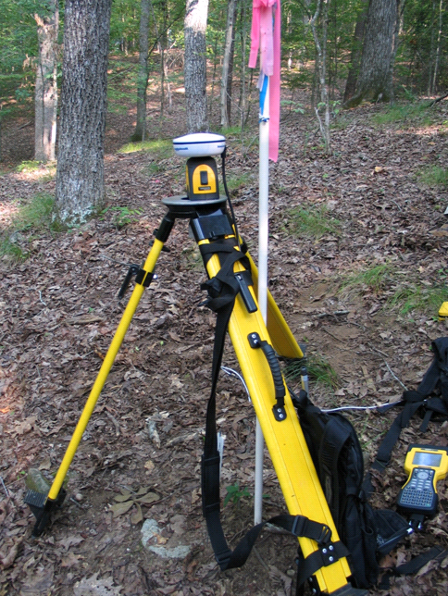
LIDAR + Field Data + Regression = Important Silviculture and Fuels Parameters
Develop Regression Equations
Build Inventory Models
Collect Data
Legend
Basal Area (SqFt/Acre)
High: 563
Low: 3
Build a statistical relationship between the LIDAR metrics (e.g. ht) and field plot parameters.
Use the statistical relationship to predict Forestry Inventory parameters across the entire lidar acquisition.
Field Plot
Measurement
Need accurate GPS
Notes:
Second order==While we can get some pretty amazing into from the lidar directly—other important information from lidar requires field data. Modeling Forest Inventory Parameters is possible with high pulse density lidar data (> 3 pulse/m^2). Not only will you need high density lidar data, but you will also have to collect associated field plots that follow an appropriate lidar field plot protocol (specific type of information recorded, fixed size (1/10th of an acre or bigger) and sub meter location accuracy) so that they are useful when creating relationships with the lidar data. Once all the field data is collected and summarized to a plot level and the correlating lidar data is subset based on the plot locations and summarized, a statistical relationship can be built between the field data and lidar metrics using linear regression. The relationship can then be applied to the entire lidar data set to predict the forest inventory parameters across the study area. It appears that the statistical relationship between the lidar data and field plots needs to be explored from scratch with each new project. This process takes a large amount of technical know how and is time consuming.

Slide 39
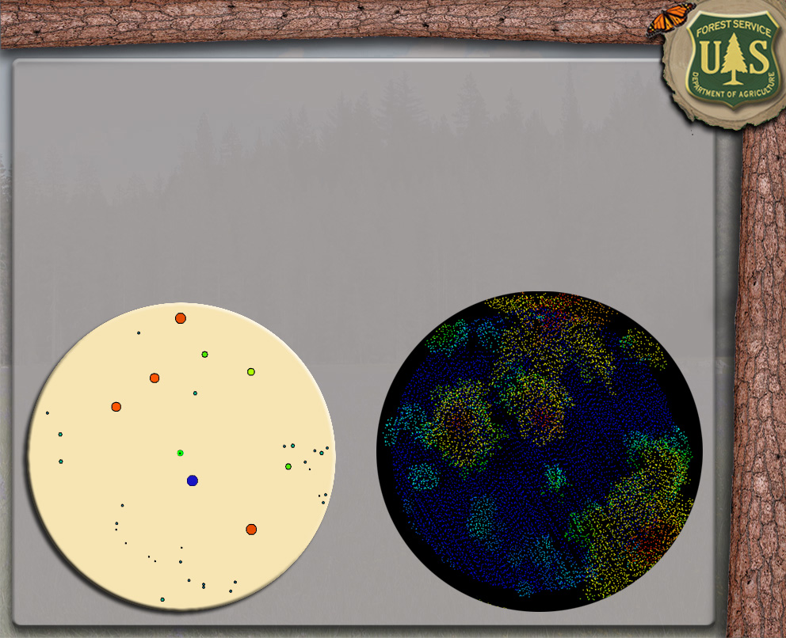
Plot-Based Product Creation Steps
Collect LiDAR-Oriented Field Data
Extract Normalized LiDAR Plot Point Clouds
Derive Plot-Level LiDAR Metrics
Develop Regression Models (LiDAR Metrics vs. Field Data)
Apply Models to Entire LiDAR Acquisition (Rasters)

Slide 40
Plot-Based Product Creation Steps
Collect LiDAR-Oriented Field Data
Extract Normalized LiDAR Plot Point Clouds
Derive Plot-Level LiDAR Metrics
Develop Regression Models (LiDAR Metrics vs. Field Data)
Apply Models to Entire LiDAR Acquisition (Rasters)

Slide 41
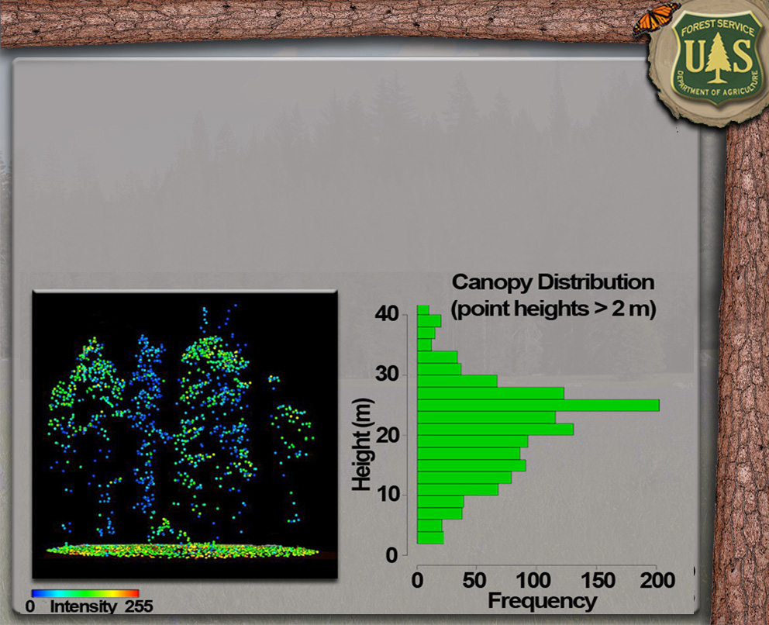
Plot-Based Product Creation Steps
Collect LiDAR-Oriented Field Data
Extract Normalized LiDAR Plot Point Clouds
Derive Plot-Level LiDAR Metrics
Develop Regression Models (LiDAR Metrics vs. Field Data)
Apply Models to Entire LiDAR Acquisition (Rasters)

Slide 42
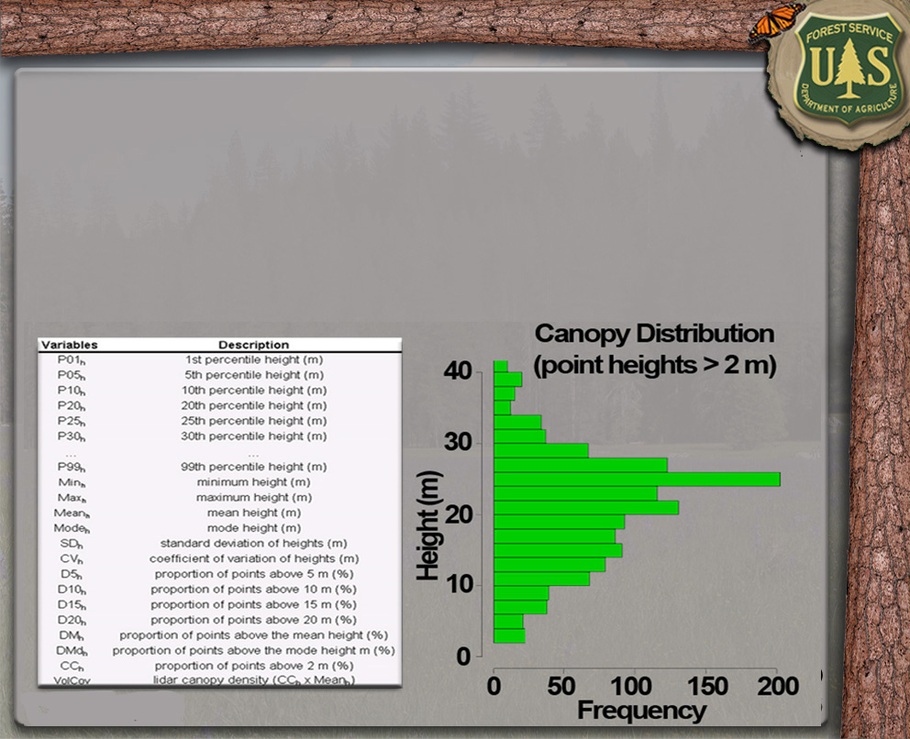
Plot-Based Product Creation Steps
Collect LiDAR-Oriented Field Data
Extract Normalized LiDAR Plot Point Clouds
Derive Plot-Level LiDAR Metrics
Develop Regression Models (LiDAR Metrics vs. Field Data)
Apply Models to Entire LiDAR Acquisition (Rasters)

Slide 43
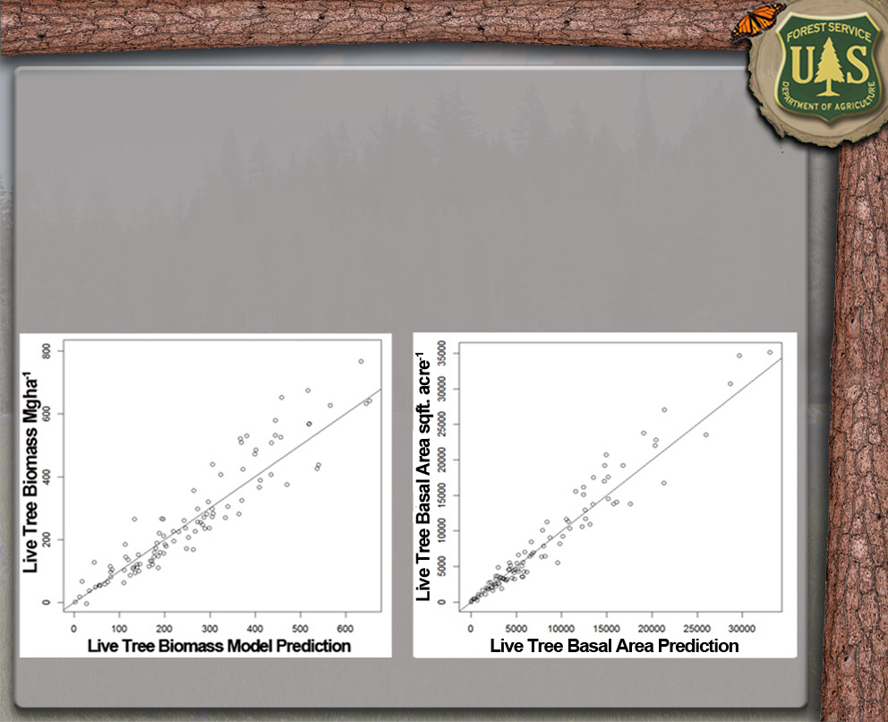
Plot-Based Product Creation Steps
Collect LiDAR-Oriented Field Data
Extract Normalized LiDAR Plot Point Clouds
Derive Plot-Level LiDAR Metrics
Develop Regression Models (LiDAR Metrics vs. Field Data)
Apply Models to Entire LiDAR Acquisition (Rasters)

Slide 44
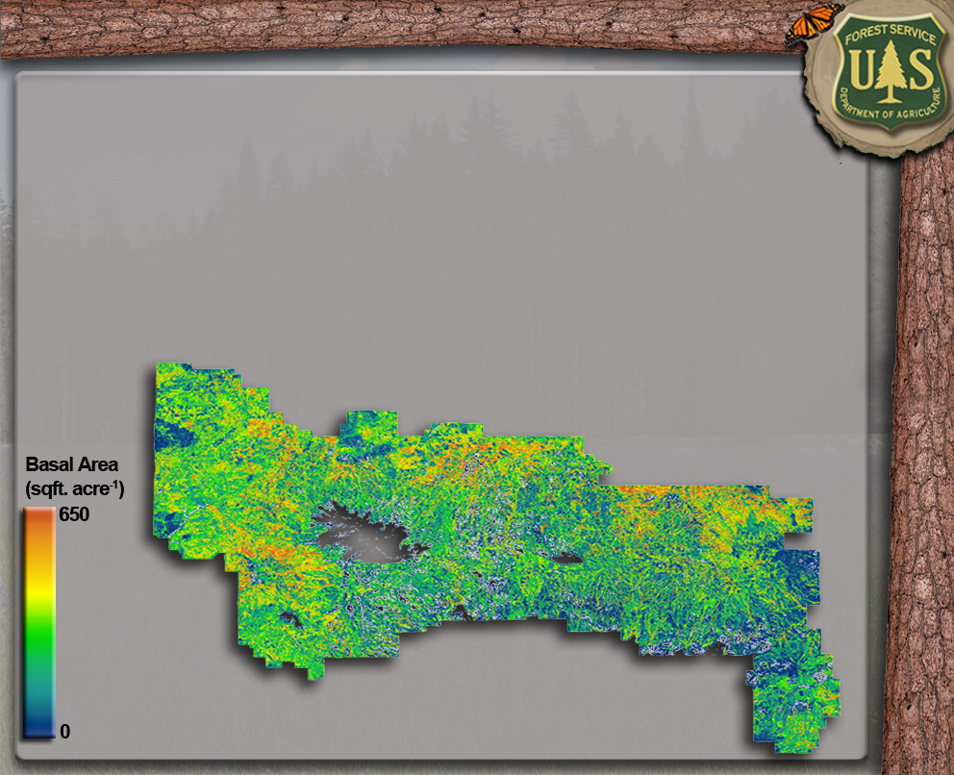
Plot-Based Product Creation Steps
Collect LiDAR-Oriented Field Data
Extract Normalized LiDAR Plot Point Clouds
Derive Plot-Level LiDAR Metrics
Develop Regression Models (LiDAR Metrics vs. Field Data)
Apply Models to Entire LiDAR Acquisition (Rasters)

Slide 45
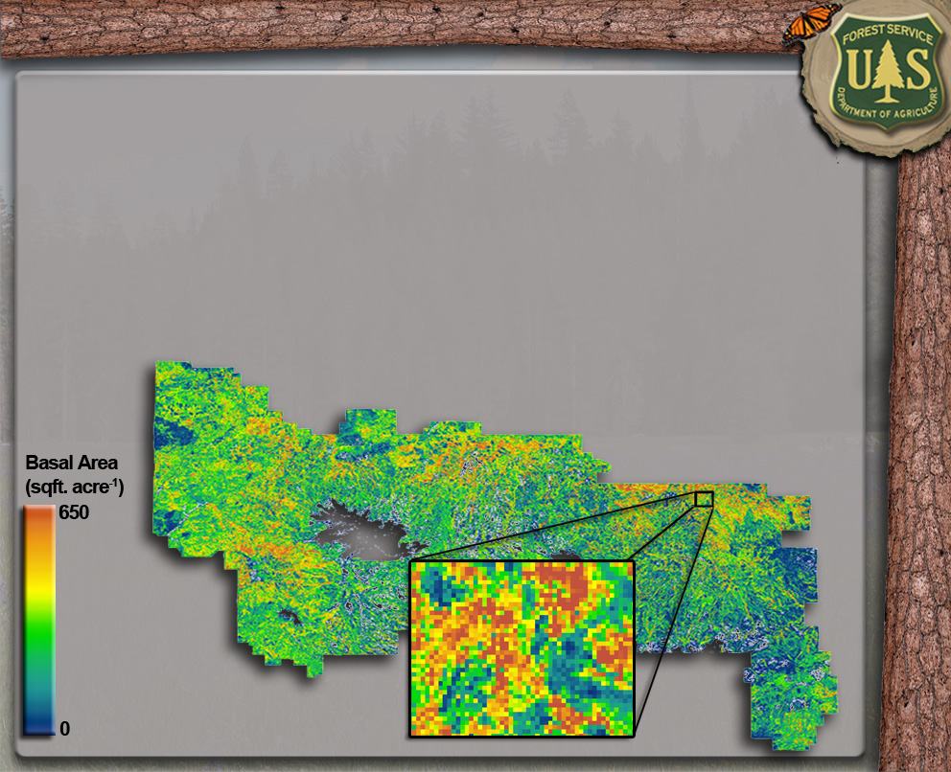
Plot-Based Product Creation Steps
Collect LiDAR-Oriented Field Data
Extract Normalized LiDAR Plot Point Clouds
Derive Plot-Level LiDAR Metrics
Develop Regression Models (LiDAR Metrics vs. Field Data)
Apply Models to Entire LiDAR Acquisition (Rasters)

Slide 46
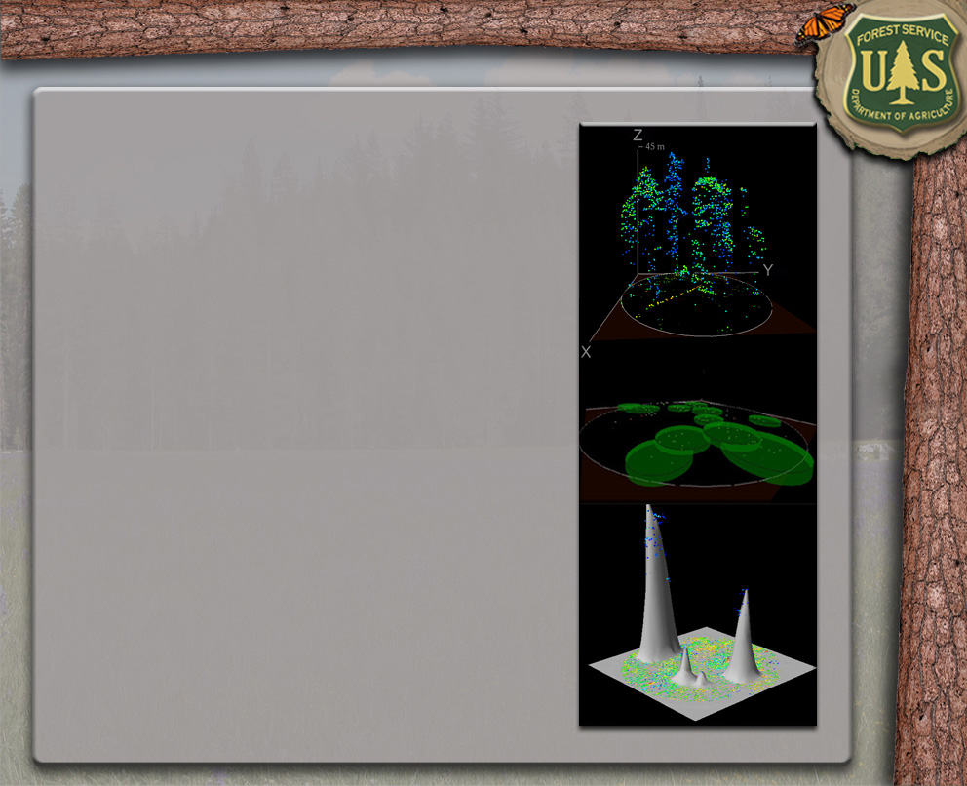
Current Products
BA (sqft. acre⁻¹) ± 10.6%
Stand Density Index
± 12.9%
Volume (cuft & bdft)
± 7.5%
Biomass (Mgha)
± 10.2%
Canopy Cover (%)
± 7%
QMD (in.)
± 11.9%
Max Tree Height (ft.)
± ~3 feet

Slide 47
Current Products
Understory Cover (%)
± 15%
Goshawk Habitat (VSS Classes)
Cover by Height Strata
Crown Bulk Density
Canopy Fuel Weight
Canopy Base Height

Slide 48
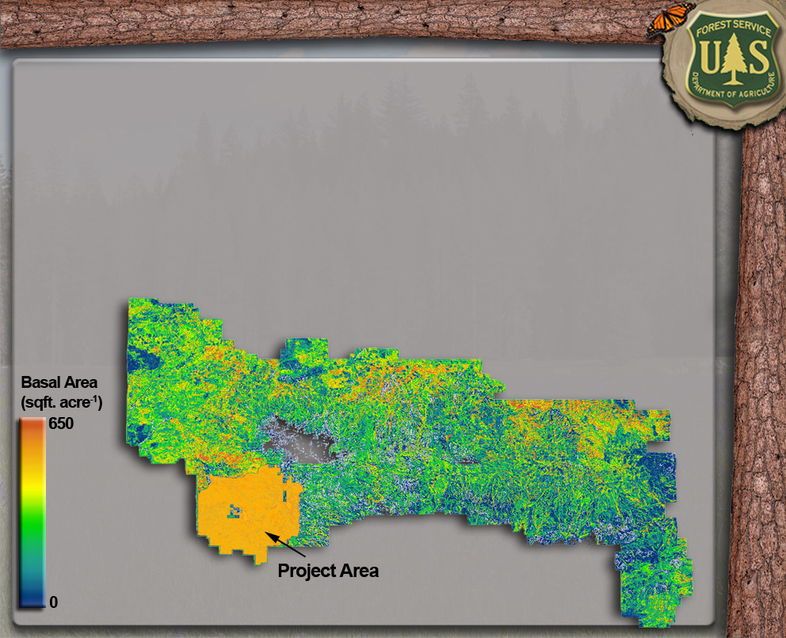
Plot-Based Product Utilization

Slide 49
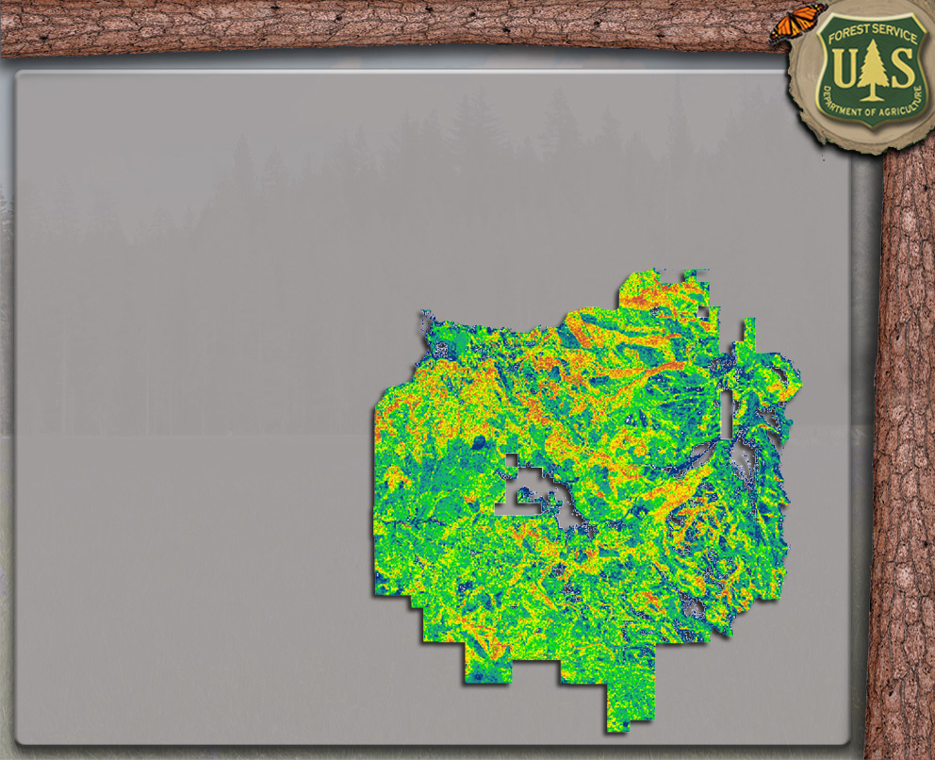
Plot-Based Product Utilization
Basal Area (sqft. acre⁻¹)

Slide 50

Plot-Based Product Utilization
Volume (bdft.)

Slide 51

Plot-Based Product Utilization
Stand Density Index

Slide 52

Plot-Based Product Utilization
Goshawk Habitat (VSS Classes)

Slide 53

Plot-Based Product Utilization
Understory Cover (%)

Slide 54

Plot-Based Product Utilization
Canopy Cover (%)

Slide 55

Plot-Based Product Utilization
Canopy Cover (%)

Slide 56

Plot-Based Product Utilization

Slide 57


Plot-Based Product Utilization

Slide 58

Plot-Based Product Utilization

Slide 59

Plot-Based Product Utilization

Slide 60

Plot-Based Product Utilization

Slide 61

Plot-Based Product Utilization
Understory Vegetation

Slide 62

Plot-Based Product Utilization
CWD Presence

Slide 63

Plot-Based Product Utilization
Snag Density

Slide 64
Presentation Outline
DEM Utilization
Individual-Tree Based Products
Creation & Utilization
Plot-Based Products
Creation & Utilization
Future Work

Slide 65
Future Work
TPA (by size class & species)
Local FVS Tree Lists
Structure Classification
Growth & Yield, Change
Late Seral ID & Potential
Snag Density & Stem Mapping
CWD (presence / absence)
Understory Veg. Cover
Wildlife Habitat Classification, Availability & Potential
Fire Severity Risk
Disease / Insect ID & Risk

Slide 66


