Slide 2



Special Habitat Mapping in Northwestern Oregon
Cory Langhoff
Northwest Habitat Institute
Corvallis, Oregon – www.nwhi.org

Slide 3
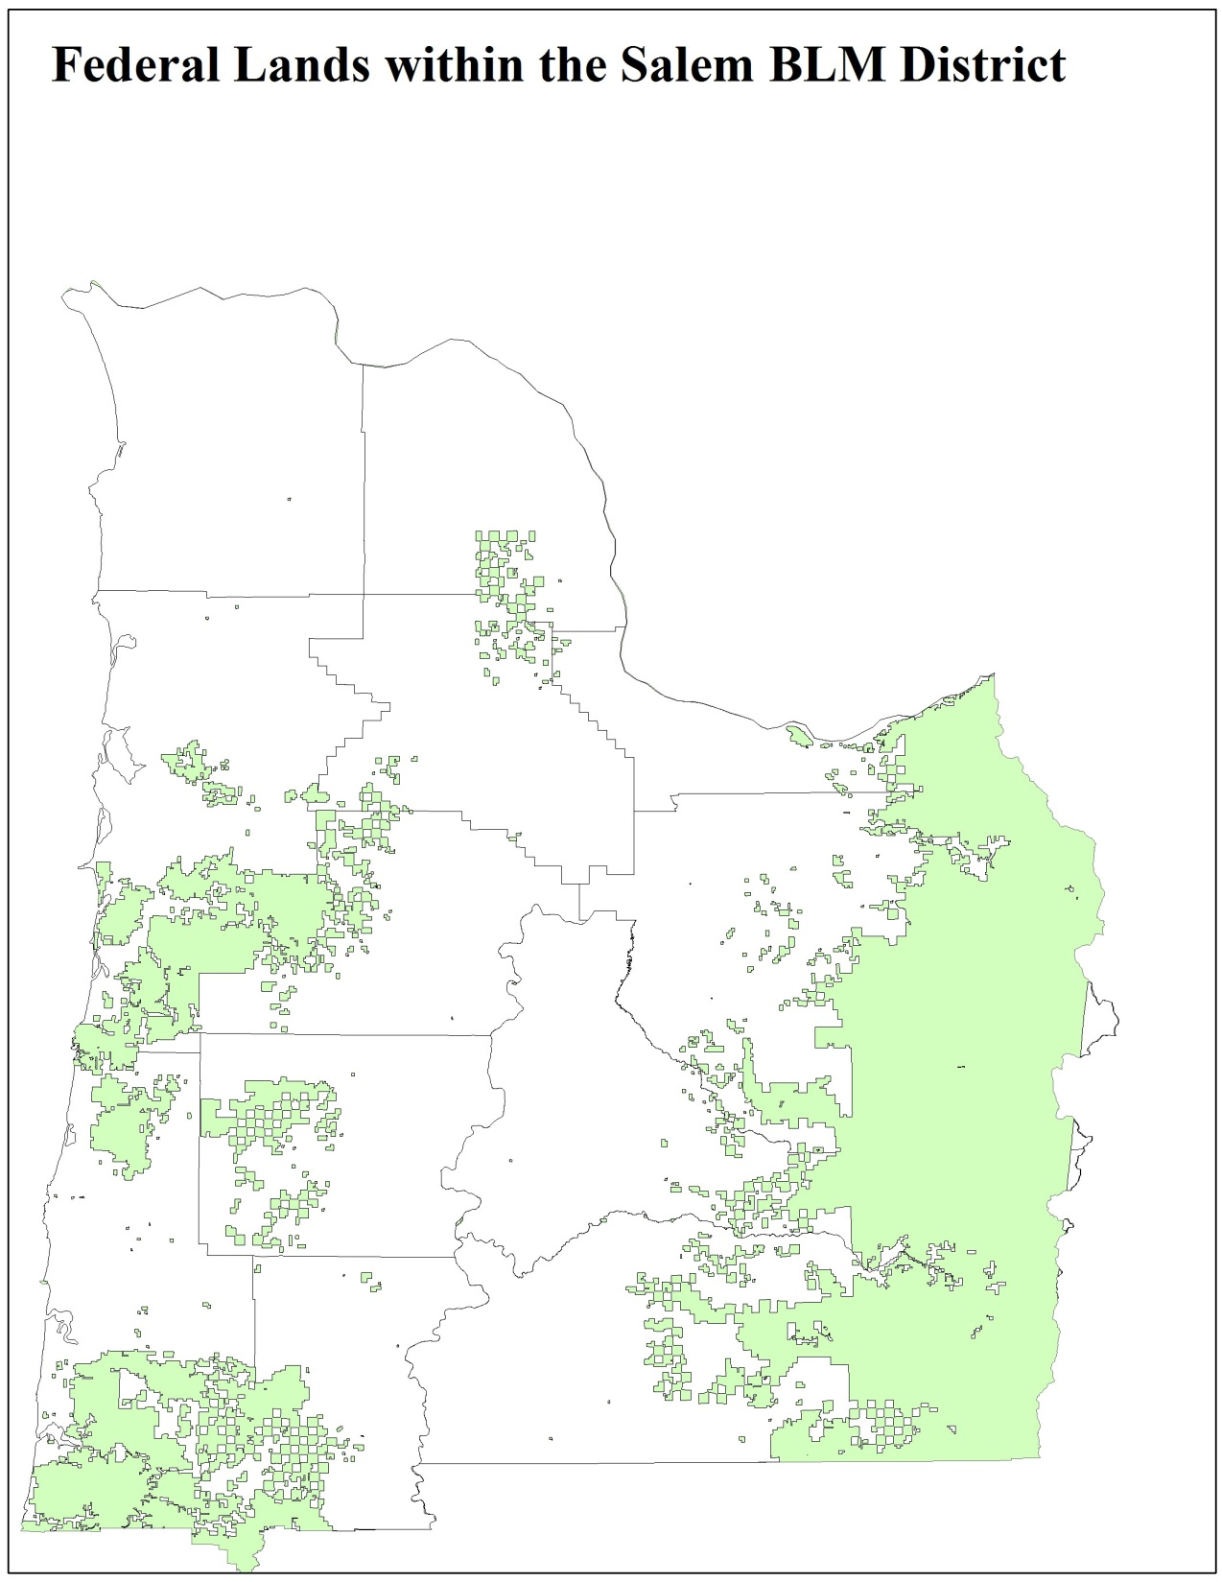

Slide 4
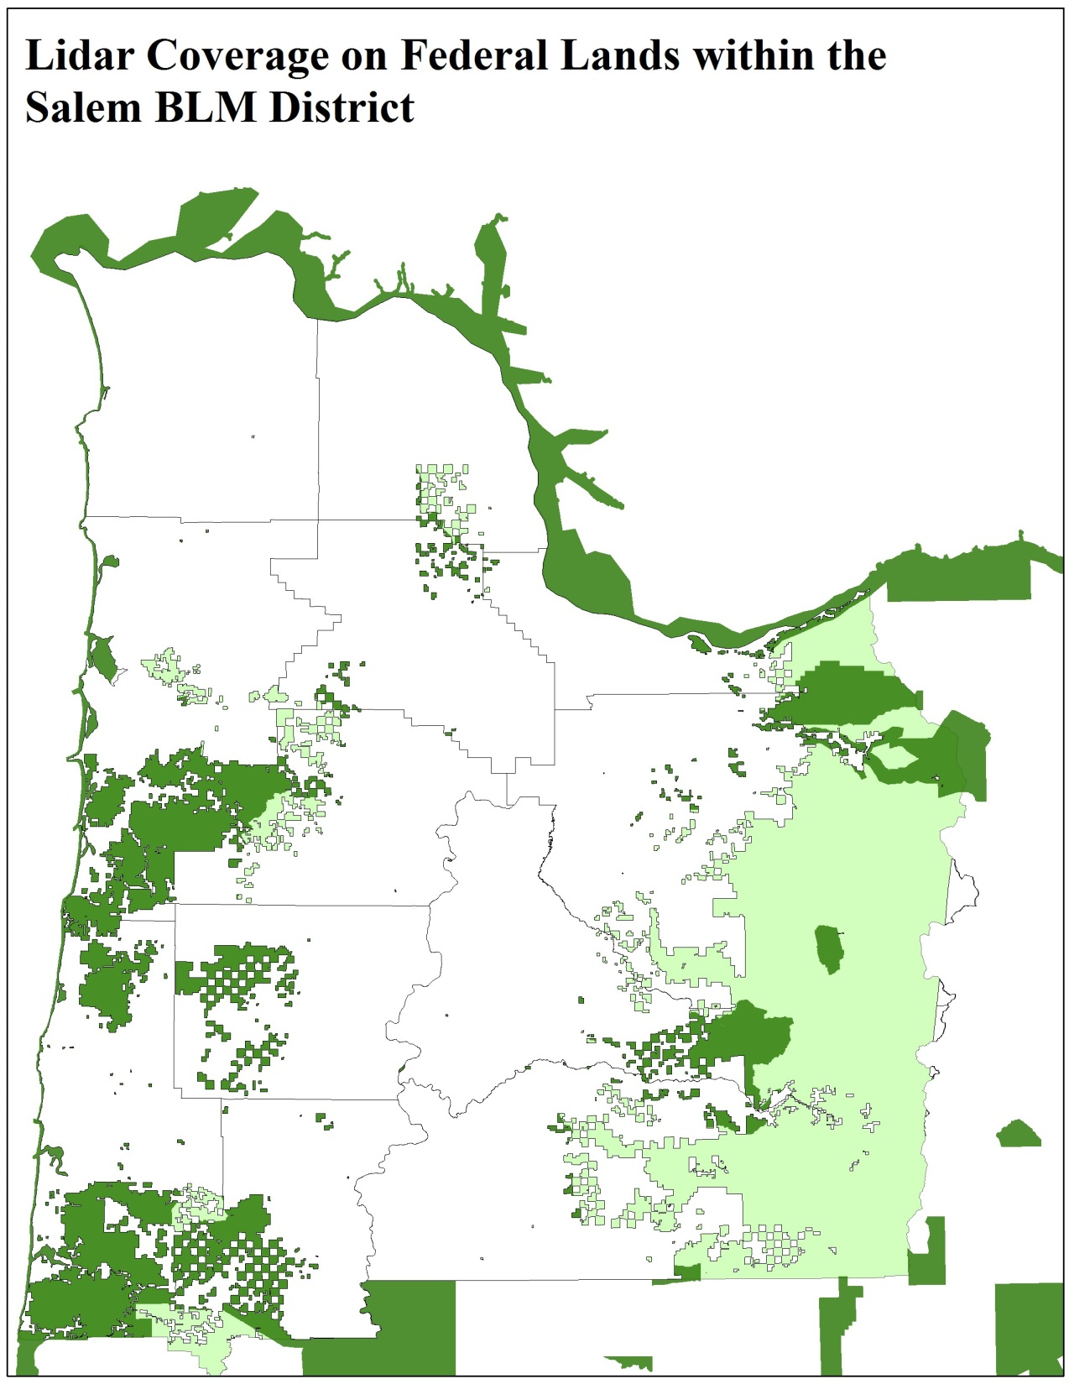

Slide 5
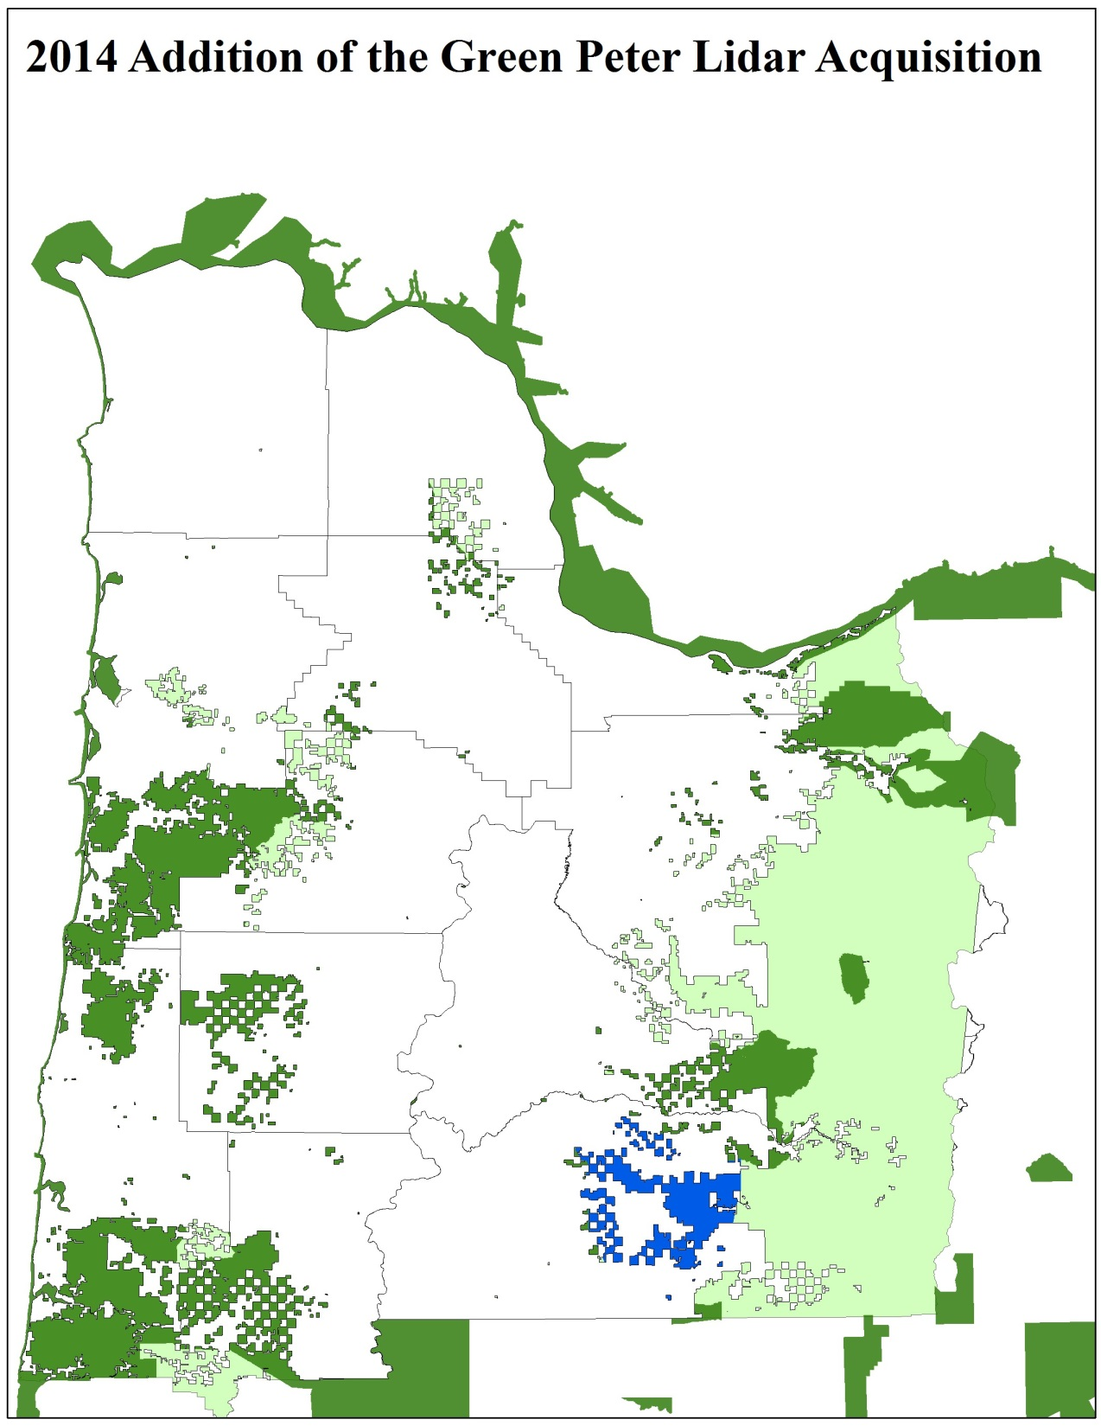

Slide 6
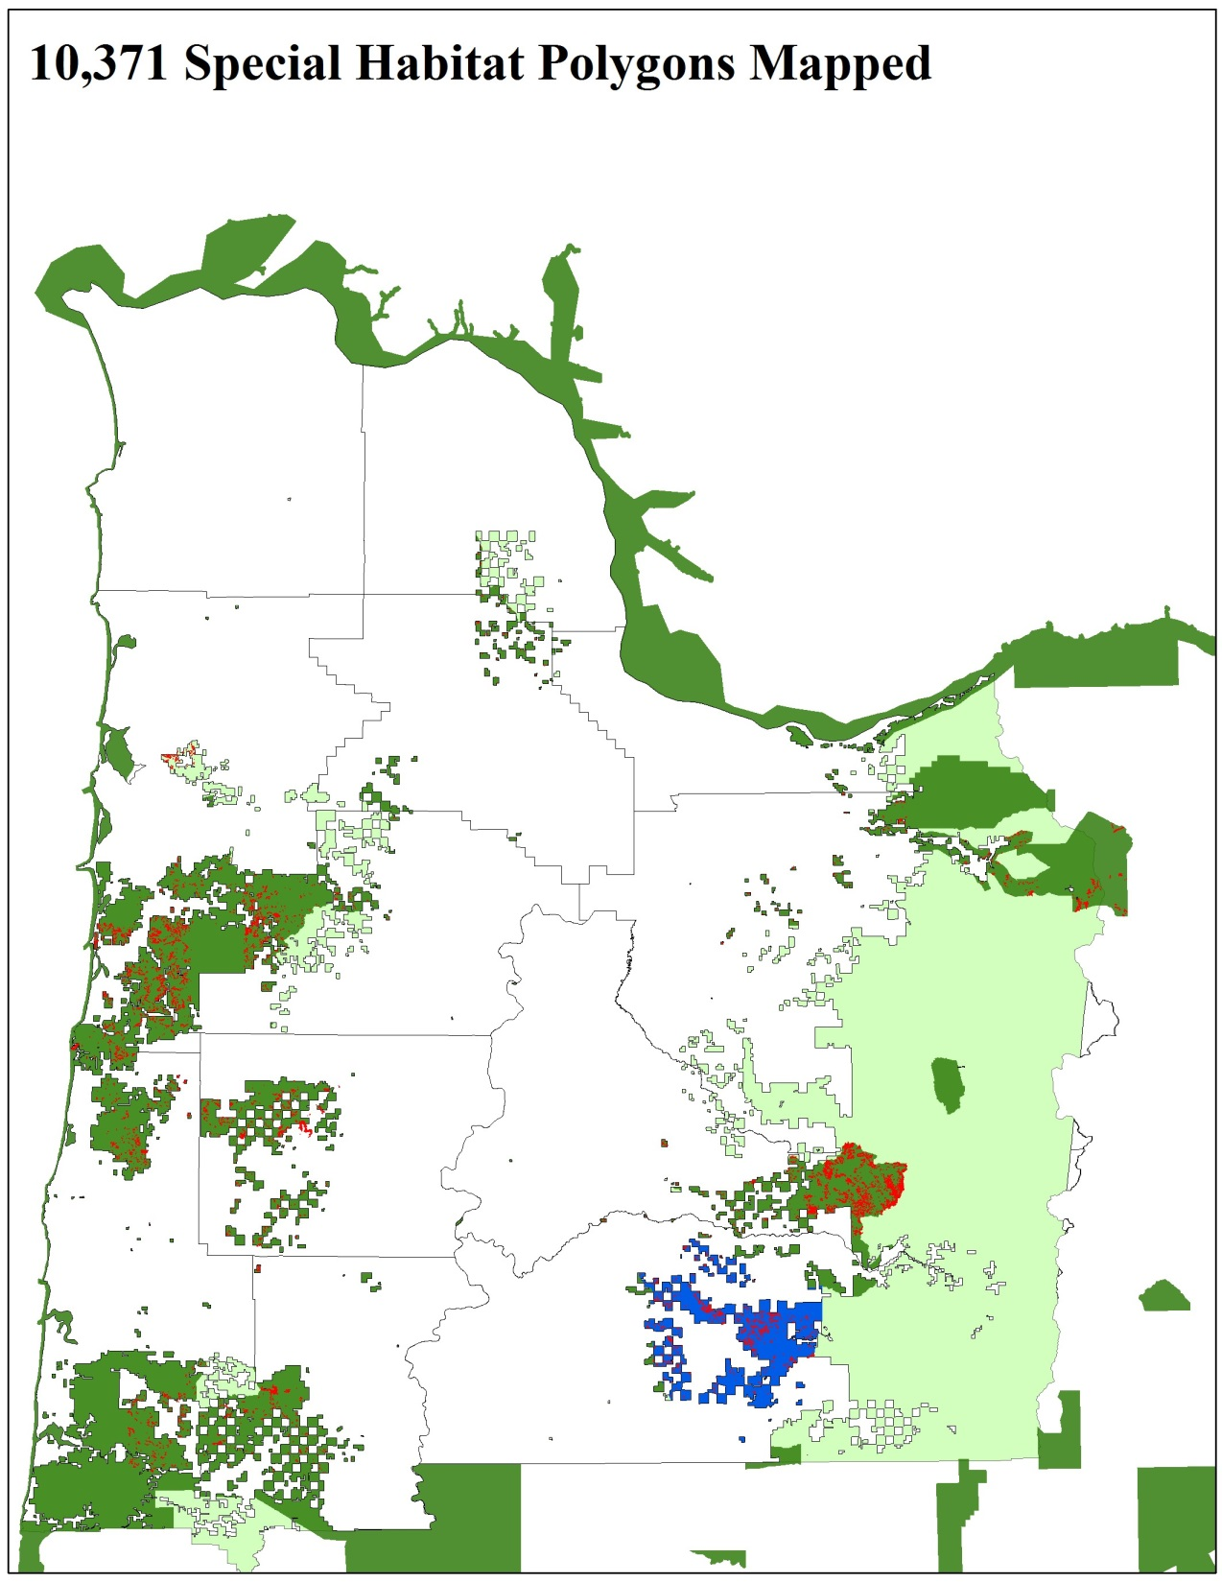

Slide 7
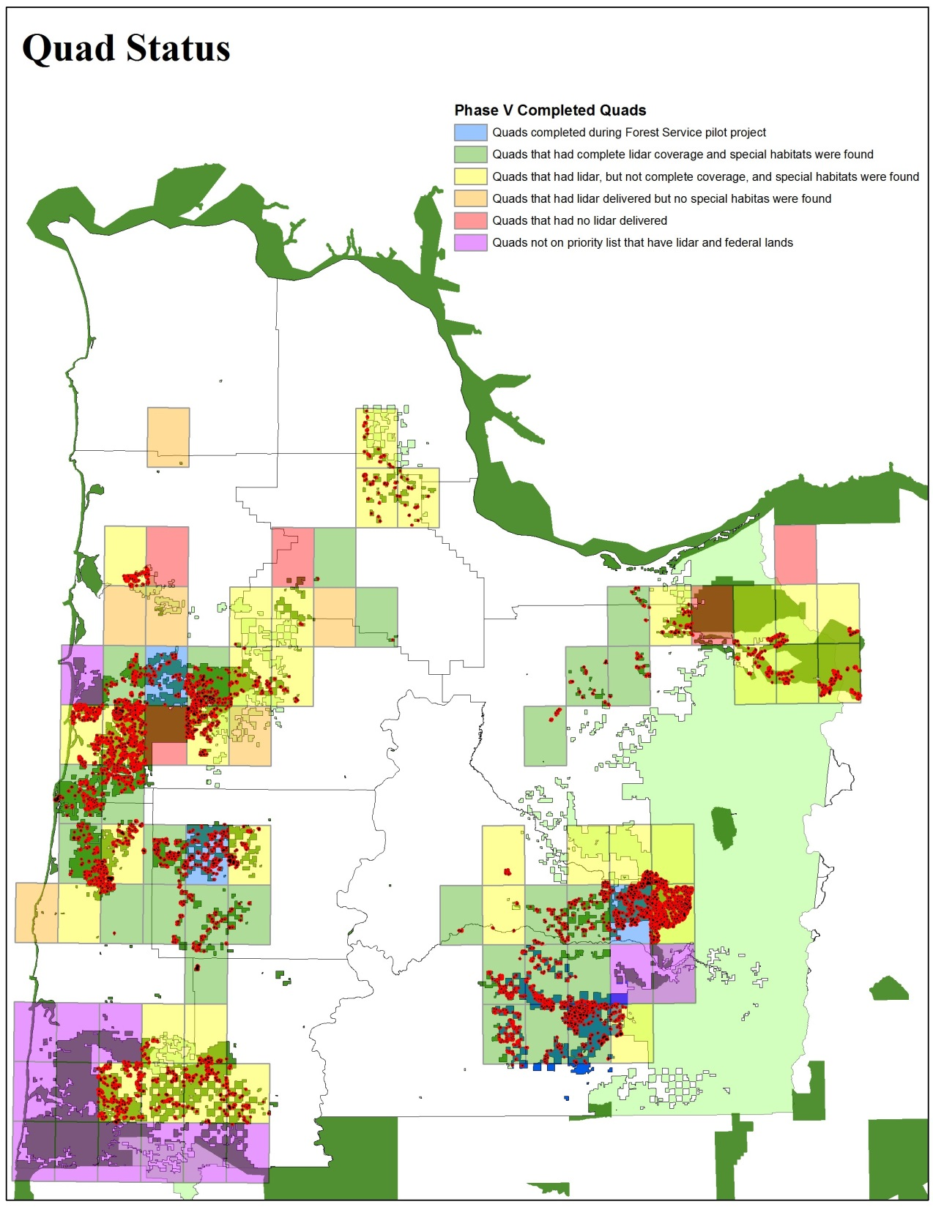

Slide 8
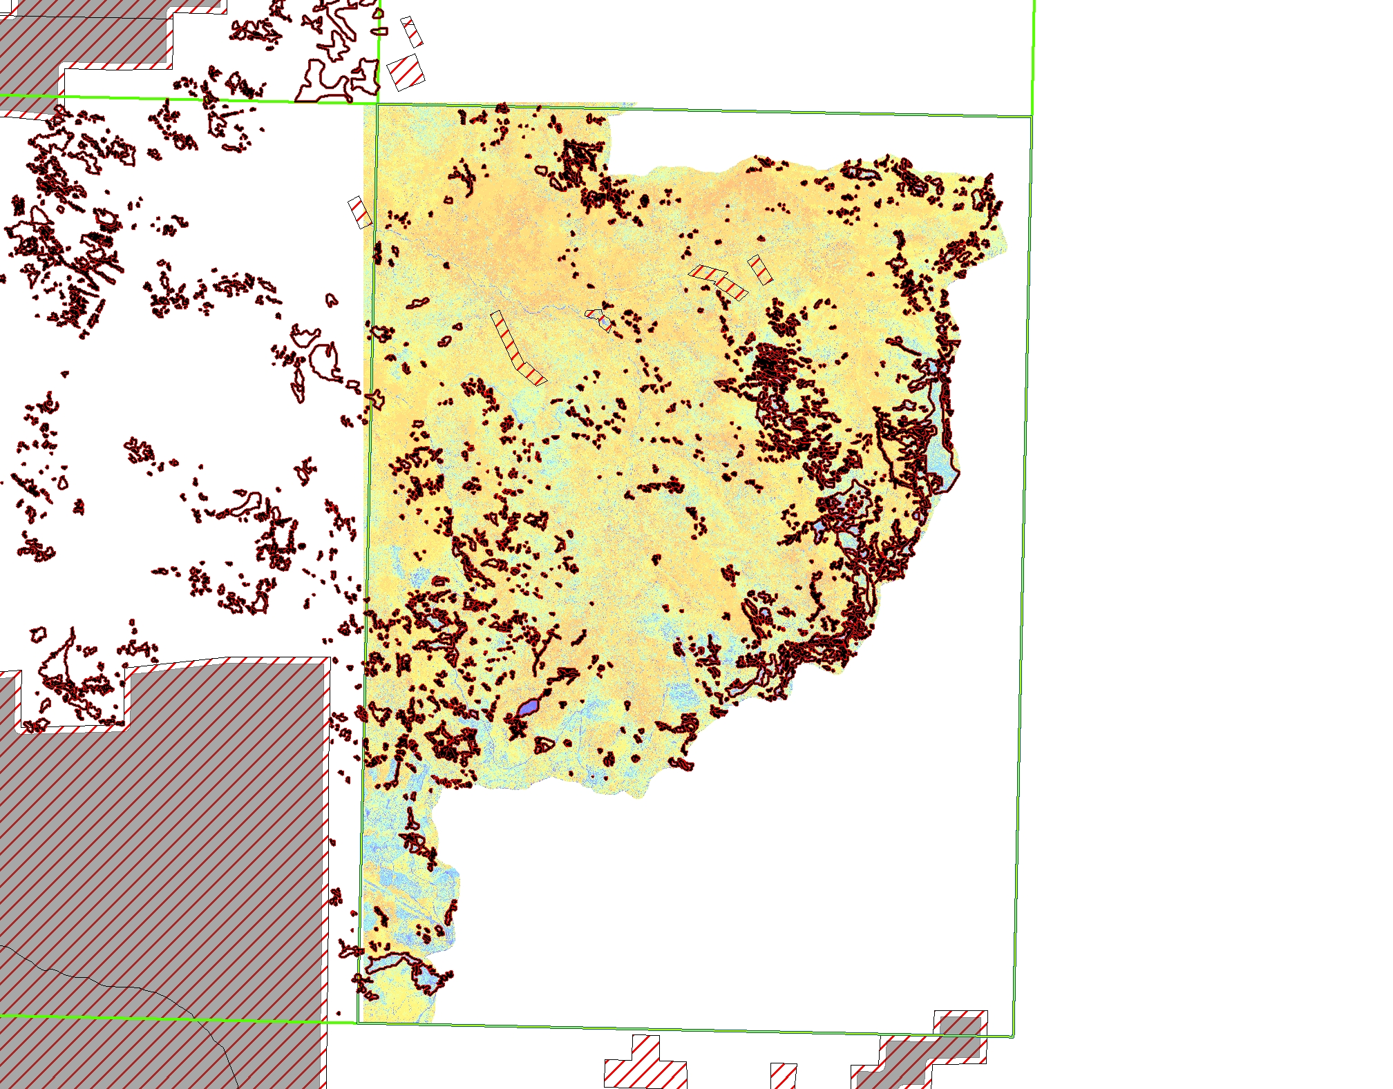
Battle Ax Quad – 44122g2
-1718 Polygons Mapped
-Very Complex

Slide 9
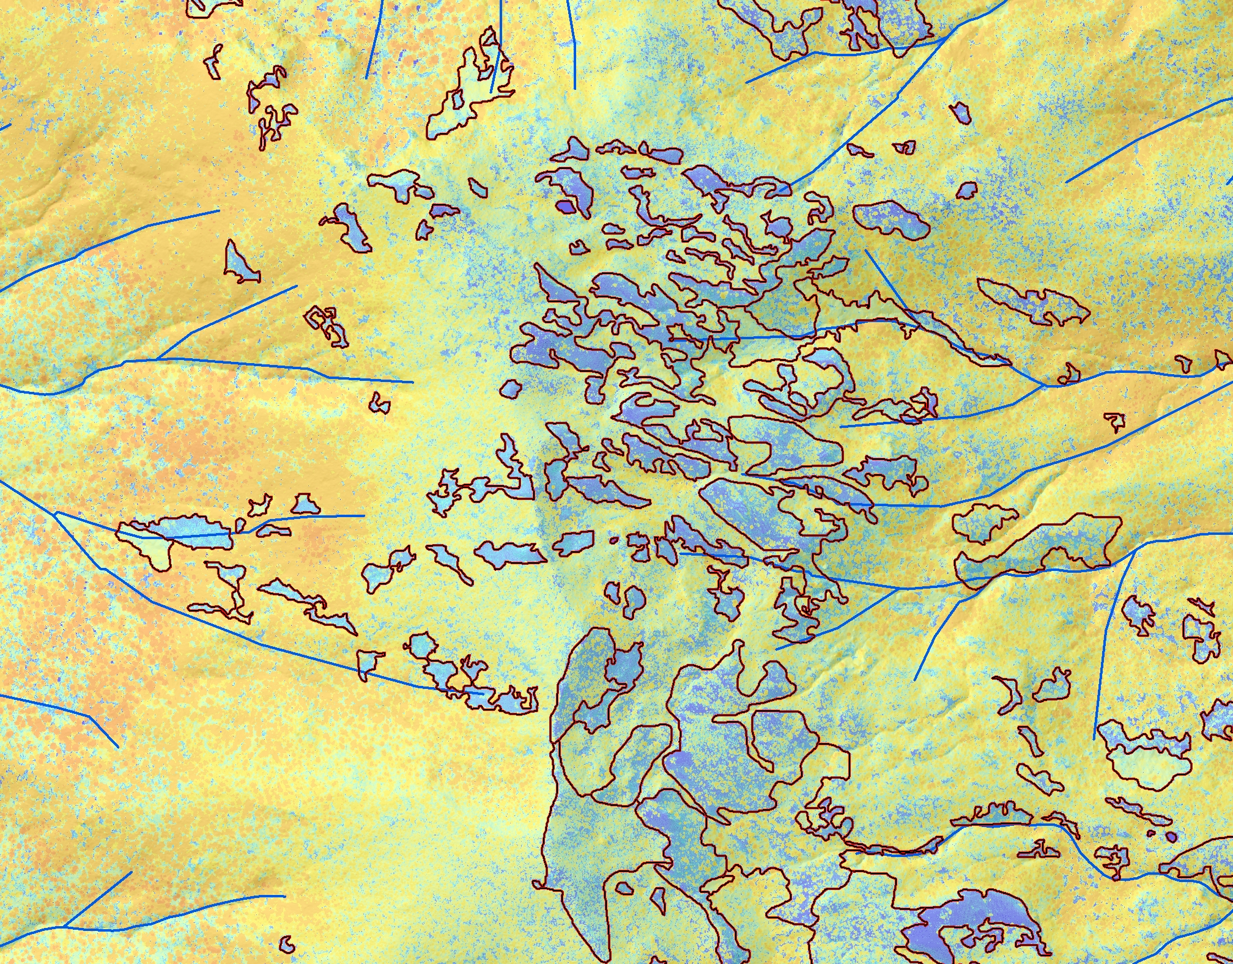
Vegetation Height

Slide 10
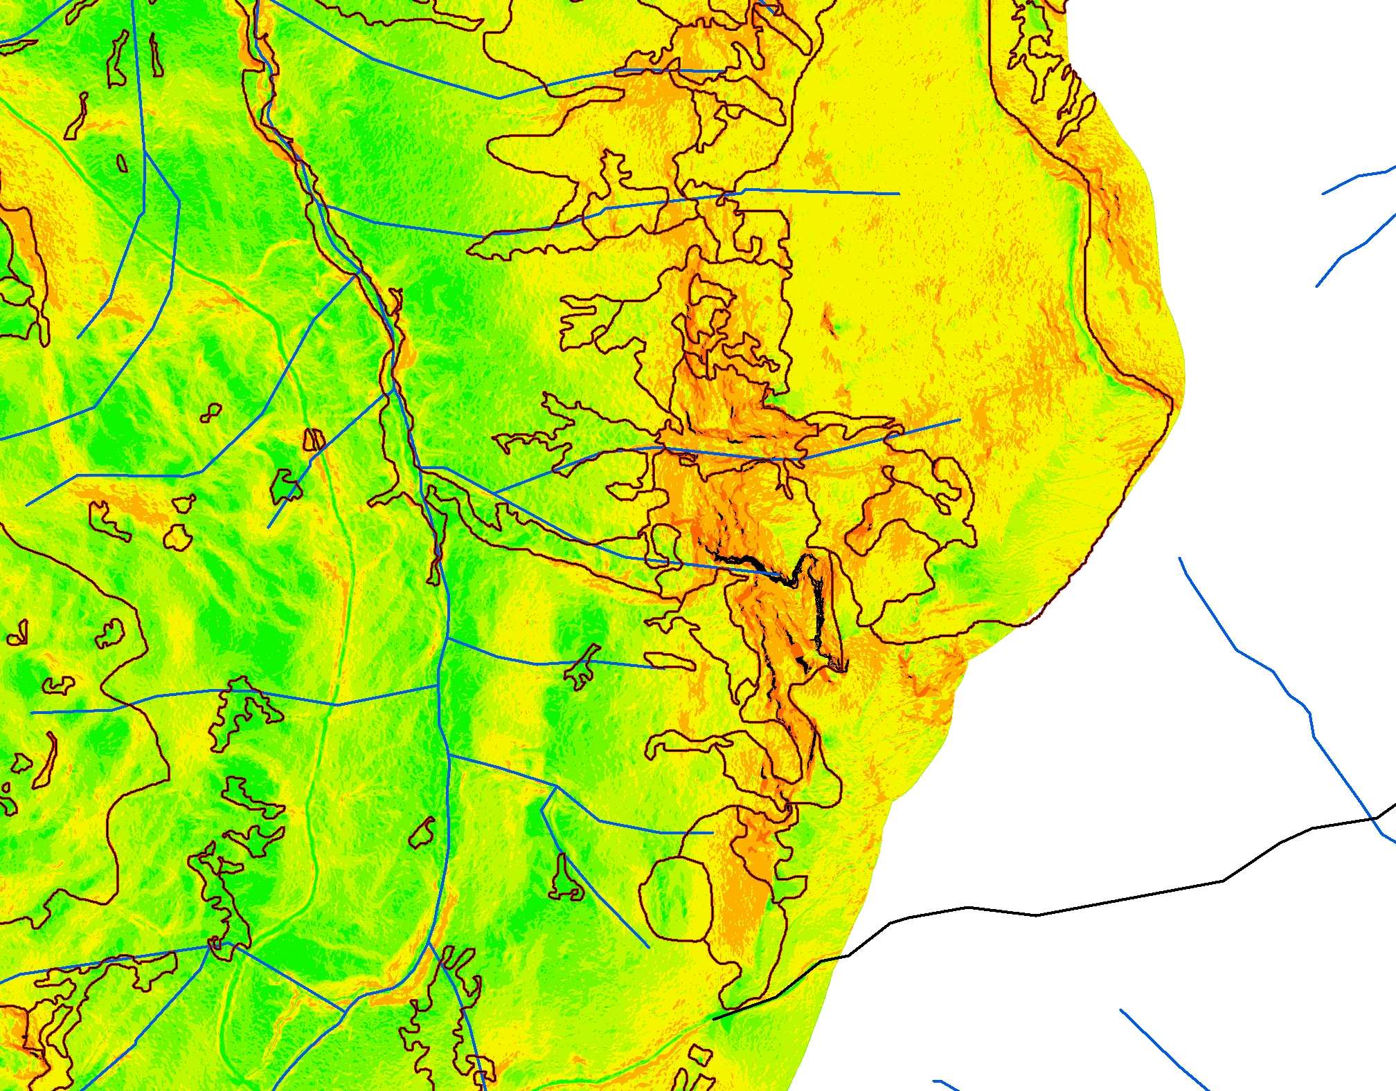
Slope

Slide 11
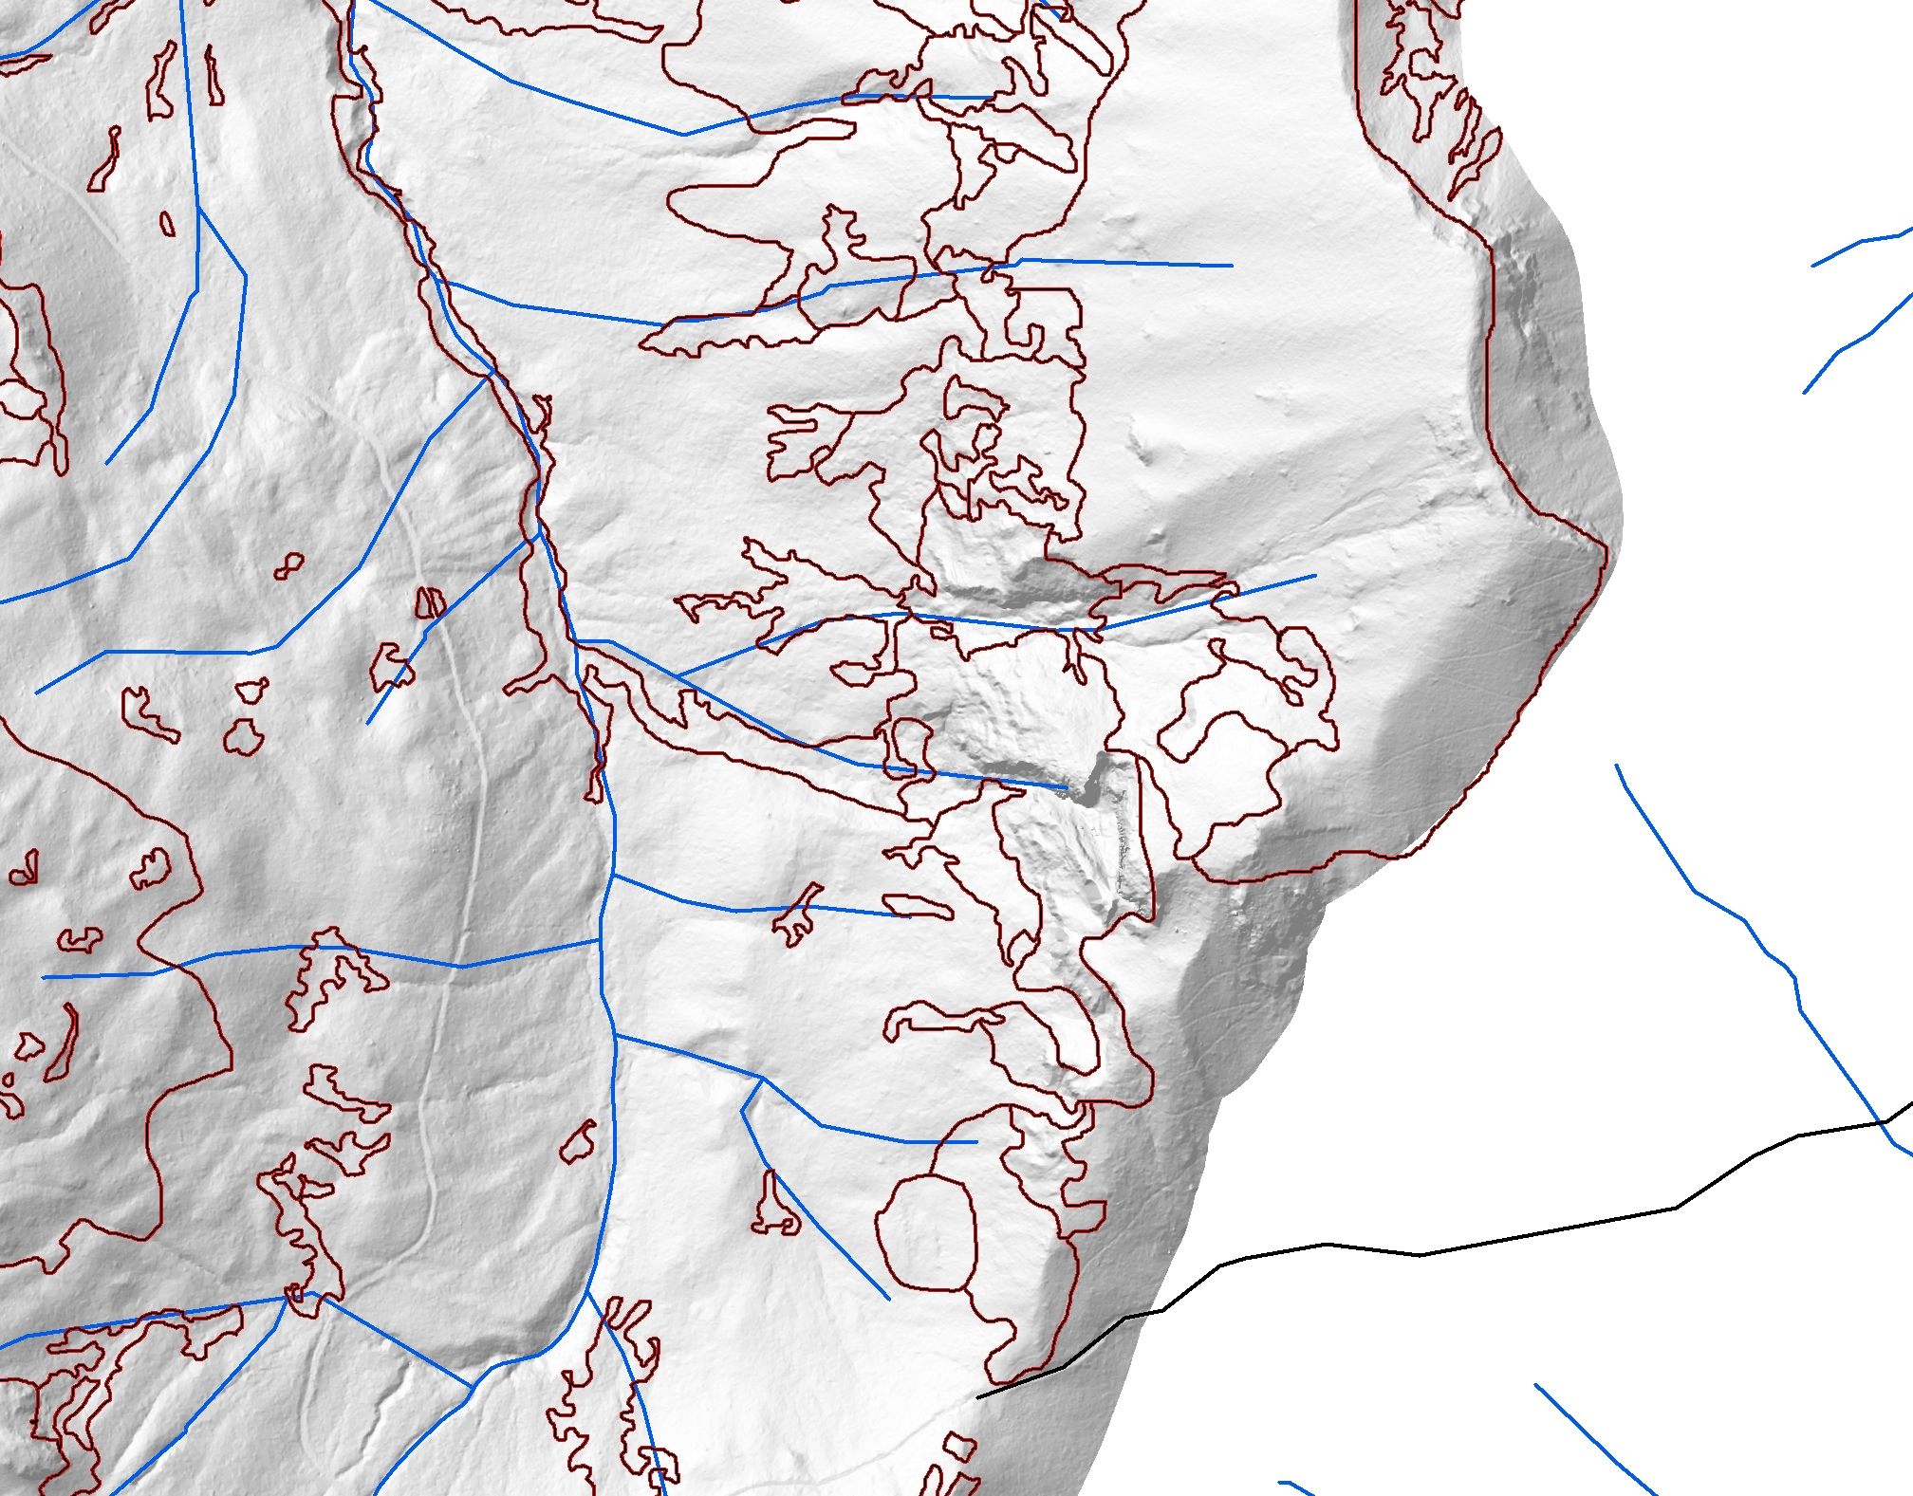
Hill Shade

Slide 12
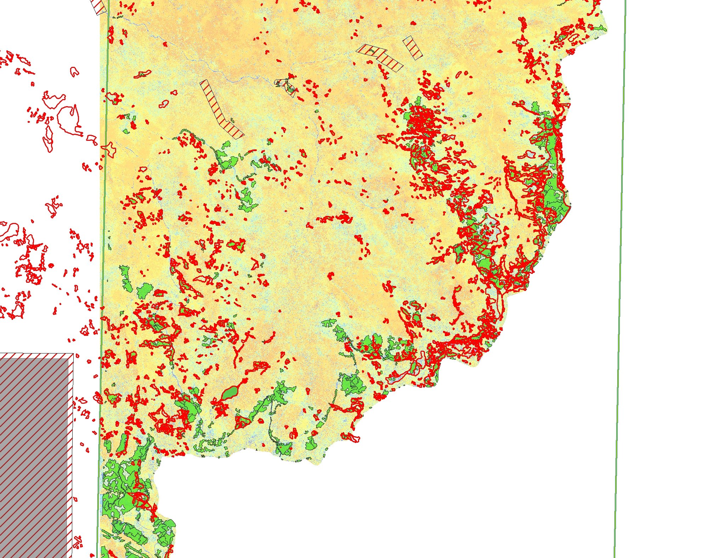
Using eCognition data to Digitize

Slide 13
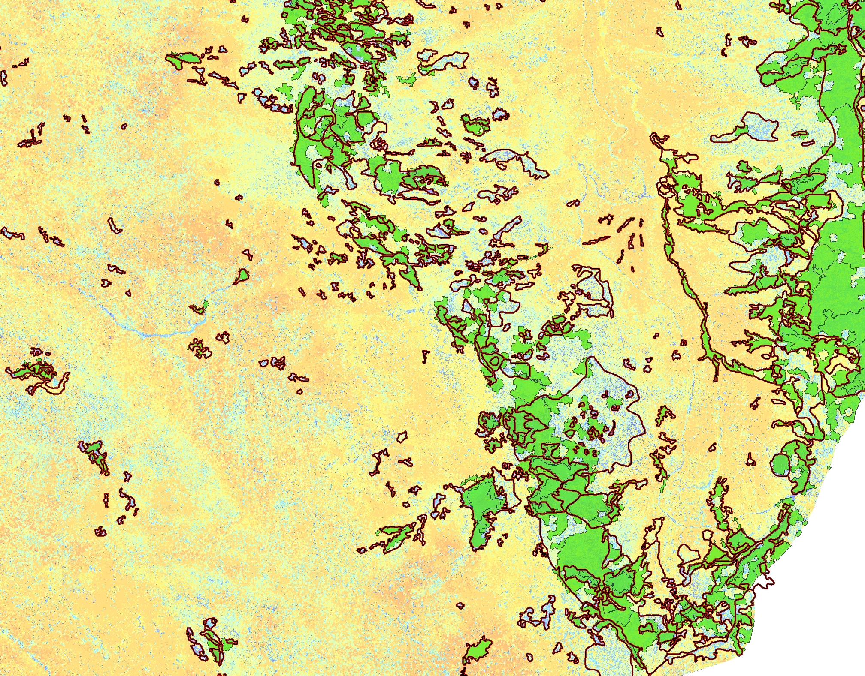
eCog Data Differences

Slide 14
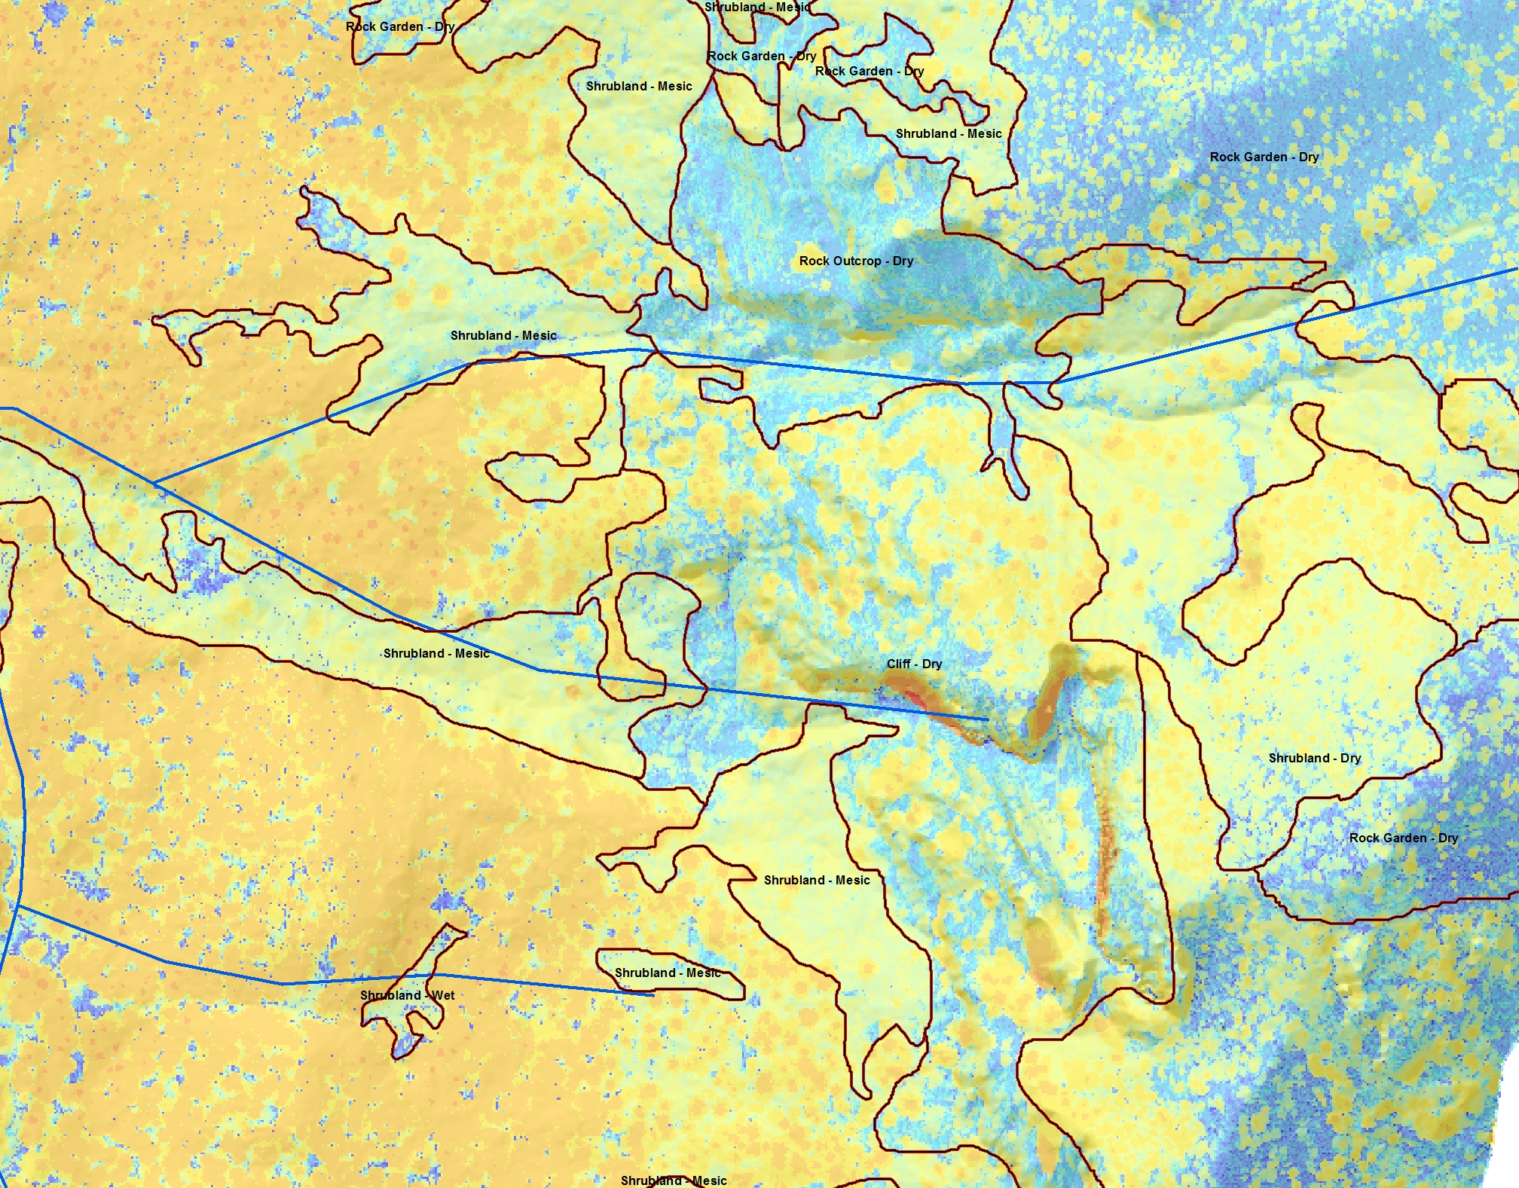
Vegetation Height Detail

Slide 15
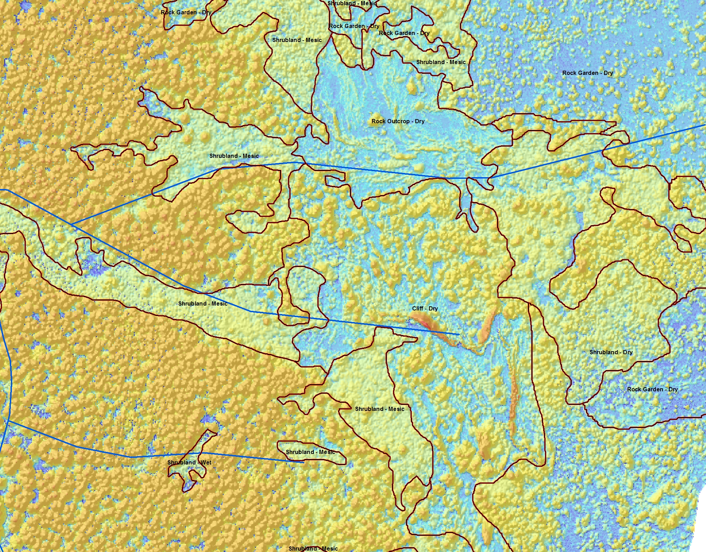
Vegetation Height Hill Shade

Slide 16
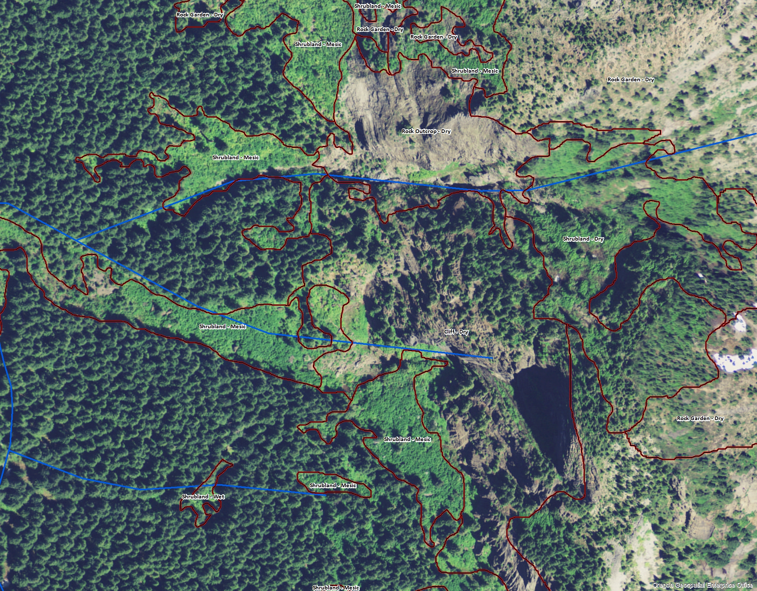
½ Meter 2009 NAIP Imagery

Slide 17
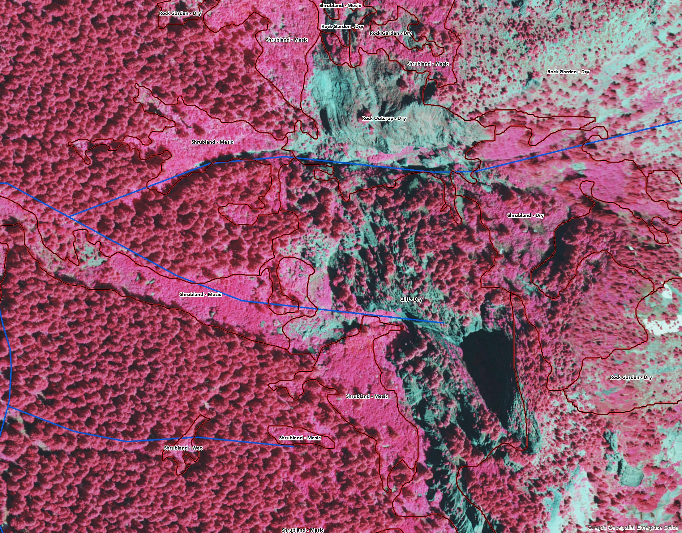
½ Meter 2009 Infrared NAIP Imagery

Slide 18
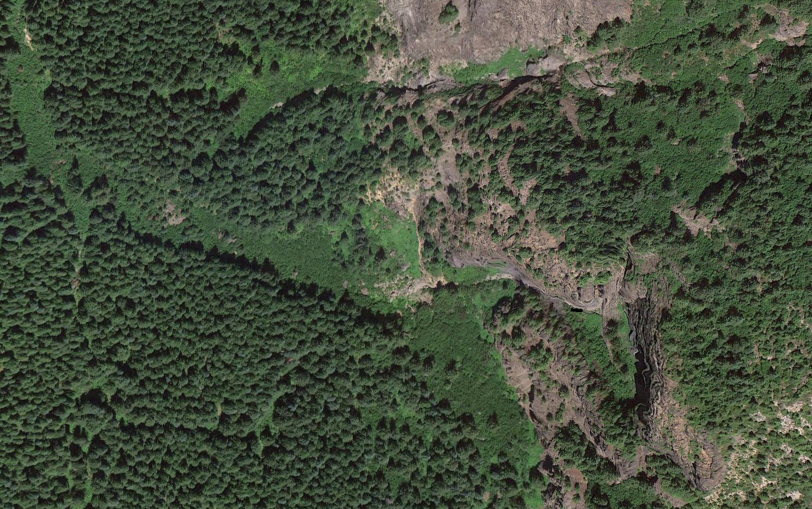
Google Maps Example – Higher Resolution, Current Imagery

Slide 19
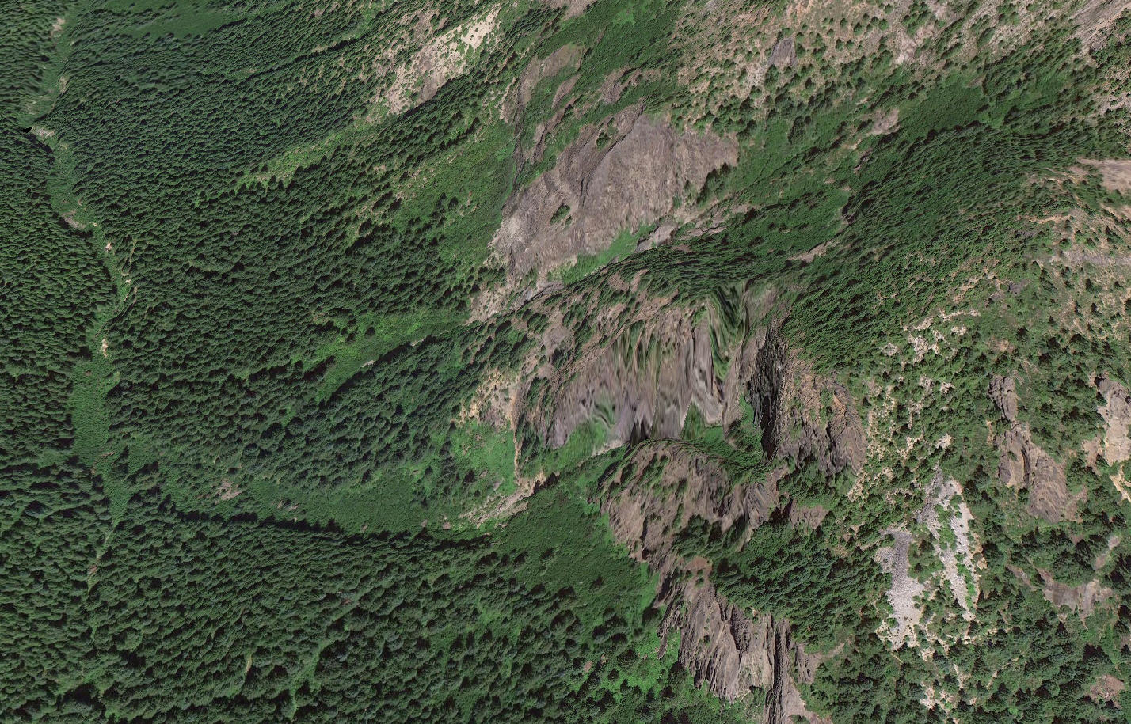
Google Maps Example – 3-D Tilt Function

Slide 20
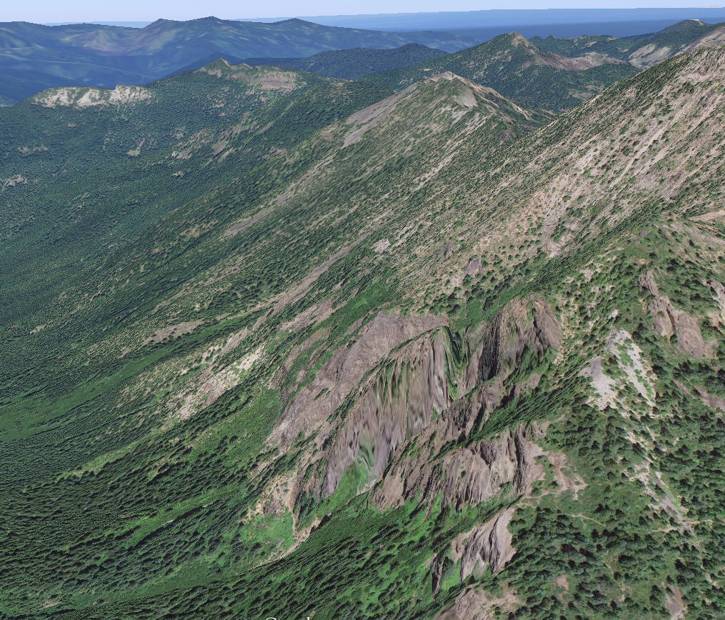
Google Maps Example – Tilt function 2

Slide 21
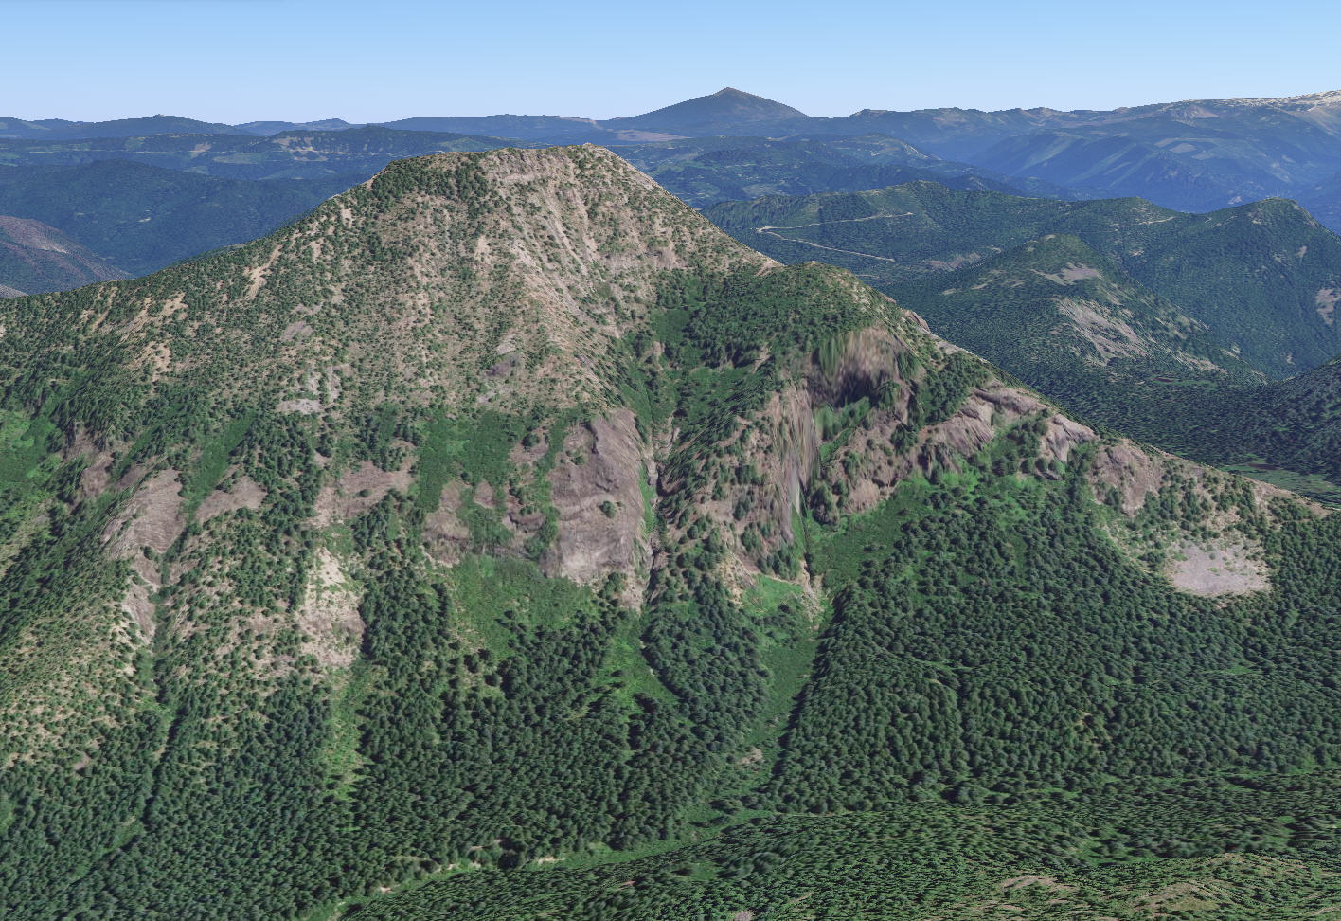
Google Maps Example – Change Look Direction

Slide 22
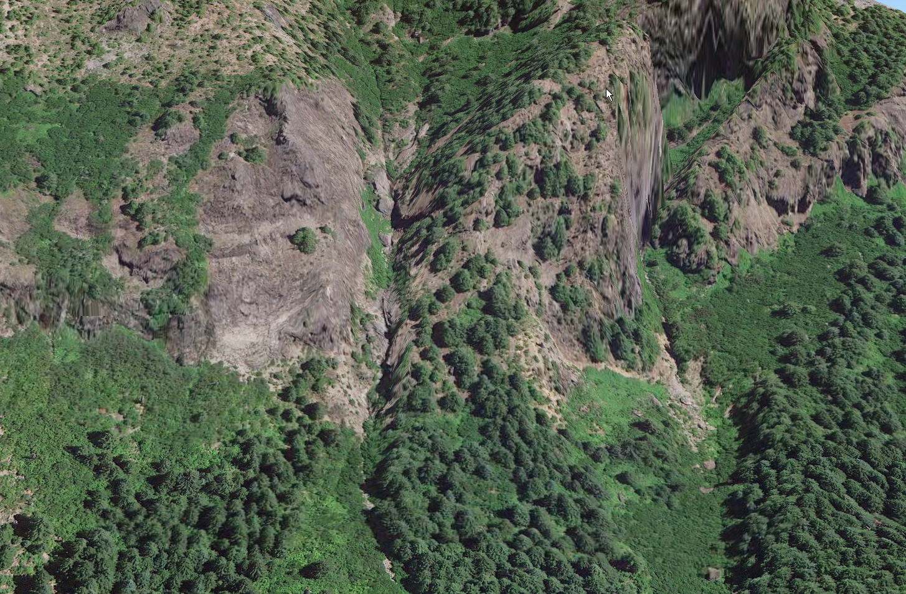
Google Maps Example – Close Up

Slide 23
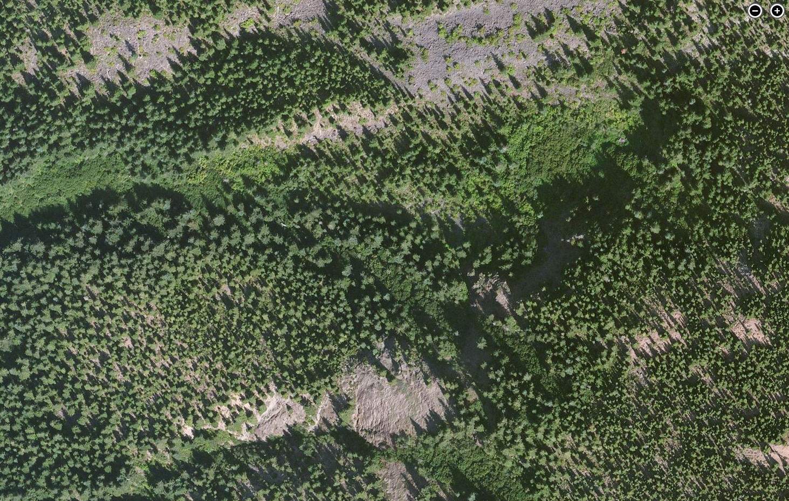
BingMaps Example – Alternate imagery, sometimes better than Google

Slide 24
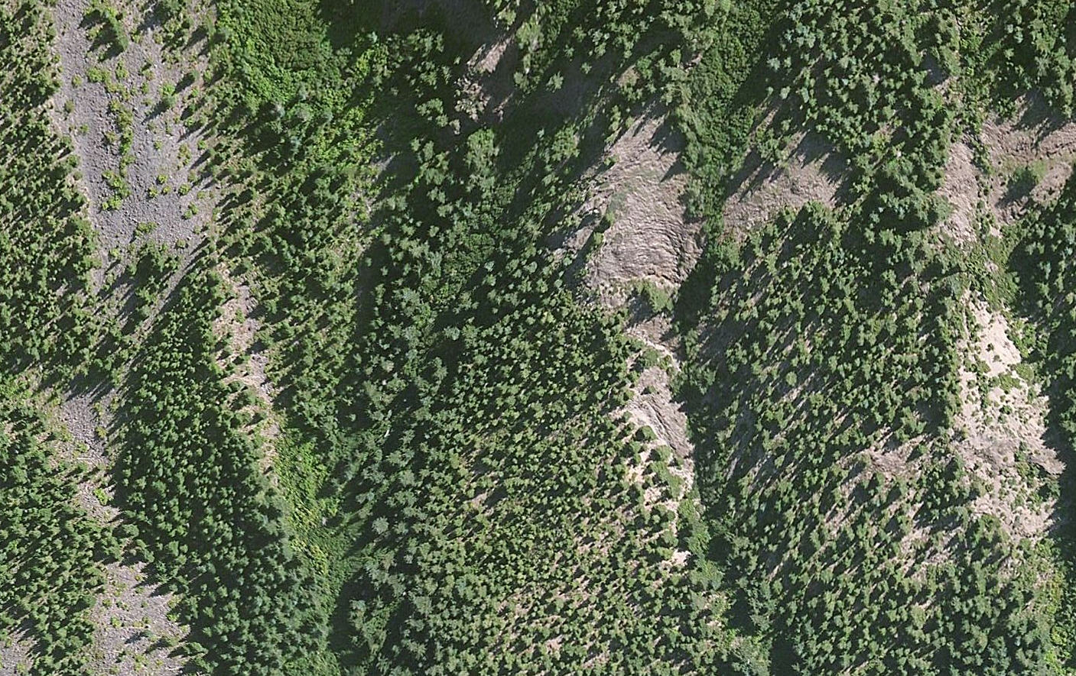
BingMaps Example – Can also tilt imagery and pan zoom around

Slide 25
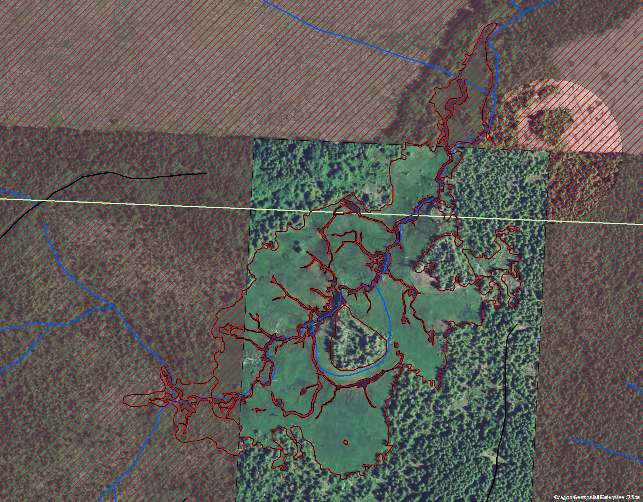
Lost Prairie, Stott Mountain

Slide 26
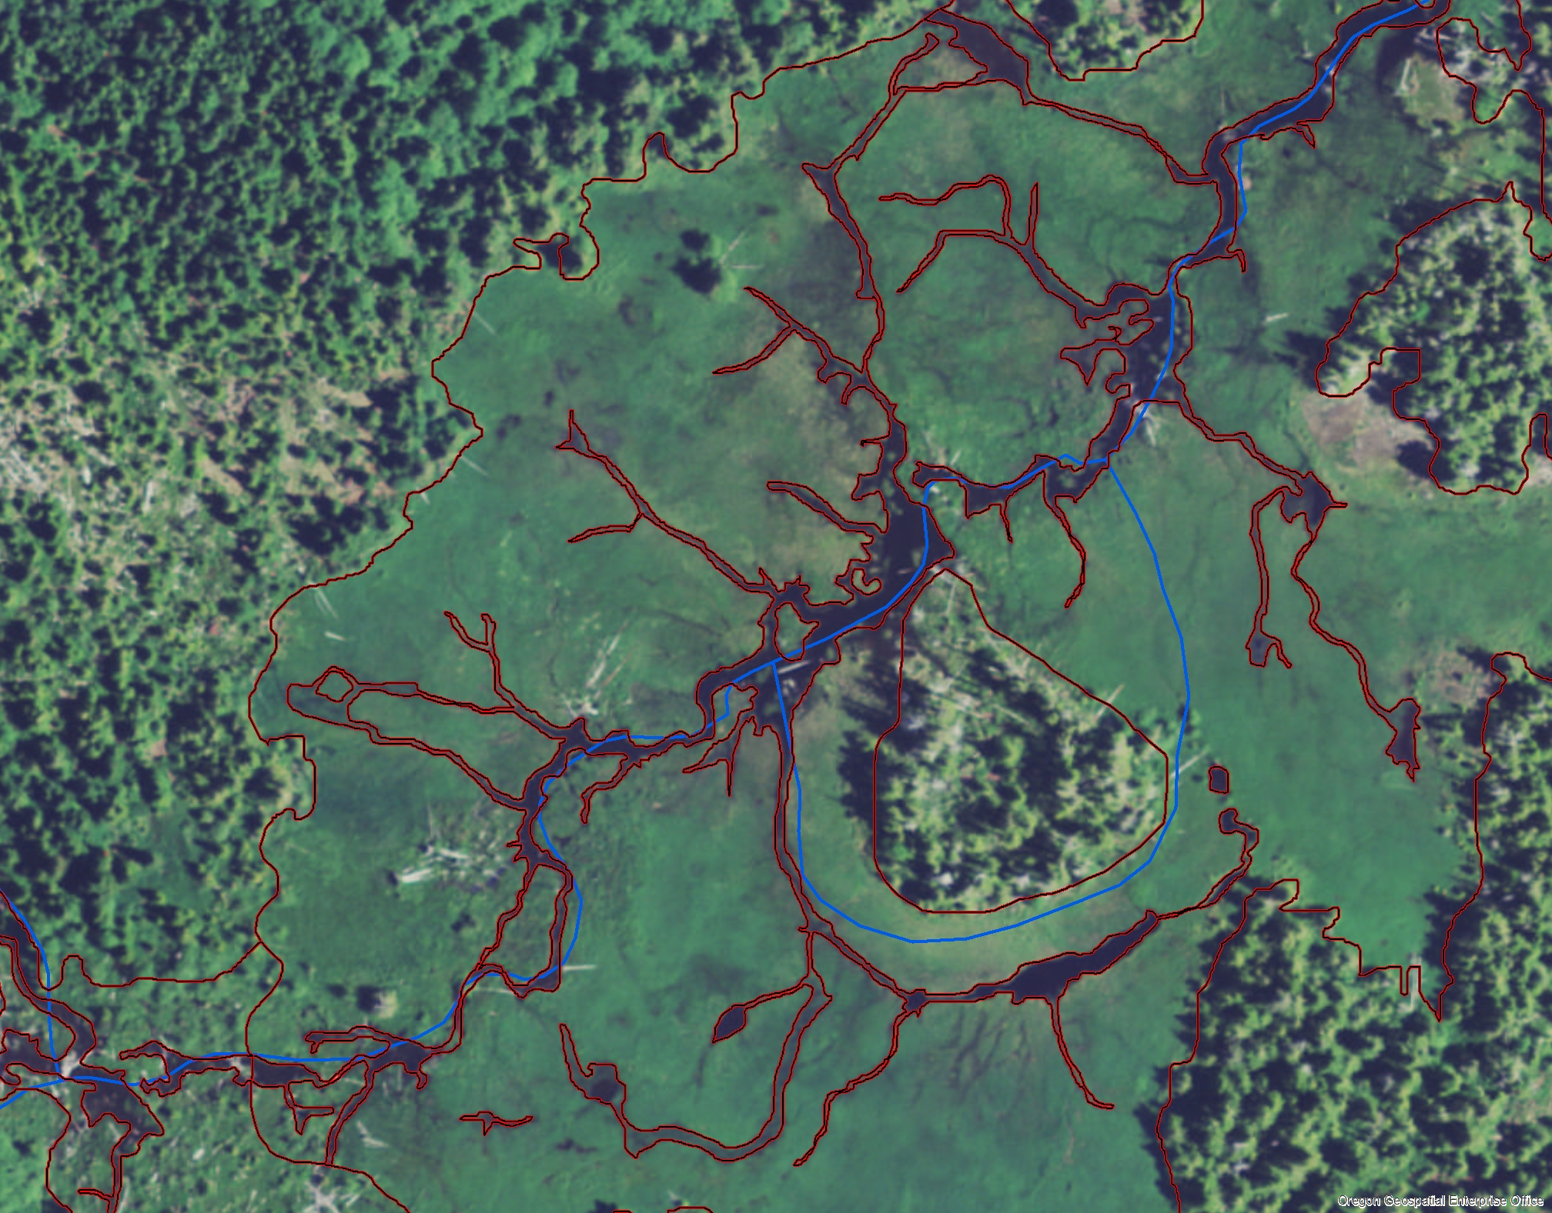
Lost Prairie, Stott Mountain, close up

Slide 27
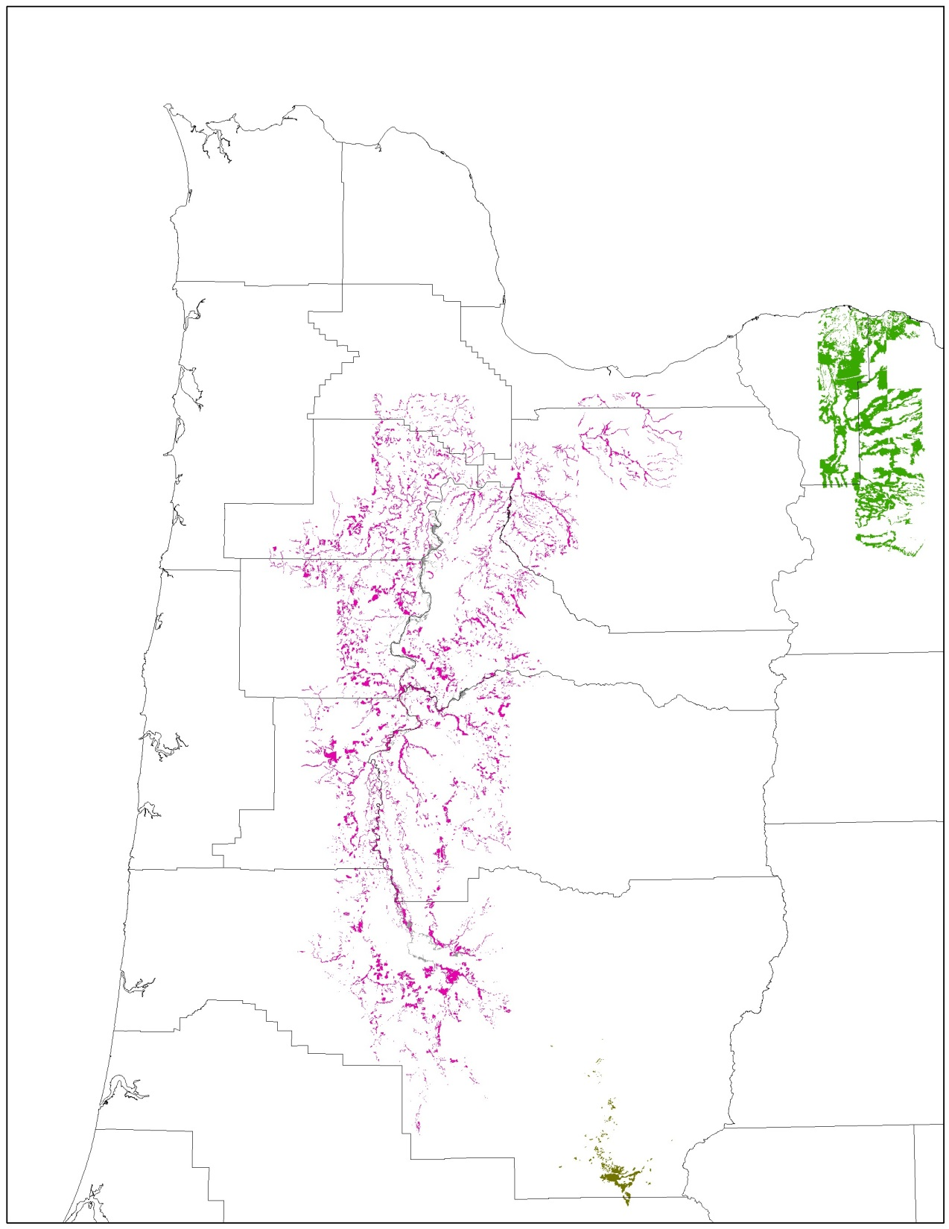
Willamette Oak/Ponderosa Pine Survey
Over 10,000 Polygons Mapped

Slide 28
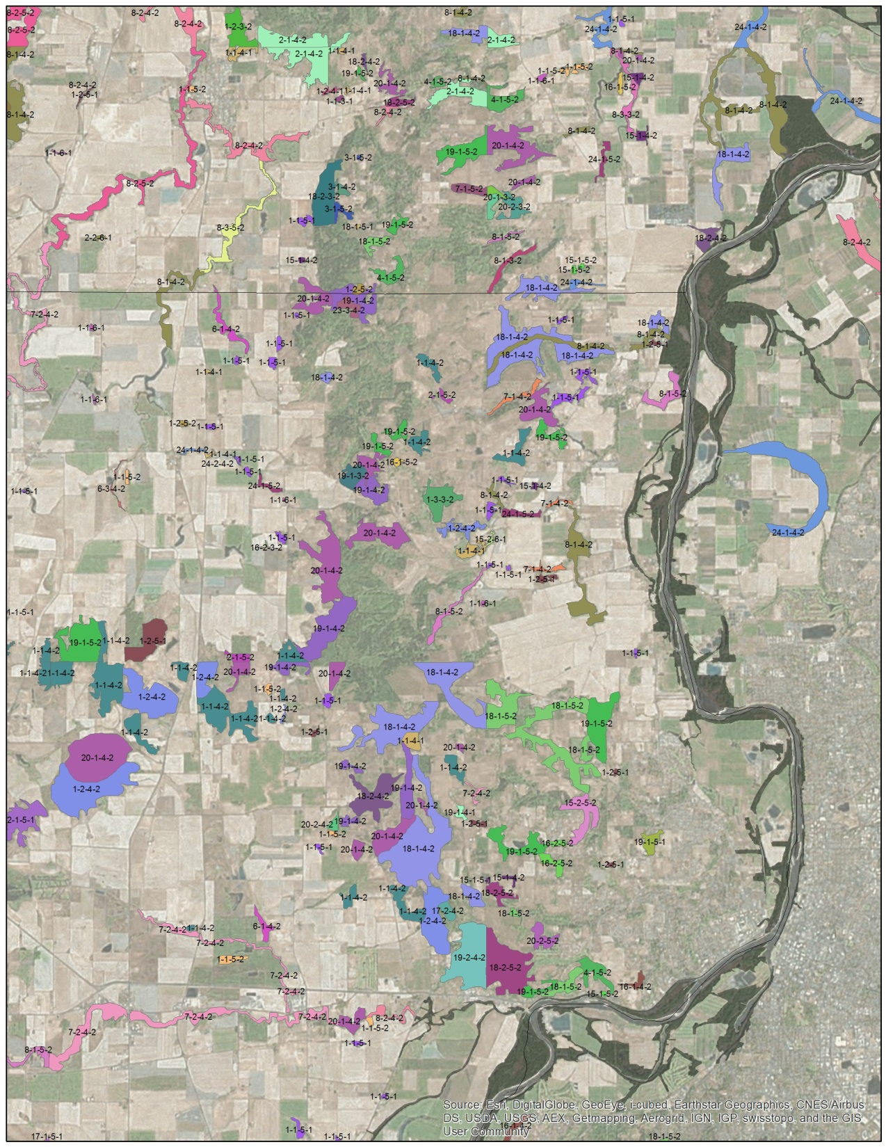
Willamette Oak
Survey Detail

