Slide 1



Population Dynamics of the Northern Spotted Owl
Reasons for Listing, Current Status, and Recovery Strategy
May 8, 2014
Notes:
My presentation will focus on the biology of the spotted owl - in particular, I’m going to talk about population status and trends for this species – including what lead to it’s listing and what has happened since that time. I’ll also provide some background on threats to the spotted owl, how these have changed over time, and how these threats have influenced the recovery strategy for this species.

Slide 2

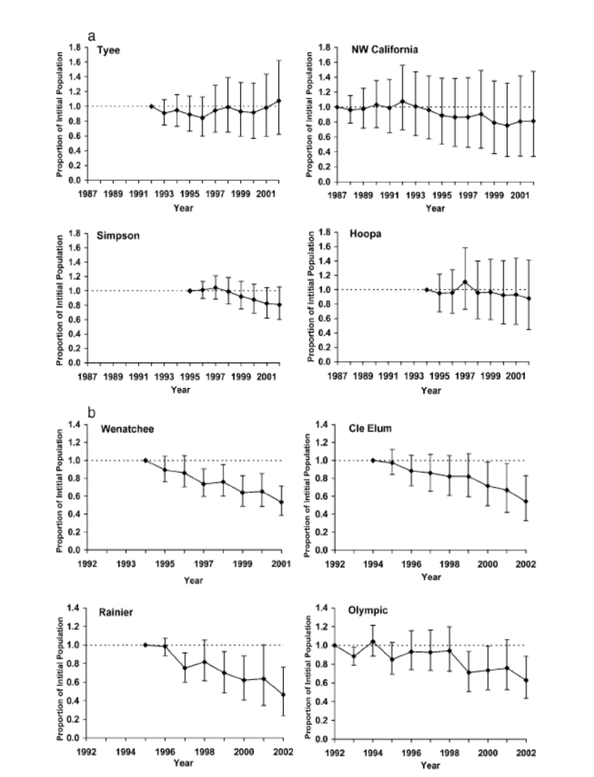
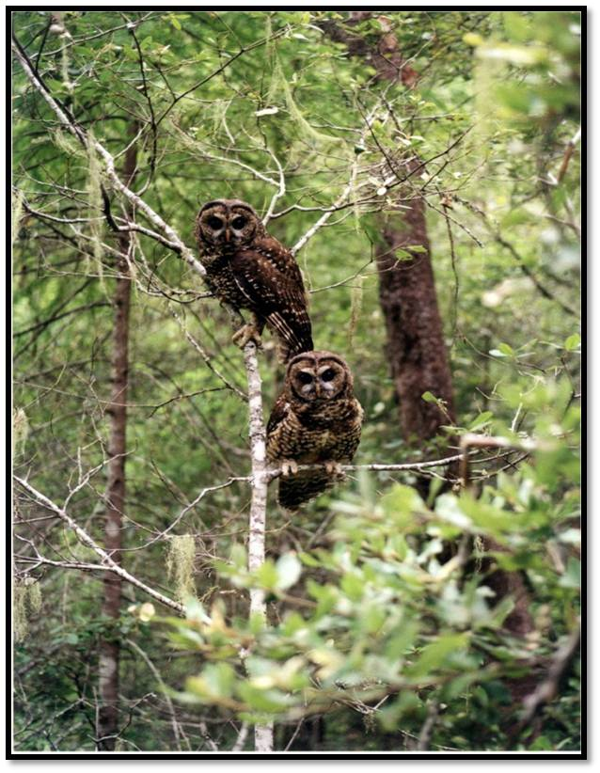
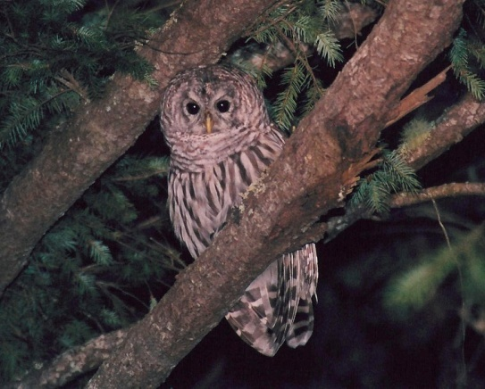
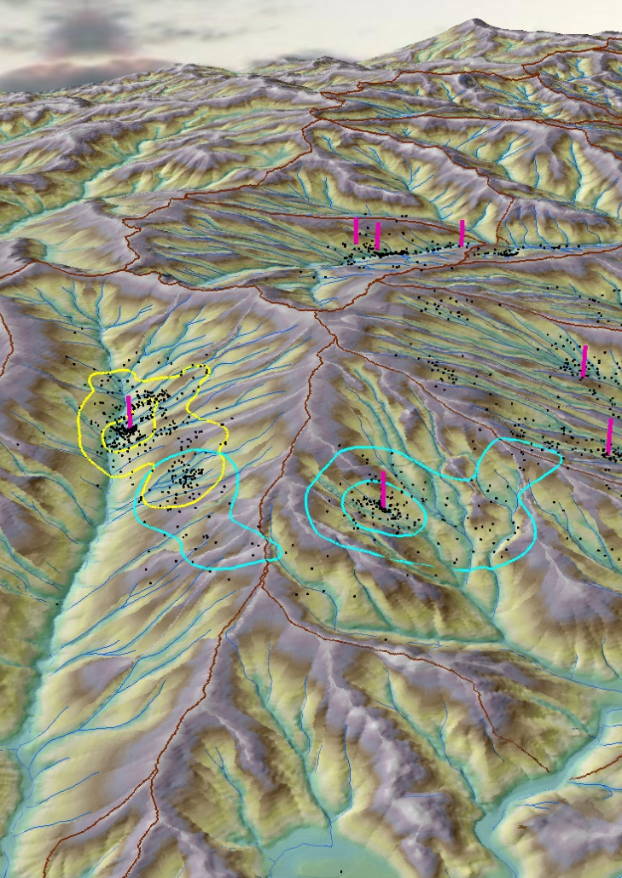
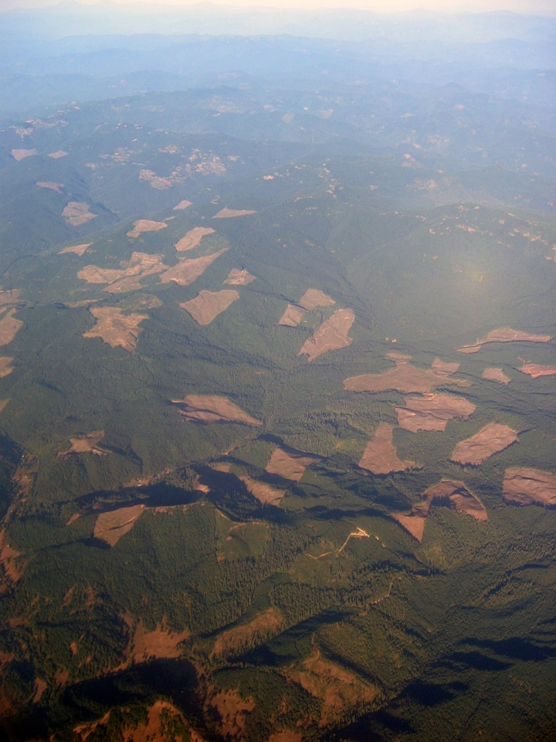
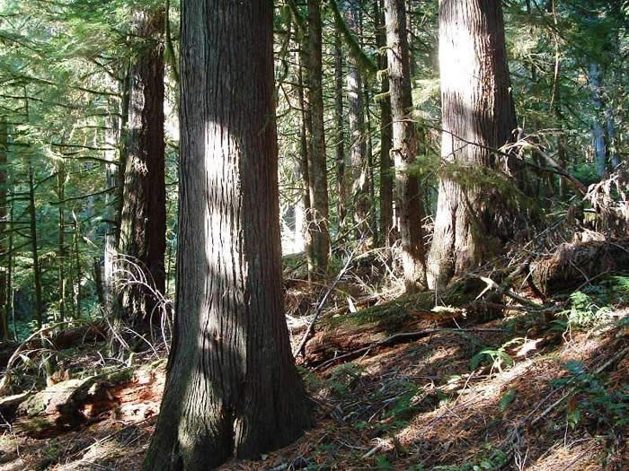
Northern Spotted Owl
Listed as threatened in 1990
Late-successional forest habitat
Territorial, large (~1500ha) home ranges. Nest in spring (Mar-Jun)
High annual survival, variable reproduction
Threats: Habitat loss, barred owls
Declining population trends
Notes:
As most of you know,
The Northern spotted owl was listed as a threatened species in 1990 (Bullet 1). It’s a medium-sized, dark brown owl that is one of 3 subspecies of spotted owls found in North America. It is a year-round resident of Pacific Northwest forests most commonly found in late-successional or old growth forest (switch to Bullet 2). Spotted owls are territorial and maintain very large home ranges – on the order of 1500ha/3000acres (Bullet 3). They next in the spring, often displaying an alternate-year pattern in nesting.
Annual survival of adult owls (Bullet 4) has, at least historically, been quite high – with an 85-90% probability of owls surviving from one year to the next. In the wild, NSOs up to age 20 have been documented. Reproduction is much more variable – often showing an alternate year pattern of reproduction or nesting attempts.
The primary threats (bullet 5) – which I’ll discuss in more detail in the next few slides – have included habitat loss and more recently, competition with the newly-established barred owl.
Since the time of listing, declines in spotted owl populations have continued to be recorded across much of the species’ range and I’ll provide more detail on these trends as well.

Slide 3

Northern Spotted Owl
Recovery Plan(s) and Critical Habitat Rule(s)
1990 – NSO Listed as Threatened
1992 – Final Draft Recovery Plan/Critical Habitat
1994 – Northwest Forest Plan
2008 – 2008 Final Recovery Plan and Revised Critical Habitat
2009 – 2008 Plan/Critical Habitat Remanded by Court Order
2011 – Final Revised Recovery Plan
2012 – Final Revised Critical Habitat
2013 – Final EIS for Barred Owl Removal Experiment
Notes:
Since the NSO was listed in 1990, there has been a long and convoluted process of recovery planning for this species. Here’s a quick run-down spotted owl recovery plan and critical habitat history over the past 20 years.
After the initial listing, a draft recovery plan and critical habitat rule were developed in 1992, but were never finalized. After the owl was listed, a series of court cases led to the shutdown of timber harvest on all federal lands. In 1993, President Clinton held a conference in Portland to address this issue and established the Forest Ecosystem Management Assessment Team (FEMAT)—an interagency, interdisciplinary team of scientists, economists, sociologists, etc. to craft balanced, comprehensive, and long-term options for the management of more than 24 million acres of federal forestlands within the range of the spotted owl.
The result of this process was the NWFP, which was finalized and implemented in 1994. The NWFP has served as an important landscape-level plan that has contributed to the conservation of the northern spotted owl and late- successional forest habitat on Federal lands across the range of the species. However, there was still no final recovery plan or final critical habitat designation for the northern spotted owl.
In 2008, a recovery plan and critical habitat rule were finalized; however, both were remanded by court order early in 2009
A final revised recovery plan was issued in 2011 and a final critical habitat rule – which is the focus of this workshop- was published in 2012.
Concurrent with these two recovery documents, the Service also published an environmental impact statement for conducting a research study on the effects of removing barred owls on spotted owl population dynamics. This will become important as we review the threats to the spotted owl and the actions needed for recovery.
So.. That summarizes the recovery plan and critical habitat process, but what were the factors that initially lead to the spotted owl being listed?

Slide 4
Key Threats
1990
Widespread habitat loss across the species’ range
Inadequate regulatory mechanisms to conserve the owl/habitat
Low population sizes/declining populations
Limited habitat/declining habitat
Inadequate distribution/isolation of habitat and populations
Vulnerability to natural disturbance
Predation/competition (barred owls?)
Notes:
At the time of listing, the Service identified
Widespread habitat loss across the species range and
Inadequate regulatory mechanisms to conserve the owl
As the two primary threats.
A number of other, more detailed factors were also evaluated for each physiographic province in the spotted owl’s range. These included factors such as
Low population sizes
Declining populations
Limited habitat
Declining habitat
Inadequate distribution of habitat/populations
Isolation of populations within physiographic provinces
Lack of coordinated conservation measures
Inadequacy of regulatory mechanisms
Vulnerability to natural disturbance
Predation/competition (barred owls?)
It was anticipated that NSO pops would decline for some years after listing – primarily the result of a lag effect from habitat loss that occurred between 1950s-1990s – but should stabilize after a while.

Slide 5
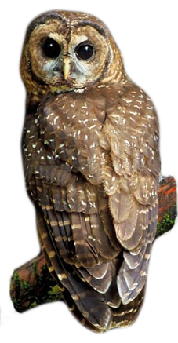
Key Threats
2011
Barred owls
Past habitat loss
Current habitat loss
Disease
Climate change
Notes:
When the final revised recovery plan was developed in 2011, key threats were reassessed at that time
Although habitat loss is still a significant threat, it was determined that competition with barred owls has become an equally important problem. Other factors identified included threats from diseases such as West Nile virus and changes in environmental conditions and ecosystem structure and function resulting from climate change.
So.. Since the time of listing, habitat loss has remained a threat, but barred owls have gone from something that might be a problem to something that is a major problem.
One of the most critical tools for identifying threats and for being able to determine how these threats affect owls is population monitoring.

Slide 6
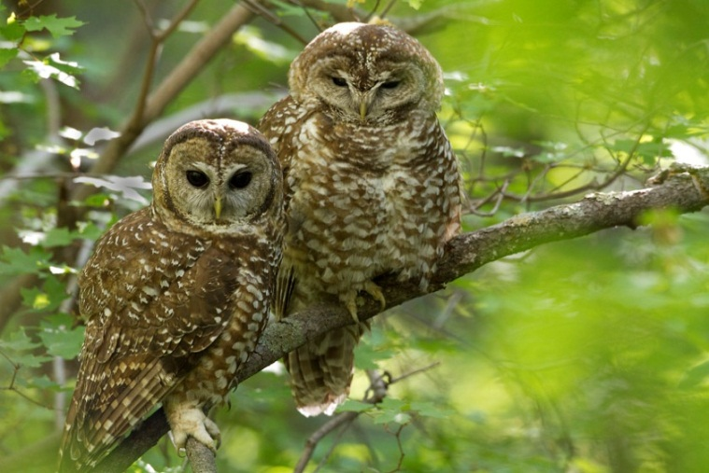
Population Monitoring
Effectiveness Monitoring for the Northern Spotted Owl
Assess status and trends in northern spotted owl populations and habitat:
Will implementing the Northwest Forest Plan reverse the downward trend in spotted owl populations?
Notes:
Since the early 1990s, long term trends in spotted owl population status has been monitored primarily under the Effectiveness Monitoring Program for Northern Spotted Owls for the NW Forest Plan. One of the objectives of this program has been to assess whether
Implementing the NWFP will reverse the downward trend in NSO populations.
The monitoring program developed to answer this question has formed the foundation for the population monitoring program.

Slide 7
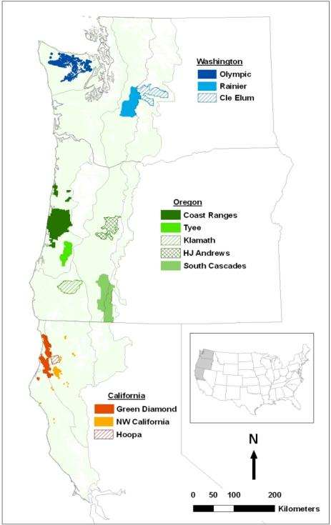
Northern Spotted Owl – Current Status
STATUS AND TRENDS IN DEMOGRAPHY OF NORTHERN SPOTTED OWLS:
1985-2008 - Forsman et al. (2011) 1985-2013 – in prep.
Meta-analyses:1991,1993,1998, 2004, 2009, 2014
11 long-term study areas
Notes:
Eight long-term spotted owl demographic study areas developed for the Effectiveness monitoring program, as well as several additional study areas that used similar methods of data collection have been the primary source for tracking spotted owl demographic rates and population trends over time. (Bullet 1)
Approximately every 5 years (bullet 2), data from all of these study areas are analyzed under a common framework to determine survival, reproduction and population change for the individual areas and in a meta analysis using data across all areas. These analyses have been conducted in 1991, 1993, 1998, 2004, 2009, and most recently - this past January. The two most recent analyses have included data from 11 study areas – 8 that are part of NWFP monitoring, and 3 additional areas with long term datasets (bullet 3).
As you can see from the map, these study areas are distributed across the range of the spotted owl and represent most of the physiographic provinces where the owl is found.
By using individually marked owls and tracking owl territories over time, these studies have been able to document annual survival, reproductive success, and annual rate of population change in northern spotted owl demographic study areas.
So.. What do the trends like?

Slide 8

Northern Spotted Owl – Current Status: 1990-2008
Area | Fecundity | Survival | λ_{RJS} | Population change
CLE | Stable | Declining | 0.937 | Declining
RAI | Increasing | Declining | 0.929 | Declining
OLY | Stable | Declining | 0.957 | Declining
COA | Increasing | Declining since 1988 | 0.966 | Declining
HJA | Increasing | Declining | 0.977 | Declining
TYE | Stable | Declining since 2000 | 0.996 | Stationary
KLA | Declining | Stable | 0.990 | Stationary
CAS | Declining | Declining since 2000 | 0.982 | Stationary
NWC | Declining | Declining | 0.983 | Declining
HUP | Stable | Declining since 2004 | 0.989 | Stationary
GDR | Declining | Declining | 0.972 | Declining
Forsman et al. (2011).
Notes:
Results from the most recent workshop are not yet available, so what I’m presenting here are results from the 2009 analysis that were presented in the Forman et al. (2011) publication.
This table provides a summary of results for trends in demographic rates for the 11 study areas included in the most recent analysis. Study areas are listed north to south on this table – with Cle Elum and Rainier in Washington down through Hoopa and Green Diamond in Northern California. Spotted owl reproduction tends to vary considerably from year to year, however, average fecunditiy – or number of female young produced per adult female owl – was declining at 4 areas, was relatively stable at 4 and was increasing at 3 areas over the study period. Annual survival was declining at 10 of the 11 areas – this result was of particular concern –because for this relatively long-lived species – annual survival is the main driver of population growth rate. Estimates of population growth rate showed declines at 7 of the 11 areas. 4 areas – located in southern Oregon and northern California appeared to be relatively stable.

Slide 9
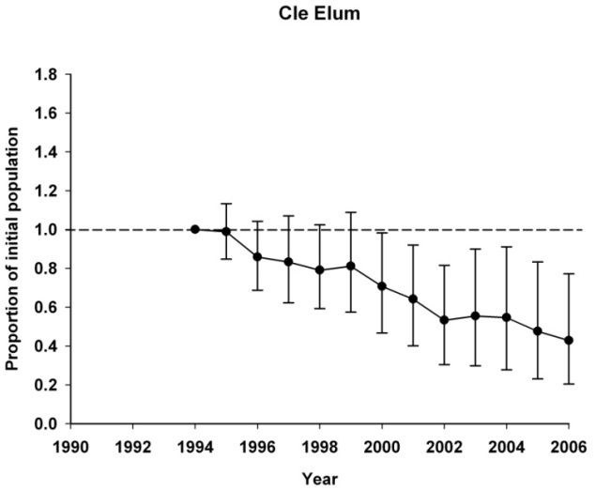
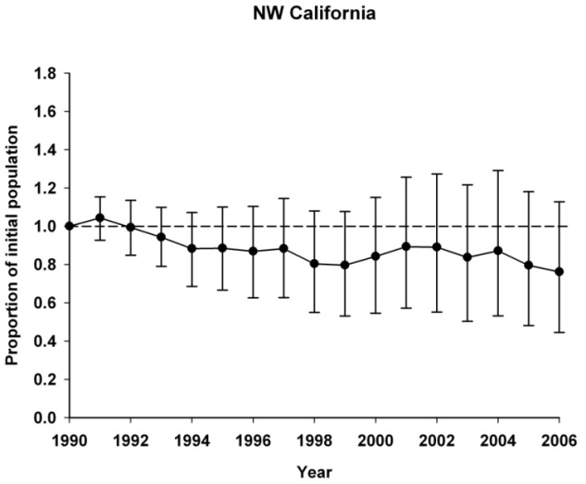
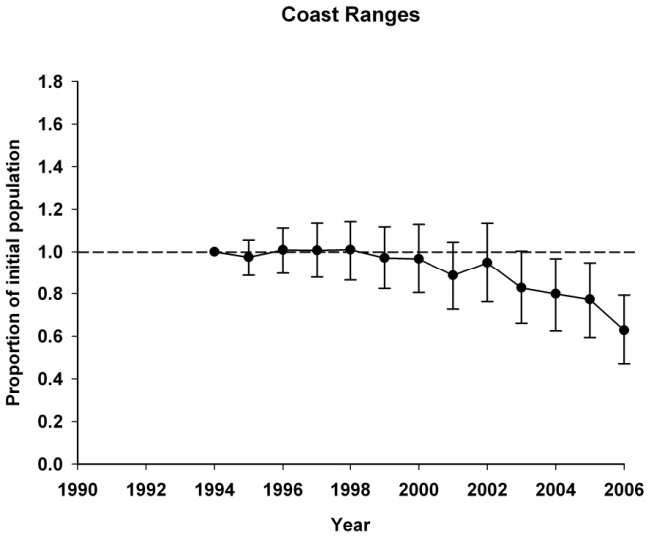
Northern Spotted Owl – Current Status: 1985-2008
Estimates of realized population change (Δλ) on study areas
Notes:
For those of you who like a more visual representation of the trends in demographic rates, these next few graphs show realized rates of population change over time. 1 represents the initial population at time 0 = which is 1990 for most areas. Again – moving from north to south – Cle Elum had the largest decrease over time, with the 2008 population showing a 60% decline since 1990. In Oregon – the Coast Range study area showed a 40% decline – which much of this occurring between the 2004 and 2009 analyses.
California showed a lesser decline; but still around 25% with most of the decline showing in more recent years.

Slide 10

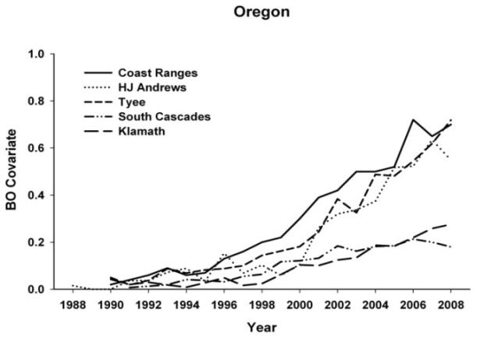
Northern Spotted Owl
Current Status: 1985-2008
Factors Affecting Demographic Rates
Amount of Habitat:
Positive effect on fecundity (4 areas)
Positive effect on recruitment in meta-analysis of population growth rate (λ)
Presence of Barred Owls:
Negative effect on fecundity on 4 study areas
Negative effect on survival on 5 study areas
Negative effect on recruitment in meta-analysis of population growth rate (λ)
Weather & Climate:
Negative effect of cold, wet springs (nesting periods) on fecundity
Forsman et al. (2011)
Notes:
Both the 2014 analysis and the 2011 report also examined factors influencing demographic rates. In 2011, results indicated that the amount of good spotted owl habitat - which was defined as complex, multi-layered, late successional forest around owl sites – was positively related to both number of young produced in the analyses of fecundity and recruitment of new individuals into populations in the analysis of population growth rate.
The effect of barred owls was of particular concern. This graph shows the proportion of spotted owl territories where barred owls were detected for the long term study areas in Oregon. As you can see, barred owls were not very common in the 1980s and early 1990s, but in recent years, as many as 70% of the spotted owl sites had barred owl detections. Barred owl presence had a negative effect on number of young fledged at 4 areas, barred owls also had a negative effect on survival at 5 areas, and a negative effect on recruitment of new owls into populations in the meta-analysis of rate of population change.
The effect of barred owls was much stronger in this analysis than in the prior region wide meta-analysis conducted in 2004.
This study also found that fecundity was lower during cold, wet springs.
So… all of these results I presented are from analyses conducted 5 years ago – it is pretty likely (my opinion only) that we are going to see considerably more dramatic declines in spotted owl vital rates from the most recent workshop. This most recent workshop continued to explore factors affecting demographic rates – barred owls and habitat in particular. The negative effects of barred owls have become increasingly evident with each successive analysis, so now I’m going to summarize the current science about barred owls, spotted owls, how the two species interact, and consequences for spotted owl recovery.

Slide 11
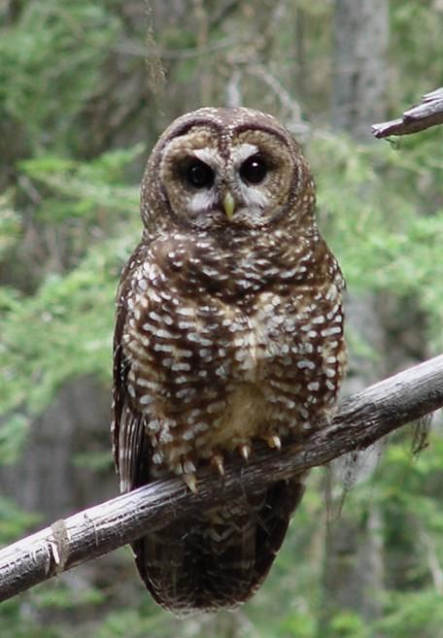
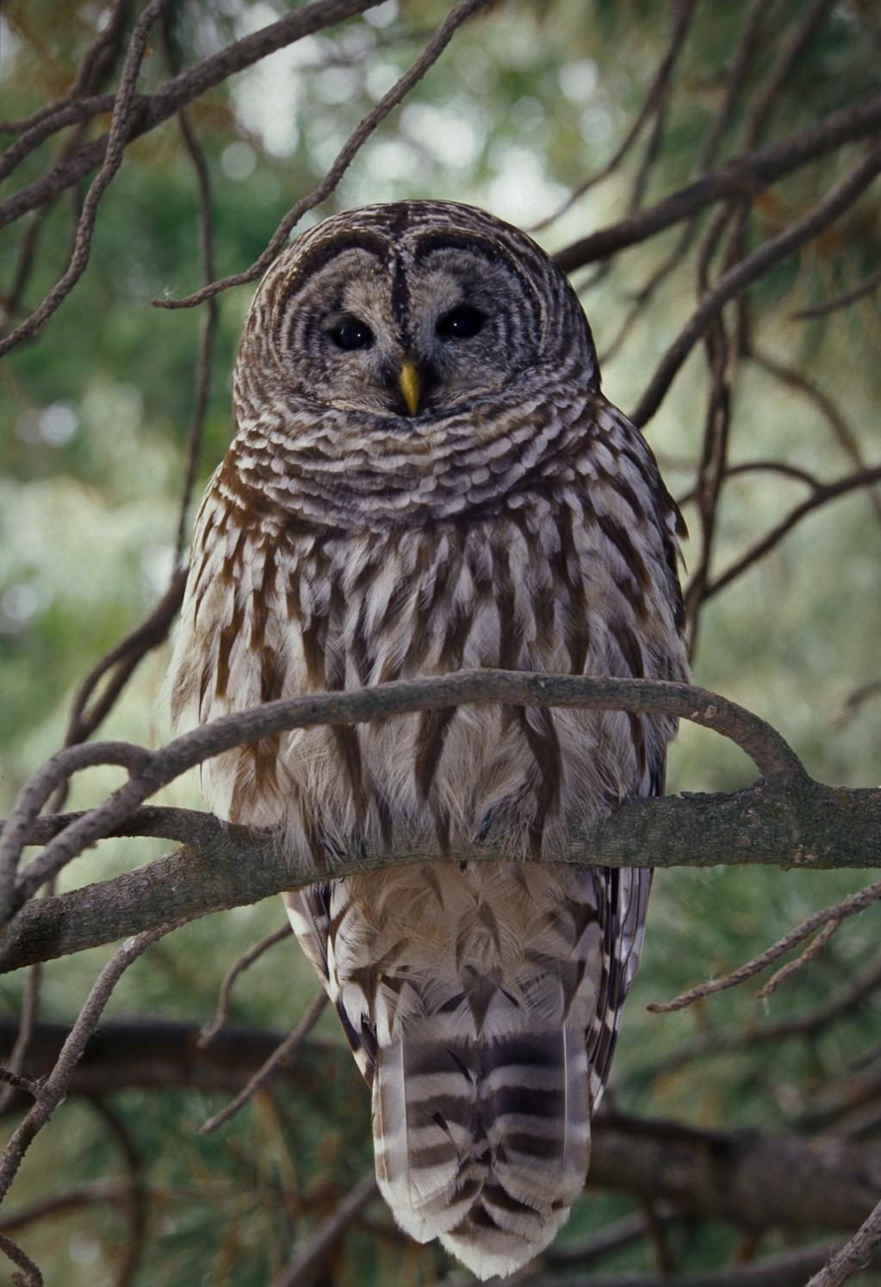
Barred Owls
Spotted Owl
(Strix occidentalis)
Barred Owl
(Strix varia)
Notes:
Barred owls are closely related to spotted owls – both species are members of the genus, Strix. Barred owls are slightly larger than spotted owls and tend to be more aggressive. Similar to spotted owls, they tend to select mature forest; however, their home ranges are typically less than half the size of spotted owl ranges.

Slide 12
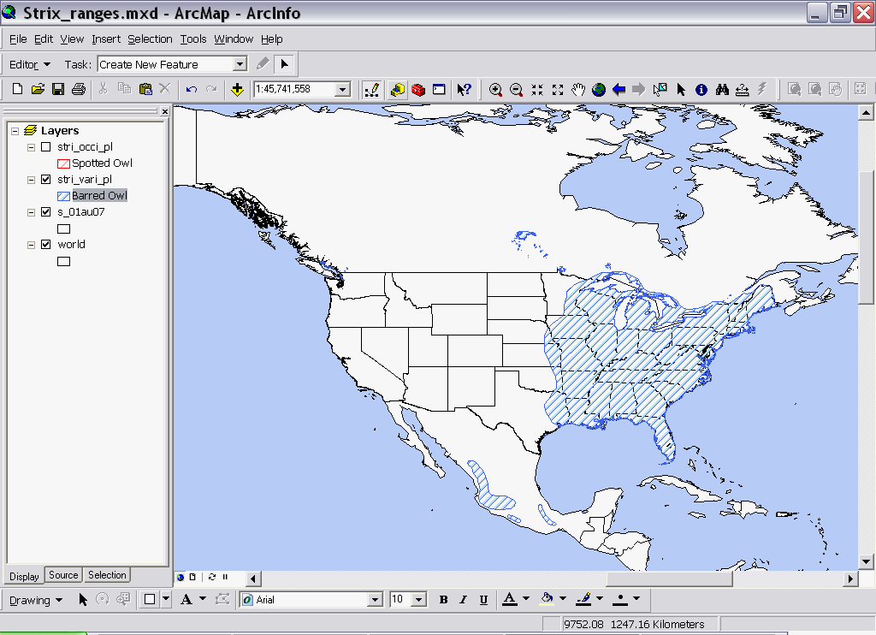
Barred Owl Range
(Pre-1900)
Notes:
At least historically, barred owls were native to forests of eastern North America.
Barred Owls live year-round in mixed forests of large trees, often near water. They tend to occur in large, unfragmented blocks of mature forest, possibly because old woodlands support a higher diversity of prey and are more likely to have large cavities suitable for nesting. Their preferred habitats range from swamps to streamsides to uplands, and may contain hemlock, maple, oak, hickory, beech, white spruce, quaking aspen, balsam poplar, and more recently …..Douglas-fir, lodgepole pine, or western larch.
In the second half of the 20th century, there were occasional reports of barred owls west of the Great Plains. By 1990, however, sightings within the range of the northern spotted owl had increased to the level where this species was identified as a potential threat to the NSO. No one was sure what threat level really was, but the 2 species appeared to occupy very similar habitat and the barred owl was slightly larger and considerable more aggressive.

Slide 13
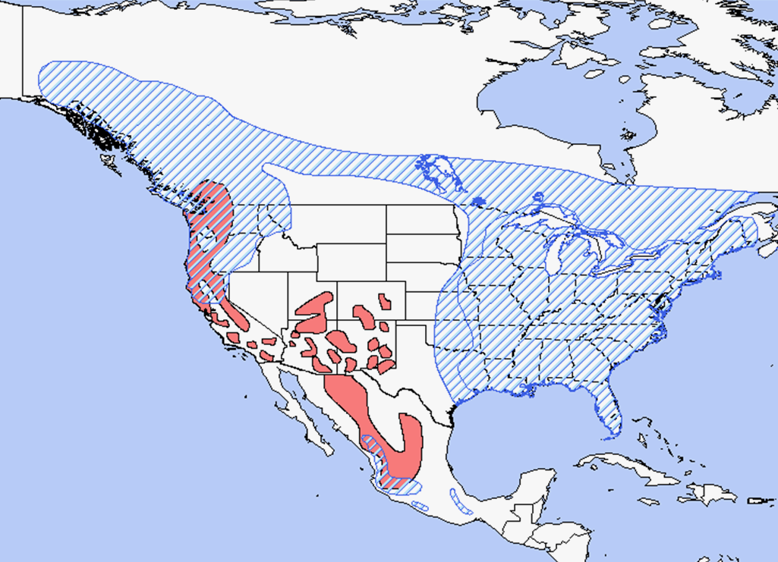
Barred Owl Range
(Spotted Owl)
Blue – Barred Owl
Red – Spotted Owl (Northern,
California, and Mexican
Notes:
By the late 1990s/early 2000s, barred owls were widespread across the northern part of the spotted owls’ range- often displacing spotted owls from their territories, and over the subsequent decade, have become widespread across the entire range.

Slide 14
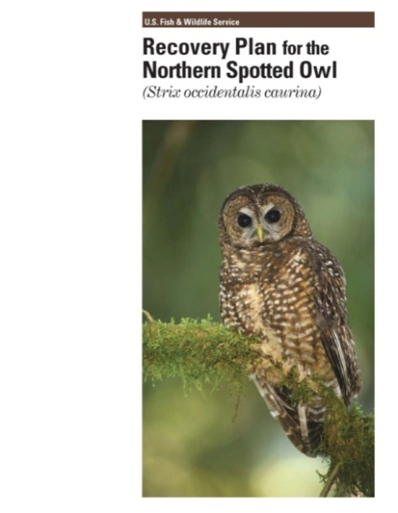
Timeline of Barred Owl Threat Recognition
1990 - Listing of Northern Spotted Owl
Barred owl competition “… of considerable concern …” but limited information available
2004 - SEI Report for 5-Year Review
Barred owl - concern increased, especially north
Level of concern as strong as habitat concerns
2011 – Revised Recovery Plan
Barred owl 1 of 3 primary threats
10 Recovery Actions relative to the barred owl
Notes:
So.. At the time of listing, barred owls were identified as a potential threat, but no one really knew much about it.
By the early 2000s, barred owls appeared to have increased fairy dramatically in the Pacific Northwest, and were recognized as an increasing threat to spotted owl recovery. In the 2004, 5 year status review conducted by the FWS and the large spotted owl research summary conducted by SEI as part of this process, identified the barred owl threat was considered of equal concern as habitat.
This concern has increased since that time, and there is now widespread recognition that the barred owl is a primary threat that needs to be addressed for spotted owl recovery.
Intensive research on barred owls and barred owl spotted owl interactions has been implemented since the late 1990s, and has been instrumental in helping us understand barred owl impacts on spotted owl populations.

Slide 15
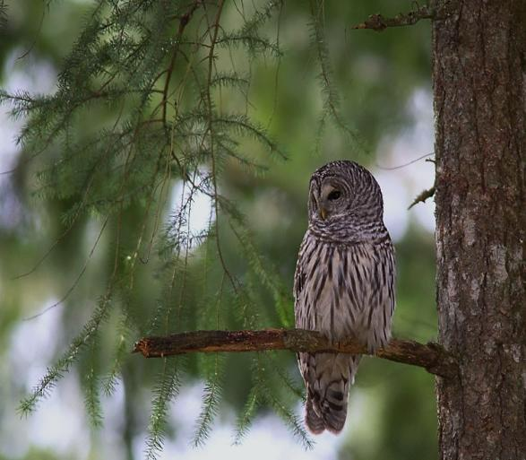
Barred Owl Competition with Northern Spotted Research Studies
Wiens (2012)
NSO – selected steep areas dominated by old conifers
BO – more even use of forest types, flatter slopes
BO – 6x as many young
Northern flying squirrel and woodrats – important prey for both, but
BO- used many additional aquatic, terrestrial, and diurnal spp.
Survival of both species was positively related to old conifer
Singleton (2013)
BO – gentler slopes/lower elevation
BO – broader range of forest structure
NSO occupancy declined less at sites
with good habitat
Kelly et al. (2003)
NSO occupancy declined after BO detection
Hamer et al. (2007)
NSO and BO home range size correlated with old forest
NSO avoid younger forest, BO use in prop to availability
Dugger et al. (2011)
BO- negative effect on NSO site colonization
BO- positive effect on NSO site extinction
Less old forest → higher site extinction
rates
Less fragmented old forest → higher colonization rates
Notes:
I’ll do a quick run-down of a few of the key studies and what we’ve learned from them, skipping over the spotted owl meta-analyses since I discussed those earlier:
One of the earlier publications was by Kelly et al – who reported that site occupancy by spotted owls declined after barred owls were detected in an area.
A study by Hamer et al. used data collected from barred and spotted owls that were radioed in the Mt Baker area of Washington in the late 1980s and found that for both species, home range size was negatively correlated with amounts of old forest and that while spotted owls avoid young forest within their home ranges, barred owls were much more general in their habitat selection within their home ranges.
In 2011, Dugger et al reported that barred owls had a negative effect on colonization of sites by spotted owls and a positive effect on spotted owl sites becoming vacant. For spotted owl territories with less old forest, site extinction rates were higher. Similarly in areas with less fragmentation, spotted owls were more likely to colonize vacant sites.
In his PhD work in the Oregon Coast Range, Dave Wiens found that NSO tended to selected steep areas dominated by old conifers while barred owls showed a more even use of forest types and tended to occupy flatter slopes. Barred owls also produced about 6x as many young as spotted owls during his study period. For both species, northern flying squirrel and woodrats were important prey, but BO used many additional aquatic, terrestrial, and diurnal spp. Wiens also found that annual survival of both species was positively related to the amount of old conifer habitat within their home ranges.
About the same time, Peter Singleton was studying barred owls in the Washington Cascades. He reported that BO selected gentler slopes/lower elevations than spotted owls and used a broader range of forest structure. Similar to Wiens results for survivial, Singleton reported that Spotted owl occupancy declined less at sites with more good quality habitat.
So… to summarize (next slide)

Slide 16
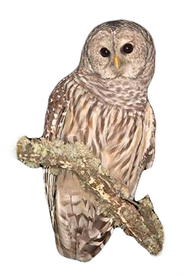
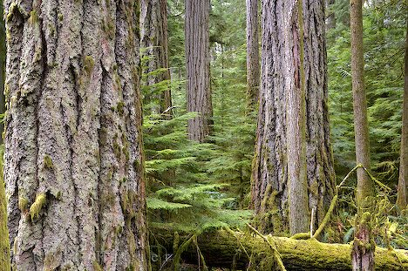
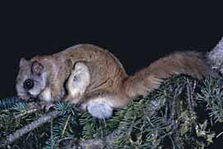
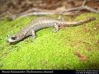
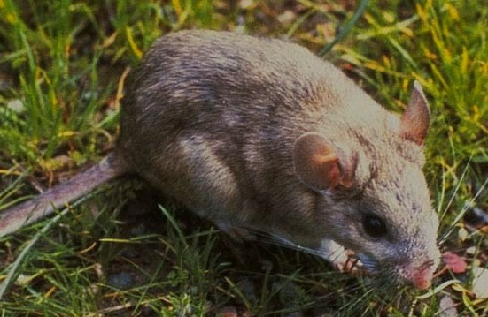


Northern Spotted Owl
(Strix occidentalis caurina)
Barred Owl
(Strix varia)
D. Wiens
Notes:
Both barred owls and spotted owls like old forest habitat, but barred owls are less picky about what habitat types the will use within their home ranges.
Barred owl home ranges are much smaller than spotted owl ranges and there can be 2-5 barred owl territories in the same space that a single pair of spotted owls might occupy. Barred owls also have much higher reproductive output.
Woodrats and flying squirrels are important for both species, but barred owls will eat just about anything that moves that they can catch
Barred owls appear to be more successful at taking over spotted owl territories with less old forest available.
While there does appear to be some niche separation in both habitat selection and diet between these two species, barred owls appear to be steadily increasing in numbers while spotted owls continue to decline.

Slide 17
Notes:
At almost all of the long-term study areas, the patterns spotted owl territory occupancy now look like this. This is the Oregon Coast Ranges – showing the total percent of spotted owl territories monitored on the y-axis and year on the x-axis. The blue line shows the % of territories that were occupied by spotted owls in each year and the red line shows the percent of those territories that had a barred owl detection.
None of these long-term study areas has yet reached a point where the increase in barred owls nor the decrease in spotted owls appears to have leveled off or reached an equilibrium. Thus – we are faced with a dilemma when it comes to implementing effective recovery strategies for the spotted owl.

Slide 18
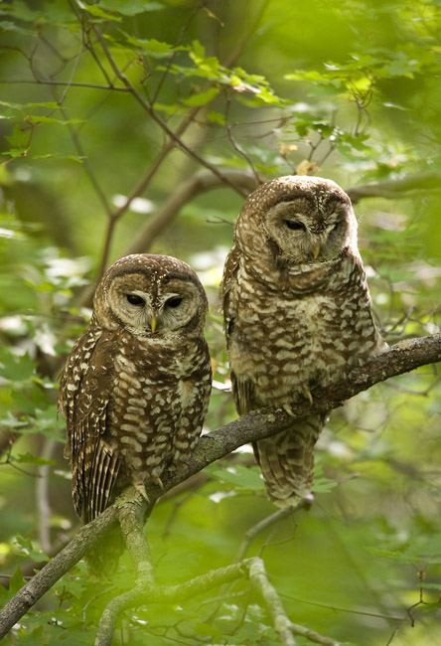
Recovery Objectives
Populations are sufficiently large and distributed such that the species no longer requires listing.
Adequate habitat is available and will continue to exist to allow the species to persist without protection of the ESA.
Effects of threats have been reduced or eliminated such that populations are stable or increasing.
Notes:
The goal of every recovery plan is to improve the status of a species so that it can be removed from protection under the ESA.
Despite the changes in the identified threats between 1990 and the present, recovery objectives for the spotted owl have focused on 3 main factors:
Populations are sufficiently large and distributed such that the species no longer requires listing.
Adequate habitat is available and will continue to exist to allow the species to persist without ESA protection.
Effects of threats have been reduced or eliminated such that populations are stable or increasing– and are unlikely to become threatened again in the foreseeable future.

Slide 19
How Do We Recover the Northern Spotted Owl?
Threats: Habitat AND Barred Owls
HABITAT→
NWFP
2011 Recovery Plan - Recovery Action 10,12, 32
2012 Critical Habitat Rule
Barred Owls →
2011 Recovery Plan - Recovery Actions 22-31
Removal Experiment - Implemented in 2013
Notes:
Hopefully, from what I’ve presented today, it should be pretty clear that in order to recover the spotted owl, we need to address both habitat AND barred owls. Neither one alone will be sufficient to reverse declining population trends and the Service has been clear about the need to address both of these threats in the final revised recovery plan and critical habitat rule.
Conservation and management of spotted owl habitat on federal lands is addressed under the NW Forest Plan, a number of recovery actions in the 2011 Recovery Plan, and most specifically by the 2012 Critical Habitat Rule for the NSO.
Strategies for addressing the barred owl threat are addressed in 10 recovery actions in the recovery plan, and the service is currently conducting a barred owl removal study on 4 long-term study areas, having started barred owl removal on the Hoopa study area in NW California last fall.

Slide 20
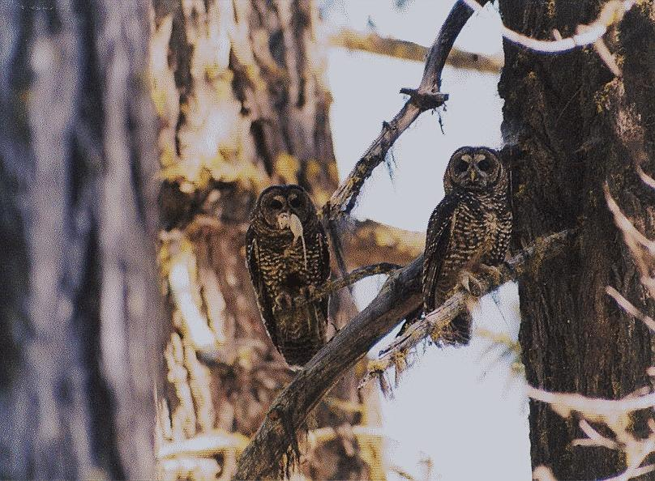
Questions?
Notes:
With that, I hope I have provided a concise summary of spotted owl population status, an assessment of the current threats to the species, and what is needed for species recovery.

