Slide 1



Reconciling Northern Spotted Owl Critical Habitat and Principles of Conservation Planning
Brian Woodbridge, Jeffrey Dunk, Nathan Schumaker, Elizabeth Glenn, David LaPlante, and Brendan White
Notes:
Why would these two things need reconciling? Past few decades great strides in population modeling, vegetation mapping and modeling and the technological integration of these tools. This has lead to robust conservation planning. However, the statutory language of the ESA (which is the primary legal authority enabling this conservation planning) has not changed since 1973 and has been subject to various and often conflicting court decisions. We must though, align our planning processes to the statute. Our process therefore was to blend in the best possible way todays conservation thinking with the ESA statute. In particular, meeting the Section 2 of the act that says provides a means whereby the ecosystems upon which T&E species depend may be conserved.
While a good number of people worked on the CH rule, would like to recognize the interagency/organization core team members listed here. Single out D. LaPlante of Natural Resources geospatial who managed a lot of the GIS work.

Slide 2
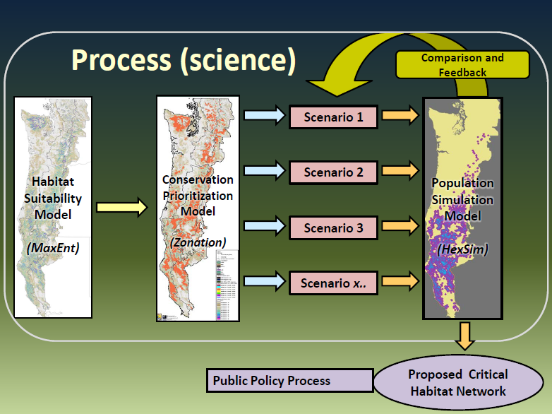
Notes:
As you’ll see in Brian’s talk, our conservation planning framework integrates 3 basic steps: a spotted owl habitat model, a habitat conservation planning model, and a population simulation model. Collectively, these modeling tools allow for comparison of estimated spotted owl population performance among alternative conservation network scenarios. The simulations from this spotted owl population model are not meant to be estimates of what will occur in the future, but provide information on trends predicted to occur under different habitat conservation scenarios. Each step in this science-based process must align with the statutory definitions contained in the ESA.

Slide 3
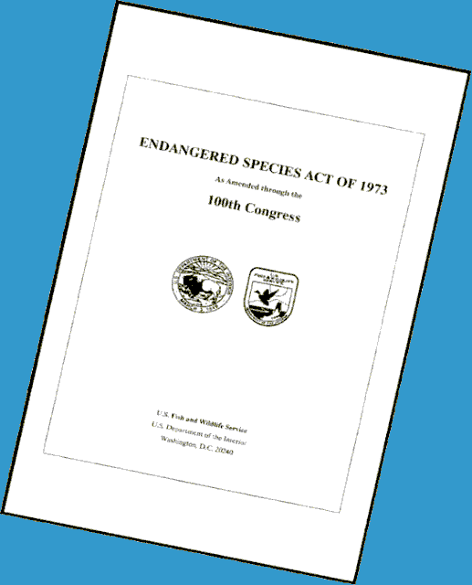
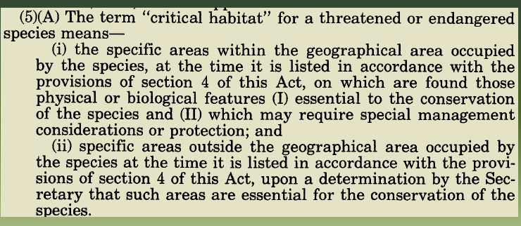
Statutory Definition of Critical Habitat
Notes:
What is the statutory definition of critical habitat? Excerpt from hallowed text
Every word from “conserve to “geographical area, to occupied,” has been defined and redefined via policy and court decisions…attempting to meet the intent of Congress. In our efforts, we focused on a subset of elements that are directly associated with our evaluation and modeling process.

Slide 4
Critical Habitat Definition - Distilled
Specific areas within the geographical area occupied by the species at the time of listing
Contain the physical or biological features essential to the conservation of the species and
Requires special management or protection
Notes:
As defined in section 3 of the Act, critical habitat includes…
The specific areas within the geographical area occupied by the species at the time it was listed (1990) AND on which are found those physical and biological features essential to the conservation of the species. IE features that adequately provide for a species life-history processes AND which may require special management considerations or protection.

Slide 5
Physical and Biological Features PBFs essential to the conservation of the species….
Space…;
Food, water,…;
Cover and shelter;
Sites for breeding…;
Habitats that are protected…
Notes:
In general terms, the PBFs include but not limited to: SPACE for individual and pop growth and normal behavior. FOOD, water, light, air or other physical requirements, SITES for breeding, rearing, reproduction, germination. HABITAT protected from disturbance or represent the historical geographical and ecological distribution of the species.

Slide 6
What are the PBFs Essential to the Conservation of Spotted Owls?
Features were identified based on decades of field research
Used a modeling approach to identify where these features are on the landscape
Forested lands that can be used for nesting, roosting, foraging, or dispersal.
Notes:
So what are the Features (in terms of space, food, cover, site for breeding etc) to the conservation of the spotted owl? To get at this question, we had decades of field research. While the NSO is considered a habitat specialist, it does have some plascticy in that it uses a broad array of forest types and this likely a reflection of the large geographical range of the subspecies.
So the combination of the research along with modeling approach to identify where these features are on the landscape and also to develop a reserve design that best incorporates these features lead us to conclude that the NSO PBFs are forested lands that can be used for Nesting, roosting, foraging or dispersal.

Slide 7
Primary Constituent Elements
“The Secretary shall focus on the principle biological or physical elements within the defined area that are essential”
PCEs may include:
Roost sites, nesting grounds, spawning areas, feeding sites, seasonal wetlands….
NSO – Forest Types that support nesting, roosting, foraging, & dispersal
Notes:
The determination of the PBFs can inform our identification of Primary Constituent Elements aka (PCEs).
In the case of the spotted owl, the PCEs include forest types and other habitat requirements that support: habitat that provides for nesting and roosting; habitat that provides for foraging, and habitat that supports the transient and colonization phases of spotted owl dispersal. Key to PCE discussion is that it also means including those elements t that make it suitable for N/R and foraging such as it Must be spatially arranged in such a manner leading to population persistence.
How did we do that for CH?

Slide 8
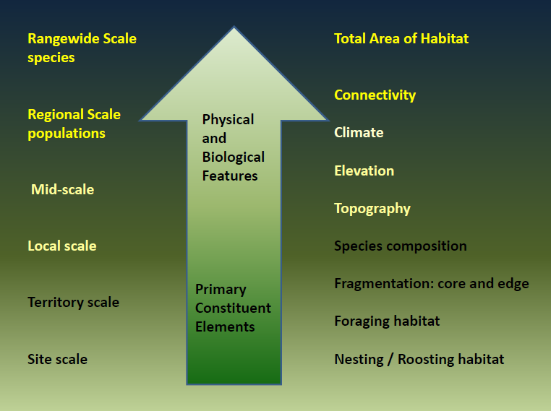
Notes:
We did this by using habitat models that assessed NSO habitat suitability based on habitat conditions within 500 acre core use areas. Because core use areas support a mix of nesting, roosting, and foraging habitats, their characteristics provide a basis for identification and quantification of PCEs.
PBFs are the forest lands that have the features
PCEs – forest types… that provide for…PCE 2, 3, 4

Slide 9
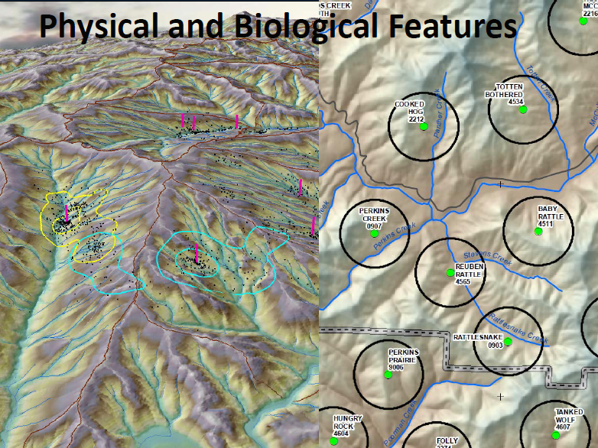
Notes:
Example of PBFs and PCEs and the interplay, dependency of many of the features…..

Slide 10
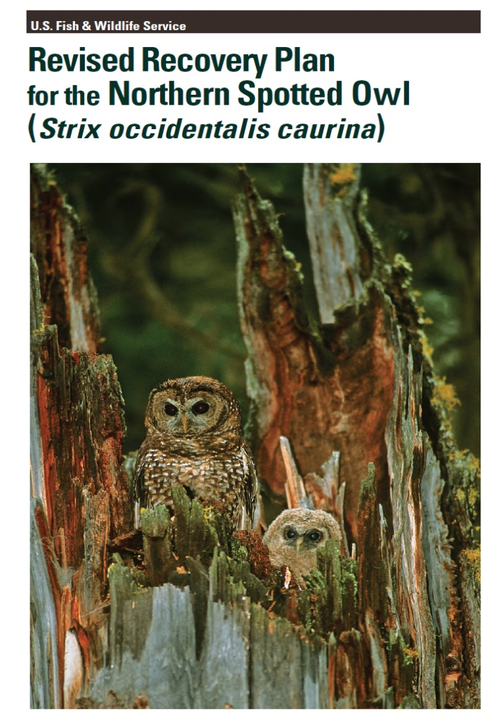
What is “essential to the conservation of the species?”
Recovery Objectives and Criteria
HEXSIM comparisons
Notes:
ESA statute does not define essential…..
Besides all of the stand, territory and landscape data on NSOs, how did we gage what we essential? We asked how well it is meeting RP Criteria of well distributed populations, population persistence, and well connected populations.
Part of this evaluation used HEXSIM which allow us to assess pop trends for the various scenarios. Again, not in future context but in comparison among the scenarios.
Quanitatively make relative comparisons and the process can be repeated.

Slide 11
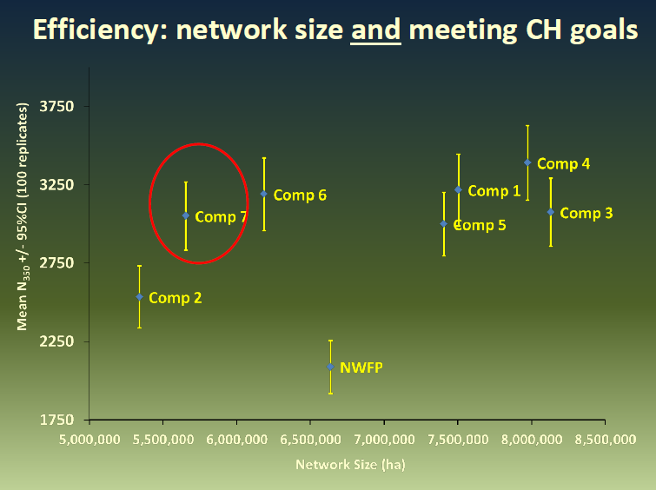
Notes:
Science and art of running various composite maps. Attempted to maximize reliance on public lands, looking first to Federal lands and secondarily to State lands, and incorporated private lands only when Federal and State lands were insufficient to meet the recovery needs of the species.

Slide 12
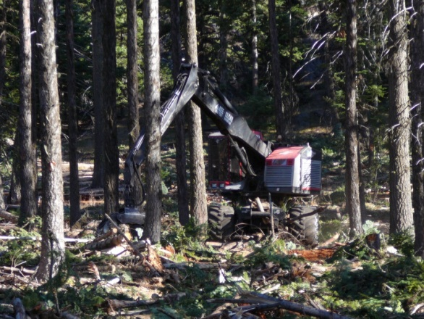
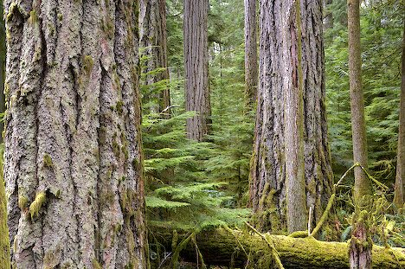
How do “ Special Management Considerations” Influence the Designation?
Conserve extant high quality habitat
Conserve occupied habitat
Includes both passive and active management
FWS provides recommendations for avoiding adverse modification
Notes:
When designating critical habitat we assess features, those PCEs, PBFs, that are essential to the conservation of the species and which may require special management considerations or protection.
An effective CH strategy needs to conserve extant high quality northern spotted owl habitat in order to reserve declining population trends and address the threat from barred owl which is a RP Criterion AND the “Continued maintenance and Recruitment of NSO habitat which is also a RP Criterion. Meeting these Criteria require special management considerations of the PBF and PCEs.
While we recommend conservation of high quality and occupied northern spotted owl habitat, long-term northern spotted owl recovery could benefit from forest management where the basic goals are to restore or maintain ecological processes and resilience.

Slide 13
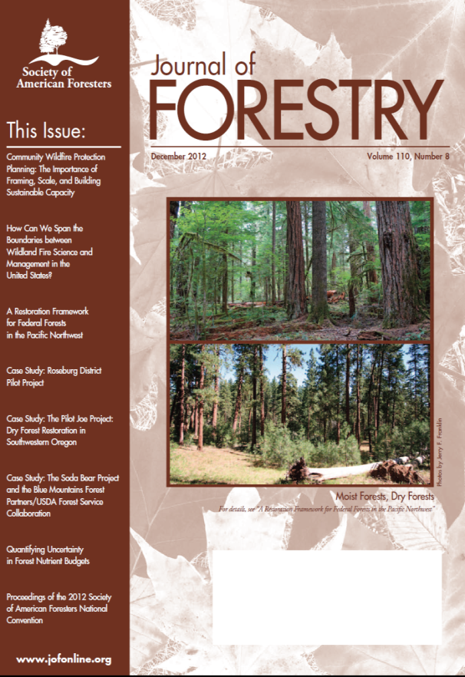
Critical Habitat is NOT…
all areas occupied by the species
a management prescription for federal lands
a reserve or set aside
Notes:
Perception that CH is handsoff. Although critical habitat is defined as having features that are essential to the conservation of the species, this does not imply that every acre or every stand, designated as critical habitat, is or must necessarily be in a suitable habitat condition at all times. In the case of the spotted owl, the quantity and quality of forest stands change spatially, structurally and temporally due to natural process and human activities. The consultation process under section 7 of the Act related to critical habitat assess the effects of a proposed federal action, taken together with any cumulative effects, on the capability of this shifting mosaic of critical habitat to serve its intended conservation role for the spotted owl.
While HQ habitat is to be protected, the CH units are large to mostly accommodate what is known about ecosystems processes and to provide for strategic, well placed projects that can address currently diminished processes.
Special management includes both passive and active management (JoF December 2012 and followup issue in 2013 debating the merits of certain types of forestry practices.

Slide 14
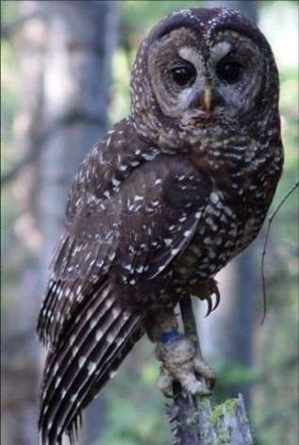
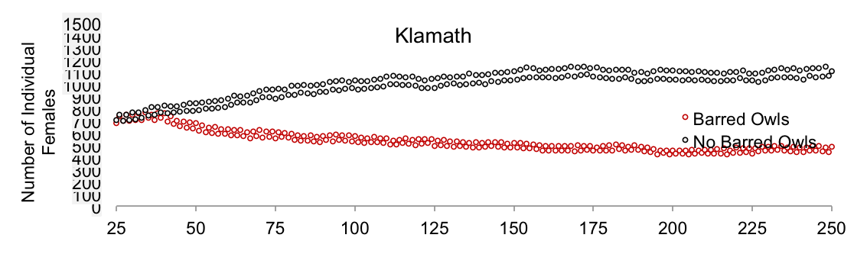
Spotted Owl Critical Habitat Summary
Guided by Principles of Conservation Biology
Modeling allowed a quantitative assessment of different networks
Modeling allowed an approach to address the CH policy issues
Conserve the species and the ecosystems upon which they depend
Notes:
So to sum up and circle back to where we started with the question of Reconciling NSO conservation planning and the ESA CH statute. The 2011 NSO RP and the 2012/13 CH rule take an ecosystem approach and it encourages 5 things for the land managers to consider: 1) conserve older forests and manage them for resilience, 2) restore fire and other natural processes where they have been suppressed or altered, 3) conserve legacy habitat element is post-fire landscapes, 4) design and implement restoration treatments at the landscape scale, and 5) reconcile any short-term impacts of this management with long-term spotted owl conservation. Essentially, weighing the risks of taking management action versus inaction? AND evaluating what are the respective tradeoffs between near-term impacts to spotted owls for longer term gains in forest health, other wildlife species, and other societal values. The plan and the rule embody this thinking.

Slide 15
Acknowledgements
Bob Anthony Barry Noon
Ray Davis Marty Raphael
Katie Dugger Jody Caicco
Karl Halupka Dan Hansen
Paul Henson MJ Mazurek
Michelle Merola-Zwartjes Bruce Marcot
Notes:
Started out the presentation by showing you the names of the CH core team. Here are the other cast members who played key roles, including Dr. Paul Henson who lead the overall effort. Bob Anthony and legacy…

