Slide 1
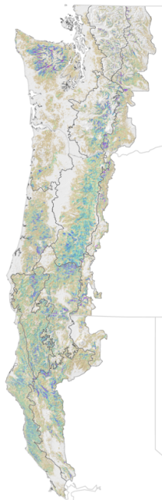
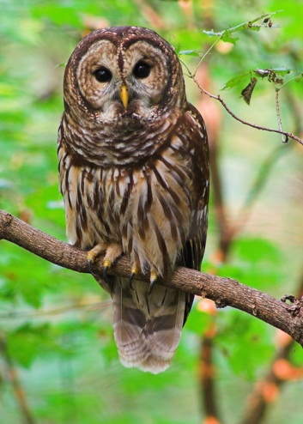
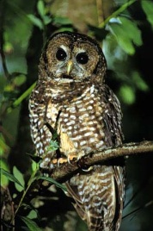



Integrating species distributional, conservation planning, and population models: A case study in conservation network evaluation for the northern spotted owl
Jeffrey R. Dunk¹, Brian Woodbridge², Nathan H. Schumaker³,
Elizabeth M. Glenn⁴, David LaPlante⁵, and Brendan White⁴
¹Dept. Environmental Science and Management, Humboldt State University, Arcata, CA
²U.S. Fish and Wildlife Service, Yreka, CA
³Environmental Protection Agency, Corvallis, OR
⁴U.S. Fish and Wildlife Service, Portland, OR
⁵Natural Resources Geospatial, Yreka, CA

Slide 2

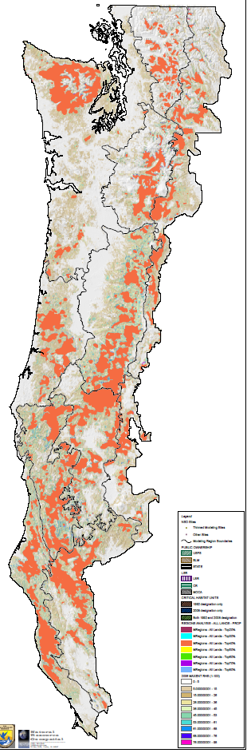
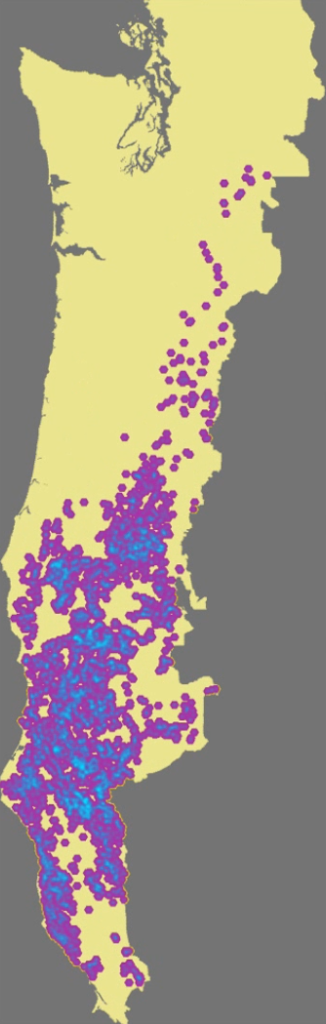
Process (science)
Comparison and
Feedback
Habitat
Suitability Model
(MaxEnt)
Conservation
Prioritization
Model
(Zonation)
Population
Simulation
Model
(HexSim)
Scenario 1
Scenario 2
Scenario 3
Scenario x..
Potential Critical Habitat Networks
Public Policy Process

Slide 3
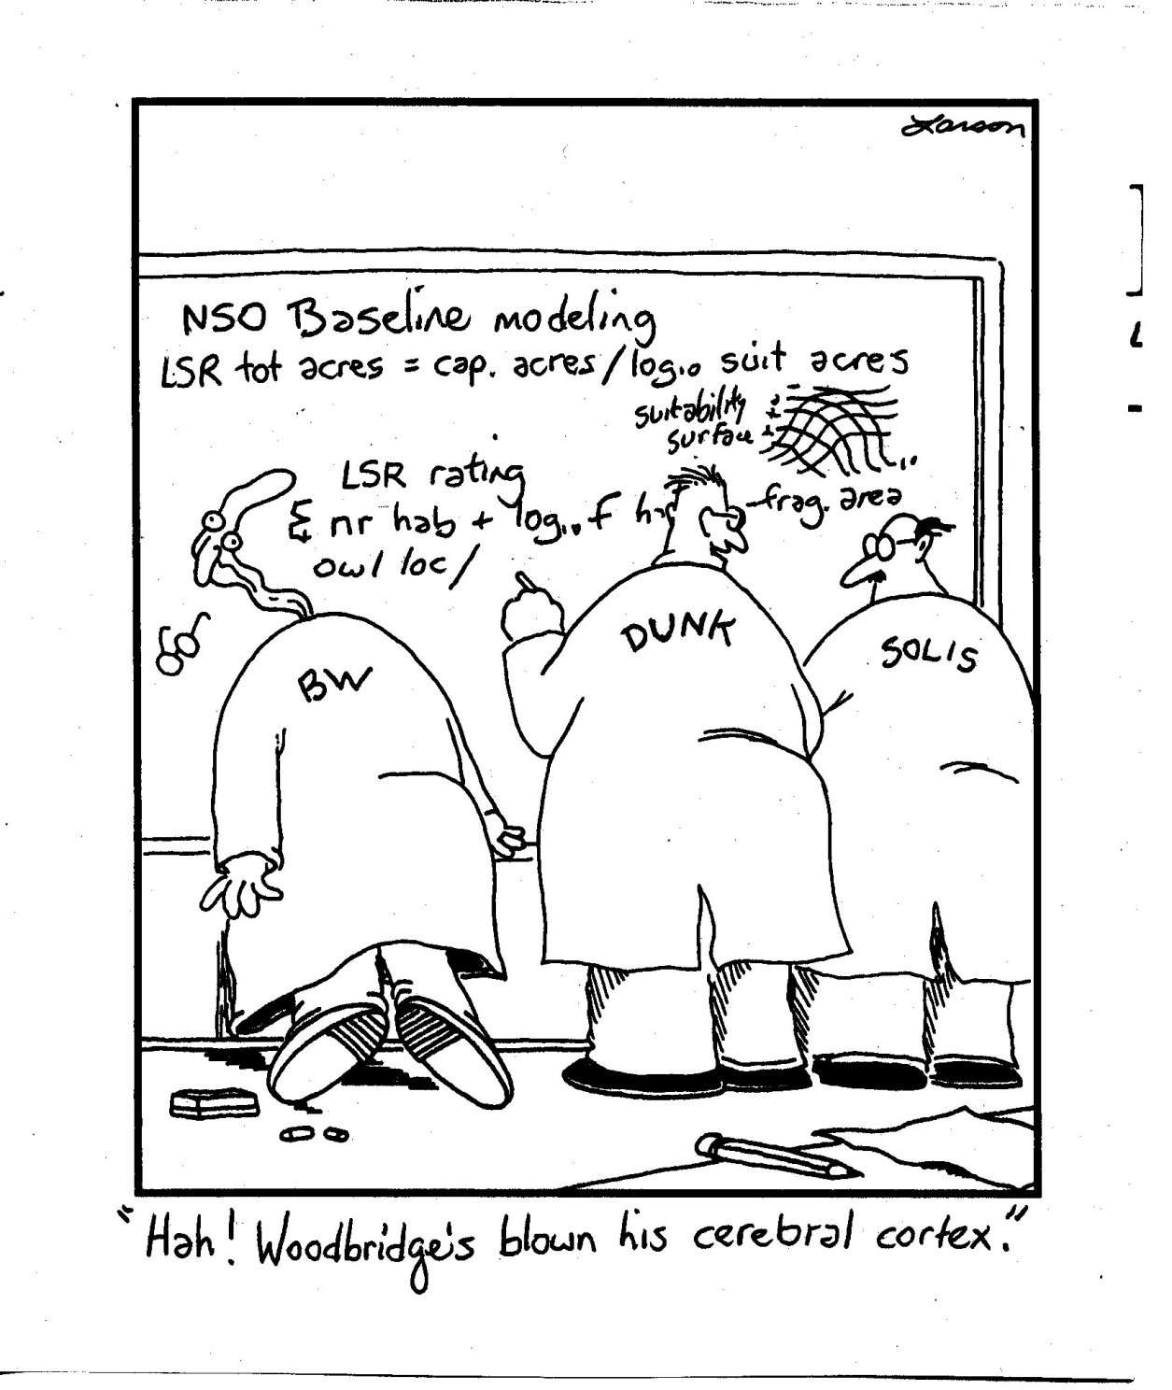
Caution….
This is the 30-minute version of an all-day workshop
= 10,000-foot view!
Marcot
“Hah! Woodbridge’s blown his cerebral cortex!”

Slide 4
Habitat Suitability Modeling
Objective: Develop models to predict habitat suitability for NSO rangewide
Equivalent to prediction of probability of NSO presence (occupancy) based on habitat suitability
Habitat suitability defined as ecological conditions (forest structure/distribution, species composition, topography, local climate) that influence probability of presence

Slide 5
Foundations of habitat modeling process
Review of Literature and Data Sets
Spotted Owl Location Data
Habitat
Suitability Model
(MaxEnt)
Habitat Expert Panels
GNN Vegetation Layer
Partition Range into ‘Modeling Regions’
Topographic, Climate Variables

Slide 6
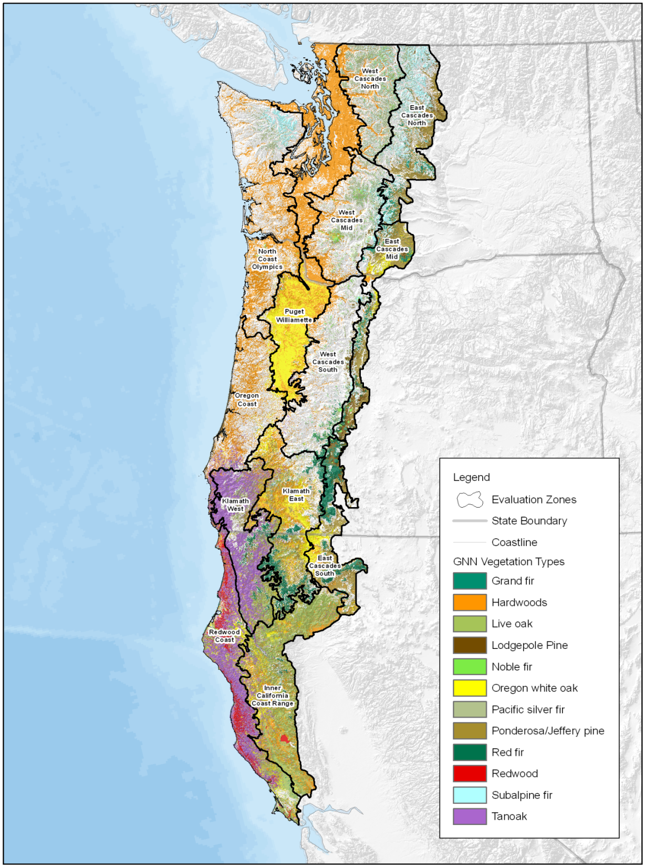
11 Modeling Regions
CODE | Description
NCO | North Coast and Olympic
ORC | Oregon Coast
RDC | Redwood Coast
WCN | Western Cascades - North
WCC | Western Cascades - Central
WCS | Western Cascades - South
ECN | Eastern Cascades - North
ECS | Eastern Cascades - South
KLW | Klamath-Siskiyou - West
KLE | Klamath-Siskiyou - East
ICC | Interior California Coast
Models projected to Puget Lowlands and Willamette Valley

Slide 7
Multi-scaled Approach* *(i.e. bottoms-up)
Climate Variables
Elevation
Topography
Species composition
Fragmentation: core and edge
Foraging habitat
Nesting / Roosting habitat
Regional Scale
Mid-scale
Local scale
Territory scale
Site scale

Slide 8
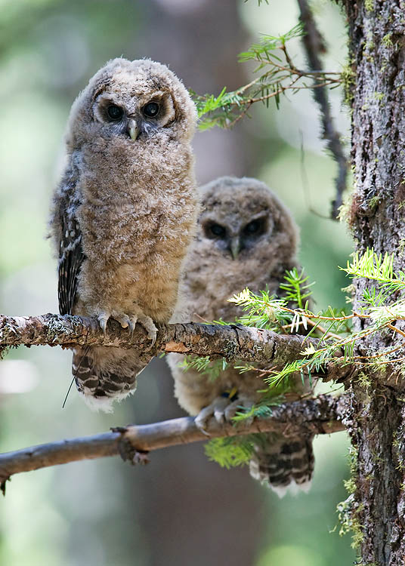
Modeling Foundations Summary
Based on extensive review of NSO habitat relationships
Very large NSO location dataset
Seamless, consistent NWFP vegetation layer
Included abiotic variables
Model at ‘core area’ scale
Developed separate models within 11 modeling regions

Slide 9
Model Results
Eastern Cascades - North
Variable | %
Nesting Hab 06 | 20
Slope position | 14.6
% Douglas-fir | 13.6
January min temp | 10.6
Elevation | 8.3
Foraging Hab 03 | 6.8
NR edge | 5.7
July max Temp. | 4.1
% Subalpine spp | 4
January precip | 3.3
Curvature | 2.9
Insolation | 2.7
July precip | 2.1
% Pines | 1.5
Western Cascades - North
Variable | %
NR edge | 34.4
Nesting Hab 05 | 17.2
Slope position | 13
Curvature | 12.6
Elevation | 8
January precip | 4.3
% Northern hardwoods | 3.7
July max temp. | 2.2
% Subalpine spp | 1.4
Insolation | 0.9
July precip | 0.9
Foraging Hab 05 | 0.8
January min temp | 0.5
NR core | 0.2

Slide 10
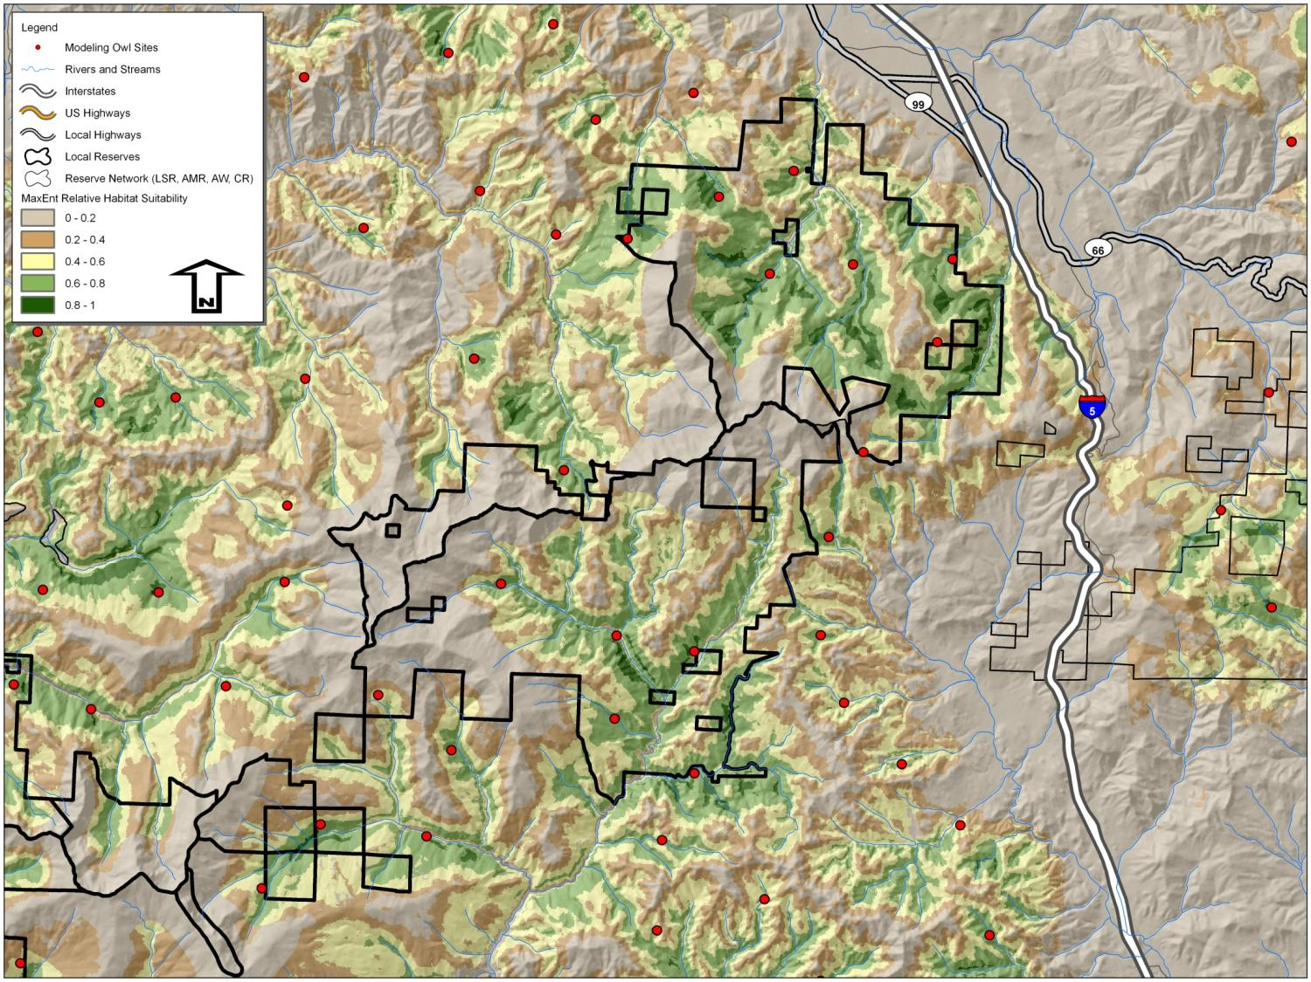
Model Evaluation

Slide 11
Distribution of RHS by modeling region
Notes:
11

Slide 12
Landscape Prioritization Modeling: Zonation Program
Provides a flexible, repeatable method for aggregating habitat value across large landscapes
Optimizes ‘efficiency’: least-cost solution
Useful for a range of conservation strategy approaches (not just = to reserves)

Slide 13
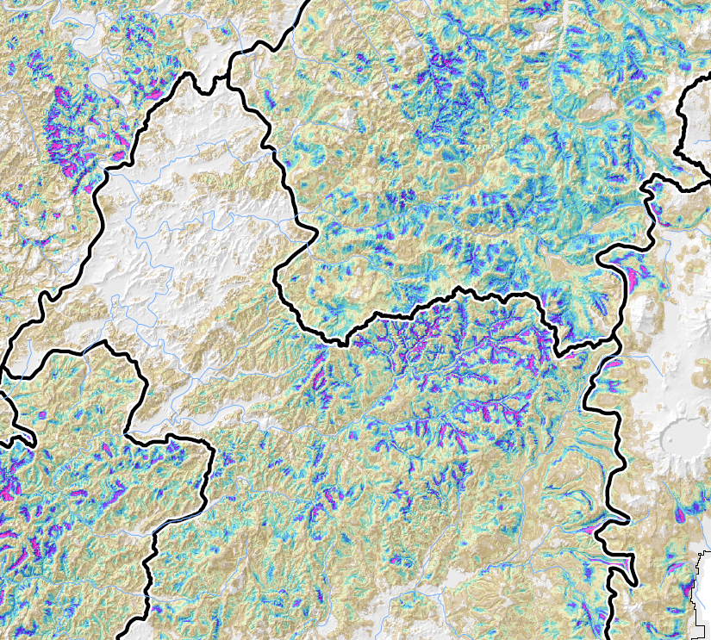
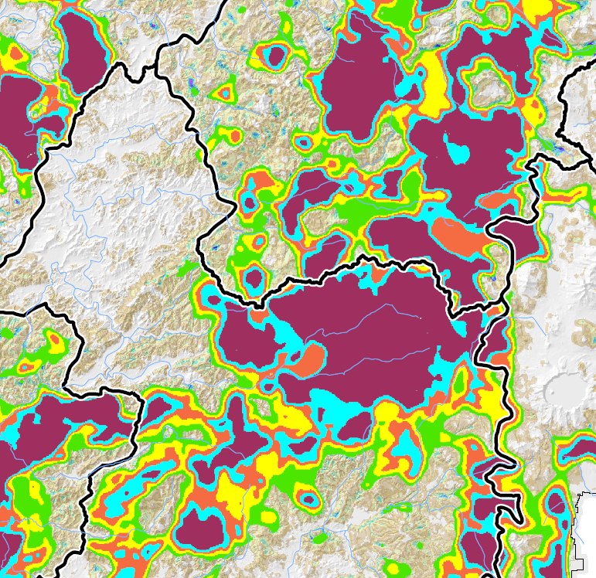


Zonation: RHS to Habitat Value

Slide 14
Network Sizes (million ha)
 | NWFP | Z30all | Z70pub | Comp 1 | Comp 2 | Comp 3 | Comp 4 | Comp 5 | Comp 6 | Comp 7
In network | 6.65 | 3.02 | 10.08 | 7.50 | 5.34 | 8.13 | 7.97 | 7.41 | 6.19 | 5.65
CR considered in network | 0.00 | 2.56 | 1.17 | 1.79 | 1.68 | 0.92 | 0.82 | 0.81 | 1.92 | 2.03
Total Size | 6.65 | 5.59 | 11.25 | 9.30 | 7.02 | 9.05 | 8.79 | 8.22 | 8.11 | 7.69

Slide 15
Population Modeling
Used HexSim, a spatially explicit, individual-based population simulation model
HexSim incorporates NSO demographic parameters, spatial information on resources and stressors, resource competition, and temporal trends in habitat conditions
Compared relative population metrics among alternative reserve designs

Slide 16



We Used HexSim to Ask
What is the relative impact on NSO populations if:
Barred owl encounter rates increase or decrease over time?
RHS increases or decreases over time?
CH was designated in a particular spatial arrangement
Allows for a consistent way to compare population responses to networks and scenarios.

Slide 17
Overview of NSO HexSim Model
Create hexagon network w/RHS map as proxy for resource abundance
Begin with 10,000 owls
Evaluate output
Owls have stopping rules for territory establishment, and acquire resources within home ranges
Model run for 250 or 350 time steps (years)
RHS changes inserted (in v. out of networks)
Barred owl encounters (Y/N) vary by modeling region – once per bird per territory
Barred owl changes inserted
Survival is determined as a function of age, resource acquisition, and barred owl Y/N (+/- 2.5%; phases 2-3)
Juvenile dispersal occurs
Reproduction happens, but only for territory holders. Related to age class (+/- 50%; phases 2-3)

Slide 18
Does our HexSim NSO Model Produce Reasonably Accurate Predictions?

Slide 19
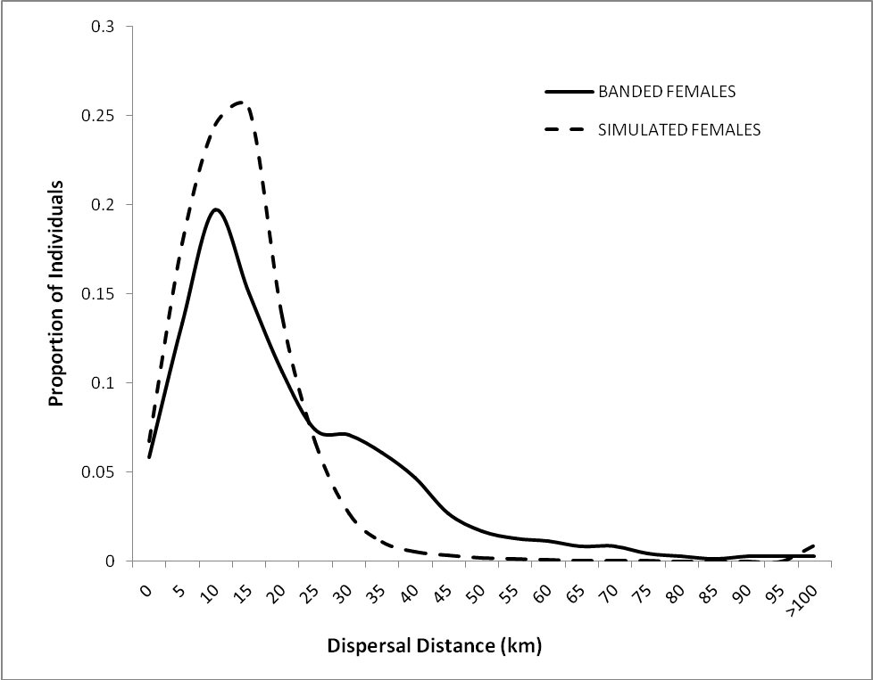
Does Our HexSim NSO Model Produce Reasonably Accurate Predictions?

Slide 20
RHS and Barred Owl Scenarios
HAB1 – isolated reserves
HAB2 – maintained high RHS on public land
HAB3 – maintained high RHS on all land
Optimistic – relatively few changes
Pessimistic – isolated reserves
no barred owls
barred owls at currently estimated encounter probabilities
barred owl enc. prob. = 0.25
barred owl enc. prob. = 0.50
ceiling on enc. prob., generally minor changes (some ↑, some↓)

Slide 21
Networks by “what if” scenarios
 | Phase 1 | Phases 2 & 3 | Phase 4
Networks (NWFP in all) | 7 | 8 | 4
RHS scenarios | 3 | 2 | 2
barred owl scenarios | 4 | 1 | 1
Network x RHS x barred owl | 84 | 16 | 8
Replicates | 5 | 100 | 100
Environmental stochasticty | no | yes | yes

Slide 22
Network Size (million acres)
 | NWFP | Z30all | Z70pub | Comp 1 | Comp 2 | Comp 3 | Comp 4 | Comp 5 | Comp 6 | Comp 7
In network | 6.65 | 3.02 | 10.08 | 7.50 | 5.34 | 8.13 | 7.97 | 7.41 | 6.19 | 5.65
CR considered in | 0.00 | 2.56 | 1.17 | 1.79 | 1.68 | 0.92 | 0.82 | 0.81 | 1.92 | 2.03
Total Size | 6.65 | 5.59 | 11.25 | 9.30 | 7.02 | 9.05 | 8.79 | 8.22 | 8.11 | 7.69

Slide 23
Metrics Evaluated
Population change over time
Pseudo-extinction thresholds in modeling regions and range-wide
Percent of simulations during which the population went extinct
Population size at last time-step

Slide 24
Barred Owl Impacts? RHS = HAB3 Metric: N₂₅₀/N₅₀*100 (range-wide)
Barred Owls | NWFP | Z30all | Z50all | Z70all | Z30pub | Z50pub | Z70pub
None | 95.3 | 94.7 | 102.2 | 103.3 | 96.8 | 102.0 | 100.9
0.25 everywhere | 64.2 | 69.9 | 77.0 | 84.0 | 65.7 | 73.5 | 77.4
Current | 59.8 | 56.3 | 58.7 | 60.5 | 58.0 | 57.7 | 63.0
0.5 everywhere | 9.0 | 10.5 | 9.5 | 13.2 | 8.7 | 8.8 | 9.3

Slide 25
Results (general)
Extinction never occurred range-wide, but occurred in some modeling regions, especially under current barred owl encounter probabilities and when they were 0.5 everywhere.
Pseudo-extinction thresholds (100 and 250) were commonly exceeded in some modeling regions, even under HAB3 and barred owl encounter probability of 0.0.
NWFP performed poorly compared to Zonation scenarios, and larger networks performed better than smaller (but not in a linear way).

Slide 26
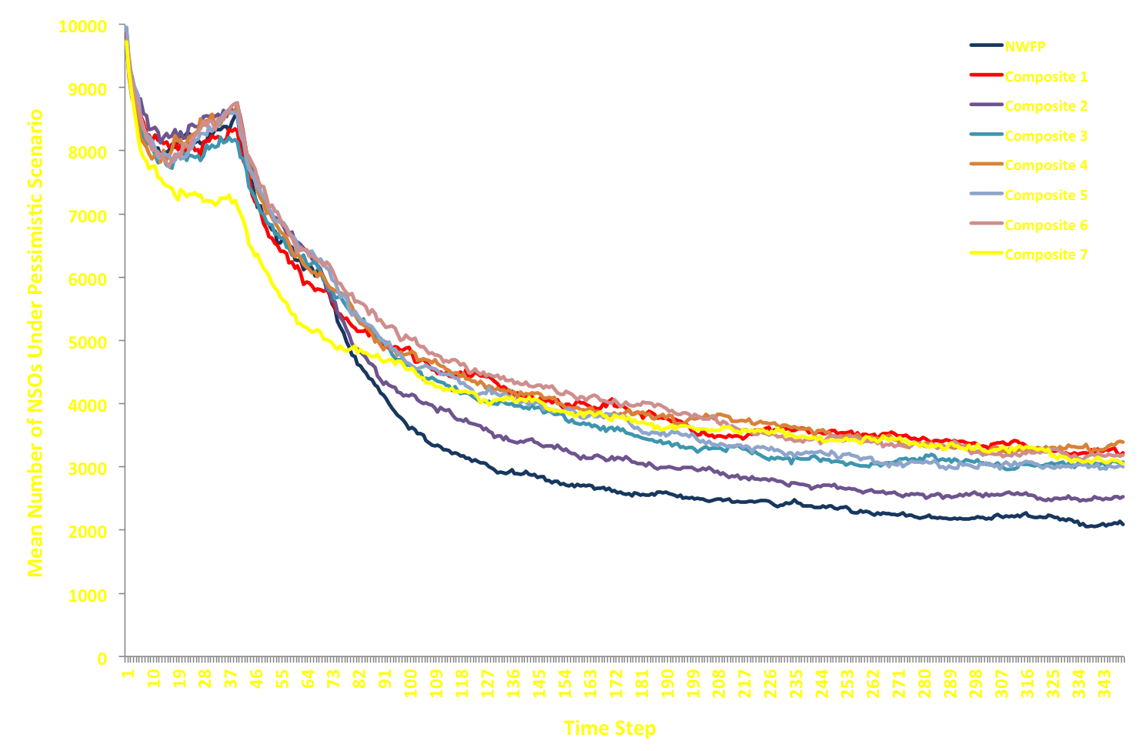
Results Summary

Slide 27
Results Summary

Slide 28
Modeling Region Generalities (pessimistic)
Some modeling regions (WCN, WCC, and NCO in particular) performed quite poorly with all networks. For example, owls went to extinction in 75% - 86% of simulations in WCN and 21% - 35% in WCC.
ICC, KLE, and KLW performed best (0 extinctions, largest populations at TS350)

Slide 29
Range-wide Comparisons (pessimistic RHS )
Population Metric | Network
 | NWFP | Comp1 | Comp2 | Comp4 | Comp5 | Comp7
N₃₅₀ | 2088 | 3216 | 2534 | 3390 | 2999 | 3051
N₃₅₀/N₅₀ x 100 | 30 | 48 | 35 | 48 | 42 | 50
% of simulations N <1250 | 43 | 11 | 26 | 14 | 11 | 12
% of simulations N <1000 | 24 | 5 | 15 | 8 | 5 | 3
% of simulations N <750 | 11 | 0 | 2 | 0 | 2 | 1

Slide 30
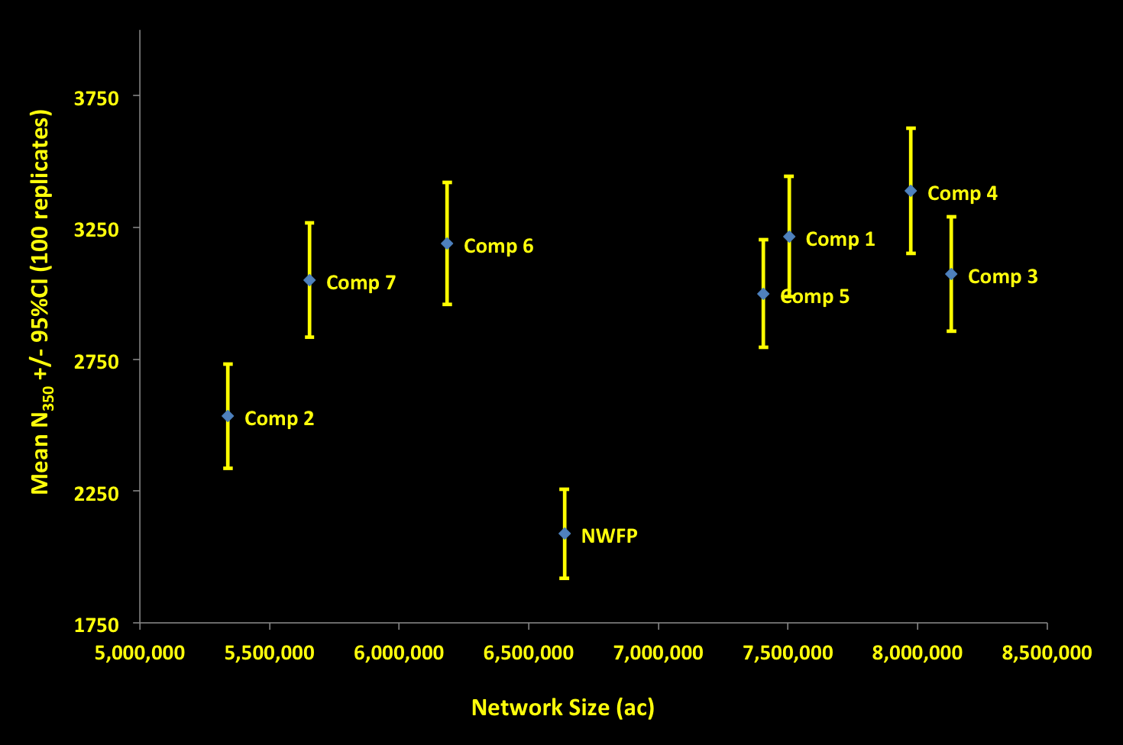
Efficiency: network size and meeting CH goals

Slide 31
Summary
Synthesizing information using MaxEnt, Zonation, and HexSim allowed for a scientifically defensible and repeatable process and for comparisons among multiple alternative CH networks. The NSO was ideally suited for this, given huge amount that we know about it.
Scientists can provide the tools and evaluate “what if” scenarios.
The process enters policy/political/public arena as choices are made on the network to move forward with – Federal Register (proposed rule), economic analysis, public comment, possible modification, final rule.

Slide 32
Acknowledgements
Bob Anthony
Ray Davis
Katie Dugger
Karl Halupka
Paul Henson
Bruce Marcot
Michelle Merola-Zwartjes
Barry Noon
Marty Raphael
Jody Caicco
Dan Hansen
MJ Mazurek
Jim Thrailkill

