Slide 1
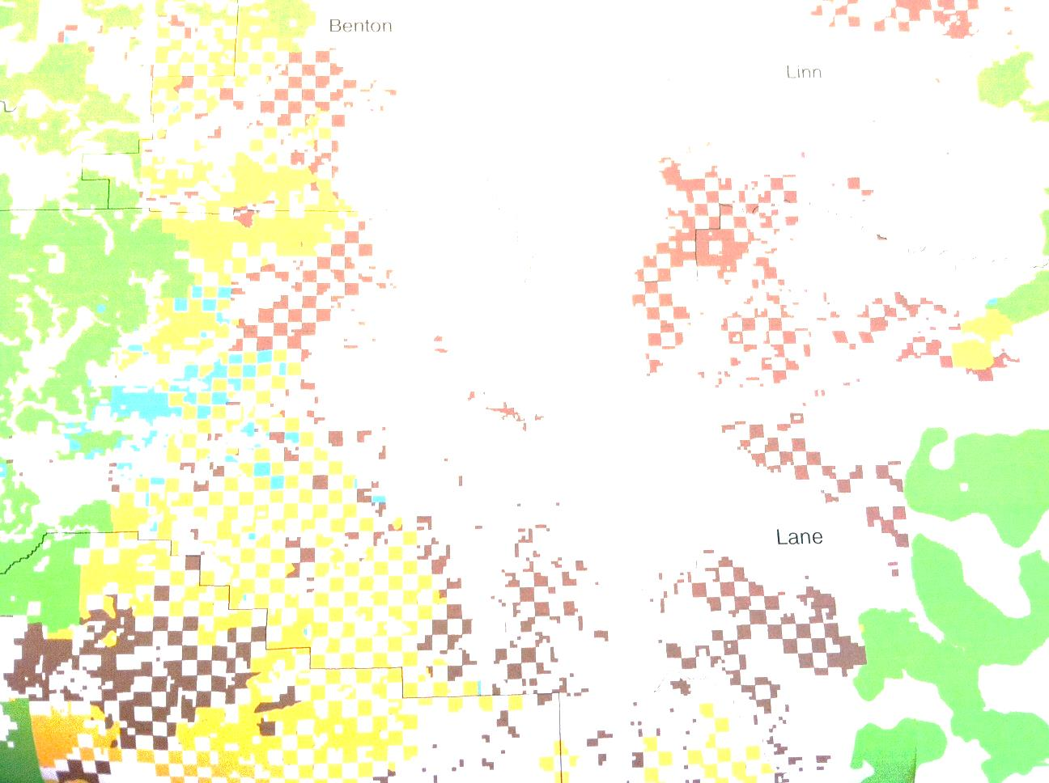
Provisions of the Spotted Owl CHU Rule:
How Are We Interpreting What It Says? And How Does
it Integrate with the NWFP?
Bruce Hollen (BLM) and Brendan White (FWS)

Slide 2
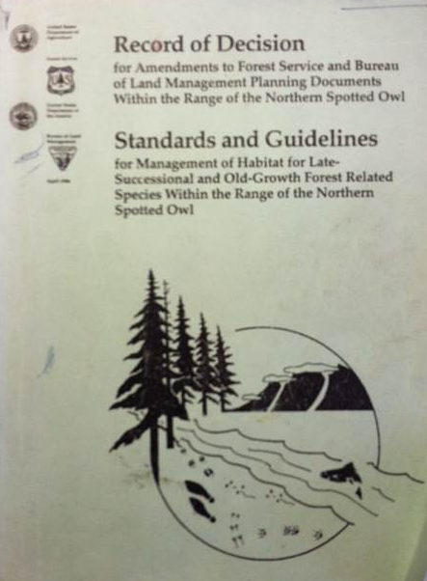
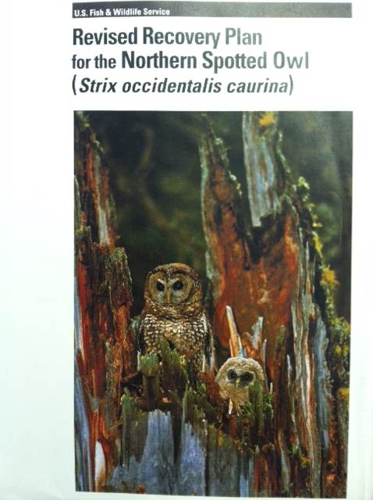
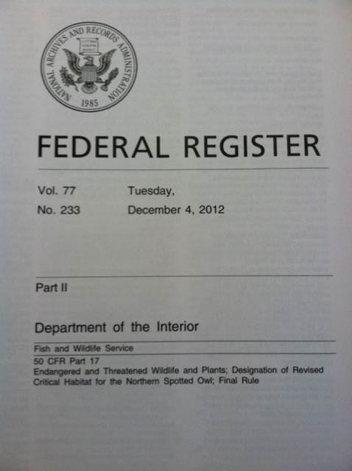

Slide 3
The goal of our critical habitat designation is to aid in the conservation of the spotted owl through the conservation and restoration of the ecosystem and ecosystem processes upon which the species relies.
Critical habitat is designed to support three of the four Recovery Criteria (Revised Recovery Plan):
Recovery Criterion 1 – Stable Population Trend
Recovery Criterion 2 – Adequate Population Distribution
Recovery Criterion 3 – Continued Maintenance and Recruitment of Spotted Owl Habitat

Slide 4
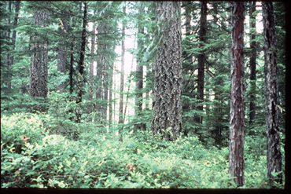
The physical and biological features/primary constituent elements (PBFs/PCEs) provide the spotted owl with the environmental conditions required for its conservation and survival.
So our goal is to retain and restore those elements to provide for spotted owl conservation
Habitat for:
-nesting/roosting
-foraging
-transience/colonization)

Slide 5
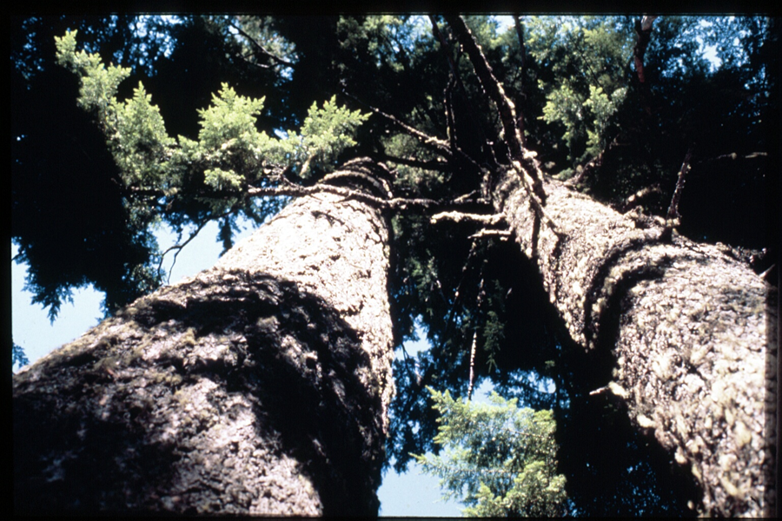
Special Management Considerations
A) Conserve older stands that contain the conditions to support northern spotted owl occupancy or high-value northern spotted owl habitat as described in Recovery Actions 10 and 32

Slide 6
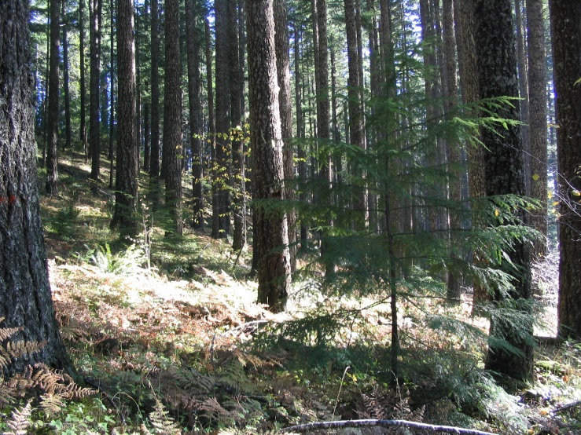
B) Actively manage forests to restore ecosystem health where necessary and appropriate
1. Focus active management in younger forest, lower quality owl habitat, or where ecological conditions are most departed from the natural or desired range of variability.
2. Avoid or minimize activities in active northern spotted owl territories (or the high- quality habitat within these territories).
3. In moist forests on Federal lands, follow NWFP guidelines as informed by the Revised Recovery Plan and focus on areas outside of LSRs (i.e., matrix).
4. In dry forests, follow NWFP guidelines and focus on lands in or outside of reserves that are most ‘‘at-risk’’ of experiencing uncharacteristic disturbance.
5. We encourage land managers to consider
a stronger focus on ecological forestry in
areas where commercial harvest and
restoration are planned.
(p.71882)

Slide 8
Special Management Considerations at a greater landscape scale
(p. 71908)
The recovery of the northern spotted owl therefore requires both protection of habitat and management where necessary to provide sufficient high-quality habitat to allow for population growth and to provide a buffer against threats such as competition with the barred owl.
Conservation and recovery of the species is dependent in part on development of additional habitat to allow for population growth and recovery. Therefore, portions of the habitat mosaic in some subunits designated as critical habitat within the geographical area occupied by the species at the time of listing consist of younger or partially harvested forest. These are essential for the conservation of the species because they are capable of developing the PCEs that support nesting, roosting, or foraging by northern spotted owls that will be necessary for population growth. (p. 71917)

Slide 9
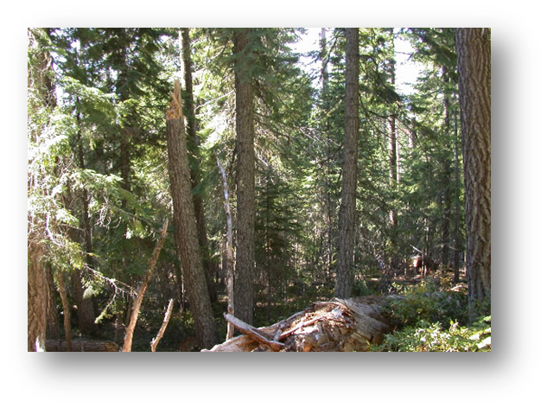
Consultation Effects Determinations
We encourage the level one consultation teams to tailor this scale of the effects determination to the localized biology of the life-history needs of the northern spotted owl (such as the stand scale, a 500-ac (200-ha) circle, or other appropriate, localized scale).
(p. 71939)
Effects analyses should consider the spatial and temporal implications of projects.

Slide 10
Integration with the NWFP
The designation of areas as critical habitat does not change land use allocations or Standards and Guidelines for management under the NWFP.
Active adaptive forest management within critical habitat – Most importantly, this approach is compatible with the ecosystem-based approach of the Northwest Forest Plan.
(p. 71880)
Our discussion of potential management considerations for the northern spotted owl are intended to be fully compatible with the objectives and Standards and Guidelines of the NWFP as informed by the conservation guidelines presented in the 2011 Revised Recovery Plan for the Northern Spotted Owl (USFWS 2011) to provide a means whereby the ecosystems on which northern spotted owls depend will be conserved.
(p. 71882)

Slide 11
Integration with the NWFP(cont)
All BLM and Forest Service lands identified as northern spotted owl critical habitat in this rule fall under the NWFP, and should be managed consistent with its standards.
With barred owls now sharing the range of the northern spotted owl, conservation of northern spotted owls outside NWFP reserved areas is increasingly important for species recovery.
…we fully recognize the ecological functions and land management goals of the different land use allocations as
outlined under the NWFP.

Slide 12
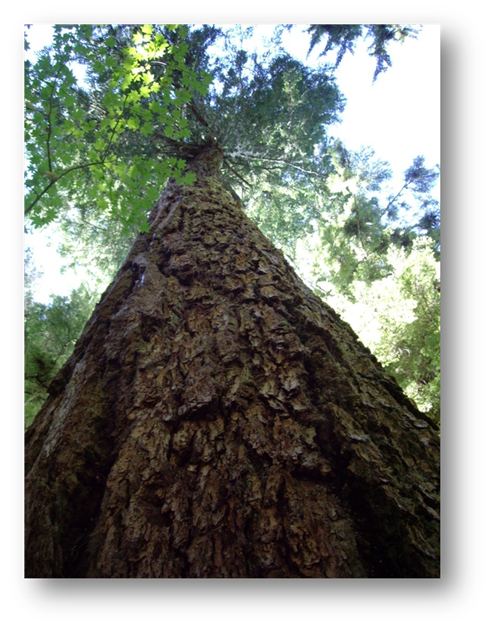

Slide 13
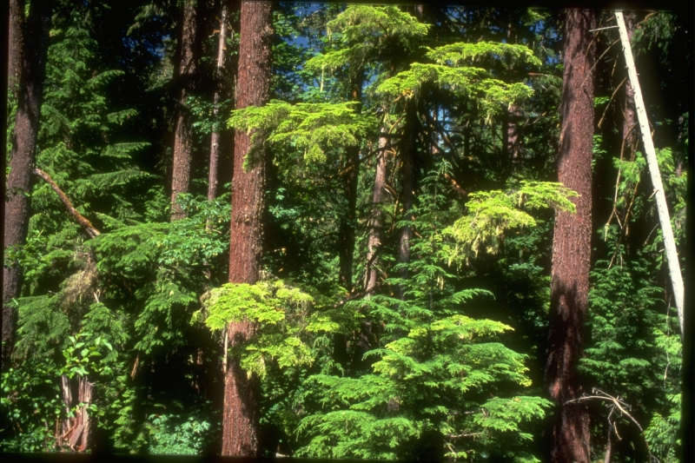
Application of the Concepts in CH Rule (and Recovery Plan).
  avoiding older, more structurally diverse stands,
  using different prescriptions in dry, mixed, and moist forest areas based on developing resistance, resilience, habitat enhancement, or timber production.
  Not treating CH as a reserve, but approaching actions in CH with varying existing conditions and management needs.

Slide 14
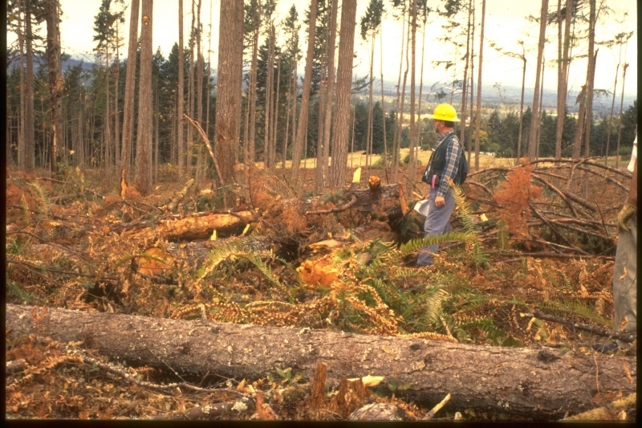
Scale and intensity questions remain when planning projects within CH:
Why this, why here, why now?
Developing context for stand level management within the existing landscape
Analysis of effects is variable among districts– sometimes effects are analyzed at the scale of a habitat element as opposed to habitat or considering effects to Critical Habitat co-extensive with the effects on NSO

Slide 15
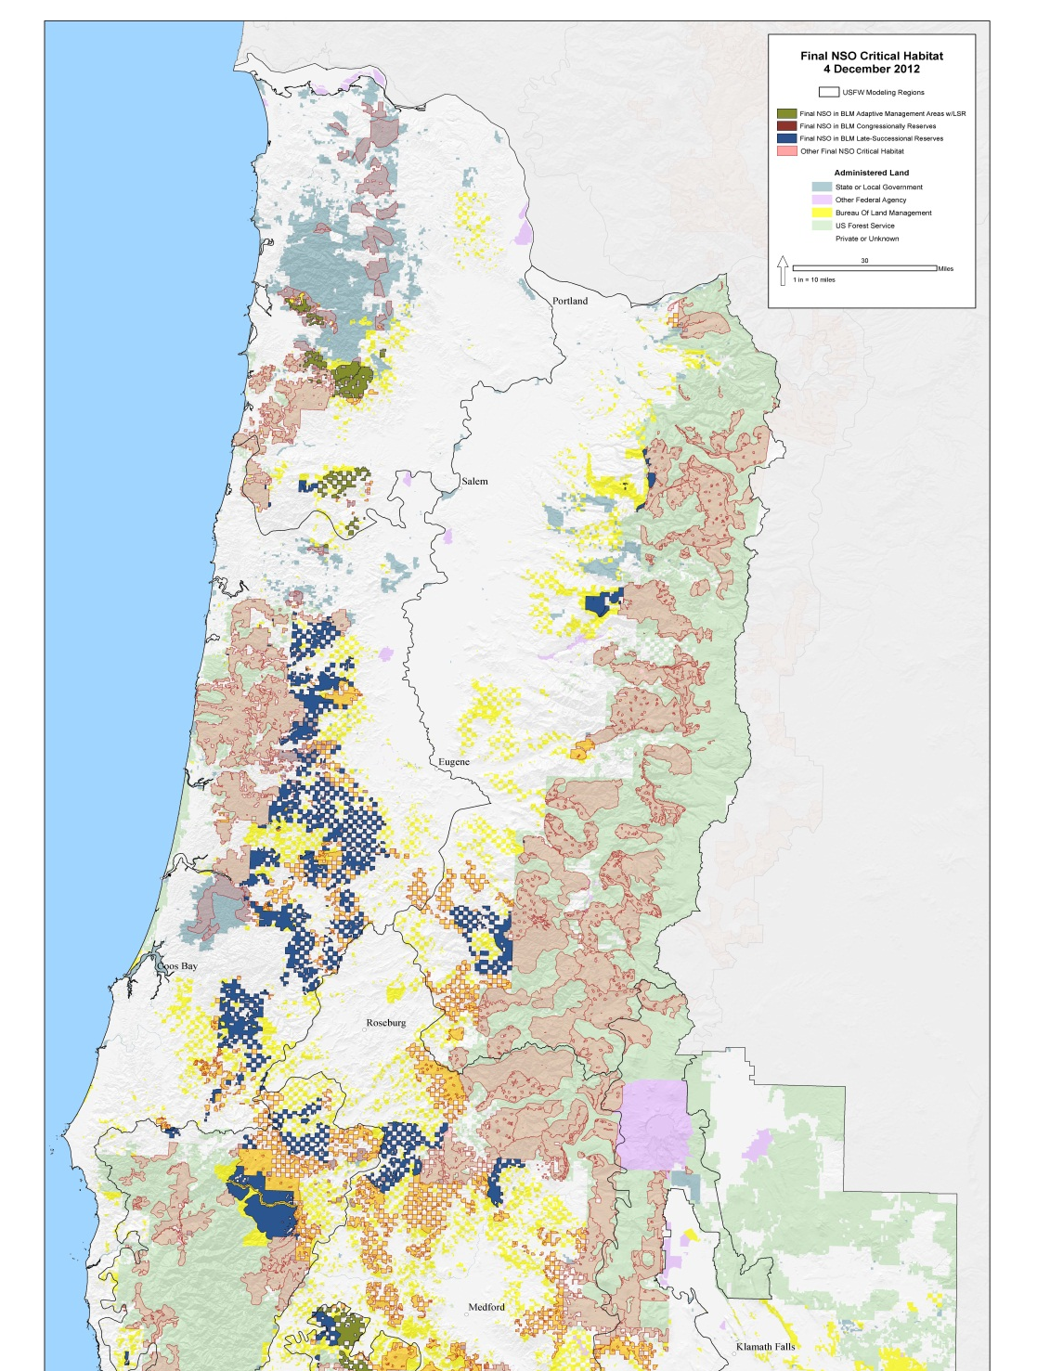
Integration with the NWFP

Slide 16
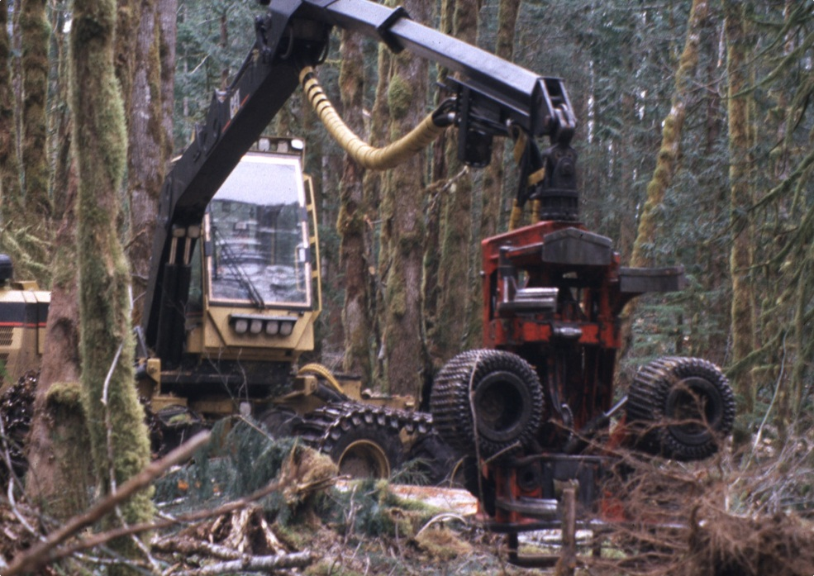
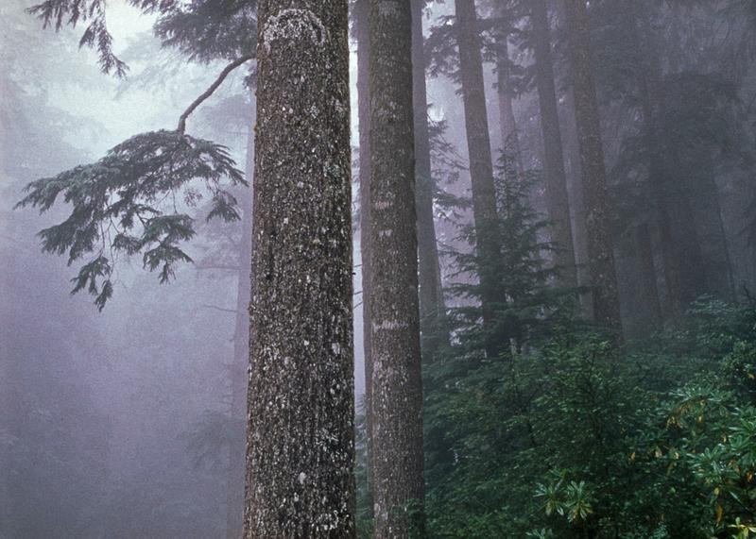
NWFP responsive to two primary needs
The need for forest habitat
The need for forest products
ESA Critical Habitat – Area required to provide for the conservation (survival and recovery) of the species. Federal actions cannot result in the Destruction or Adverse Modification of designated critical habitat.
Notes:
NWFP – Hierarchical classification of land into allocations. Activity in each allocation governed by purpose and need and Standards and Guides. Sets limits on management action that can occur within each allocation.
NWFP – Ecosystem based plan designed to maintain habitat for old-growth related species across the landscape while providing for forest derived goods and services (timber and non-timber forest resources).

Slide 17

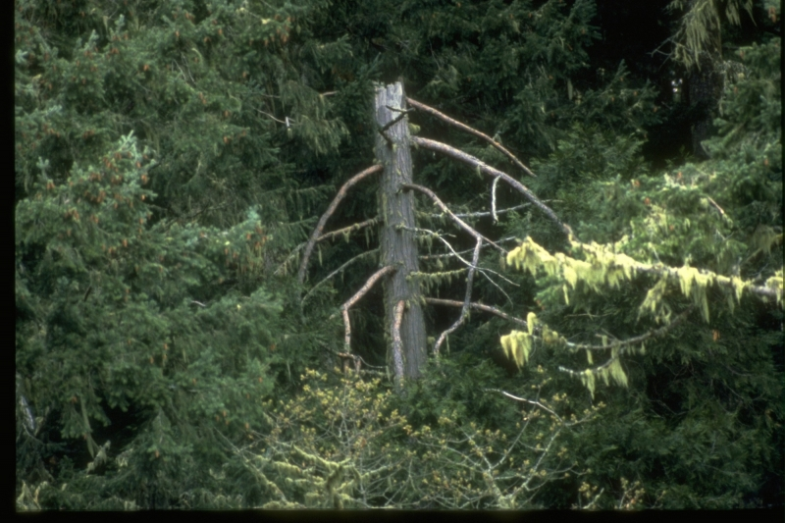
The NWFP S&Gs create a framework of minimum and maximum limits for allowable management within each land allocation. Management activities must fit within the framework.
”
BLM and the FS must operate within the NWFP framework, while not violating their section 7 requirements to avoid destruction/adverse modification.
Federal agencies also have ESA section 7(a)(1) responsibilities to “utilize their authorities in furtherance of the purposes of this Act by carrying out programs for the conservation of endangered species and threatened species….”

Slide 18
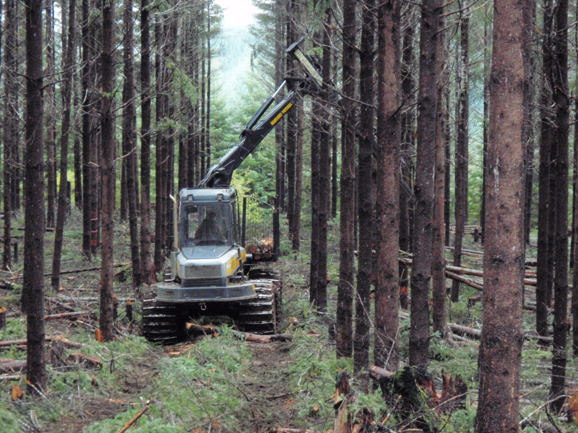
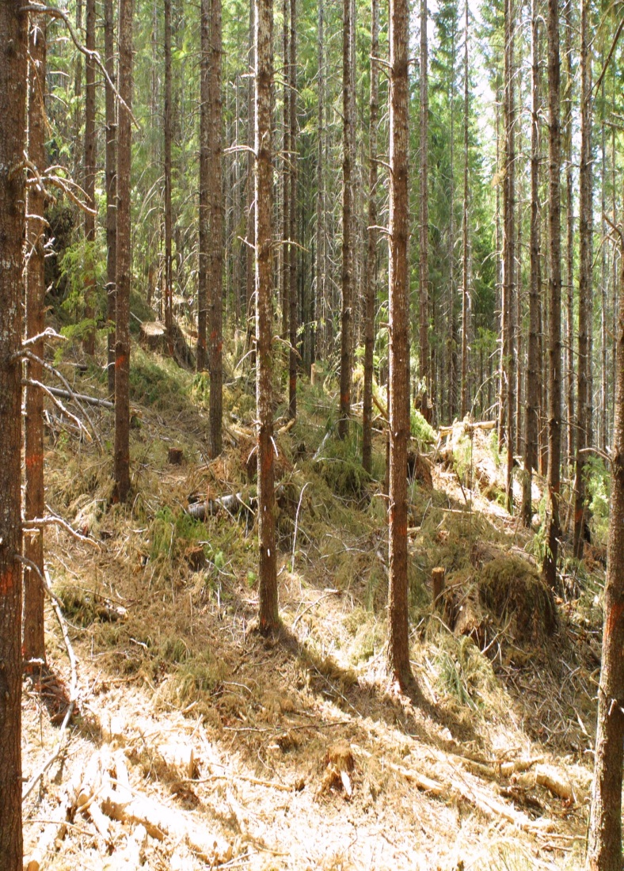
CH designation is not an absolute prohibition on management that would adversely affect Critical Habitat.
“Adverse effects on …. constituent elements or segments of critical habitat generally do not result in….adverse modification determinations unless that loss, when added to the environmental baseline, is likely to result in significant adverse effects throughout the species’ range, or appreciably diminish the capability of the critical habitat to satisfy essential requirements of the species.” (ESA Consultation Handbook)
Notes:
Butte Environmental Council v Salazar 2010

Slide 19
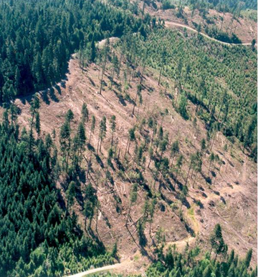
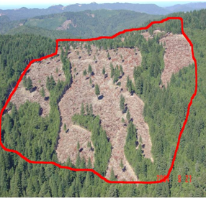
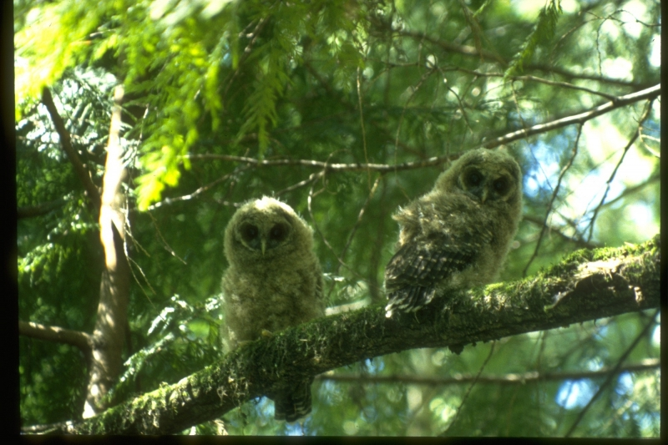
The inherent flexibility of the NWFP and implementing LRMP/RMPs will allow forest management that is not inconsistent with the guidance, recommendations, and purpose described in the Critical Habitat rule
– To a point.

