Slide 1

Lower South Fork McKenzie River Floodplain Enhancement Project
Use of LiDAR in Restoration Design
Kate Meyer, USFS Fisheries Biologist
Willamette National Forest, McKenzie River Ranger District

Slide 2
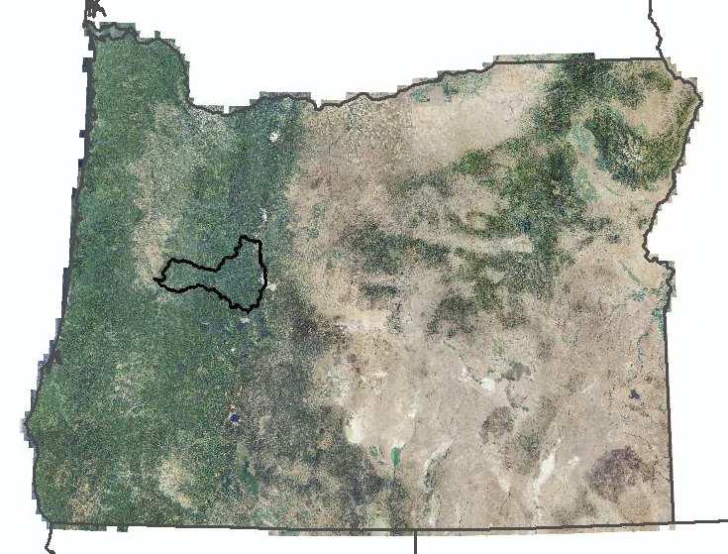

Slide 3
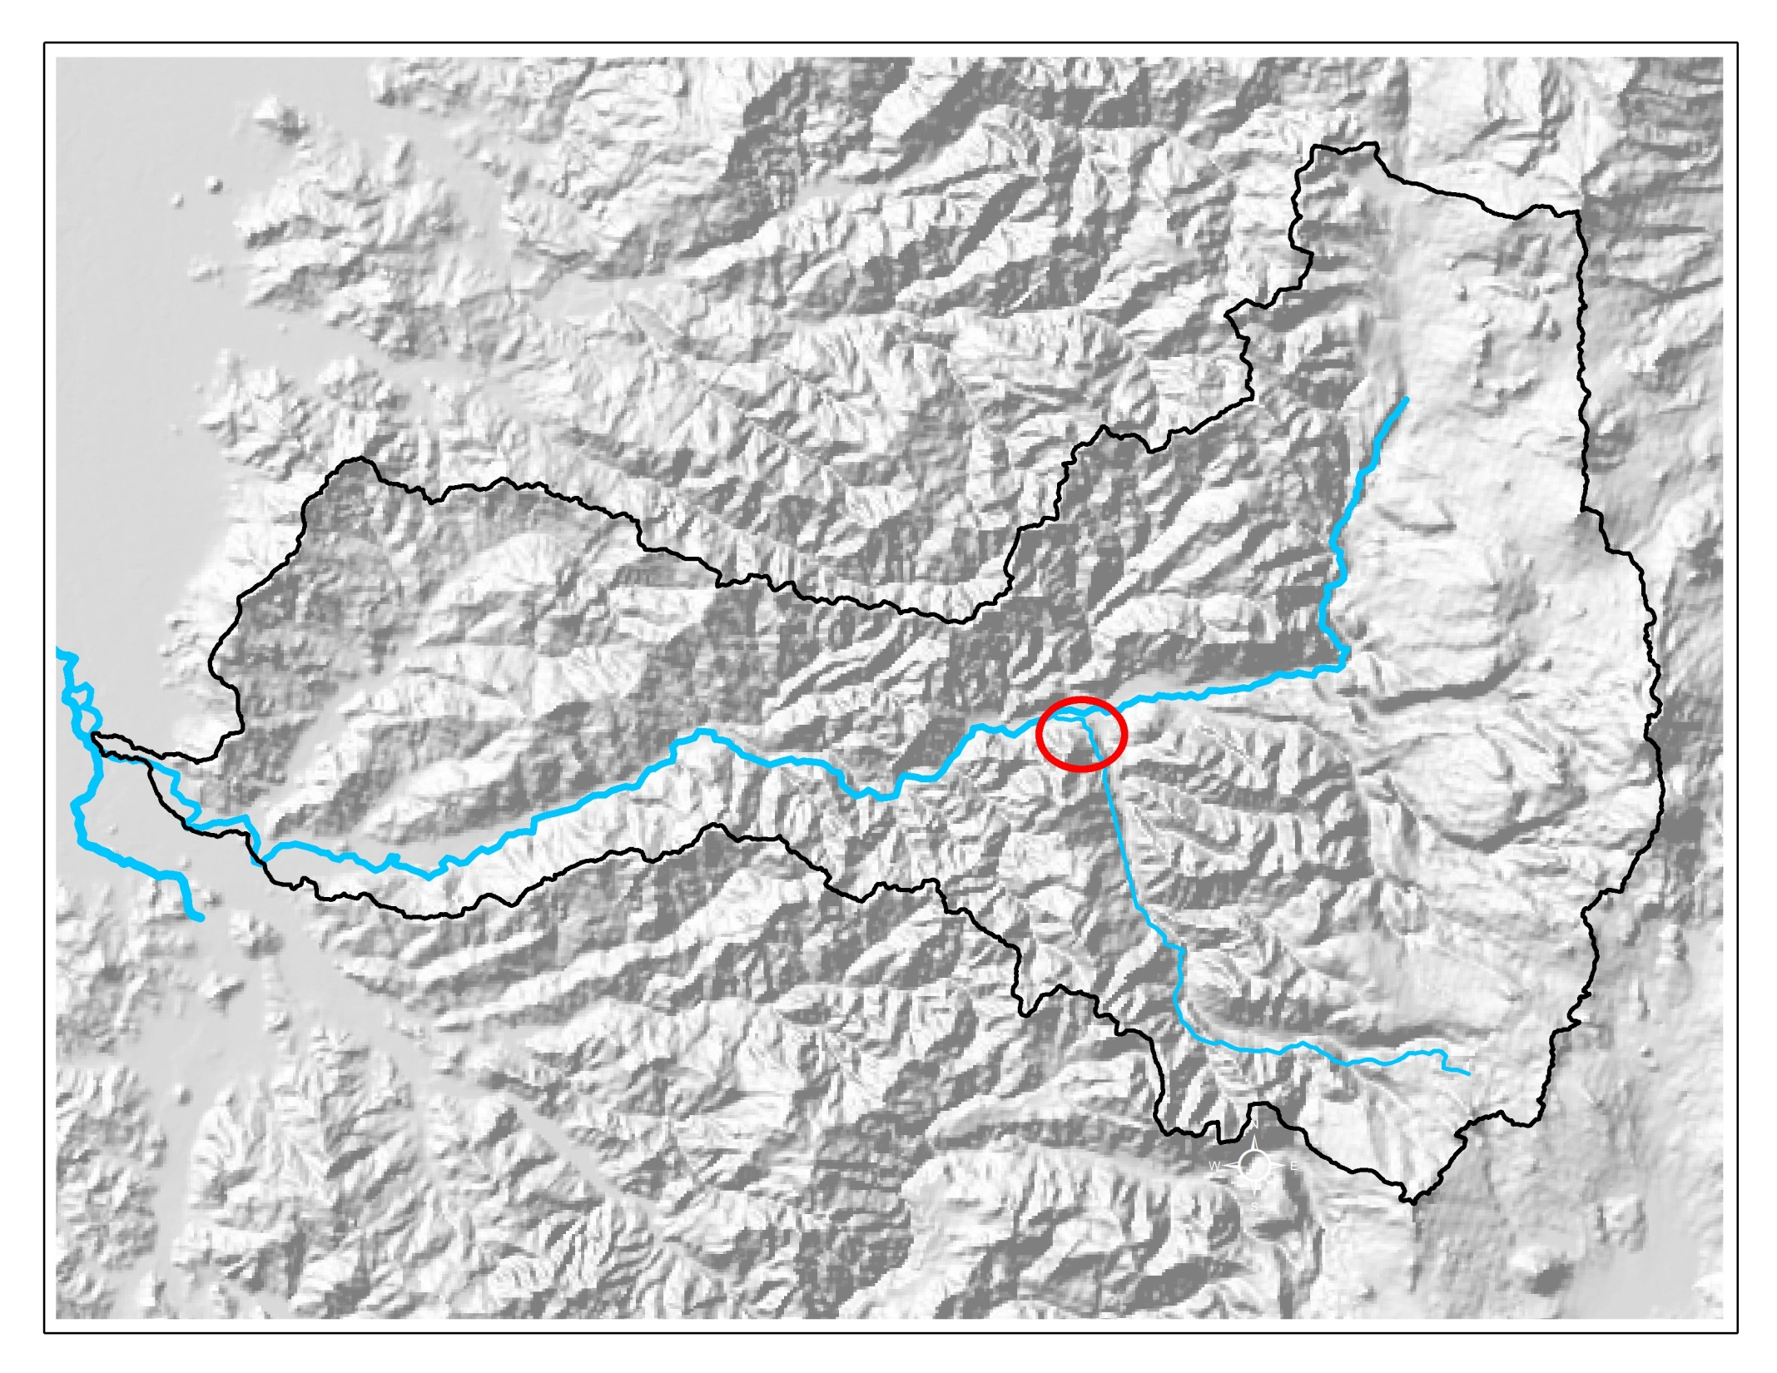
McKenzie River
Project Area
South Fork

Slide 4
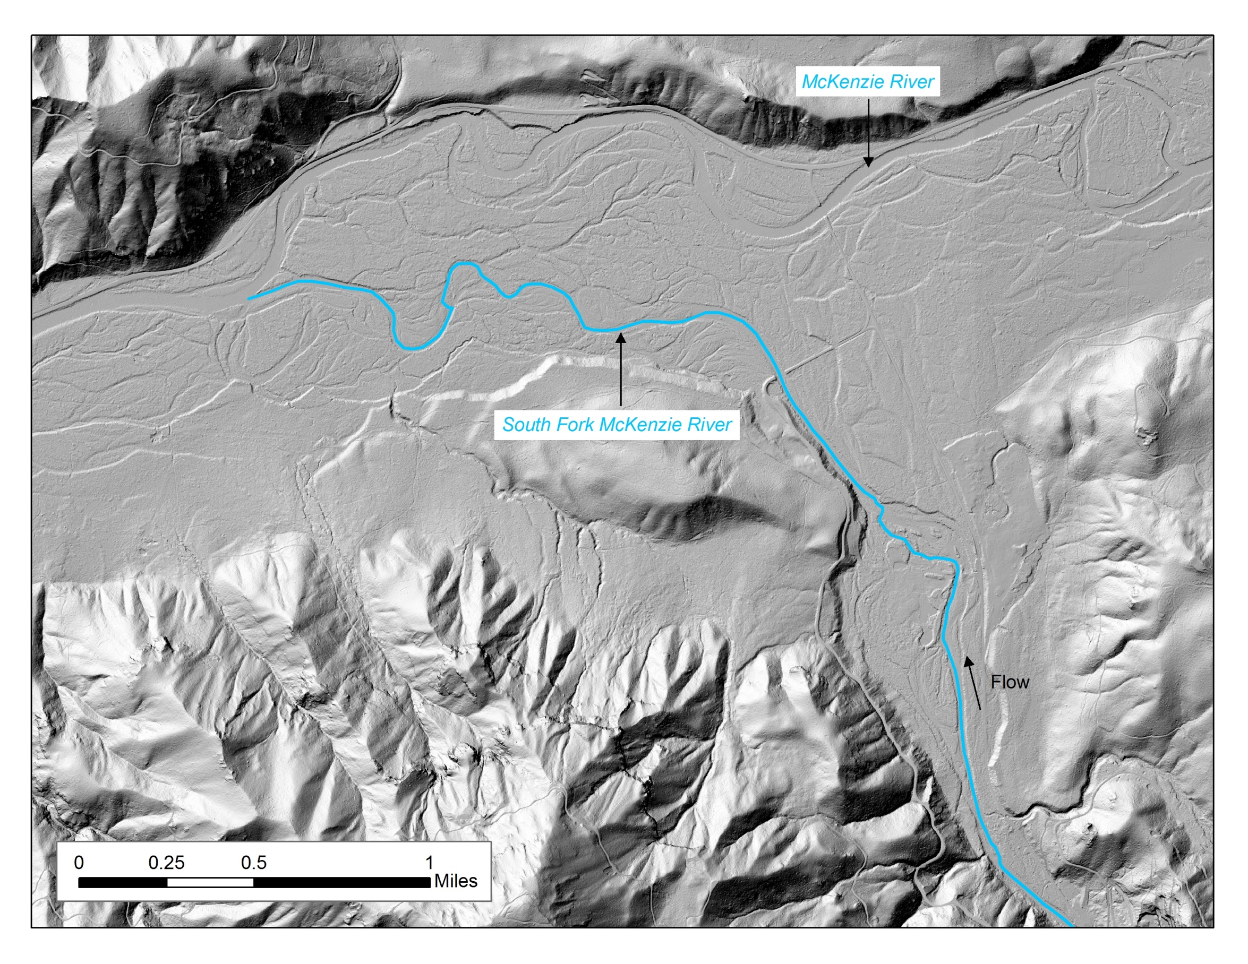

Slide 5
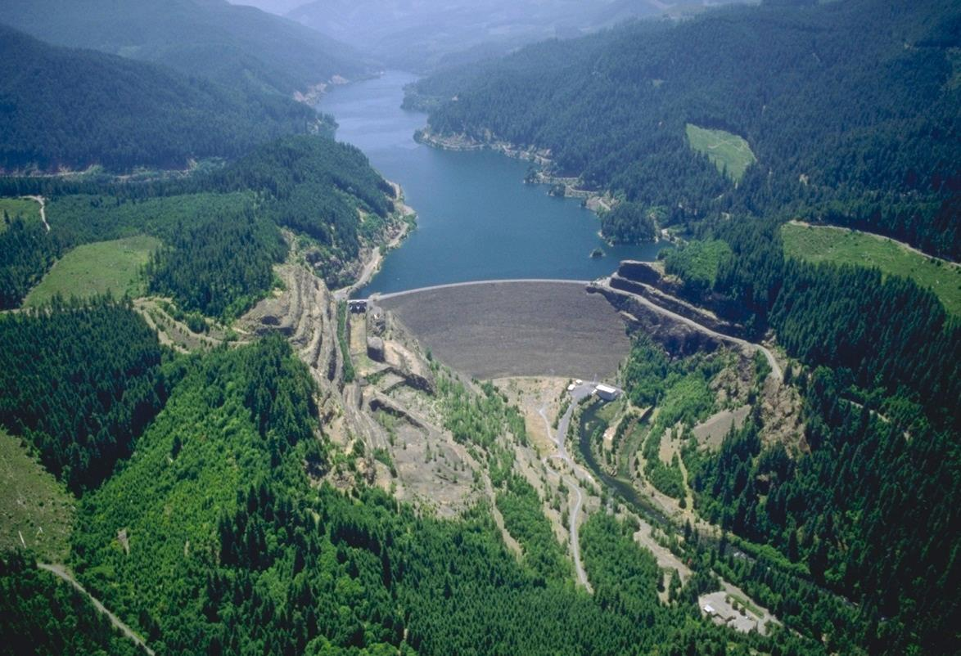
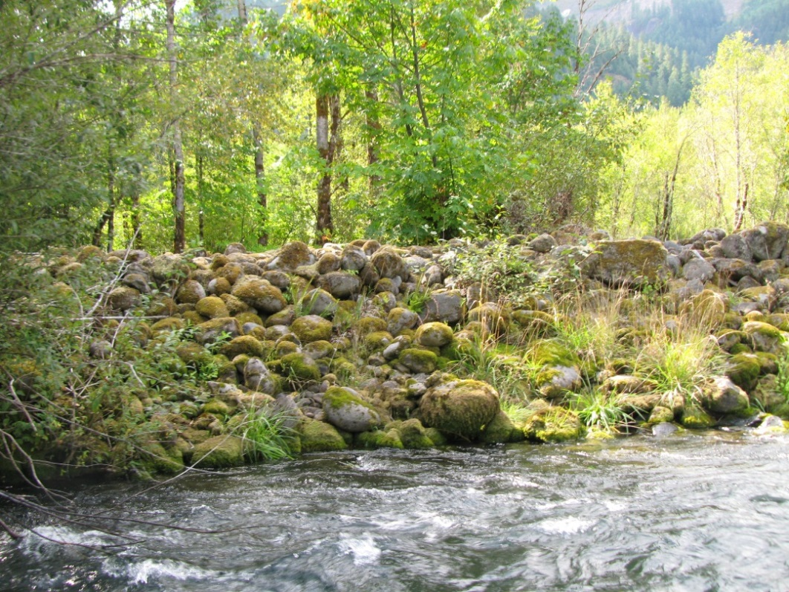
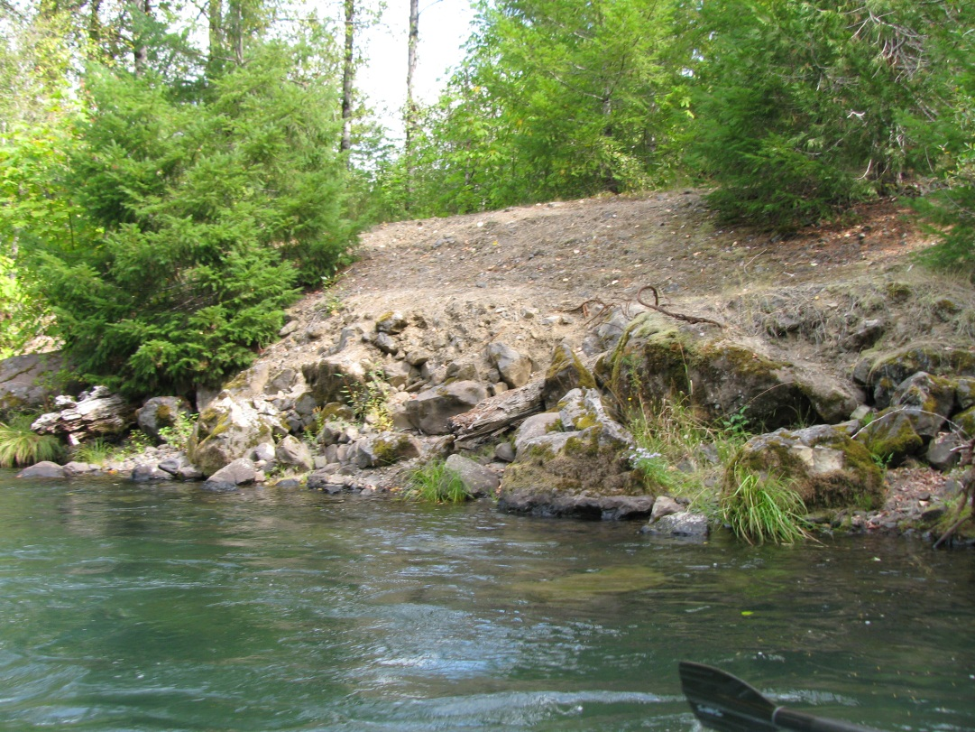
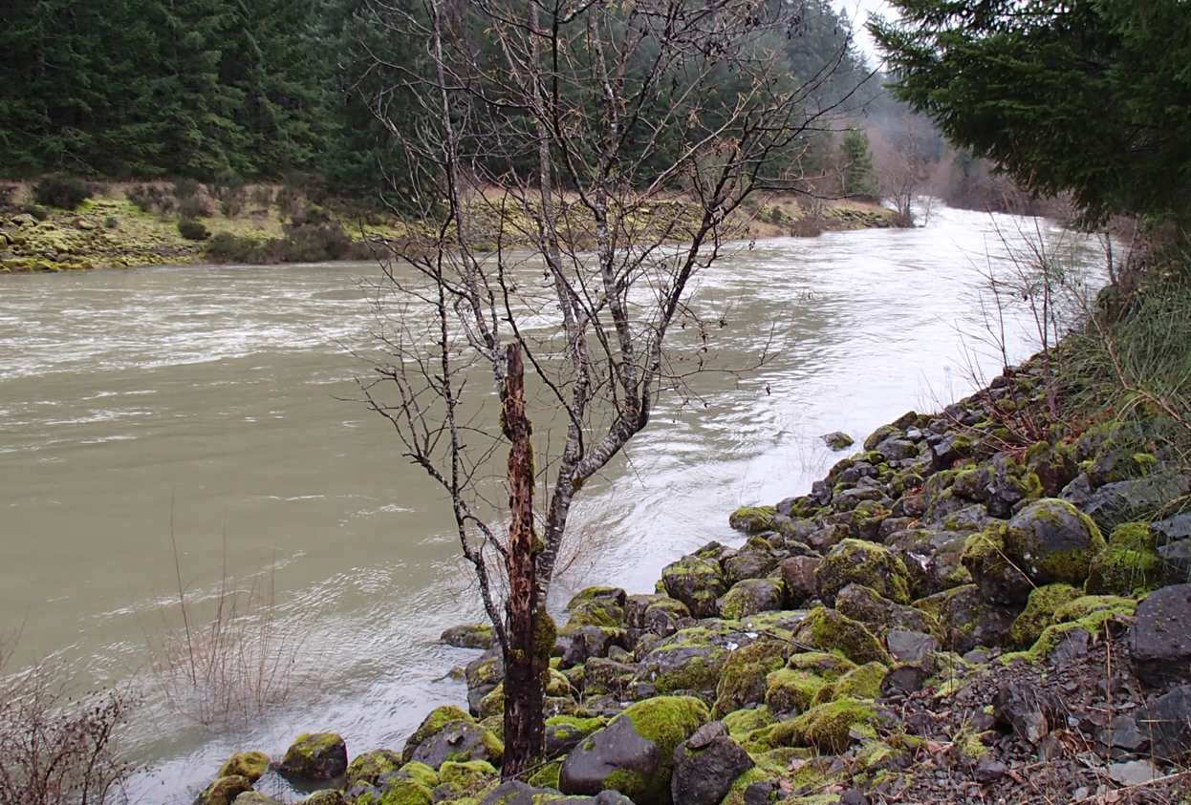

Slide 6
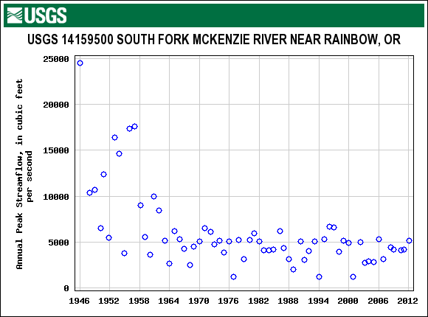
Pre-dam
Post-dam

Slide 7
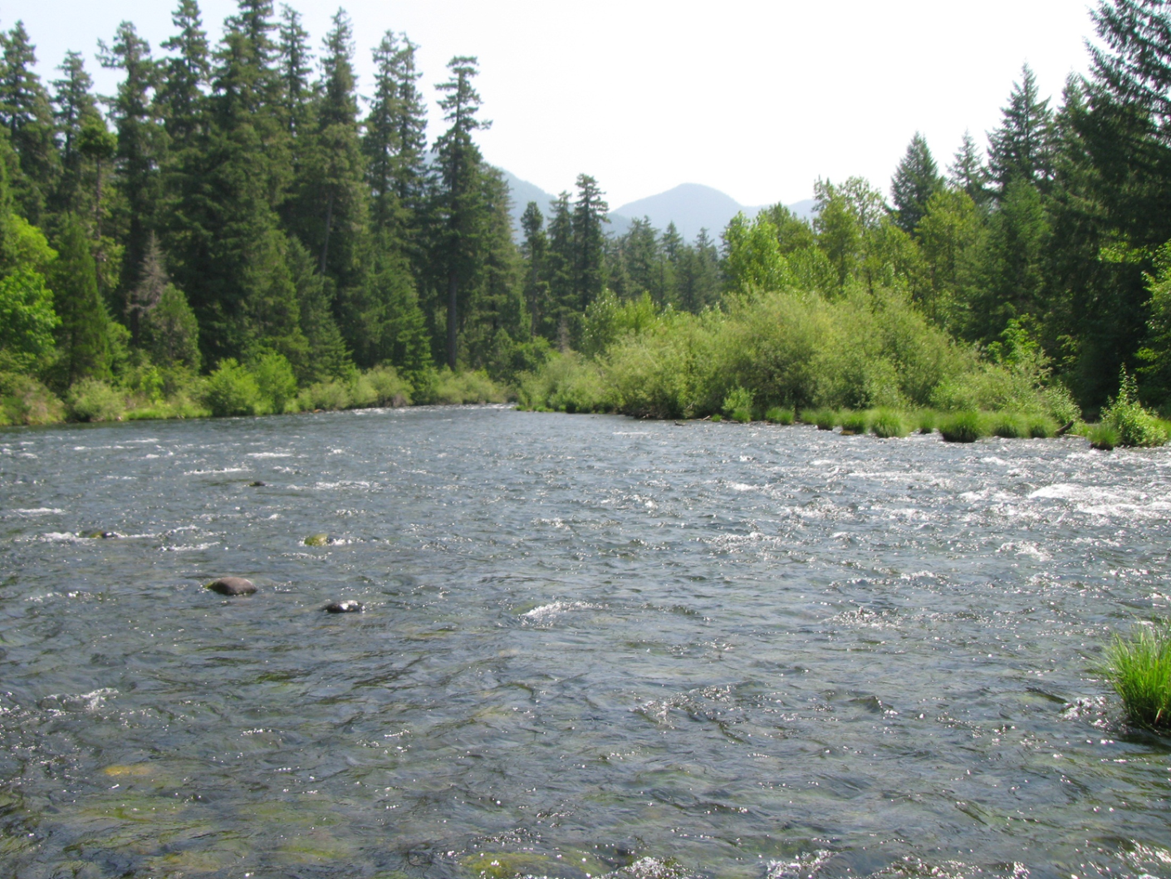
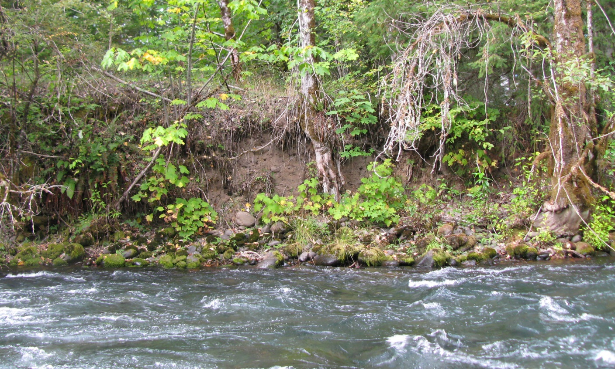
< 3 pools/mile (80% loss of pools since 1937)
10 pieces of wood/mile
Lack of spawning gravels
Channel incision over 10 feet

Slide 8
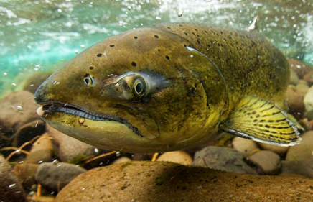
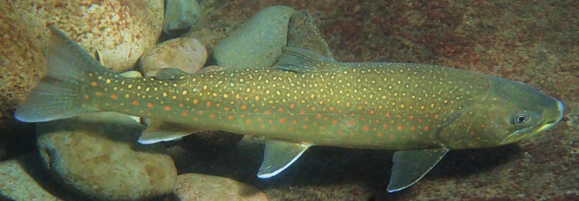
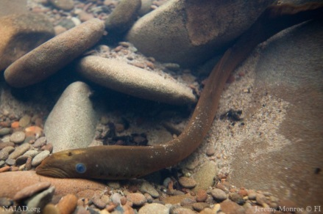
Project Goals and Objectives
Goal:
Improve physical, chemical, and biological processes that support a healthy, resilient ecosystem and sustain habitat conditions for native species
Objectives:
Increase floodplain inundation, side channel habitat, large wood, pools, and spawning gravels
NAIAD.org
K. Meyer
NAIAD.org

Slide 9
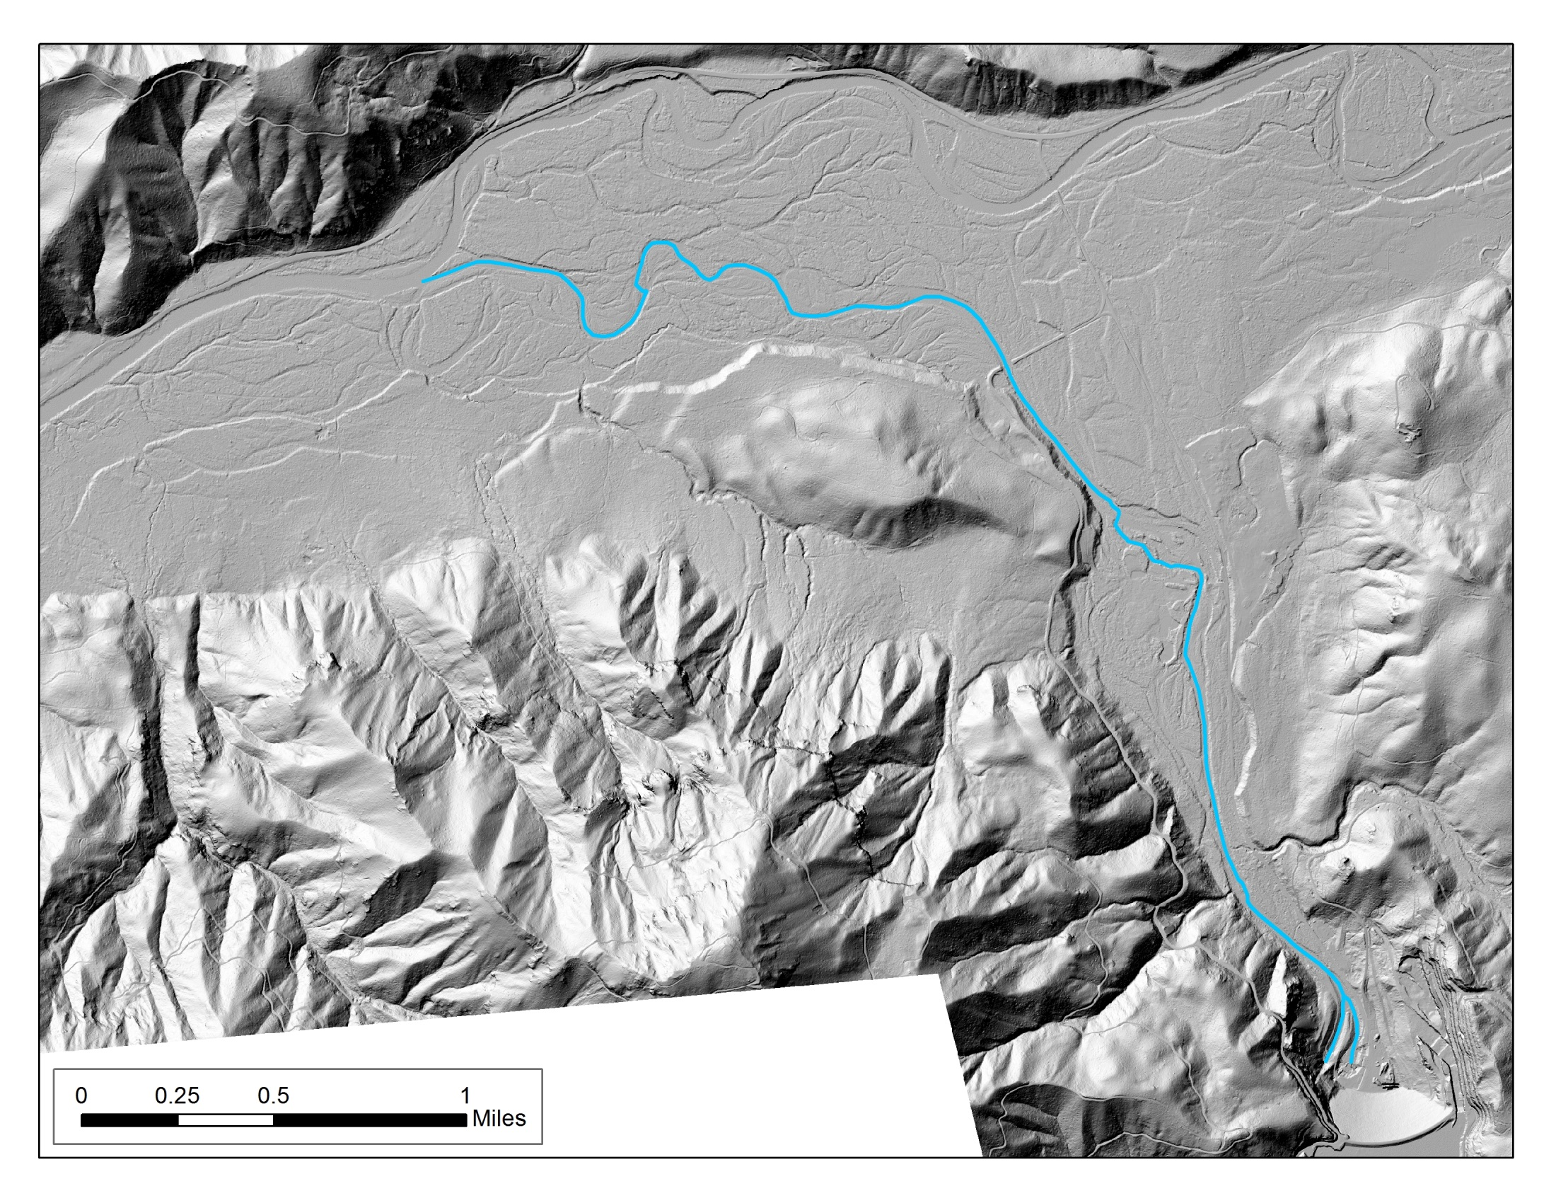
LiDAR Application #1: Map Historic (Pre-dam) vs. Active (Post-dam) Channels
Flow

Slide 10
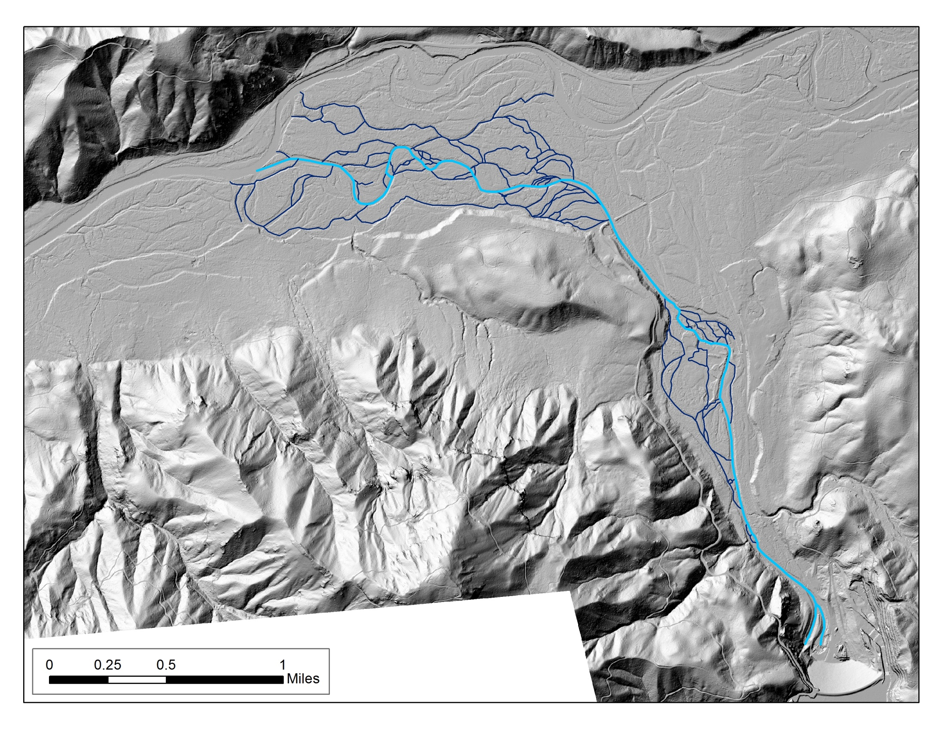
LiDAR Application #1: Map Historic (Pre-dam) vs. Active (Post-dam) Channels
Flow

Slide 11
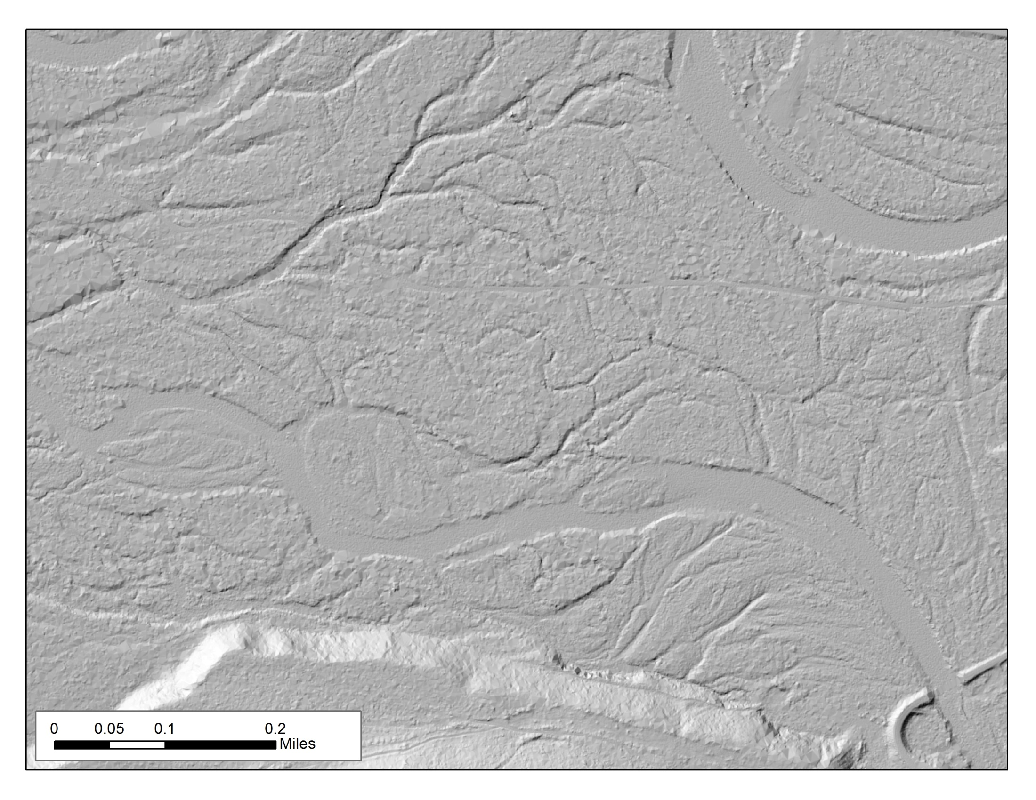
LiDAR Application #1: Map Historic (Pre-dam) vs. Active (Post-dam) Channels

Slide 12
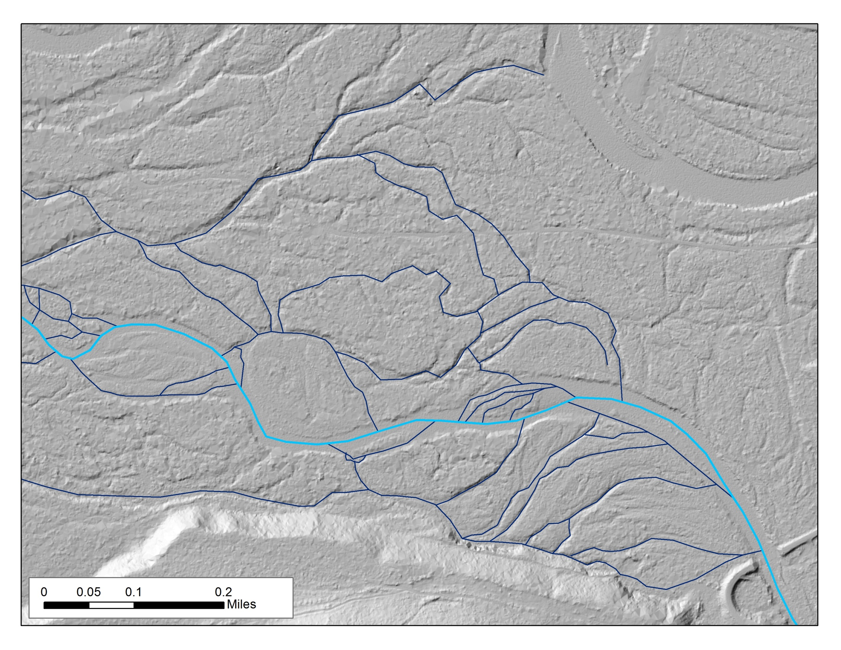
LiDAR Application #1: Map Historic (Pre-dam) vs. Active (Post-dam) Channels

Slide 13
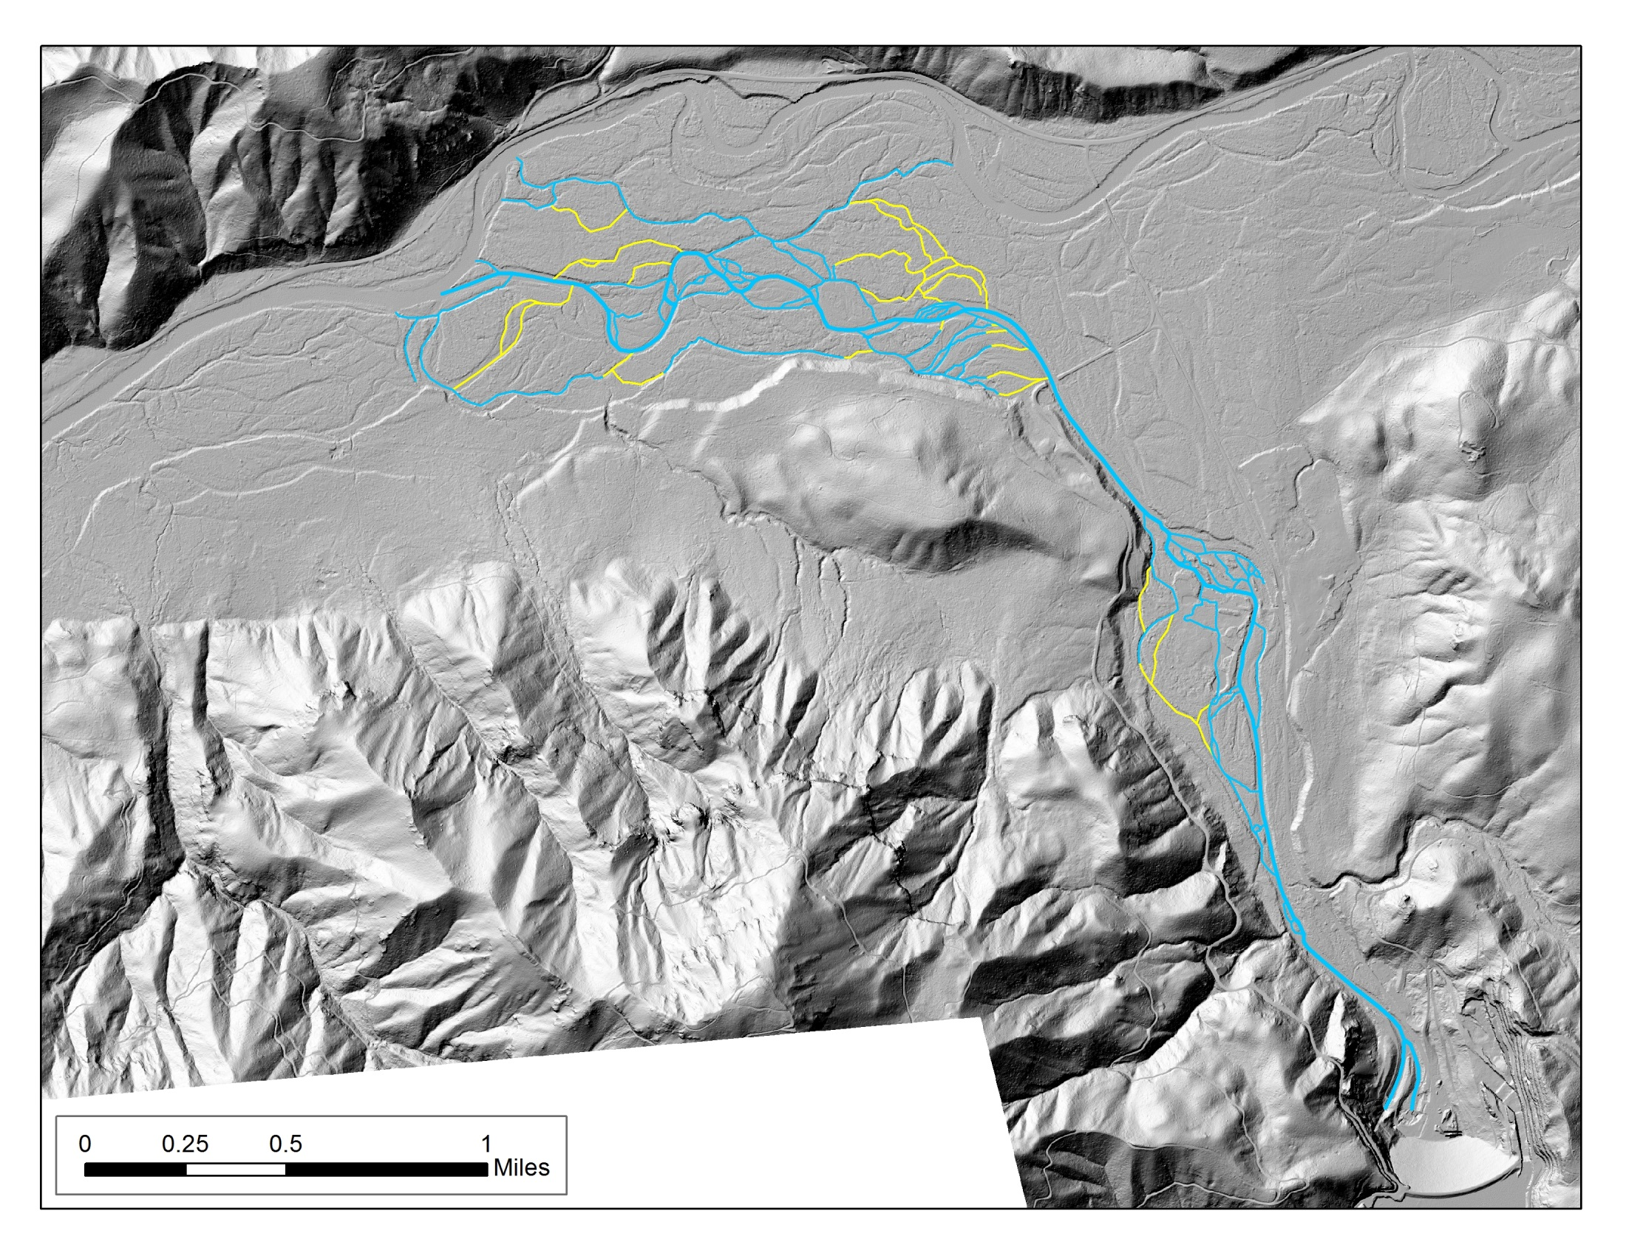
LiDAR Application #1: Map Historic (Pre-dam) vs. Active (Post-dam) Channels
Flow

Slide 14
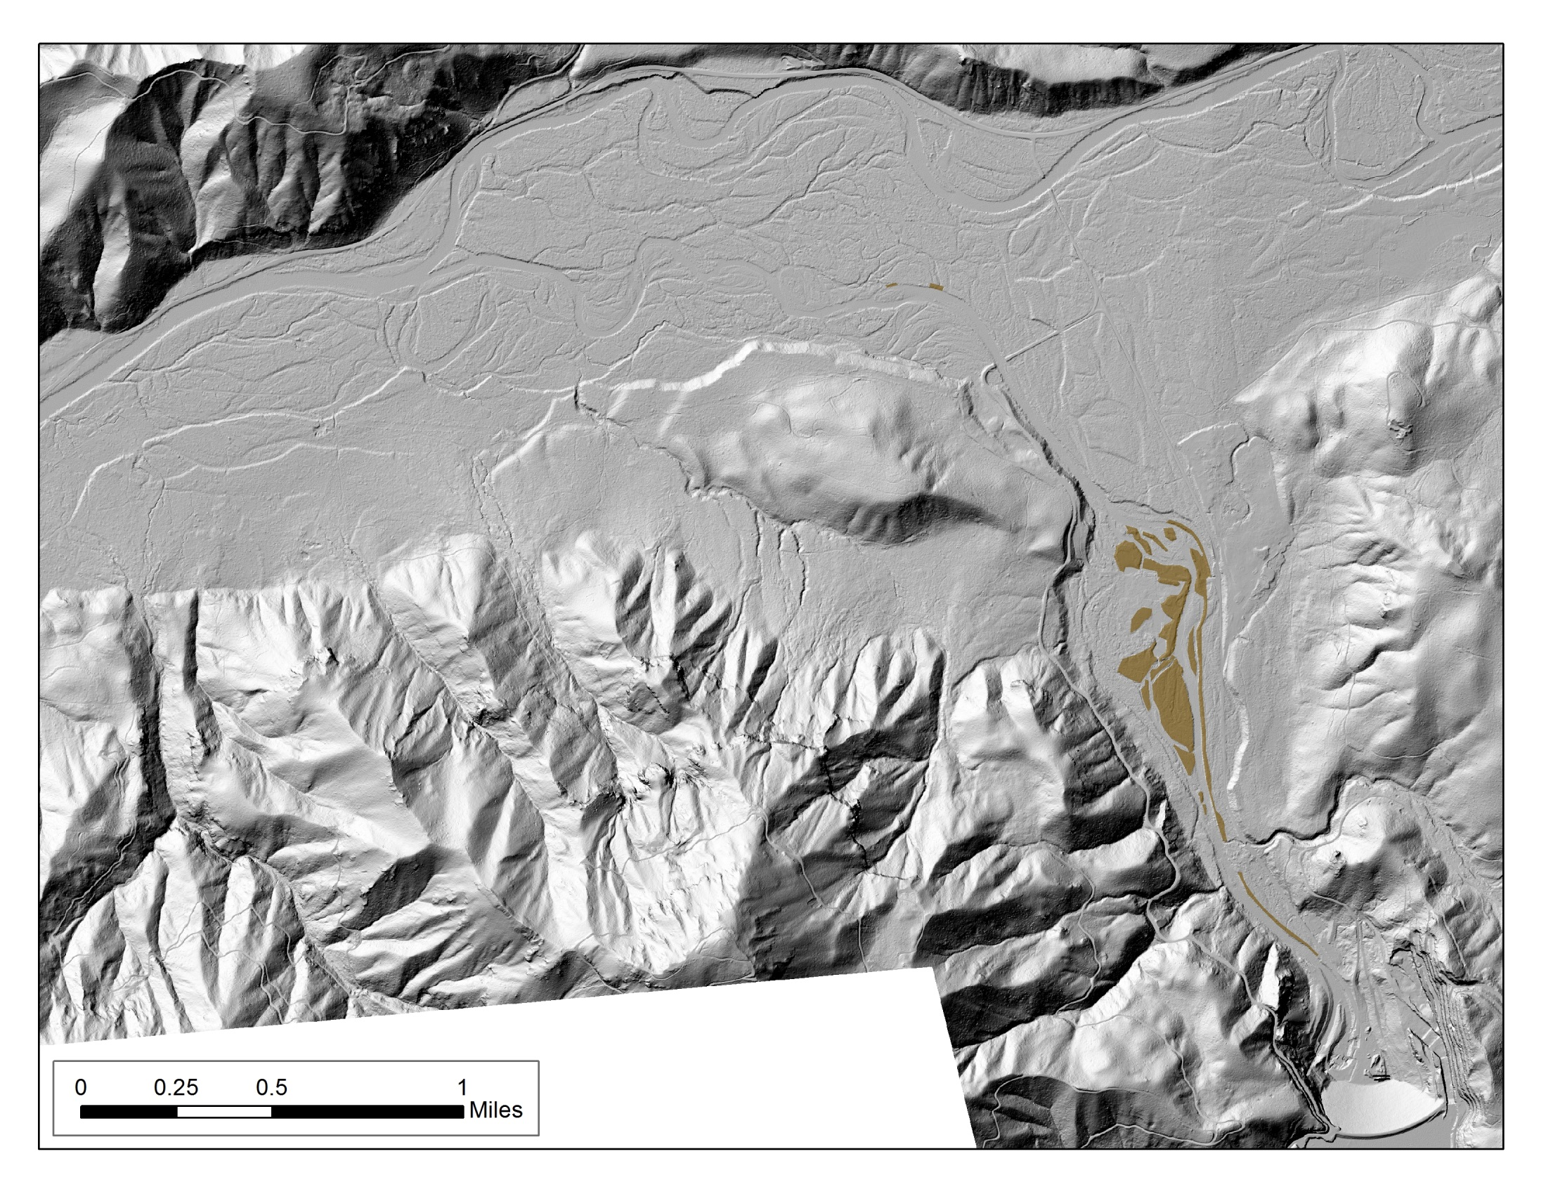
LiDAR Application #2: Map and Calculate Amount of Levee/Revetment Material

Slide 15
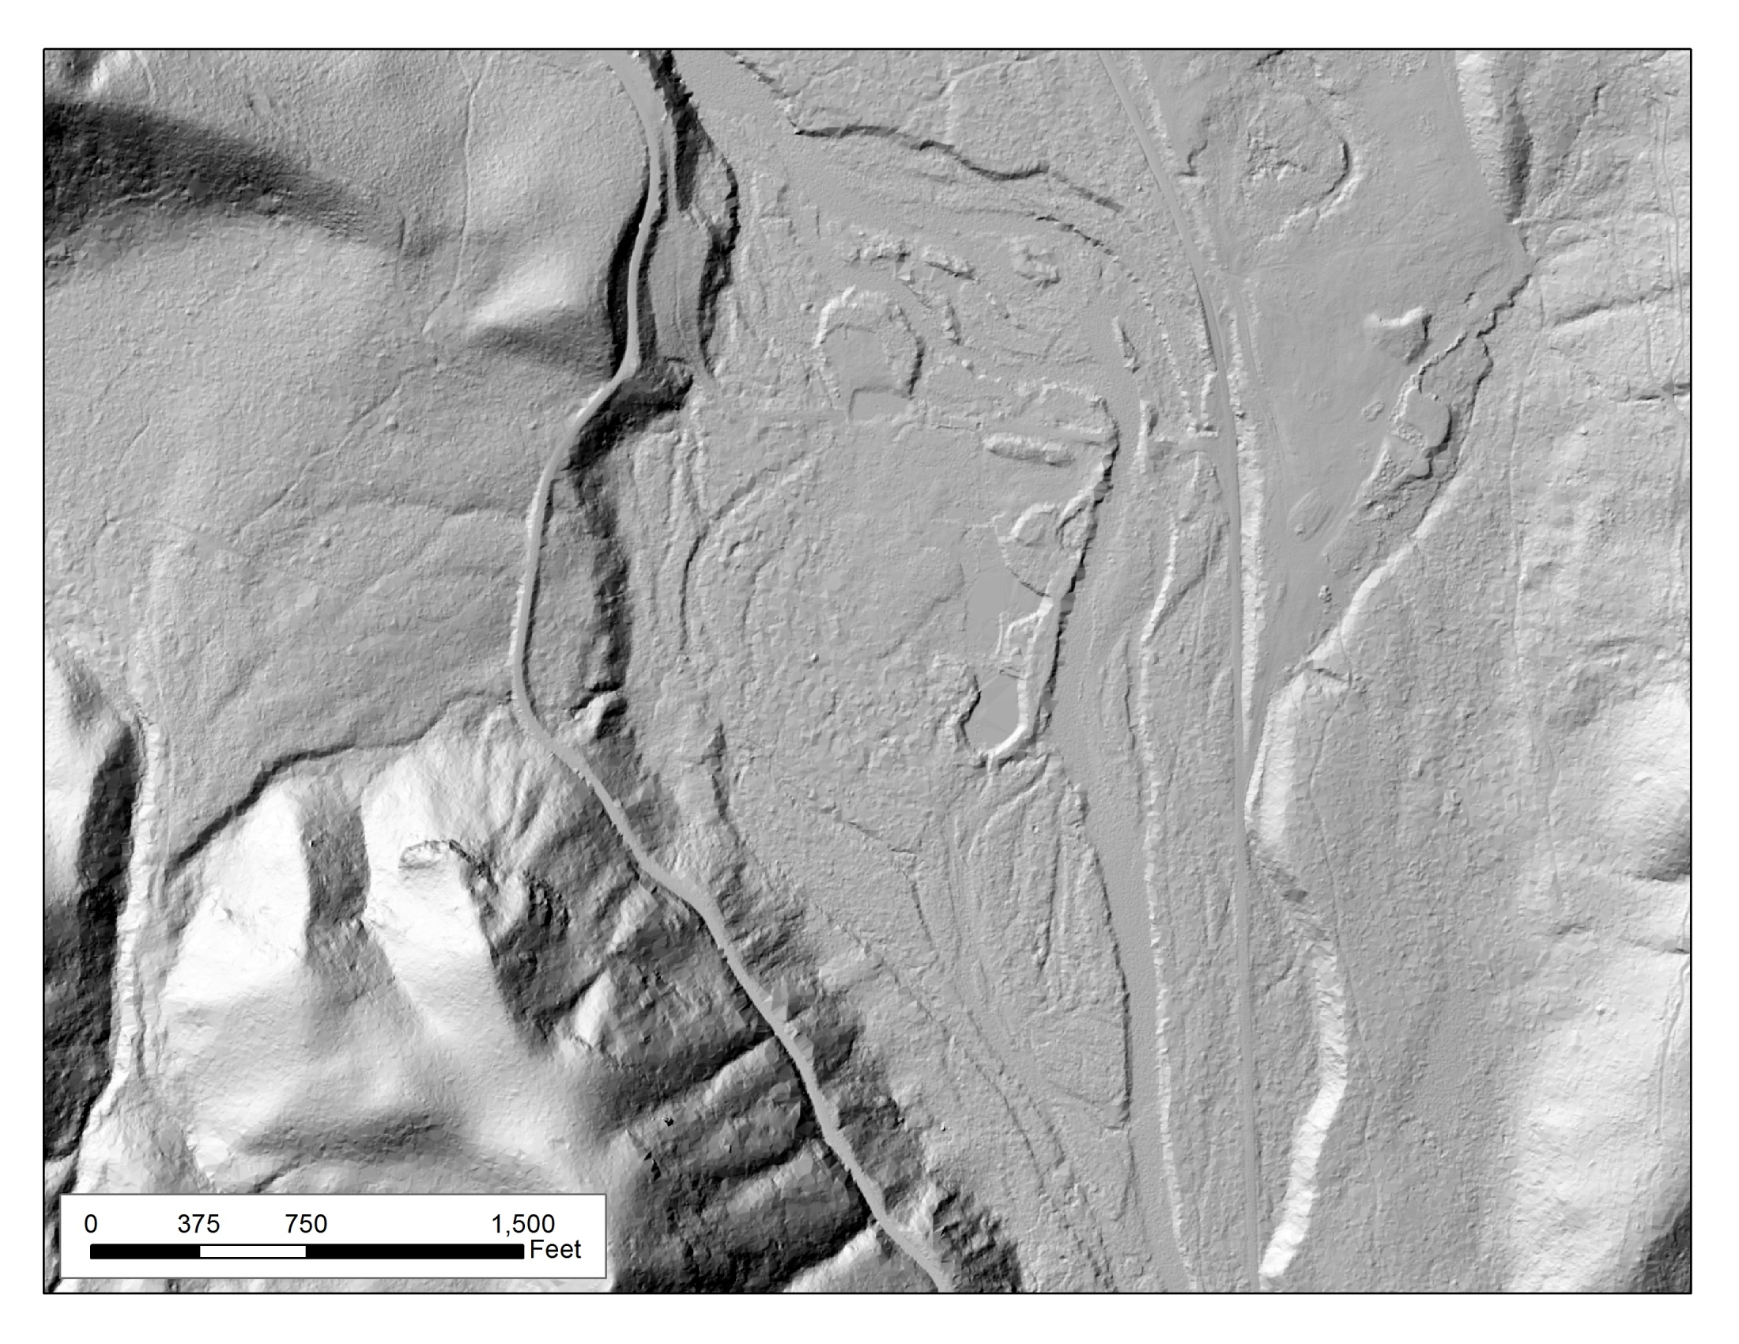
LiDAR Application #2: Map and Calculate Amount of Levee/Revetment Material

Slide 16
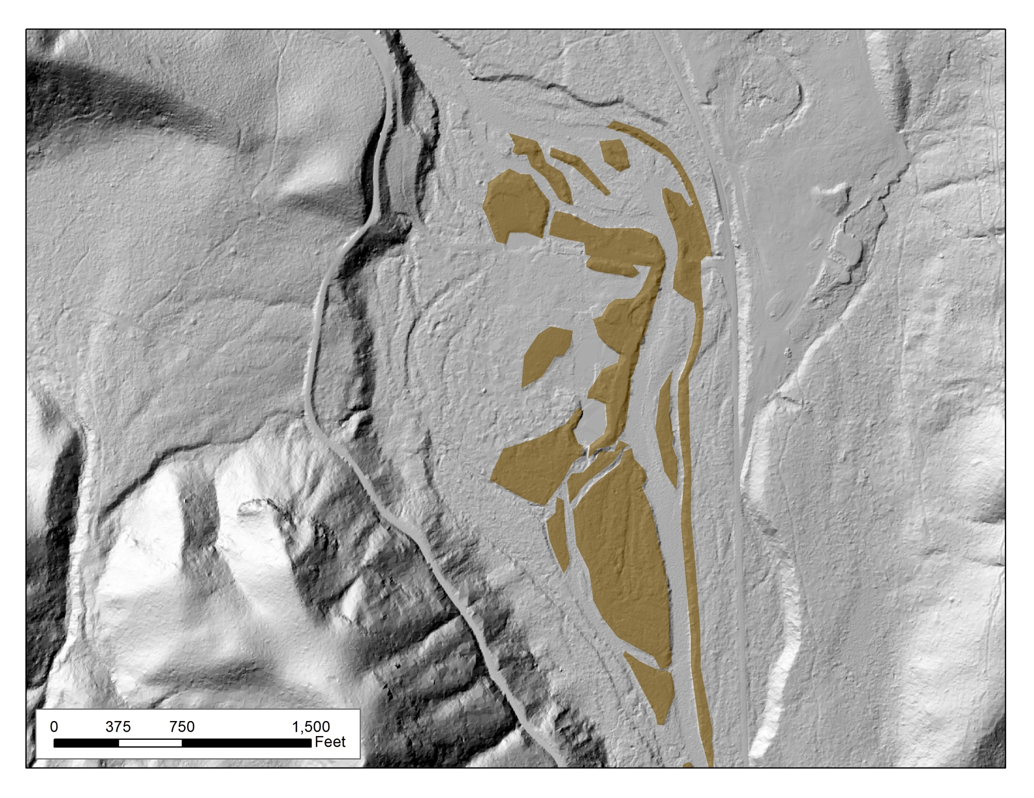
LiDAR Application #2: Map and Calculate Amount of Levee/Revetment Material

Slide 17
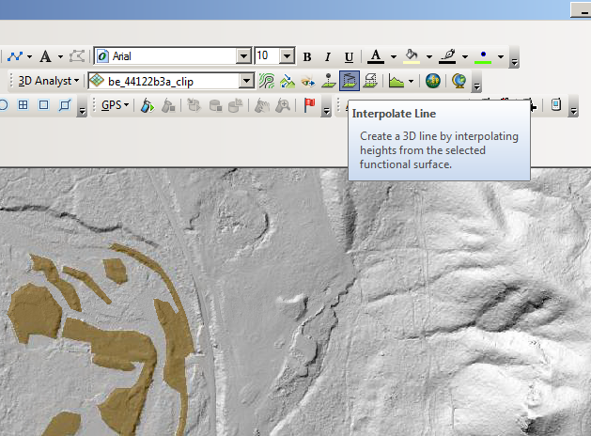

Slide 18
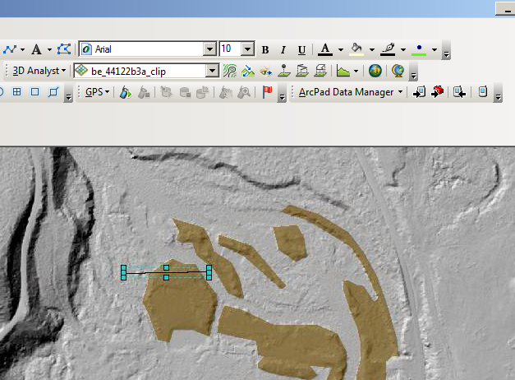

Slide 19
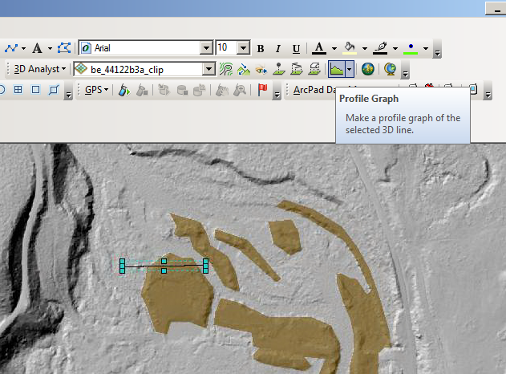

Slide 20
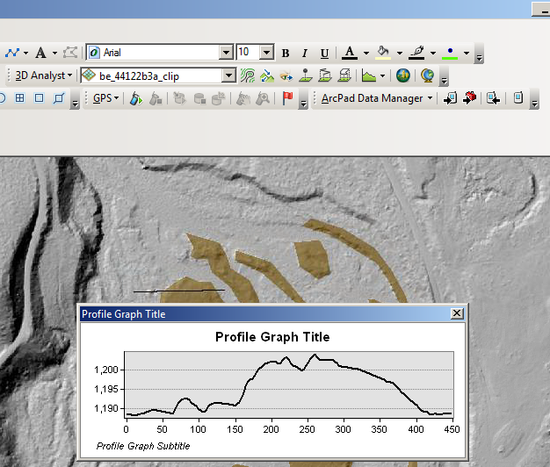

Slide 21
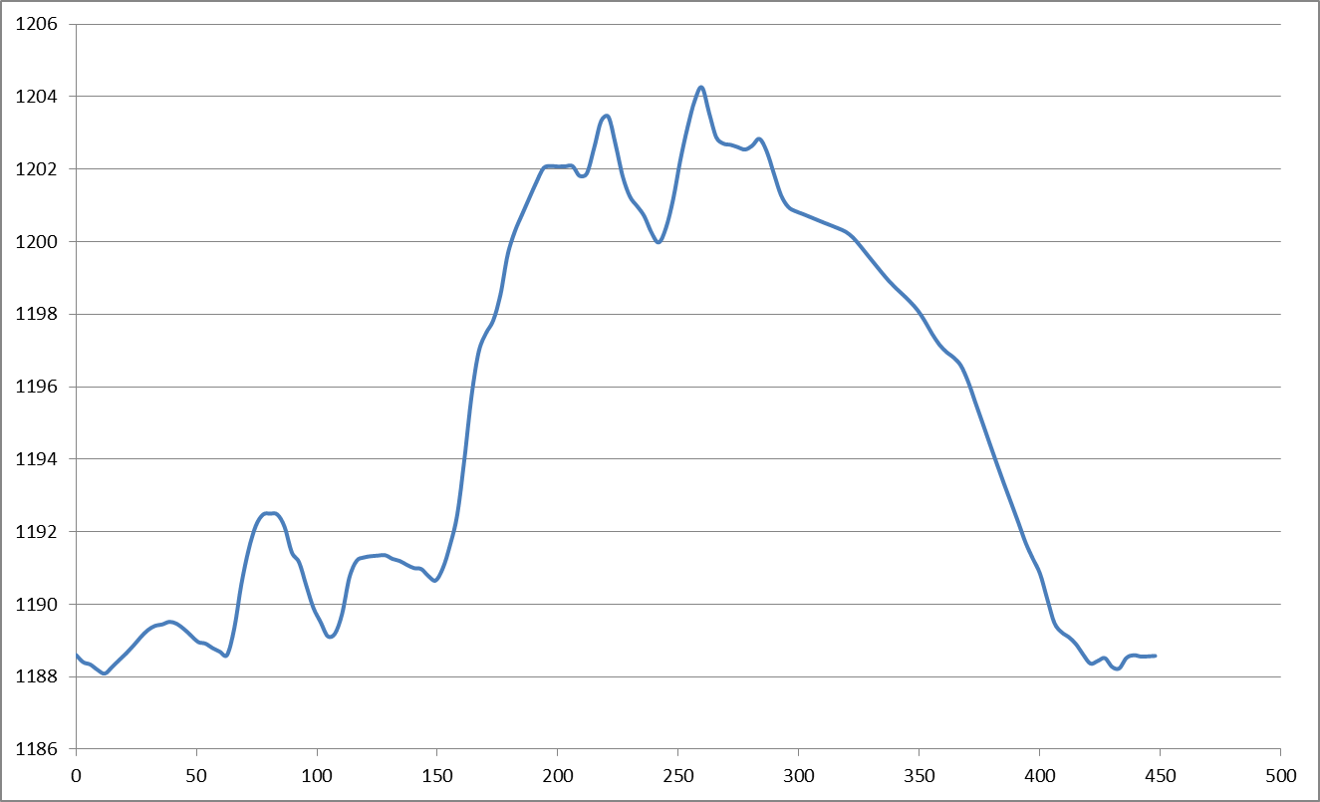
Cross-section 1
average height = approx. 10 feet
10 feet

Slide 22
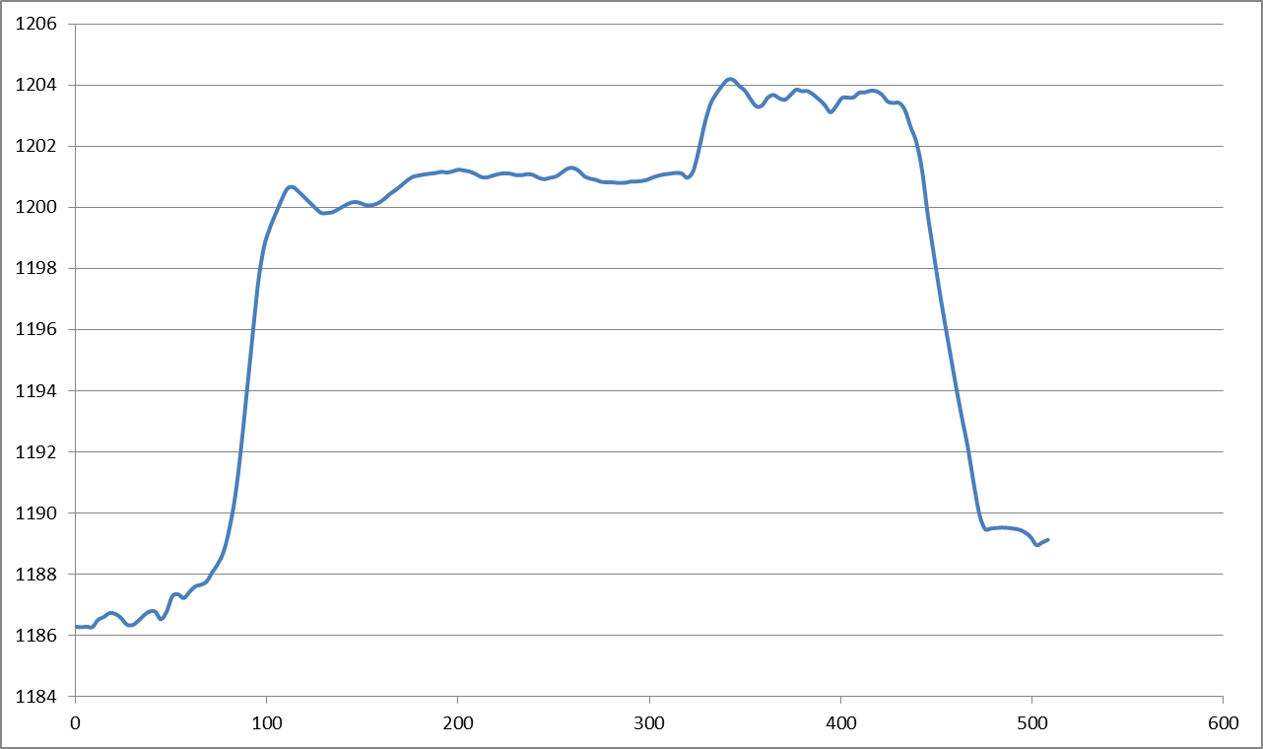
Cross-section 2
average height = approx. 13 feet
13 feet

Slide 23
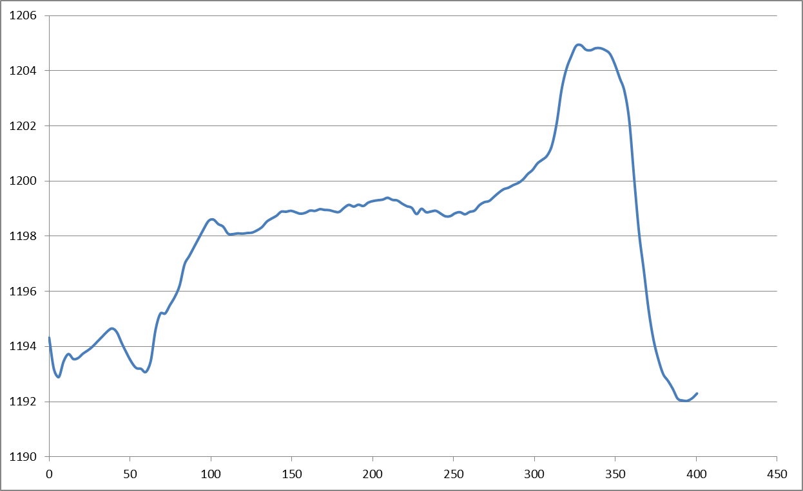
Cross-section 3
average height = approx. 6 feet
6 feet

Slide 24
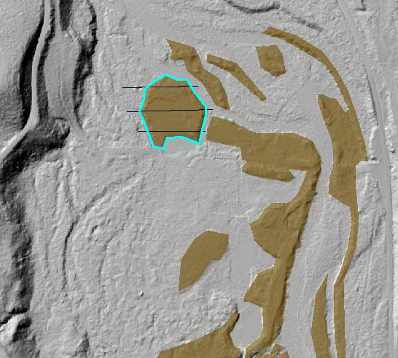
Polygon area = 120,000 square feet
Average levee height = 10 feet
120,000 x 10 = 1,200,000 cubic feet
or
~44,000 cubic yards of material

Slide 25
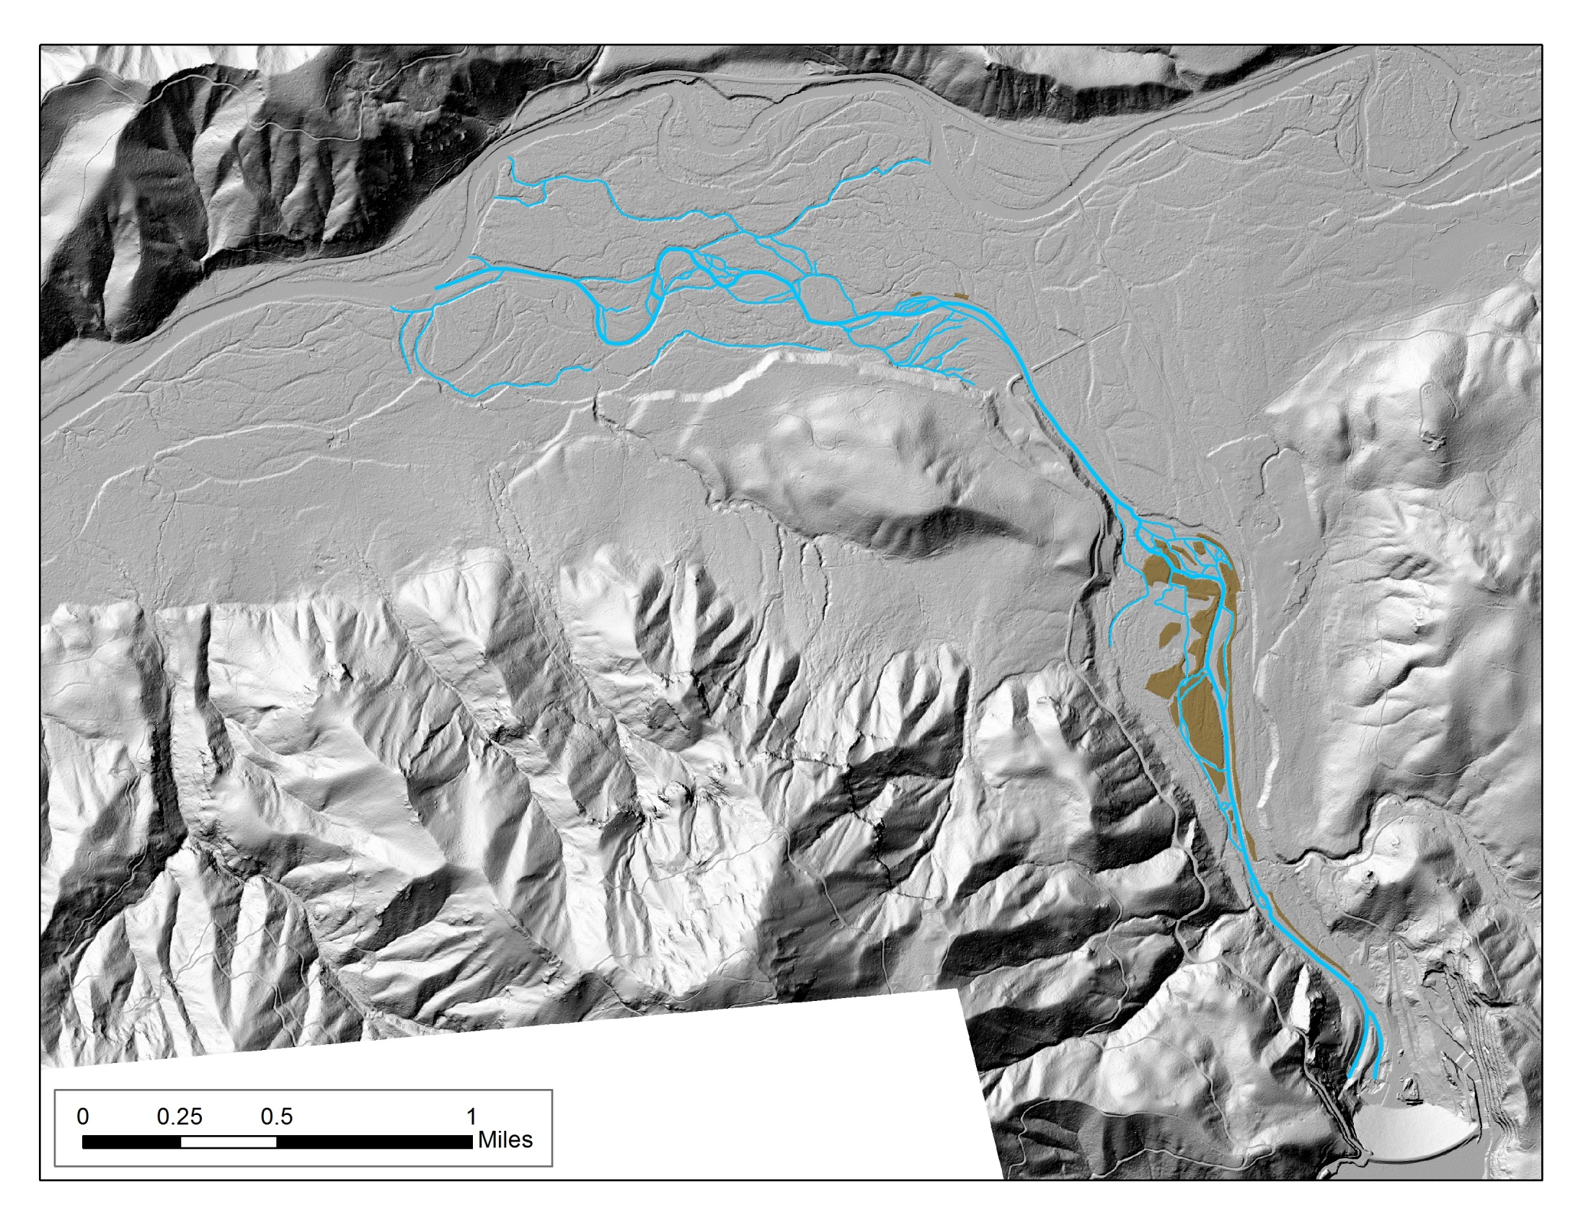
LiDAR Application #3: Conceptualize Existing and Proposed Floodplain Inundation
Flow

Slide 26
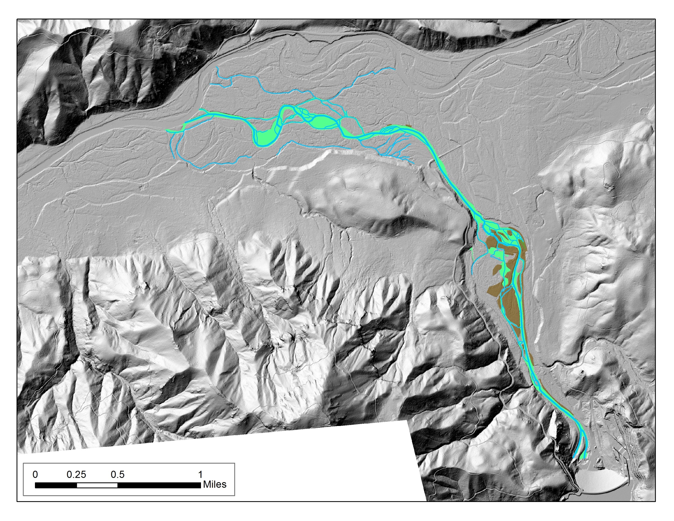
LiDAR Application #3: Conceptualize Existing and Proposed Floodplain Inundation
Flow

Slide 27
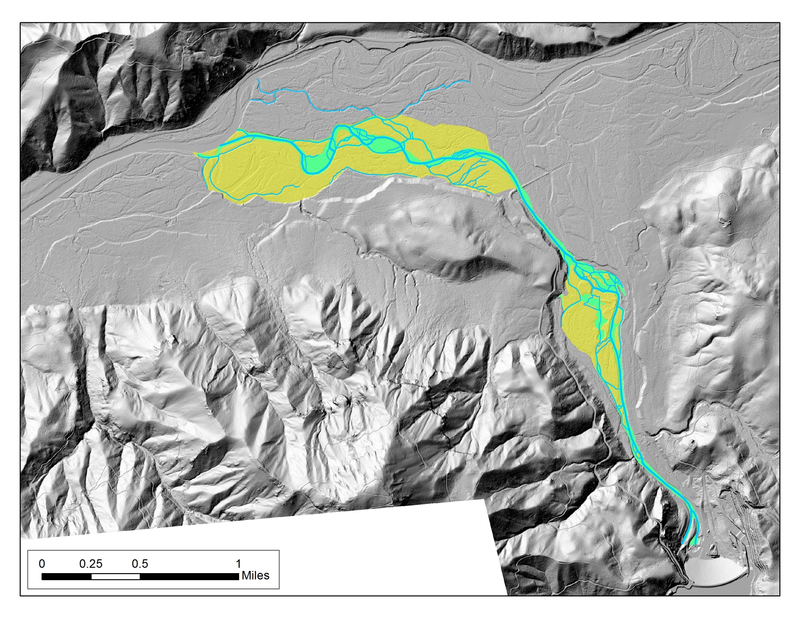
LiDAR Application #3: Conceptualize Existing and Proposed Floodplain Inundation
Flow

Slide 28

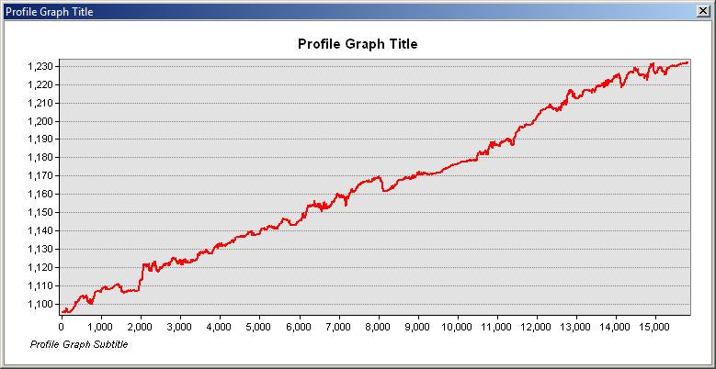
LiDAR Application #4: Use Longitudinal Profile and Cross-sections to
Design New Channels and Reconnected Floodplain
Flow

Slide 29
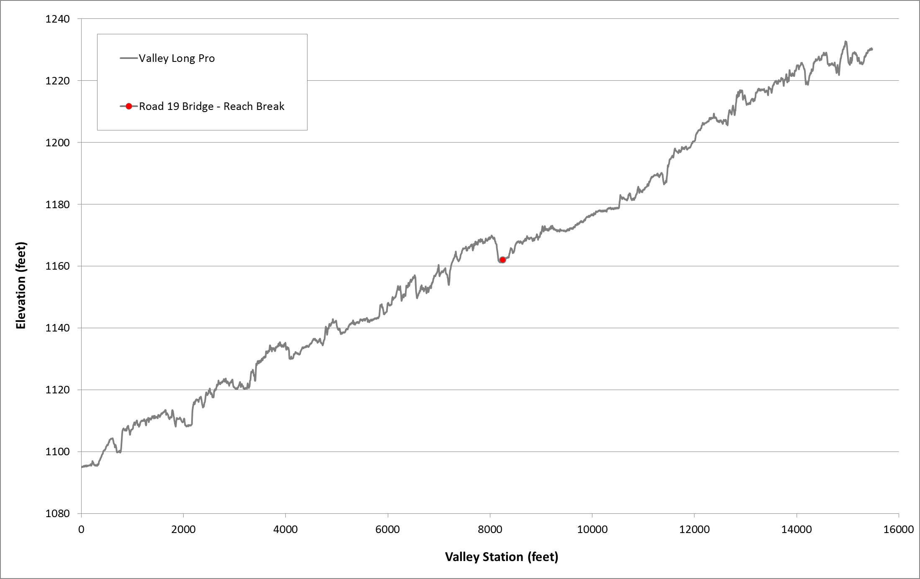
Valley Longitudinal Profile

Slide 30
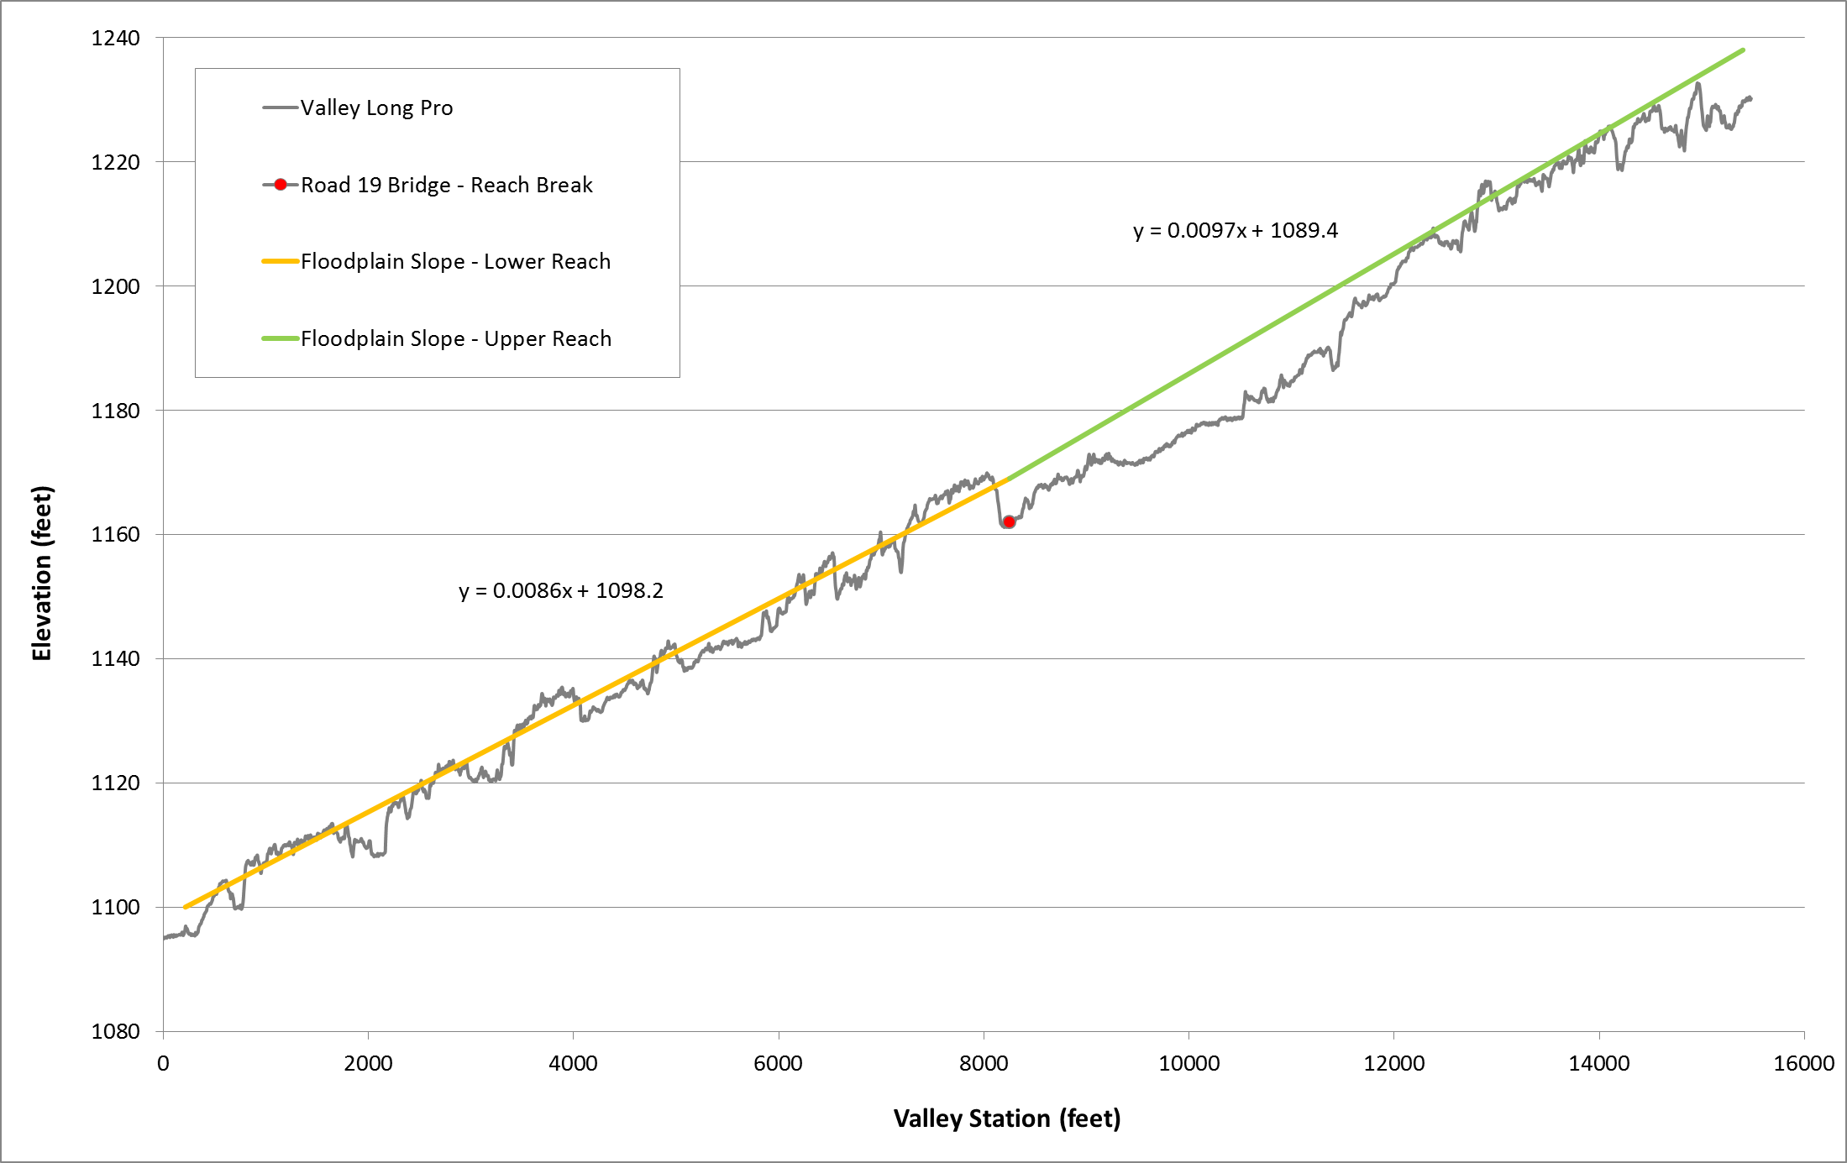
Valley Longitudinal Profile and Floodplain Slope

Slide 31
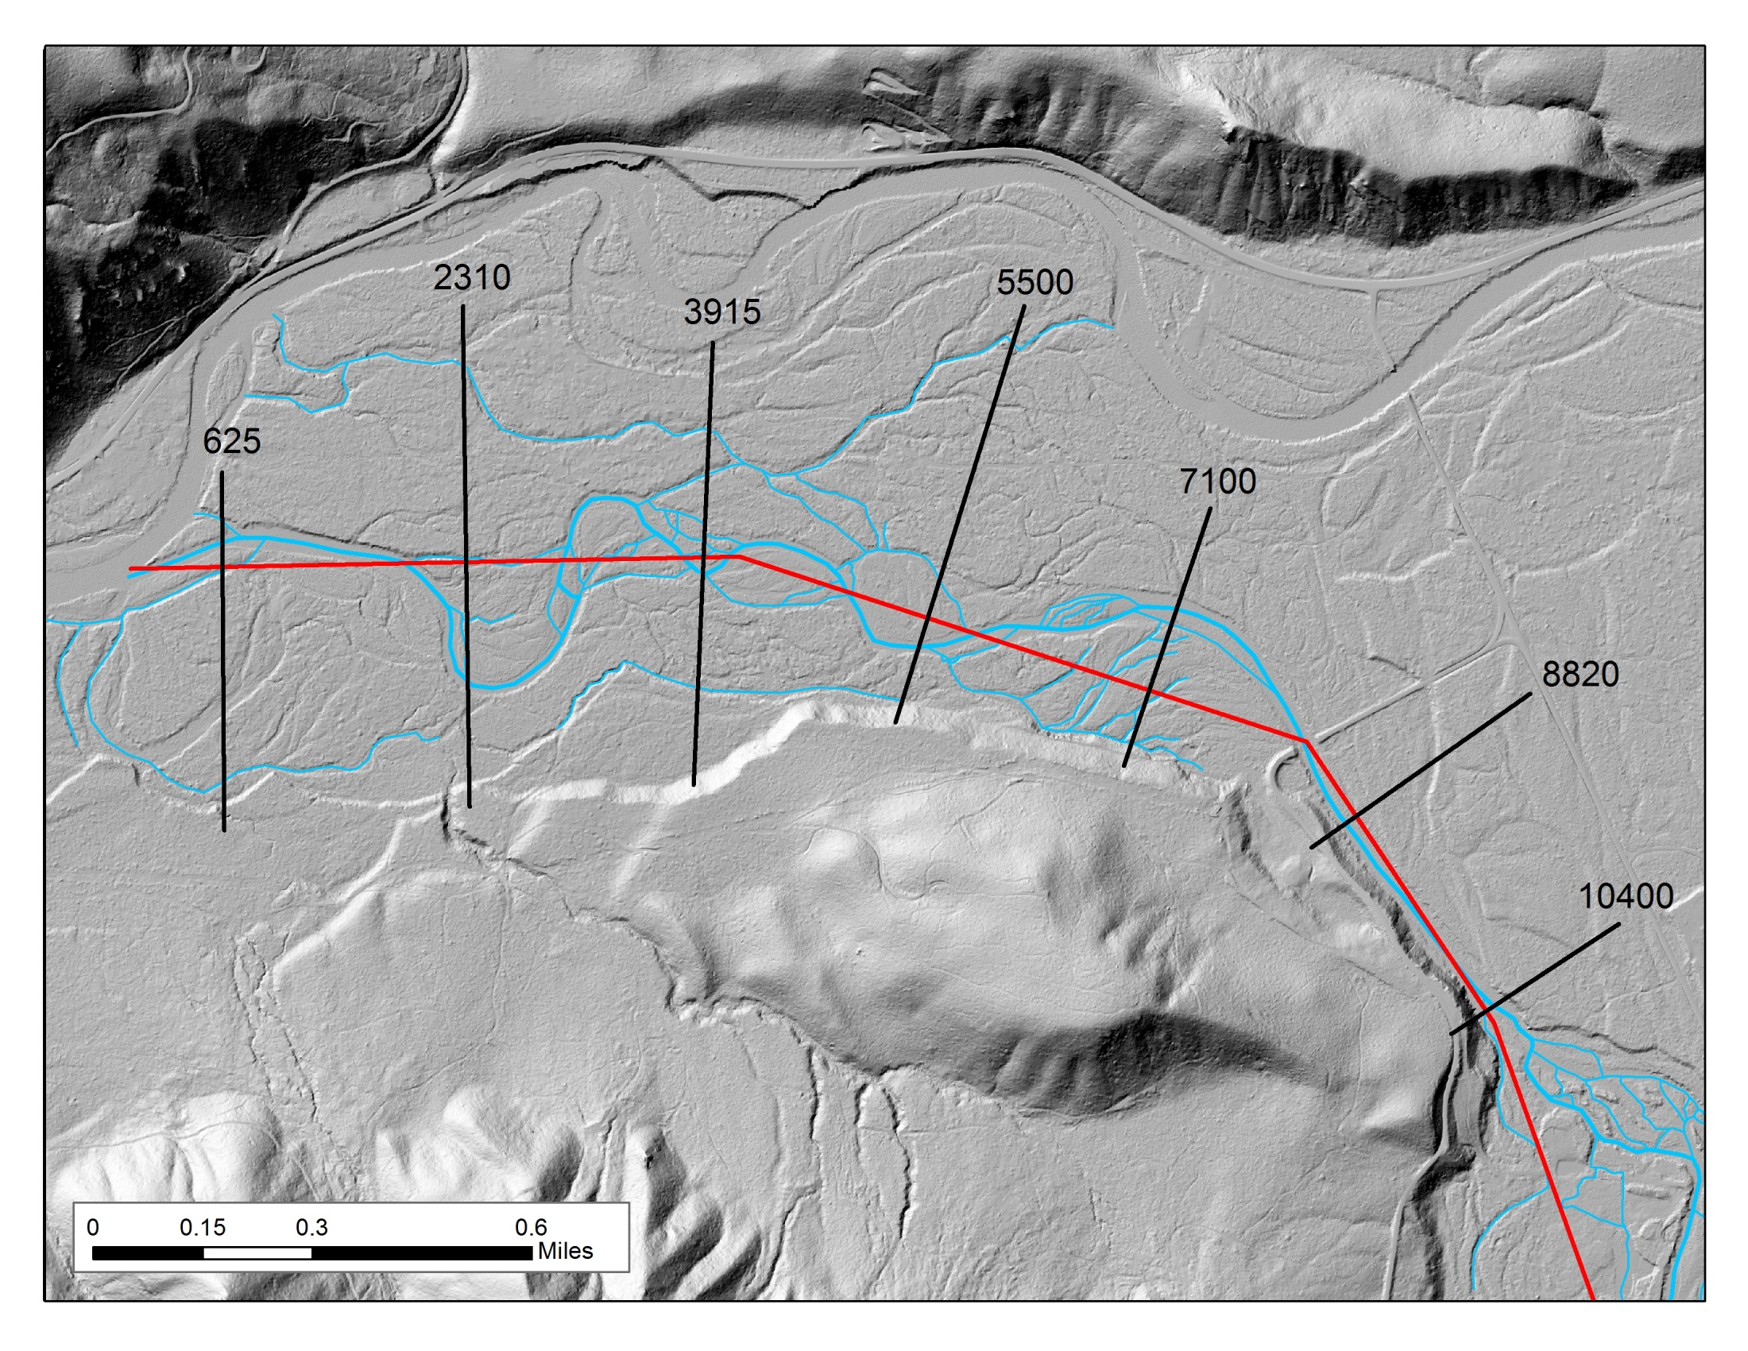

Slide 32
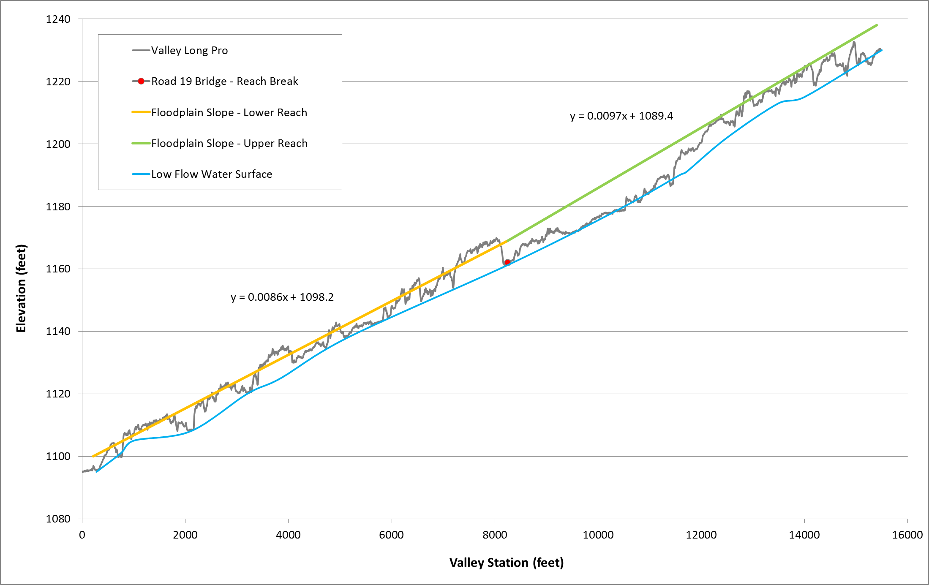
Valley Longitudinal Profile, Floodplain Slope, Water Surface

Slide 33
Valley Longitudinal Profile, Floodplain Slope, Water Surface

Slide 34
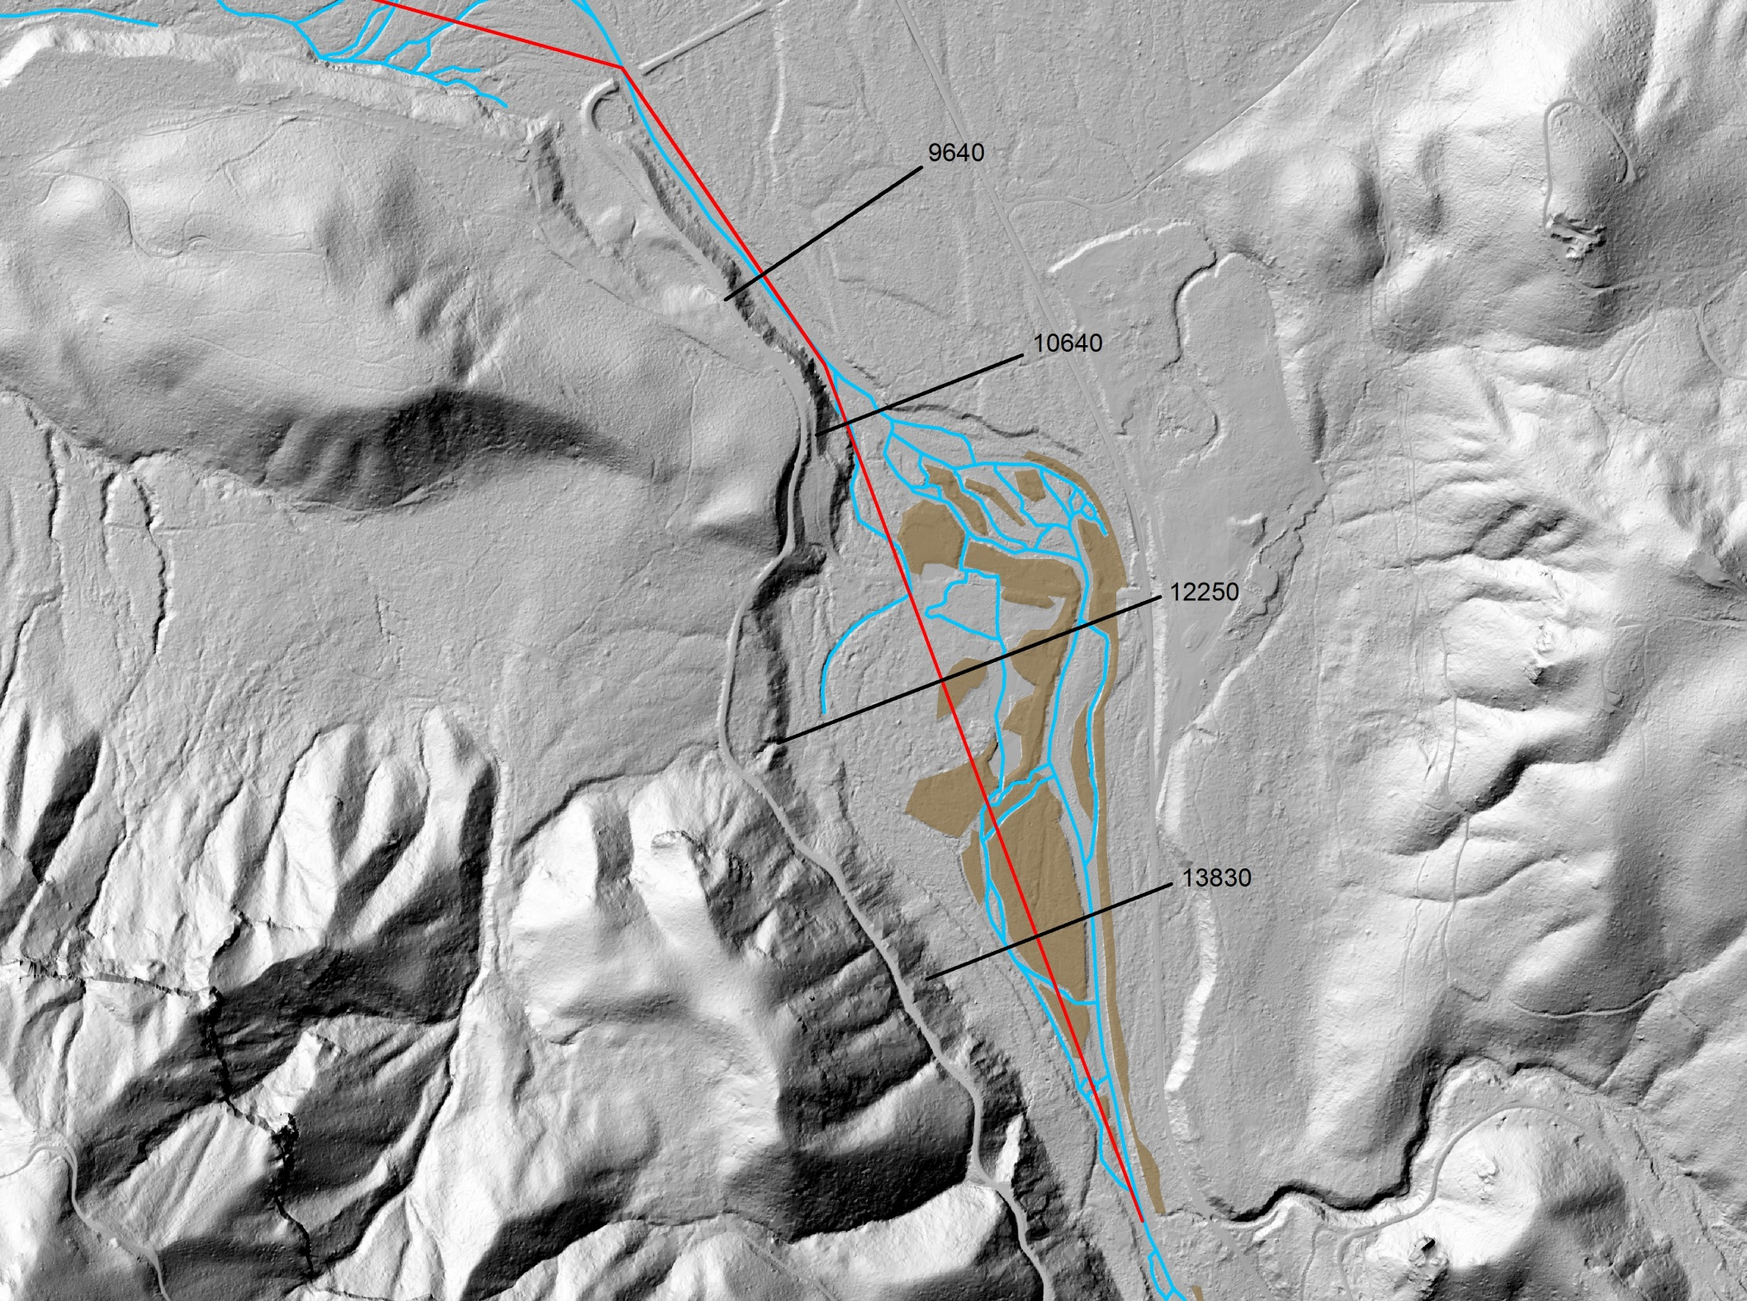
Flow

Slide 35
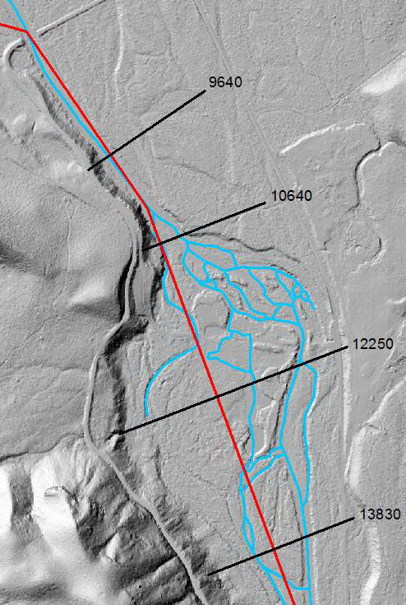
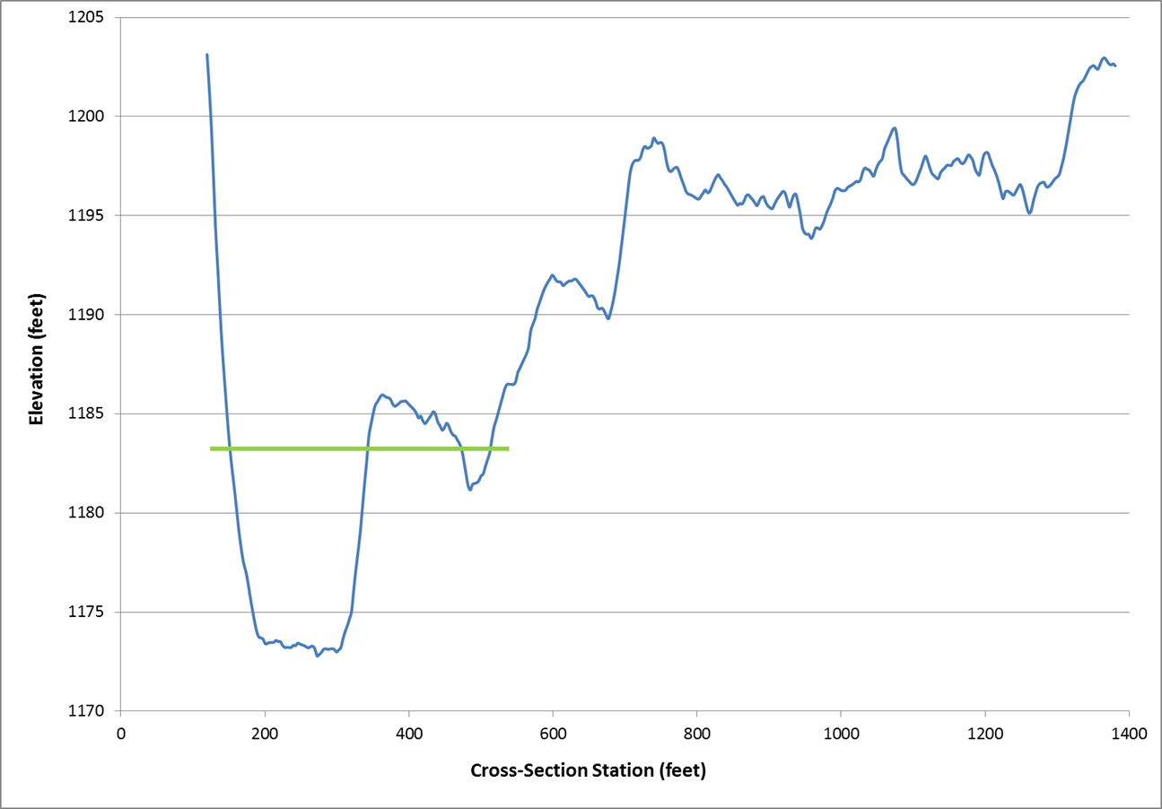
Cross-section @ Valley Station 9640
y = 0.0097x + 1089.4
Floodplain Slope Elevation

Slide 36
Cross-section @ Valley Station 9640
y = 0.0097x + 1089.4
Floodplain Slope Elevation
10 feet
Water Surface Elevation

Slide 37
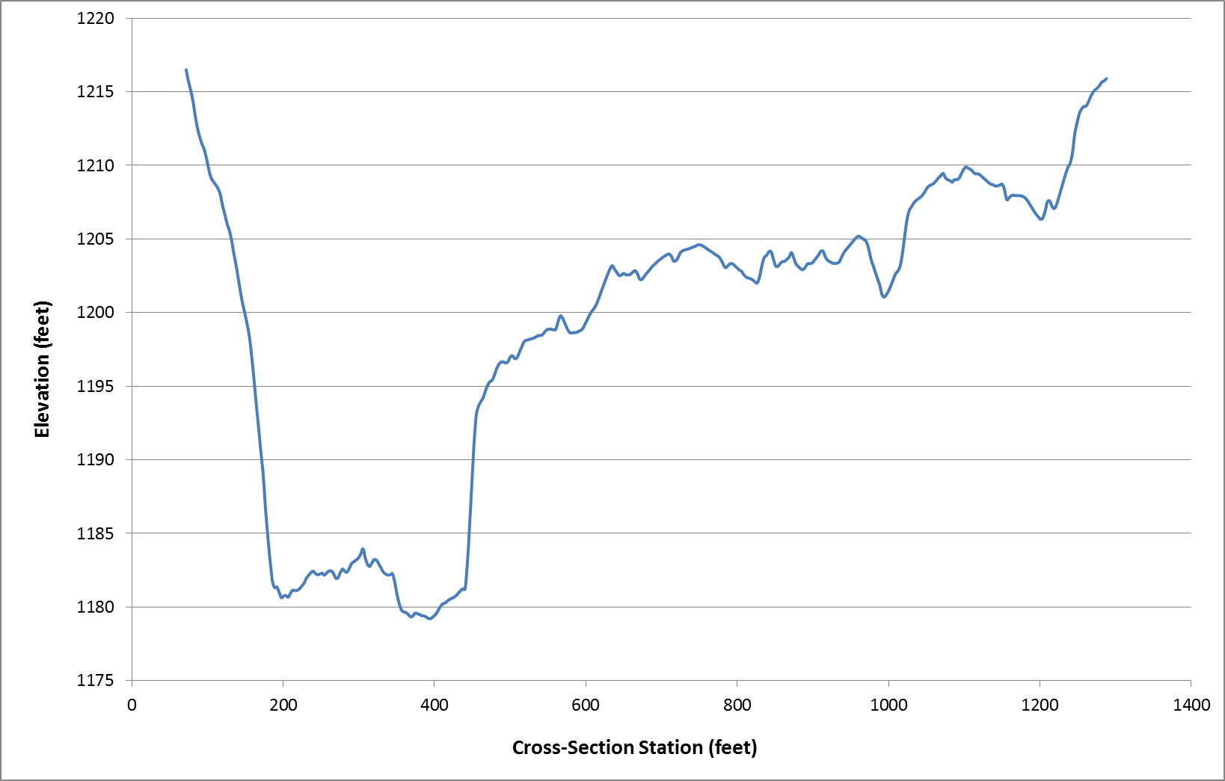
Cross-section @ Valley Station 10640
y = 0.0097x + 1089.4
Floodplain Slope Elevation

Slide 38
Cross-section @ Valley Station 10640
y = 0.0097x + 1089.4
Floodplain Slope Elevation
13 feet
Water Surface Elevation

Slide 39
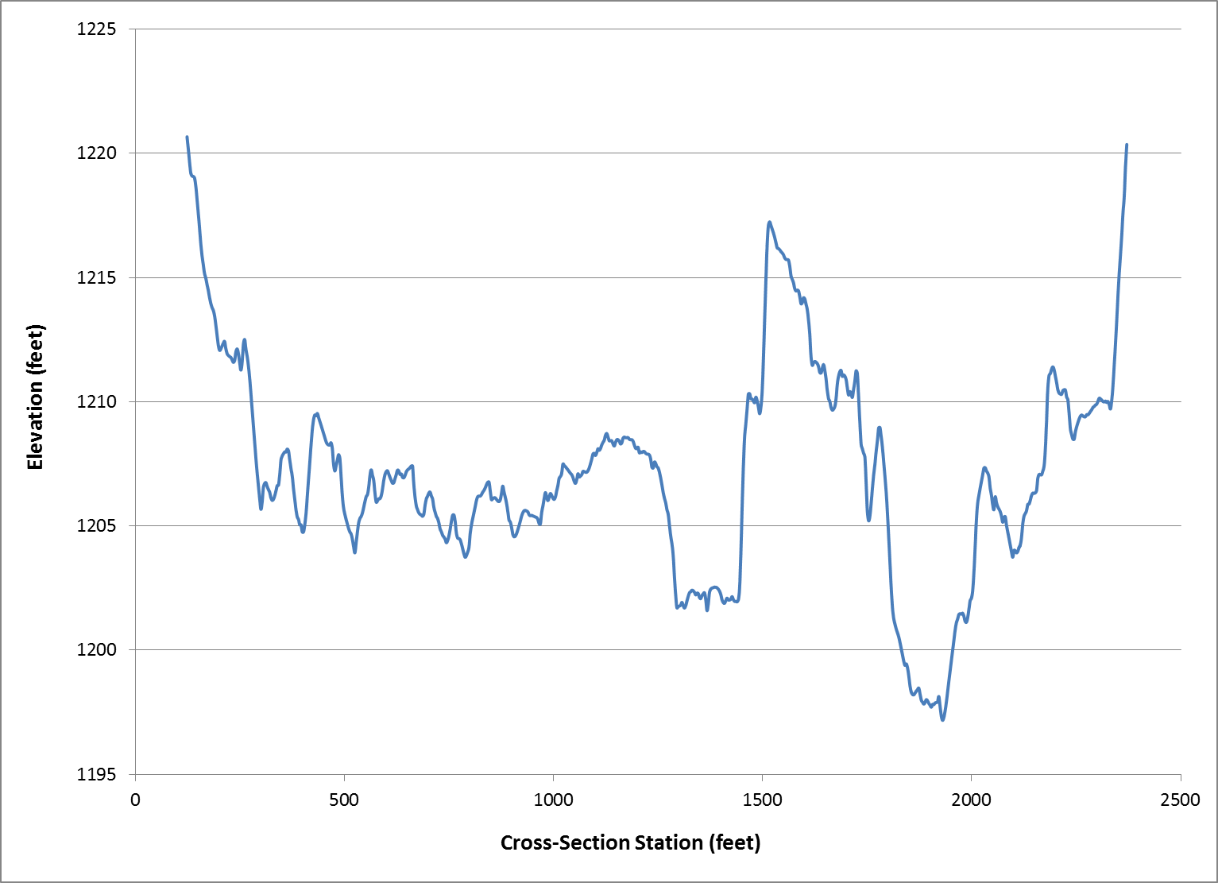
Cross-section @ Valley Station 12250
y = 0.0097x + 1089.4
Floodplain Slope Elevation

Slide 40
Cross-section @ Valley Station 12250
y = 0.0097x + 1089.4
Floodplain Slope Elevation
10 ft
Water Surface Elevation

Slide 41
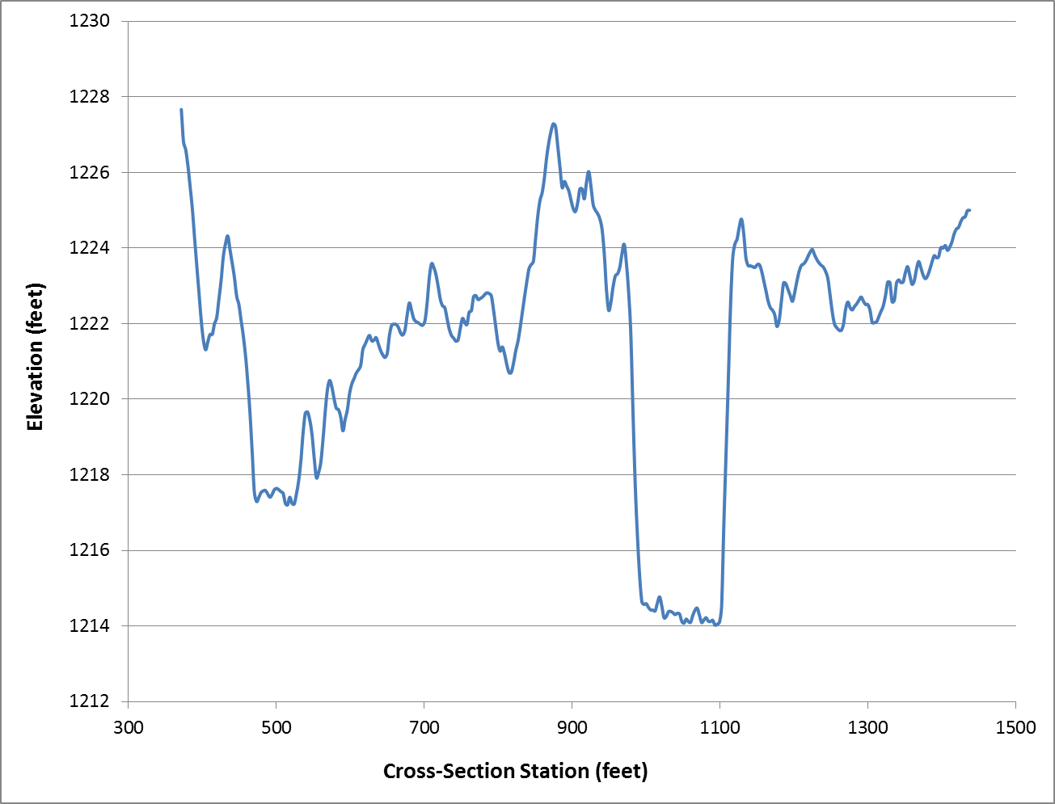
Cross-section @ Valley Station 13830
y = 0.0097x + 1089.4
Floodplain Slope
Elevation

Slide 42
Cross-section @ Valley Station 13830
y = 0.0097x + 1089.4
Floodplain Slope
Elevation
9 ft
Water Surface Elevation

Slide 43
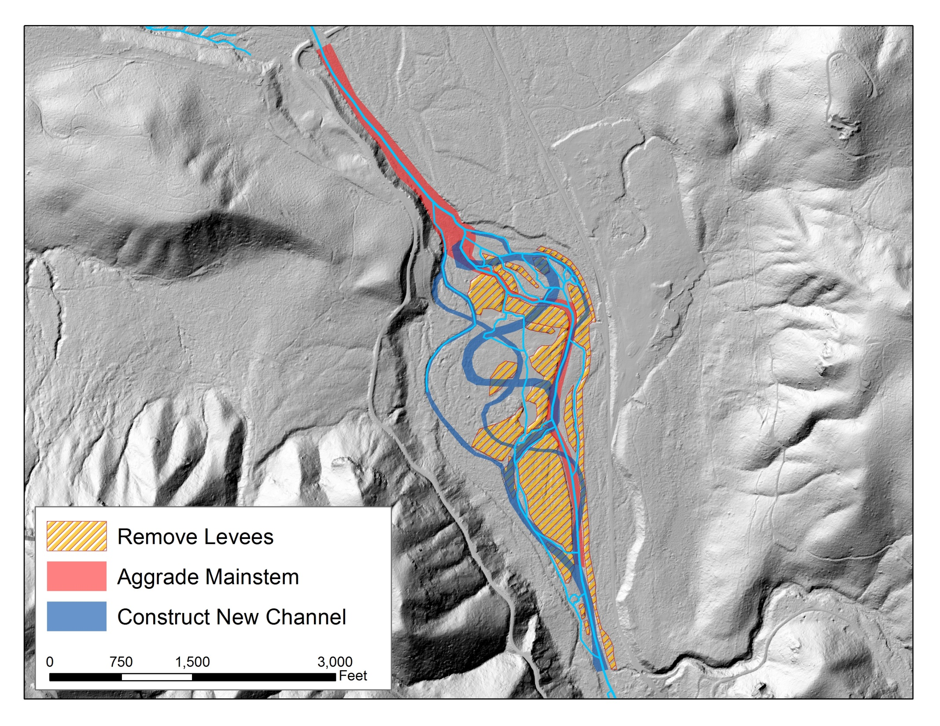
Flow

Slide 44
Applications from the Mt. Hood NF (Todd Parker, Hydrologist, Zigzag Ranger District)
Reissuing 20 year permits for summer homes along Cool Creek
Permits do not allow improvements or rebuilding of recreational residences in the 100-year floodway
Delineated the 100-year floodplain using HEC-RAS (USACE software that models floodplain inundation based on flow) and HEC-GeoRAS (ArcMap application that allows you to spatially visualize the model results of HEC-RAS)
Ran the model with a 10m DEM and LiDAR Bare Earth DEM to compare (also compared it to FEMA)
LiDAR allowed them to more accurately map the floodplain (validated by flood events after the mapping) and do it very efficiently

Slide 45
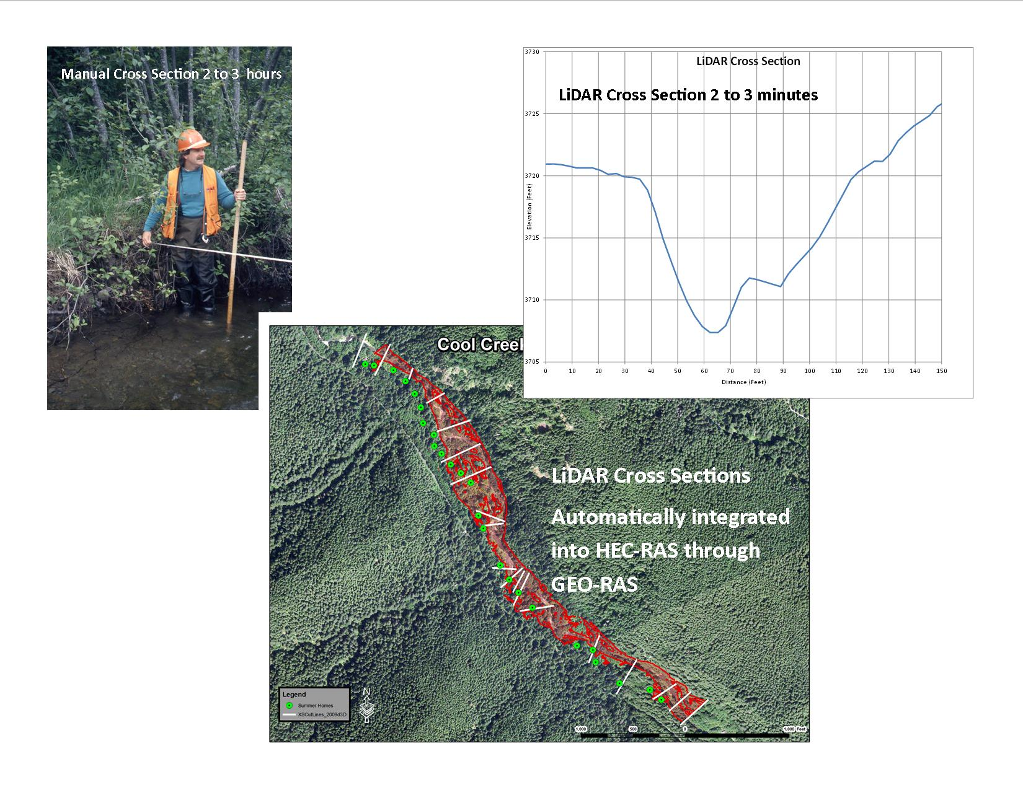

Slide 46
FEMA 10m DEM LiDAR

Slide 47
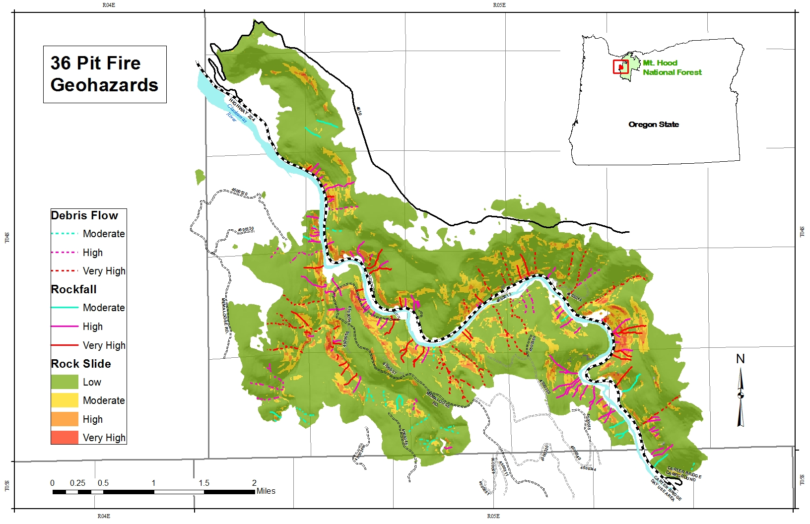
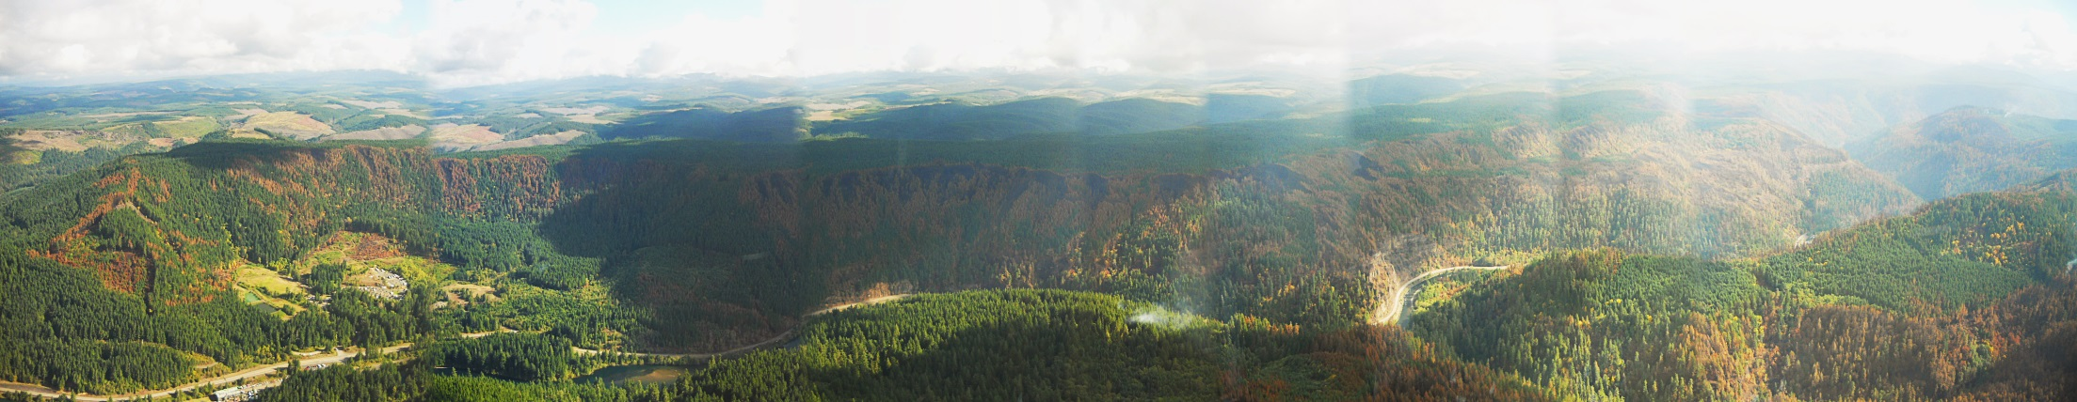

Slide 48
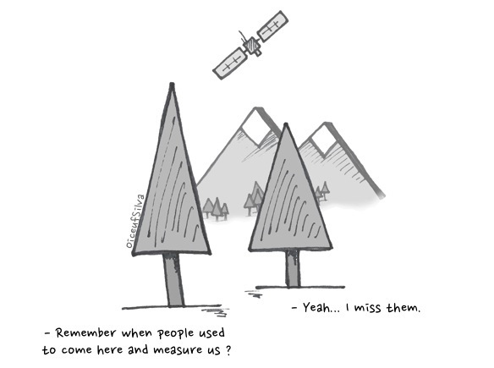
Advantages of LiDAR
Accuracy
Resolution
EFFICIENCY!!!

Slide 49
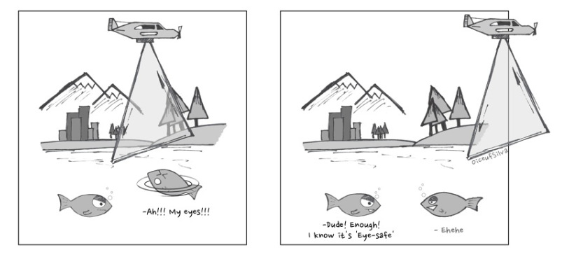
Limitations of LiDAR
Lose accuracy in dense canopy
Water surface elevation only (unless you get green LiDAR)

Slide 50


