Slide 1
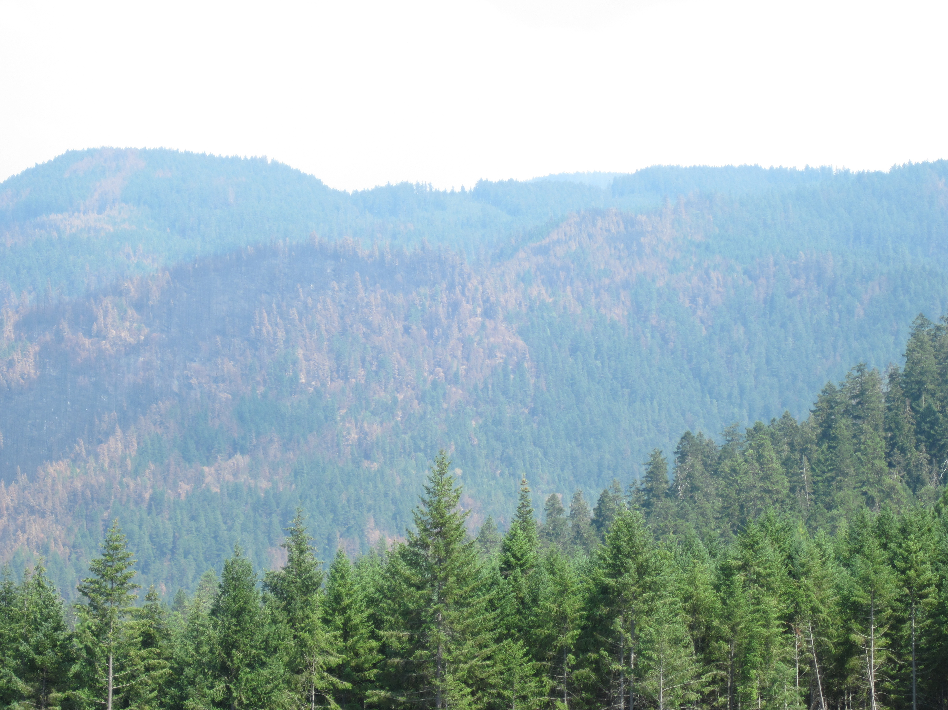
The Umpqua National Forest’s Process For Planning Landscape Scale Projects in Critical Habitat
Josh Chapman
¹ Forest Biologist Umpqua NF

Slide 2
Objectives
Describe the location of the Umpqua and the Critical Habitat Units it contains
Discuss differing special management considerations for each Critical Habitat unit on the Forest
Discuss biotic and abiotic variables that the Umpqua is using to develop projects in critical habitat

Slide 3
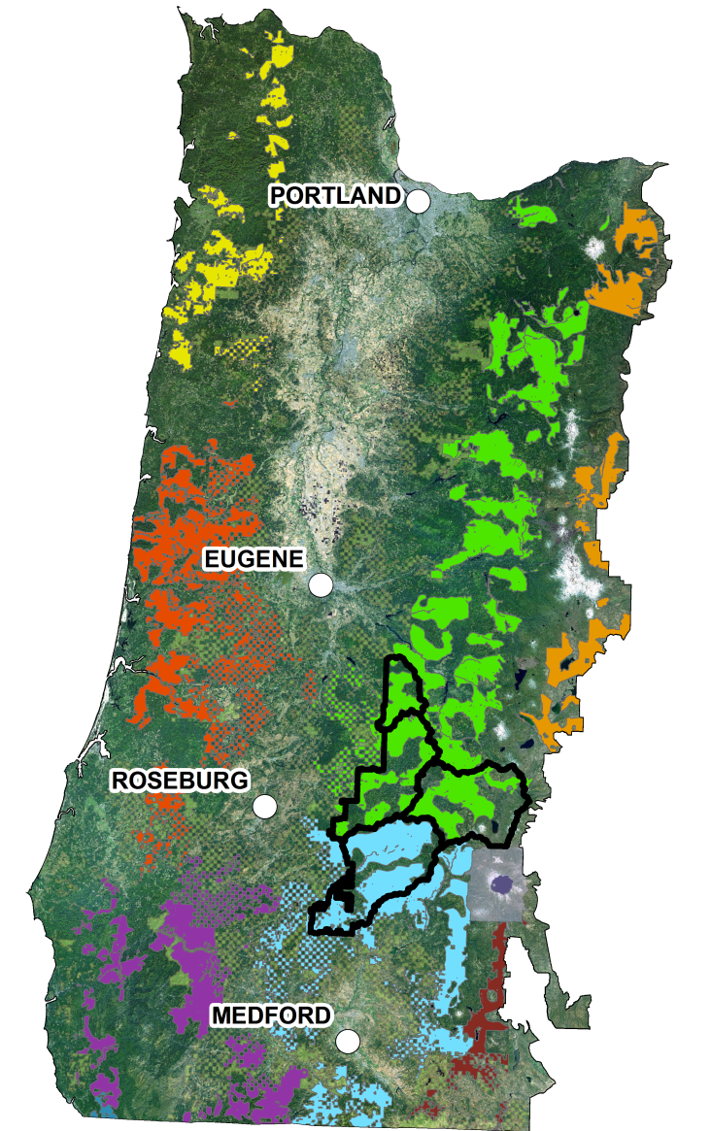
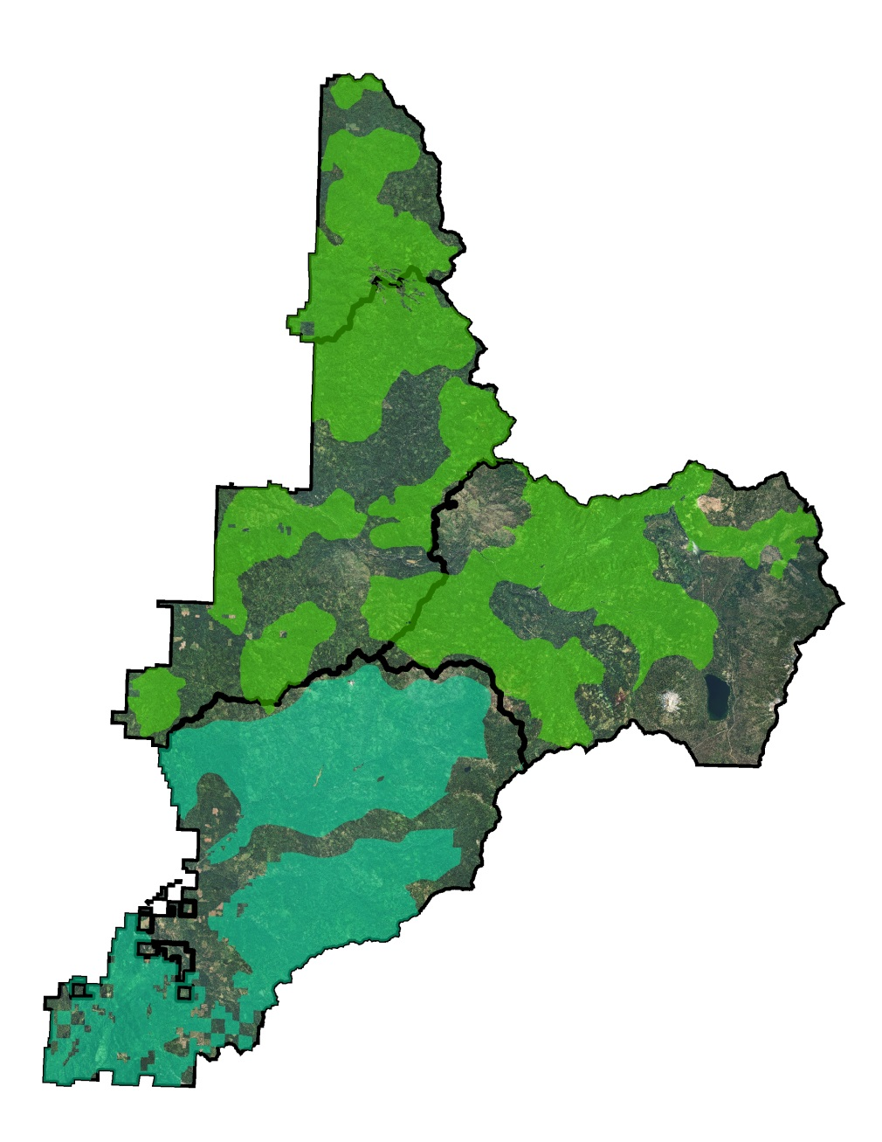
Critical Habitat in Oregon and on the Umpqua National Forest
Western Cascades
Subunit 5
Umpqua National Forest
Klamath East
Subunit 1
Notes:
Key points here is that of the Umpqua’s Matrix, 65% is CHU, and when IRA’s and Riparian Reserves are added that that, 73% is in a semi protected land use allocation. While 60% of the Umpqua is CHU, with wilderness 68% is in a protected land use designation. Also of note here is that the Umpqua contains two different critical habitat units, the Western Cascades and the Klamath East which have different special management considerations

Slide 4
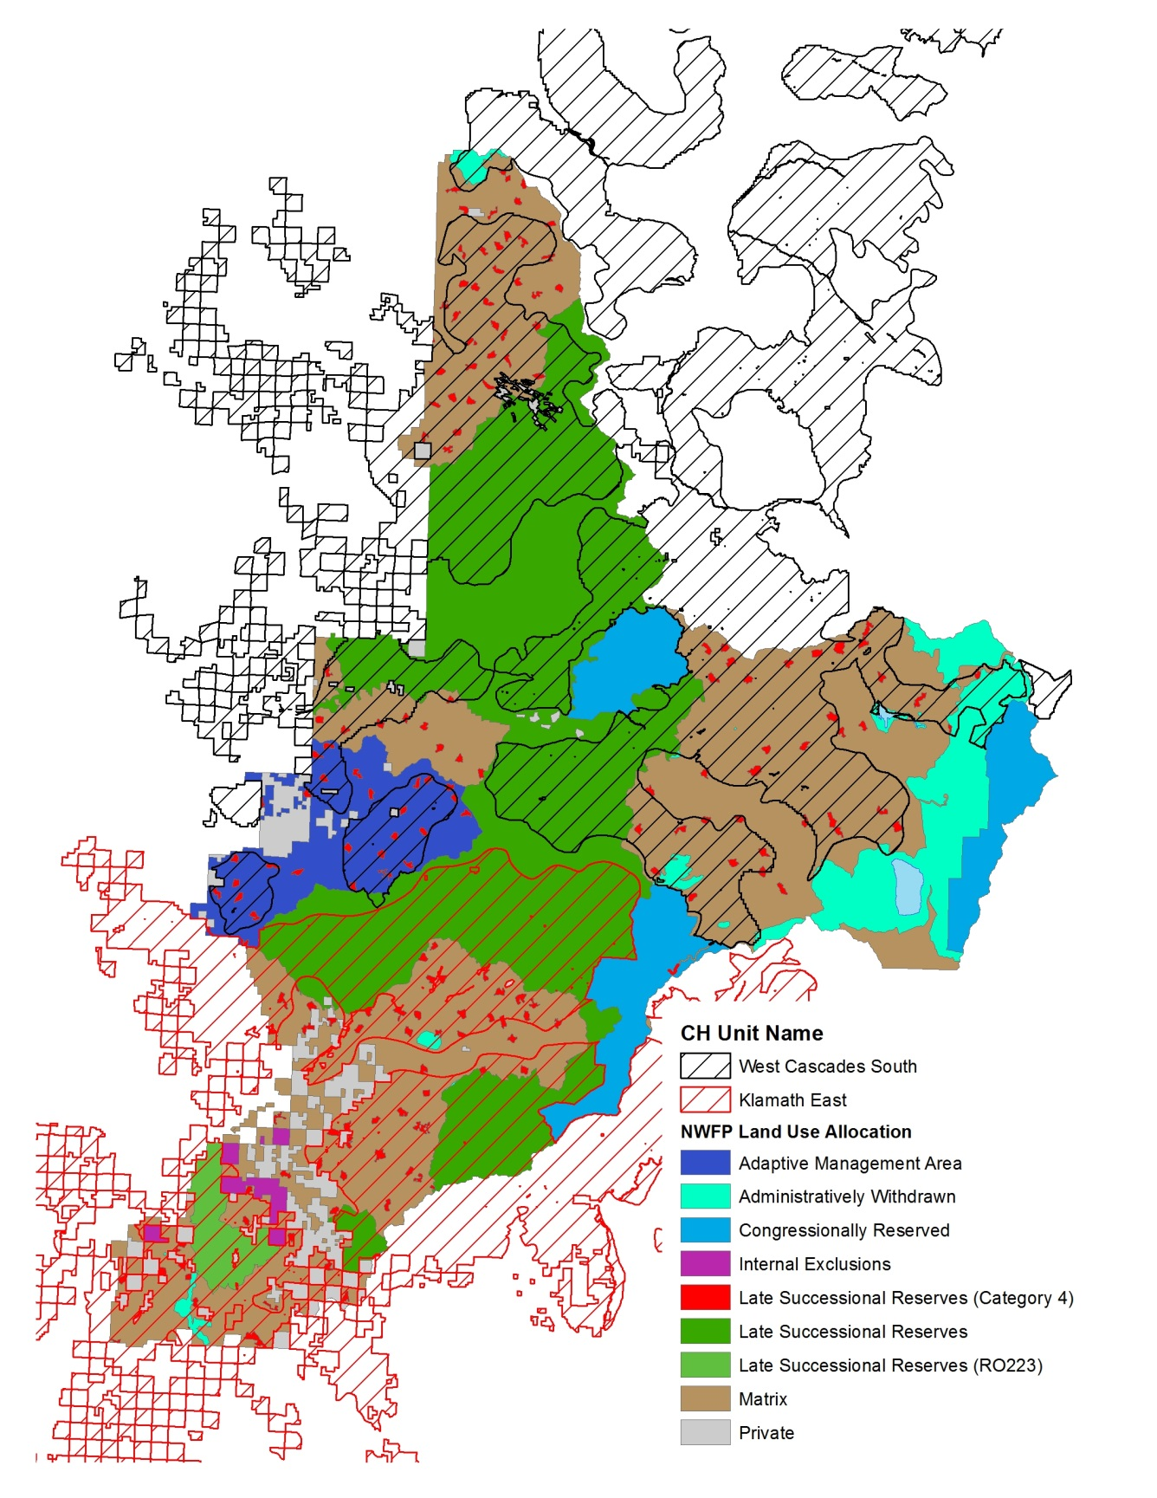
Critical Habitat Overlaid on NWFP Land Use Allocation
Northwest Forest Plan Land Use Allocation | Acres of Critical Habitat | % of Total Land Use Allocation | Total Umpqua NF Acres
Adaptive Management Area | 30,615 | 50% | 60,852
Administratively Withdrawn | 14,455 | 22% | 66,350
Congressionally Reserved | - | 0% | 71,819
Matrix | 268,233 | 65% | 411,983
Late Successional Reserves | 282,993 | 75% | 375,157
Totals | 596,296 | 60% | 986,160

Slide 5
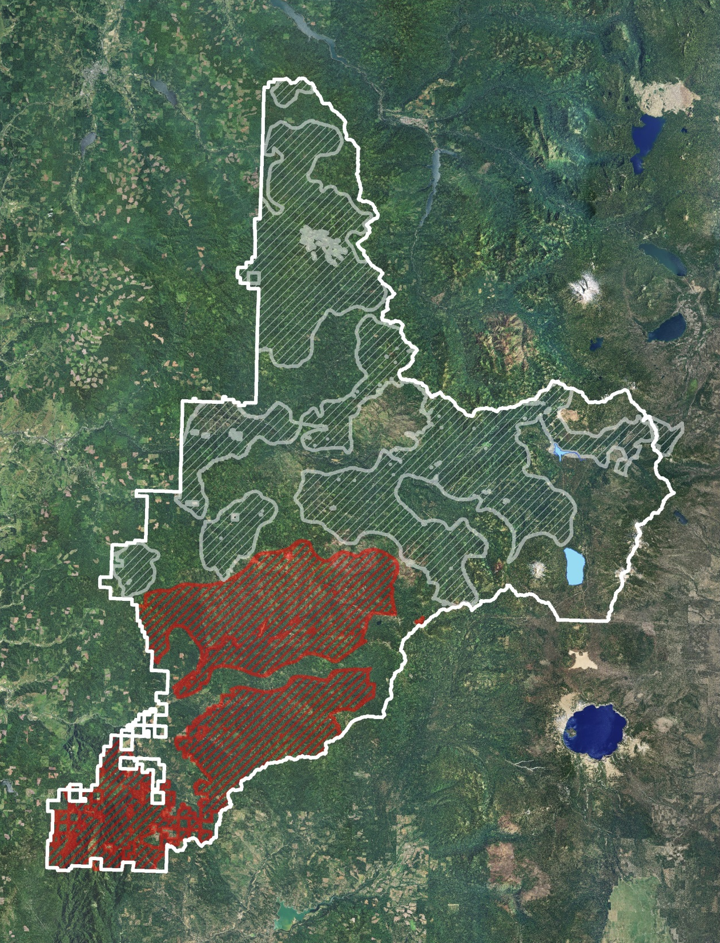
Critical Habitat Sub Units on the Umpqua Western Cascades South and Klamath East

Slide 6
Critical Habitat Objectives Western Cascades South Subunit 5
Threats:
Current & Past Timber Harvest
Barred Owls
Purpose of Subunit:
Demographic Support
East/West and North/South Connectivity

Slide 7
Western Cascades South Subunit 5
Special management considerations:
Conserve older stands that contain the conditions to support northern spotted owl occupancy or high-value northern spotted owl habitat as described in Recovery Actions 10 and 32.
2. Management emphasis needs to be placed on meeting northern spotted owl recovery goals and long-term ecosystem restoration and conservation. When there is a conflict between these goals, actions that would disturb or remove the essential physical or biological features of northern spotted owl critical habitat need to be minimized and reconciled with long-term ecosystem restoration goals.

Slide 8
Western Cascades South Subunit 5
Special management considerations:
3. Continue to manage for large, continuous blocks of late-successional
Forest.
4. In areas that are not currently late seral forest or high-value habitat and where more traditional forest management might be conducted (e.g.matrix), these activities should consider applying ecological forestry prescriptions.

Slide 9
Critical Habitat Objectives Klamath East Subunit 1
Threats:
Current & Past Timber Harvest
Loss of habitat from wildfire
Barred Owls
Purpose of Subunit:
Demographic Support
East/West and North/South Connectivity

Slide 10
Klamath East Subunit 1
Special management considerations:
Combines the moist forest recommendations of the West Cascades Units and dry forest recommendations of the East Cascades.
Dry Forest Recommendations include:
Vegetation and fuels management in dry and mixed-dry forests may be appropriate both within and outside designated critical habitat where the
goal of such treatment is to conserve natural ecological processes or restore them (including fire) where they have been modified or suppressed.

Slide 11
Approach for Integrating Ecological Restoration and NSOs
Explicit consideration of scale is essential for successful integration of NSO into forest restoration planning (=strategic)
Need to know landscape–level context before stand–level Rx (=top-down approach)
Recognize and foster or mimic the role of fire in creating habitat mosaics as well as maintaining within-stand elements (=bottom-up approach; Stand-level)

Slide 12
“Explicit consideration of scale”
Scale | Spotted Owl | Planning
Regional (CH Unit) | Forest community (Dry to Moist) Disturbance regimes Spotted Owl population ecology | Forest restoration and management approach
Landscapes (CH Subunit - Watersheds) | Abundance, Quality, Distribution of habitat and relative risk level Abundance, density, distribution of spotted owl territories | Project objectives and prioritization “why here, why now?”
Home Ranges | Habitat quality and owl fitness Distribution of owl use, based on topography, forest structure | Amount and spatial pattern of forest habitats (stands)
Stand | Resource availability Within-stand resources Prey, nest sites, cover | Stand-level prescriptions

Slide 13
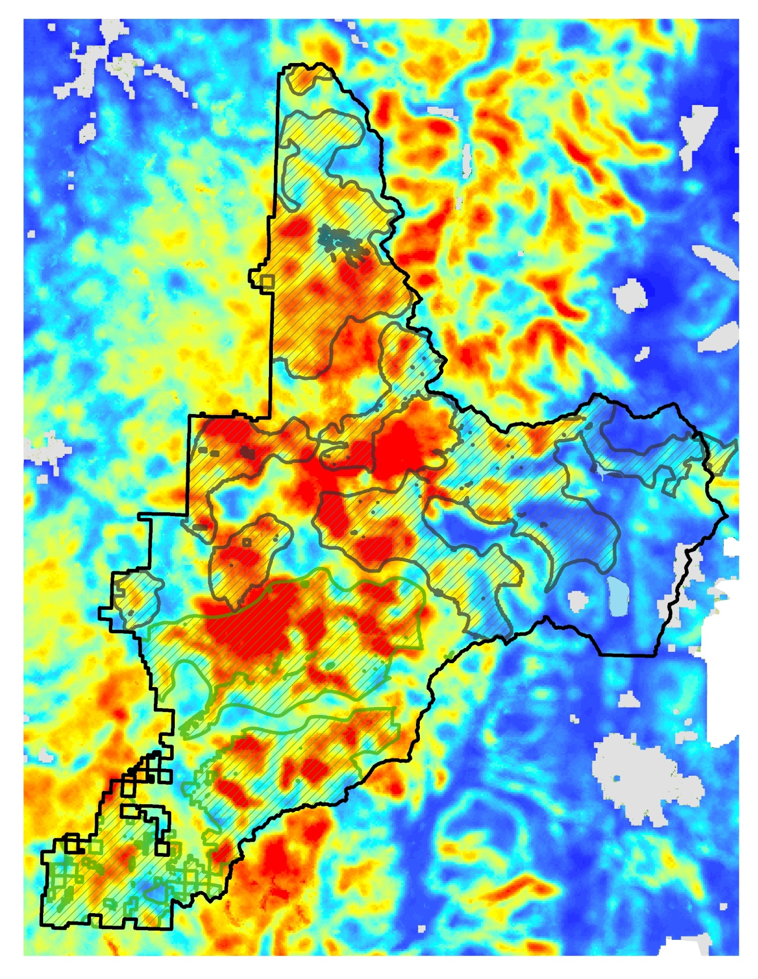
Large Fire Suitability Model (Davis 2011) Model Variables Included: August Max Temperature Slope Lightning Ignitions Distance to road* Elevation Summer Precipitation Solar Radiation *Use in conjunction with roads layers Trained by historic wildfire data 1970-2002, Useful at the 5th field watershed scale (or larger, approximately 20 square miles)

Slide 14
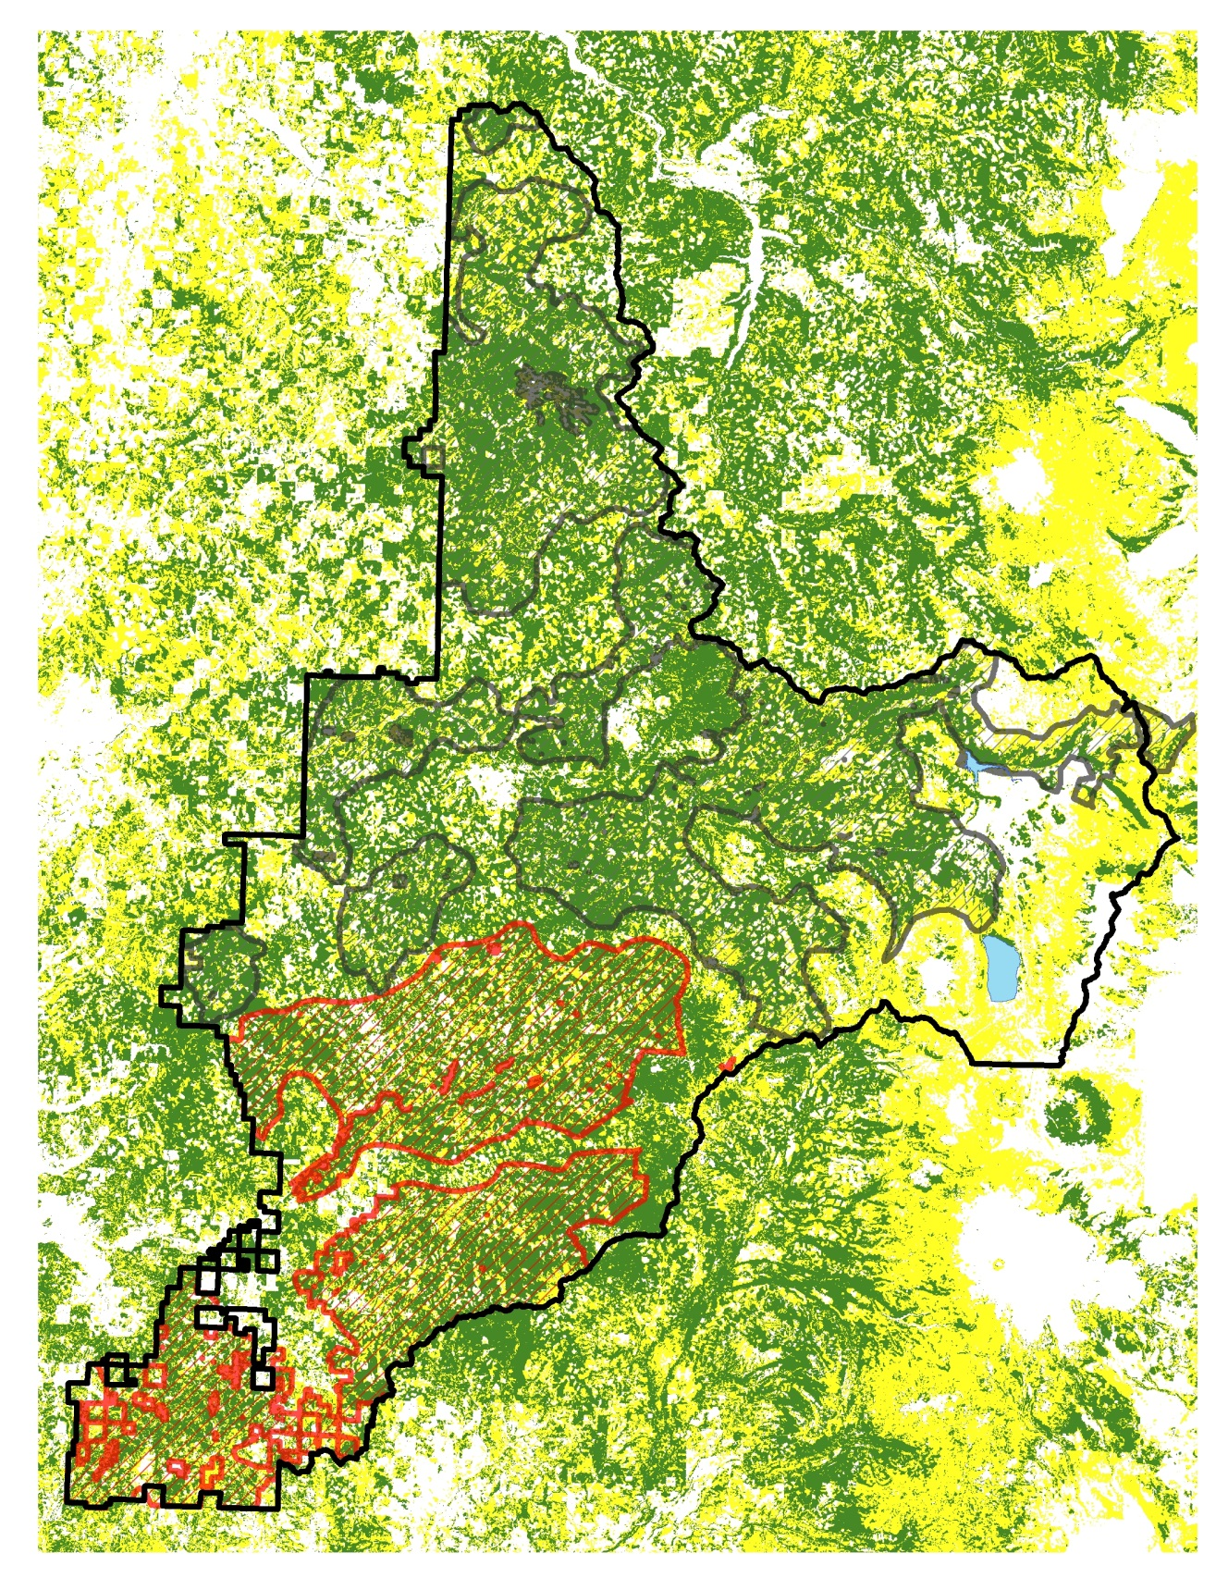
Nesting, Roosting and Dispersal Habitat Model (Davis et al. 2011) Model Variables Included: Conifer Cover Large conifer density Diameter diversity index Stand age Mean conifer d.b.h. Stand height 5 forest species composition variables This model is not smoothed, but still should be used at 6th to 5th field watershed scale due to coarseness of environmental variables.

Slide 15
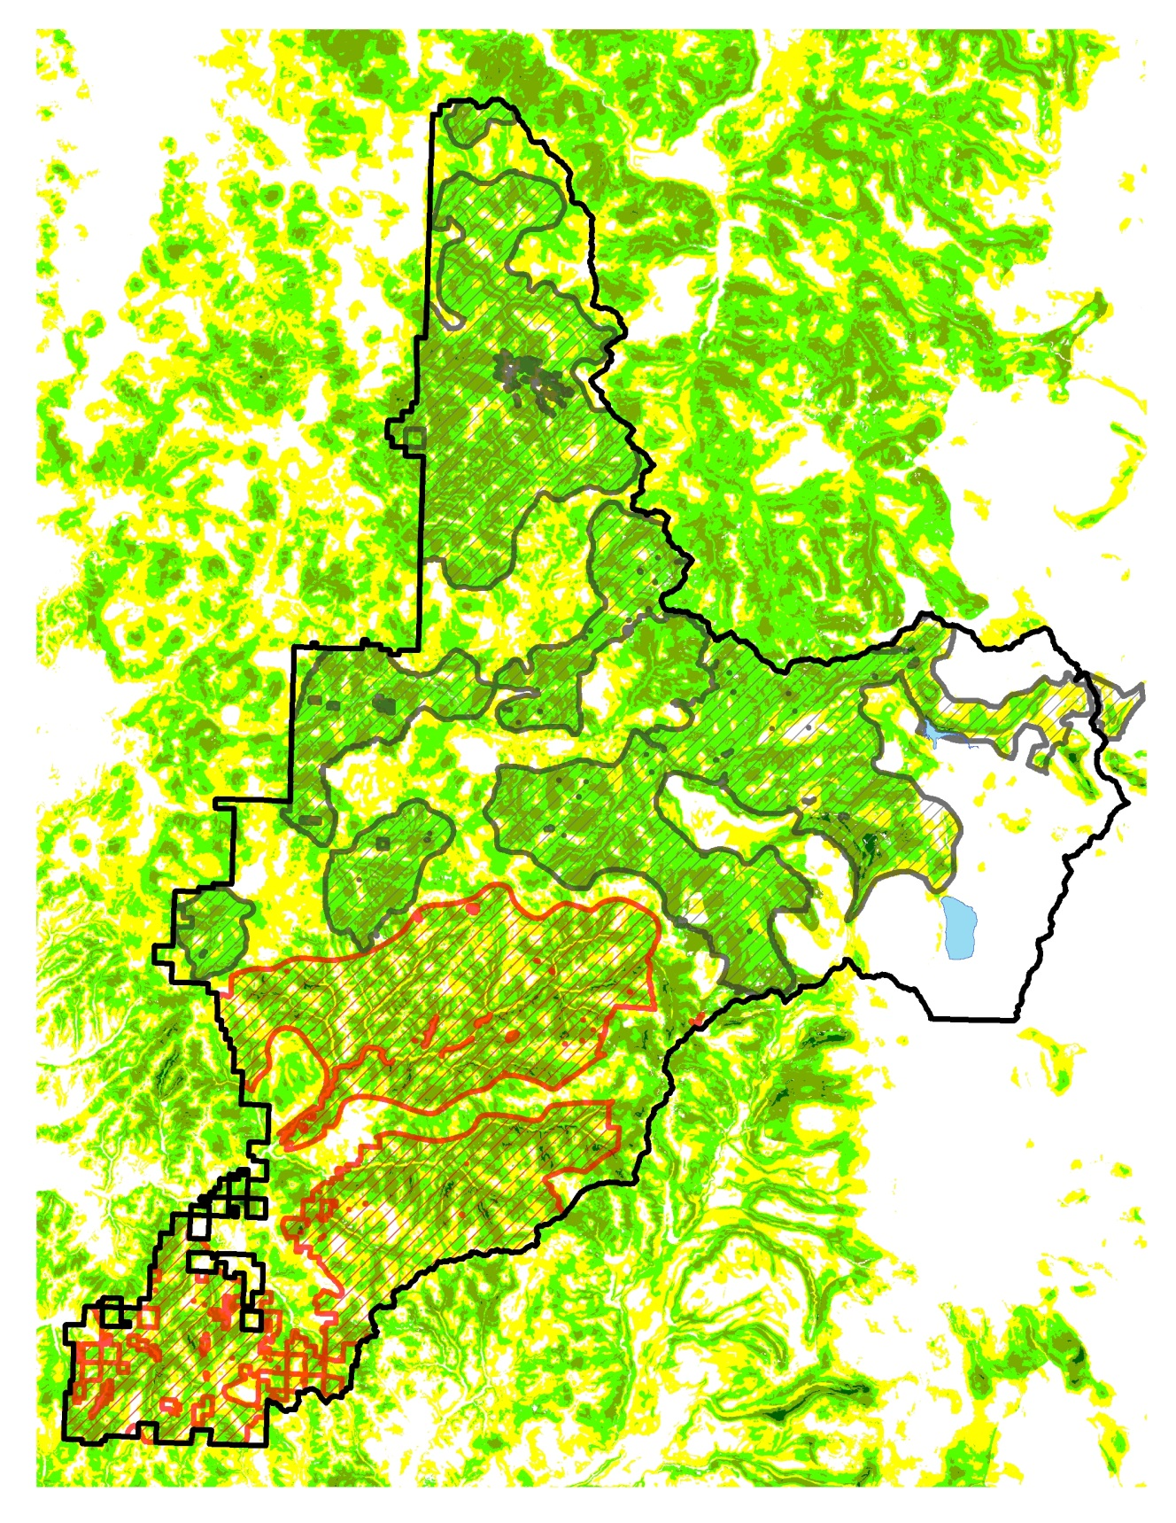
USFWS Relative Habitat Suitability Model Model Variables Included: Habitat Structure Variables Habitat pattern at Core and Edge of Nesting/Roosting habitat Species Composition Variables Topographic Position (Slope, Curvature, Insolation) Climate/Elevation Model was smoothed at 200 ha scale to simulate habitat at the core use area scale.

Slide 16
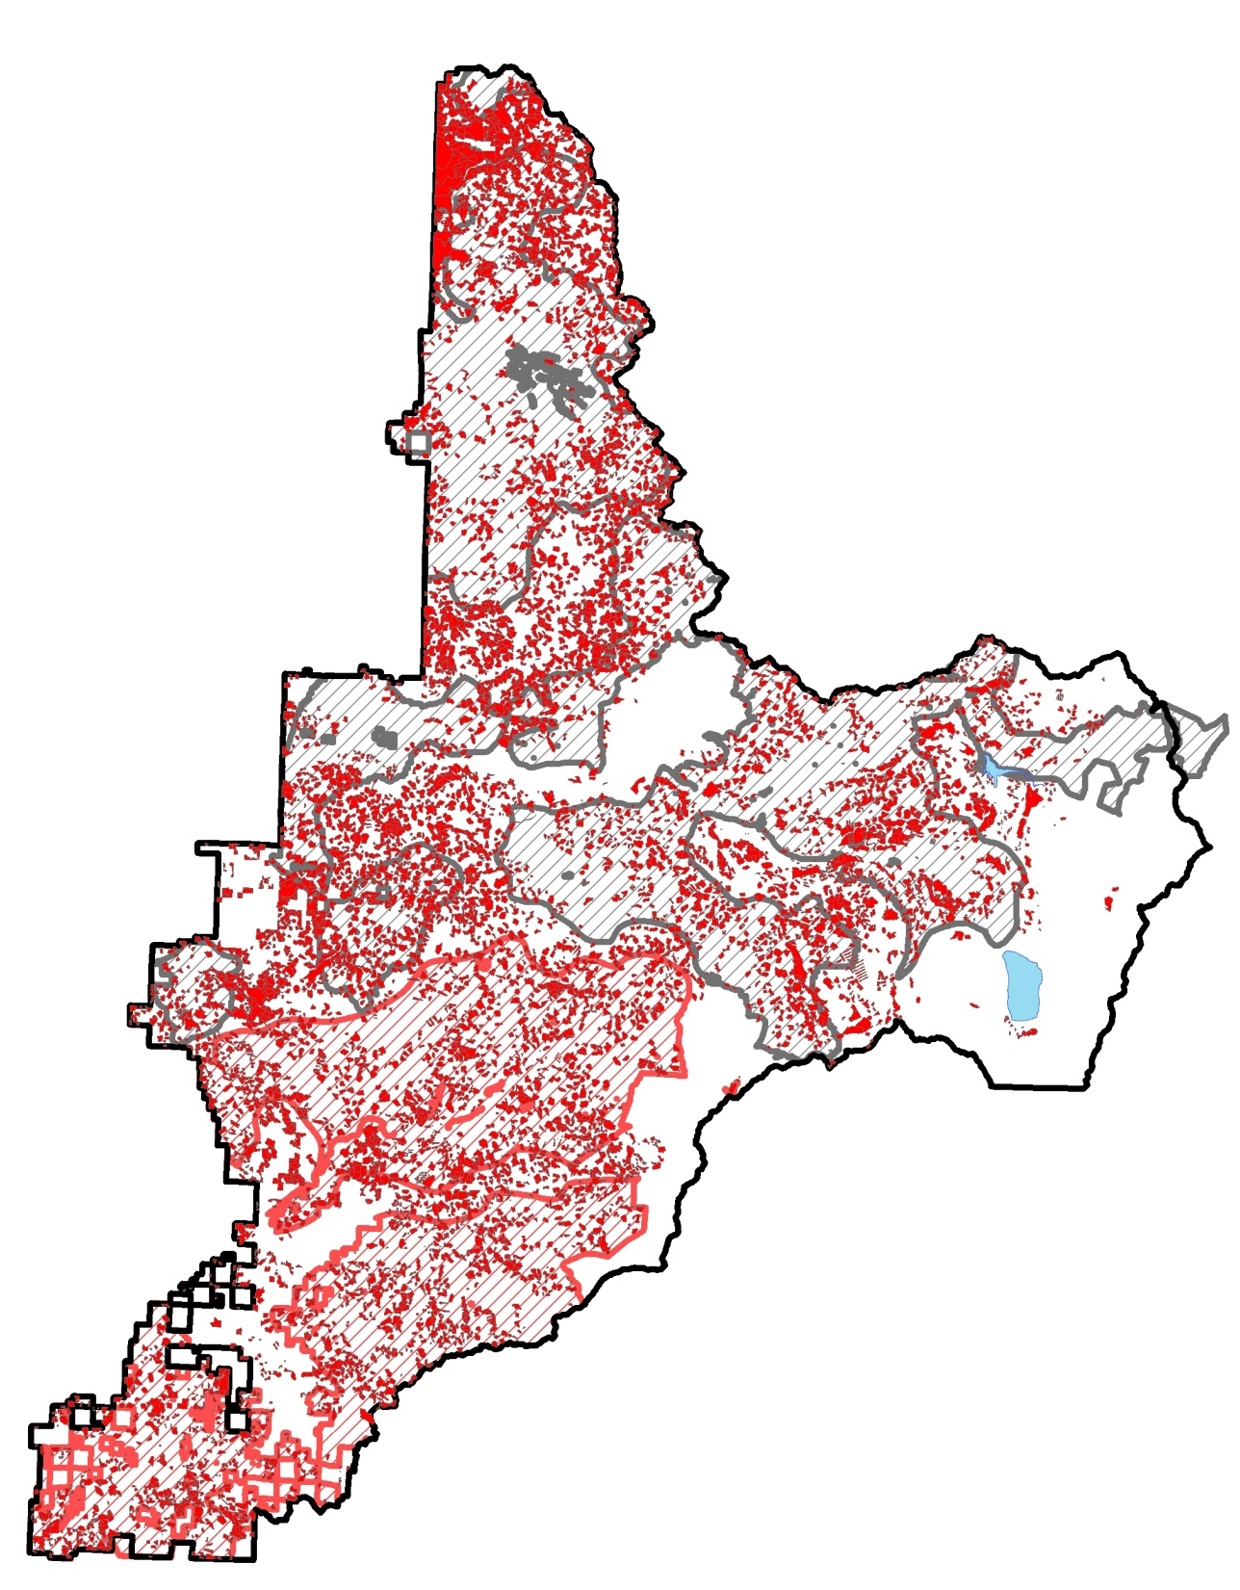
Umpqua National Forest Regeneration Harvest History 1913-2002 Stand Level Data

Slide 17
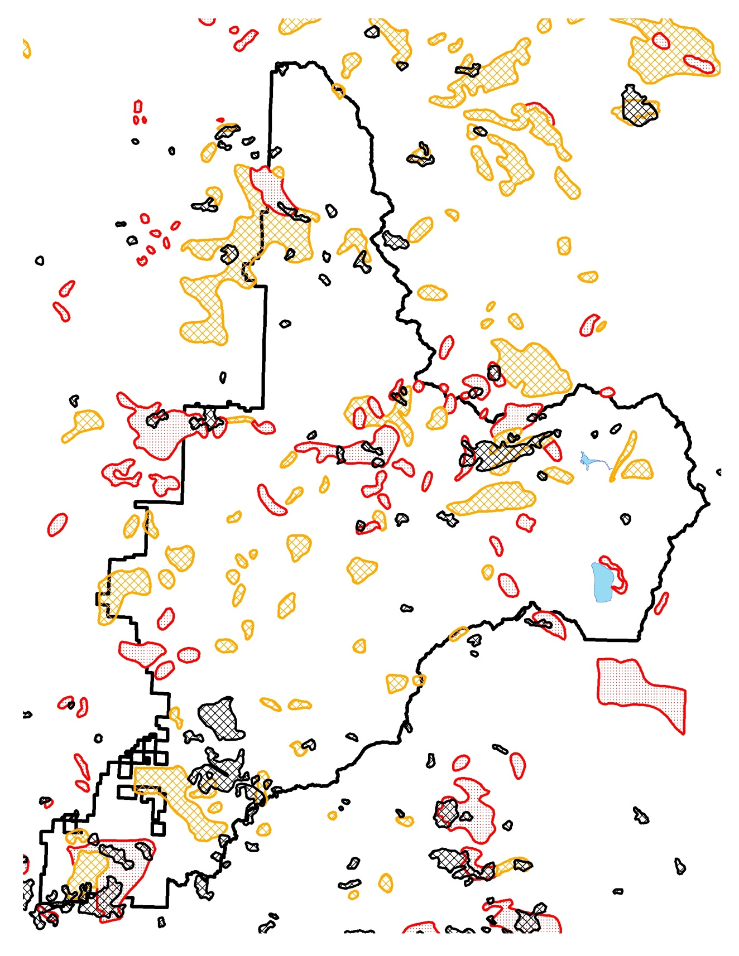
Map of Historic Fires from 1914 and 1930-1936 This pattern of stand replacement fire can serve to inform early seral habitat creation patch size and also identify areas of single cohort stand development that could benefit from silvicultural treament

Slide 18
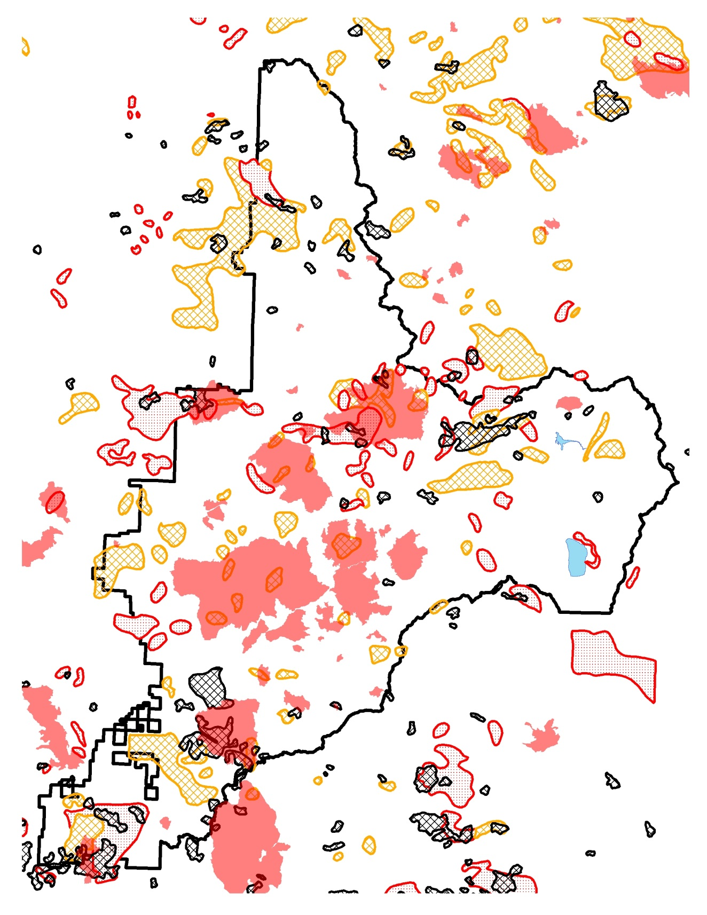
Fire History 1914-2014 Average size 1914: 2,405 acres Average size 1970-2014: 3,950 acres

Slide 19
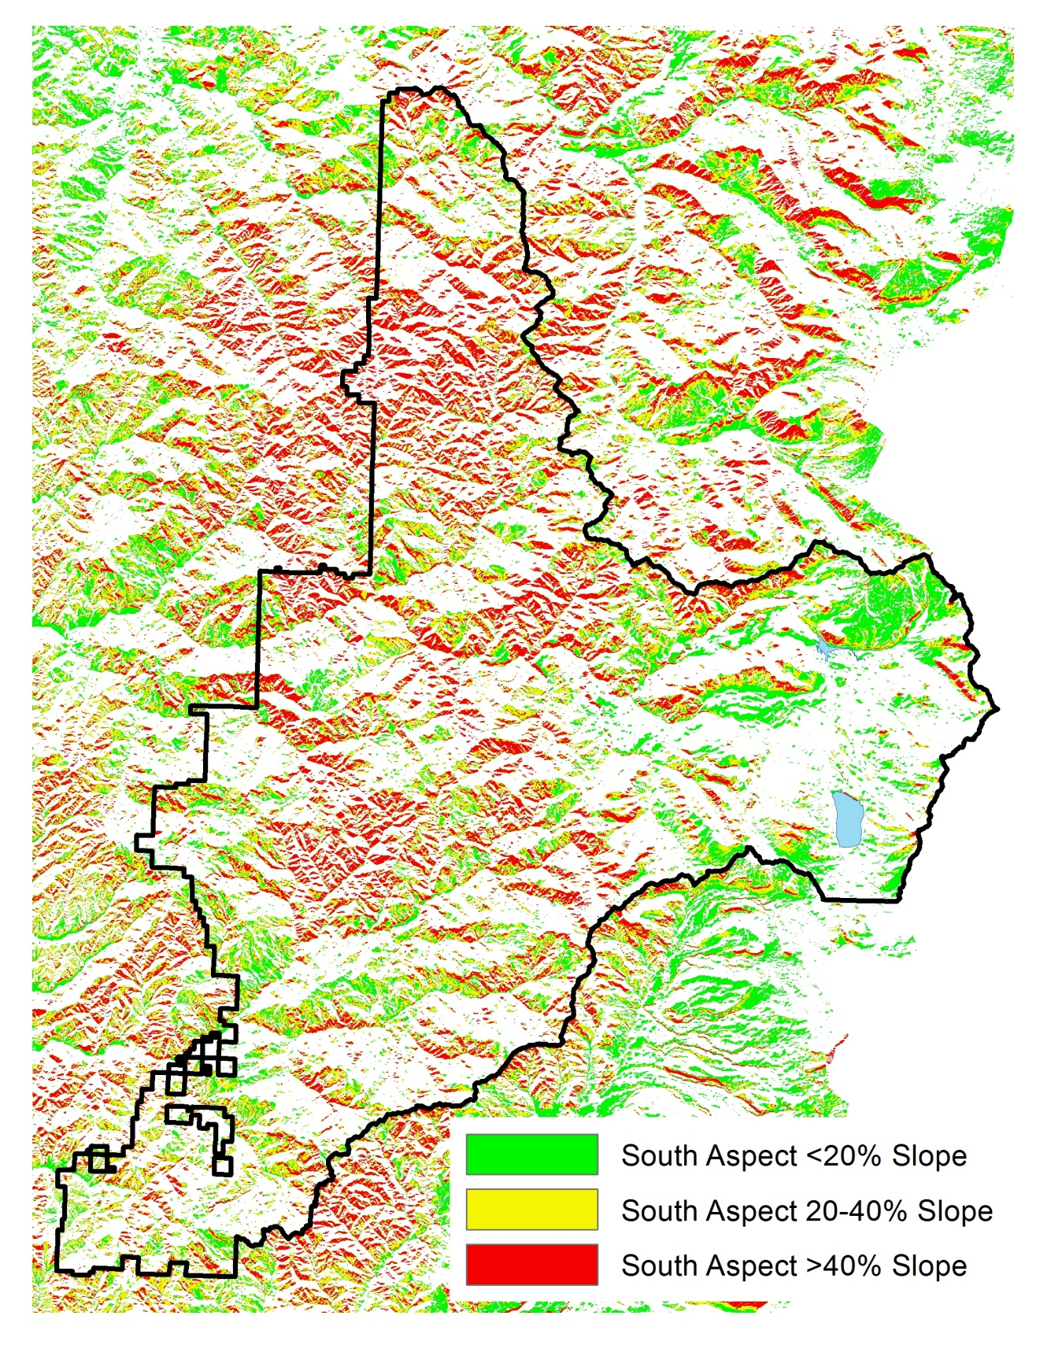
“Topography as a template for diversity”¹ South aspects and steep slopes are areas where fires historically have burned more severely and more frequently, and therefore are areas on the landscape less suitable for long term NSO habitat and more suitable for higher intensity silviculture and fuels reduction treatments 1. Stolen from a Tom Spies talk on moist conifer restoration

Slide 20
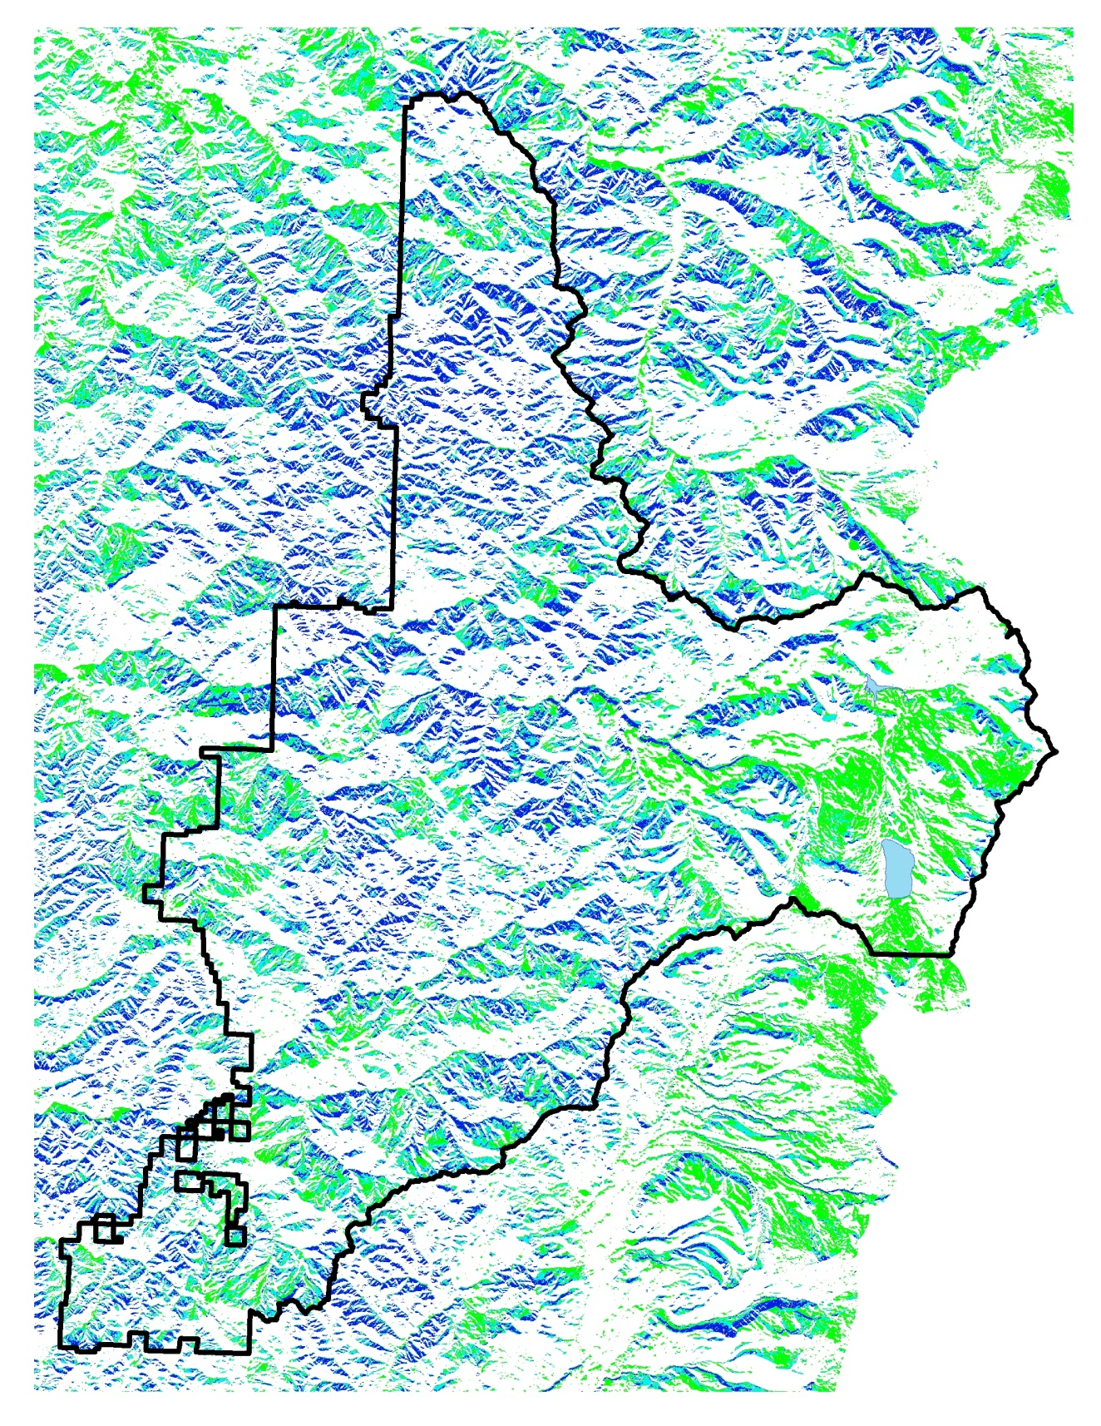
“Topography as a template for diversity”¹ North aspects and gentler slopes are areas less likely to burn at moderate to higher severities and are therefore places to consider treating younger stands to accelerate the development of late successional habitat characteristics. Existing habitat should be maintained as these are more likely to be retained in the face of future disturbances. 1. Stolen from a Tom Spies talk on moist conifer restoration

Slide 21
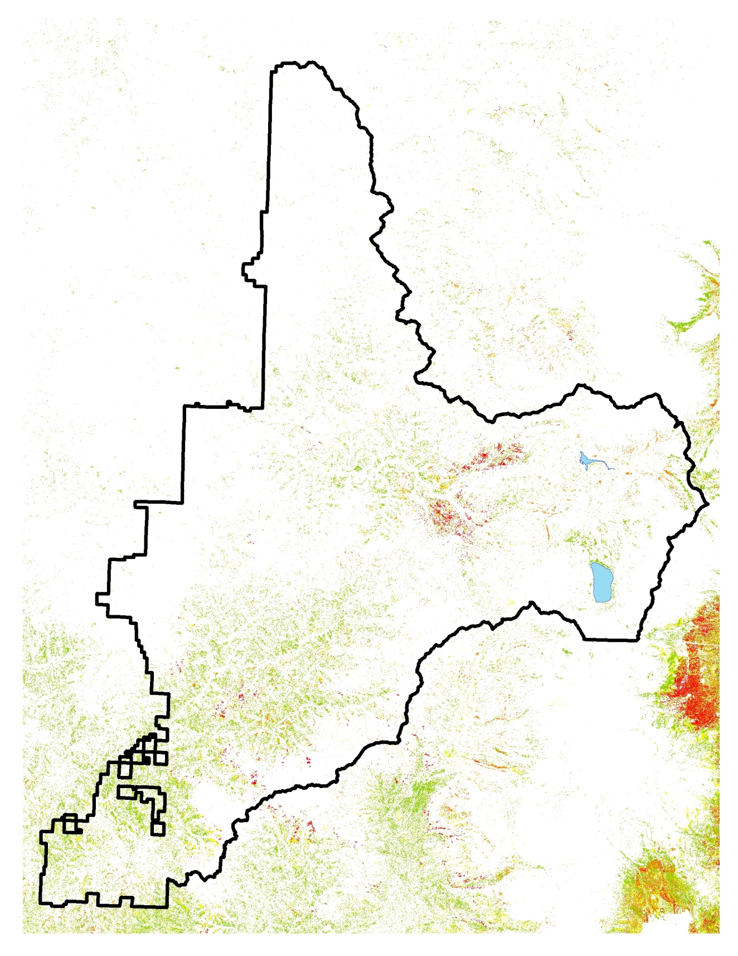
Ponderosa Pine Distribution Ponderosa pine on the Umpqua present opportunities for restoration as many areas they are being encroached upon by other conifers where fire has been excluded. They are also evidence of more frequent fire return interval.

Slide 22
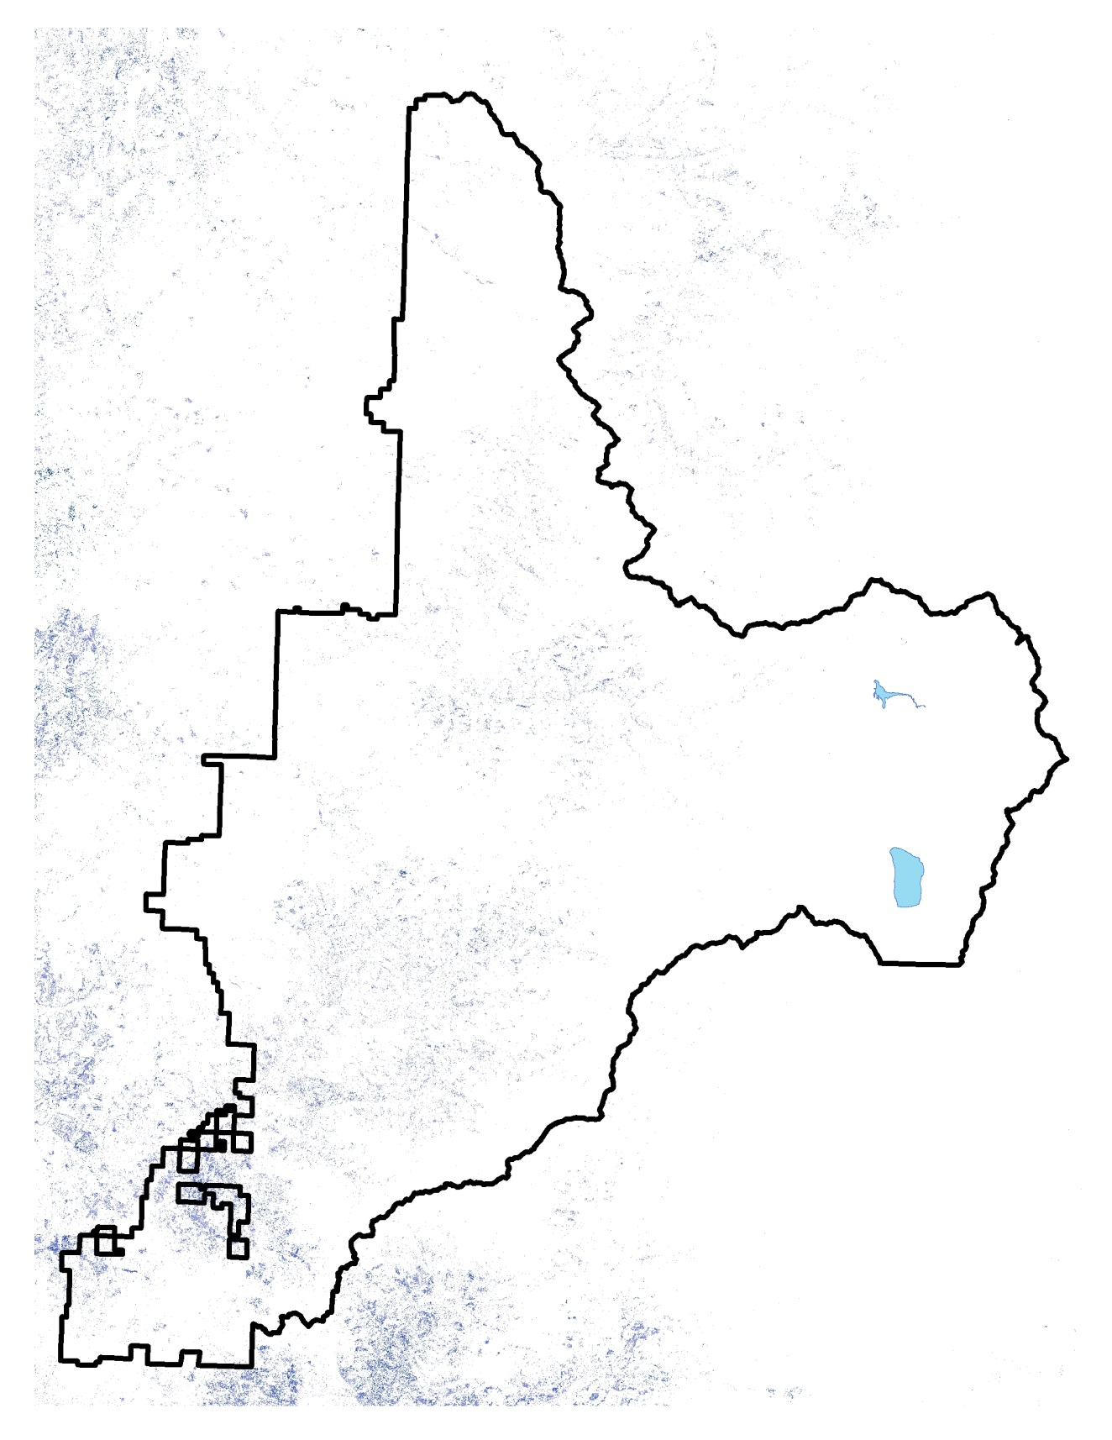
Oregon White Oak Distribution A more rare species on the Umpqua which in many areas are being encroached upon by conifers due to fire exclusion. Reducing competition and maintaining this species on the landscape does not provide NRF habitat, but they are an important piece of habitat diversity and represent a great opportunities for restoration objectives consistent with the critical habitat rule.

Slide 23
Some Take Home’s
We are still working this out as a Forest, trying to balance between restoration objectives described earlier and providing forest products to the communities
We are trying to work from large to small, identifying restoration opportunities at a landscape scale, then work down to the specific unit locations
Level one team flexibility in interpreting the special management considerations is key to managing for critical habitat objectives in a transition forest like the Umpqua

Slide 24
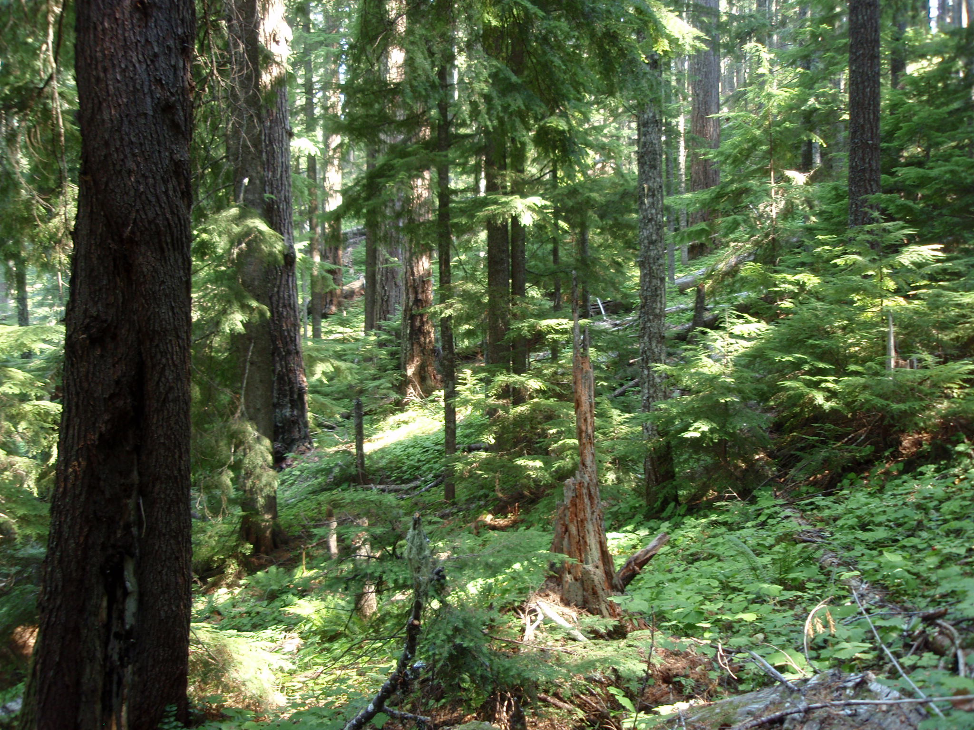
Questions/Comments?

