Slide 1
Managing in Critical Habitat
A California Perspective

Slide 2
Critical Habitat Projects – A California Perspective
Summarize three past (KNF) and one current CH / LSR projects (C.Jordan / K.Fitzgerald – Elk Project - STNF)
Ecological conditions
Projects’ objectives (Purpose and Need)
Treatments / Applicable Science
Effects to CH
Level of FWS involvement
Planning / Implementation Challenges
Successes
Notes:
Questions pertaining to fine details may need to be directed to Dan

Slide 3
Project | Mt. Ashland | Singleton | Johnny O’Neil
Era | 2006; 2008 ROD 1992 CH LOC 10/2007 Project Partially Implemented | 2010; 2013 ROD 2008 CH / 2012 Proposed CH LOC 5/2012 Plantations thinned 2013 | 2008; ROD 2012 2008 CH /2012 Proposed CH LOC 6/2012 Currently being marked
Notes:
Context of time and general indication of how long projects take to plan and implement – FWS involvement – all reinitiated.

Slide 4
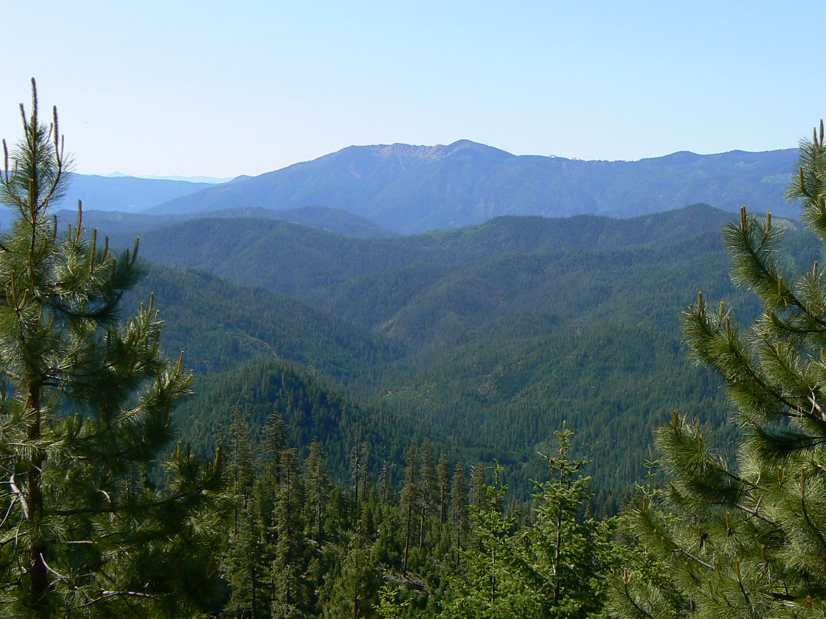
Ecological condition
All project areas share similar departures from natural fire return intervals – few fires of consequence in last 100 years
Notes:
Interior Klamath Province. Recognized as area threatened by HS fire.

Slide 5
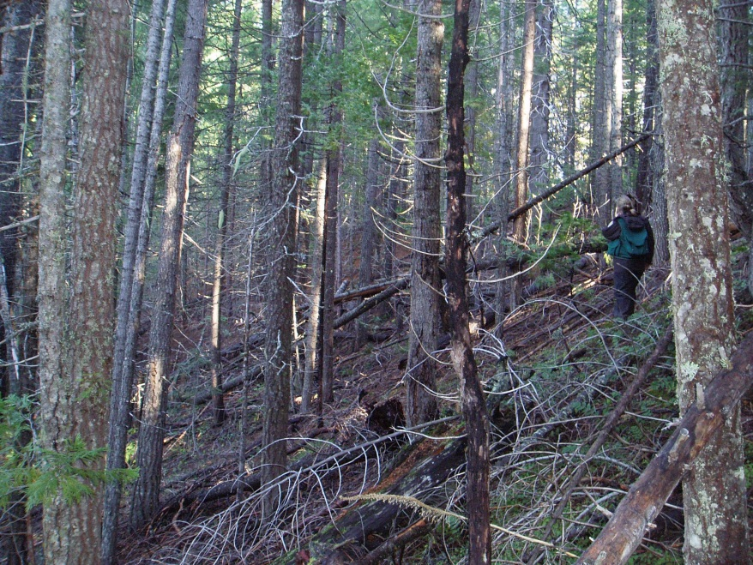
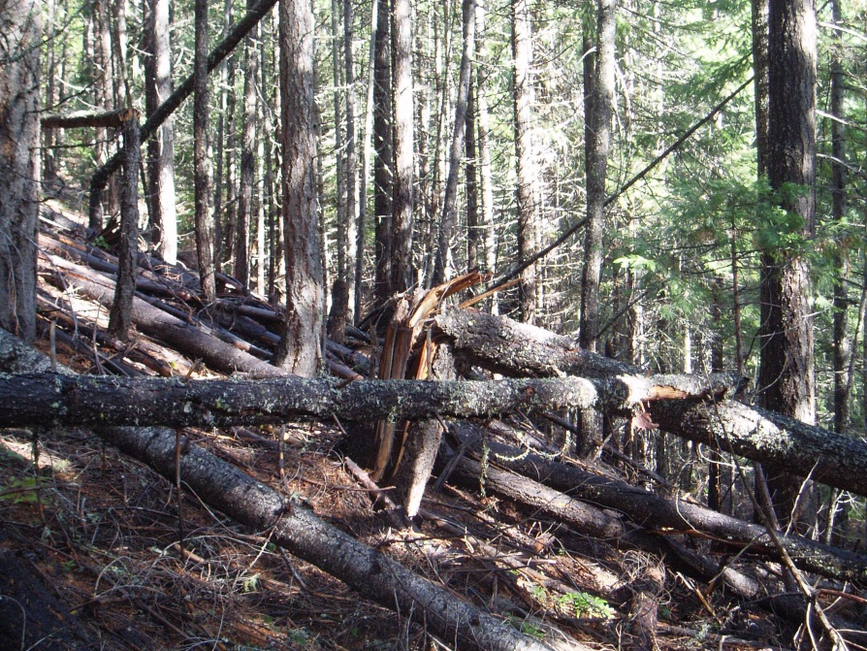
Mt. Ashland
Current habitat influenced by
-Railroad logging
-Fire suppression,
-Checkerboard ownership.
-Overall low structural diversity
-Dense homogenous 2nd growth,
-Deficit in LS habitats
Notes:
Right on the OR/CA border-Mixed conifer with little hardwood component

Slide 6
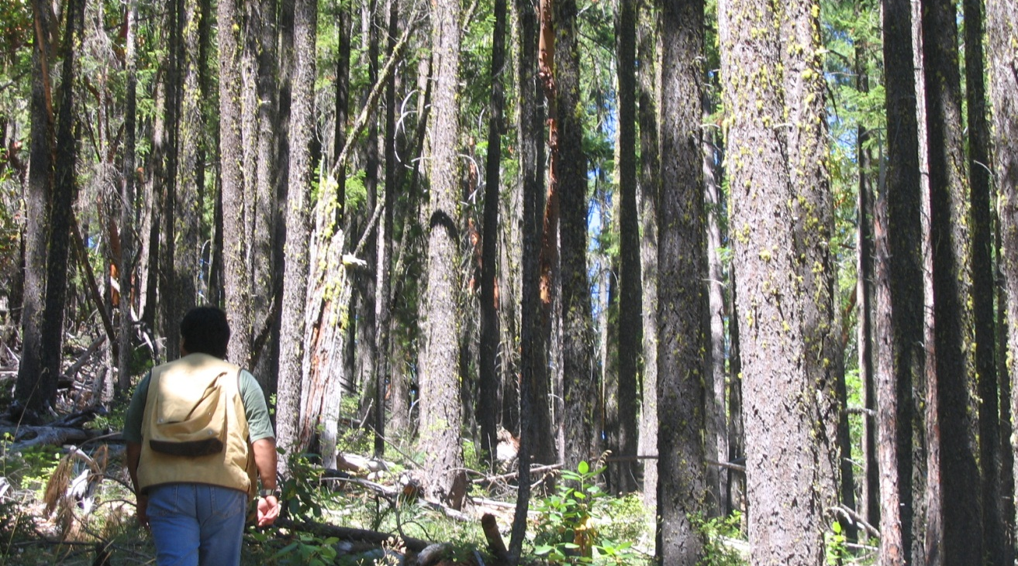
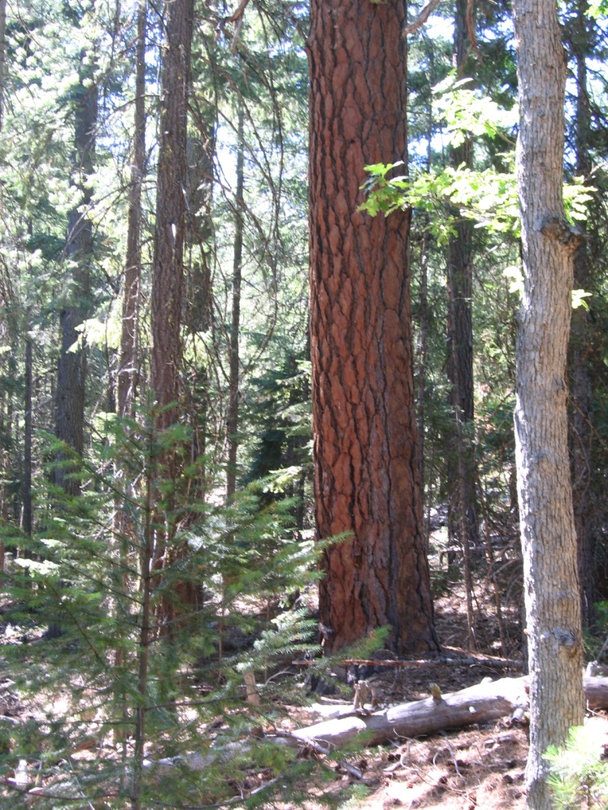
Singleton
Highly diverse veg influenced by soil types, fire frequency, and past mgmt. Over all low availability of LS habitats and limited connectivity, high surrounding fuels.
Notes:
Biologist and silv. developed section by section objectives for tx

Slide 7
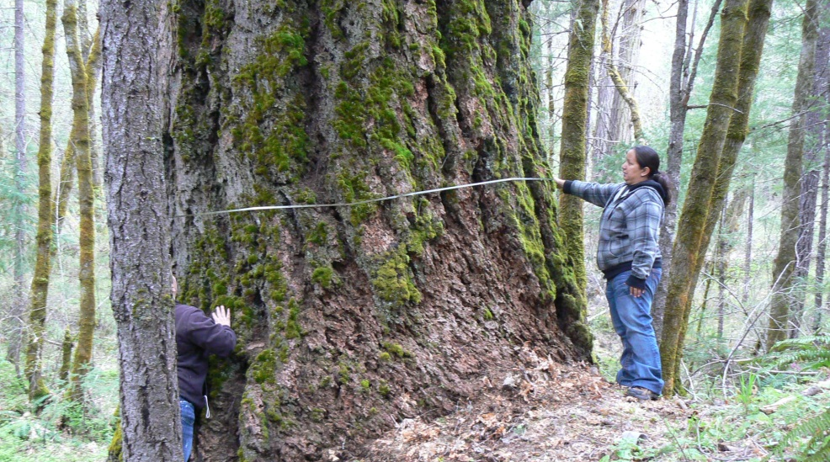
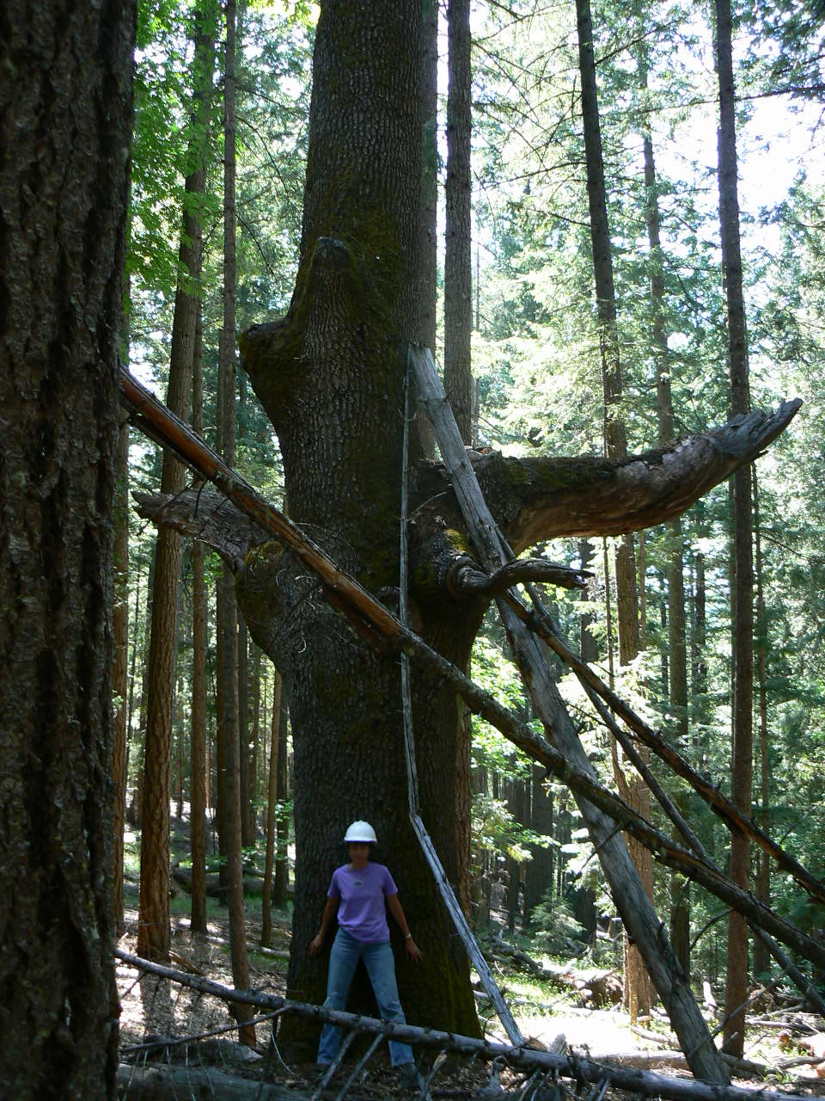
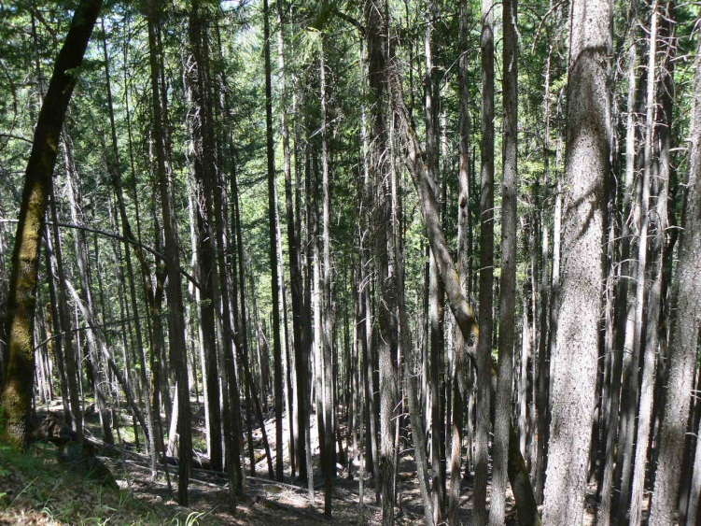
Johnny O’Neil
Much higher component of LS habitats; large individual hardwoods and LS trees surrounded / overtopped vulnerable to fire, dense sterile stands
Notes:
Heavy hardwood component

Slide 8
Purpose and Need
Promote the development and connectivity of late-successional forest habitat and reduce the threat of high severity fire (Singleton/MT A)
Protect mid and early seral vegetation from loss to large-scale disturbance events such as wildfire or insects and disease (all)
Accelerate development of late-seral characteristics
Reduce fuels in strategic areas on the landscape / Reduce fuel continuity and increase the structural heterogeneity across the landscape (all)
Increase within stand resistance to effects of HS fire
Retain LS features (JO)
Notes:
Driven by LSR assessments – multi-fauceted

Slide 9
TX in Critical Habitat
TX = mix of CT/NCT, NCT only, Roadside Fuel reduction up to 200’ (Singleton) or DFPZ (upper slopes/ridges) and RX fire.
Projects focused on treatments in mid-early seral stands - lower quality habitats
Variable Density Thinning – Increase heterogeneity/reduced fuel continuity, decrease competition, increase growth/vigor, increase hwd BA.
RXs focused on reducing fuel continuity around individual LS features (JO)
Retained all large trees (all had 20” dbh limit)
All proposed re-introduction of low severity fire
All treatments were designed to retain function (except landings and very small amount of strategic fuel defense zones (Mt.A)
Variability within and between units avoided large continuous treatments –MANLAA
Notes:
LSRA

Slide 10
Effects to CH (2012 Reinitiation)
Project | PCE 2 | PCE 3 | PCE 4
Mt Ashland | 22 (in 17 units) | 403 (in 93 units) | 1,695 (in 138 units)
Singleton | 11 +166 ac Rx Fire | 359 min 50% CC 150 min sq ft BA +340 Rx Fire | 135
Johnny O’Neil | 74 (40 ac NCT in NR) min 60% CC min 210 sq ft BA +2000 ac Rx Fire | 739 40-60% CC min 120-180 sq ft BA + 1800 ac Rx fire | 51

Slide 11
Tx and Effects to CH
Incorporation of historic stand conditions – within and between stand variability
Reduced densities of shade tolerant species
Considered more open stand conditions on upper slope (ridges) and south facing slopes
Denser canopy cover and higher basal area in lower slopes and north facing slopes
Effects to CH evaluated degree of change to habitat function as pertained to life history.
Notes:
Considered design of the project. Mt A…consultaion described the range of available habitats within units – smaller patches of habitat w/in tx units.

Slide 12
Planning Challenges
Checkerboard ownerships
High road densities
Watershed concerns-sediment
Ground based logging/ RR tx
Temp roads
High level of within and between stand variability=stand specific Rx’s
Balancing objectives with feasibility
Silviculturist and Fuels planner were TEAMS resources (JO)

Slide 13
Implementation Challenges
Contract marking crew can be problematic. Can minimize issues by:
Work with marking crew at beginning of /throughout project
ID/discuss hab components to focus on.
Intended variability of NC component at first not met because of spacing
Stewardship – learning process for Forest
Distance to mill - $$
Terrain – limited for chip trucks
Rx fire – qualified staffing/Rx limitations
Notes:
Implementation review – validate assumptions

Slide 14
Successes!
No litigation
Areas are being treated – big step forward
We are learning a lot (FWS and FS)
use of science
implementation
Positive working relationships
Shared interest in evaluating implementation and validation of our assumptions

Slide 15
Managing in Critical Habitat - CA
Thanks to:
Dan Blessing (Resource Staff Officer KNF)
Sam Cuenca / Chad Bell – bios KNF
David Johnson (YFWO)

Slide 16
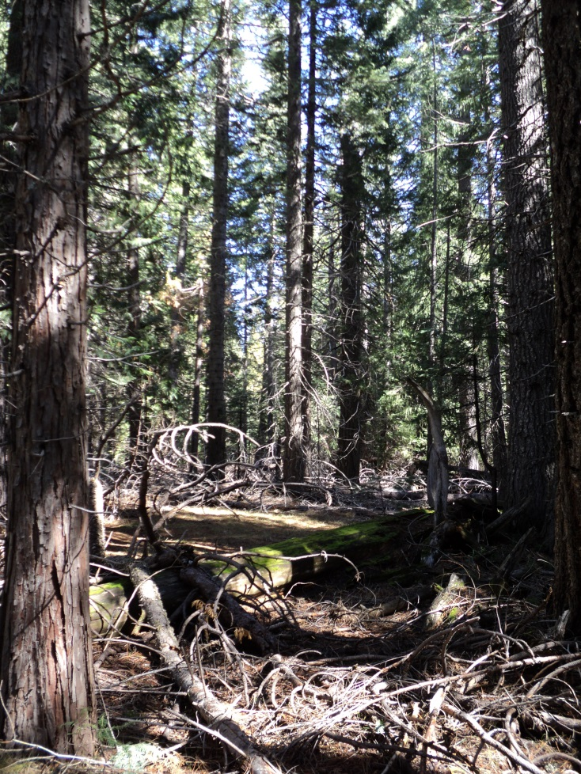
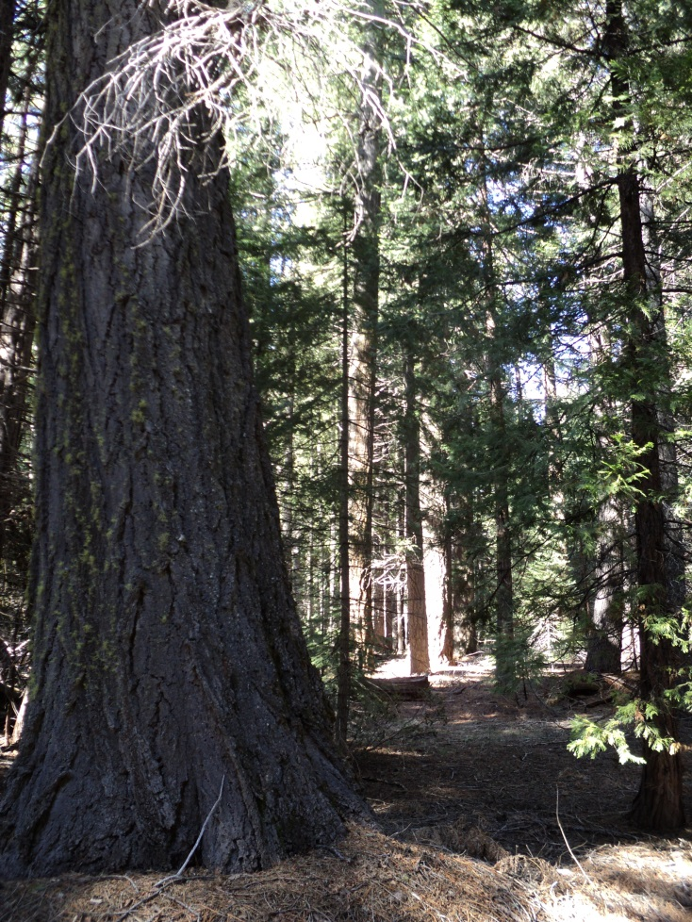
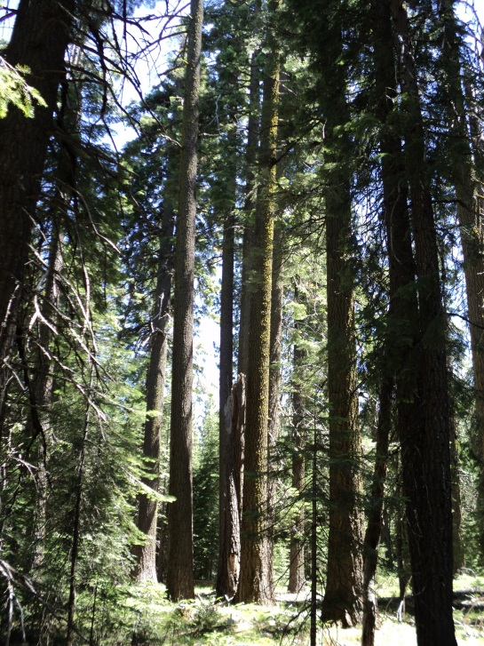
Elk Late-Successional Reserve Enhancement Project
Shasta-McCloud Management Unit
Shasta-Trinity National Forest
Notes:
USFS & FWS: Project Summary of treatment development and streamlined consultation with the FWS Level 1 team. Focus on critical habitat objectives vs. the entire project area.

Slide 17
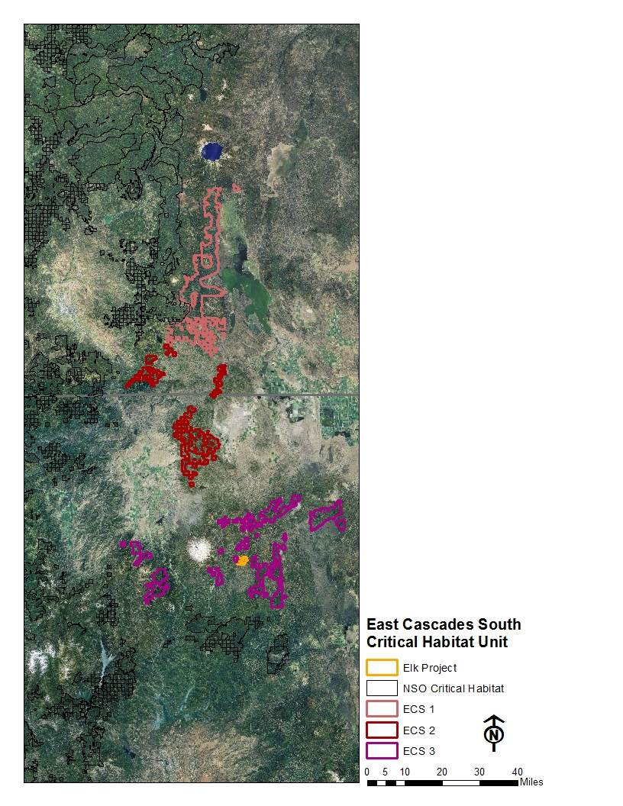
East Cascades South Critical Habitat Unit – ECS-3
Flatter than other parts of range
Railroad logged in the past
Fire suppression is effective
Dry climate
Low/mixed severity frequent fire regime before the advent of fire suppression
Pine is more dominant
Pure ponderosa pine stands, or pine with small diameter white fir understory, do not make NSO habitat
Good NSO habitat is associated with small increases in elevation, mixed-conifer stands
Species composition altered due to fire suppression and past railroad logging
increased white fir
decreased Douglas fir, sugar pine, ponderosa pine, oak
Sparsely-distributed habitat and federal land
Notes:
FWS: From CH Rule: ECS unit: Topography is gentler and less dissected than the glaciated northern section of the eastern Cascades. A large expanse of recent volcanic soils (pumice region) (Franklin and Dyrness 1988, pp. 25–26), large areas of lodgepole pine, and increasing presence of red fir (Abies magnifica) and white fir (and decreasing grand fir) along a south-trending gradient further supported separation of this region from the northern portion of the eastern Cascades. This region is characterized by a continental climate (cold, snowy winters and dry summers) and a high frequency/ low-mixed severity fire regime. Ponderosa pine is a dominant forest type at mid-to-lower elevations, with a narrow band of Douglas-fir and white fir at middle elevations providing the majority of northern spotted owl habitat. Dwarf mistletoe provides an important component of nesting habitat, enabling northern spotted owls to nest within stands of relatively younger, smaller trees.
ECS3 subunit: The function of this subunit is to provide demographic support in this area of sparsely distributed high-quality habitat and Federal land, and to provide for population connectivity between subunits to the north and south.

Slide 18
East Cascades South Critical Habitat Unit – ECS-3
Flatter than other parts of range
Railroad logged in the past
Fire suppression is effective
Dry climate
Low/mixed severity frequent fire regime before the advent of fire suppression
Pine is more dominant
Pure ponderosa pine stands, or pine with small diameter white fir understory, do not make NSO habitat
Good NSO habitat is associated with small increases in elevation, mixed-conifer stands
Species composition altered due to fire suppression and past railroad logging
increased white fir
decreased Douglas fir, sugar pine, ponderosa pine, oak
Sparsely-distributed habitat and federal land
Notes:
FWS: habitat conditions, drier, pine influence

Slide 19
East Cascades South Critical Habitat Unit – ECS-3
Flatter than other parts of range
Railroad logged in the past
Fire suppression is effective
Dry climate
Low/mixed severity frequent fire regime before the advent of fire suppression
Pine is more dominant
Pure ponderosa pine stands, or pine with small diameter white fir understory, do not make NSO habitat
Good NSO habitat is associated with small increases in elevation, mixed-conifer stands
Species composition altered due to fire suppression and past railroad logging
increased white fir
decreased Douglas fir, sugar pine, ponderosa pine, oak
Sparsely-distributed habitat and federal land
Notes:
FWS: Zoomed in on Elk project area. Critical habitat is in northwest portion. Private lands to north and west.

Slide 20
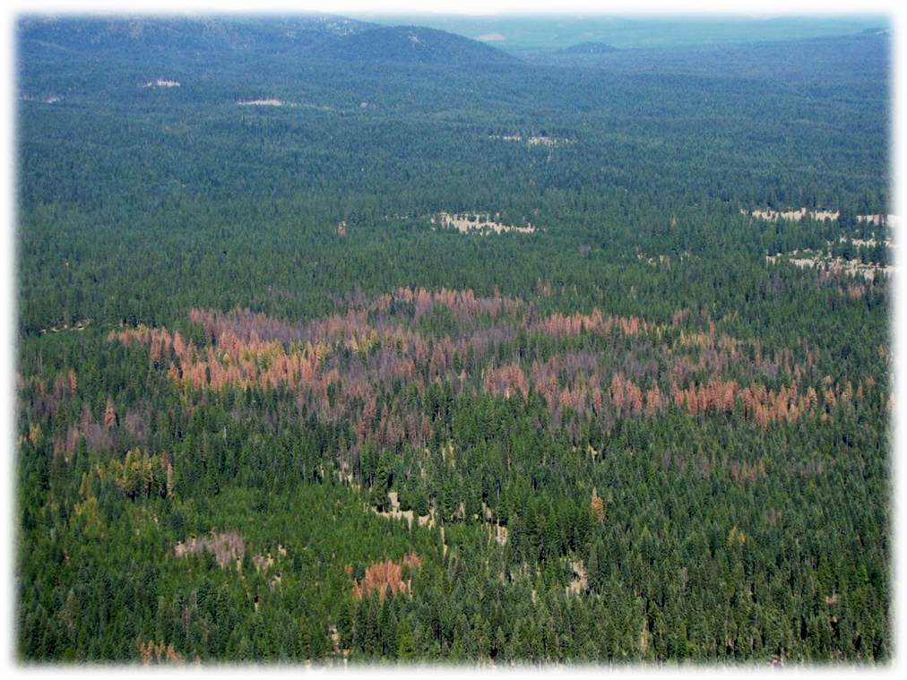
Elk Late-Successional Reserve Enhancement Project Area
Representative of conditions described for ECS CH subunit
Homogeneous, crowded plantations
Some good owl habitat
Huge old growth trees >80” dbh
Large mature trees >30” dbh
Overstocking → disease
Annosus in white fir
Black stain in pine
Western pine beetle
Growing mortality patches
Notes:
FWS

Slide 21
Elk Late-Successional Reserve Enhancement Project Area
Representative of conditions described for ECS CH unit
Includes homogeneous, over-crowded pine plantations
Some good owl habitat
Huge old growth trees >80” dbh
Large mature trees >30” dbh
Overstocking → disease
Annosus in white fir
Black stain in pine
Western pine beetle
Growing mortality patches
Notes:
FWS

Slide 22
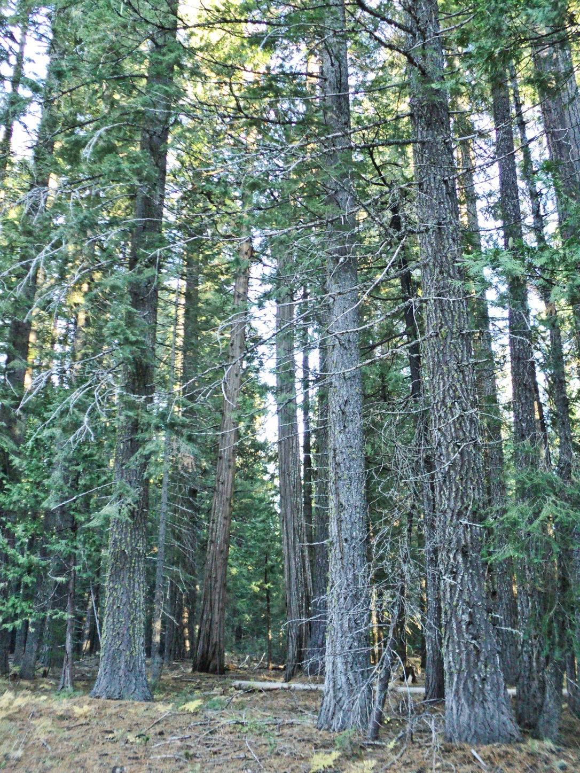
Elk Late-Successional Reserve Enhancement Project Area
Representative of conditions described for ECS CH unit
Homogeneous, overcrowded pine plantations
Natural stands include some mixed conifer stands that appear to be good NSO habitat
Huge old growth trees >80” dbh
Large mature trees >30” dbh
Overstocking → disease
Annosus in white fir
Black stain in pine
Western pine beetle
Growing mortality patches
Notes:
FWS

Slide 23
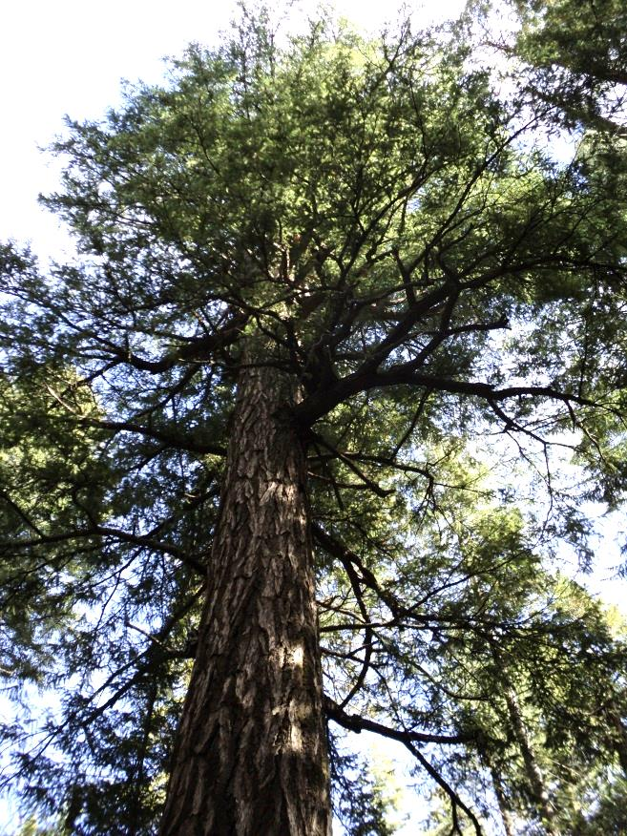
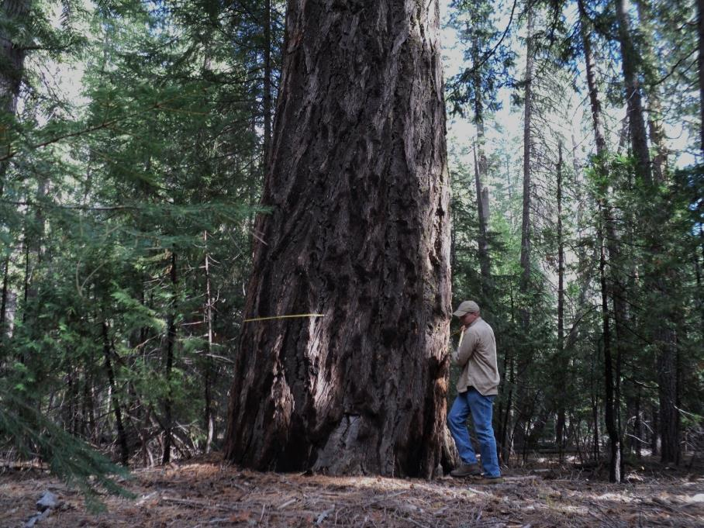
Elk Late-Successional Reserve Enhancement Project Area
Representative of conditions described for ECS CH unit
Homogeneous, crowded plantations
Some good owl habitat
Huge old growth trees >80” dbh
Large mature trees >30” dbh
(not old growth; good site conditions)
Overstocking → disease
Annosus in white fir
Black stain in pine
Western pine beetle
Growing mortality patches
Notes:
FWS

Slide 24
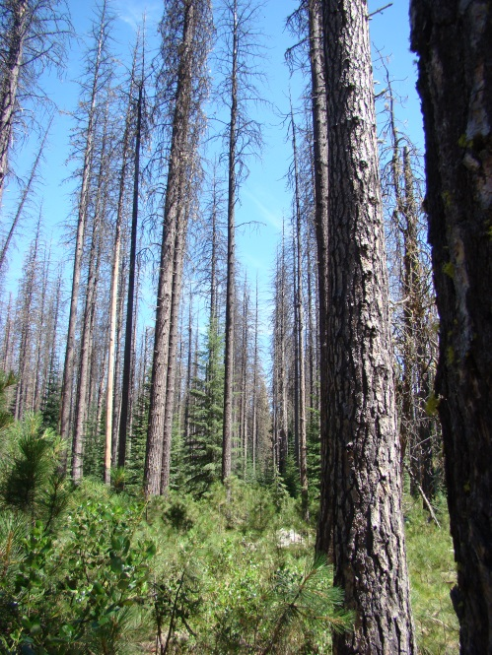
Elk Late-Successional Reserve Enhancement Project Area
Representative of conditions described for ECS CH unit
Homogeneous, crowded plantations
Some good owl habitat
Huge old growth trees >80” dbh
Large mature trees >30” dbh
Overstocking → disease
Annosus in white fir
Black stain in pine
Western pine beetle
Growing mortality patches
Notes:
FWS

Slide 25
Purpose and need
Reduce current and future risk of large-scale disturbance events within early, mid and late-successional habitat in the Elk Flat LSR
Notes:
USFS: 3,420-acre project area surrounded by private to north and west; 25% in critical habitat; one historic NSO AC with no current use/low risk (last nesting in 1992); Treating to meet long term ECS-3 objectives for connectivity and demographic support/recolonization.

Slide 26
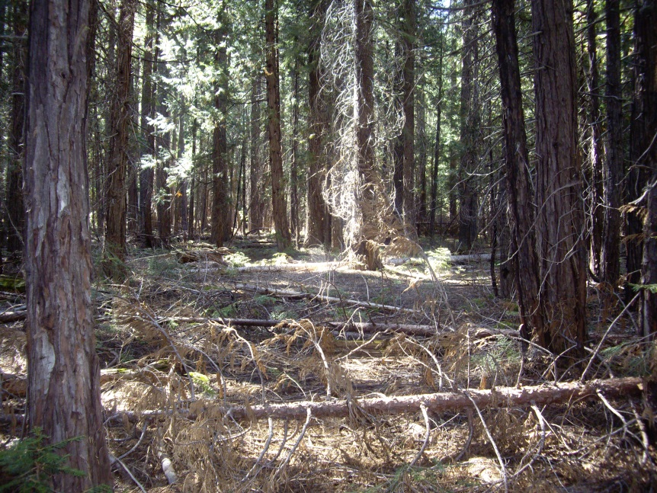
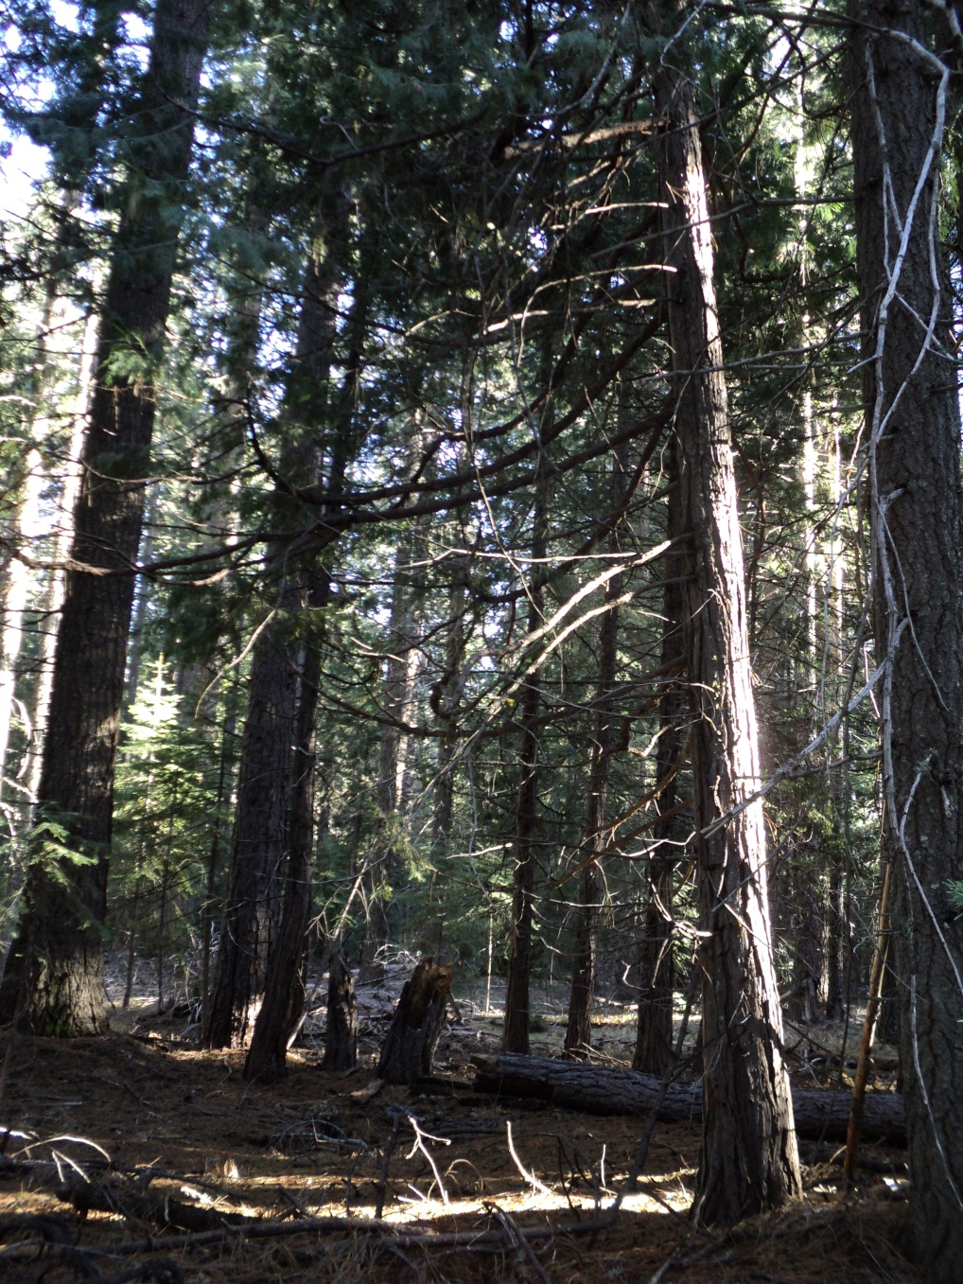
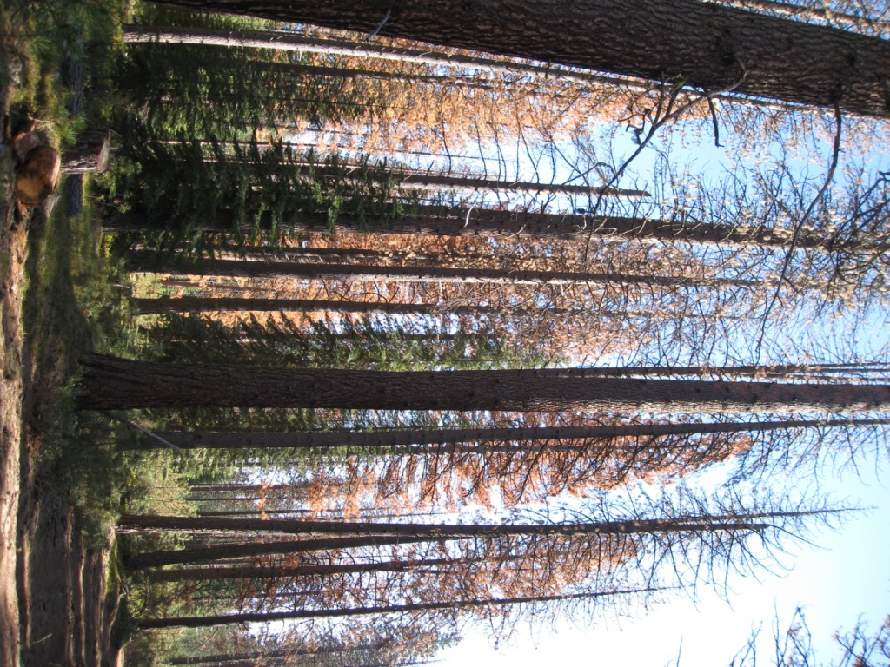
Notes:
USFS: High stocking and disease; 10 to 200 tons per acre fuel loading; 97th percentile fire models under no action show 40% mortality in natural stands; quality habitat for dispersing young/recolonization; low risk currently due to no use of AC;

Slide 27
Key Objectives
Reduce risk of late-successional habitat loss to stand density, drought, disease, insect and fire-related mortality & return natural low intensity fire interval
Maintain, protect, enhance vegetation conditions and elements that provide suitable habitat for late-successional dependent species, and open stands for late-successional ponderosa pine
Reduce root disease spread
NSO Recovery Plan Consistency
Reduce potential for extreme fire behavior on adjacent private lands and in Wildland Urban Interface
Notes:
USFS: describe main objectives of project in LSR/Critical Habitat. Others include Riparian Reserve enhancement consistent with ACS Objectives and meadow enhancement in Elk Flat. Other LS species taken into consideration (northern goshawk, Pacific fisher, American marten)

Slide 28
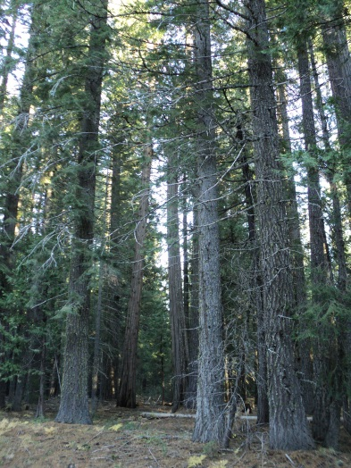
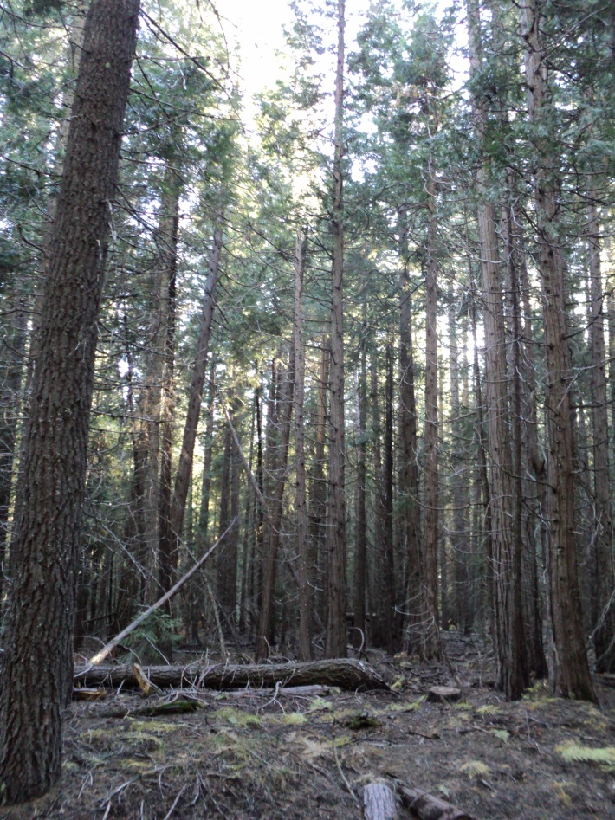
Prioritization In Nso Habitat and critical habitat
Excluded high quality habitat (PCE2/PCE3)
from mechanical thinning
Prioritized natural stands with low to
moderate quality foraging habitat
(PCE3) and lower quality habitat
(PCE4/capable) in plantations to
improve habitat function and
facilitate development
Notes:
USFS: Prioritization of treatment areas project wide and in Critical Habitat.

Slide 29
Strategic treatments within NSO core, home range and Critical Habitat
High quality habitat to be underburned only (PCE2/PCE3)
Limits of acceptable mortality / cool season burns
Facilitate individual tree growth, health and resilience in pine and mixed-conifer areas of PCE3/PCE4 with:
Variable density thinning treatments (125-200 sqft basal area)
Radial thinning of legacy pine
Group selection in 40 to 50-year old pine plantations and replanting Douglas fir, sugar pine, incense cedar
Increase hardwood diversity with oak and aspen release:
Removing conifers within 30 feet of dripline to south aspects
Maintaining Douglas fir, sugar pine & incense cedar > 24”dbh
Notes:
USFS: Describe development of stand-specific treatments dependent on position, composition, quality….biologist worked with fuels and silviculturist to modify depending on conditions (no “one size fits all” prescriptions used in critical habitat units/core)

Slide 30
Additional Project Design Features
Retain all predominant trees
Retain Douglas fir, sugar pine, cedar, white fir in tightly spaced groups of 3 to 6 trees/snags with decadent branching, cavities, defect, and/or broken tops and understory trees for thermal cover
Rate of 4 to 6 small clumps per acre & 3 larger clumps per acre
Retain 10 to15 percent of thinning units in an unthinned condition with no direct ignition when underburning
Large trees, snags, small trees, coarse wood
Retain Douglas fir, sugar pine and incense cedar snags >20 inches diameter
Modified species preferences in Critical Habitat vs. rest of project area
Notes:
Additional measures developed by biologist and IDT; discussed with FWS to modify as needed (mostly underburning objectives). PDFs meet RA32 and CH Rule.

Slide 31
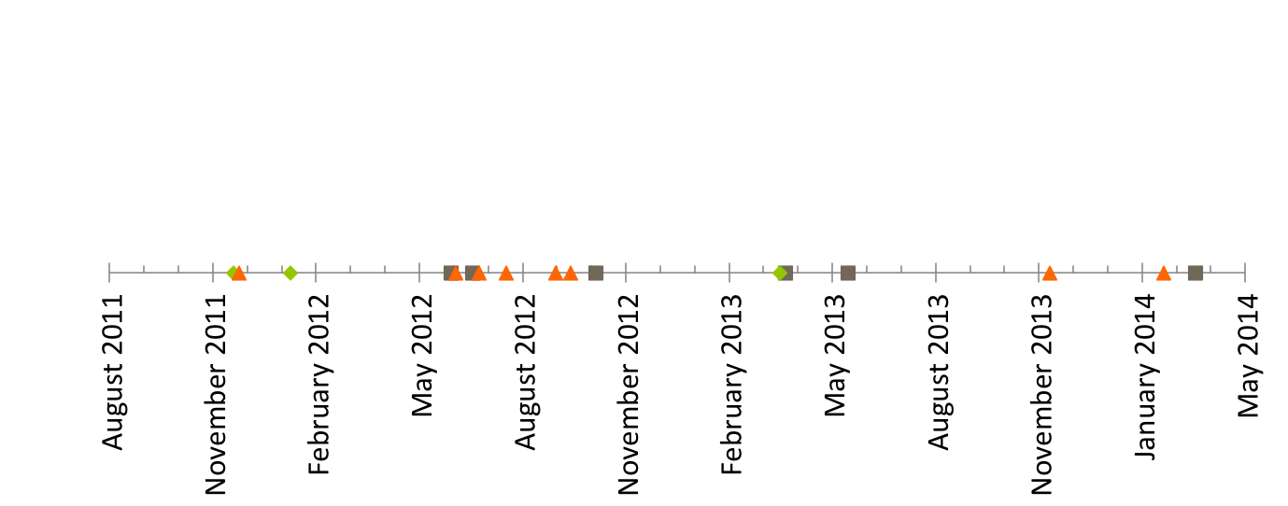
Streamlined consultation
Identified information gaps
and other NSO issues
Focus on underburn Rx
in high quality habitat
Introduction to the project
(Level 1, field visit)
IDT meeting: overlap between
NSO & hydrology issues
Public meeting with
FWS participation
Stewardship
collaboration
meeting
Updated Project Information
Form presented at L1
Survey strategy
discussion at L1
Check-in on
Recovery Plan
consistency
Focus on habitat typing,
Recovery actions
Notes:
FWS: Timeline of consultation – project development started with TEAMS and another FWS office in 2009; transition to SMMU in fall 2011; field work in 2012; Draft PIF in 12-12 with Finalized PIF in March 2013; Scoping in February 2013; At Draft BA stage currently in Aril 2014.

Slide 32
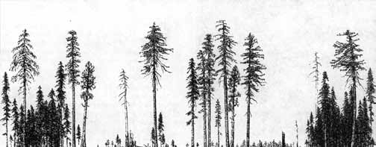
Science used
Increasing Resilience in Dry Forests
Maintaining large trees, creating gaps in homogenous stands, radial thinning large pine component, influencing fire behavior, returning fire to historic low-intensity intervals
GTR 220 / Franklin & Others 2007/ Agee and Skinner 2005
Notes:
USFS: Summary of science used from the NSO Recovery Plan; dry forest restoration objectives; ecological forestry; return of natural fire regime. Project is planned Stewardship and will have a commercial component/timber receipts used to meet the primary purpose of risk reduction in the LSR, habitat restoration in RRs & Elk Flat meadow and LS habitat enhancement; some stewardship elements of small diameter thinning, road decommissioning.

Slide 33
Notes:
FWS: Summarize additional information on using the best available science when working on litigation challenges.

Slide 34
Planning challenges
Working with Team members to vary thinning treatments and modify fuels treatments to achieve long-term objectives – major shift in treatment design from the norm
Addressing ladder fuel misconceptions – site specific
High levels of within and between stand variation = very stand specific prescriptions
Balancing numerous objectives with the feasibility of treatment implementation
Very specific marking guides
Varying scales of habitat retention (1/10 to ¼ to 10 to 100+ acres)
Notes:
USFS: Speak to team integration, changing prescriptions and integration of ecological forestry techniques; very speficif treatmtments – will be working with he marking crew to assure we are meeting objectives

Slide 35
Planning Successes
Integration of Recovery Plan from the Start – Everyone on the IDT is on the same page at the Draft analysis stage
Integration of FWS at the IDT Level – Working on the ground with the silviculturist, fuels specialist
Frequent, Effective Communication – Are you sure we are consistent by burning this stand??
Balancing a Landscape Approach Considering Private Lands, LSR, Critical Habitat
Monitoring Results of Recent Projects to Modify Treatments
Notes:
USFS: several successes to date during the planning phase; use of adaptive management to verify meeting objectives and adjusting if not.

Slide 36
Some Public concerns / addressing issues
Currently between Scoping and Draft BA/EIS:
NSO habitat destruction & violation of the ESA
NSO use of burned stands (no action)
Logging large and/or old growth trees
Snag retention and early seral habitat
Alternatives of no treatment of natural stands in Critical Habitat and consideration of a 20” DBH limit
Very site-specific project design features, treatments and use of Best Available Science
Notes:
USFS: Summary of issues from Scoping.

Slide 37
Effects to Critical habitat
Treatments Will Retain Components of PCE2, PCE3 and PCE4 in the short term and over the long term for NSOs, prey, cover, and thermal refugia:
Large old trees
Snags and down logs
Canopy cover
Vertical/horizontal structure in unthinned and treatment areas
Short Term Adverse Effects:
Continuous treatments across the landscape / in Critical Habitat
While retaining habitat function, compounding treatments and impacts to foraging habitat and prey
Notes:
USFS: Describe expected effects to Critical Habitat – short term adverse and rationale.

Slide 38
Effects to Critical habitat
Long Term Benefits to PCEs:
More resilient trees and stands over the long term
Larger snags and down logs over the long term
Increased conifer and hardwood species diversity for NSO
Increased vertical and horizontal structure
Promotion of stand heterogeneity at sustainable levels over a longer period of time
Conditions that allow for a frequent, low intensity fire return interval
Increased habitat suitability and availability over the long term to provide connectivity and demographic support
Notes:
FWS: Describe expected effects to Critical Habitat – long term benefit – tie back to ECS-3 CH subunit objectives.

Slide 39
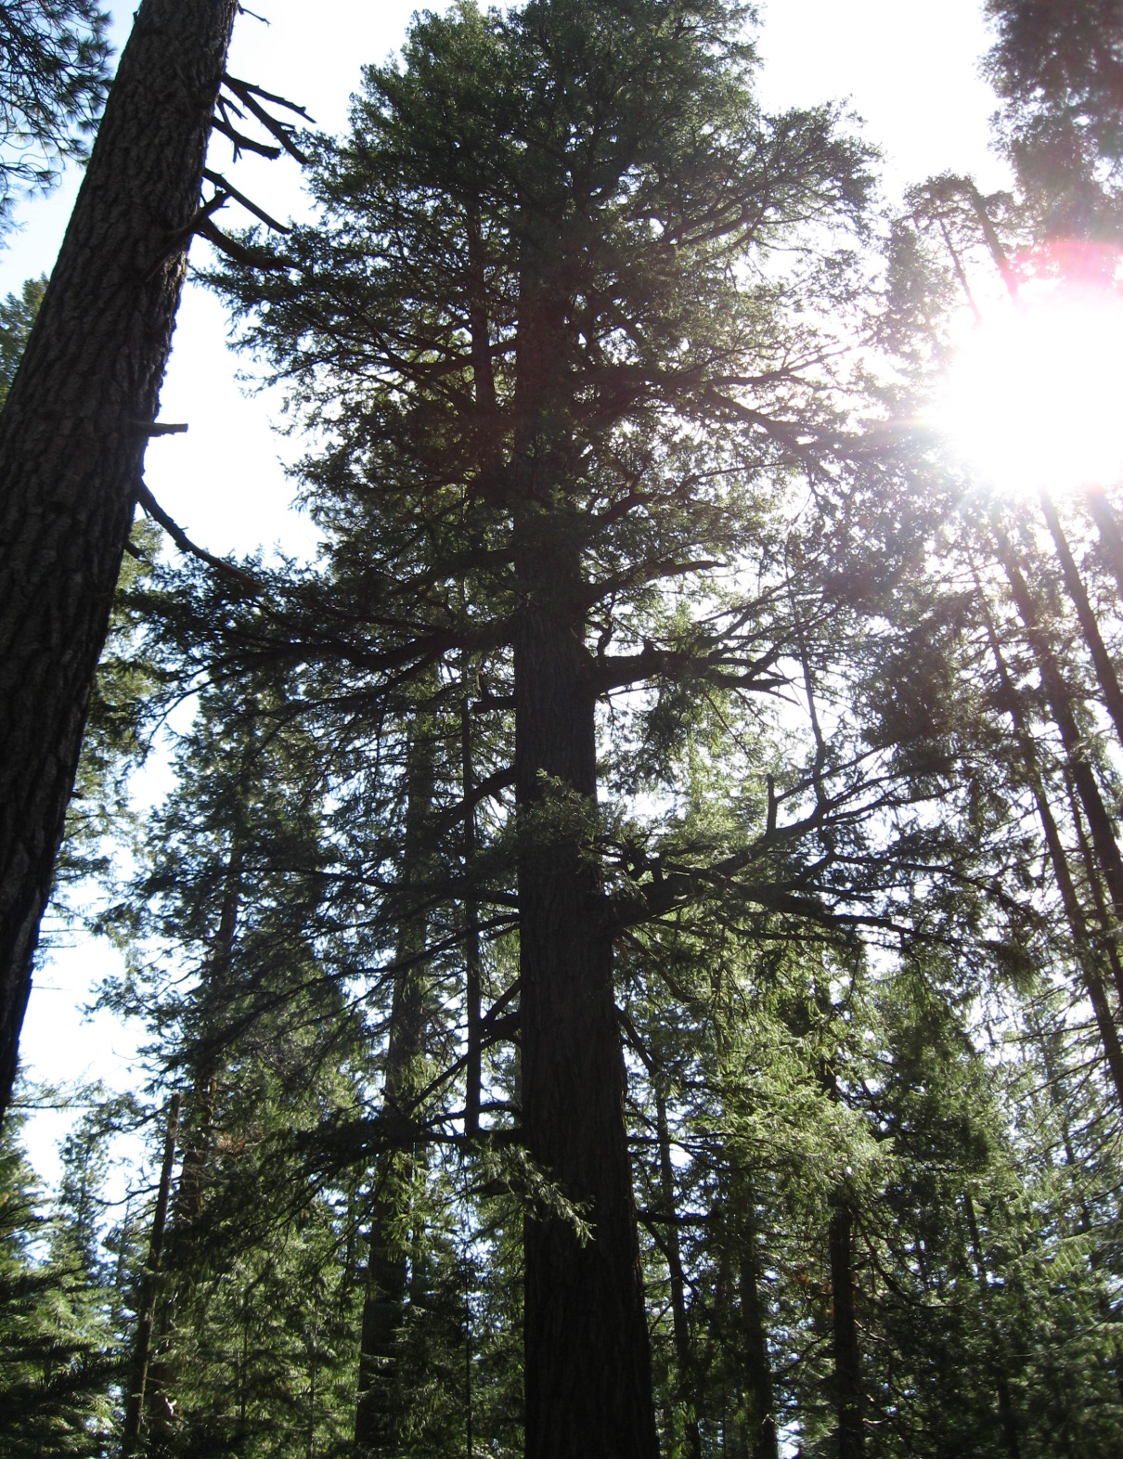
QUESTIONS?
Thanks To:
Lauren Payne and
Craig Sewell (silviculturists)
Steve Clark and Heather McRae (fuels specialists)
Carolyn Napper
(SMMU District Ranger)
Yreka FWS Office Biologists
Katherine Fitzgerald
Dave Topolewski
Notes:
USFS: Line Officer support through whole process from fall 2011 forward; core team working together in the field.

