Slide 1
Restoration on the Okanogan Wenatchee National Forest
Presented to USFS, USFWS and BLM National Leadership
22 April 2013
Notes:
Good afternoon. Thank you for the opportunity to share some ideas into which we’ve invested a great deal of ourselves as we aspire to restore our landscapes.

Slide 2
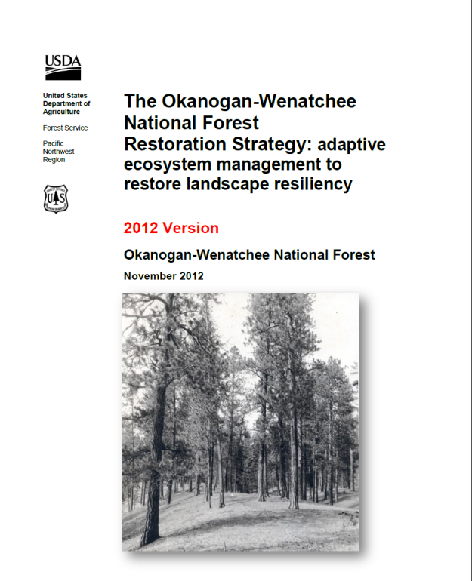
The Forest Restoration Strategy Vision
… landscapes will become more resilient to changing climates and disturbances …
… work collaboratively and strategically across landscapes…
… focus on desired restoration outcomes
and measure our success …
… continue to adapt strategies based on
new science, changed conditions, and
monitoring
Notes:
Based on our National and Regional direction, and the Best Available Science, we developed a Vision for the Restoration Strategy designed to restore forest patterns, processes, and functions to increase resilience to climate change and disturbances, such as wildfire and flooding. The OWF has written and peer-reviewed a Restoration Strategy (show document) that looks at complete landscapes – assessing the condition of the current landscape relative to reference conditions. There are many things in this document that are aimed at holistic restoration, including growing and protecting old trees with character, and hydrologic, aquatic, and roads issues. This strategy was developed with extensive involvement from the PNW Lab and review and input from FWS and other agencies and groups.
We plan to work closely with our partners, to focus on outcomes, like sustainable wildlife habitats, and not just outputs, like analyses produced. We will adapt our management actions and Strategy as needed and incorporate lessons learned.

Slide 3
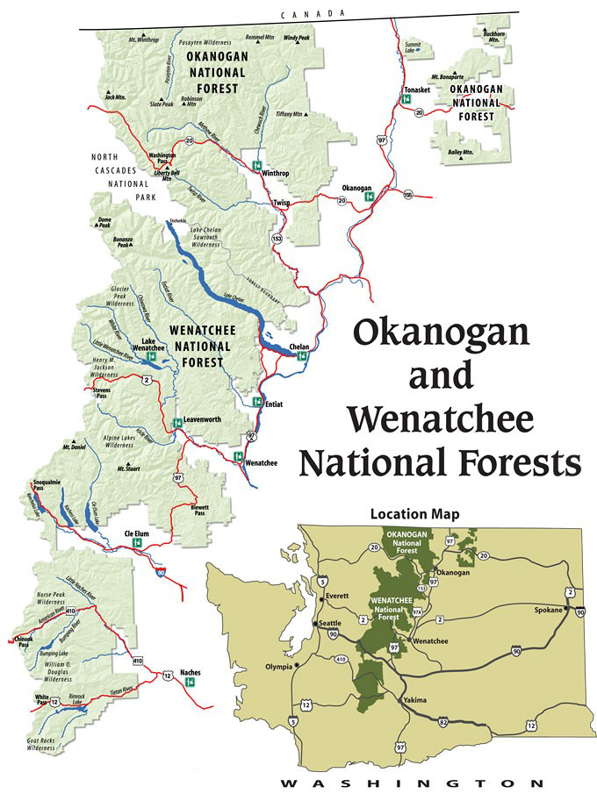
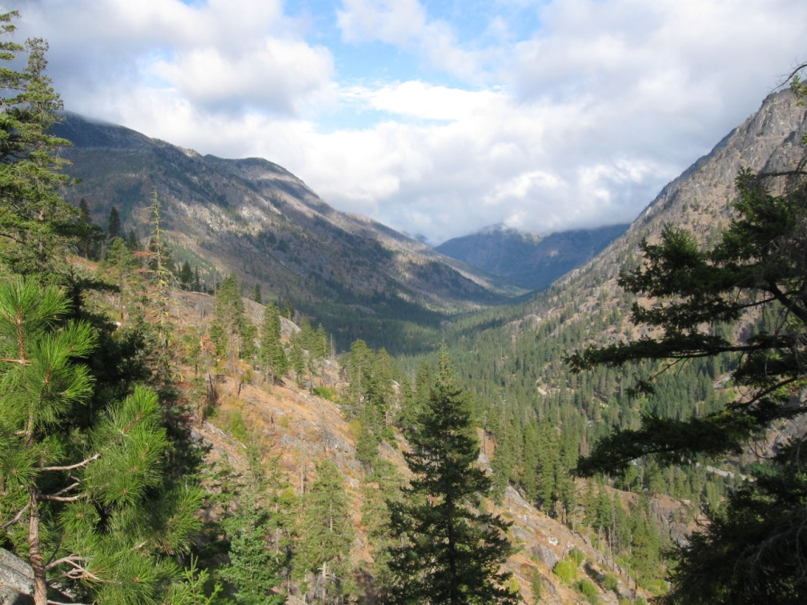
Context: The Okanogan Wenatchee National Forest
4 million acres
East Cascades, WA state
Varied ecosystems
Notes:
The Okanogan-Wenatchee comprises 4 million acres along the East side of the Cascade Mountains in Washington State. The forest stretches from the Canadian border to Mt Rainier. Elevations range from 800 to 9500 feet. We get a range of annual snow and rain amounts from 10” in the far Eastern edges of the forest to 140” at the crest of the Cascade mountains. This wide variety of conditions create an incredible diversity of ecosystems, which support nearly 400 species of fish and wildlife, including a number of threatened and endangered species like Northern Spotted Owls and Steelhead Trout. Much of the forest was historically dry, and mostly covered with widely spaced ponderosa pine and Douglas fir trees. Fires in this area were historically frequent, but rarely very large or hot.

Slide 4
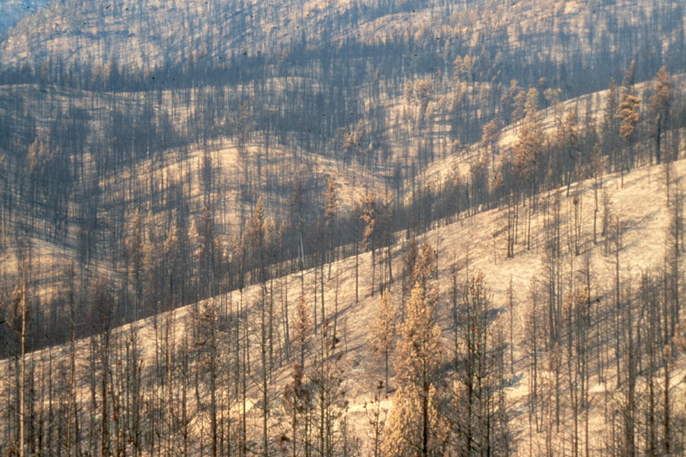
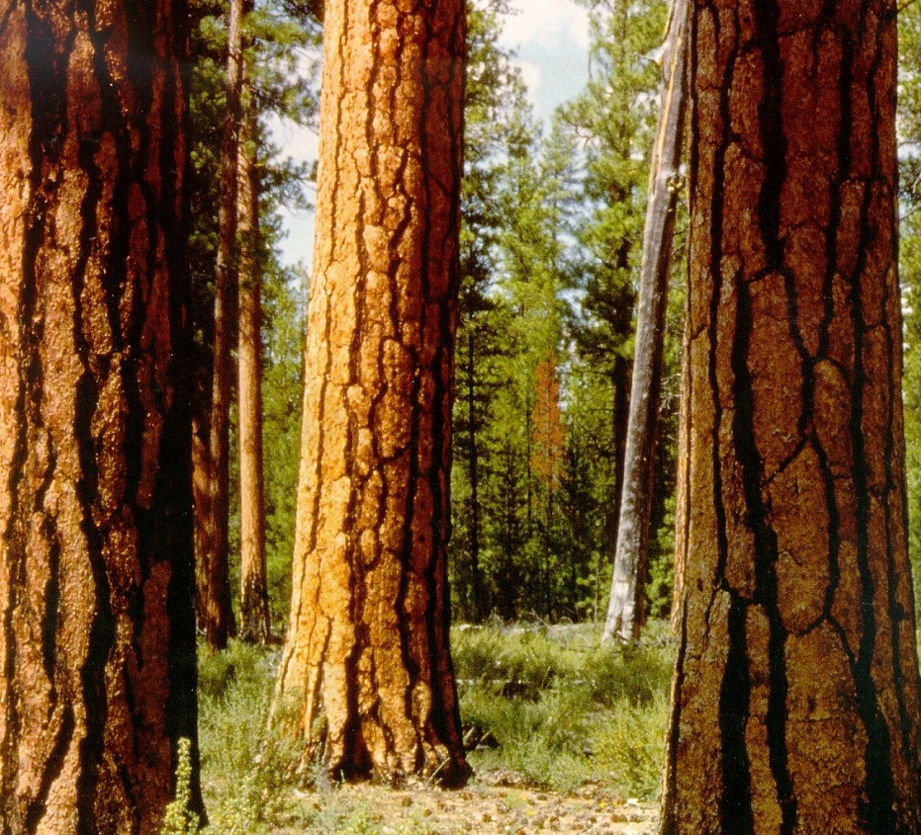
Restoration Strategy Development
1998 Dry Forest Strategy
1994 Fires
Risk of uncharacteristically severe wildfires
Large –Scale Disturbances
Altered fire regimes
Insects and disease
Habitat sustainability
Communities at risk
National-Regional-Forest emphasis on restoration and resiliency
Climate Change
Shifts in species distribution – connectivity
Interactions with disturbances
2-3 X area burned by 2040s
Changes in Hydrologic Regimes
Interactions with infrastructure
Notes:
So how did we get to this RS? In 1994 we had a severe fire season resulting in over x acres burned. We started thinking about mgmt differently and needed a plan to address the changes in the context of large scale disturbance. The RS began a a “Dry Forest Strategy” back in 1998. Some of the considerations included: altered fire regimes, insects and disease outbreaks, habitat sustainability, and communities at risk. About this time we were also starting to see a shift in emphasis on restoration and resiliency. We were also learning much more about potential impacts of climate change that could result in shifts in spp distribution and loss of habitat connectivity. Increases in disturbance may also increase with predictions of 2-3X more area burned in the next 30 years. We may also see changes in hydrologic regimes resulting in increased flooding and road damage or road networks that prevent watersheds from functioning “appropriately”.

Slide 5
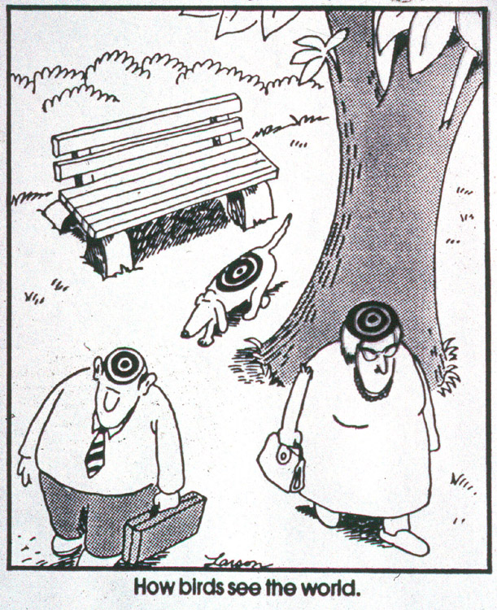
Key Restoration Issues
Landscape Evaluation
Integration across resources
Current amount and arrangement of habitats compared to Reference Conditions
Aquatic restoration priorities
Road/Aquatic Interactions
Key Ecological Features
Stand Level Considerations
Efficient Planning
Double restoration footprint over the next 10 years.
Notes:
All of this information morphed into the RS (show doc). Where we are moving away from looking at stands only and instead start by looking at the landscape and how we can make improvements at that larger scale.
We begin with a landscape evaluation (of usually 2 subwatersheds that covers about 50k acres) and we integrate the process across resources. So you have veg, fire, wildlife all at the table looking at the current amount and arrangement of habitats compared to reference conditions.
The four major components are vegetation patterns (Cover-type, Potential Vegetation, Structural Classes, insect and disease risk, including key ecological features such as Large and Old Trees with Spatial Variability), fire movement, insects and disease and wildlife.
We use an Ecosystem Management Decision Support Framework (EMDS) to model our Departure from Reference Conditions, which is based on the Natural Range of Variability and Future Range of Variability (helps get at climate change) and then we key into the stands to determine where we can make the right changes (such as addressing Large and old trees or clumps and gaps).
You’ll notice I didn’t include aquatics in that description because that is one of the elements we are still struggling to finalize. At present aquatics runs in parallel.
Within the landscape evaluation the districts will then focus in on 5-10k acre treatment areas. The evaluation provides opportunities for multiple projects. This should increase our planning efficiencies and our goal is to double our restoration footprint over the next 10 years.

Slide 6
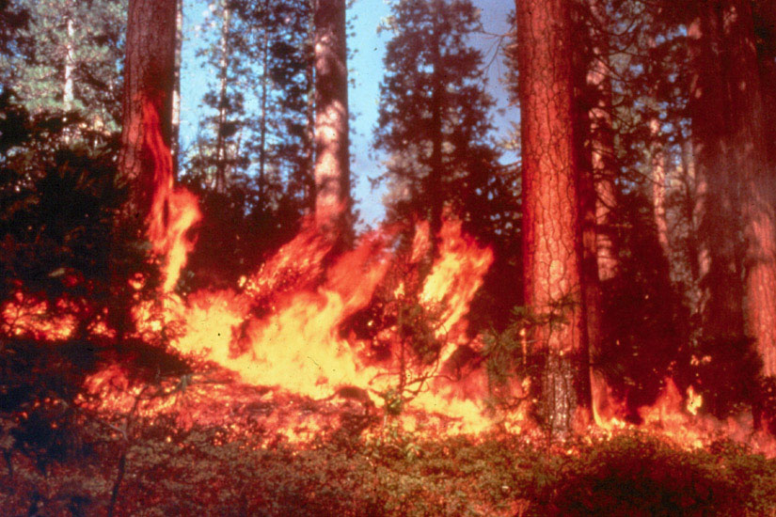
Benefits of the Strategy
Landscape-scale analysis for multiple resources, across ownership boundaries
Compares current landscapes with a range of historical conditions
Enables climate change adaptation actions by comparing current landscapes with warmer/drier and warmer/wetter adjacent landscapes
Helps to manage for wildlife habitat in
a dynamic, future-oriented fashion
Allows pre-evaluation of a variety of treatment scenarios and potential outcomes
Transparent analysis and decision-
making promote effective
collaboration and public involvement
Notes:
What are the benefits of a strategy like this?
As I described before, it is a Landscape-scale analysis for multiple resources that even goes across ownership boundaries, providing tremendous partnership and collaborative opportunities. It does so in a transparent fashion so folks can see why we made the choices we did.
Compares current landscapes with a range of historical conditions based on rigorous science
Enables climate change adaptation actions by comparing current landscapes with warmer/drier and warmer/wetter adjacent landscapes
Helps to manage for wildlife habitat in a dynamic, future-oriented fashion instead of as a mitigation. We can plan for the outcome we’d like to see.
The process allows us to game different scenarios across the landscape and see different outcomes.

Slide 7
Vegetation Pattern
Fire Movement
Road Network Evaluation
Wildlife Habitat
Landscape Evaluation
Climate Change
Large and old tree guidelines
Project Level NEPA
Potential Landscape Treatment Area
-P&N
-Landscape Prescription
-Stand Level Prescriptions
Multiple Projects/Landscape Evaluation
Notes:
I just covered 118 pages of information in 5 minutes so I like this graphic as it helps to reiterate the concepts.
We begin with our base data that feeds into EMDS to give us infomration on the departure of these resources. Wildlife, fire, vegetation, Insect and disease, parallel aquatics. From that landscape we then chose our PLTA. We then game different scenarios (creation and protection of owl habitat, development of WHWO habitat)
My bias, what’s really cool is it gives the wildlife bio a seat where they can actually drive the bus and fuels and veg are fine with that…
So the team develops landscape Rx and a Purpose and need which feeds into the projects level NEPA and stand level Rx that incorporate other issues such as large and old tree guidelines. And then they can go back into the existing landscape evaluation, make the changes that resulted from implementing their project and see where they should go next. Here’s where the efficiencies come into play.
Our Forest Supervisor, Becki Heath, has made implementation of the Restoration Strategy a forest priority. As such all 7 districts are at a different place in the process.
The first complete project to come out of our new Restoration Strategy was called Glass Angel. This project is on the Naches Ranger District, which is just East of Mount Rainier. They signed their EA in April 2011. The first one took some time because they were the guinea pigs for the RS, but the 2nd EA to come out of this analysis was completed in <18 mths.
How did the consultation process go? Jeff Krupka will provide a highlight reel…

Slide 8
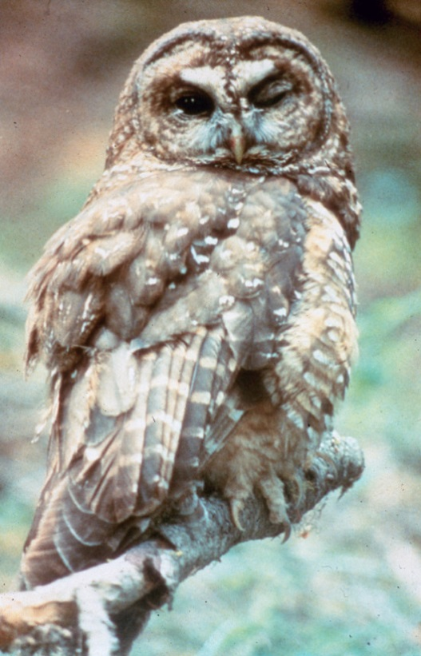
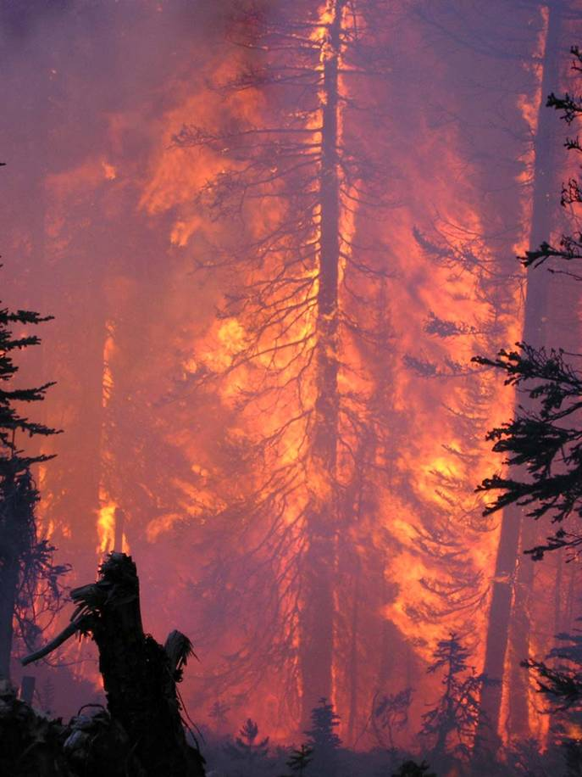
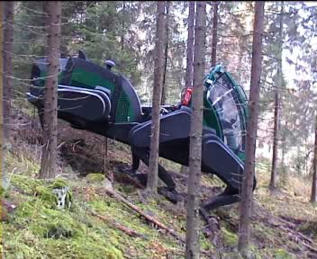
Why is this a good idea for spotted owls?
Spotted owl habitat decline in fire prone provinces.
Area | Northern Spotted Owl Habitat ª
 | NRF | Core
Washington East Cascades | - 4.5% | - 6.9%
Oregon East Cascades | - 6.5% | - 6.8%
ª – based on 15 year NWFP Monitoring report (Davis and Dugger 2011)
Causes of habitat removal
4
:
1
Notes:
Recent data:
Table 1. illustrates the decline in spotted owl habitat within the 2 eastside (of the range) fire-prone provinces over a 10 year period.
Note- NWFP expected a 5% decline with half attributed to timber and half to fire. The majority was due to fire. And exceeded assumptions of NWFP in more contiguous (core) habitat (at almost 7%).

Slide 9
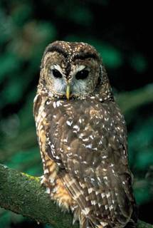
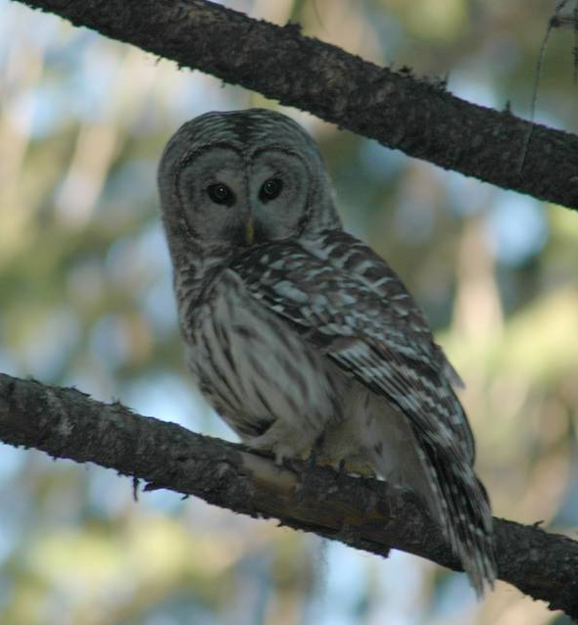
Why is this a good idea for spotted owls?
vs
Notes:
Habitat issues are further exacerbated by Barred Owl Spotted Owl interactions.
Peter Singleton recently finished his research and through that we better understand that barred owls are displacing spotted owls into more dry/mesic habitats - which means the dry/mesic types are becoming more important to and are seeing greater emphasis for restoration with respect to NSO recovery.
The NSO cannot persist if we lose moist forest to Barred Owl and mesic/dry forests to natural disturbance.

Slide 10
Why is this a good idea for spotted owls?
Consistent with Recovery Plan and Critical Habitat Rule
Emphasizes ecosystem restoration and resilience
Forest restoration at the landscape scale

Slide 11
Why is this a good idea for spotted owls?
Parsing the Landscape
HIGH
Emphasize forest ecosystem restoration
Potential for conflict among objectives at site scale
Restoration of Ecosystem Processes Value
Emphasize spotted owl habitat
(retention and development)
LOW
LOW HIGH
Spotted Owl Habitat Value
Notes:
if we can strategically place treatments across the landscape that treat 20-30% then we can change landscape fire behavior and optimize habitat (based on work by Mark Finney and John Lehmkuhl). This illustrates that we have opportunities to treat over 50% of the landscape and in the process protect the high quality NSO habitat by treating around it. This is one of the reasons for the landscape fire analysis in the Restoration Strategy.

Slide 12
Is this a good idea for spotted owls?
Managing Uncertainty
Addresses 2 out of 3 key questions:
Where to treat?
How much to treat?
How to treat?
Collaborative adaptive management

Slide 13
Challenges and Opportunities
Completion of Restoration Strategy
Full aquatics/roads module
Prioritization at sub-basin scale to determine where to initiate landscape analysis
Efficiency in completing environmental compliance
Districts and teams are at maximum capacity
CH rule may increase workload - streamline
Complete process in revised critical habitat is unknown
Collaboration with science
Traditional measure of accomplishments does not focus on outcomes
Measuring volume does not give an indication of resilience
Restoration-related accomplishments (acres restored)
Notes:
There are some challenges with implementing restoration in CH, but Challenges present opportunities to do things differently.
We consider the Restoration Strategy a living document. We plan to revise it annually but there are still a couple of critical pieces that are incomplete. We are working on this…
2nd challenge is in our efficiency in completing environmental compliance. One of the reasons for the development of the RS was to increase our efficiency. To do so we need to increase our efficiency before we can hit the ground. As described before the Strategy has that potential but the forest seems to be operating at maximum capacity with discussion of workforce planning and budget reductions in the background. As we go along we don’t foresee problems with consultation. The CH rule may increase workload but agencies are working together to streamline. Very good relationship between FS and FWS on OW and we both want to make this easier.
Because the districts are at such different stages in implementation of the RS we have yet to work through the process in revised critical habitat. We’re planning to test a method developed by Josh Chapman on the Umpqua.
3rd challenge is very much an opportunity to test our hypotheses by collaborating with scientists. We believe in our strategy and the rigorous science that supports it but to improve and truly test the effects to owls we are working with John Lehmkuhl, Peter Singleton and other scientists from the PNW to examine treatment effects on spotted owl prey. There is tremendous opportunity to learn from our actions and that support to PNW is crucial.
Final challenge presents itself in how we measure accomplishments. Traditional measure of accomplishments does not focus on outcomes but rather outputs. However, measuring volume does not give an indication of resilience. It can also distract from restoration goals and put a strain on interagency relationships. We’d like to suggest a transition to Restoration-related accomplishments such as “acres restored” to help get all resources on the same path.

Slide 14
Restoration Test Drive: Cle Elum Ranger District
Three large LSRs
Snoqualmie Pass AMA (managed as LSR)
104 known owl locations
Notes:
The Cle Elum Ranger District is Kittitas County, Washington. The district straddles interstate 90, between Seattle and Ellensburg. About 90% of the district outside of wilderness is managed as LSR

Slide 15
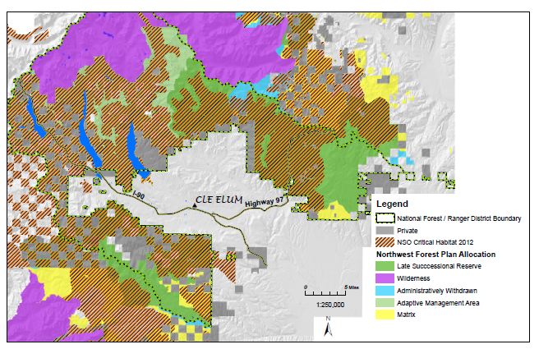
NSO Critical Habitat comprises most of the district.
Notes:
A high percentage of the district was designated critical habitat for spotted owls in 1992, and 2012.

Slide 16
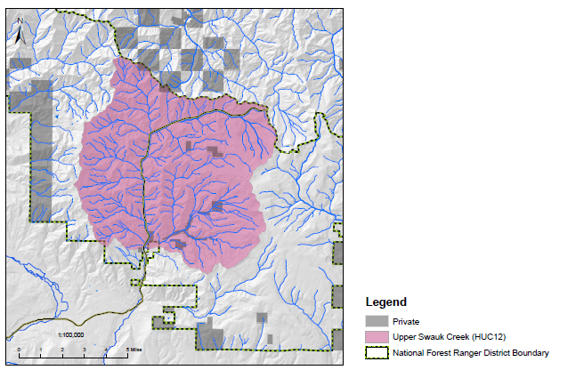
Biggest Restoration Challenge: Swauk Creek
Source LSR
NSO Critical Habitat
Occupied NSO Habitat
Long-term NSO Demography Study
Wildland Urban Interface
Large-scale and prolonged spruce budworm defoliation
Adjacent to recent large fire (Table Mountain 2012)
Long history of timber harvest, grazing, gold mining, fire suppression;
Diverse landscape (dry, mesic, and mixed forest types)
Highway 97, and high densities of Forest roads and trails.

Slide 17
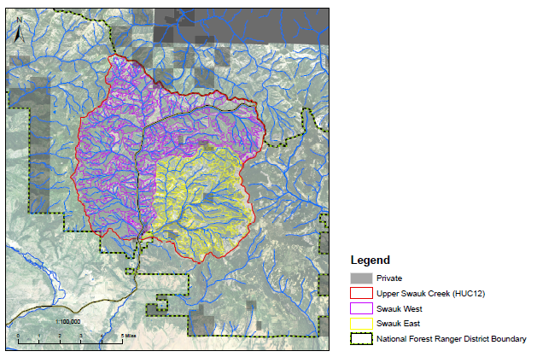
Applying the Strategy
Swauk Pine EMDS
It all starts with “PI”
(photo interp)
Describe stand structure, cover, and vege over a large landscape;
Describe attributes derived from vegetation (habitats, I&D risk, fire risks;
Compare to historic conditions (two ecological reference conditions here).

Slide 18
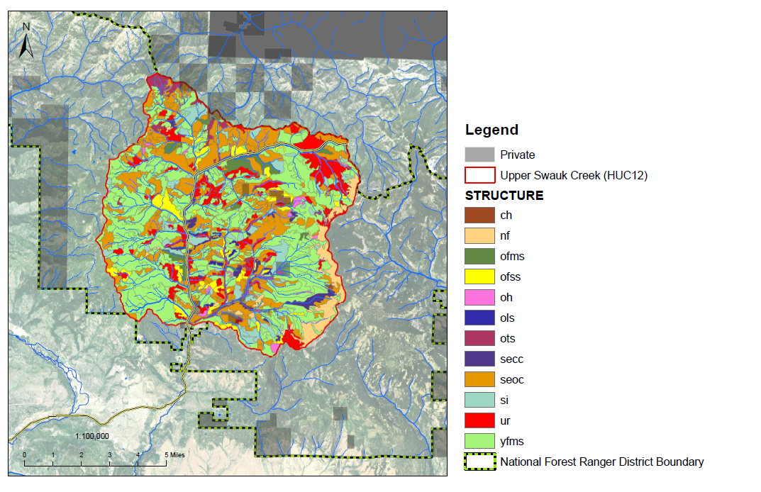
Example: Structural condition

Slide 19
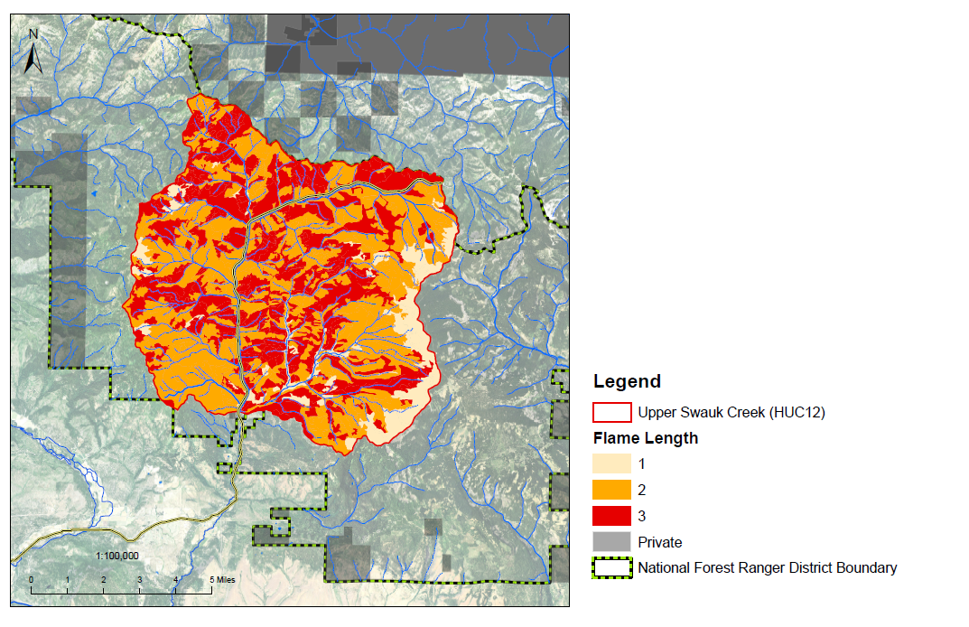
Example:
Existing condition for flame length (a derived attribute).
(implications for fire suppression).
Notes:
Just an example. We also looked fire flow paths, running crown fire potential from FLAMMAP.

Slide 20
Revision Pending

Slide 21
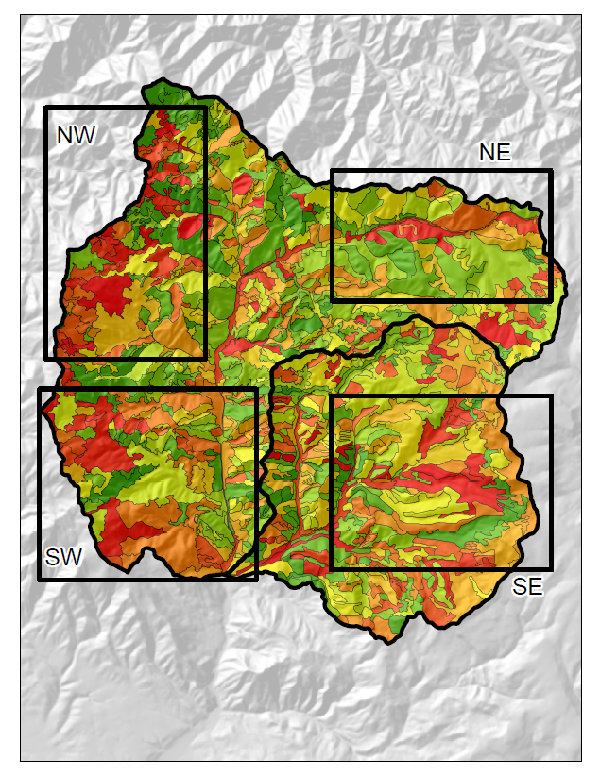
“UBER Map”
Displays where we have departed stands.
A tool for the Line Officer to decide where to focus restoration efforts.
She chose “SE”. Next step: refine the PLTA.
Notes:
EMDS software analyzes departures from historic conditions, for both stand and landscape level metrics.

Slide 23
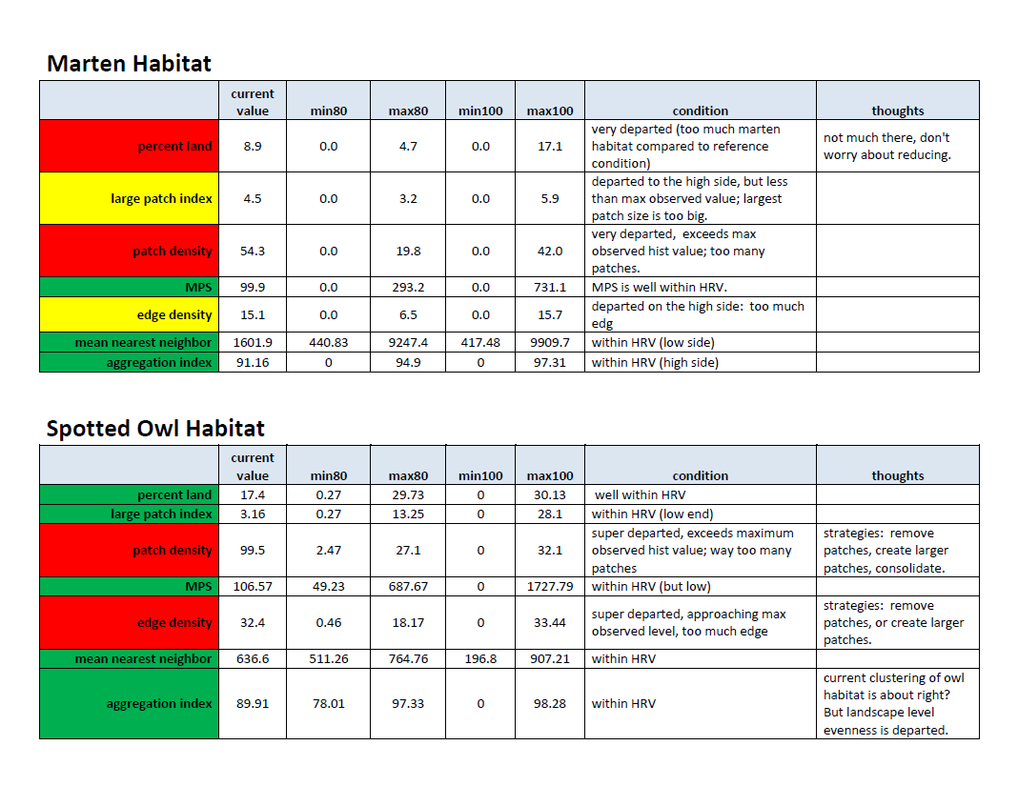

Slide 24
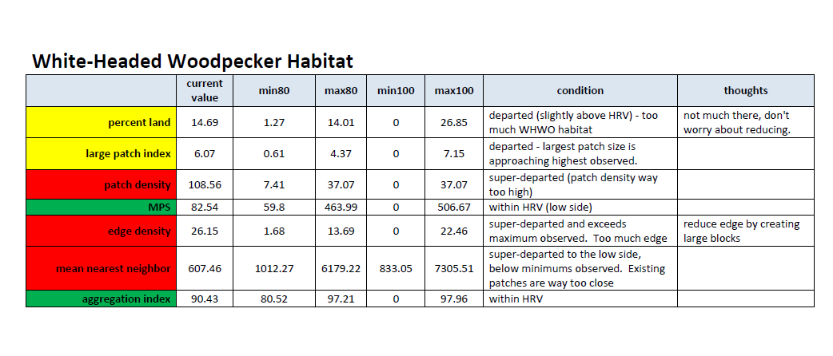

Slide 25
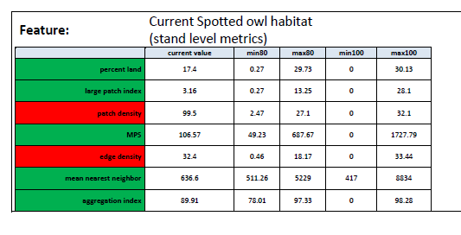
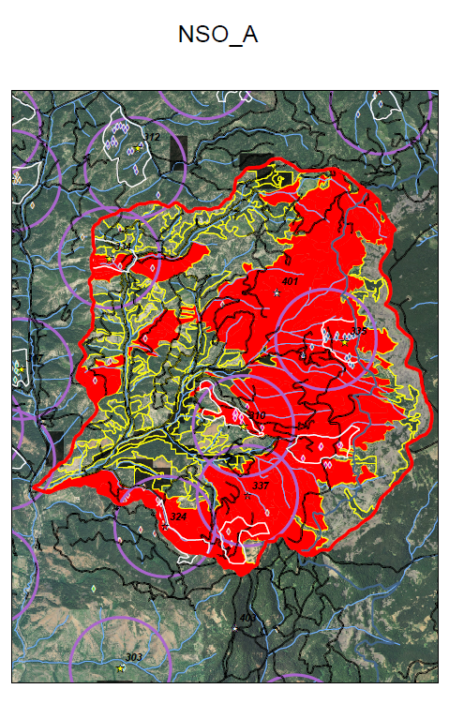
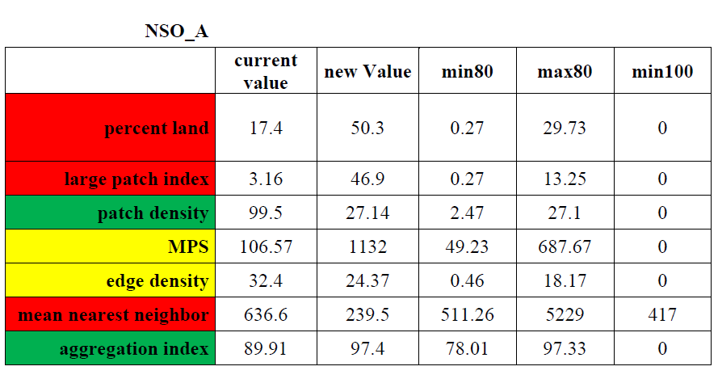

Slide 26
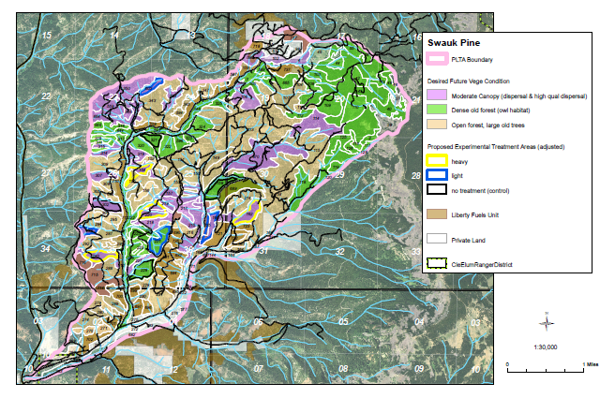
Landscape DFC!!

Slide 27
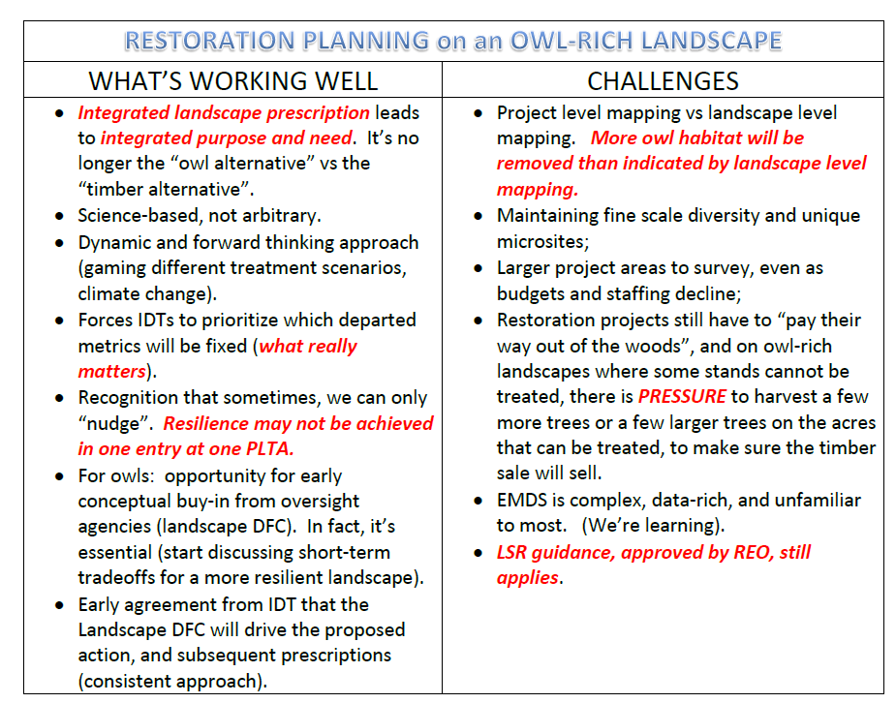

Slide 28

Questions/Comments

