Slide 1

Bruce Shindler, Emeritus Professor Dept. of Forest Ecosystems & Society
What does the public think about the Forest Service?
How can understanding public attitudes help us with our communication and in building trust?

Slide 2
It depends.

Slide 3
There is no public...
there are many publics.

Slide 4
Little trust in big government, big business, bureaucracies.

Slide 5
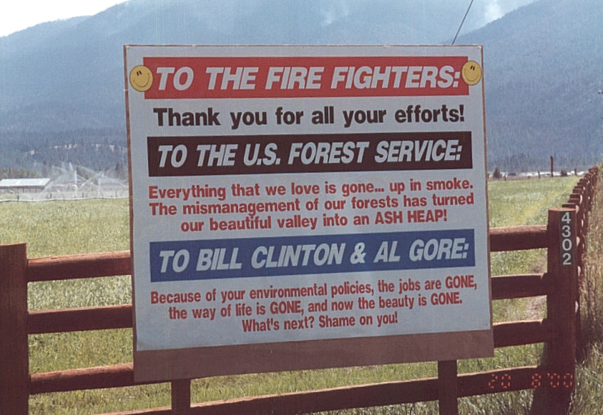

Slide 6
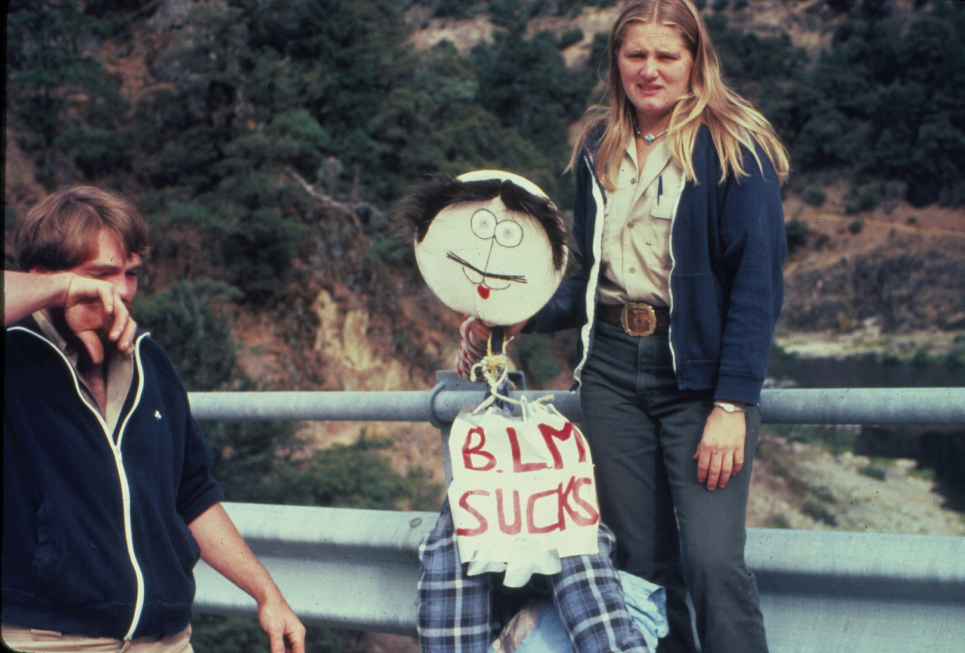

Slide 7
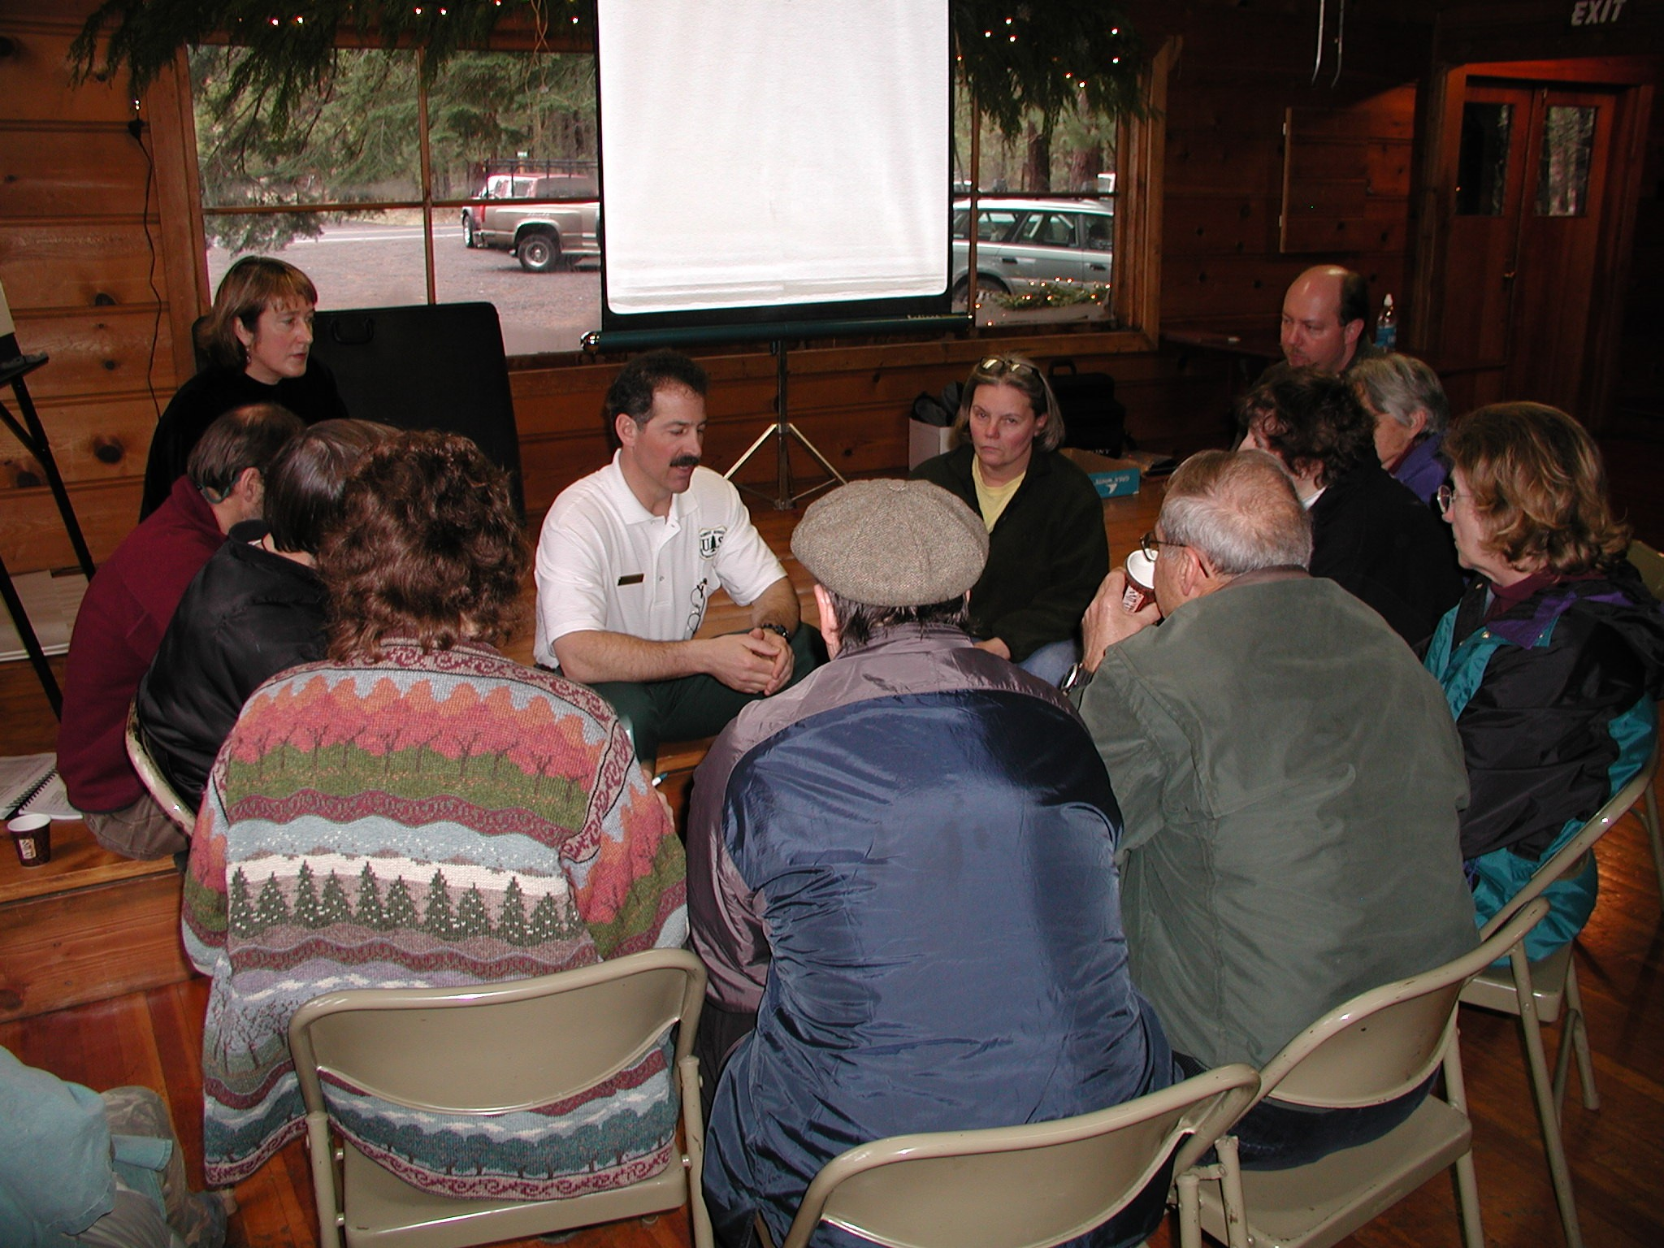

Slide 8
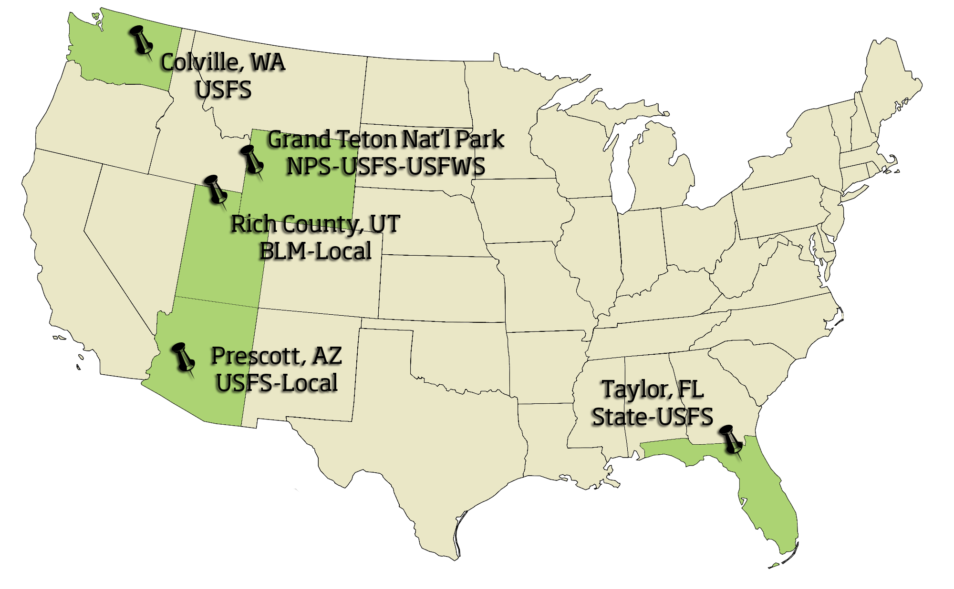

Slide 9
Trustworthy qualities are often
measured by:
Competence
Belief in managers’ ability to make good decisions and effectively implement practices.
Fairness and equity
Belief that managers are sincere and genuinely engage citizens about plans/decisions. That the individual will act in the best interest of the community.

Slide 10
Also by:
Shared values
Managers are perceived to have the same concerns and priorities as the community… the he/she will pay attention to local places important to stakeholders.
Accountability
Doing what you say you will do… building up credibility over time through promise-keeping.

Slide 11
Citizen –agency Interactions
Lack of trust… or skepticism… is usually the starting point.

Slide 12
Citizen –agency Interactions
Parties need to be able to trust each enough to allow them to begin work together.

Slide 13
Trust Building Loop
Reinforce trusting attitudes
Build foundation for more ambitious plans and projects
Aim for realistic (initially modest) but successful outcomes
Form expectations about the future of the relationship based on reputation or past behaviors
Have enough trust, be willing to take a risk, and initiate a cooperative effort

Slide 14
Recognize the context of the issue
Agencies and managers regularly encounter a range of conditions, projects, and interested stakeholders.
Small scale management activities
Often informal interactions where trust is built through mutual experience and successful implementation of low-risk activities.

Slide 15
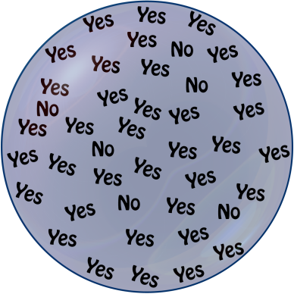
Small Scale Activities
Trust evolves over time as participants interact and move gradually toward modest local projects.
Small Wins

Slide 16
… the context of the issue
Large-scale activities or landscape level projects
Involve multiple agencies, organizations, and stakeholders—often to meet the requirements of a government initiative.

Slide 17

Large scale projects
Often involve the formation of a “collaborative” or “partnership.” These are complex projects that require coordination and deliberate action to maintain a balance of trust.
High stakes

Slide 18
Actions for achieving
outcomes that foster trust
Levels of responsibility and interaction
Management agencies
Individual managers
Stakeholders

Slide 19
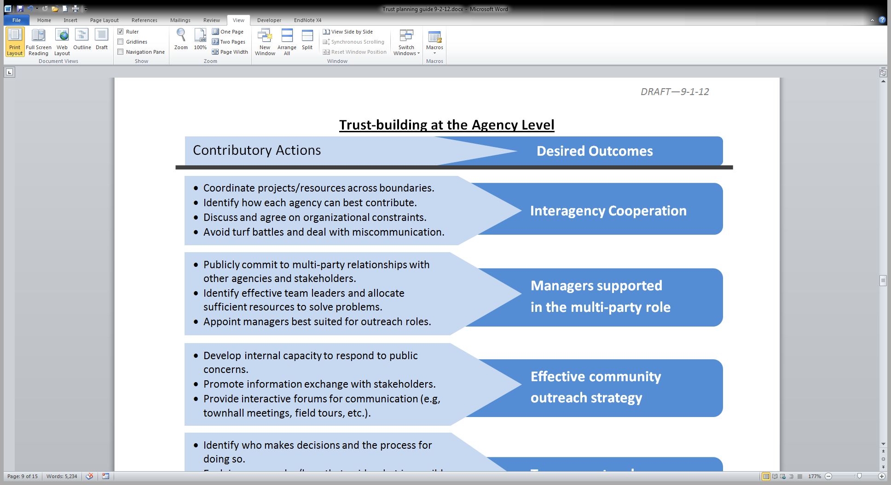

Slide 20
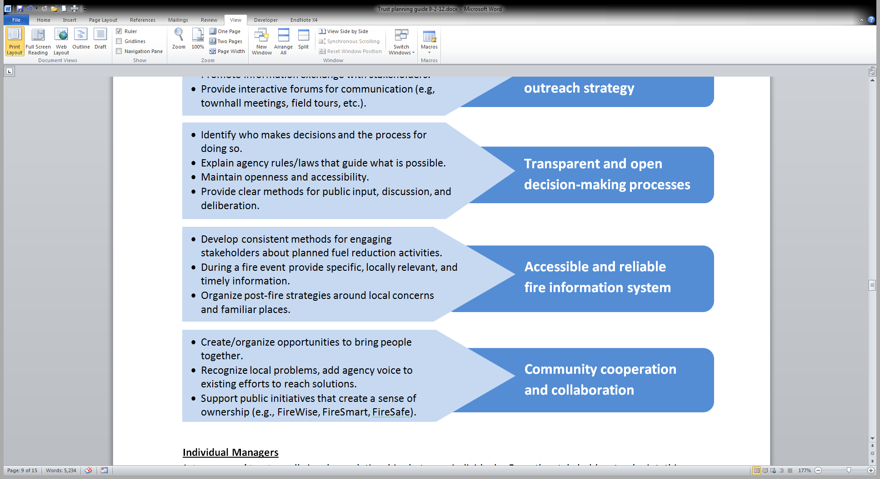

Slide 21
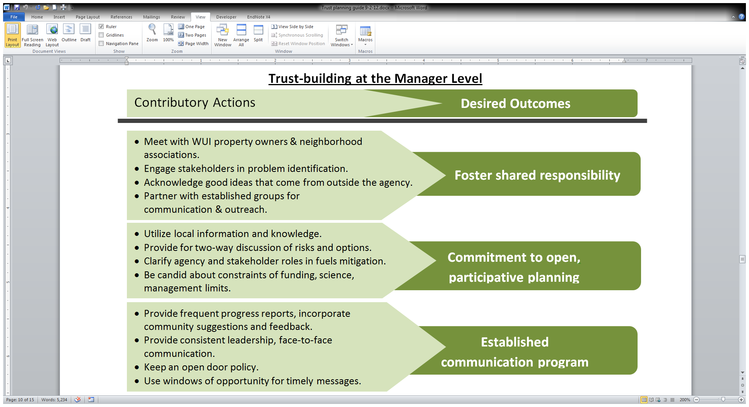

Slide 22
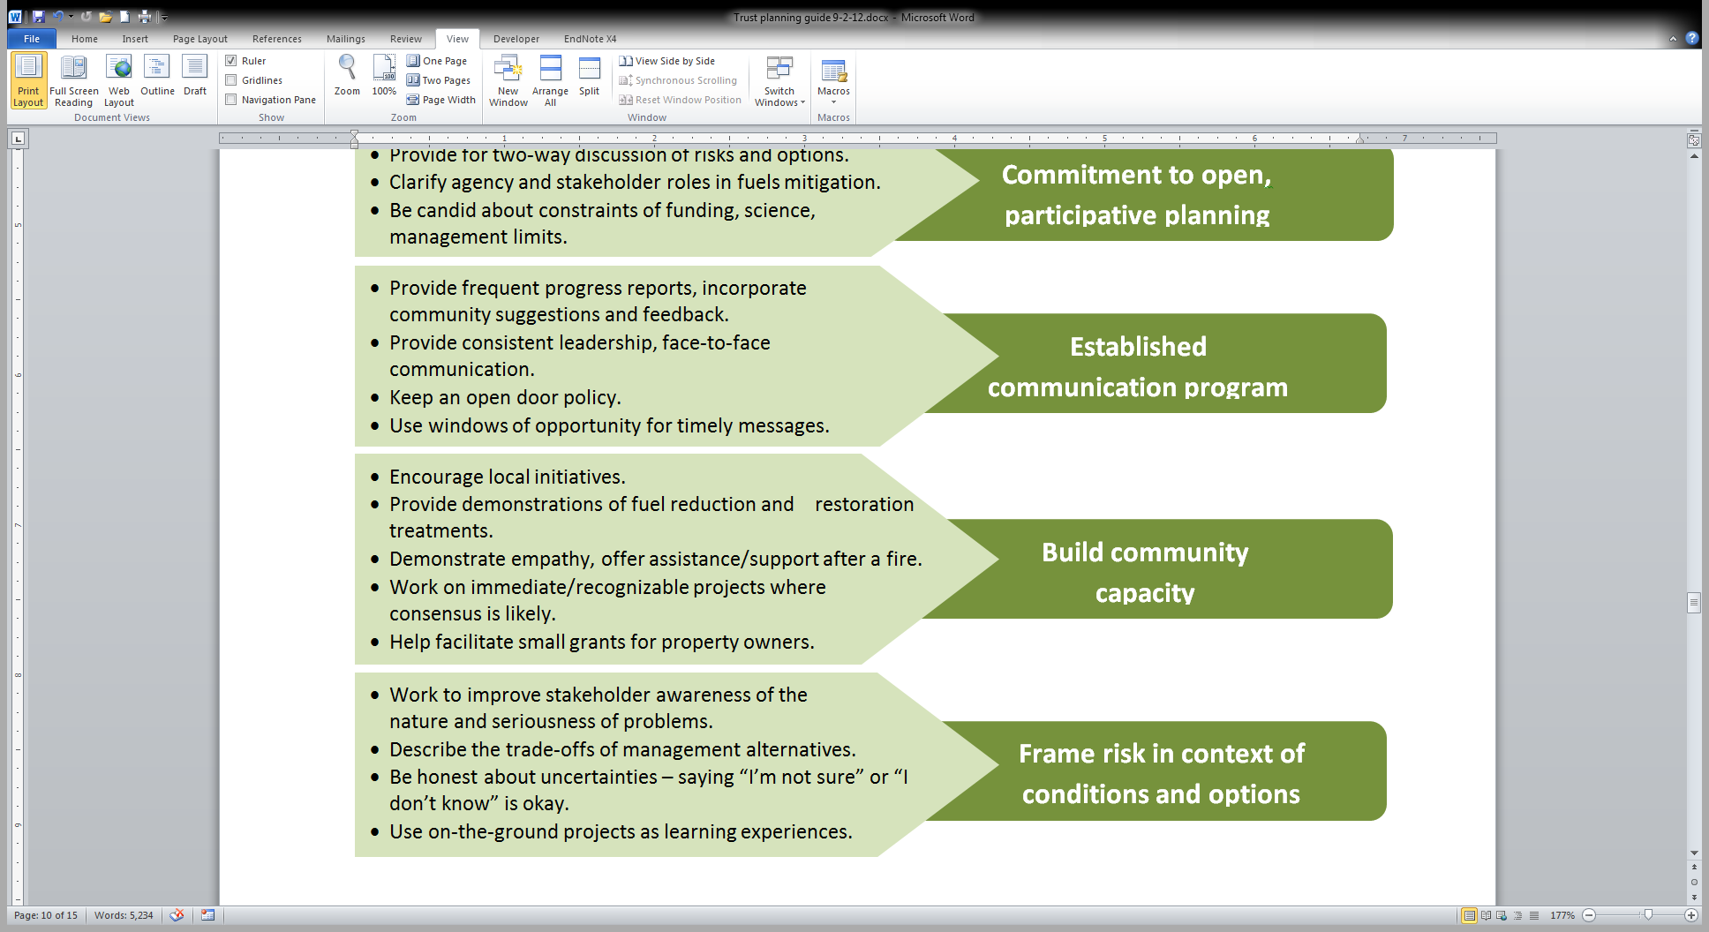

Slide 23
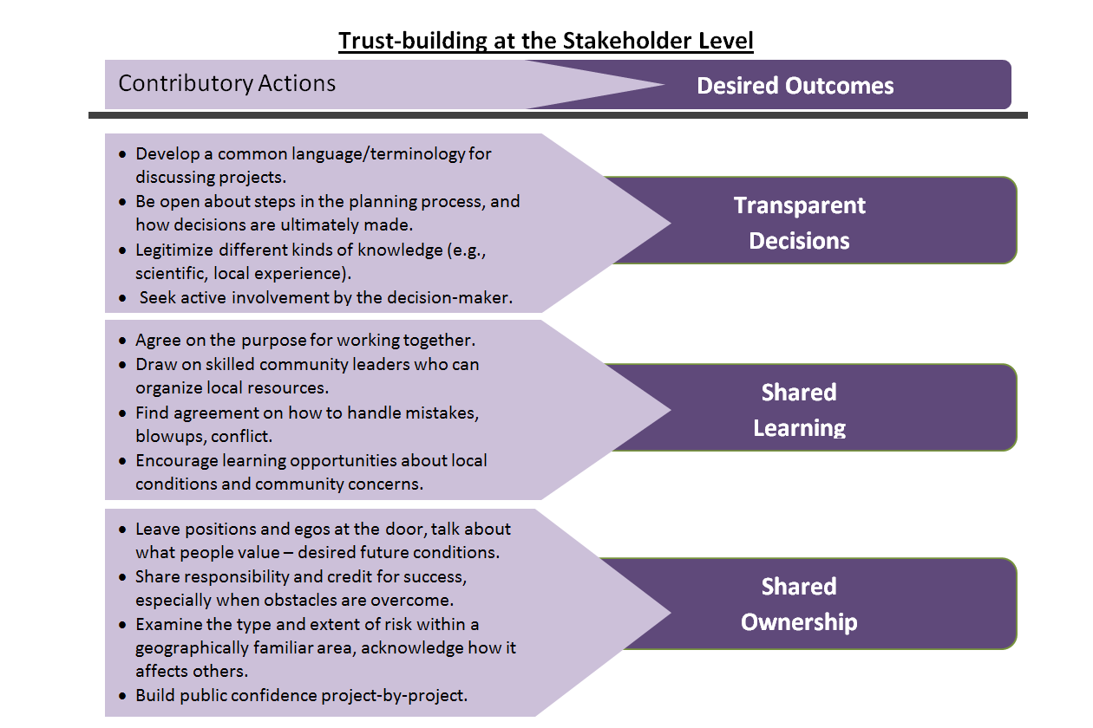

Slide 24
Management implications
Field personnel must have broad agency support
Agency capacity to commit to more collaborative approaches will be an issue in some places
Staff turnover is a problem
Shifting populations (urban to rural) makes trust- building more challenging
Building and maintaining trust carries through all phases of forest management

