Slide 1
Collaboration & Power Sharing What does that mean? Why is it important?
Dale J. Blahna
Research Social Scientist
USFS Pacific Northwest Research Station
May 7, 2013
Willamette National Forest
Notes:
I’d like to Thank the Grad Students for inviting me.
As I understand it, my task is to address my vision of the Future of Forestry.
Later revised to include Future of Natural Resource Management and Future of Environmental Science!
IN 15 MINUTES!!
Interesting assignment.
I Can’t help but think this the graduate students trying to get back at us for YEARS of perceived impossible assignments!

Slide 2
Era of Collaboration
Shift from participation to collaboration & partnerships
“Push from RO” (Friesen 2013)
USFS Strategic plan
Planning rule
Road rule/sustainable roads initiative
Collaborative restoration projects
Recreation sustainability framework
Key elements
Iterative, ongoing process
Two or more people or organizations
Work together to realize shared goals
Joint problem-solving
Significant (paradigm) change in federal land management agency roles
Notes:
Like to start with a video of a watershed restoration project that I got in my inbox last week.

Slide 3
Overview
Tale of two road plans
Ducks-Swains access management, Dixie NF
Grand Staircase-Escalante NM road plan
Lessons learned
Issue framing for ‘shared goals’
‘Issues’ are conflicts, and avoiding conflicts exacerbates them
‘Joint problem-solving ‘ requires power-sharing
Different form of leadership
Revisiting ecosystem management ‘triple bottom line’
Notes:
I’ll give it a whirl.
First I’d like to provide 3 examples of innovative forestry, natural resource, environmental management
Then focus on what I think the future
Which is ways of understanding how to make scientific innovative applications the norm, rather than accidential occurances.

Slide 4
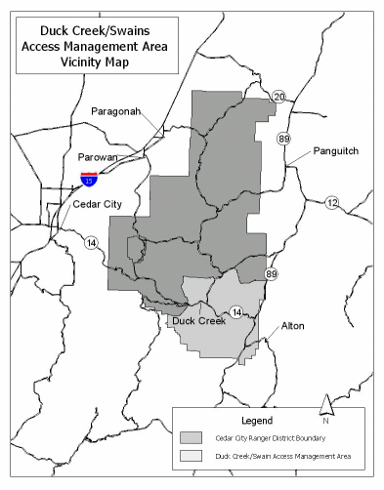
Duck Creek/Swain’s Access Management
Dixie NF, Cedar City RD
Travel Management Rule prototype
Destination OHV trails
Access to Las Vegas and SLC, UT
Inholdings, subdivisions
RS 2477 issues
Same region as Grand Staircase-Escalante NM

Slide 5
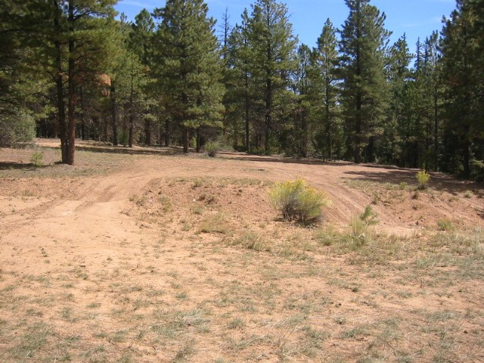
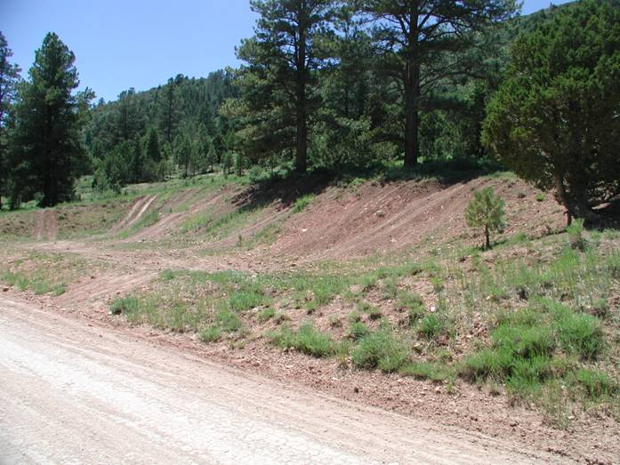
“Proliferation of Unplanned Routes”
Very high road density
Old logging roads
User created routes
~6 miles/sq. mil.
Resource impacts
Conflict and confusion
Near Grand Staircase
Escalante NM

Slide 6
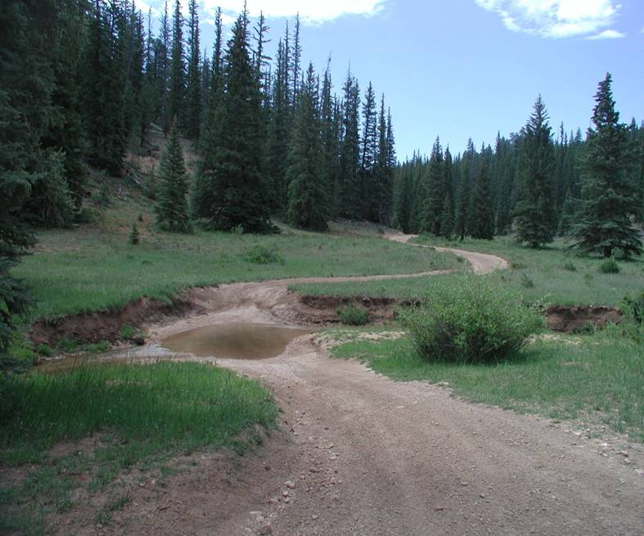
Dixie Process
Completed route GPS/GIS
Better route map
Erosion and runoff data
Extensive public engagement & iterative mapping
Targeted groups protesting GSENM road ‘closures’
Alternative met access, recreation, resource protection needs

Slide 7
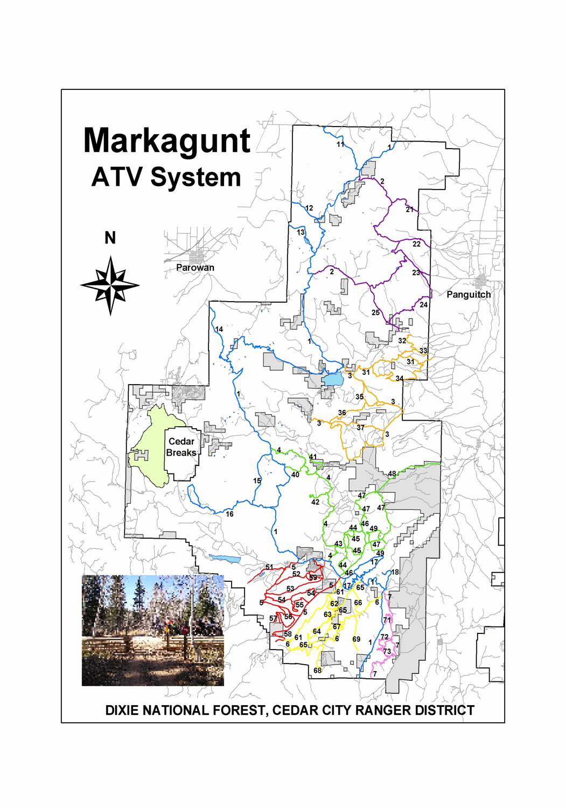
Outcome
Year 1: Designated the system
Added, rehabbed segments,
Color-coded map
500 signs
Year 2: Closed routes not on system
60% of routes
Density reduced to 2.4 mi./sq. mi.
No appeals, litigation
GSENM opponents supported plan
Partnerships & grants to implement
Expanded to District & whole Forest
Links to State ATVe system

Slide 8
Cooperation Led to Funding
District obtained > $200,000 in grants from State and counties to:
improve OHV opportunities with well-designed trail system appropriate settings and expectations
mitigate resource impacts
do high-quality mapping and signing
increase law enforcement
Result: Resource protection, visitors pleased and better served, economically feasible.

Slide 9
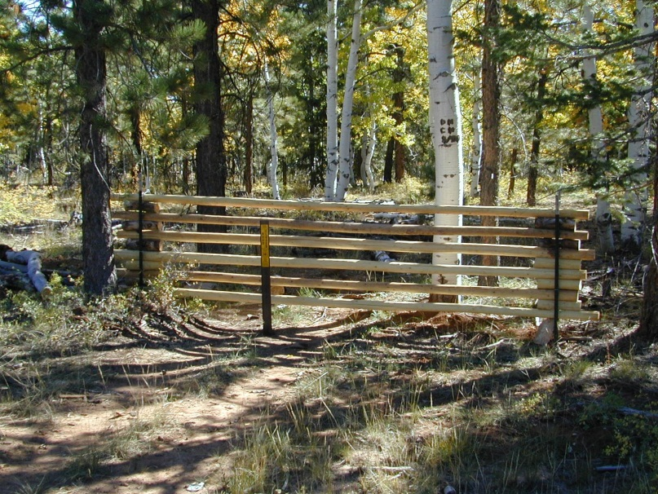
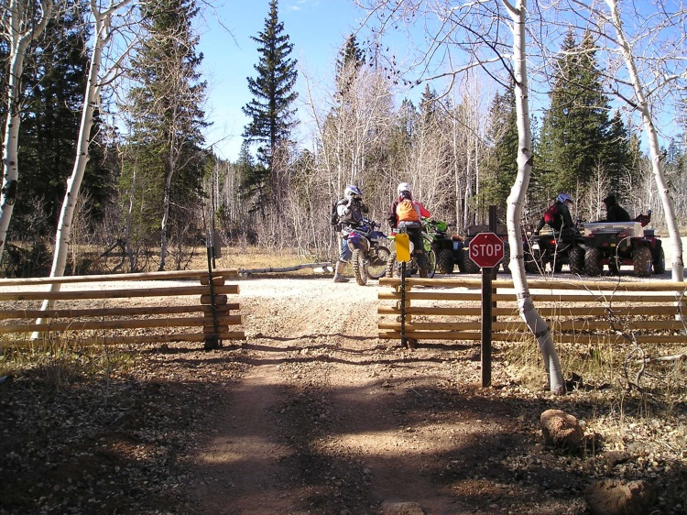
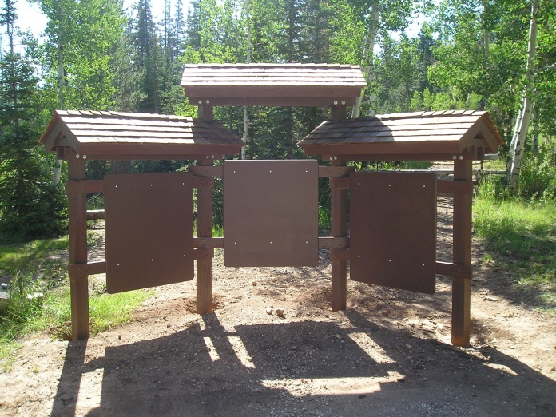
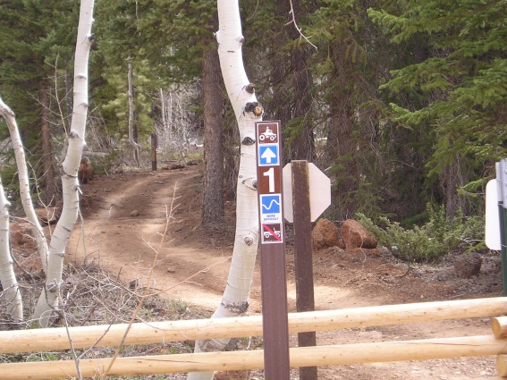
Recreation Improvements on the Dixie
Duck-Swains Access Management Project
(State and County grant contributions)
Structures to Protect Rehabilitation
Trail Gates
Route Markers
Information
Kiosks

Slide 10
Ecosystem Management Criteria
Decisions can integrate
Collaboration was key
Plan development
Restoration
Implementation
Little research
How meet criteria
WHY Successes?
Social and political
Ecologically sustainable
Economically
feasible
Socially acceptable

Slide 11
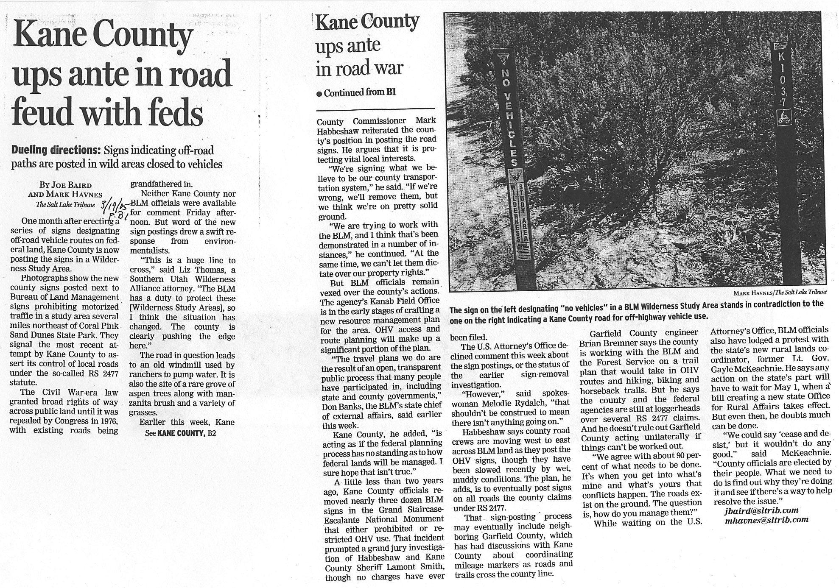
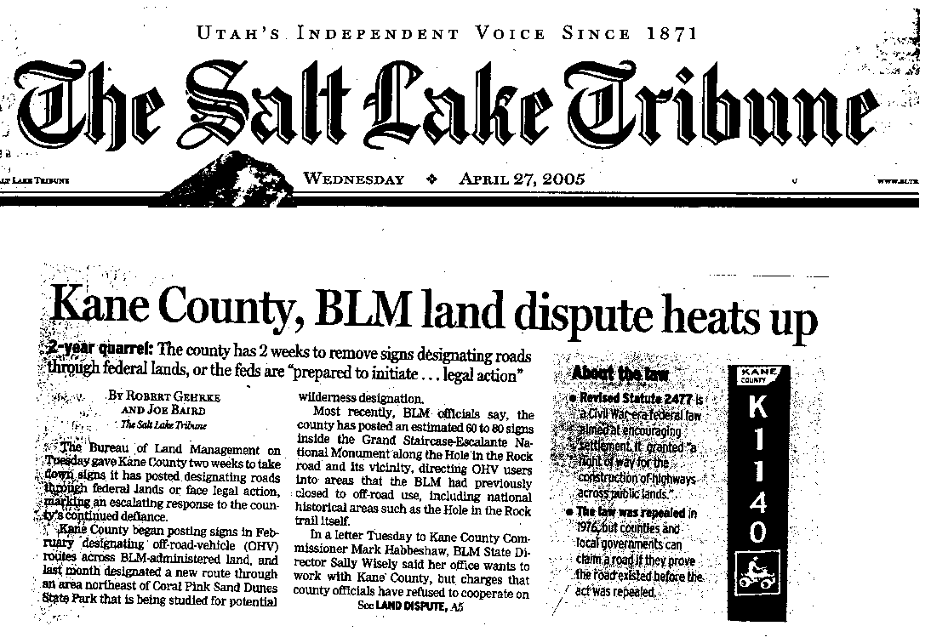
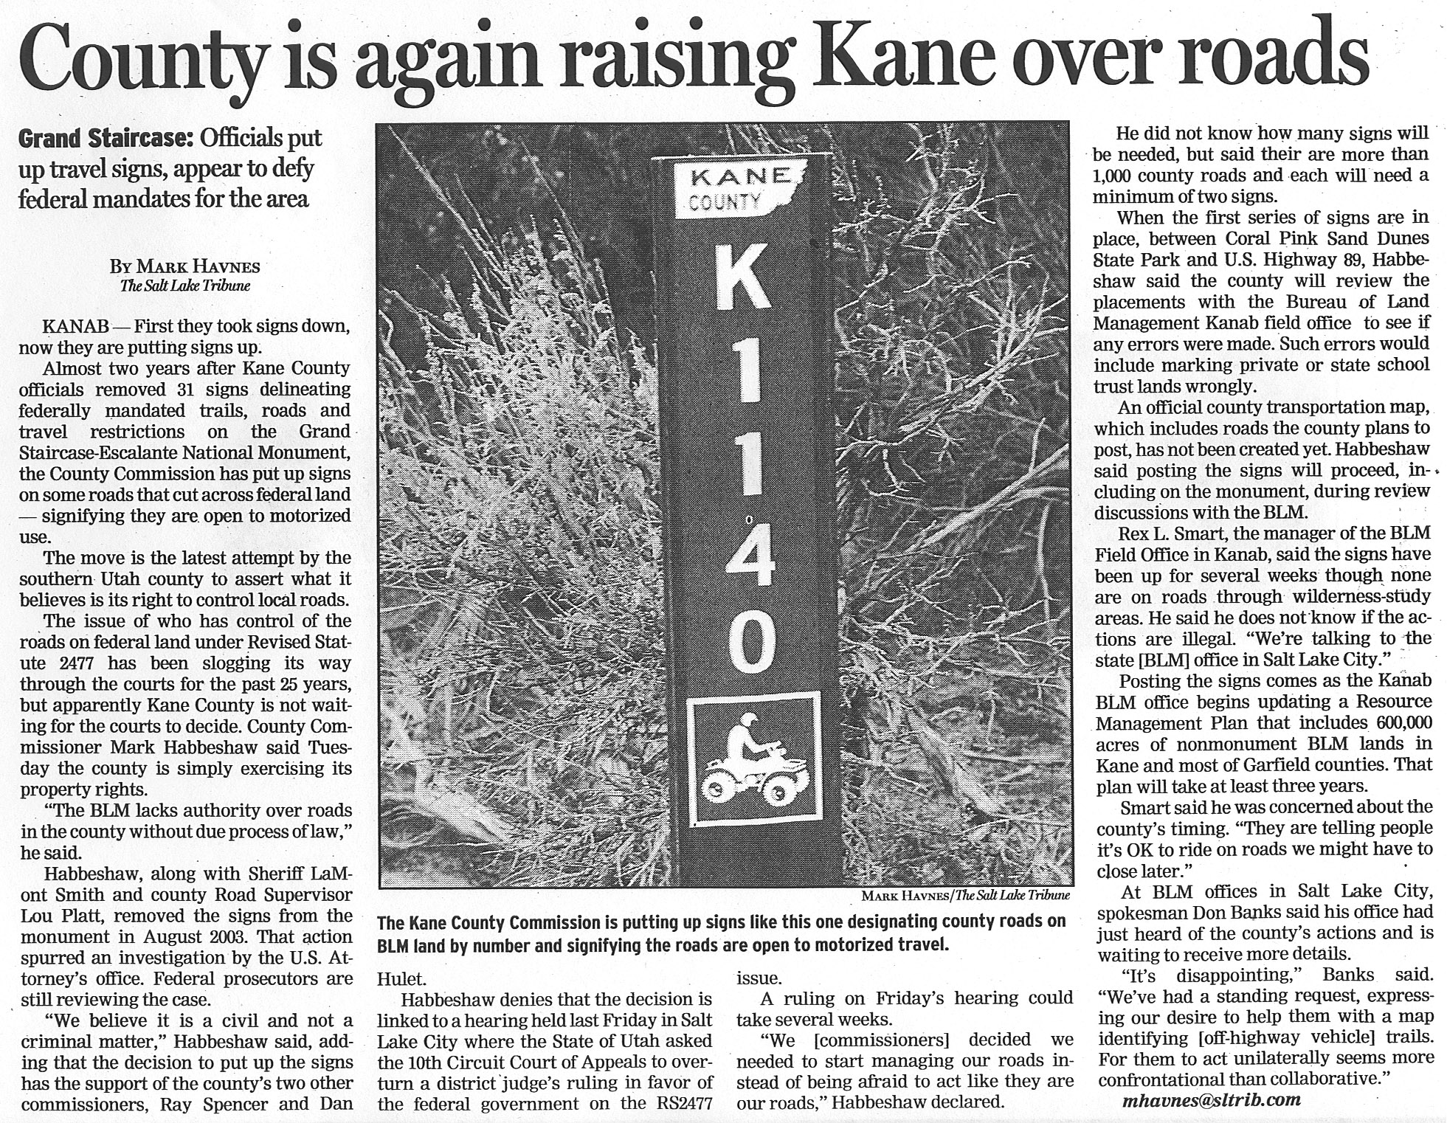
GSENM outcome
1998-2004 plan: close 1,200 miles of routes (~50%)
Analysis based on 1998 LMP
2004 State/county sued BLM
2005 County commissioner, Sheriff, others pulled up 40 signs
2007 County designated routes
2009 last lawsuits settled
2013 still controversial, implementation
NM issues very contentious

Slide 12
Social Acceptability
Anne Thomas (2006)
Compared participant perceptions of Dixie and GSENM road plan processes
27 participants:
Dixie only (n=9)
GSENM only (n=8)
Both processes (n=10)
Measured 6 dimensions:
Involvement, motivation, knowledge
Satisfaction with process, outcome, implementation

Slide 17
Hypothetical Conflict Curves
Review of 6 NFs during 1st round of forest planning
3 high conflict/not expected
3 low conflict/expected
GSENM
Courts ruled on final appeal 2009
Roads still very controversial
Spillover to other controversies?
Dixie NF
Ducks-Swains: no appeals
Travel Management Plan 2007
6 appeals-5 collaborated
0 lawsuits
Stakeholder collaboration continues

Slide 18
Collaboration & the Power Paradox
Issues early, throughout
Avoidance exacerbates conflict
Manage, not ‘resolve’ conflict
Issues ongoing
Implementation and next set of issues
Key is sharing ‘power’
Joint problem solving
Listen, use, and respond
Iterative: revise, respond, revise . . .
Share power to increase trust AND discretion in long run
Share power → Trust → Retain decision discretion

Slide 19
Lessons: Issue Framing
‘Issues’ address conflicts
Avoiding conflicts exacerbates them
Frame issues for shared goals
Social & environmental goals simultaneously
Road ‘designation’ not ‘closure’
Sustainable roads, not ‘minimum roads’
Accelerated restoration about forest health and jobs
Difficult often counter-intuitive
Focus on few specific issues & use them to . . .
ID data, stakeholders, partners, monitoring
Notes:
I’ll give it a whirl.
First I’d like to provide 3 examples of innovative forestry, natural resource, environmental management
Then focus on what I think the future
Which is ways of understanding how to make scientific innovative applications the norm, rather than accidential occurances.

Slide 20
Lessons: Power Sharing
General forms of public involvement
Informing
Consultation (public feedback for analysis, alternatives, decisions)
Collaboration (partner to develop alternatives, make decisions)
Empowerment (public makes final decision)
Extent of collaboration
Planning/decision-making (finite end point)
Stewardship/Implementation (ongoing)
Co-management (legal partners)

Slide 21
What Needs to be Shared?
Rarely formal decision authority (upper case ‘P’)
Co-management is rare
Increasing with ‘all lands’, accelerated restoration, tribal rights, NGO partners
Informal power (lower case ‘p’ power)
Active listening
Decision makers attend meetings
Using input to generate alternatives
Share decision space, flexible
joint problem-solving, iterative . . .
Government as leader/encourager/follower (Koontz et al. 2004)
Staff and budget support
Influence of Expertise (Fischer 2000)
Expertise in service of political decisions
Expert as facilitator

Slide 22
Lessons: Different Form of Leadership
Collaborative leaders are . . .
Risk takers
Active listeners
Passionate about resources and people (triple bottom line)
Able to share knowledge, power, and credit
Control
Traditional management development is based on giving potential managers a team of people and a set of resources to control, and success is rewarded with more resources to control. . . Collaboration requires managers to achieve success through people and resources outside their control and for this they have no preparation (Rod Newing, Financial Times).

Slide 23
Technical Experts as Facilitator
Rather than providing technical answers designed to bring political discussions to an end, the task is to assist citizens in the efforts to examine their own interests and to make their own decisions . . . Beyond merely providing analytic research and empirical data, the expert acts as a “facilitator” of public learning and empowerment. (Fischer 2000: 40)

Slide 24
Revisit: ‘Triple Bottom Line’
Changing ‘model’ of ecosystem management decision criteria?
Ecologically sustainable
Economically
feasible
Socially acceptable
Environment
Economy
Society

Slide 25
New Ecosystem Management “Model”? Source: 2010 RPA Assessment (USFS 2012)
Environment
Economy
Society
Environment
Society
Economy

Slide 26
Problems with new EM ‘model’?
Environment focus
Describes reality, but implies description
Inventory limitless–‘analysis paralysis’ (no ‘stopping rule’)
Provides analyst no guidance
Deemphasizes goals, purpose of management?
Criteria for success or failure?

Slide 27
Drivers and ‘fixes’ are human
Ecosystem degradation ‘footprint’ (Source: 2010 RPA (USFS 2010)
Population
Urbanization
Land use change
Climate change
Stewardship collaboration ‘footprint’
Agencies
Environmental groups
NGOs
Ecosystem Services
Natural resource management
Environmental science
Environment
Society
Economy

Slide 28
Many Collaboration Questions Remain
Framing issues as shared goals
Link social and environmental goals
Address, managing conflicts & traditional adversaries
Culture of power-sharing?
Link methods to collaboration forms and extent
Legal? Agency culture? Power-sharing paradox?
Evaluating collaboration leadership
Targets? More complexity!
Funding, staffing, training?
Ecosystem management still the goal
Do not dilute ‘triple bottom line’
Evaluate the role of expertise

Slide 29
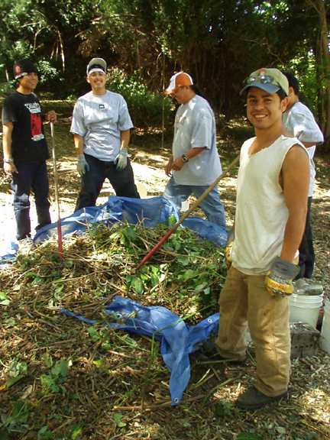
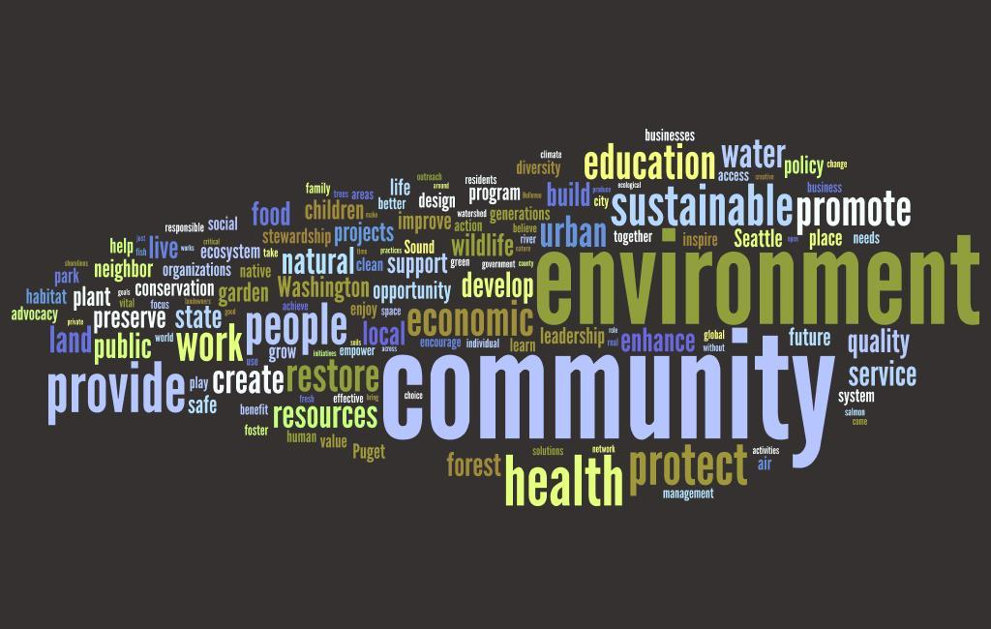
Collaboration & Stewardship Footprint
Green Cities Research Alliance
Over 600 groups active in Seattle/Tacoma (Wolf, Brinkley, et al.)
Citizen groups: Environment a secondary motivator (Asah et al.)
Agency partnerships: 13 different motivations (Cerveny et al.)
Urban Waters Federal Partnership

