Slide 1


WHO IS THE INVISIBLE MIDDLE?
Understanding our Publics and New Tools for Public Engagement
Lee Cerveny, Ph.D.
Research Social Scientist
Pacific Northwest Research Station
Seattle, WA
Willamette National Forest
May 7, 2013

Slide 2
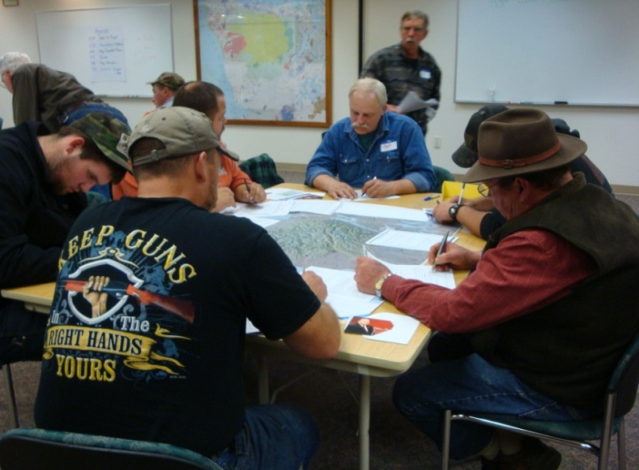
PUBLIC ENGAGEMENT: Expanding opportunities for individuals, stakeholders, communities, tribes, and other agencies to get involved.
What does successful public engagement look like?
Involves participants at various project phases
Includes all communities in the landscape
Invites multiple publics and diverse stakeholders
Is well-funded, facilitated, staffed and supported
Incorporates data and science
Is monitored using objective standards
Leach, W.D. 2006. Public involvement in USDA Forest Service policymaking. Journal of Forestry.
Notes:
Involves participants in all project phases
Project design & planning
Implementation & active management
Monitoring & learning (citizen science)
Includes all communities in the landscape
Direct beneficiaries (jobs & income)
Indirect beneficiaries (secondary spending, transport)
Communities not aligned with restoration goals (amenity destinations, retirement)
Urban centers (concentrated demand)
Invites multiple publics [FACA]
Formal stakeholders (corporations, NGOs)
Less structured groups (enthusiasts, stewards)
Environmental justice (EJ) groups
Private landowners
Is monitored using objective standards
Quantity/diversity of outreach efforts

Slide 3
Why engage? Agency Goals
Inform the public about a proposed action
Learn about perceived effects of proposed actions
Promote public ownership of resource decisions
Encourage residents to share knowledge & collaborate
Provide opportunity to deliberate & debate
Build support for current & future decisions
Brainstorm creative solutions to problems
Promote healthy forest-community relations
Develop an ethic of civic engagement
Generate interest and identify partners & volunteers

Slide 4
Why engage? Public Goals
Learn about important resource issues
Be involved and aware of proposed actions
Be seen and heard (by self & others)
Vocalize concerns about projects and their perceived impacts
Influence planning or decision outcomes
Represent others who may be impacted
Help federal agencies manage public lands

Slide 5
Mystique of the Invisible Middle
Extreme Opponents
Invisible Middle
Extreme Proponents

Slide 6
Public Meetings: Who shows up?
Who | What | Why
Professional Advocates | Paid to come and represent interest of their organization or industry | Advocate a position
Passionate Activists | Active enthusiasts with passion for a particular issue or place | Advocate a position
Leaders | Represent interests of their constituents, tribal members, residents | Protect and defend
Marginalized | Seek a forum to express frustration, fear, distrust | State their case and possibly derail
Watchers | Staff from other government agencies, community groups, media | Listen and report back
Civic Participants | Chronic meeting junkies ; civic duty to be involved | Learn, engage, help
Socialites | Public meeting is the event of the day | Socialize, learn, help
Accidentals | Uncle Joe who got dragged along; showed up at wrong meeting | Surprise
Visible Middle

Slide 7
Common Features of Participants
Feature | Description
Stake | Passion/interest in the issue or place
Awareness | Access to information about event
Fluency | Comfort with democratic process & protocols
Voice | Empowered; desire to represent or be heard
Availability | Free time in the day
Access | Transportation
Is that everyone? Who is missing?

Slide 8
Unpacking the Invisible Middle
I do care, but…
Not directly impacted.
Not a speaker of English.
Why aren’t you here?
Have given up.
Fighting other battles.
Not aware of the issue.
No free time in my day.
No ride to the meeting.
Not comfortable in organized public settings.
Don’t know about the meeting.
Not empowered to speak up.

Slide 9
Voice= capacity to engage (skills, knowledge, understand process)
+ Voice
Latent Engaged
Disengaged
Activist
Situational Activist
- Stake
+ Stake
Disinterested
Disenfranchised
Stake= high interest in resource management issue(s) or directly impacted by issue
- Voice

Slide 10
Who are the actors in the process?
Activist – strong voice, organizational skills, knowledge; high interest in issue
Situational Activist – moderate voice, organizational skills, and high knowledge; becomes interested or engaged when mobilized by others or when issue impacts them directly. Could be single-issue focused. May rely heavily on public lands.
Latent Engaged - moderate voice and potential capacity or ability; barriers to accessing public engagement process (lack of transportation, time, funds, technology); possible desire to engage.

Slide 11
Who are the actors in the process?
Disengaged – strong voice, organizational skills, low knowledge; low or no interest in resource management or no perceived stake in the issue
Disenfranchised – no voice, organizational skills, but high knowledge; high interest or a strong stake in the issue (may rely on public lands); may include environmental justice groups
Disinterested – no voice, organizational skills, low knowledge; no interest in resource management, no perceived stake in the issue

Slide 12
Engaging Actors in Natural Resource Management
Actors | Voice Capacity to Engage | Stake Interest in issue | Public Engagement Strategy
Activist | HIGH | HIGH | Continue to listen
Situational Activist | MODERATE | EPISODIC | Find ways to expand engagement beyond single issue
Latent Engaged | MODERATE (due to barriers) | MODERATE | Remove barriers to engagement
Disengaged | MODERATE | LOW | Engage using passive approaches (education)
Disenfranchised | LOW | HIGH | Build new capacity to engage (institution-building; training)
Disinterested | LOW | LOW | Ignore
The Invisible Middle

Slide 13
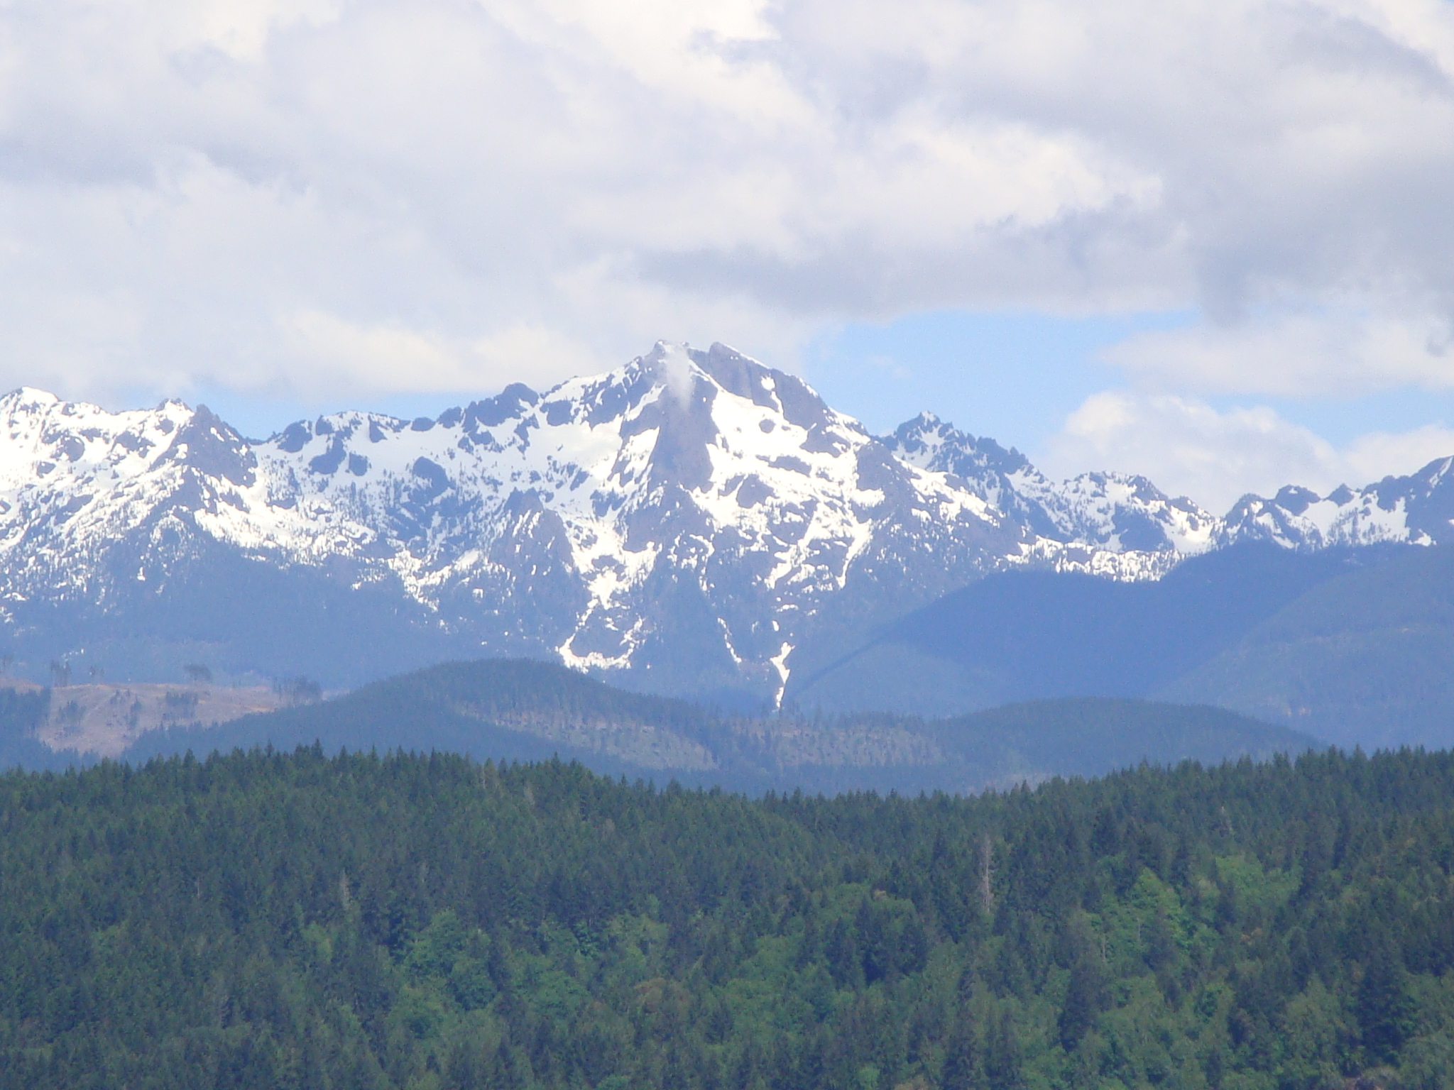



Human Ecology Mapping Project
Rebecca McLain, Institute for Culture and Ecology
Kelly Biedenweg, Stanford University
Diane Besser & David Banis, Portland State University
Dale Hom, Olympic National Forest
Project funded through USDA Forest Service Research, Pacific Northwest Research Station

Slide 14
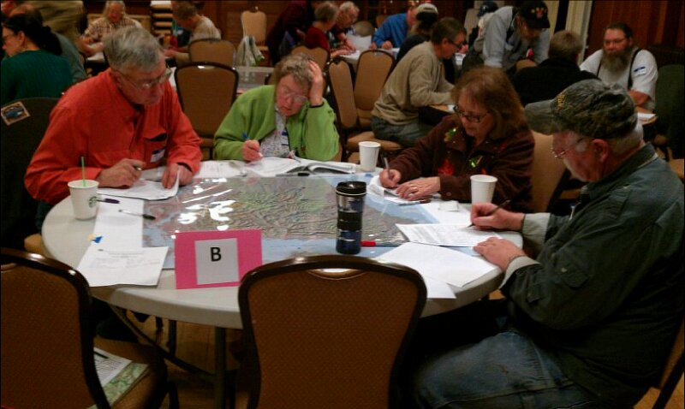
Human Ecology Mapping (HEM): A Strategy for Public Engagement
What approaches are used?
Public information sessions
Web-based portals
On-site (booth, district office)
Voluntary geographic info. (VGI)
Mail surveys
Special Places Mapping, Quinault, 2012
What can be mapped?
Places of social or biological value
“Hotspots” of intensive resource use
Special places
Areas needing management attention
Treatment preferences
Desired forest outcomes or conditions
Multiple geometries
Points
Lines
Polygons
Notes:
HEM is a tool developed by social scientists and GIS specialists that can be adapted for use in landscape-scale restoration. HEM can be used to gather information from communities, stakeholders, landowners, public agencies, and special populations.

Slide 15
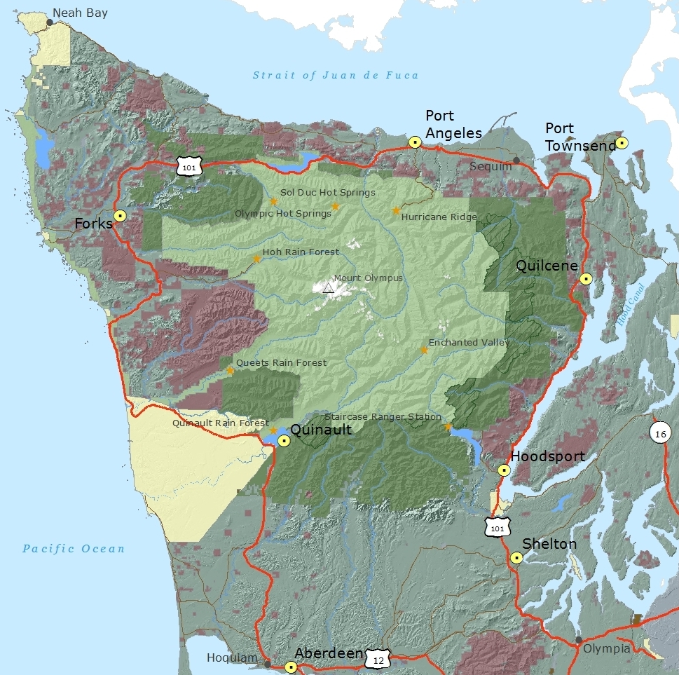
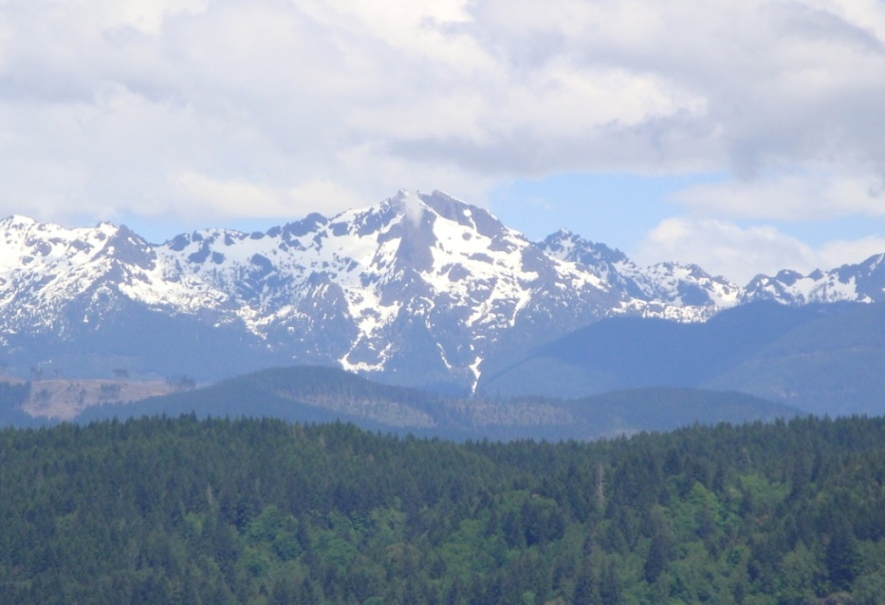
Olympic Peninsula (2010-11)
Community Workshop | Number of Participants
Aberdeen /Hoquiam | 17
Shelton | 17
Hoodsport | 17
Quilcene/Brinnon | 10
Port Townsend | 18
Port Angeles | 19
Forks | 32
Quinault | 39
TOTAL | 169

Slide 16
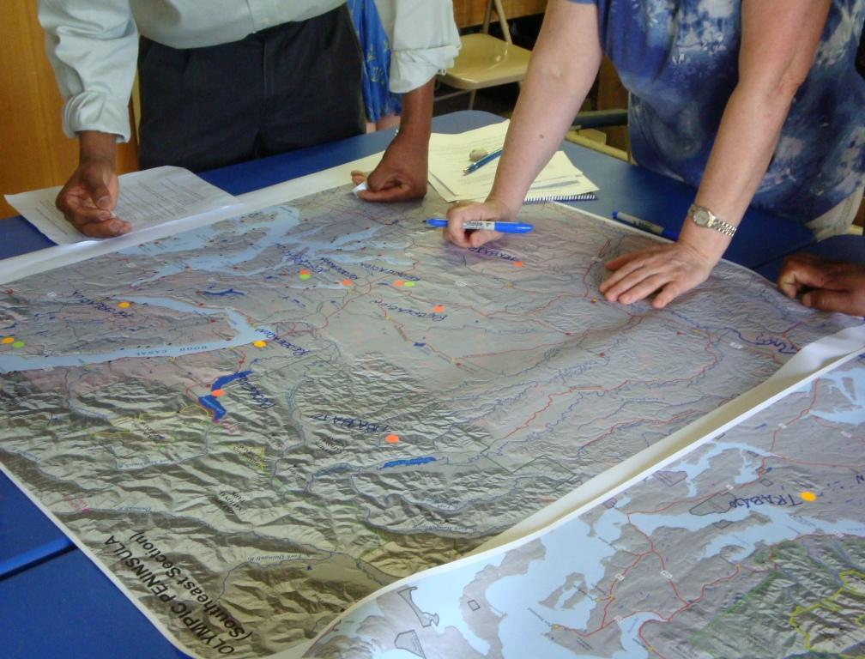
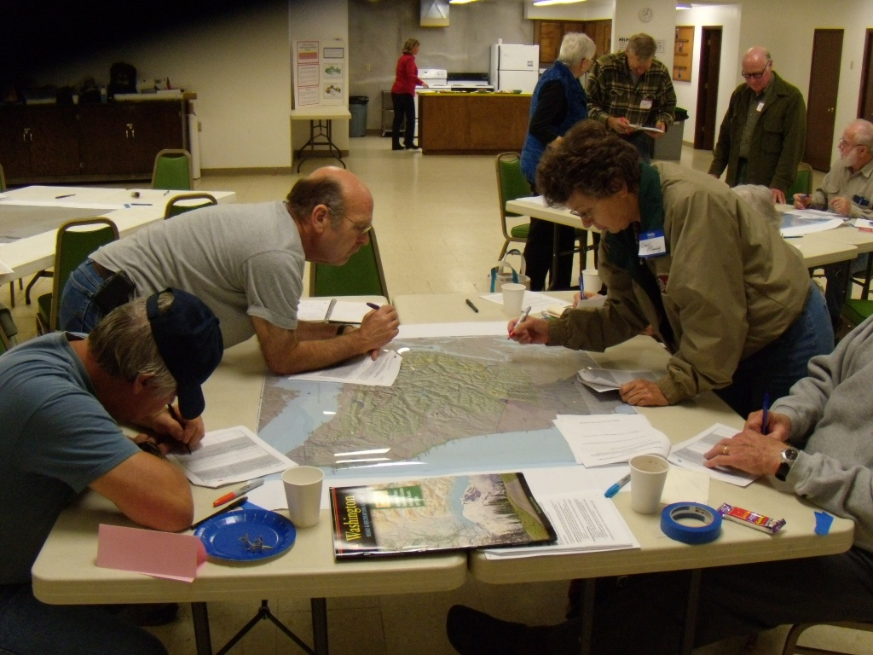
HEM Workshops
Workshop Structure (90 min)
Exercise A. Social Values Map
“Pick 5 places important to you.”
Exercise B. Outdoor Activities Map
“Pick 3 favorite outdoor activities and tell us where you go to do them.”
Mapping Tables
4 to 6 participants per table
One 36x36” map per table
Color-coded markers
Workshop packets (data )
Notes:
For each workshop, we organized 4 to 6 people around tables with a 36 by 36” map in the middle. Maps were covered with mylar. Maps displayed general topographical features and landmarks, such as major roads, towns, and rivers, but we wanted to avoid lots of labels, such as names of campgrounds, which might bias what people choose to map.
Each participant had a workshop packet with prompts helping them along. We gave participants separate colors for marking their packets and their maps. We had reference materials available to help people find their places.
Workshops were 90 minutes and we had two major mapping exercises, which took 25 minutes each.

Slide 17
Exercise A. Social Values Map
Landscape Values
Identify 5 places on the Olympic Peninsula important to you.
Worksheet:
Name & describe place
Primary & secondary value
Activities/uses
Map:
Mark on map with a point, line, or polygon
Label map with ID code
Aesthetic
Economic
Environmental Quality
Future
Health
Heritage
Home
Intrinsic
Learning
Recreation
Social
Spiritual
Subsistence
Wilderness
Brown, G. (2005) Mapping spatial attributes in survey research for natural resource management. Society and Natural Resources 18: 1-23.
Notes:
The first activity involved mapping special places and identifying core values associated with those places. We handed out a list of 14 landscape values and read through these. We asked people to identify five places on the Olympic Peninsula that were meaningful or special. Tell us where the places are located, the values (primary and secondary) they assign to this place, and what they do there. After writing about this on their worksheet, they grabbed their assigned pen and circled places, drew dots, or lines and labeled them.

Slide 18
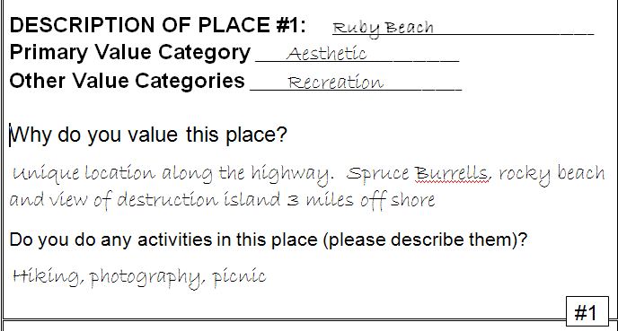
Exercise A. Social Values Map

Slide 19
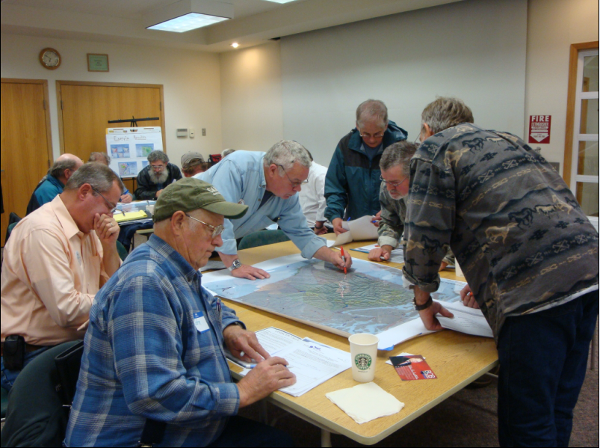
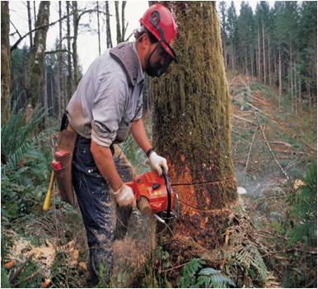
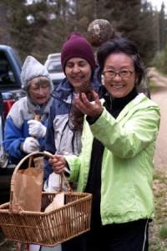
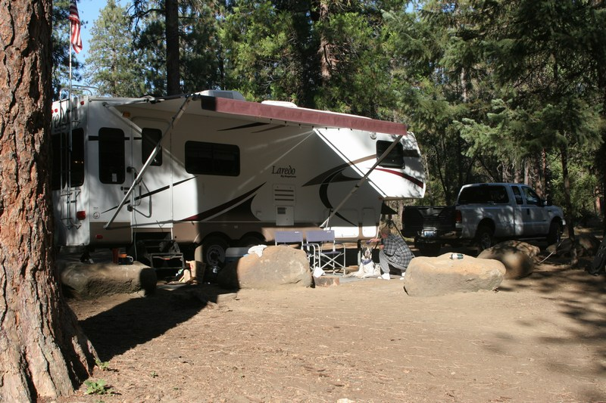
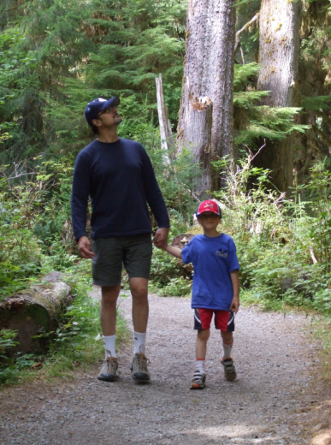
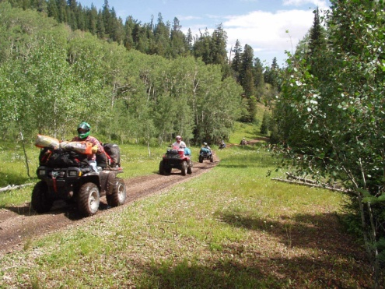
Exercise B. Mapping Resource Use
Identify 3 outdoor activities that are important to you.
Worksheet:
Name & describe 3-5 places you go for each activity.
How often do you visit?
Why do you visit this place?
Map:
Mark on the map with a point, line, or polygon.
Label with ID code
Notes:
The second activity involved asking people what outdoor activities are most important to them. They were told to pick 3 activities that were important. For each activity, we wanted to know 3 to 5 outdoor places they go to do this.
We asked them to tell us about this place in words (on their worksheets) and asking them how often they go to each place and what they do while they are there.
Then, they identified these places on the map. Again, they drew on the maps with markers – each table sharing one map.

Slide 20
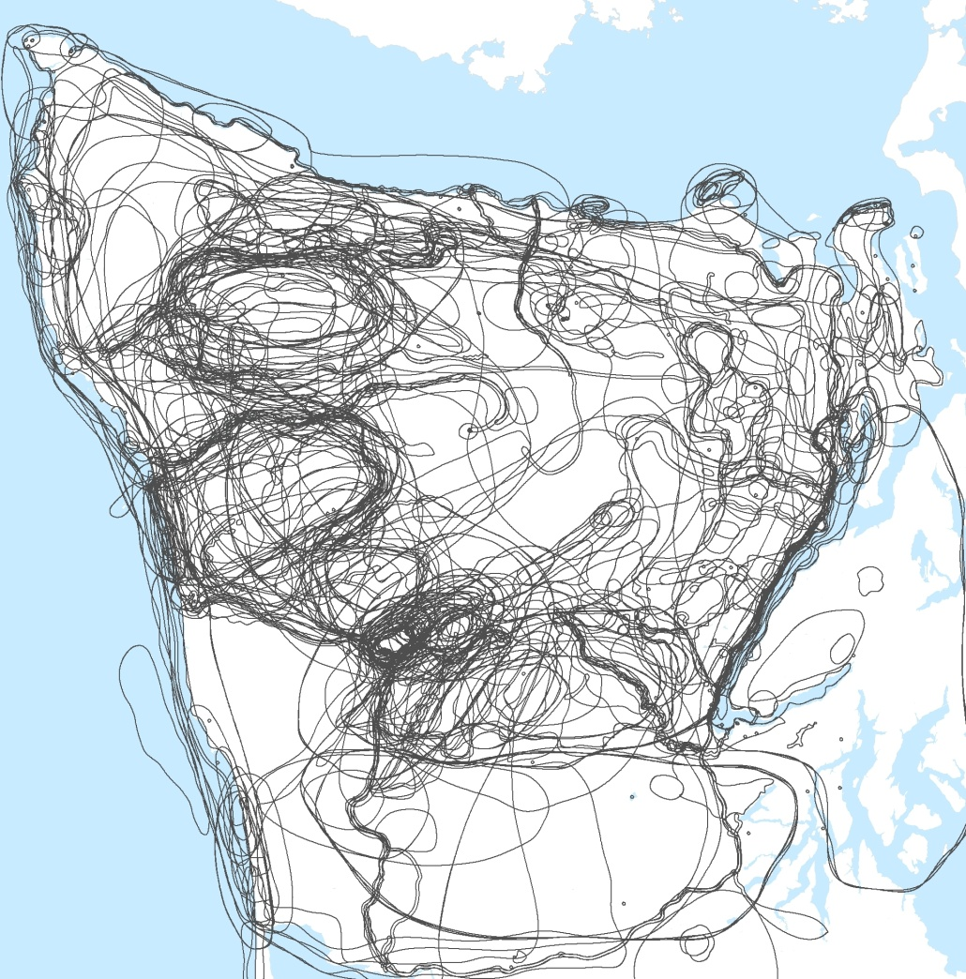
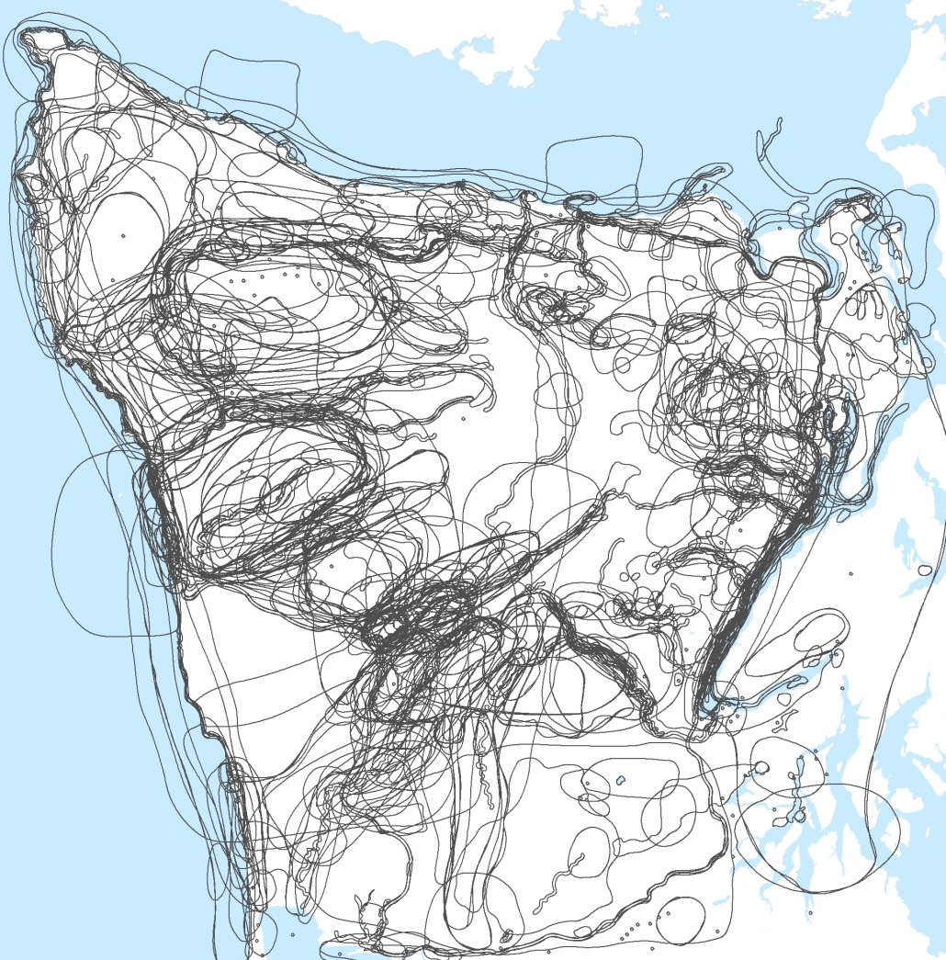
Mapped Features: Composite of 169 individual maps
Landscape Values
Resource Uses

Slide 21
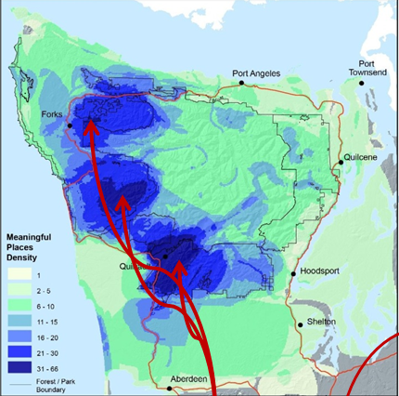
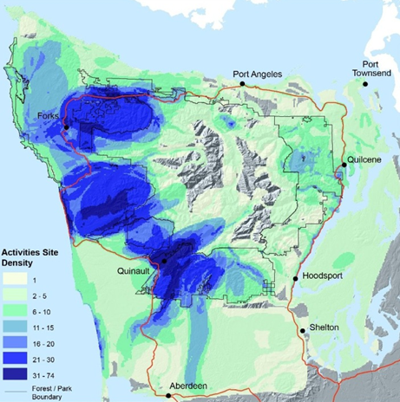
Olympic Peninsula
Density of Landscape Values
Density of Resource Uses
Human ecological hot-spots
Human ecological hotspots can be integrated spatially with biological hotspots or overlaid with information about managed areas.

Slide 22
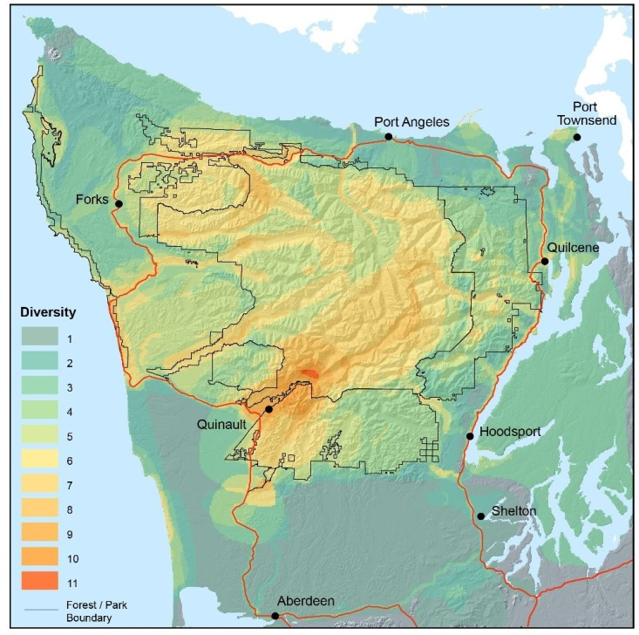
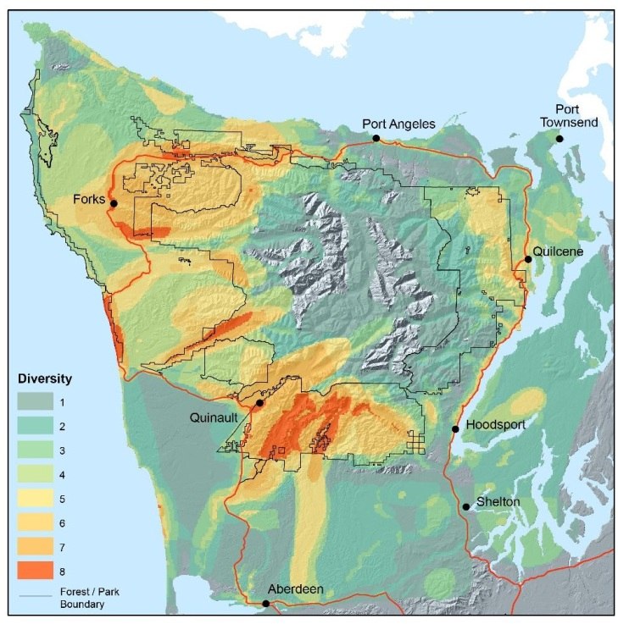
Landscape Values Diversity
Olympic Peninsula
Diversity in Resource Uses
Places of potential resource conflict?

Slide 23
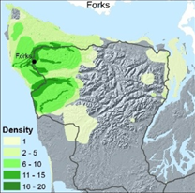
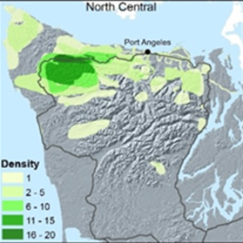
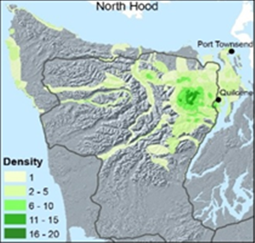
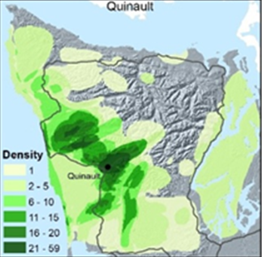
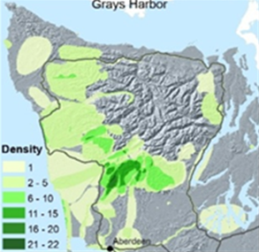
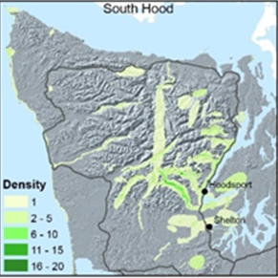
Forks
North Central
North Hood Canal
Quinault
Grays Harbor
South Hood Canal
Mapping reveals community-specific information about landscape priorities and uses

Slide 24
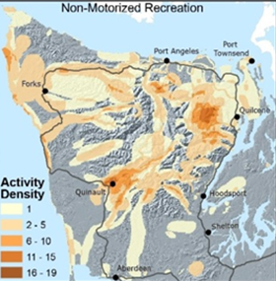
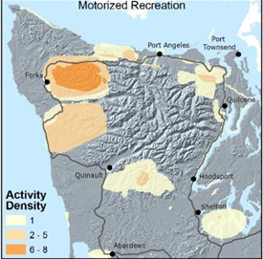
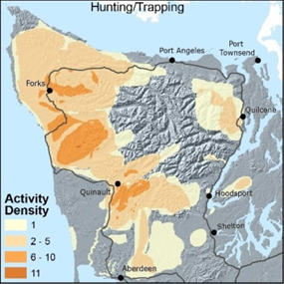
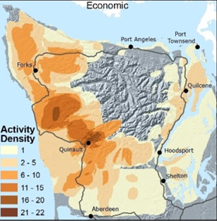
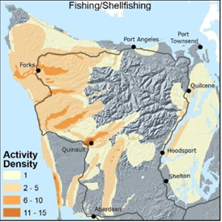
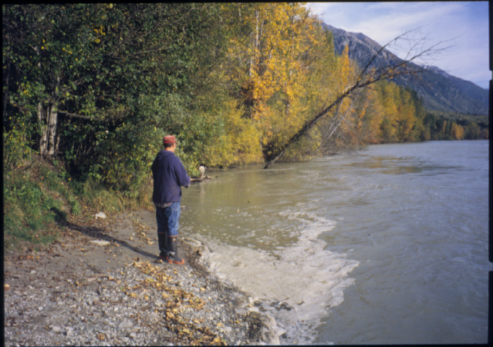
Non-motorized Recreation
Motorized Recreation
Hunting/trapping
Economics
Fishing/shell-fishing
Mapping reveals diversity in landscape uses among stakeholders

Slide 25
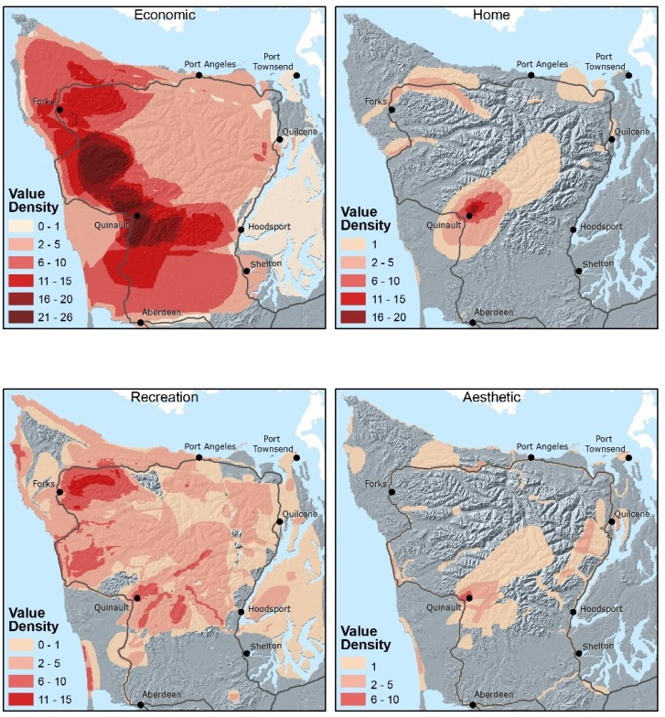
Mapping reveals diversity in landscape values
Economic
Home
Recreation
Aesthetic

Slide 26
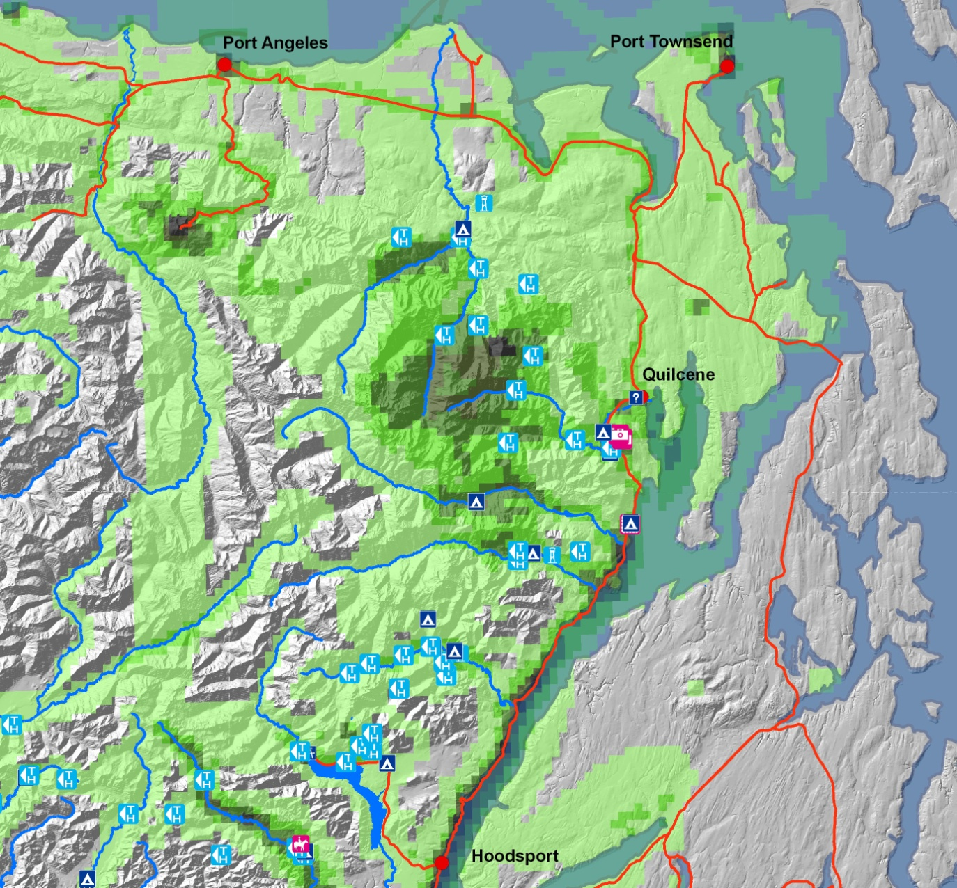
Integrating Community Data with Other Layers
Management & Planning
Services and Amenities
Sensitive Habitat
Public Access
Notes:
Finally, I wanted to show you how we can potentially integrate our mapping data with other layers. Here we drew from a map with recreation sites and overlayed that with our recreation activities map to see if there is a connection between existing recreation infrastructure and recreation activity.

Slide 27
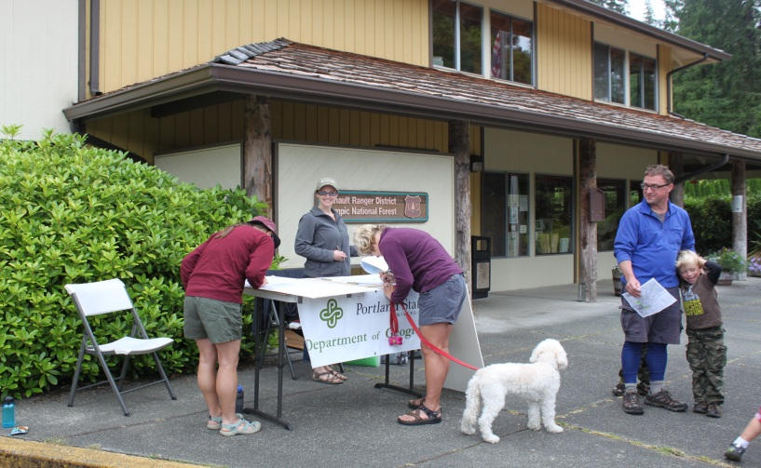
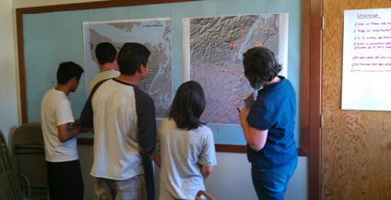
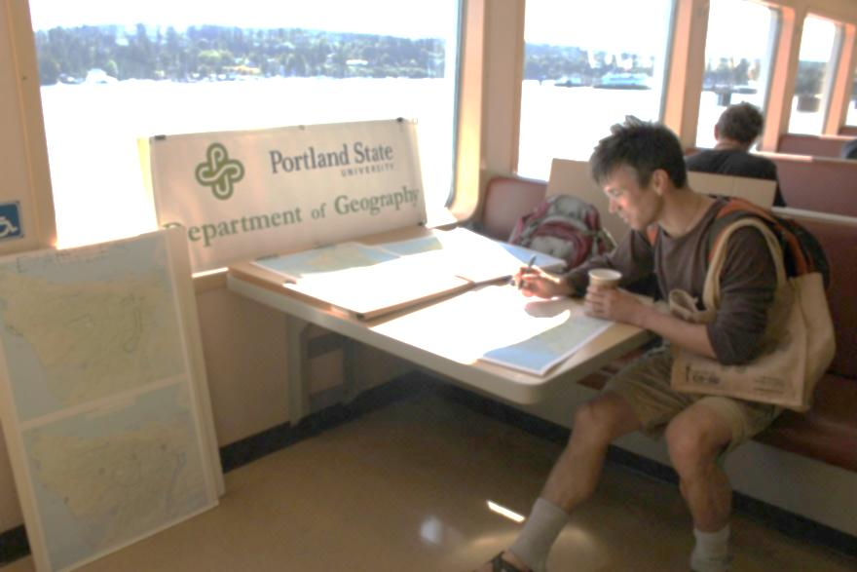
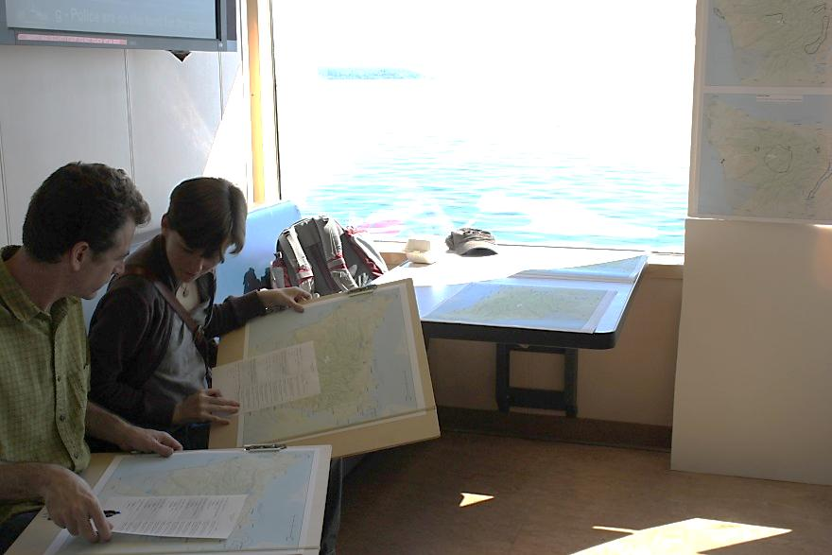
Alternative Approaches
Visitor Mapping on the Olympic Peninsula
Summer 2012
Latino Forest Mapping, Shelton, WA 2011

Slide 28
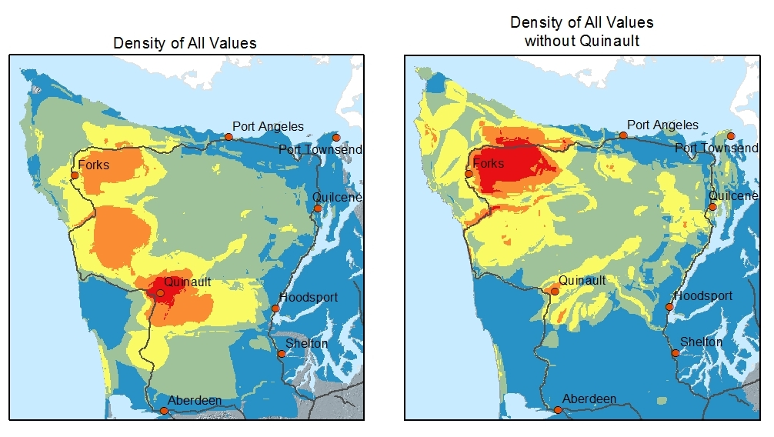
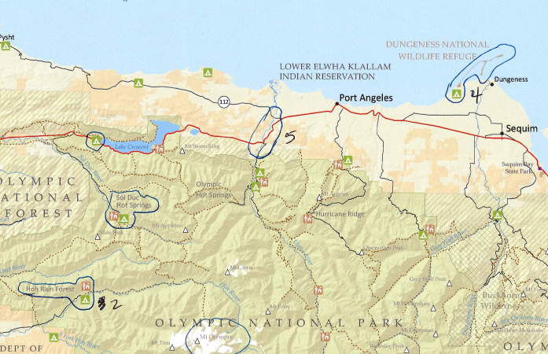
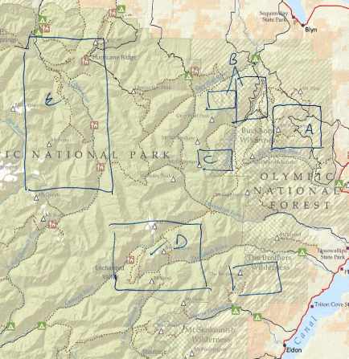
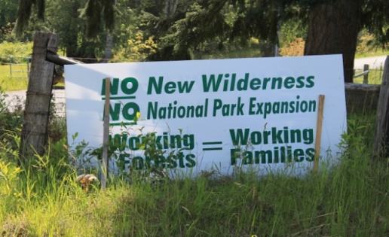
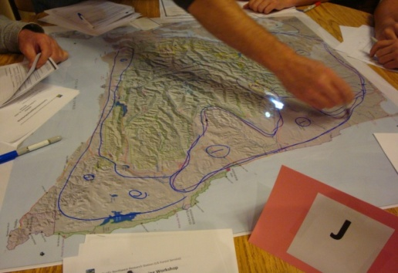
Lesson #1
How people map affects the analyses.
1. Individual mapping styles
2. Strategic mapping
Photo by A. Todd
Photo by R. McLain

Slide 29
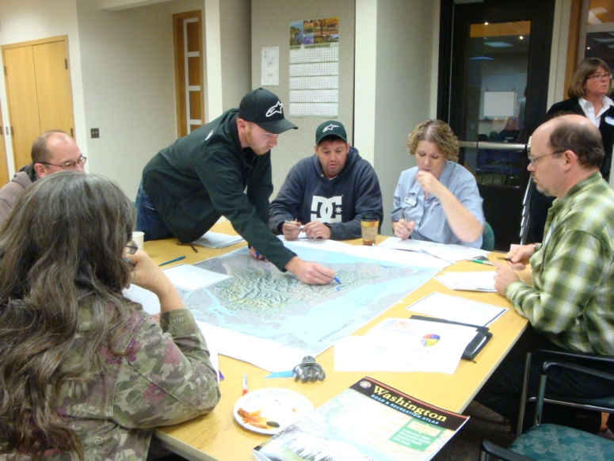
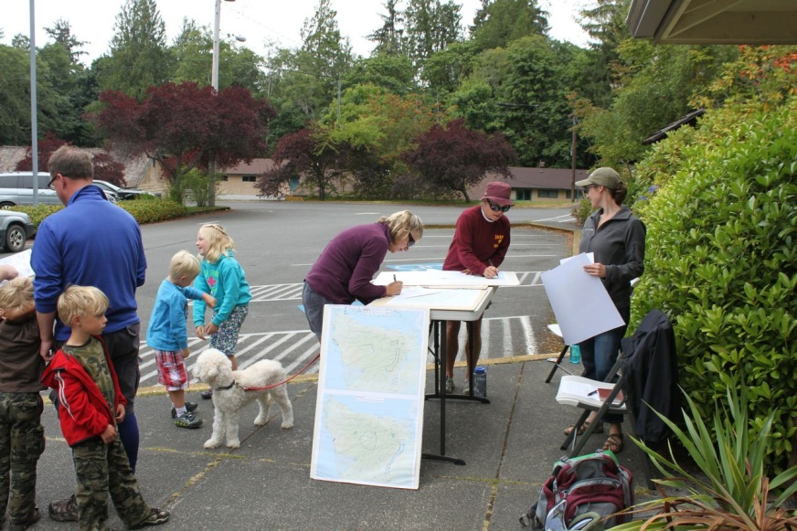
Lesson #2
How you collect the data affects who participates, which can affect how people map.
Standard community workshop
Face-to-face survey
Photo by R. McLain
Photo by A. Todd
More standardization in mapping styles
Able to reach blue-collar workers (with appropriate outreach)
Challenging to reach ethnic minorities
More individuality in mapping styles
Captures visitor and resident data
More efficient in terms of volume
Missing from both: Children and young adults; people who neither live on or visit the Olympic Peninsula

Slide 30
Human Ecology Mapping Applications
Travel management & sustainable roads
Special places
Forest planning
Recreation planning
Special forest products management
Notes:
But, our project has generated some momentum within the USFS and other federal agencies and we are beginning to explore other applications and adaptations to suit particular planning needs. Specifically, we are being asked to inform a roads planning process on a national forest in Oregon. We are being asked to do mapping at different scales or places with distinct geophysical properties, such as a watershed, marsh, or grove. We are exploring ways to make HEM mapping a standard part of national forest planning. And, there are potential applications for management of particular program areas such as recreation or special forest products.

