Slide 1



How Do People Make Decisions?
A recipe of information and emotion
CCAMP Meeting
May 7, 2013
Springfield, OR
Michael P. Nelson
Department of Forest Ecosystems and Society
College of Forestry

Slide 2
Greatest Demand:
Clear Thinking

Slide 3
Assumes a process – which is probably mistaken
Other questions are important here too – what do they decide and why?
Maybe more important to understand what a wise/thoughtful/intelligent decision-making process would look like
How Do People Make Decisions?
A recipe of information and emotion
As if!
While there might be no recipe there are likely better or worse ways to go about this
Exercise Caution!!!
Especially in language use and what that language implies (here – not so clear the reason and emotion stand in contrast in this way)

Slide 4
The Practical Syllogism
P1. Descriptive, empirical This is the way the world is.
P2. Normative, ethical This is what is valuable, this is
what is right, this is how the world
ought to be.
____________________________________________________
Conclusion This is what we ought to do.
Management decisions end here – they are prescriptive

Slide 5
Egocentrism
Only I count
Anthropocentric
Anthropocentrism
All and only humans
count
Zoocentrism
Some non-human animals
count
Biocentrism
All living things count
Non-anthropocentric
Ecocentrism
Collectives count: (species,
ecosystems, the land)

Slide 6
External Authority
Divine Command
Natural Law
Motives
Consequences
Rights and Duties
Utilitarianism
Actions,
Behaviors,
Policies
Virtues:
respect, humility, care, love, empathy
Pragmatism

Slide 7

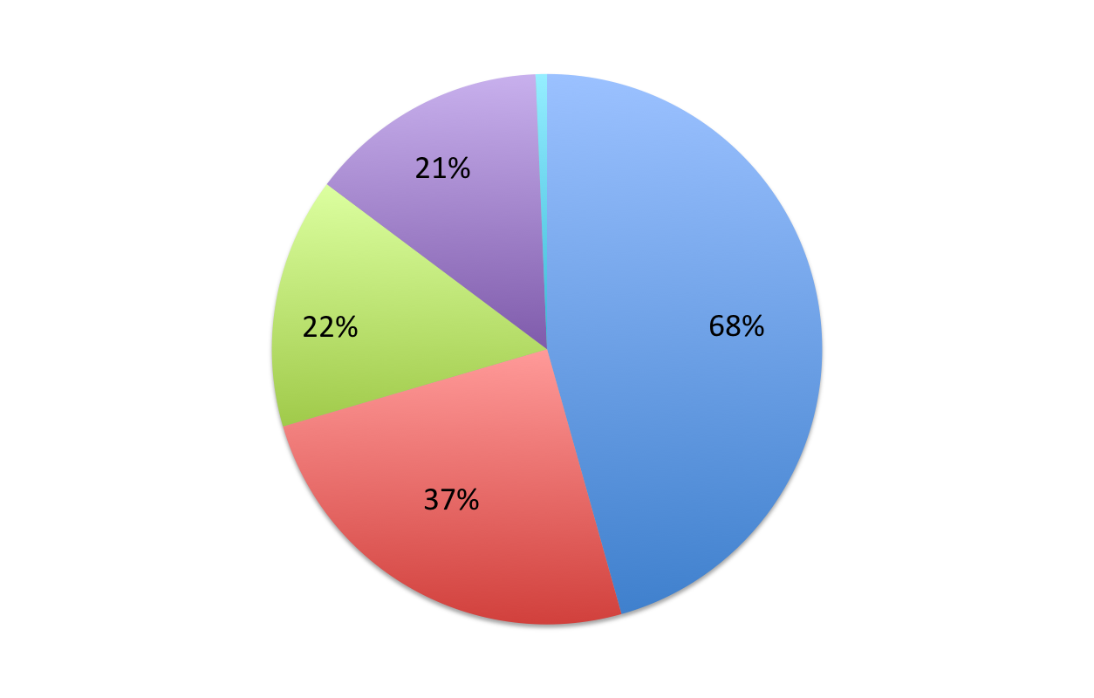
Do Isle Royale Wolves Need Genetic Rescuing?
divine command
natural law
human authority
consequentialist
motive
Gore et al. 2012, Conservation Letters

Slide 8
Should YNP Rangers Have Shot the Moose?
Motive
Natural
law
26%
52%
Human
authority
15%
Divine
command 1%
7%
Consequentialism

Slide 9
2 cases:
Ideas about decisions – who do people think should make them?
2) Conservation Ethics – Mute Swans in MI

Slide 10
“
“centralize the decision-making process, focus on technical knowledge associated with the decision, and minimize the role of social factors such as public input or stakeholder engagement”
“Best available science”
administrative rationalism
“expert-authority”
and
democratic pragmatism
“ballot-box biology”
“decision making to be democratized to varying degrees, such as public consultation, community-based management, co-management right-to-know legislation, and referenda”
Gore et al., “Ballot box biology versus scientific knowledge? Public preferences for wolf management processes
in Michigan” under review at Human Dimensions of Wildlife.
Notes:
A potentially important limitation of administrative rationalism is failing to focus enough attention on the idea that effective wildlife management is not a wholly determined technical phenomenon, but also depends on social factors such as fairness, trust, tradition, and power

Slide 11
"Wolves should only be hunted if biologists believe the wolf population can sustain a hunt"
"The decision to hunt wolves should be made by public vote"
10%
50%
29%
11%

Slide 12
In general: higher education level and liberal ideology predicted greater support for technical knowledge (administrative rationalism)
In general: Significant predictors of support for public input (democratic pragmatism) were less formal education, and firmer commitment to conservative ideology.
Interestingly – there may be disconnects between people’s preferred decision making processes and the likelihood of the results favoring them.

Slide 13
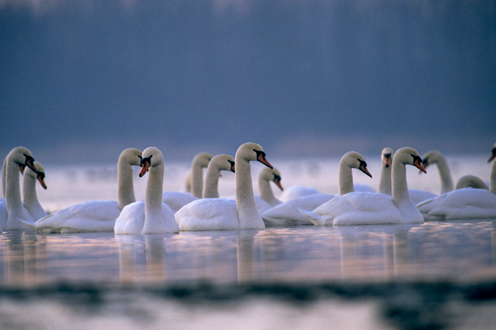
Michigan mute swans: A case study approach to ethical argument analysis
By Corey A. Jager
Department of Fisheries and Wildlife
Michigan State University
Advisor: Michael P. Nelson

Slide 14
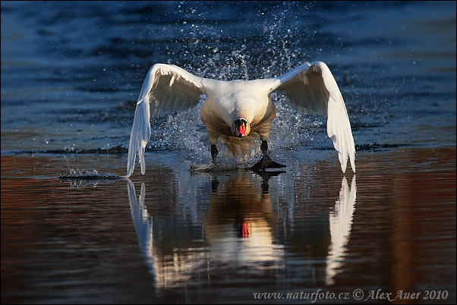
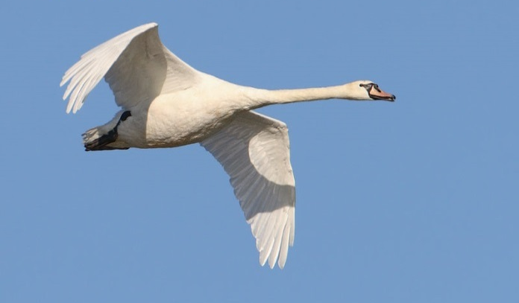
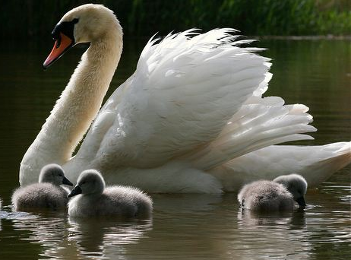
Environmental Ethics
Research Questions
Which reasons are having an impact in Michigan’s mute swan discussion?
2. Which reasons should have an impact in Michigan’s mute swan discussion?

Slide 15
Methodological Framework
Methodological Framework
Content Analysis:
Which reasons are being used and which are most common?
Argument Analysis:
From these reasons, which produce logical, appropriate and robust arguments?
Results:
Which arguments should be used to defend or critique mute swan control?
Theoretical Implications:
How can this case assist us in future conservation discussion?
Notes:
Question 1: content analysis, question 2: argument analysis. Theoretically speaking, the results from this case might allow us to define a more systematic approach for addressing values in management frameworks.

Slide 16
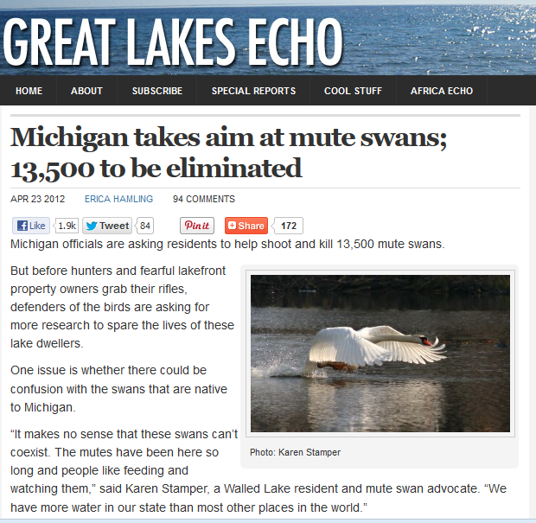
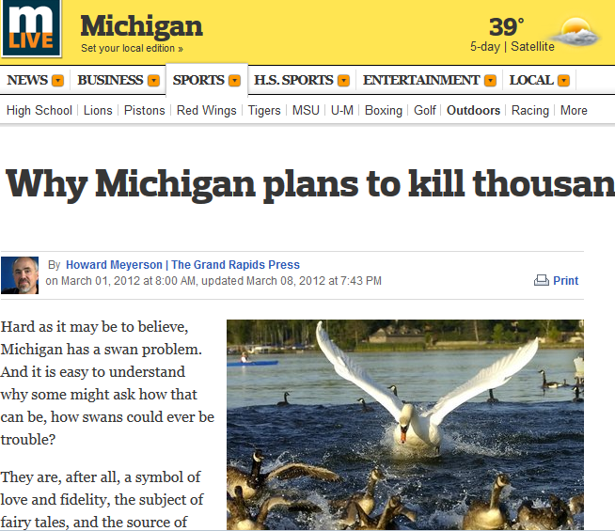
Content Analysis Results
Qualitative Content Analysis
Notes:
Type of CA
Sample strategy: how searched, why news- environmental information and impact: Michigan news sources are likely to best represent Michigan issues, and most likely to influence Michiganders.
Conventional CA: My explicit interest was to determine the reasons in support of or against the mute swan policy, an objective that could be served with a conventional approach to content analysis. This approach allows codes to emerge directly from the sources, rather than designating preconceived categories to the data, and thereby limits assumptions and prejudices imposed on the data

Slide 17
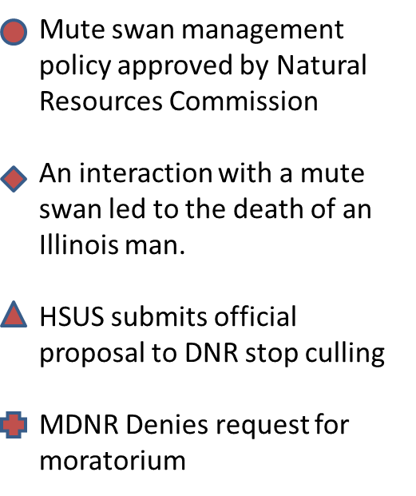
Results: Content Analysis
Notes:
My sample resulted in 51 articles over a ten month period. This graph displays the number of articles over the sample period and a few key events which might have triggered additional coverage.

Slide 18
What reasons are having impact?
In support of mute swan management: | In opposition to mute swan management:
Mute swans are aggressive toward humans (51) | Methods of control are inhumane (41)
Mute swans damage aquatic vegetation (22) | The best available science was not used (37)
Methods of control are efficient/effective (16) | Mute swans are aesthetically valued (25)
Notes:
Remind that these answer first research question: ended up with 3 reasons in support an 3 opposed from 18 total. These are likely to have the most impact. Moreover, beyond these reasons the frequency was minimal, suggesting they are not having a great impact in this discussion.

Slide 19
Code Frequencies Over Time
Percent Frequencies
Month-year
Notes:
Remind that these answer first research question: ended up with 3 reasons in support an 3 opposed from 18 total. These are likely to have the most impact. Moreover, beyond these reasons the frequency was minimal, suggesting they are not having a great impact in this discussion.
This is the frequency of codes over time. So in January less than 10% of aggression codes occurred

Slide 20
Code Frequencies per Month
Code Frequencies per Month
Percent Frequencies
Month-Year

Slide 21
Reasons into Arguments
Reasons into Arguments
“Mute swans will attack people on land who
wander too close to their nests or their young.”
(The News-Herald, 2012)
Reason
Empirical premise
Premise 1. Mute swans are a danger to humans.
Normative Premise
Premise 2. We should control animals that are a danger to humans.
Argument
Conclusion
Conclusion 1. Therefore, we should control mute swans.

Slide 22
Complex Arguments
“If we don’t do anything to reduce mute swan populations, we could have 24,000 in five years. If we allow this to happen… there would be unacceptable levels of conflict with people.”
(Donnelly, 2012)
P1. Mute swans pose an increasing risk to humans.
P2. We should limit risks to humans whenever possible.
P3. Controlling mute swan populations will limit risks to humans.
P4. It is wrong to control mute swans without an adequate reason.
P5. Limiting risks to humans is an adequate reason to control the mute swan population.
C1. Therefore, we should control Michigan’s mute swan population.
Notes:
This is a lengthy process…
Risk might be replaced with “conflict”, “aggression” “danger”, but risk is a more general term for all of these variations.

Slide 23
Argument Assessment
Argument Analysis
Primary Argument | Kind of Premise | True/Appropriate? | Controversial?
P1. Mute swans pose an increasing risk to humans.
P2. We should limit risks to humans whenever possible.
P3. Controlling mute swan populations will limit risks to humans.
P4. It is wrong to control mute swans without an adequate reason.
P5. Limiting risk to humans is an adequate reason to control the mute swan population.
C1. Therefore, we should control Michigan’s mute swan population.
Notes:
Using this information and what we know about the situation we can determine if it is controversial. Ultimately, in an argument like this, the controversiality of the claim is where opposition arises (or should arise), and by tending to these premises, we strengthen our arguments, and communication of the issue.
There are two issues with premise 1- the first is determining that the risk is increasing, the second is determining that a risk does in fact exist.
We do have evidence mute swan numbers are increasing. The problem is we aren’t very good at providing evidence to support the risk to humans is increasing. Much of what we know about mute swan aggression is based on anecdote. If that is sufficient, then the argument might be OK. However, we know this is controversial, and therefore anecdotes are likely insufficient evidence to make this claim. More importantly, just because the population is increasing does not necessarily mean risk to humans are increasing.
In addition to P1, what we might not know is that controlling mute swans will in fact limit mute swan threats.
The point in all of this is to determine which premises need the most work. As long as we have weak premises, we have a weak conclusion.
If our conclusions are weak, we are unable to reasonably justify our actions.

Slide 24
Argument Assessment
Argument Conclusion
Primary Argument | Kind of Premise | True/Appropriate? | Controversial?
P1. Mute swans pose an increasing risk to humans. | Sociological, biological | Possibly true | Yes
P2. We should limit risks to humans whenever possible. | Ethical | Yes | No
P3. Controlling mute swan populations will limit risks to humans. | Sociological, biological | Maybe | Yes
P4. It is wrong to control mute swans without an adequate reason. | Ethical | Certainly true | No
P5. Limiting risk to humans is an adequate reason to control the mute swan population. | Sociological | Maybe | Yes
C1. Therefore, we should control Michigan’s mute swan population.
Notes:
Strongest arguments will Using this information and what we know about the situation we can determine if it is controversial. Ultimately, in an argument like this, the controversiality of the claim is where opposition arises (or should arise), and by tending to these premises, we strengthen our arguments, and communication of the issue.
There are two issues with premise 1- the first is determining that the risk is increasing, the second is determining that a risk does in fact exist.
We do have evidence mute swan numbers are increasing. The problem is we aren’t very good at providing evidence to support the risk to humans is increasing. Much of what we know about mute swan aggression is based on anecdote. If that is sufficient, then the argument might be OK. However, we know this is controversial, and therefore anecdotes are likely insufficient evidence to make this claim. More importantly, just because the population is increasing does not necessarily mean risk to humans are increasing.
In addition to P1, what we might not know is that controlling mute swans will in fact limit mute swan threats.
The point in all of this is to determine which premises need the most work. As long as we have weak premises, we have a weak conclusion.
If our conclusions are weak, we are unable to reasonably justify our actions.

Slide 25
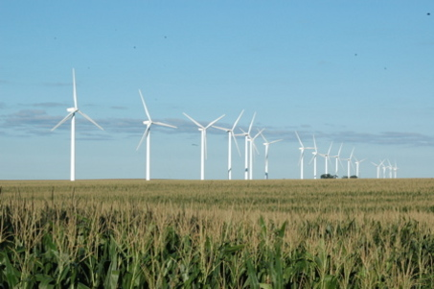
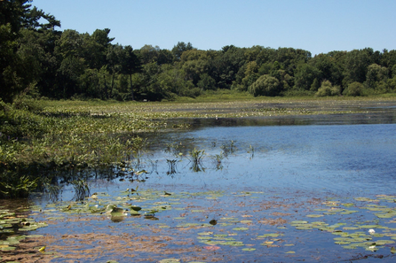
Implications
“Wind energy is the renewable technology that really provides the highest return in terms of energy production and cost-effectiveness”
(Dau, 2013).
“Senate Bill 78 is an irresponsible piece of legislation that jeopardizes the health, productivity, and sustainability of Michigan state lands”
(Cardinale and Foufopoulos, 2013).

Slide 26
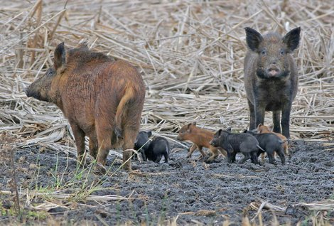
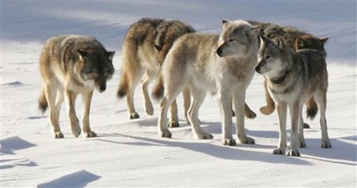
Implications
“The Division concluded that on the basis of the best available science, feral swine are an invasive species in Michigan” (MDNR, 2010).
“State and federal law already covers targeting of individual wolves. .. It’s just about killing for fun. It’s about getting the trophy. It’s completely unjustified recreational killing.”” (Martin, 2012).

Slide 27
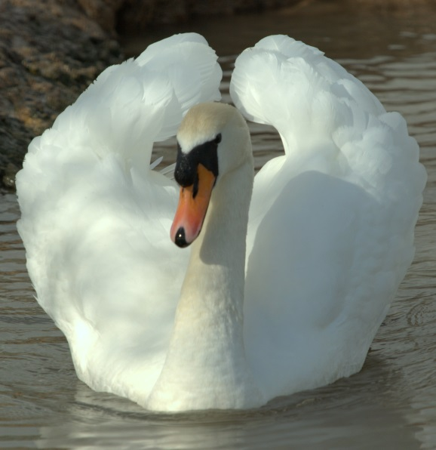
Conclusion
“Ethical discourse is not about defeating anything; it is about discovery”
(Vucetich and Nelson, 2012)
Determine and prioritize research needs
Makes values explicit
Argue more effectively
Determine the most reasonable and appropriate approaches to address a conservation issue.

Slide 28
