Slide 1

Strategies for success
James Johnston | james.johnston@oregonstate.edu
May 7, 2013

Slide 2
Strategies for success
Examples (2) of discourse
Diagnosing pitfalls of discourse
— Interests vs. positions
— “Reification”
Strategies for success
— Winning
— Collaboration

Slide 3




II. Discourse Examples

Slide 4
III. Diagnostic tools
Fisher and Ury (1981):
Interests: Focus on underlying interests, not positions
Options: Invent options for mutual gain
Criteria: Use objective criteria in evaluation
BATNA: Understand your Best Alternative to a Negotiated Agreement
People: Negotiate as if relationships matter
A position is what you say you want. It is a preformed idea of what your ideal outcome is.
Interests are the needs, hopes, fears, concerns, and desires that underlie positions.

Slide 5


Reification
(Concretization of abstract things.)

Slide 6
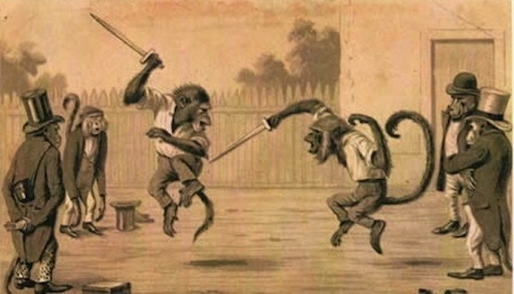
Strategies
I. Winning

Slide 7


“Only twelve headwall leave areas have been set aside in the Mapleton District. Of these, only five have been successful in preventing landslides. The only other evidence of leave area effectiveness consists of the Delphi survey results and the unsupported predictions of the Forest Service personnel. The Forest Service does not discuss the uncertainty of leave-area effectiveness. It does not question the effectiveness of leave areas in calculating impact on fish habitat; it merely assumes it to be approximately 100 percent.”
National Wildlife Federation v. U.S. Forest Service 592 F. Supp. 931,934 (D.Or 1984).

Slide 8

“…the Forest Service’s basic scientific methodology, to be reliable, required that the hypothesis and prediction of the model be verified with observation. The predictions of the model… were not verified with on the ground analysis.”
Lands Council v. Powell (Lands Council I ), 379 F.3d 738 (9th Cir.2004), amended by 395 F.3d 1019 (2005)
“…the Forest Service was required to conduct on-the-ground analysis to verify its soil quality analysis and to establish the reliability of it’s hypothesis that treating old-growth forest is beneficial to dependent species.”
Ecology Center v. Austin, 430 F.3d 1057, 1062 (9th Cir.2005)

Slide 9
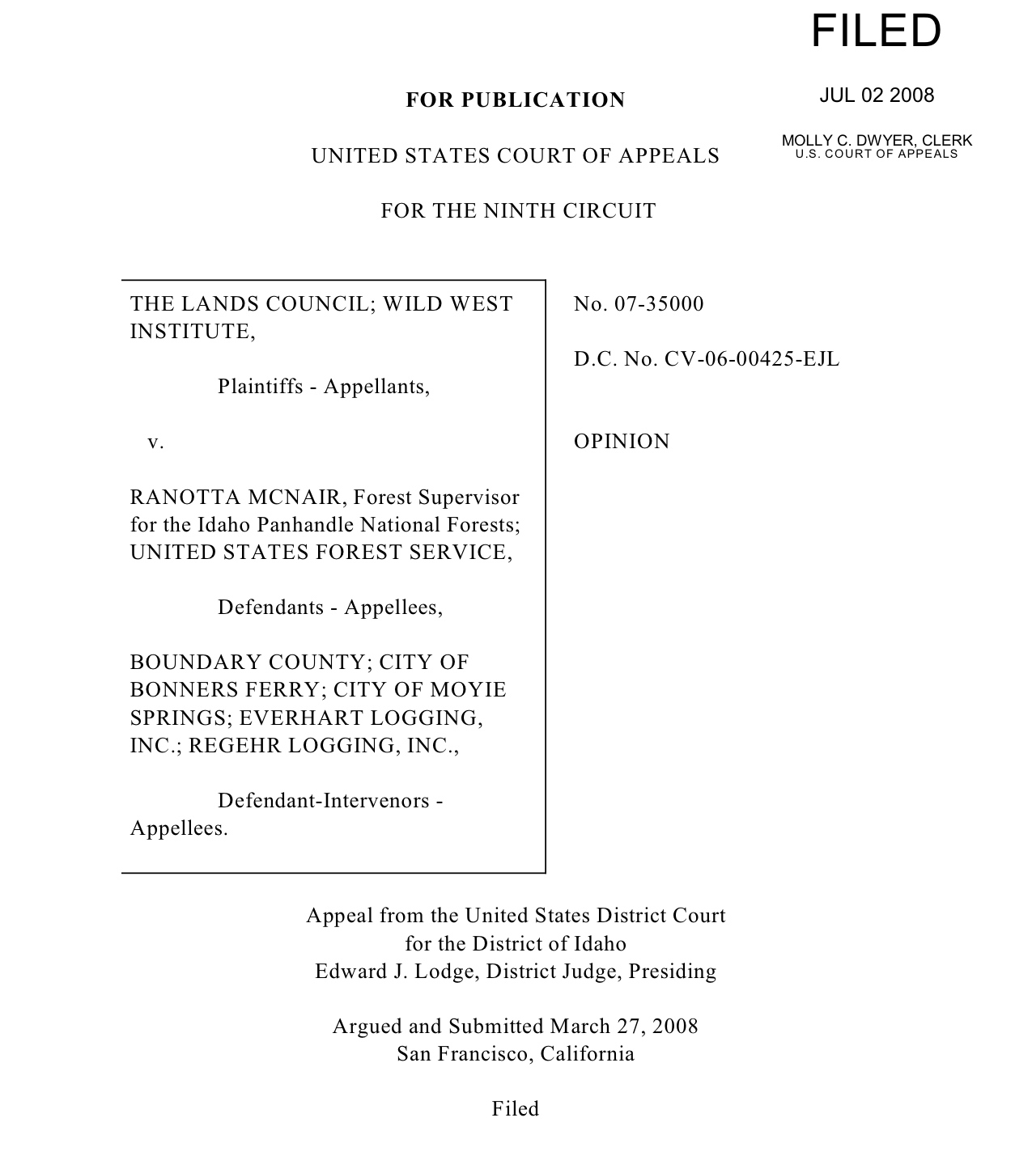


Slide 10
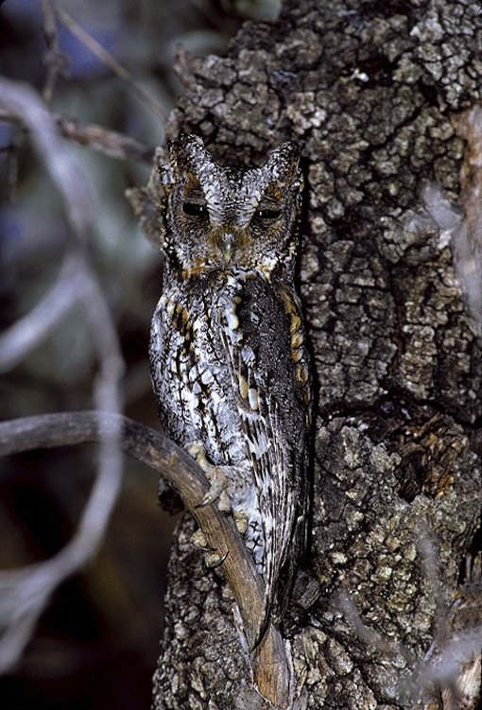

Lands Council v. McNair (Lands Council II), 494 F.3d 771 (9th Cir. 2007)

Slide 11
“Review under the arbitrary and capricious standard is narrow, and [we do] not substitute [our] judgment for that of the agency. Rather, we will reverse a decision as arbitrary and capricious only if the agency relied on factors Congress did not intend it to consider, entirely failed to consider an important aspect of the problem, or offered an explanation that runs counter to the evidence before the agency or is so implausible that it could not be ascribed to a difference in view or the product of agency expertise.
…
In recent years, our environmental jurisprudence has, at times, shifted away from the appropriate standard of review and could be read to suggest that this court should act as a panel of scientists that instructs the Forest Service how to perform its expert duties.”
Lands Council v. McNair, 537 F.3d 981, 987-988 (9th Cir. 2008) (en banc)

Slide 12

Strategies
II. Collaboration
Notes:
Brahma (Creator/Legislator), Vishnu (Preserver/Maintainer/Executive), Shiva (Destroyer/Judiciary)
Plato (The Republic)
Charles-Louis de Secondat, baron de La Bréde et de Montesquieu
James Madison

Slide 13
— Proximity
— Get into the field
— “Extend the sphere”
“The greater number of citizens and extent of territory which may be brought within the compass of republican than of democratic government; and it is this circumstance principally which renders factious combinations less to be dreaded in the former than in the latter. The smaller the society, the fewer probably will be the distinct parties and interests composing it; the fewer the distinct parties and interests, the more frequently will a majority be found of the same party; and the smaller the number of individuals composing a majority, and the smaller the compass within which they are placed, the more easily will they concert and execute their plans of oppression. Extend the sphere, and you take in a greater variety of parties and interests; you make it less probable that a majority of the whole will have a common motive to invade the rights of other citizens; or if such a common motive exists, it will be more difficult for all who feel it to discover their own strength, and to act in unison with each other.”
James Madison, Federalist #10, November 1787

