Slide 1
Landscape Assessment Tools and Processes For Forest and Project Planning -- Where do Forest Management Projects Come From?

Slide 2
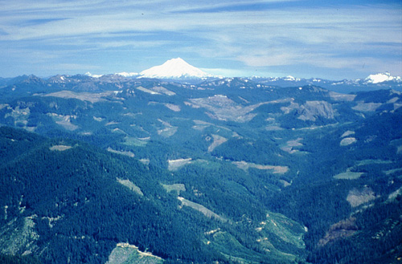
Is this a good landscape or a bad landscape?

Slide 3
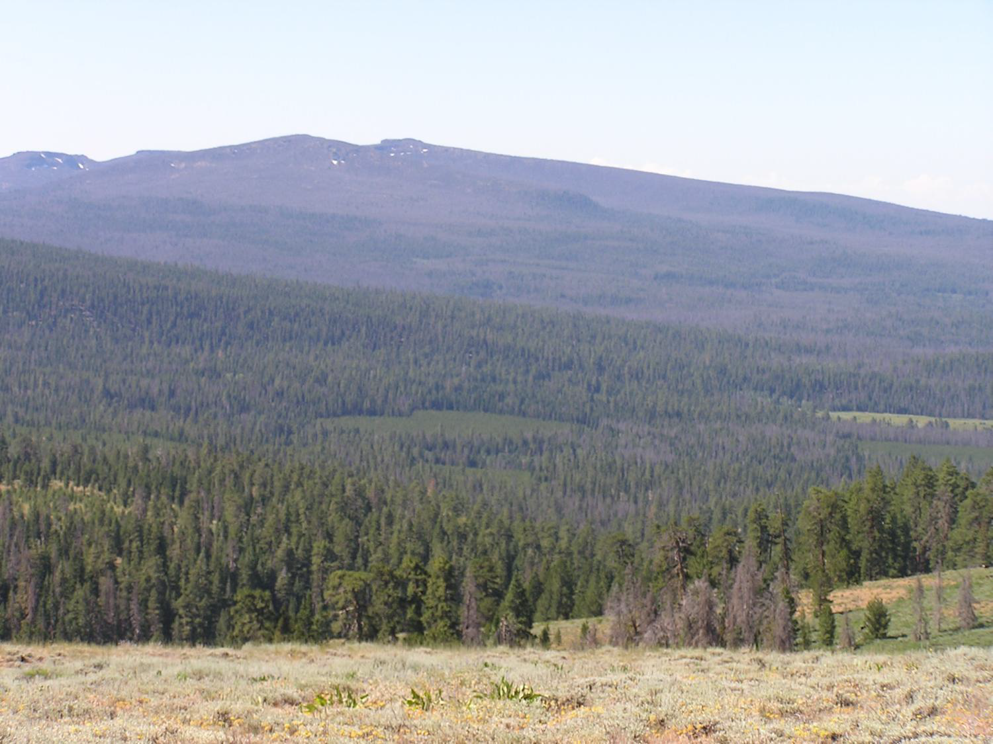

Slide 4
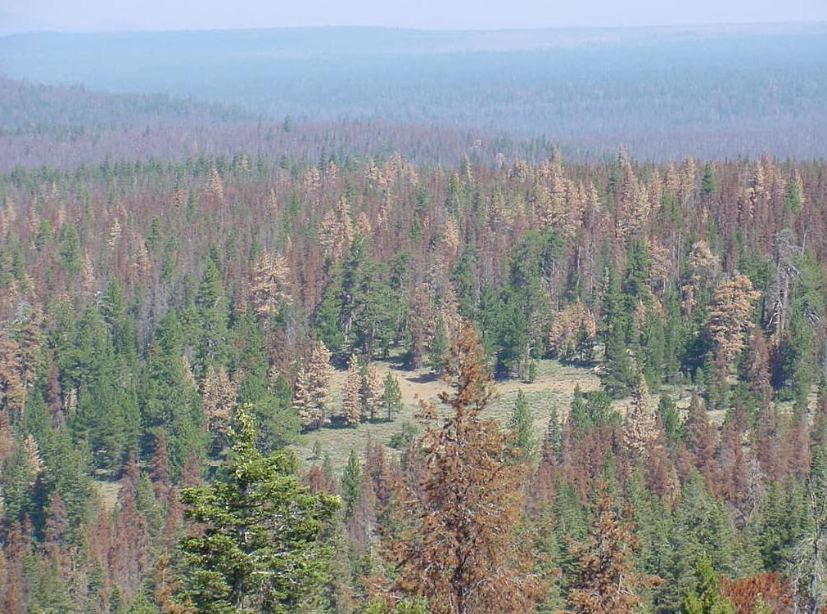

Slide 5
“It Depends…” Purpose of Today

