Slide 1
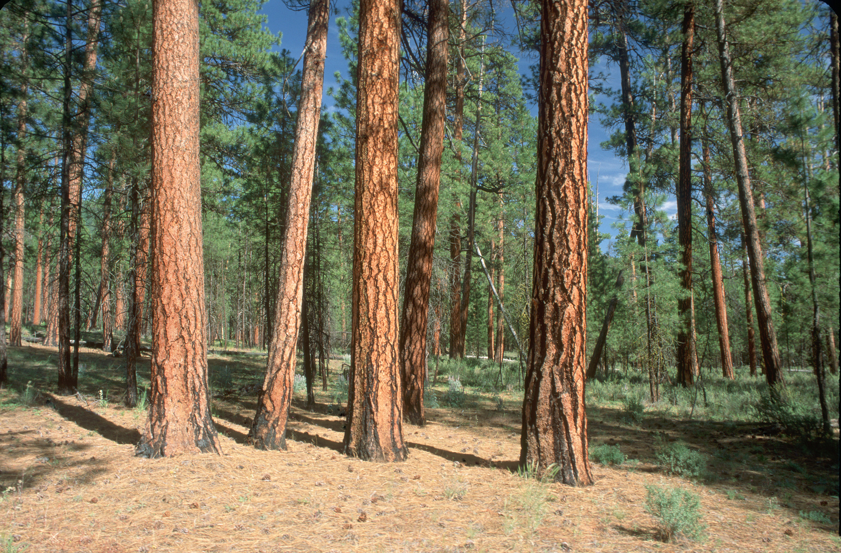

Slide 2
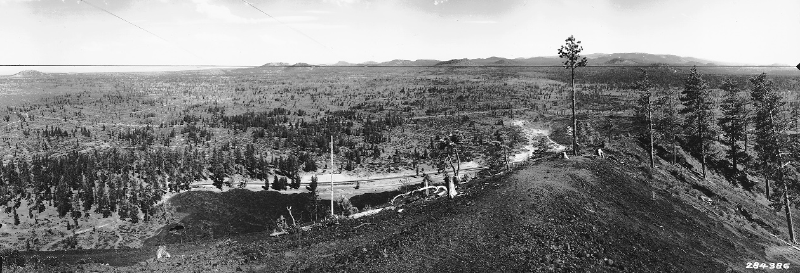

View East from Lava Butte Lookout
1933
1990

Slide 3
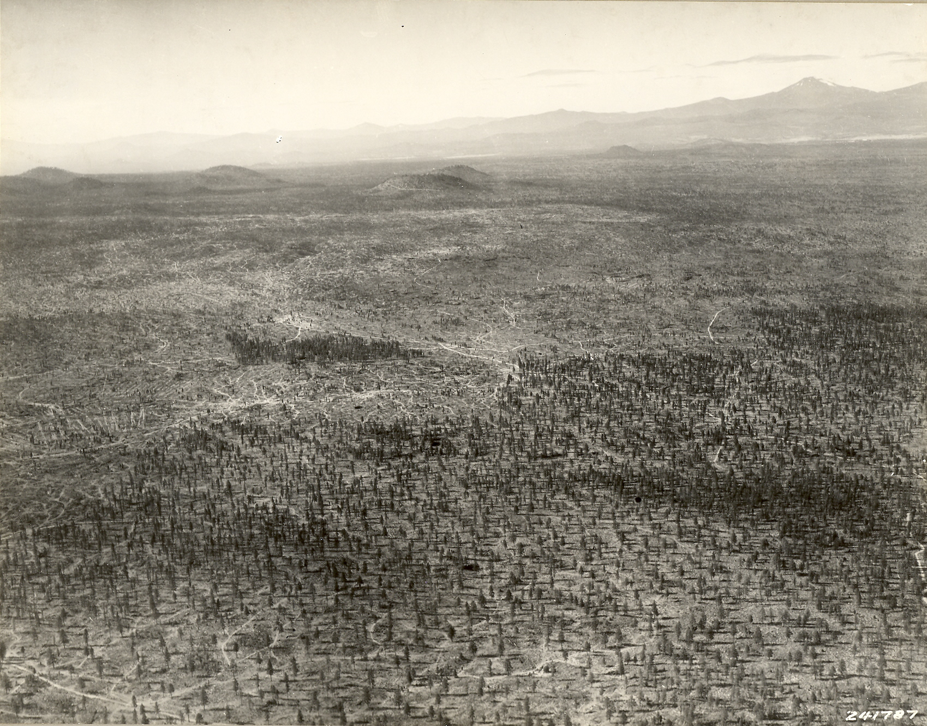
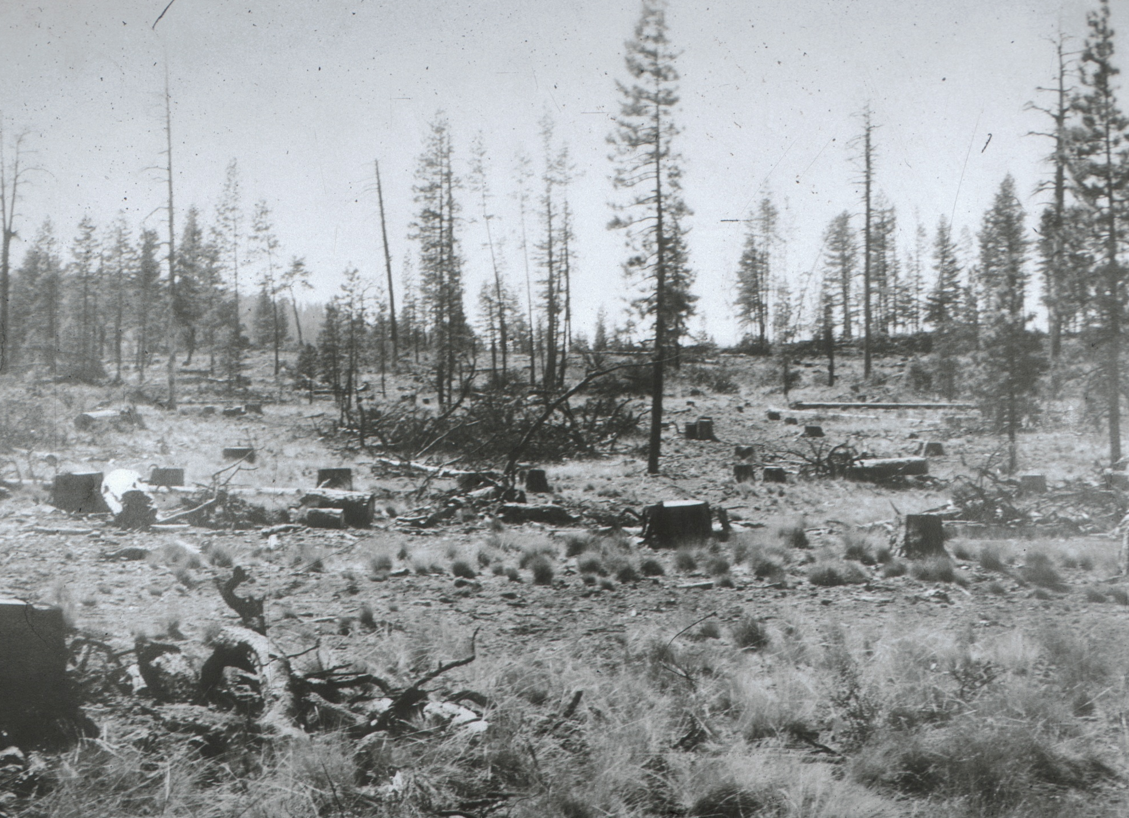
View West from Horse Ridge Area
Mt Bachelor
Lava Butte
Arnold Ice Cave

Slide 4
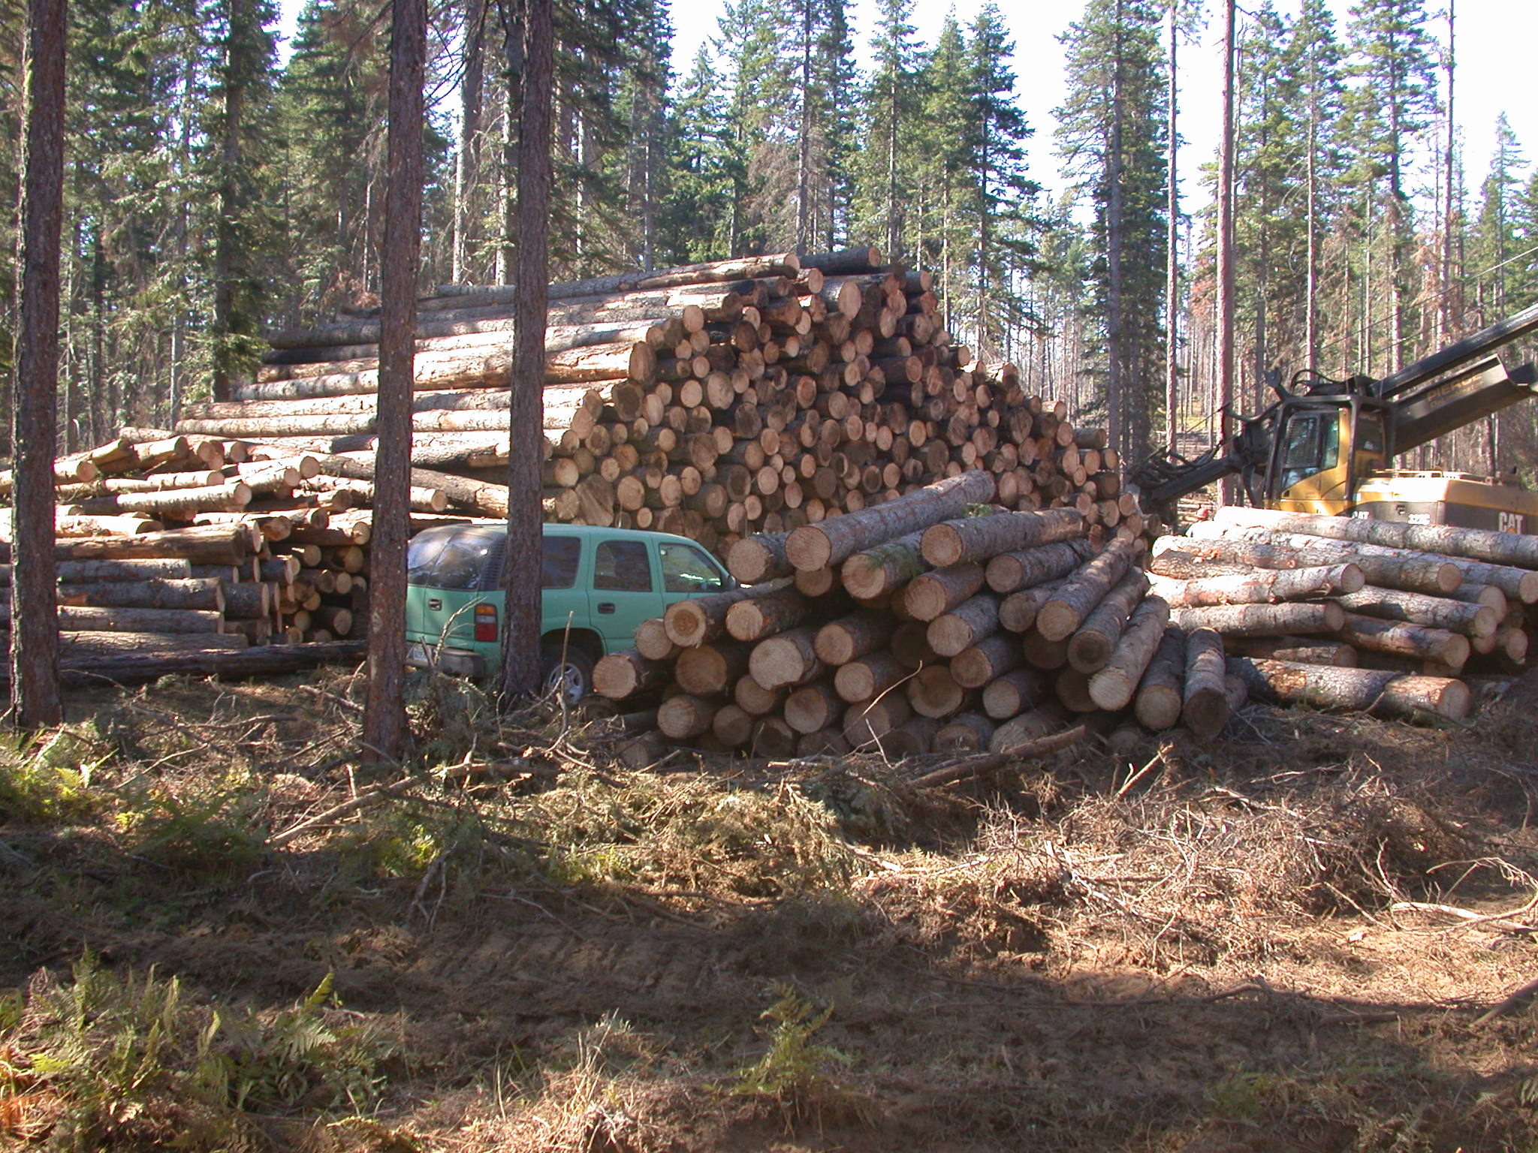

Slide 5
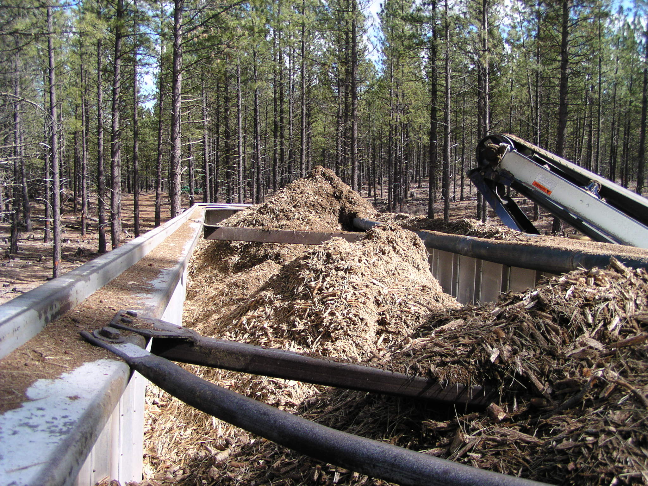
Notes:
The chip market fluctuates and has been a big part of our program at times.

Slide 6
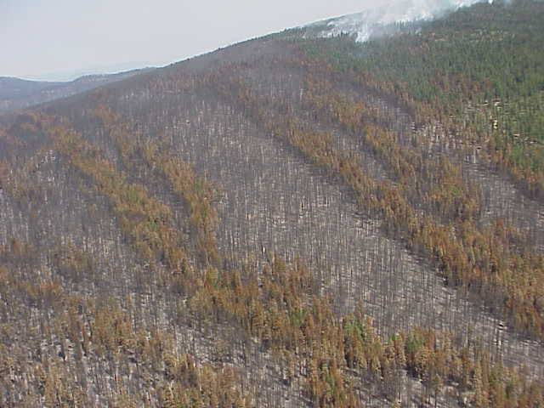

Slide 7
