Slide 1
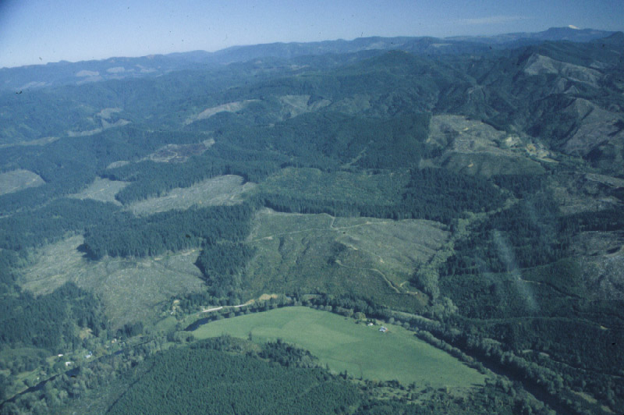
Application Landscape Ecology in Forest Management: A Glass Half Empty?
Thomas Spies
USDA Forest Service
Pacific Northwest Research Station

Slide 2
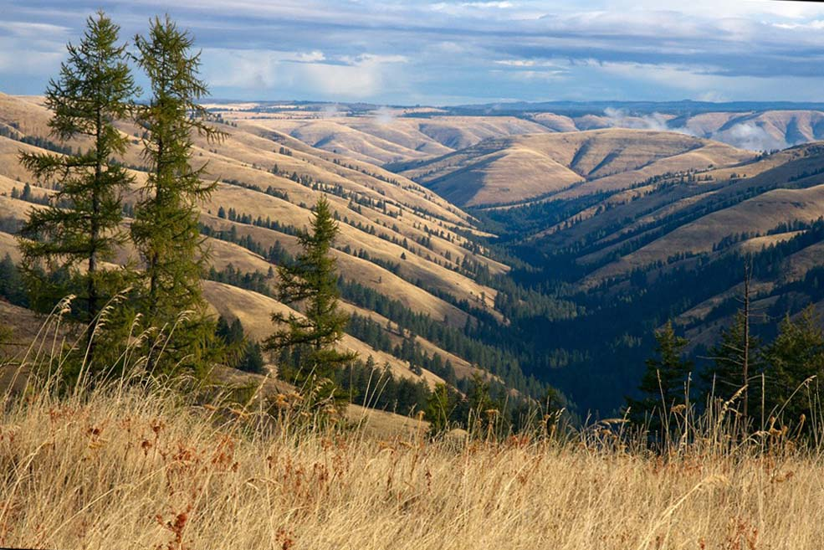
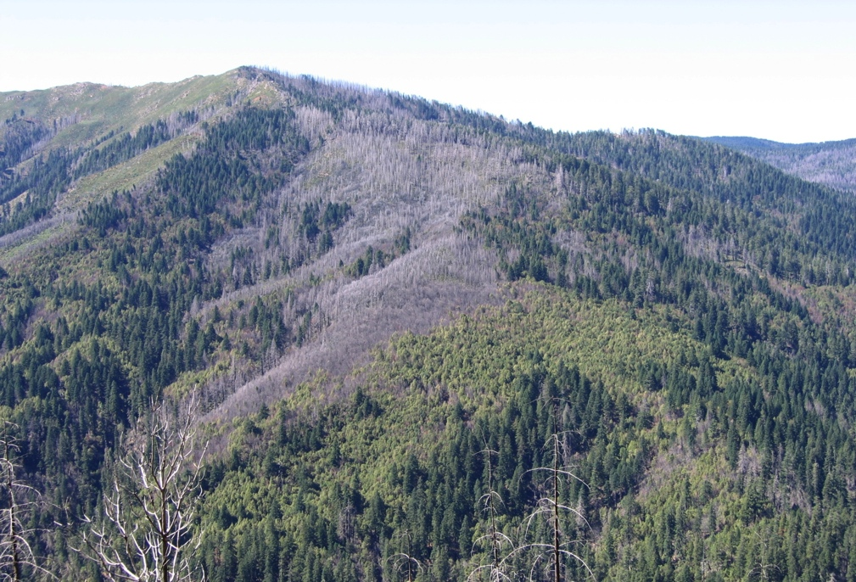
Landscapes
What are they?
Why important?
Management Applications
Challenges
Opportunities

Slide 3
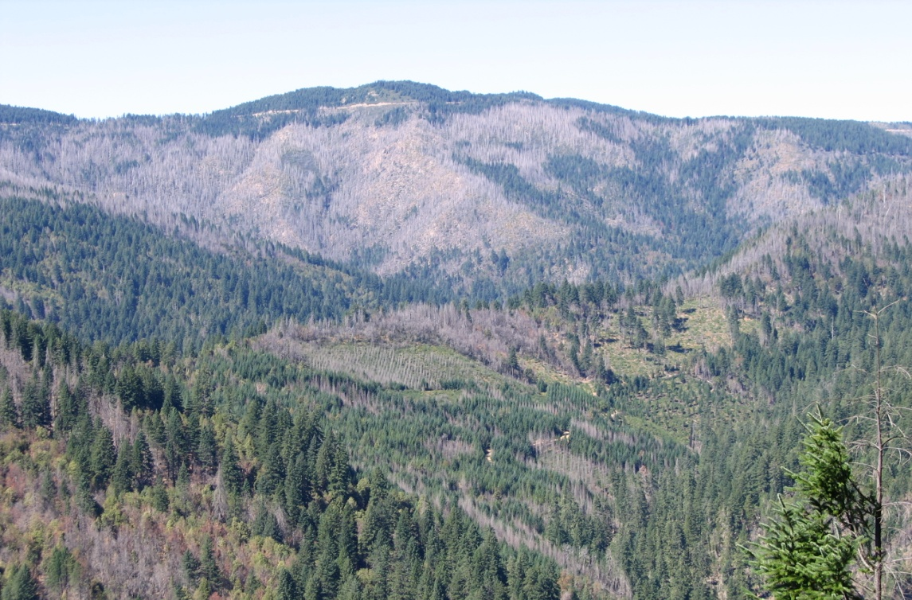
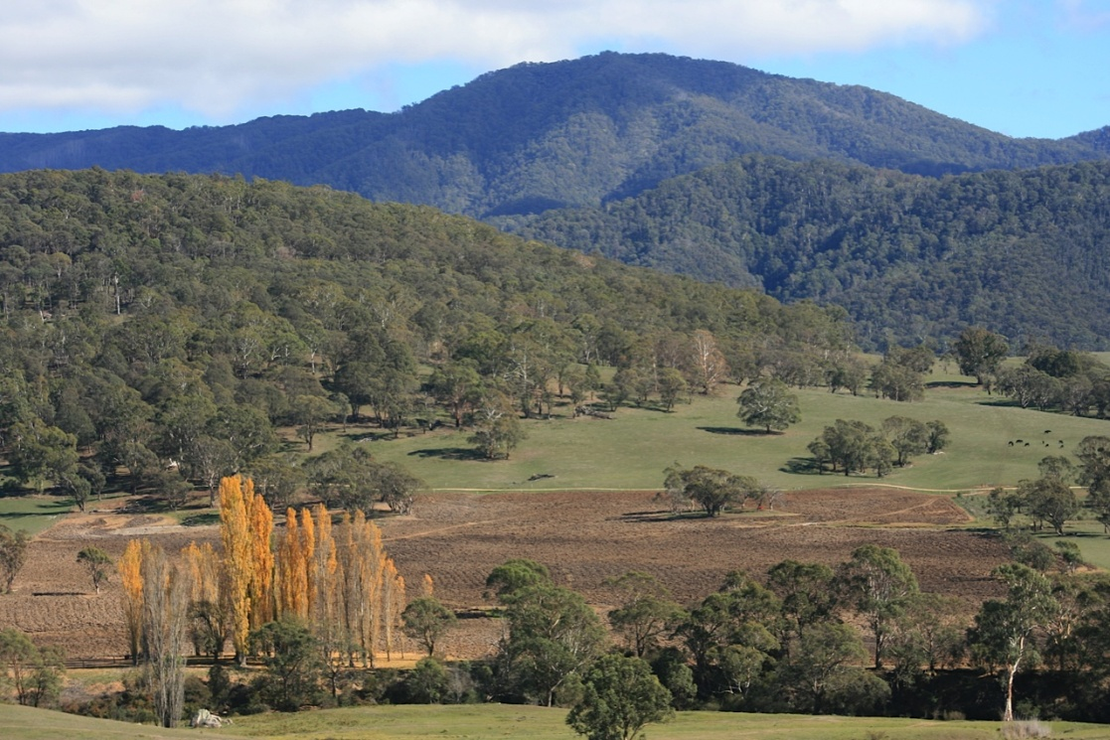
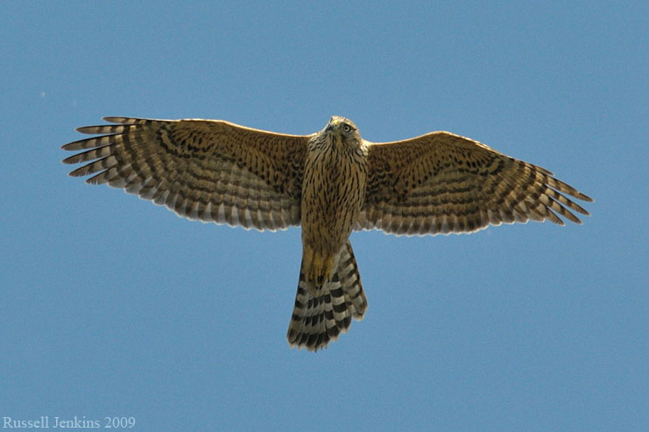
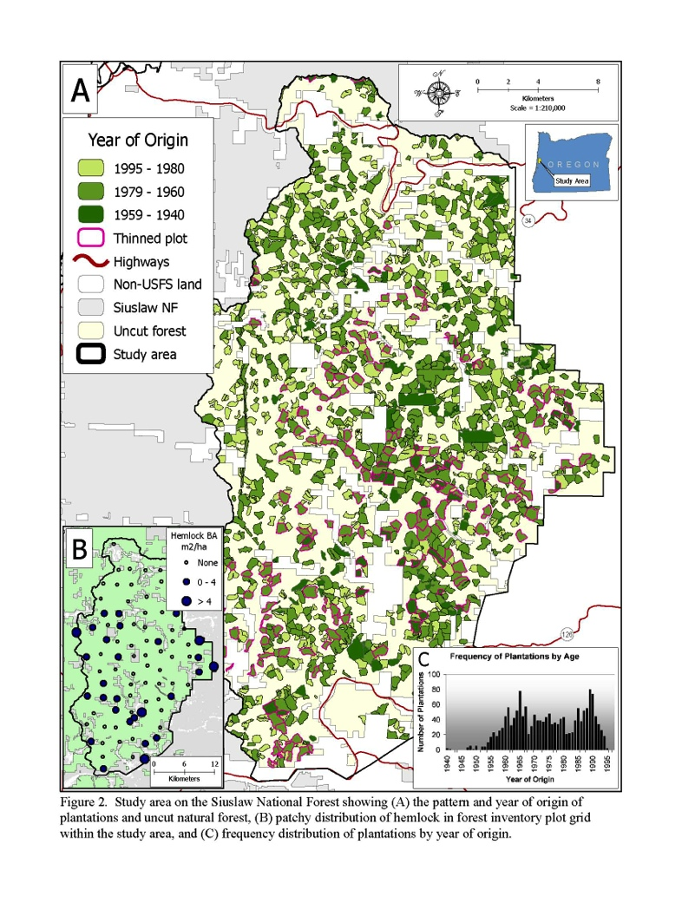
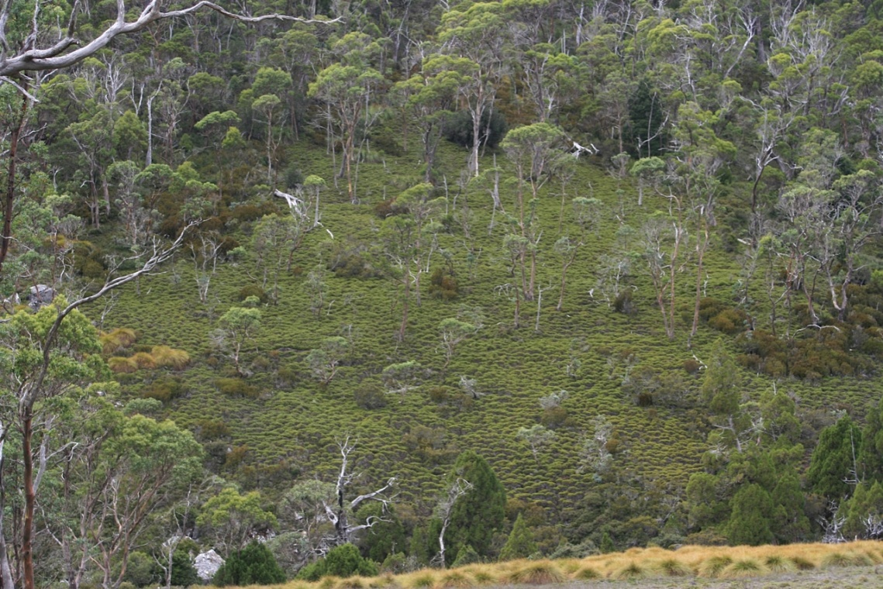
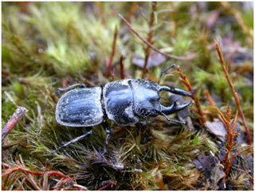
What are landscapes?
Spatially Heterogeneous ecosystems
10² ~ 10⁵ ha; part of spatial hierarchy
Human influences
Species and process dependent
Forest Plantations on Siuslaw
National Forest
Notes:
Wedge tail eagle and stage beetle

Slide 4
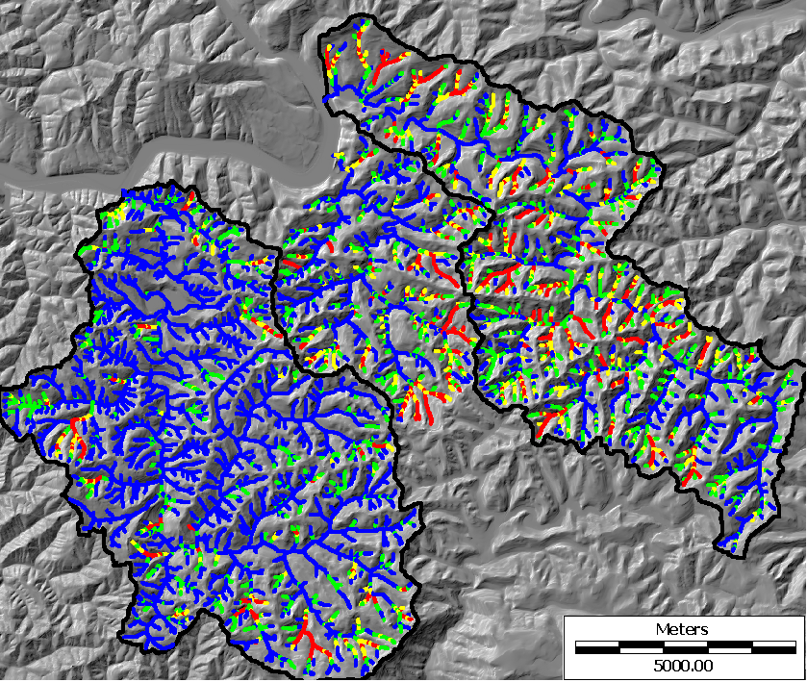
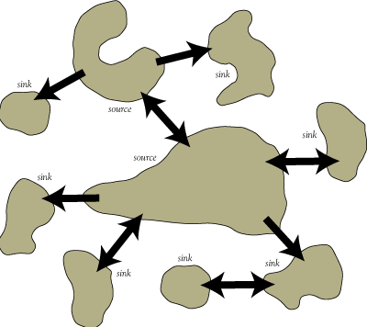
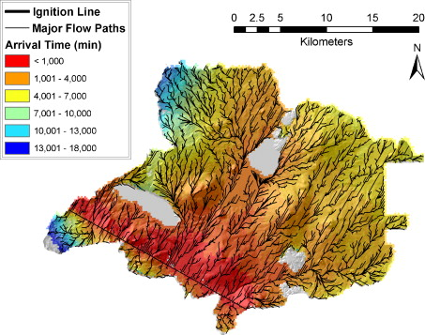

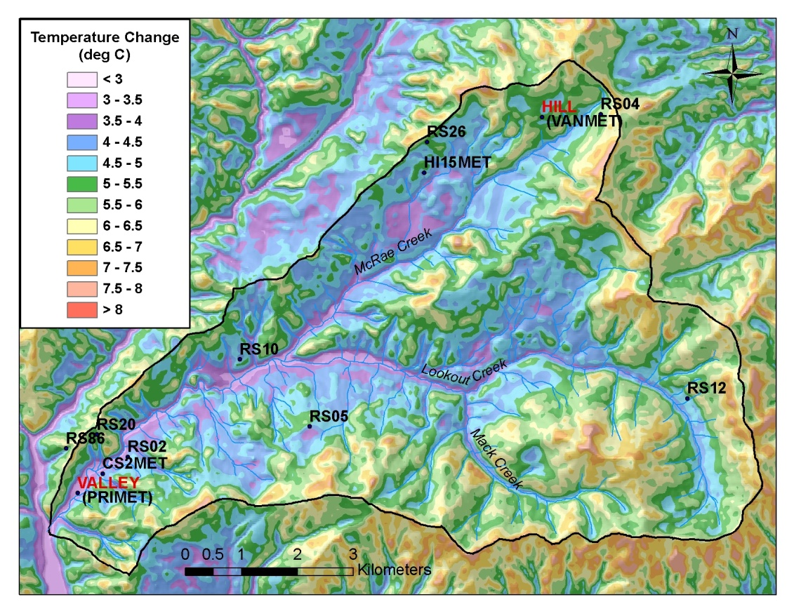

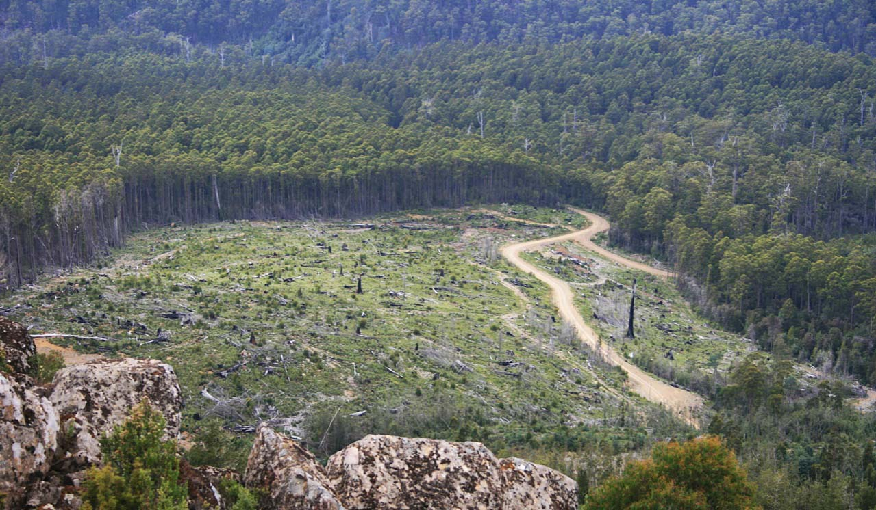
Why Landscapes?
Flows of species and processes across landscapes
Stand/patch level constrained by landscape level
High variability in forests
Forests provide multiple and sometimes conflicting ecosystem services
Cold air drainage in mountains affects
expected changes in temperature under
climate change
Flow Paths of Fire
Debris Flow Delivery Probability
Knowles Creek
Sweet Creek
Sink
Source
Sink
Sink
Source
Sink
Sink
Sink
Sink
< 5% 10% 15% >15%

Slide 5
We’ve Excelled at Landscape Planning
Deschutes Forest Plan Allocations
NWFP Allocations

Slide 6
But, that was the Easy Part Challenges for Further Application Landscape Ecology in Forest Management
Dynamics (e.g Disturbance and Climate)
Reference condition/Goals
Multi-owner Landscapes
Uncertainty and flexibility

Slide 7
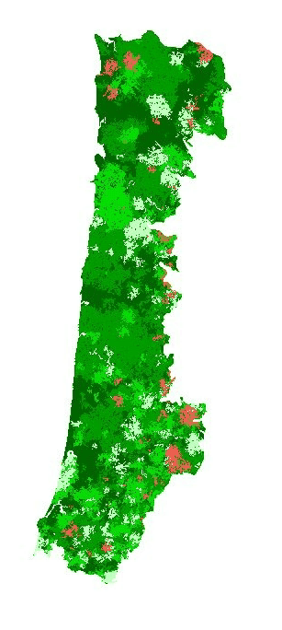
Dynamics
Three Centuries
Of Simulated
Pre-Columbian
Fire History in
Oregon Coast
Range
Stand Age
< 10
11 - 40
41 - 80
81 - 200
> 200
By Nonaka
Wimberly and Spies

Slide 8
Historical Range of Variability Oregon Coast Range % of Landscape
Early Seral: 10-25%
Old Growth: 35-60%
Probability
% of Landscape

Slide 9
Can We Go Back?
Forests 200-450 years old in the Coast Range
Historical Range of Variation
150 y
400 y
Wildfire Scenario
Patch Proximity and Shape Complexity
250 y
100 yr
100 yr
Current Policy Scenario
NOW
Area and Aggregation
Based on Nonaka and Spies 2005

Slide 10
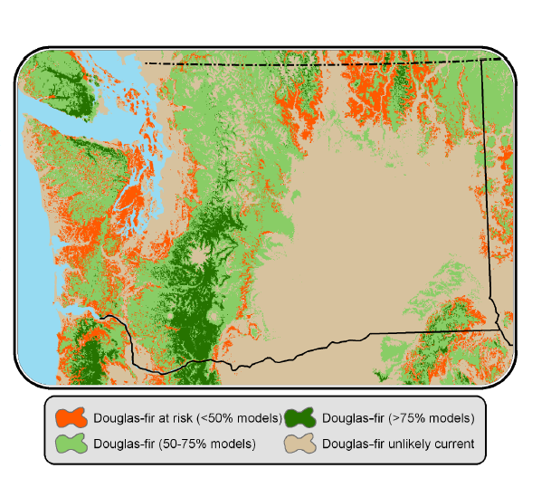
Climate Change
Range of Alaska Yellow Cedar
Douglas-fir at risk under future climate
.
Littell et al. 2009

Slide 11
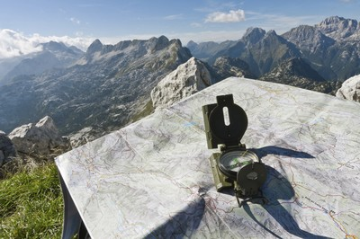
HRV
Reference Conditions/Goals
Waypoint rather than Endpoint
Reference point for navigation to destination
Other Waypoints
Future Range of Variability
Social Acceptability

Slide 12
Future Range of Variation (FRV)
Estimated range of ecological conditions in future given climate change, land-use change and social acceptability

Slide 13
Resilience Instead of Restoration Evolving Scientific Perspectives
Metric
Engineering
Resilience
Ecological
Resilience
Socio-Ecological
Resilience
Time
Metric 2
Metric 1
Metric 2
Based on Folke 2006
Metric 1

Slide 14
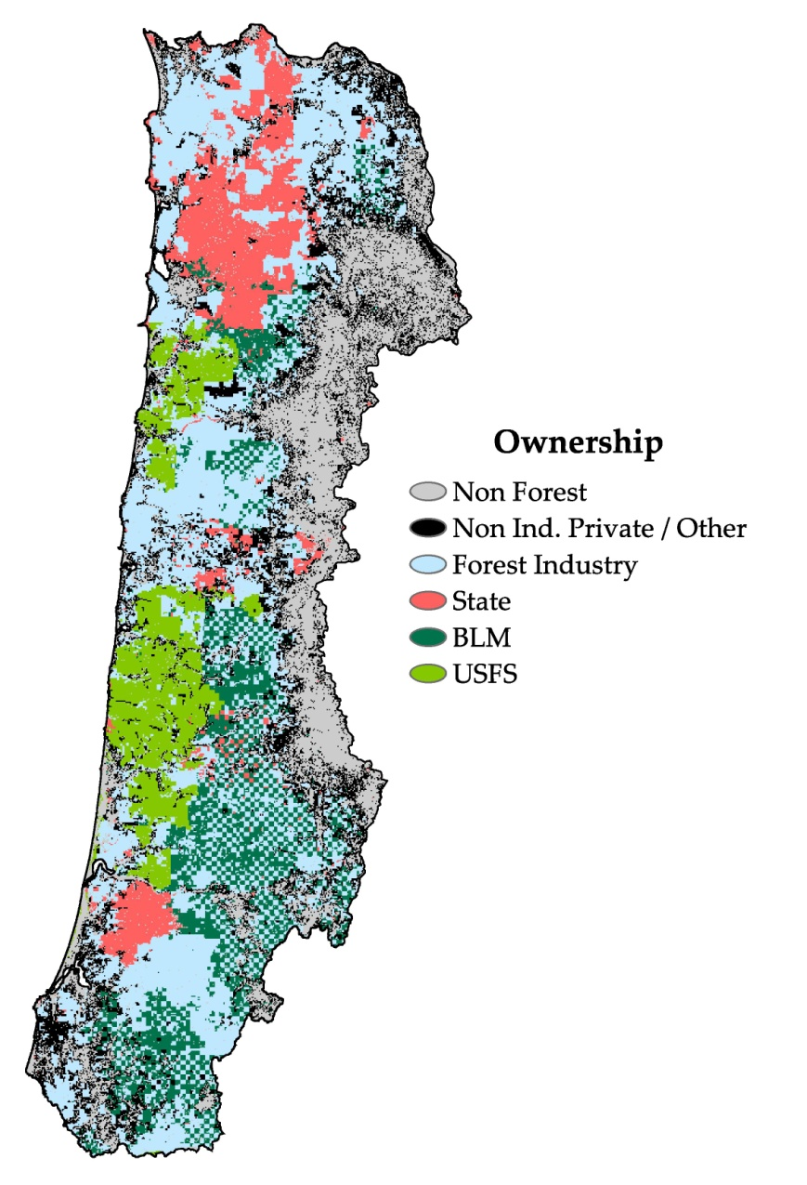
Multi-ownership Landscapes
Owner
Policy
Goals
Strategy
USFS and BLM
NW Forest Plan Forest Plans
LS/OG T&E species Aquatic Commodities
Reserves Matrix Gr-Tree retention AMA
State of Oregon
Healthy forests
Indigenous
species
Abundant timber
T&E species
Structure-based management
Hab. Cons. Plan
New
Forest
plans
Private. Industrial and Non-Industrial
Forest
Practices
Act
Priority to growth
and harvest of
trees
Protect
environment
and fish/wildlife
Retain trees in clearcuts,
Streamside protection rules
Coastal Oregon

Slide 15
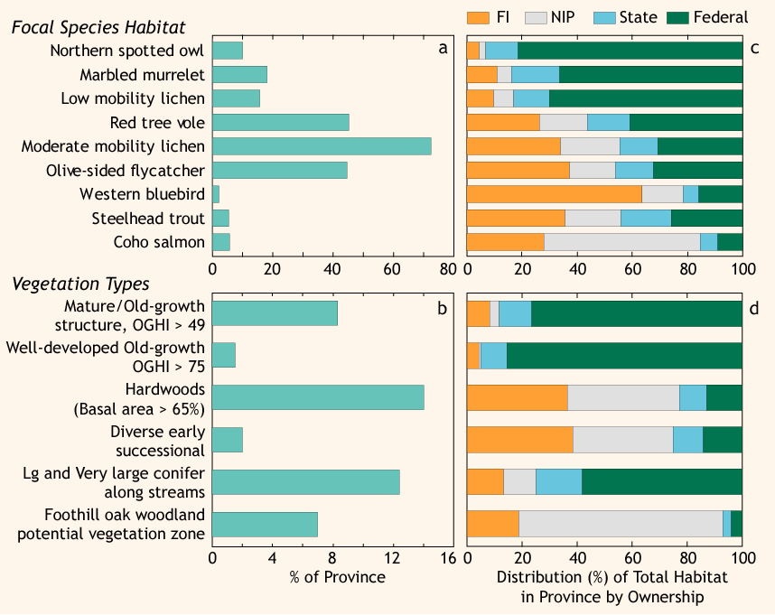
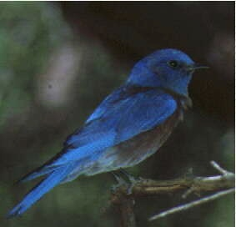
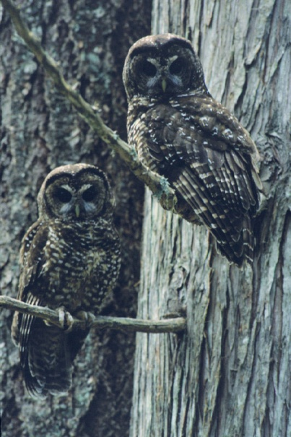
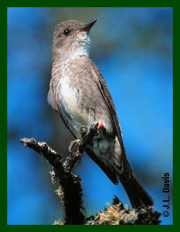
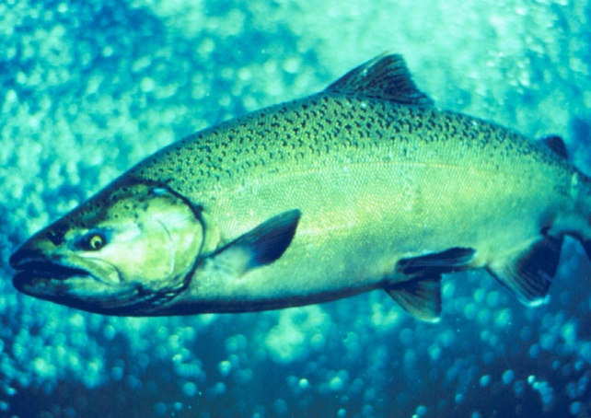
Multi-ownership Landscapes

Slide 16
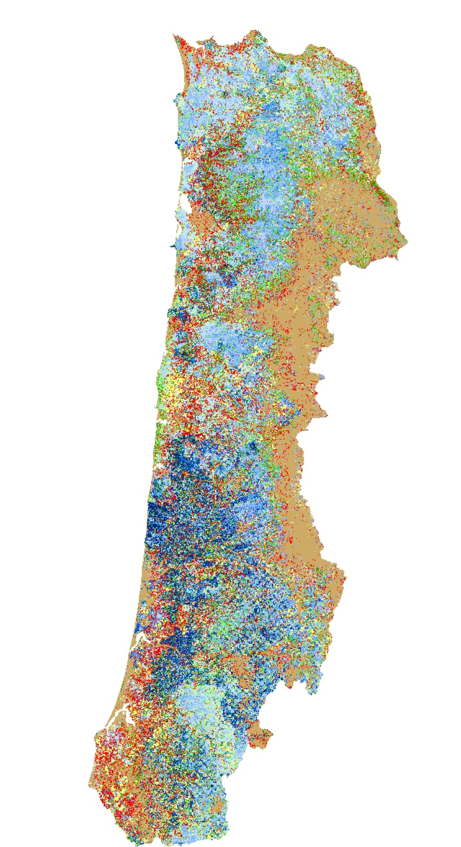

Vegetation Classes
1996 – Initial Period
Base Policy
GNN
Not Simulated
Open Forest
Broadleaf
Mixed Small
Mixed Medium
Mixed Large
Mixed Very Large
Conifer Small
Conifer Medium
Conifer Large
Conifer Very Large
Mixed Very Small
Conifer Very Small
Remnants

Slide 17
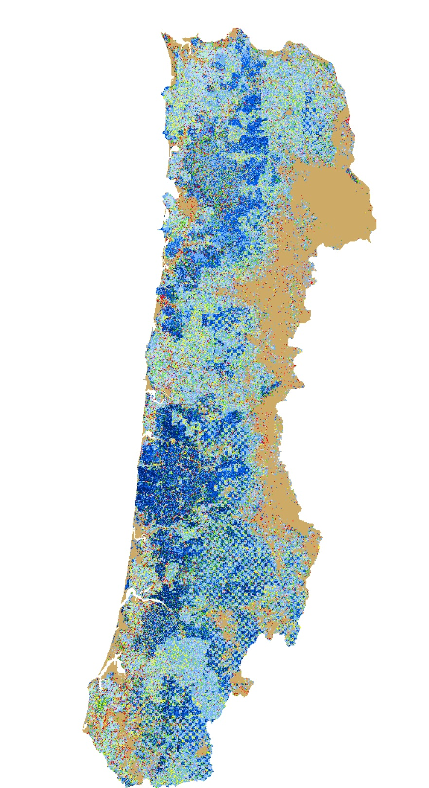
Vegetation Classes
2046 Base Policy
Simulated
Not Simulated
Open Forest
Broadleaf
Mixed Small
Mixed Medium
Mixed Large
Mixed Very Large
Conifer Small
Conifer Medium
Conifer Large
Conifer Very Large
Mixed Very Small
Conifer Very Small
Remnants

Slide 18
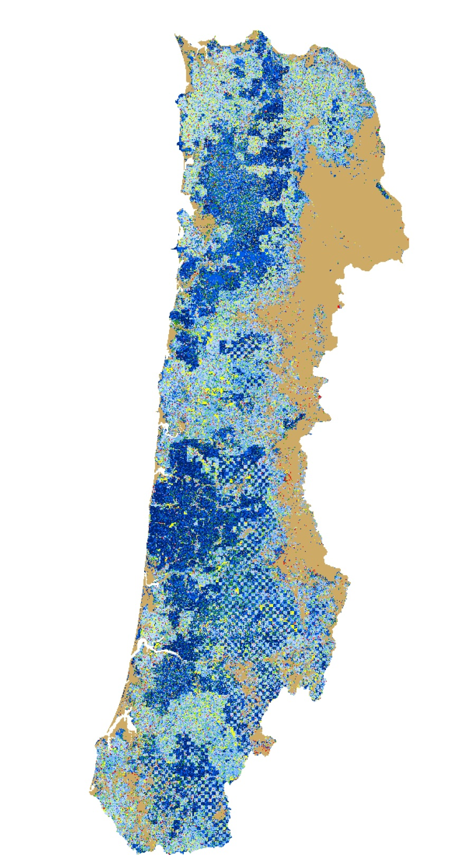
Vegetation Classes
2096
Base Policy
Simulated
Not Simulated
Open Forest
Broadleaf
Mixed Small
Mixed Medium
Mixed Large
Mixed Very Large
Conifer Small
Conifer Medium
Conifer Large
Conifer Very Large
Mixed Very Small
Conifer Very Small
Remnants

Slide 19
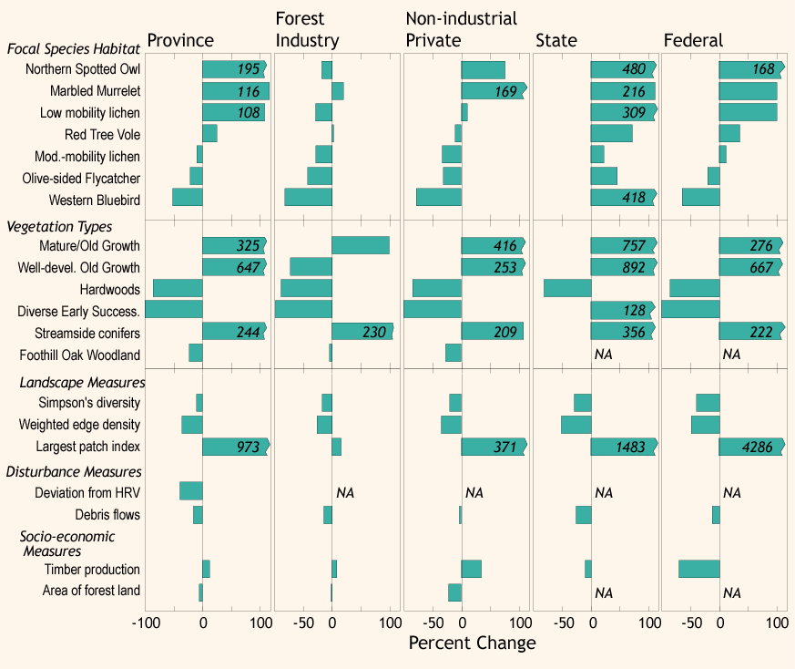
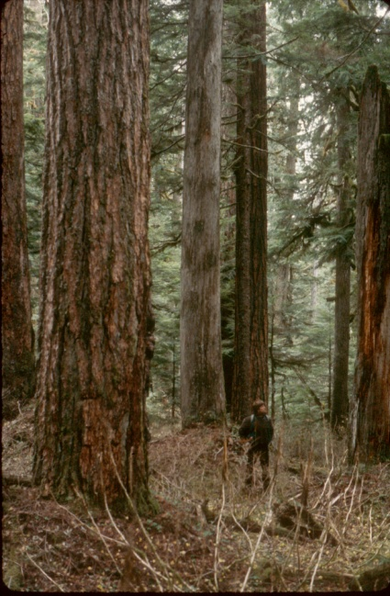
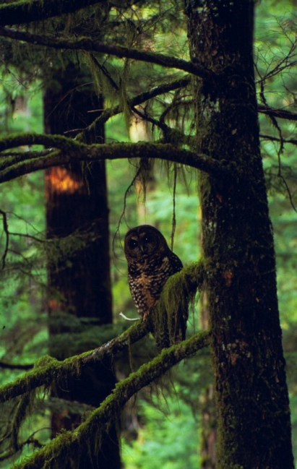
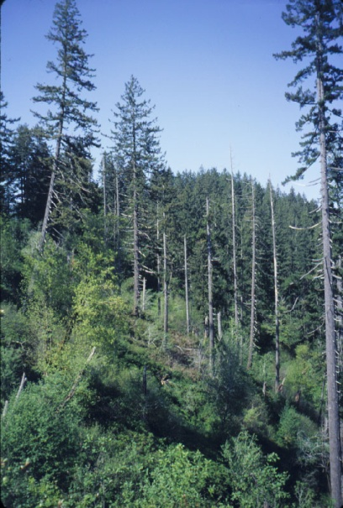
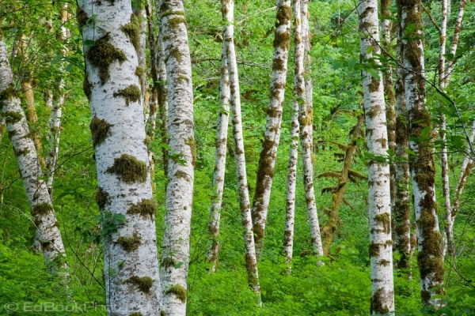
Potential changes in 100 years as % of initial conditions
++
+
Percent Change

Slide 20
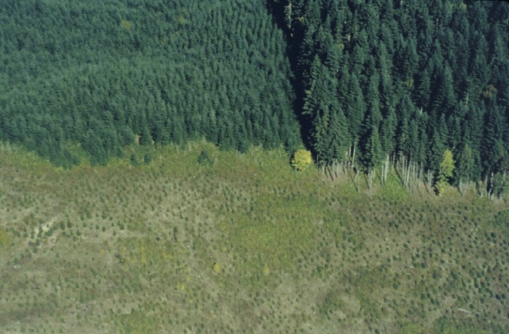
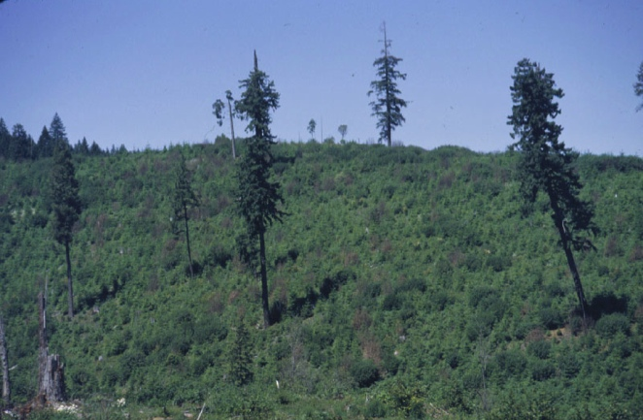
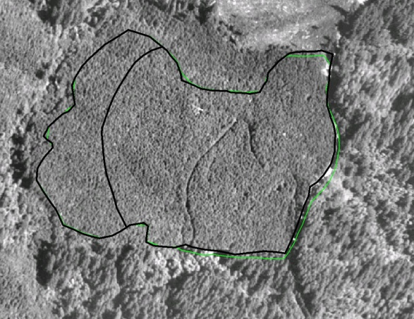
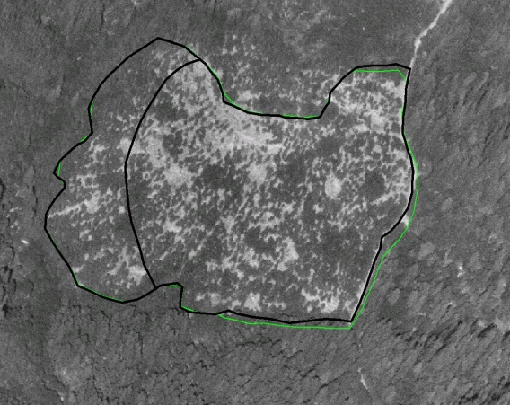
Policy Scenarios
1. Base policy What the managers are doing now
Increased Green Tree
Retention on Private Lands
No Restoration thinning on Federal Lands

Slide 21

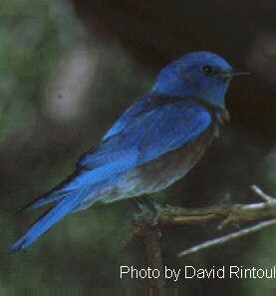
Potential Effects of Alternative Scenarios on Bird Habitat
Northern Spotted Owl
Western Blue Bird
Current policy
Green tree retention
No Fed thinning
Olive-sided Flycatcher

Slide 22
Applications of Landscape Ecology in Forest Management
What has worked?
Spatial pattern through allocation and zoning
Recognizing process for some species/components
What has not yet worked well?
Implementing dynamics-based approaches
Revising allocations based on new knowledge
Working across boundaries
Adaptive management

Slide 23

Changing Landscape Management Plans is Scary
Blue River Plan
NWFP
Social Reaction

Slide 24

Barriers to Implementation of Landscape Concepts
Social/Political
Economic
Institutional

Slide 25
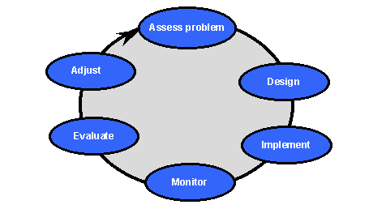
Uncertainty: Not an Excuse for Inaction
Embrace it
Landscape management as experiment
Learn and adapt in each successive cycle of management.
Scenario planning and dialog

Slide 26
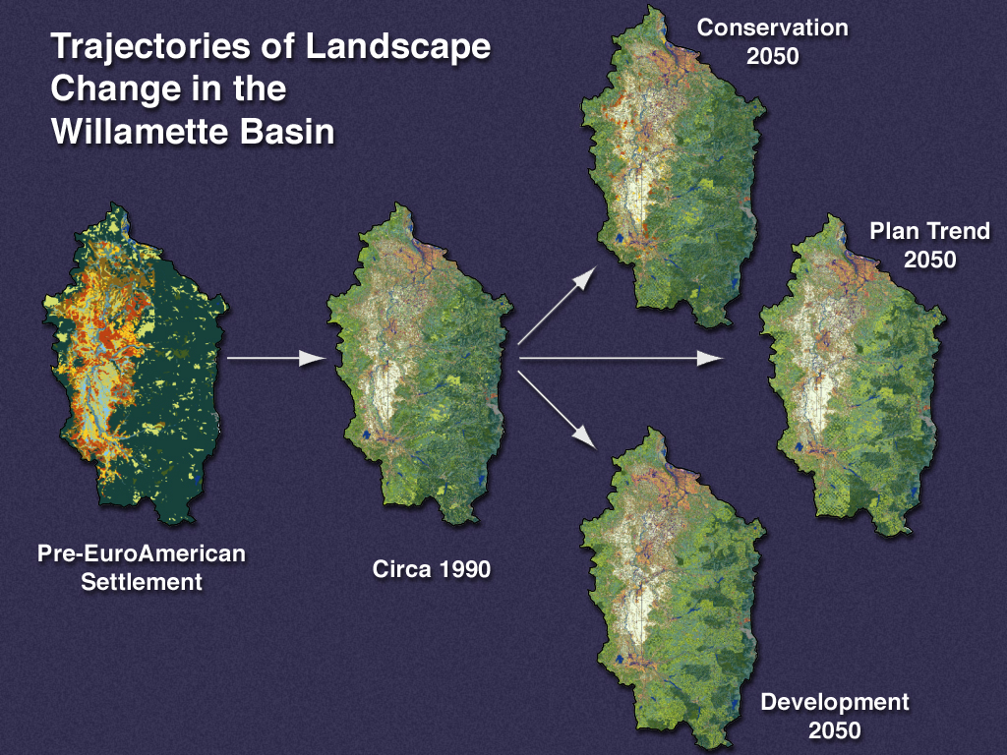
Scenario Planning

Slide 27
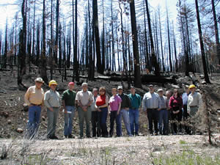
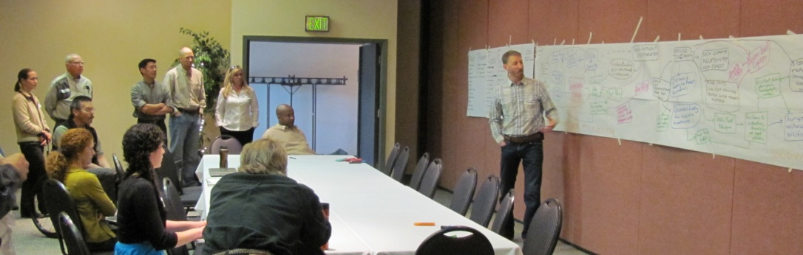
Opportunities
New technologies to visualize landscapes and scenarios
Collaboratives may increase range of social acceptability
Implement on small landscapes and less controversial projects

