Slide 1


Exploring Landscape Planning Alternatives South Fork McKenzie Watershed Willamette National Forest Allison Reger, Forest Analyst Jane Kertis, Forest Ecologist Lisa Helmig, Forest Silviculturist

Slide 2
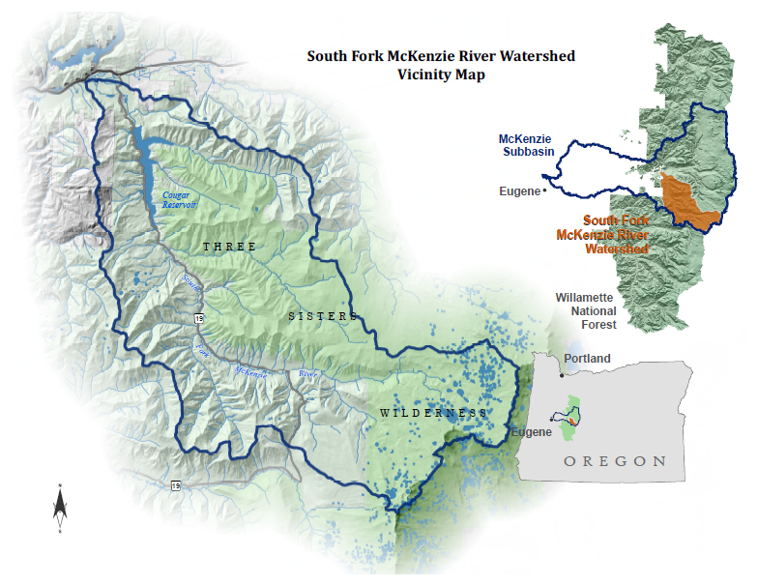

Slide 3
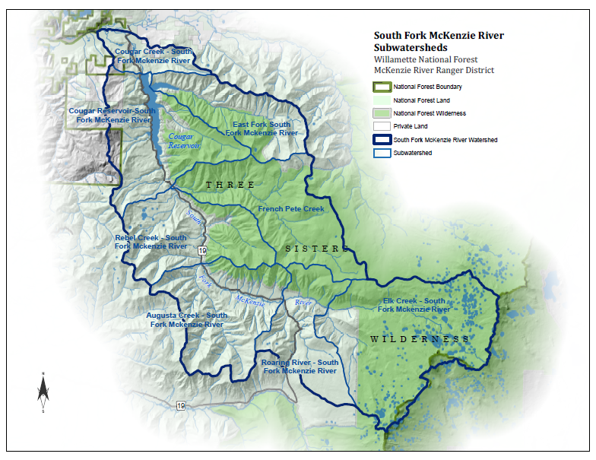

Slide 4
Project Goals
Develop a seral distribution in a 5th field watershed.
Demonstrate a process to evaluate and compare different alternatives
over time and space.
WHY?
Spatially communicate alternative scenarios.
Provide rationale for vegetation management prescriptions.

Slide 5
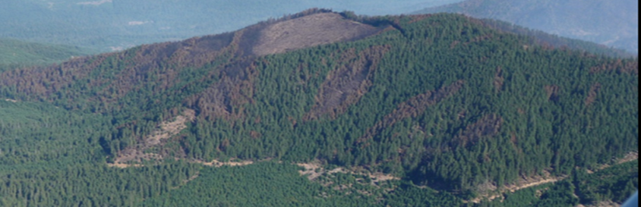
Project Questions
What is the seral distribution based on a historical reference condition - no fire suppression?
What is the current condition related to fire and seral stages?
What is the trend over time?
Can we maintain a range of seral conditions within the historical range in the watershed?

Slide 6
Analysis Models
Path
State and transition model
Formerly known as VDDT
ST-SIM
State Transition Simulation Model
Formerly known as TELSA
Spatial
Non-Spatial

Slide 7
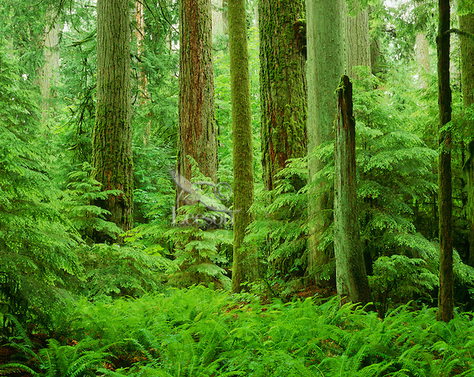
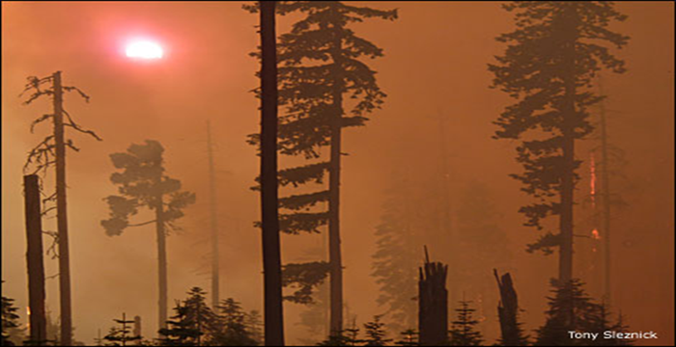
Path
Giant trees
Closed canopy
Multi-layered
A “State” is the compositional and structural characteristics of vegetation
A “transition” is the driver that directs the direction and speed a state proceeds. Common drivers are natural disturbance, management or succession.
Stand replacing wildfire

Slide 8

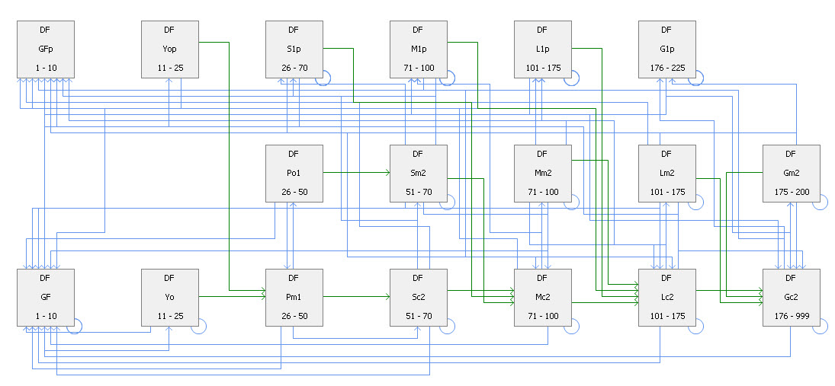

Slide 9

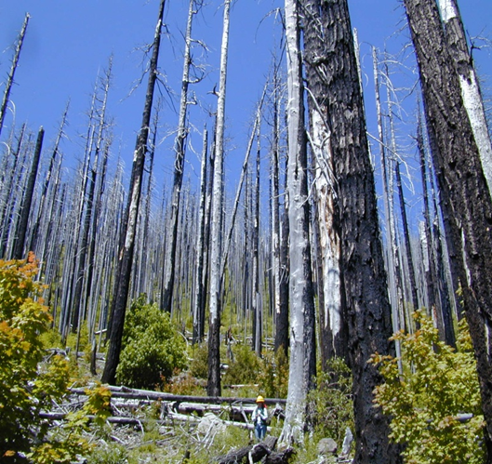

Slide 10


Slide 11
From Stratum | From Class | To Stratum | To Class | Transition Type | Prob | Propn | Age Min | Age Max | Age Shift | Age Reset
123_OWC_fwi_f4 | DF:Lm2 |  | DF:GFp | WFSR | 0.003 | 1 | 101 | 175 | 0 | Yes

Slide 12
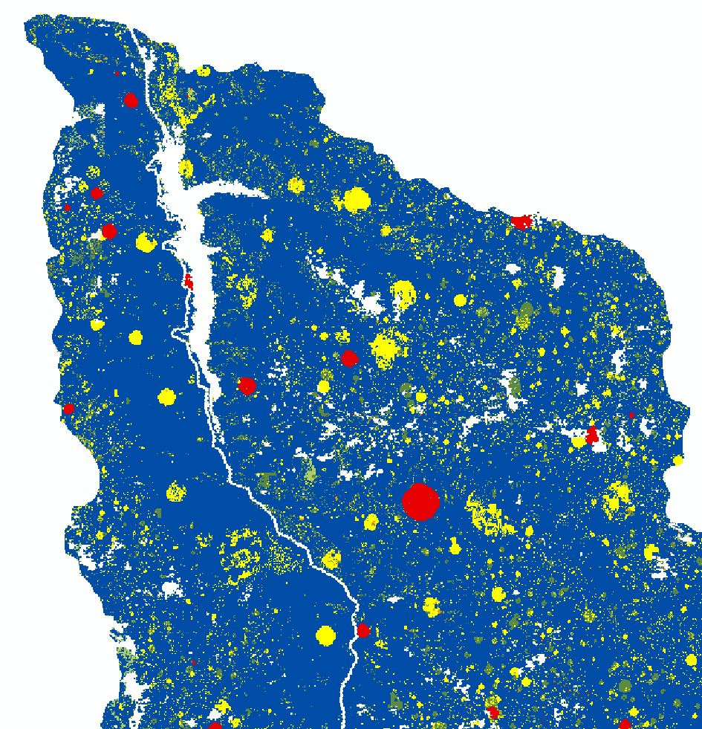

ST-STIM
Wildfire
A state and transition “simulation” model which allows you to project changes in vegetation through time. Because it is spatially explicit, the location of vegetation “states” within a landscape are incorporated into the model so the effect of vegetation changes over time can be examined.
Imprint of early seral
resulting from wildfire

Slide 13
Analysis Process
Step 1: Develop scenarios
Step 2: Develop desired future condition range
Step 3: Summarize current conditions
Step 4: Setting management scenario
Step 5: Compare results

Slide 14
^{#1} DEVELOP SCENARIOS
What is the current condition and trends over time
related to historical fire regimes, current fire regimes
and how would active management play a role in
developing a seral distribution within the historical
range of the watershed ?

Slide 15
^{#1} DEVELOP SCENARIOS… another way of considering the scenarios
What is the current condition and trends over time
related to historical fire regimes, current fire regimes
and how would active management play a role in
developing a seral distribution within the historical
range of the watershed ?
No Management
Management

Slide 16
^{#2} DEVELOP DESIRED FUTURE CONDTION
Characterized data using LANDFIRE Rapid Assessment Vegetation Models to determine potential vegetation type (PVT).
Developed a crosswalk for the PVT to the PATH models.
Develop a desired future condition “Range”

Slide 17
EARLY SERAL RANGE
LANDFIRE DESCRIPTION
Succession Stage | Canopy Cover
 | Closed | Open
Early Development | A
Mid-Development | B | C
Late-development | E | D
Crosswalk
PATH veg type | PNVG | Succession Class A |  | Early Seral Range
FWi | DFHEdy | 5 |  | 2.5-7
FSi | ABAMup | 10 |  | 5-15
FSw | ABAMlw | 15 |  | 7.5-22
FMc | MTHE | 10 |  | 5-15
FWx | DFHEdy | 15 |  | 7.5-22

Slide 18
LATE SERAL RANGE
LANDFIRE DESCRIPTION
Succession Stage | Canopy Cover
 | Closed | Open
Early Development | A
Mid-Development | B | C
Late-development | E | D
Crosswalk
PATH veg type | PNVG | Succession Class D E |  | Early Seral Range
FWi | DFHEdy | 75 |  | 38-100
FSi | ABAMup | 63 |  | 31-94
FSw | ABAMlw | 62 |  | 31-93
FMc | MTHE | 65 |  | 32-98
FWx | DFHEdy | 75 |  | 38-100

Slide 19
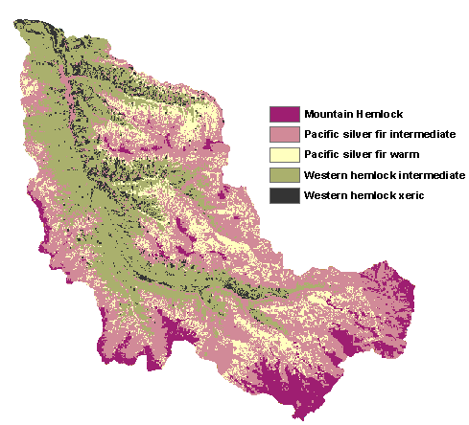
^{#3} SUMMARIZE
CONDITIONS

Slide 20
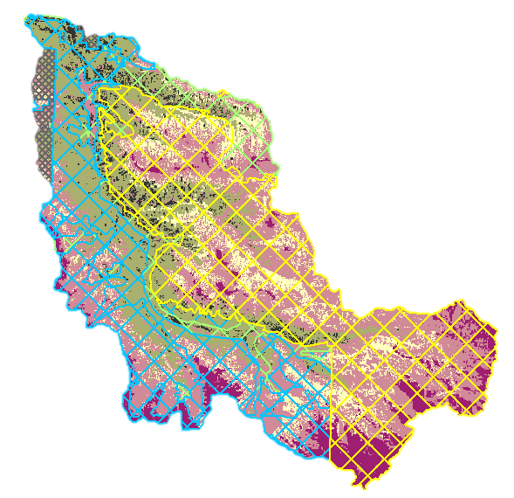
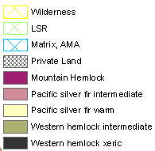

Slide 21
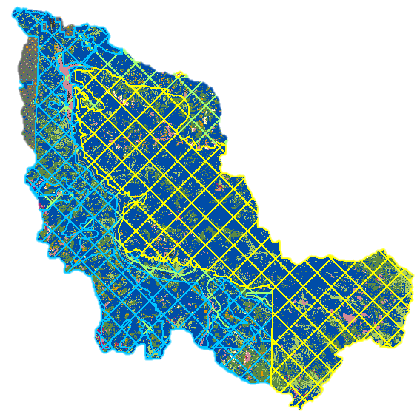
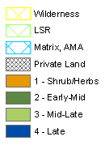

Slide 22
^{#4} SETTING THE MANAGEMENT SCENARIO
LSR, Matrix and AMA allocations used to actively manage early and late seral objectives.
Developed a crosswalk of candidate and target states from which to create or maintain early and late seral classes.
Identified a list of management actions (PCT, Thinning, Regeneration, Fire).
Developed a rate based on assumptions from observing earlier runs and evaluating what the non-managed landscape would produce.

Slide 23
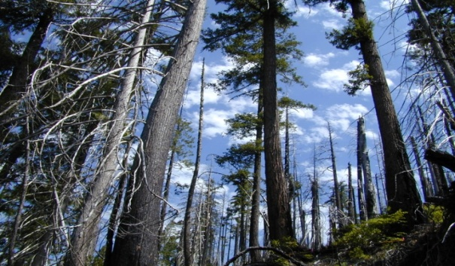

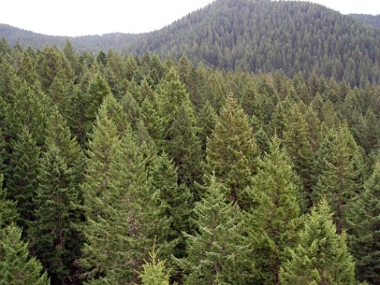
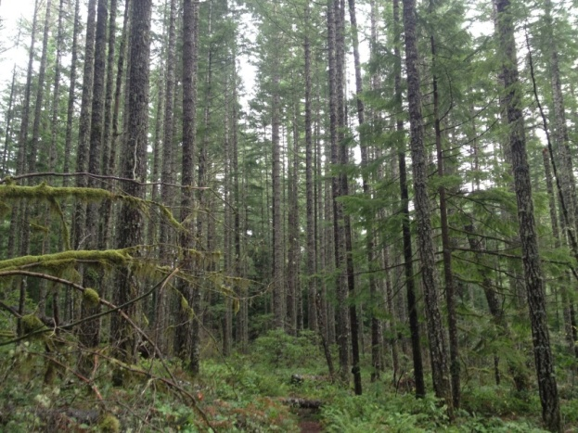
What states currently provide early seral and what states provide the opportunity to create early seral?
TARGET STATE
CANDIDATE STATES

Slide 24
^{#5} COMPARING RESULTS
Key differences
Key similarities
What level of active management achieved our goal – if it could be achieved at all?

Slide 25
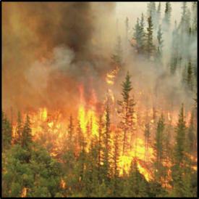
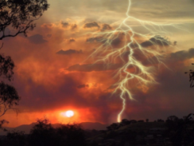
Comparing results….
Watershed early seral range -
6-18%
What will natural processes
produce?
Compare to the number of acres typically managed each decade on the McKenzie River Ranger District –
Approx. 5,500

Slide 26
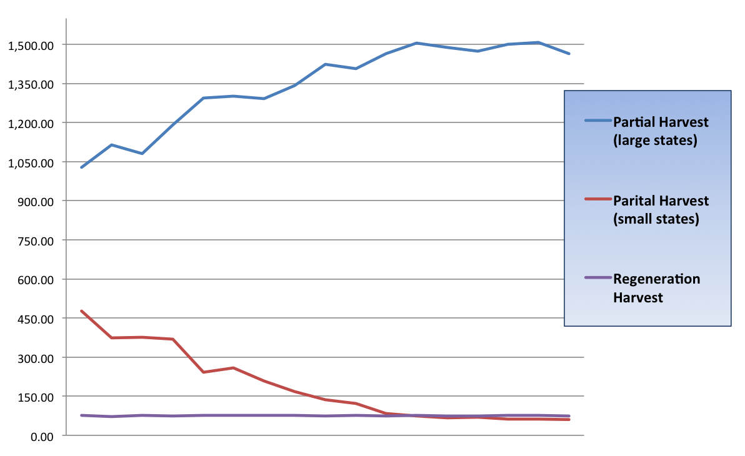
Tracking Tool….
Acres
10
100
160
Year

Slide 27
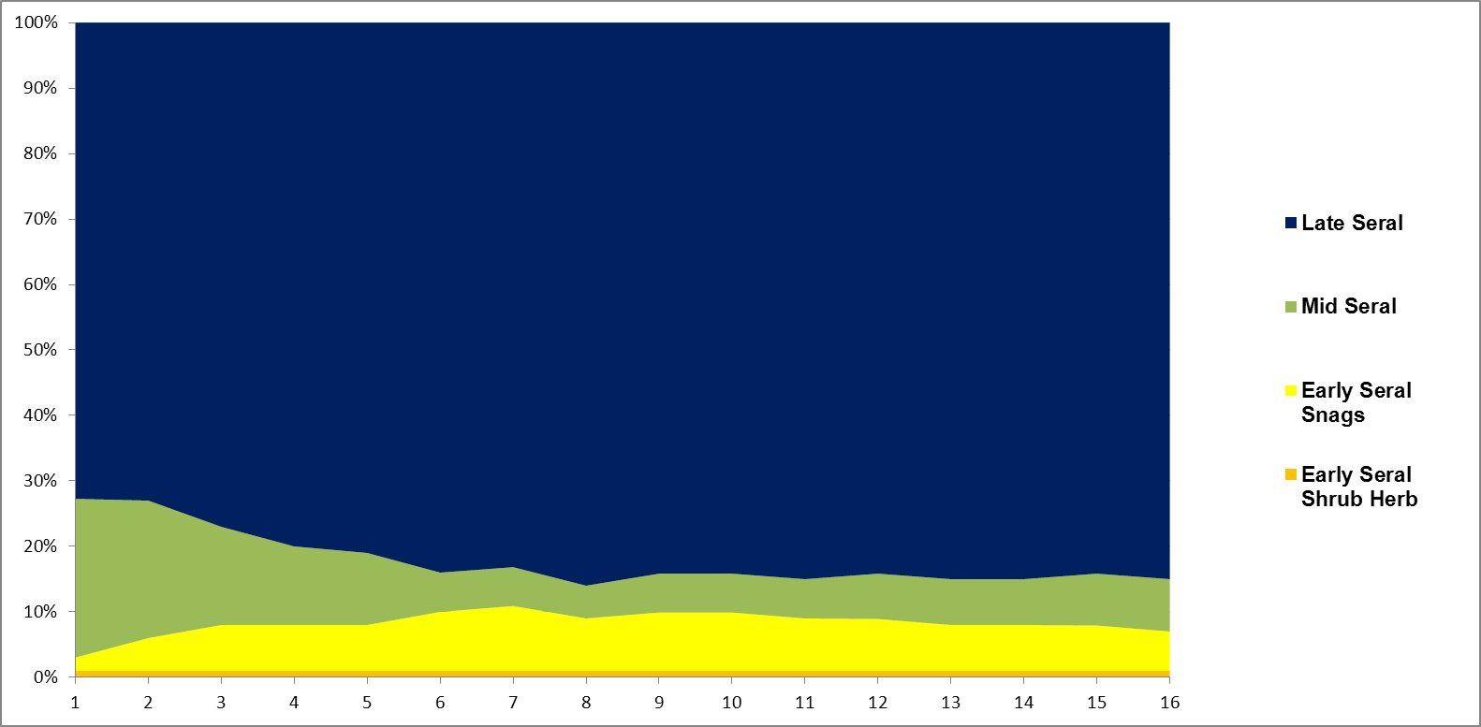

Slide 28
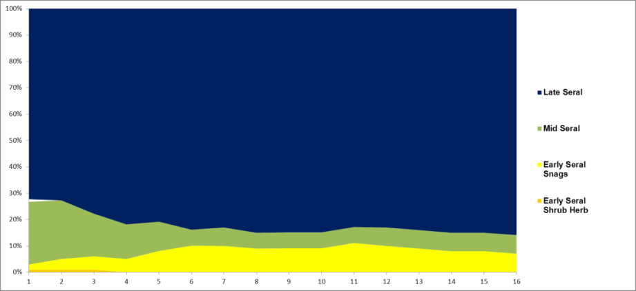
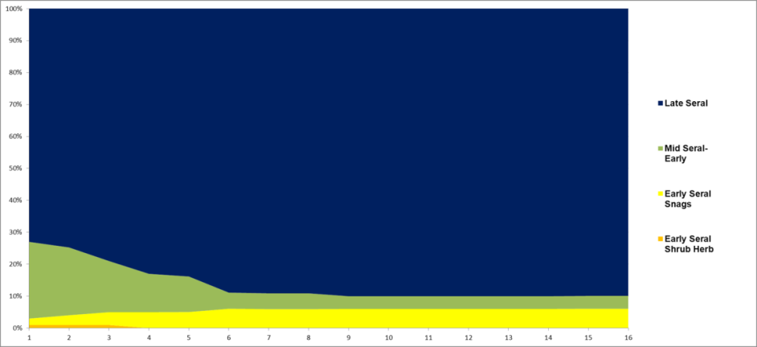

COMPARING RESULTS
Historical fire regime
Current fire regime
Active Management for
Early and Late Seral

Slide 29
^{#5} COMPARING EARLY SERAL RESULTS
Scenario | % Shrub & Herb |  | % Snags |  | Total Range (%)
 | Min | Max | Min | Max
Without Fire Suppression | 0 | 1 | 1 | 13 | 2-14
Fire Suppression | 0 | 1 | 2 | 6 | 2-7
Active Management for Seral Distribution | 0 | 1 | 3 | 10 | 3-11
6-18%

Slide 30
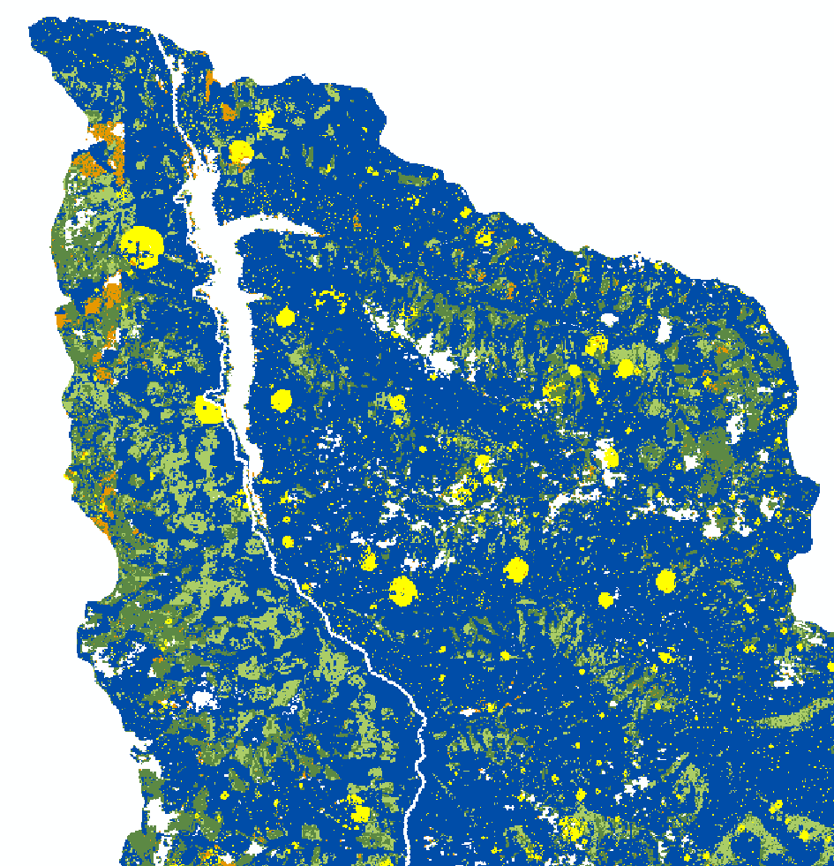
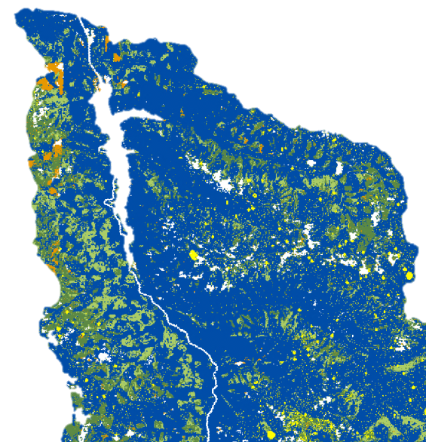
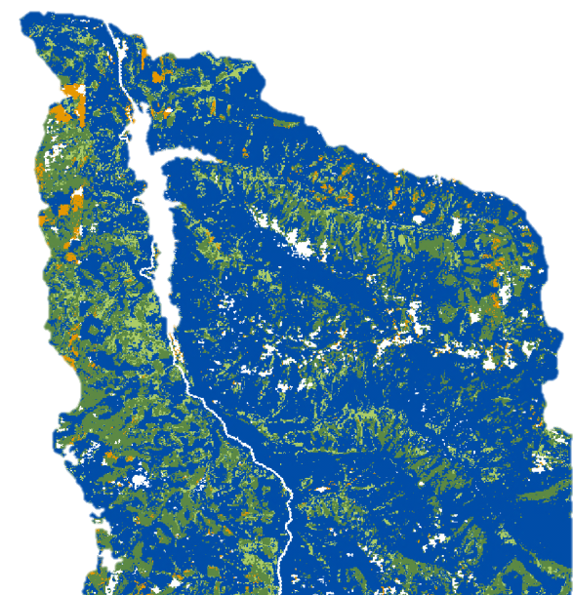
^{#5} COMPARING SPATIAL RESULTS ^{Year} ²⁰
Active Management
Without fire suppression
With fire suppression

Slide 31
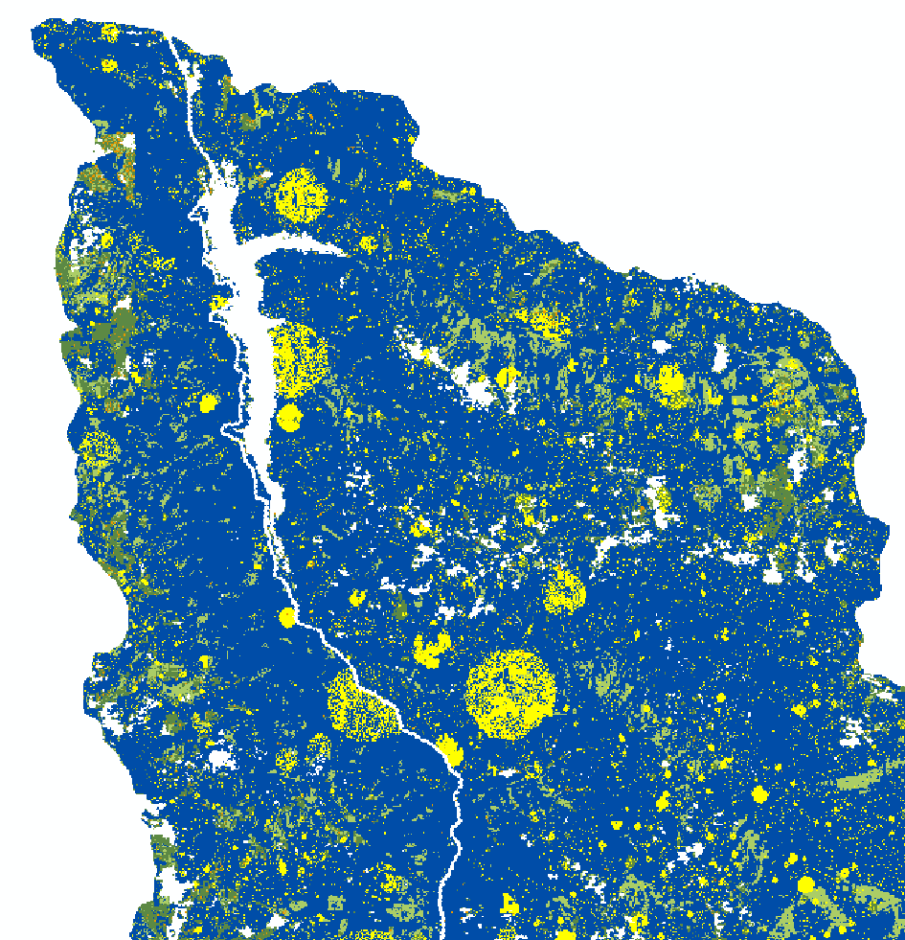
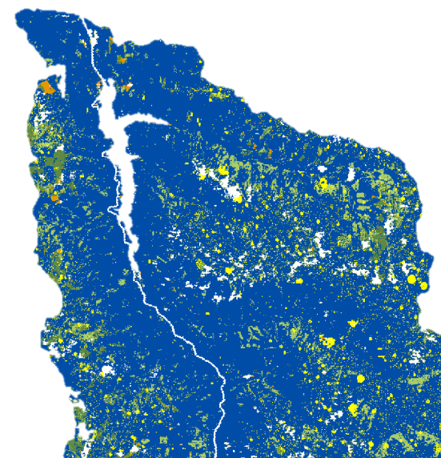
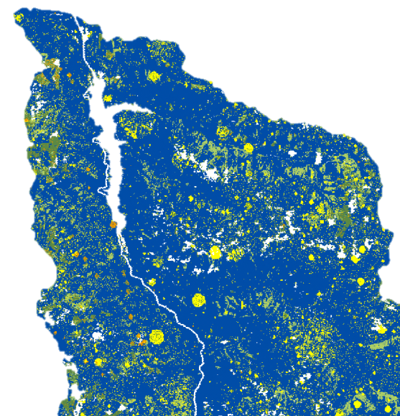
^{#5} COMPARING SPATIAL RESULTS ^{Year} ⁵⁰
Active Management
Without fire suppression
With fire suppression

Slide 32
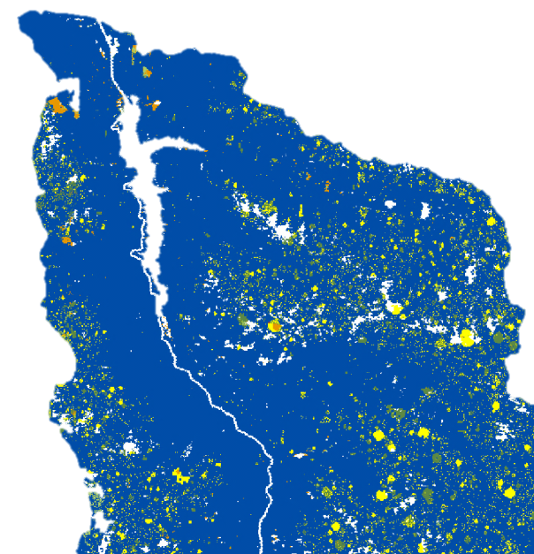
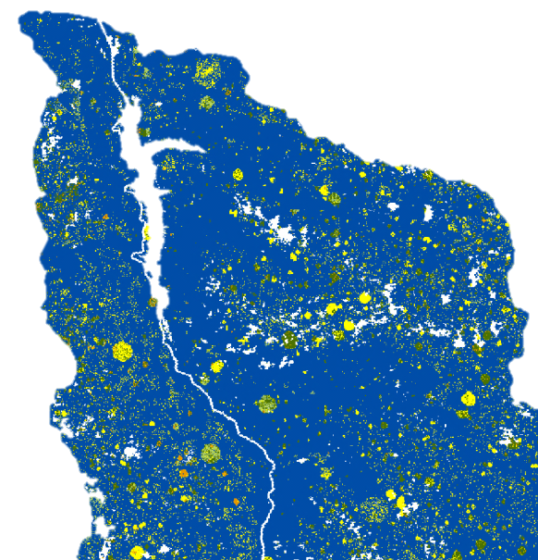
^{#5} COMPARING SPATIAL RESULTS ^{Year} ¹⁰⁰
Active Management
No fire suppression
With fire suppression
Notes:
This supports area graph and also supports why I have most late early seral no mng fire suppression and most early seral in historical and in the middle with seral distribution.

Slide 33


