Slide 1
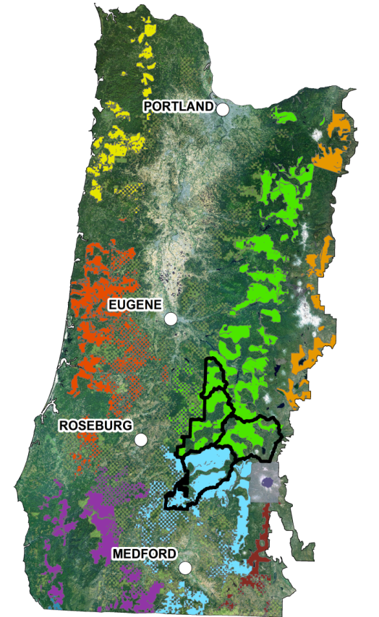
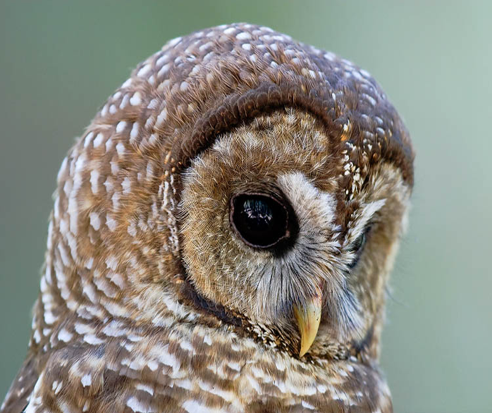


Integration of Northern Spotted Owl Critical Habitat in Forest Management: Umpqua National Forest’s Elk Creek Watershed
Scott Center¹ and Josh Chapman²
¹US Fish and Wildlife Service, Roseburg, OR
²USDA Forest Service, Umpqua National Forest, Roseburg, OR
Notes:
Presenters is different than on the agenda because.
While primary focus is NSO CH, will include NSO RP considerations.

Slide 2
Objectives
Provide an overview of NSO Recovery Plan and Critical Habitat and their role in project planning
Identify potential spatial products to guide project planning
Provide potential insights for project placement
Notes:
No specific projects yet identified for Elk Creek. However, general locations based on the analysis thus far are where we are likely to go.

Slide 3
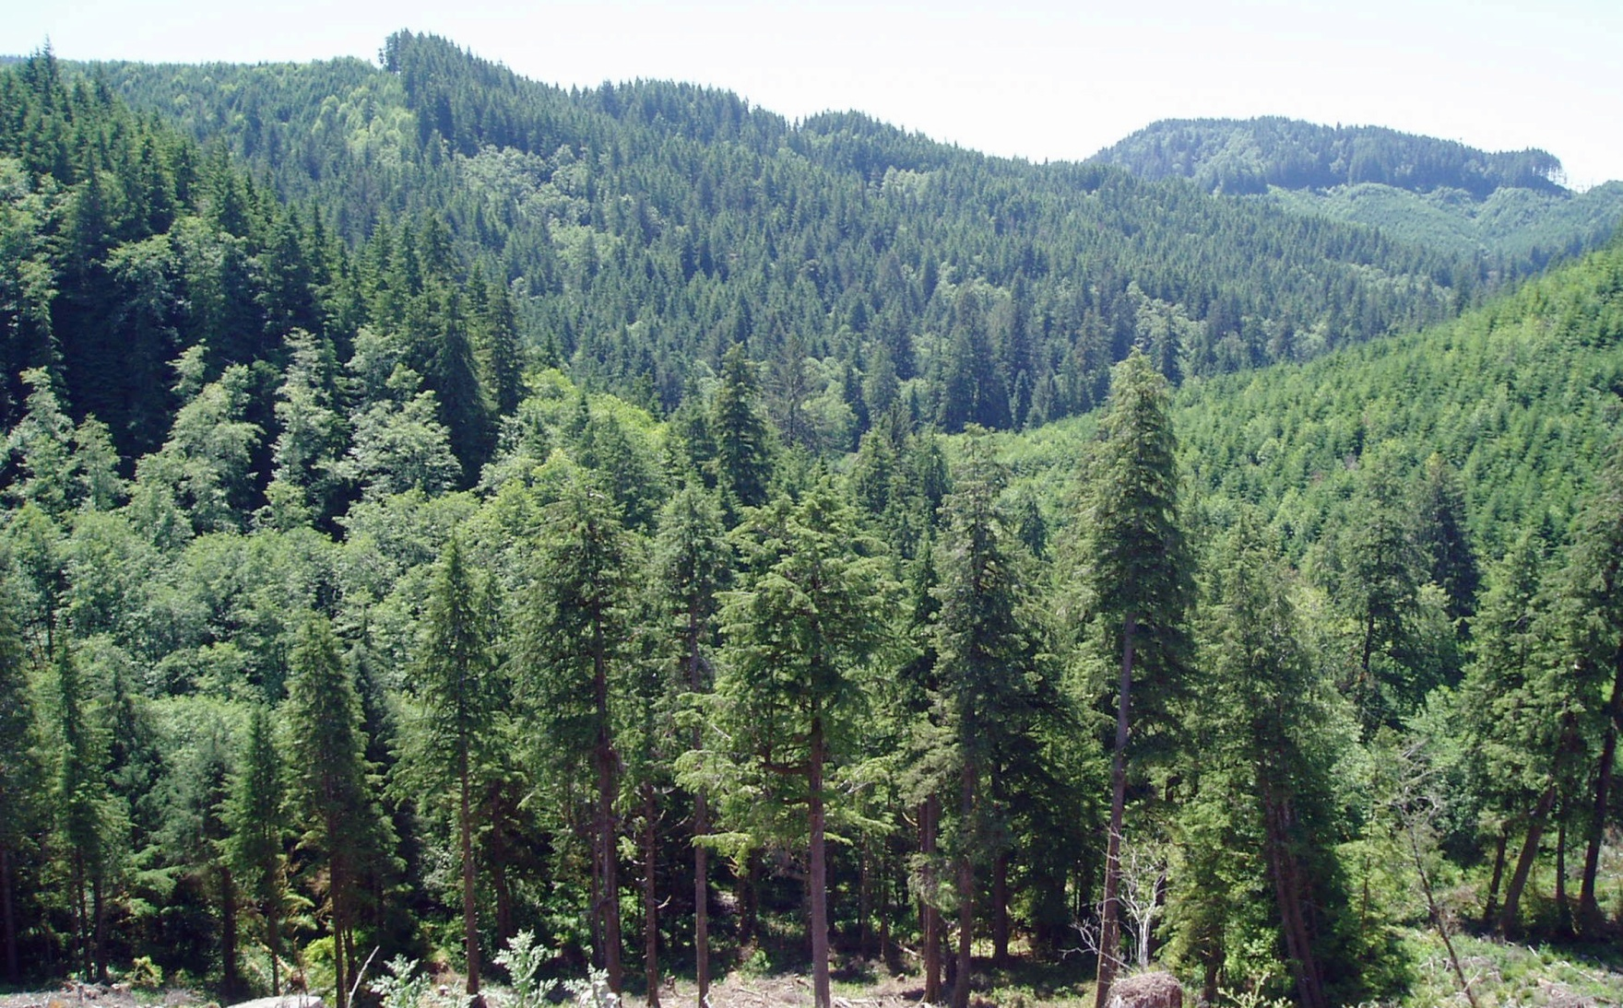
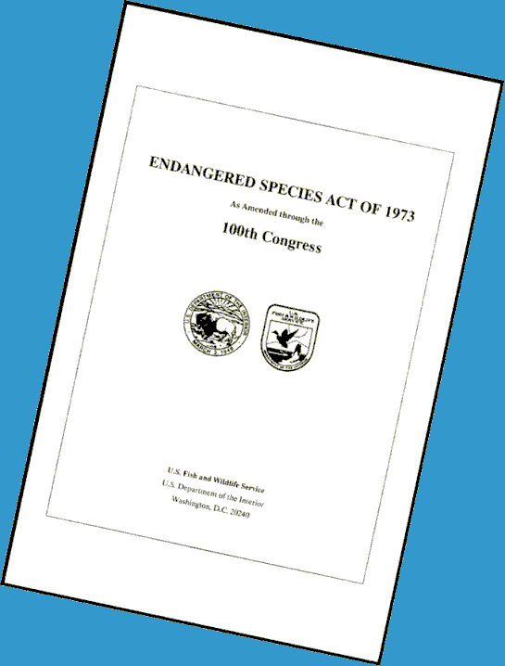
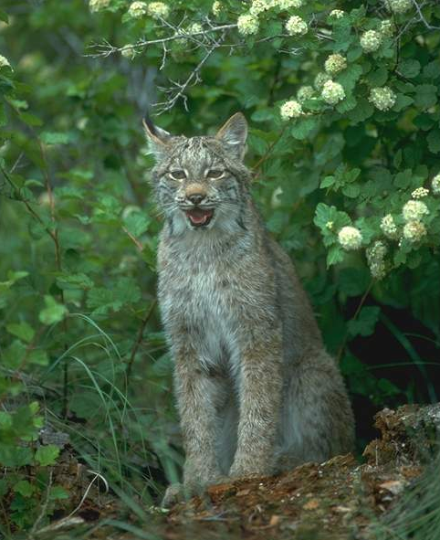
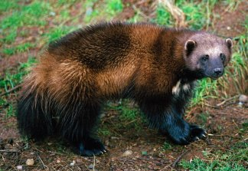
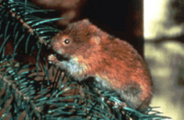
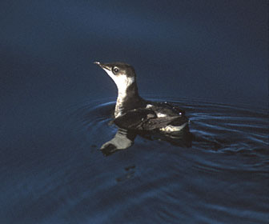
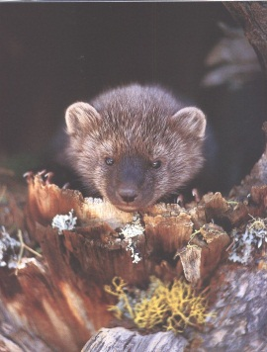
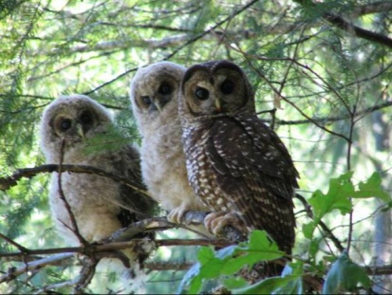
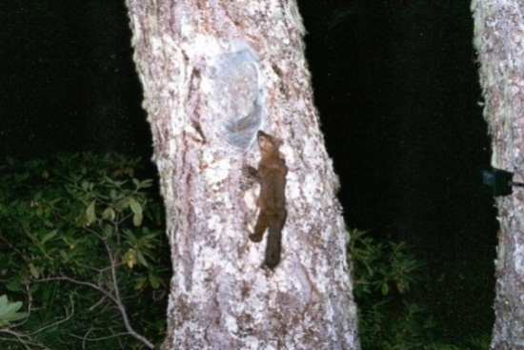
“Conserve the species and
the ecosystems upon which they depend”
Notes:
Section 2 of the ESA directs us to also conserve the ecosystems upon which species depend

Slide 4
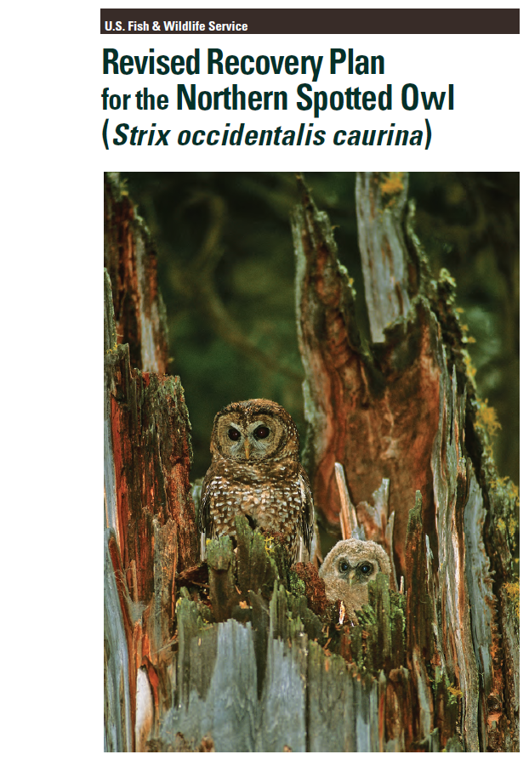
Ecological Restoration/
Active Management
Manage for:
Restoring forest ecological
structure, composition and
process
Consistent with spotted owl recovery
Responding to climate change (Secretarial Order 3289)
Notes:
Incorporating components of the Franklin and Johnson, …restoring processes. NSOs are part of these ecosystems and ESA mandates conserving the ecosystems upon which the species depend. We view restoration, when conducted strategically, as a means to helping conserve these systems.
Bullet 2. We recognize that spotted owl recovery is one of several goals, sometimes competing, sometimes complementary – and that land managers must take this into account when deciding how best to meet management objectives on their lands. However, we believe that through front loading the pilots with the tools and process described here, we can meet the challenge of spotted owl conservation and generating some timber volume.
Bullet 3. Climate change. We need to be thinking of accommodating spotted owls as our systems change/adapt to climate change. Here we need to think of strategies that include 1) resistance options to forestall impacts and protect high valued resources and 2) resilience options which improve the capacity of ecosystems. This would include some active management to have ecological processes and structure restored to forests to provide resilience and the pilots may be a good way to demonstrate stand and landscape level approaches to address climate change. 3289 Incorporate climate change impacts into DOI plans (Sept 2009). Opportunity to reconcile climate change mitigation goals with NSO recovery goals

Slide 5


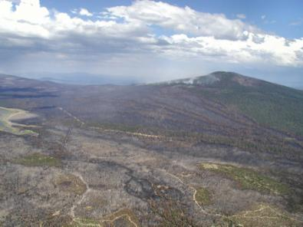
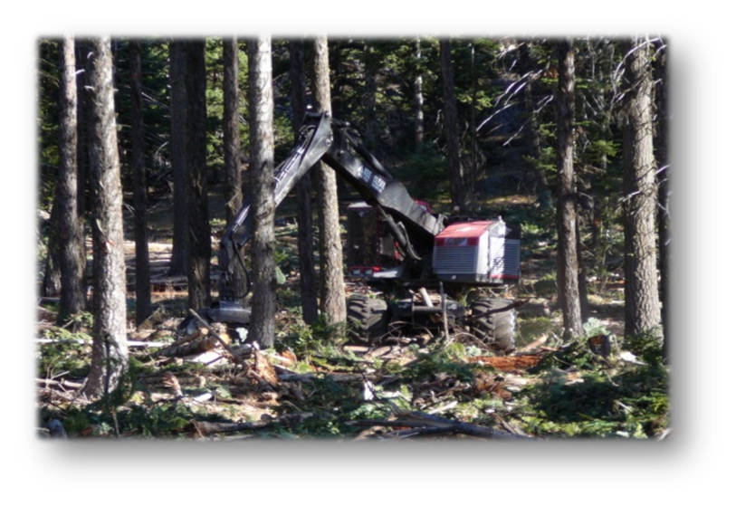
CH, Forest Health and Restoration
Critical Habitat is not a Reserve
OK for active mgmt inside NSO CH: Ecological Forestry
Local impacts to NSO reconciled with forest ecosystem goals
Support forest restoration
Forest health, processes and resilience is the goal
Notes:
The Revised Recovery Plan recommends the spotted
owl recovery strategy be embedded within, and be
consistent with, a broader framework of conservation
of forest ecosystems for the Pacific Northwest.
Species-specific needs of the spotted owl
should not be the sole determinant of landscape
management decisions.
should fit within a broader strategy whose goals
include the conservation of the full assemblage of
species and ecological processes in a given
landscape, so that it will be more resilient to
future losses of spotted owl habitat or ecosystem
change resulting from climate change and other
disturbances.

Slide 6
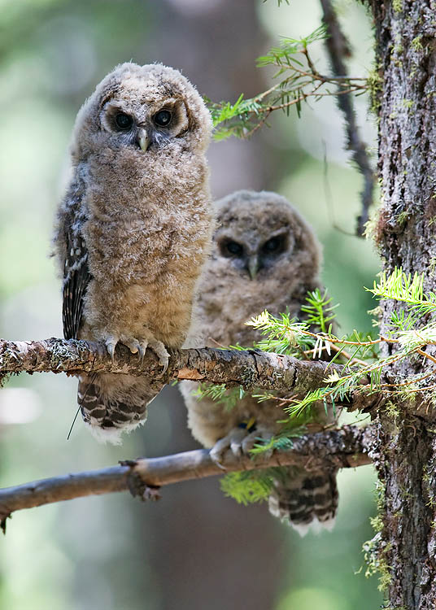
FWS’s Goals in Project Development
NSO recovery factored
into forest restoration
Identify best restoration
and NSO opportunities
Forest management to
support local communities
Notes:
Bullet 1. We believe that in many cases NSO recovery and forest restoration goals are compatible and this will be dependent on landscapes characteristics. We recognize that spotted owls are a part of forested ecosystems and that restoration of these systems may take some active management to make the systems more resilient to disturbance regimes and adapt to impending climate change.
Bullet 2. Here, identify activities that are neutral and beneficial. Also identify tradeoffs of proposed projects – best opportunities for commercial activities. This will begin with landscape assessment using tools describe here.
Bullet 3- FWS concerned about our local economies and want to have timber jobs and community infrastructure maintained. Our folks live and work in these same communities and feel the impacts as well. We recognize the other forest management – harvest - may likely be needed concurrent with the pilots to achieve timber volume.

Slide 7
“Explicit consideration of scale”
Scale | Spotted Owl | Planning
Regional (CH Unit) | Forest community (Dry to Moist) Disturbance regimes Spotted Owl population ecology | Forest restoration and management approach
Landscapes (CH Subunit - Watersheds) | Abundance, Quality, Distribution of habitat and relative risk level Abundance, density, distribution of spotted owl territories | Project objectives and prioritization “why here, why now?”
Home Ranges | Habitat quality and owl fitness Distribution of owl use, based on topography, forest structure | Amount and spatial pattern of forest habitats (stands)
Stand | Resource availability Within-stand resources Prey, nest sites, cover | Stand-level prescriptions

Slide 8
Approach for Integrating Ecological Restoration and NSOs
Explicit consideration of scale is essential for successful integration of NSO into forest restoration planning (=strategic)
Need to know landscape–level context before stand–level Rx (=top-down approach)
Recognize and foster or mimic the role of fire in creating habitat mosaics as well as maintaining within-stand elements (=bottom-up approach; Stand-level)

Slide 9
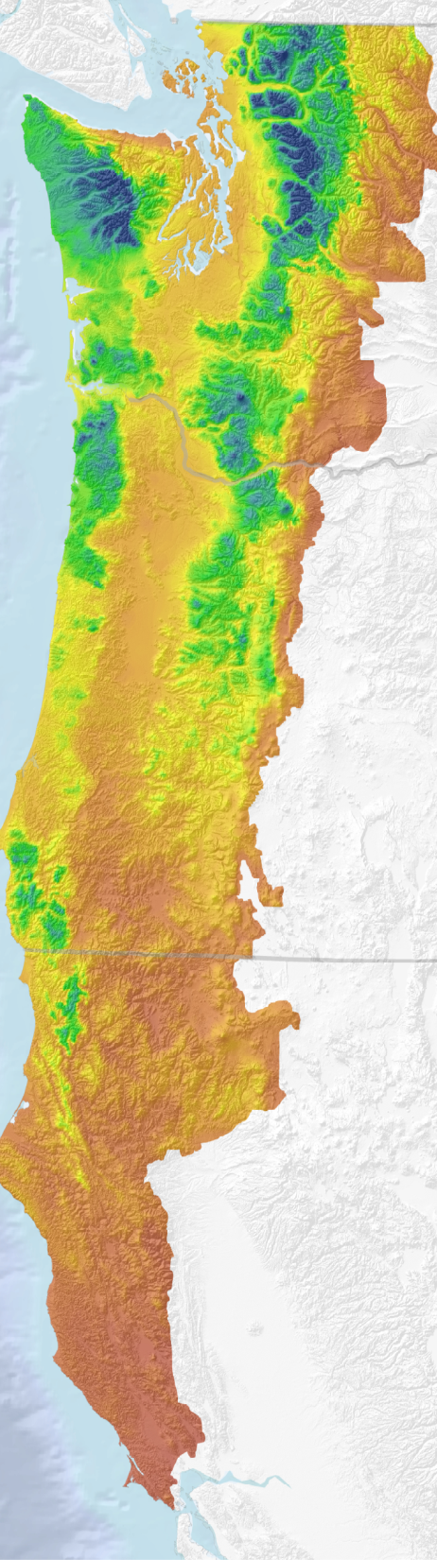
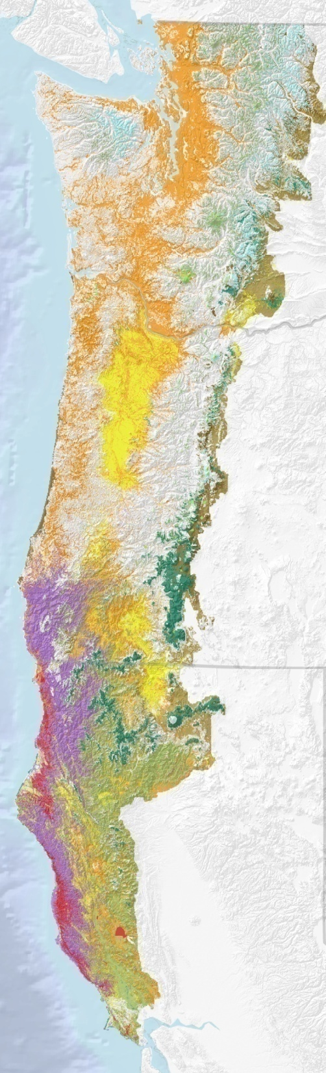
Regional Variation
At broad scales, the influences of climate elevation and latitude result in different ecological regions inhabited by Northern Spotted Owls:
Forest communities
Disturbance regimes
NSO ecology
Notes:
CH accounted for regional variation in that modeling regions were developed based on the ecological conditions.

Slide 10
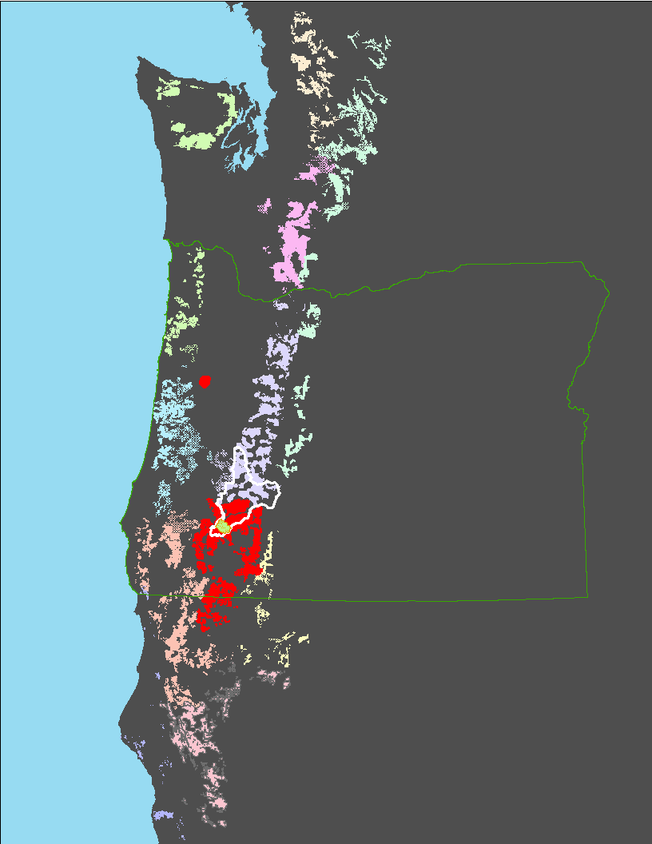
Critical Habitat Units

Slide 11
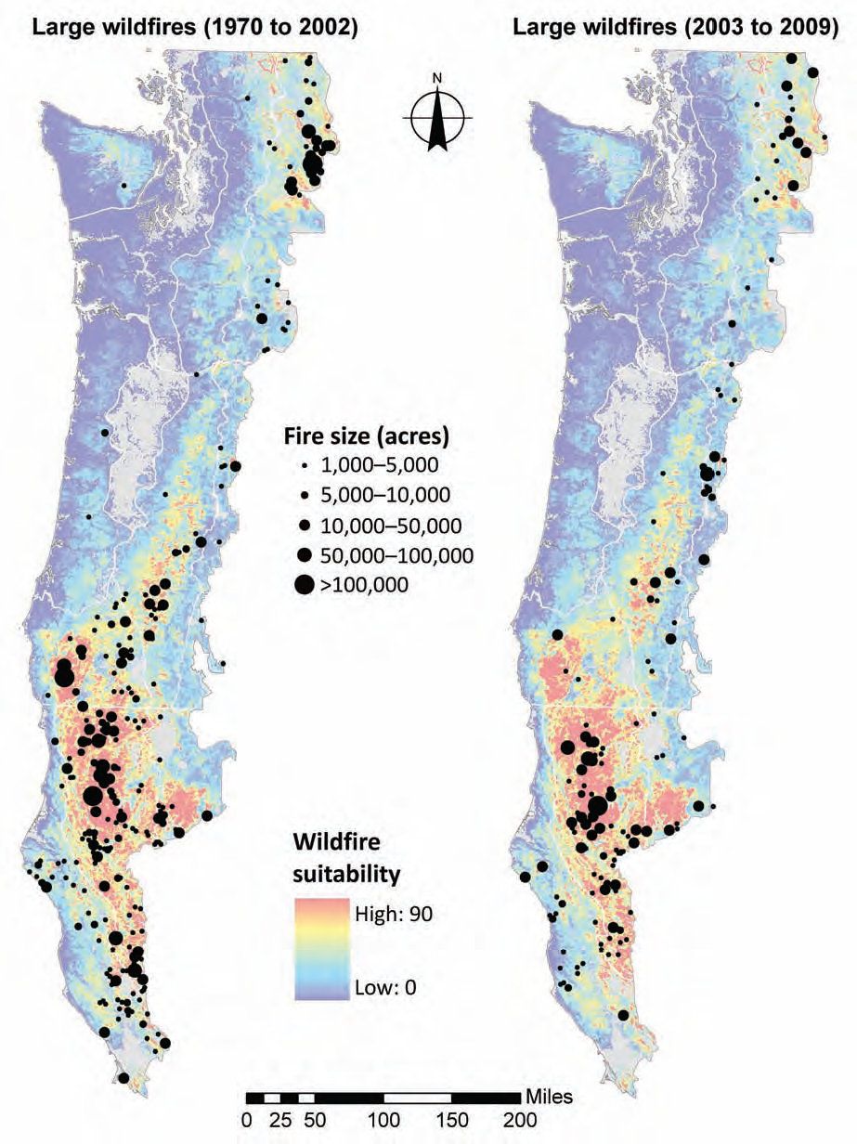
Notes:
Knowledge of where and how frequent fire starts……

Slide 12
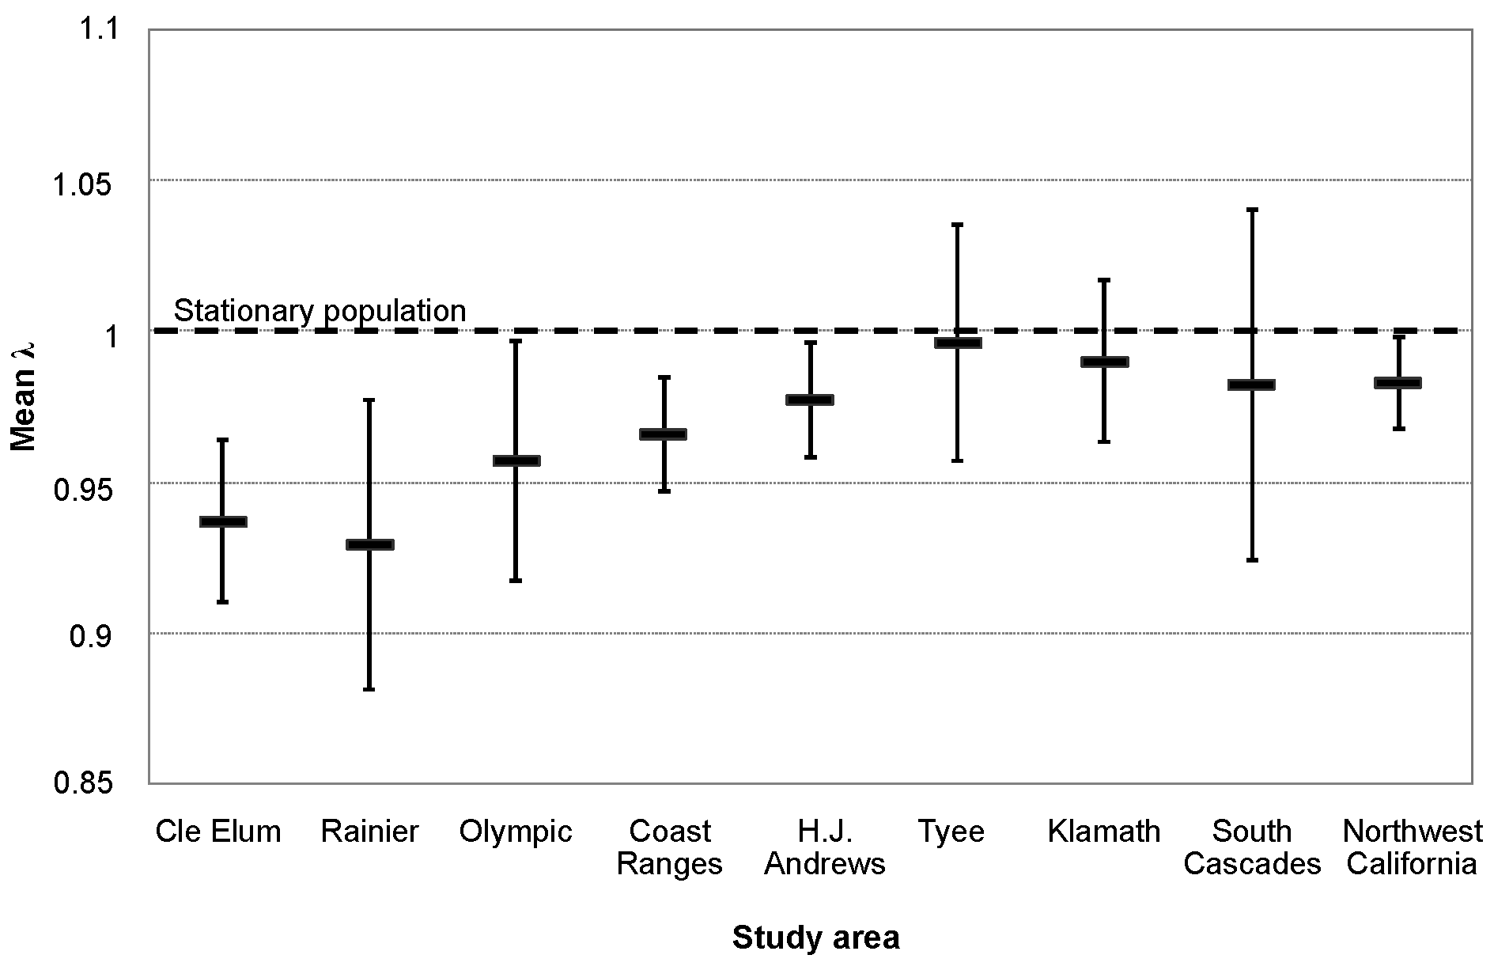
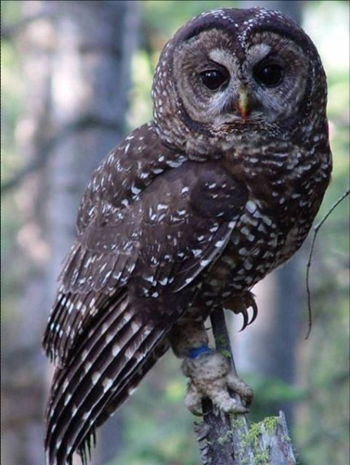
Spotted Owl Population Trend
Forsman et al. 2011
Notes:
9 NSO demographic area across the range. 4 of them surround the UNF and these are some of the more relatively stable populations.
Though do know that the barred owl effect complicates these values. How does this factor into project planning?

Slide 13
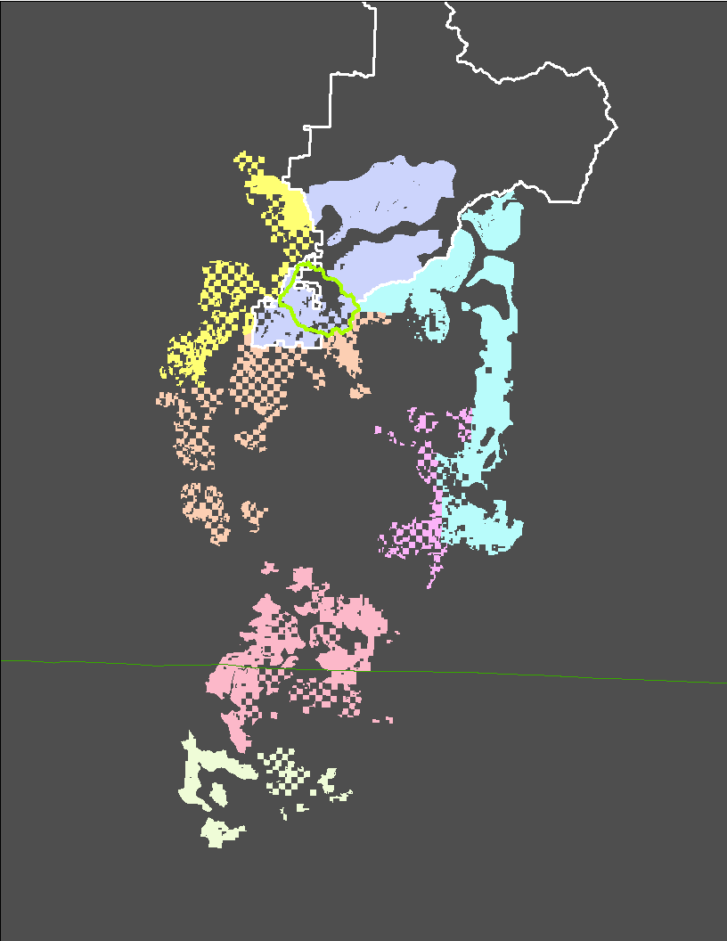
Critical Habitat Subunits in Klamath East (Unit 10)

Slide 14
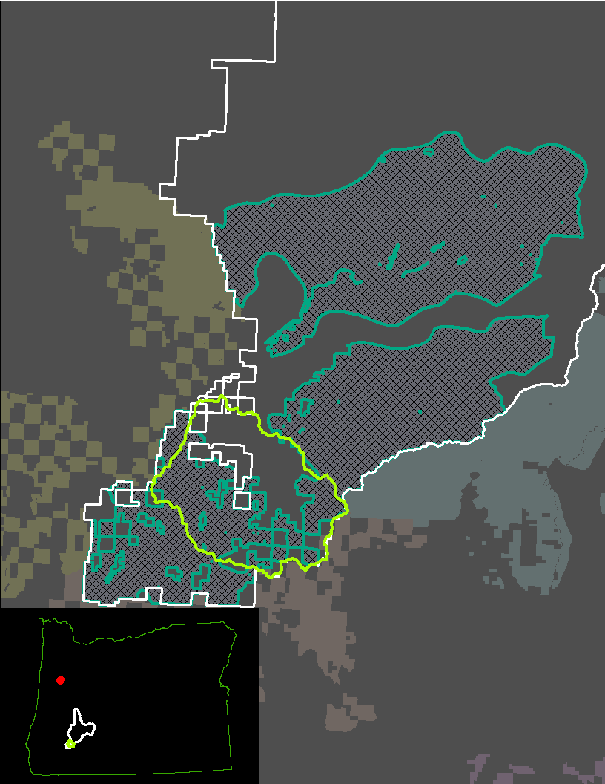
Critical Habitat Subunit KLE-1
Notes:
Subunit objectives = Special management considerations or protection are required in this subunit to address threats to the essential physical or biological features from current and past timber harvest, losses due to wildfire and the effects on vegetation from fire exclusion, and competition with barred owls. This subunit is expected to function primarily for demographic support to the overall population, as well as north-south and east-west connectivity between subunits and critical habitat units.
The increase and enhancement of northern spotted owl habitat is necessary

Slide 15
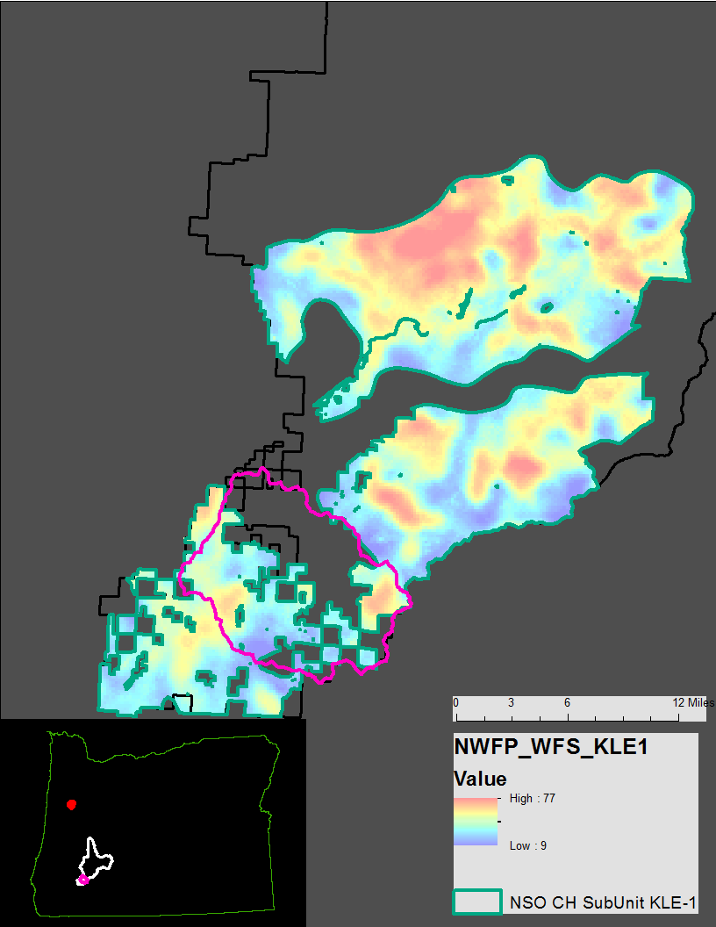
Critical Habitat Subunit KLE-1

Slide 16
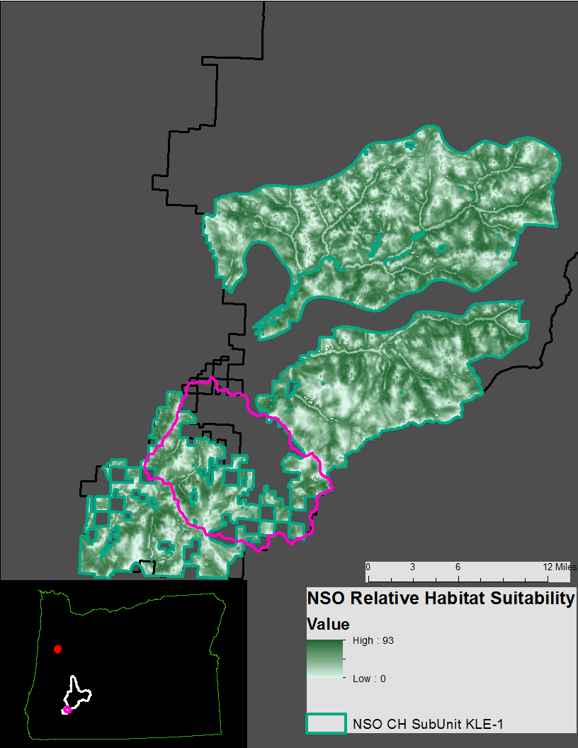
Critical Habitat Subunit KLE-1

Slide 17
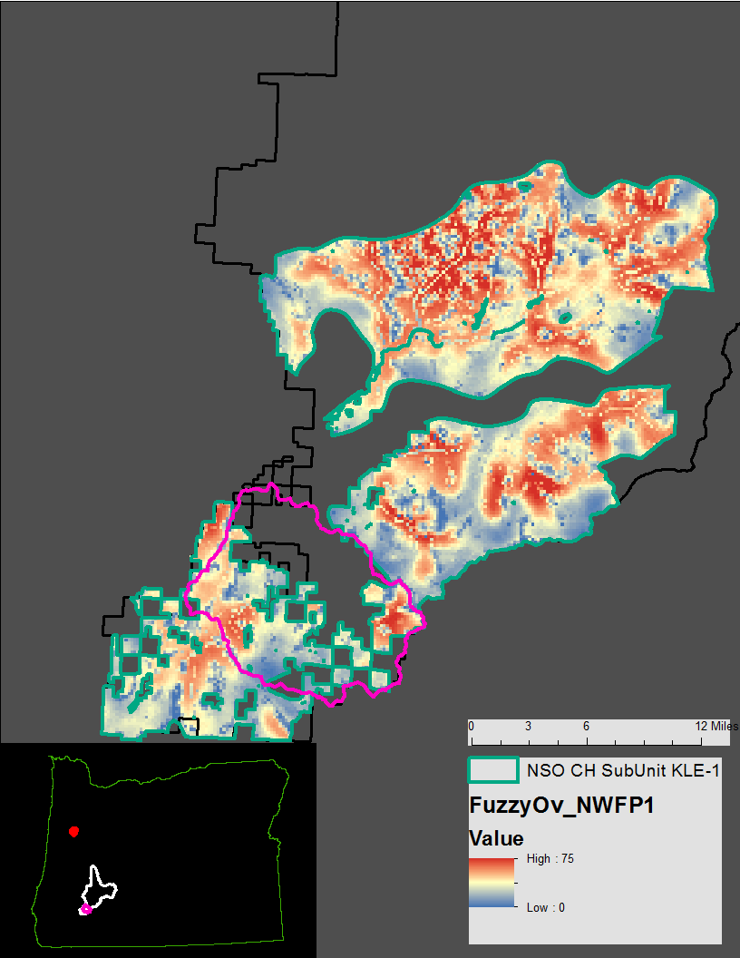
Critical Habitat Subunit KLE-1

Slide 18
“Explicit consideration of scale”
Scale | Spotted Owl | Planning
Regional (CH Unit) | Forest community (Dry to Moist) Disturbance regimes Spotted Owl population ecology | Forest restoration and management approach
Landscapes (CH Subunit - Watersheds) | Abundance, Quality, Distribution of habitat and relative risk level Abundance, density, distribution of spotted owl territories | Project objectives and prioritization “why here, why now?”
Home Ranges | Habitat quality and owl fitness Distribution of owl use, based on topography, forest structure | Amount and spatial pattern of forest habitats (stands)
Stand | Resource availability Within-stand resources Prey, nest sites, cover | Stand-level prescriptions

Slide 19
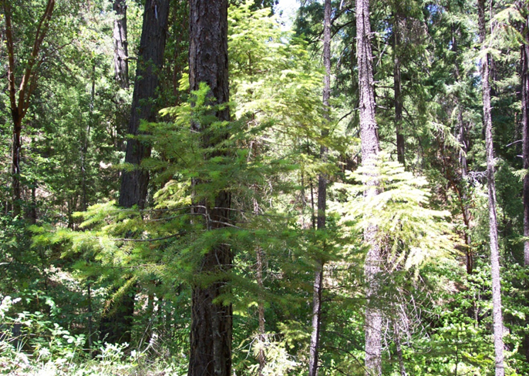
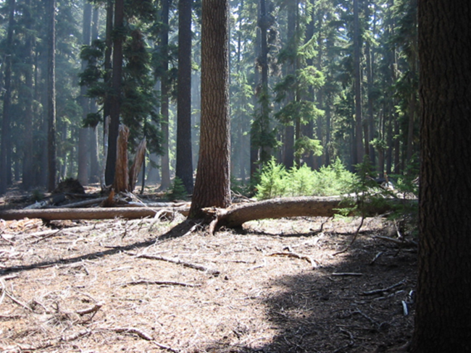
UNF’s Elk Creek Project Initiation Letter
“..purpose is to restore ecological function and resilience to the watershed….”
“.. projects will be based on the range of variability for local landscape reference conditions…”
Notes:
Early analysis shows significant departure of forest and veg condition from historic conditions. only one in four 6th field watersheds is considered functioning properly…” “..decline in rare and unique habitats
Mostly attributable to fire suppression and past harvest activities.
Project activities could include activities that protect and enhance NSO habitat
Enhnace rare and unique habitats
Timber is a byproduct of restoring function and resilience to the watershed.

Slide 20
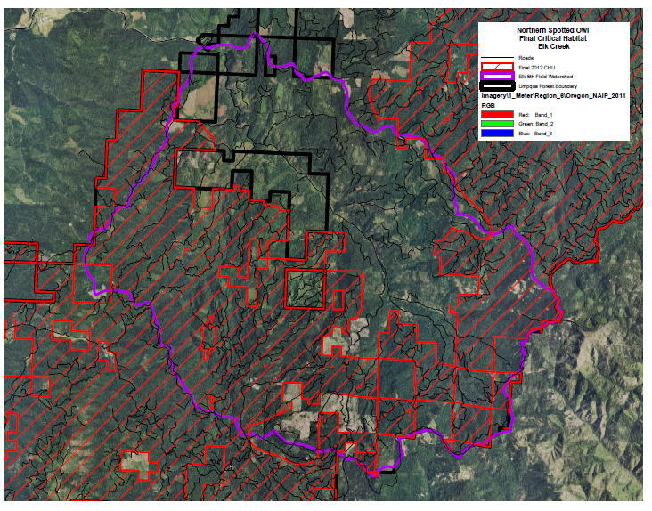
Elk Creek Watershed Planning Area
Notes:
How many overall acres in the watershed? 54,374.
How many CH acres?

Slide 21
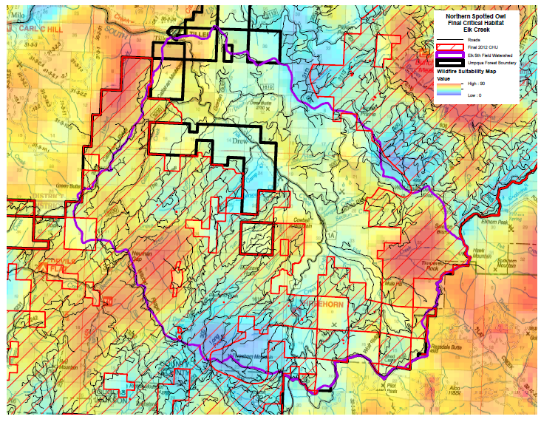
Wildfire Suitability
Notes:
How wildfire suitability factors into this planning….

Slide 22
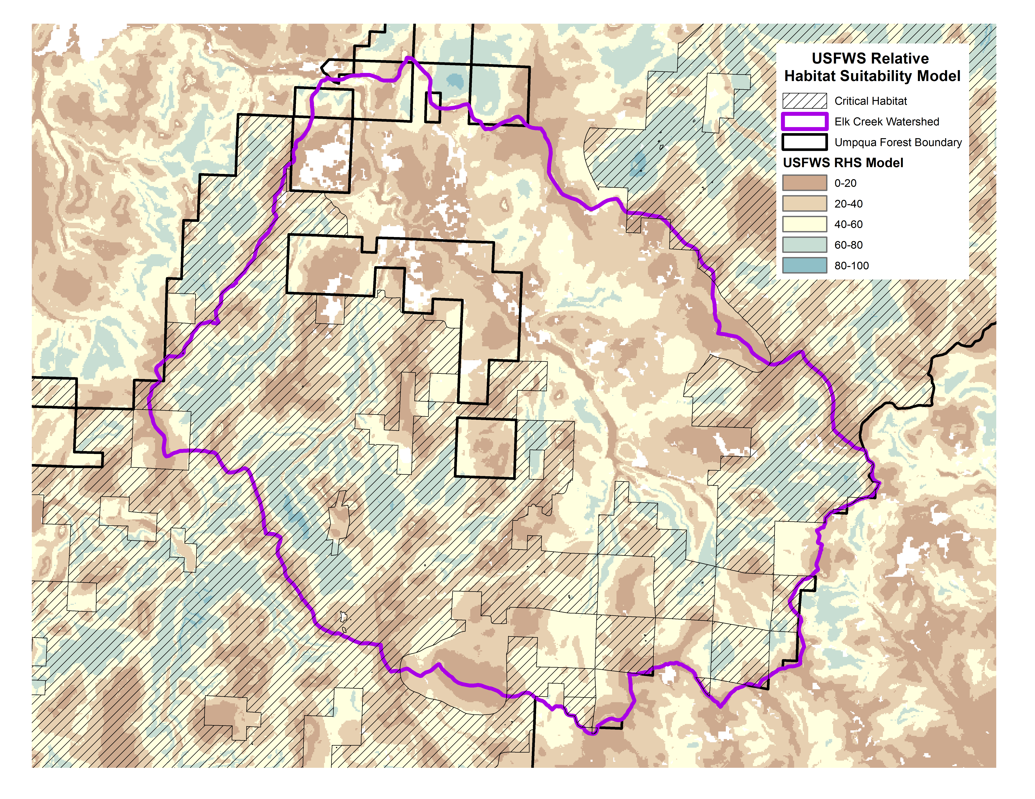
NSO Relative Habitat Suitability

Slide 23
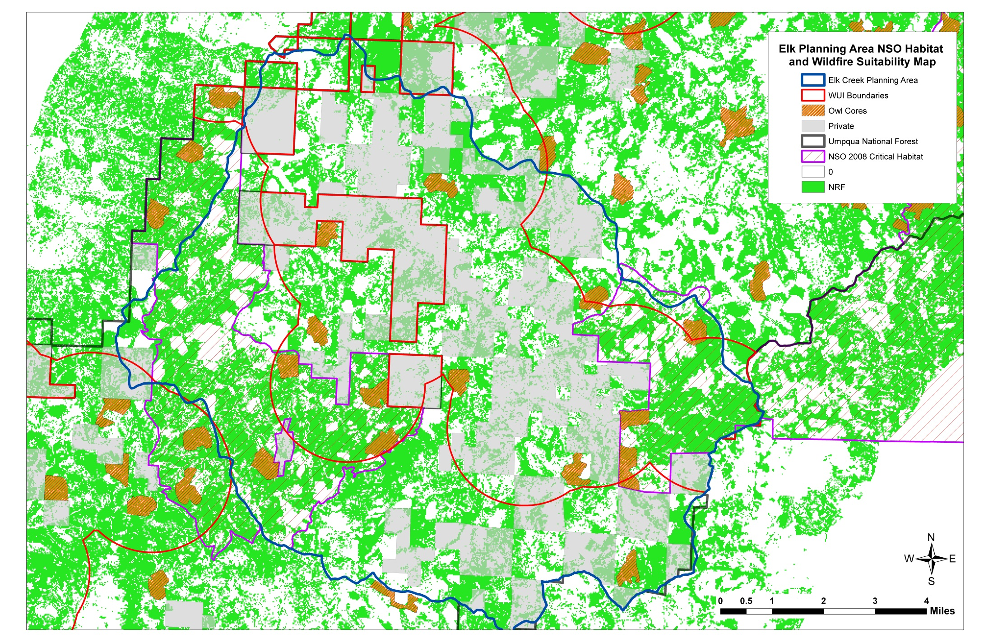
NWFP 15 Yr Rpt – NSO Habitat
Notes:
Note private lands and early seral habitat likely.

Slide 24
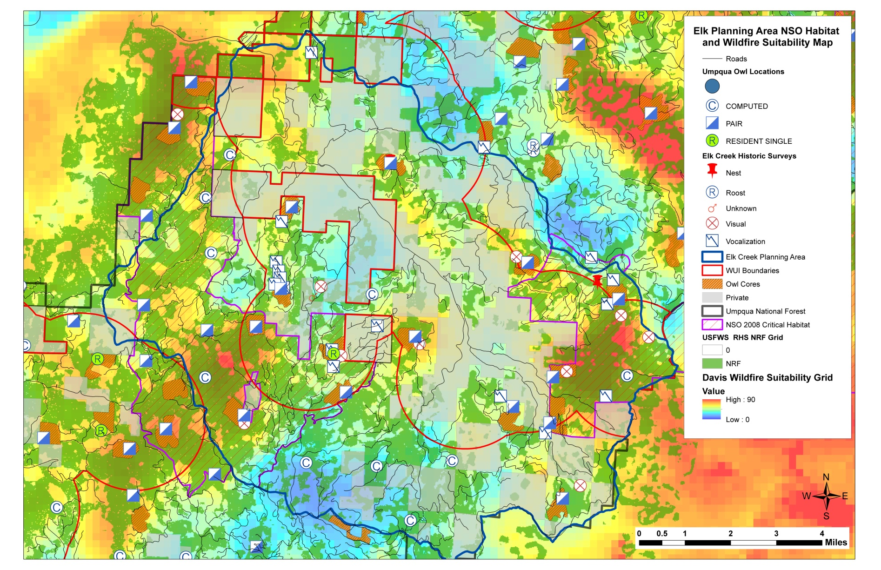
Why Here, Why Now?
More fire prone areas to potentially treat to reduce fuels to reduce risk of habitat loss current Spotted Owl habitat from future wildfires
Notes:
Combining NSO habitat and wildfire suitability. The Bloody circles moved!
Orange circles - More fire prone areas to potentially treat to reduce fuels to reduce risk of habitat loss current Spotted Owl habitat from future wildfires
Blue Circles - Less fire prone areas to potentially treat
to improve current younger habitat for
Spotted Owls into the future
WUII for sure plus these other areas for starters and why…..

Slide 25
“Explicit consideration of scale”
Scale | Spotted Owl | Planning
Regional (CH Unit) | Forest community (Dry to Moist) Disturbance regimes Spotted Owl population ecology | Forest restoration and management approach
Landscapes (CH Subunit - Watersheds) | Abundance, Quality, Distribution of habitat and relative risk level Abundance, density, distribution of spotted owl territories | Project objectives and prioritization “why here, why now?”
Home Ranges | Habitat quality and owl fitness Distribution of owl use, based on topography, forest structure | Amount and spatial pattern of forest habitats (stands)
Stand | Resource availability Within-stand resources Prey, nest sites, cover | Stand-level prescriptions

Slide 26
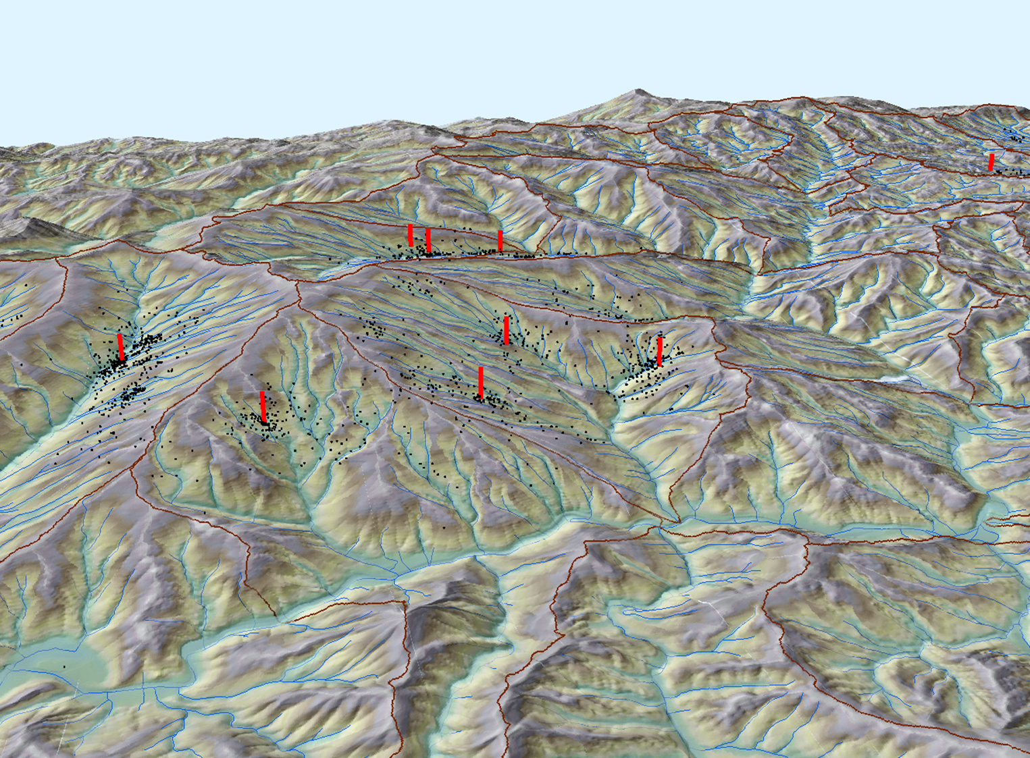
Elevation
Slope position
Insolation
Curvature
Local climate
Abiotic influences on territory distribution:
Notes:
Project planning cues in context of CH
Discuss lower to mid slope position for habitat use and relate to project planning
Insolation – the amount of light hitting the ground and micro climate concerns
Curvature – concave and convex

Slide 27
Fire Severity Patterns
Upper Slope
Greater %
High Severity
Mid Slope
Intermediate
Lower Slope
Greater %
Low Severity
Taylor & Skinner 1998
Notes:
Disturbance patterns helpful to know in project area and lead to protection of NSO refugia areas that are sustainable

Slide 28
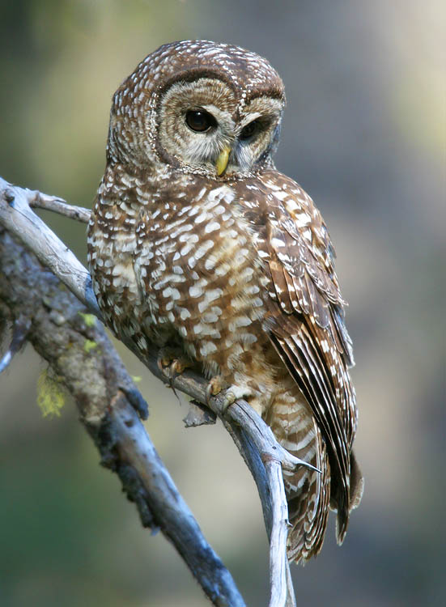
Summary: Integration
Ecological restoration and spotted owl recovery can be compatible when…
they are integrated
Ecological restoration and NSO
Planning tools (top-down and bottom-up)
FWS involved in project conception and planning

Slide 29
Questions?

