Slide 1
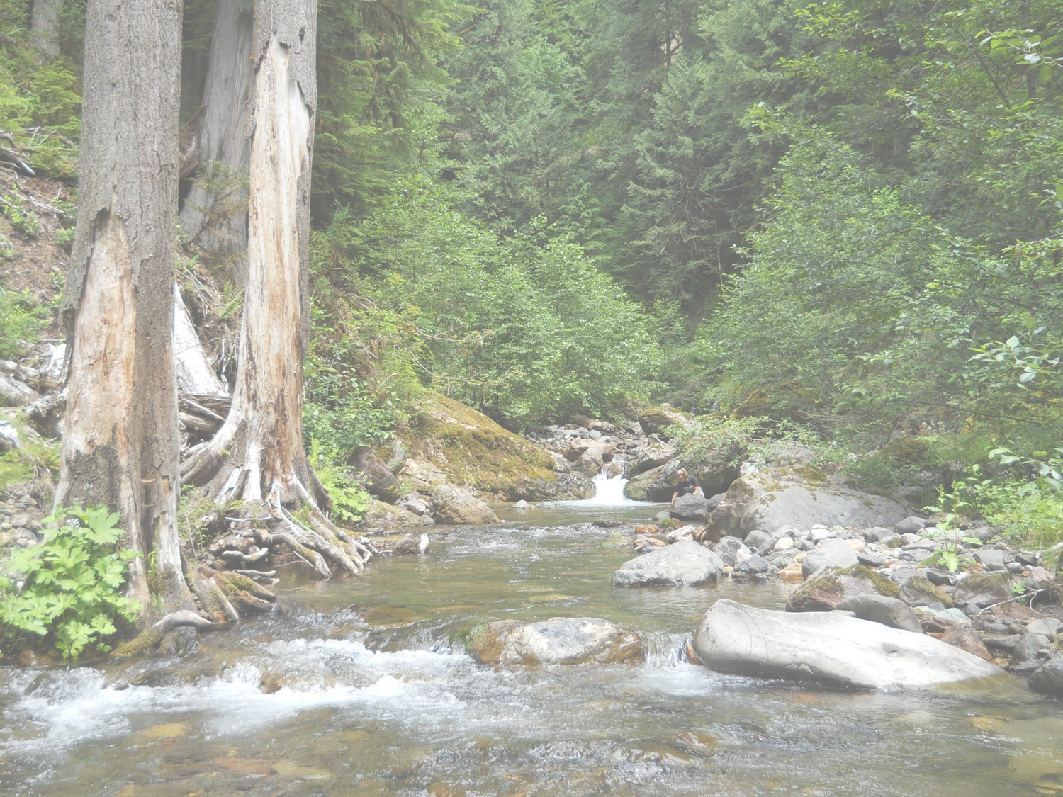


Compliance with the Aquatic Conservation Strategy Objectives using landscape modeling tools
Brett Blundon
Assistant Forest Fish Biologist
Willamette National Forest
bblundon@fs.fed.us

Slide 2
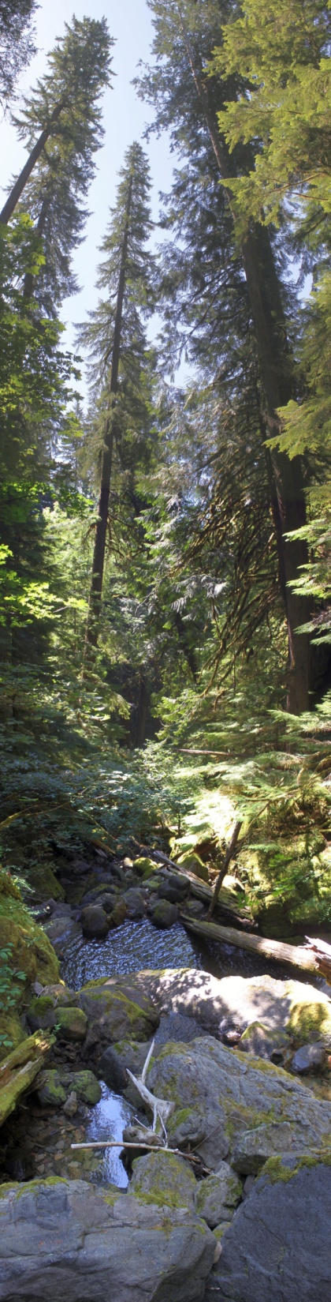

Overview
Primer on Aquatic Conservation Strategy Objectives (ACSOs)
Conceptual Framework
Landscape Analysis Tools
Summary

Slide 3
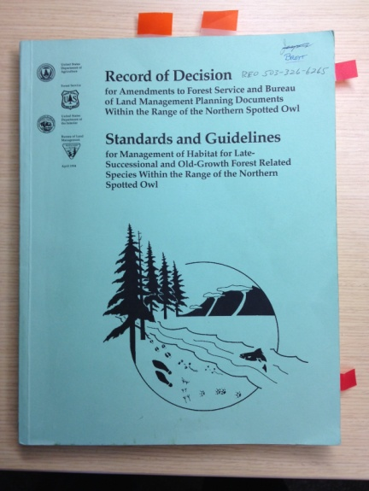
Primer on ACSOs
“Apply silvicultural practices for Riparian Reserves…needed to attain ACSOs” ROD 1994, C-32
“ACSOs must strive to maintain and restore ecosystem health at watershed and landscape scales to protect habitat for fish and other riparian-dependent species and resources and restore currently degraded habitats.”
ROD, 1994 B-9
Key points for compliance with ACSOs
ACSOs are not attained at the unit scale
Restoration is for the benefit of aquatic and riparian-dependent species
Treatments will maintain and/or restore landscape scale processes with the tradeoff of site scale impacts
Identify and quantify tradeoffs

Slide 4
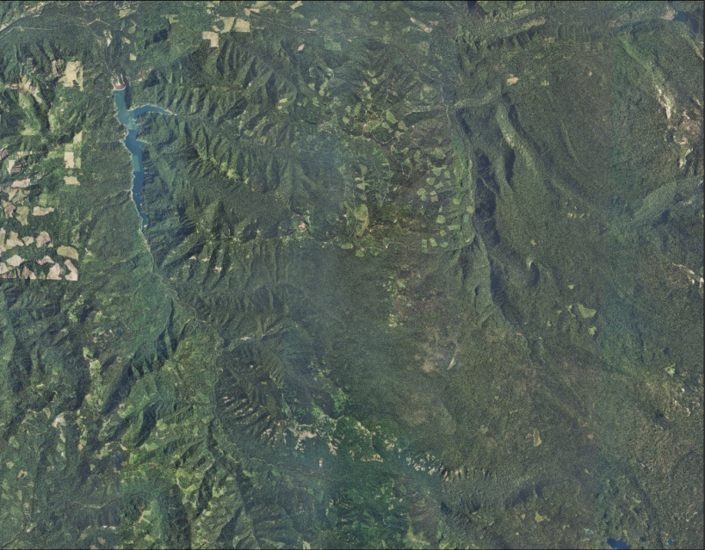
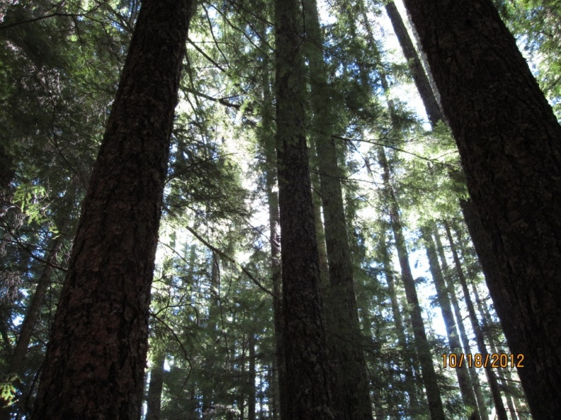
Conceptual Framework
Perform a landscape analysis of the watershed/project area
Identify landscape processes (ACSOs) that have been degraded
Identify active and passive treatments that will move towards the attainment of landscape processes (ACSOs)
Identify tradeoffs. Quantify and describe outcomes including a temporal component (ie. Time to recovery).

Slide 5

Landscape Analysis Tools
Existing Condition
Traditional overlays (PAGs,
Fire history, Soils, etc…)
LiDAR
Imagery
Effects of the Action
Netmap
How we determine where and why treatment is necessary. Identification of disrupted landscape processes
Spatial method for identifying and quantifying impacts. Also good for identifying mitigations

Slide 6
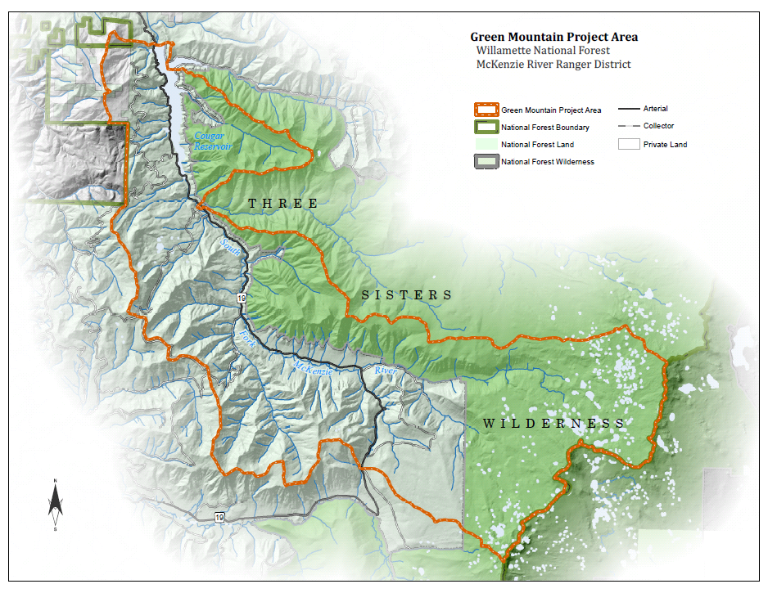
Green Mountain Project Area

Slide 7
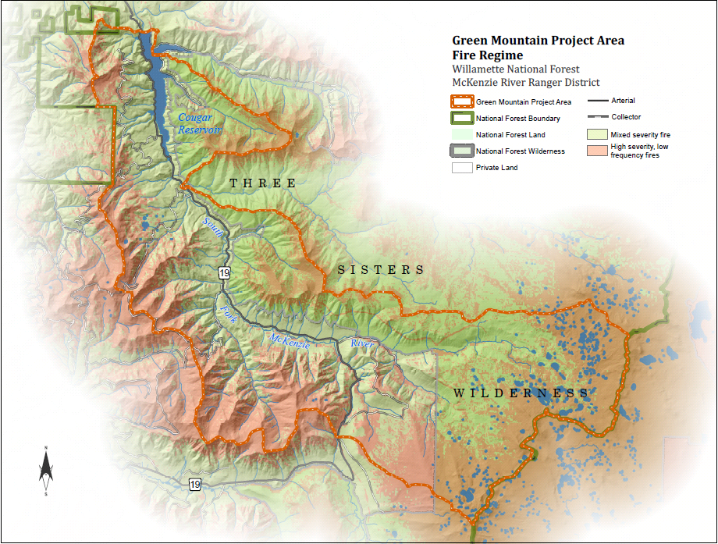
Fire Regime

Slide 8
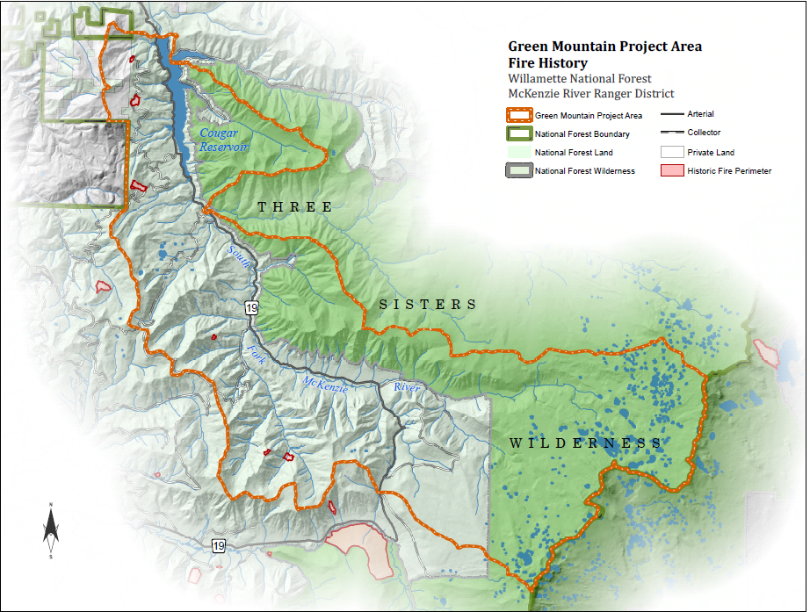
Fire History

Slide 9
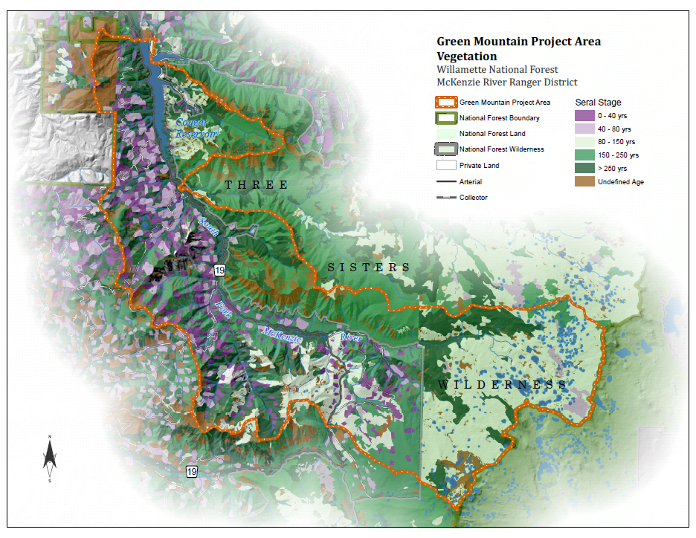
Management History

Slide 10
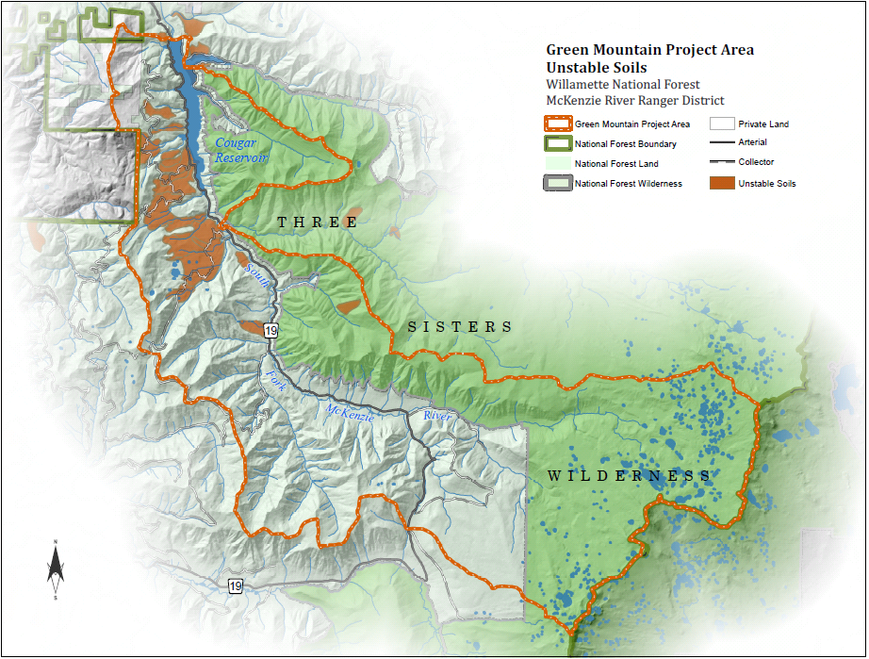
Soils

Slide 11
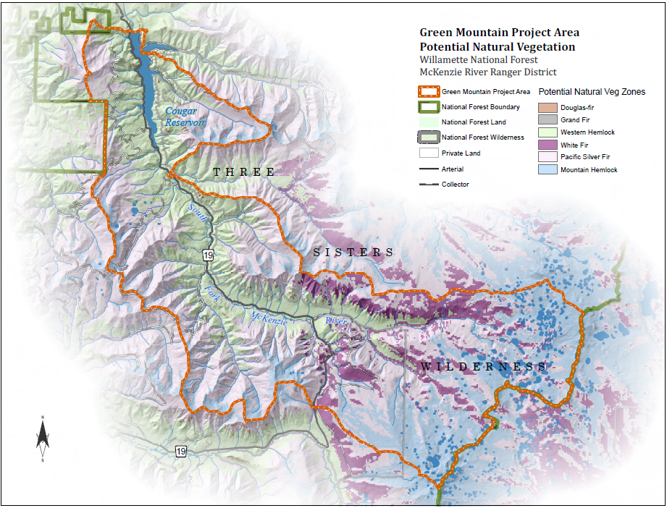
Plant Association Groups

Slide 12
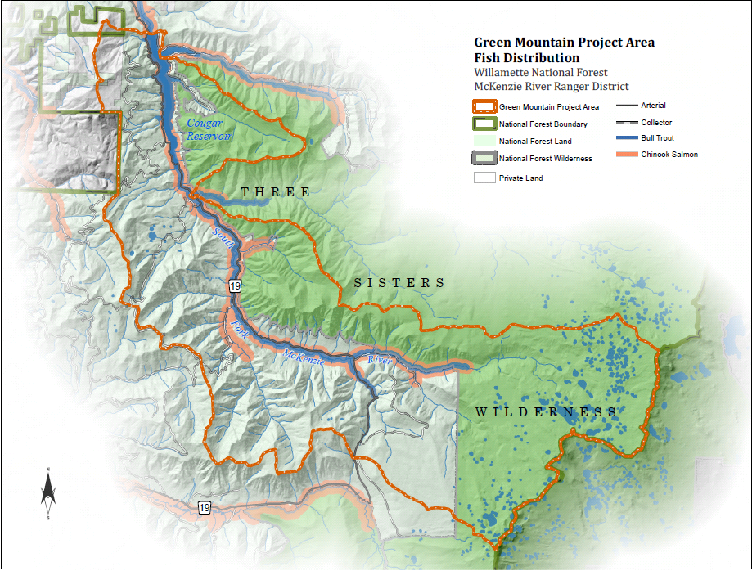
ESA Listed Fish Distribution

Slide 13
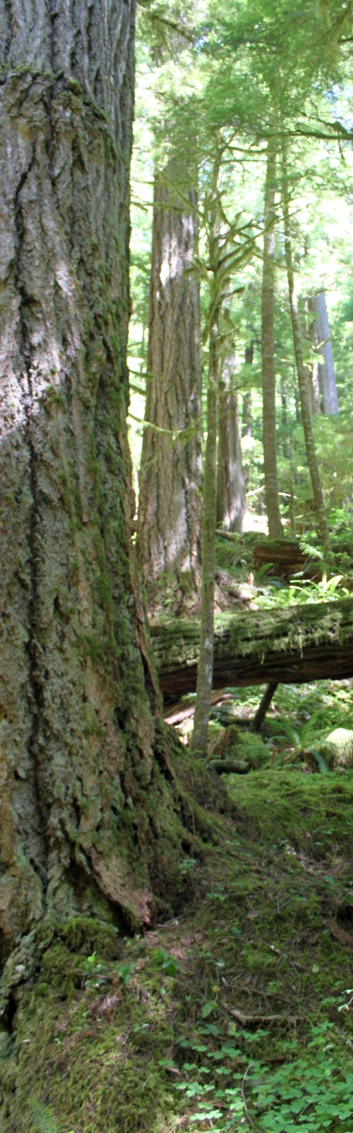
Traditional Overlays Summary
Benefits
Very easy to use
No computer skills required
Can be produced quickly
Drawbacks
Coarse scale analysis
No quantification of attributes
Makes assumptions about vegetation
Contact your local GIS specialist for assistance!

Slide 14
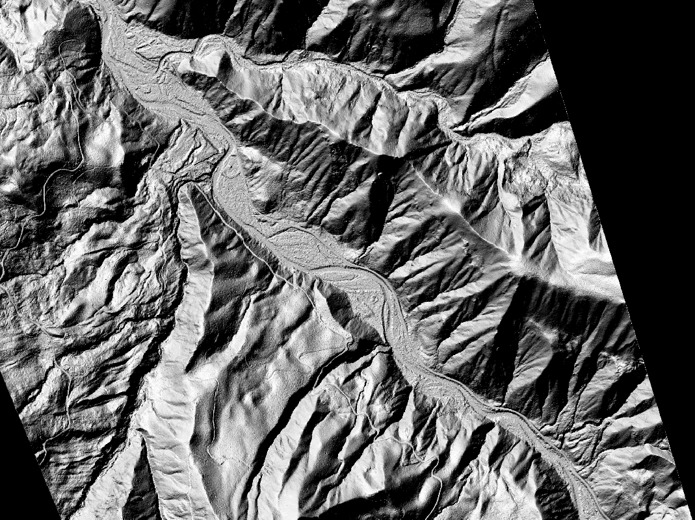
LiDAR

Slide 15
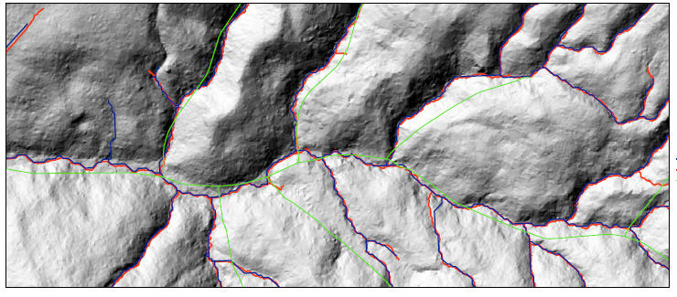
LiDAR- Automated Stream Delineation

Slide 16
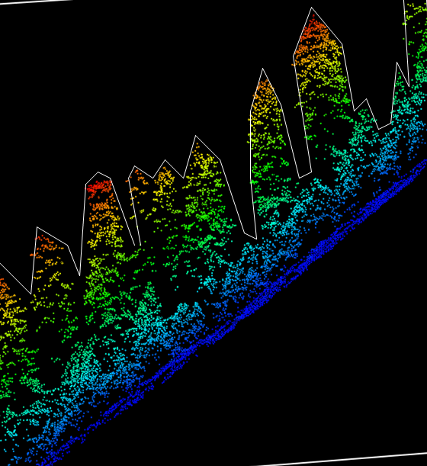
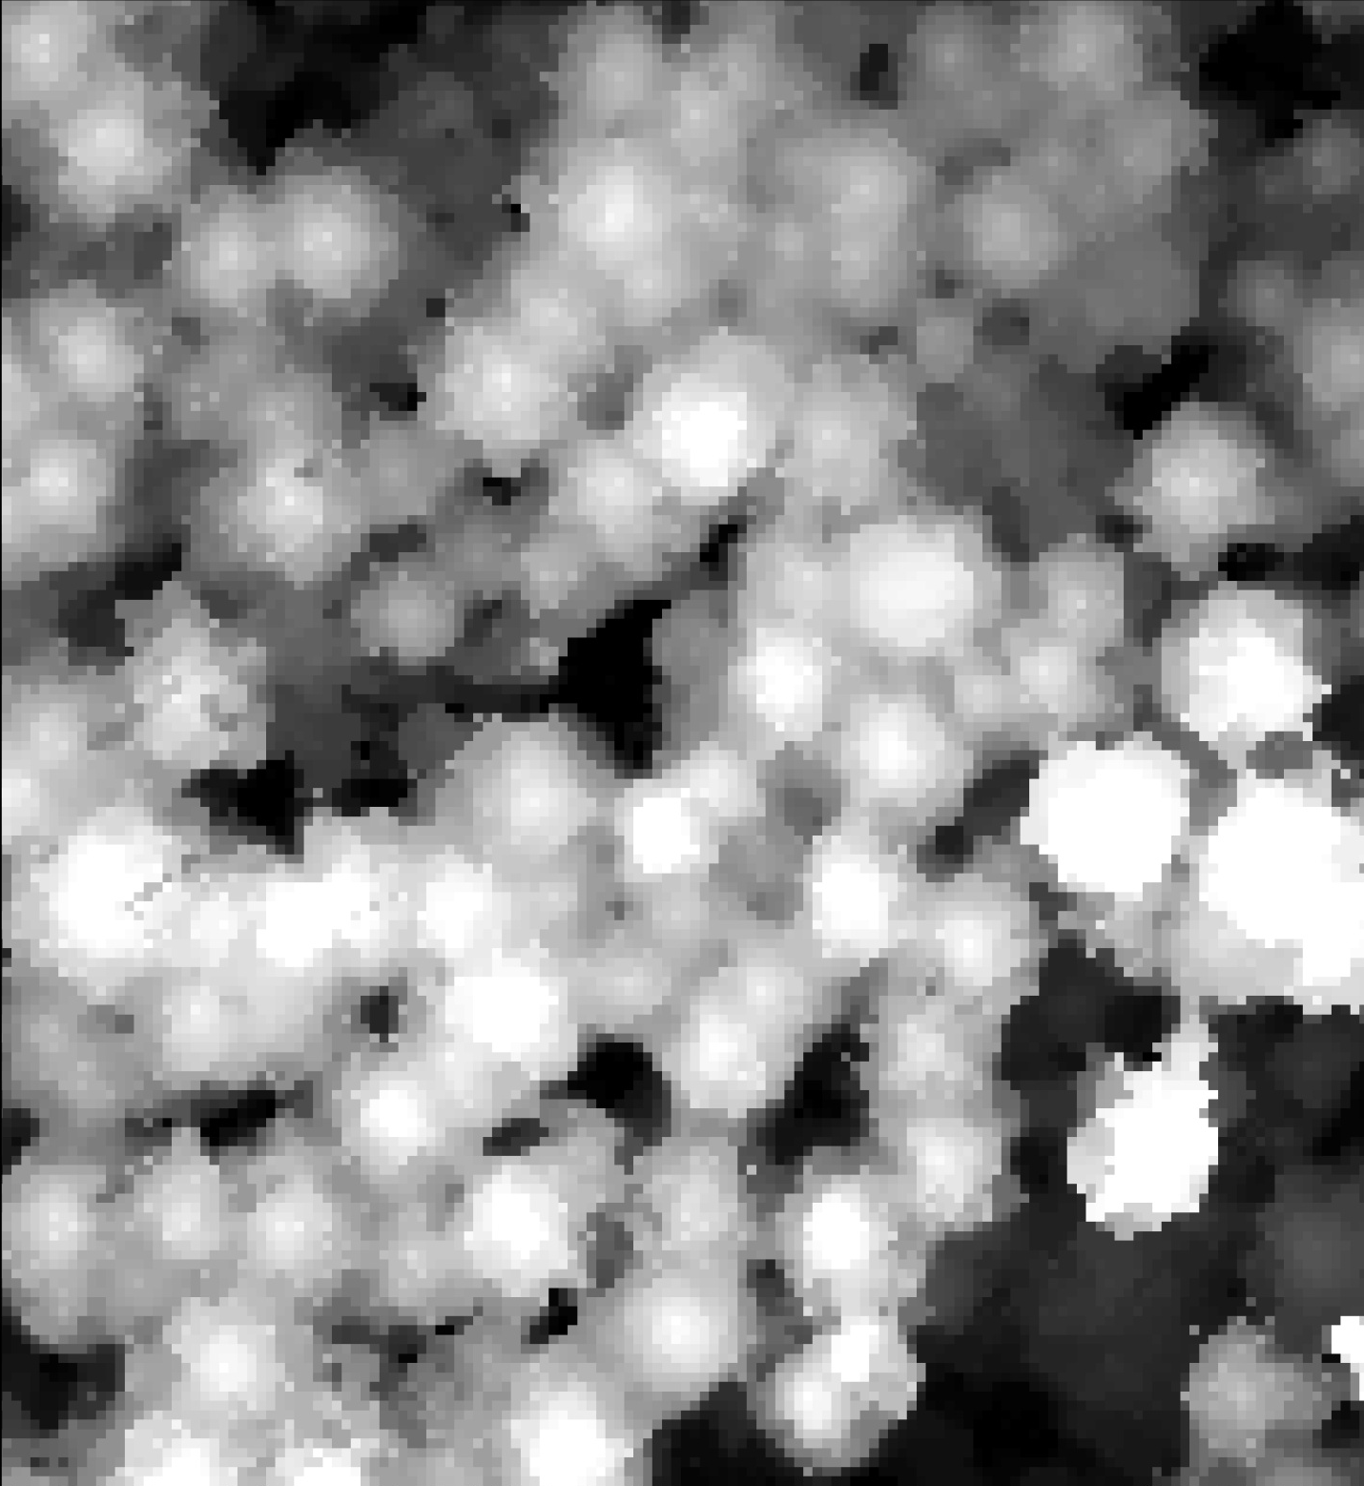
LiDAR vegetation
Examining horizontal diversity of canopy structure

Slide 17
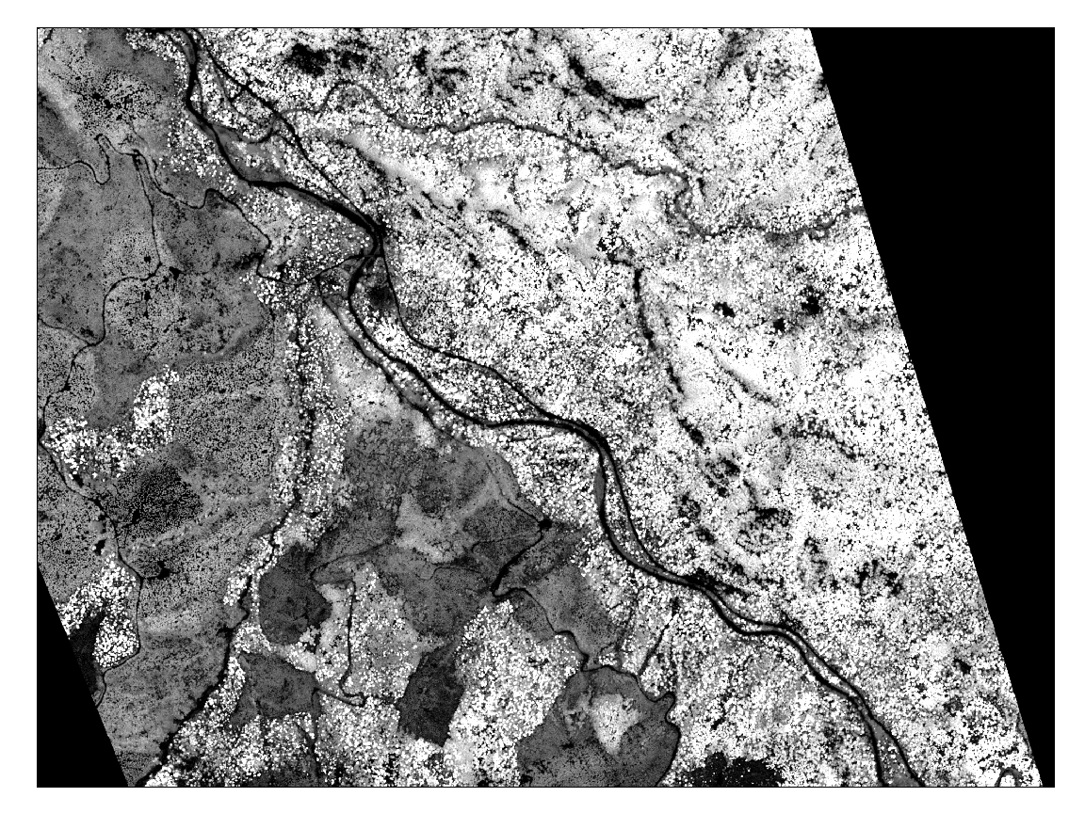
Canopy Height
Wilderness

Slide 18
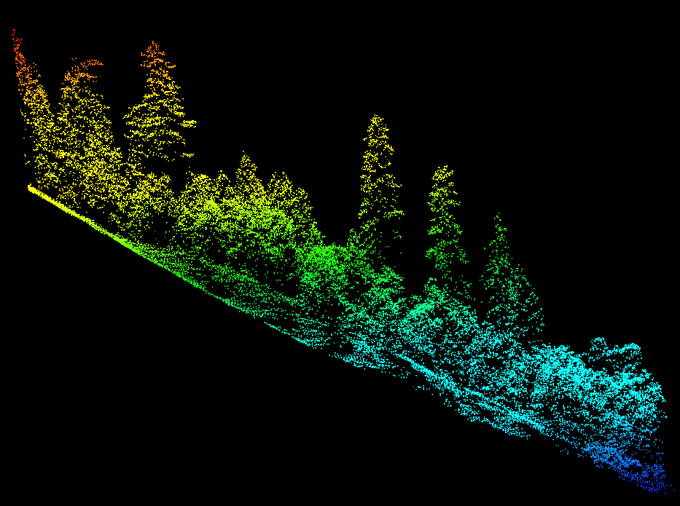

Estimating Veg Attributes Directly
Crown Cover by Height Strata
(Vertical Diversity)
Estimating
We can summarize the proportion
of LiDAR returns by various height
strata (i.e., estimate the amount of
veg by height strata)

Slide 19
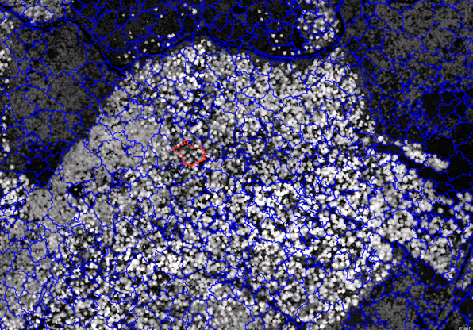
Ecognition

Slide 20
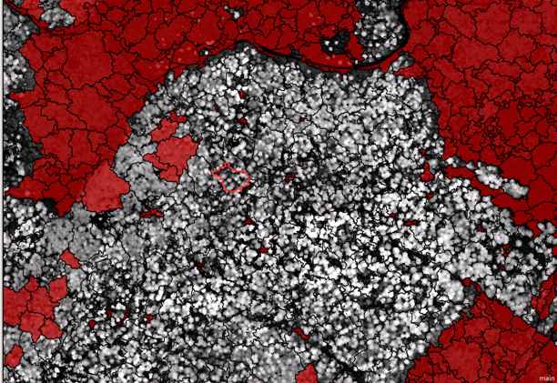
Ecognition

Slide 21
LiDAR summary
Benefits
High resolution
High precision
Can identify many characteristics on the landscape
Focuses field work from data collection to “big picture” resource objectives
Many, many, many other uses!
Drawbacks
Expensive!! ~$600/ mi²
Need technical expertise
Requires field verification
Vegetation data is a snapshot in time
Requires advanced planning (ie. Need to schedule flights about a year prior to project planning)
But there is help!! Call Pete Heinzen 503-808-2865 or Jim Muckenhoupt 503-808-2857, USFS Remote Sensing Group

Slide 22
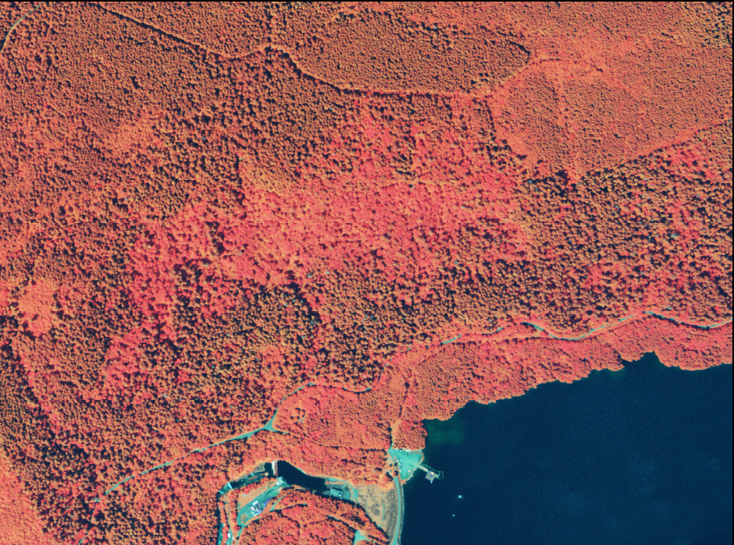
NAIP Imagery

Slide 23
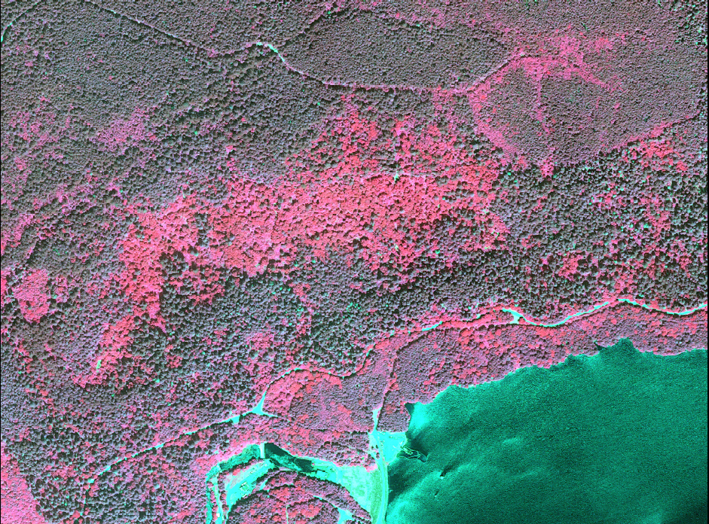
Worldview Satellite Imagery

Slide 24
Imagery cont.
Benefits
Spatial distribution of hardwoods vs. conifers
Avoids assumptions regarding species composition
Only requires modest GIS skills
Free!!!
Drawbacks
Requires digitization of a large land area
Need upfront planning to get coverage
Limited Time Offer
Call Pete at 503-808-2865 to schedule your flight today!

Slide 25
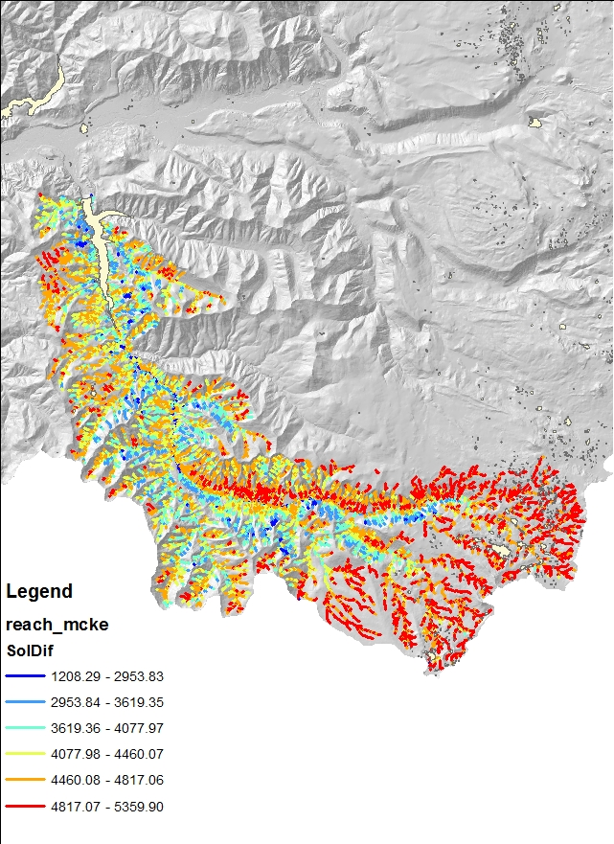
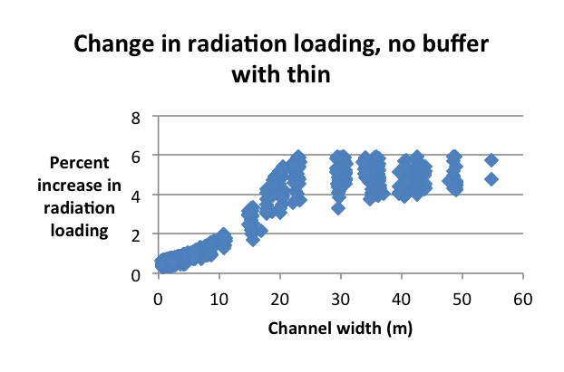
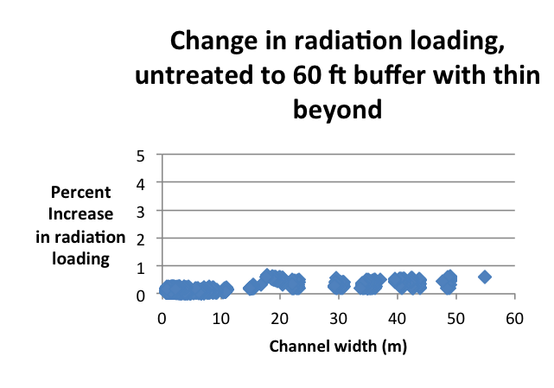
Netmap- Thermal Loading

Slide 26
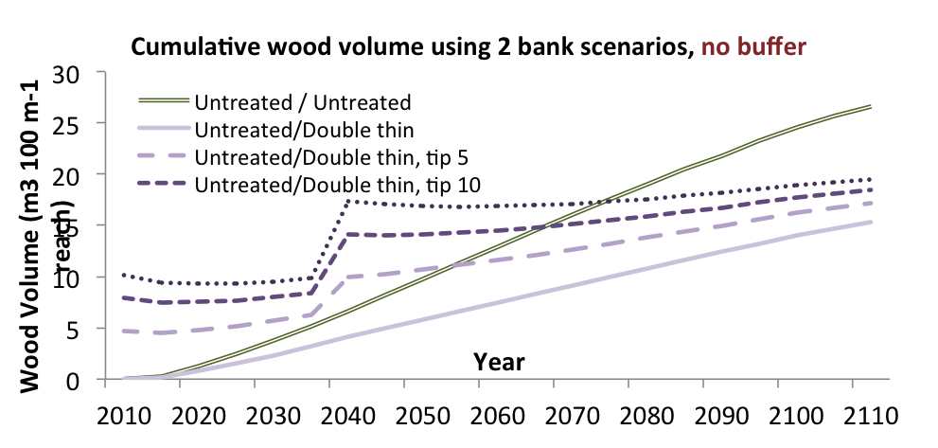
Wood Recruitment

Slide 27
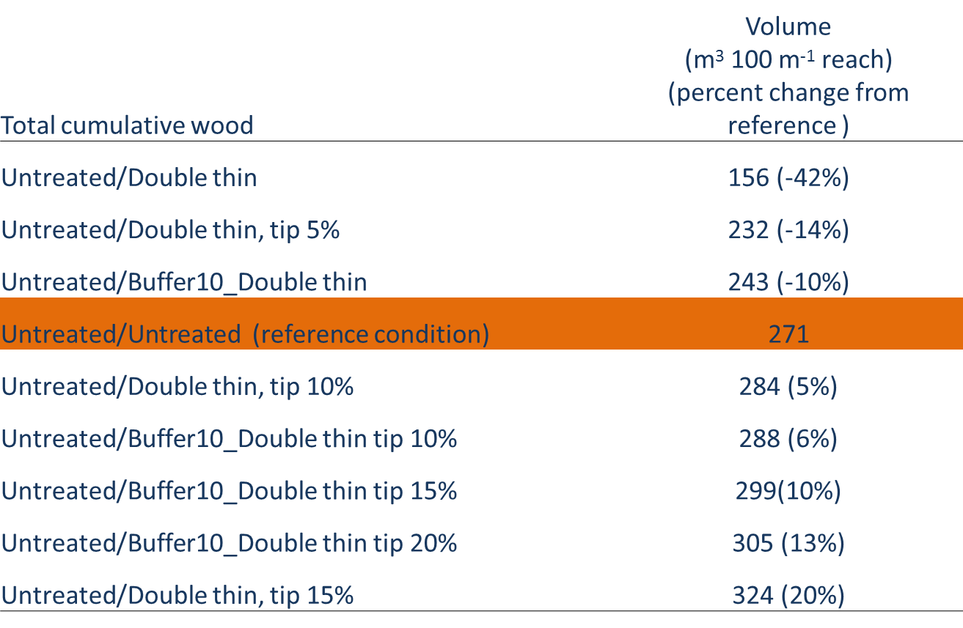
Wood Recruitment cont.

Slide 28
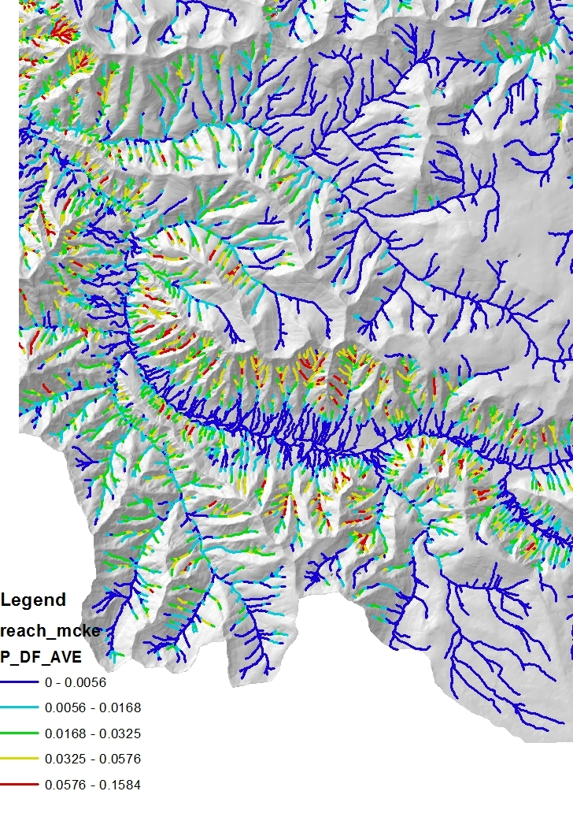
Debris Flow Potential

Slide 29
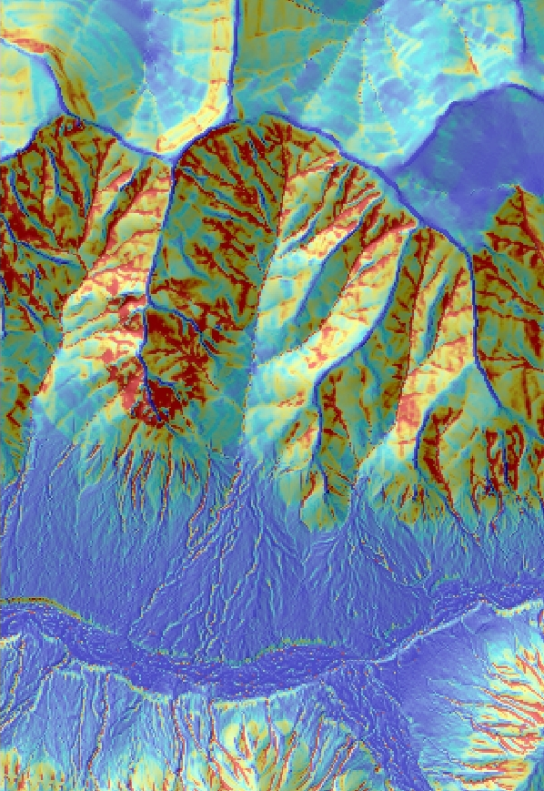
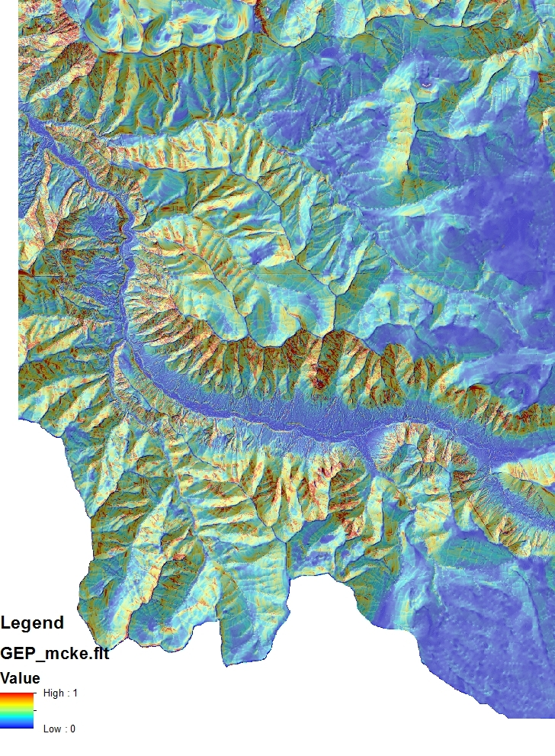
Erosion Potential

Slide 30
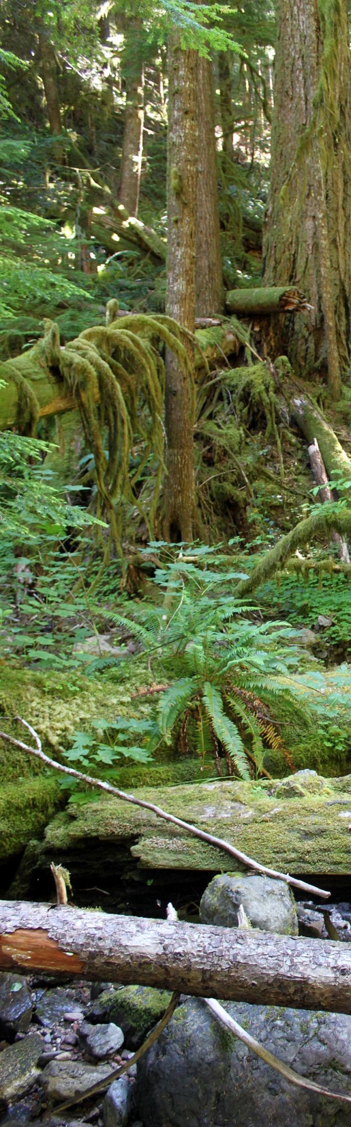
Netmap Summary
Benefits
Quantitative measure of potential effects
Can run sensitivity analysis on the landscape
Can experiment with different treatment scenarios
Does not require much up-front planning
Relatively easy to use
It is currently free
Drawbacks
Validation of the tools still needed
Need other modeling inputs
Netmap for Arc10 available soon! Visit www.netmaptools.org

Slide 31
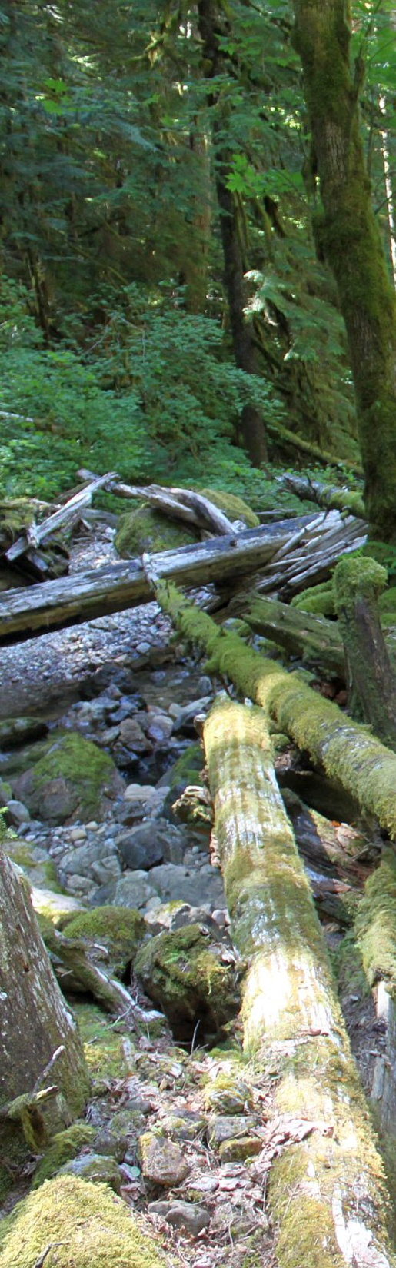
Summary
Landscape analyses takes upfront planning and investment
There are other methods of analysis to comply with ACSOs… this is simply one idea
These analyses are not meant to be prescriptive, simply focus limited reconnaissance time on resource objectives
Field work is still necessary to verify modeling efforts.

Slide 32
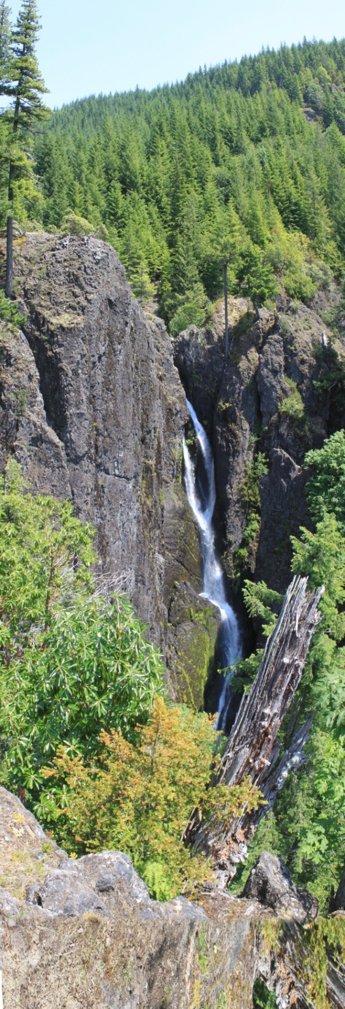
Acknowledgements
Nikki Swanson, Aquatics Program Manager, WNF
Johan Hogervorst, Forest Hydrologist, WNF
Peter Heinzen, Remote Sensing Specialist, RO
Jeremy Hobson, GIS/Data Services Specialist, DRM/WNF
Lee Benda, Netmap, Earth Systems Institute

Slide 33

Questions??
“To keep every cog and wheel is the first precaution of intelligent tinkering.” ― Aldo Leopold, Round River: From the Journals of Aldo Leopold

