Slide 1
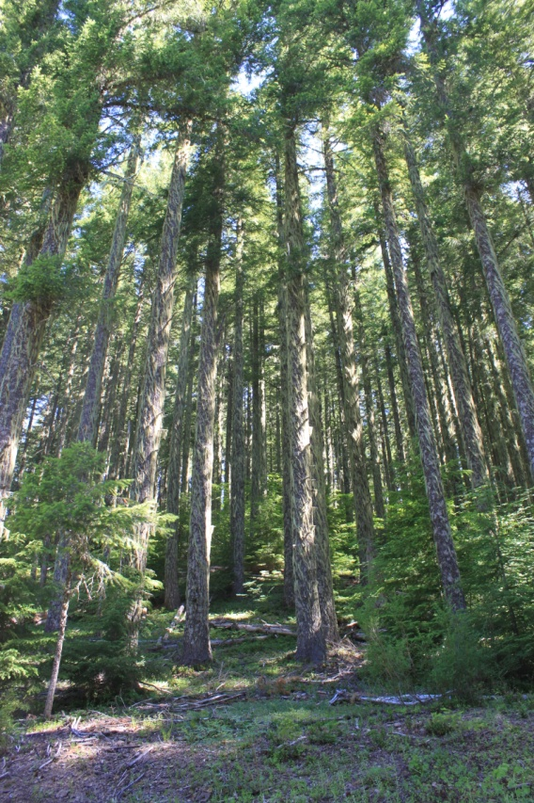
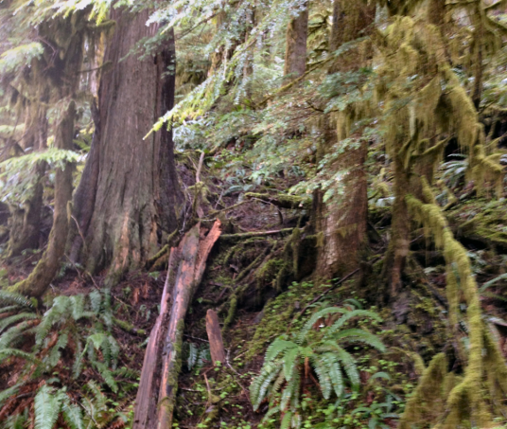
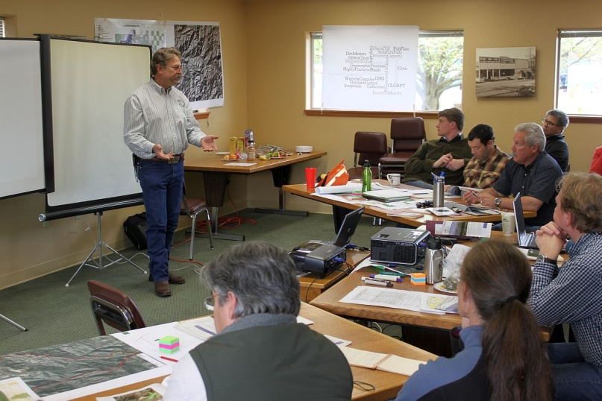
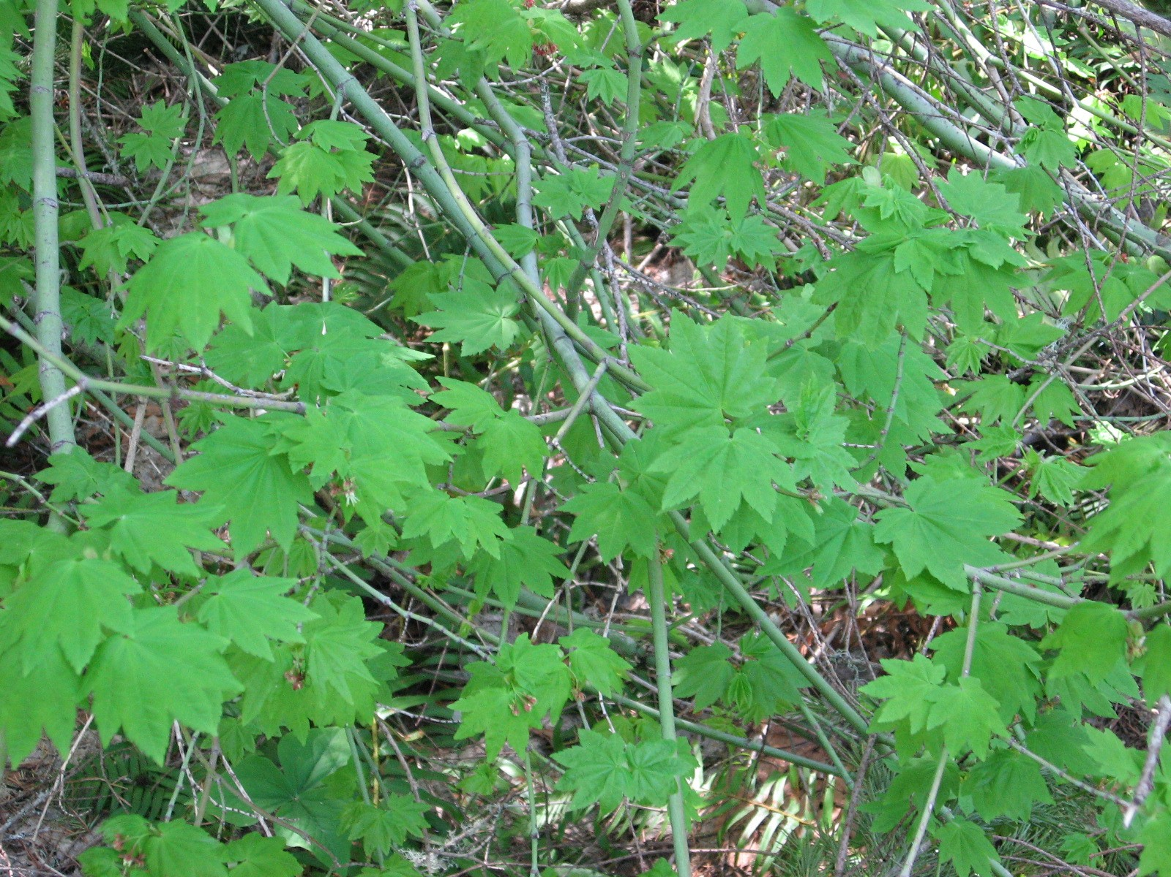
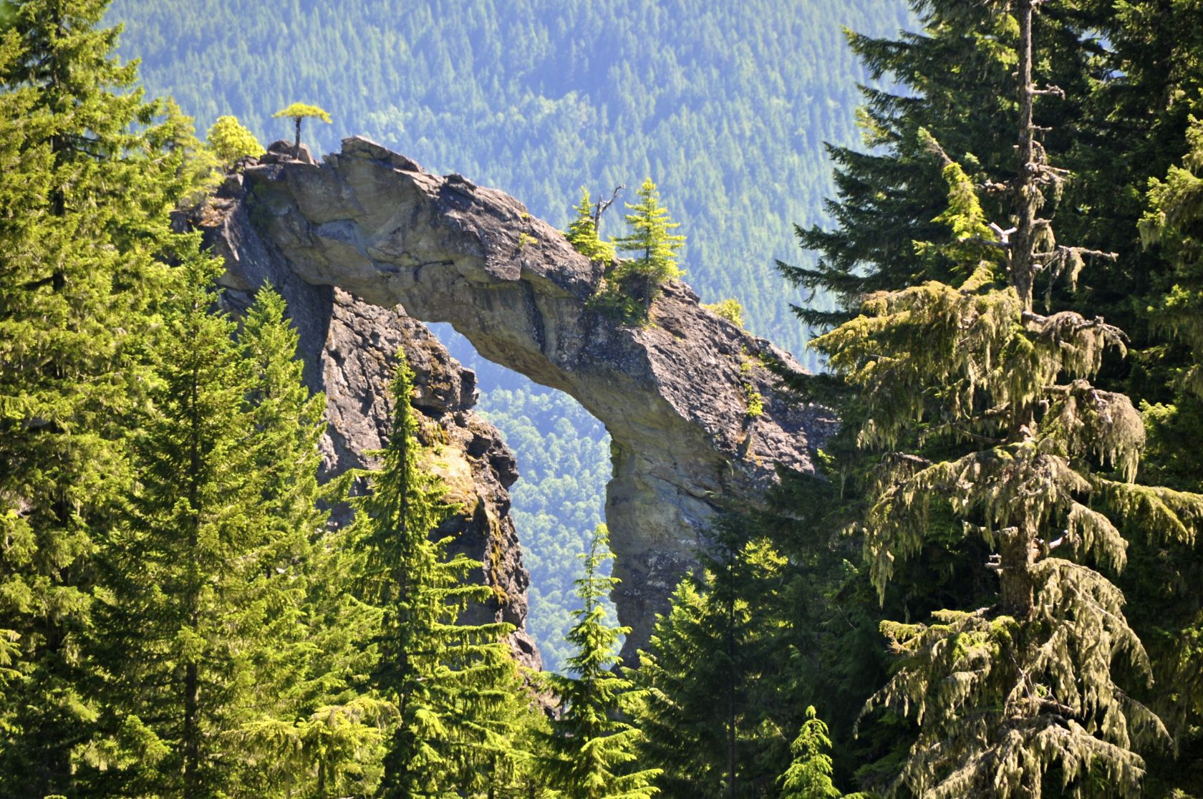
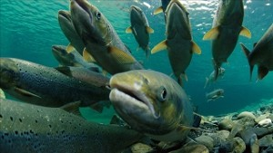
Collaborative Restoration Planning
Cool Soda All Lands Approach
Johan Hogervorst, Forest Hydrologist, Willamette NF
Karen Bennett, Regional Soils Program Manager, Region 6

Slide 2
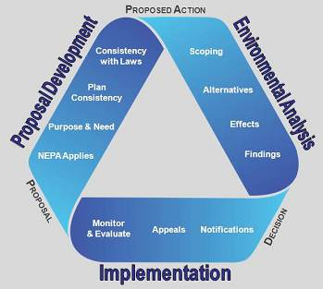
Traditional USFS Assessments
Traditionally:
Silviculturally driven
Ties to landscape
processes were weak
Didn’t meaningfully
involve the public
Notes:
NEPA triangle: In the proposal stage, traditionally driven by silvicultural reasons (units) and does not include the public. Previously managed units that need thinning are brought forward and specialists of the IDT respond or mitigate to the selected units. Additional projects connected to the timber sale are identified, but they are identified in relationship to the units that were selected, not necessarily from any kind of landscape scale reasoning.

Slide 3
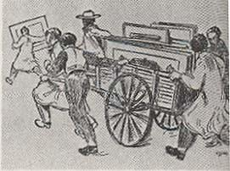
A Different Approach -
The Charette Process
Intensive effort to finish a design project
  French Architecture term “cart”
Iterative process
  Knowledge shared
  Ideas developed with a community of interest
  Repeated pin-ups of the latest products to obtain feedback
Used this process in the Soda Fork sub-watershed on the Sweet Home RD to develop the proposal pre-NEPA.

Slide 4
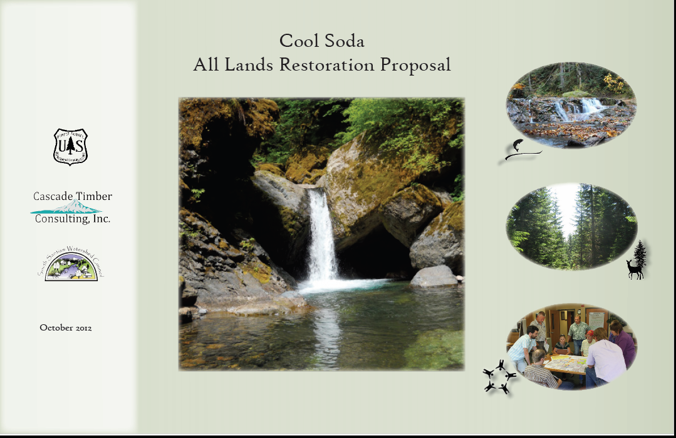
Cool Soda Charette Process Steps
1. Designate:
  Project Area
  Team Leader/Facilitator
  Core team
  Consultants to the core team
  Community of Interest (Stakeholders)
  to give feedback
2. Knowledge Transfer
  Intensive Introduction to the Area
3. Collective Learning
  Community of Interest gives feedback to “Pin ups”
  Investigation and Data Collection
    Cultural, Ecological, Social, Economic
4. Restoration Design Concept
  Community of Interest feedback
5. Graphic Report of the Design

Slide 5
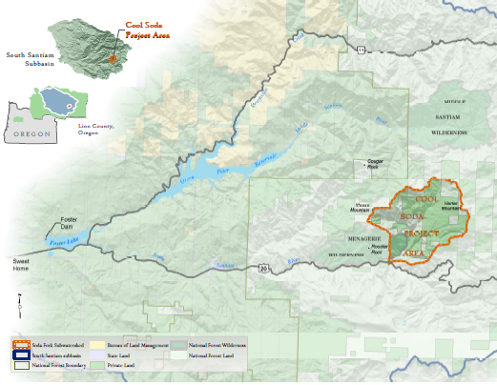
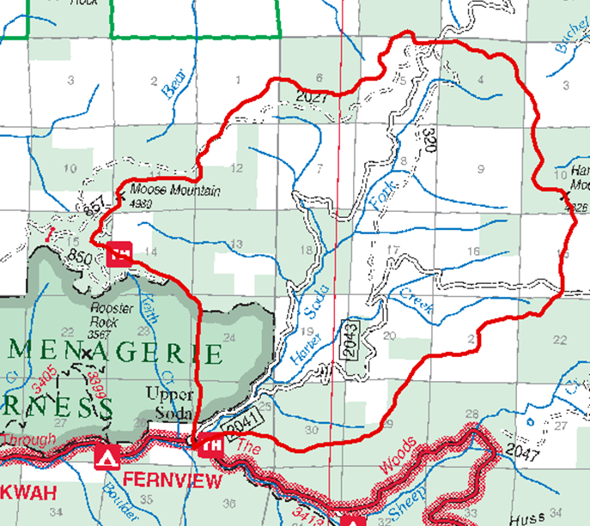
Project Area

Slide 6
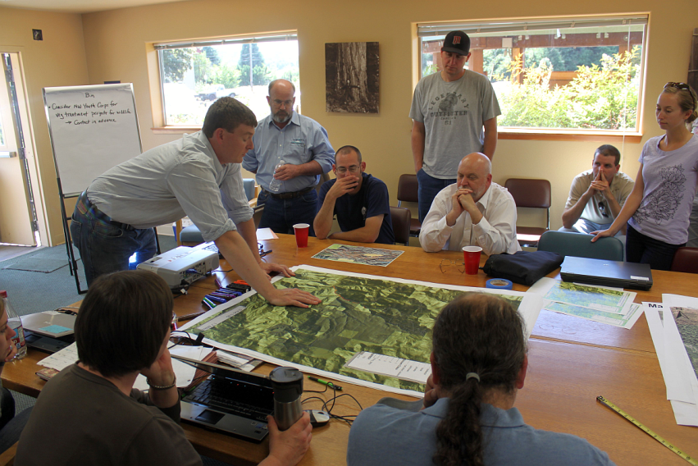
Participants
USFS Core Team (Consultants)
  Team Leaders: Johan Hogervorst /Anita Leach
  Watershed Specialist– Lance Gatchell (Doug Shank)
  Aquatic Biologist – Brett Blundon
  Terrestrial Ecologist – Anita Leach (Leslie Elliott, Nanci Curtis, Jane Kertis)
  Wildlife Biologist – Tiffany Young
  Cultural, Heritage, Recreation – Jon Meier (Tony Farque)
CTC Core Team
  Dave Furtwangler
  Milt Moran
  Bill Marshall
GIS analyst – Jeremy Hobson

Slide 7
Community of Interest
City of Sweet Home
Linn County Park Dept.
South Santiam Watershed Council
Sweet Home Economic Development Group
Portland State University Students
University of Oregon Ecosystem Workforce Group
Oregon State University
Oregon Dept. of Fish and Wildlife
Confederated Tribes of Grand Ronde Community of Oregon
Confederated Tribes of Siletz Indians
Confederated Tribes of Warm Springs Reservation of Oregon
Oregon Wild
Cascadia Wildlands
Rocky Mountain Elk Foundation
Oregon Hunters Association
American Forest Resource Council
General Public

Slide 8
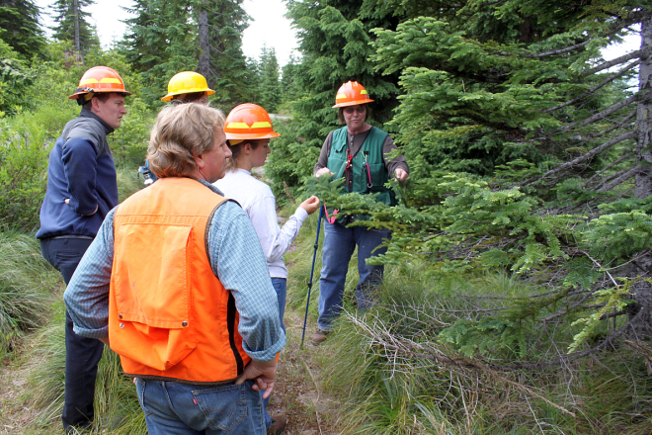

Knowledge Transfer
Field visit with experts (scientists/locals)
  Vegetation Dynamics
Wildlife Habitat
Watershed and Aquatic Sciences
Heritage and Cultural Resources
38 speakers over five separate days

Slide 9
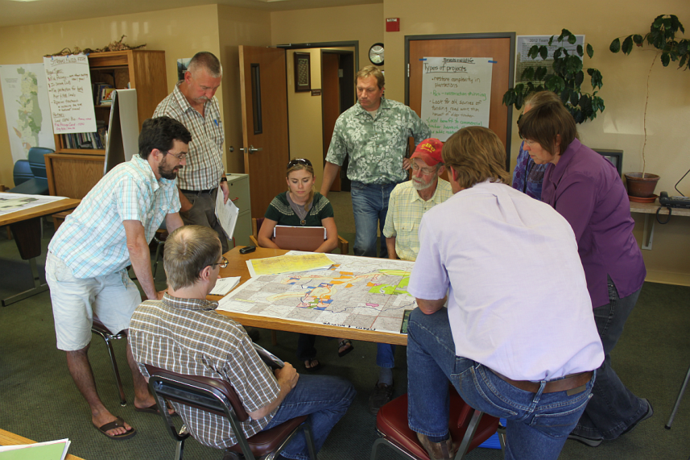
Collective Learning
Collaborative Pinup #1
– Inherent Capacity
- Community Values
Collaborative Pinup #2
– Existing Condition
– Refine Community Values
Collaborative Pinup #3
– Draft Restoration Ideas
Collaborative Pinup #4
– Final Restoration Design

Slide 10
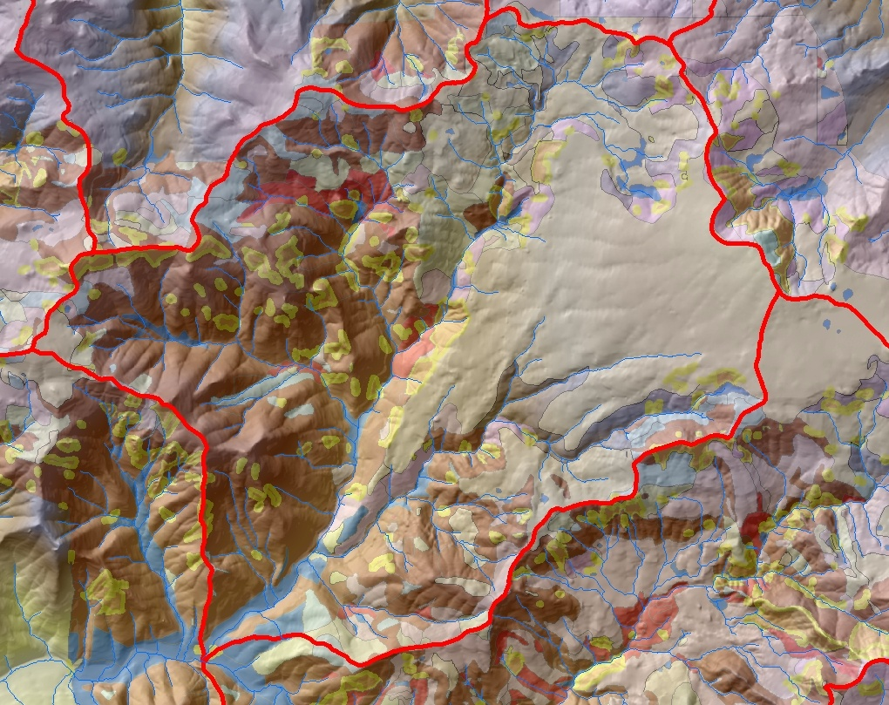
Geology, Soils, Landforms
Springs and Wet Areas
Sediment Producing Areas
Upland Glacial Benches
Rocks and Cliffs
Volcanics, Tuffs and
Breccias, Steep
Sediment Storage Areas

Slide 11
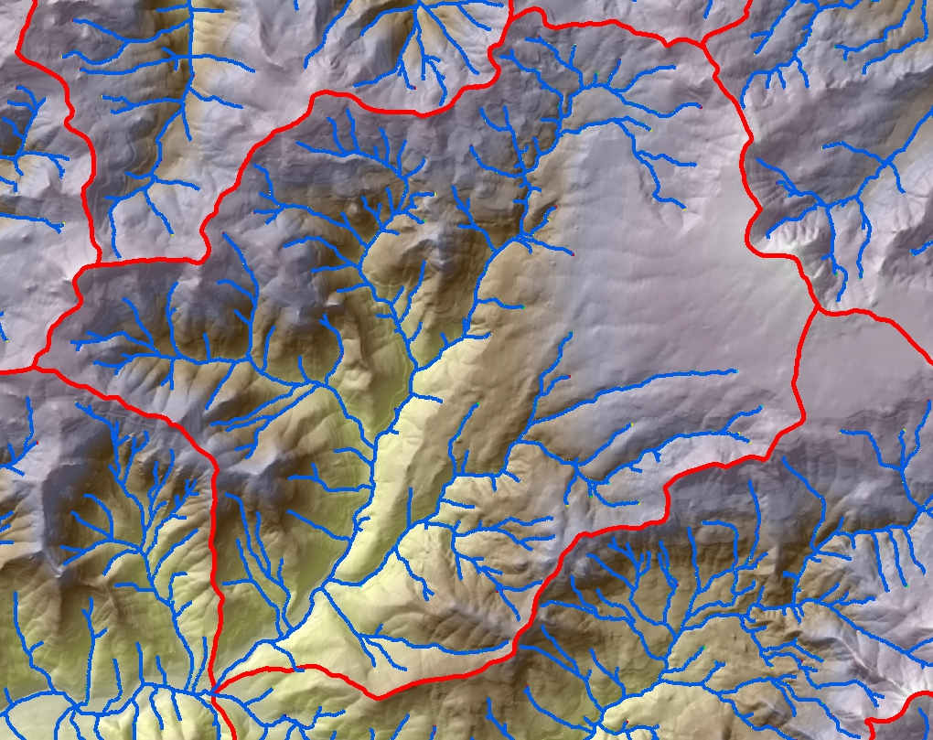
Hydrology
Hummocky Terrain
Streams not as latticed
Less flashy, more infiltration
Suttle Camp Creek
Steep Flashy System
Shallow Soils, less water storage
Very Powerful Peak Flows
Low Summer Flows
Fractured Basalt
Very little stream development
Large groundwater source
Soda Fork Surprisingly cold
Result of large groundwater input?

Slide 12
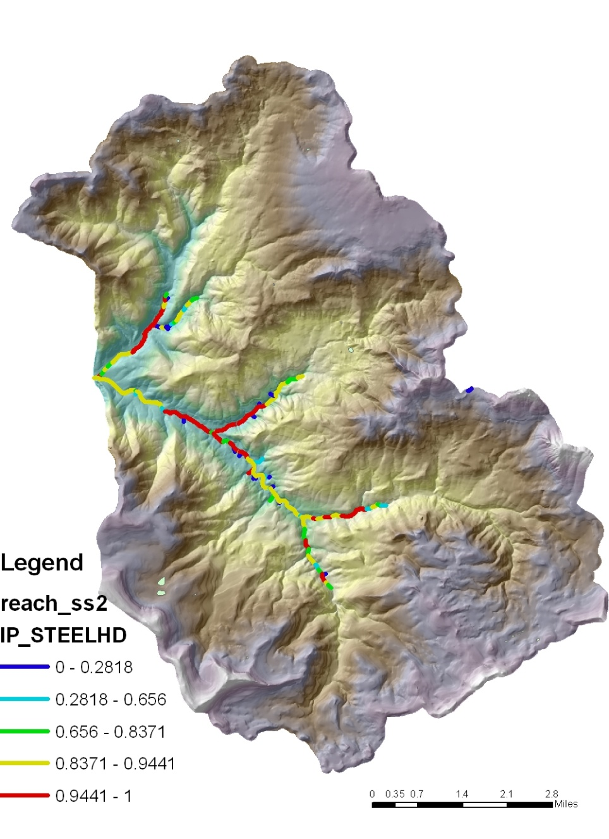
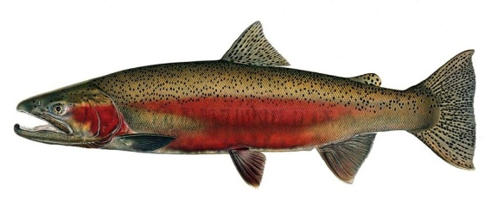
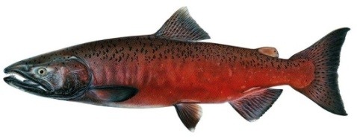
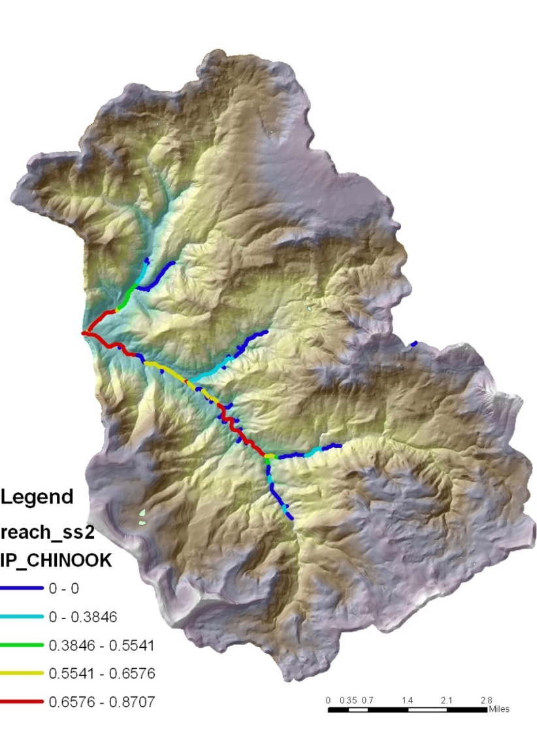
Fisheries Resources
Salmonid Intrinsic Potential

Slide 13
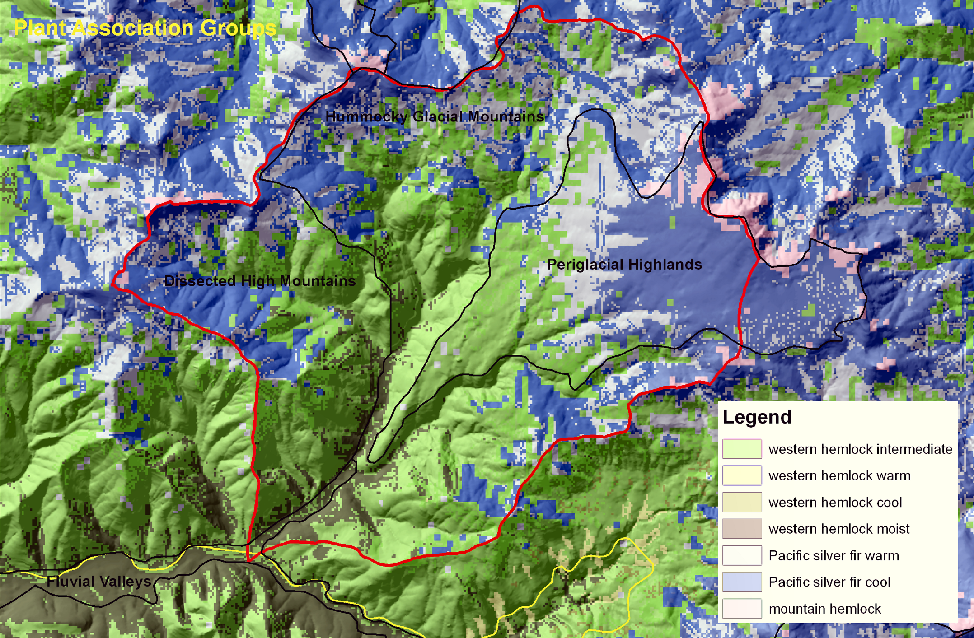
Historic Vegetation

Slide 14
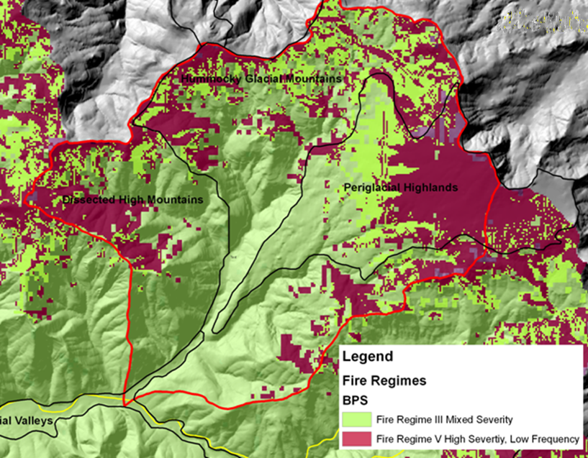
Fire Regimes

Slide 15
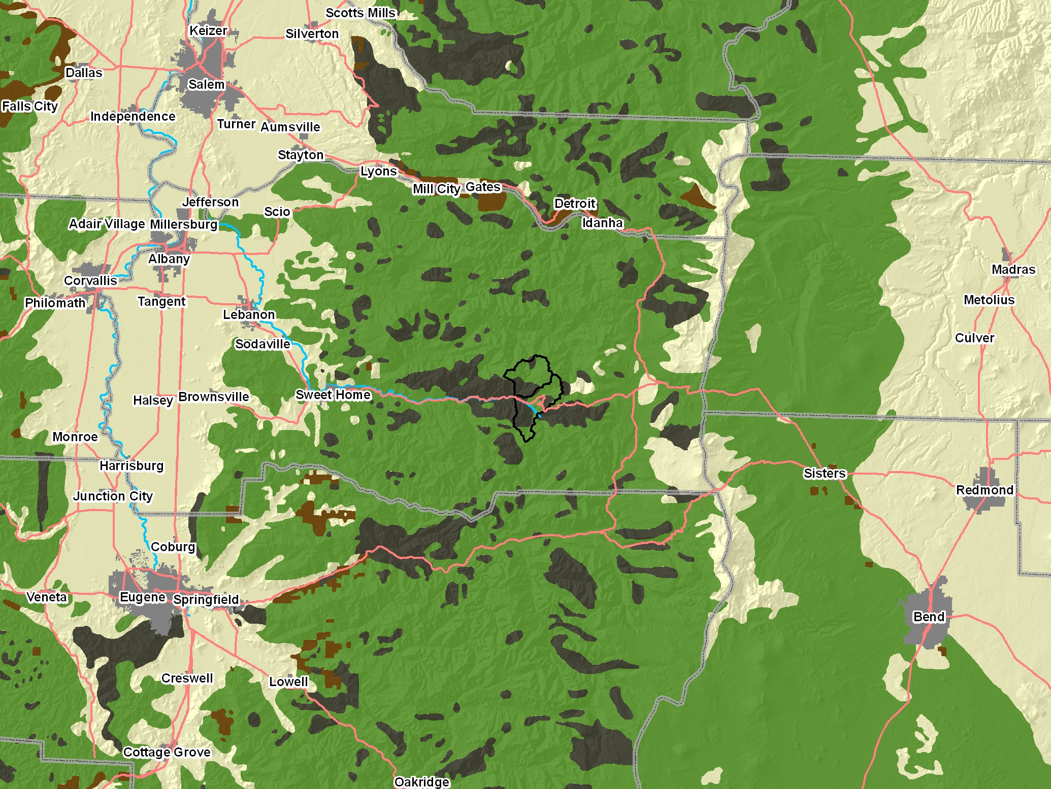
The dark gray areas represent what was mapped in the 1914 map as “deforested burns”… representing the stand-replacement patches caused by large wildfires from the last half of the 19th century, and first decade of the 20th (roughly 6 decades of fire patterns).

Slide 16
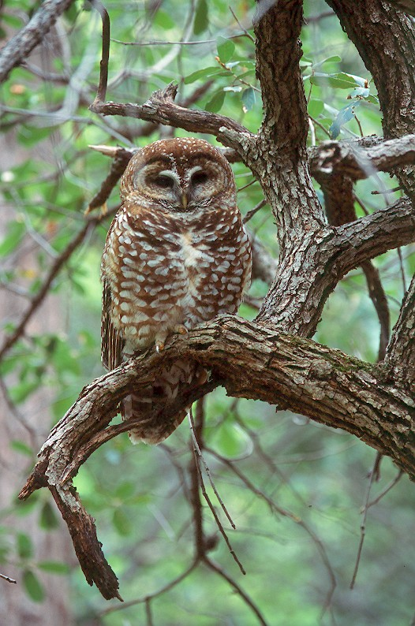
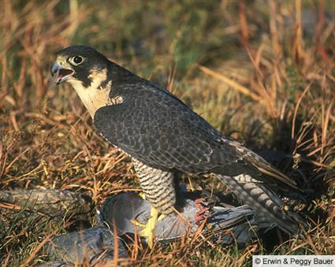
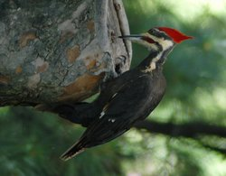
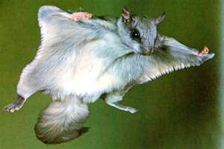
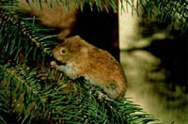
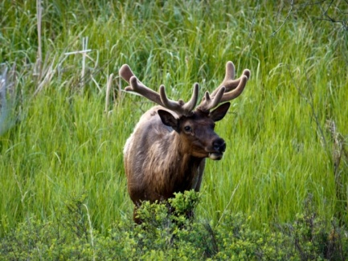
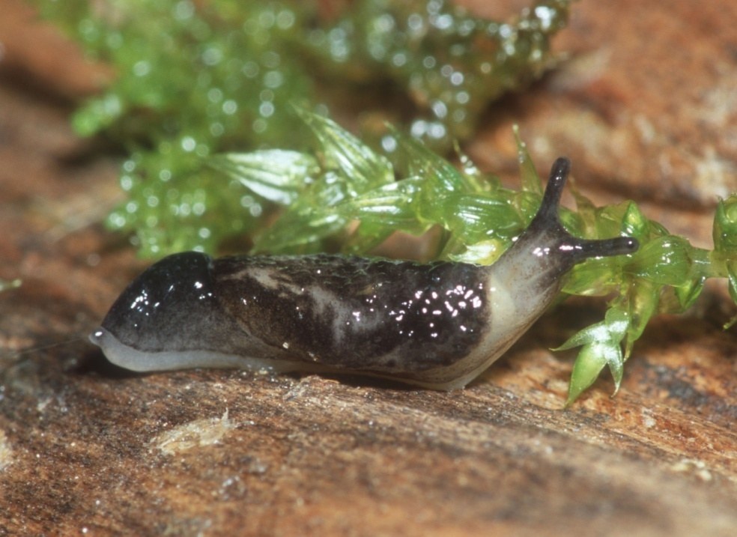
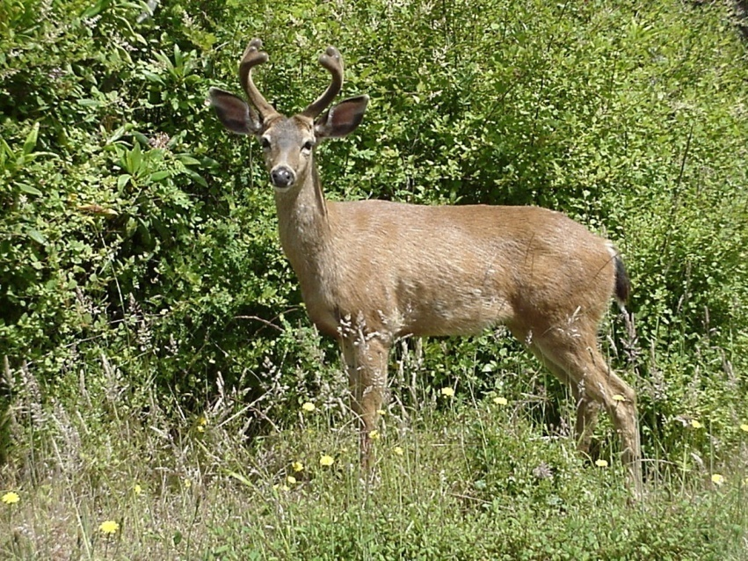
Historic Wildlife Species
Bill Leonard

Slide 17
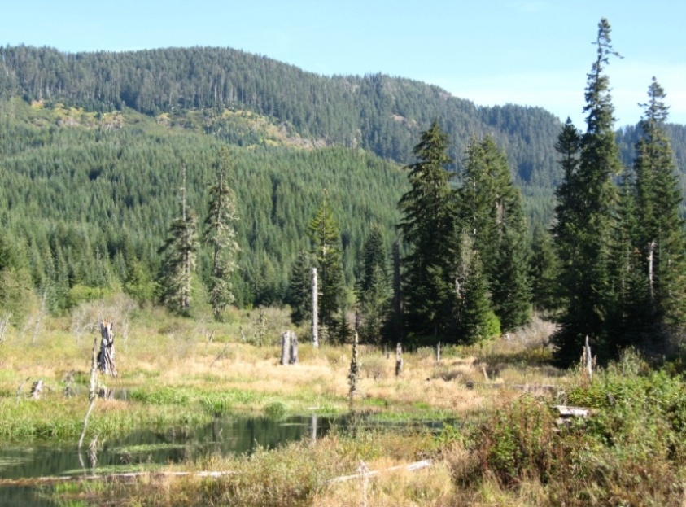
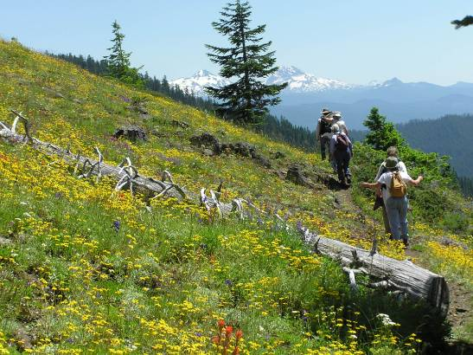
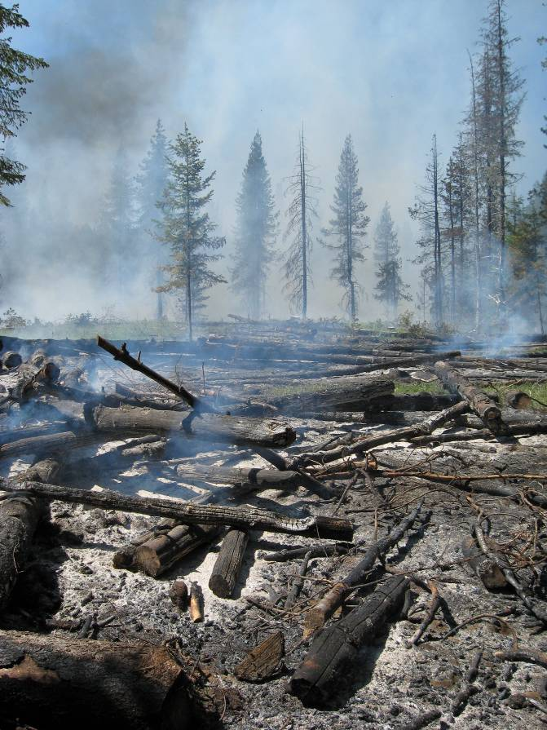
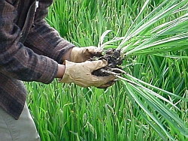
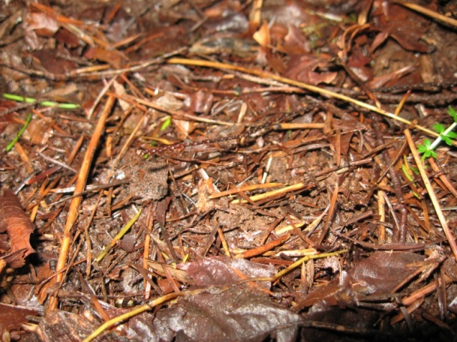
Special Habitat Types
Dry Meadow Habitats
Wet Meadow Habitats
Ponds and Seeps
Rock Talus Areas
Skunk Cabbage Patches
Older Vine Maple areas

Slide 18
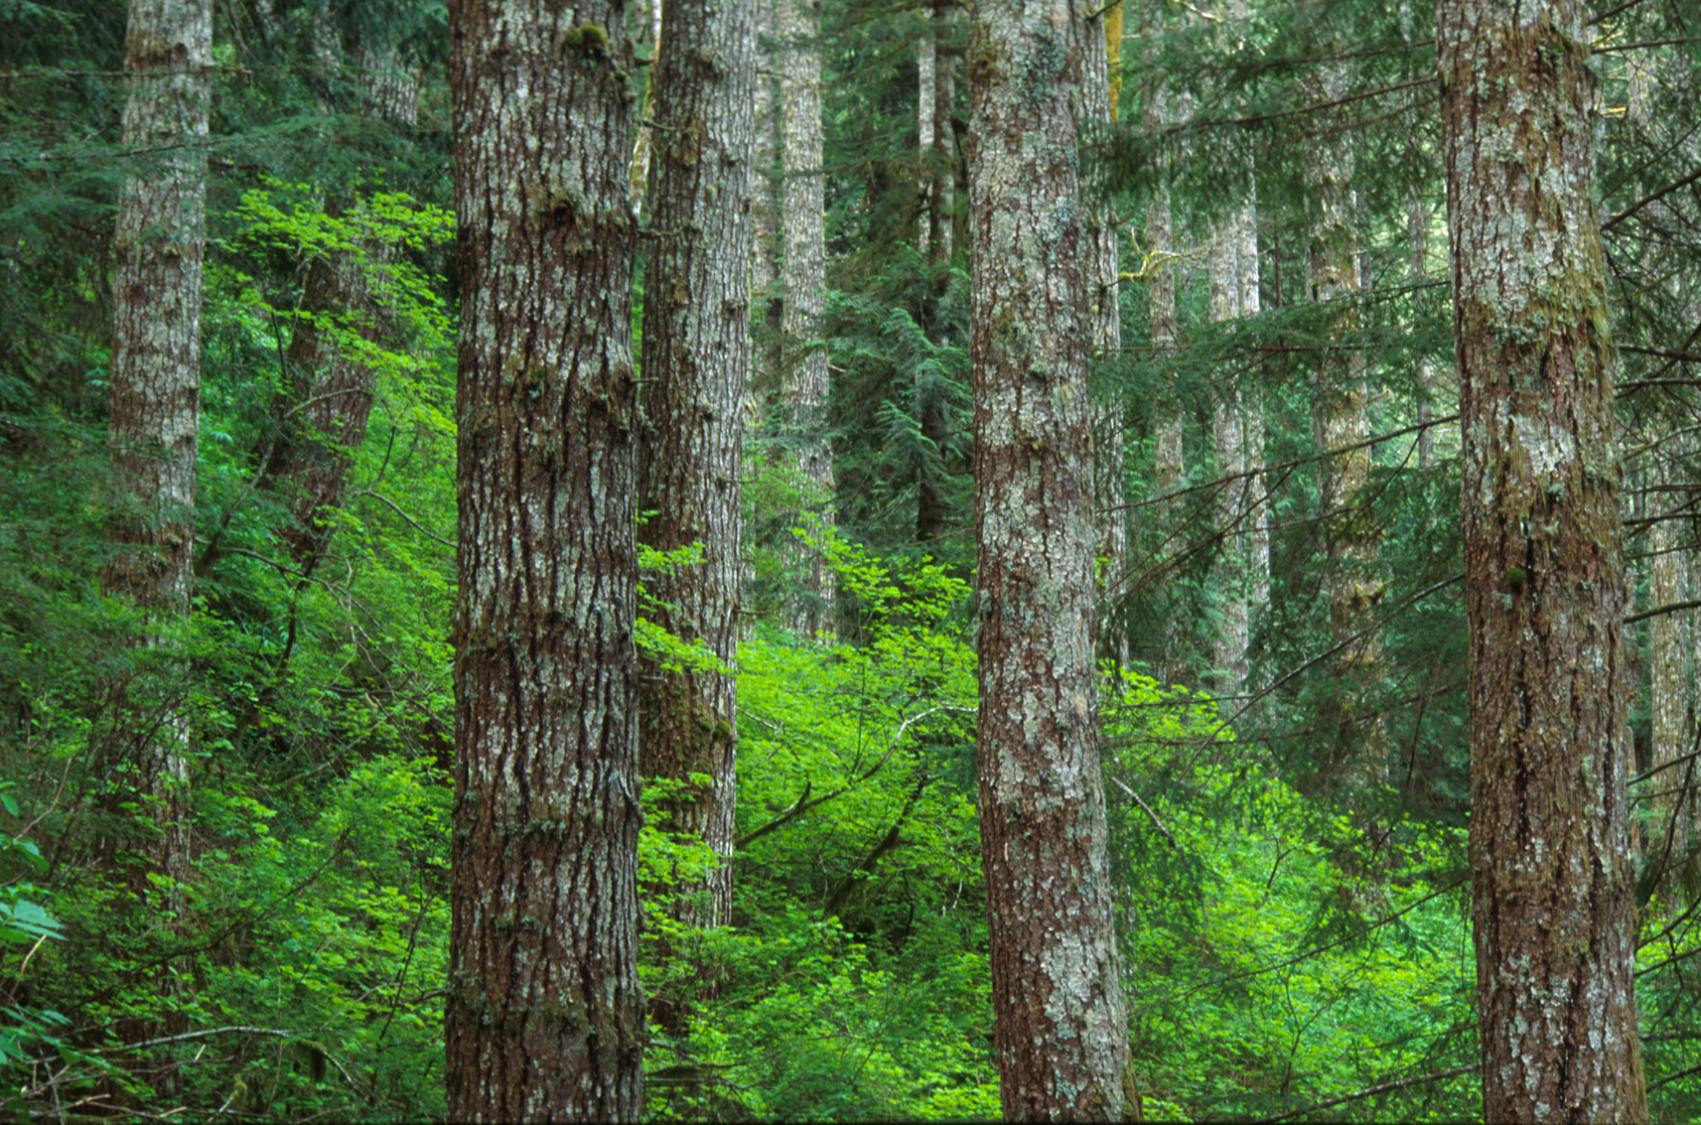
Ecosystem Services or Benefits from Nature
The benefits that people receive from nature...
SUPPORTING – PROVISIONING – REGULATING - AESTHETIC
Fish and wildlife habitat
Clean air and water
Pollination
Mitigation of environmental hazards
Control of pests and diseases
Carbon sequestration
Soil productivity
Wood products
…are often undervalued or unrecognized.

Slide 19



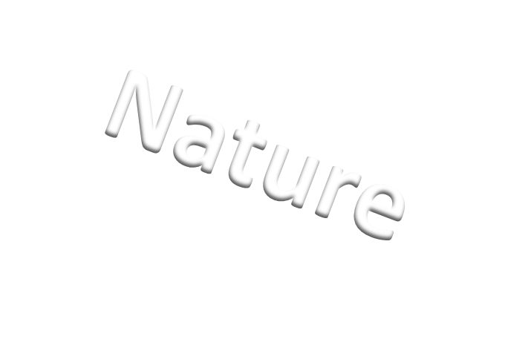
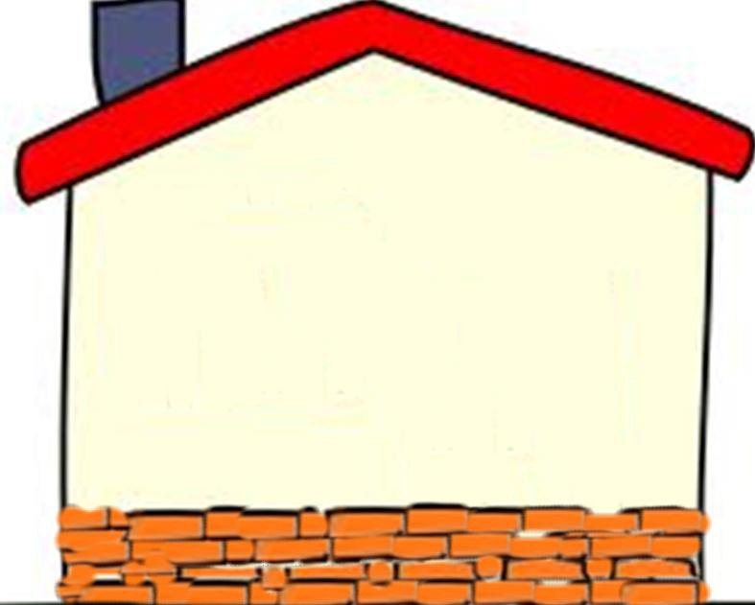






Provisions
Visual quality
Scenery
First foods (huckleberries)
Recreation potential
• Dispersed camping
• Swimming holes
• Hiking, fishing, hunting
Existence value
Spiritual (Native values and
general recreation)
Solitude, Space
Cultural heritage
Rich settlement history
Public access
Special or unique species
Clean cold water
• drinking water
Food
• fish, plants, elk, deer, upland birds
• First foods (huckleberries)
Forest products
• Wood products
• Special forest products
Mineral sources
• Stream gravel
• Road rock
Jobs and economic activity
Community revenue source
Riparian
•Aquatic, floodplain
Upland Forest
•Old growth, mid-
seral, early seral
Shrub
•Vine maple patches
Meadows
•Wet and dry
Ponds and seeps
Rock talus
Human Actions (Potential to affect above or below): Flood Control Dam, Forest Management, Road Construction and Maintenance, Fire Suppression , Recreation
Underlying Processes and Functions (Foundation)
Nutrient cycling , Nutrient fixation (red alder), Soil formation , Natural Disturbance (Fire, wind,
landslides, insects and disease) ,Water cycling (Collection, storage, release, filtration, cooling) ,
Carbon cycling , Photosynthesis (Oxygen production) , Elevational diversity, Air purification
Community Values
Additional benefits from this landscape project:
• Partnership potential of checkerboard landscape
• Shared resources, cost saving

Slide 20
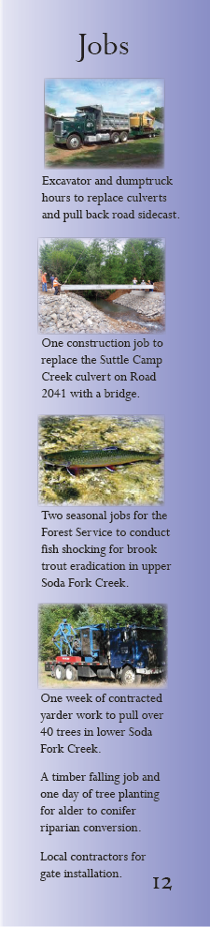
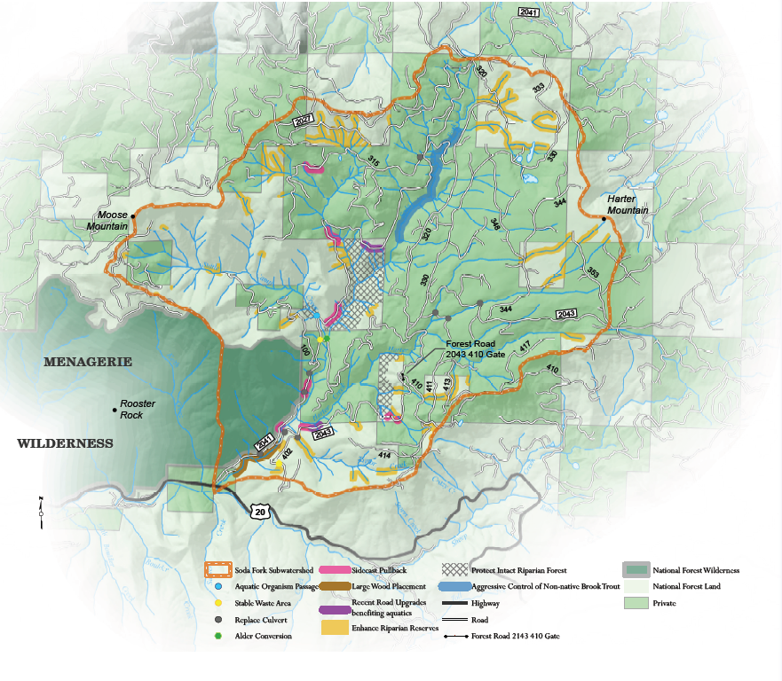
Streams and Wild Fish
Restoration Design
Landscape Challenges…Desired Condition…World of Ideas…Near Term Actions

Slide 21
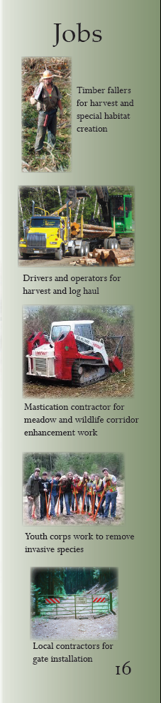
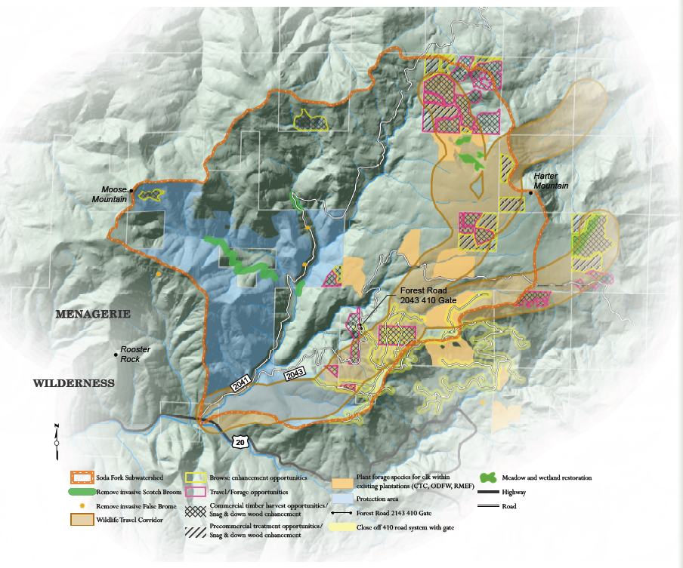
Forests and Wildlife
Restoration Design
Landscape Challenges…Desired Condition…World of Ideas…Near Term Actions

Slide 22
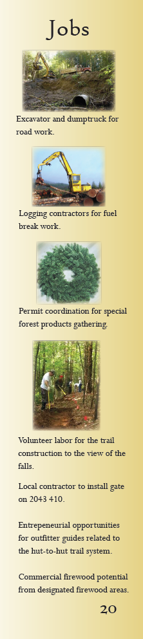
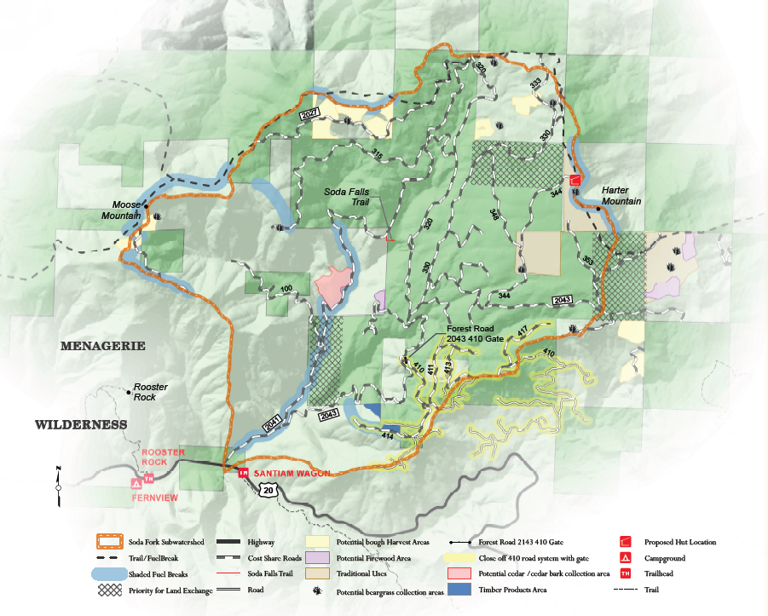
Community and Culture
Restoration Design
Landscape Challenges…Desired Condition…World of Ideas…Near Term Actions

Slide 23
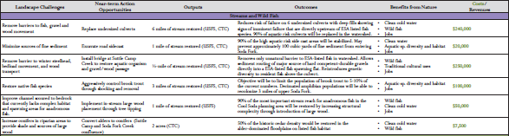
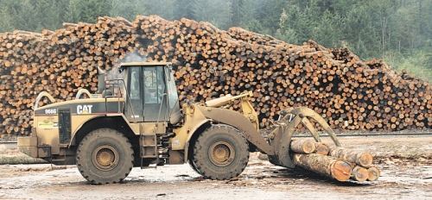
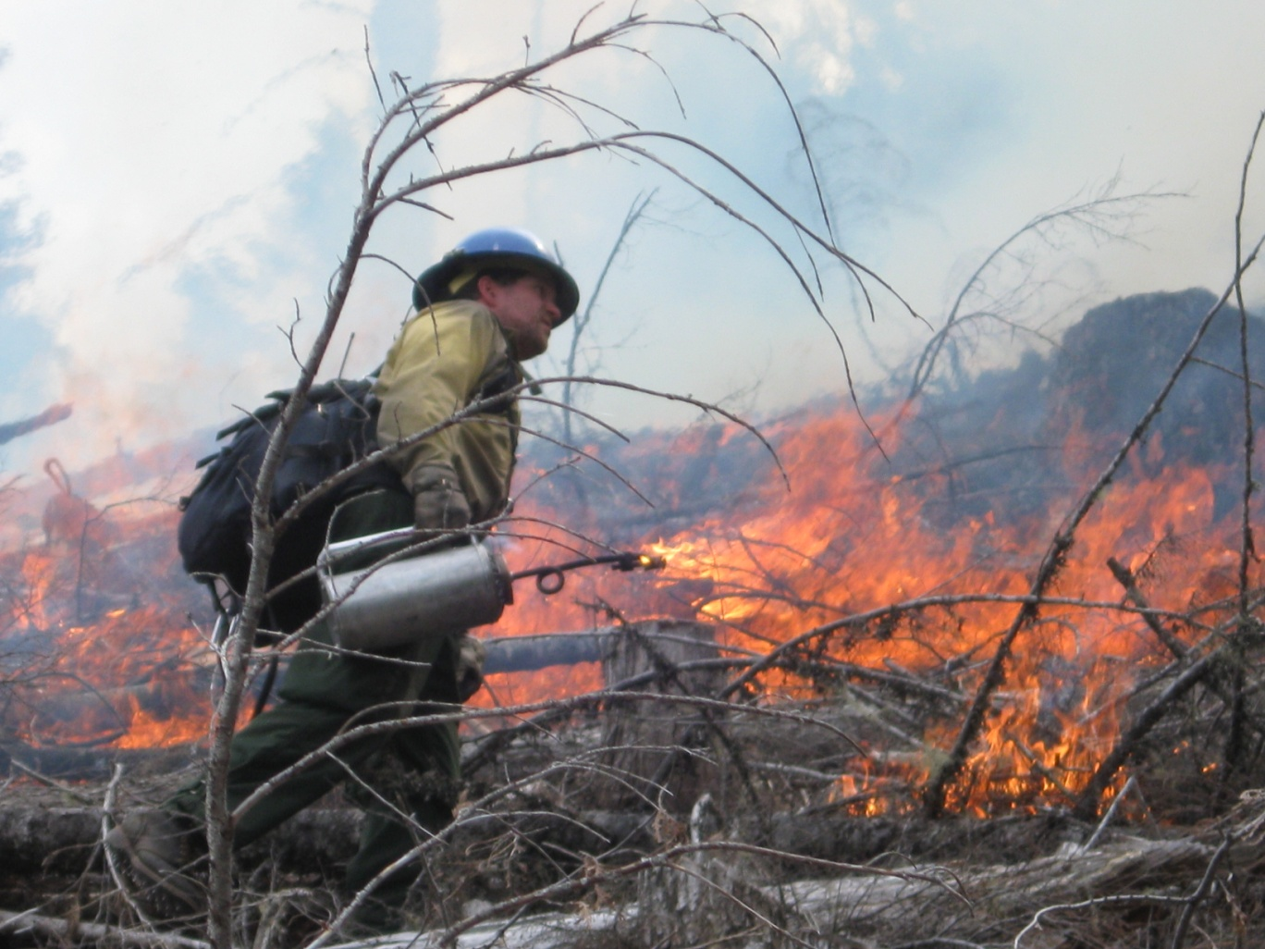
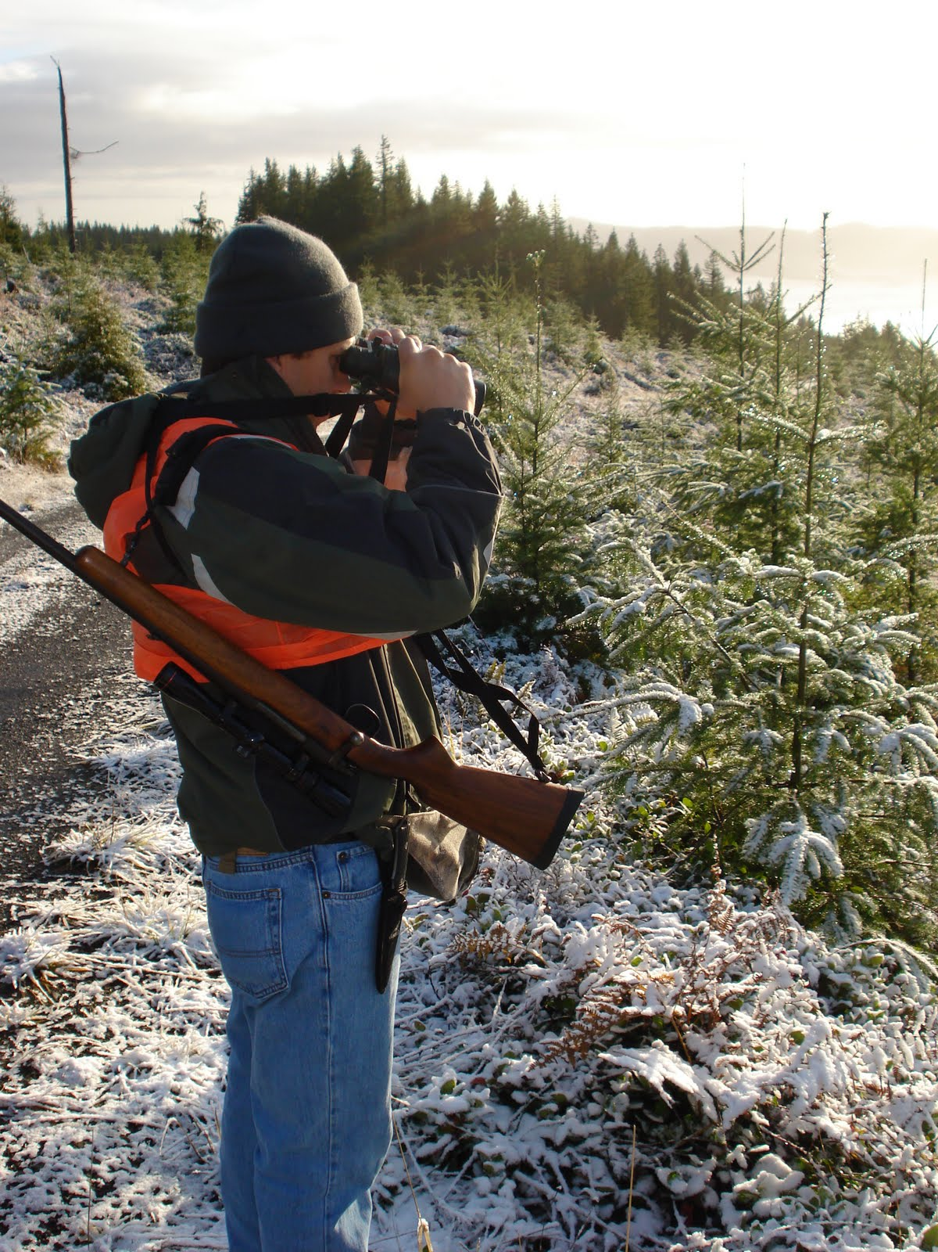
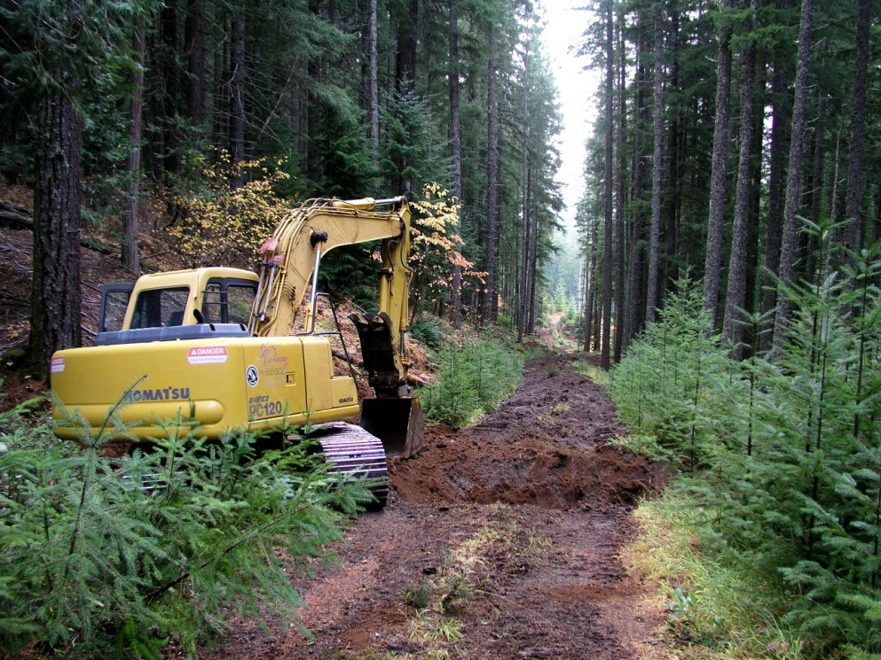


Proposed Action Table
EXAMPLE:
Restoration Opportunity:
Install Bridge
Output:
½ mile of stream restored
Outcome:
- Removes only unnatural
barrier in ESA listed fish
stream
- Allows key source of durable
gravel to enter key fish habitat
- Adds genetic diversity to
isolated population
Landscape Challenges
Restoration Opportunities
Outputs
Outcomes
Benefits From Nature
Costs/Revenues

Slide 24
Major Outcomes
Fire protection actions for private lands
Wildlife habitat enhancement along an identified corridor
Timber Volume
  - Greater than what was originally planned
Open dialog with neighbors / community of interest
Aquatic Restoration (Road Strategy and In-stream)

Slide 25
Sign up for a copy at the registration table

Slide 26
Questions or Discussion?

