Slide 1
Landscape Modeling for the Resource Management Plans for Western Oregon
Prepared by Carolina Hooper
Vegetation Modeling Lead
Oregon State Office
4/23/13
Notes:
I will just be talking about 1 aspect of this project and that is the modeling and the data behind the modeling. There is a lot of topics and decisions that won’t involve veg modeling, and I won’t be discussing any of these. I will finish the presentation with a slide that shows our website and some contact info for non-modeling questions.
We signed the notice of intent to do the plan revision last spring. We have spent most of the first year scoping and building rapor with our cooperating agencies, so the preparation of the data and the model building started last December. Unfortunately, I don’t have any results to show you yet. Everything that I will am presenting is a work in progress, and depending on how well it develops, we might very well need to make some changes.

Slide 2
What is the Intent of Landscape Modeling?
Simulate the management actions
and allocations of the alternatives to
project the development of the forest
over time.
Provide quantitative basis for
comparing alternatives.
Notes:
Very important to keep in mind, that this is being done for NEPA. Many of the choices that we make are designed to illustrate potential differences that the public or our state director can understand.

Slide 3
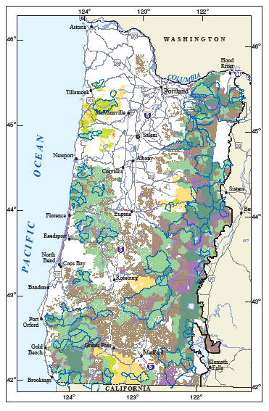
NWFP
Allocation Driven
Broad Assumptions on How Forests Would Develop.
Very Little Vegetation Modeling
40 Acre Pixel
Notes:
Quick trip down memory lane
Two major efforts in the last 20 years. The first is the NWFP. This is the plan that we are currently implementing.
3 plan evaluations. Parts of the plan have been very successful, other parts have not.

Slide 4
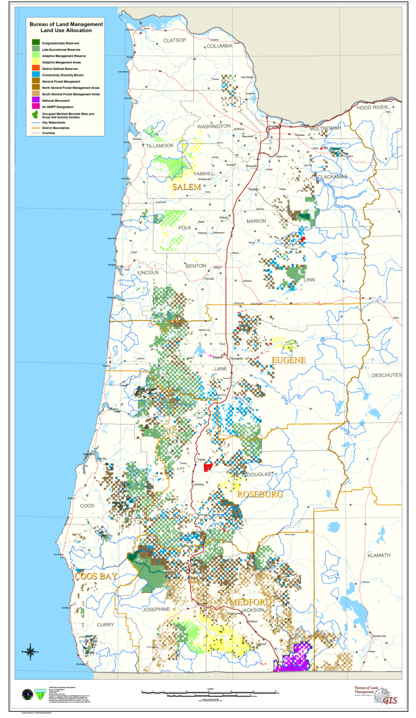
1995 RMP’s
Harvest Scheduling
Modeling Matrix Lands.
Used TRIM +
Age Based
Habitat Interpretations.

Slide 5
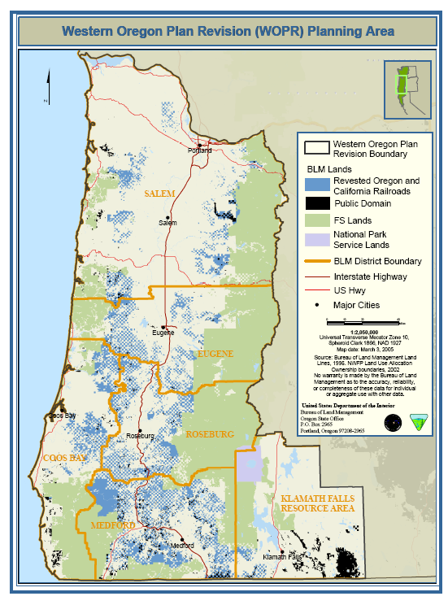
WOPR
Vegetation Modeling
On All BLM Lands.
Rate of Change in
Forest Conditions.
Spatial Projections
And Analysis.
OPTIONS : Scenario Based, Land Management Simulator, D.R. Systems Inc.
Notes:
Significantly more complex and larger undertaking than the NWFP.

Slide 6
Resource Management Plans for Western Oregon
Vegetation Modeling on all BLM Forested Lands.
Rate of change in Forest Conditions.
Spatial Projections
And Analysis.
Woodstock Model: Linear programming based
Forest Management Model
Remsoft
Notes:
Having just competed a RMP in 2008, the BLM has some very recent practical experience. Want to take advantage to the maximum extent of those techniques and process that worked for us.
This effort is in it’s infancy and we may move in different directions by the time we are done with this project.
As our management has increased in complexity so have the expectations for modeling.

Slide 7
Modeling Philosophy
To the extent possible, we will use data that has been collected on BLM managed land. Our stand-level and permanent plot-level information has been developed, collected and maintained by BLM employees for use in developing Resource Management Plans, and provides the best available information.
Notes:
As one goes through an RMP process there are literally thousands of decisions that need to be made. One of the most basic decisions is what data are you going to use?

Slide 8
Three Main Data Sources
Forest Operations Inventory (FOI) - Stand-level inventory
Current Vegetation Survey (CVS) - Permanent Plot inventory
Geographic Information System (GIS)

Slide 9
Forest Operations Inventory
Stand-level data that is stored in the Microstorms database. (approx. 79,000 stands)
Derived from stand-level inventories, photo interpretation, and lidar.
Includes information on stand age, treatment history, vegetative description and condition, surveys, stand exams, location. (many attributes)

Slide 10
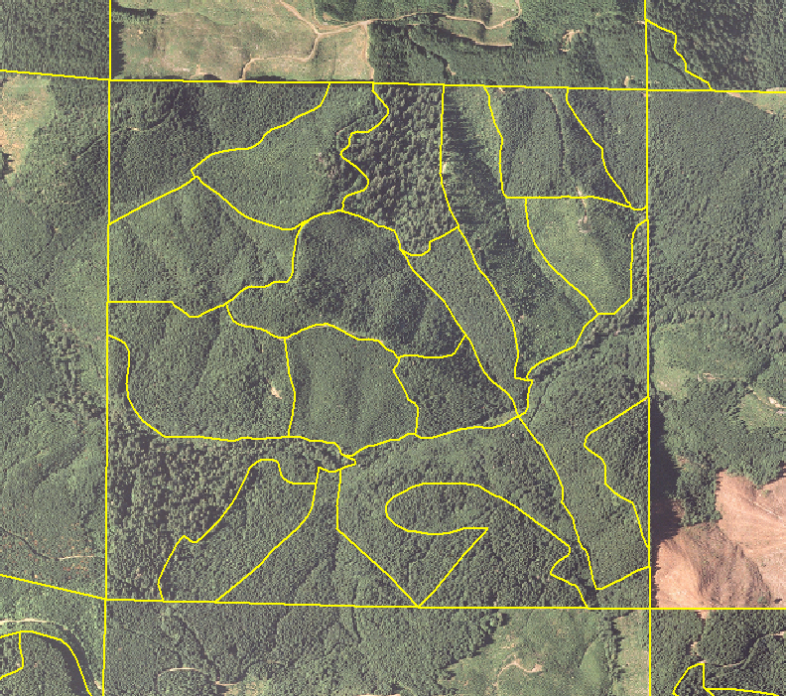
79,000 Forest Operations Inventory Units

Slide 11
What will be used from FOI?
From FOI: Stand Age, Stand Description (birthdate, forest type, density, species in overstory and understory), management history (planting, harvest history, pre-commercial thinning)

Slide 12
Current Vegetation Survey
The sampling design and measurement protocols are intended to provide data for Resource Management Plan analysis.
The complete database was finalized in January 2013. For the first time, we have change information on the measured data elements.
Notes:
The 2008 WOPR analysis used only the initial dataset.

Slide 13
CVS cont.
Permanent plots are established on a systematic 1.7 mile grid across all BLM land in Western Oregon. The grid covers the Salem, Eugene, Roseburg, Coos Bay, Medford District and the west side of Klamath Falls Resource Area.
Plots were installed if one or more subplot centers are on BLM, and the plot is forested.
The plot grid was divided into 4 panels for establishment and remeasurement.
Panel 1 was installed in 1997, panel 2-4 were installed between 1999 and 2001. Every 3 years afterward the next panels were re-measured. Panel 4 was completed in 2011.
Notes:
Forested land 10% stocking (stand density, usually measured in terms of basal area)

Slide 14
CVS Database
Approximately 1400 permanent plots. 1 plot for every 1600 acres of forested BLM land.
210,000 individual trees (live trees, >4.9”dbh). Each tree is individually identified and we follow individuals. We have growth, ingrowth, mortality, changes in insect and disease etc.
Usually 1 to 5 site trees per PSU that are over 20 years old.

Slide 15
Snags and Down Wood
30,000 dead trees. Individually identified, information on height, decay class, species, insect and disease, wildlife usage. Includes both hardwoods and softwoods.
34,000 pieces of down woody material. These are a minimum of 3 feet long and 3 inches diameter. We have large end, small end, intersect diameter, total length, and decay class. Not uniquely identified, but we do have occasion 1 and occasion 2 measurements. Includes both hardwoods and softwoods.

Slide 16
What will be used from CVS?
Measured tree lists from CVS subplots. These will be grown in Organon. Will use empirical data to describe the older stands.
Snags/Down Wood data
Marbled Murrelet Platform data

Slide 17
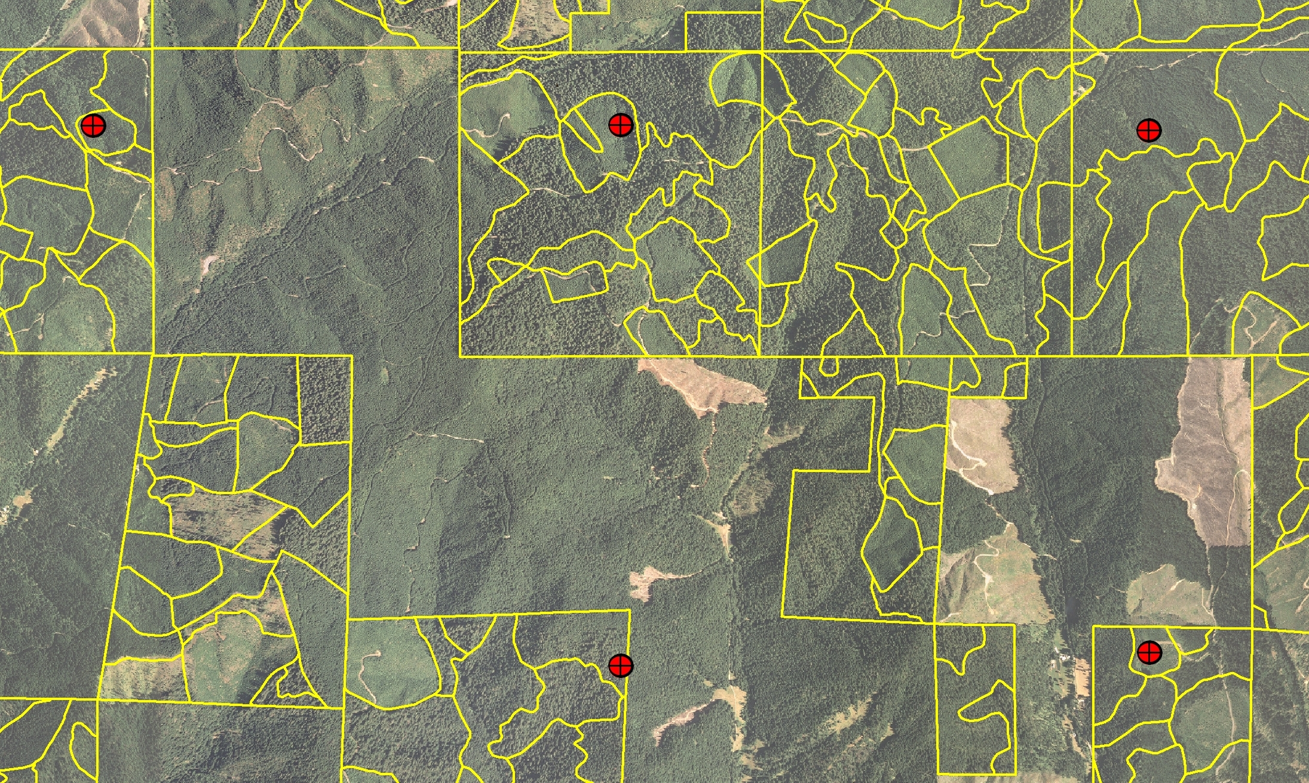
Stand and Permanent Plot Data
Notes:
Measured plot inventory
– highly detailed measured data on plots every 1.7 miles
– Plots re-measured every 3 years
Statistical basis for forest conditions not available at the stand level.
One plot for every 1600 acres of forested BLM ground.

Slide 18
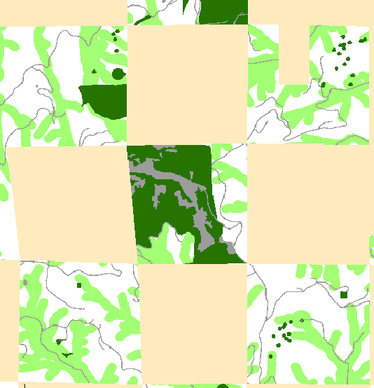
GIS Data to Woodstock
Notes:
Updating all of the GIS layers to represent current information
Rastorize in 10 meter pixels for input in to Woodstock

Slide 19
GIS Themes
ACECs
Land Status
NS Owls sites
5th Fields
MAMU
Counties
S&M
Provinces
VRM
Swiss Needle Cast
W&SR
Critical Habitat Units
Recreation
TPCC
Riparian
Forest Operations Inventory
And Many More

Slide 20
Site Index Determination
Use BLM measured SI where we have it. (12,562 FOI’s, 625,500 acres)
Use NRCS site index maps to fill in the roughly 75% that is not measured.
Adjust the NRCS classification to move acres between site classes to come up with the CVS distribution.
Notes:
As all foresters know, one of the most important pieces of information needed for veg modeling is site index.
Measured SI came from CVS, stand exams, or CFI inventory
The majority of the species were mapped to a Hann or King site curve and were based on breast height age and total height.
Either 50 or 100 year, it depends on what it was measured in.

Slide 21
Tree Growth and Harvest Models
Harvest Scheduling and the changes in vegetation composition and structure will be modeled with Woodstock.
Contracted with Mason, Bruce and Girard to set-up and run the vegetation model.
Growth and Yield Modeling will be done with Organon 9.1
Notes:
Timeline has already started, clock is ticking
Remsoft – Linear programming based forest management model. Not spatially explicit, Spatial constraints can be approximated. The larger the area the less likely to use a spatial model. Call themselves the world’s leading software for sustainable, spatial optimization planning. Woodstock Modeling Platform.
Why did we choose Organon? Go with Organon as it was used in WOPR. We reviewed why Organon was used in 2008. The Organon in FVS effort is still in the beta-testing phase, it is not ready for production runs and we are not familiar with it. FVS does not do a good job of emulating the NW stands, and there are not good variants to use to southern Oregon. Makes sense to stay with Organon as we can readily compare with 2008 results; also we understand how it works
We are comparing BLM growth with the Organon equations.

Slide 22
BLM Modeling Needs
Strategic-level Planning
2.5 million acres
200+ year time frame
Spatial representation and analysis
Notes:
Not operational, tactical type of analysis

Slide 23
The Woodstock Model
Linear programming model
The model will determine the BEST solution among a number of management scenarios.
Specify the kind of solution we are looking for, and then the model solves the linear programming function to determine what activity levels are needed to achieve our goals.
Notes:
In no way do I claim to be an expert in this.
Extremely basic explanation of how we will proceed.
The Woodstock framework provides a very flexible approach and it can be set-up in numerous different ways. It can be set-up to run Monte Carlo simulations, used for stochastic processes;

Slide 24
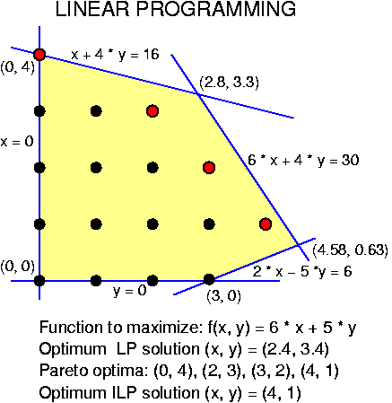
Woodstock continued
Fundamentally different from previous efforts.
For the 2008 analysis we used ‘Scenario-based’ analysis methods.

Slide 25
Woodstock Inputs
A Method of Describing the Forest (a classification scheme).
A Range of Silvicultural Activities and Natural events.
A Means of Measuring the Impacts of Interventions and Natural Events.
A Method of Accounting for the Passage of Time.

Slide 26
What is New in the RMP’s for WO?
Incorporating Stochastic Change Due to Fire into the Model Runs
Modeling Snags, Coarse Woody Debris
Habitat Suitability Index for the Northern Spotted Owl and the Marbled Murrelet.
Demographic Modeling for the Northern Spotted Owl
Notes:
Speculative, the work hasn’t been accomplished yet. We will be developing new alternatives based on State director guidance, and scoping efforts
As the complexity of our management has increased, so has the expectations and complexity of the modeling.
It has only been four years since the WOPR have been published, our abilities and the modeling expectations have increased considerably.
For example: the final designation for Critical Habitat for the Northern Spotted Owl, the 15-year monitoring report for the NSO from the Forest Service, represent the best available science. for the
Following process described in GTR’s

Slide 27

Modeling on non-BLM
We need to understand the relationship between how actions on BLM may affect species demographics range-wide.
From: wikipedia.org
Notes:
Complexities have increased dramatically.
Specifically, under ESA we need to understand the inter-relationships between how actions on BLM may affect species demographics rangewide, and also how actions on other ownerships may affect what we do on BLM. For most species we don’t have the data to do that type of analysis, but the Northern Spotted Owl is an exception.
Benefit from having a recent USFS 15-year monitoring report and final critical habitat designations.
On non-blm willl be using GNN derived variables from Ivmp imagery

Slide 28
Other Models
Using MaxEnt model to develop habitat suitability index’s for both the NSO and the Marbled Murrelet. (PNW-GTR-848, 2011; PNW-GTR-850, 2011)
NSO range-wide demographic analysis using the HexSim model.
Notes:
Status and Trends of Northern Spotted Owl Populations and Habitats
Status and Trends of nesting Habitat for the Marbled Murrelet

Slide 29
Modeling Timeline
Putting the inventory plots into strata
Beginning the Growth and Yield work
Benchmark runs done in June and July
The No-Action Alternative modeled in July
Modeling the Alternatives this Summer and Fall
Draft EIS by Winter of 2014.
Modeling the proposed RMP’s fall and winter of 2015.

Slide 30
RMP’s for WO
Website: http://www.blm.gov/or/plans/rmpswesternoregon/
Project Manager: Mark Brown m4brown@blm.gov
Public Affairs: Jodi Bean jbean@blm.gov
Veg Modeling : Carolina Hooper chooper@blm.gov

