Slide 1
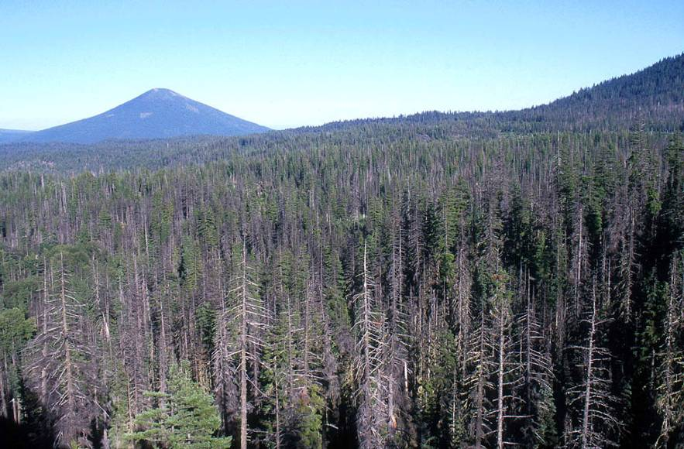
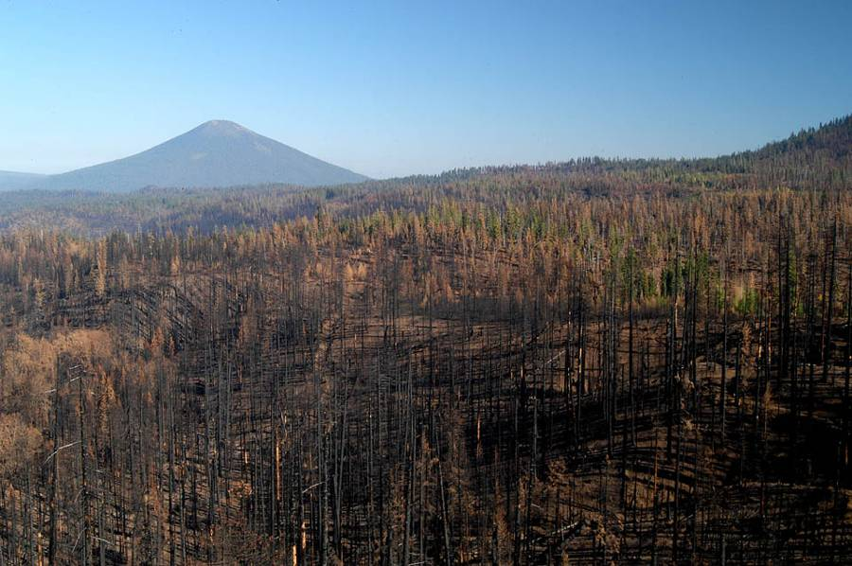
Landscape Ecology and Forest Restoration for the eastern slope of the Cascades
James Dickinson, Andrea Lyons, Richy Harrod, William Gaines, Paul Hessburg, Sr.,
Okanogan-Wenatchee NF and Wenatchee Forestry Sciences Laboratory

Slide 2
Presentation Objectives
Restoration Strategy
  Benefits
  Process
  Timeline
Need
  Landscapes
  Process, pattern, function
  Climate Change
Details
  Outputs
  Scales of analysis
  Reference Conditions
  PLTA
Notes:
The objective of today’s talk is to give a succinct view of the process that we are undertaking to restore large landscapes on the Okanogan Wenatchee NF. Today I’m going briefly talk about landscapes, not stands.
I’ll also cover the analysis, timeline, and products that the OWF FRS provides – and many the details of the process.

Slide 3
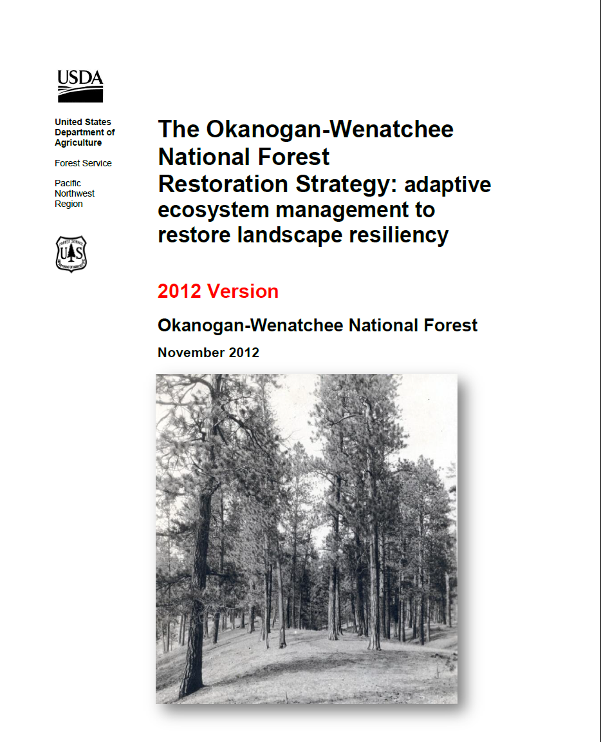
“Restore forest patterns, processes, and functions to increase resilience to climate change and to disturbances.”
Notes:
The OWF has written and peer-reviewed a Restoration Strategy that analyzes complete subwatersheds. Importantly we are attempting to restore patterns, composition, and processes to increase overall resilience to climate change and disturbance.

Slide 4
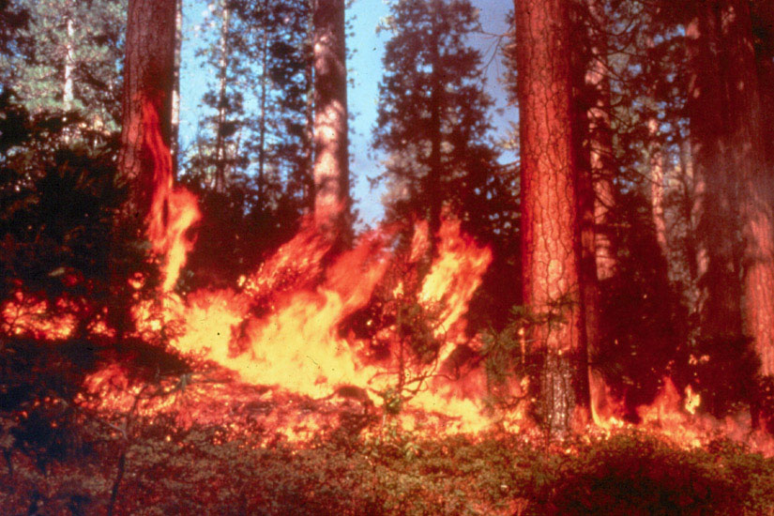
Key Forest Restoration Issues
  Restoring Resiliency to Landscapes
  Spotted Owl Recovery
  Climate Change
  Road/Aquatic Evaluation
  Adaptive Management and Monitoring
Notes:
The key issues that we wanted our Restoration strategy to address were….

Slide 5
Restoration Approach
Manage for landscape patterns of all structures
Restore native fire regimes across landscapes, while planning for chance events
Restore native patch size distributions
Restore spatial variability within stands
Retain fire tolerant structures
Develop long-term plans for maintaining our investment
Notes:
Our approach to solving those issues …

Slide 6
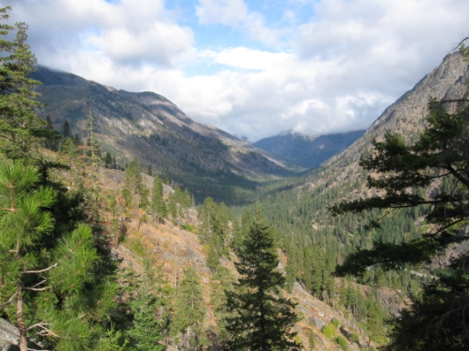
Benefits of the Strategy
Doing the right things in the right places
  Identify priority areas
  Make transparent decisions
  Prepare for the future
Focused field work, realistic timelines
Efficient planning (NEPA)
Integrated set of desired conditions
Emphasize and plan for outcomes
Incorporates science, support, collaborations
Notes:
We feel that our strategy has many benefits, some of which include:

Slide 7
Vegetation
Wildlife Habitat
Climate Change
Insect and Disease
Road/Aquatic Evaluation
Fire and fuels
Landscape Evaluation
Current state w/rspct to ROV
Decision makers’ priorties
Modeled Fire
Large and old tree guidelines
Biomass/Econ.*
Project Level NEPA
Potential Landscape
Treatment Area
-P&N
-Landscape Prescription
-Stand Level Prescriptions
Multiple Projects/Landscape Evaluation
Notes:
This is our Restoration Strategy in a nutshell. The green items are analyzed with respect to Historical ROV’s… climate change being an assessment driven by the comparison with landscapes that developed in warmer drier conditions than our current landscape.
We also incorporate Decision maker’s priorities…. Which reflect current socio-economic issues… and can include additional data. We currently assess fire simulation outputs and will be beta-testing a road aquatics module later this year.
Biomass/Economics is a place holder for a module to be developed… we recognize it as a key consideration doing restoration work with limited budgets.
We develop PLTA’s, we develop traditional nepa, and we incorporate large and old tree guidelines and within stand tree spacing variability (clumps and gaps).

Slide 8
Timeline
Photointerpretation
27 days
add 20 days for additional
20,000 – 30,000 acres of analyzed landscape + data
Processing, analysis
Landscape level diagnosis /prescription
5-10,000ac. of proposed action, with stand specific objectives, prescriptions and effects
PLTA diagnosis/prescription
/alternative development
7 days
Field Recon, verification of feasibility, stand level, and other NEPA issues as usual
Notes:
A realistic timeline with an experienced analyst looks like this… on the left is the part of the analysis… the timeline necessary… and then the product in green.
You’ll notice that we do photointerpretation. We have lost a lot of our experienced PIers, but from past experience, we know that we can get a waterhsed every 2-2.5 weeks PI”d. But at 27 days, that’s still 1,000 acres of analysis a day.
The PLTA diagnosis takes about 7 days, but there is definitely some iteration that depends on the operational/project level information found at the stand level.
The analysis can, depending on the Potental Landscape Treatment Areas chosen, be used for multiple NEPA documents.
I’ll discuss this slide a little more in depth today.

Slide 9


Why NOT stand level management?
Notes:
But first,
For decades we have managed our resources at the stand level. We have identified a stand, set an objective and frequently met that objective. But Landscape ecology tells us that its not just the stand itself that we are treating – we are impacting the stands around it.
Regardless of how hard we try the stands that we manage are part of a bigger picture.
Managing the stands not of interest can be as important as managing the stand of interest.

Slide 10

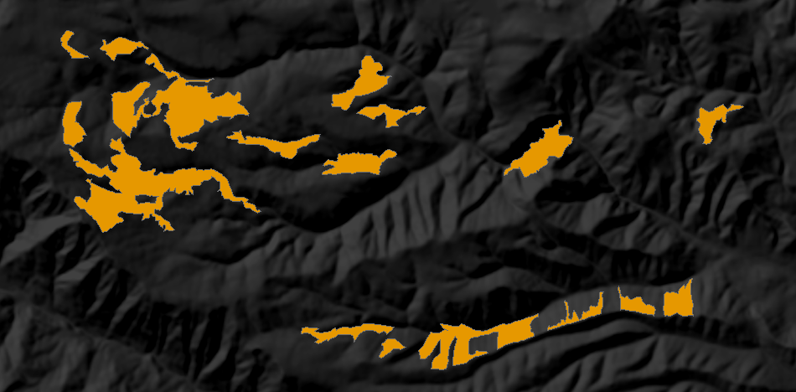
Quantity
Configuration
Uniqueness
Interactions
Notes:
For any given stand these are the kinds of questions that should be asked.
How much of this is on the landscape –
Where are the other stands
Is this unique
Does this interact appropriately with other stands
You can see that pattern on the landscape becomes important.
Without answering at least some of these questions – there is no way to set an objective that has much, if any ecological relevance.

Slide 11
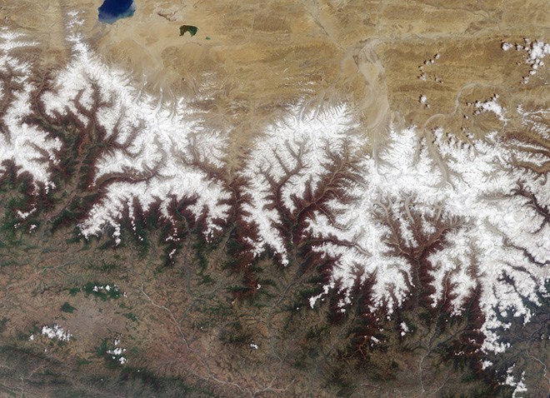
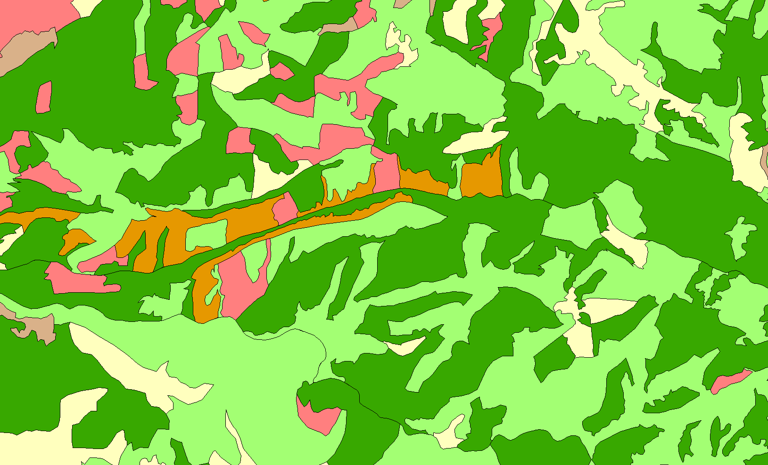


Notes:
Functional large scale landscapes (not the mountains necessarily) are the result of being able to absorb disturbance while propagating the underlying processes. Those underlying processes are inextricably entwined with the pattern and composition on the landscape. The pattern and composition are composed (or described by) patches with unique characteristics. Those patches are composed of trees and other vegetation (live and dead).
At each scale we observe emergent structures and patterns that result from smaller scale, underlying processes and patterns….
It follows that if we can quantify and analyze the underlying pattern and composition at smaller scales, then we can begin to manage for the resilience of the larger landscapes.

Slide 12
Area and aggregation of forest structure influenced by climate change
100%
50%
Max. Aggregation of area
0%
0%
50%
100%
Landscape Area
Notes:
Here is the pattern of a forest Structure class (in terms of aggregation and landscape area), this the envelope of conditions that occur across a sample of landscapes…
Our approach to Climate Change on the Okanogan Wenatchee NF is to assume that as different climate regimes take effect, our ecosystems will begin to shift in a direction that accomodates that new regime, not that climate change impacts will happen instantaneously. As we look at these climate change over time, we expect that the envelope of patterns (Area and Agregation) change accordingly.
We are managing our landscapes to push patterns and compositions in a direction that is compatible with a warm/dry climate scenario….
What we want to avoid is a feature of interest suffering disturbance processes that in one or two quick bursts removes it from the landscape.
Our ecosystems have seen different climates in the past… we want to buy them hang time to adapt, if they can.
We aren’t trying to have THE RIGHT answer, merely an answer that respects the theory of landscape ecology and plant physiology.

Slide 13
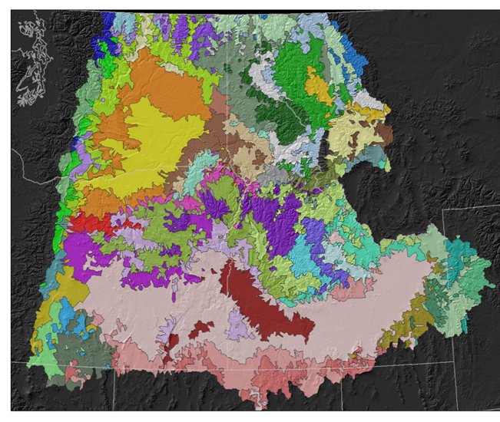
Ecological subregions of the Interior Columbia Basin
Interior Columbia Basin Ecosystem Management Project (ICBEMP)
Hessburg et al. 2000
Based on:
Temperature
Precipitation
Solar insolation
PVG
Bailey’s Eco’s.
54 ESRs
Notes:
If we could find use climate change analogs – conditions where a warm/dry or warm/moist conditions have had an impact on the pattern and composition we’d be able to specify how the envelope of patterns would need to morph to fit our climate change scenario.
Our approach to incorporate climate change into planning is to use the Ecological subregions 1st developed in the Interior Columbia Basin Project – and later improved and refined by hessburg et al.
The entire ICBEMP consists of 54 ecoregions, whose relationships we can track through a statistically derived hierarchical tree… ie. We know which ESR is the next warmer, drier ESR to an ESR of interest.

Slide 14
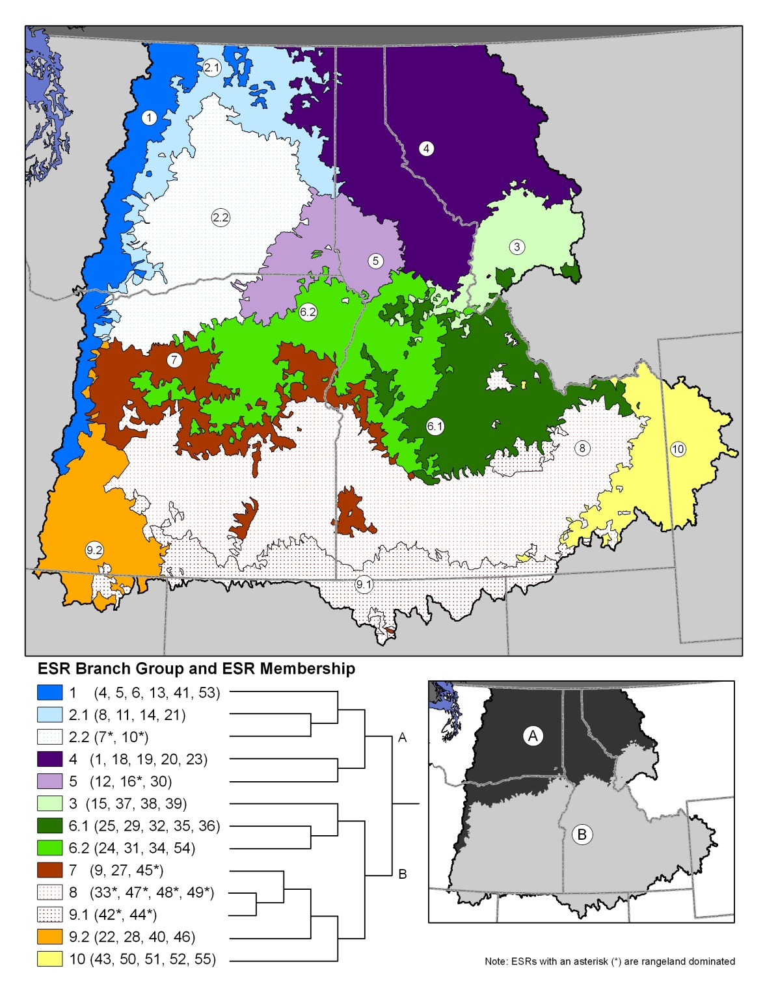
Temperature
Precipitation
Notes:
In other words we know which ESR is the next warmer, drier ESR to an ESR of interest. These ESRs developed over long time lines.. So a warm dry ESR has landscapes that have developed in more warm, more moisture limited landscapes. We can use these ecoregions to analyze the pattern and compostion of features of interest across multiple landscapes.
We are able to use these ecoregions… more specifically the pattern and composition of the watersheds that compose the ecoregions as climate change analogs.

Slide 15
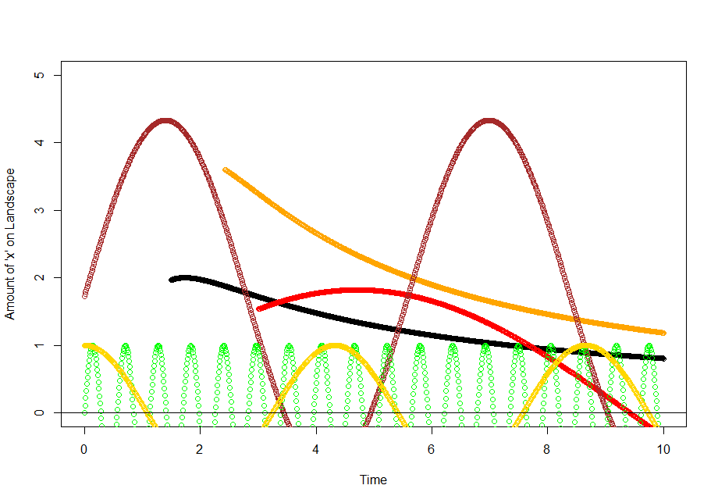
Hypothetical development trajectory of six landscapes
Notes:
If we could go back and catch a snapshot and Measure the amount and location (hence pattern) of ‘X’ across these landscapes that would define the envelopes of conditions for attributes of interest.

Slide 16
Notes:
… and it was done for historical landscapes.
All told 300 and some odd landscapes were photo-interpreted. And attributes were derived.
Going back in time is difficult, but the oldest stereo-photos, available for the sampled watersheds were used to PI these landscapes.
What other options exist?
These photo-interpreted watersheds, represent a ~10 of the area of the ESR that they were sampled from – so they are a statistically valid sample of the EcoRegion. These form the Reference Conditions – or the Historical References….
But this is the basis of our restoration strategy which I’ll also be talking about later today.

Slide 17
~70 derived attributes; wildlife, fire, vegetation, I&D.
Notes:
We also collect the same information on current landscapes.
A set of standardized rules are applied to photointerpreted data to derive attrributes of interest:
Wildlife habitats: [Spotted owl habitat (darker color)]
Insect and disease vulnerability: [WSB]
Fire Behavior : [RCF]
Forest Structure…
We use about 13 in our analyses, but have regular access to about 28 total.. The others just aren’t used by our specialists.

Slide 18
Landscape metrics are computed for an attribute (e.g. Forest Structure) for the entire mosaic.
Richness (PR)
Diversity (SHDI, N1, N2)
Evenness (MSiEI, Alatalo’s)
Arrangement (Contag., IJI)
Notes:
Each feature of interest is analyzed using Fragstats to derive both landscape.

Slide 19
Class metrics measure the aggregate properties of the patches belonging to a single class or patch type.
Percent Land
Largest Patch index
Patch Density
Mean Patch size
Mean nearest neighbor
Edge Density
Aggregation Index
Notes:
and class (or stand) level metrics…. Both of which quantify the landscape patterns.
This work has already been done for the historically sampled watersheds that make up our ROV reference conditions..
And we do this for our current landscape being analyzed

Slide 20
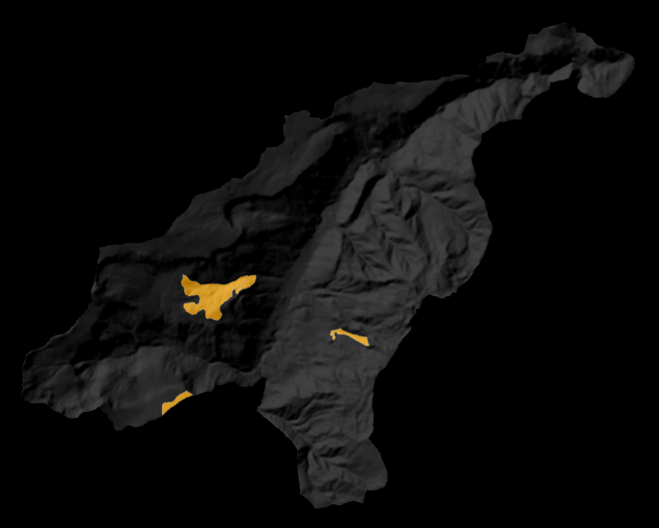
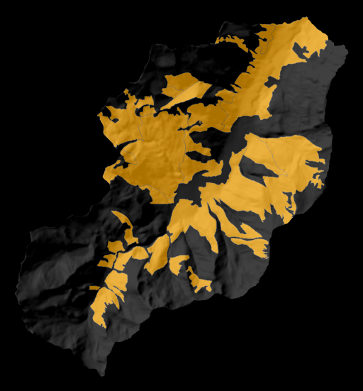
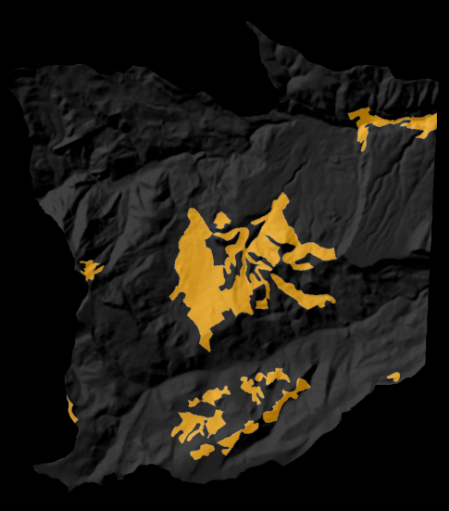
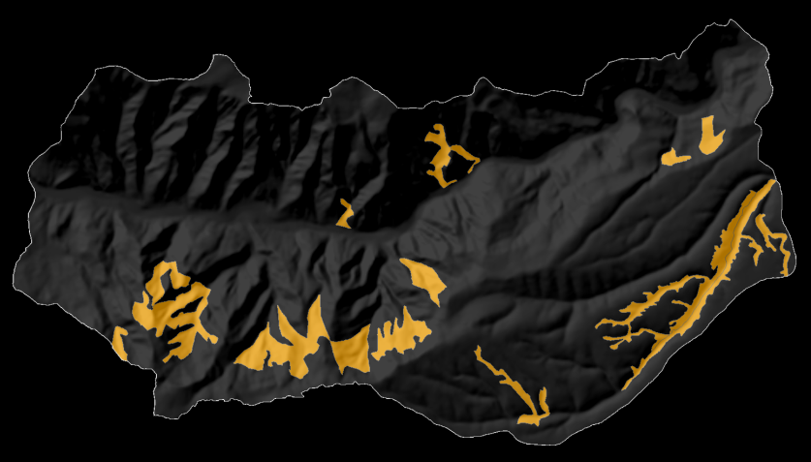
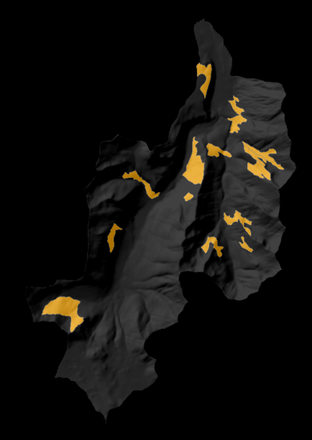
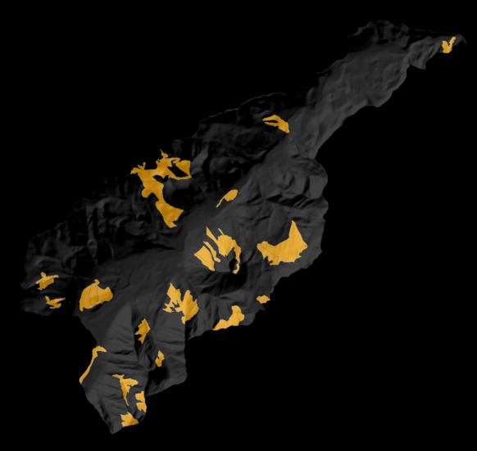
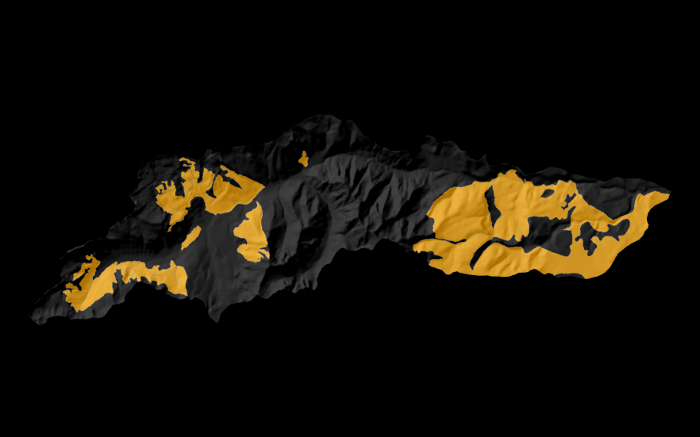
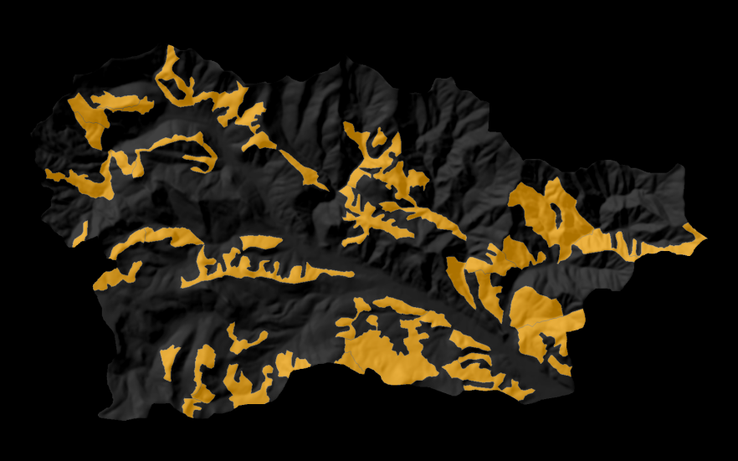
Notes:
For example we’d get something that looks like this across the ten landscapes.. Each of these is a data point in the envelope of patterns that we saw a minute ago…
This attribute is derived identically across all 300+ watersheds in the historical sample… The ecoregional subregion map determines which watersheds are used to compare for the NRV and which are used for the FRV comparison.

Slide 21
Cooler/moist ESR
Warmer/drier ESR
Class Metrics
Notes:
Our analysis, uses the Ecosystem Management Decision Support software to analyze the current state of the system.
EMDS helps us identify where patterns and compositions are within the shared ranges of condition of both the historical normal for the watersheds current ecological subregion and of the warmer drier subregion.. (or where they are departed)
The further outside of this intersection of envelopes, simultaneously across all of these metrics, the more departed the watershed, and the higher a restoration priority it rates.
It should be noted, that the manager can still choose to favor one climate scenario over another due to a variety of reasons… for example uniqueness or WUI concerns… this is a DSS

Slide 22
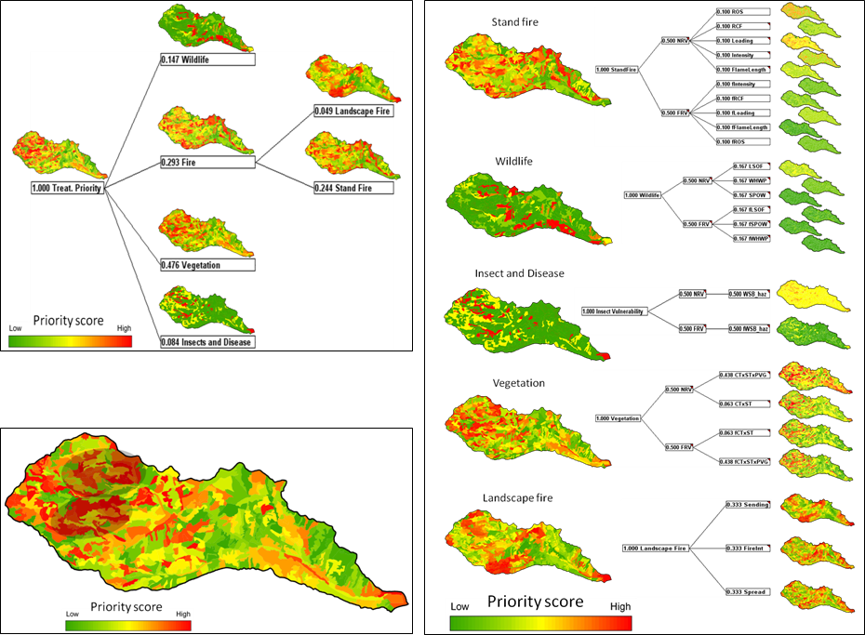
Notes:
This analysis works hierarchically – with the logical analysis of the current state of the system occurring on the right… and the decision making criteria making the adjustments to the relative importance of each of the variables.
Each layer of the analysis is graphically summarizing the lower levels of the analysis…
Until we end up with the final prioritization – where red polygons indicate areas of where the highest departures from NRV and FRV occur.

Slide 23
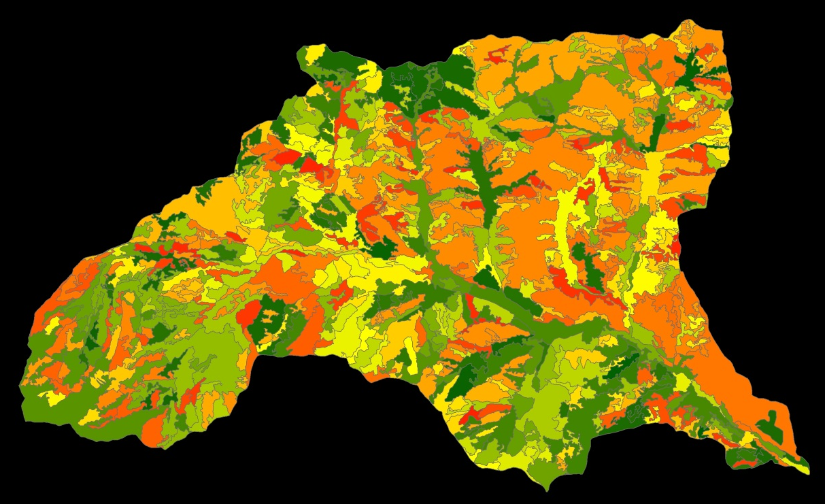
Potential Landscape Treatment Areas
Landscape Rx → P&N
3-5 PLTAs per subwatershed
  ~ 5-10k acres each
  Chosen based data in underlying tables
Can have multiple projects per PLTA
Notes:
Our EMDS analysis summarizes 168 pieces of departure data to give us a map where the most restoration value for the investment might occur… and provides all the data (and more) to start solving the landscape issues within the PLTA

Slide 24
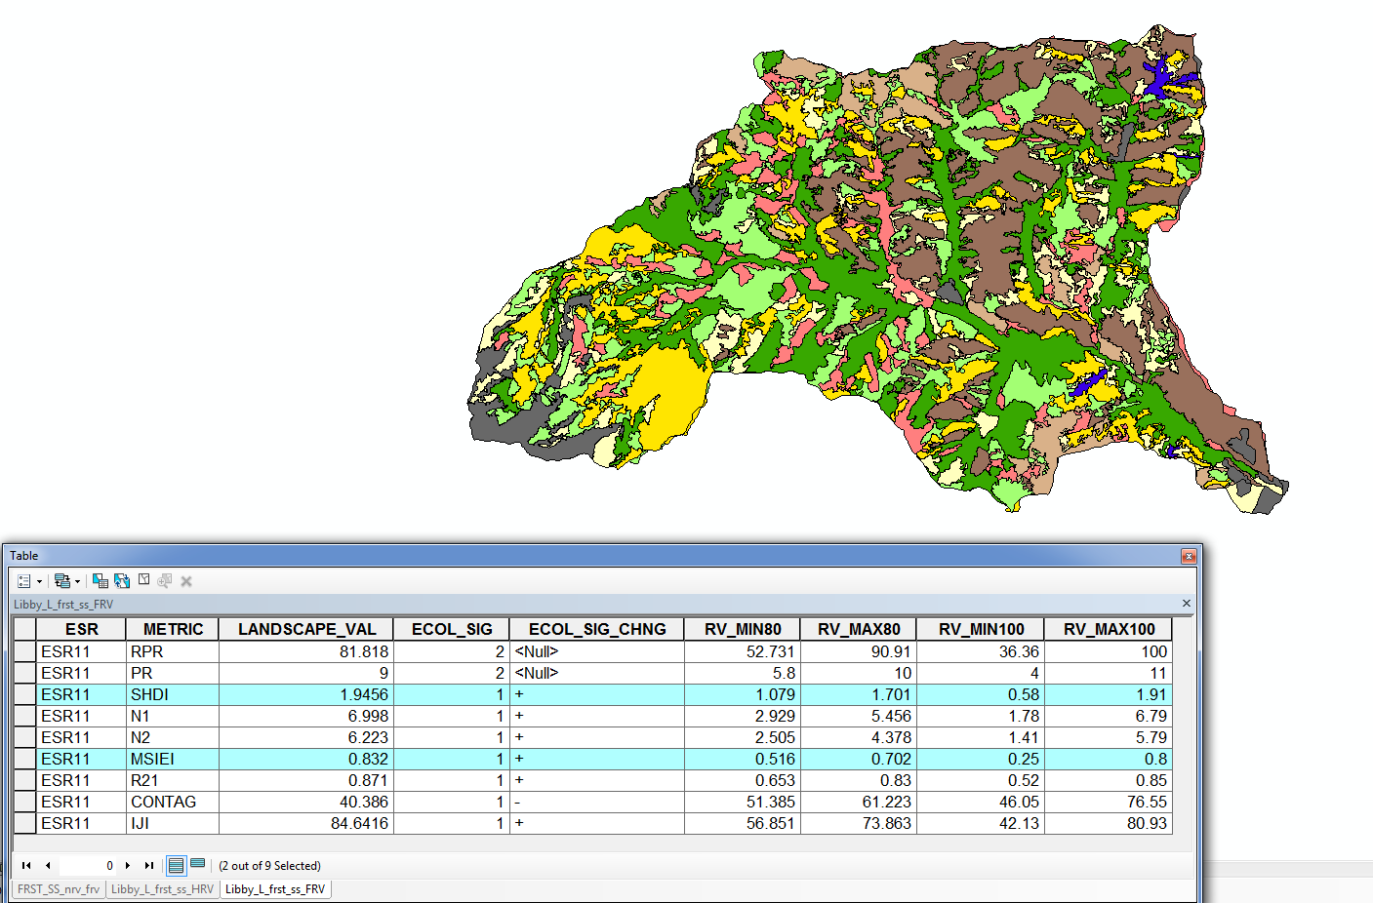
Notes:
For any given attribute (e.g. Forest structure) we can easily assess whether the Richness, Diversity, Evenness, or Arrangement of the all the structure classes on a landscape are within the NRV or FRV

Slide 25
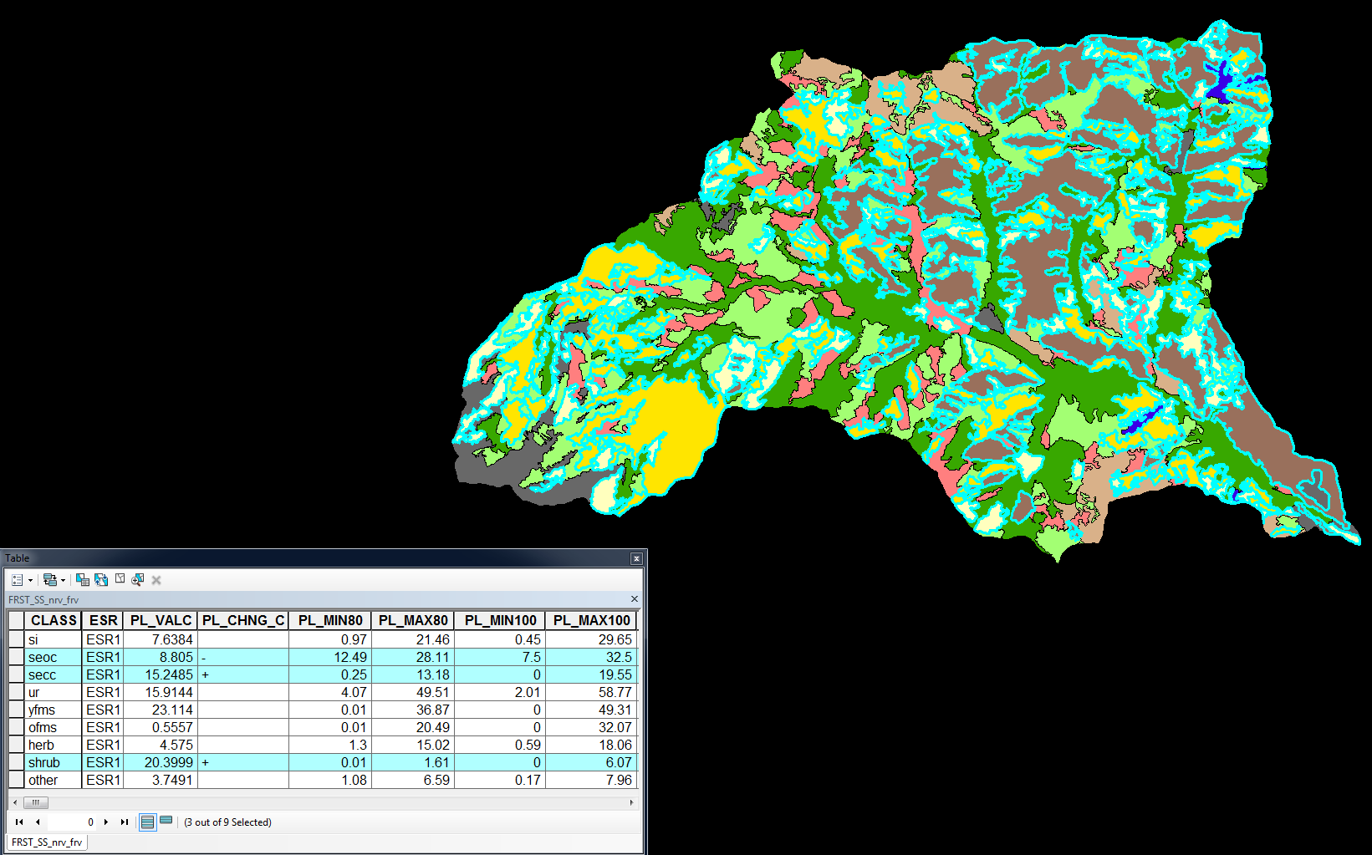
Notes:
And with practice we can easily assess which individual classes are driving the landscape issues – therefore identifying how to treat any given stand type :
Do we try and modify :
the number of patches?
Amount (area) on the landscape?
Reduce edge?
the average patch size?
Distance to nearest neighbor?
And several others

Slide 26
The Landscape Evaluation
‘PI’ the Landscape
(Raw Data)
Derive attributes
EMDS
Calculate Departures/Priorities
by Resource
Landscape Rx, Scenarios, Alternatives
Integrate/
Weight Resources
Calculate other Decisionmaker Priorities
NEPA

Slide 27
Conclusions
The Restoration Strategy:
addresses analysis, policy, and ecoystem issues.
provides a robust analysis of how processes functioned across large landscapes, not just stands, and is supported by ecological theory
provides enough data so that the user can ask, and answer nearly any question of the landscape
provides a framework for planning efficiencies, long term monitoring, and adaptive management
Policy
Efficiency
Science
Notes:
OWNF Restoration Strategy is intended to develop a landscape approach that accounts for multiple resources, has a defined transparent process, and is efficient in its analysis.
The strategy is able to put forward a reasonable approach to restore resilience across entire landscapes because processes don’t just happen in one stand, they happen across many stands.
There is a tremendous amount of detail that is summarized in the analysis, but all of the information is available for additional work.
We are convinced that we can do a tremendous amount of true ecological restoration while building capacity to provide ecosystem services including biomass and traditional timber.
The crux is that we must analyze, diagnose, prescribe and treat at landscape scales to achieve either goal.
Forest Service policy directs us to use the best science, the best science gives us the understanding and the tools to necessitate working at landscape scales in order to be efficient so that we can fulfill our stated policy of restoring resilience to landscapes.
For once, its possible that policy, science and management are working in conjunction with each other not opposed.

Slide 28
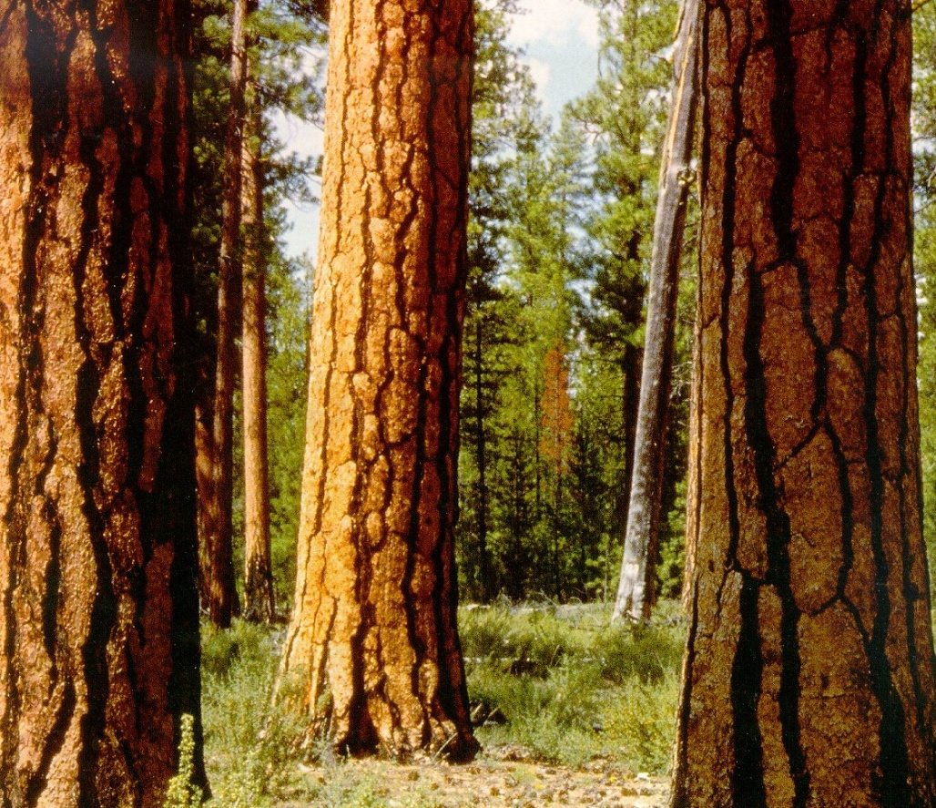








Questions & Comments

Slide 29
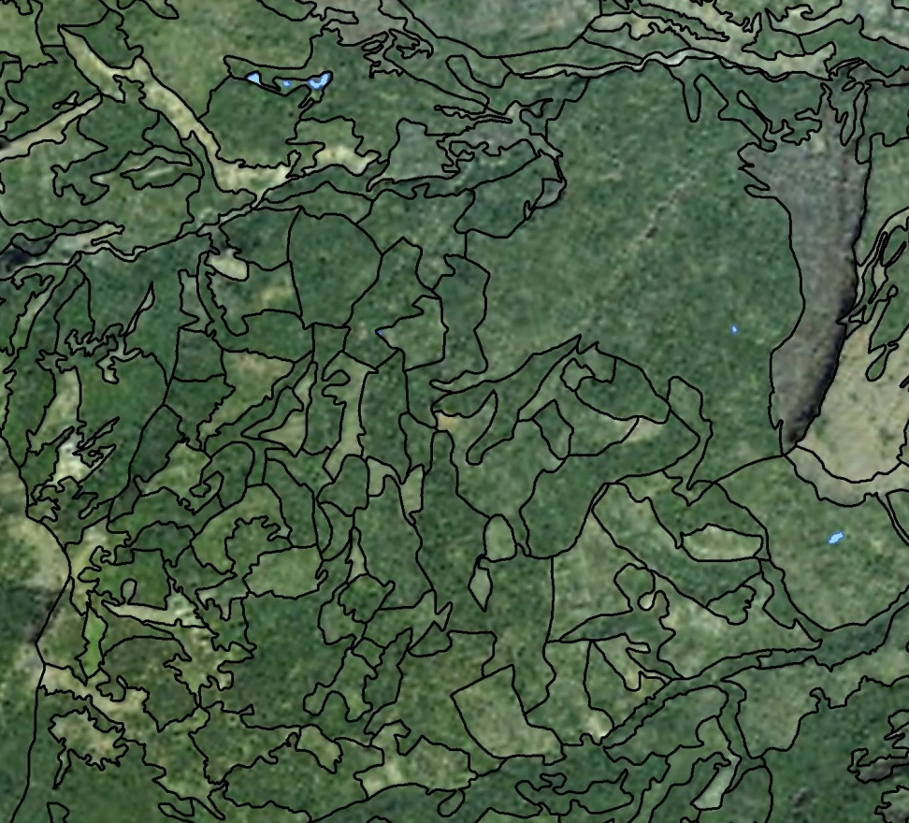
Photo Interpreted Attributes
% Canopy cover
# Canopy layers
Species composition (overstory, understory)
Tree size
Clumpiness of trees
24 attributes collected; 70 derived
Attributes → wildlife habitat, fire and insect risk
Notes:
But if I’m going to spend the time capturing orange, maybe I should measure many attributes. Attributes that I could use to describe ORANGE and many other things.
In fact if I were to collect about 24 variables, I could derive about 70 attributes from that base data….
This is in fact exactly what was done….

Slide 30
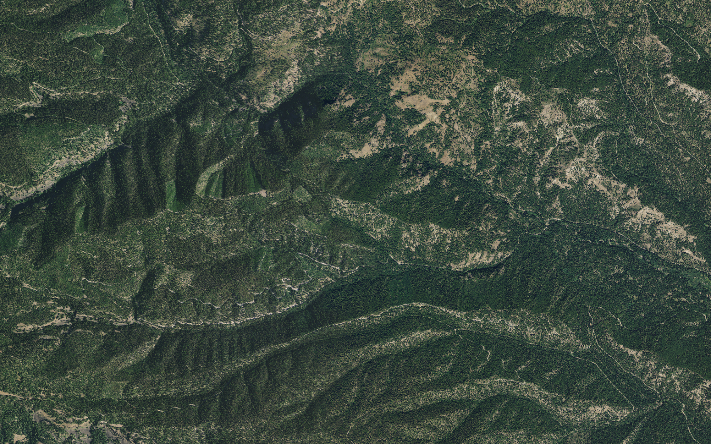


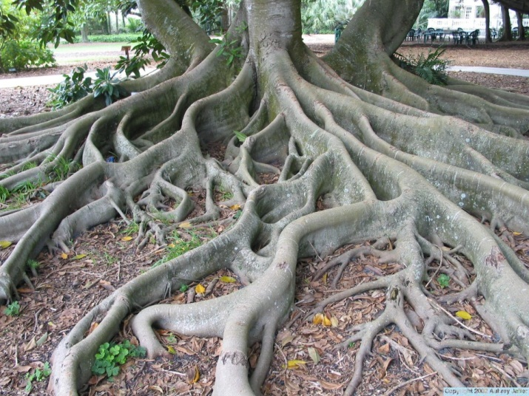
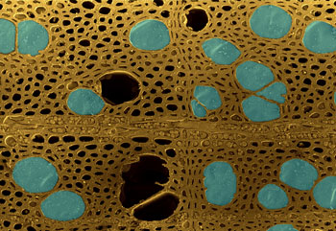
Notes:
At the mid-scale we find patch sized distributions that are fractal in nature - processes that beget processes that beget processes
At the tree scale branches are fractal, the vascular system of the leaves are fractal, the root systems are fractal, and even the xylem system is fractal.
These fractal relationships imply that the emergent property (the tree, the landscape) is the result of the underlying processes, and that there is a tremendous amount of resilience built into the system just as a result of those underlying processes.

Slide 31
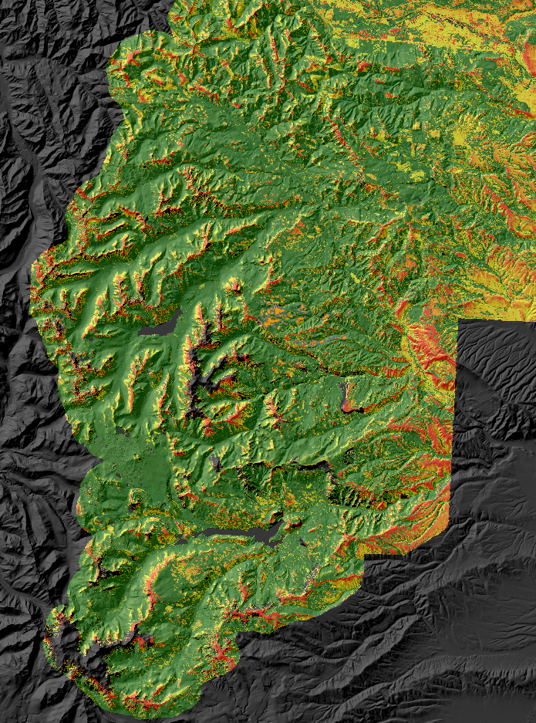
Major Flow Routes
Fireline Intensity
Rate of Spread
Modeled using current fuels maps
No ROV
Incorporated using the DSS

Slide 32
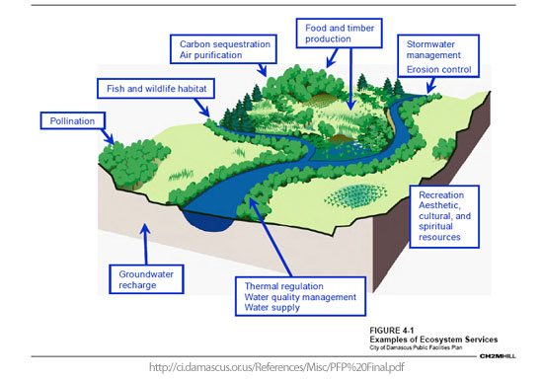
“Ecosystem restoration” is ecologically based providing ecosystem services as the tangible outputs.
Notes:
Ecosystem services include water, other fiber output, and other forest products.
Therefore, we are attempting to manage processes, and more specifically, patterns and compositions at the right scale.

Slide 33
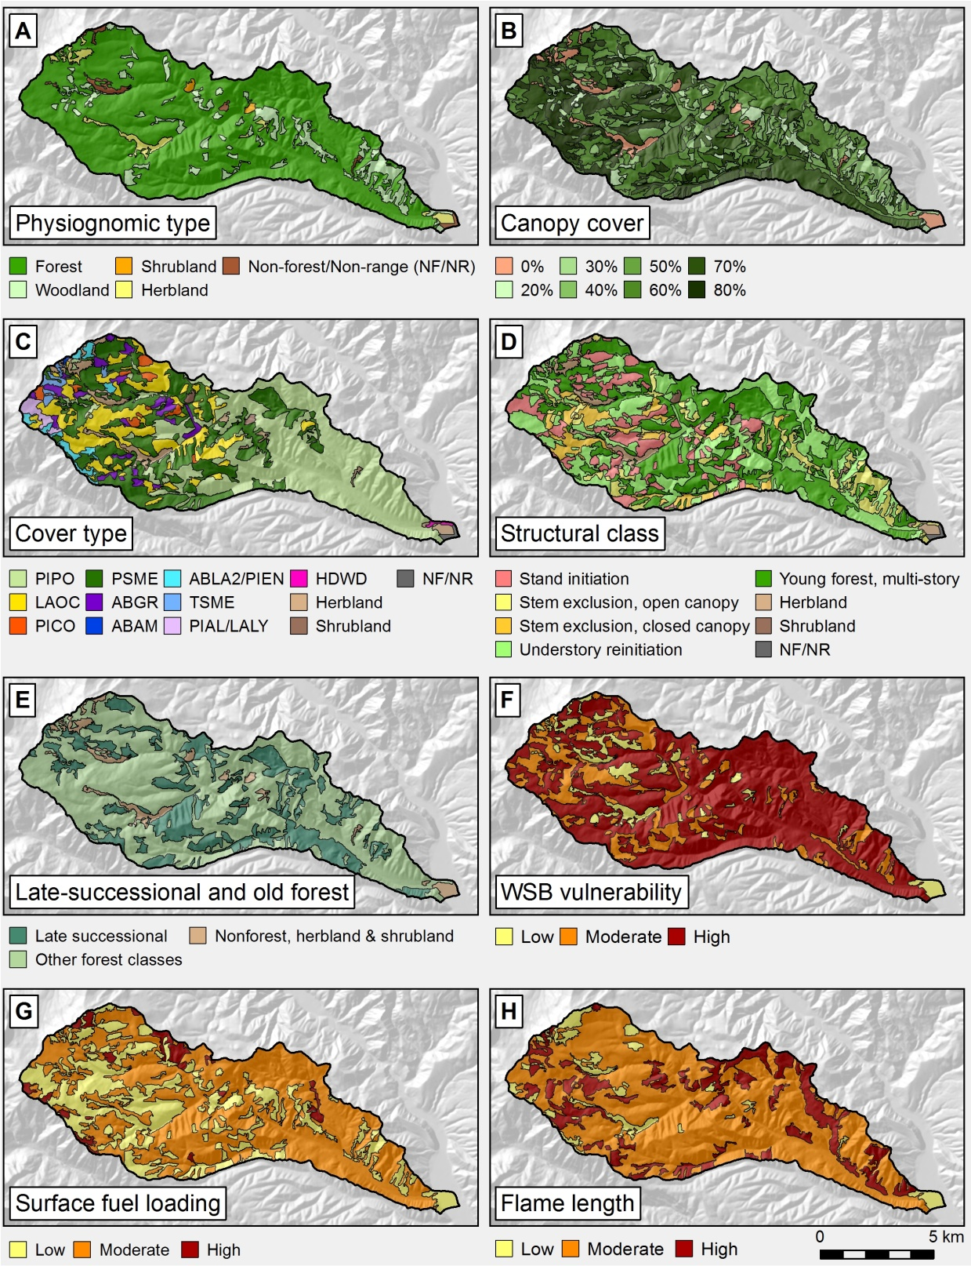
Notes:
Now we can describe ‘ORANGE’ which is actually SECC structure. And many others. Some of these derived items are better than others. But our entire landscapes can be consistently classified, described, and used for management purposes.

Slide 34
Ecological subregions of the Interior Columbia Basin
Interior Columbia Basin Ecosystem Management Project (ICBEMP)
Hessburg et al. 2000
Based on:
Temperature
Precipitation
Solar insolation
PVG
Bailey’s Eco’s.
54 ESRs
Notes:
In fact, that is exactly what happened.
The tremendous amount of variability in the natural environment requires that we stratify the landscape, to partition as much variance as possible.
We use the Ecological subregions 1st developed in the Interior Columbia Basin Project – and later improved and refined by hessburg et al.
The entire ICBEMP consists of 54 ecoregions, whose relationships we can track through a statistically derived hierarchical tree… ie. We know which ESR is the next warmer, drier ESR to an ESR of interest.

