Slide 1
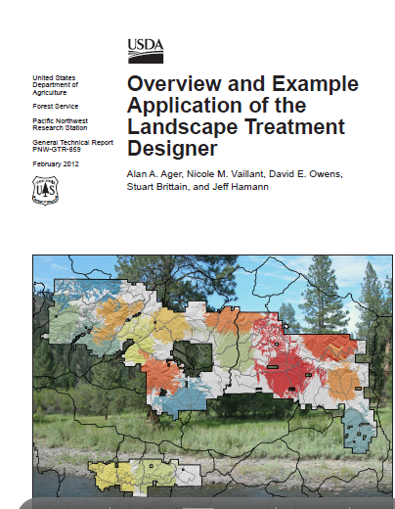
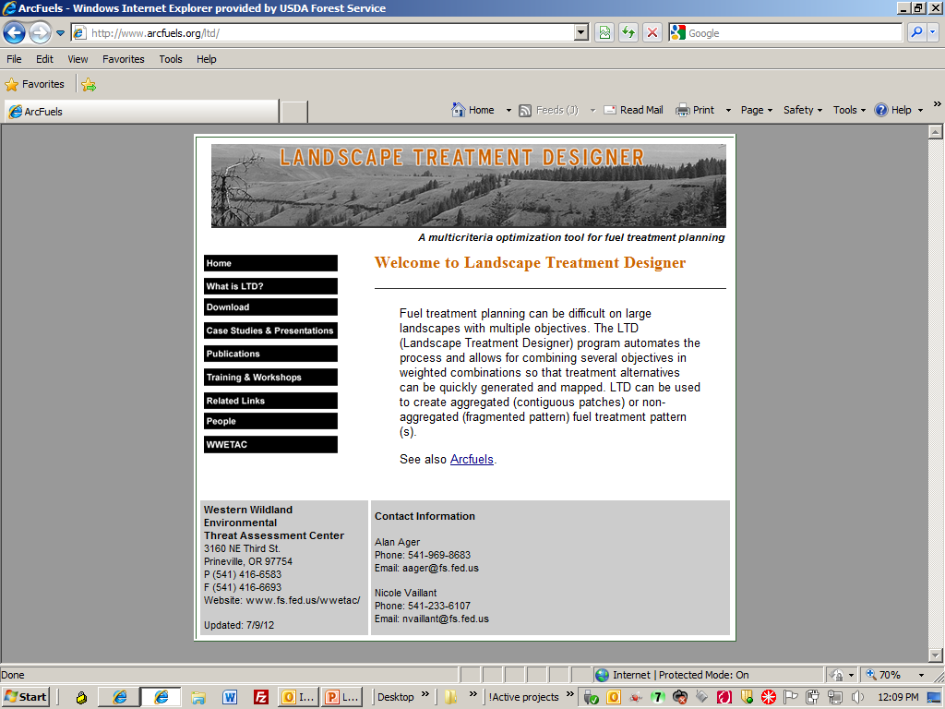



Landscape Treatment Designer: Spatial optimization for restoration and fuel treatment planning
Alan Ager, Western Wildland Environmental Threat Assessment Center, PNW Research Station, aager@fs.fed.us

Slide 2
WWETAC Landscape Risk Dynamics Focus Area
FlamMap
(RMRS)
Landscape Treatment Designer
Arcfuels
Wildfire Risk Framework
LSIM Re-engineered FVS planning model
Envision Agent based planning model
NEPA Support Restoration and Fuels planning
Management and Policy Research

Slide 3
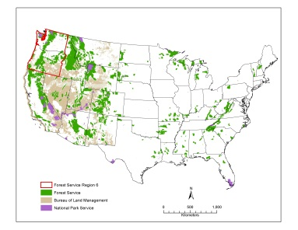
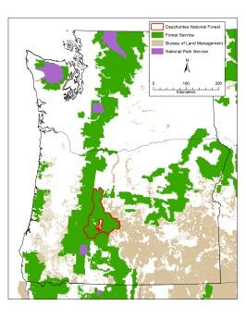
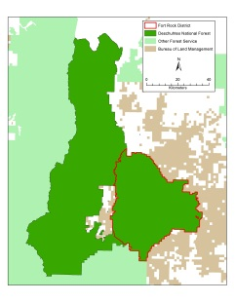
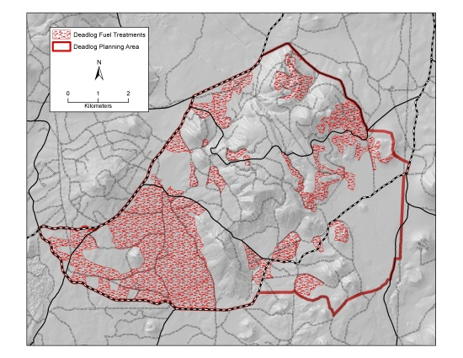
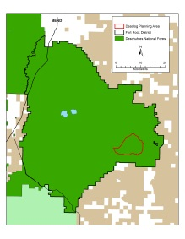

Wildfire Risk Framework - Application of risk concepts and science at multiple scales
National program
Investment prioritization among administrative units
Region
Landscape design of fuel treatments
National Forest
Projects
Ranger District

Slide 4
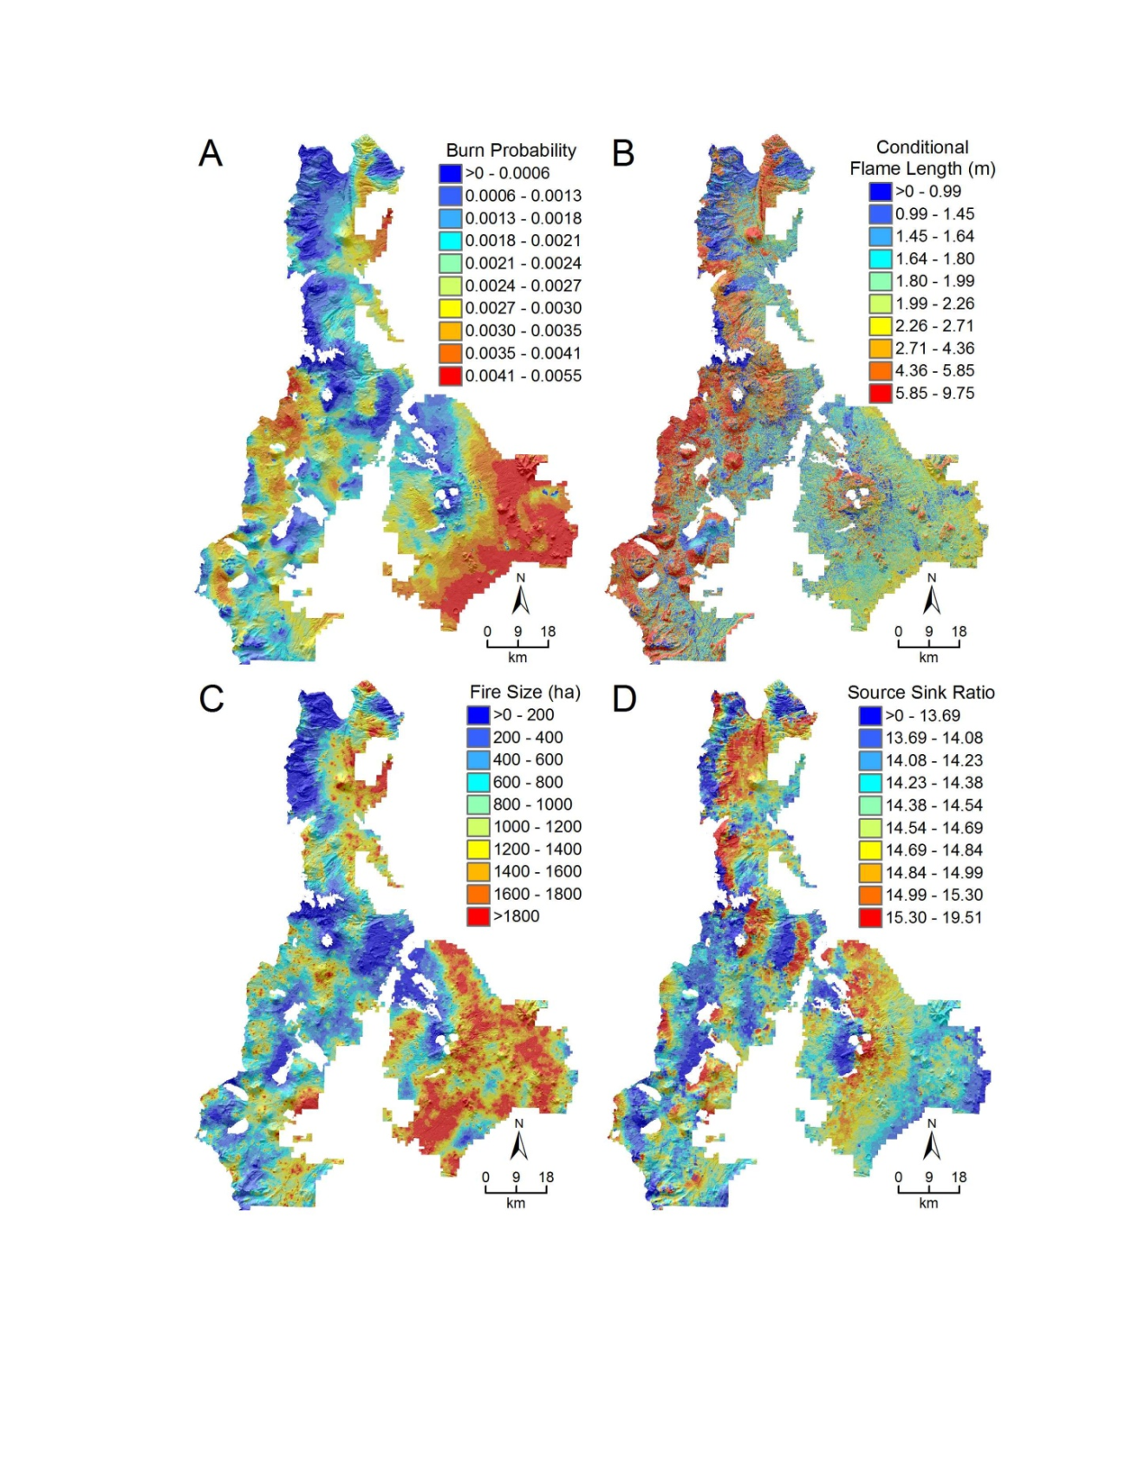
Exposure profile for the Deschutes NF
A) Burn probability
B) Flame length
C) Fire size
D) Source sink ratio

Slide 5
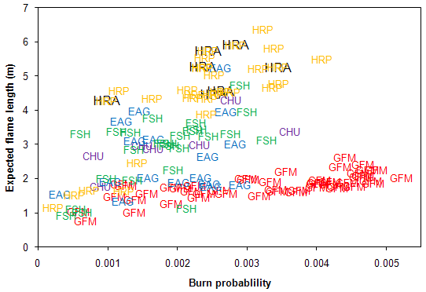
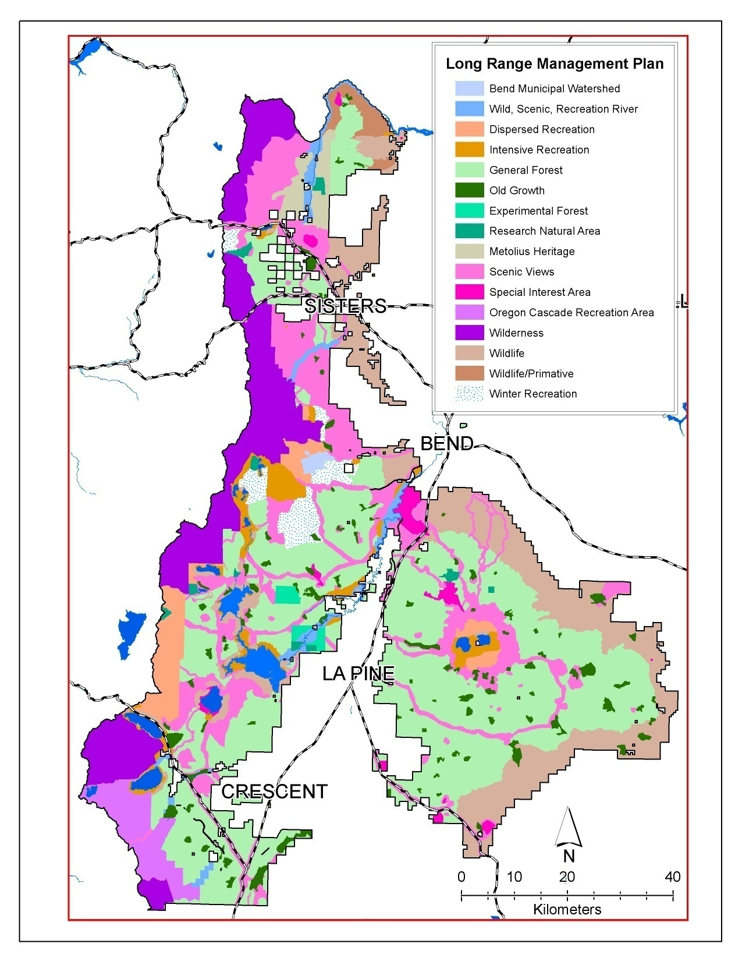
Simulation outputs can be used to prioritize specific values at risk
Low probability, high hazard
High overall exposure
Low hazard, high probability
GFM – general forest matrix EAG – eagle habitat CHU – NSO critical habitat units
FSH – stream conservation areas HRA – NSO home range active HRP – NSO home range potential

Slide 6
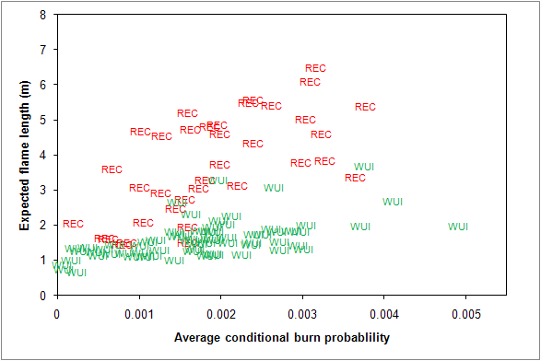
Simulation outputs can be used to prioritize specific values at risk
Low probability, high hazard
High overall exposure
Low hazard, high probability

Slide 7
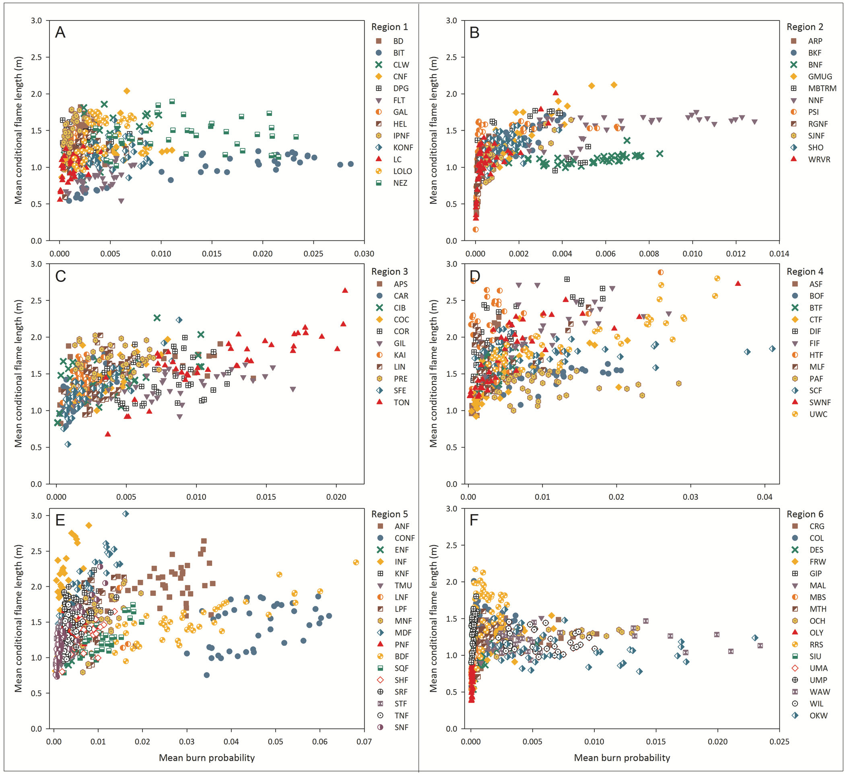
Exposure plots for the 82 western national forests

Slide 8
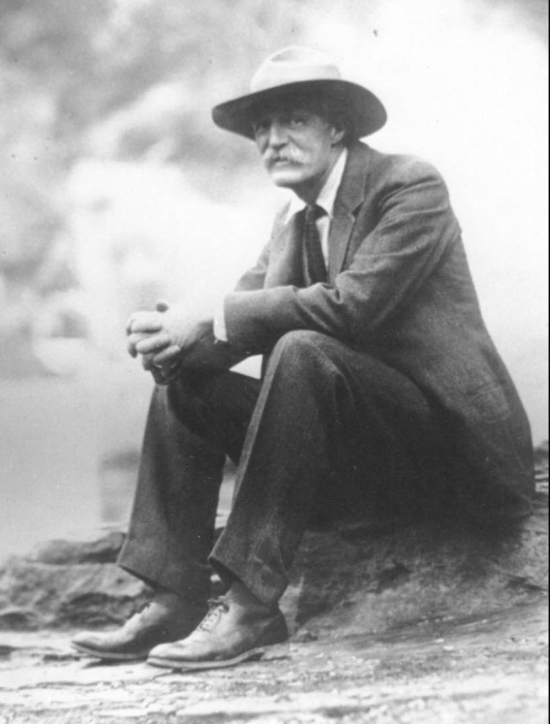
Motivation
Optimize the greatest good for the greatest number
FS spends a great deal of effort on assessments
Simple decision support systems are lacking to process these assessments and expose choices and tradeoffs
Nor do systems exist to explore optimal mixes of investment strategies, i.e. the frontiers of restoration
  Project size
  Treatment intensity and patterns
  Economics
Choices exist because of landscape heterogeneity in relation to management goals and constraints

Slide 9
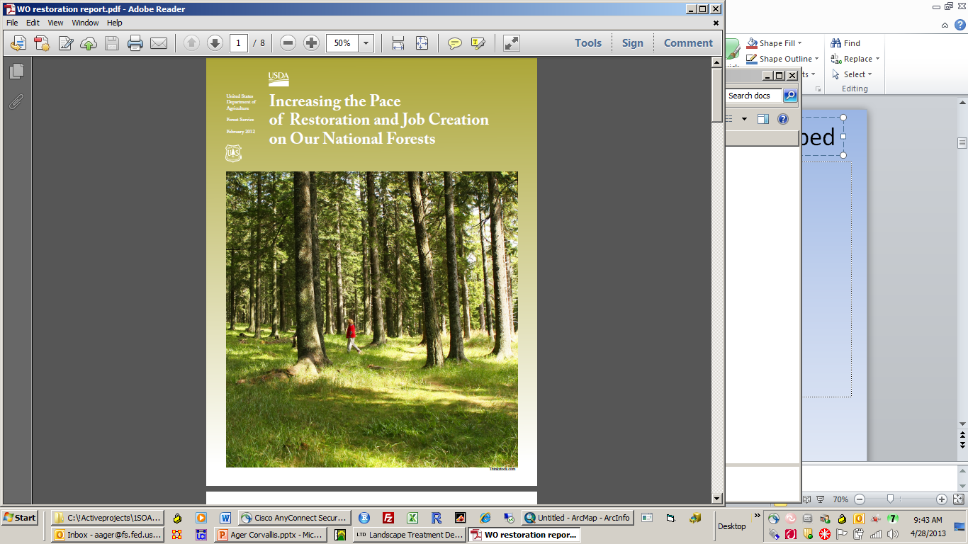
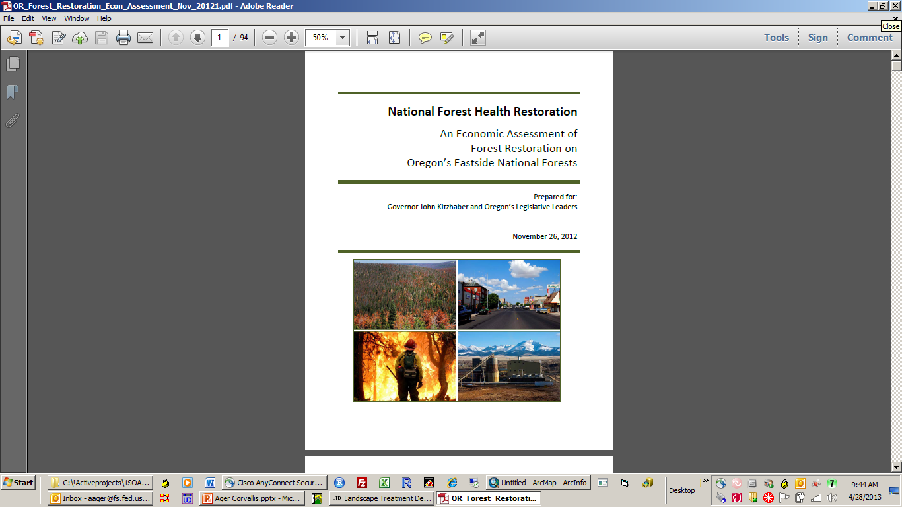
Policies need to be downscaled for prioritization and implementation
Restoration
Wildfire risk
Economics

Slide 10
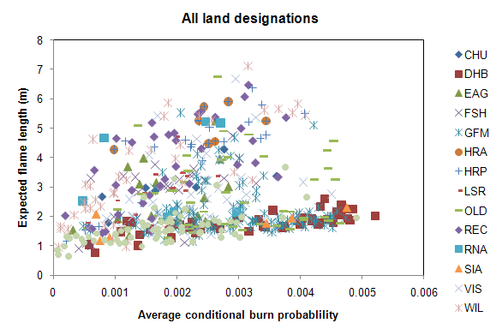
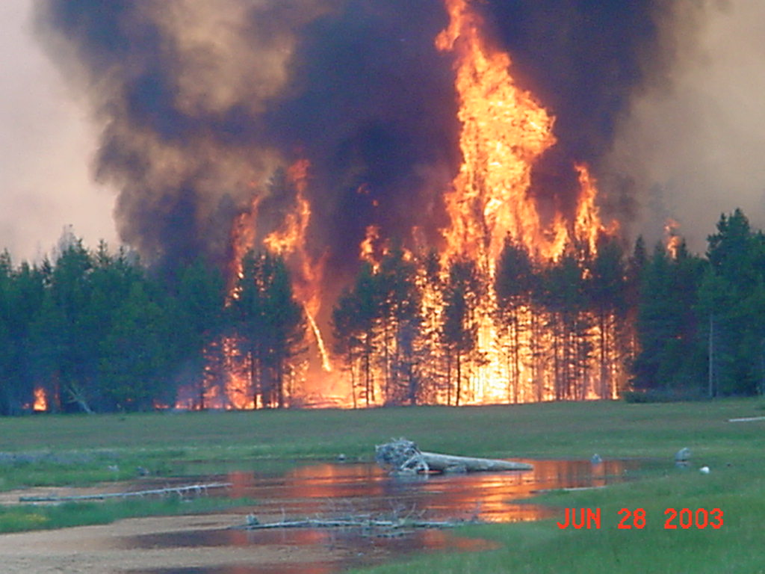
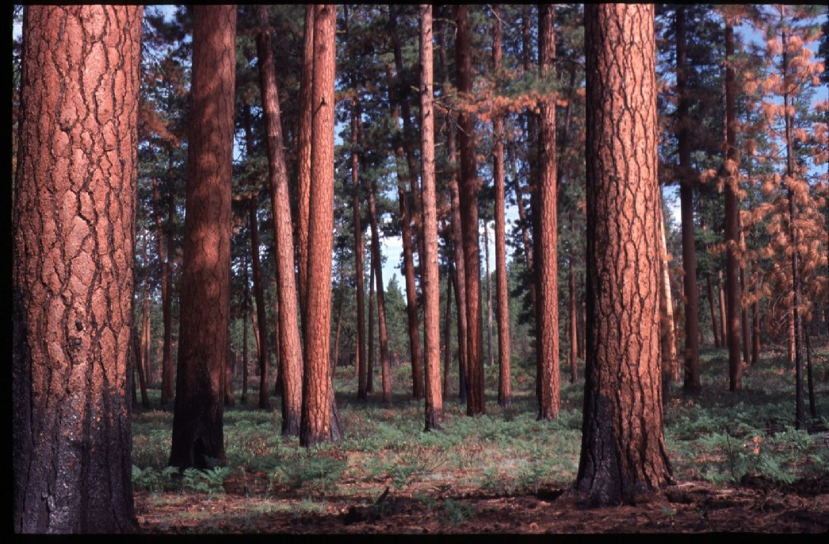
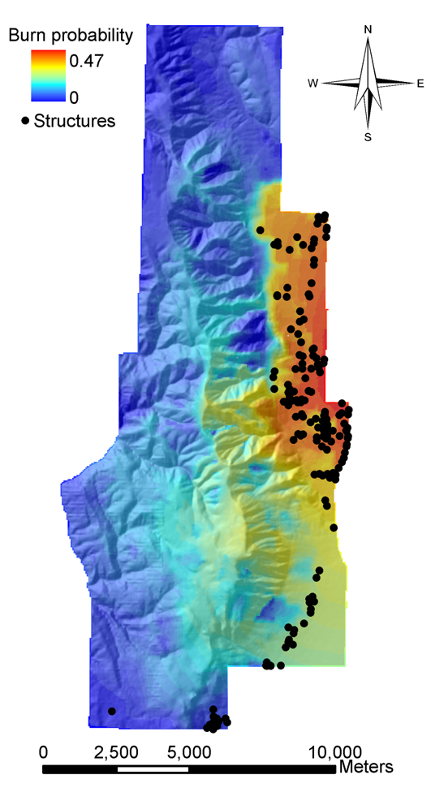
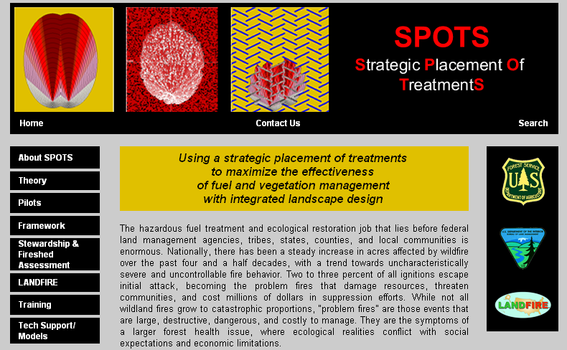
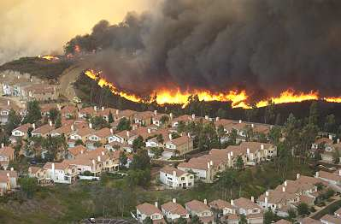
Another reason for LTD: we need better tools for project level planning
Combine risk analyses and fuel treatment optimization concepts
Wildfire ecology
Risk Factors
Optimum spatial treatment strategy
Optimization concepts
Spatial pattern of values

Slide 11
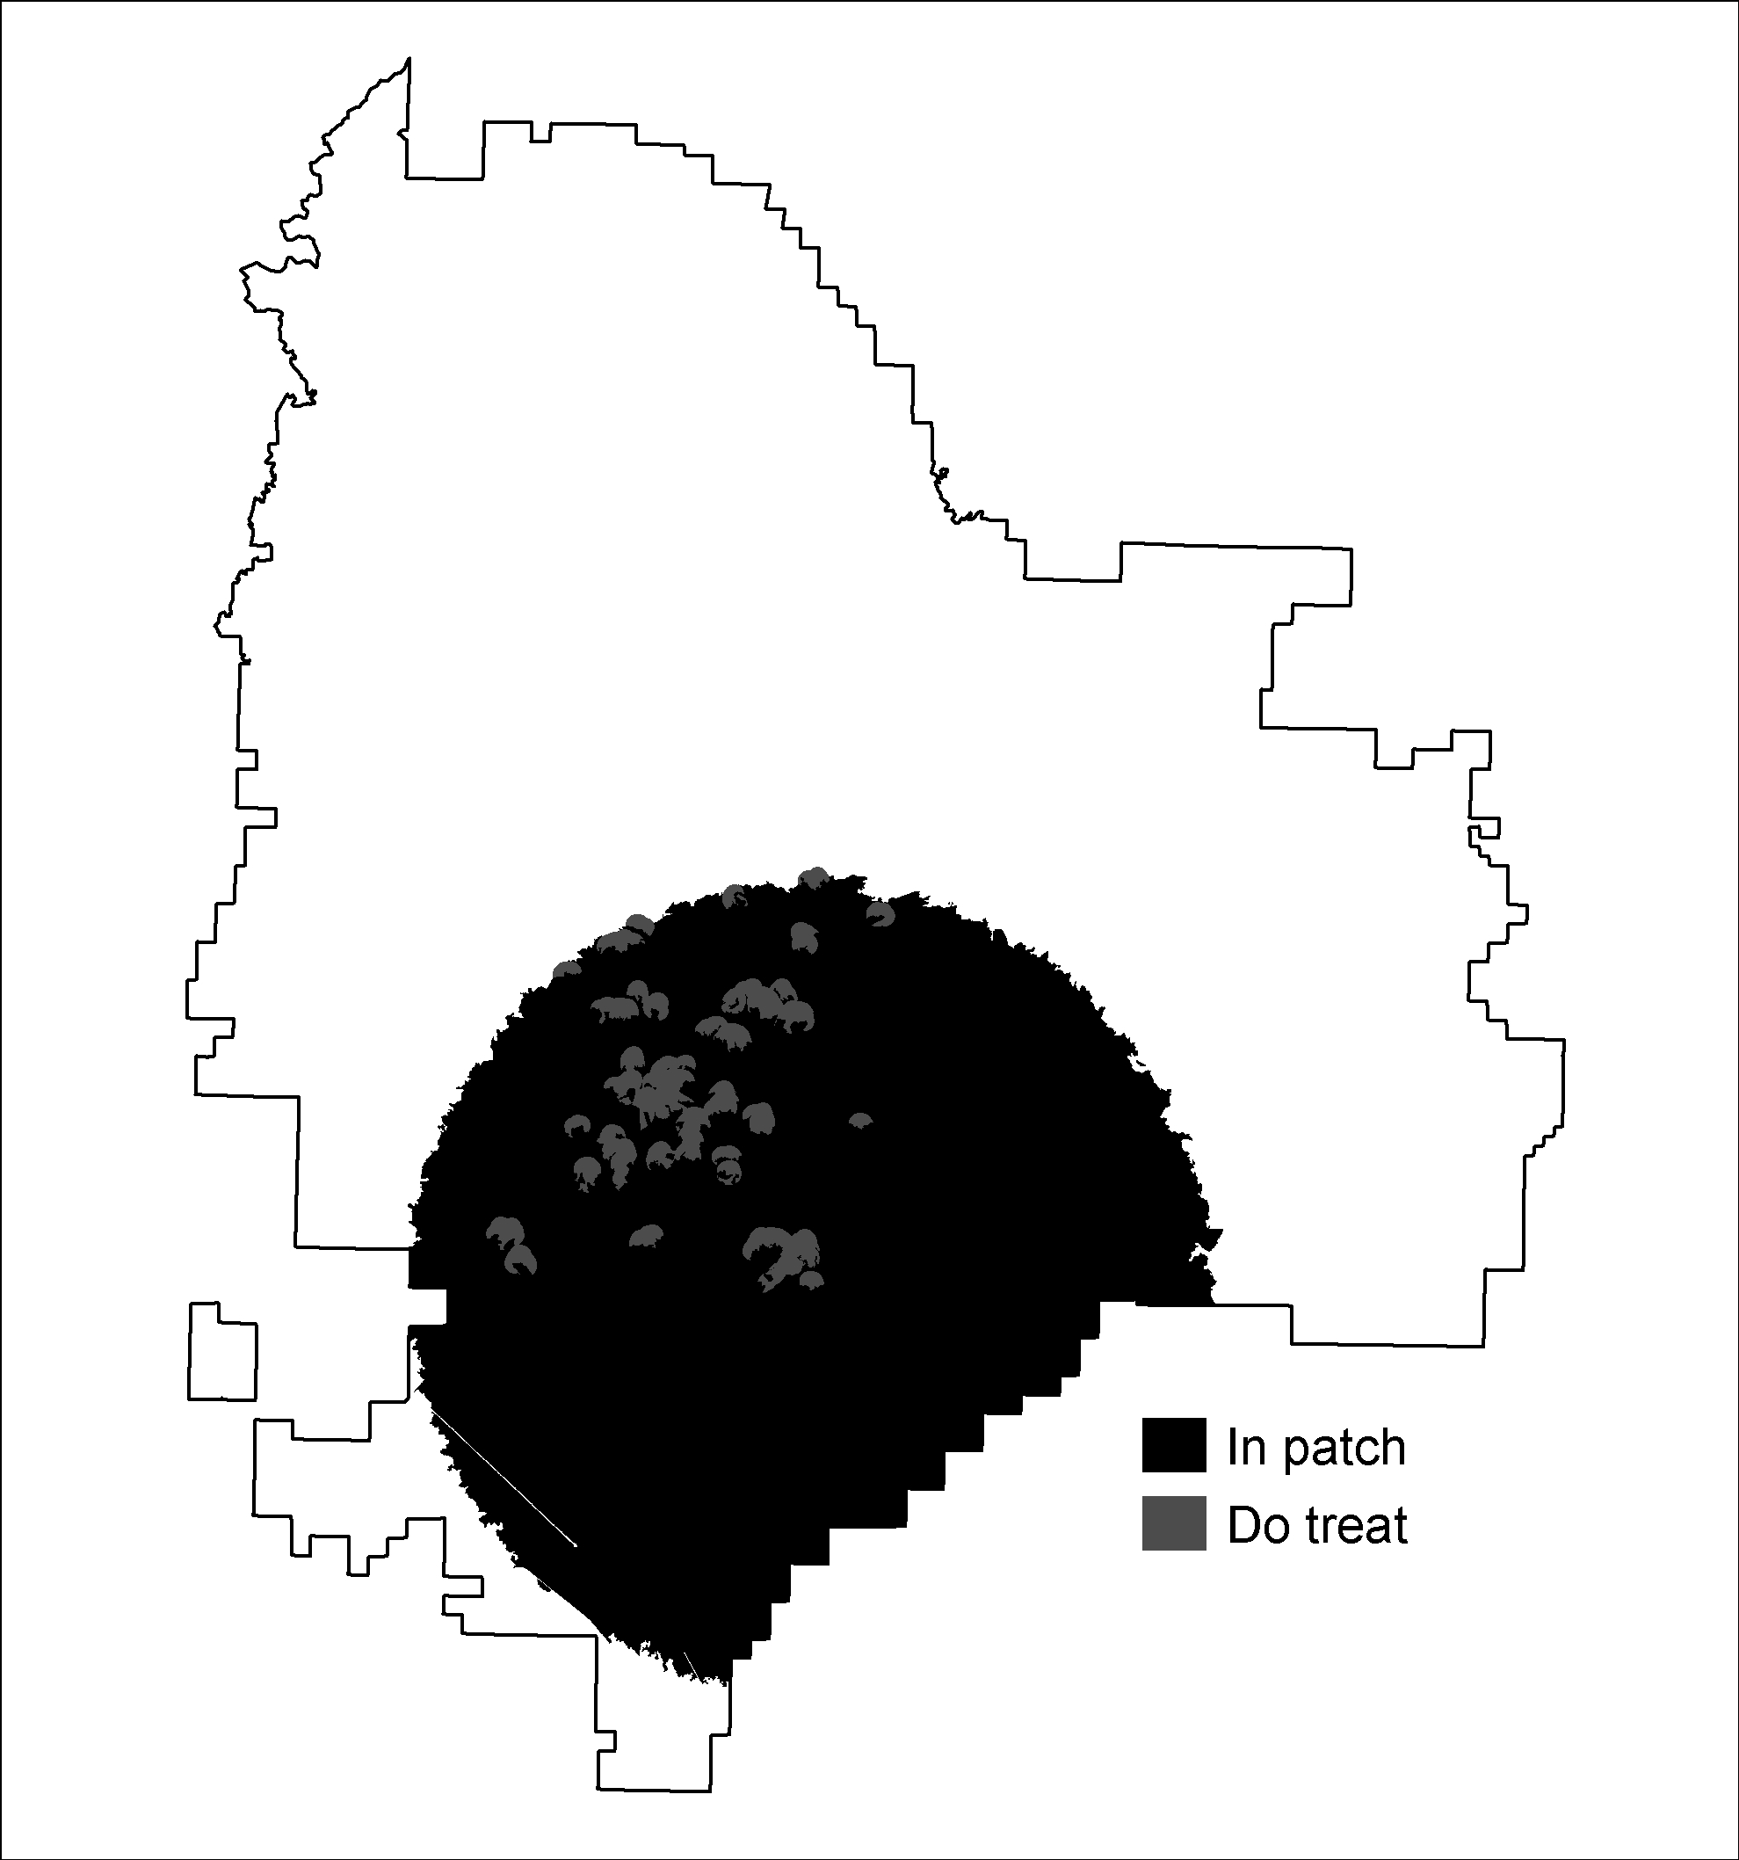
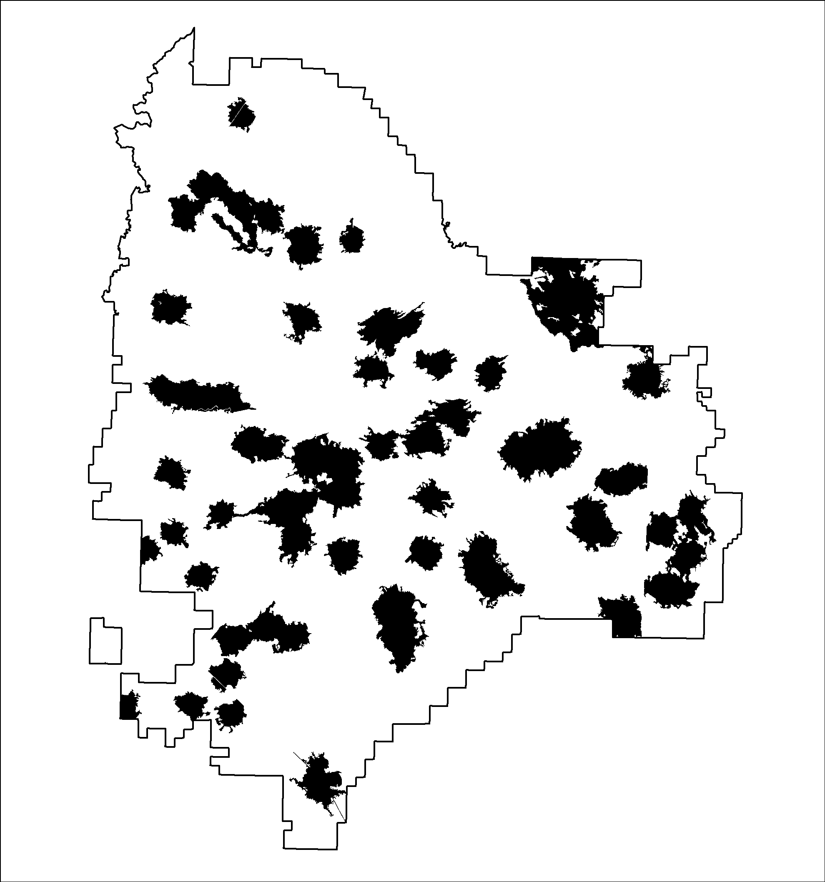
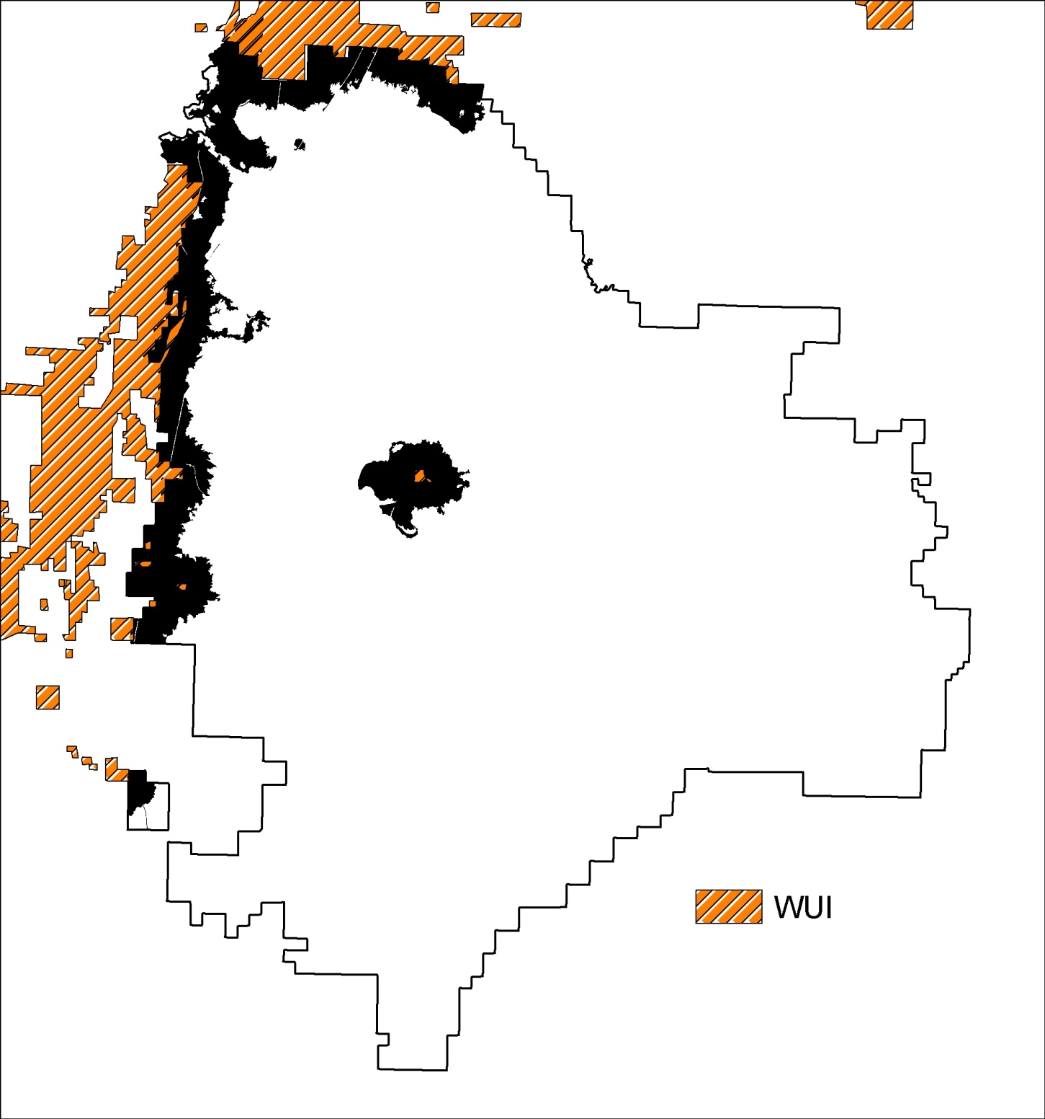
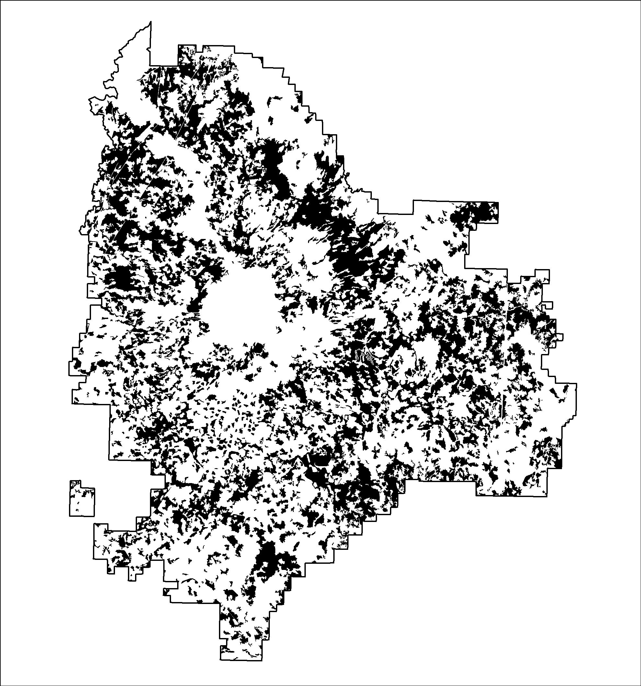
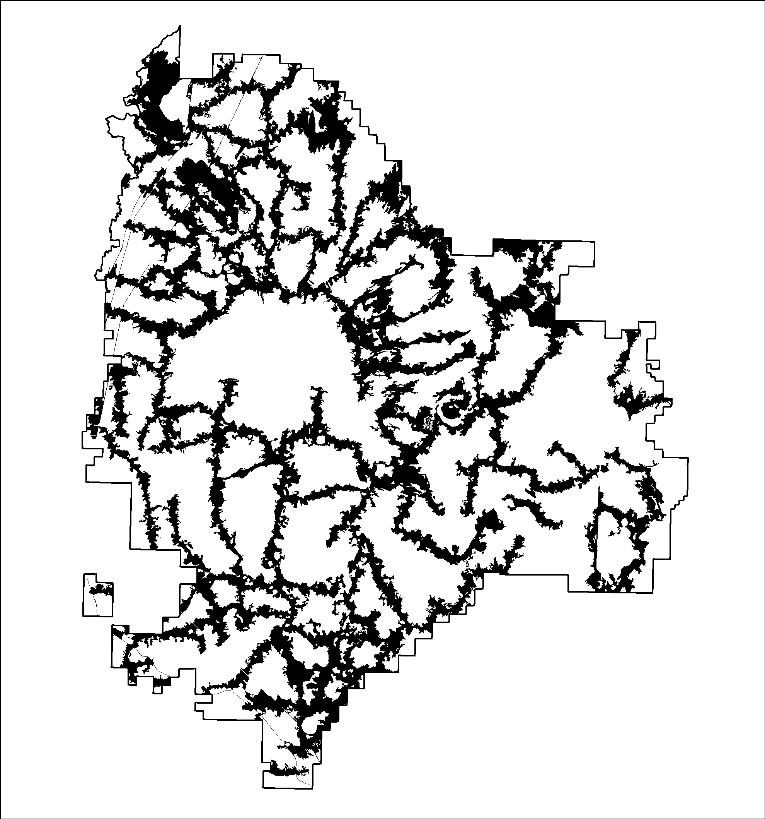
Example spatial fuel treatment designs
Fuel treatment goals
Restoration Protection Contain
Low hazard fire containers
Strategic
Restoration of natural
fire breaks
Focused defensible fuel breaks
Dispersed fuel breaks
Treatment optimization model
High hazard
fire containers
WUI
Black polygons represent treatment units

Slide 12
LTD Overview
Modeling a spatial planning problem in LTD requires
  Objective function Quantifies the goals or potential response from management activities
  Constraints Specify the restrictions on budgets or activities
  Management thresholds Defines conditions where treatments are needed

Slide 13
LTD Overview (cont.)
LTD Maximizes (or minimizes) the objective function subject to constraints
Management is allocated based on the treatment threshold
Options
  Aggregation – Management units need to be connected
  Iteration – repeat the optimization identify a list of priority projects
  Step treatments and constraints – performs sensitivity analysis –

Slide 14
LTD hardware and data requirements
64 bit computer – hardware depends on the problem
Shapefile of management units
  Stands
  HUC4/5/6’s
  Districts
  etc
Attributes data that describe
  Objectives
  Constraints
  Treatment thresholds
  Availability
  XY centroid

Slide 15
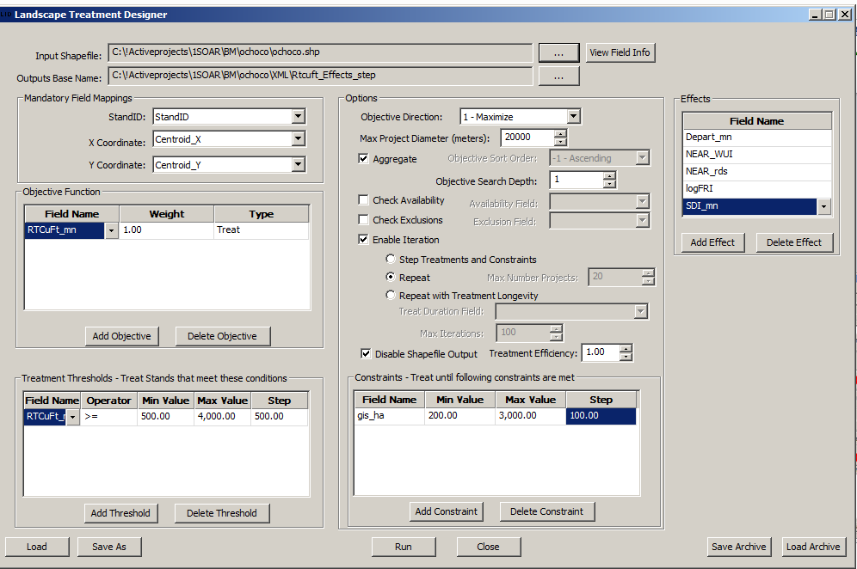
LTD Interface

Slide 16
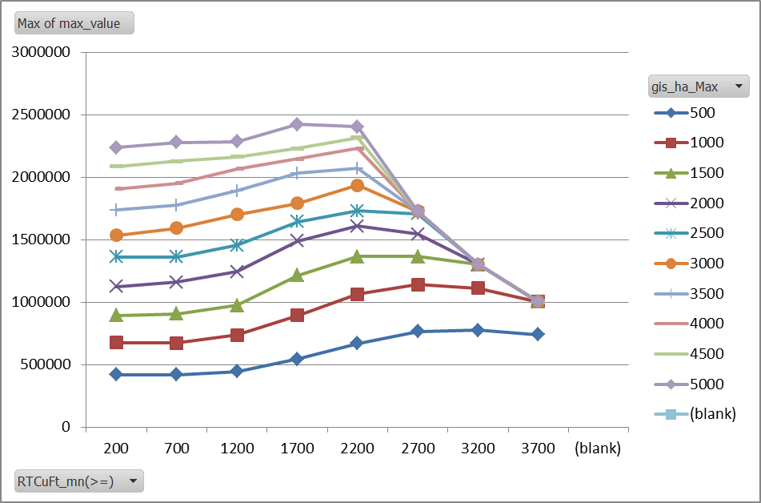
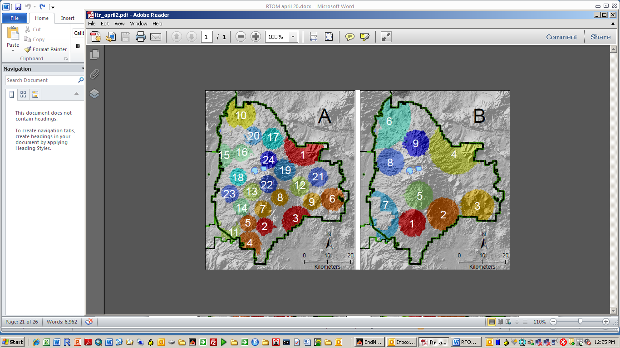
Outputs
Shapefile with management priorities, i.e. project areas that maximize the objective function given the constraints.
Summary text files for analyzing tradeoffs
objective
constraint
Management thresholds

Slide 17
Example search for locating spatial optima
Can treat 8 cells total in project
Treat when stand density > 5
Maximize treatment of high fire risk
Project area
Treated pixels
Fire risk
Stand density
2 | 1 | 2 | 3 | 1 | 3 | 6 | 5
3 | 1 | 3 | 4 | 10 | 4 | 5 | 2
4 | 2 | 7 | 5 | 3 | 5 | 6 | 3
5 | 3 | 12 | 4 | 4 | 4 | 5 | 12
12 | 9 | 5 | 8 | 10 | 3 | 4 | 5
4 | 9 | 10 | 9 | 2 | 4 | 3 | 6
3 | 6 | 3 | 3 | 1 | 5 | 34 | 7
2 | 1 | 2 | 3 | 1 | 3 | 6 | 5
3 | 1 | 3 | 4 | 10 | 4 | 5 | 2
4 | 2 | 6 | 5 | 3 | 5 | 6 | 3
5 | 7 | 8 | 4 | 4 | 4 | 5 | 12
8 | 3 | 5 | 8 | 3 | 3 | 4 | 5
4 | 9 | 10 | 9 | 2 | 4 | 3 | 6
3 | 6 | 10 | 12 | 1 | 5 | 34 | 7

Slide 18
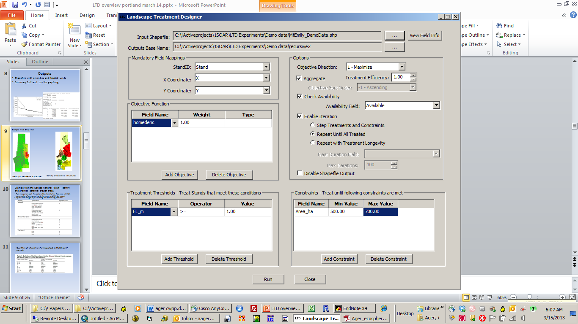
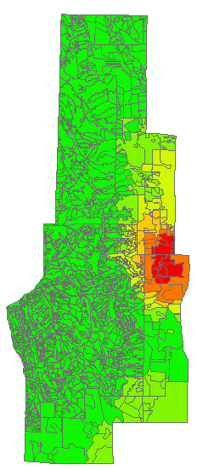
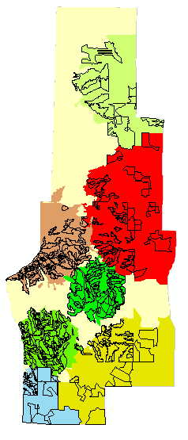
Example – Mt Emily WUI, La Grande Ranger District
Density of residential structures
Priority projects and treatments

Slide 19
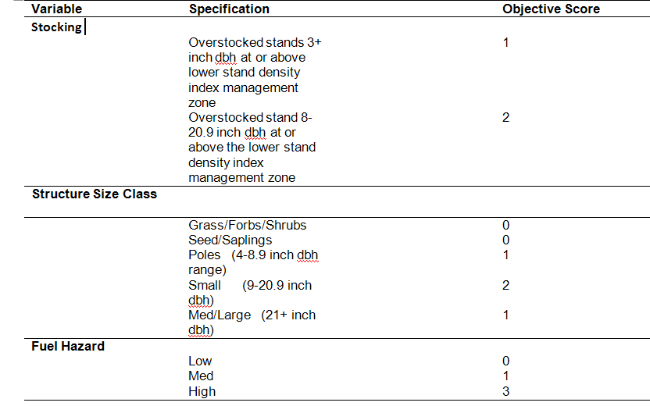
Example from the Ochoco National Forest – Identify and prioritize potential project areas.
Treat areas with high concentration of overstocked stands, large trees, and high fuel hazard.
Crown fire x flame length

Slide 20
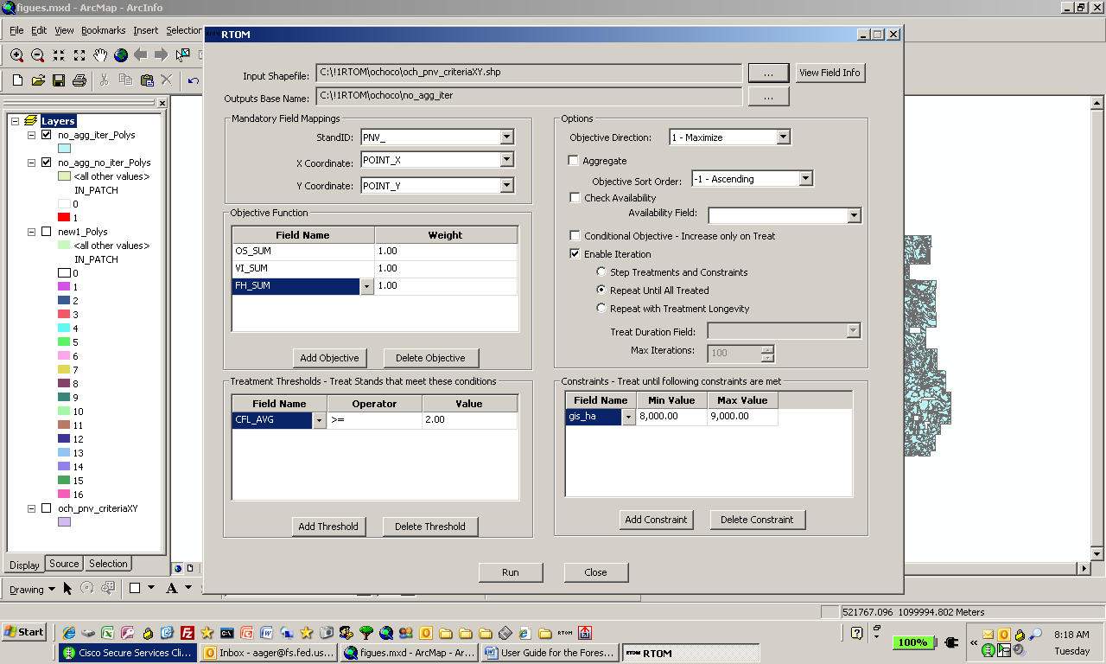

Slide 21
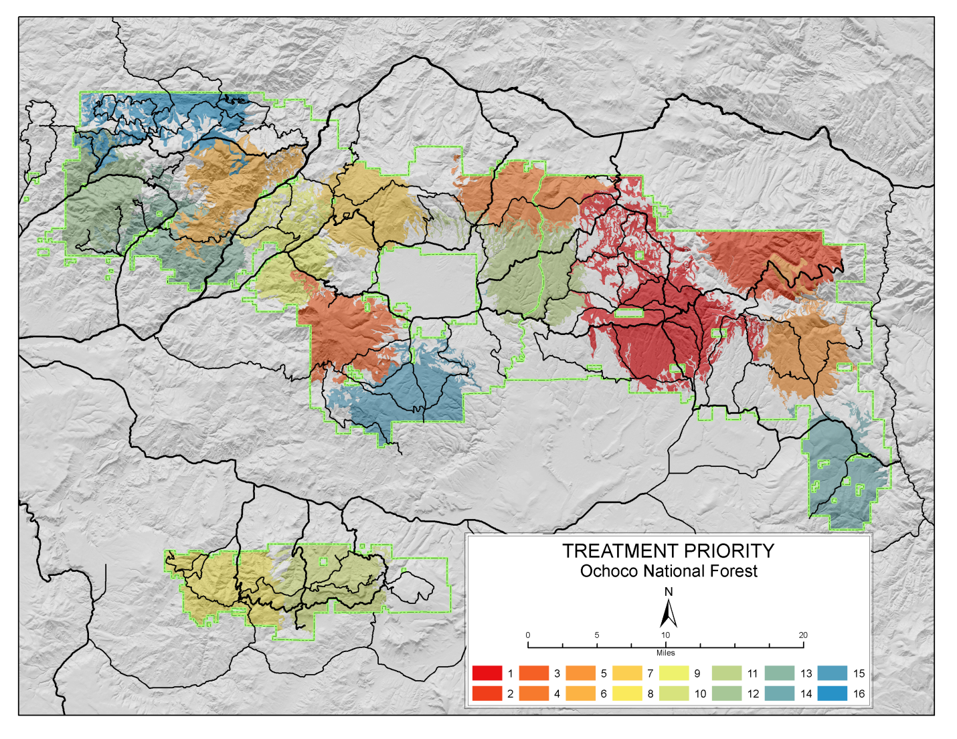
Project areas are identified that maximize the objective function – color indicates priority

Slide 22
Case study 3. Wallowa Whitman NF
Goal: Create high hazard fire containers surrounded by defensible zones.
Treat along roads and ridges, near WUI, treat stands with crown fire behavior
Input data
    Distance to road
    Distance to WUI
    Slope position
    Percent stand in crown fire condition

Slide 23
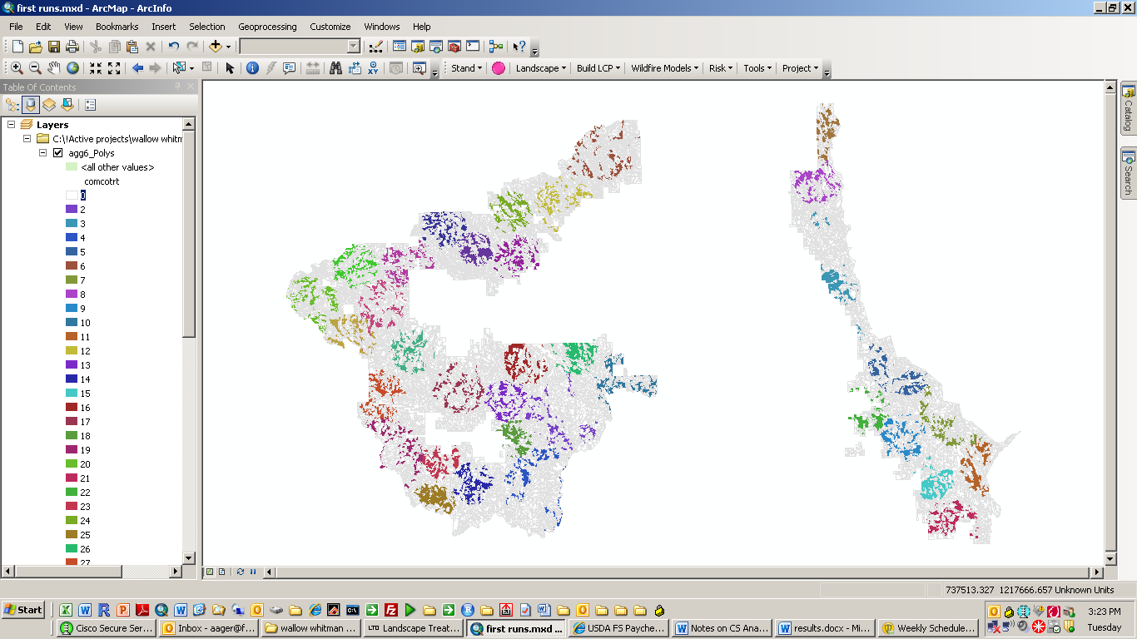
Project areas. High priority = on ridges with high concentration with crown fire stands near roads. (only treated stands are shown) WUI not considered

Slide 24
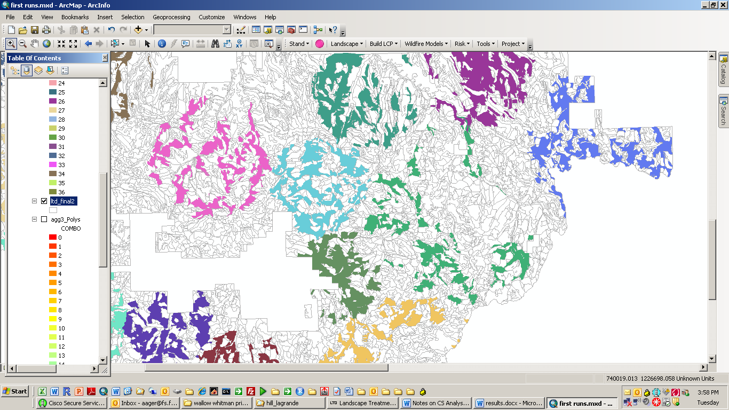
Treatment units within projects

Slide 25
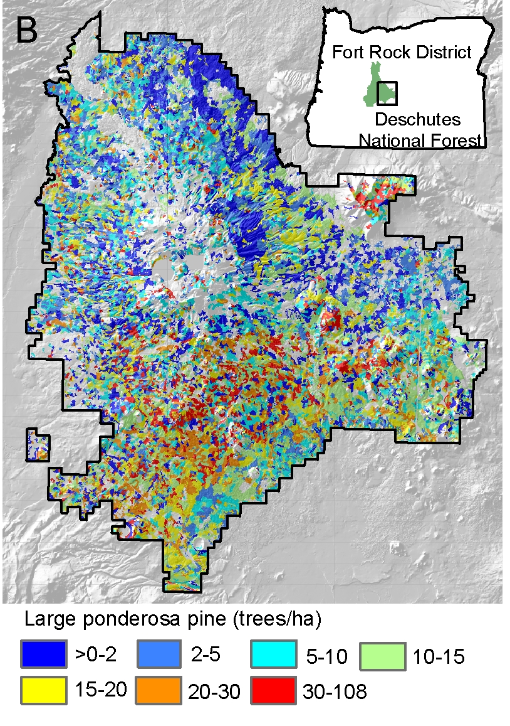

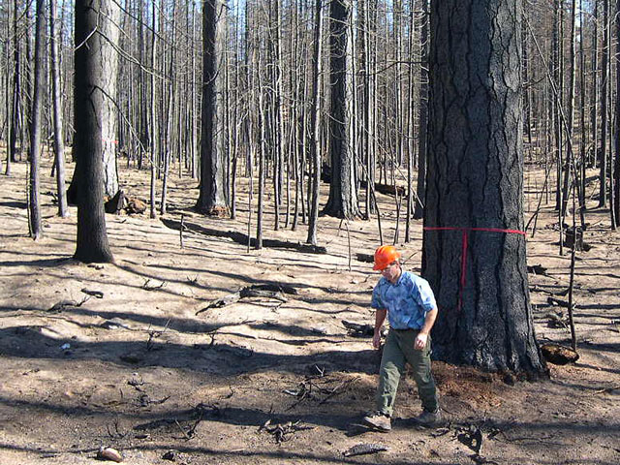
Density of old growth ponderosa pine (>21” DBH)
Optimizing dry forest restoration
Locate and treat stands to build low hazard fire containers to protect old growth ponderosa pine
Ager et al. Ecosphere Feb, 2013.

Slide 26
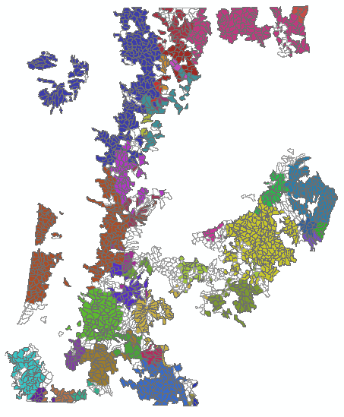
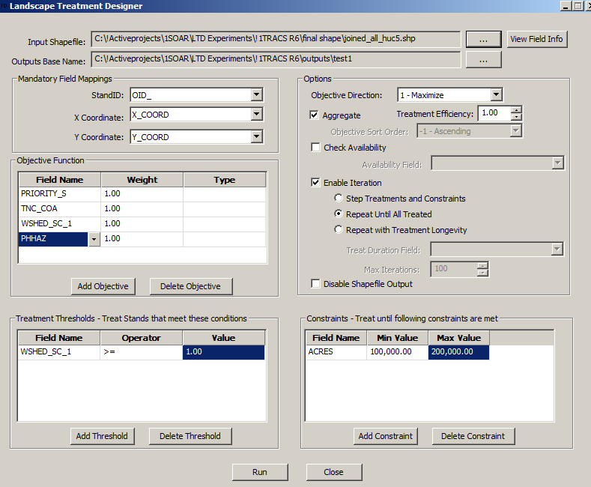
R6 prioritization experiment
Sub-watershed scale indices obtained for TRACS and wildfire exposure
Components equally weighted
Generated prioritization schedule

Slide 27
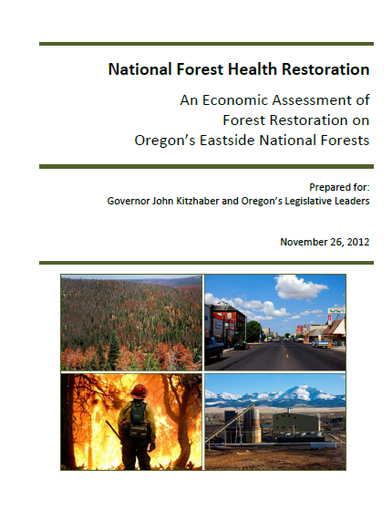
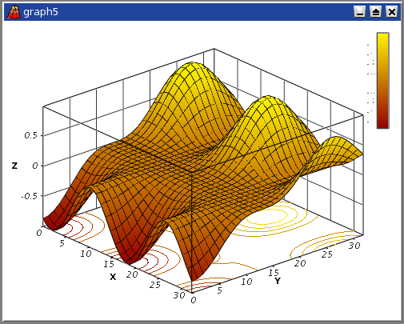
Blue Mountains Study
Spatial Optimization for Accelerated Restoration
What are the management tradeoffs between restoration, wildfire risk, and economic benefit?
What are optimal project design parameters (area treated, treatment threshold, percent of project treated)?
Do spatial optima exist?
Effect of conservation and WUI protection on optima?
Thin Volume
Reduction in wildfire risk
Restoration

Slide 28
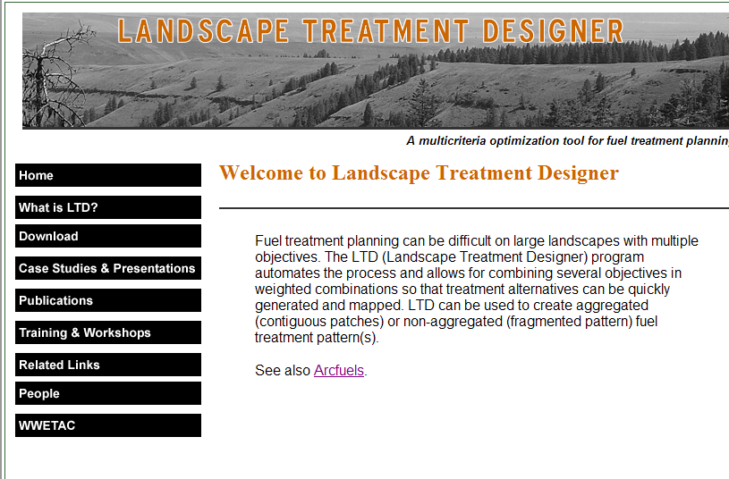
Website with program and tutorial: www.arcfuels.org/ltd

