Slide 1
Integrating Climate Change into Landscape Planning
Modeling climate and management interactions within the ILAP framework
April 23, 2013
Jessica Halofsky
Emilie Henderson

Slide 2


Modeling
“Essentially, all models are wrong, but
some are useful.” – Box & Draper 1987
“It’s Only a Model.”
– Patsy, 1975

Slide 3





Projects behind today’s talks
Integrated Landscape Assessment Project (ILAP)
  Climate Change Module
  Central Oregon Study Area
Climate, Management and Habitat

Slide 4
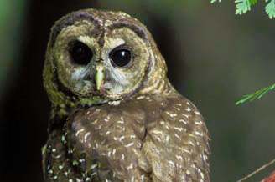
How might climate and land management interact to shape vegetation and habitat?
Coastal Washington
Northern Spotted Owl
Greater Sage Grouse
Southwest Oregon
Southeast Oregon

Slide 5

Scenarios
 |  | Management
 |  | Current Management | Restoration | Natural Resources Economy
Climate | Hadley (Hot/Dry)
 | MIROC (Hot/Wet)
 | CSIRO (Warm/Moist)
What can we do to improve the probability that we will like what comes?
Notes:
We sketched out a 3x3 table to outline the shape of the stories that we would like to explore.
Here’s a sketch of how we might find a story within this matrix. Note: THESE ARE NOT RESULTS OR HYPOTHESES. (hence the cheesy clip-art).
Our goal within this project is to understand the shape of this space primarily with respect to the vegetation, as it relates to owl habitat.

Slide 6
General Topics for today’s talk:
Starting conditions
STMs without climate
Climate impacts modeling

Slide 7
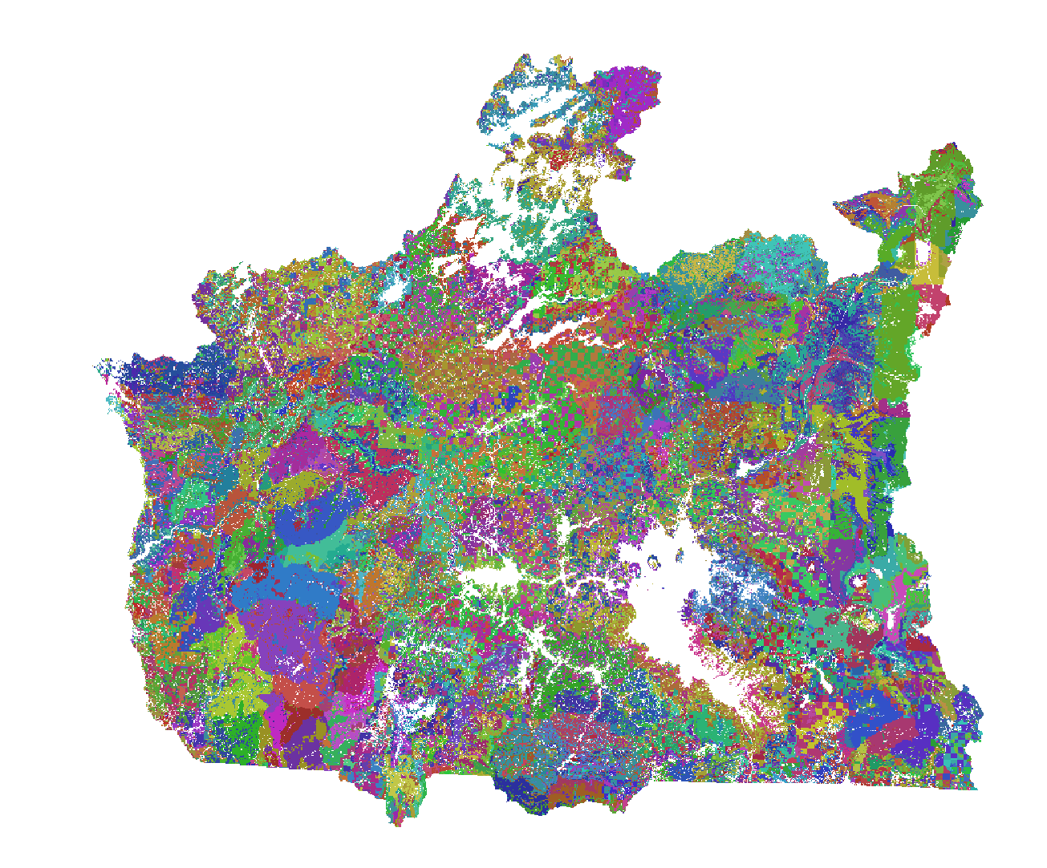
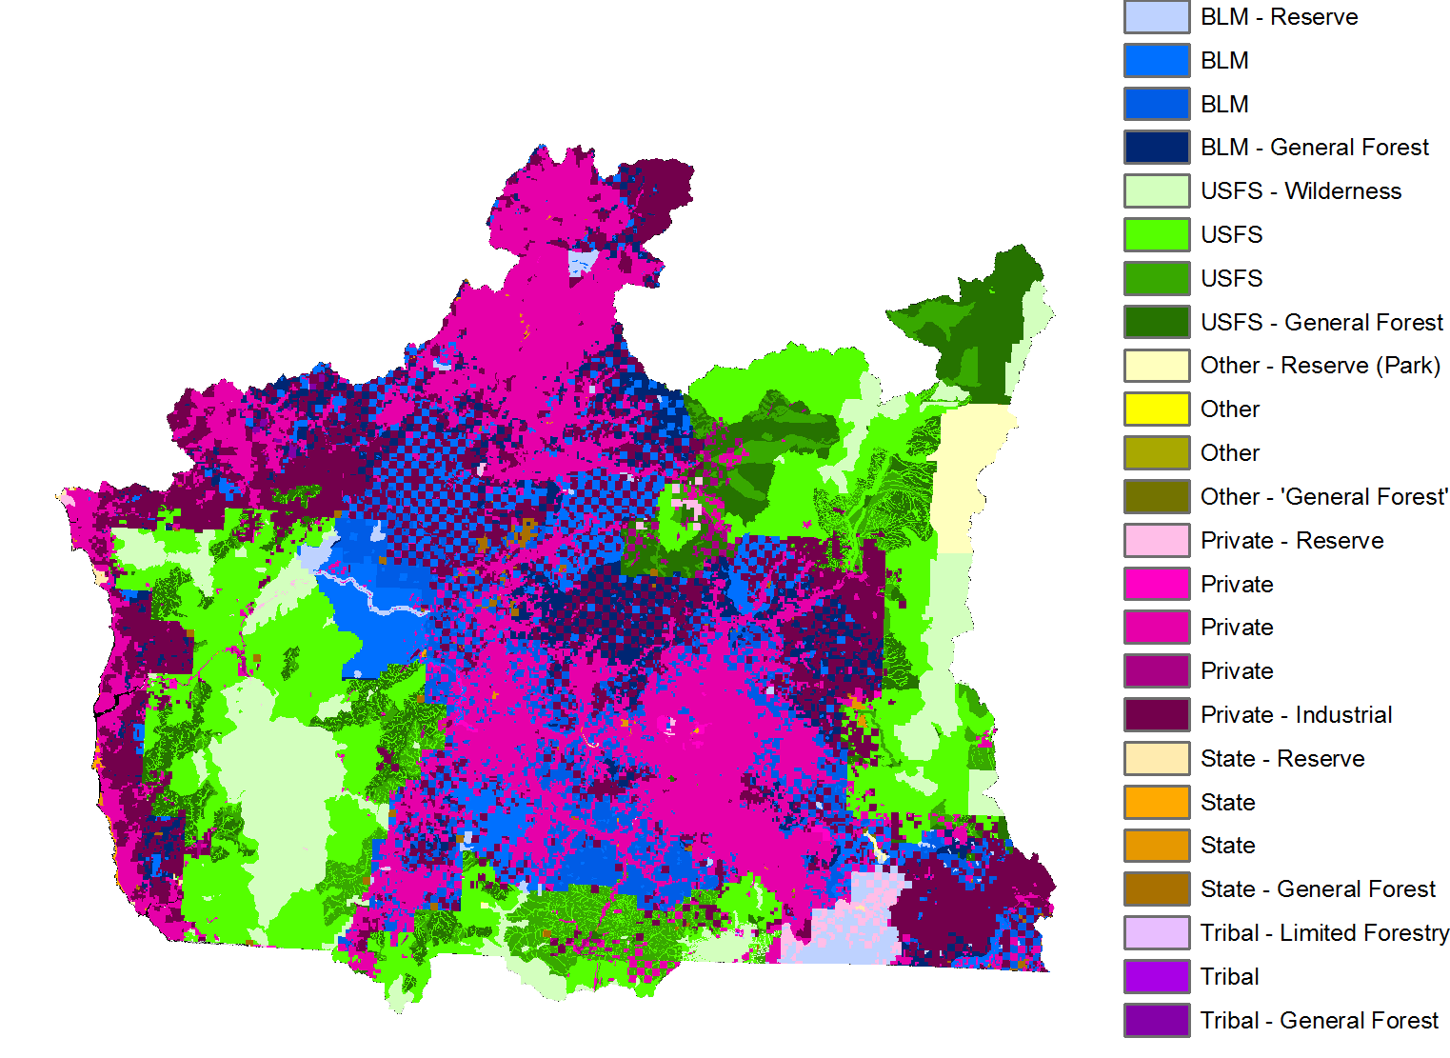
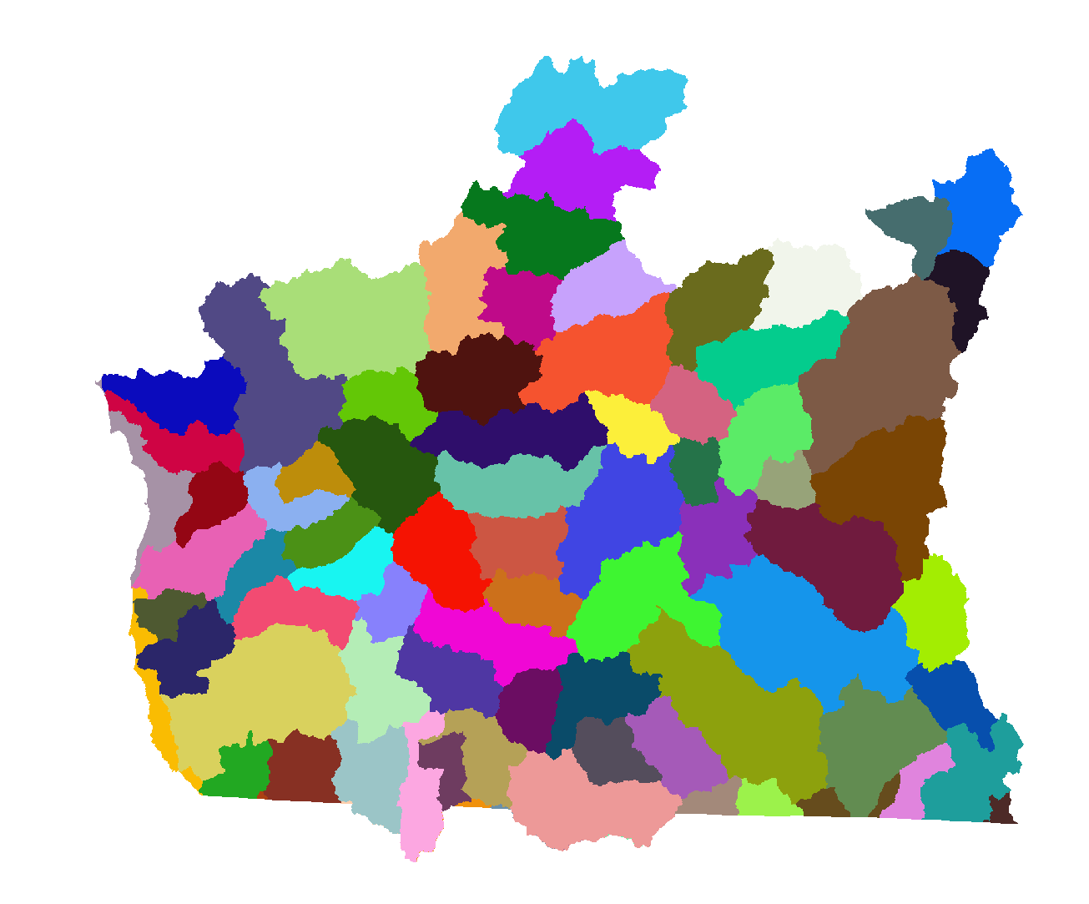
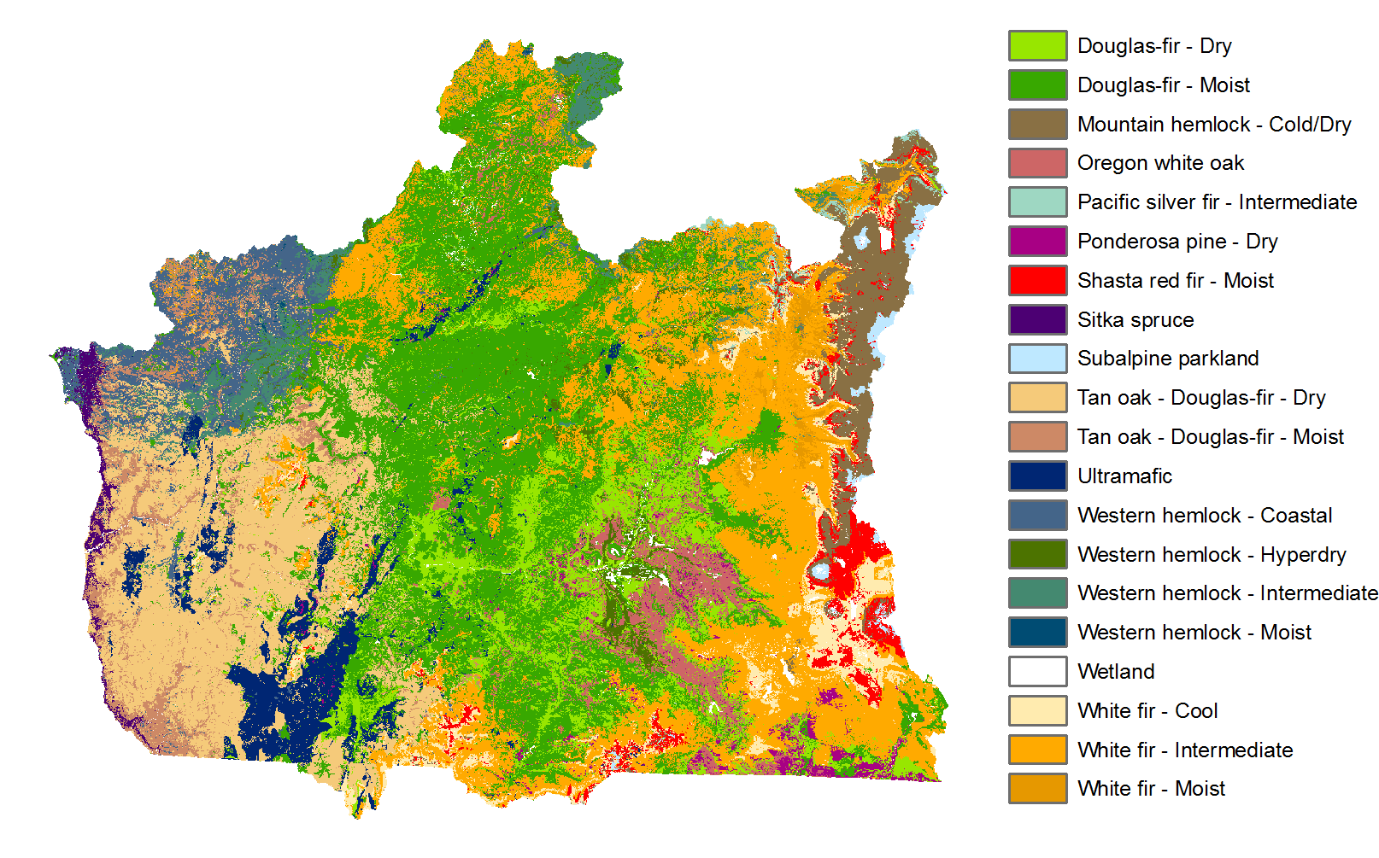
Modeling Strata

Slide 8



The overall picture:
Not locally precise.
Useful for describing landscape-to regional trends.

Slide 9

Current Vegetation
GNN = Gradient Nearest Neighbor
  A spatial depiction of the FIA plots.
  Structured by an ordination model.
Gives us information on current vegetation within each modeling stratum.
Janet Ohmann, Matthew Gregory, Heather Roberts

Slide 10
General Topics
Starting Conditions
State Transition Modeling, without accounting for climate
Climate impacts modeling

Slide 11
State and Transition Modeling
Early Successional
Young Forest
Growth
Fire
Regeneration
Harvest
Mature Forest
Old Growth Forest

Slide 12
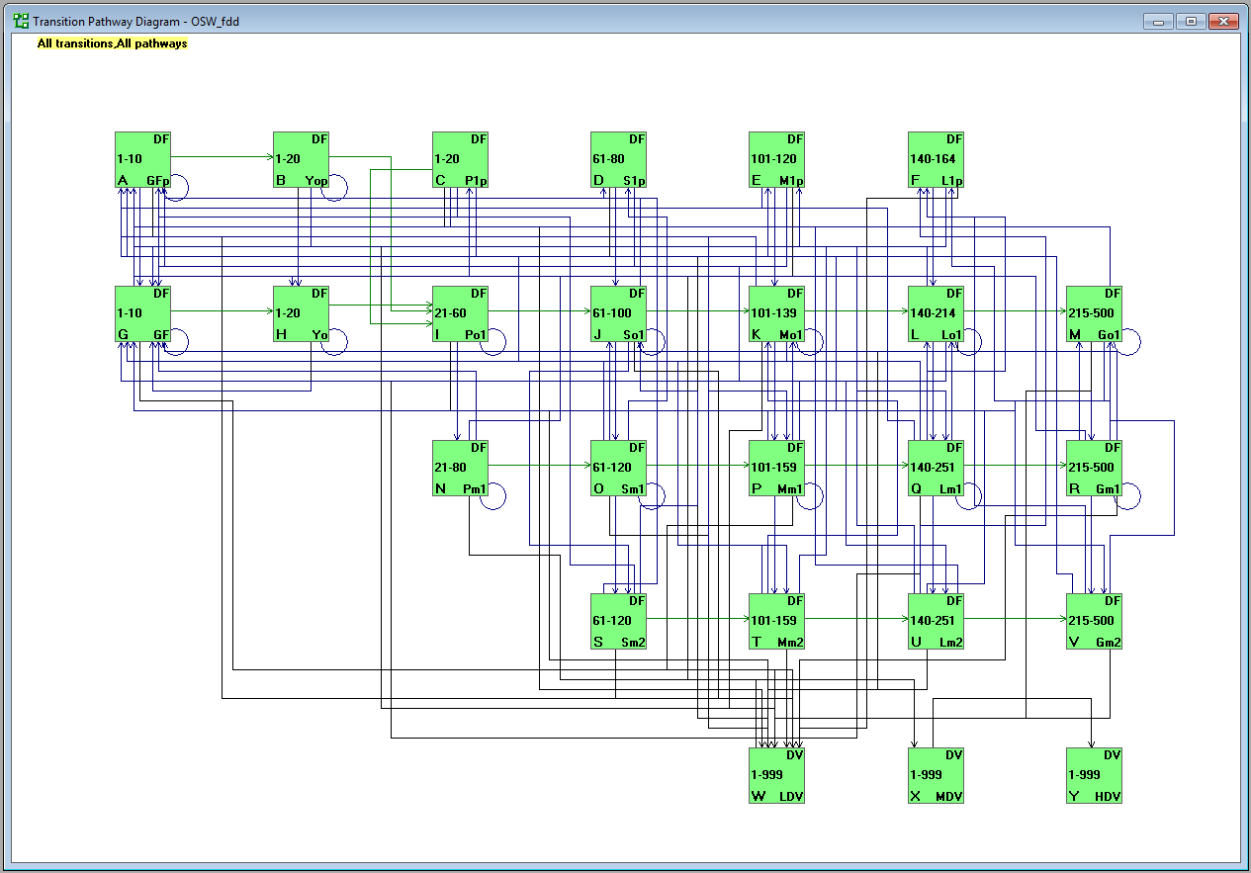

State and Transition Modeling:
Dry Douglas-fir
Pole-stage, single-story, post-disturbance
Grass-Forb
Giant Trees
Moderate Canopy
Multi-Layered

Slide 13
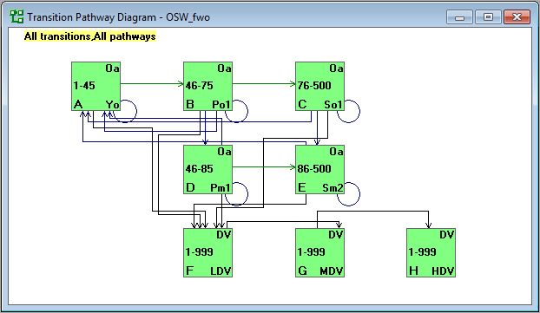
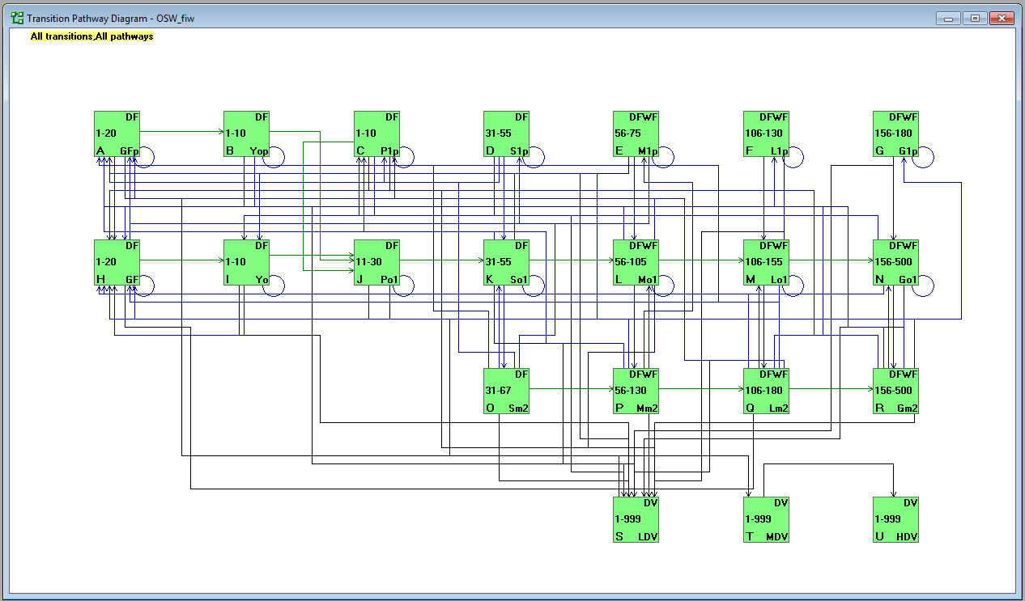
ILAP Potential Vegetation Types
PROBLEM:
Basic framework assumes that
this map doesn’t change.
When climate shifts, so
will potential vegetation.
Dry Douglas-fir
Oregon White Oak
Intermediate White fir

Slide 14
State and Transition Modeling
Early Successional
Young Forest
Growth
Fire
Regeneration
Harvest
Mature Forest
Late Successional Old Growth

Slide 15
Estimated harvests from the LANDSAT record in
Southwest Oregon
Thanks to Robert Kennedy for the LandTrendr maps of disturbance history

Slide 16
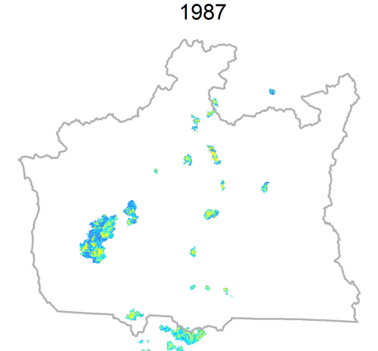
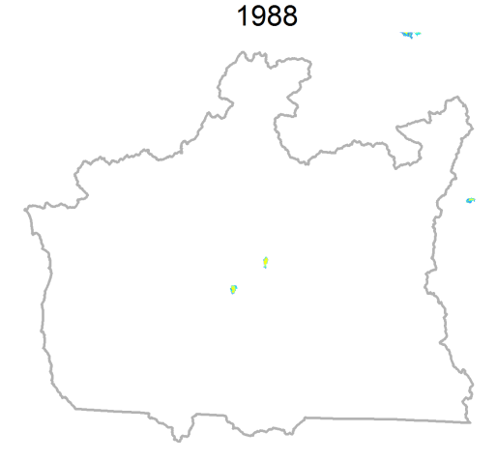
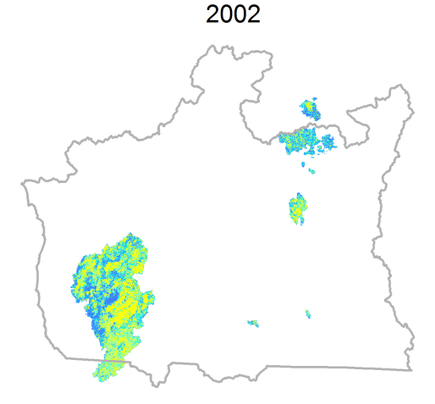
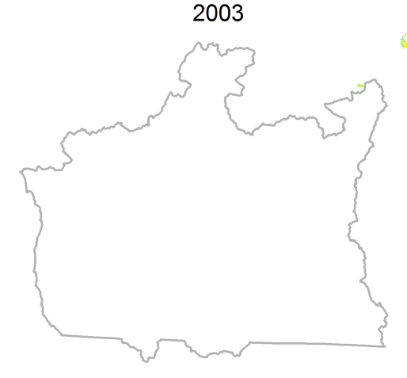
Current Fire
PROBLEM:
Fire regimes are set to
resemble the recent past.
They will probably change with
shifting climate.
Extracted from Monitoring Trends in Burn Severity dataset: mtbs.gov

Slide 17
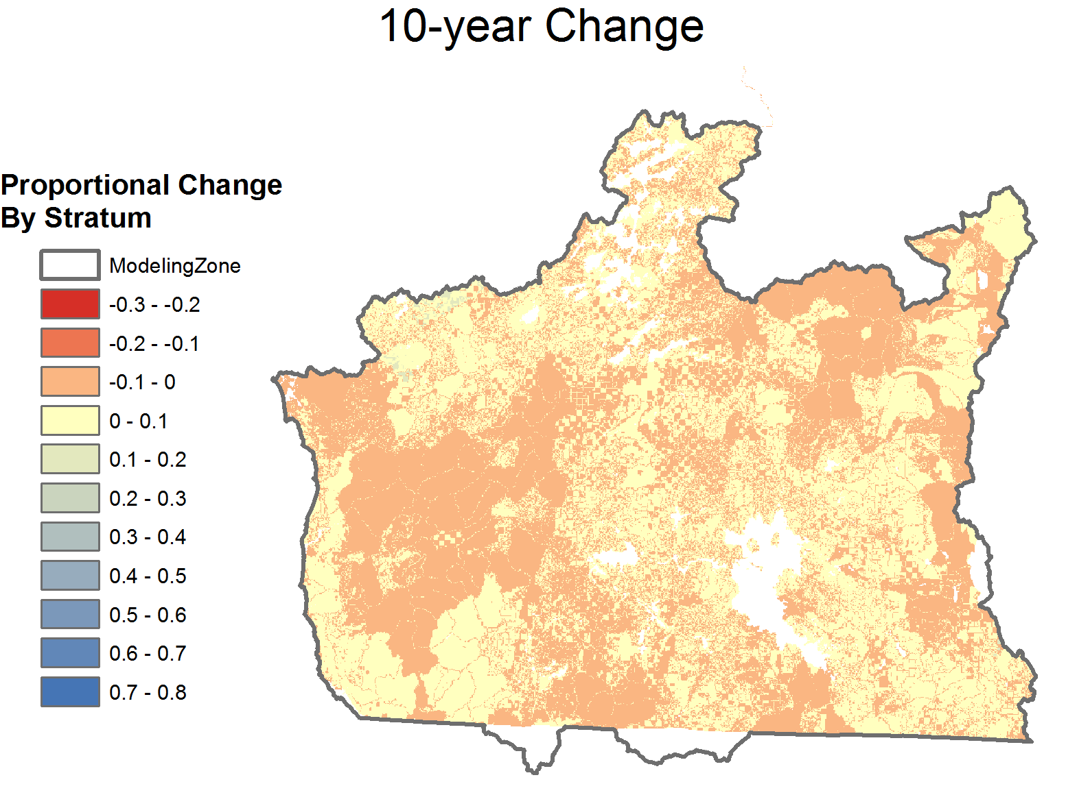

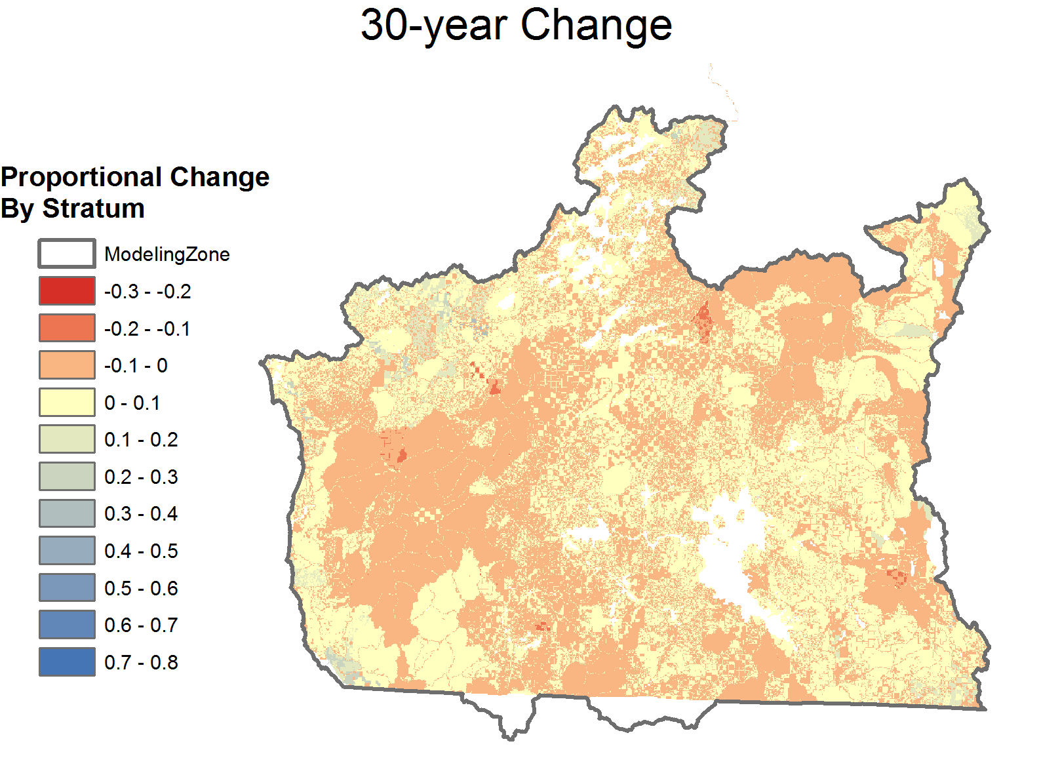
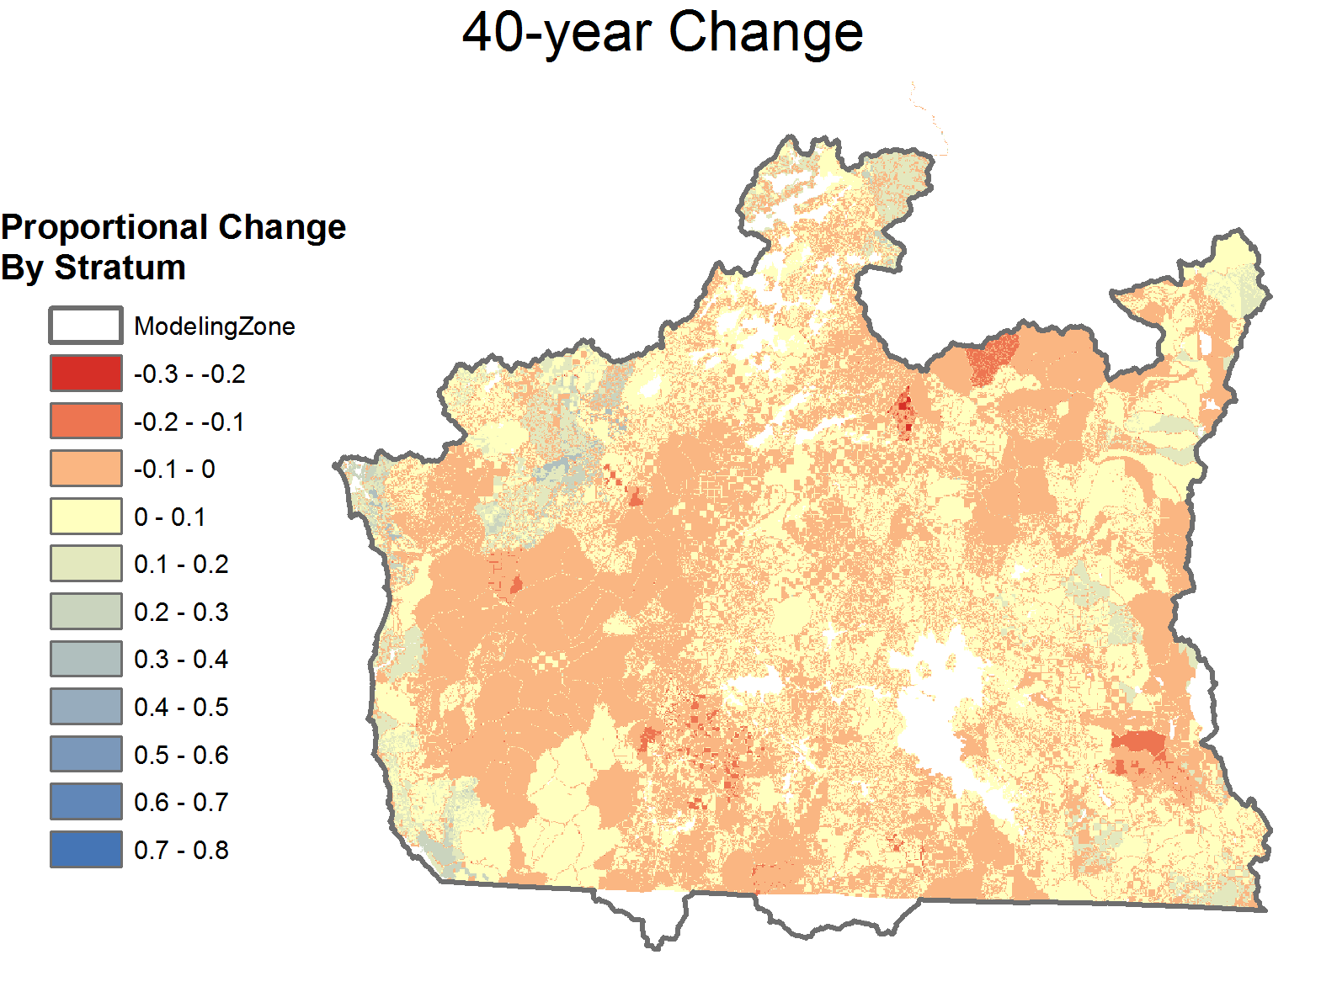
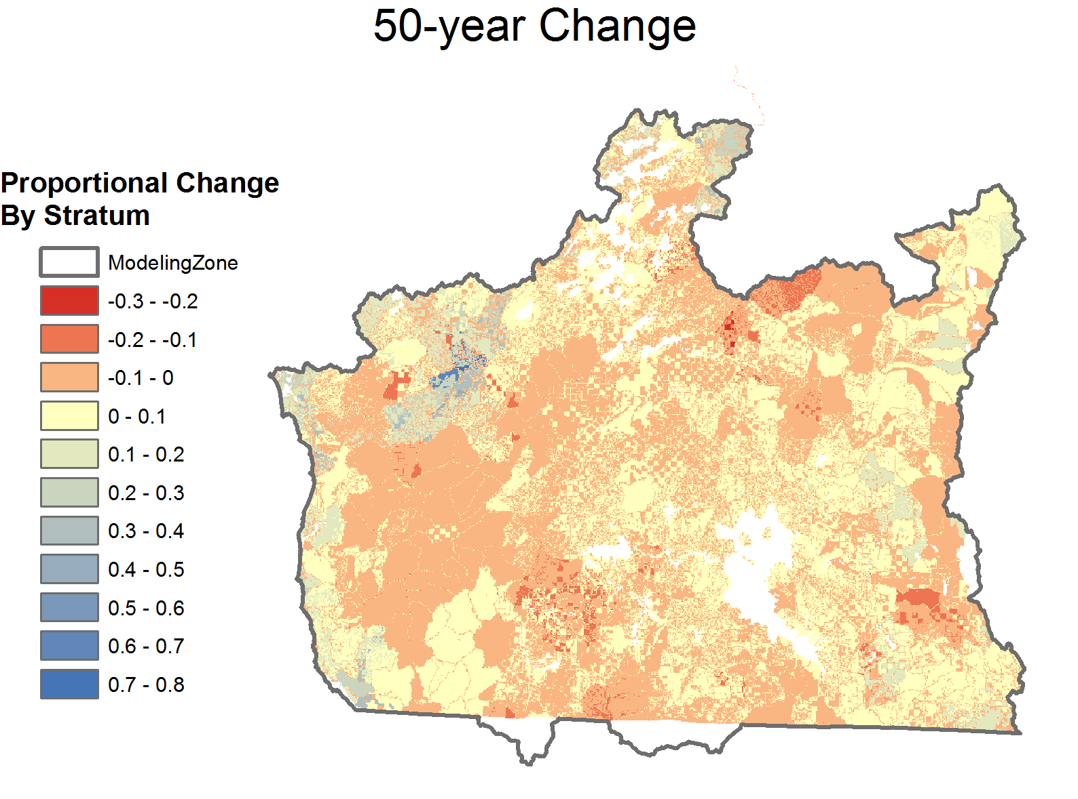
Preliminary results for Southwestern Oregon:
Current management
Area with Large and Giant Trees
No Climate Change

Slide 19
General Topics
Starting Conditions
State Transition Modeling, without accounting for climate
Climate impacts modeling
  ILAP extension – Central Oregon Study Area

Slide 20
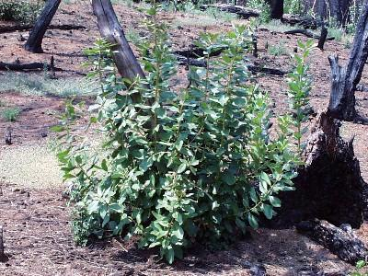
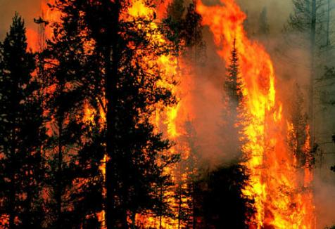
What about climate change?
Climate controls
ecosystem processes, including:
  Plant establishment, growth, and mortality
  Disturbance
    Drought
    Fire
    Insect outbreaks
Notes:
Emilie mentioned our efforts to make STMs climate-smart, but when we started the Integrated Landscape assessment project, STMs did not account for potential effects of climate change.
We know that many ecosystem processes that are implicitly or explicitly included in these state-and-transition models are either directly or indirectly tied to climate, and so climatic change is likely to affect them in the future.
But up until ILAP, site potential in these models did not change through time, resulting in a static potential vegetation type for any modeled location. So with a warming climate, a site in a Pacific silver fir type couldn’t shift into a western hemlock type; once a site was classified into a potential vegetation type, it stayed there through time.
Fire frequency and severity was also unchanged through time.
So we attempted to incorporate climate change into STMs in two focus areas for the ILAP project, one in central Oregon, and one in eastern Arizona.

Slide 21
Dynamic Global Vegetation Models (DGVMs):
Link state-of-the-art knowledge of:
  plant physiology
  biogeography
  biogeochemistry
  biophysics
Simulate changes in vegetation structure and composition and ecosystem function through time
Notes:
We did this by using output from Dynamic Global Vegetation Models.
Dynamic global vegetation models (or DGVMs) are currently considered to be among the most advanced tools to assess climate change effects on ecosystems.
They integrate information on a number of physical and biological processes and mechanisms
And they incorporate information from global climate models to simulate changes in vegetation structure and composition and ecosystem function through time. So they can produce results for a number of different potential climate futures.

Slide 22
The MC1 Dynamic Global Vegetation Model
lifeform mixture
Biogeography
Biogeochemistry
(MAPSS)
(CENTURY)
live biomass
fire
occurrence
biomass mortality
nutrient loss and release
Fire
(MCFire)
lifeform
mixture
carbon pools
soil moisture
*adapted from: Bachelet, D., J. M. Lenihan, C. Daly, R. P. Neilson, D. S. Ojima, and W. J. Parton. 2001. MC1: A Dynamic Vegetation Model for Estimating the Distribution of Vegetation and Associated Ecosystem Fluxes of Carbon, Nutrients, and Water. USDA Forest Service General Technical Report PNW-GTR-508.
Notes:
MC1 is a DGVM that integrates biogeography, biogeochemistry, and fire modules into a single modeling environment and has been used for regional- to global-scale assessments of potential climate change effects on ecosystems.
It was developed here in the Pacific Northwest, at the Pacific Northwest Research Station, by Ron Neilson and others.
This figure shows the structure of MC1, which stands for MAPSS-CENTURY hybrid, version 2.
The MAPSS model simulates the changing distribution of vegetation as the climate changes.
The CENTURY model simulates the growth and decline of vegetation over time, both above and belowground, as the climate varies.
The fire model simulates fire as a function of the vegetation type and simulated fuel characteristics.
The model gives output for 800 m squared pixels (or at coarser resolutions) for relatively broad plant functional types.

Slide 23
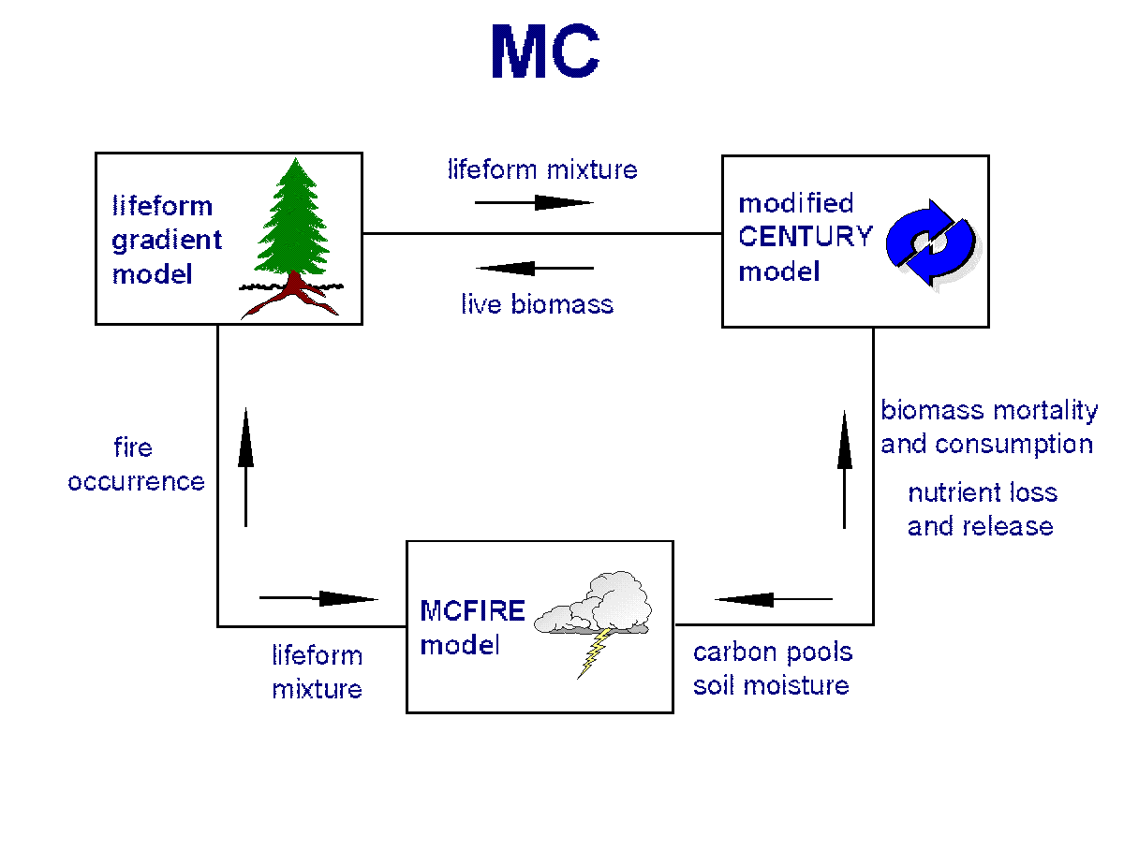

A Linked Model Approach
STMs
MC1
Juniper woodland
Xeric Ponderosa Pine
Dry Mixed Conifer
Moist Mixed Conifer
Notes:
We effectively linked the mechanistic climate-smart power of the MC2 DGVM with the detailed vegetation dynamics in STMs.
We summarized projections of future vegetation and wildfire regime changes from MC1 and incorporated the projections as trends that alter both potential vegetation type and wildfire probabilities in a suite of local STMs.
The outcome is a collection of “climate-smart” STMs which are connected to each other, allowing climate-driven shifts in vegetation type to occur.
So before this project, if a site was in any one of these four PVTs, it couldn’t shift PVT over time, even with changing climate.
What our work did was link these different PVTs, so area on the landscape could transition from one PVT to another with changes in climate. So for example, some are in the wet mixed conifer PVT, with warming and drying under climate change, may shift into the dry mixed conifer PVT.

Slide 24
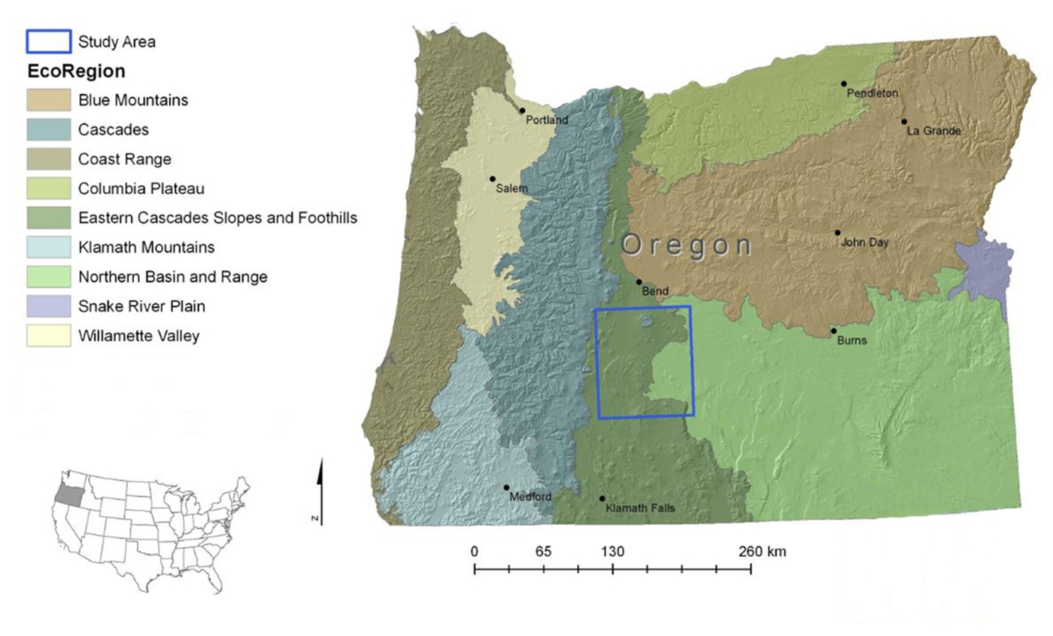
Central Oregon Study Area
Notes:
As I mentioned, we developed climate-smart STMs for two focus area, including one in central Oregon. I’m going to describe the process we used in central Oregon to give you a better idea of what it entailed.
This shows the study area, which is approximately 2 ½ million acres or just over 1 million hectares.

Slide 25
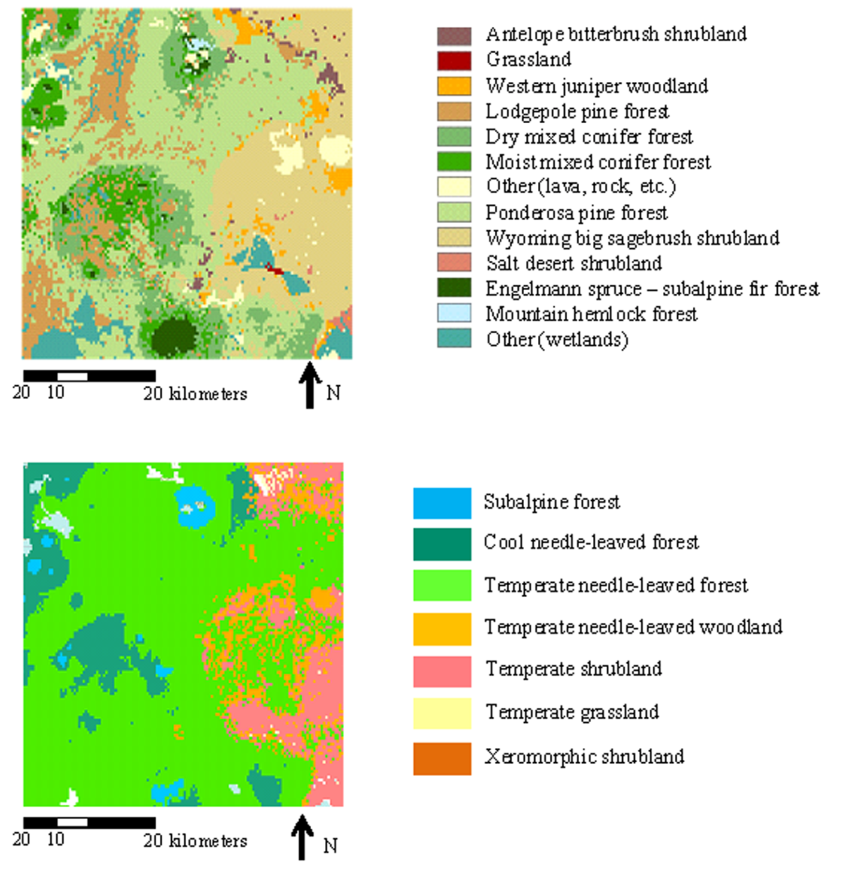
Historical vegetation in the study area
Notes:
This shows two historical vegetation maps for the study area. The top is the potential vegetation map used in the state-and-transition modeling. You can see in this map that the study area was historically dominated by ponderosa pine, dry and moist mixed conifer forests, with Wyoming big sagebrush shrubland being the dominant arid land type.
The bottom map is MC1 simulated historical vegetation. You can see these types are much more coarse, with the much of the area being simulated as temperate needle-leaved forest, and more moist forest types simulated as cool needle-leaved forest.

Slide 26
Vegetation type crosswalks
MC1 Functional Vegetation Type | STM Potential Vegetation Type
Subalpine forest | Mountain hemlock and subalpine fir forests
Cool needle-leaved forest | Moist mixed conifer and white fir forests
Temperate needle-leaved forest | Ponderosa pine, lodgepole pine, and dry mixed conifer forests
Temperate needle-leaved woodland | Mountain big sage – western juniper woodland and shrubland
Temperate shrubland | Wyoming big sage shrubland
Xeromorphic shrubland | Salt desert shrubland
Temperate grassland | Bluebunch wheatgrass – Sandberg bluegrass grassland
Warm-season grassland | Warm-season grassland
Notes:
Once we saw what MC1 vegetation types occurred in the study area, we cross-walked them to STM potential vegetation types in previously-developed STM models for the study area.
We did this with map overlays and expert opinion.
This table is color-coded by forests, and arid lands.

Slide 27
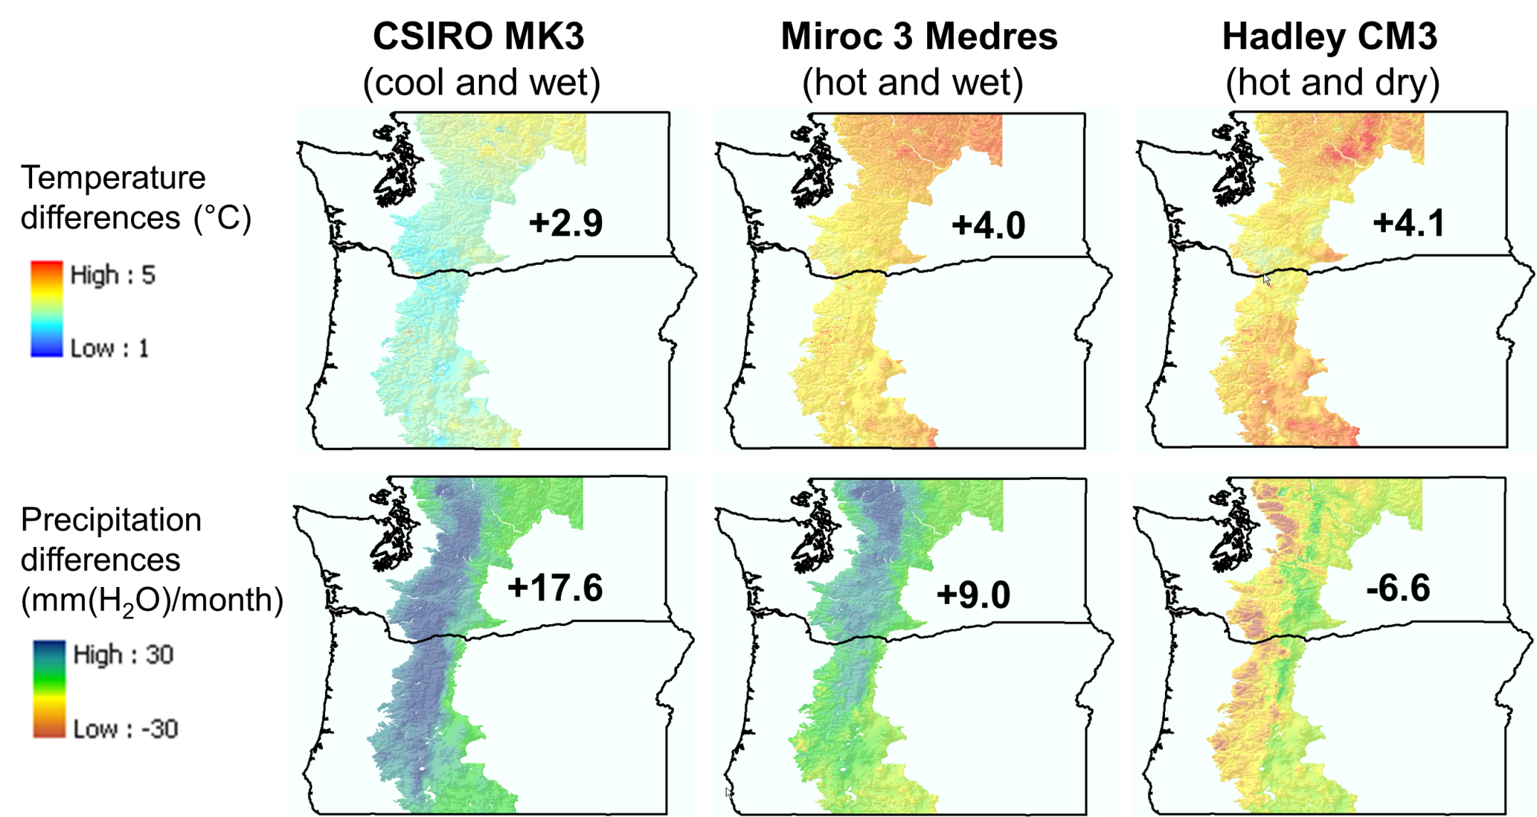
Climate Scenarios
Notes:
The next step was to run future scenarios in MC1.
Input climate information to run MC1 came from 3 global climate models
And each of these models was run under a carbon dioxide emission scenario from the IPCC’s fourth assessment report. A2 is characterized by relatively high CO2 emissions.
This shows differences between future (2070-2099) and historical (1971-2000) mean monthly temperatures and precipitation for the A2 scenario

Slide 28
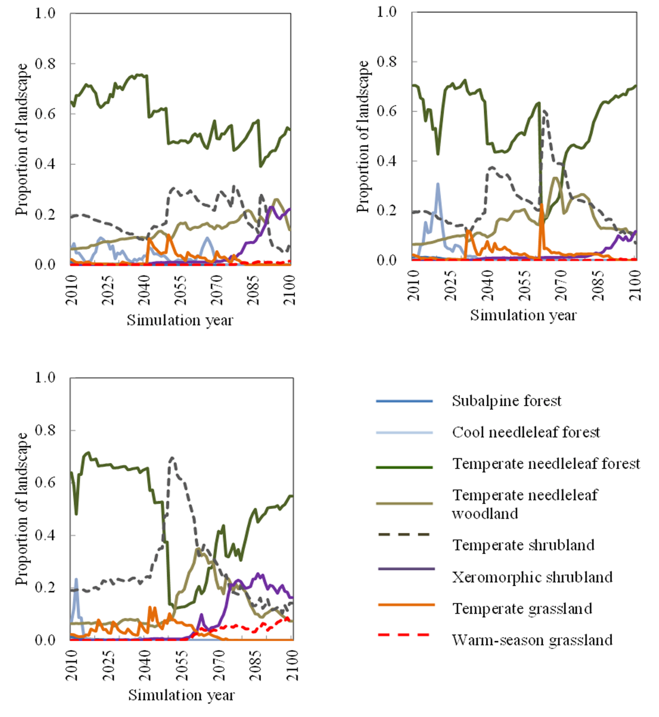
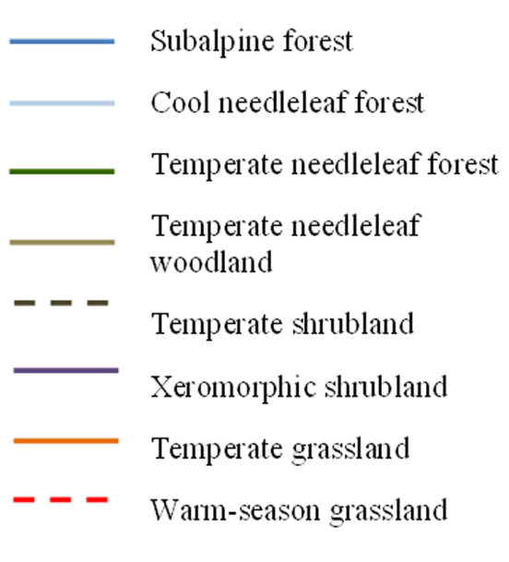
MIROC
CSIRO
MC1 Functional Vegetation Type Projections
Hadley
Halofsky et al. in review
Notes:
So we ran MC1 with the different climate input data, and these are some of the results. So these aren’t the linked model results but rather the trends that were incorporated into STMs.
Functional types can and do fluctuate sharply over relatively short timeframes as climate conditions evolve. The model does not take into account landscape legacy, or the lag between changes in environmental conditions and the actual replacement of the existing vegetation. For example, MC1 does not account for the ability of some tree species to survive several episodes of climate extremes over many centuries.
Under all three scenarios, temperate needleleaf forests remain the dominant vegetation type, but there is a (sometimes dramatic) drop in this vegetation type with widespread fires in the 2040s.
Generally, there was decline in both subalpine and cool needleleaf forests.
There was also a general increase in temperate needleleaf woodland, xeromorphic shrubland, and under Hadley, an increase in warm-season grassland.

Slide 29
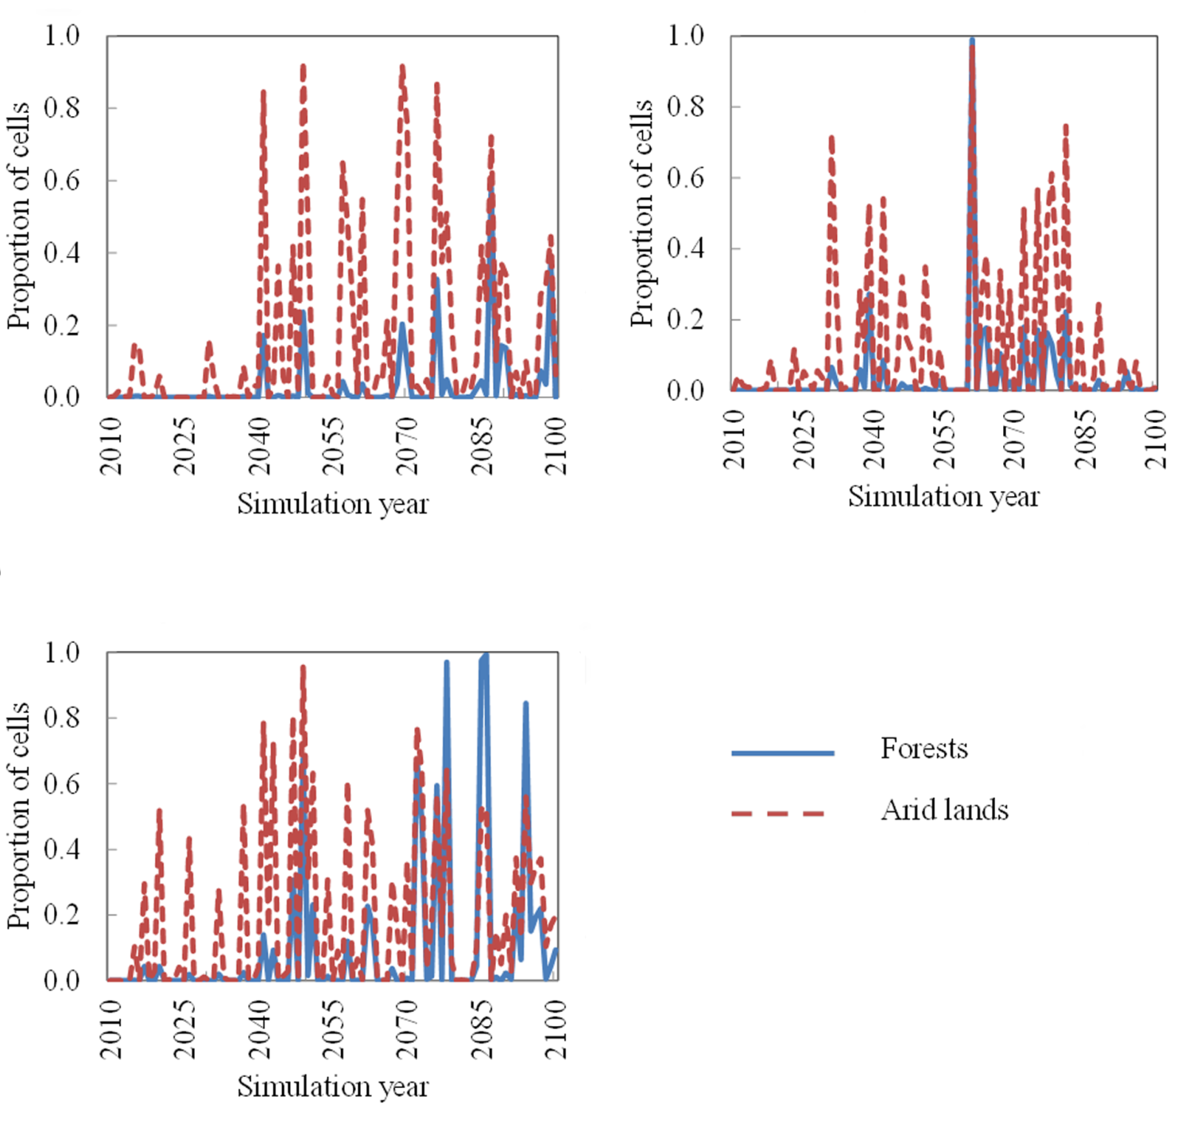

MC1 fire projections
MIROC
CSIRO
Hadley
Halofsky et al. in prep
Notes:
This figure shows the fire trends out of MC1 for forests and arid lands under the three scenarios.
You can see there are substantial increases in fire under all three scenarios. Increases in forest fire are especially apparent under Hadley, the hot and dry scenario.

Slide 30
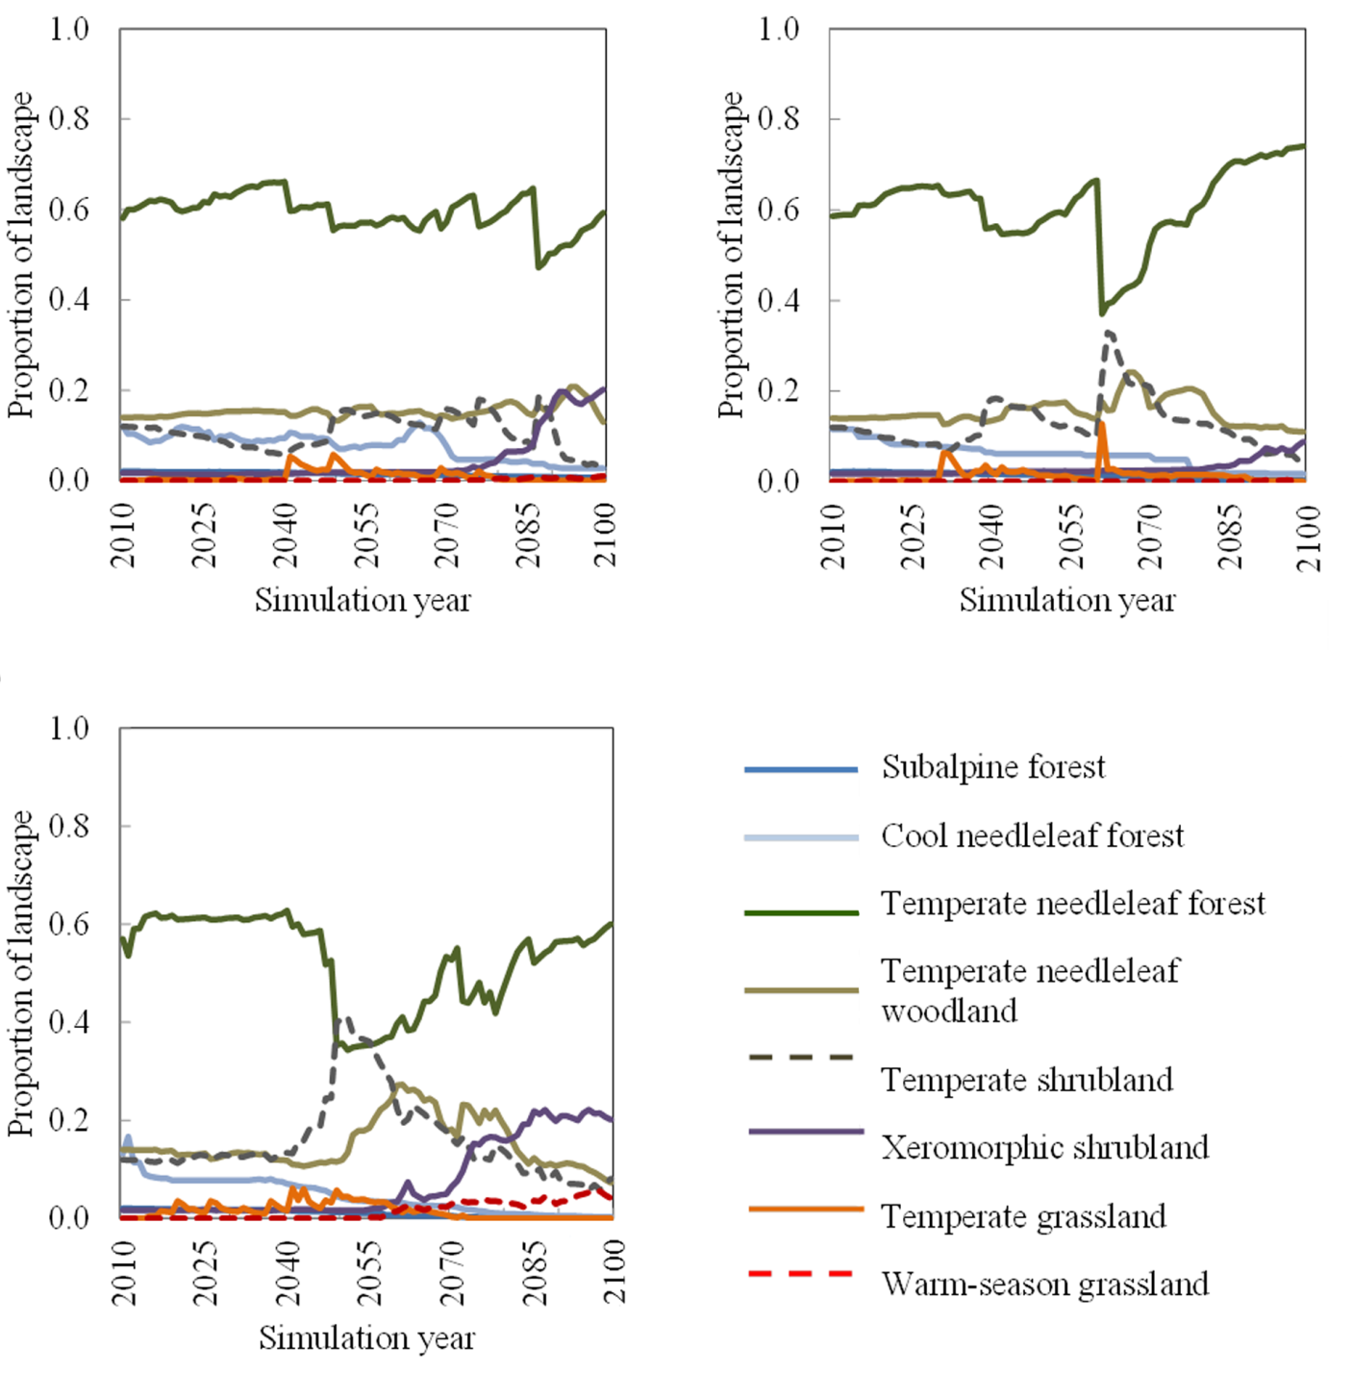
Linked model results
MIROC
CSIRO
Hadley
Halofsky et al. in prep
Notes:
So again, we used the MC1 output to alter fire probability and probability of vegetation type change in the STMs.
Then we ran the climatized STMs, and here are some of the results.
One of the first things we noticed about this output is that the fluctuations in area of the different vegetation types aren’t as dramatic as they were with the MC1 output.
STMs constrain changes in vegetation type. In STMs, once a pixel is on a given successional trajectory in a given PVT, it will stay on that trajectory unless it is in an early-successional or open condition or there is a stand-replacement disturbance, at which point it has the opportunity to move onto a different trajectory in a different PVT.
All three climate change scenarios projected by our linked DGVM-STM suggested continued dominance of temperate needle-leaved forest in our study area. All three also forecast declines of cool needle-leaved and subalpine forests.
All three agreed that temperate needle-leaved woodlands will likely remain an important arid-lands vegetation community and that temperate shrublands will likely decline by the end of the century.
All three models forecast increasing abundance of xeromorphic shrublands with the hot and dry Hadley-A2 scenario showing that they may become the dominant arid-land vegetation community by the end of the century.
The Hadley-A2, and to a lesser extent the MIROC-A2, scenarios suggest increasing abundance of warm-season grasslands, which are currently not present.
It’s also interesting to note that under the Hadley and CSIRO scenarios, there is little change up until about 2040, when forcing under A2 increases and more fire is simulated in MC1.
This might mean that habitat for species of interest and other ecosystem services might give the impression of being relatively stable for a few decades, then experience wide swings during the following decades.

Slide 31
Central Oregon Management Scenarios
Fire suppression only
  Fire frequencies same as the last 25 years under fire suppression
  No other active management
Resilience
  Light to moderate levels of thinning and some prescribed fire in dry forest types
Notes:
In addition to looking at STM results under different climate scenarios, we also looked at the linked DGVM-STM results under different management scenarios.
The STMs were run under two management scenarios.
Fire frequencies derived from Modern Trends in Burn Severity data, which is satellite data of all fires greater than 1000 acres.

Slide 32
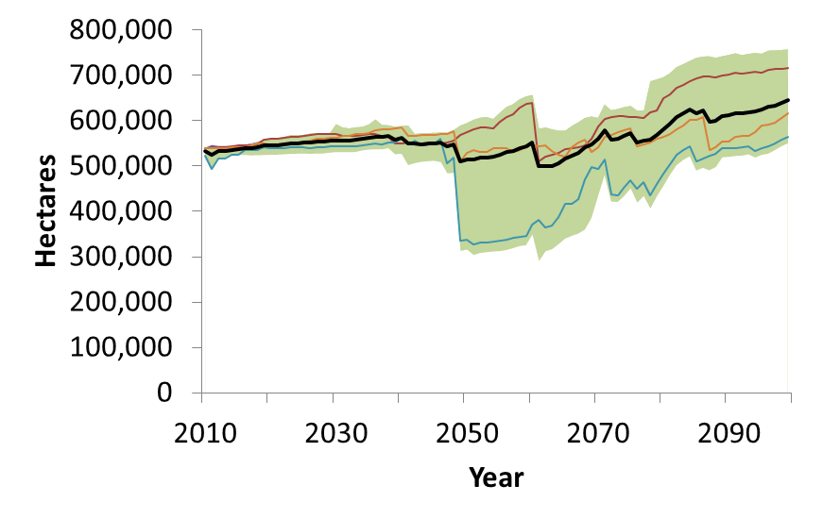


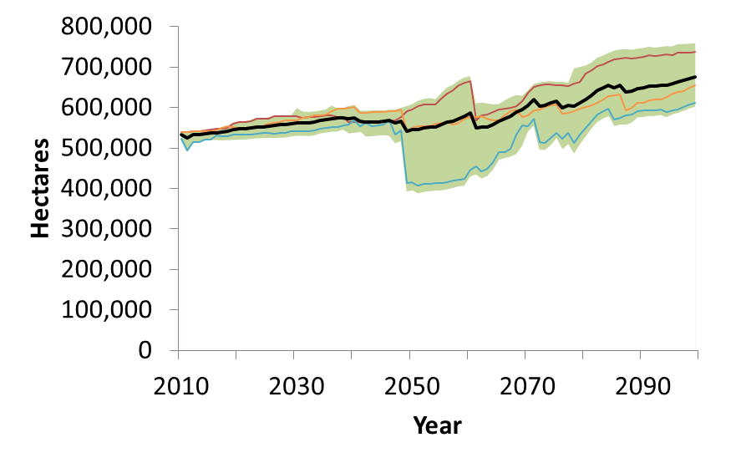

Effects of management on dry forests
Fire suppression only
Mean
Min to max
Randomly selected simulations
Resilience
Halofsky et al. in prep
Notes:
These are some of the state-and-transition model results for different management scenarios
We did an analysis looking at area in dry forests, or temperate needleleaf forests from the previous figures, and moist mixed conifer forests, or cool needleleaf forests from the previous figures, under the two management scenarios, fire suppression only, and a resilience scenario characterized by moderate levels of thinning in dry forests and some prescribed fire.
This shows the mean number of hectares of dry forests across all three climate scenarios. Since there were 30 Monte Carlo simulations for each climate scenario, this is the mean of 90 Monte Carlos.
The area in green is the area between the minimum and maximum area across Monte Carlos.
These other lines are randomly selected Monte Carlo (of 90) to show you some of the variation in trends
Trends similar between the two scenarios, except the min is greater under the resilience scenario
You can also see variation among scenarios is pretty low until the 2040s, when there’s a ramp up in CO2 forcing under the A2 scenarios and a lot of fire in MC1.

Slide 33
Effects of management on:
dry forests with large trees and open canopy
Fire suppression only
Resilience
Halofsky et al. in prep
Notes:
This shows trends in area of dry forests with large trees greater than 20 inches (50.8 cm) and open canopy (10-40%) under the two management scenarios. These forests represent the forest structure we think was common in the study area before fire suppression and a structure that is relatively resilient to fire.
Under the fire suppression scenario, the mean amount of area in large diameter open dry forest conditions continuously declined. Conversely, LGo area was maintained, and even increased slightly, under the resilience scenario due to management treatments, which thin dense forests and therefore maintain the larger diameter, more fire tolerant, dry pine species.

Slide 34
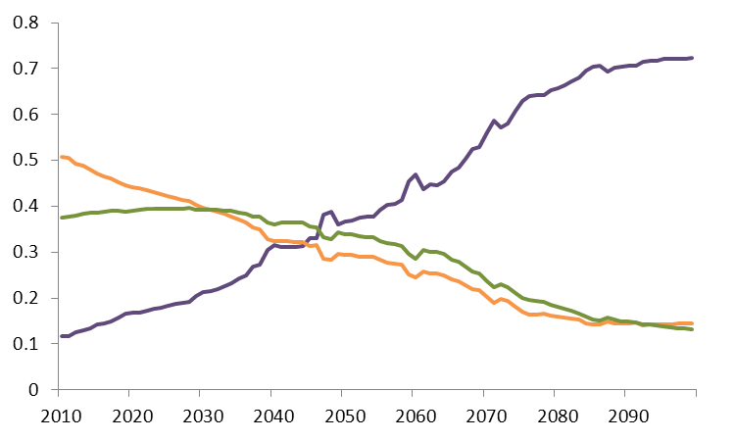

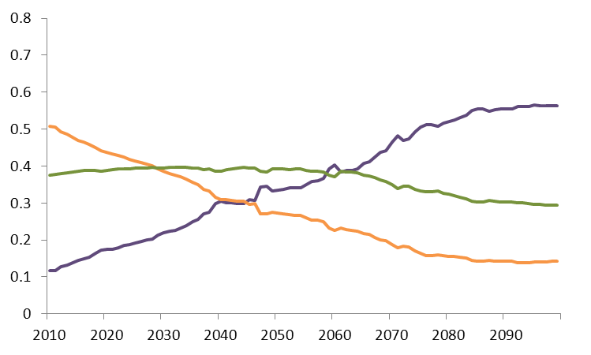

Trends in dry forest structure
<12.7 cm
Fire suppression only
12.7-50.8 cm
>50.8 cm
Landscape proportion
Resilience
Landscape proportion
Notes:
However, we did see some interesting trends in forest size classes over time.
By the end of the simulations, the landscape under both management scenarios was dominated by the smallest size class with the medium size class comprising approximately 15% of the landscape. The area in largest tree diameter class declined by about half under the fire suppression scenario, but was maintained under the resilience scenario.
We saw similar patterns in the moist mixed conifer type, suggesting that

Slide 35
Conclusions for Central Oregon
Linked DGVM-STM output suggests greater vegetation resilience than DGVM alone.
Dry ponderosa pine and mixed conifer forests will likely maintain dominance in the central Oregon study area.
In some cases, management may dampen the magnitude of forest change under changing climate.
Halofsky et al. in prep
Notes:
This project showed that including species-specific fire resistance and some realistic constraints on vegetation change, such as legacies of long-lived trees, dampens sudden shifts in vegetation conditions and results in greater vegetation resilience than a DGVM alone might indicate.
There could be changes in species composition and structure with climate change, but the current dominant vegetation types will likely remain dominant.
Management aimed at increasing ecosystem resilience may minimize losses of moist mixed conifer forest and dry forests with large trees and open canopy. However, we saw that regardless of management, losses of moist mixed conifer forests are likely, which poses a problem for maintenance of spotted owl habitat in the study area. We also saw that there may be more limited opportunities, due to increased fire frequency, to recruit large trees.
Overall, we think the coupled MC1-STM model is useful in assessing potential climate change impacts on vegetation and can be used for landscape planning efforts to target treatments and increase resilience to climate change.

Slide 36
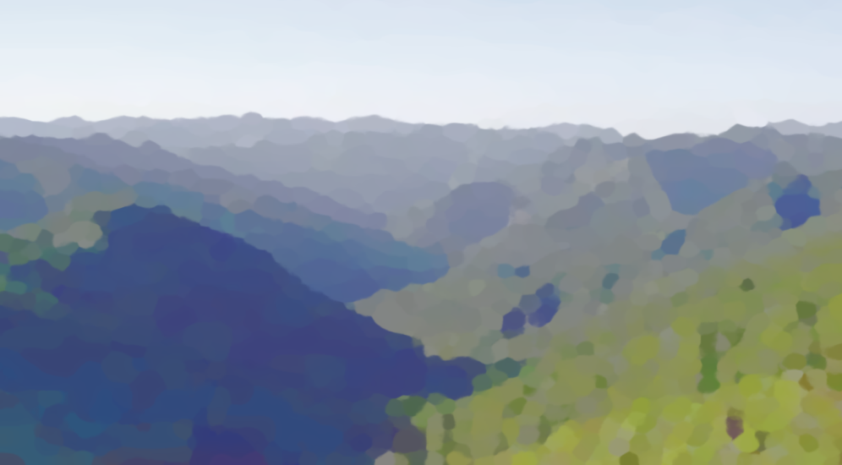
Technical Thoughts
All models are wrong, ours could be useful
These models provide big-picture projections
The linked model process is data-, labor-, and software-intensive
Notes:
Are these models providing accurate predictions of what will happen on these landscapes? Probably not, but they can help us to explore potential futures and facilitate development of no regrets adaptation actions.
These models cannot tell you exactly what is going to happen in a project area, although they can give some indication of the potential trends in that area
The process we described here requires a lot of data and effort to implement, but the base STMs are there, it’s flexible on climate input data, and we’re streamlining the linkage process, which will bring down future costs.

Slide 38
Getting to Landscape Planning
We haven’t described the planning process itself, which involves conversations and people.
  Stakeholders
  Decision Makers
Our models are useful storytelling tools.
  Enable the asking of questions.
  Realistic and plausible stories.
  Enhance the role of science in conversations about planning.
Notes:
In a meeting last week in Southwest Oregon, I was speaking with one participant afterwards who told me that “You know that this work doesn’t really mean anything until it impacts what really happens on the ground”.
On one hand, I was a little offended. His definition, it implies that the work is useless unless it is applied. I’m quite certain that my ‘restoration scenario’ will be applied on the ground across an entire ecoregion is extremely low. Thus, ‘failure’ is likely.
On the other hand, his comment is useful food for thought. Yet another published scientific paper, will not, in and of itself, translate into good policies that are effectively carried out over whole landscapes.
In light of that, I view our work as a tool for telling useful stories that can nudge the planning process towards formulating plans and policies that are likely to succeed.
If our models can tell stories that have credibility beyond our little group of researchers, then they can serve as teaching tools form the basis for productive and informed conversations in the public sphere.
This has always been a primary goal of ILAP, which has already been a tool to help inform national forests as they revise their forest plans.
With the CMH project, a key component of our work is in outreach, starting from the very beginning with a set of outreach meetings asking folks who are likely to be involved in the planning process for their input.

Slide 39

Half of science is asking the right questions.
  -- Roger Bacon (c. 1214 – 1294)¹
Emilie, you really need to refine your questions!
-- Dr. David Mladenoff, numerous times throughout my career as a PhD student in his lab.
  ¹Wikiquotes

Slide 40
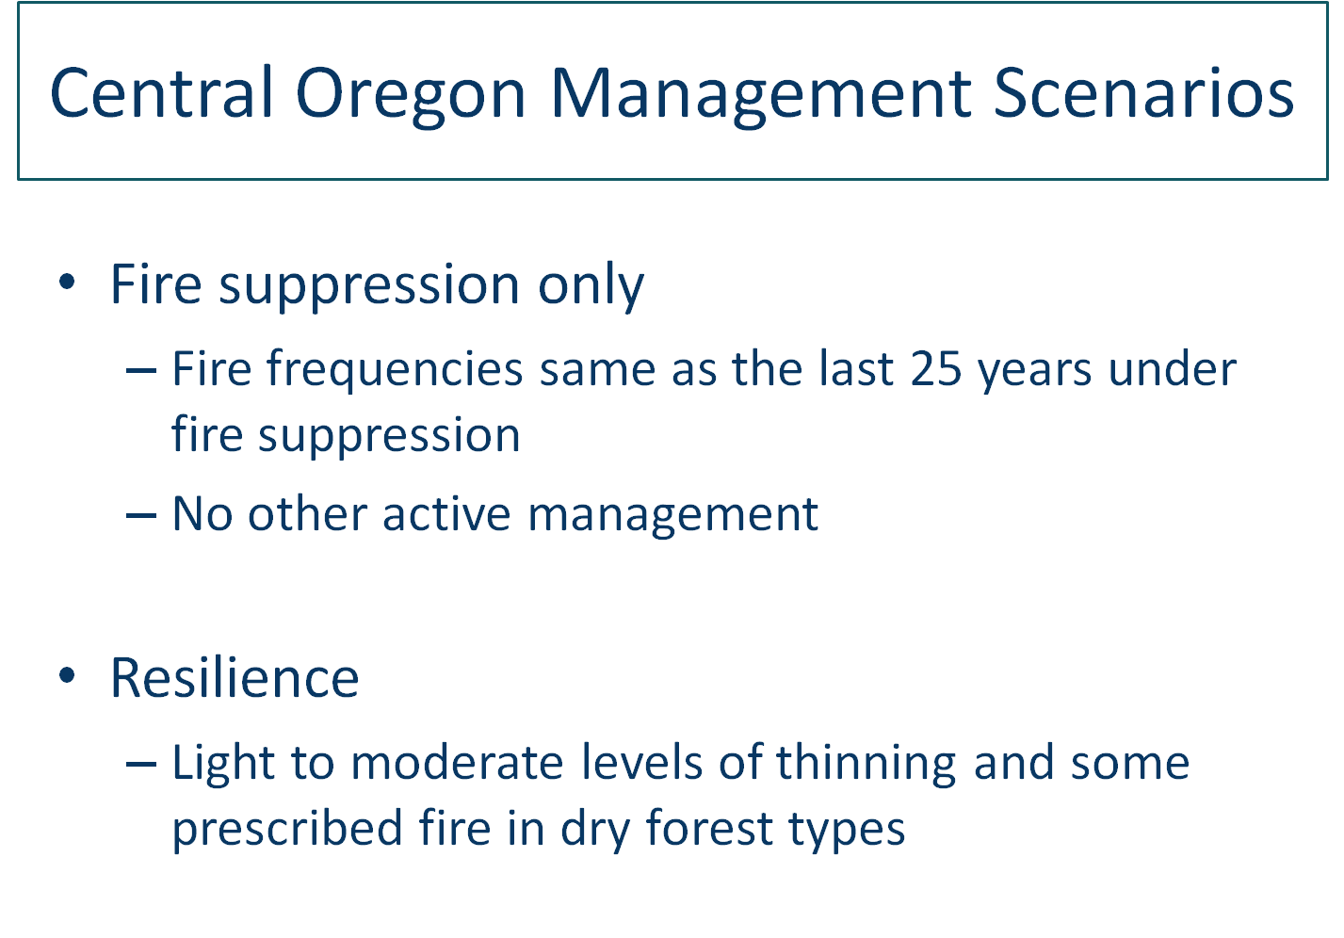
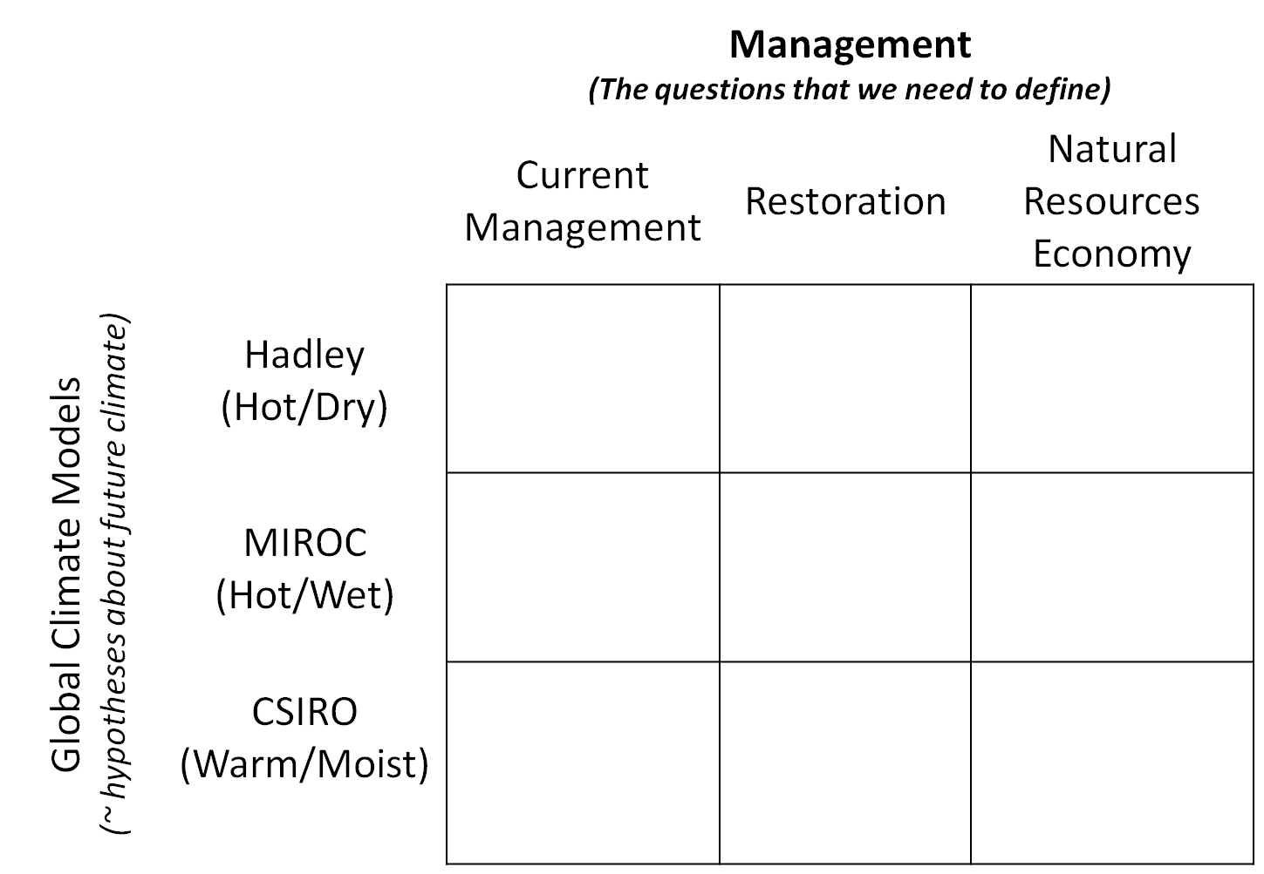
Notes:
So, back to this 3x3 matrix. This matrix effectively defines our question-space.
Questions about landscapes are not simple to define.
Luckily for us, some dimensions of this matrix are already fairly well-defined: The climate hypotheses. We’re building off of others’ work.
Current Management: Wherever we can pull information about what is currently being done on which lands, we use that to parameterize our models. Again, the decisions are somewhat made for us already.
Restoration/NR Economy scenarios: Here is where the most work is needed. Designing scenarios involves an almost infinite array of questions, that can be approached in many different ways.

Slide 41

What activities?
e.g., partial harvest
regeneration harvest
restoration harvest
prescribed fire
At what rates?
Where should they be applied?
Groups we have spoken with:
The Nature Conservancy
Bureau of Land Management
US Forest Service personnel – regional and local
Local chapters of the Society of American Foresters
Washington Department of Natural Resources
Oregon Department of Forestry
Consulting foresters who serve nonindustrial private landowners
County commissioners
4 activities
24 ownership/allocation categories
∞ variations in rates

Slide 42

Our Hope for our Work
Save the world!
Tell informative stories that are grounded in science about how different landscape management policies and plans may lead to different futures.
Relevance and credibility beyond the science community.

Slide 43









Dominique Bachelet Emilie Henderson
David Conklin James Kagan
Megan Creutzburg Becky Kerns
Jessica Halofsky Anita Morzillo
Joshua Halofsky Janine Salwasser
Miles Hemstrom
Research
Team:
Funding:
Notes:
We want to acknowledge the larger research team on the ILAP and CMH projects, and also the funding providers.

