Slide 1
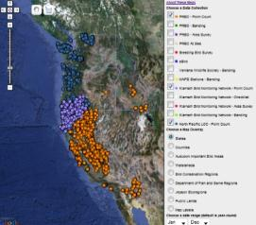
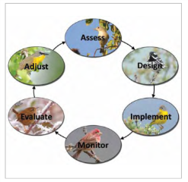
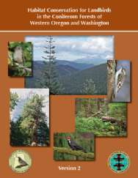
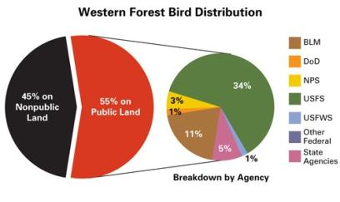




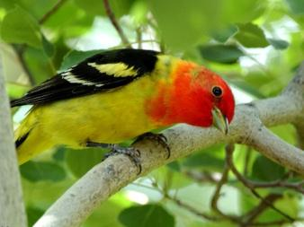
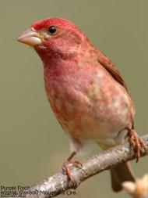
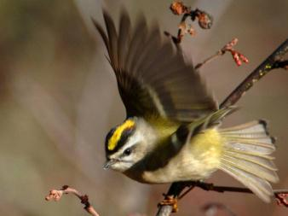
Bird Conservation Tools for Strategic Forest Planning
John D Alexander
Jaime L Stephens
Barb Bresson
Landscape Assessment
for Forest Planning Workshop
April 23, 2013
Notes:
Setting aside using PIF tools for bird conservation, let’s think about it from a land management point of view. How can the PIF products catalyze implementation?

Slide 2

Outline
Data Community Informing Conservation
Broad-scaled Opportunities Assessment
Management Planning
Climate Smart Decision Making
Applied Example

Slide 3
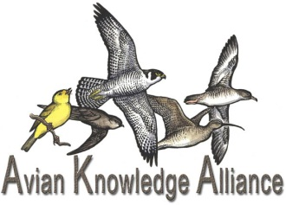
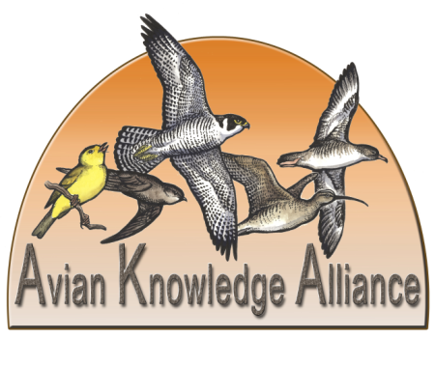
Avian Knowledge Alliance
Collecting,
Caretaking, and Communicating
Avian Knowledge
Data Collection
Data Management
Synthesis
Education
Outreach
Client (eg., land manager)
Issues
Design
Unique
Capacities and Roles of NGOs
Avian
Knowledge
Network
(Stephens et al. 2009, PIF Proceedings)
Notes:
The Avian Knowledge Alliance (AKA) is an international group of organizations dedicated to amassing, caretaking, and communicating knowledge gained from the study of birds. The Avian Knowledge Alliance:
Promotes and helps design coordinated monitoring projects;
Facilitates the gathering, archiving, visualization, and delivery of observational data and analyses; and
Maintains dialog with land managers and other stakeholders to improve conservation outcomes.
Adding value to the bird conservation arena the AKA brings together the unique capacities and roles of non-government organizations (NGOs) that include:
Focus and consistency in missions and visions;
Sustained environmental monitoring efforts, long-term datasets, and highly developed expertise and knowledge;
Effective collaborations and partnerships that transcend geographic, political, and academic boundaries;
Cost-effectiveness with administrative and fiscal flexibility;
Trust and credibility with public agencies, providing balance among disparate missions; and
Consistent, objective, credible, and science-based perspective on issues.

Slide 4

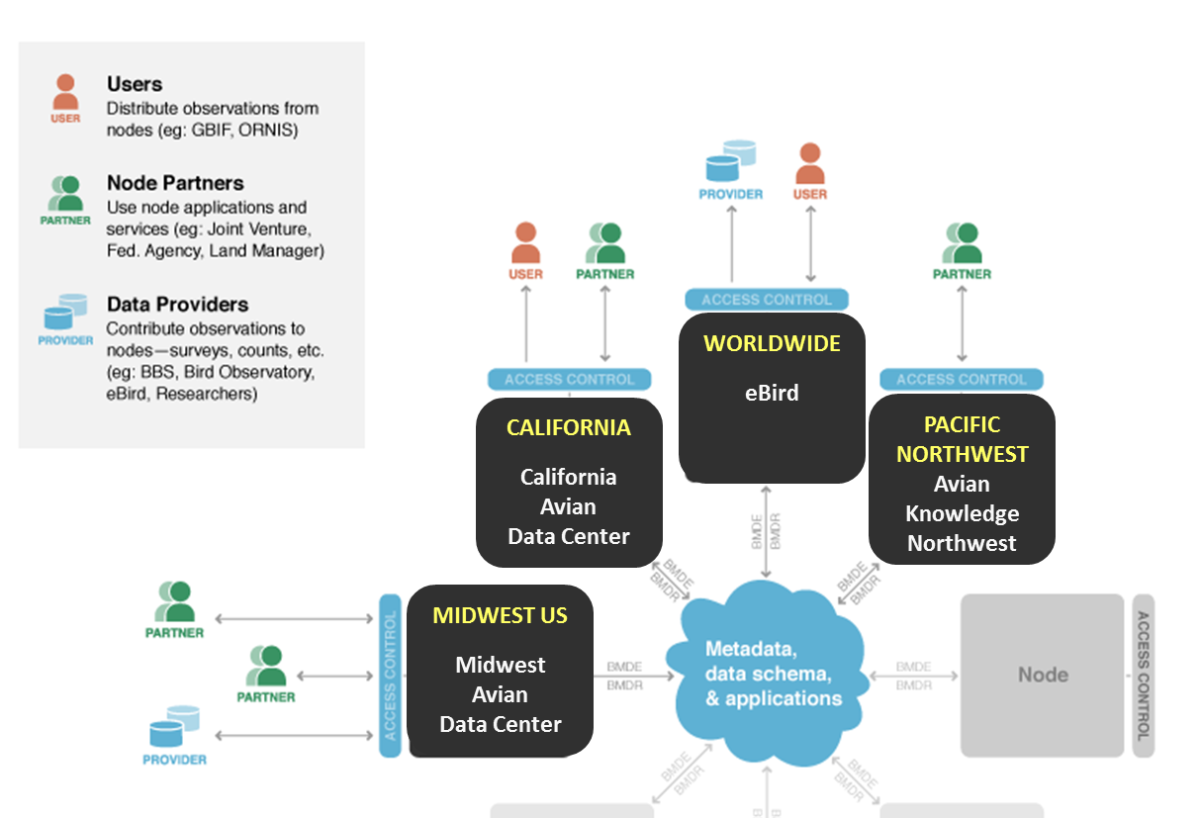
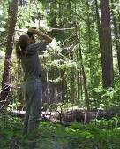
Avian Knowledge Network
Notes:
Sophisticated data archive and delivery solutions for states

Slide 5
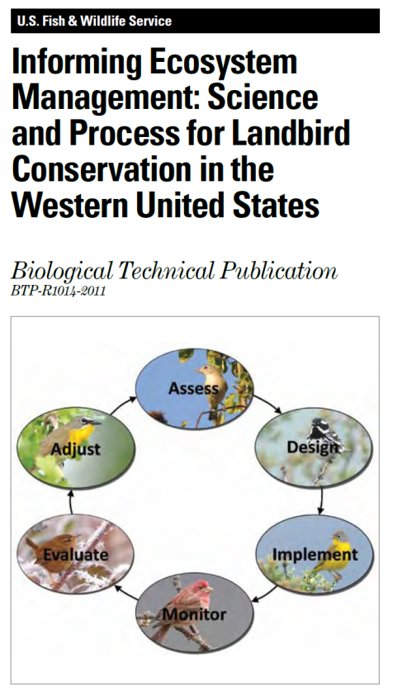
Multi-species Science-based Approach
Adaptive Management
  Assess conservation needs
  Set measurable objectives
  Design management
  Measuring effectiveness
Science-based tools
  Species assessment database
  Standard monitoring techniques
  Conservation plans
  Conservation design process
(Stephens et al. 2011, USFWS BTP)
Notes:
We recently published a series of examples that highlight successes in bird conservation, both the science and process of adaptive management. This is available online: library.fws.gov/BTP/information-ecosystem-management-2011.pdf

Slide 6
Resource/Land Management Planning
Assess Stewardship Responsibility/Opportunity
Set quantitative habitat and population objectives
  Align with broad objectives of RMPs/LMPs
  Considered at multiple scales
Inform an alternative with the PIF Conifer Plan
Evaluate alternatives using PIF tools
Project planning – Quantifiable objectives & NEPA
Notes:
We recently published a series of examples that highlight successes in bird conservation, both the science and process of adaptive management. This is available online: library.fws.gov/BTP/information-ecosystem-management-2011.pdf

Slide 7
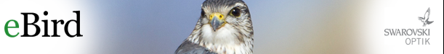


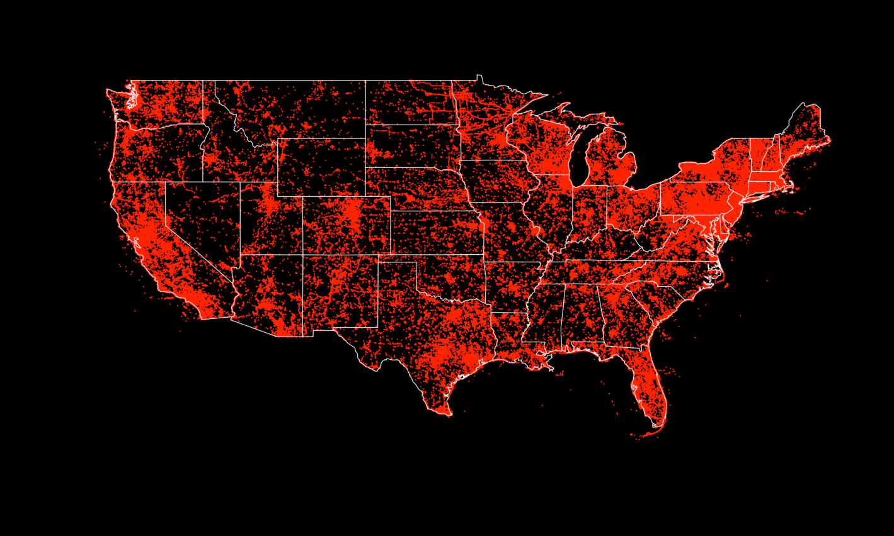
Who Contributes to eBird
More than…
100 million observations
1 million locations
93 thousand contributors
7.6 million field hours
and a global bird watching community
www.eBird.org
Notes:
What is significant is that this birder entered his sighting of the Brewer’s Sparrow into eBird – where it is combined with over 100 million other sightings as part of the largest observational database on any group of organizations on the planet.
The result is an unprecedented resource available for ornithological science and bird conservation.

Slide 8
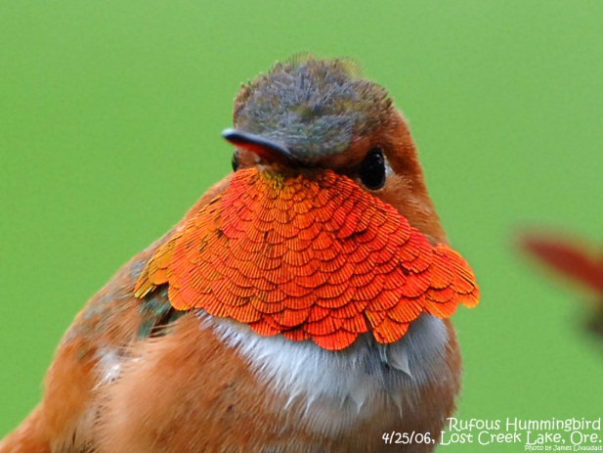
Stewardship Responsibilities for Birds

Slide 9
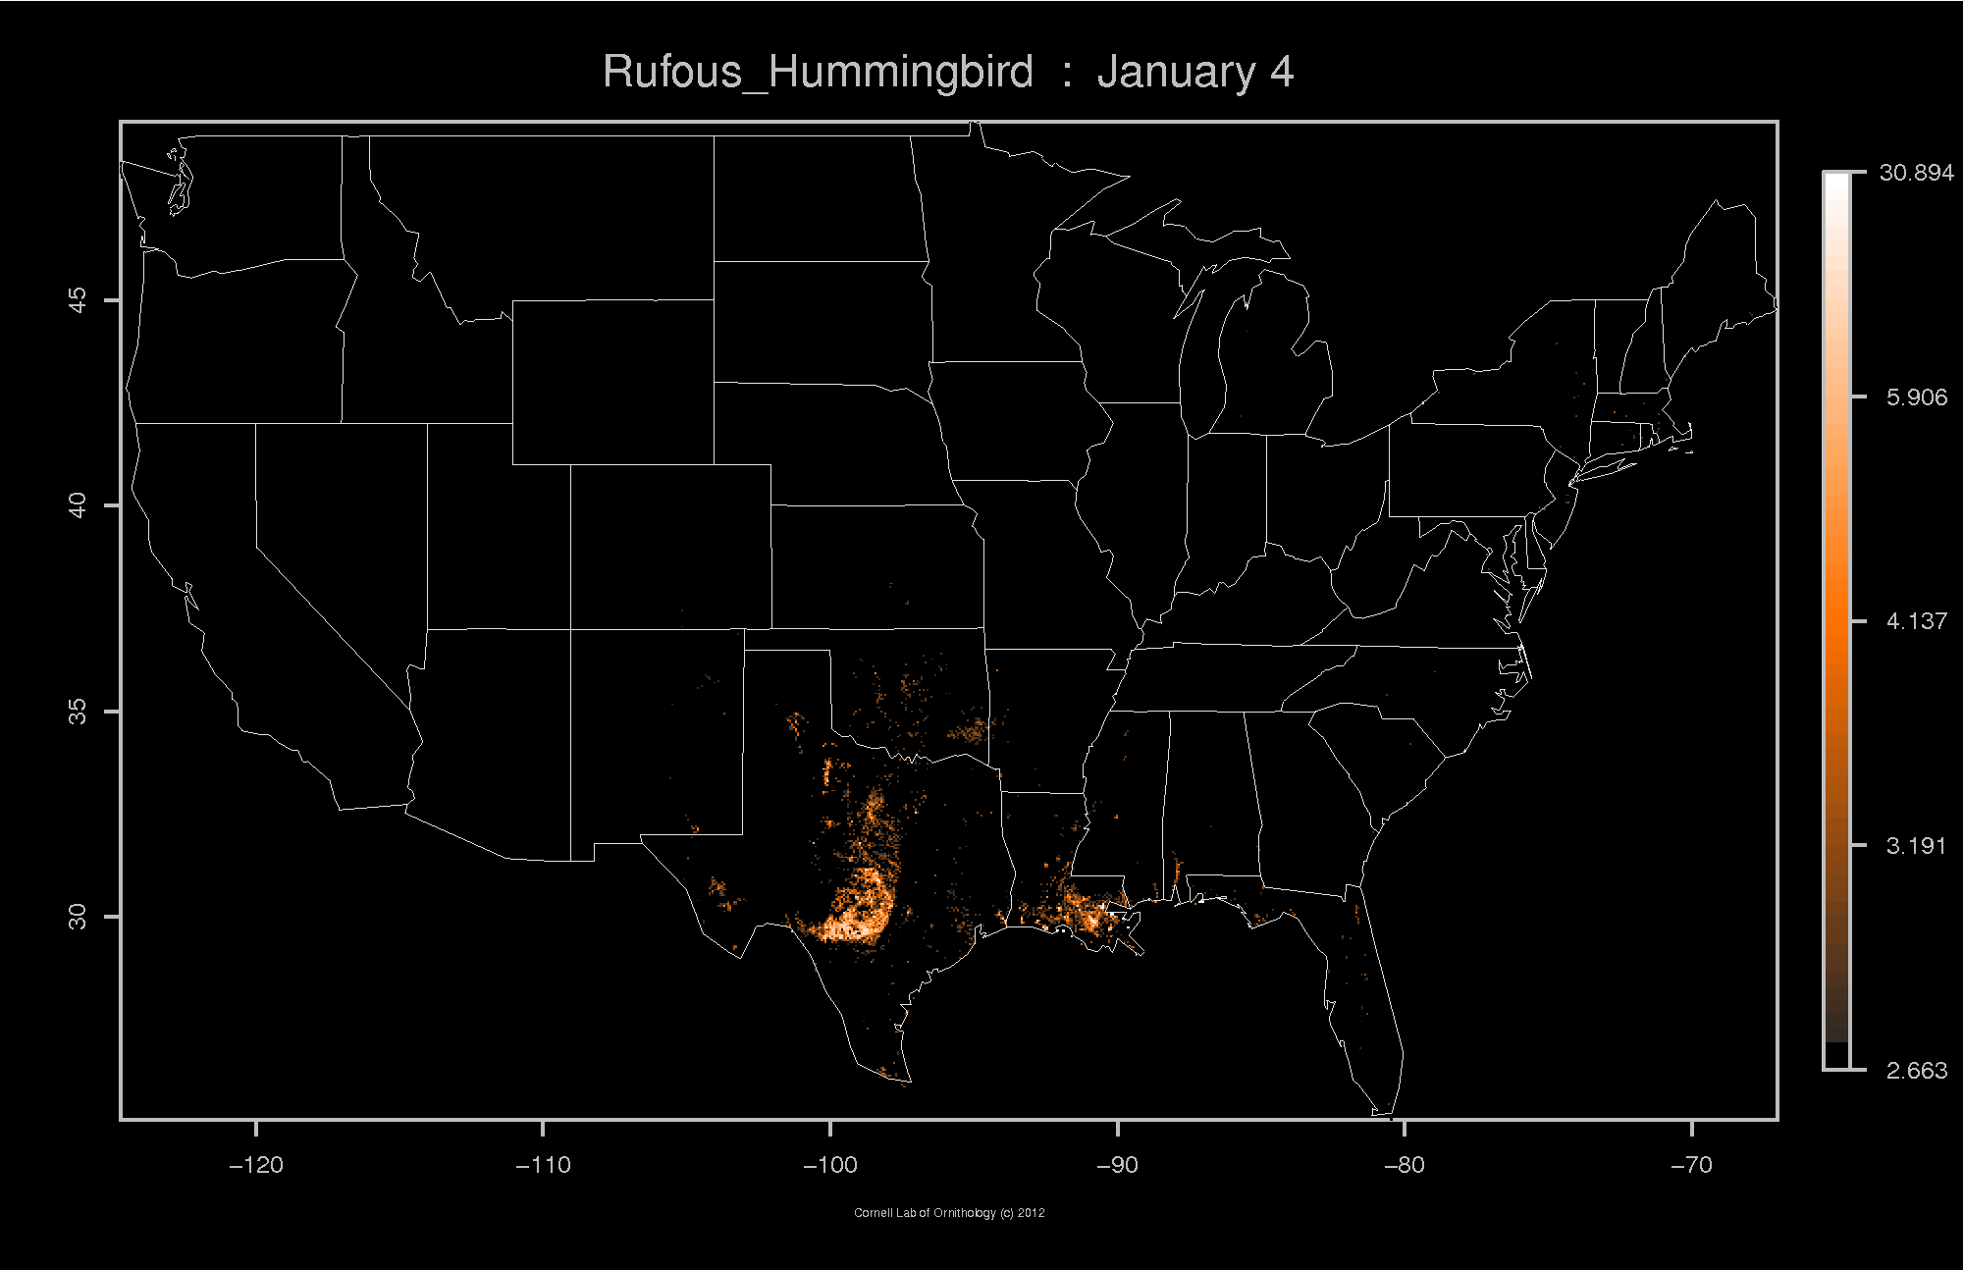

Slide 10
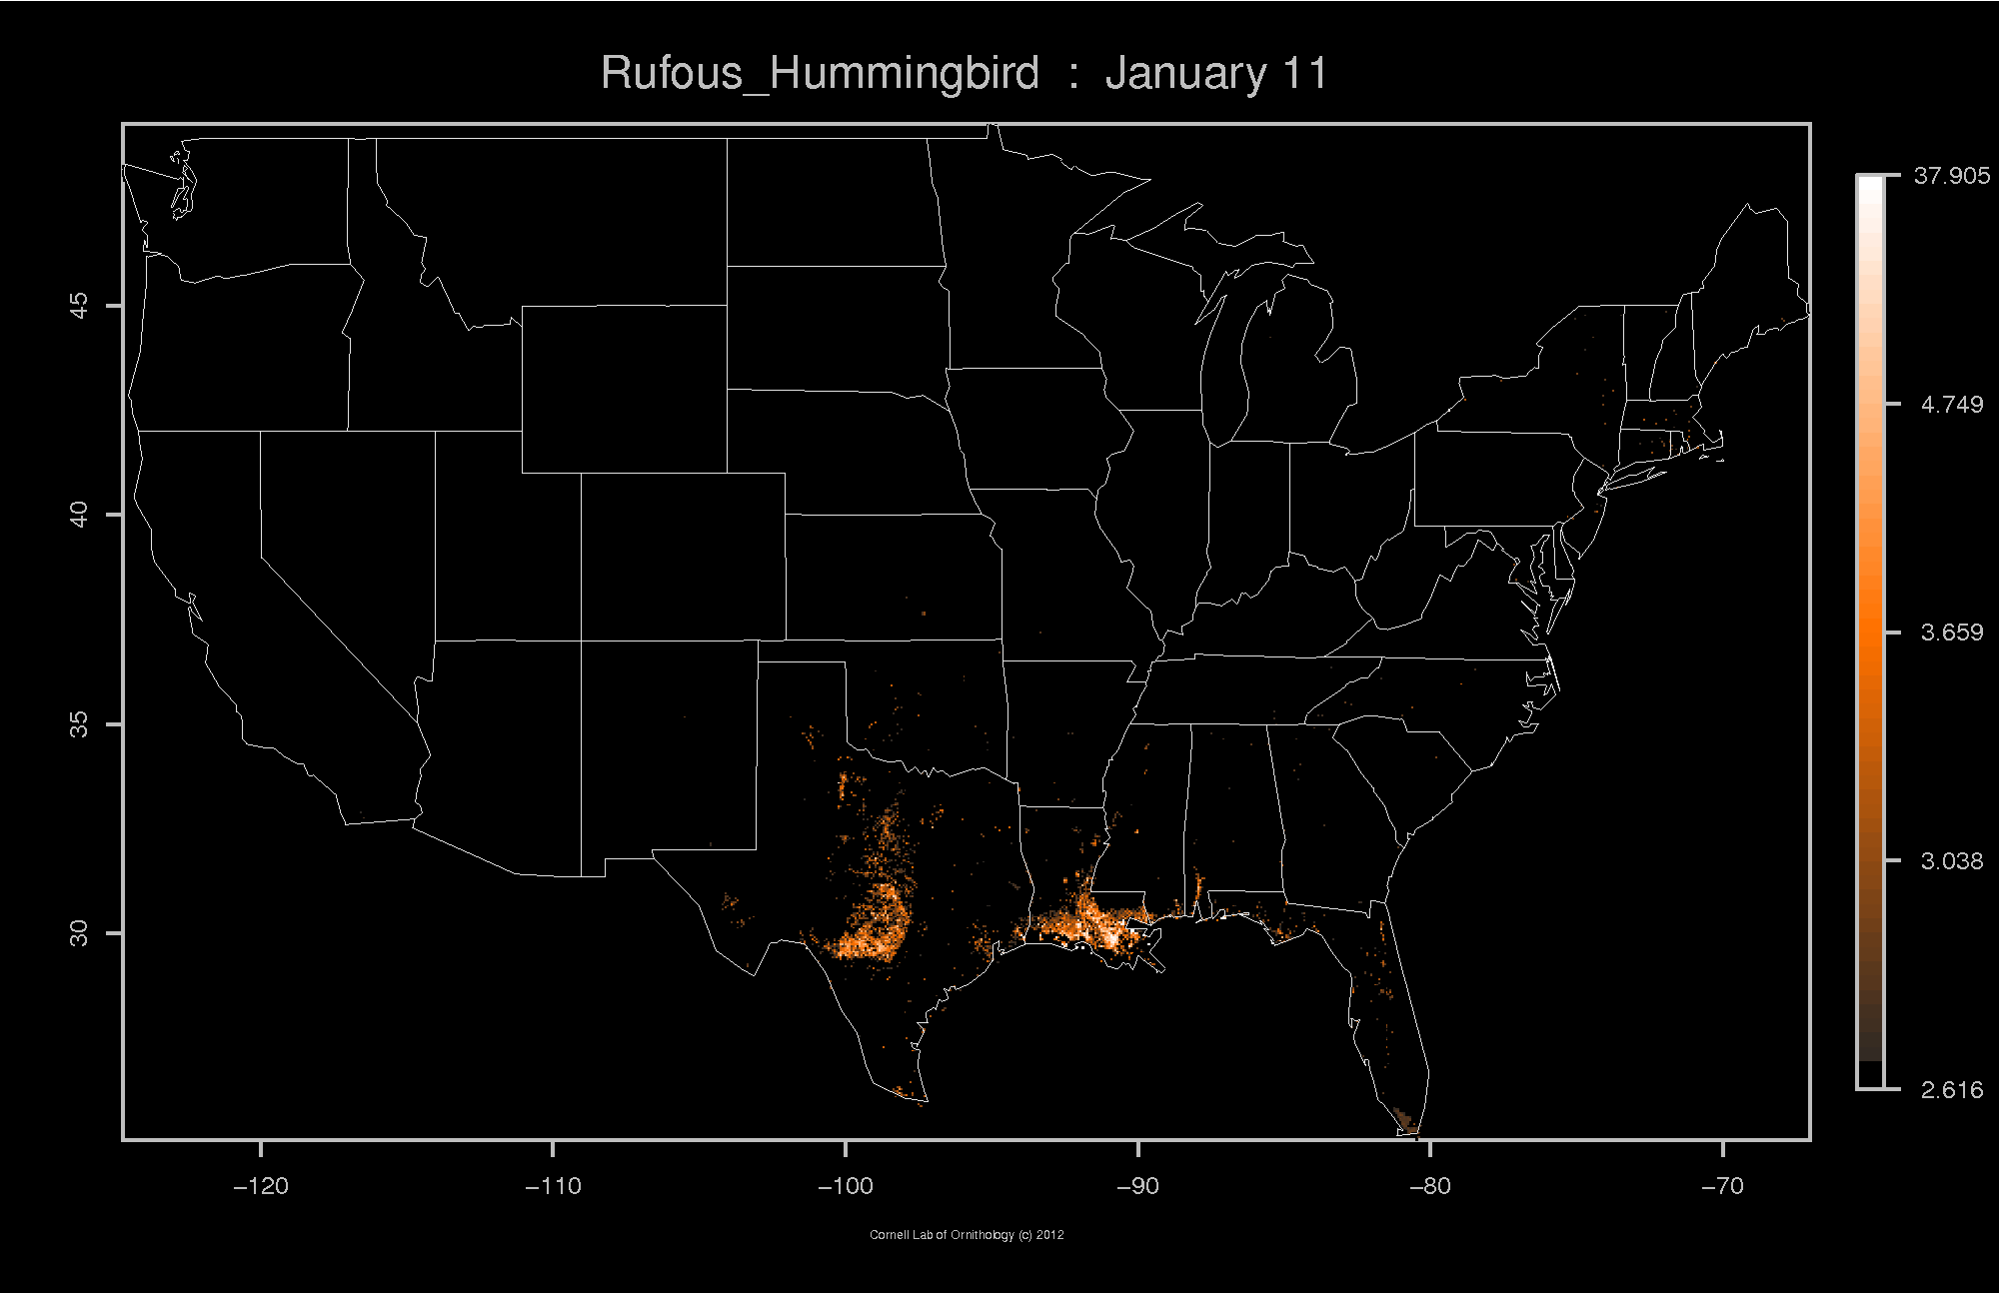

Slide 11
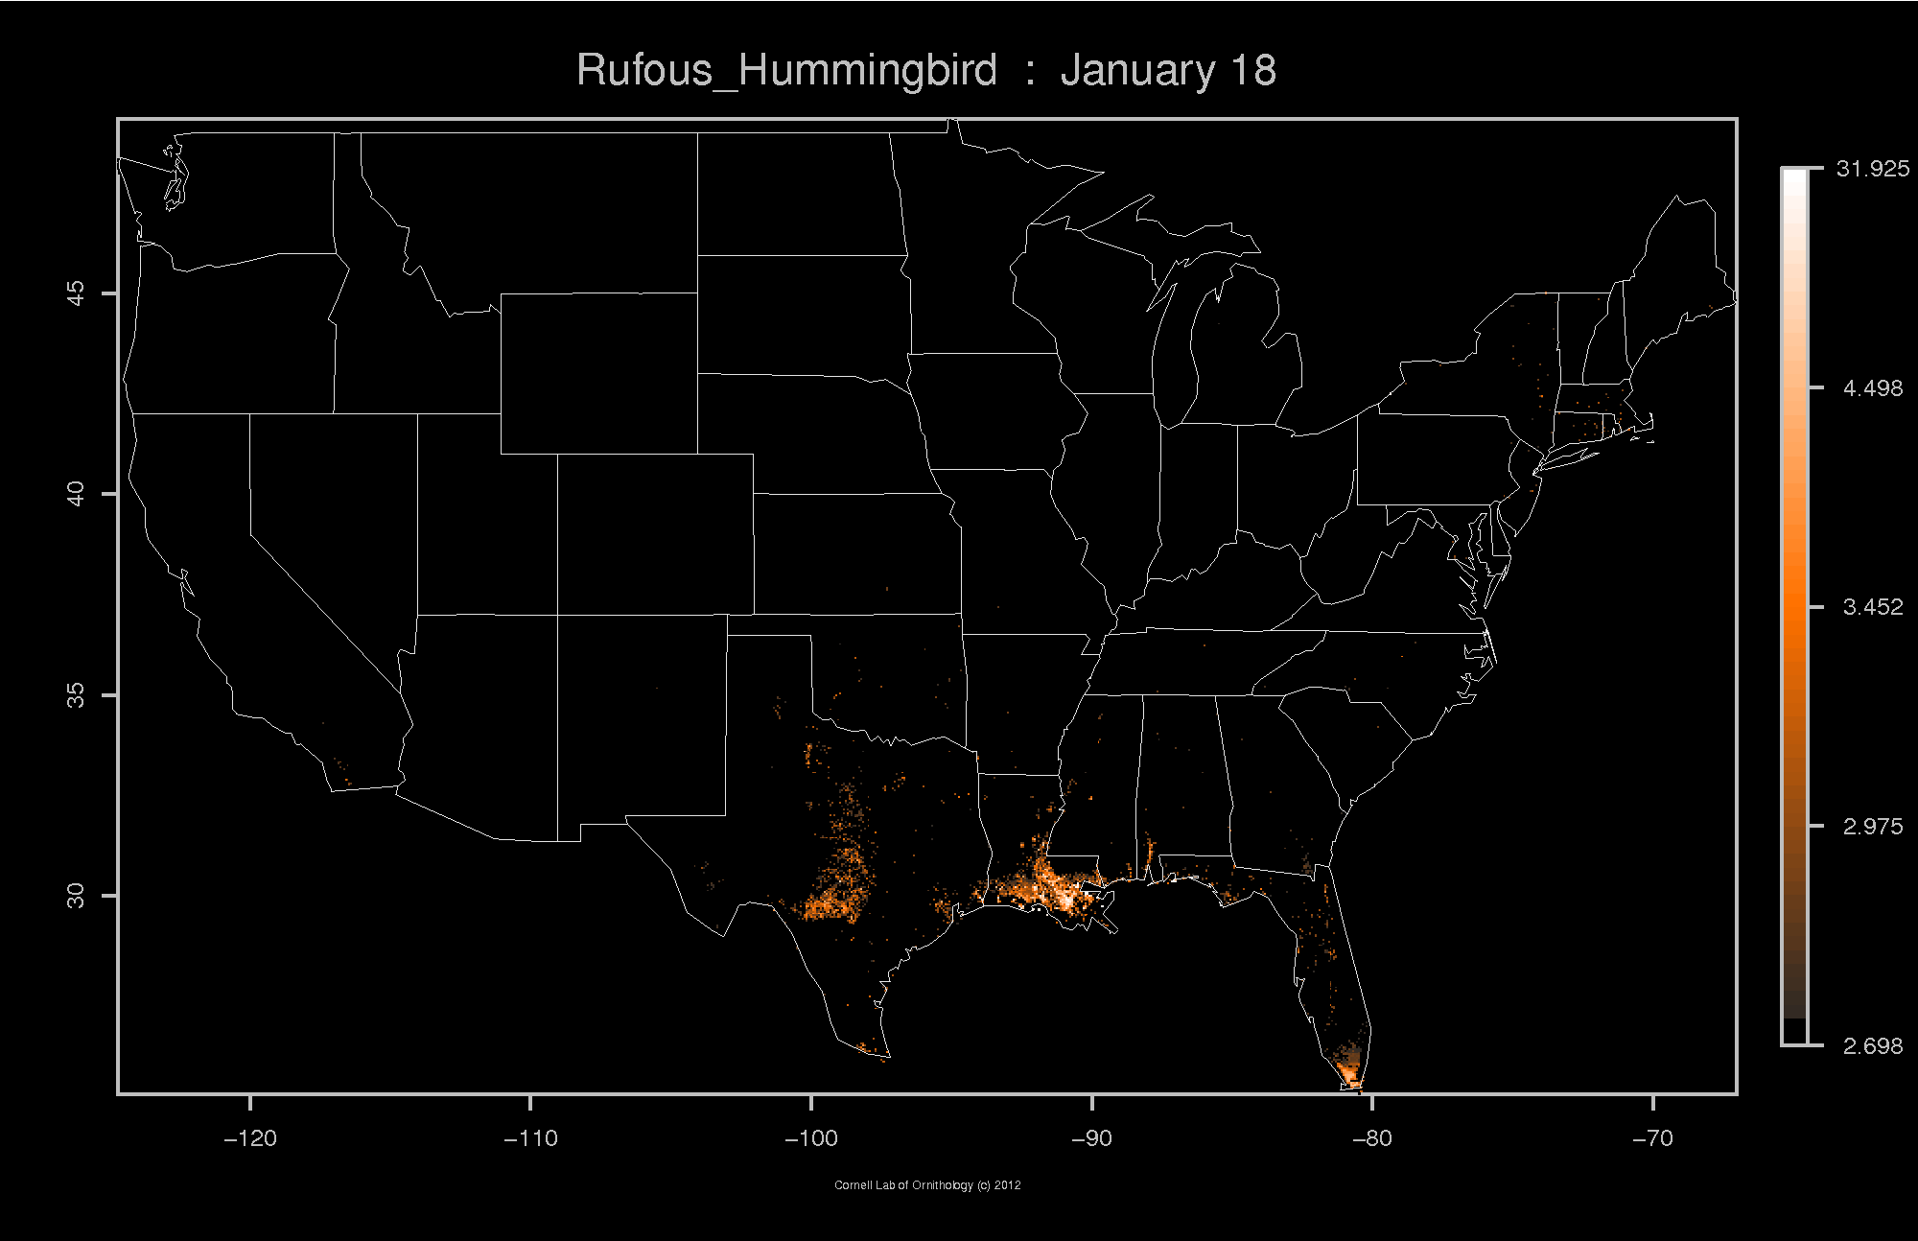

Slide 12
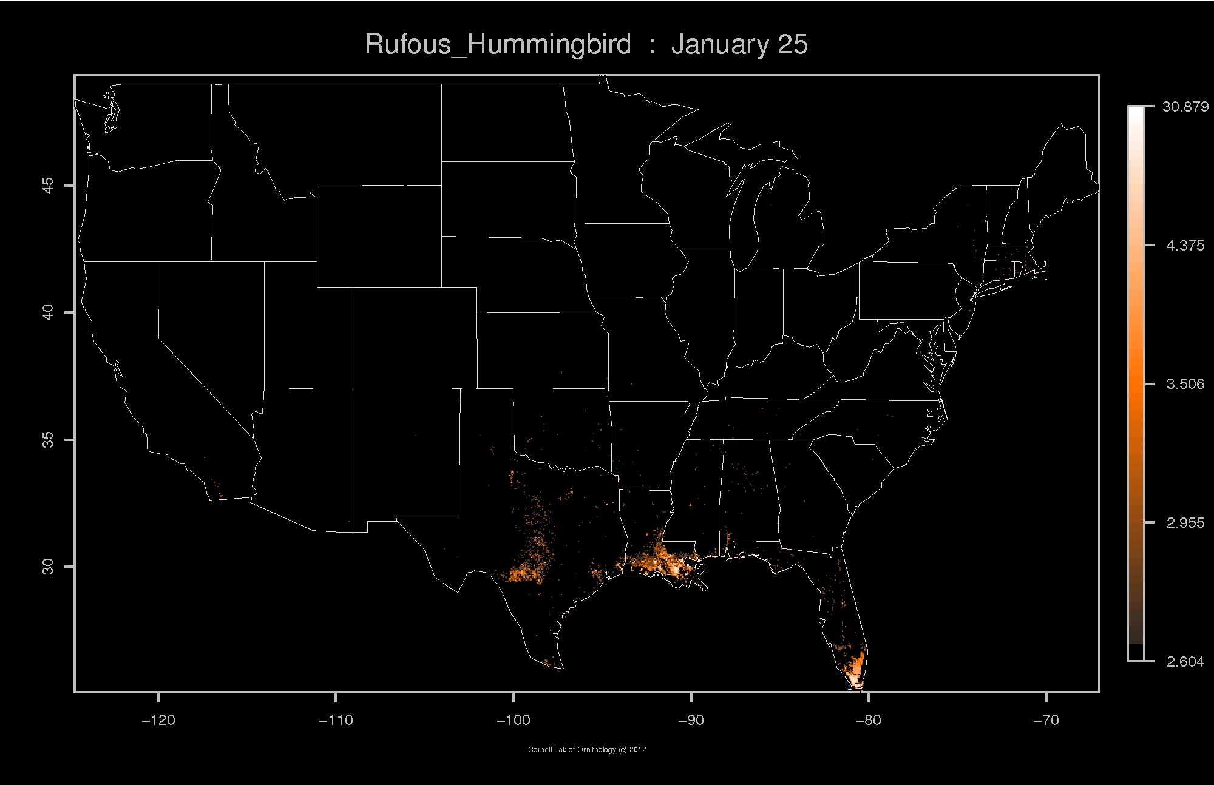

Slide 13
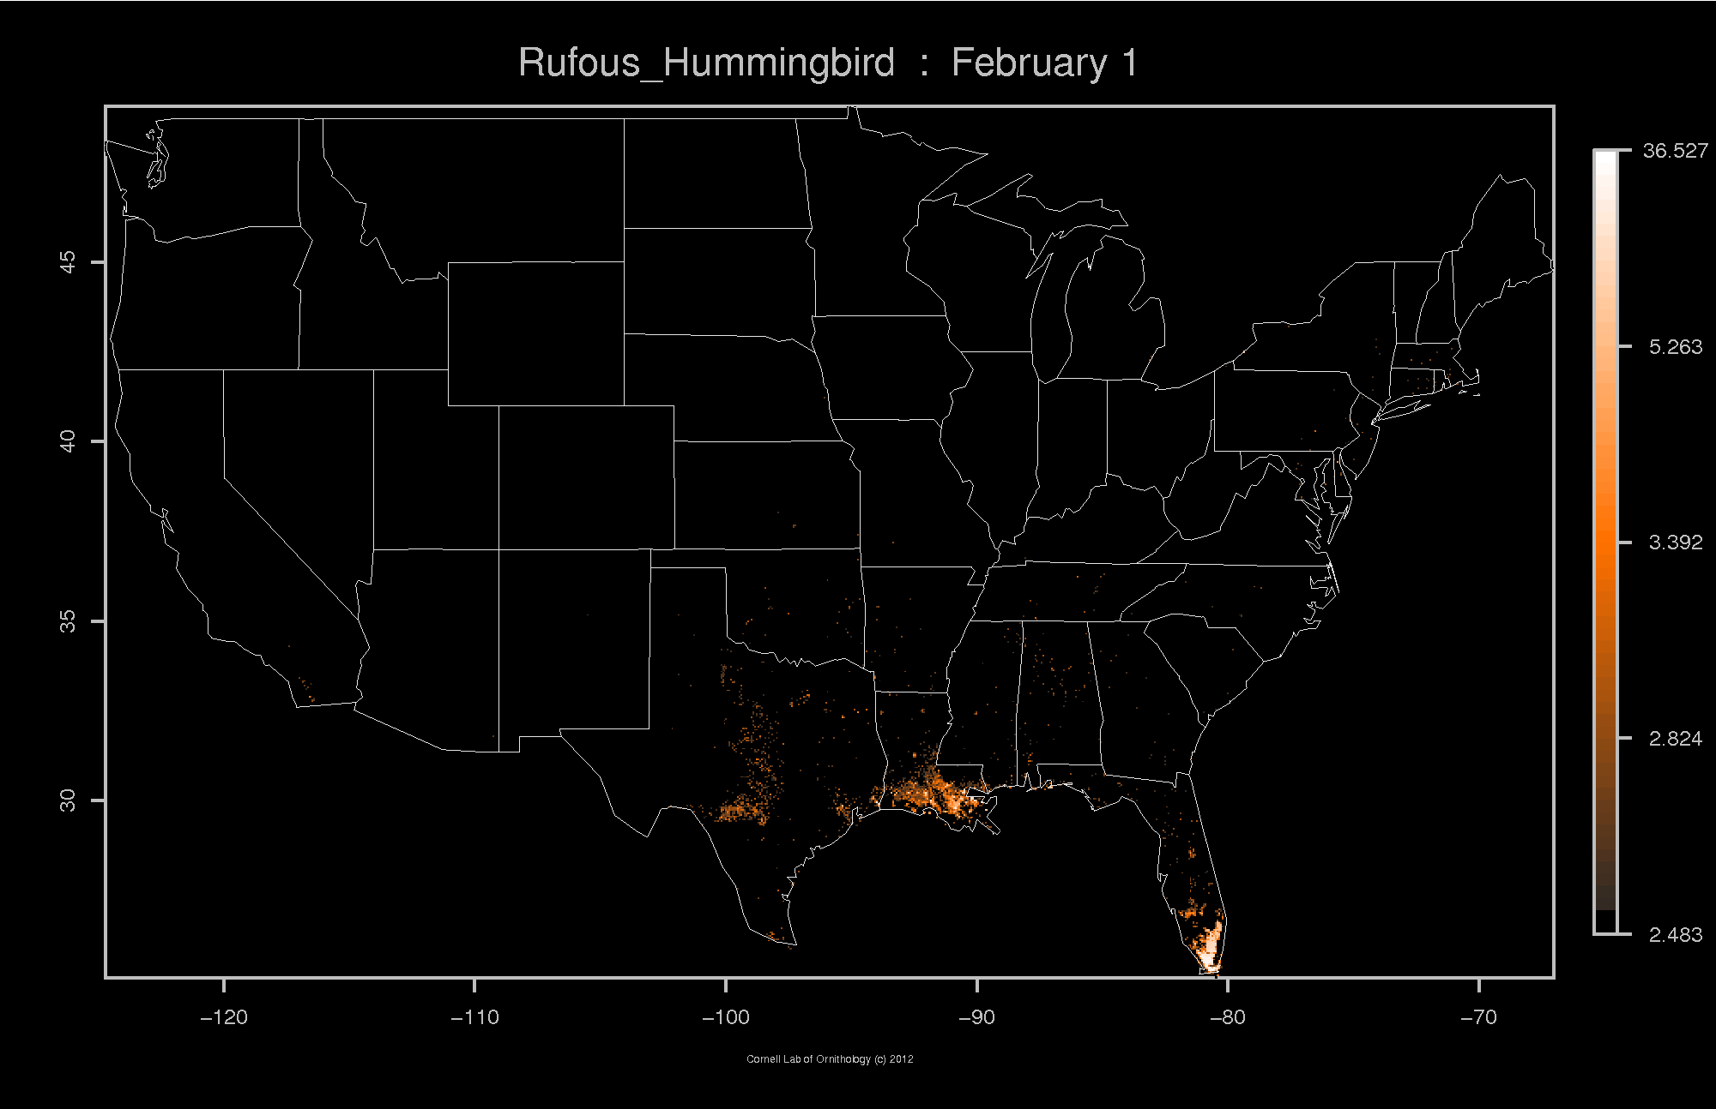

Slide 14
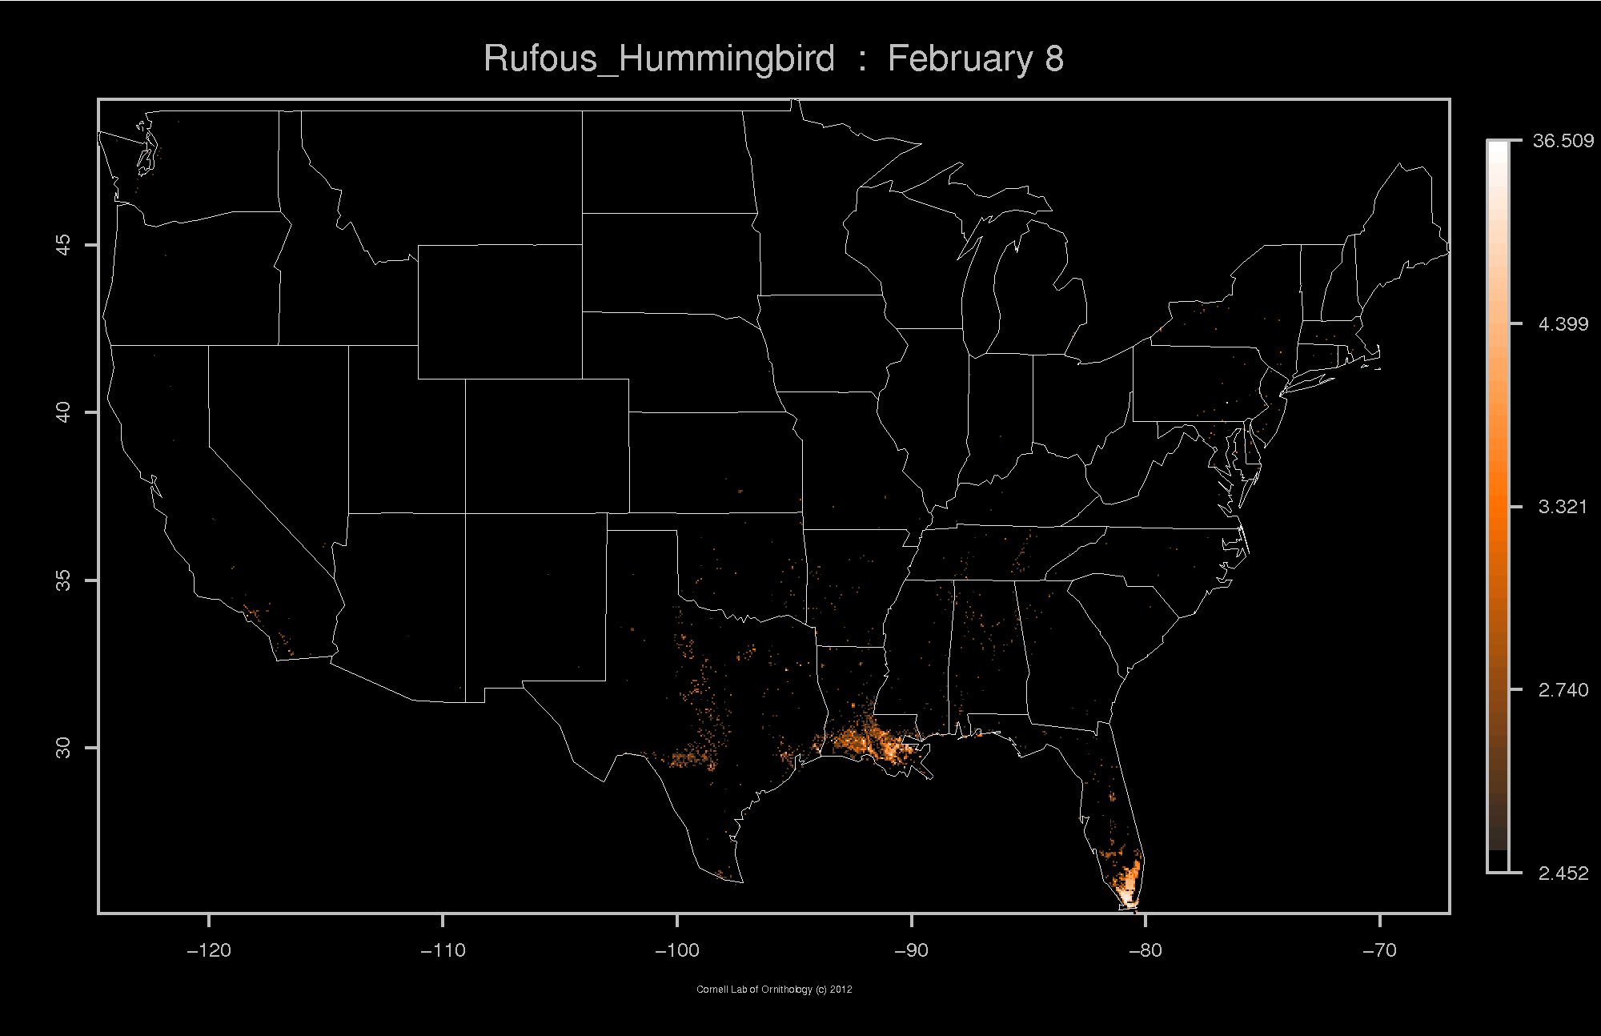

Slide 15


Slide 16
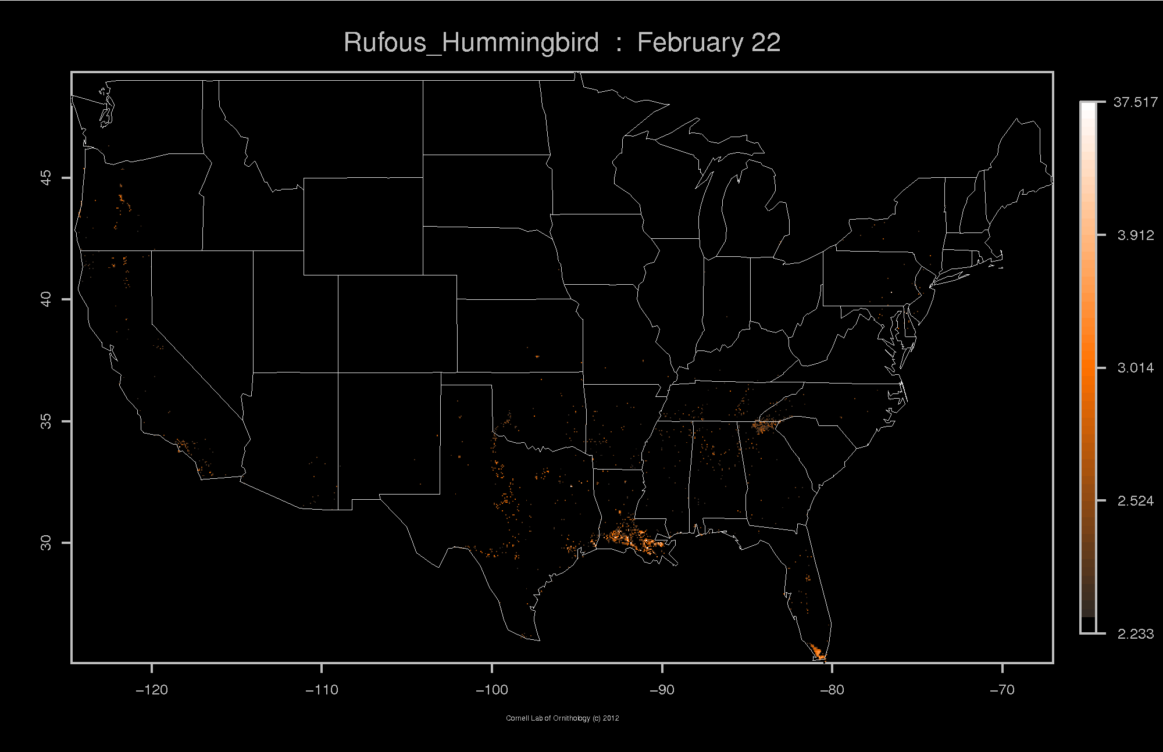

Slide 17
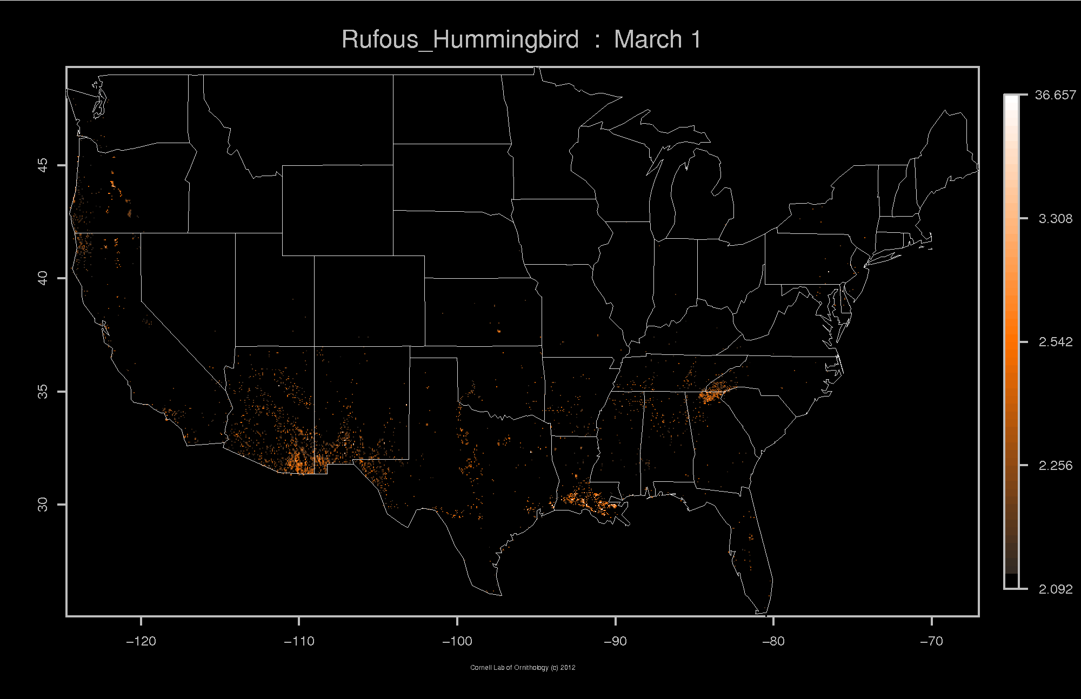

Slide 18
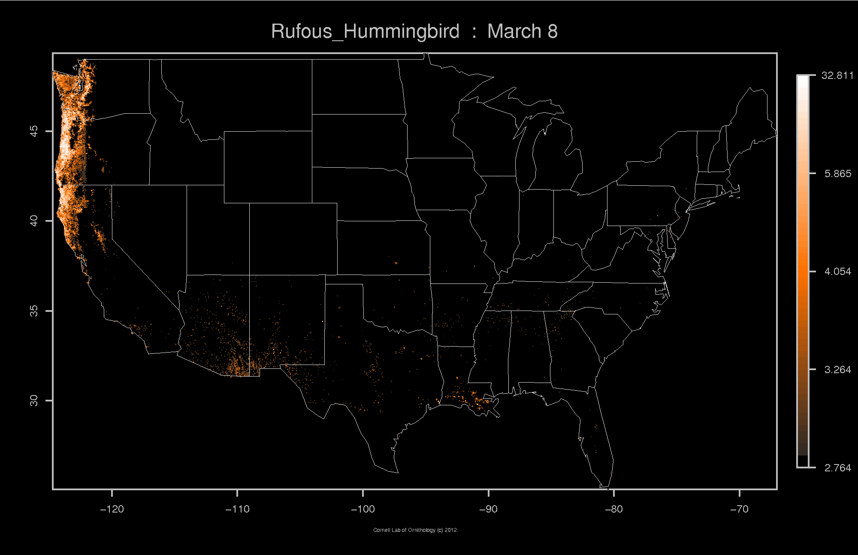

Slide 19
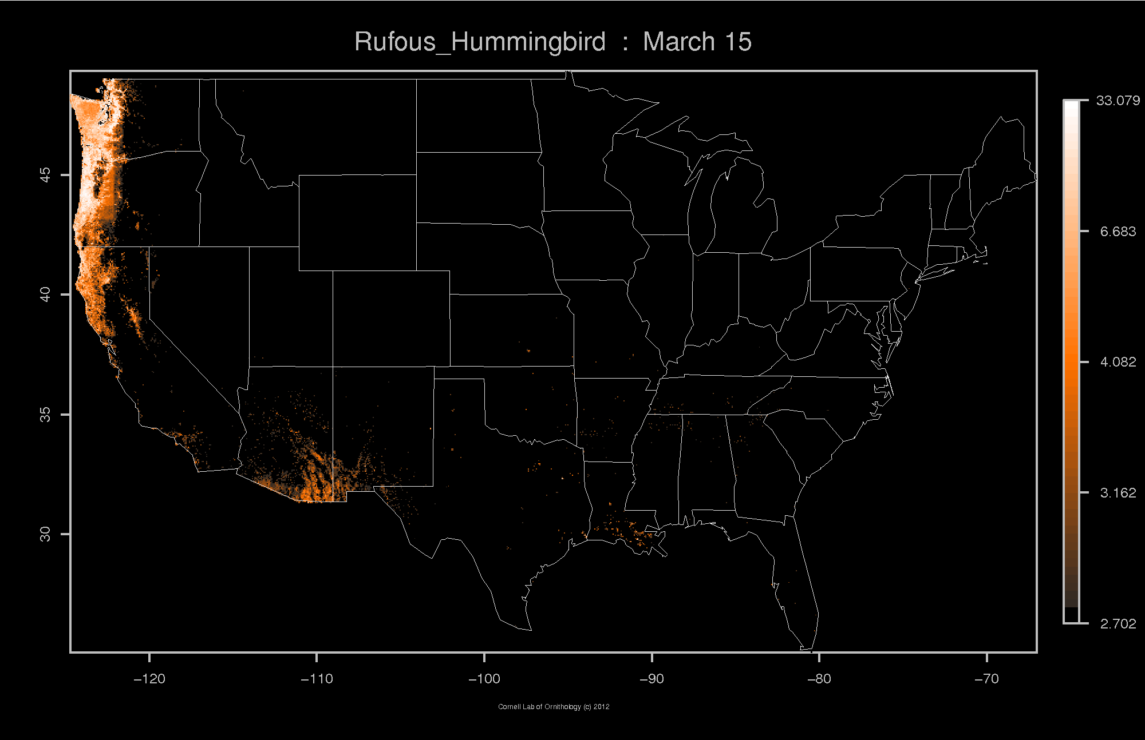

Slide 20
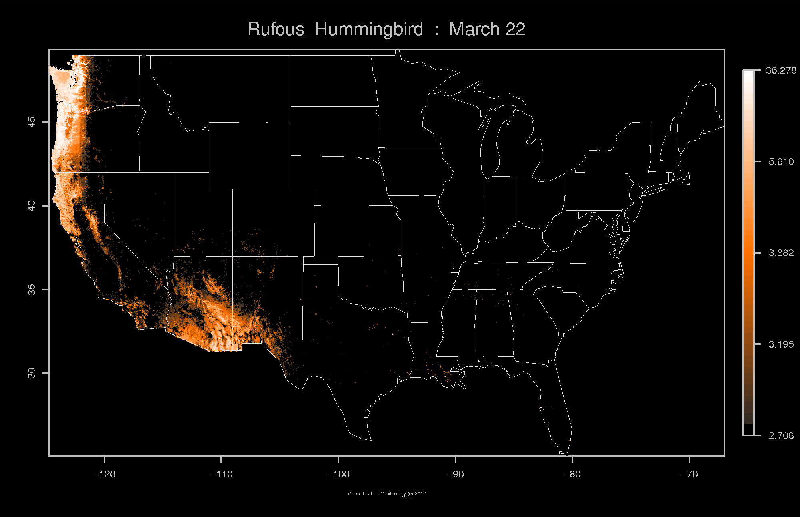

Slide 21
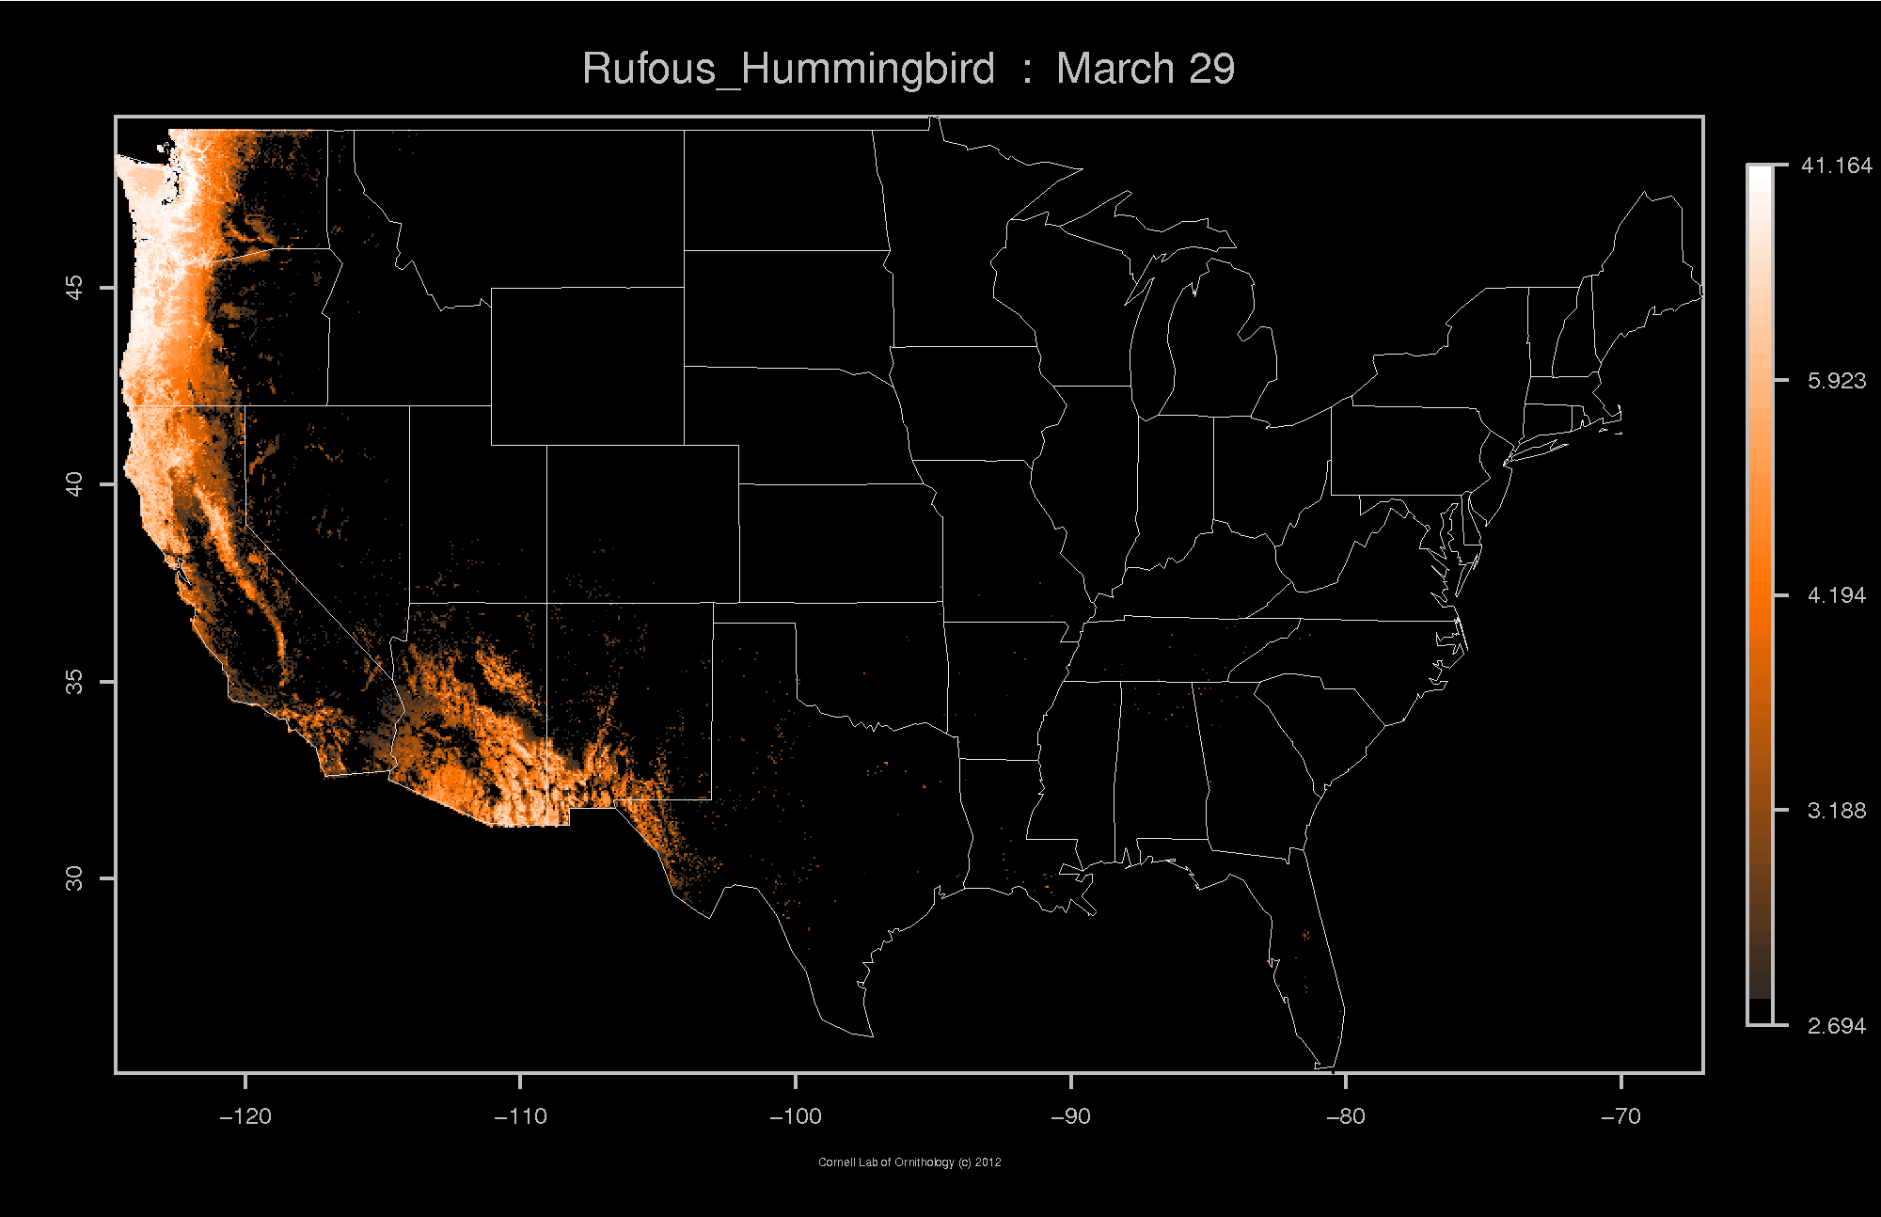

Slide 22
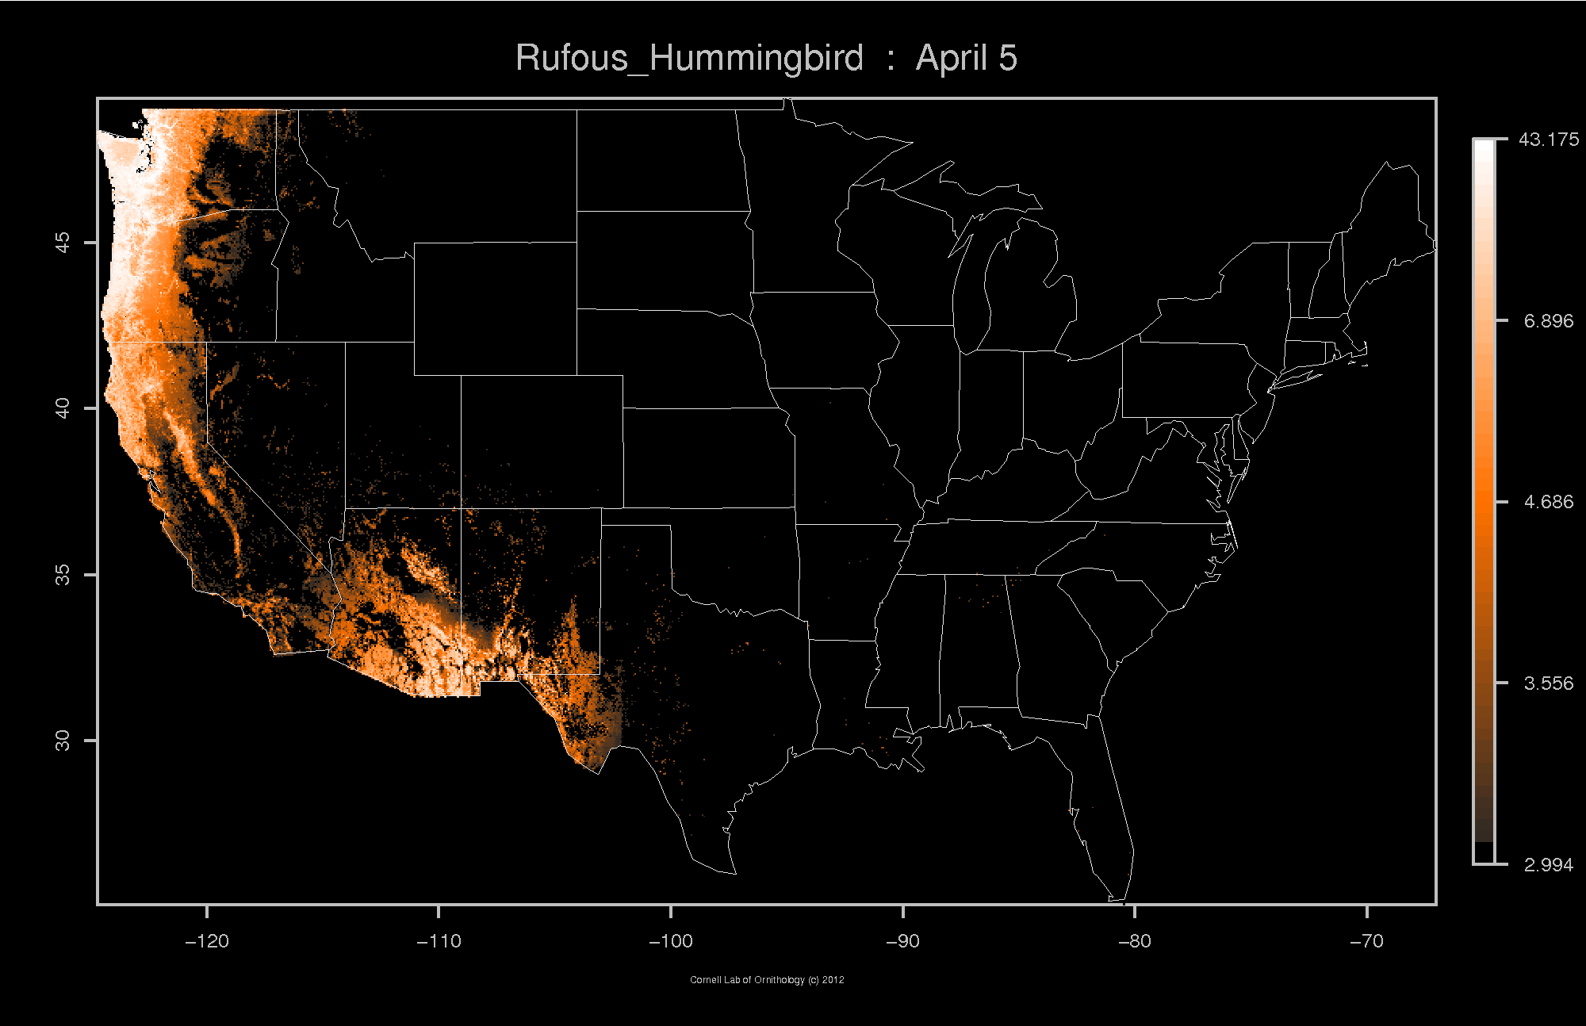

Slide 23
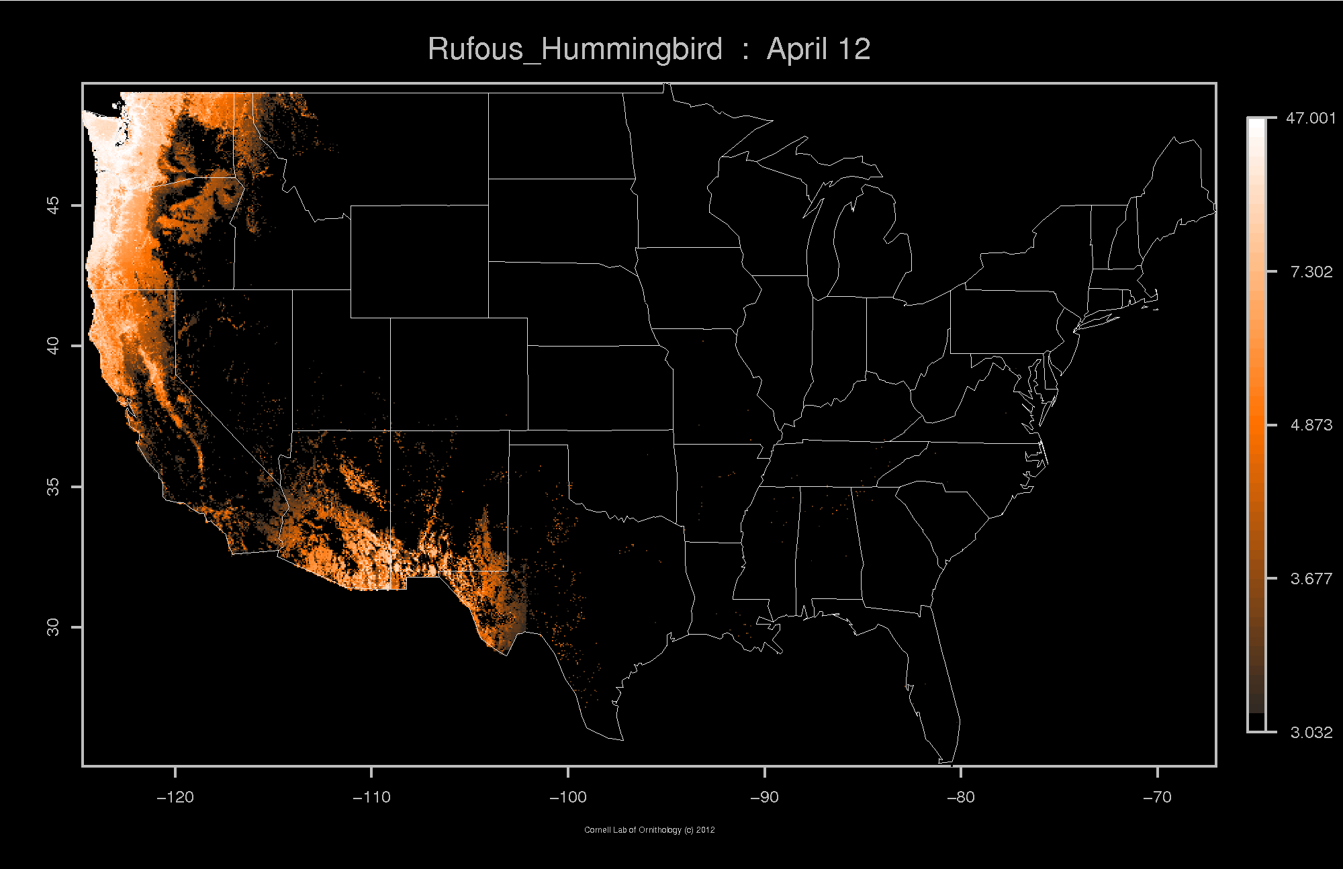

Slide 24
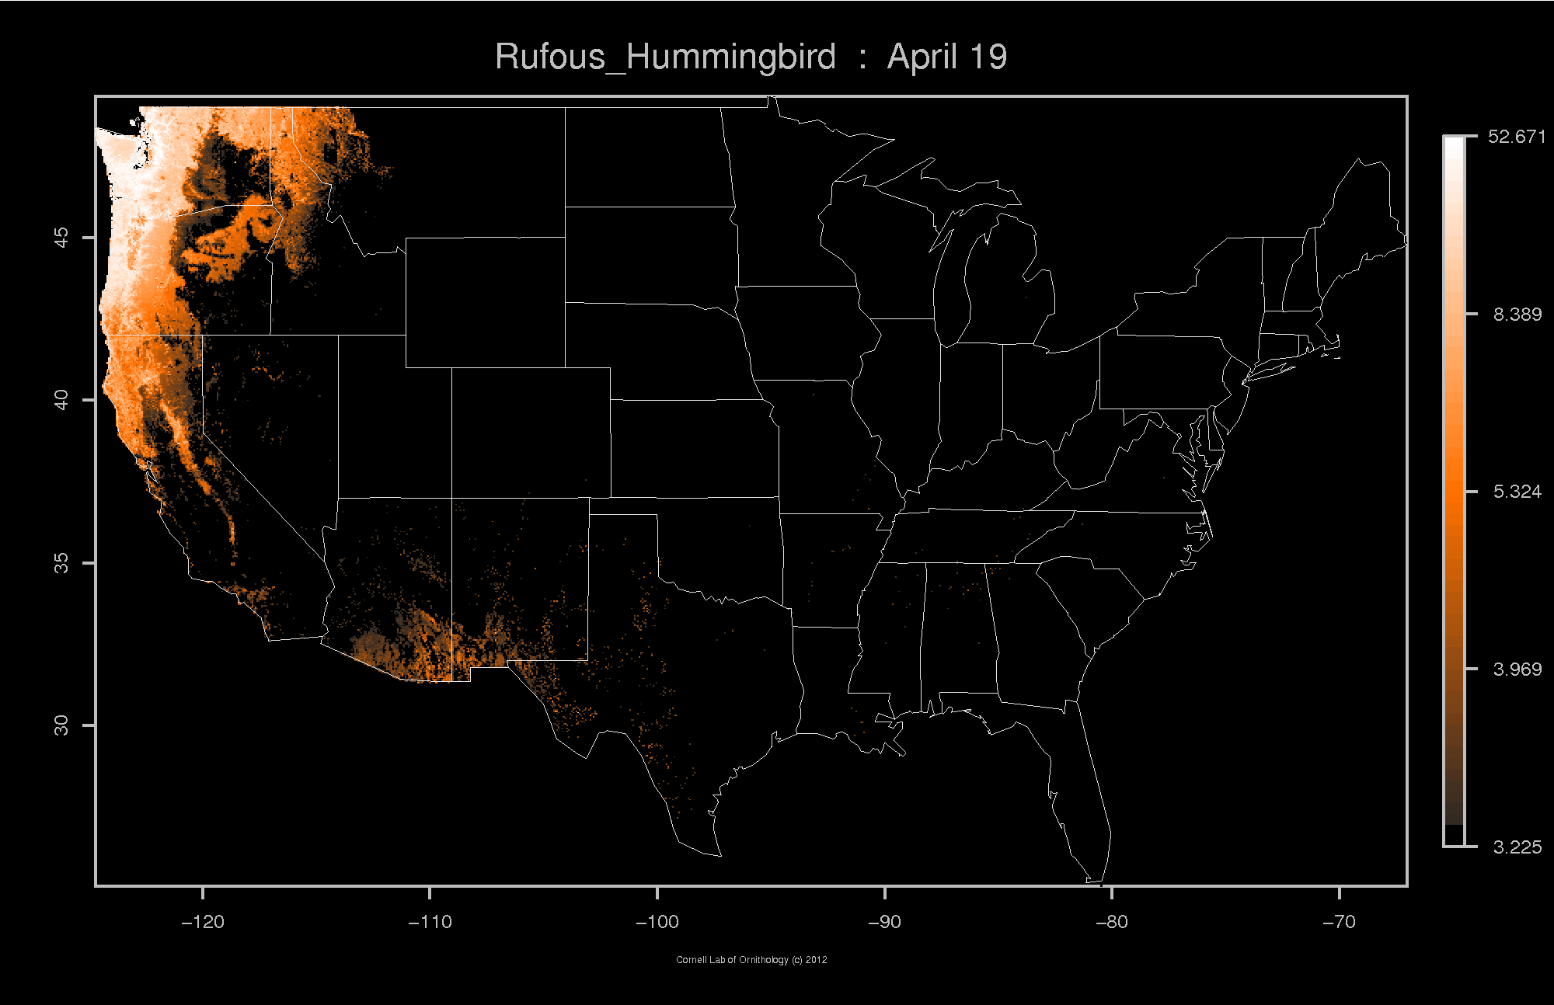

Slide 25
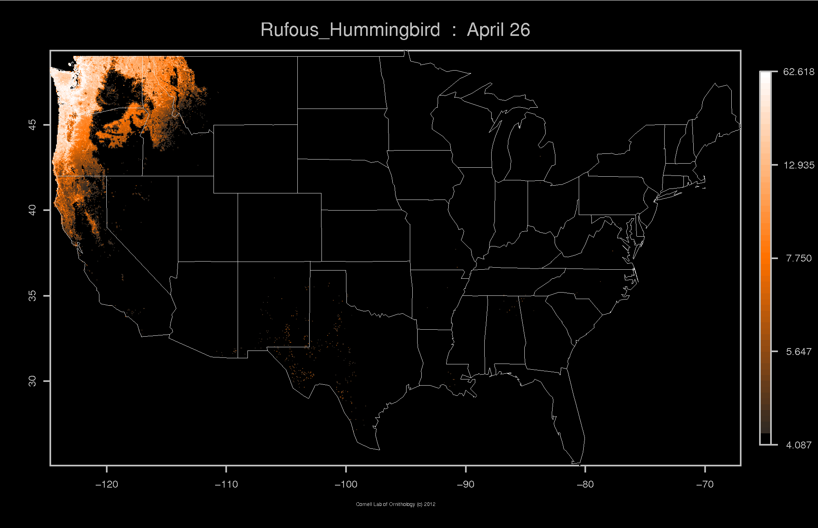

Slide 26
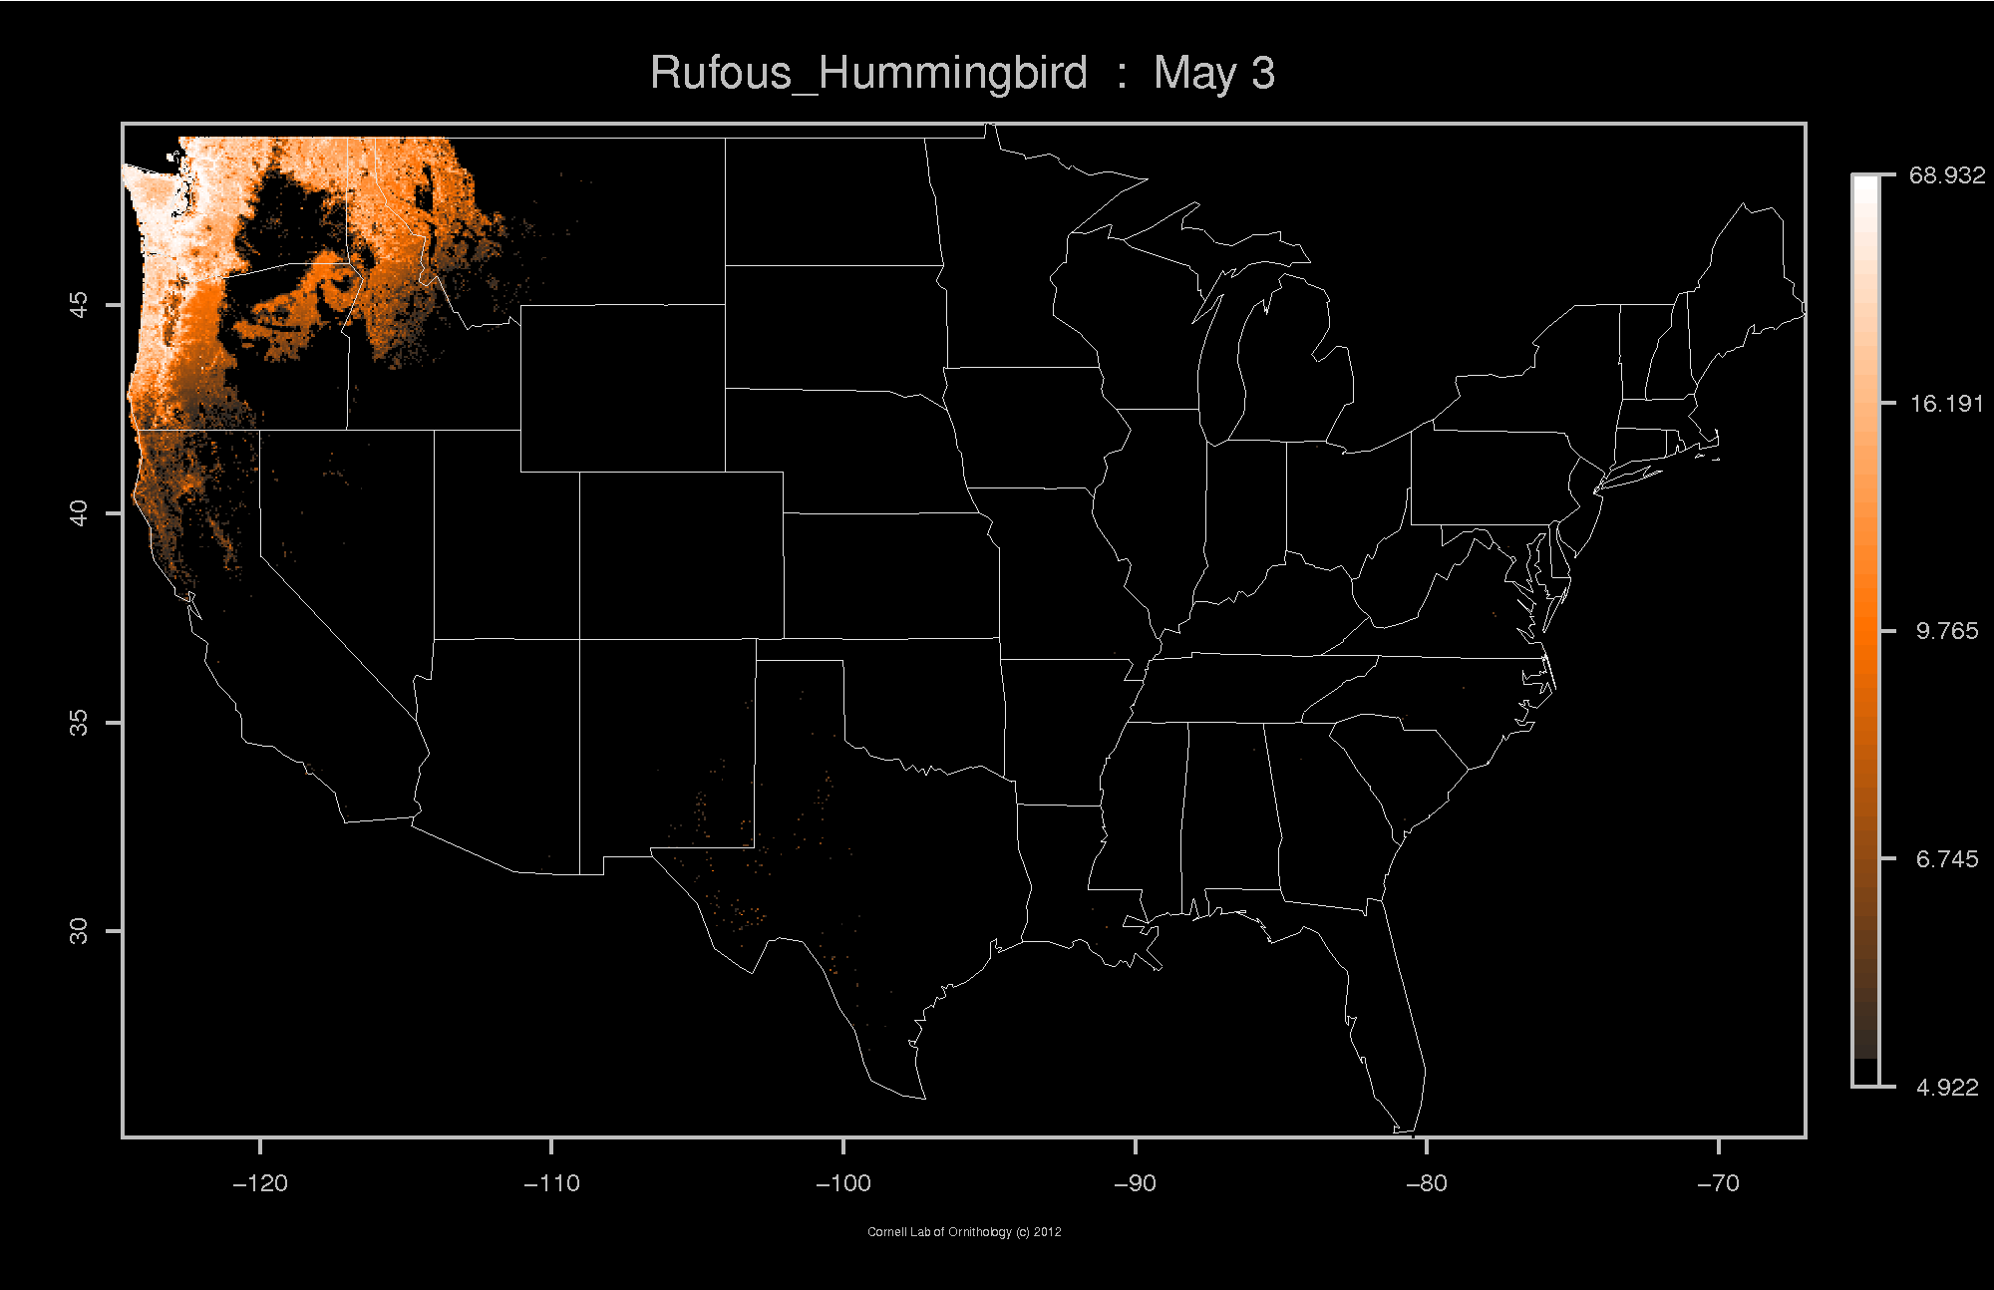

Slide 27
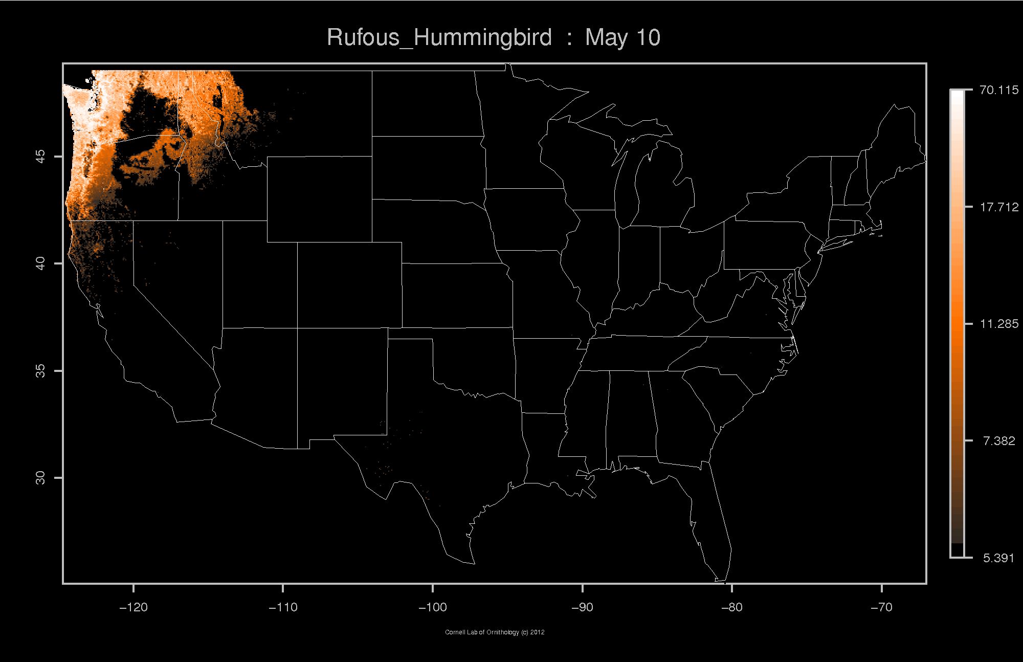

Slide 28


Slide 29


Slide 30
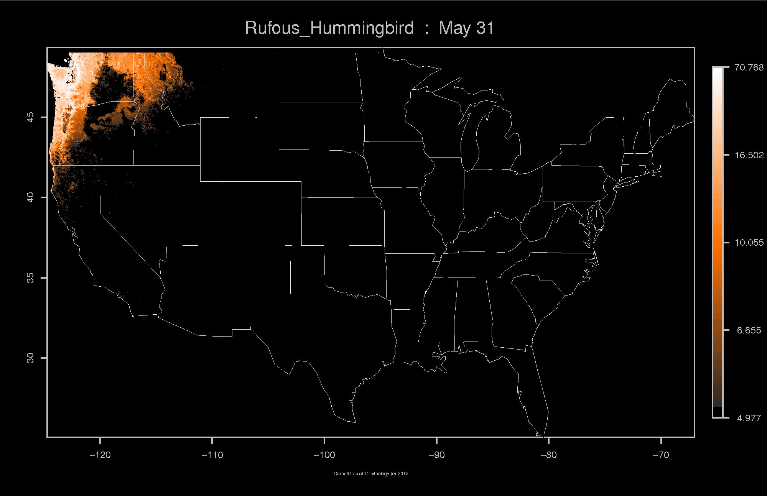

Slide 31


Slide 32


Slide 33
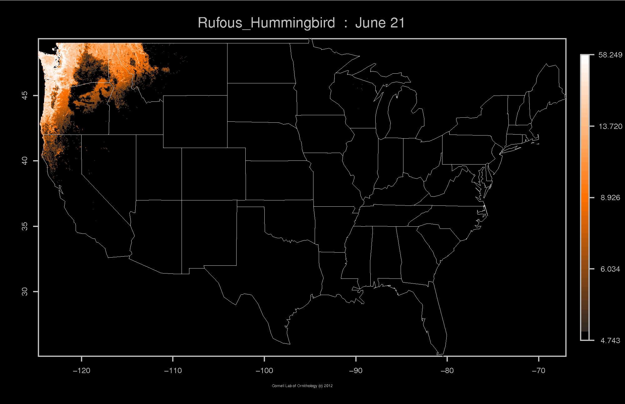

Slide 34
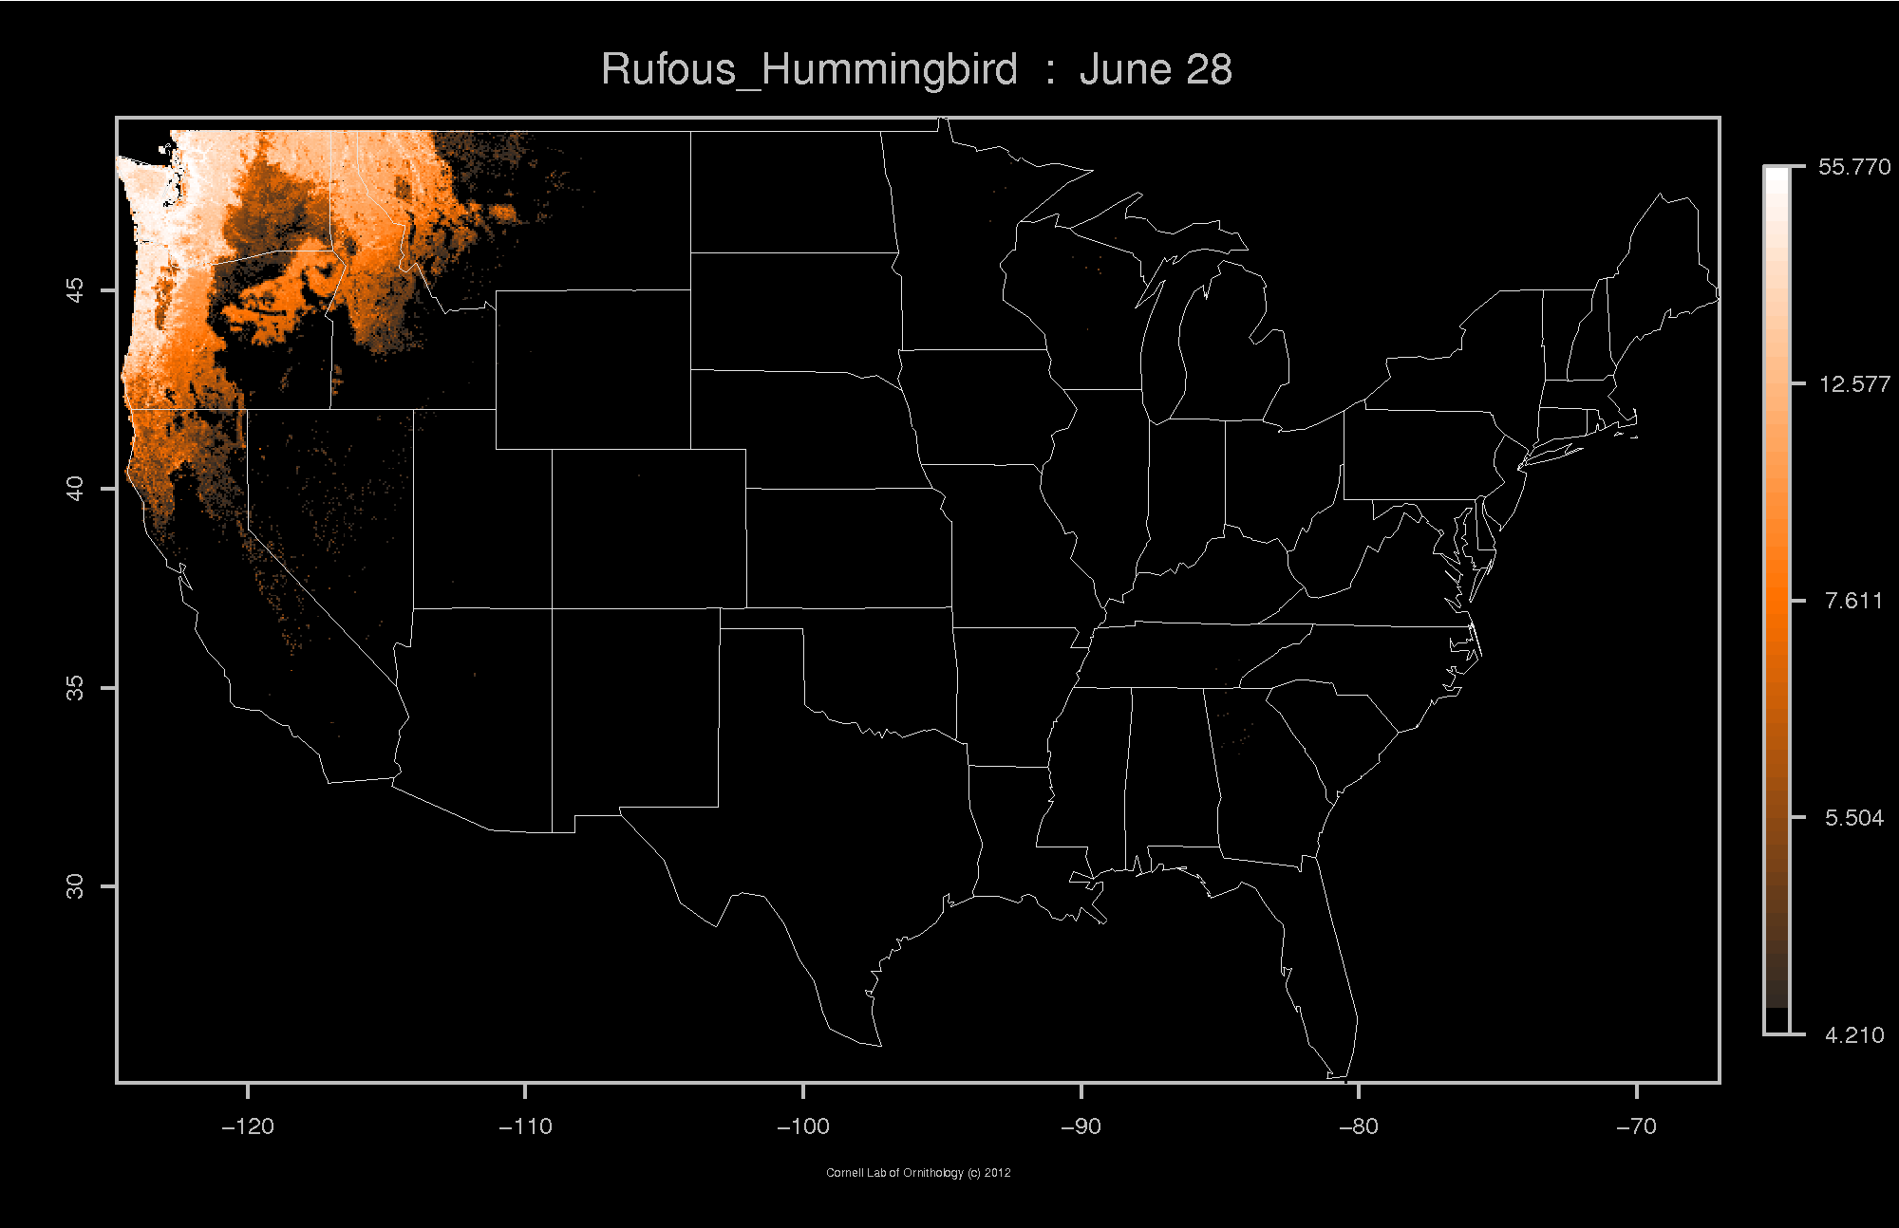

Slide 35
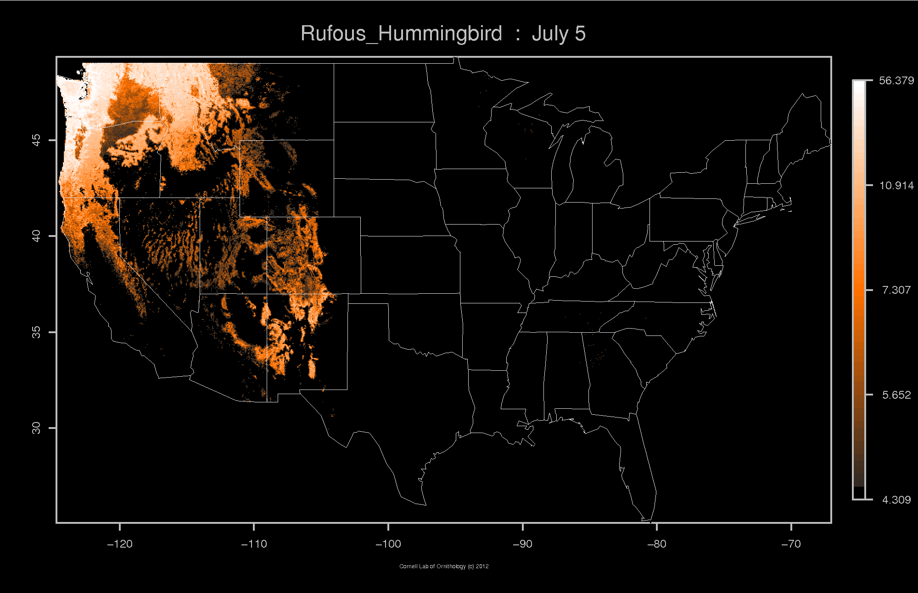

Slide 36
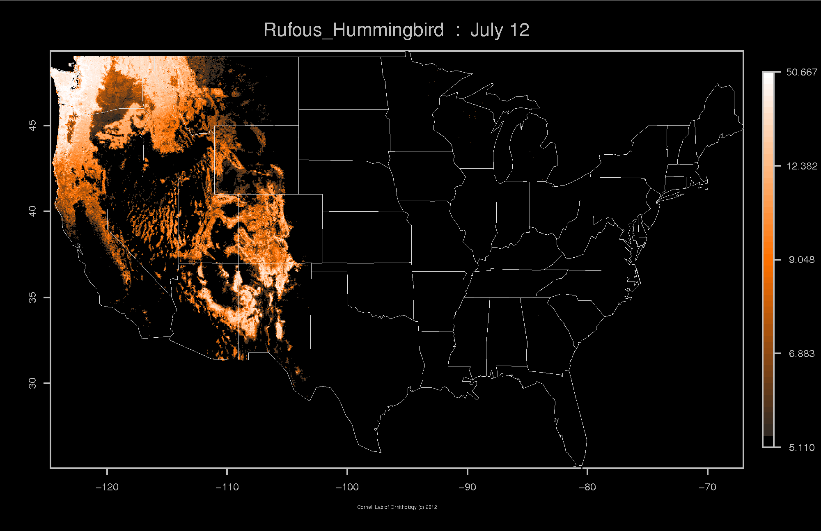

Slide 37
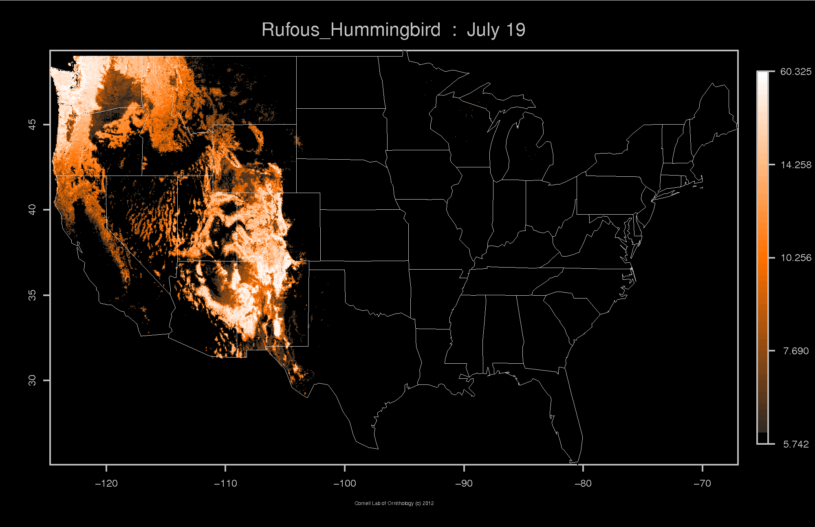

Slide 38


Slide 39
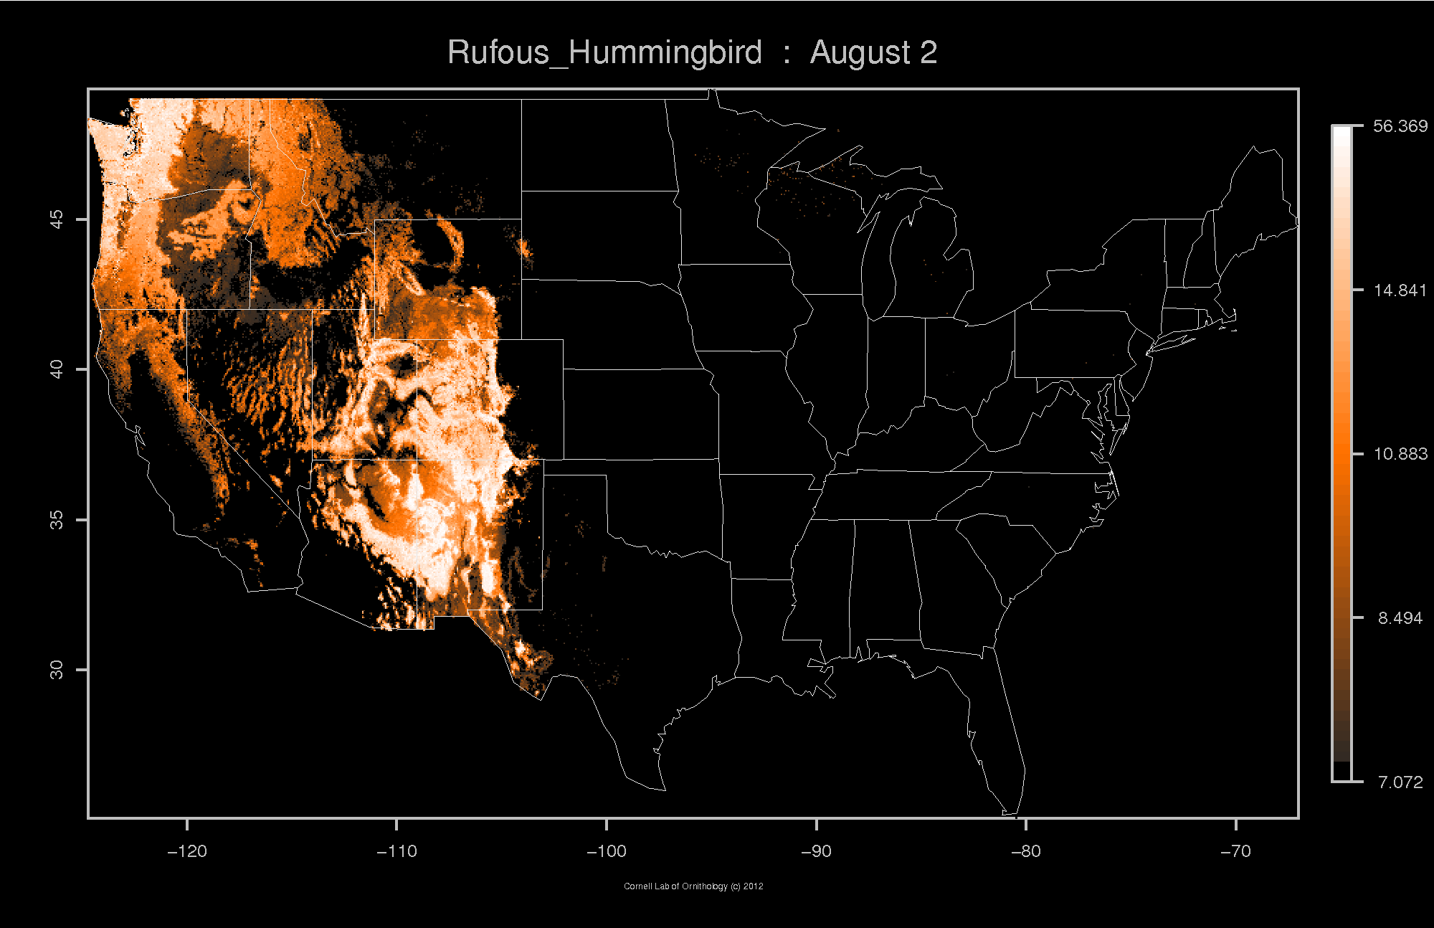

Slide 40
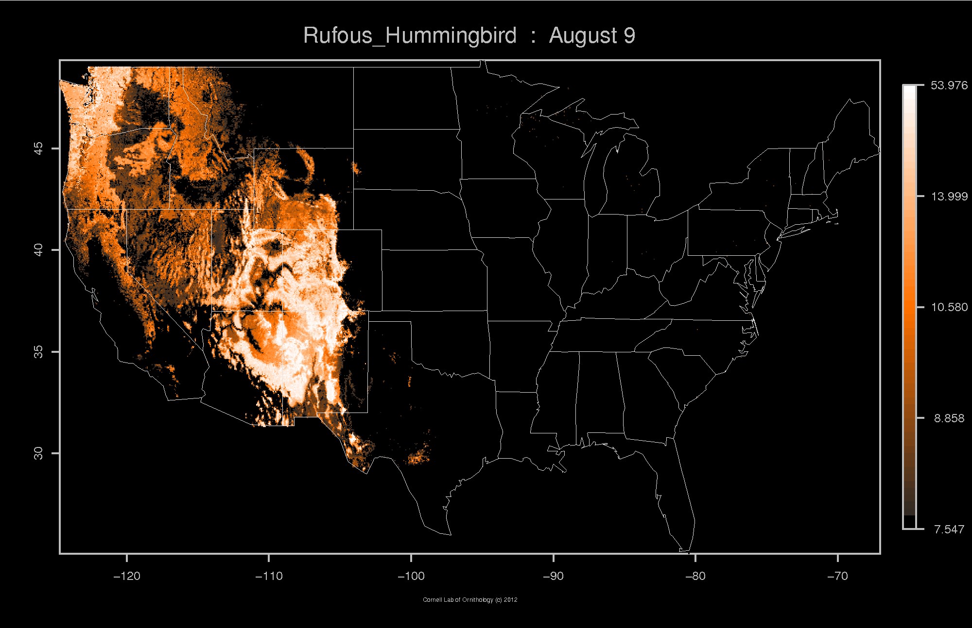

Slide 41
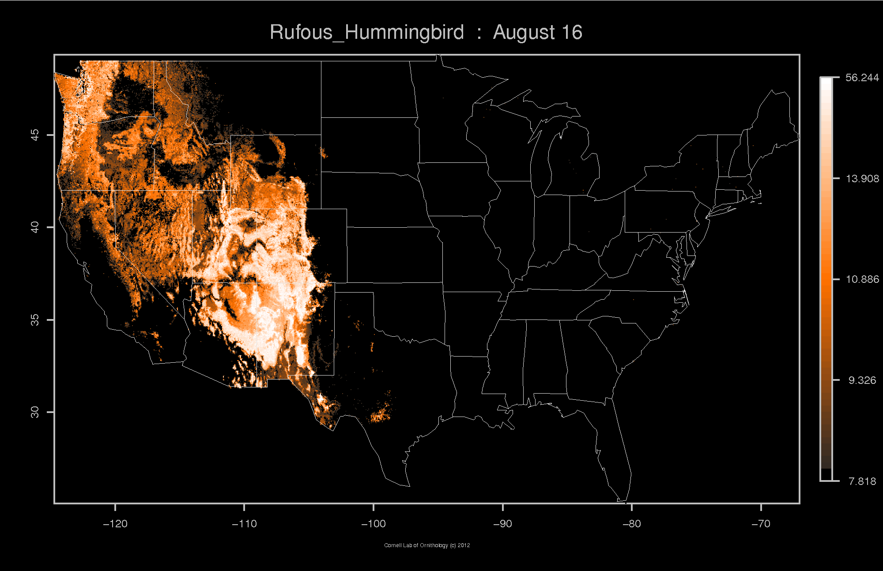

Slide 42
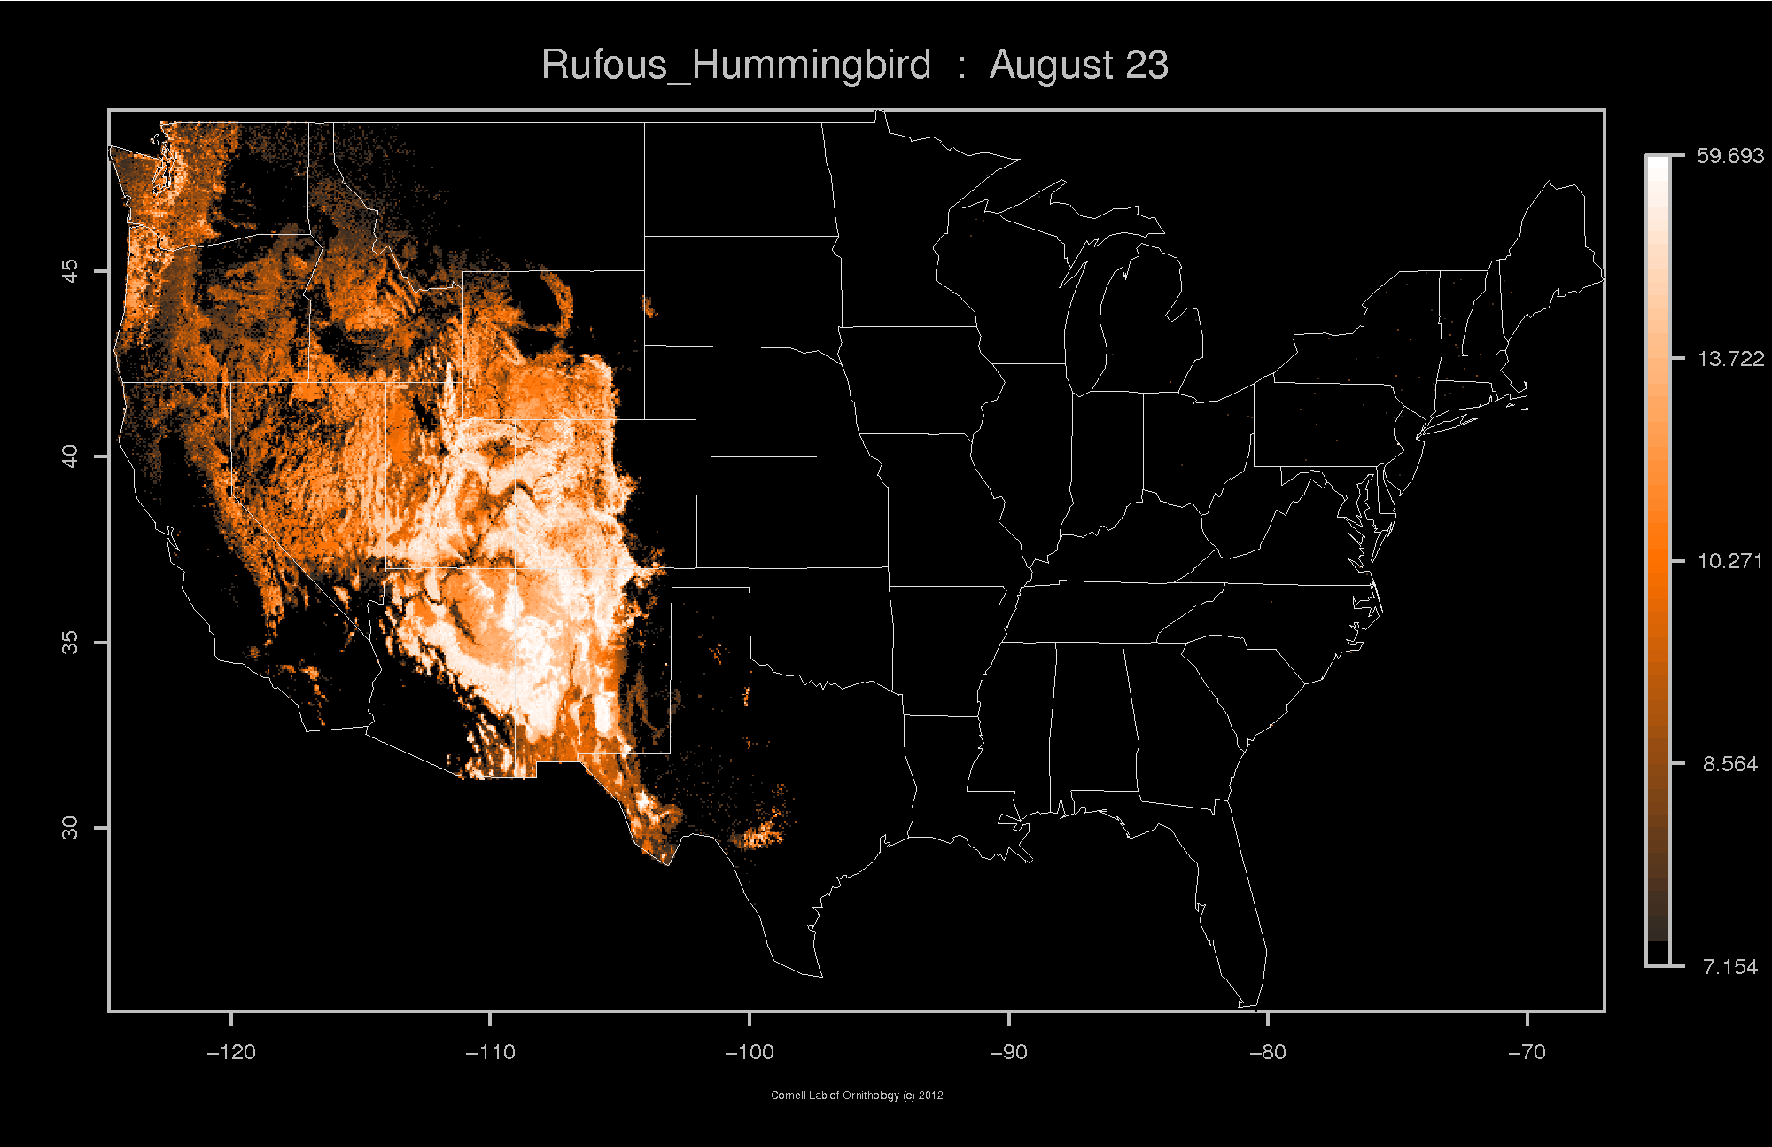

Slide 43
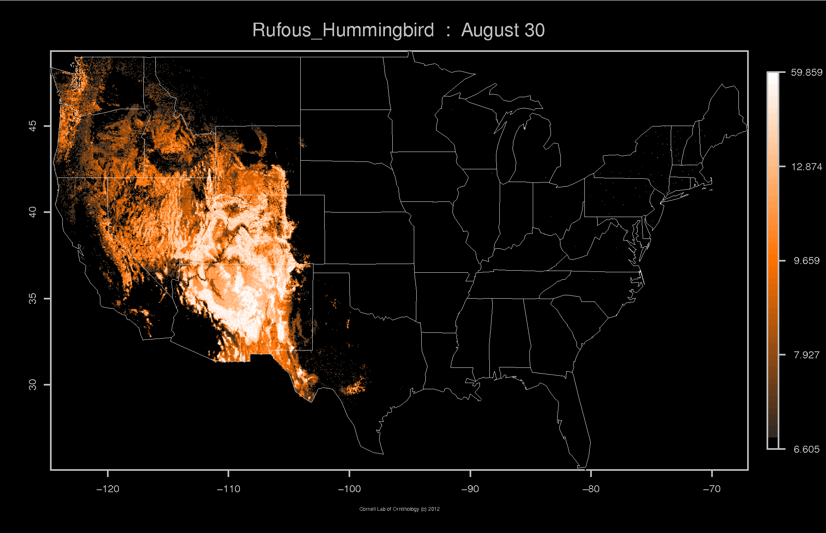

Slide 44
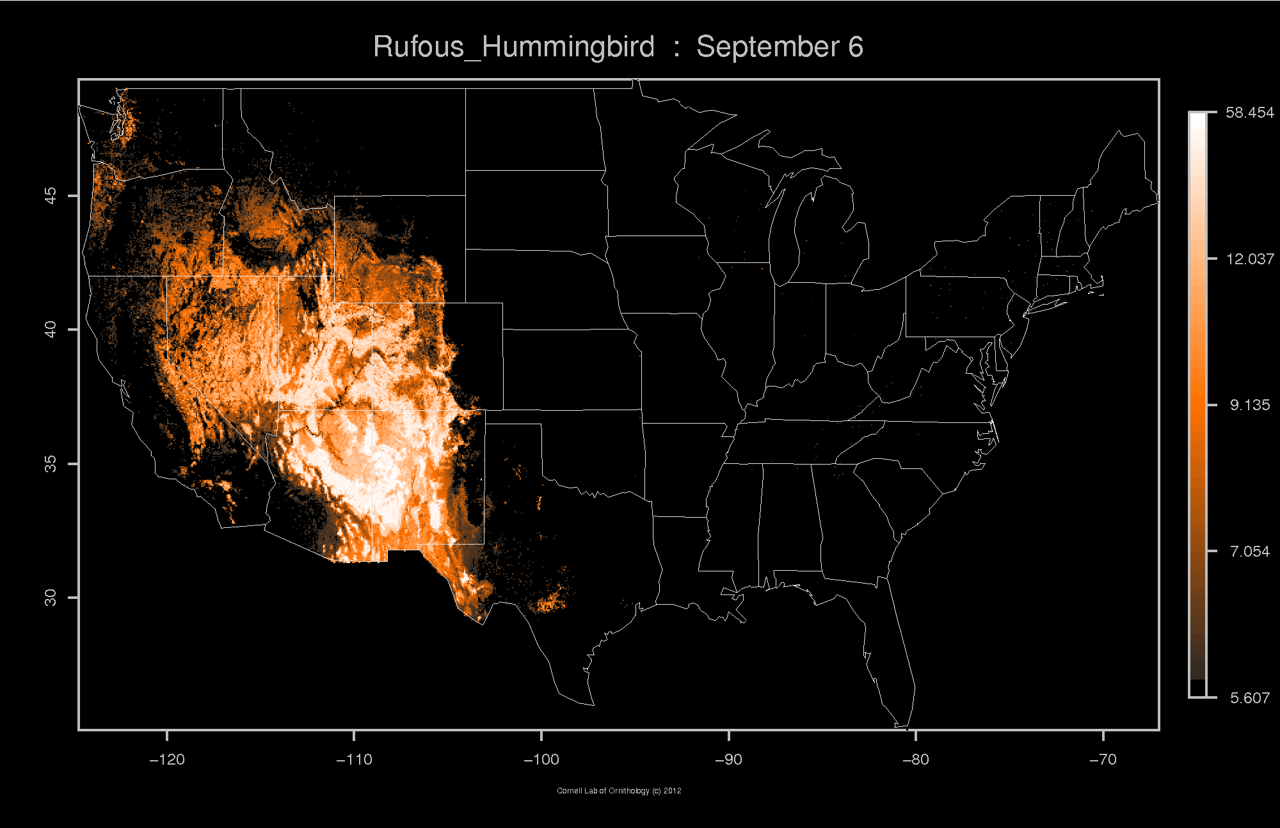

Slide 45
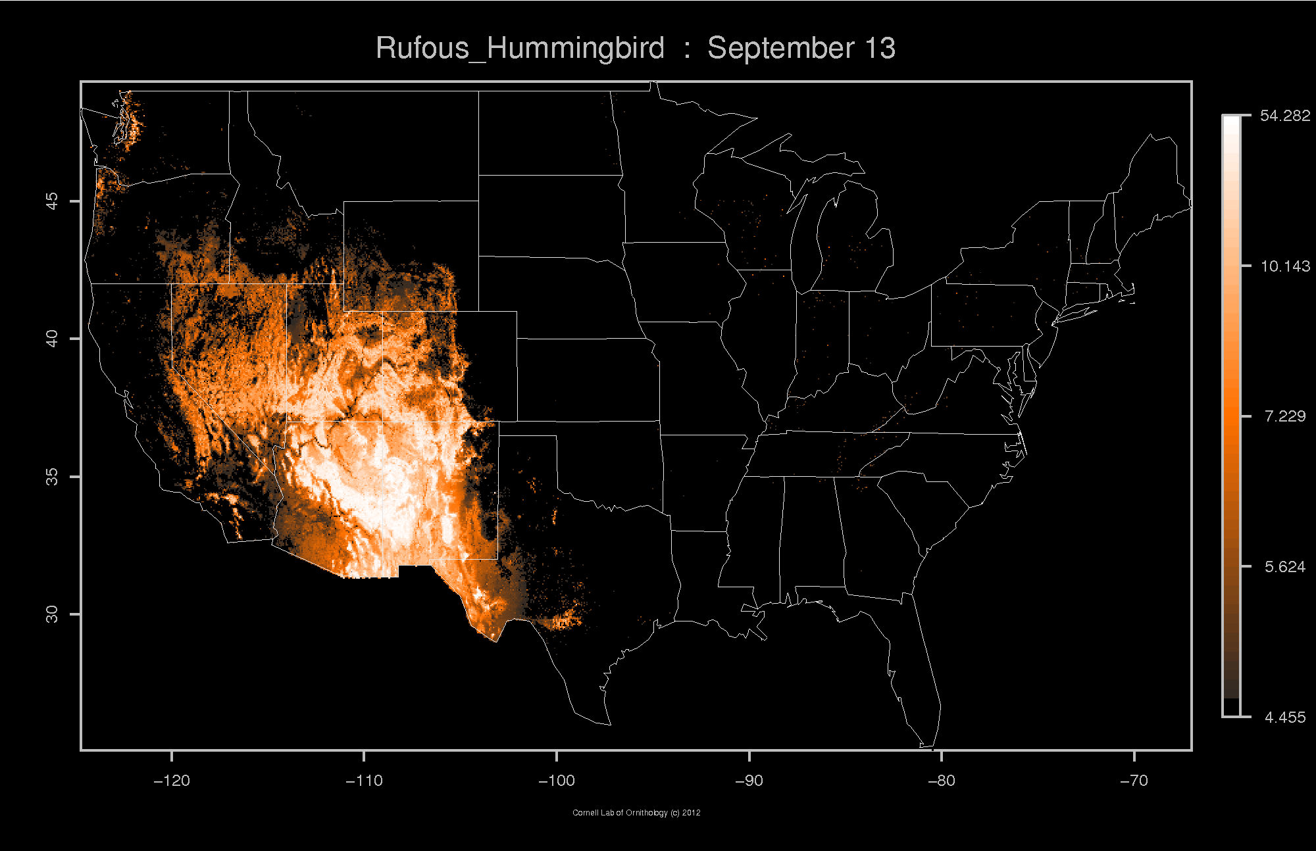

Slide 46
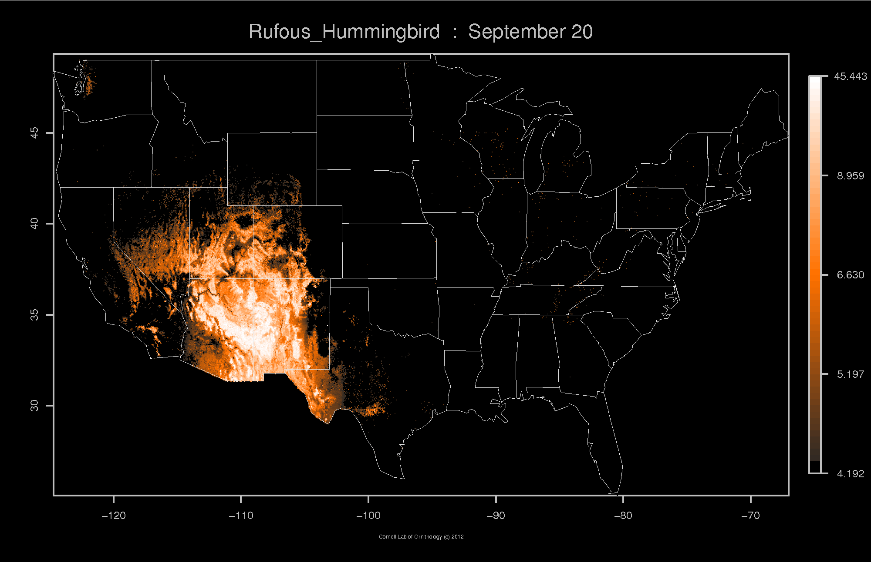

Slide 47


Slide 48
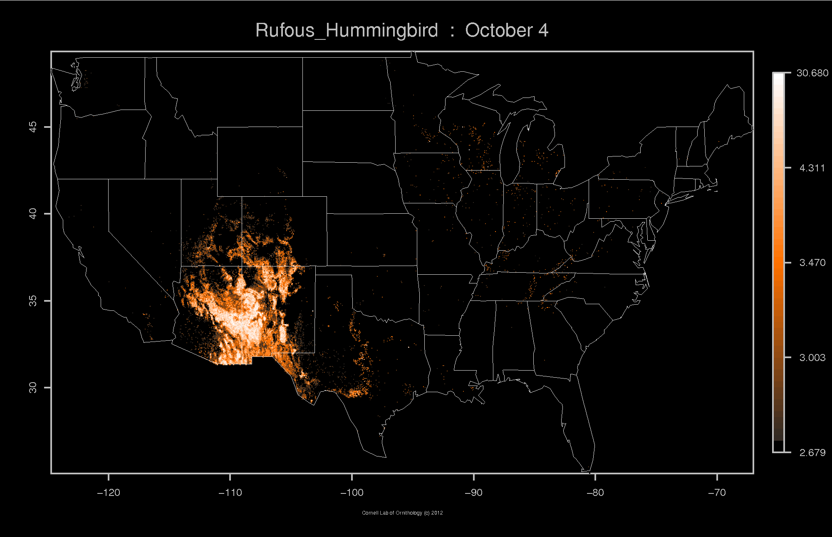

Slide 49
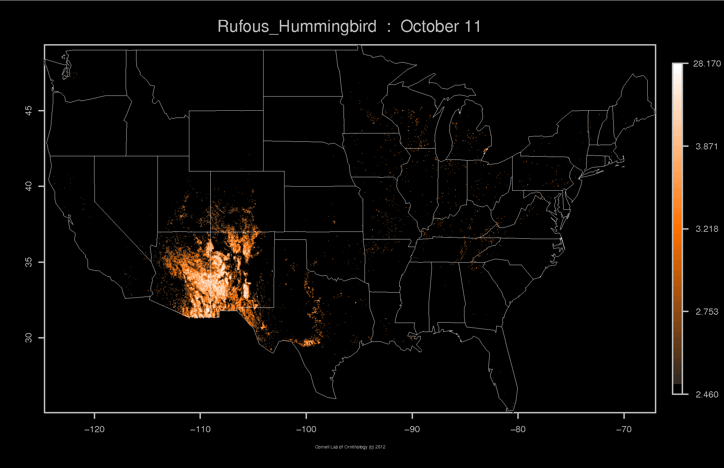

Slide 50
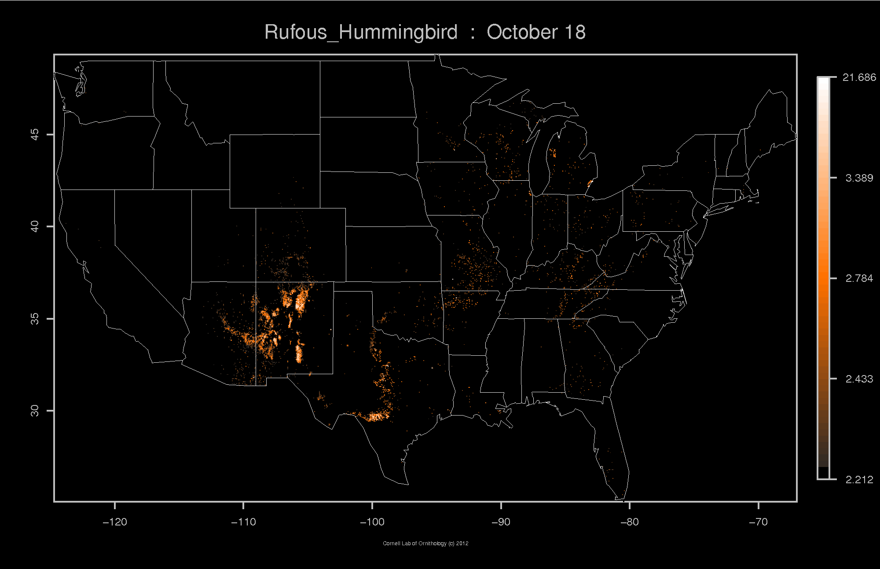

Slide 51


Slide 52


Slide 53


Slide 54


Slide 55


Slide 56


Slide 57


Slide 58


Slide 59


Slide 60


Slide 61

Stewardship Responsibilities for Birds

Slide 62


The State of the Birds 2011
Public Lands and Waters
Nation's first assessment of the distribution of birds on public lands and waters
Notes:
This report provides the nation's first assessment of the distribution of birds on public lands and the opportunities for public agencies in each habitat. We combined bird distribution data from the eBird citizen-science project with the Protected Areas Database of the U.S. to determine the percentage of each species’ U.S. distribution on public lands.

Slide 63

Opportunities
(North American Bird Conservation Initiative 2011)
Notes:
Agencies strive to realize management models.
Ecosystem Management and Adaptive Management
Core to the current management paradigms in place in the US.
Are these models being fully implemented?
Management at relevant scales – fire adapted ecosystems, bird population objectives
Monitoring – considered in management design or used to evaluate effectiveness
Linking PIF approach to ecosystem management and adaptive management

Slide 64

Opportunities
Notes:
Agencies strive to realize management models.
Ecosystem Management and Adaptive Management
Core to the current management paradigms in place in the US.
Are these models being fully implemented?
Management at relevant scales – fire adapted ecosystems, bird population objectives
Monitoring – considered in management design or used to evaluate effectiveness
Linking PIF approach to ecosystem management and adaptive management

Slide 65
Opportunities
Notes:
Agencies strive to realize management models.
Ecosystem Management and Adaptive Management
Core to the current management paradigms in place in the US.
Are these models being fully implemented?
Management at relevant scales – fire adapted ecosystems, bird population objectives
Monitoring – considered in management design or used to evaluate effectiveness
Linking PIF approach to ecosystem management and adaptive management

Slide 66

Integrating PIF’s “best available science” into land management planning
Notes:
We recently published a series of examples that highlight successes in bird conservation, both the science and process of adaptive management. This is available online: library.fws.gov/BTP/information-ecosystem-management-2011.pdf

Slide 67




Conservation Plans
(Altman and Alexander 2012; Altman 2000)
Notes:
Regional plans use a focal species approach (Chase & Geupel, 2005) to propose habitat-based conservation objectives for both at-risk and more common species. The habitat objectives and focal species represent a variety of conditions needed to recover and sustain diverse landbird populations within the areas and habitats covered by the plans.

Slide 68



Focal Species
Conservation Objectives
Habitat attributes of healthy functioning ecosystem
(Altman and Alexander 2012; Alexander et al. 2007, FEM; Chase and Geupel 2005, PIF Proceedings)
Notes:
The plans use a focal species approach to propose habitat-based conservation objectives for both at-risk and more common species. The habitat objectives and focal species represent a variety of conditions needed to recover and sustain diverse landbird populations within the areas and habitats covered by the plans.
Focal species approach (Chase & Geupel, 2005) to propose habitat-based conservation objectives for both at-risk and more common species. The habitat bjectives and focal species represent a variety of conditions needed to recover and sustain diverse landbird populations within the areas and habitats covered by the plans.

Slide 69


Focal Species
(Altman and Alexander 2012)
Notes:
The plans use a focal species approach to propose habitat-based conservation objectives for both at-risk and more common species. The habitat objectives and focal species represent a variety of conditions needed to recover and sustain diverse landbird populations within the areas and habitats covered by the plans.
Focal species approach (Chase & Geupel, 2005) to propose habitat-based conservation objectives for both at-risk and more common species. The habitat bjectives and focal species represent a variety of conditions needed to recover and sustain diverse landbird populations within the areas and habitats covered by the plans.

Slide 70

Forest Management Habitat Models
Broadleaf-conifer mix
Bushtit
Lazuli Bunting
Spotted Towhee
Black-headed Grosbeak
*Black-thr. Gray Warbler
Nashville Warbler
High volume conifer
Golden-crowned Kinglet
Townsend's Solitaire
*Brown Creeper
*Hermit Warbler
*Pacific-slope Flycatcher
*Winter Wren
Conifer generalists
Red-breasted Nuthatch
Yellow-rumped Warbler
Low volume conifer
Mountain Chickadee
Green-tailed Towhee
Chapparal and Oak woodland
Bewick's Wren
Bullock's Oriole
California Towhee
Lesser Goldfinch
Western Scrub-Jay
Western Wood-pewee
White-breasted Nuthatch
* Oregon-Washington PIF Focal Species (Western Coniferous Forests)
(Altman and Alexander 2012, OR-WA PIF; Seavy and Alexander 2011, JWM; Betts et al. 2010, Eco Apps)
Notes:
Identify groups of birds with different habitat associations.

Slide 71







Notes:
Data brought together in a new node of the Avian Knowledge Network – Avian Knowledge Northwest

Slide 72

(North American Bird Conservation Initiative 2010)
Notes:
Climate Smart adaptative

Slide 73





Science and data based tools to help with climate smart decision making
Project Approach
Identify, obtain, federate and curate existing avian observations
Compile GIS layers of current/future climate; use to assess exposure
Model current/future distribution and abundance of 26 land bird species
Use models to estimate conservation priorities
Create tools where managers can use the models to support decisions

Slide 74

Vegetation:
What classification works well for managers?
Explored several sources of vegetation maps
  Can we project into the future?
  Do we have avian observations associated with each type?
  What is useful for managers?
Hybrid GAP classes

Slide 75

Modeling changes in bird distribution and abundance
How well do our avian observations sample available environmental space?

Slide 76

Current and Future Distribution Models

Slide 77

Assessing where there will be the most change from a habitat and wildlfie perspective

Slide 78




Prioritization of bird distributions representing different habitat types
Zonation Conservation planning
Prioritize core areas for all species
Prioritize current & future
Discount areas with high variability among scenarios

Slide 79



Prioritization of bird distributions representing different habitat types
Conifer
species
Grassland
species
Riparian species
Oak woodland
species

Slide 80

The Five Elements Process
Landscape Assessment
Population Response Modeling
Opportunities Assessment
Landscape Design
Monitoring and Evaluation
(Will et al. 2005)
Notes:
Integrated approach to bird conservation brings together human resources from three interrelated spheres: (a) biological foundations; (b) conservation design; and (c) conservation delivery.
5 Elements process involves a set of five elements that are not necessarily sequential (Will et al., 2005):
1. Landscape characterization and assessment describes current broad-scale habitat conditions and ownership, with attention to the ability of landscapes to sustain bird populations.
2. Bird population response modeling involves finer-scale analyses relating vegetation with patterns of species distributions and demographics to predict the response of populations to land management and landscape changes.
3. Through conservation opportunities assessment, the cumulative contributions of various holdings, including those that currently support populations as well as those that have the potential to contribute towards populations, are estimated. In essence, conservation opportunities assessment involves the comparison of similar habitat patches to determine which offers the maximum opportunity for meeting conservation
objectives based on a variety of factors, including ownership.
4. Optimal landscape design models integrate the needs of priority species, landscape capability, opportunity cost (economics), and partnership potential into proposed optimal solutions for meeting a balanced set of conservation objectives for an entire set of priority bird/habitat suites within an ecoregion.
5. Monitoring and evaluation gauge progress and success, and evaluate the validity of the assumptions used in meeting the other four elements.

Slide 81


Watershed Prioritization – Quantified Objectives
Notes:
Integrated approach to bird conservation brings together human resources from three interrelated spheres: (a) biological foundations; (b) conservation design; and (c) conservation delivery.
5 Elements process involves a set of five elements that are not necessarily sequential (Will et al., 2005):
1. Landscape characterization and assessment describes current broad-scale habitat conditions and ownership, with attention to the ability of landscapes to sustain bird populations.
2. Bird population response modeling involves finer-scale analyses relating vegetation with patterns of species distributions and demographics to predict the response of populations to land management and landscape changes.
3. Through conservation opportunities assessment, the cumulative contributions of various holdings, including those that currently support populations as well as those that have the potential to contribute towards populations, are estimated. In essence, conservation opportunities assessment involves the comparison of similar habitat patches to determine which offers the maximum opportunity for meeting conservation
objectives based on a variety of factors, including ownership.
4. Optimal landscape design models integrate the needs of priority species, landscape capability, opportunity cost (economics), and partnership potential into proposed optimal solutions for meeting a balanced set of conservation objectives for an entire set of priority bird/habitat suites within an ecoregion.
5. Monitoring and evaluation gauge progress and success, and evaluate the validity of the assumptions used in meeting the other four elements.
Will, T. C., J. M. Ruth, K. V. Rosenberg, D. Krueper, D. Hahn, J. Fitzgerald, R. Dettmers, and C. J. Breardmore. 2005. The Five Elements Process: Designing Optimal Landscapes to Meet Bird Conservation Objectives1. Partners in Flight Technical Series No. 1. Partners in Flight. http://www.partnersinflight.org/pubs/ts/01-FiveElements.pdf.

Slide 82


Models Applied – Project Planning
Notes:
Finally, we developed a map identifying where the highest conservation values can be achieved through conservation actions, i.e., establishment of additional refuges or preserves.

Slide 83
Acknowledgements
Sam Veloz
Dennis Jongsomjit
Nathan Elliot
Leo Salas
Grant Ballard
Bob Altman
Ken Rosenberg
Notes:
Setting aside using PIF tools for bird conservation, let’s think about it from a land management point of view. How can the PIF products catalyze implementation?

Slide 84
Questions / Discussion
John Alexander
jda@KlamathBird.org
www.AvianKnowledgeNorthwest.net
Notes:
Setting aside using PIF tools for bird conservation, let’s think about it from a land management point of view. How can the PIF products catalyze implementation?

