Slide 1
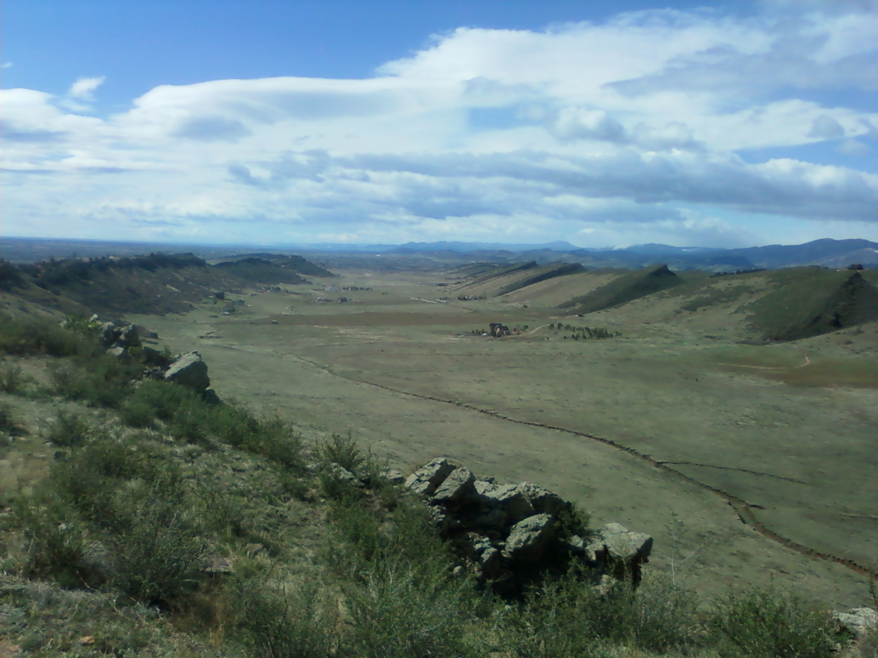
Appropriate Scales: Landscape Analysis Units
Landscape Assessment Tools and Processes Corvallis, OR April 23, 2013
Ayn Shlisky, USFS Eastside Restoration Strategy
Jane Kertis, USFS NW Oregon Ecology Program

Slide 2
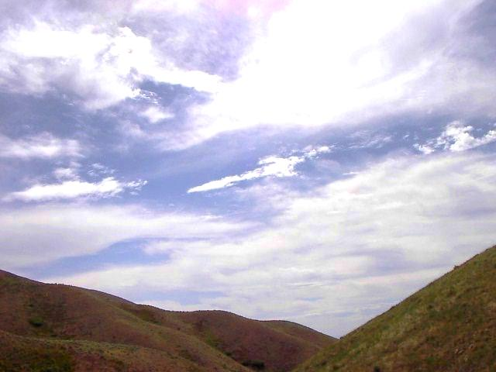
Objective
Provide a foundation for greater understanding of scales of analysis
Catalyze discussions of scale during workshop presentations and future applications

Slide 3
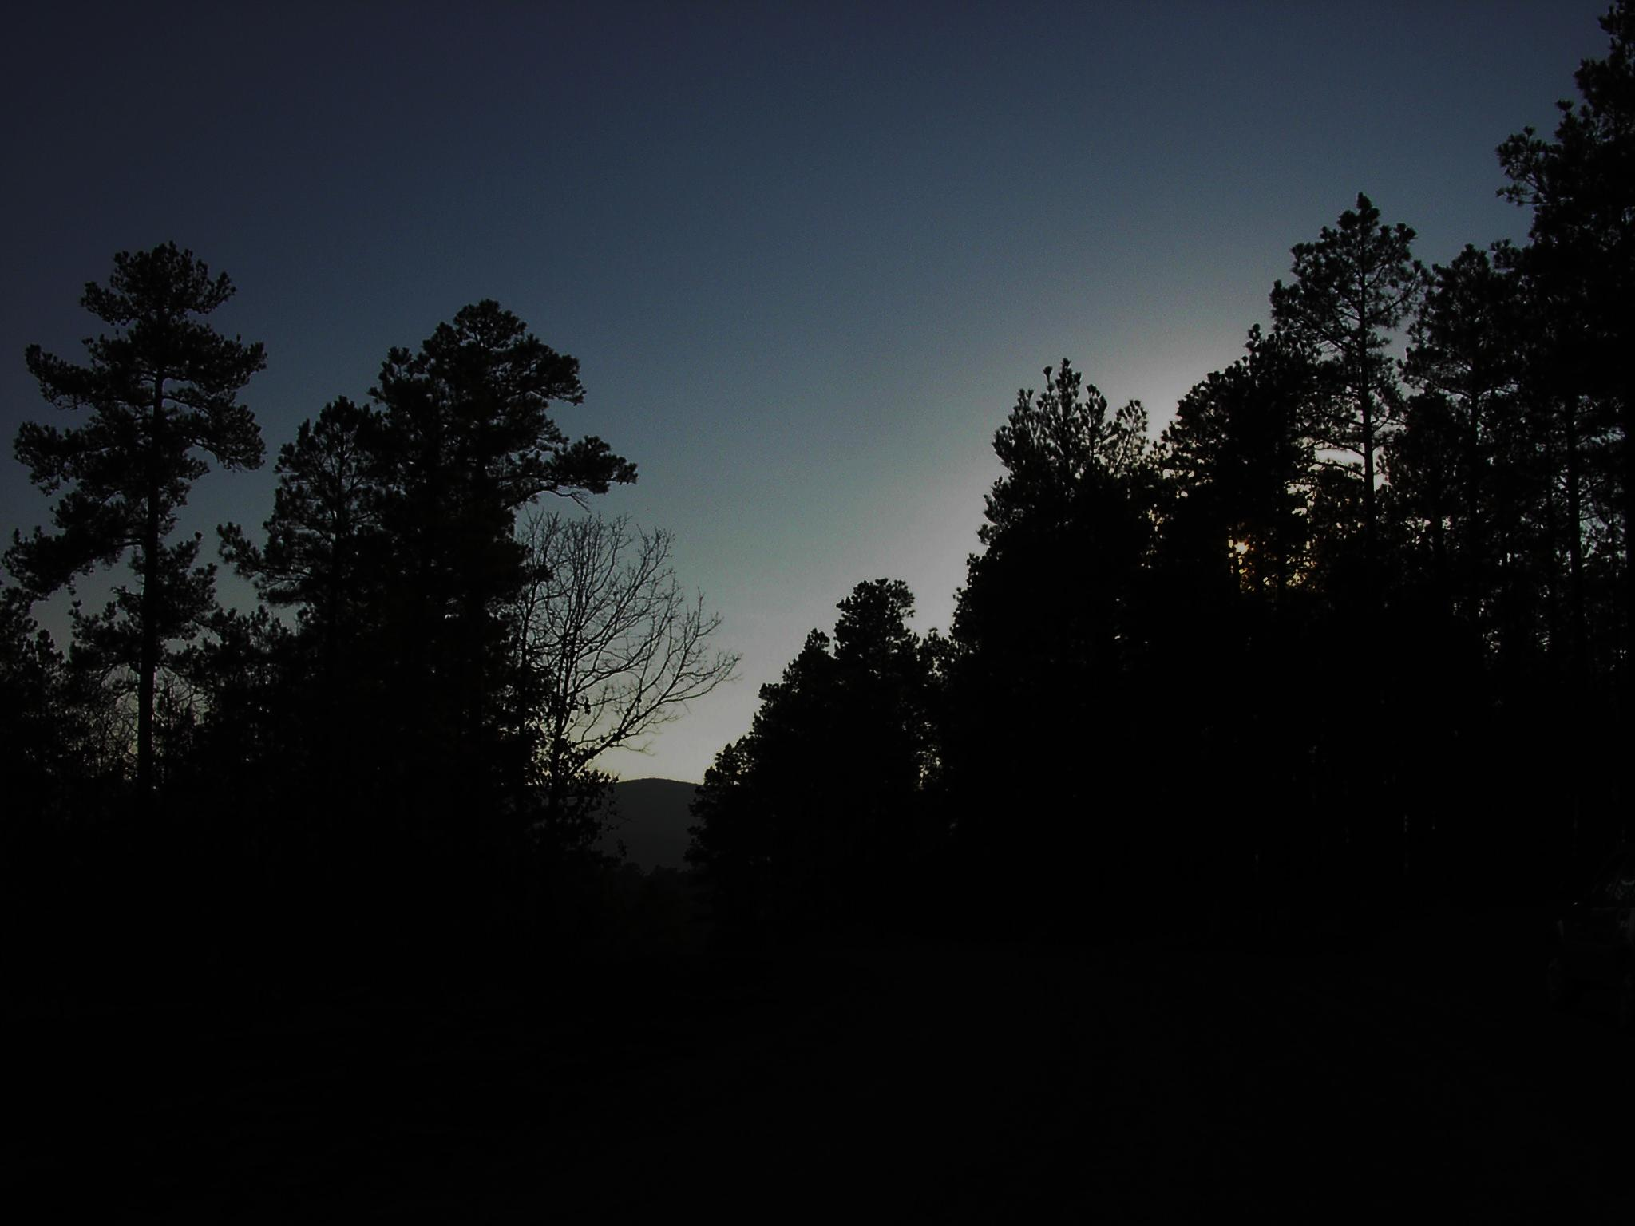
Outline
What are “analysis units” and why do we care?
Considerations when defining analysis unit scale
Applications

Slide 4
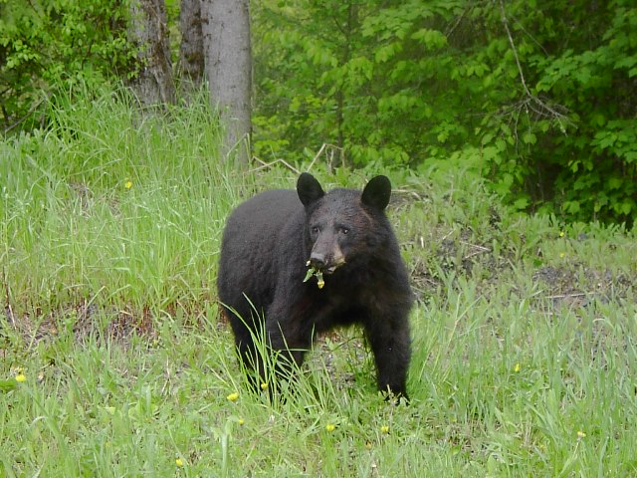
How do we usually address a question?

Slide 5
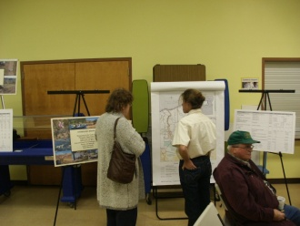
Our analysis units were determined using this simple equation:
Amfsª÷ [Bda^{b} * Cdr^{c}]+(cos Dsdfs^{d} ÷ [Eda^{e} *Fdr^{f}])+(sin Gmis^{g}÷ [Hda^{h} * Idr^{i}])+Jsdis^{j}
∑Ktr^{k} ÷[Lda^{l} * Mdr^{m}] * ∏ * {Nc^{n} ÷[Odaº * Pdr^{p}]} + Qtr^{q} ÷[Rda^{r} * Sdr^{s}] * Tg^{t}
Where:
Yg^{x} = geomorphology
Yc^{x} = climate
Yda^{x} = data accuracy factor
Ydr^{x} = data resolution factor
a-w = respective weight exponents
A-V = respective weight coefficient
Ymfs^{x} = fire size
Ysdfs^{x} = fire size variation
Ymis^{x} = insect mortality
Ysdis^{x} = insect variation
Ys^{x} = soils
Yv^{x} = vegetation
Ytr^{x} = topographical roughness

Slide 6
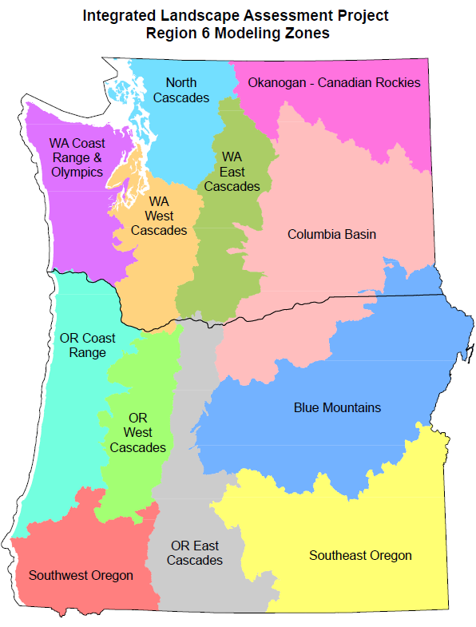
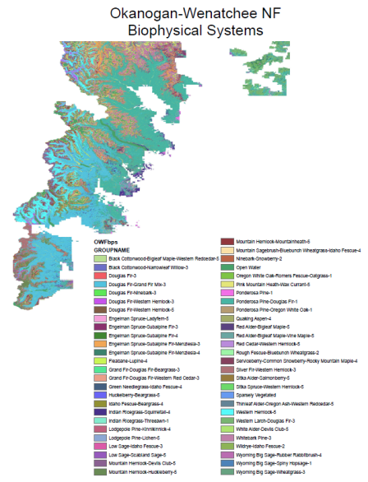
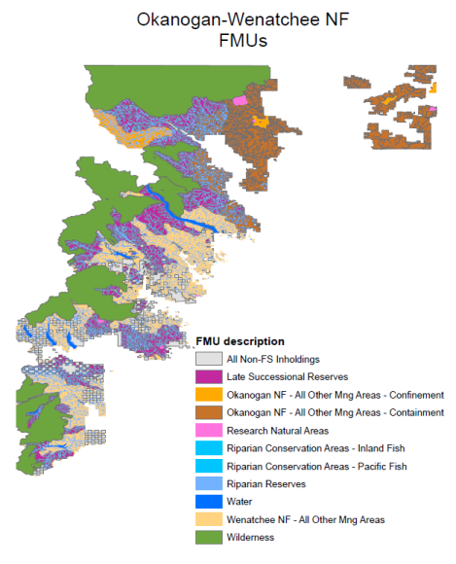
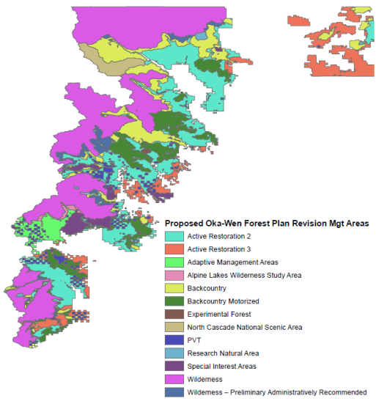
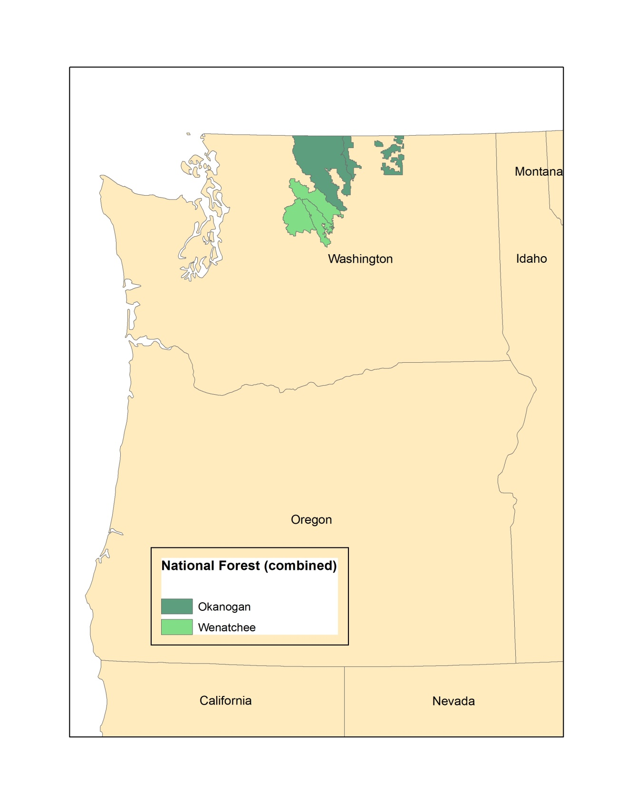
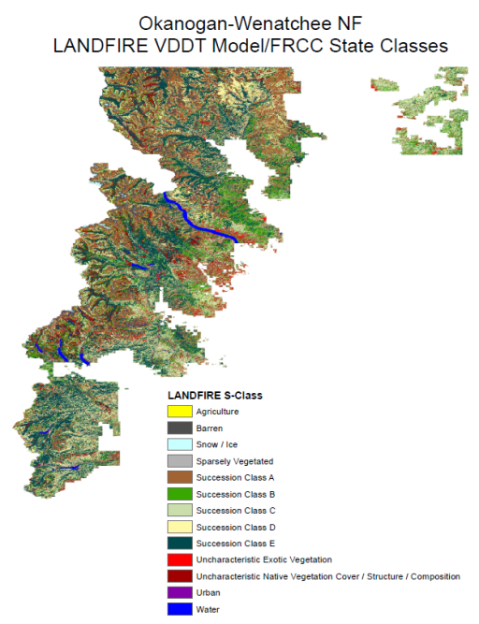
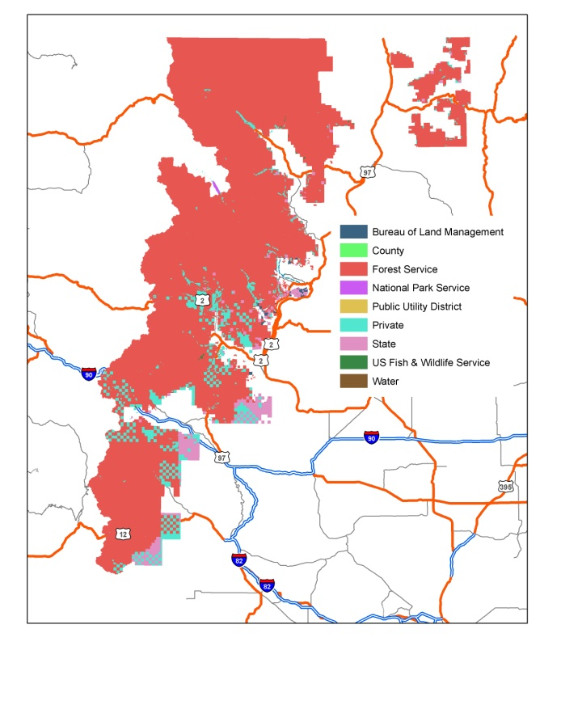
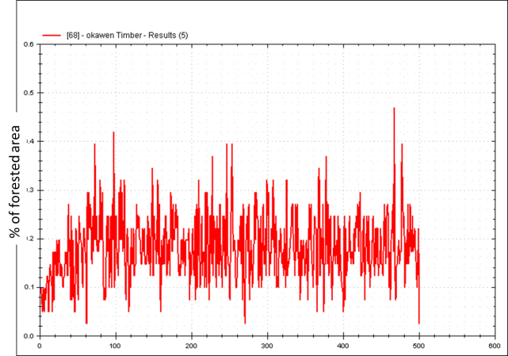
What is an analysis unit?
Basic unit of observation within the analysis extent
Sets context for smaller scales
Foundation for detecting differences in conditions

Slide 7
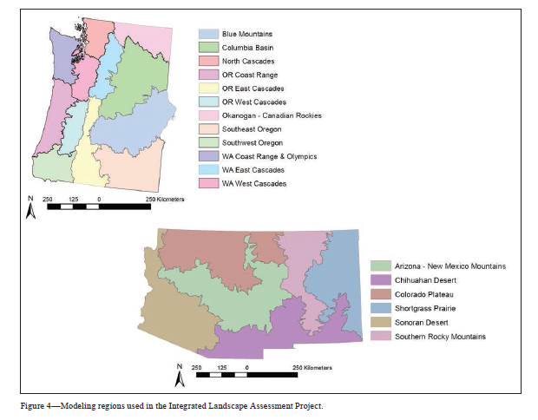
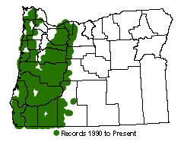


What are analysis units and why do we care?
Analysis units:
Constrain variation of data and information
Can introduce bias relative to issues of interest
Create foundations for future applications and monitoring
Miles Hemstrom et al. 2012. The ILAP Project. In:
Northern spotted owl occurrence

Slide 8
Analysis Unit
Summary Unit
Basic unit of observation within the analysis extent
Sets context for smaller scales
Foundation for detecting differences in conditions
Basic unit of interest
Sets context for taking action
Can vary summarization boundaries with same analysis results

Slide 9


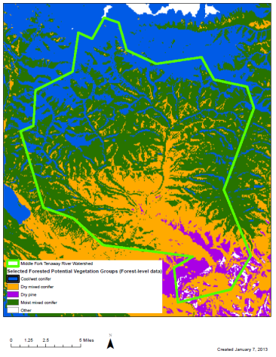
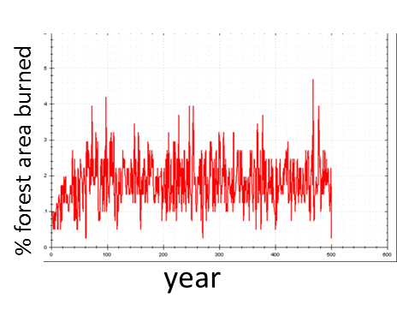
Analysis Unit
Summary Unit
Primary driving forces
Primary applications of information

Slide 10
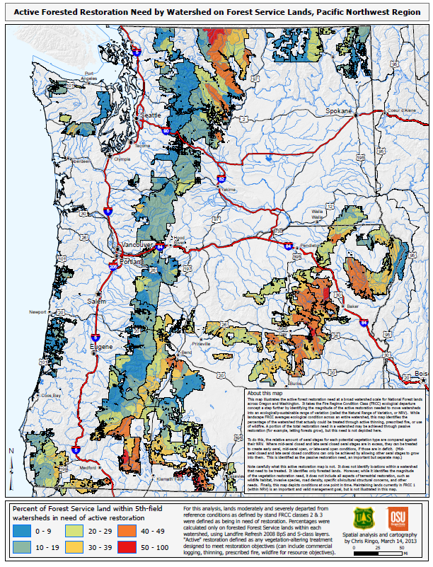
Considerations when defining analysis units
Scale (extent and resolution)
Issues
Project extent
Variation
Spatial
Temporal
Opportunities for integration
Facilitates
Hinders
Reference
Certainty and uncertainty
People and data
From: Beck, Crim, DeMeo, Mellen-McClean, Ringo, Shlisky. April 2013 USFS R6 Restoration needs assessment.

Slide 11
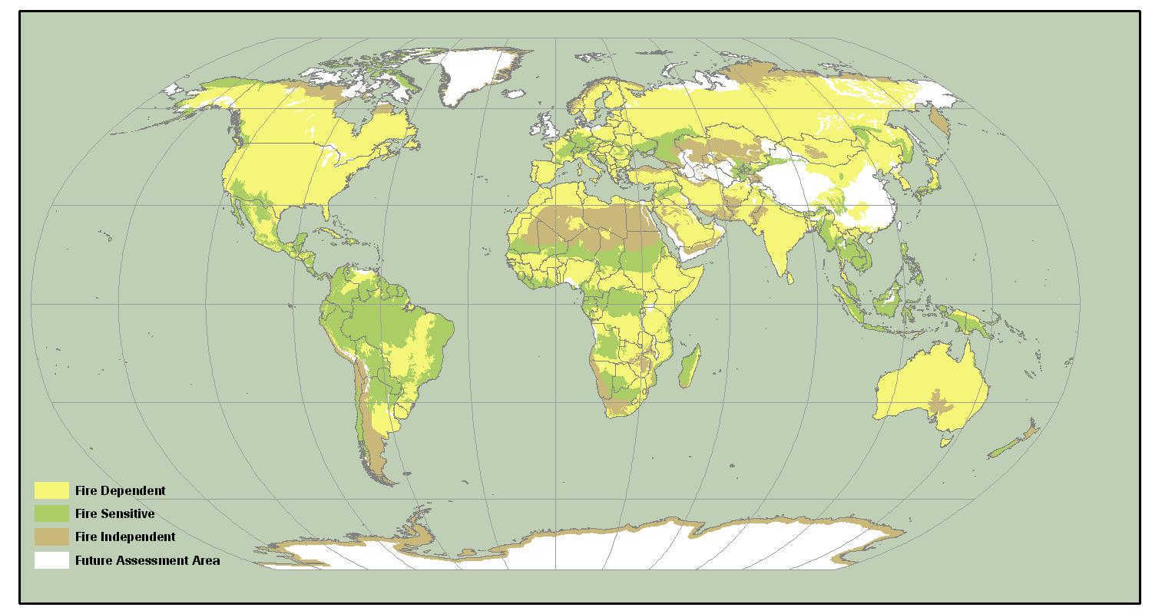
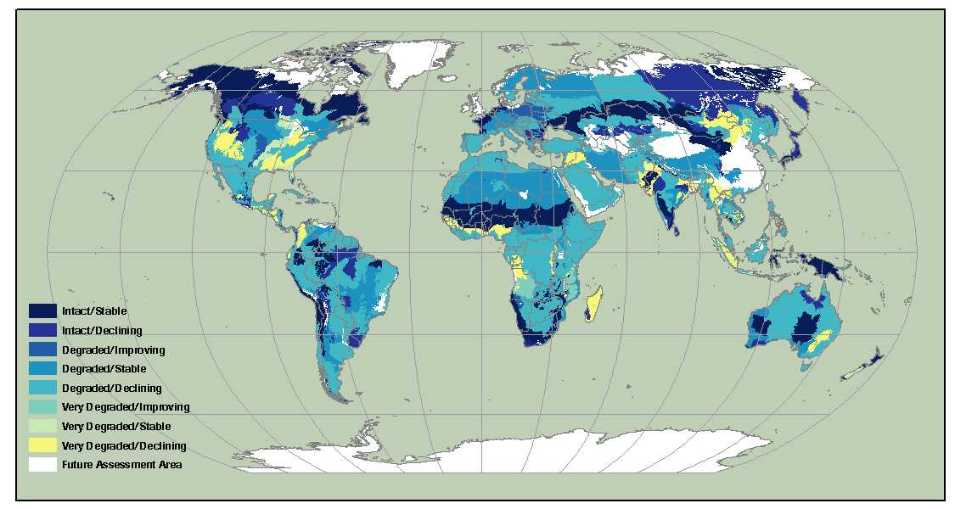
Scale of analysis unit and extent depends on the issue and the expected project application
Global Fire Assessment
Goal to foster ecologically-based fire management policies
Context for country/multilateral applications
Ecoregions integrate fire regimes and vegetation, but cross economic and social boundaries
Shlisky, A., J. Waugh, P. Gonzalez, M. Gonzalez, M. Manta, H. Santoso, E. Alvarado, A. Ainuddin Nuruddin, D.A. Rodríguez-Trejo, R. Swaty, D. Schmidt, M. Kaufmann, R. Myers, A. Alencar, F. Kearns, D. Johnson, J. Smith, D. Zollner and W. Fulks. 2007. Fire, Ecosystems and People: Threats and Strategies for Global Biodiversity Conservation. Global Fire Initative Technical Report 2007-2. The Nature Conservancy. Arlington, VA.
Notes:
This is a global assessment of fire regime types and conditions. The goal was to develop an ecologically-based assessment to improve ecologically- and socially appropriate multi-lateral to country-level fire management policy. The best available ecological unit was TNC Ecoregion, which is available globally.

Slide 12
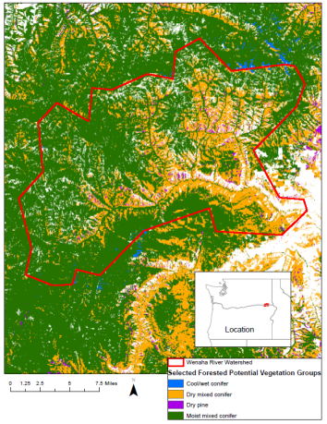
Scale of issue and the expected project application
Project scale
Analysis units:
4, 5 and 6th field watersheds
Potential Natural Veg
HRV reference
Summary units:
5th field watersheds
National Forest
Reserve vs Non-reserve status
Beck, Crim, DeMeo, Mellen-McClean, Ringo, Shlisky. April 2013 USFS R6 Restoration needs assessment.
Notes:
What are the relative active restoration needs at the level of between-project prioritization and planning? How can resources be strategically deployed to address active forest structure restoration needs within and across NFs and regions? Can a process be developed that is replicable across the U.S.?

Slide 13
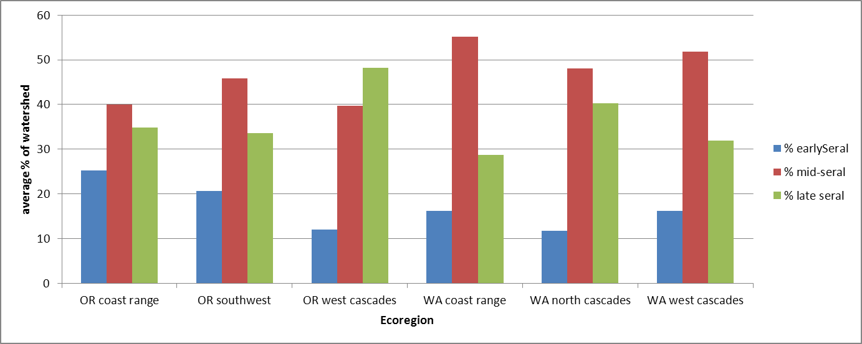
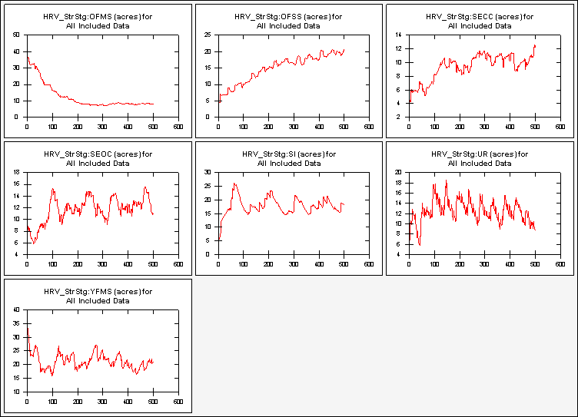
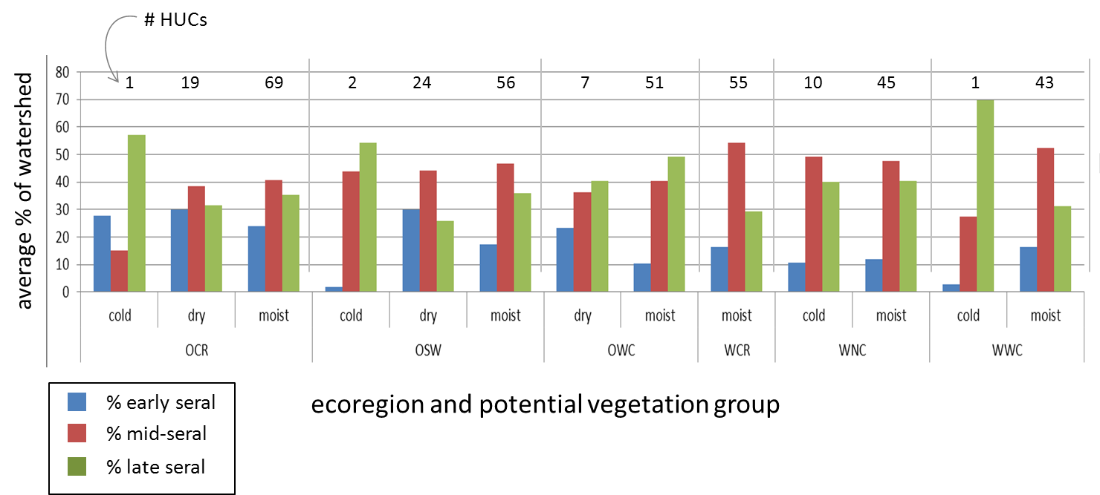
Analysis units define the level of spatial and temporal variation
ecoregion
early
late seral
% of landscape in forest structural stages over time
mid-seral

Slide 14
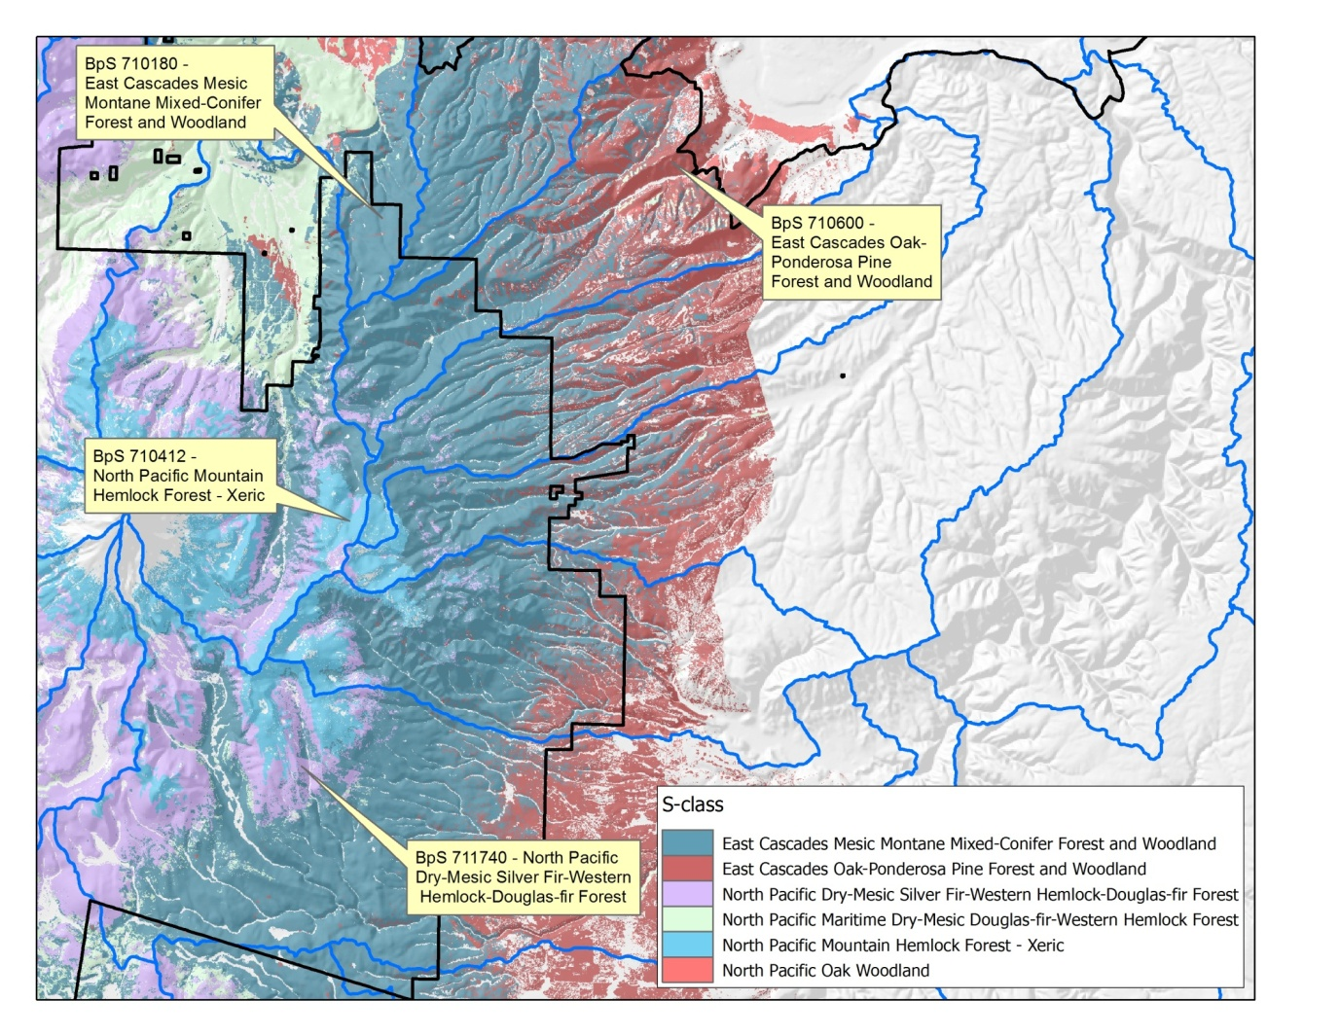
Integration
5th field watershed
slivers and bits
Alternative:
Terrestrial hierarchy (ecoregions/landtype associations)
Biophysical System

Slide 15
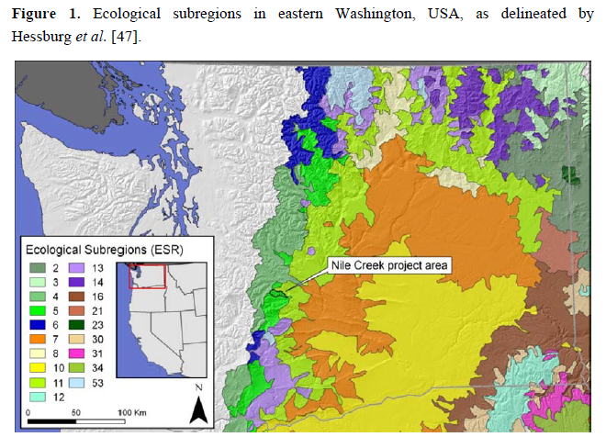
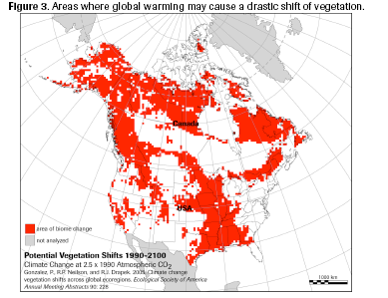
Certainty/Uncertainty
Biophysical
System
Hessburg et al. 2013. Landscape evaluation for restoration planning on the Okanogan-Wenatchee National Forest, USA. Sustainability. 5, p. 805-840.
Notes:
If potential natural vegetation is a key attribute to delineate analysis units, how will climate change impact trend analyses?

Slide 16
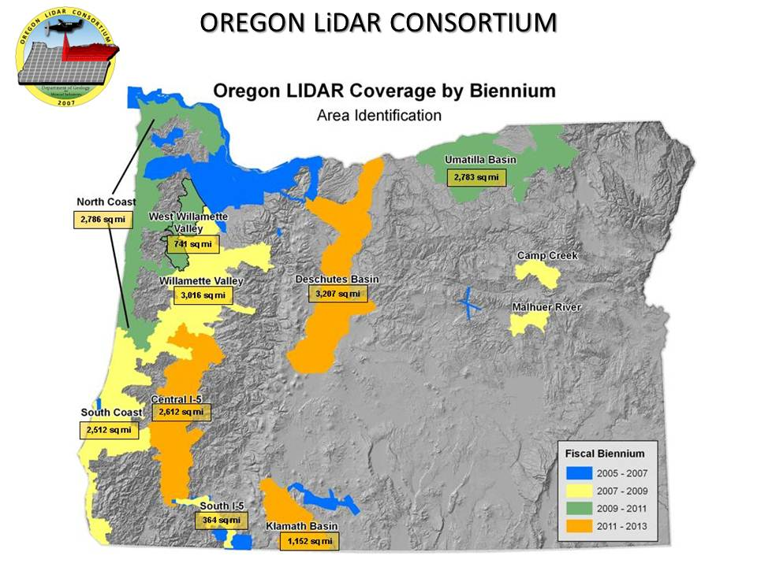
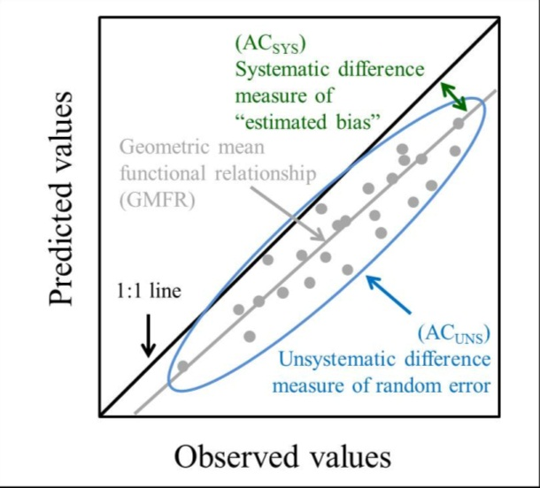
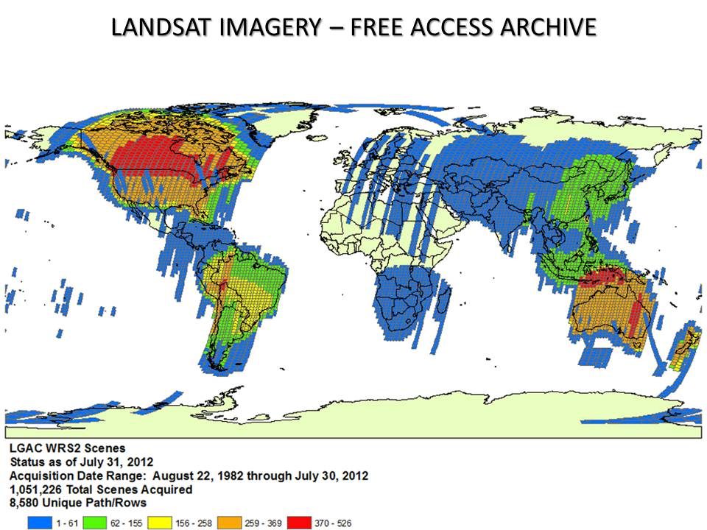
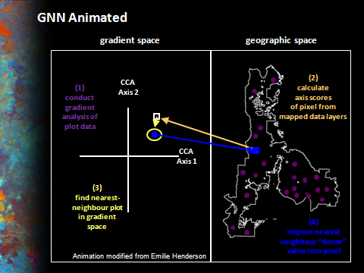
What data is available, at what resolution? Is it worth creating data?

Slide 17
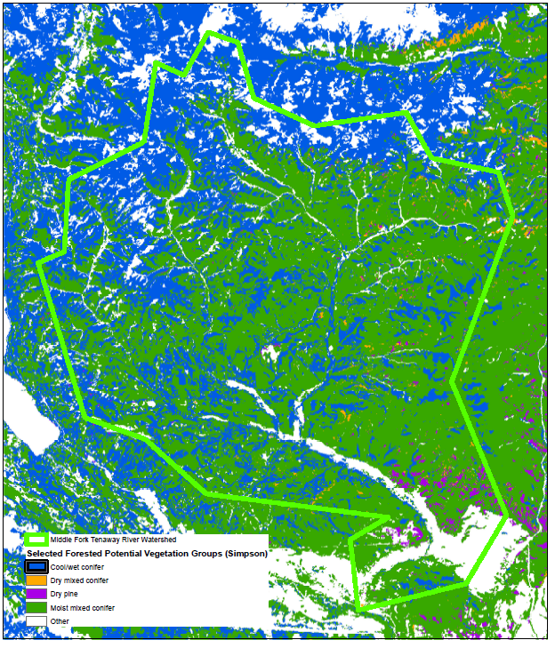
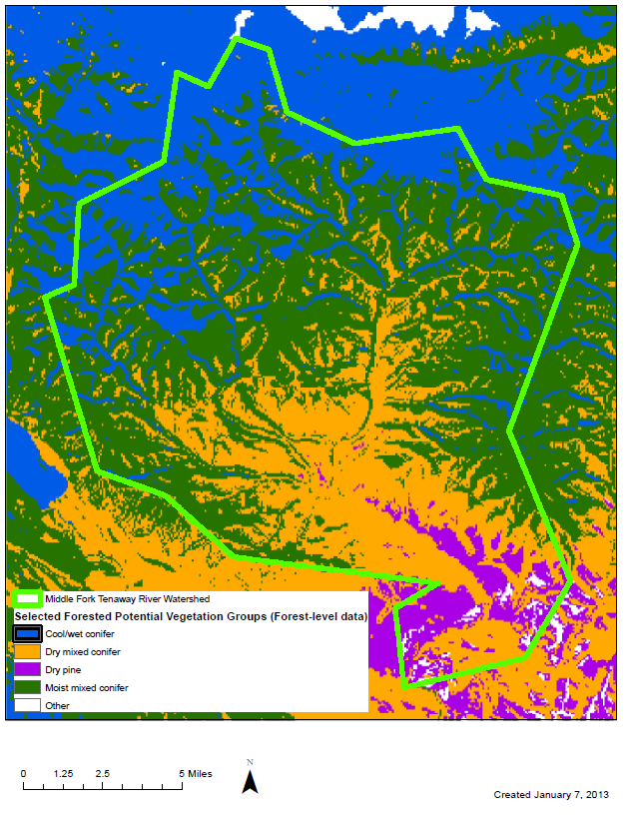
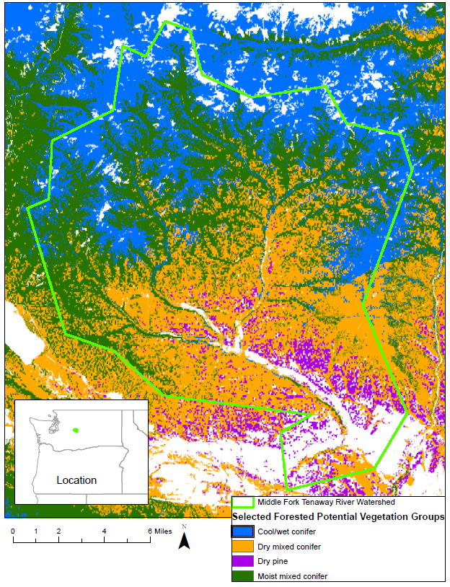
What biases are inherent in the data? Do some data sets have greater buy-in? Is there a need for consistency between assessments?
ILAP
3 Potential vegetation maps (Middle Fork Tenaway watershed, WA)

Slide 18

Lumpers versus Splitters

Slide 19

Summary
Scale should reflect the primary drivers of the systems assessed, key issues of interest, and their applications.
Analysis units should be designed to capture spatial and temporal variation important for context.
Opportunities for integration can be built into the design of analysis units, summary units, or both.
Reference conditions may influence analysis scale.
Certainty can help identify key variables; uncertainty can help identify greater needs for flexibility.
The people involved and data available are often the most important reason for analysis scale decisions.

