Slide 1
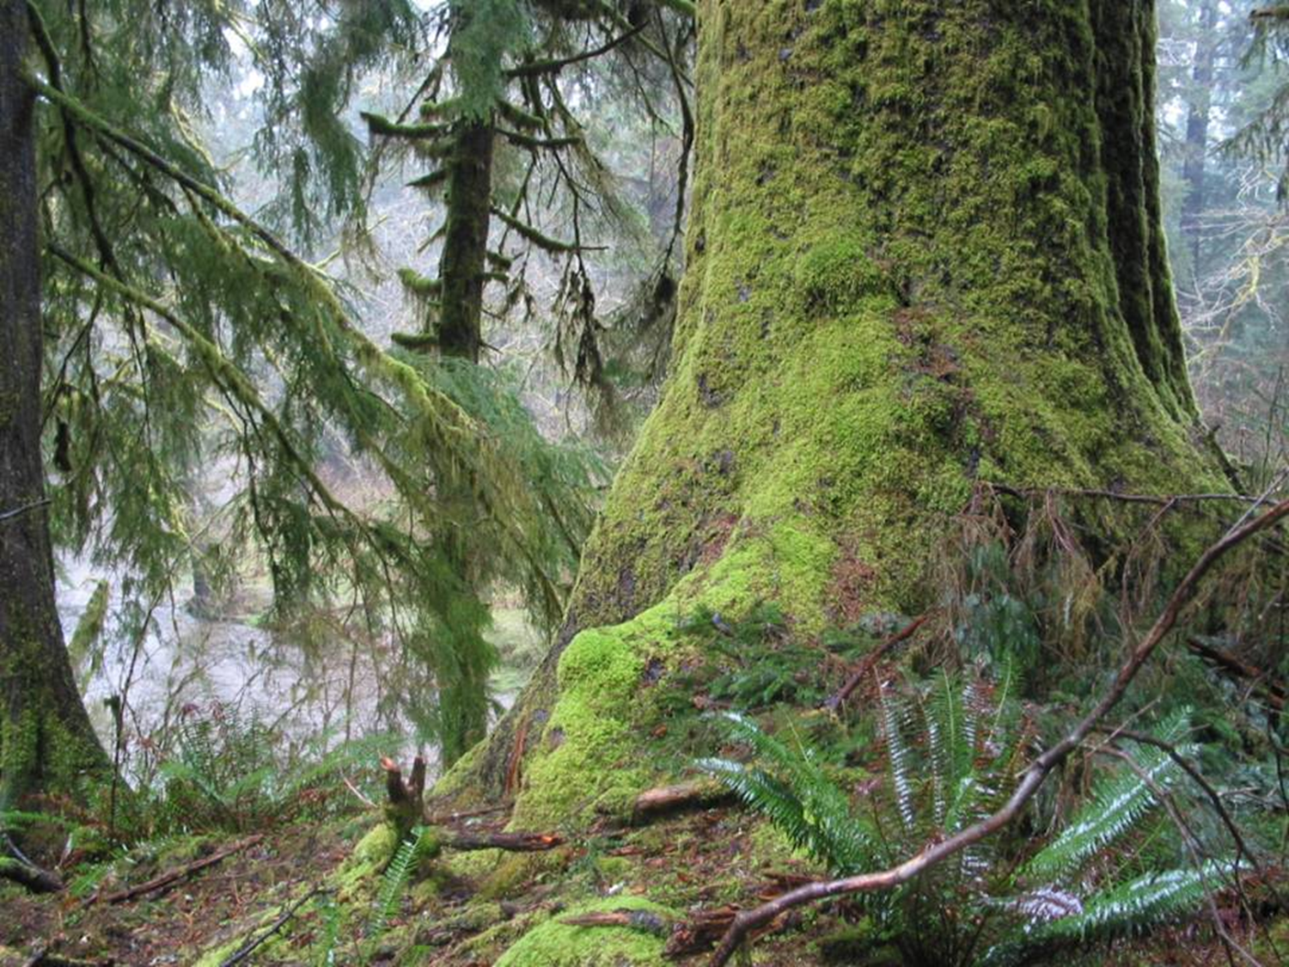
Thinning in Oregon’s Coast Range to Meet ACS Objectives

Slide 2
Overview
Siuslaw National Forest context
Commercial Thinning Buffers
Streamside Management to Restore Large Conifers
Notes:
In this talk I’m going to tell you (1) a bit about the conditions in the coast range and on the Siuslaw NF and what makes us different from the Cascades and other points east, (2) briefly go into what size buffers we recommend for commercial timber harvest on NF lands, and (3) talk a little more in depth about how we attempt to deal with a challenge relatively unique to some of our coast range systems of extensive alder stands.

Slide 3
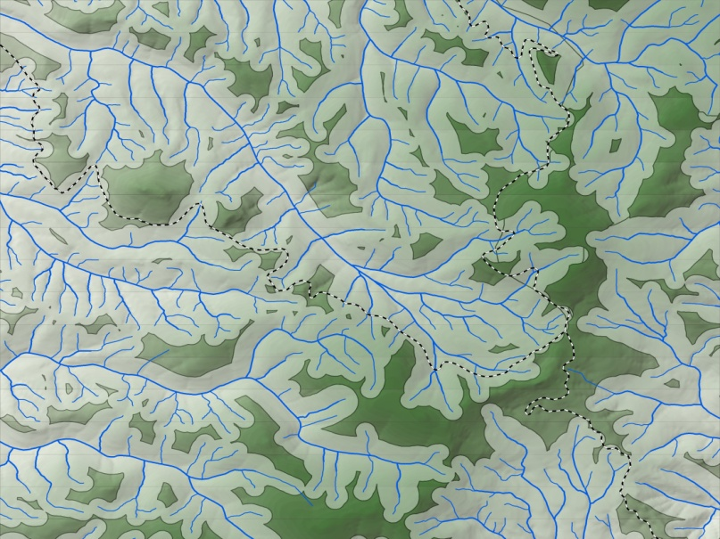
Siuslaw National Forest Land Allocations
80 to 90% - Riparian Reserves
within 520’ of fish-bearing streams,
within 260’ of non-fish-bearing streams
varying widths on other wetlands
73% - Late Successional Reserves
31% - Adaptive Management Area
9.6% -Congressionally Reserved Areas
3.2% - Matrix – (scattered in ridge top stands
<10 acres in size)
Notes:
Based on Northwest Forest Plan land allocations as determined in the June 15, 1995 Siuslaw N.F. PSQ revision letter and the January 1998 Late Successional Reserve Assessment for Oregon’s NCRAMA
The Coast Range and SNF have a very high stream density and large site potential trees, as a result, most of the Forest is included in Riparian Reserves designated in the NW Forest Plan, in addition ¾ of the land is designated as Late Successional Reserves.
Only 3% of the land base is considered “matrix” where timber production is a primary function and these areas are too small and scattered that to be managed as such. Therefore, the entire Forest is managed for Riparian and Late Successional Objectives.

Slide 4
Objectives for Siuslaw National Forest Lands
Protect and enhance old-growth forest conditions
Manage lands to achieve Aquatic Conservation Strategy objectives
Notes:
NW Forest Plan ROD p.8 and Standards and Guides p.B-11
Simply – to put our Forest stands on a trajectory to develop old growth characteristics
Specifically:
*Maintain/enhance tree growth (40+ inch DBH)
*Encourage development of multi-layer canopy
*Encourage appropriate species mix
*Encourage development of large limbs, large trees with broken or forked tops, and cavities
*Maintain understory shrubs and forbs
*Encourage development of large snags (16+ feet tall & 20+ inch DBH) and large down wood (32+ inch diameter & 20+ feet long)
And from the ACS:
*Everything I just mentioned – to improve species composition and structural diversity of plant communities
*Maintain shade on streams to protect stream temperatures
*Implement Best Management Practices for yarding/skidding and road maintenance/ construction to protect physical integrity of streams and prevent sedimentation

Slide 5
Siuslaw NF Conditions
Extremely high stream density
ESA listed fish in all stream systems
Historic large wood in streams and riparian areas largely gone
Different forest trajectories in certain stand types (e.g., alder/salmonberry)
About 1/3 of Forest lands previously harvested
Notes:
The Coast Range and Siuslaw NF are pretty different from the Cascades and other drier Forests
Last bullet – 200,000 acres of plantations

Slide 6
Siuslaw National Forest High Priority Stands for Thinning
Young, managed stands (past clearcuts)
Managed stands planted with off-site stock
Alder dominated stands
Notes:
(1) Young, managed stands that developed from past clear-cuts (generally 25 – 60 years old, often dominated by a single tree species)
(2) Young, managed stands that were planted with off-site stock (generally 60 – 100 years old, Douglas-fir dominated stands)
(3) Alder dominated stands that regenerated in areas that would naturally be conifer dominated
Best example of #s 2 and 3 is Mt. Hebo where “pioneer-generated” fires burned the same area 3 times (1851, 1890, & 1910 or 1934).
Priorities based on how long & how far removed we think these types of stands are from achieving LSR objectives.

Slide 7
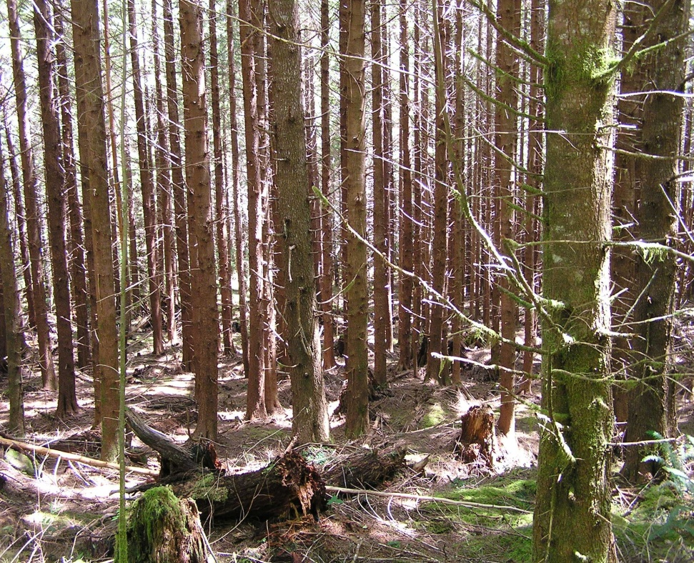
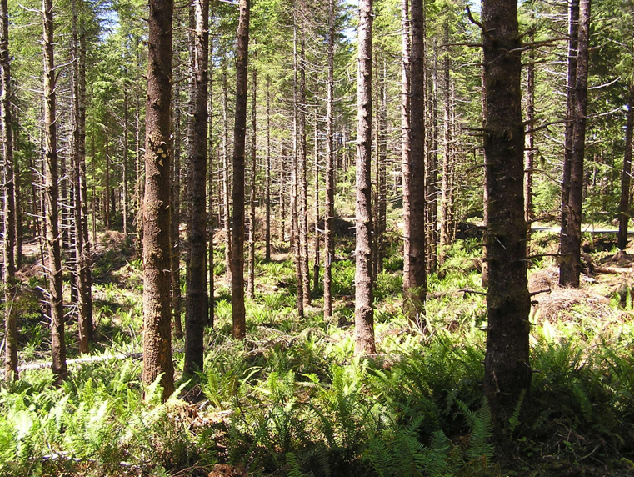
Young Managed Stand Thinning
Post-treatment
Pre-Treatment
Notes:
Typical young managed stand treatment

Slide 8
Recent No-Cut Buffer Widths for Commercial Timber Sales
Perennial Stream - 2 rows of conifers, minimum distance 30 feet
Intermittent Stream– 1 row of conifers, minimum distance 15 feet
Outside of Buffers – Stand thinned from below, down to 50 – 100 trees/acre
Notes:
In a effort to get large trees growing closer to streams to assure that large down wood would be most likely to end up in those streams Siuslaw Fisheries Biologists recommended these treatments to minimize short-term impacts to coho and maximize potential positive long-term effects – IN YOUNG, MANAGED STAND THINNINGS
It’s important to note that these recommendations were developed by our fisheries biologists to help restore riparian conditions and grow large trees near the streams for future instream large wood.
It’s also important to note that these are minimums and in our larger fish-bearing streams, especially lower reaches with coho salmon, there is a hardwood throat between the stream and the plantation. The 2 rows/30’ buffer width starts at the edge of the plantation to retain the 2 closest rows of conifers.
Harvest only occurs in previously clear-cut plantations with the goals to put them on a trajectory to develop old growth characteristics.

Slide 9
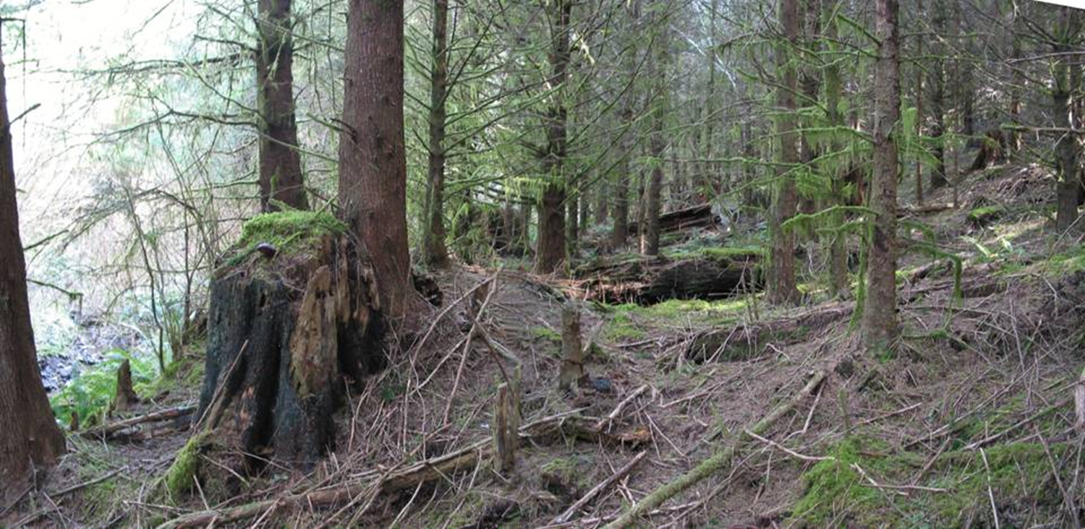
Buffer in Young Stand Thinning
Stream
No Cut Buffer ←|→ Thinned Area
Notes:
This is what a no-cut buffer along a stream looks like in a thinned young, managed stand in an area without an alder throat.

Slide 10
Deciduous Dilemma
How do we address lack of stream-side conifers within buffers in areas where alder and shrubs dominate?
Notes:
In some of our areas, alder is extensive and not on a trajectory to convert back to the low-density, large conifer, mixed hardwood stream side Forests that were there before the human disturbance.

Slide 11
Non-Commercial Thin & Underplant Within Buffers
Fell individual alders and under-plant along entire stream length
Selectively release existing conifers that are already growing under the alder canopy
Cut all alder in ½ to 1-acre patches and plant the opening
Plant existing openings and cut alders along the edge to allow light into the opening
Notes:
We’ve experimented with many different types of thin and under-plant options

Slide 12
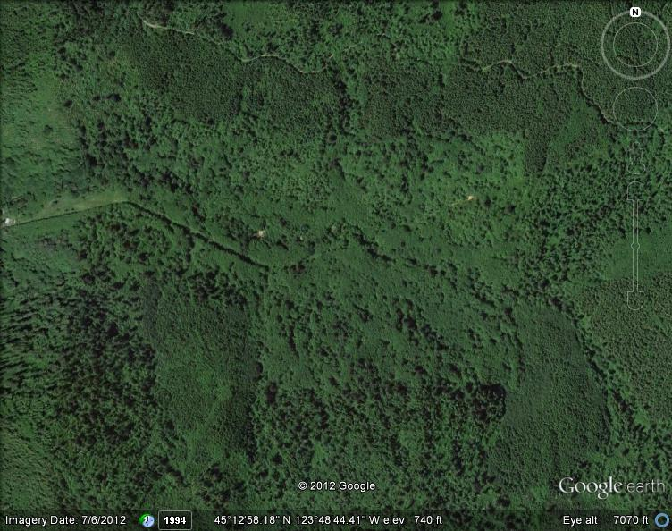
60- to 80-year Old Alder Stand
Notes:
180-acre Cedar Creek alder-dominated stand w/<2 conifer/acre

Slide 13
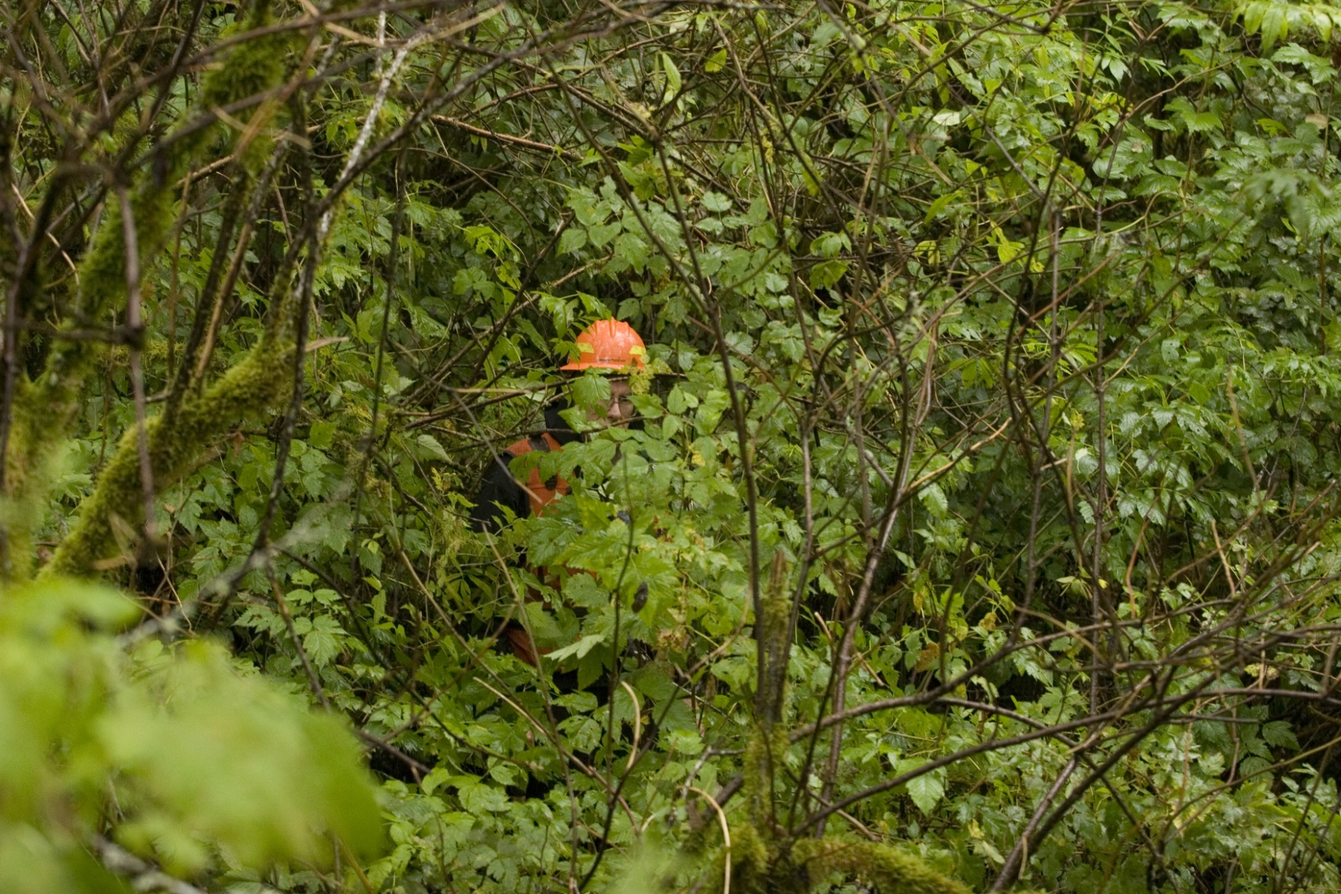
Shrub Layer Beneath Alder Stand
Notes:
Photographer ~60 feet away - note head-high salmonberry and 10+’ tall elderberry. However, note that you can see most of me – shrubs not as dense and vigorous

Slide 14
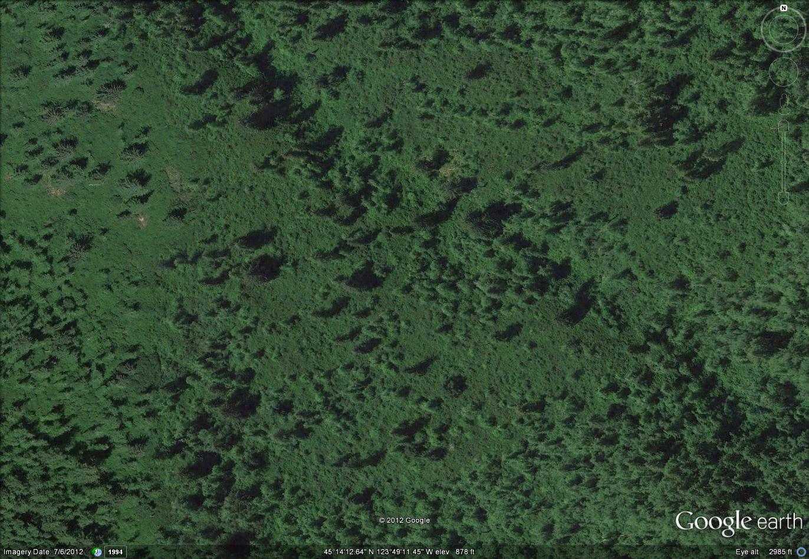
100-year Old Alder Stand
Notes:
120-acre George Creek stand w/less than 2 conifer/acre. Conifers are dark green, Alders are light green

Slide 15
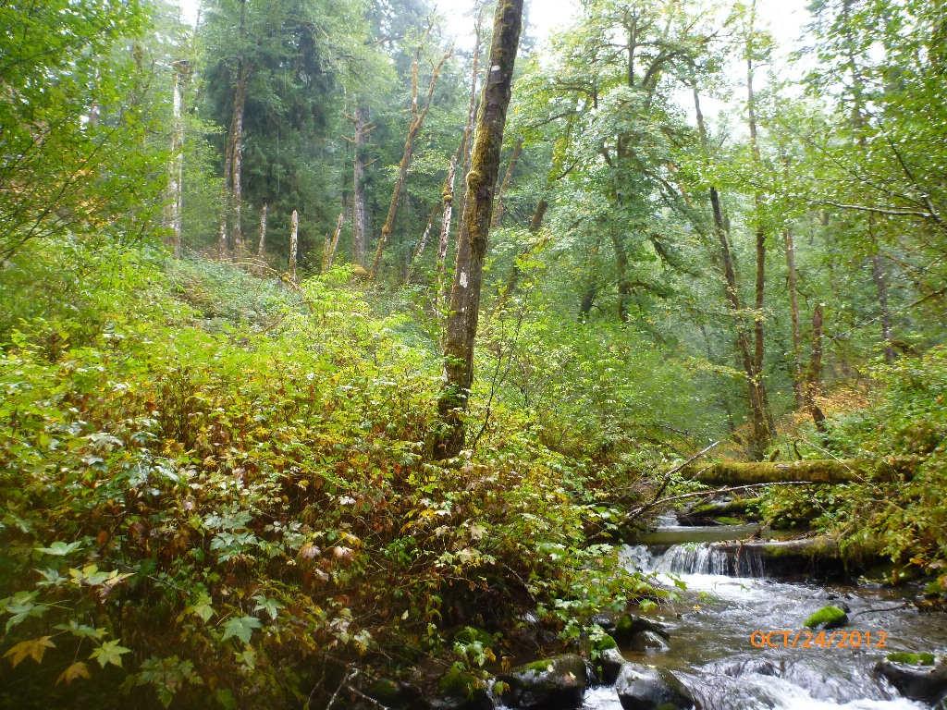
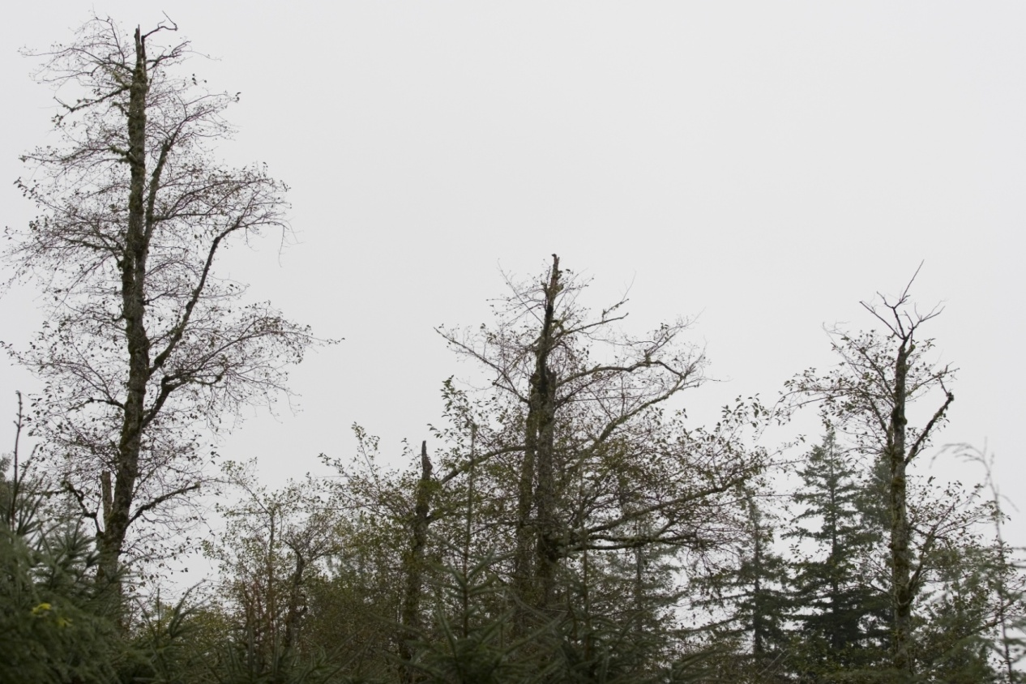
100-year Old Alder Dies Out
Notes:
Senescent alder

Slide 16
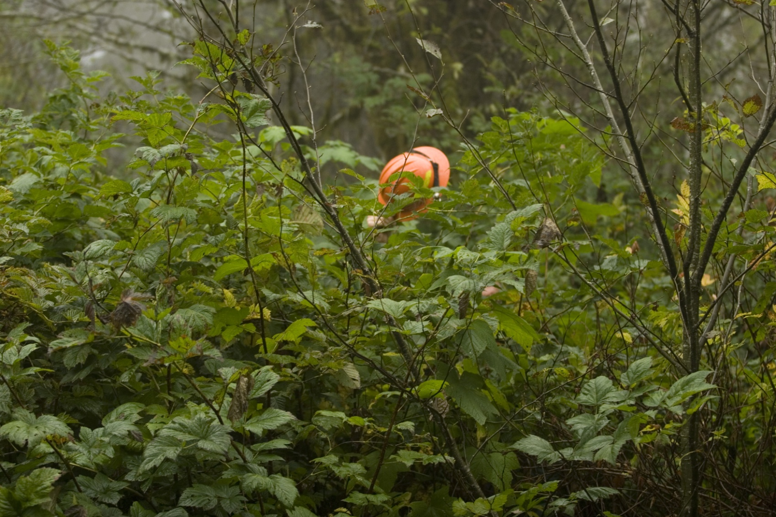
Shrub Layer Beneath Dying Alder
Notes:
Photographer 30 feet away AND I’m standing on a down alder about 20” diameter holding my hardhat as high as I can
(Alder trajectory does not lead to conifer reestablishment)

Slide 17
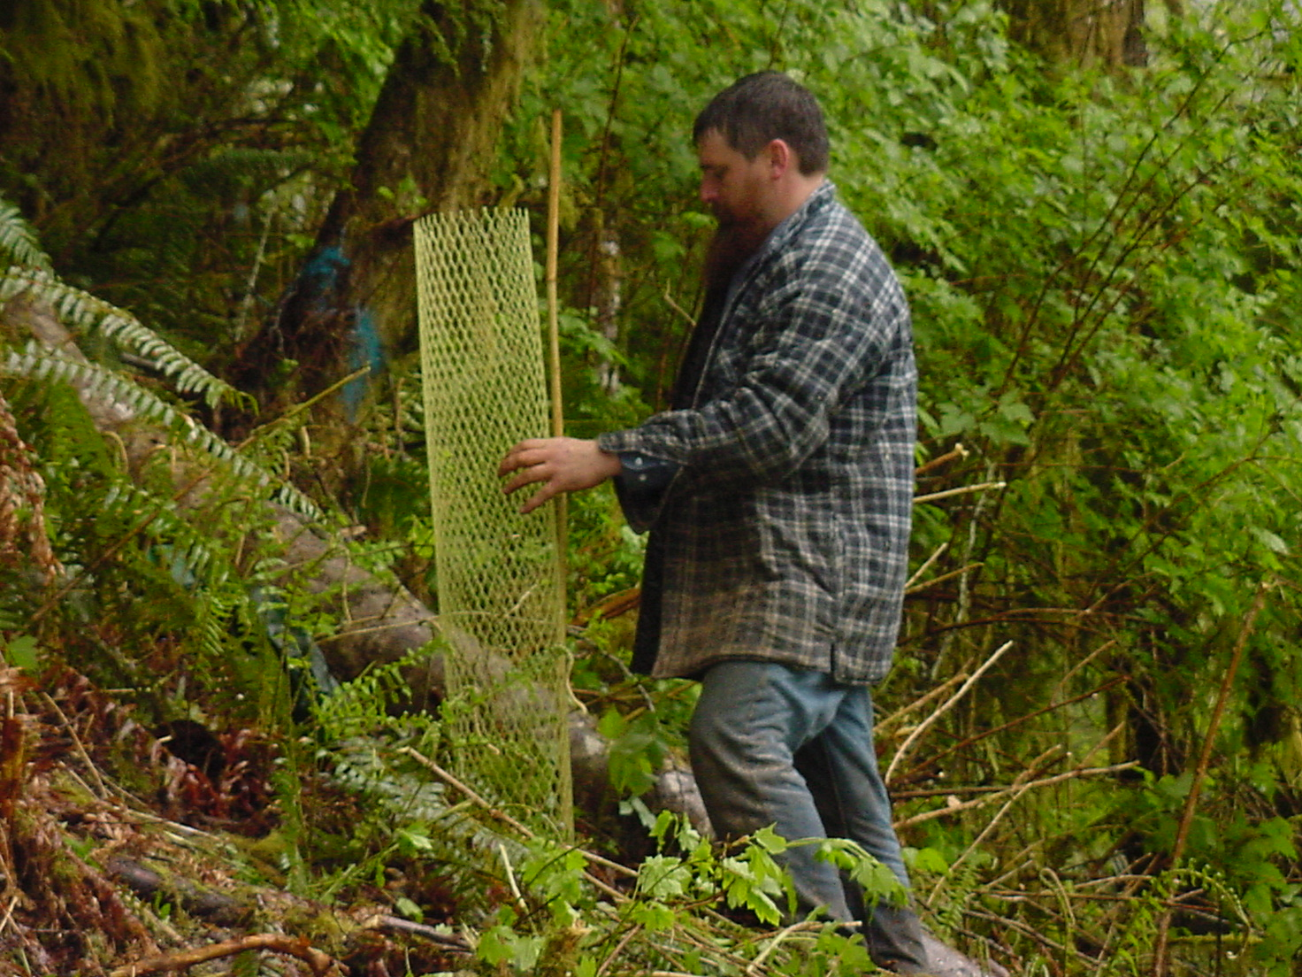
Plant and Thin Project Throughout the Stand
Notes:
Originally, we thinned the alder much like we were doing conifer thinning and then planted through the thinned area. It was really difficult to plant and tube through all of the slash, so we became expert at planting, then felling the alder overstory with limited damage to the newly planted seedlings. Very expensive w/limited success.

Slide 18
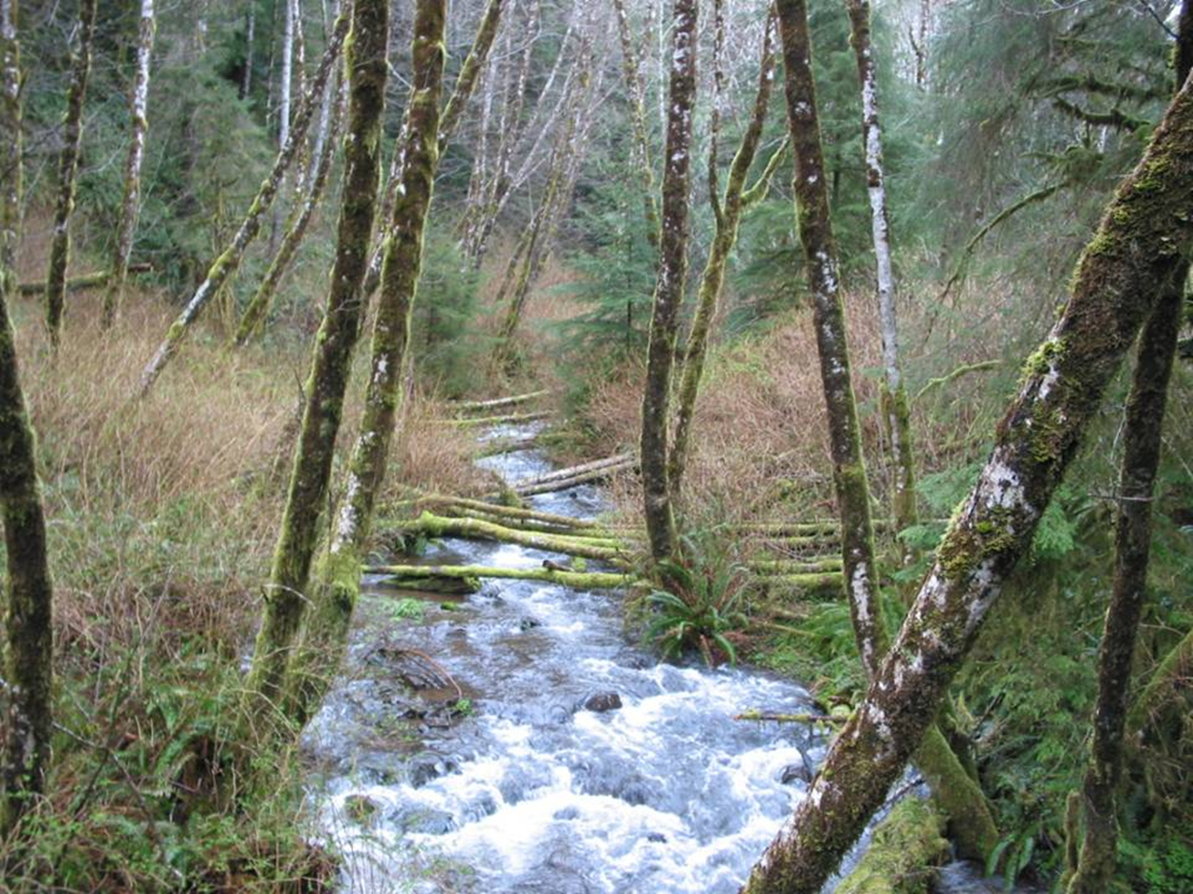
Release Understory Conifer from Alder Overstory
Notes:
Relatively inexpensive and very effective. However, it has limited application.

Slide 19
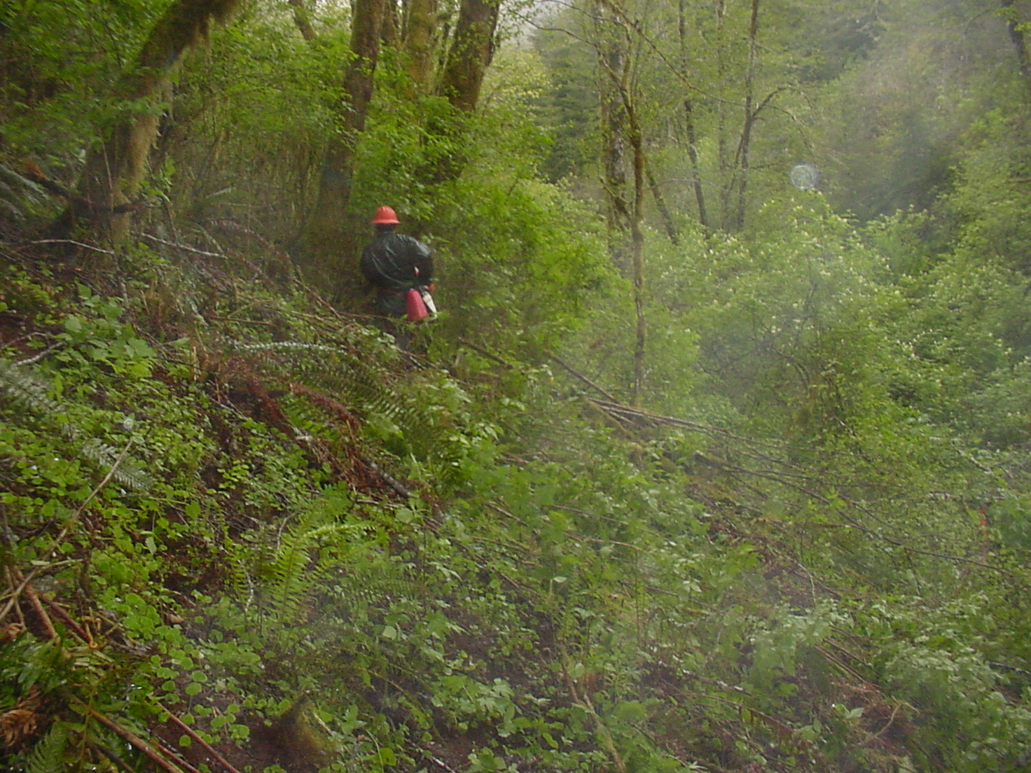
Creating ½-acre Opening
Notes:
An effective, but expensive, method of establishing stream side conifers involves creating then planting ½-acre to 1-acre openings. This is on Moon Creek

Slide 20
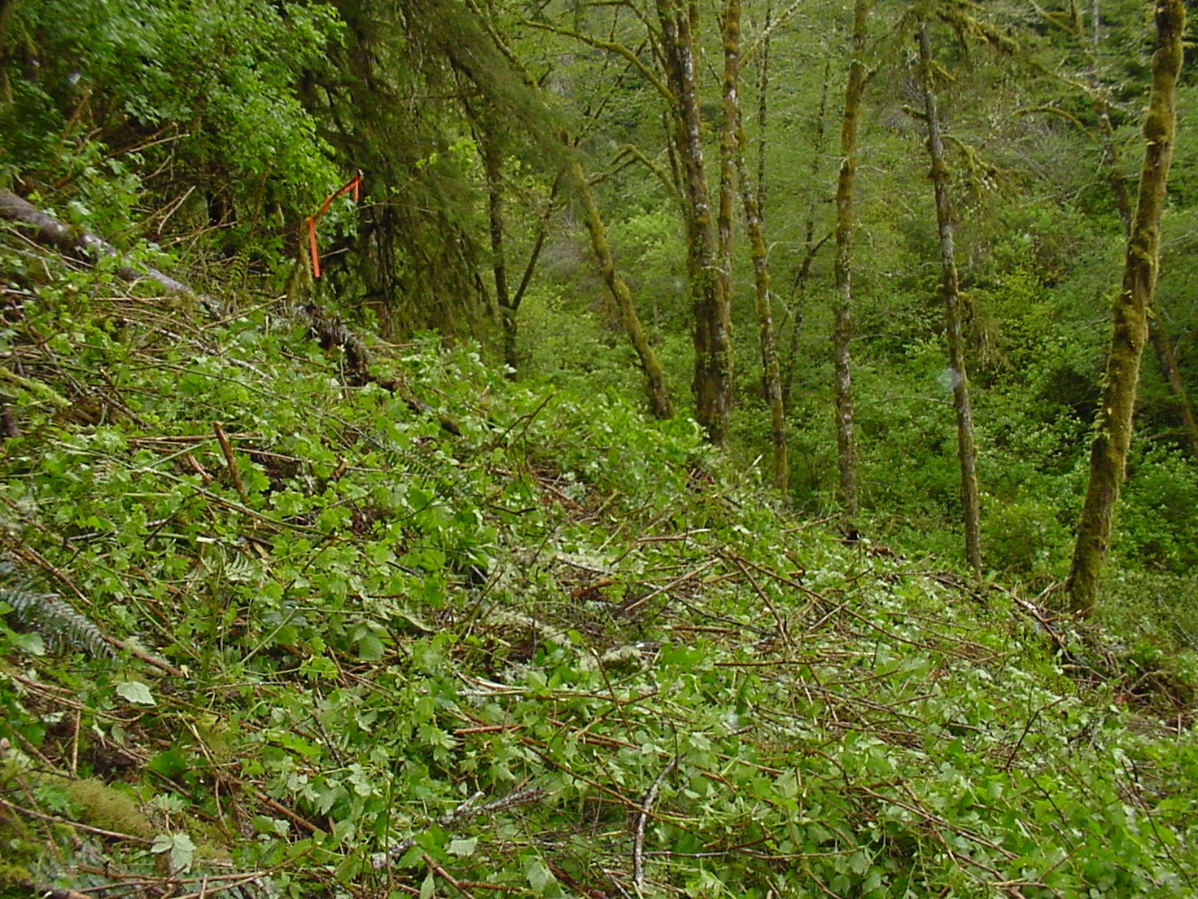
Row of Alder Left Between Opening and Stream
Notes:
To maintain shade on stream

Slide 21
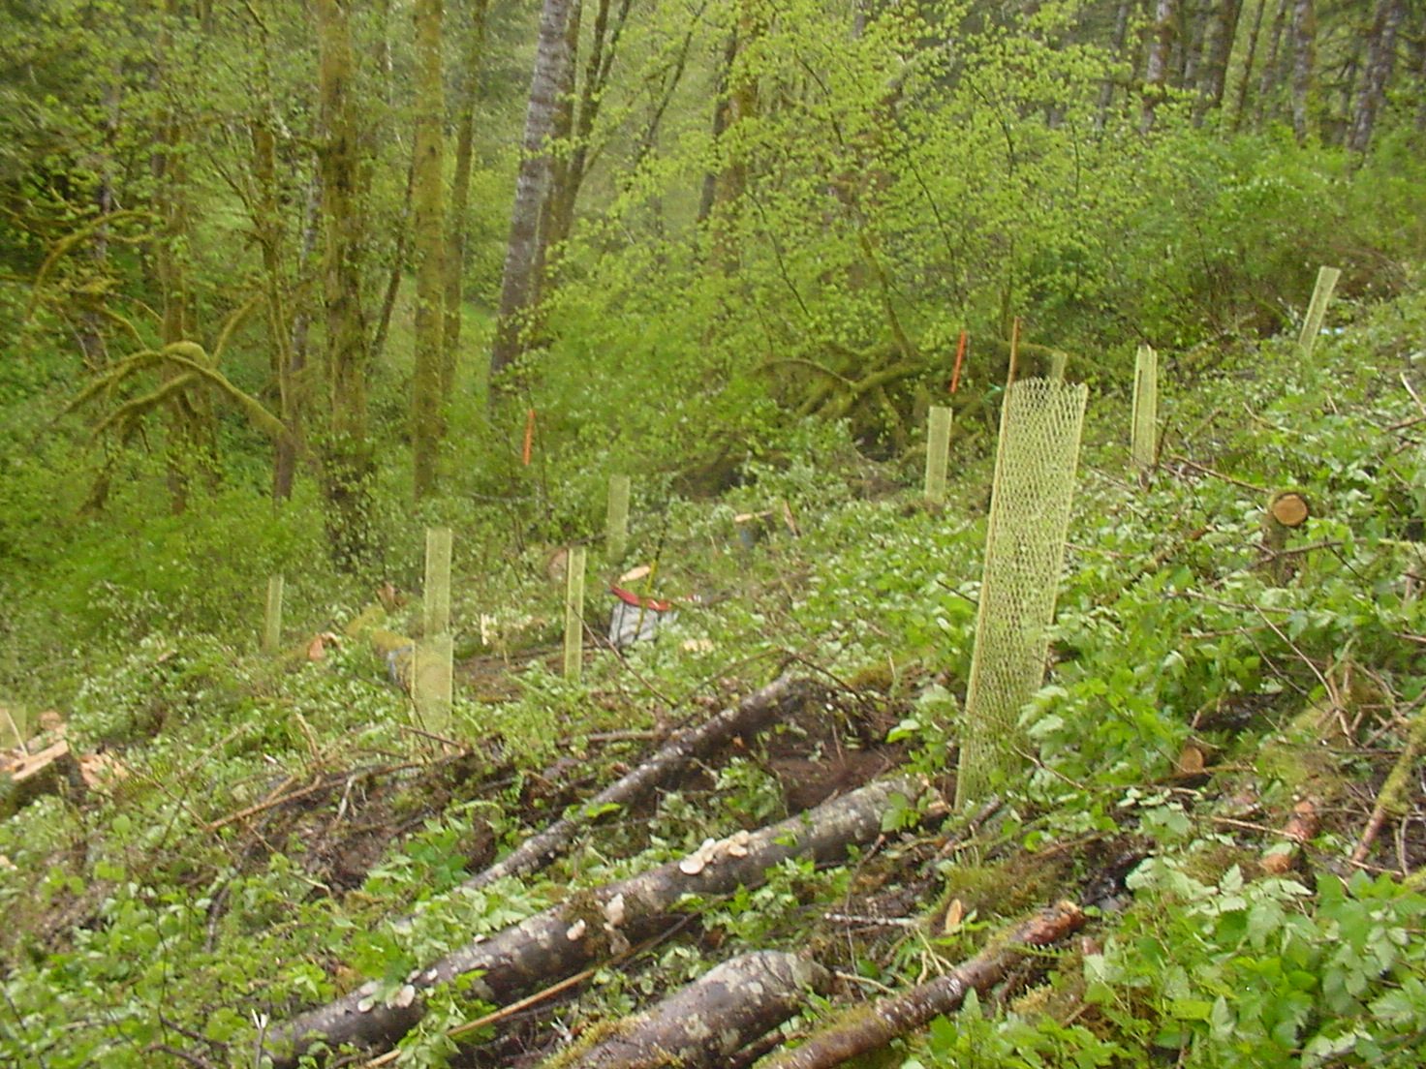
Planted Opening

Slide 22
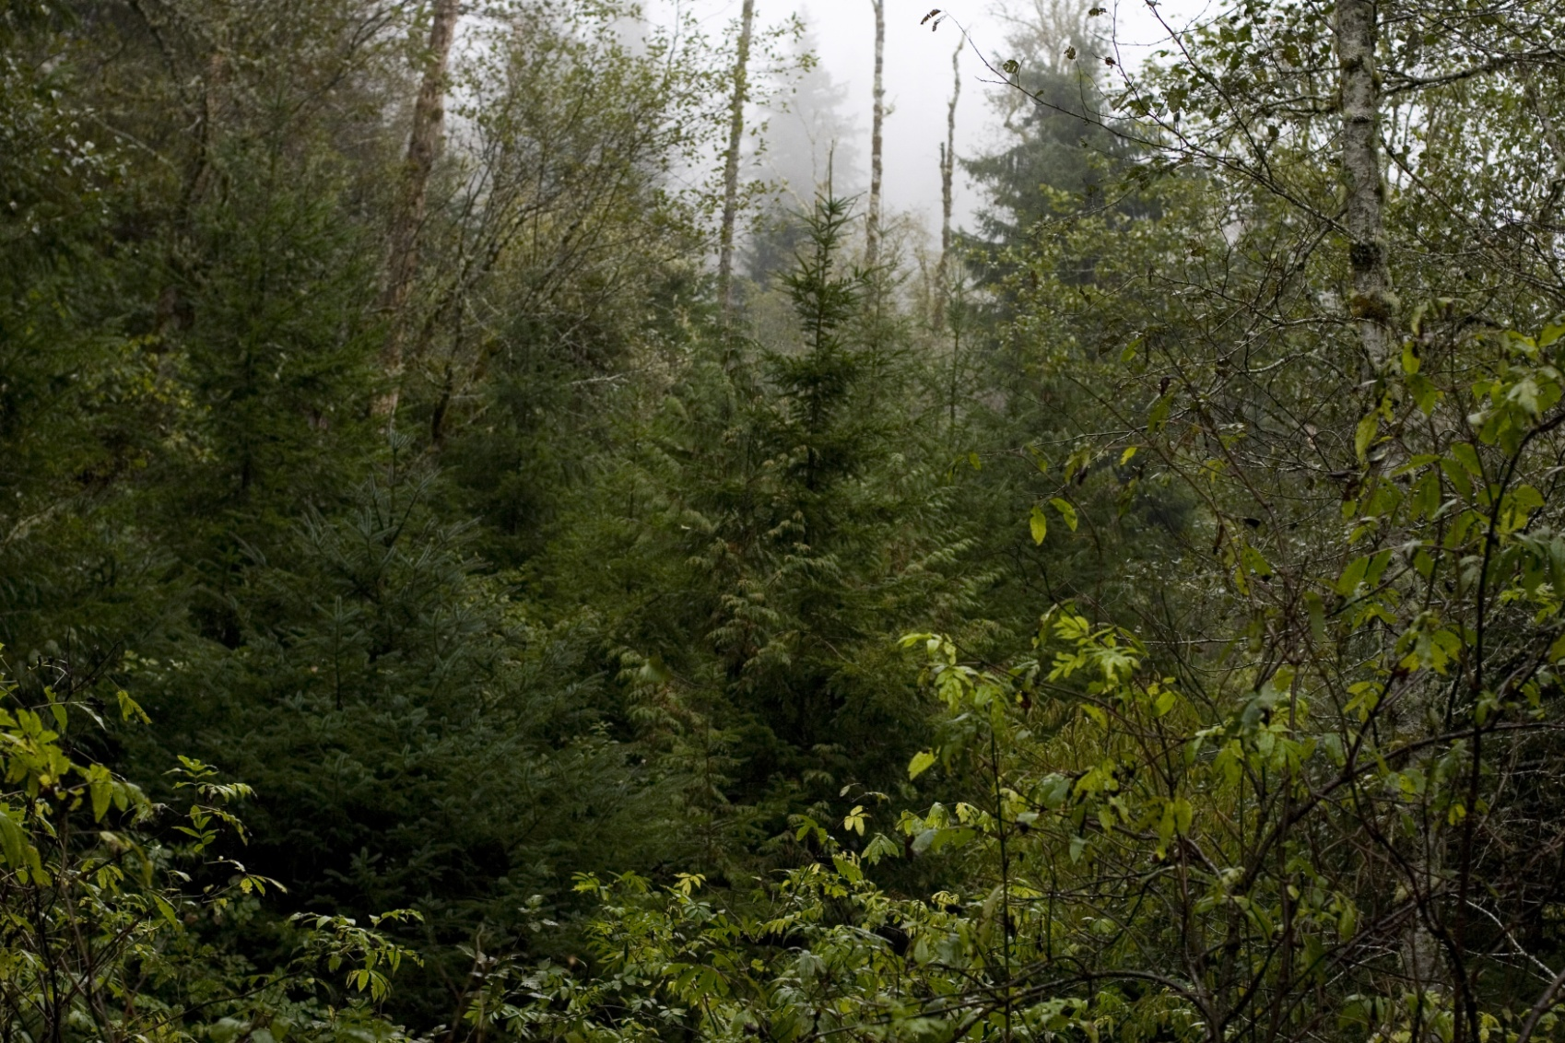
Natural Openings Planted
Notes:
Cedar Creek tributary – planted natural opening and felled 1 – 4 alder around each opening with some additional alder felled 3 years after planting. Also, expensive, but effective.

Slide 23
What We Have Learned
Each riparian area is different - topography, overstory competition, understory competition, potential for various impacts from animals, etc.
Treatments need to be varied to fit circumstances on the ground and available $s
Do not thin until you are ready to plant
Do not plant until you are confident you can afford to maintain the site until established
Because of alder’s high value, adjacent commercial harvest can help fund treatment

Slide 24
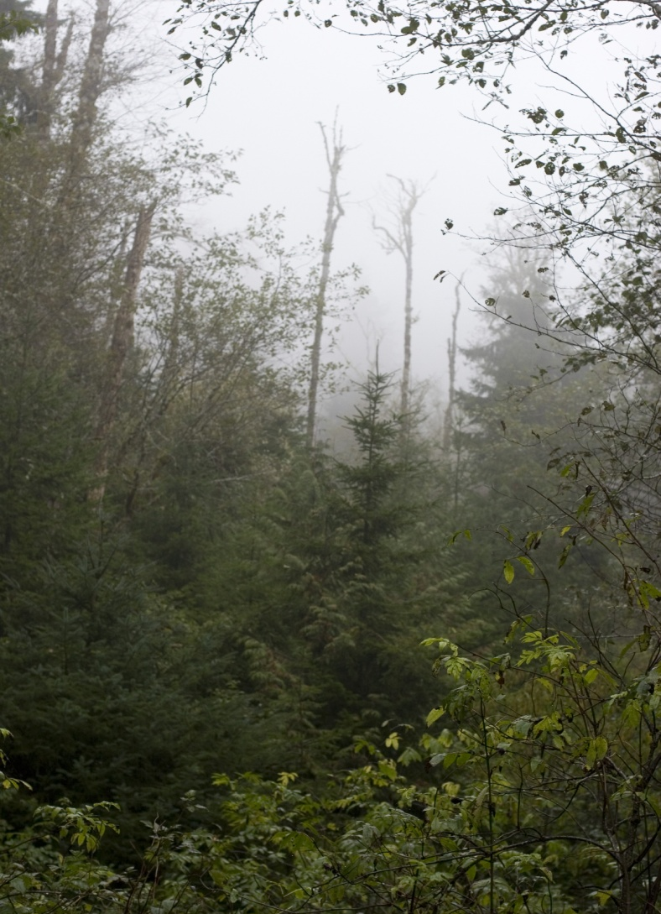
SPECIAL THANKS TO -
Concepts, outline, & edit:
Christine Hirsch
Jack Sleeper
Jason Wilcox
Jeremy Groom
Stu Johnston
Photographs:
Google Earth
Jack Sleeper
Jenny Bocko
Terri Campbell

