Slide 1
Uncertainty
Stan Gregory
Oregon State University
Notes:
1

Slide 2
Source of uncertainty
Science
Policy
Practice
People
Politics

Slide 3
What is a p value?
What level of certainty to you use to make decisions in your life?

Slide 4
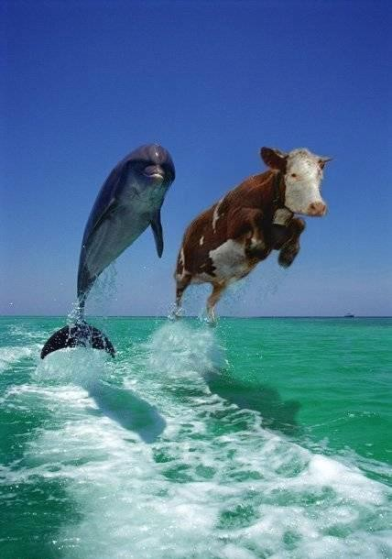
How do we find solutions?

Slide 5
