Slide 1

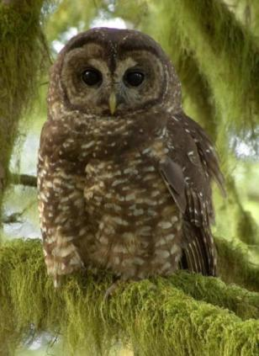

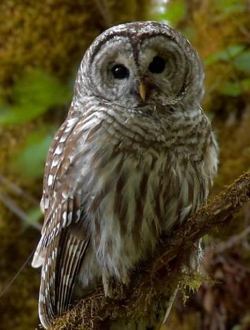
Dietary Overlap between Northern Spotted Owls and Barred Owls in Western Oregon
Northern spotted owl
J. David Wiens
USGS Forest and Rangeland Ecosystem Science Center
U.S. Department of the Interior
U.S. Geological Survey
©Patrick Kolar
Barred owl
Notes:
“Resource Partitioning” = Similar species using limiting resources in different ways. The study looked at space, habitat, and food.

Slide 2
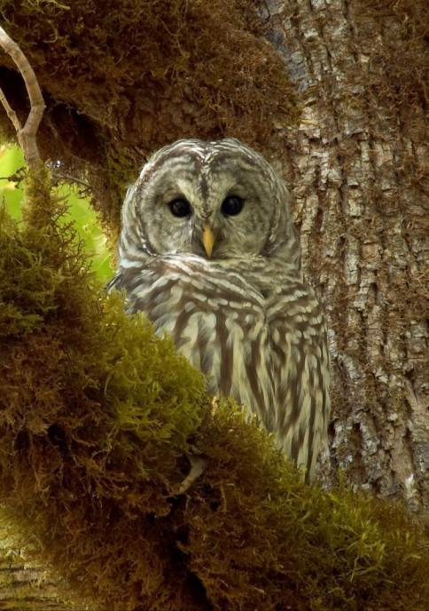

Management Uncertainties Associated with Barred Owls
Role in NSO population declines?
Mechanisms and magnitude
of competition?
Implications to spotted owl
recovery efforts and potential
need to control barred owl
populations?
©Patrick Kolar

Slide 3
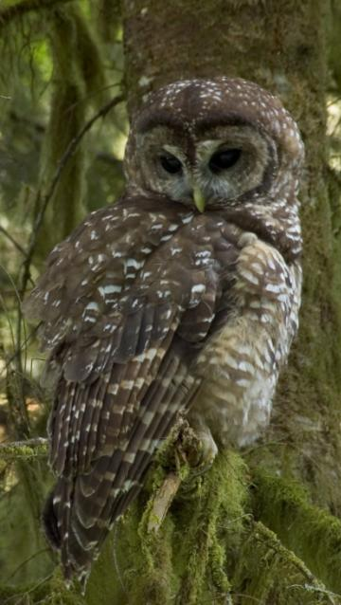
Primary Research Questions
What is the degree of resource
partitioning between spotted owls
and barred owls where they now
co-occur?
Does the presence of barred owls
influence resource selection, survival,
and reproduction of spotted owls?
©Patrick Kolar

Slide 4
Components of Research
Spatial
relationships
Habitat
selection
Diets
and foraging
Overlap in resource use
Influence on movements,
resource selection, and fitness characteristics?

Slide 5
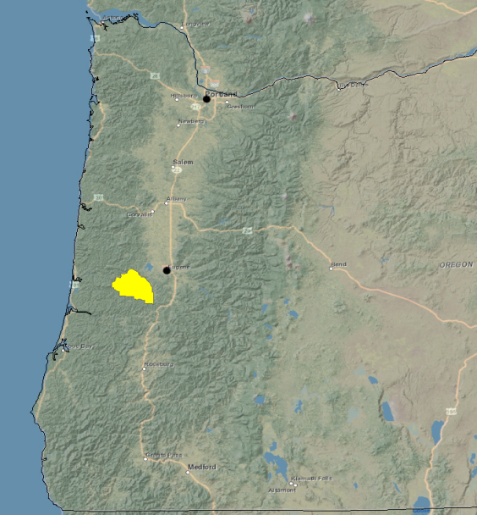
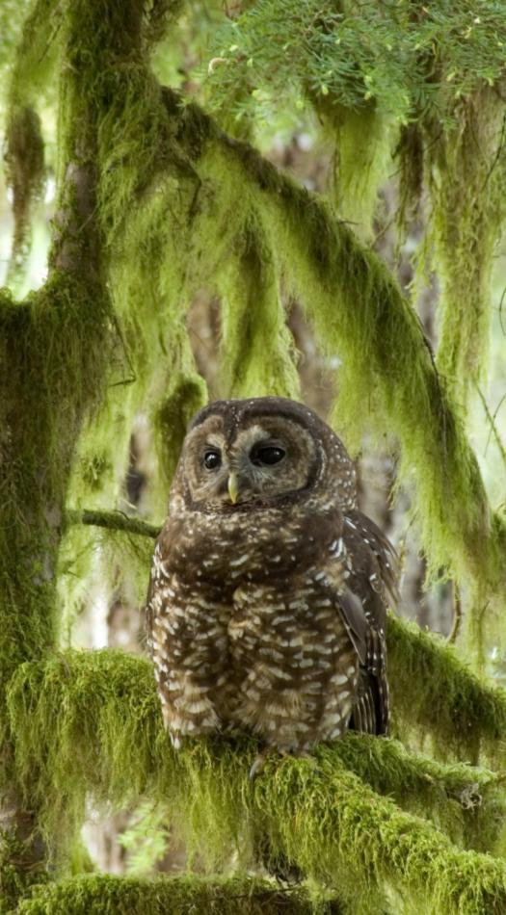
Owl Interaction Study Area, 2007–2009
Oregon
Study area = 975 km²
©Patrick Kolar
Kolar
Notes:
Area selected because needed year-around access (not a lot of snow), could not be a current demographic site, needed land ownership access throughout, and was a demographic study up to 1995 so had a lot of early data on the site

Slide 6
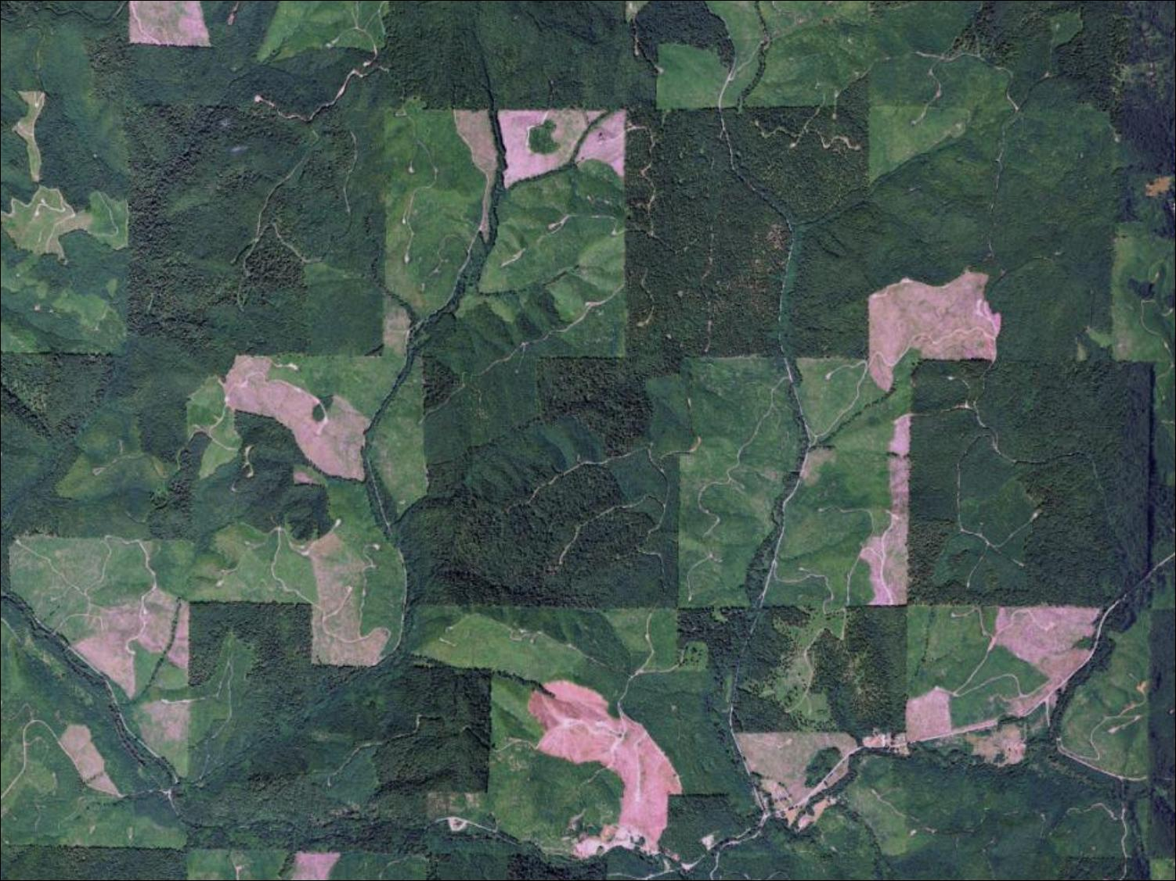
Notes:
Fragmented habitat, mixed ownership

Slide 7
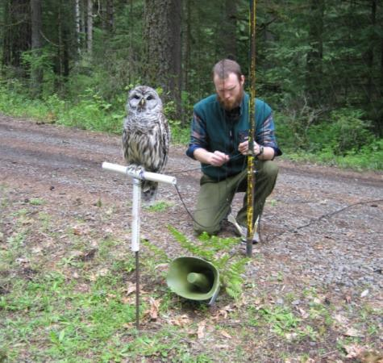
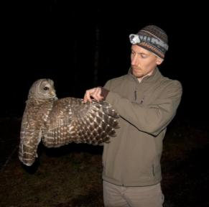
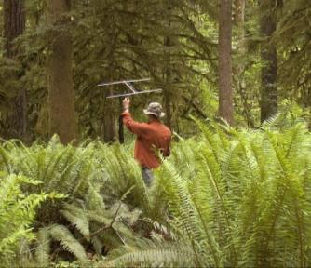
Methods: Owl Surveys and Radio-telemetry
Conducted annual surveys of both species, 2007 – 2009
Captured and radio-marked 29 spotted owls, 28 barred owls
Tracked owls using standardized radio-telemetry methods
Directly monitored space-use, habitat selection, and diets
Individual owls monitored for an average of 593 days (~20 months)
Notes:
Monitored for 24 months continuously

Slide 8
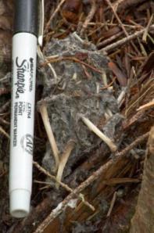

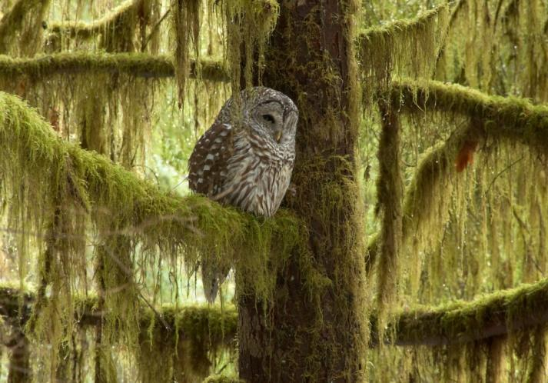
Methods: Owl Diets
Collected owl pellets from roosts and
nesting areas used by radio-marked owls
Identified prey remains in pellets using
dichotomous keys and local reference collection
Estimated dietary composition by territory
(n = 15 spotted owl, 24 barred owl)
©Patrick Kolar
Notes:
Lower picture: snail shells from barred owl pellet

Slide 9
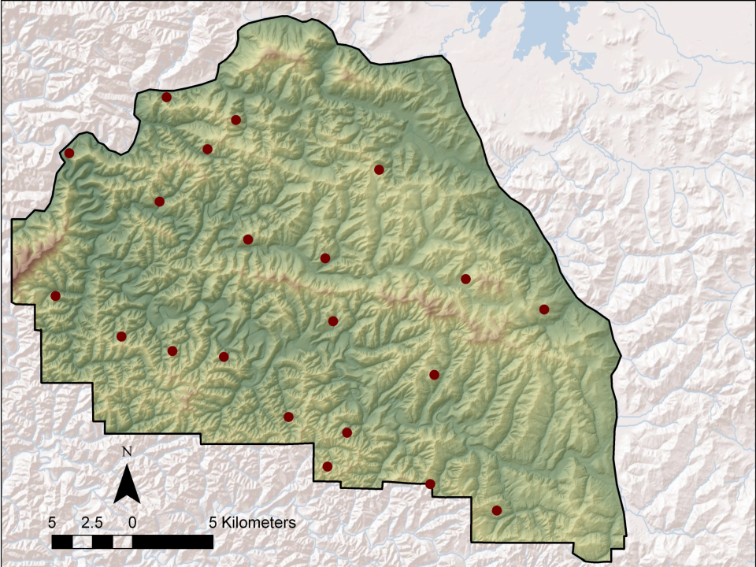
Results: Owl Surveys
Spotted owl territory
(15 pairs)

Slide 10
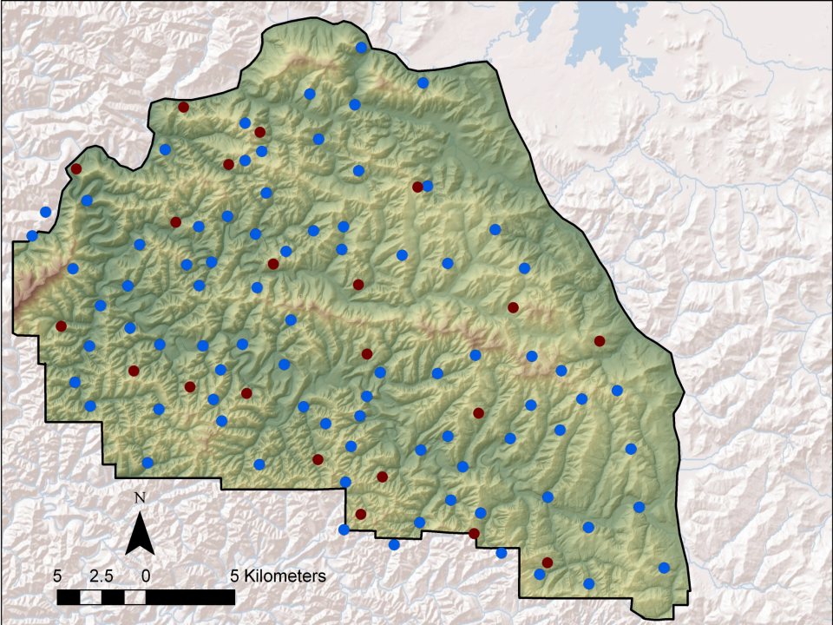
Results: Owl Surveys
Spotted owl territory
(15 pairs)
Barred owl territory
(82 pairs)

Slide 11
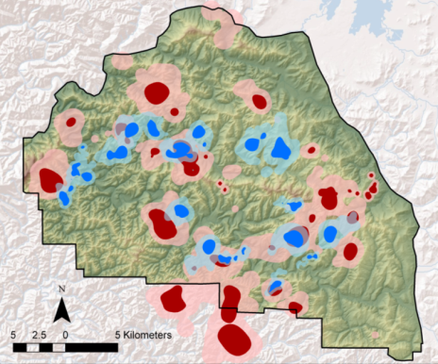
Spatial Relationships
Home ranges of spotted owls were
2 – 5 times larger than those used
by barred owls
Broadly overlapping home ranges
with minimal overlap among
core-use areas containing nests
Notes:
home range = area regularly traversed by an owl during its daily activities
core use areas = areas where owls concentrated their activities during the breeding season, primarily for roosting and nesting

Slide 12
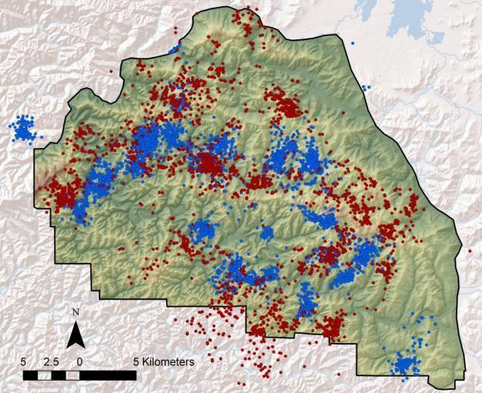
Nighttime Habitat Selection
Both species most often foraged in patches of old (>120 yrs old) conifer forest or riparian areas containing large hardwood trees
Barred owls used available forest types more evenly than spotted owls
Overlap in use of primary forest types = 81% (range = 30 – 99%)
NSO
BO
Young
Mature
Old
Hardwood
5,809 nighttime foraging locations

Slide 13
Nighttime Habitat Selection

Slide 14
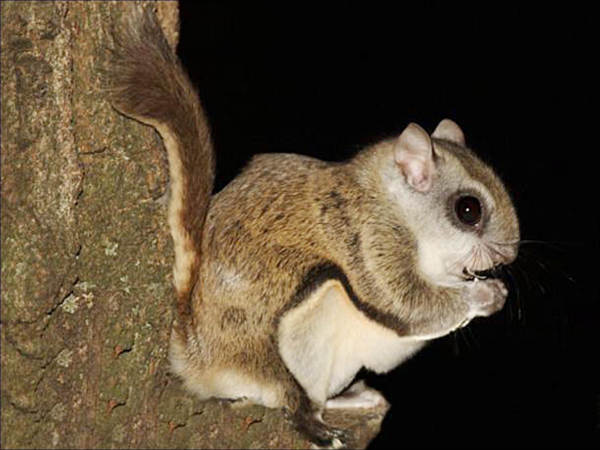
Diets and
Foraging Behavior
©AnimalSpot.net

Slide 15
Dietary Composition (% of prey numbers)
1,246 prey items
51 species
4,306 prey items
95 species
Mean dietary overlap = 42% (range = 28 – 70%)
Notes:
Both ate mostly nocturnal mammals
Spotted owls foraged over larger distances if higher likelihood to encounter barred owls.
Dietary overlap – the amount of diet that overlaps between the two species. The difference is primarily because BO ate a lot of smaller species.
Overlap in WA is closer to 70%, could indicate that impact could be greater for those birds
Insects: ground beetles, millipedes, snails
Amphibians – Salamanders
Reptiles – Alligator lizards
Snails

Slide 16

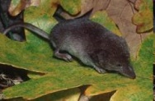
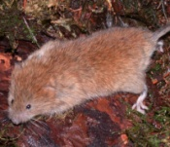
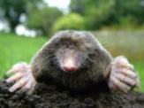
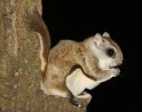
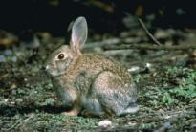
Dietary Overlap by Prey Size Class

Slide 17

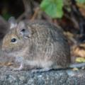
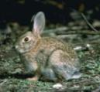
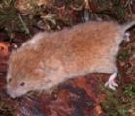

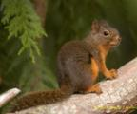
Primary Contributors to Dietary Biomass
445
493
91
84
49
508
63
89
179
155
4
11

Slide 18
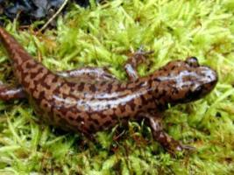
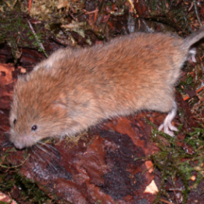
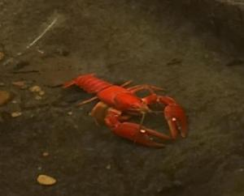
Diet Composition by Prey Activity Zone

Slide 19
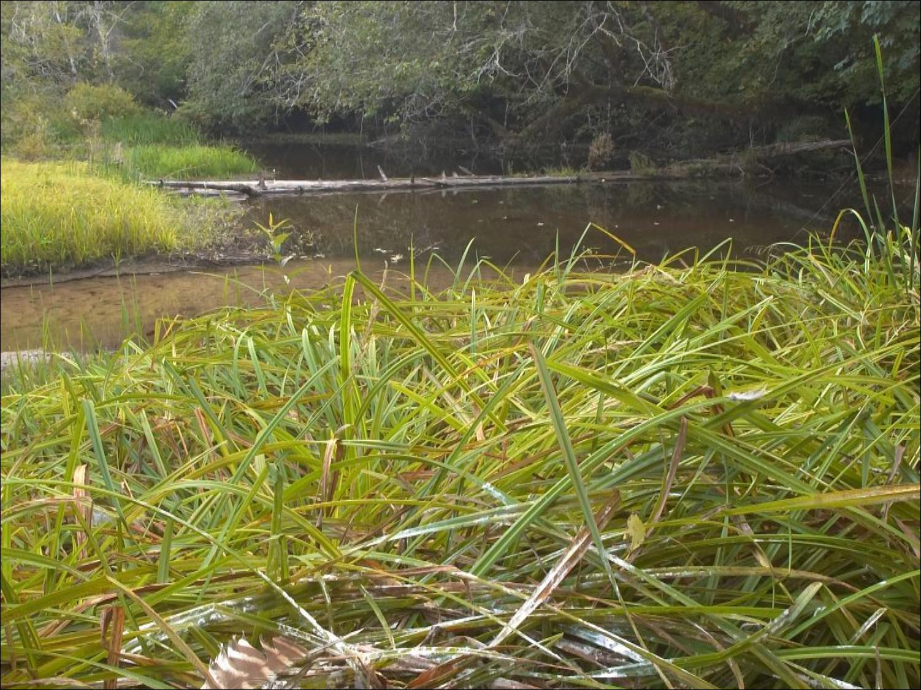
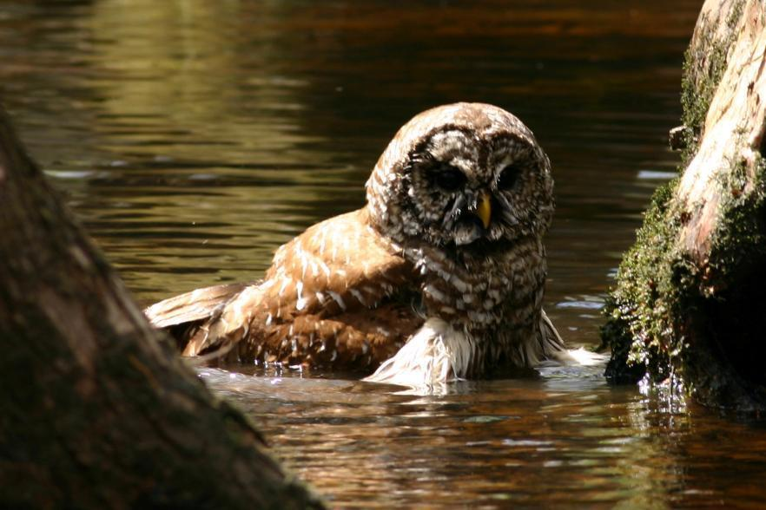
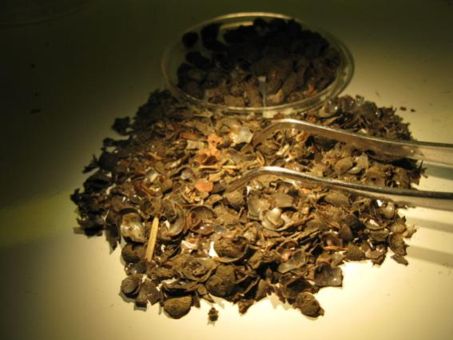
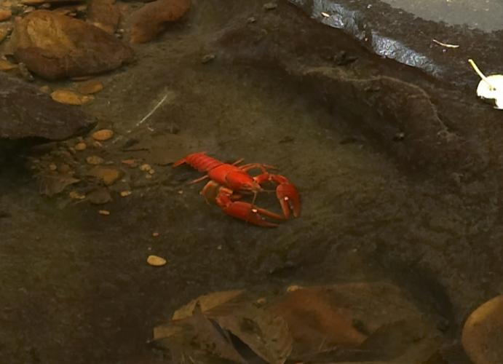
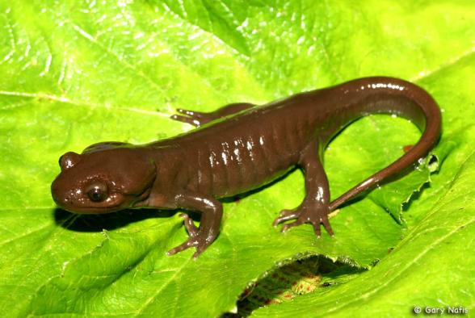
©Will Stuart

Slide 20
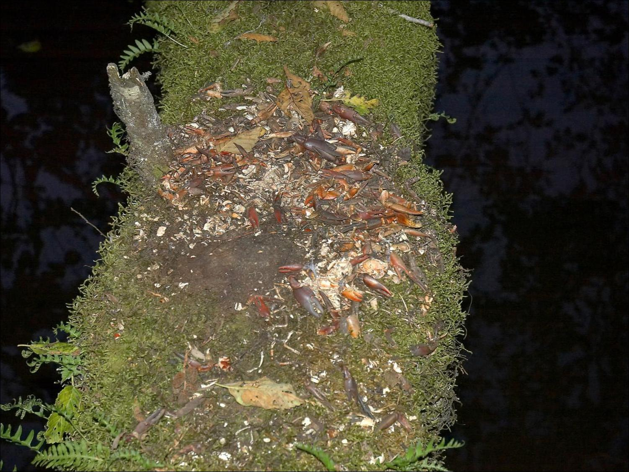

Slide 21
Seasonal Changes in Diets, 2007 – 2009
Breeding
(Mar – Aug)
Dietary overlap = 45%
Nonbreeding
(Sep – Feb)
Dietary overlap = 68%

Slide 22
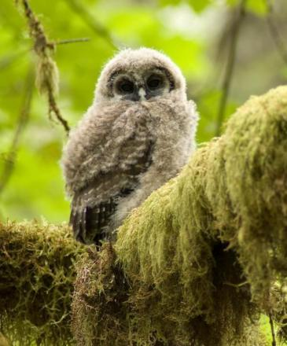
Reproductive Output
Number of Young Fledged per Pair
Spotted owl 0.31 (SE = 0.11, n = 14)
Barred owl 1.36 (SE = 0.14, n = 20)
Barred owls produced 6 – 9 times as many young as spotted owls annually
All spotted owls that attempted to nest with in 1.5 km of a barred owl’s nest failed to produced young
Notes:
BO produced 80 young over 3 years, SO produced 13 young

Slide 23
Summary of Key Findings
Barred owls outnumbered spotted owls by >4:1
Both predators had broadly overlapping home ranges and displayed similar patterns of habitat selection within shared foraging areas
Spotted owls specialized on arboreal mammals whereas barred owls foraged opportunistically across a broad range of prey sizes and types
Both predators relied on a similar set of high-biomass prey species (e.g., flying squirrels, woodrats, lagomorphs, tree voles, deer mice)
Habitat overlap (81%) was greater than dietary overlap (42%)
Dietary overlap increased during fall and winter months
Evidence of differential foraging strategies and fine-scale habitat partitioning (terrestrial vs. arboreal prey species)

Slide 24
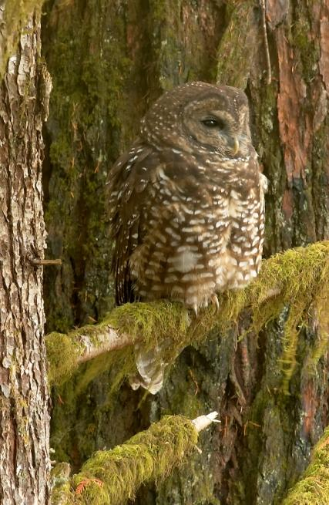
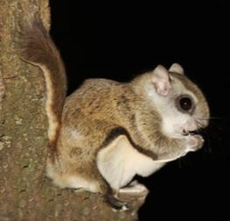
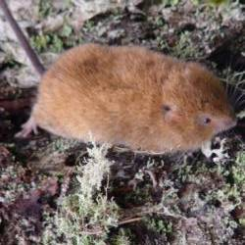
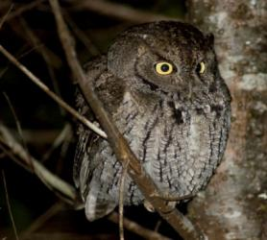
Conservation Implications
Results emphasize the importance of old conifer forest and moist streamside habitats to resource partitioning
Additional loss of older forest can further constrain both species to a common set of limiting resources, thereby increasing competitive pressure
Potentially cascading effects of barred owls on other native wildlife?
©Patrick Kolar

Slide 25






Funding Agencies and Cooperators
Research Cooperators
Oregon State University
Boise State University
Westside Ecological
Roseburg Forest Products
Weyerhaeuser Company
Swanson Superior
National Council for Air &
Stream Improvement
Biological Information Specialists

Slide 26

Additional information and publications available at:
www.fresc.usgs.gov/research/study_ID=547

