Slide 1
The NWFP and Riparian Reserves
An overview

Slide 2

A Little History

Slide 3
Aquatic Conservation Strategy (ACS)
Watershed Analysis
Landscape Scale Assessment of Important Physical, Biological, Chemical, and Social Processes
Key Watersheds
Establish Extra Protection in areas providing refugia for salmonid species
Restoration
Riparian Reserves

Slide 4
Riparian Reserves
Land Allocation where the management emphasis is on meeting ACS Objectives
Include: Streams, Floodplains, Inner gorges, Extent of Riparian vegetation (Riparian Area)
Extend a minimum distance from the stream, depending on type of stream

Slide 5
Minimum Distances
Fish Bearing Streams – The greater of two site potential tree heights or 300 feet
Perennial Streams – The greater of one site potential tree height or 150 feet
Intermittent streams – The greater of one site potential tree height or 100 feet
Natural lakes and ponds - The greater of two site potential tree heights or 300 feet

Slide 6
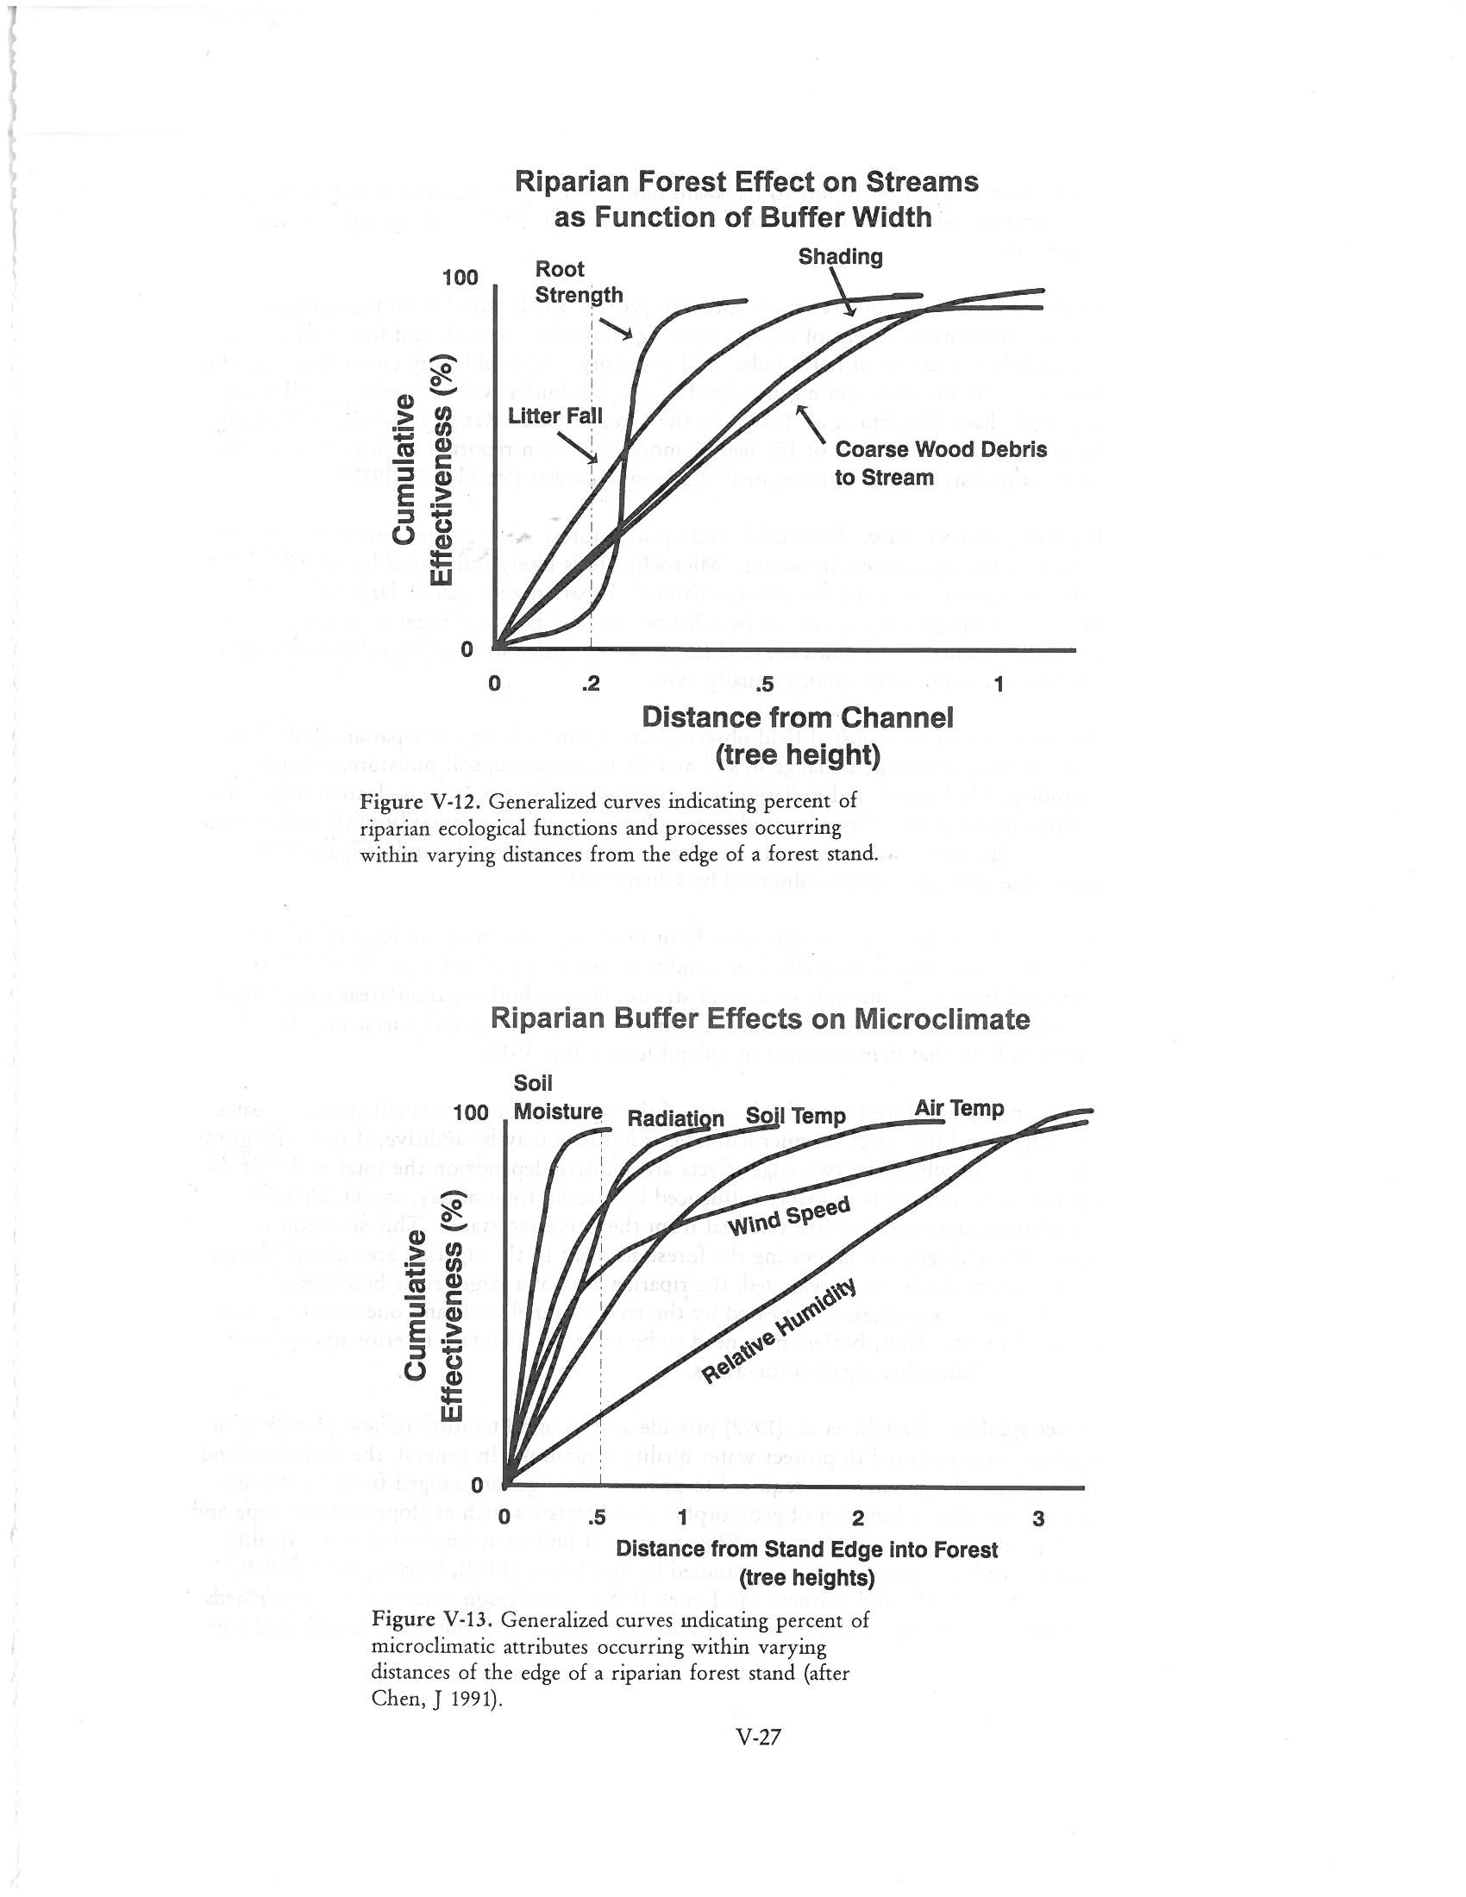

Slide 7
Amended not Replaced

Slide 8
Thinning?
TM-1. Prohibit timber harvest, including fuel wood cutting, in Riparian Reserves, except as described below. Riparian Reserve acres shall not be included in calculations of the timber base.
c. Apply silvicultural practices for Riparian Reserves to control stocking, reestablish and manage stands, and acquire desired vegetation characteristics needed to attain Aquatic Conservation Strategy objectives.

Slide 9
When is thinning appropriate?
Whenever thinning can be identified as an effective means to meet specific ACS objectives.
Whenever the benefit of meeting the identified objectives outweigh possible adverse effects on other ACS objectives
These are context sensitive

Slide 10
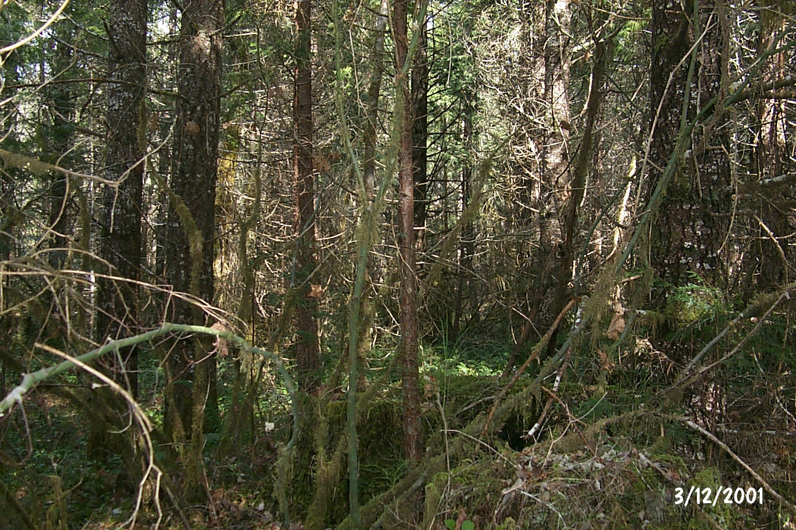
Stagnant Riparian Stands

Slide 11
What does the rest of the watershed look like?
Stream Surveys – do streams currently have adequate wood, or are they short?
Riparian Age Classes – Are there other sources of all sizes of wood?
What are the streams like?

Slide 13


Slide 14
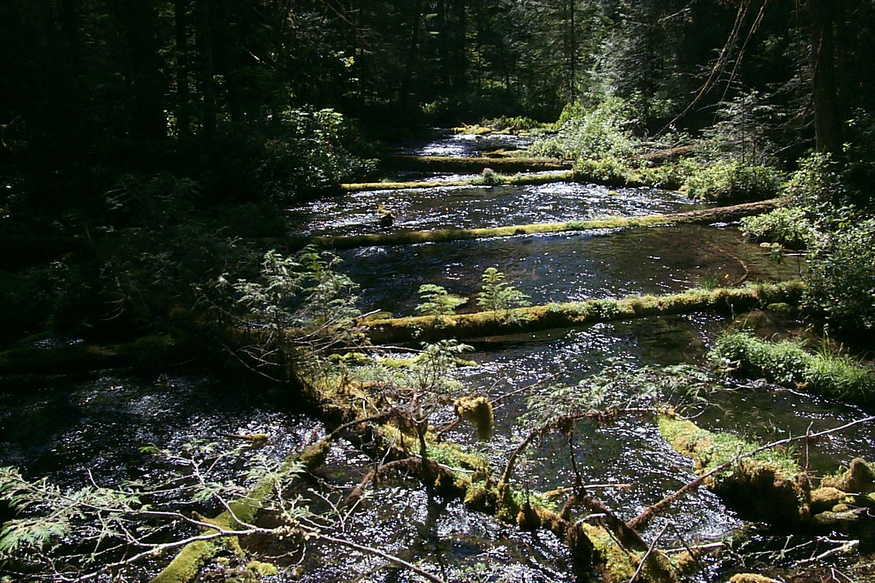

Slide 15
Riparian Reserves are about more than fish
Management Strategies must be developed inter-disciplinarily
Management Strategies must consider multiple scales and evaluate potential trade offs relevant at different scales
Even a passive “No Action” decisions can involve trade offs with regard to lost restoration opportunities or maintenance of other objectives

Slide 16


