Slide 1
INFLUENCE OF COMMERCIAL THINNING OF DOUGLAS-FIR FORESTS ON POPULATION PARAMETERS OF NORTHERN FLYING SQUIRRELS AND TOWNSEND’S CHIPMUNKS
Robert G. Anthony & Douglas M. Gomez
Oregon Cooperative Fish & Wildlife Research Unit, Dept. of Fisheries and Wildlife, Oregon State University, Corvallis, OR
John P. Hayes
Formally with: Department of Forest Science, Oregon State University, Corvallis, OR

Slide 2
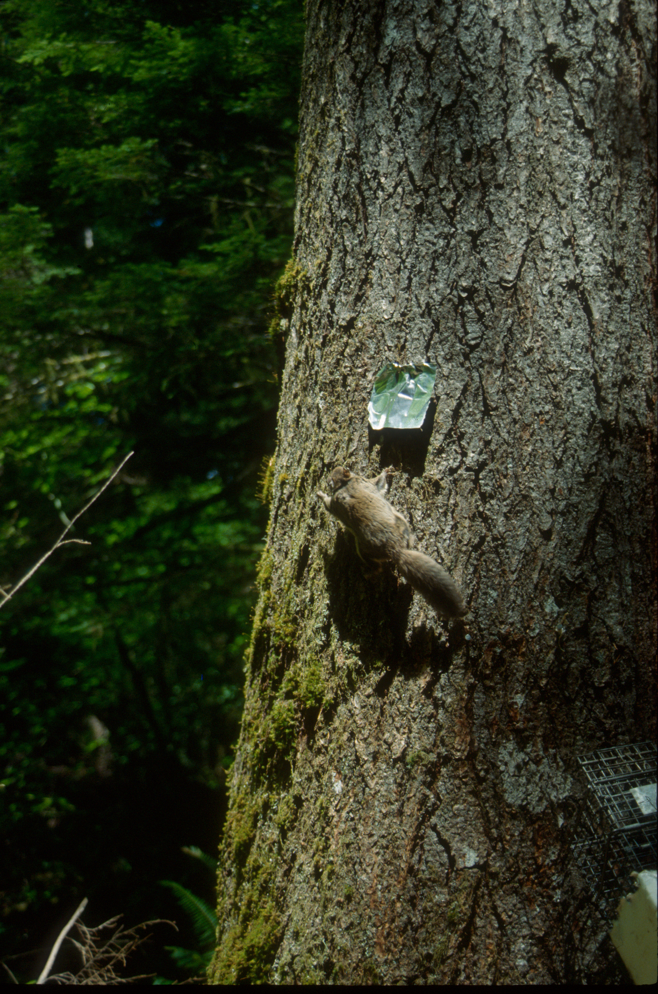

Slide 3
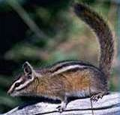
Life History of Townsend’s chipmunks
Diurnal
Longevity of 1-2 yrs
High densities in coniferous forests
Eat seeds and vegetation
Prey for several avian and mammalian predators

Slide 4
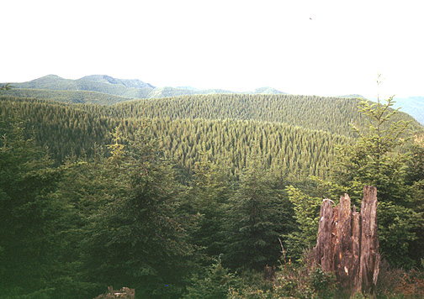
Tillamook Burn Today
A “sea of green”
Extensive reforestation efforts
35-50 year old stands
Predominantly Douglas-fir

Slide 5
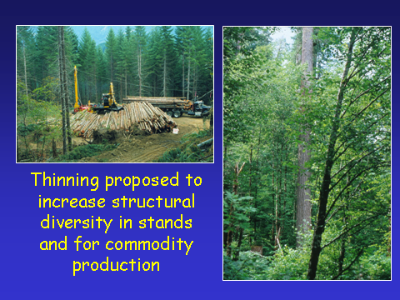

Slide 6
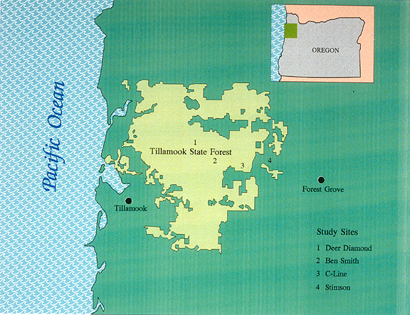
Tillamook Thinning Study
.
.
.
Four
replicated
blocks
.
Notes:
oo

Slide 7
Tillamook Thinning Study
Ben Smith Replicate
3 stands
per block
Moderate
Control
Minimum
stand size
65 acres
Heavy
1 km
Treatments randomly allocated to stands

Slide 8
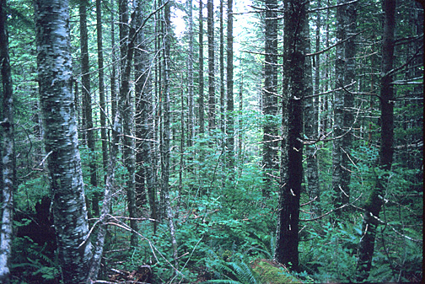
Tillamook Thinning Study
Control
Stands
Unthinned (180-270 TPA)

Slide 9
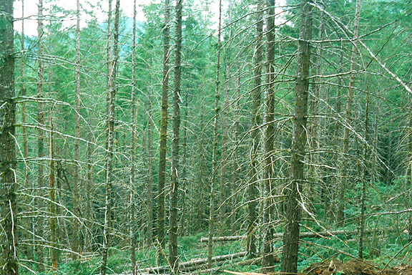
Tillamook Thinning Study
Moderate
Thinning
Treatment
Thinned to roughly 100-130 TPA
Similar to standard operational thin

Slide 10
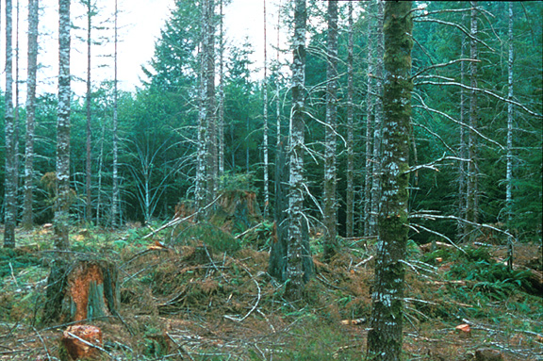
Tillamook Thinning Study
Heavy
Thinning
Treatment
Thinned to roughly 60-85 TPA
Designed to increase light to understory
and accelerate tree growth

Slide 11
HYPOTHESES:
Abundance of flying squirrels in these young, structurally simple forests will be lower than in older forests.
Commercial thinning will reduce survival rates and density of northern flying squirrels.
Commercial thinning will have a positive effect on abundance of Townsend’s chipmunks.

Slide 12
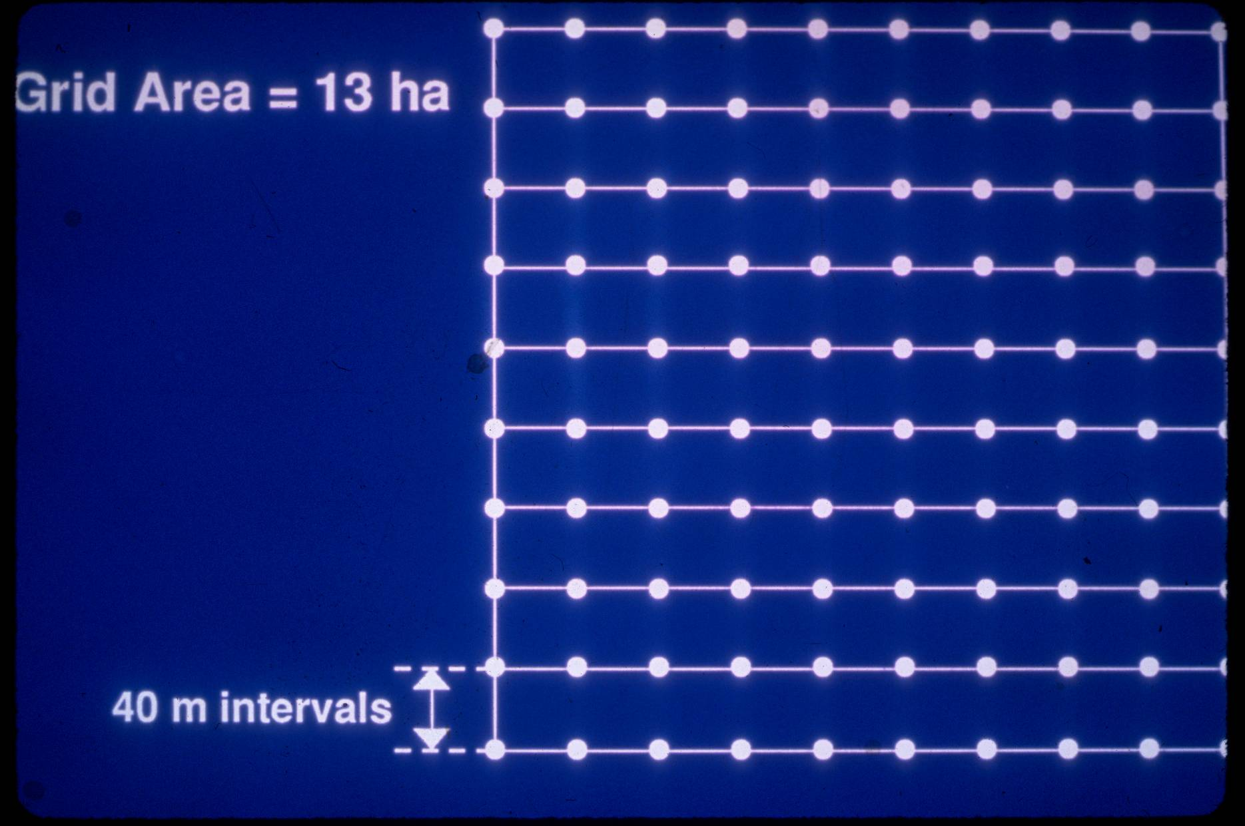
Trapping Grid Used for Studies

Slide 13
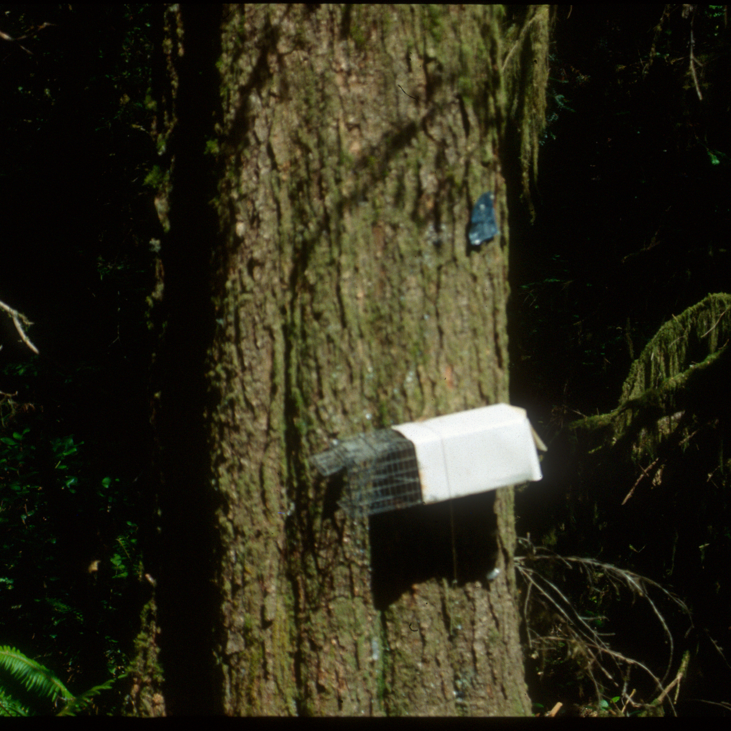

Slide 14
STATISTICAL METHODS:
Used the Jackknife estimator in program CAPTURE to estimate abundance
Computed mean maximum distance moved between successive trap occasions
Estimated annual survival rates with Cormack-Jolly-Seber open population models in program MARK

Slide 15
STATISTICAL METHODS:
Tested for differences among treatments with randomized block design
Density, body mass, and movements
Used linear regression to assess the relation of squirrel and chipmunk density to vegetative characteristics and abundance of hypogeous fungi

Slide 16
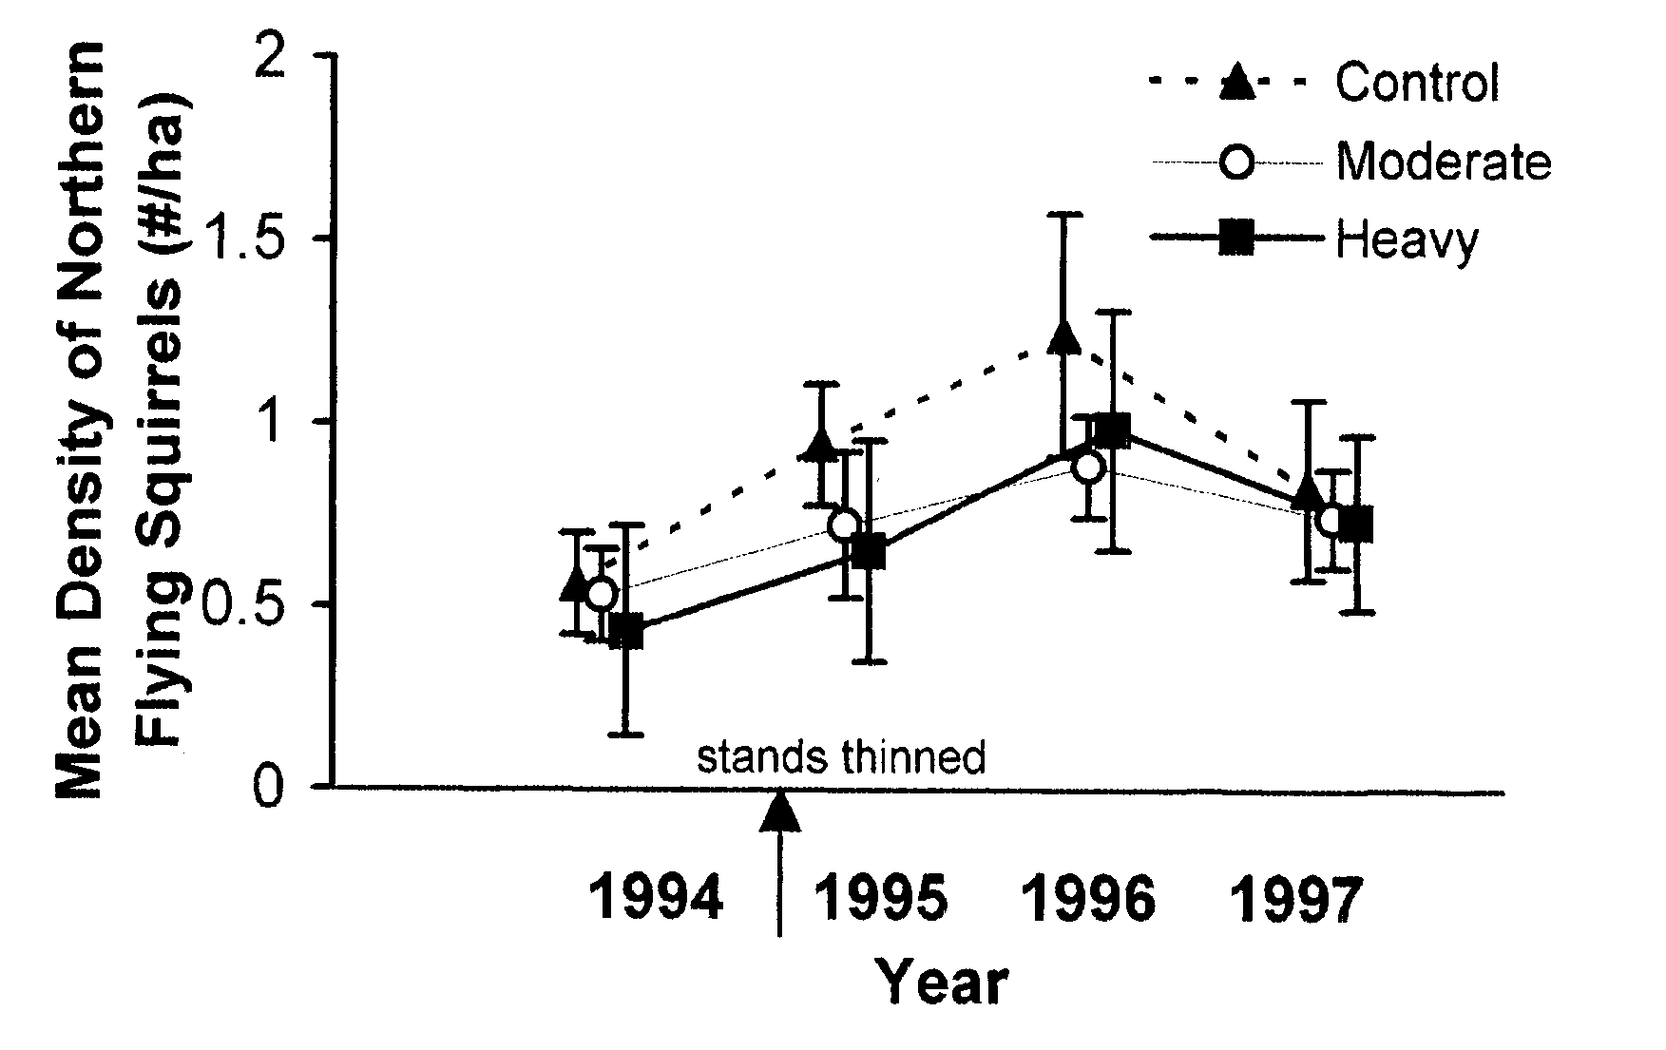
Flying Squirrel Densities, 1994-1997

Slide 17
Top Models for Apparent Annual Survival Rates [p (sex)]
Model | No. Parameters | ∆ AIC
Φ (t) | 5 | 0.00
Φ (t + replicates) | 8 | 1.33
Φ (t + sex) | 6 | 1.56
Φ (t + treatments) | 7 | 2.40
Φ (t + sex + reps) | 9 | 2.57
Φ (t +sex + treat) | 8 | 3.81

Slide 18
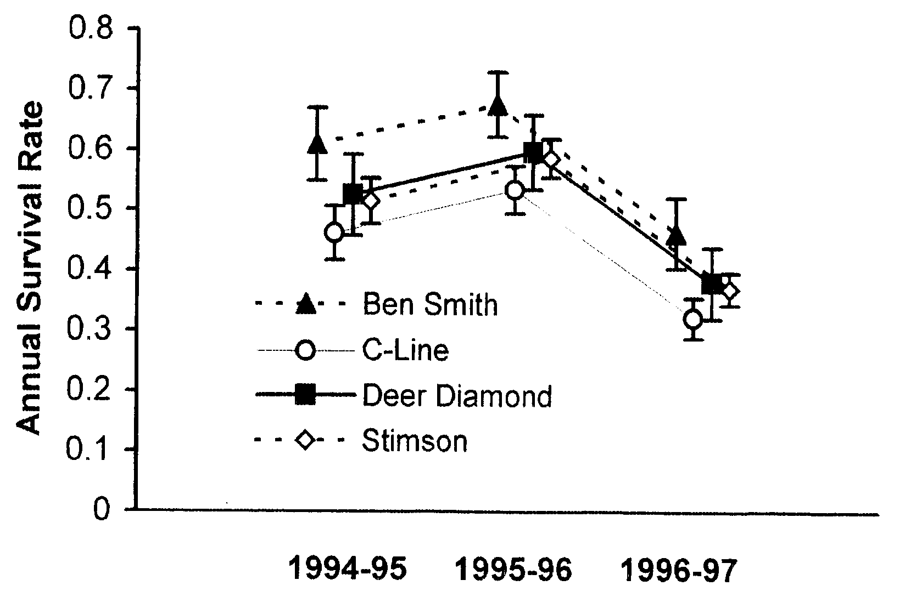
Flying Squirrel Annual Survival Rates, 1994-1997

Slide 19
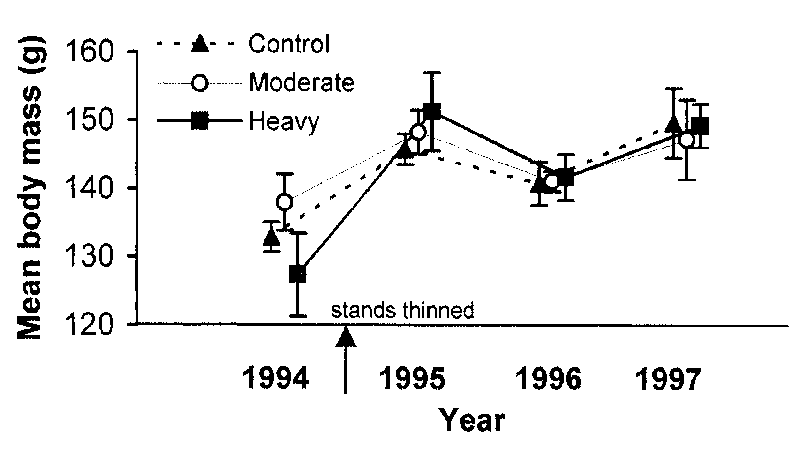
Body Weight of Flying Squirrels

Slide 20
Percent Frequency of Fungal Genera in Flying Squirrel Fecal Pellets:
Plant material | 98
Rhizopogon | 73
Hysterangium | 36
Melanogaster | 36
Hymenogaster | 22
Gautieria | 19
Tuber | 13
Geopora | 13
Hydnotrya | 12

Slide 21
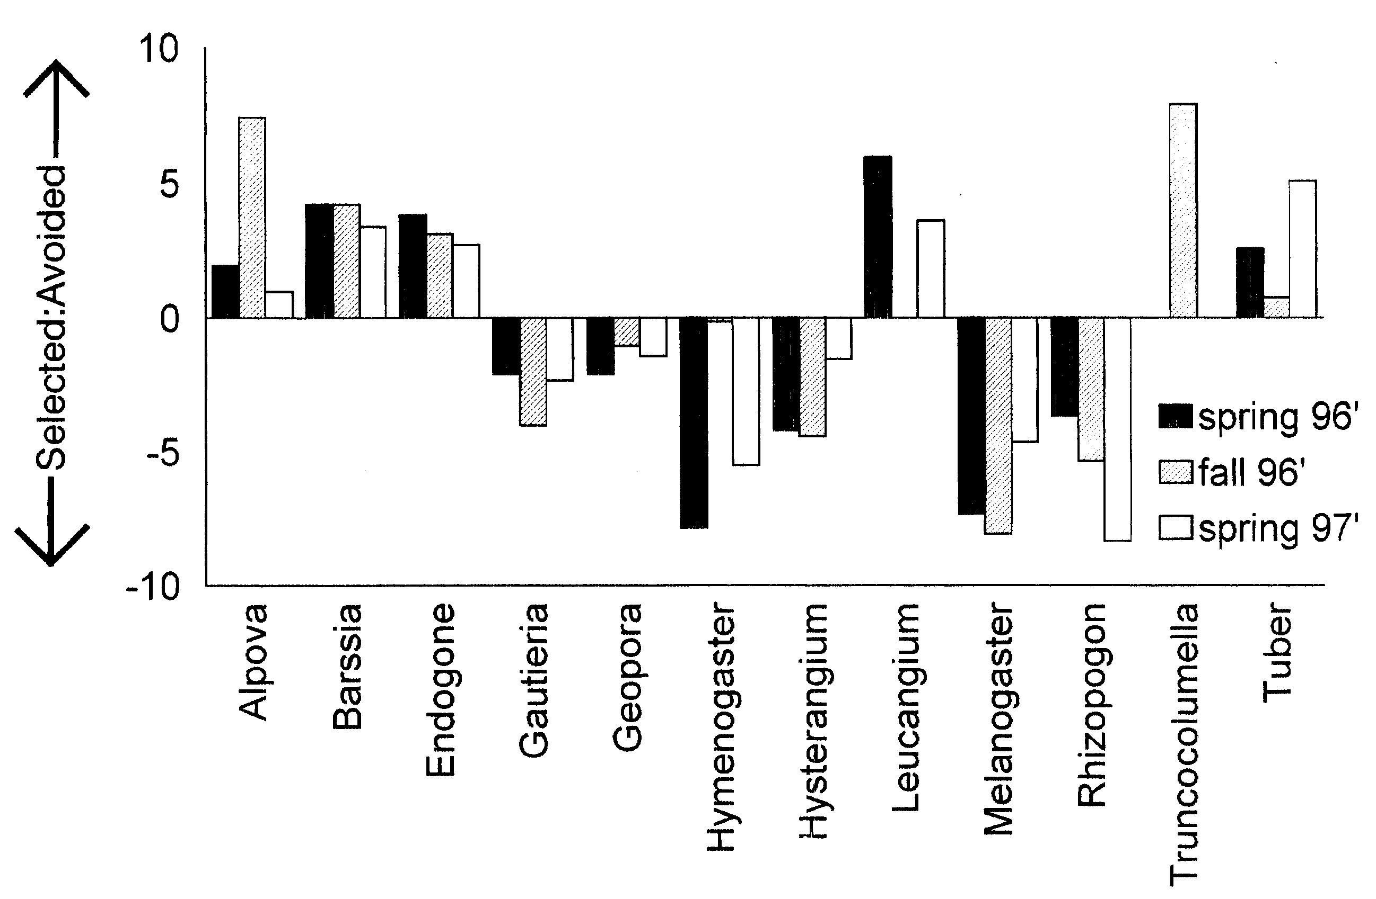
Selection of Fungi by Flying Squirrels

Slide 22
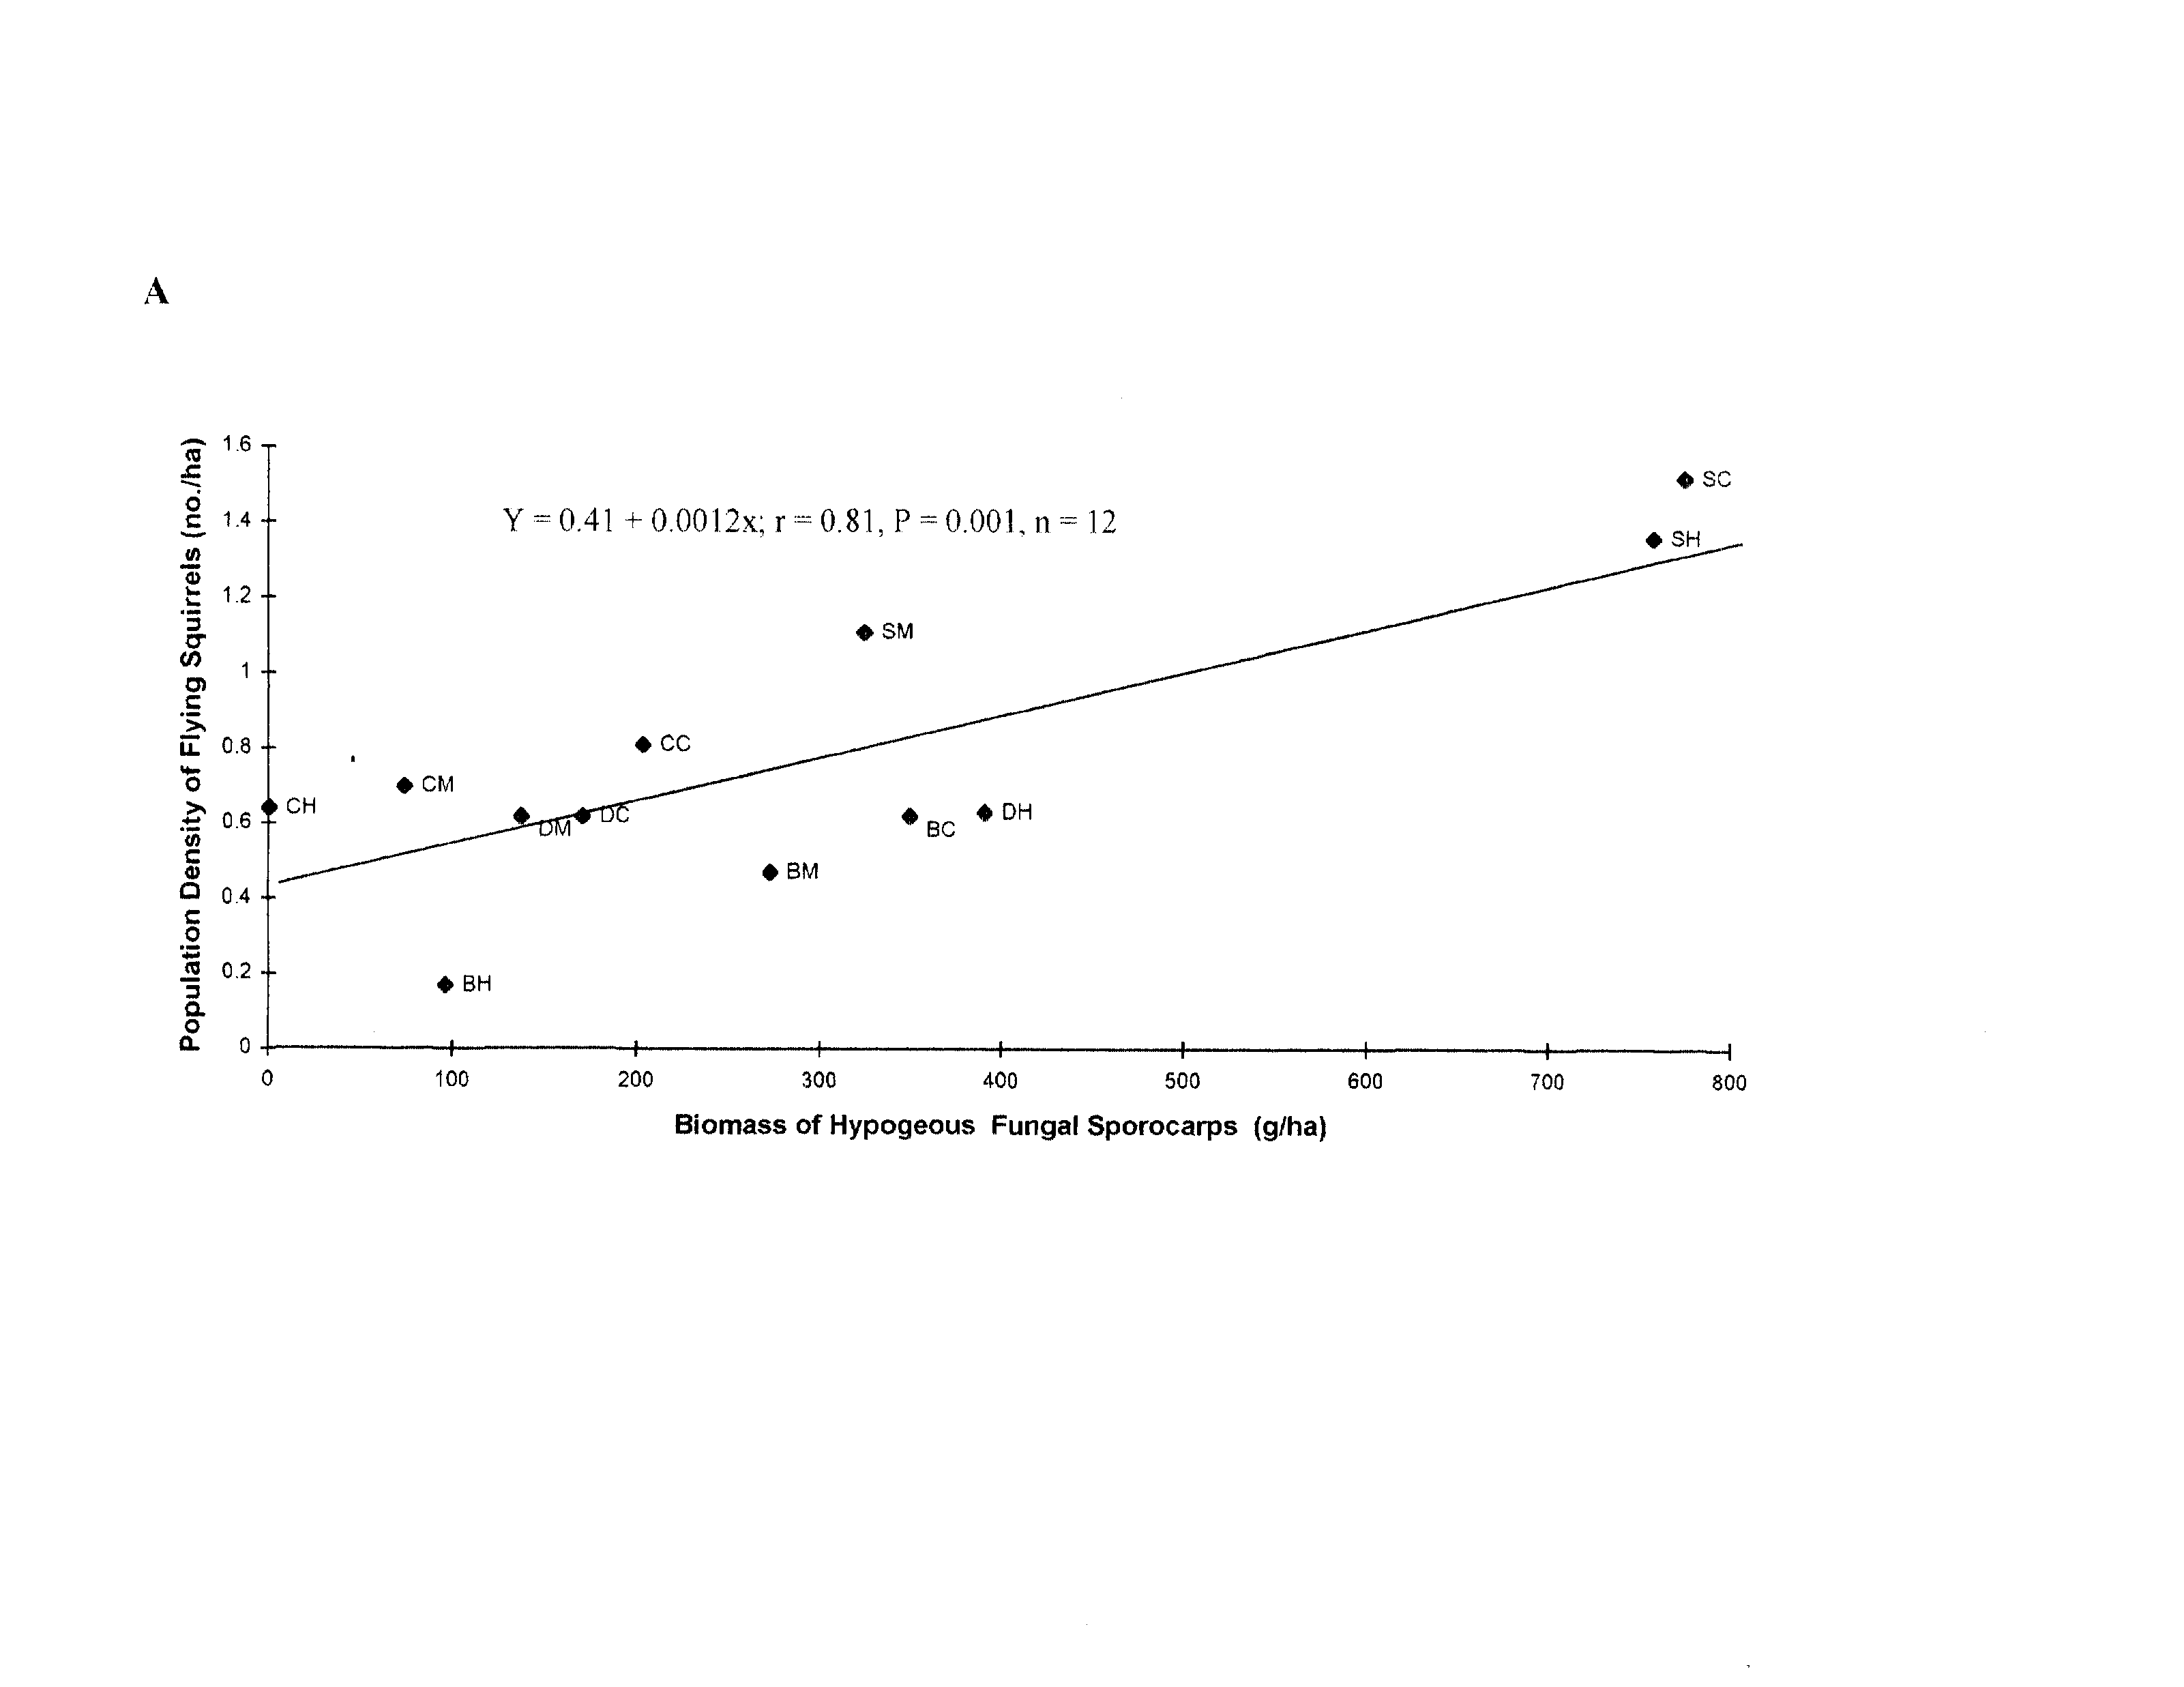
Relationship Between Flying Squirrel Density and Abundance of Fungi
r = 0.81, P = 0.001

Slide 23
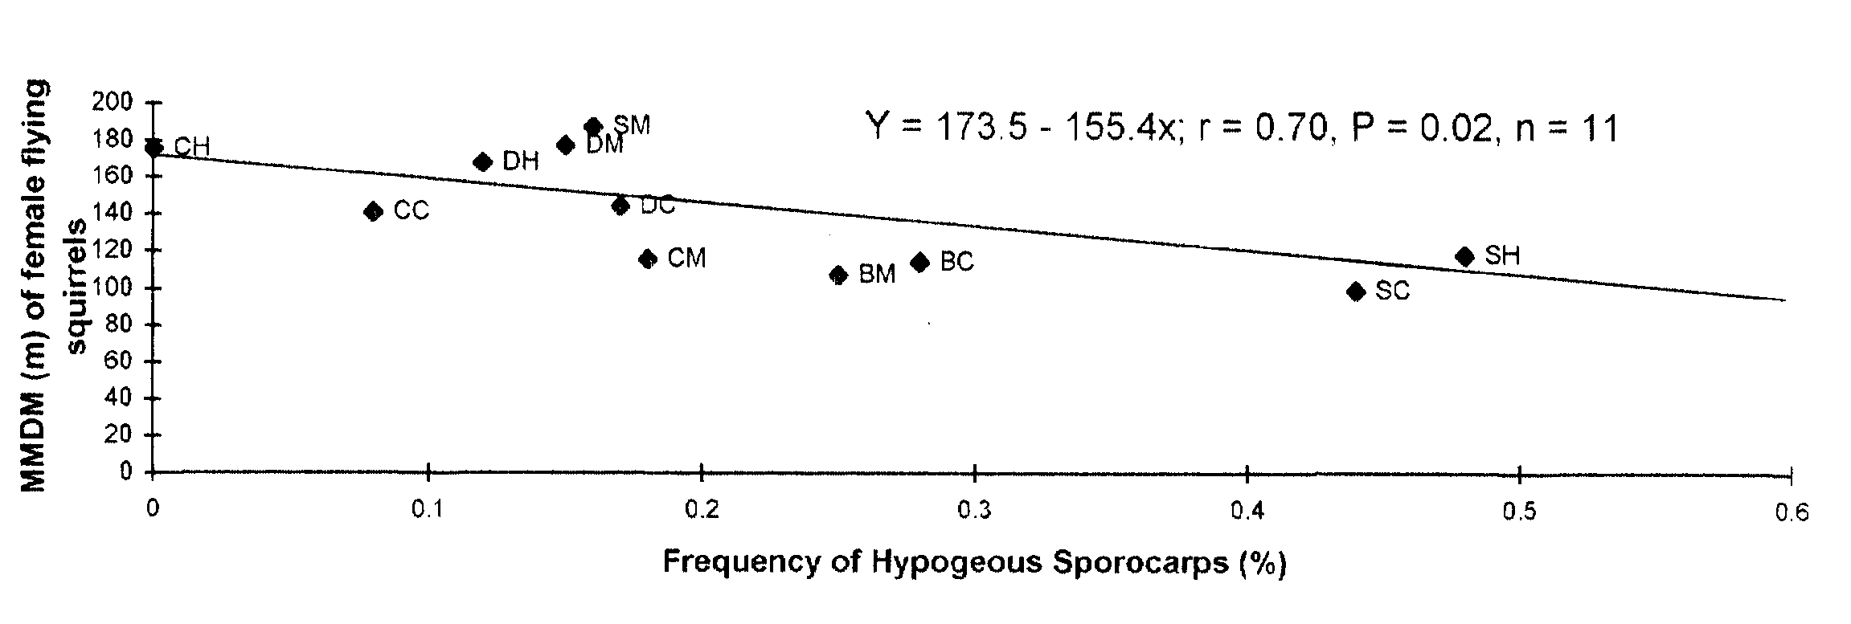
Relationship Between Flying Squirrel Movements and Abundance of Fungi
r = -0.70, P = 0.02

Slide 24
Abundance of Northern Flying Squirrels in Douglas-fir Forests in Oregon
Stand Age | Mean (#/ha) | Range (#/ha) | Reference
Young | 1.0 | 0.2─2.2 | This Study
Young | 1.1 | 0.7─1.6 | Carey et al. 1992
Young | 1.9 | 1.1─2.5 | Rosenberg & Anthony 1992
Old-growth | 1.8 | 1.1─2.2 | Carey et al. 1992
Old-growth | 2.3 | 1.4─3.3 | Rosenberg & Anthony 1992

Slide 25
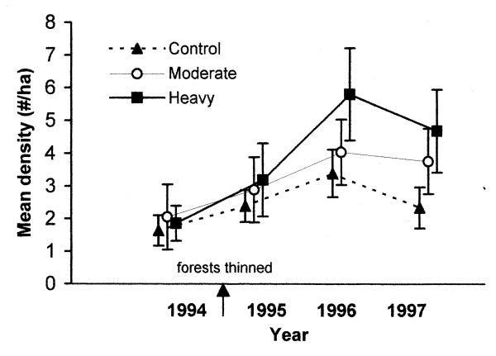
Density of Townsend’s Chipmunks

Slide 26
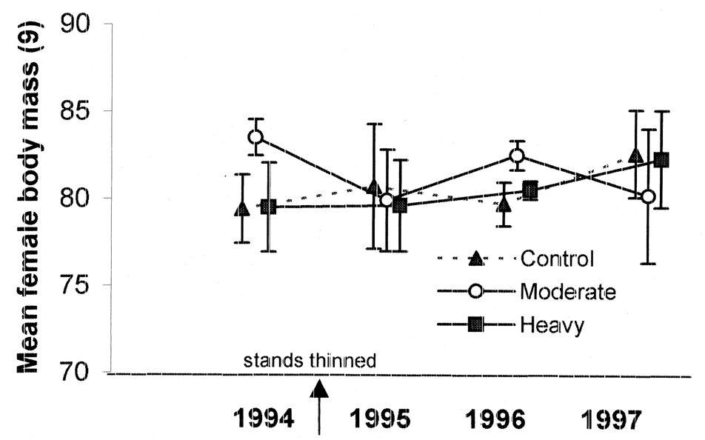
Body Weight of Female Townsend’s Chipmunks

Slide 27
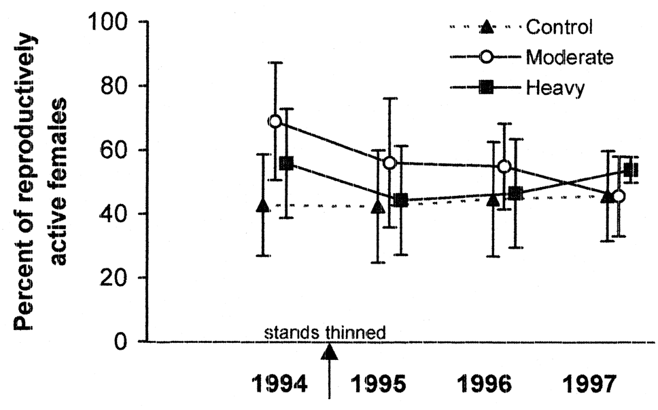
Reproductive Rates of Townsend’s Chipmunks

Slide 28
Corrections among Vegetative Characteristics and Density of Townsend’s chipmunks
Variable r-value p-value
Large conifers 0.48 0.11
Small snags 0.44 0.15
Large logs 0.53 0.08
Volume of Slash 0.55 0.07
p-values for 9 other variables were > 0.20

Slide 29
SUMMARY (Flying Squirrels):
Commercial thinning had no negative short-term effect on density, survival, or body mass
Flying squirrel abundance was positively correlated with biomass of hypogeous fungi
Female flying squirrels traveled greater distances in forest stands that had a low frequency of fungi among sampling plots

Slide 30
Summary (Townsend’s Chipmunks)
Densities of were higher in heavily thinned stands compared to controls.
Densities were positively correlated with the amount of slash and large logs.

Slide 31
CAVEATS:
The effects of commercial thinning could be manifested over longer periods of time because flying squirrels have relatively small home ranges and are relatively long lived
Our results are applicable to commercial thinning of young forest stands originating from wildfire in the northern Oregon coast range.

Slide 32
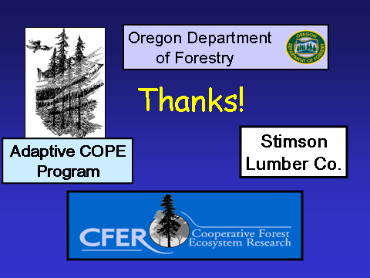

Slide 33

ACKNOWLEDGMENT:
Reference:
Gomez, D.M., R.G. Anthony, and J.P. Hayes. 2005. Journal of Wildlife Management 69:1670-1682.

