Slide 1
Ecology of and Habitat Management for the Dusky-Footed and Bushy-Tailed Woodrat
Presented by
Jim Heaney
Wildlife Biologist
Coos Bay District BLM

Slide 2
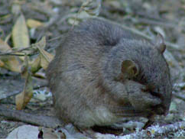
Dusky-footed Woodrat (photo pirated from the internet!)

Slide 3
Dusky-footed Woodrat - Mostly nocturnal, semi-arboreal, endemic to the Pacific coastal states. Head and body: 7 3/5 to 9 inches (193 -229 mm), tail: 6 4/5 to 8 2/3 inches (173 -220 mm), weight: 8 -13 ¾ oz. (227 – 390 g), body: grayish brown above, grayish to whitish below, tail may be slightly paler below than above, hind feet sprinkled on top with dusky hairs.

Slide 4
Food items include apple, vine maple seed, crabapple, snowberry, willow, rose, Douglas-fir, red current, Oregon white oak, madrone, blackberry, common sword fern.
Females may produce two or more litters per year with one to three young per litter.

Slide 5
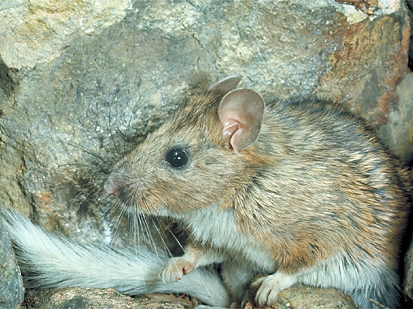
Bushy-tailed Woodrat (pirated this one to!)

Slide 6
Bushy-tailed Woodrat - Active nocturnally, most arboreal of the genus. Head and body: 7 to 9 2/3 inches (178 – 245 mm), tail: 5 1/5 – 7 2/5 inches (132 – 188 mm), weight: 7 ½ -20 2/5 oz. (212 – 580 g), body: from pale gray washed with tawny to nearly black above, hind feet are white.

Slide 7
Food items consist of cones and needles of coniferous trees, berries, leaves, shrubs, and forbs. In lodgepole pine and grand-fir habitats of northeastern Oregon fungi are a major food item and woodrats are vectors of spore dissemination.
Females may produce two or more litters per year with two to four young per litter.

Slide 8
Habitat and Management
Dusky-footed woodrats build their own houses, can live in large colonies and seem to be limited more by food, water, and vegetative cover than by housing sites. In California, Raphael (1988), Ward (1990), and Sakai and Noon (1993, 1997) all found dusky-footed woodrats to be most abundant in early seral stages, with a secondary peak of abundance in a bimodal distribution in late seral stages. No bushy-tailed woodrats were found in their studies.

Slide 9
Sakai and Noon found the highest number of woodrats in sapling and brushy pole timber (20 – 30 year old) although these stands are seldom used by spotted owls (Forsman) probably because woodrats are inaccessible to the owls. Still these areas are a good source of woodrats dispersing out into older stands more frequented by foraging spotted owls and accessible to owls hunting along the edges where old forest meets young.

Slide 10
Carey et al hypothesized that the abundance of dusky-footed woodrats over a landscape could be increased by landscape-level management that includes variable-density thinning in managed stands that is designed to mimic spatial patterns characteristic of old-growth and niche-diversification forests.

Slide 11
Strategies for the dusky-footed woodrat could include:
Variable-density thinning combined with course woody debris management,
Creation of debris piles from thinning slash,
Management of stream side areas to restore course woody debris and complex vegetation structure,
Management of mass-wasting areas to promote recruitment to streams of course woody debris and course rocky debris at failure.

Slide 12
Most subspecies of the bushy-tailed woodrat are associated with rocky environments such as talus slopes, rockslides, boulder fields, rock outcrops and cliffs. Where scarce they’ll use hollow trees, mistletoe, logs and course woody debris for denning, foraging and shelter.
In the Pacific Northwest one of the preferred landscapes are closed pole-sapling stands.

Slide 13
In western Oregon and western Washington they preferred mature (>80 years), unmanaged upland Douglas-fir-western hemlock streamside forests more than young (35 to 80 years) “managed” streamside forests.

Slide 14
Strategies for the bushy-tailed woodrat could include:
Creation of debris piles from thinning slash
Management of streamside habitat to restore coarse woody debris and complex vegetation structure.
Retention of large snags and woody debris on the scale of 0.5- to 1.2-acre (0.2 to 0.5 ha) patches.

Slide 15
How important are woodrats?
Carey found in mixed conifer forest woodrats averaged 53% of the biomass consumed by spotted owls and 24% of the biomass in river valley forests.
Zabel et al found that spotted owl breeding-season home-range size were smaller in Mad River, California where woodrats occurred in 58% of the pellets analyzed and increased in size to the north as flying squirrels became more prominent in the diet.

Slide 16

That’s the biggest mouse I’ve ever seen!!!!

