Slide 1
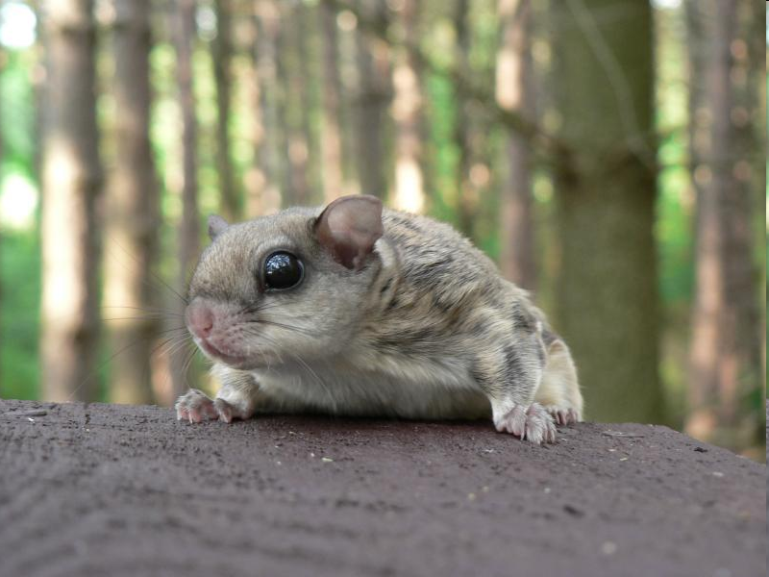
Flying Squirrel Response to Thinning in the Oregon Cascades
Tom Manning¹, Joan Hagar², Brenda McComb¹
¹ OSU - Forest Ecosystems and Society
² USGS – Forest & Rangeland Ecosystem Science Center

Slide 2
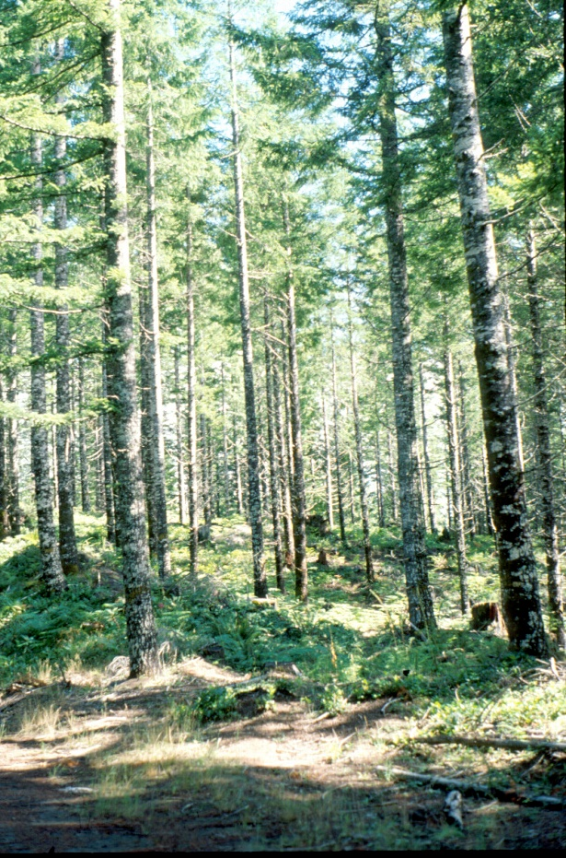
Thinning: A Tool for Restoring Diversity
Short term:
Increase structural diversity
Long term:
Accelerate development of late-seral habitat
Maintain structural diversity

Slide 3
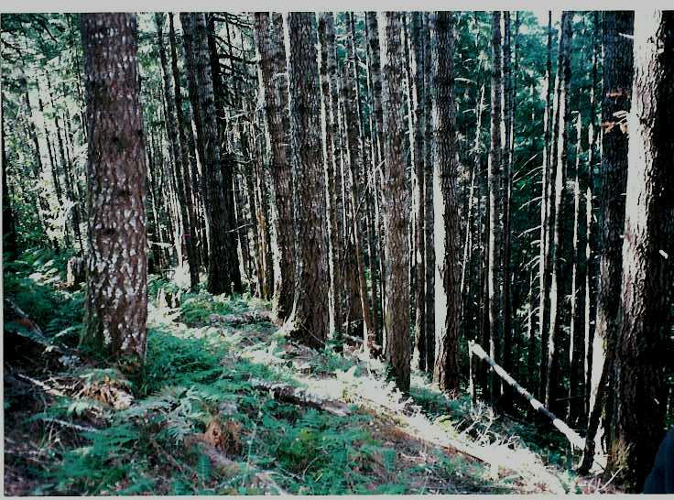
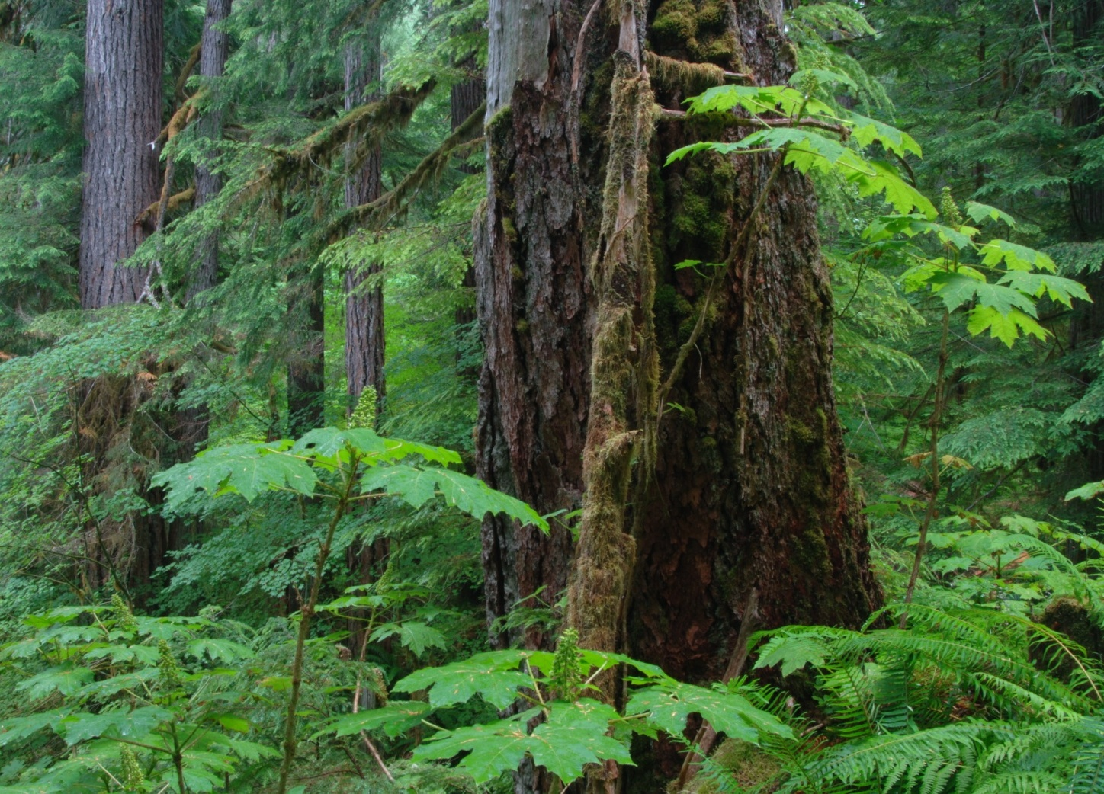
???
Notes:
Low structural diversity in a dense young stand, 40 years after clear-cutting;
Perpetuated by short rotations: no chance to recover structural diversity.

Slide 4
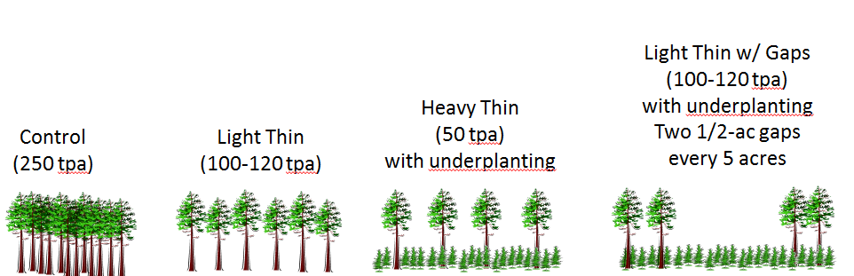
The Young Stand Thinning & Diversity Study
Notes:
We are using the YSTDS to address these questions for the Northern Flying Squirrel and a variety of organisms: songbirds, small mammals, amphibians

Slide 5
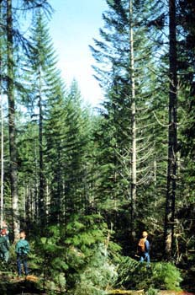
Questions of Interest
How can thinning be adapted to meet diversity goals?
What is the effect of different patterns and intensities of thinning on responses of management concern?
Notes:
Until the 1990’s, thinning had been used mainly as a silvicultural tool to increase timber production.
Early studies examined effects of conventional thinning on wildlife, finding that variation in intensity and pattern would create more structural diversity, but what is the effect of alternative thinning strategies on wildlife?

Slide 6
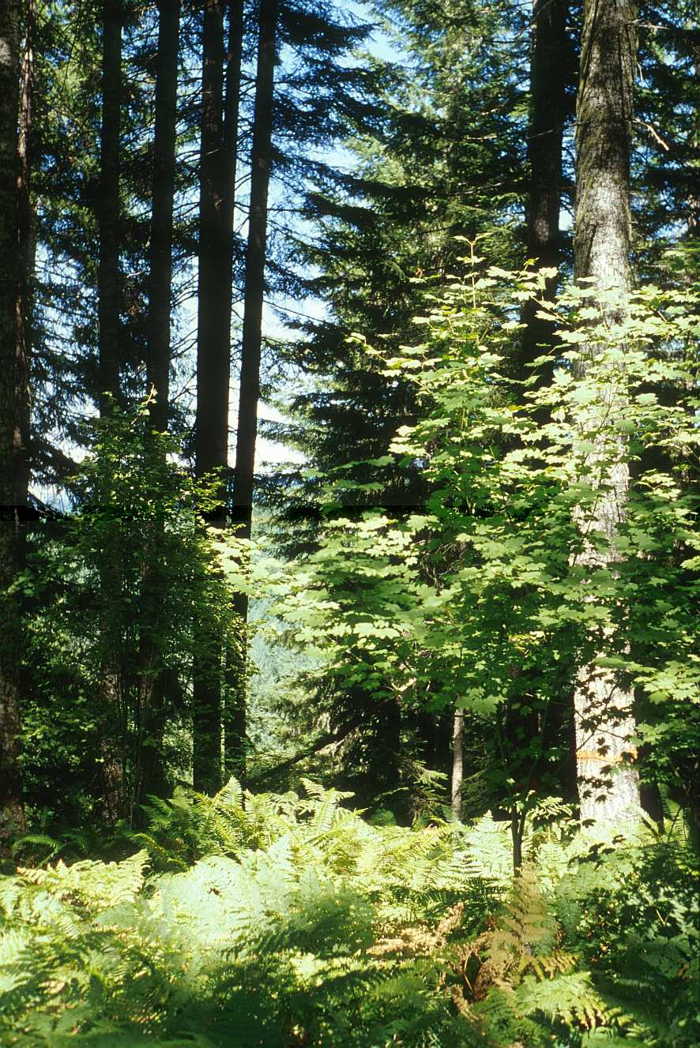
Long-Term Questions
Will response direction change over time?
How soon will thinned stands support old forest wildlife species?
Notes:
Most studies have focused on immediate response to thinning (because thinning for diversity has not been practiced for very long).
Expect changes in response as vegetation develops following thinning. Of particular interest is how long it will take for old-forest habitat to develop.

Slide 7
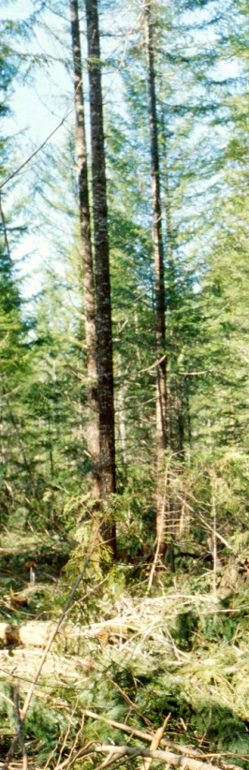
YSTDS: Replicated Study With Controls
4 replicates of each treatment
Data collected before and after harvest
Controls track baseline changes in bird density
Notes:
Northern flying squirrel: if not strictly an old-forest associated species, is associated with dense, closed canopy forest
Short-term negative response to thinning

Slide 8
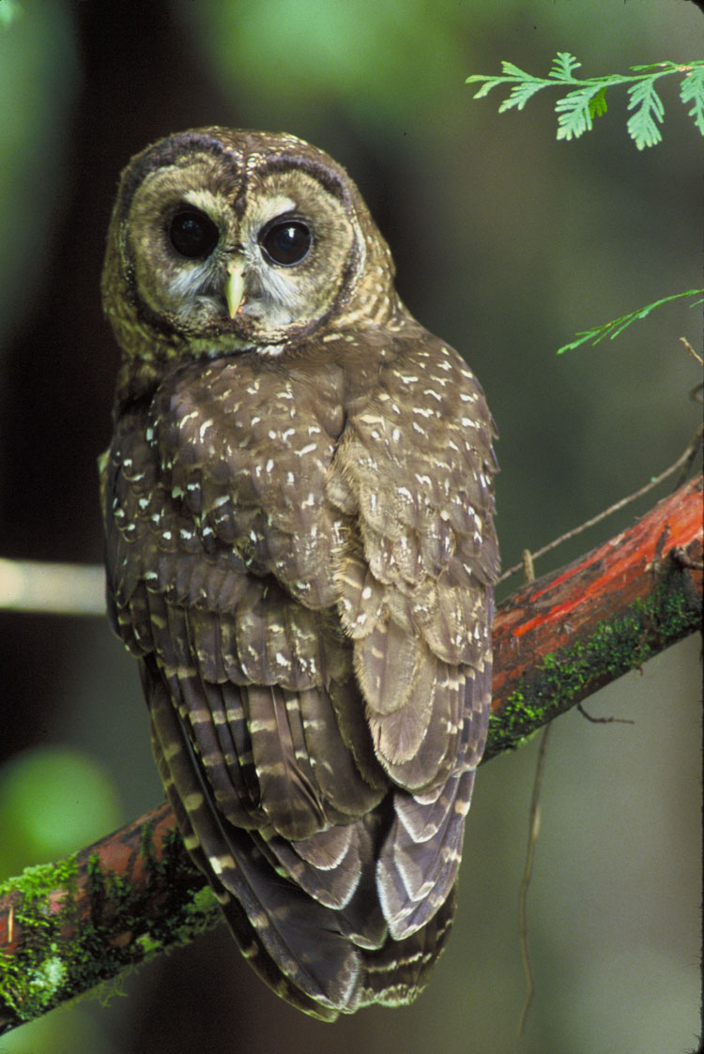
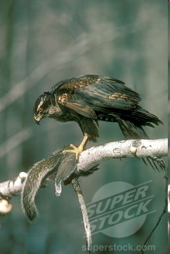
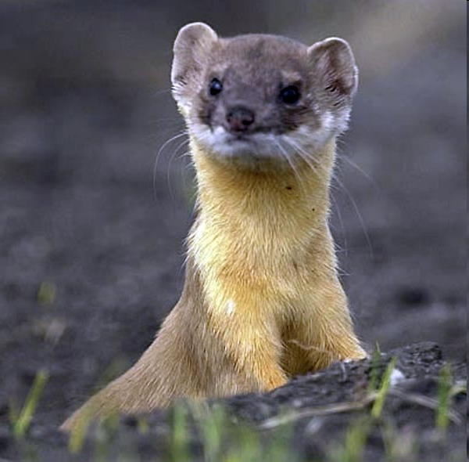
Notes:
Prey for old-growth associated species: NSO

Slide 9
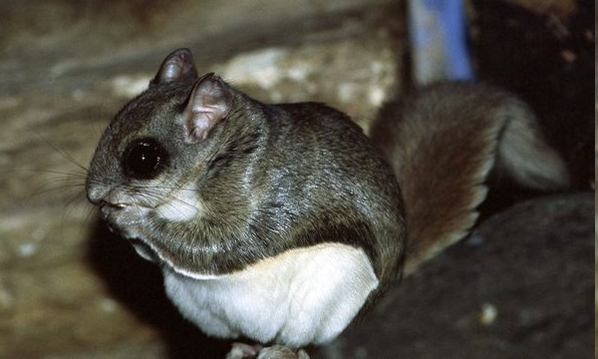
Previous Thinning Studies
Decreases
Mt. Lassen, CA
Ft. Lewis, WA
Blue Mtns, OR
Algonquin Park, ONT
Teakettle, CA
No Effect
Central BC
Coastal BC
Tillamook, OR
Notes:
Thinning studies mostly show decreases
Of the work that’s looked at effects of thinning on flying squirrels, most have concluded that thinning decreases densities of fliers. 2 studies have found no difference between thinned and unthinned stands.
Few studies have tracked long-term response
Two experimental studies measured squirrel densities more than 5 years after thinning. Wilson (2010) found that flying squirrel densities were low (<0.2 squirrels/ha) 12 years after variable-density thinning on the Forest Ecosystem Study (FES) in the Puget Trough of western Washington.
Ransome et al. (2004), working 12–14 years after pre-commercial thinning of young lodgepole pine forests in British Columbia, found densities of 0.14, 0.37, and 0.51 northern flying squirrels/
ha in stands thinned to low, medium, and high tree densities, respectively, and 0.20 flying squirrels/ha in unthinned control stands. Medium- and high-density thinning treatments had significantly
higher flying squirrel densities than control stands (P = 0.05).

Slide 10
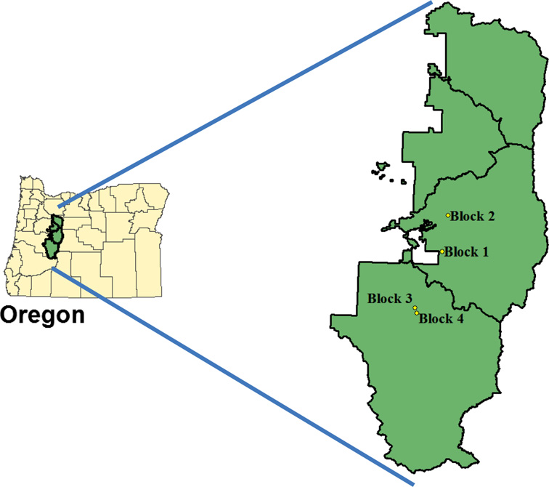
The Young Stand Thinning & Diversity Study
Notes:
Willamette National Forest: McKenzie Bridge and Oak Ridge RDs

Slide 11
The Young Stand Thinning & Diversity Study
Notes:
Study was initiated in early 1990s in 40-year old Douglas-fir stands that developed following clear-cut harvesting
Review of treatments

Slide 12
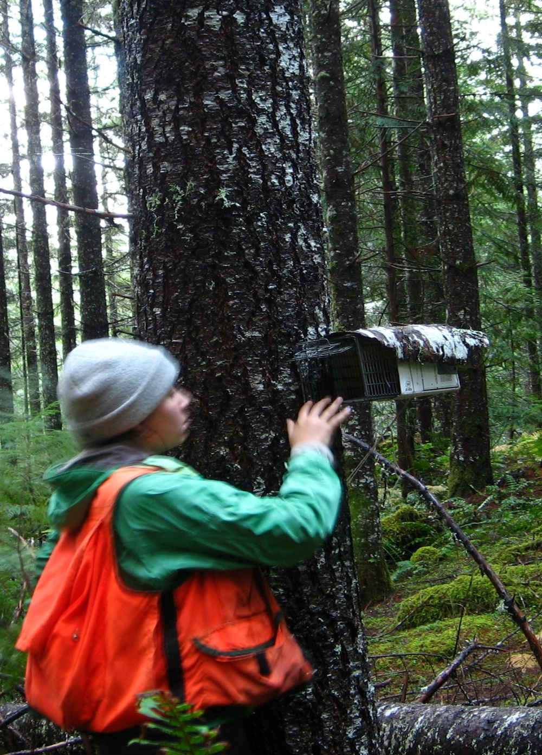
2007-2008 Sampling (~ 12 yrs post-thin)
Early rainy season (Sept-Nov)
Sherman traps: 50 per stand
Tomahawk traps: 50 per stand
50% of Tomahawks on trees, 1.5 m high
Mark-Recapture, 4-night session
Notes:
About 12 years post-thinning;
pre-treatment and early post-treatment trapping methods were not effective for catching fliers
Rainy season: when fliers are most likely to be foraging near the ground and thus more susceptible to trapping.
Half of the traps placed about a meter and a half up on trees.
4 nights in each stand per year

Slide 13
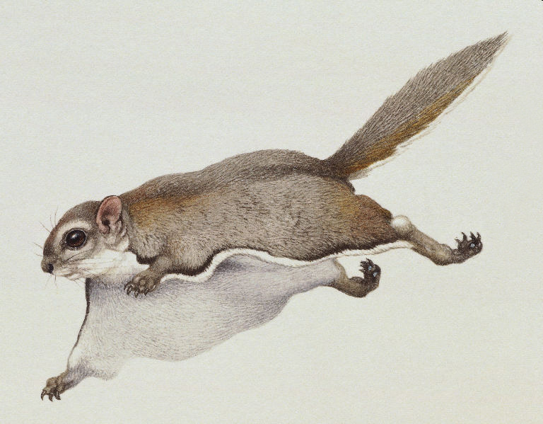
RESULTS

Slide 14
Flying Squirrel Densities with 95% CI's
A
A
2007
Notes:
Y-axis: individuals/ha
Consistent pattern between years
Density in thinned is roughly 1/3 or less that in unthinned
HT supported lower densities than Light and Light with Gaps

Slide 15
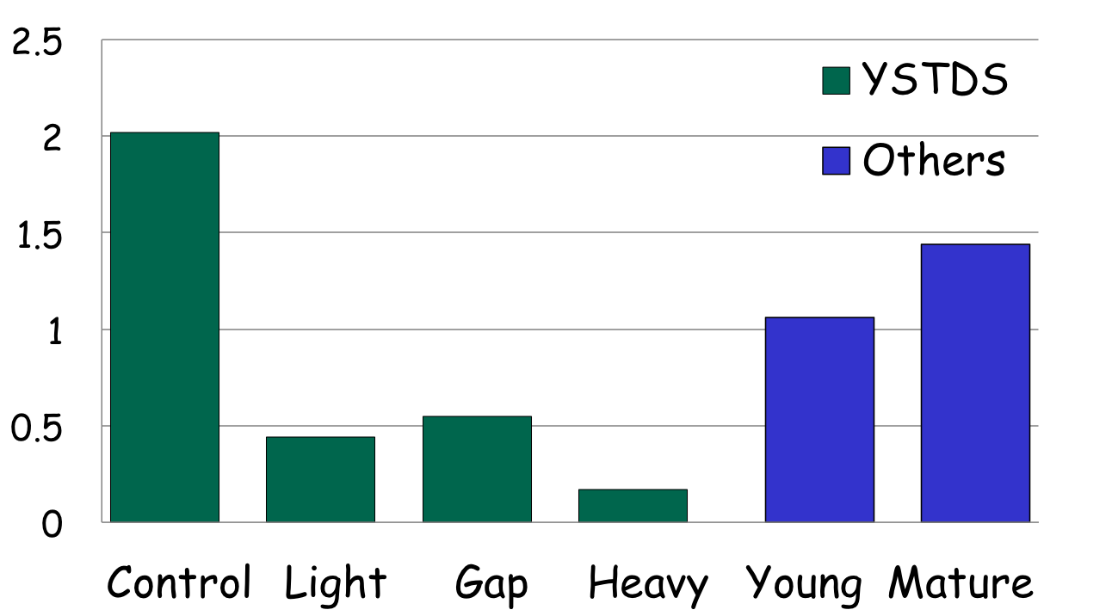
Comparison of Squirrel Density to other Studies
Notes:
Other studies:
Carey et al., 1992; Rosenberg and Anthony, 1992; Witt,1992; Carey, 1995; Waters and Zabel, 1995; Ransome and Sullivan, 2002, 2003; Gomez et al., 2005; Lehmkuhl et al., 2006; Herbers and Klenner 2007

Slide 16
Habitat Associations
+ Snag Density
Low Shrub Cover
(+ Basal Area)
Notes:
Results of mixed-effects linear regression

Slide 17
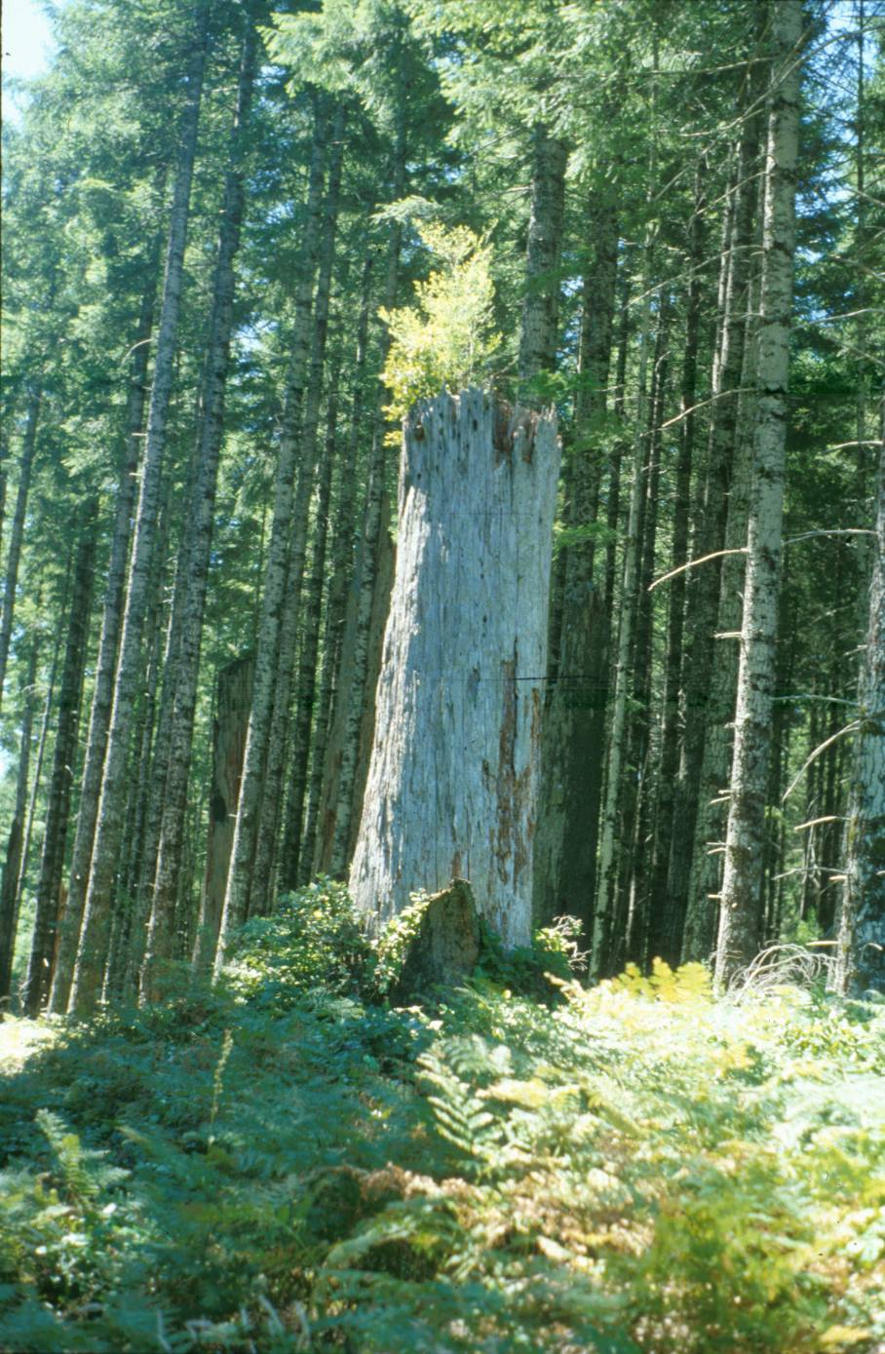
SNAGS
Flying squirrel density positively associated with snag density
Snags rare in thinned stands
Thinning causes decrease in density-dependent mortality
Notes:
Flying squirrel density was positively related with snag density, and negatively related with low shrub cover.

Slide 18
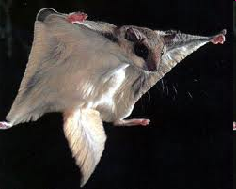
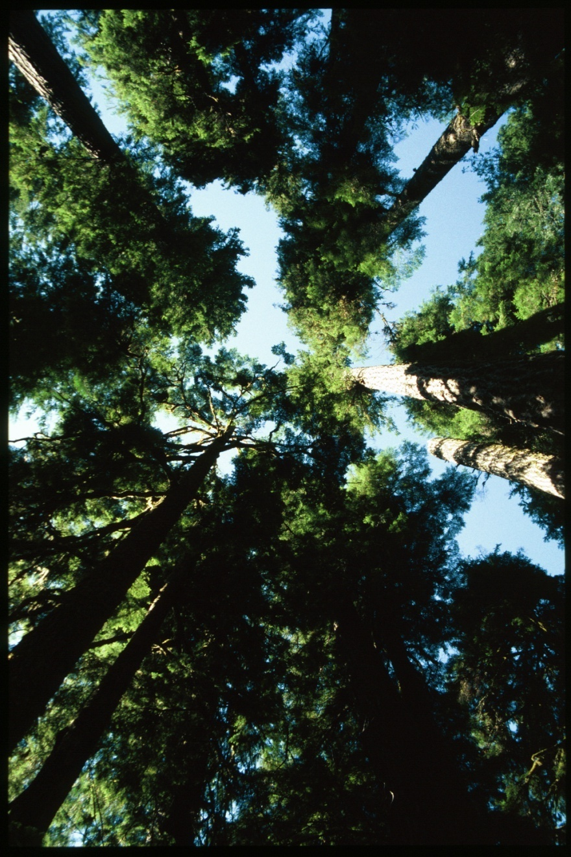
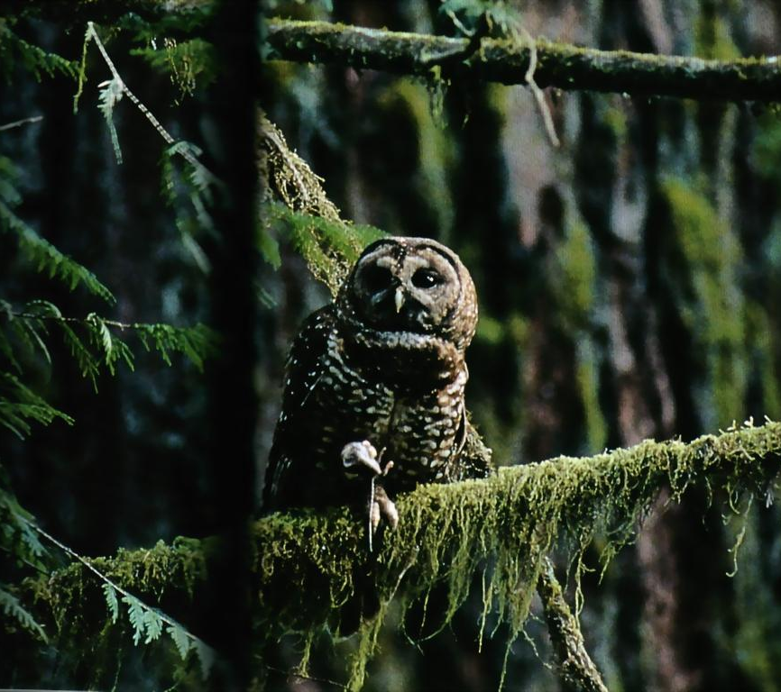
Importance of Overstory Characteristics
Notes:
BA was the only overstory variable in our regression model; mid-story cover is known to be biologically important to flying squirrel.
Likely negative correlation with shrub cover and overstory cover. Shrub cover as integrator of stand structure?
Canopy gaps = exposure to predators
Tree trunks = safety

Slide 19
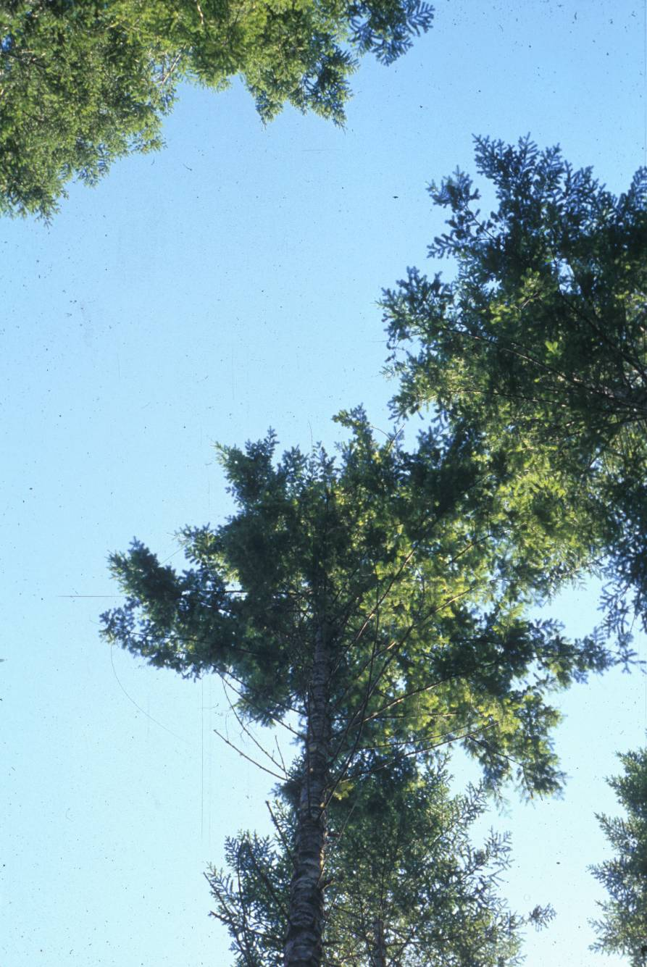
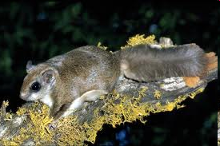
Summary
Lower densities in thinned young stands
Negative impact lasts at least 12 years
Impact proportional to thinning intensity
Notes:
Canopy cover in LT similar to CO by 10 years post-thin, but squirrel densities are not.

Slide 20
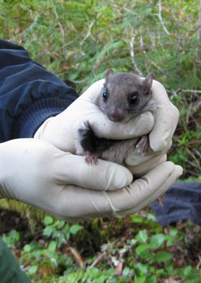
Yet to Learn…
Do differences in density reflect habitat quality?
Do fliers have lower fitness in thinned stands?
Reproduction
Survival
How long will it take for flier densities to recover?
Landscape-level question: Configuration or Composition?

Slide 21
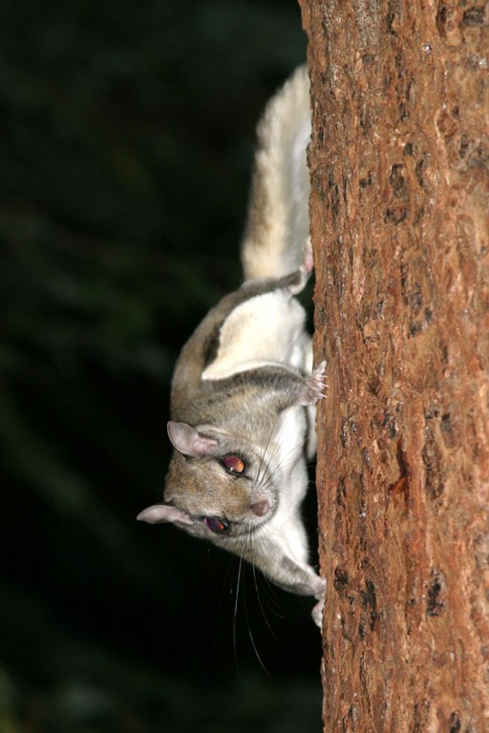
Management Implications
If goal is to maintain flying squirrel habitat, thinning may be incompatible in short- term
Long term…?
There are always Winners and Losers
© Larry Master
Notes:
Long term:
Forest development models suggest Thinning can probably accelerate development of late-seral structure, and benefit o-g associated species;
Empirical data lacking at this point, but continued monitoring on YSTDS will provide long-term information
In interim: Landscape level planning to maintain unthinned forest in combination with thinning seems like a reasonable strategy.
No matter what we do, manage or not, there will be winners and losers.

Slide 22
YSTDS: Small Mammal Responses 12 Years After Thinning
Increasers:
Chipmunk
Deer Mouse
Creeping Vole
Decreasers:
Trowbridge’s Shrew
Pacific Shrew
Red-backed Vole
Flying Squirrel

Slide 23
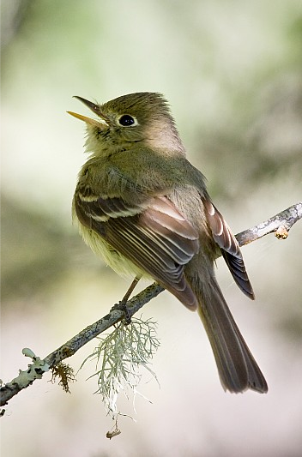
YSTDS: Response of Song Birds to Thinning
Increases in species associated with open canopy conditions
Decreases in species associated with dense, closed conifer canopy
Overall increase in species richness
Notes:
Response directions of some species starting to change after 12 years.

Slide 24
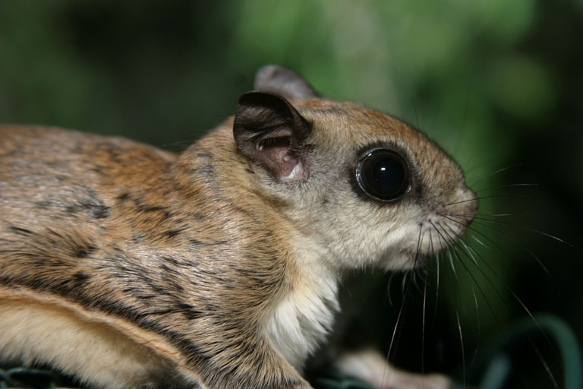
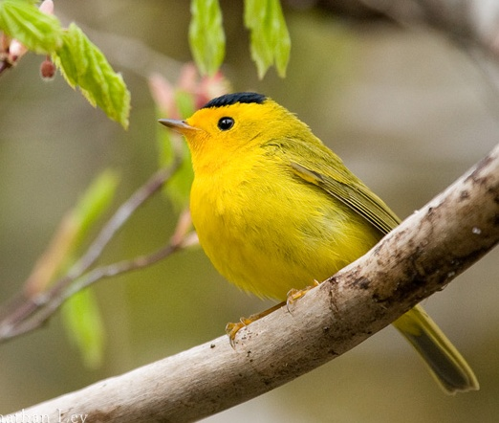
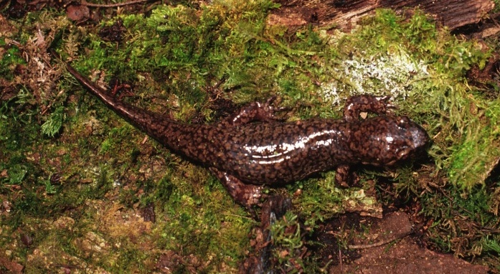
Conclusions
Thinning is a valuable tool for enhancing diversity in managed forests
Important to consider landscape context to manage conflict between short- and long-term habitat requirements

Slide 25
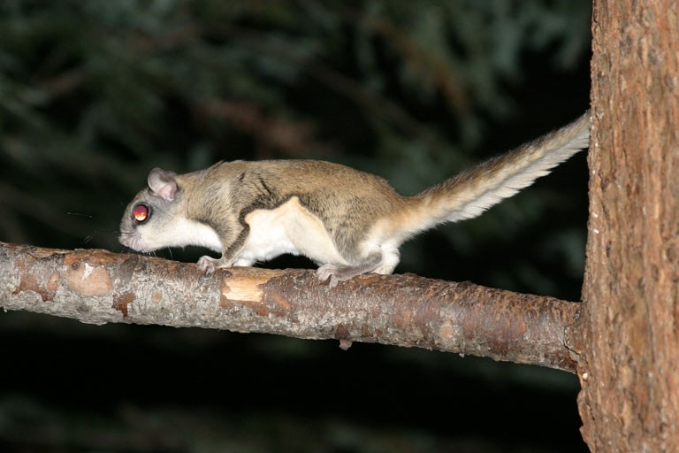
© Larry Master

