Slide 1

Northern Spotted Owl Prey Ecology: What’s for Dinner?
Ecology and Habitat Management for Deer Mice, Pocket Gophers, Snowshoe Hares, and Western Red-backed Voles
Aaron J. Wirsing, Assistant Professor

Slide 2

Acknowledgements
Steve West, Professor and Interim Associate Director
…and, Cheryl Friesen, for the invitation!

Slide 3
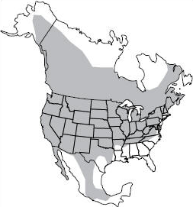
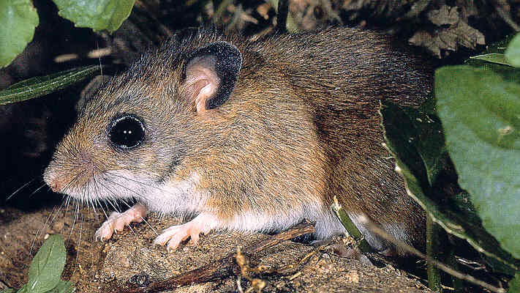
Deer Mice
P. maniculatus
Three species in the genus Peromyscus
Peromyscus crinitus
Canyon mouse
P. maniculatus
Deer mouse
P. truei
Piñon mouse
Deer mouse
incredibly broad distribution
Alaska, Yukon, and Northwest Territories down to Mexico
occurs throughout Oregon
Verts and Carraway (1998) Land Mammals of Oregon

Slide 4
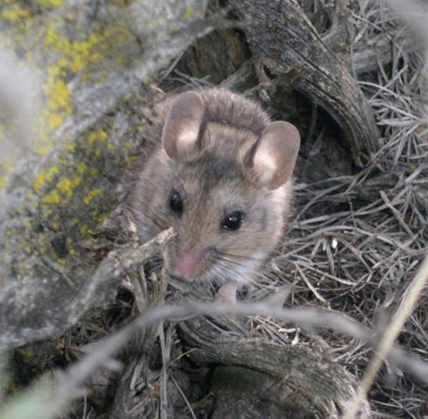
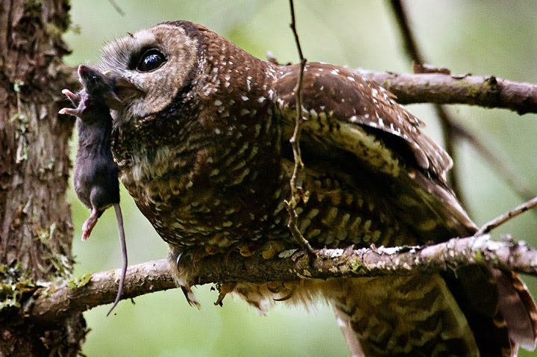
Deer Mice: Ecology
Habitat generalist (below treeline)
recent clear-cuttings to old growth
sage-brush steppe to renovated grasslands and pastures
Omnivorous diet
plant matter, fungi, arthropods
Prey for carnivorous mammals, raptors, and snakes
predators include spotted owls*
Carrier of hantavirus in western US
Hantavirus Pulmonary Syndrome
*Rosenberg et al. (2003) Can J Zool

Slide 5
Deer Mice: Management
An abundant but secondary prey species
Ubiquitous
< 2% of biomass as prey*
No management necessary
will be available to spotted owls irrespective of management strategy
*Rosenberg et al. (2003) Can J Zool

Slide 6
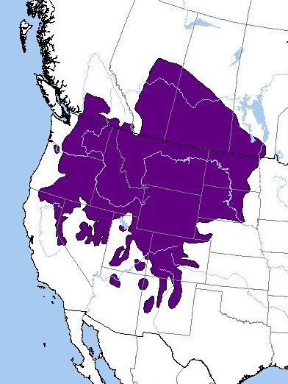
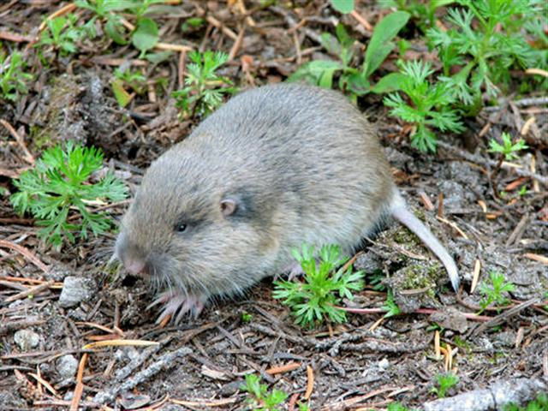
Pocket Gophers
T. talpoides
Five species in OR
Two are potential prey species
Northern pocket gopher
Thomomys talpoides
Verts and Carraway (1998) Land Mammals of Oregon

Slide 7
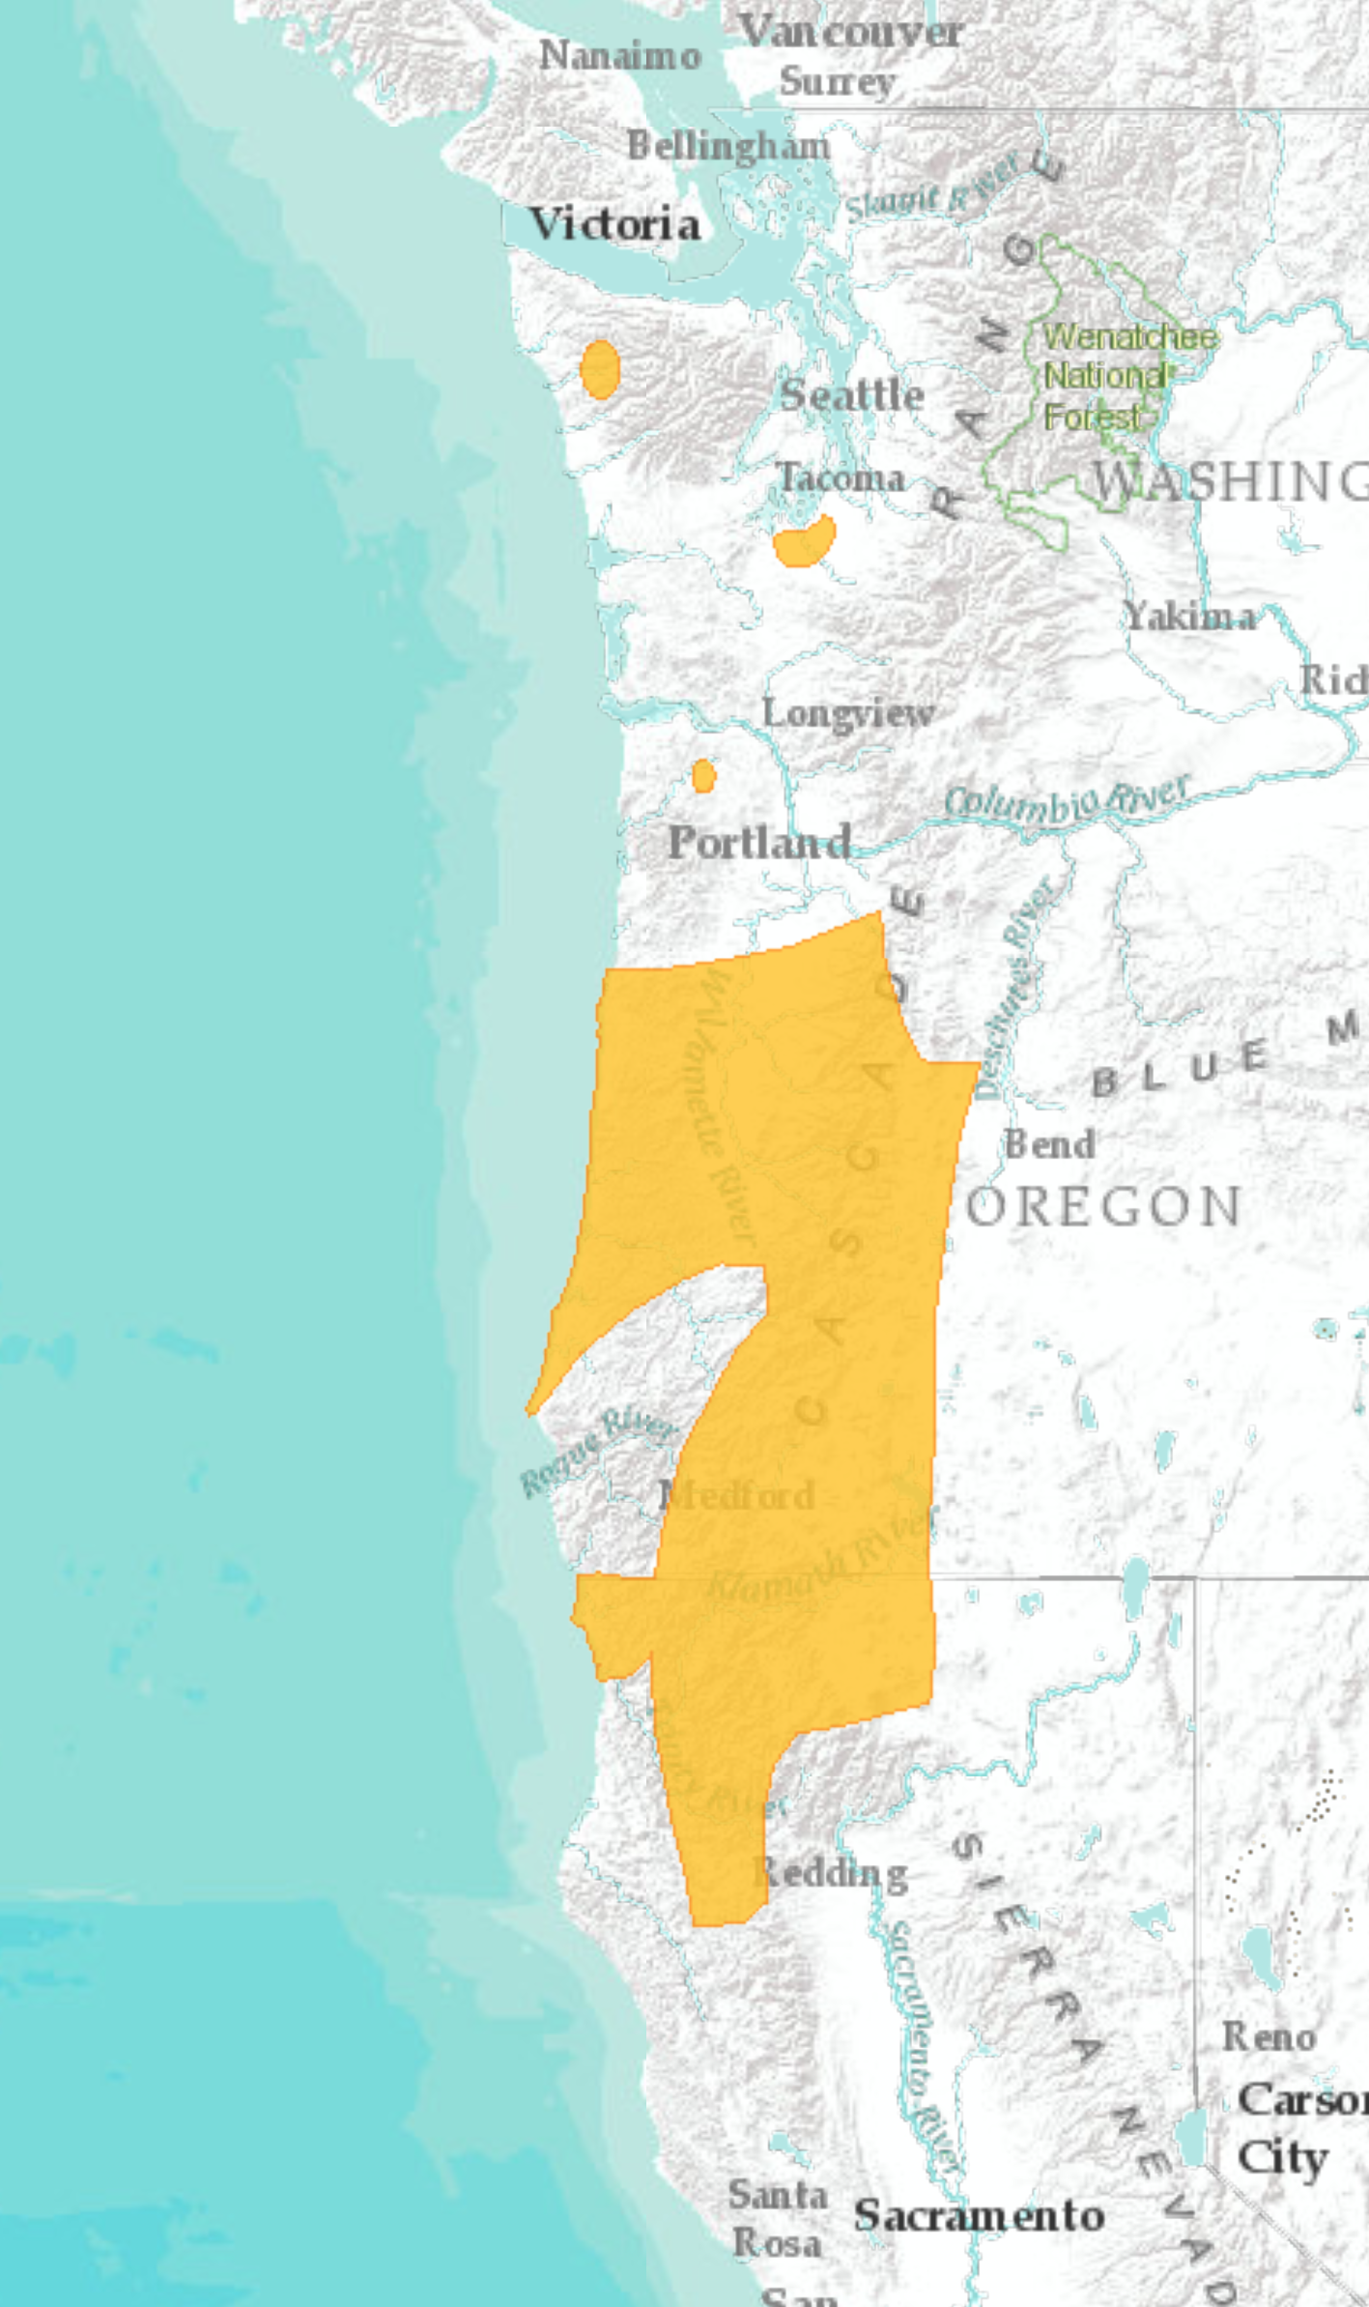
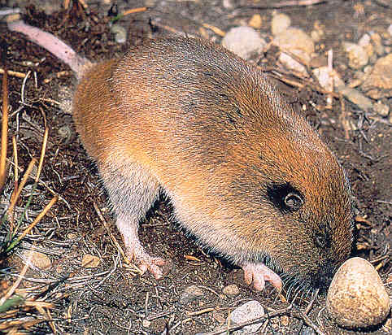
Pocket Gophers
T. mazama
Another prey species
Western (Mazama) pocket gopher
Thomomys mazama

Slide 8
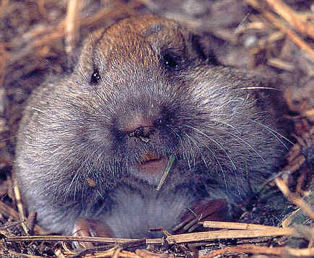
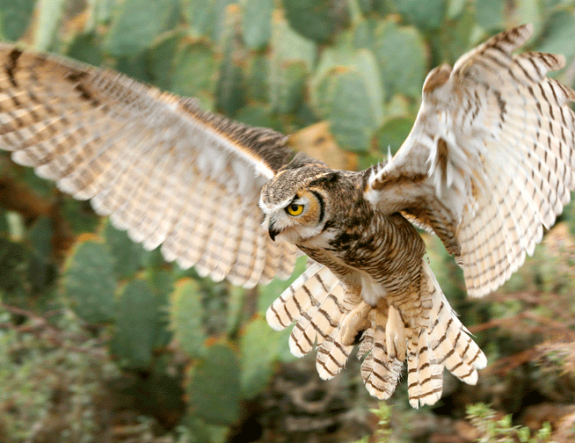
Pocket Gophers: Ecology
Largely fossorial
Habitat
most common in prairies, mountain meadows, and agricultural fields
also along forest edges; in recent cuts and thinned stands (esp T. talpoides)
not in dense forest
Herbivorous diet
above-ground plant parts and roots
external cheek pouches
Common prey species for owls
great horned, barn, long-eared
less so for spotted owls (7% of biomass)*
*Rosenberg et al. (2003) Can J Zool

Slide 9
Pocket Gophers: Management
Secondary prey species
restricted range (northern) and habitat (both species) overlap with spotted owls
Availability increased by
creation of forest edges, open forest (thinning), openings
Prairie dogs of the PNW
perceived as problem for agriculture and livestock
crop depredation
extensive burrow systems with mounds at openings

Slide 10
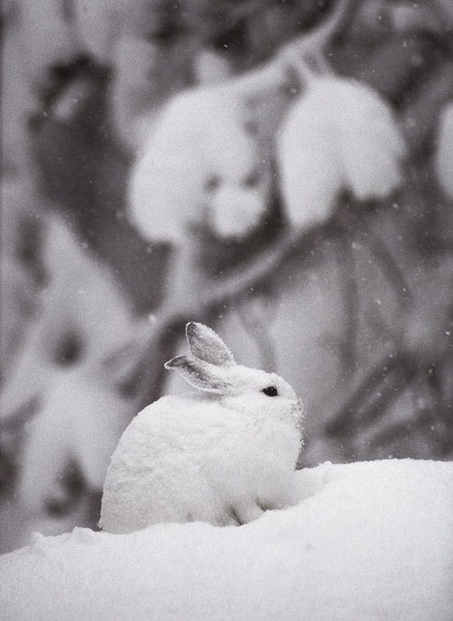
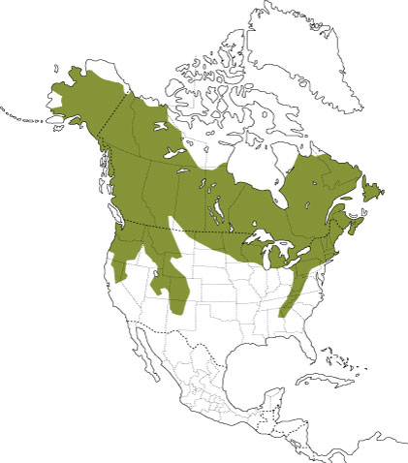
Snowshoe Hares
Lepus americanus

Slide 11
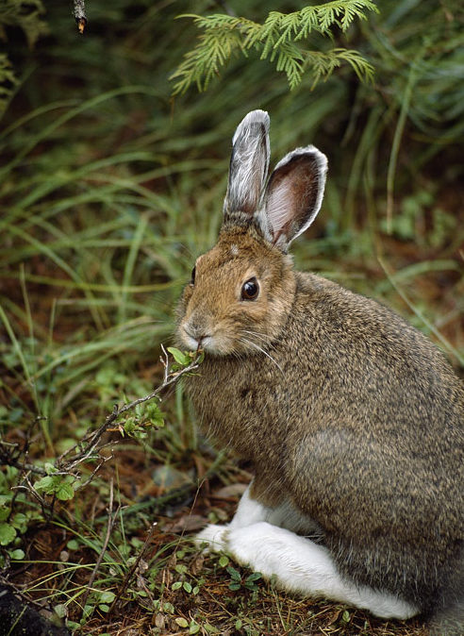
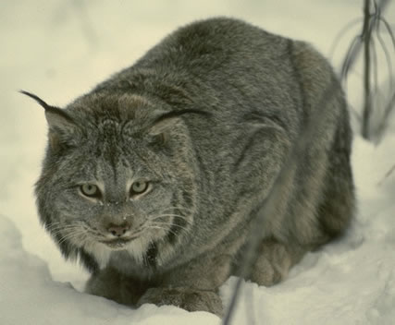
The Snowshoe Hare: Ecology
Habitat
boreal, montane forests of the Pacific Northwest
highest abundance in regenerating coniferous stands, 15-40 years old (cover)
Herbivorous diet
herbaceous browse in summer; woody browse in winter
A “strongly interacting” species
can alter plant community structure and chemical composition
prey species for diverse group of mammalian and raptorial predators
notably, Canada lynx (Lynx canadensis)
Soule et al. (2003) Con Biol

Slide 12
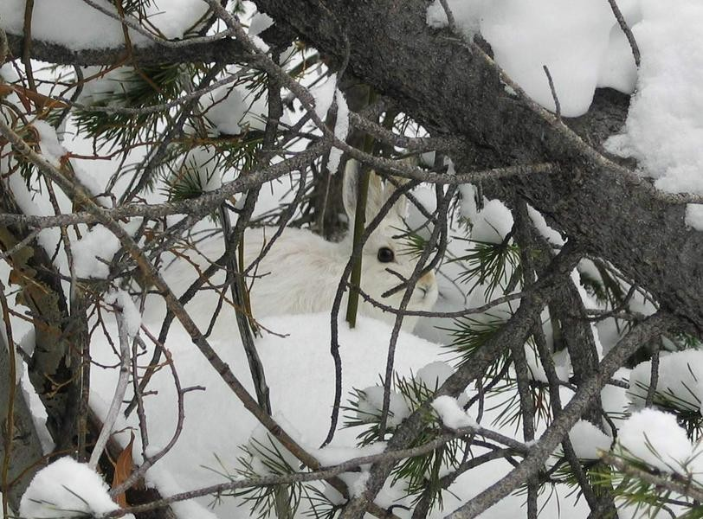
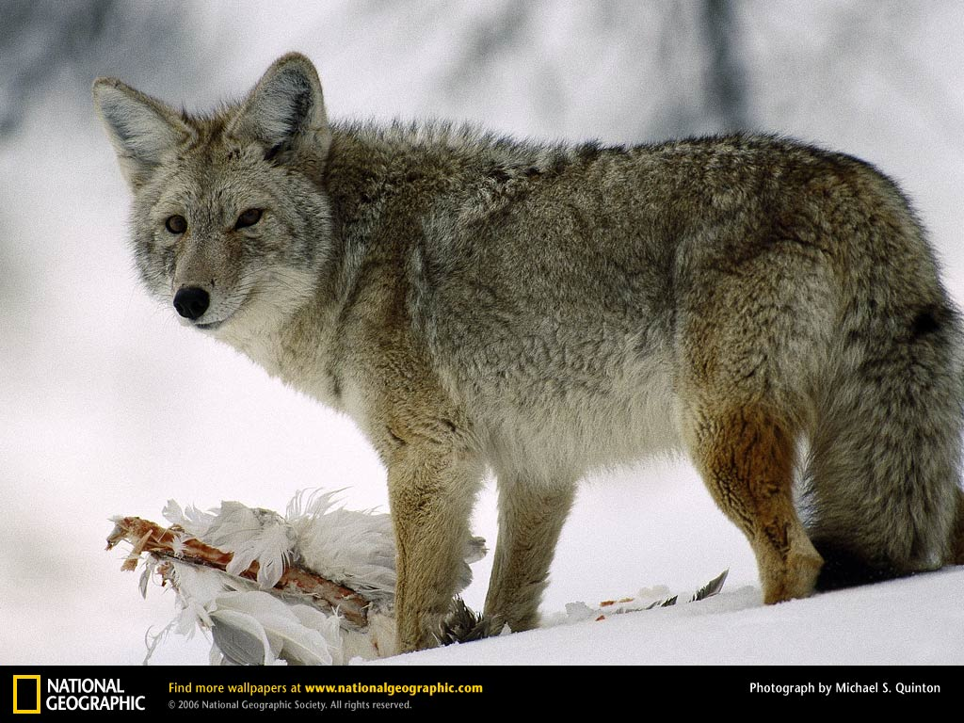
The Snowshoe Hare: Ecology
Textbook species for cyclic dynamics
10-year cycle product of time-lagged predation by specialists (lynx)*
cycle attenuated or absent in southern range
fragmentation, predation by generalists
‘Poster child’ for effects of climate change
loss of snowy habitat
mismatch between pelage and background
increased exposure to predators during winter
*Krebs et al. (1995) Science

Slide 13
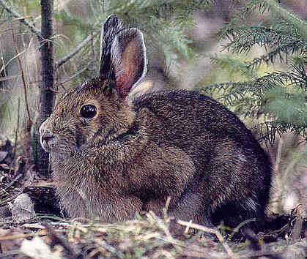
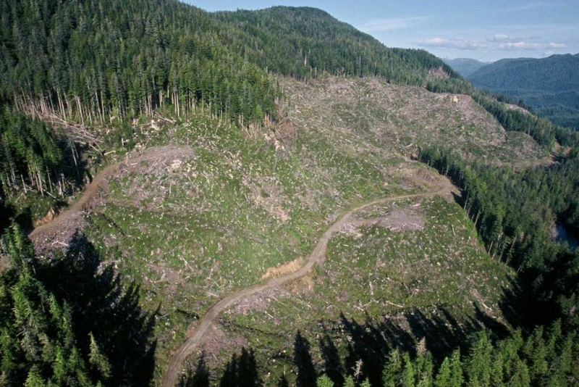
The Snowshoe Hare: Management
Secondary prey species for spotted owls
represent a big meal (10% of biomass)
Closely associated with protective understory cover
highest abundance where visual obstruction up to 2.5 m is 40-60%
8000 – 12000 stems/ha
Use silviculture, fire to create
15-20 ha stands, aged 15-40 years
pockets of high hare density
edges between mature and regenerating forest
Hodges (2000) Ecology of snowshoe hares in southern boreal and montane forests

Slide 14
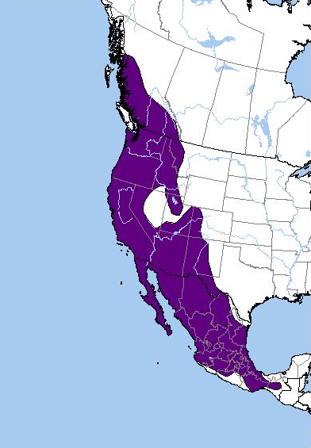
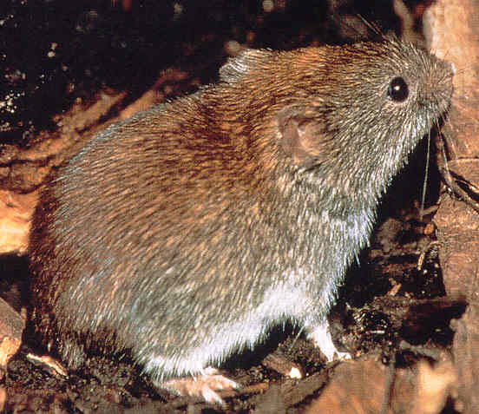
Western Red-backed Vole
Myodes californicus
Broadly speaking
Range encompasses all of OR
Southern red-backed vole
Clethrionomys gapperi
actually found to the north
M. californicus
Verts and Carraway (1998) Land Mammals of Oregon

Slide 15
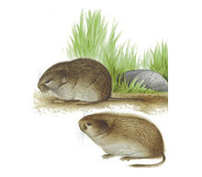
Western Red-backed Vole: Ecology
Habitat
forest ecosystems
most abundant in closed-canopy old-growth with ample woody debris
western OR, primarily associated with coniferous forests
Diet
primarily fungal sporocarps and lichens
also insect larvae and conifer seeds
Prey for
mammalian carnivores, raptors
spotted owls (5% of biomass in OR)*
*Rosenberg et al. (2003) Can J Zool

Slide 16
Western Red-backed Vole: Management
Secondary prey species
widely available (high habitat overlap)
Intolerant of clearcuts*
sharp declines observed in first two years post-harvest (WA, OR)
local extinction likely
especially where sun exposure is high (e.g., south facing slopes)
Availability for spotted owls in OR increased by
managing for closed-canopy old-growth coniferous forests
woody debris
key resources: shade, moisture, protection, food
*Gitzen et al. (2007) For Ecol Manage

Slide 17
Summary
Suite of potential prey species
all secondary
could be locally important depending on landscape conditions
Divergent management pathways
Deer mice: no management needed
Snowshoe hares and pocket gophers: manage to simulate disturbance that creates cover-rich regenerating forest, edges, and openings
Western red-backed voles: manage for closed-canopy old-growth

