Slide 1
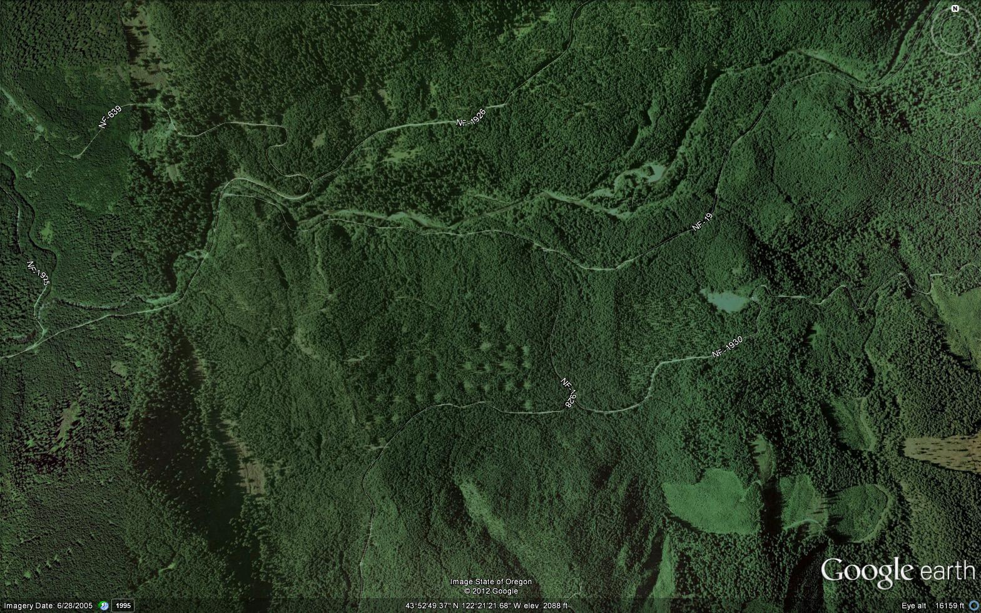
Spotted Owl Prey in a Landscape Mosaic: Implications for Conservation

Slide 2
Landscape Analysis
Define the Extent
Define the Grain
Define the Context
Define patch types
Map patches
Assess composition
Assess structure
Does the landscape
Inhibit or facilitate
Important processes?

Slide 3
Landscape Metrics
Composition – patch types, richness, etc.
Structure – configuration, shape, arrangement, etc.
Are these associated with animal fitness? Abundance? Occurrence?
Do certain patch types, and arrangements contribute to conservation of species?
FRAGSTATS
http://www.umass.edu/landeco/research/fragstats/fragstats.html

Slide 4
What patterns do we see?
Species | Landscape Composition |  |  | Landscape Pattern
 | F | P | R² | Variable | F | P | R²
Calif. Red-backed vole | 6.18 | 0.02 | +0.18 | Area-Weighted Mean Patch Fractal Dimension | 12.5 | 0.003 | -0.40
Shrew-mole | 0.04 | 0.85 | 0.001 | Contrast Weighted Edge Density | 7.10 | 0.02 | -0.32
Deer mouse | 8.50 | 0.01 | +0.23 | Edge Density | 113 | 0.001 | +0.32
White-footed vole | 1.81 | 0.19 | 0.06 | Core Area Density | 4.20 | 0.06 | -0.18
Red tree vole | 1.60 | 0.22 | 0.05 | Patch Density | 4.81 | 0.05 | -0.19
Coast mole | 2.25 | 0.15 | 0.07
Pocket Gopher | 1.95 | 0.17 | 0.06
Small r-squares – very little variance in captures accounted for
Not very mobile species
Why is there not a more striking association with landscape conditions?

Slide 5
Populations and Connections: Flying squirrels in the central Cascades
Integrate a patch network and inter-patch connectivity into harvest planning; leave unthinned patches and unthinned corridors.
Future thinning of unthinned stands should consider the recovery time associated with thinned stands. How long until thinned stands again become suitable?

Slide 6
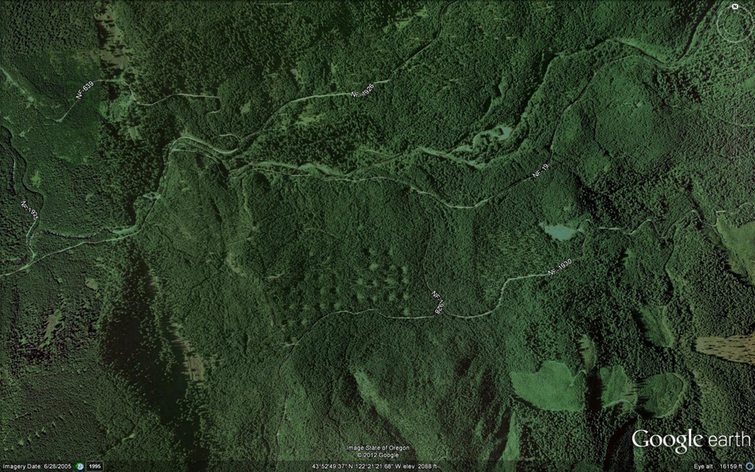
How do you map patches for Spotted Owl prey?
What is the extent?
What is the grain?
What is the context?
How will you define patch types for spotted owl prey?
How will you know where to draw patch boundaries?

Slide 7
How do you map patches?
How consistently are patch types mapped?
Cushman, S.A.; Evans, J. S.; McGarigal, K.; Kiesecker, J.M. 2010. Toward Gleasonian Landscape Ecology: From Communities to Species, From Patches to Pixels. Res. Pap. RMRS-RP-84. Fort Collins, CO: U.S. Department of Agriculture, Forest Service, Rocky Mountain Research Station. 12 p.

Slide 8
Clementsian Landscape Ecology
“The predominance of classified, categorical maps as the basis for landscape ecology is a historical legacy and a management convenience.” Cushman et al. 2010.
Patch types do not reflect the requirements of each species individually. A patch type is not a surrogate for one or multiple species.
Patches are not static in composition, size or shape, they are continually in flux. Patches are usually considered fixed in space and over time (e.g., stands)

Slide 9
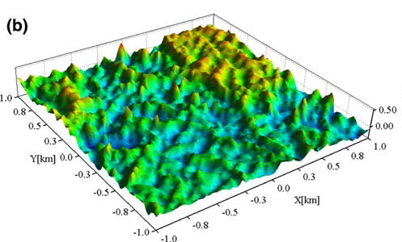
Gleasonian Landscape Ecology
Assess habitat for each species to reflect as near as possible its realized niche
Where plant species composition is important to an animal species, map individual plant species (not forest types or plant communities)
Assess at a fine grain (e.g., pixel) and aggregate data along surfaces, rather than patches. OR
Where patches are defined, recognize that patches change over time
Scale each landscape to each species.
McGarigal, K., S. Tagil, and S.A. Cushman. 2009. Surface metrics: An alternative to patch metrics for the quantification of landscape structure. Landscape Ecology 24: 433-450. PDF

Slide 10
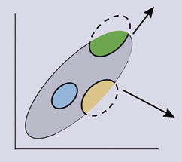
Climate Change, Fires, and Diseases
A pixel-based, species-based approach allows for changes in response to disturbances and pressures
Patch types (e.g., habitat types, forest types) will not change en masse to changes in climate. Responses will be species specific
No analog environments
could lead to differential
effects on species
C
E1
A
B
E2

Slide 11
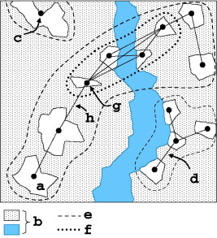
Connectivity
Typical approach is to think of barriers, corridors, stepping stones and other patch-based concepts.
Probability of movement, survival assigned to patch types.
Inter-patch distance is often related to dispersal capabilities of the organism.
Paul Galpern, Micheline Manseau, Andrew Fall, Patch-based graphs of landscape connectivity: A guide to construction, analysis and application for conservation, Biological Conservation, Volume 144, Issue 1, January 2011, Pages 44-55, ISSN 0006-3207, 10.1016/j.biocon.2010.09.002.

Slide 12
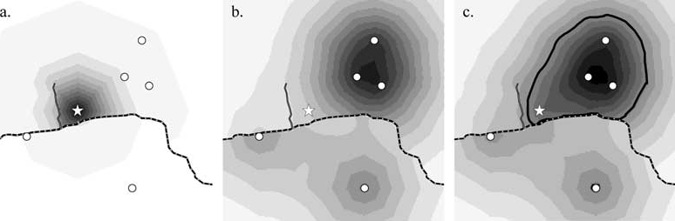
Connectivity
Each pixel is assigned a resistance to movement based on characteristics of the pixel that can change over time
Gradients connectivity can be visualized and quantified
Compton, B., K. McGarigal, S.A. Cushman and L. Gamble. 2007. A Resistant-Kernel Model of Connectivity for Amphibians that Breed in Vernal Pools. Conservation Biology 21: 788-799.

Slide 13
Comparing Approaches
Clementsian
Gleasonian
Patch based: habitat types, forest types
Multi-species
Patch boundaries unlikely to migrate over time
Relate multiple species to each patch type
Structure and composition metrics are assumed related to habitat quality
Gradient based
Species based realized niches
Habitat represented by surfaces or by patches that change over time in shape and value
Surface metrics likely to replace patch metrics

Slide 14
Take home messages
Recognize that patch-based approaches are not realistic. Change to Gleasonian approaches won’t happen over night, but we need to begin to move in that direction. New version of FRAGSTATS will help.
If you must use patches, then define patches based on the requirements of each species. Avoid using habitat types or forest types as surrogates for habitat
Map habitat for individual species; don’t lump them
Scale all landscapes, gradients and patches to the use of space and time by each species.
Use first principles of landscape ecology to guide management until we know more; maintain large areas of suitable habitat , close together, and connected

