Slide 1
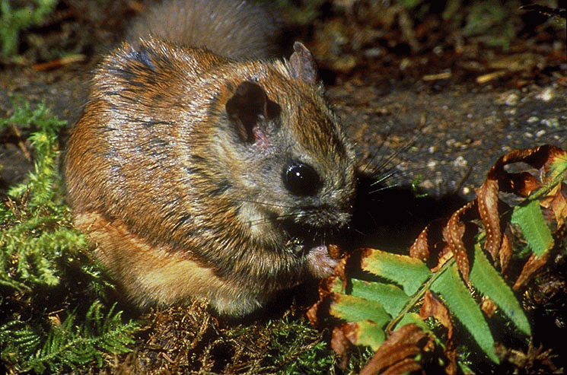
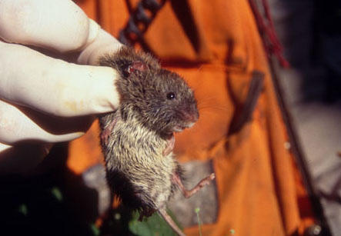
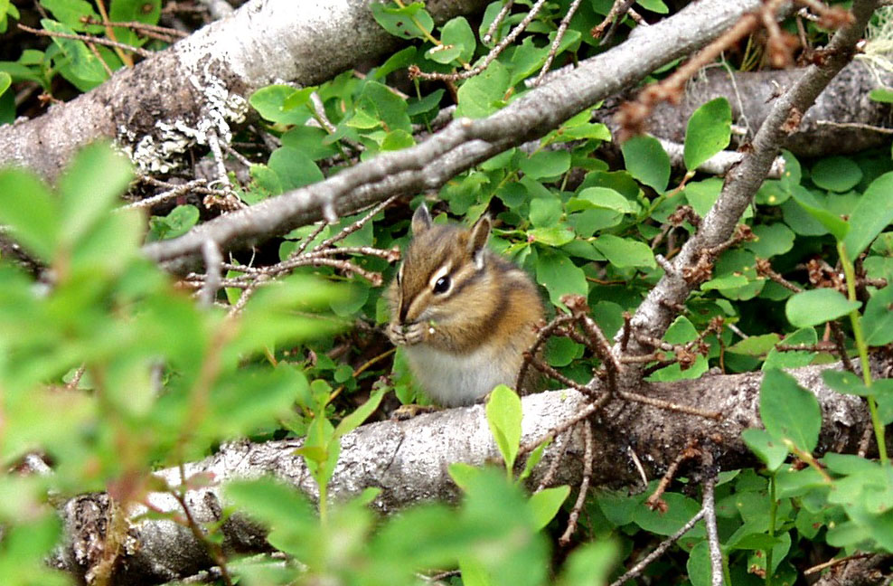
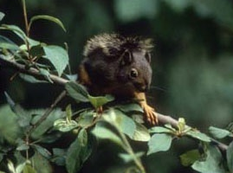
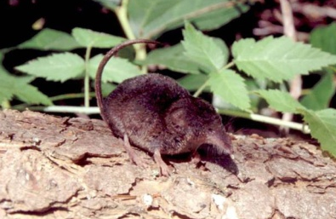
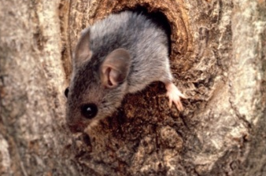
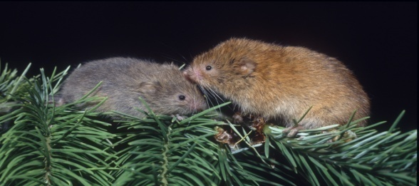
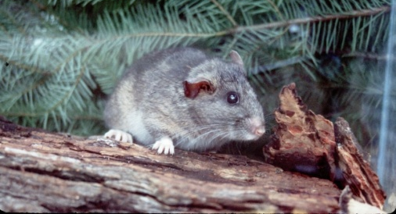
Stand-level Niches: How Does Everybody Fit In?
(and what might we do about it?)

Slide 2
Gradient in Tree Use
Tree voles
Flying squirrels
Other tree squirrels
Mice
Chipmunks
Ground voles
Shrews
Moles

Slide 3
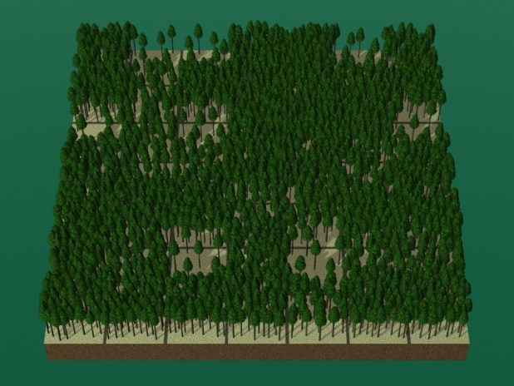
Thinning has a negative effect
Bull et al. 2004
Carey 2000, 2001
Gomez et al. 2005
Herbers and Klenner 2007
Holloway and Malcolm 2006
Manning et al. 2011
Meyer et al. 2007
Ransome et al. 2004
Waters and Zabel 1995
Waters et al. 2000
Wilson 2010

Slide 4
Abundance Matters!
VS

Slide 5
To Thin or Not to Thin?
Much of the landscape in a simplified condition
Some of these forests will be slow to develop desired conditions
Need to restore frequent fire return intervals
Notes:
Too much landscape in simplified condition. Some forests get stuck in competitive exclusion. Need to restore frequent fire return intervals.

Slide 6
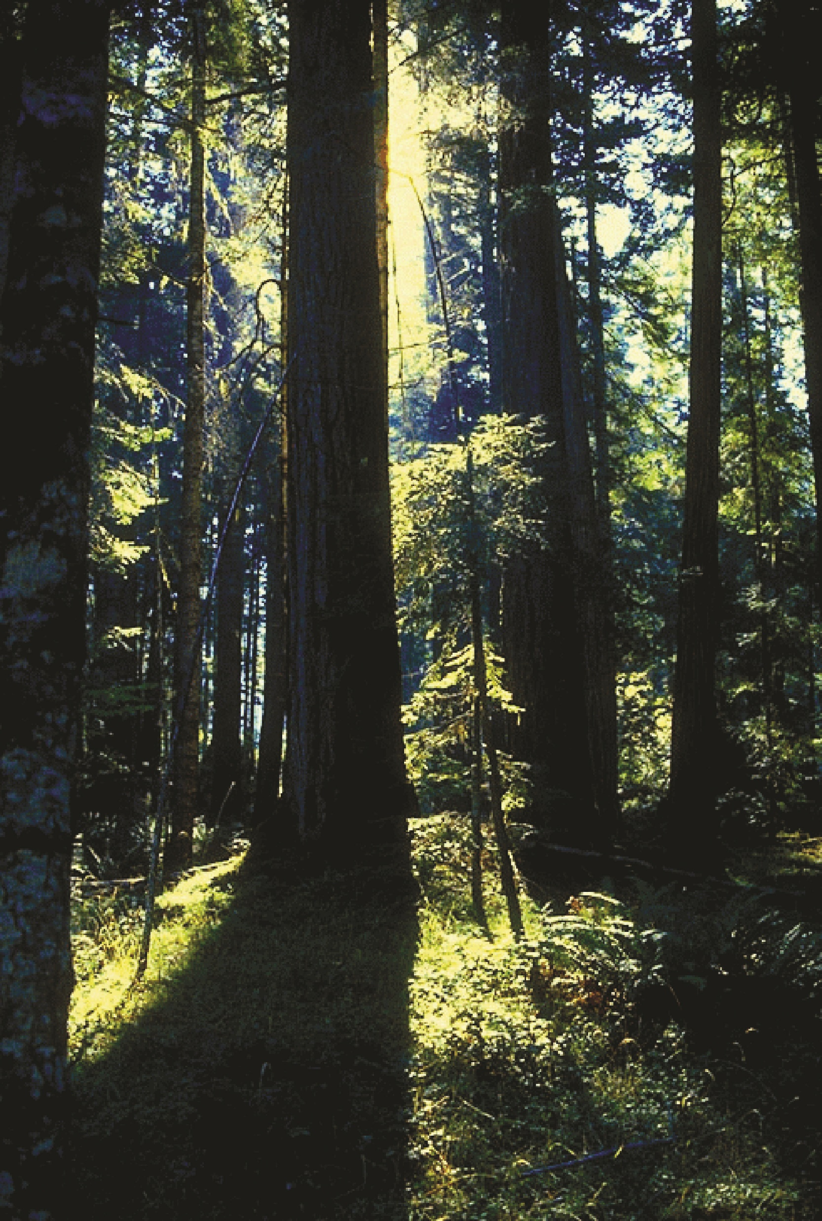
How best to move landscape trajectories toward more complex forests?
Real Question:

Slide 7
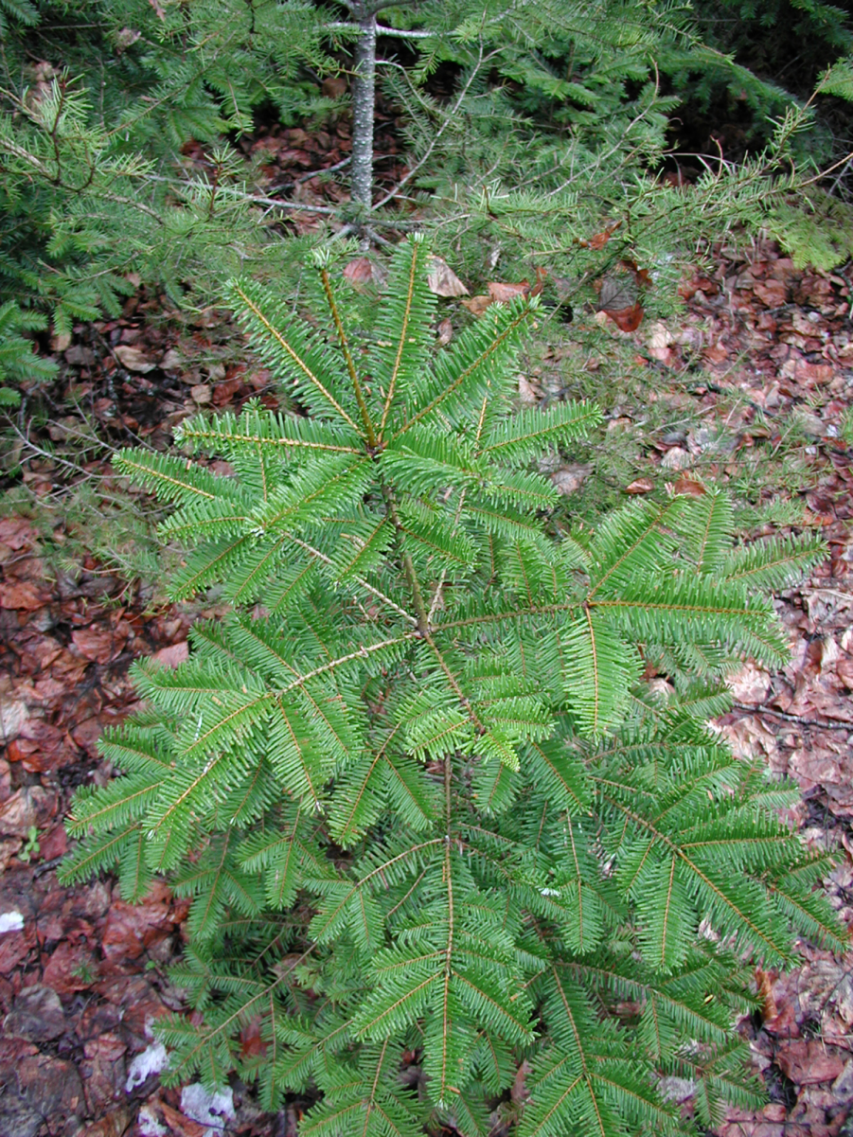
Focus on acceleration
of midstory
Underplanting
Understory Management
Regeneration Management

Slide 8
Include young (<25yr) stands
Achieve multiple layers sooner
Flying squirrels may not yet use these stands
High stem density for horizontal occlusion

Slide 9
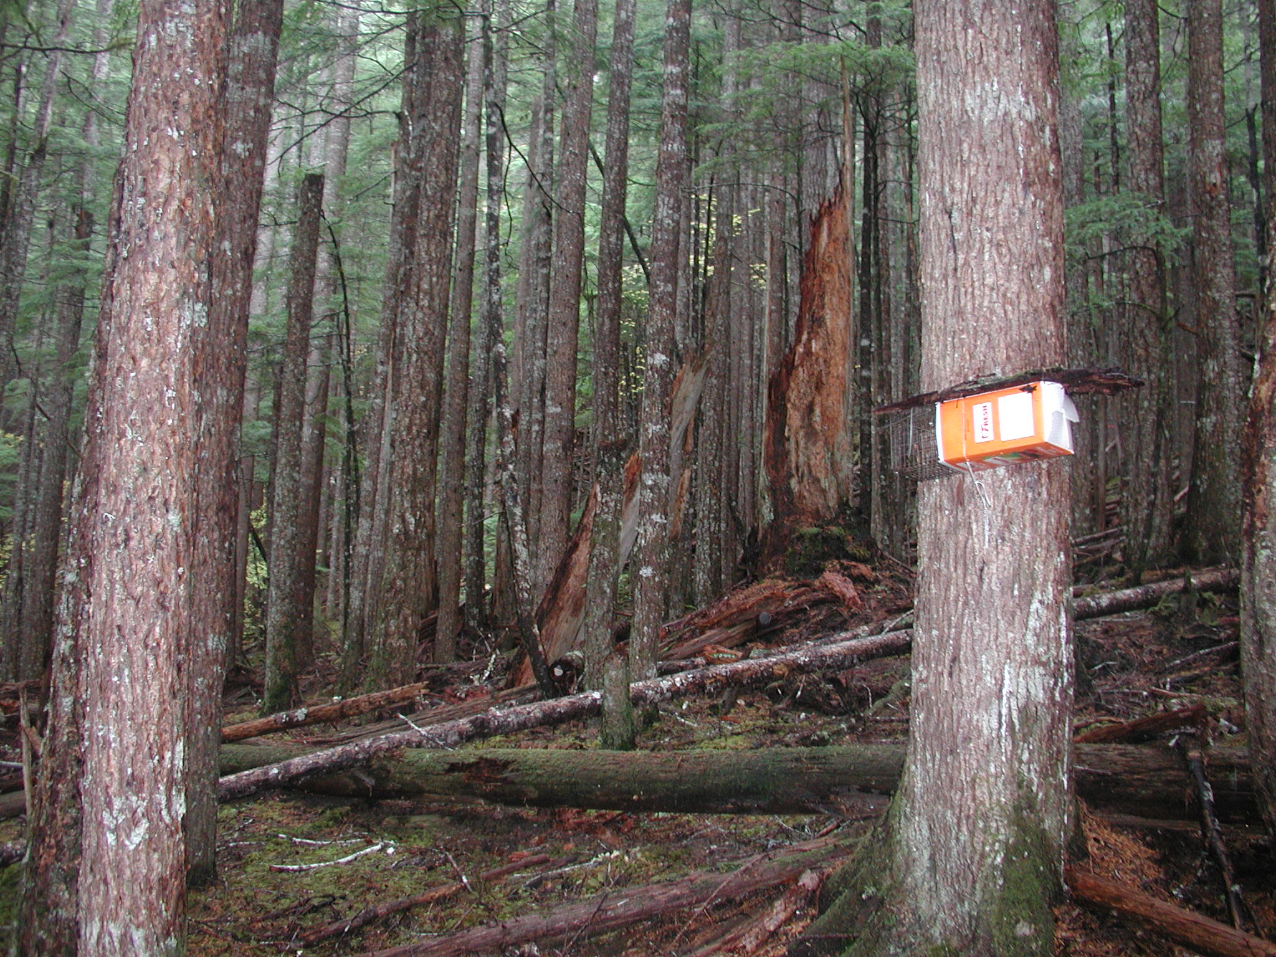
Keep some high-density forest

Slide 10
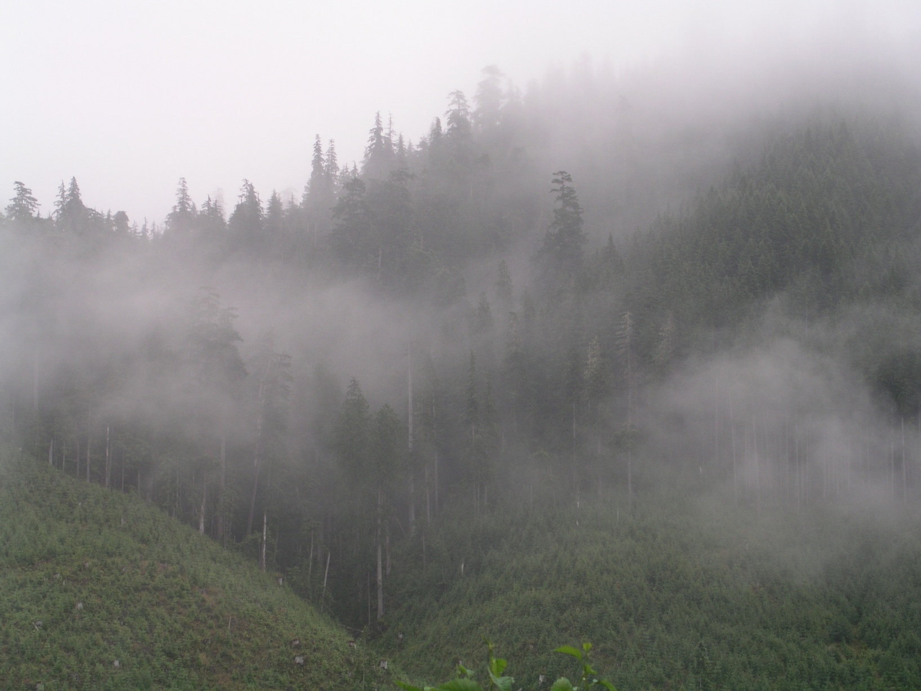
Adjacency
Notes:
Ft lewis stands next to each other

Slide 11
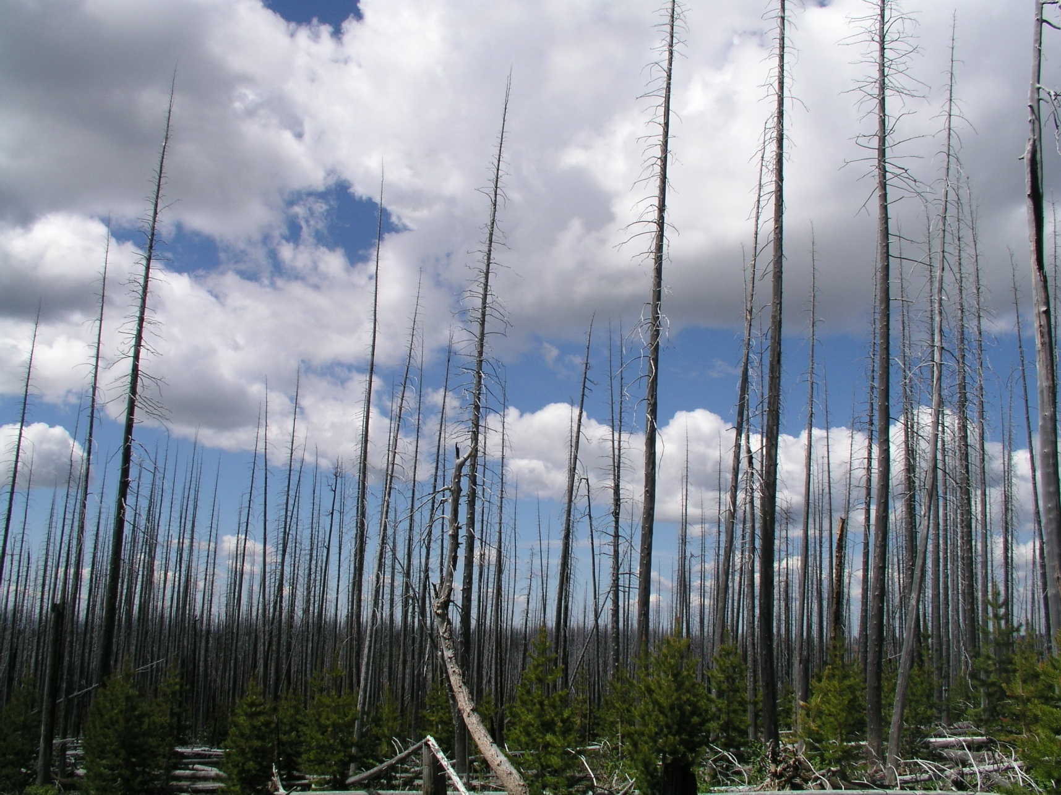
Protect existing high-quality habitat
Notes:
Thin, permeable buffers

Slide 12
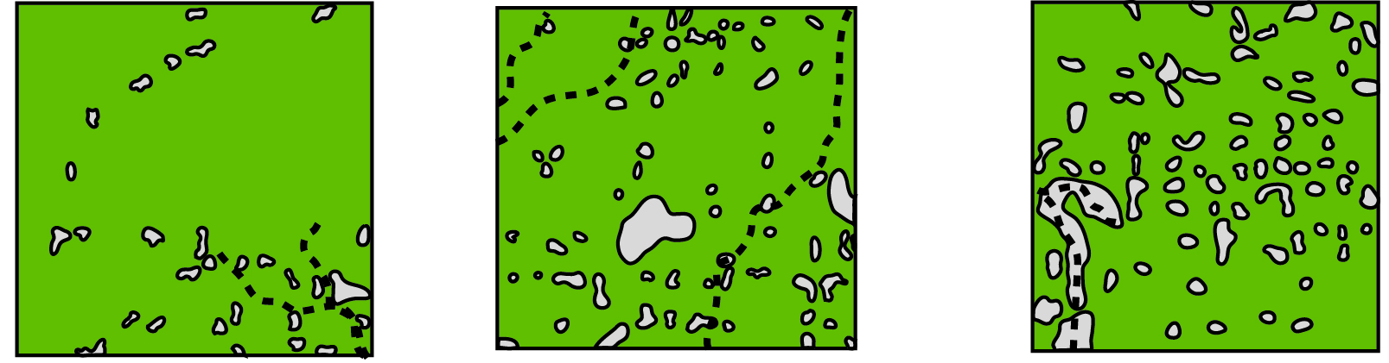
New Prescriptions?
Pattern matters
Skips and small gaps
Maintain canopy connectivity
Protect nest substrates
Notes:
Best in high density forest or mixed conifer

Slide 13
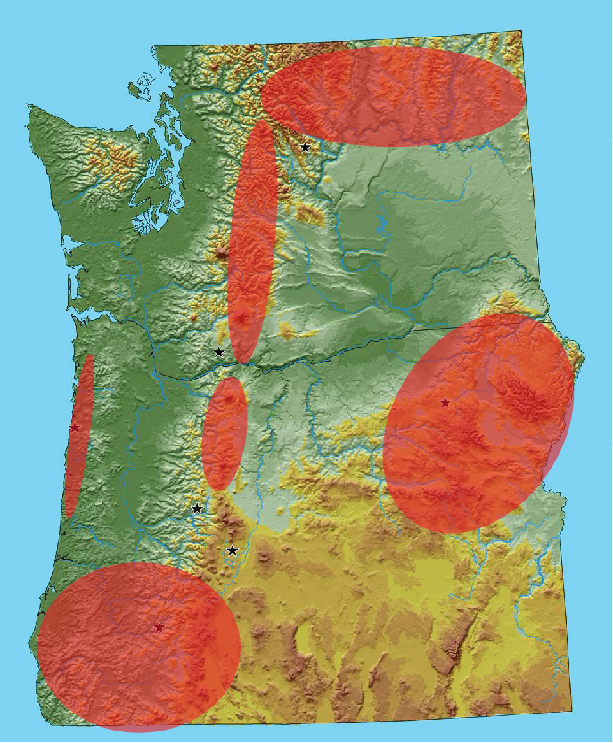
What Next?
Expand flying
squirrel model…

Slide 14
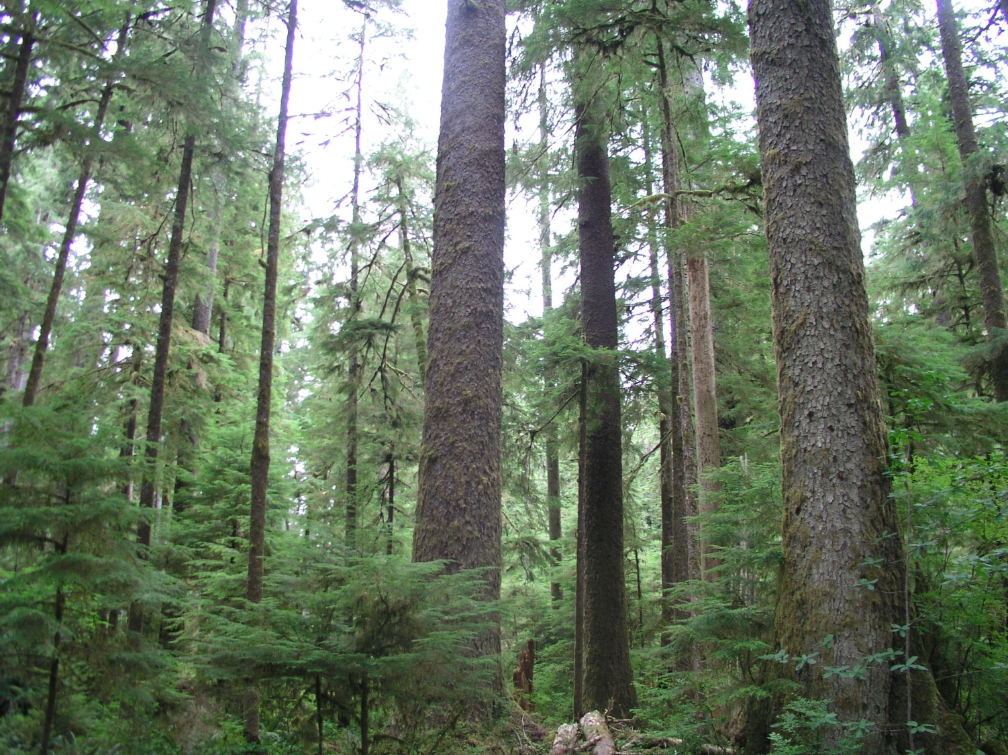
Better metrics for evaluating squirrel habitat

Slide 15

Woodrats?

Slide 16
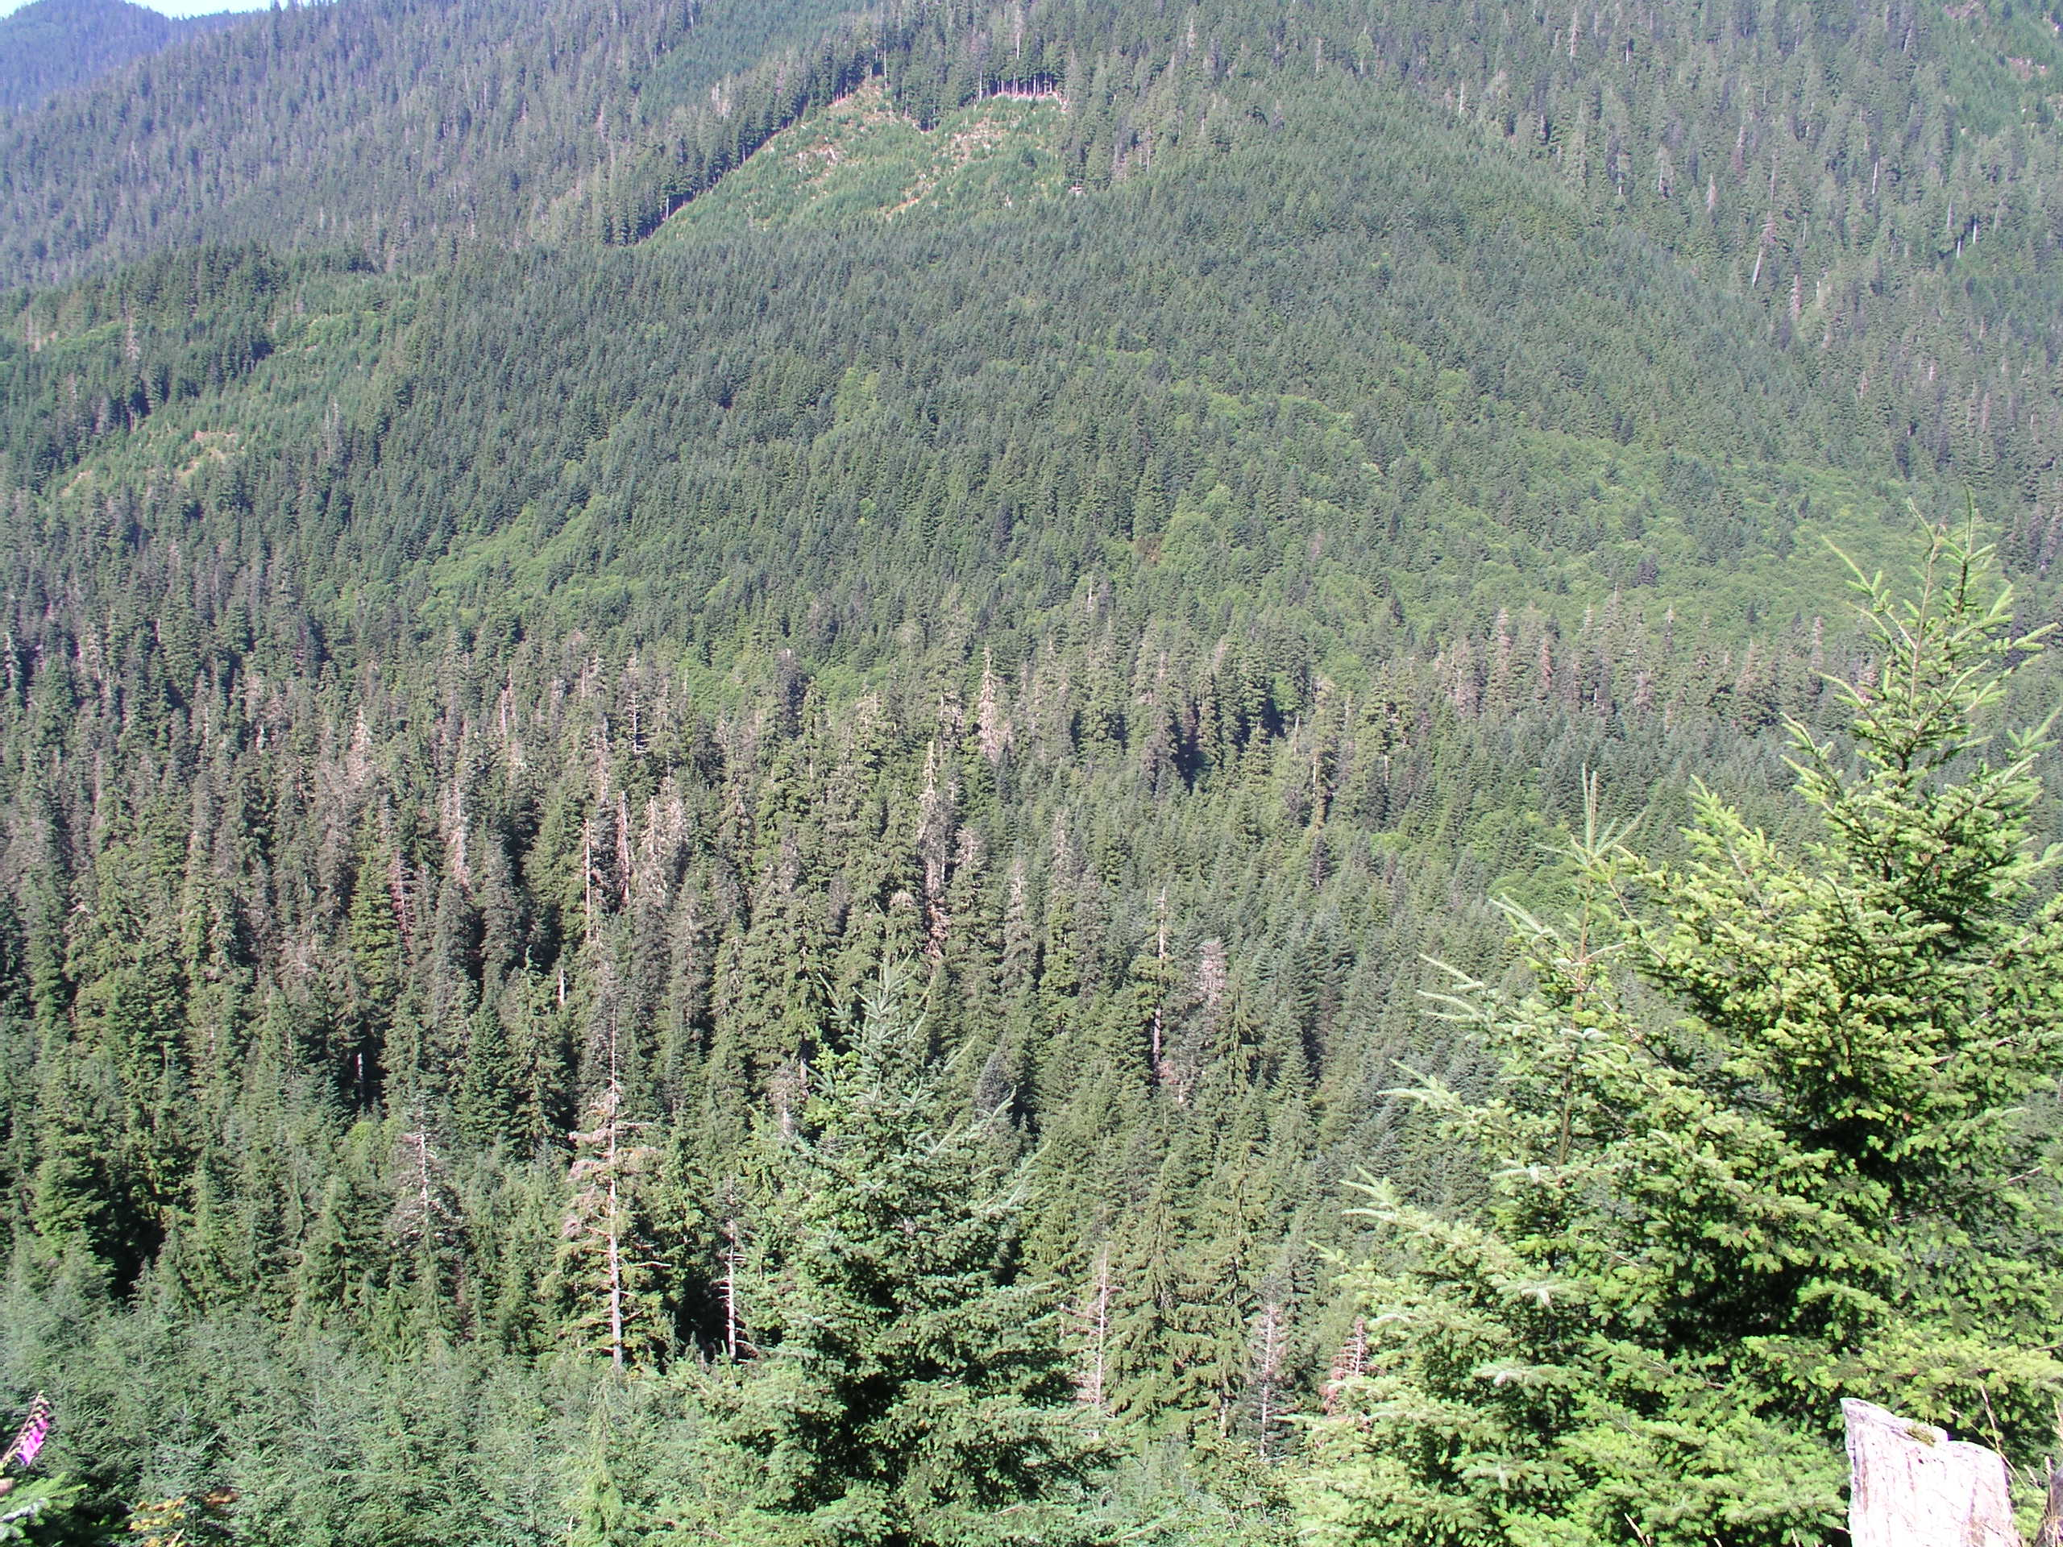
Landscape and Regional
Strategy

Slide 17
Conclusion
Notes:
Have to think spatially and temporally and in multiple dimensions. Now have some metrics that can be applied in thinning prescriptions. Continue expanding research and search for management partners.

