Slide 1
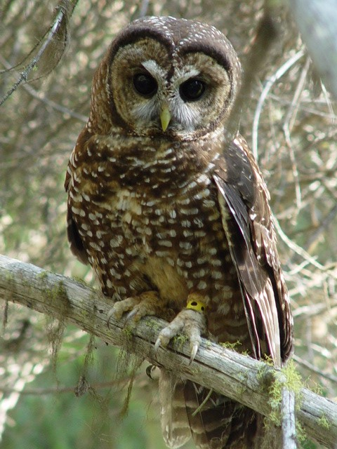
REGIONAL, LOCAL AND ANNUAL VARIATION IN DIETS OF SPOTTED OWLS
ERIC FORSMAN
U. S Forest Service,
Pacific Northwest Research Station
Corvallis, OR

Slide 2
Oregon Study Area 1970-2011

Slide 3
Objectives:
ESTIMATE MEAN PREY MASS
EXAMINE LOCAL, REGIONAL AND SEASONAL VARIATION IN DIET
ESTIMATE NUMBER OF PREY CAPTURED PER YEAR BY INDIVIDUAL OWLS

Slide 4
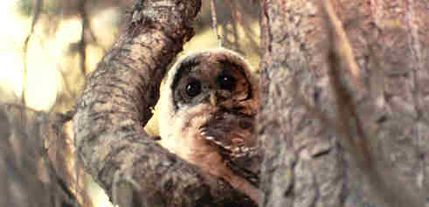
Why do we care what they eat?

Slide 5
Methods
  Diet Composition
  Estimate composition of diet of each pair based on the % of prey numbers and % of prey biomass.
  Average across territories to estimate the average diet in each region (sample is the territory, not the total number of prey).

Slide 6
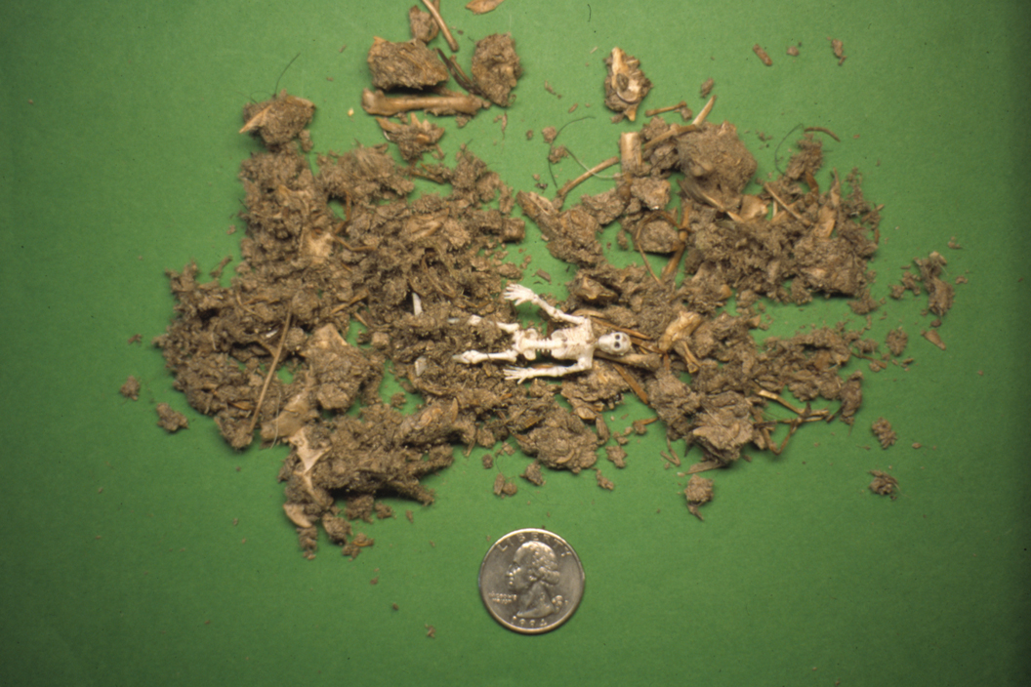
Most prey were identified by dissecting owl pellets and keying skeletal remains

Slide 7
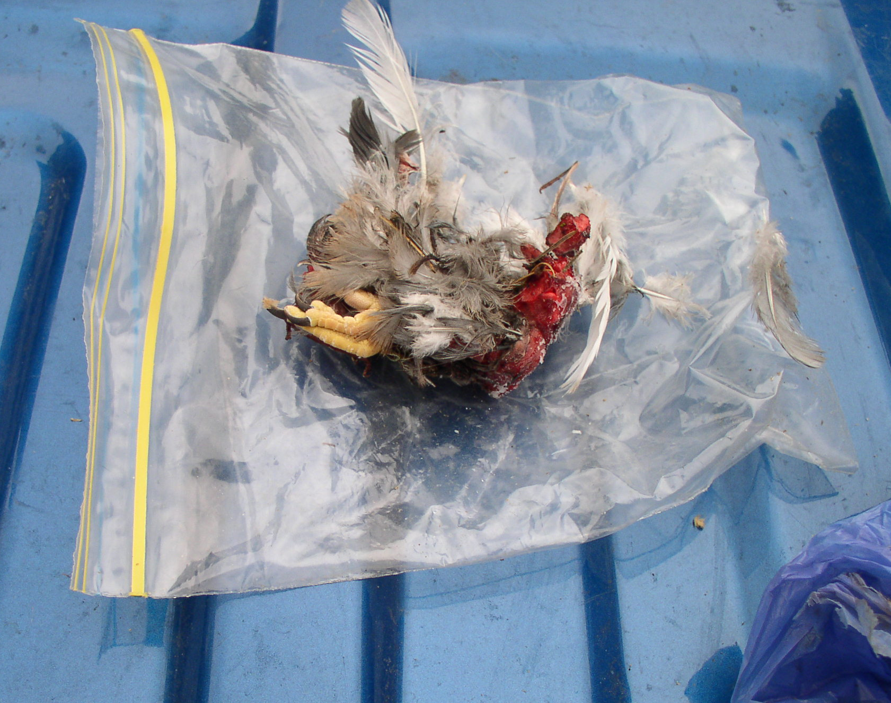
Small numbers of prey were identified from fur or feathers

Slide 8
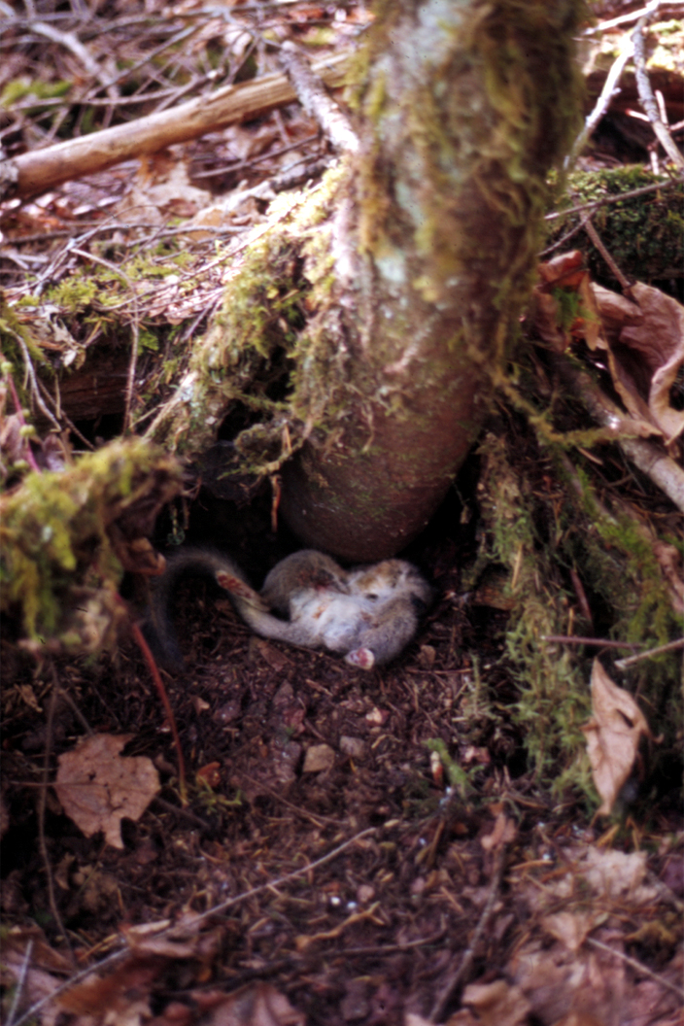
If they catch more than they can eat, spotted owls store their food and retrieve it later

Slide 9
  Mean Prey Mass
  Estimate mass of each prey item and calculate mean prey mass at each
  owl territory.
  Average across territories to get mean prey mass in each region.

Slide 10
  Dietary Diversity
  Used the reciprocal of Simpson’s Index (1/q) to estimate dietary diversity at each territory:
  1/q = 1 / ∑(proportions)²
  For our samples this index could vary from 1 (only 1 species in diet) to 18 (all 18 prey types equally abundant in diet).

Slide 11
  Number of Prey Captured
  Assume that an average adult spotted owl (619 grams) consumes approximately 11% of its body mass per day (73 grams) or 26,718 g per year
  Multiply 26,718 g by the proportion of biomass of each species in the diet to estimate the total biomass of each species captured per year per owl.
  Divide the total biomass of each species by the mean mass of each species to get the estimated number captured per year.

Slide 12
Results
  Collected pellets at 1,386 owl territories in Oregon and 242 owl territories in Washington.
  Total number of prey was 38,069 in Oregon and 6,743 in Washington.
  Oregon sample included 91% mammals, 4% birds, 4% insects, and 1% miscellaneous.
  Washington sample included 90% mammals, 6% birds, 4% insects, and a trace of Amphibians.

Slide 13
Number of species in diet
  We identified 131 species in pellets from Oregon, including 48 mammals, 41 birds, 3 reptiles, 1 frog, 1 crayfish, 1 scorpion, 2 snails, and 33 insects.
  We identified 57 species in pellets from Washington, including 31 mammals, 22 birds, 1 amphibian, and 4 insects

Slide 14
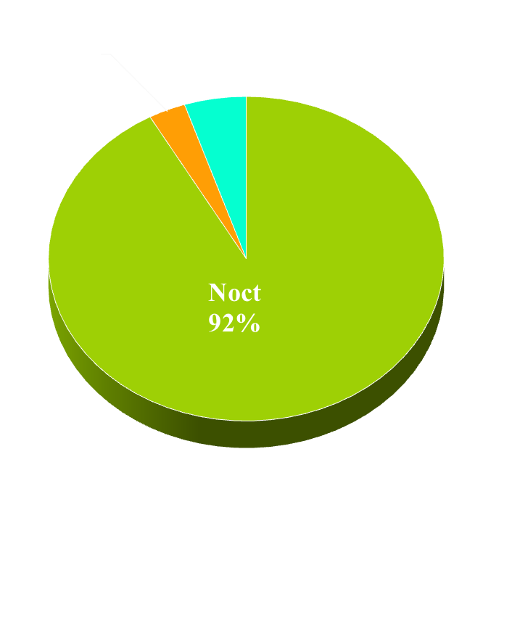
Prey composition in diets of Spotted Owls in Oregon
Life Zones
Activity Periods
3%

Slide 15
Estimated mean mass of prey captured by spotted owls
in Oregon, 1970-2001
Region | N | Mean ± SE
North Coast | 9 | 123.6 ± 10.3
Central Coast | 90 | 112.8 ± 3.3
South Coast | 180 | 131.4 ± 2.7
SW Interior | 75 | 142.4 ± 5.0
North Cascades | 4 | 90.7 ± 14.1
Central Cascades | 150 | 108.5 ± 2.8
East Cascades | 26 | 98.9 ± 8.4
Overall Average | 7 | 115.5 ± 6.9

Slide 16
Diets of Spotted Owls in Oregon 1970-2011
 | Coast Ranges |  |  |  | SW |  | Cascades
Species | North | Cent. | South |  | Interior |  | North | Cent. | East
Shrews | 1.7 | 0.7 | 1.3 |  | 2.2 |  | 0.4 | 2.0 | 1.0
Moles | 1.0 | 0.9 | 0.4 |  | 2.6 |  | 2.5 | 0.8 | 0.9
Lago | 8.0 | 3.9 | 4.3 |  | 2.6 |  | 6.3 | 4.8 | 3.9
Diurn. Sqrl. | 1.5 | 2.2 | 1.0 |  | 2.1 |  | 5.2 | 1.6 | 3.9
Flying Sqrl. | 52.9 | 49.3 | 32.8 |  | 31.4 |  | 43.1 | 39.5 | 45.8
Gophers | 1.1 | 0.6 | TR |  | 4.6 |  | 0.2 | 3.1 | 6.1
Deer Mice | 10.4 | 9.2 | 5.5 |  | 4.5 |  | 1.0 | 5.3 | 2.0
Woodrat | 11.5 | 8.8 | 22.4 |  | 28.1 |  | 7.8 | 12.9 | 7.8
R-B Vole | 0.0 | 2.2 | 3.1 |  | 7.3 |  | 10.9 | 8.2 | 9.4
Tree Vole | 2.1 | 12.3 | 16.6 |  | 2.1 |  | 1.3 | 8.8
Microtus | 2.4 | 1.3 | 1.6 |  | 2.2 |  | 0.0 | 1.6 | 3.2
Othr Mamm | 4.4 | 2.8 | 4.4 |  | 2.1 |  | 2.5 | 4.8 | 3.5
Birds | 2.4 | 4.2 | 4.3 |  | 5.4 |  | 8.6 | 4.1 | 3.9
Insects | 0.4 | 1.6 | 2.1 |  | 2.7 |  | 10.2 | 2.5 | 8.6
Misc | 0.3 | 0.1 | 0.0 |  | 0.1 |  | 0.0 | 0.1 | 0.1

Slide 17
Diets of Spotted Owls in Oregon vs Washington (% numbers)
Prey | Oregon (n = 7) | Washington (n =3)
Shrews | 1.3 | 2.0
Moles | 1.3 | 0.4
Lagomorphs | 4.8 | 3.9
Diurnal squirrels | 2.5 | 2.7
Flying squirrels | 42.2 | 41.4
Gophers | 2.2 | 3.7
Deer mice | 5.4 | 11.0
Woodrats | 14.2 | 5.1
Red tree vole | 6.2
Red-backed vole | 5.9 | 7.5
Microtus spp. | 1.8 | 3.1
Other mammals | 3.4 | 9.0
Birds | 4.7 | 5.6
Amphibians/reptiles | 0.1 | 0.1
Insects/arthropods | 4.0 | 4.5

Slide 18
Diets of Spotted Owls in Washington (% of prey numbers),1983-96
Prey | Olympic (n = 151) | W. Cascades (n = 57) | E. Cascades (n = 34)
Shrews | 0.8 | 3.8 | 1.4
Moles | 0.3 | 0.7 | 0.3
Lagomorphs | 6.3 | 4.9 | 3.9
Diurnal squirrels | 2.8 | 2.5 | 2.7
Flying squirrels | 54.3 | 29.3 | 40.7
Gophers | Tr | 6.9 | 4.3
Deer mice | 11.3 | 15.2 | 6.5
Woodrats | 5.3 | 1.3 | 8.7
Red-backed voles | 5.8 | 10.3 | 6.4
Microtus spp. | 1.7 | 5.7 | 1.9
Other mammals | 4.6 | 10.9 | 7.2
Birds | 6.4 | 6.0 | 4.4
Amphibians | 0.1 | 0.0 | 0.0
Insects/Arthropods | 0.4 | 2.5 | 10.6

Slide 19
Index of Dietary Diversity (1/q)
Mean = 4.4

Slide 20
Average % of prey biomass by species and region, Oregon, 1970-2001
 | Coast Ranges |  |  |  | SW |  | Cascades
Species | North | Cent. | South |  | Interior |  | North | Cent. | East | AVG
Rabbit/Hare | 2.2 | 9.9 | 11.6 |  | 5.9 |  | 0.0 | 12.5 | 12.7 | 7.8
Flying Sqrl | 52.4 | 58.2 | 38.6 |  | 30.1 |  | 74.5 | 45.7 | 56.3 | 50.8
Gophers | 2.5 | 0.5 | 0.1 |  | 4.2 |  | 0.0 | 4.8 | 7.1 | 2.8
Deer Mice | 3.9 | 2.5 | 1.2 |  | 1.0 |  | 0.0 | 1.5 | 0.9 | 1.6
Woodrats | 25.9 | 16.1 | 37.1 |  | 48.7 |  | 5.0 | 20.7 | 12.4 | 23.7
R-B Voles | 0.0 | 0.5 | 0.6 |  | 1.3 |  | 8.2 | 2.7 | 3.5 | 2.4
Tree Voles | 1.0 | 3.8 | 4.2 |  | 0.6 |  | 0.0 | 2.3 | 0.0 | 1.7
Othr Mammal | 7.9 | 4.5 | 3.9 |  | 4.6 |  | 1.7 | 6.9 | 3.8 | 4.7
Birds | 4.3 | 3.9 | 2.8 |  | 3.5 |  | 10.7 | 2.8 | 2.4 | 4.3
Insects/Misc | 0.1 | 0.1 | Tr |  | 0.1 |  | 0.0 | 0.1 | 0.9 | 0.2
Totals | 100.0 | 100.0 | 100.0 |  | 100.0 |  | 100.0 | 100.0 | 100.0 | 100.0

Slide 21
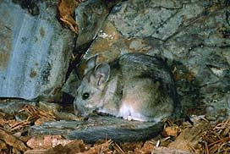
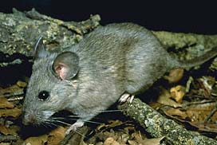
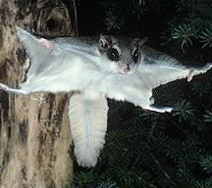
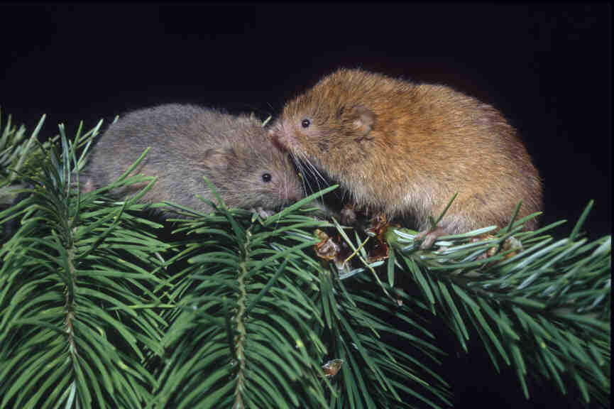
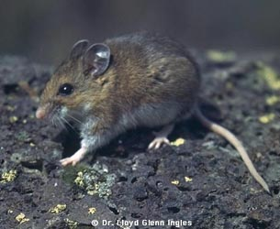
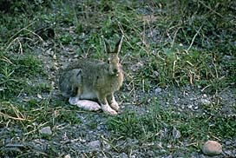
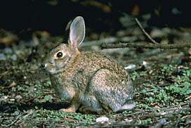
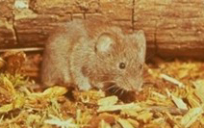
Major prey of Northern Spotted Owls
Bushy-tailed woodrat
Dusky footed woodrat
Northern flying squirrel
Red Tree Vole
Deer mouse
Snowshoe hare
Brush rabbit
Western RB vole

Slide 22
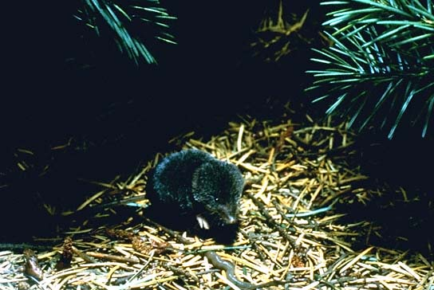
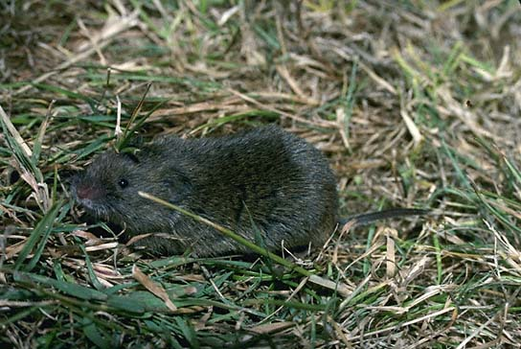
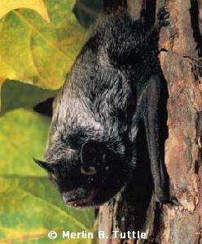
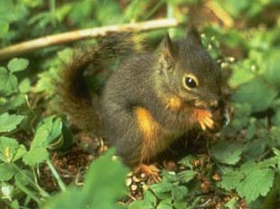
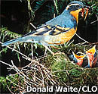
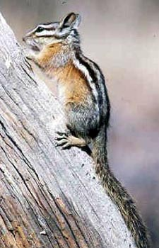
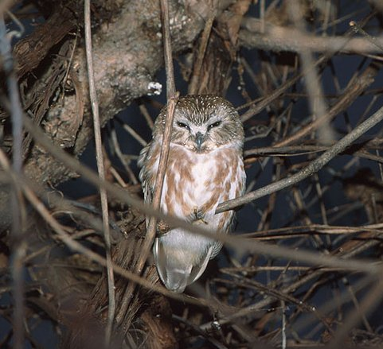
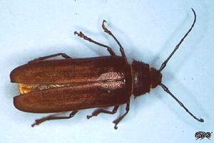
Other prey species in the Oregon
Trowbridge’s shrew
Creeping vole
Douglas squirrel
Silver-haired bat
Varied Thrush
Towwsend’s
chipmunk
Saw-whet Owl
Ponderous woodborer

Slide 23

Burt Gildart

Slide 24
Annual Variation Diet of spotted owls at Oak Creek site, 1970-74
 | Percent of prey by year
Species | 1970 | 1972 | 1973 | 1974
Flying Squirrel | 5 | 37 | 29 | 6
Red tree vole | 66 | 10 | 44 | 11
Red-backed vole | 0 | 3 | 0 | 0
Deer Mouse | 8 | 15 | 0 | 79
Woodrat | 2 | 8 | 3 | 0
Brush rabbit | 1 | 2 | 0 | 2
Other prey | 18 | 25 | 24 | 2

Slide 25
Estimated number of prey captured per year by spotted owls in Oregon
 | South |  | SW |  | East |  | Per | Pair +
Species | coast |  | Interior |  | Cascades |  | owl | 2 Yng
Shrews | 3 |  | 8 |  | 6 |  | 7 | 17
Moles | 0 |  | 7 |  | 4 |  | 2 | 5
Rabbits | 10 |  | 5 |  | 11 |  | 7 | 18
Flying Sqrl | 79 |  | 62 |  | 113 |  | 104 | 277
Gophers | 0 |  | 12 |  | 20 |  | 8 | 21
Deer Mice | 15 |  | 12 |  | 11 |  | 19 | 50
Woodrats | 35 |  | 46 |  | 12 |  | 22 | 59
R-B Vole | 7 |  | 15 |  | 39 |  | 28 | 73
Tree Vole | 43 |  | 5 |  | 0 |  | 17 | 46
Othr Mamm | 17 |  | 14 |  | 18 |  | 17 | 46
Birds | 9 |  | 11 |  | 7 |  | 14 | 36
Insect/Misc | 5 |  | 21 |  | 143 |  | 27 | 74
Total | 222 |  | 217 |  | 384 |  | 271 | 722

Slide 26
Summary:
Most prey are nocturnal and either arboreal or scansorial.
Mean prey mass is large for such a small owl.
Diet varies regionally but is generally dominated by flying squirrels, woodrats, lagomorphs, red tree voles, red-backed voles and deer mice.
Red tree voles are important prey in mesic forests, especially in coastal regions of southwest Oregon.

Slide 27
Management Implications
Management practices that favor arboreal or scansorial forest mammals such as flying squirrels, woodrats, and tree voles are beneficial to spotted owls.
Although many of the primary prey species are forest species, some edge habitats may benefit spotted owls because woodrats, rabbits, snowshoe hares, and pikas are common in non-forest types adjacent to forests.

Slide 28
Prey composition in diets of Spotted Owls
South Coast
Central Coast

Slide 29
% of prey numbers in diets of barred owls and spotted owls
Prey | Barred Owl (n = 265) | Spotted Owl (n = 296)
Shrews / shrew moles / moles | 23.8 | 4.0
Hares | 8.3 | 6.0
Douglas squirrels / chipmunks | 9.0 | 1.7
Flying squirrel | 20.0 | 50.7
Deer mice | 6.8 | 20.6
Woodrats | 0.0 | 4.4
Red-backed vole | 1.1 | 6.8
Microtus | 6.7 | 0.7
Other mammals | 0.4 | 1.3
Birds | 11.0 | 2.8
Fish / Amphibians | 8.3 | 0.0
Molluscs | 0.8 | 0.0
Insects | 3.8 | 1.0

Slide 30
Home Range and Habitat Use of Spotted Owls on the Olympic Peninsula, Washington
Conducted April 1987-August 1989
20 adult owls (9 pairs and 2 paired males)
Average tracking period = 438 ± 34 days
Sampling schedule = 1 location per day or night
Average relocations per owl = 366 ± 35
Total foraging locations = 3,931
Total roosting locations = 3,262 (902 visual)
Median telemetry accuracy = 100 m (mean = 140 ± 17 m)
1 mortality (choking?)

Slide 31
Estimates (in hectares) of median ranges of Spotted Owls on the Olympic Peninsula, Washington, 1987-89
Estimator | Males | Females
Annual 75% FK | 1,186 | 967
Annual 95% FK | 2,533 | 2,235
Annual MCP | 3,288 | 1,915
Cumulative 75% FK | 1,152 | 1,173
Cumulative 95% FK | 2,404 | 3,384
Cumulative MCP | 2,870 | 2,912
Conversion: 2.5 acres per hectare

Slide 32
Selection of forest cover types by spotted owls on the Olympic Peninsula, 1987-89. Preference ranks from compositional analysis.
 | Preference rank
Cover type | Foraging | Roosting
Old-forest | 6 | 6
Mature forest | 4 | 5
Young + remnant forest | 5 | 4
Young forest | 2 | 3
Pole-sapling forest | 1 | 1
Hardwood forest | 3 | 2
Clear-cut/non-forest | 0 | 0

Slide 33
Size of home ranges was negatively correlated with the % cover of older forest types (Old + mature) regardless of which home range estimator was used.

Slide 34
Difference between spotted owl foraging locations and random locations relative to elevation, distance to the nearest edge, or distance to the nearest stream, Olympic Peninsula, 1987-89. All measurements in meters.
Variable | Observed | Random | Signif.
Forest edge | 233 ± 24 | 304 ± 34 | 0.001
Nearest stream | 98 ± 14 | 94 ± 10 | 0.475
Elevation | 315 ± 31 | 354 ± 36 | 0.002

