Slide 1
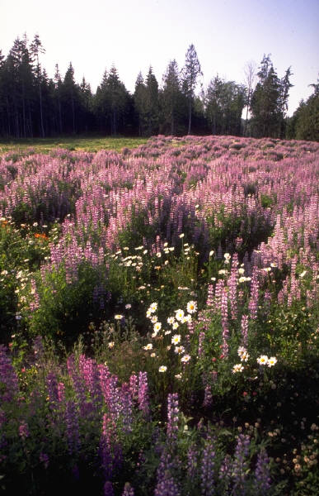





MEADOW RESTORATION FIELD TOUR Practical Approaches for Diagnosis and Treatment

Slide 2
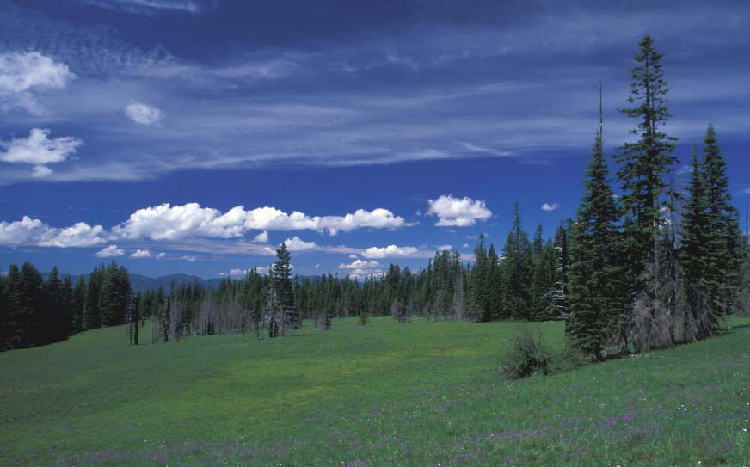

Slide 3
Overview of Factors Influencing Meadows
…how they got there in the first place will be a talk later this AM…

Slide 4
Contemporary “wisdom”
IT MUST HAVE BEEN CREATED AND MAINTAINED BY FIRE!!

Slide 5
Hmmmm…
Fire return interval ~30 years
Fire return interval ~200yrs

Slide 6

Lightening drawn to grass…?

Slide 7
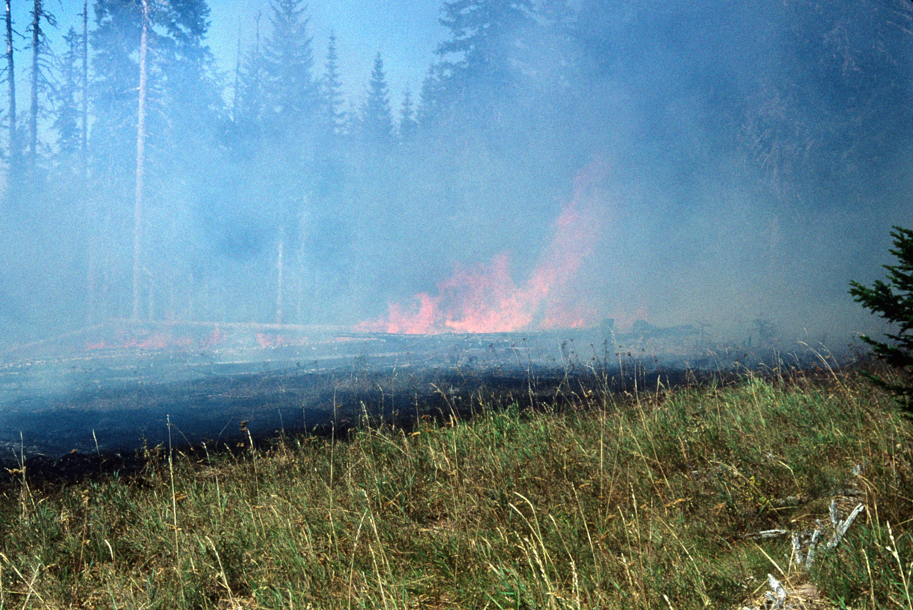

Slide 8
Have we Given Full Consideration to other “Maintenance” Processes?
Bioturbations
Wind
Snow and Frost
Pollinators
People – modern and historic
Hydrology
Soils
Nutrients

Slide 9
BIOTURBATION
“BIO-” Life
“Perturbation” Disturbance

Slide 10
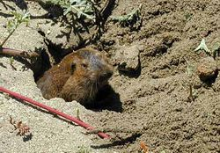
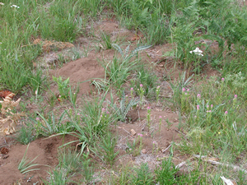
Subterranean Ecosystem Engineers: Gophers
100% turnover in 3 yrs

Slide 11
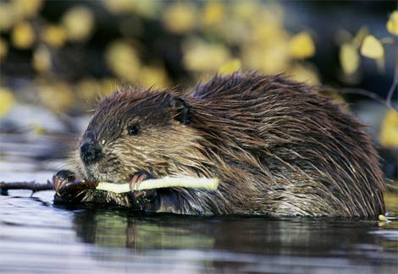
Terrestrial Ecosystem Engineers: Beaver
Forest -> drowned forest -> sediment build-up -> wet meadow -> dry meadow -> ?

Slide 12
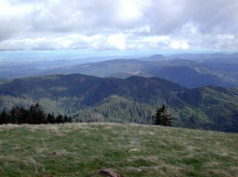
Wind = Shallow Soils
Mary’s Peak: Bald

Slide 13
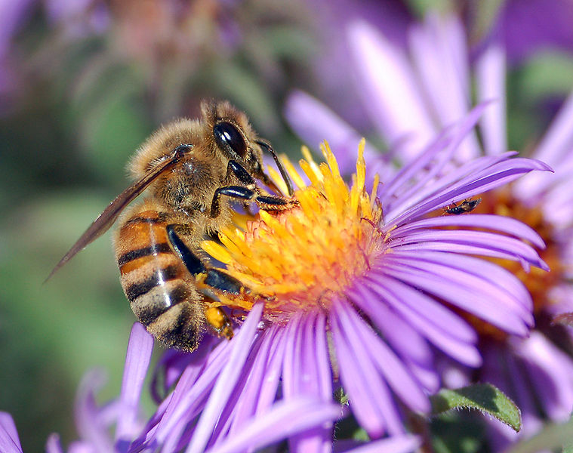
Pollinators

Slide 14
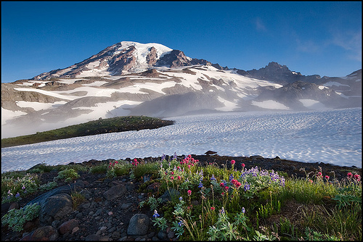
Snow and Frost

Slide 15
Landform Processes
SLOPE – Ravel, avalanche
ELEVATION -- Temperature
ASPECT -- Sun exposure
SOIL DEPTH -- Rooting

Slide 16
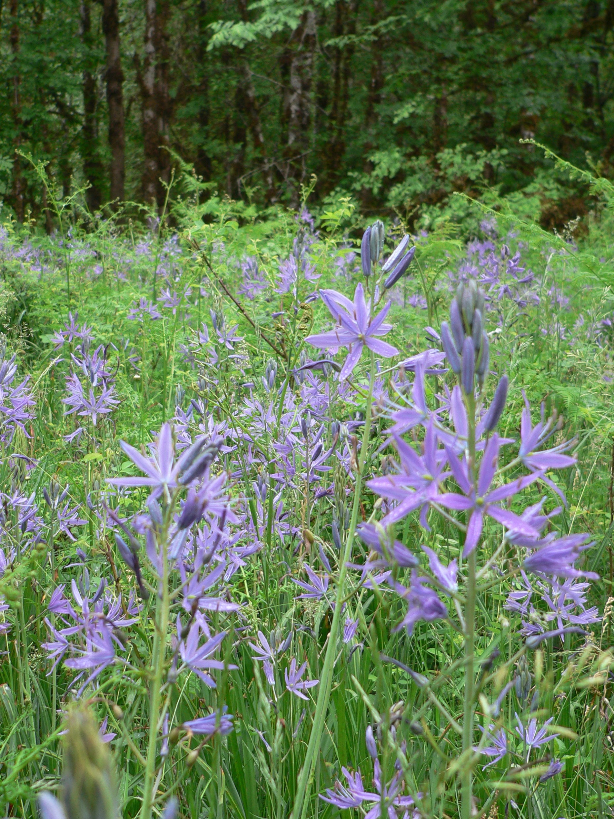
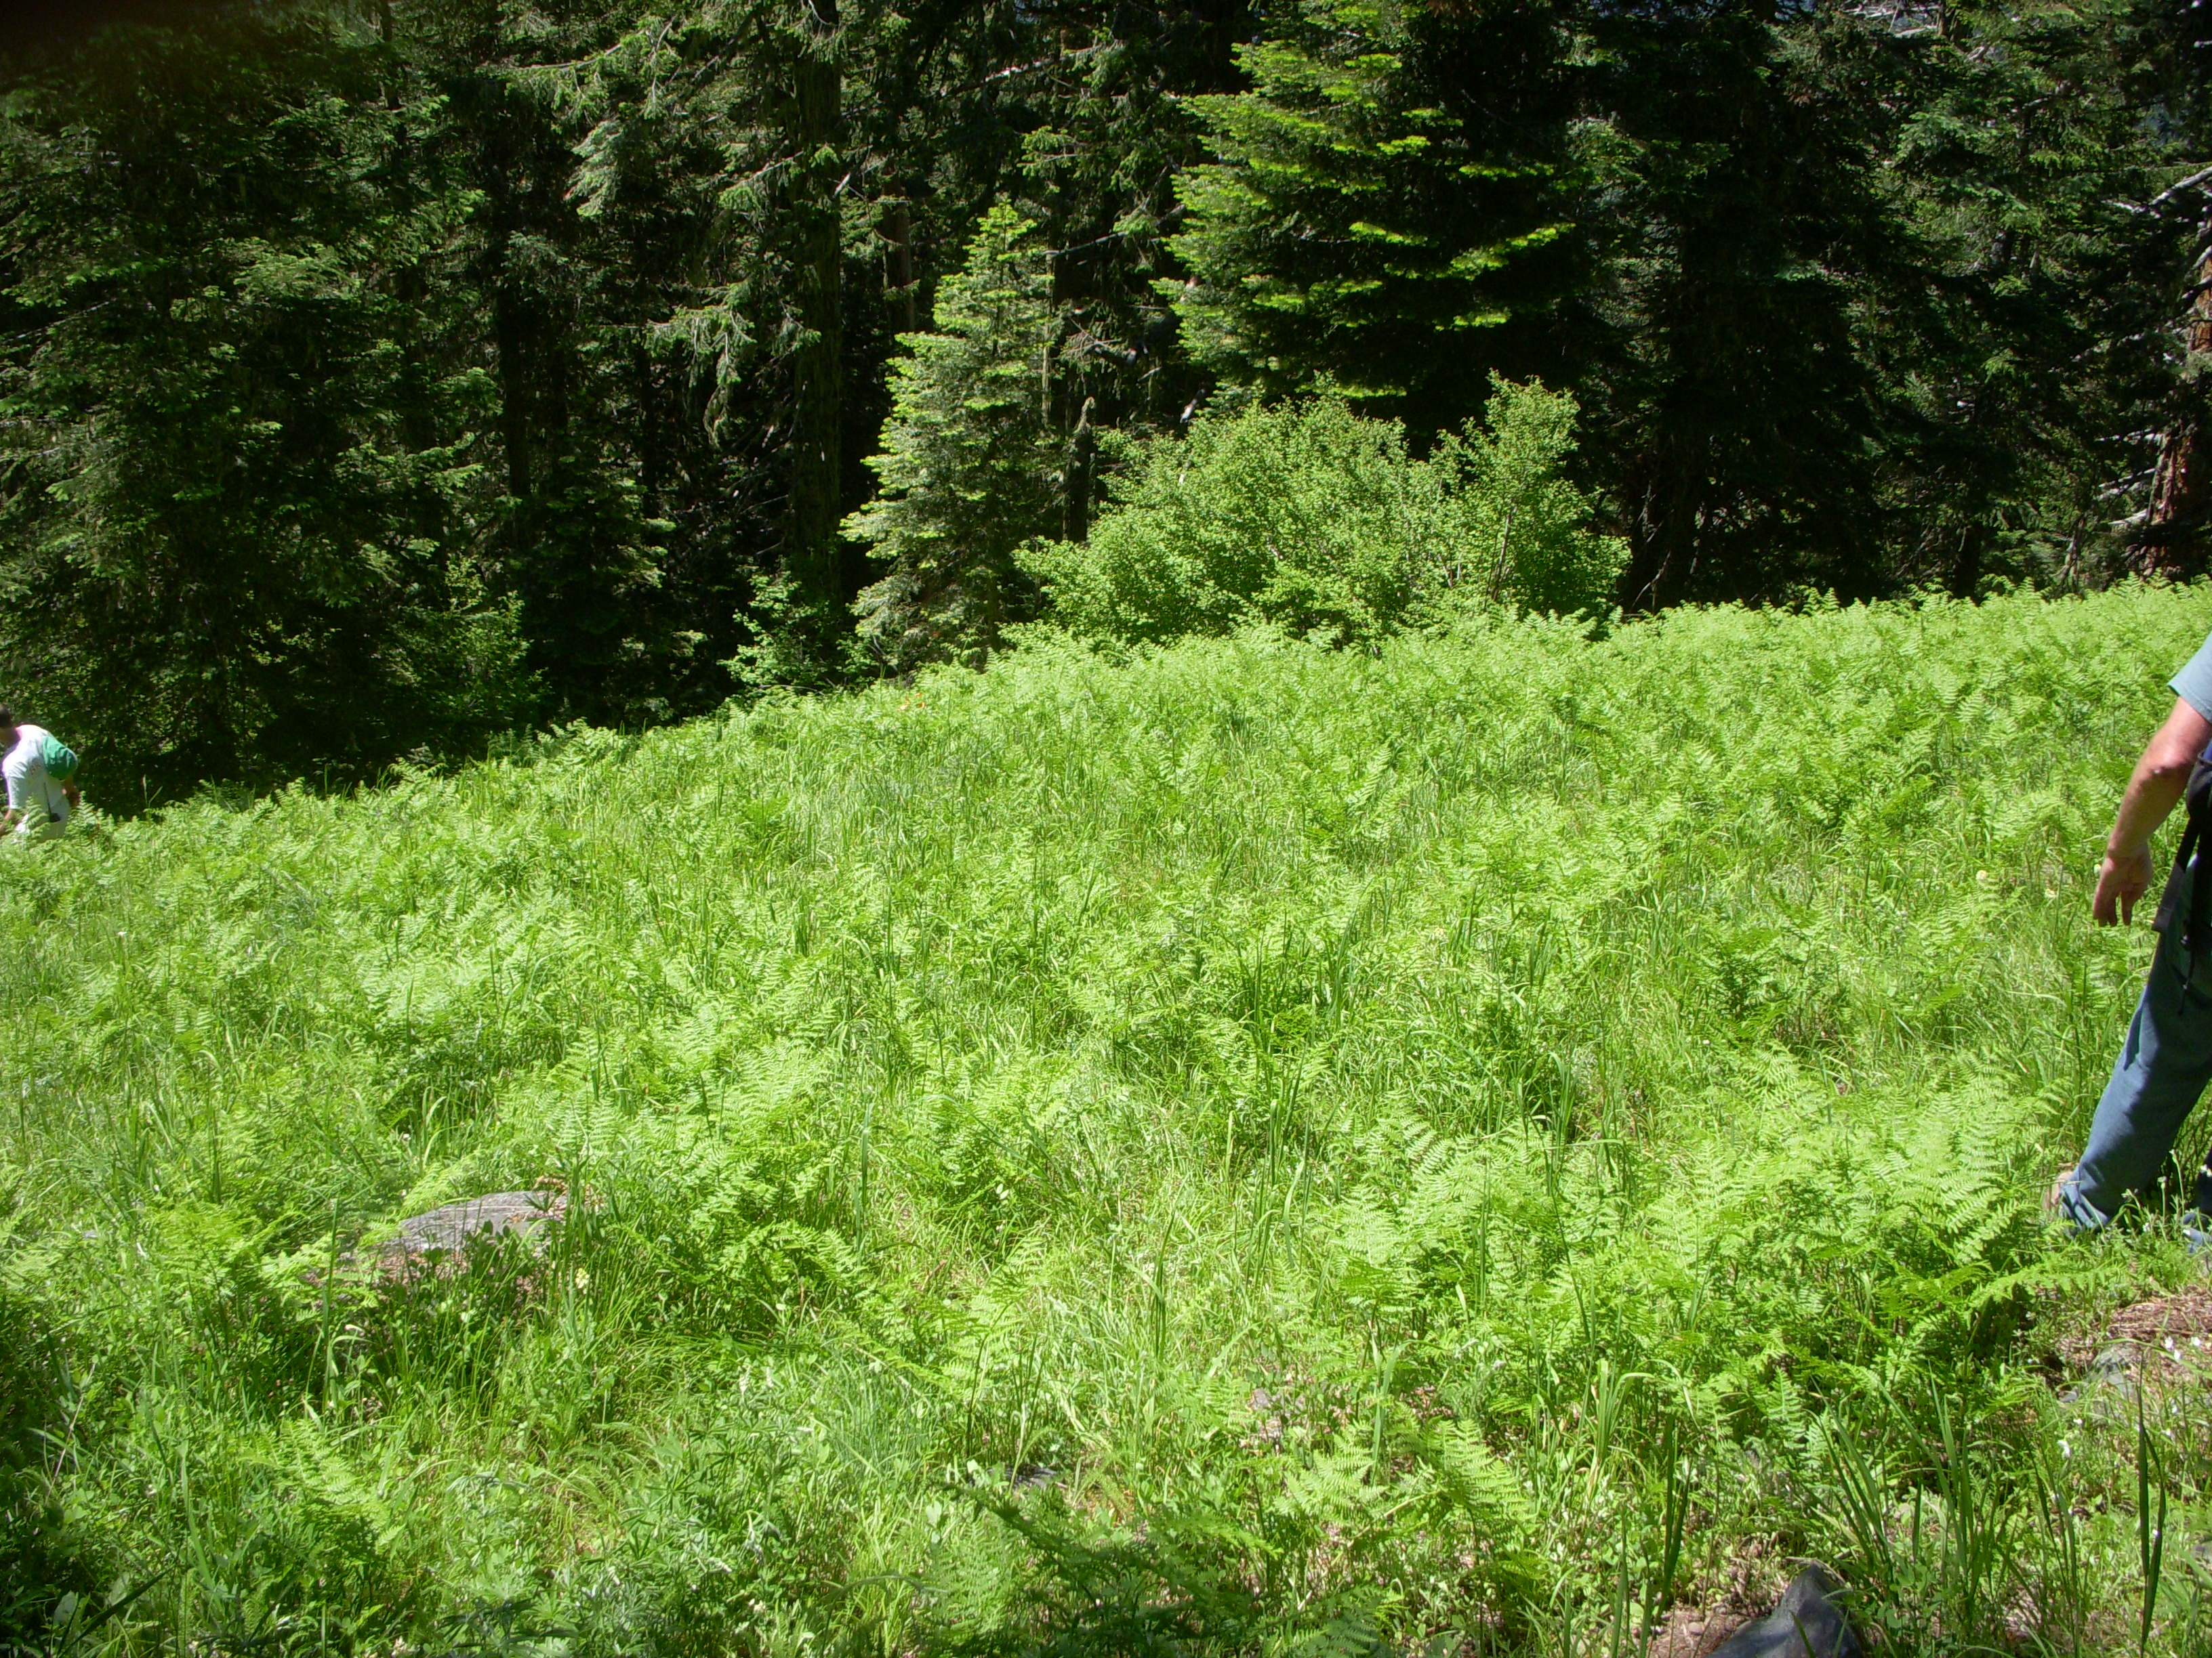
Chemical Processes: Nutrients

Slide 17
People
Grazing
Indigenous Resource Management Activities
Homestead Clearing
Cultivation / Agriculture
Heavy Recreation Use
Logging

Slide 18
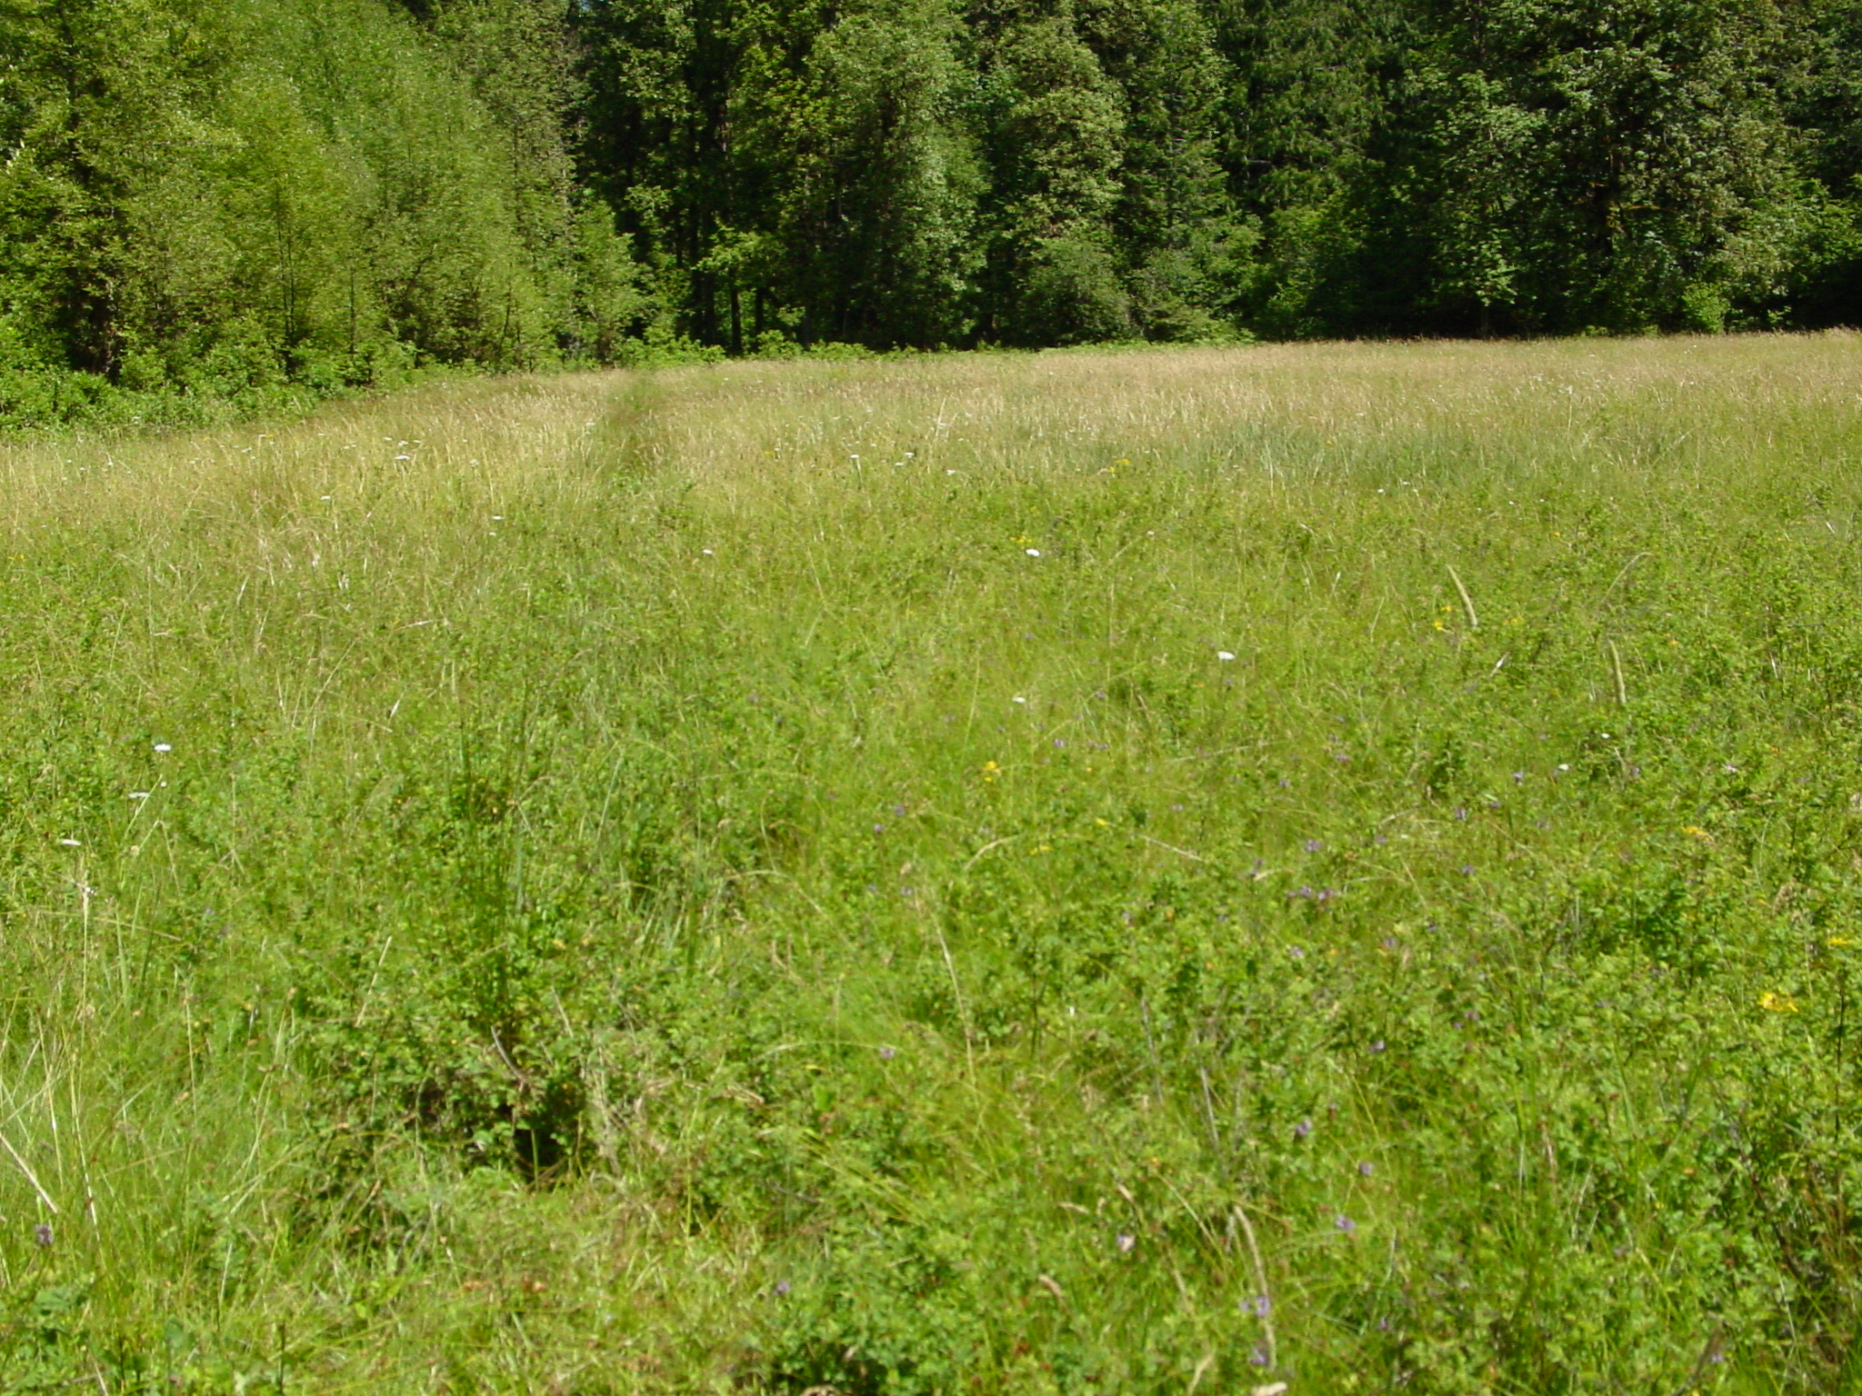
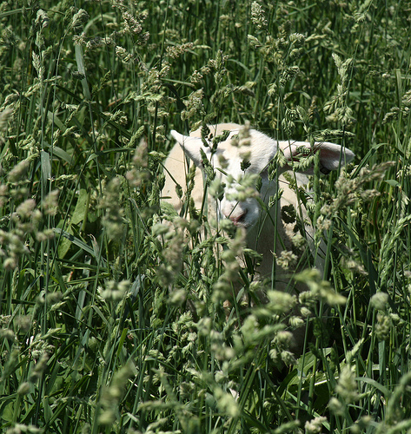
Water Management
Grazing

Slide 19
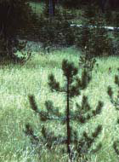
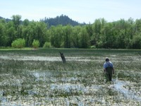
But What Catches our Eye First? And raises our ire…
Native “Invasions”
Non-Native Invasions (Knapweed)

Slide 20
WHAT TO DO?
We are “Action Biased” out of
Guilt
Partner Pressure
Aesthetic Pressure
Target Pressure
Sense of Urgency

Slide 21
“Investigators dig deep to find who destroyed meadow”
“Four-wheelers tear up Three Creeks Meadow”

Slide 22
PURPOSE OF THIS WORKSHOP!

Slide 23
GAIN UNDERSTANDING…
A single modern ecosystem condition may result from diverse antecedents…
but ecosystems may not carry a memory of all the processes driving their historical dynamics.

Slide 24
Describe the Value at Risk
Forage
Aesthetics
Biodiversity
Great Gray Owl Habitat
Hunting opportunity
Sensitive Plants

Slide 25
Pick a Desired Condition
Entirely Value Driven!

Slide 26
Pick a Tool…
Mowing
Girdling
Brush Cutting / Pulling
Timber Sale
Flooding
Reintroduce Beavers
Herbicides
Exclosure – human and animal!
Fire
Grazing

Slide 27
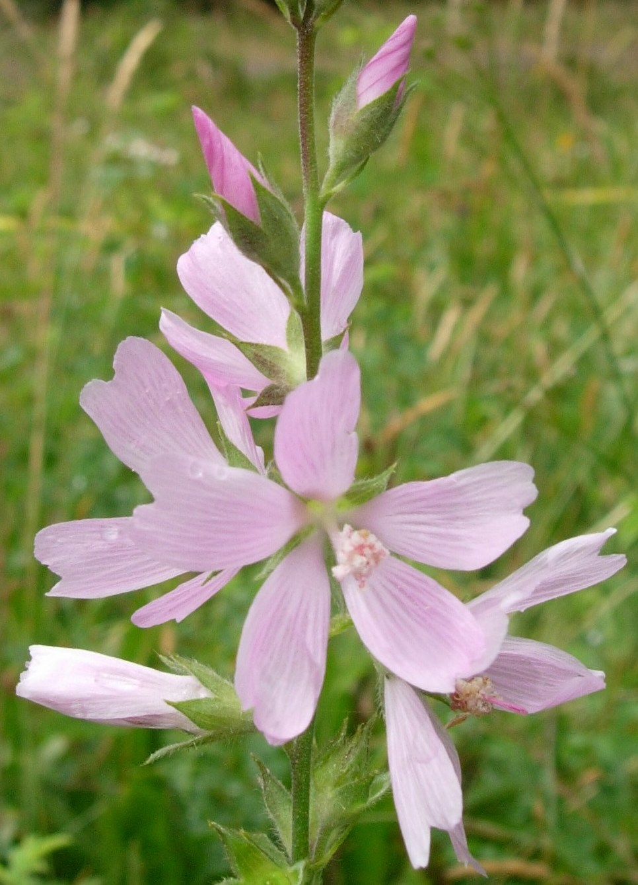
Cross your fingers and go for it!

