Slide 1
Geomorphic Influences on Meadow Landscapes
Can you tell which way the train went by looking at the tracks?

Slide 2
Processes that Affect Meadow Development and Persistence
Volcanism
Tectonics
Snow and Ice
Rivers and Streams
Soil and Groundwater
Nature’s Helpers
Climate and Air Flow

Slide 3
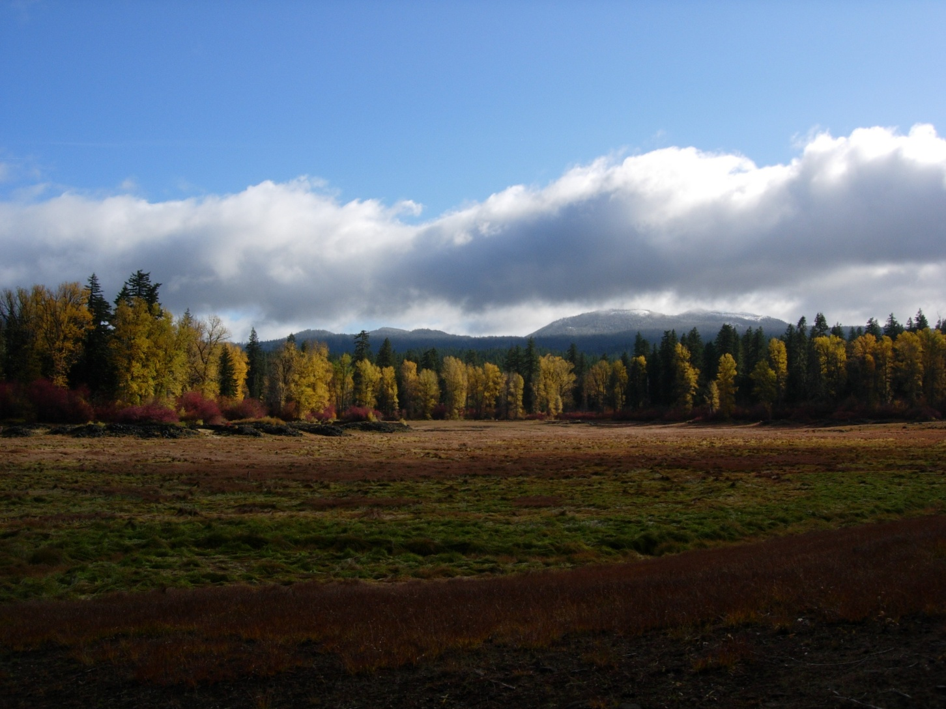
Fish lake

Slide 4
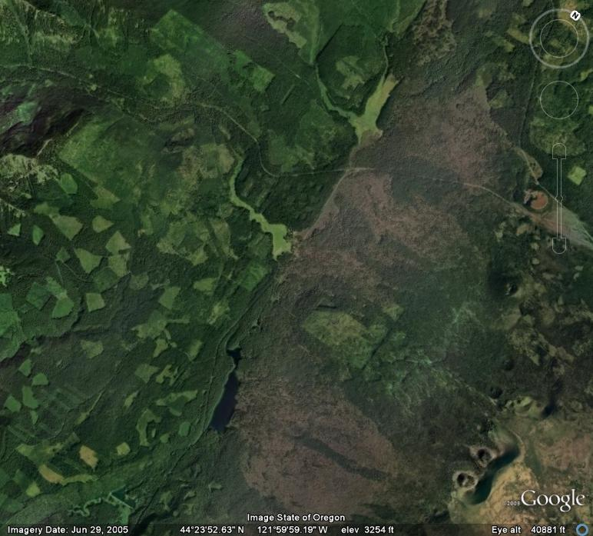
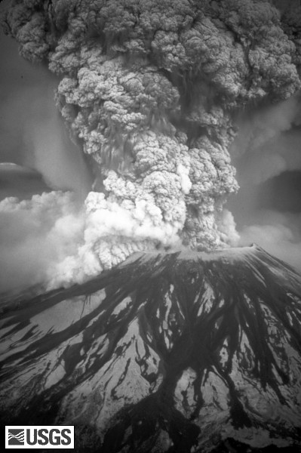
Volcanism and Tectonics

Slide 5
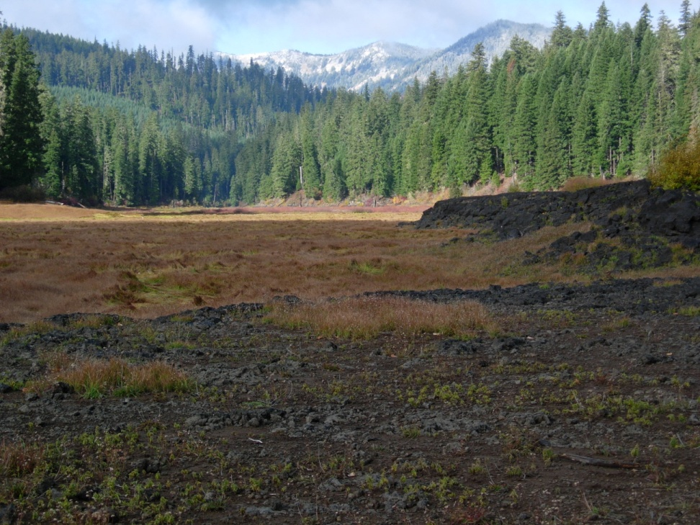
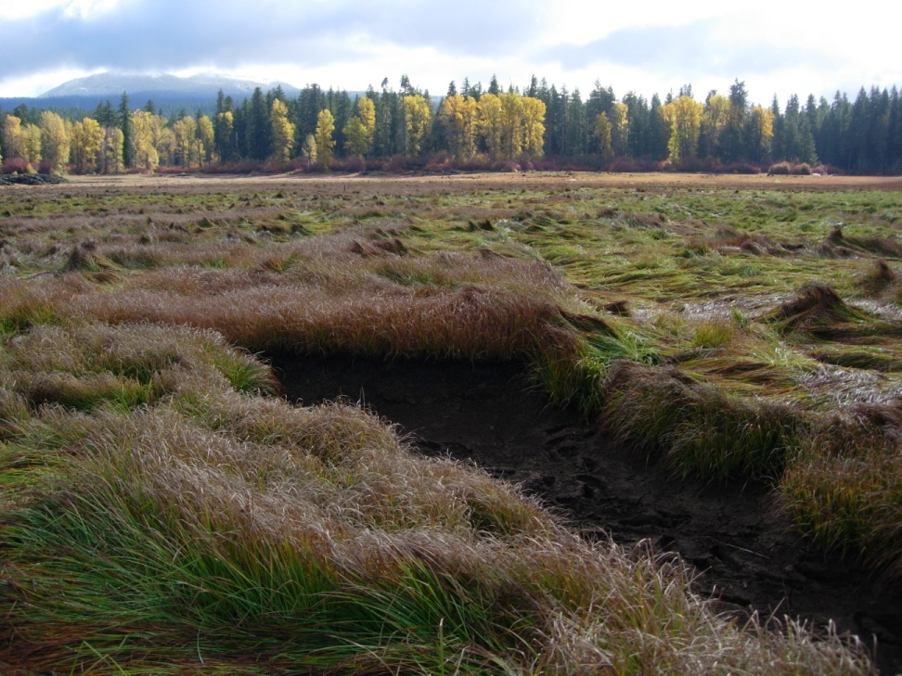
Streams and Soils

Slide 6
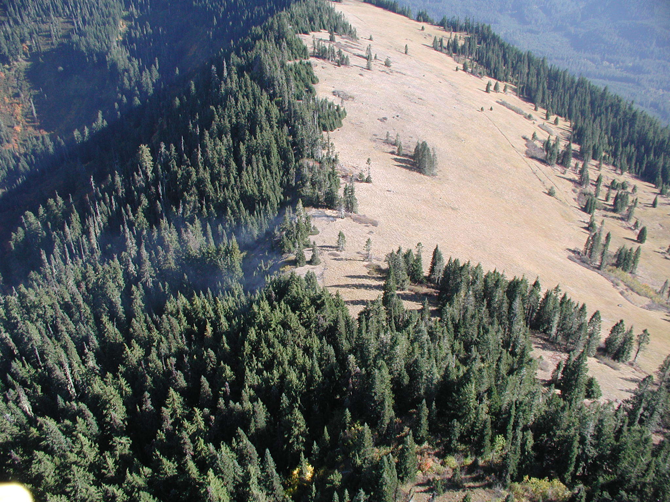
Grasshopper Meadow

Slide 7
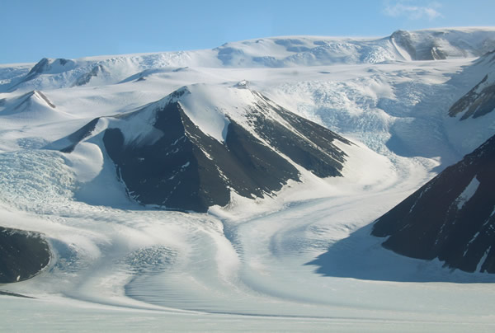
Glaciers

Slide 8
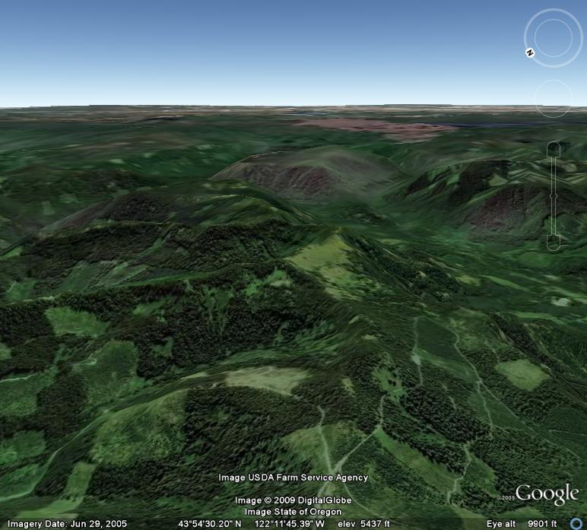
Glacial Landscape

Slide 9
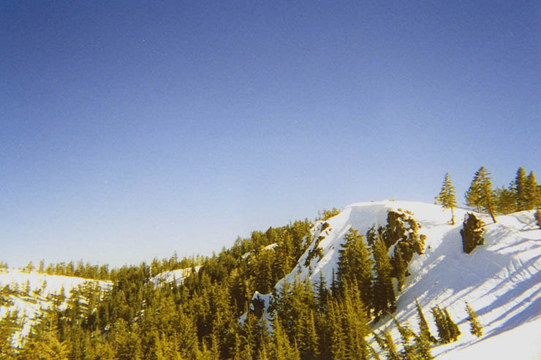
Snow

Slide 10
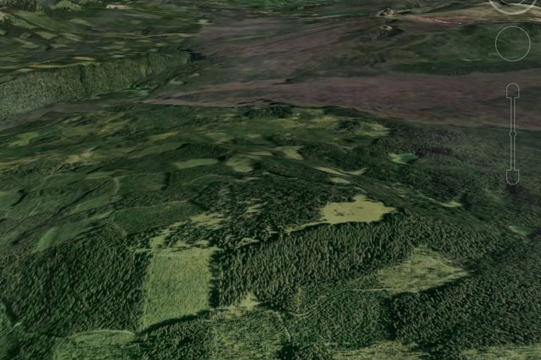
Bunchgrass Meadow

Slide 11
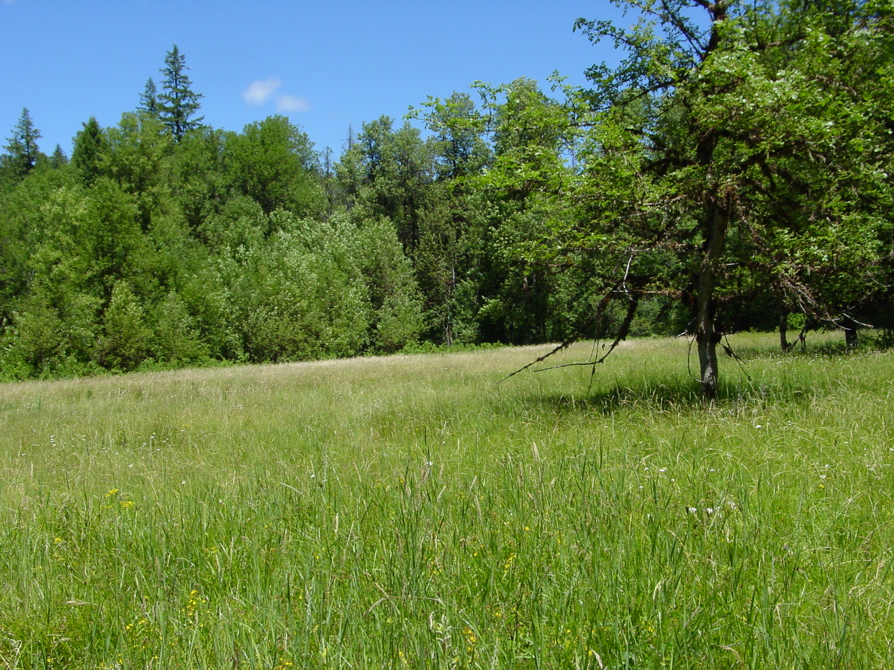
Owl Creek Meadow

Slide 12
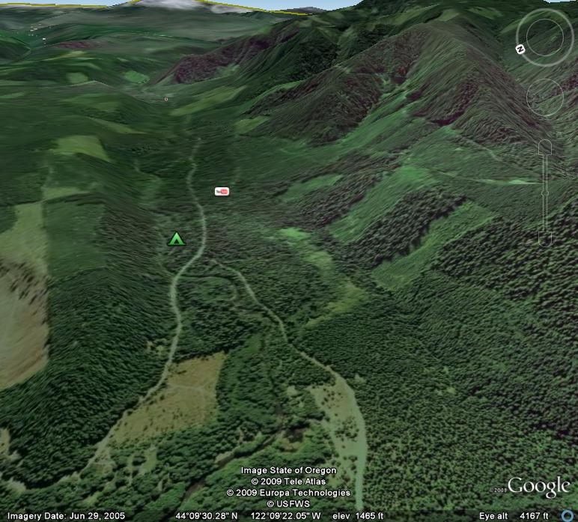
Horse Creek Drainage

Slide 13
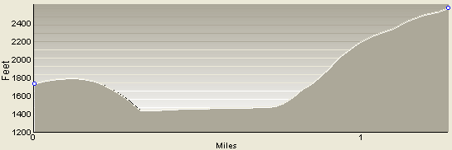
Horse Creek Valley Profile

Slide 14
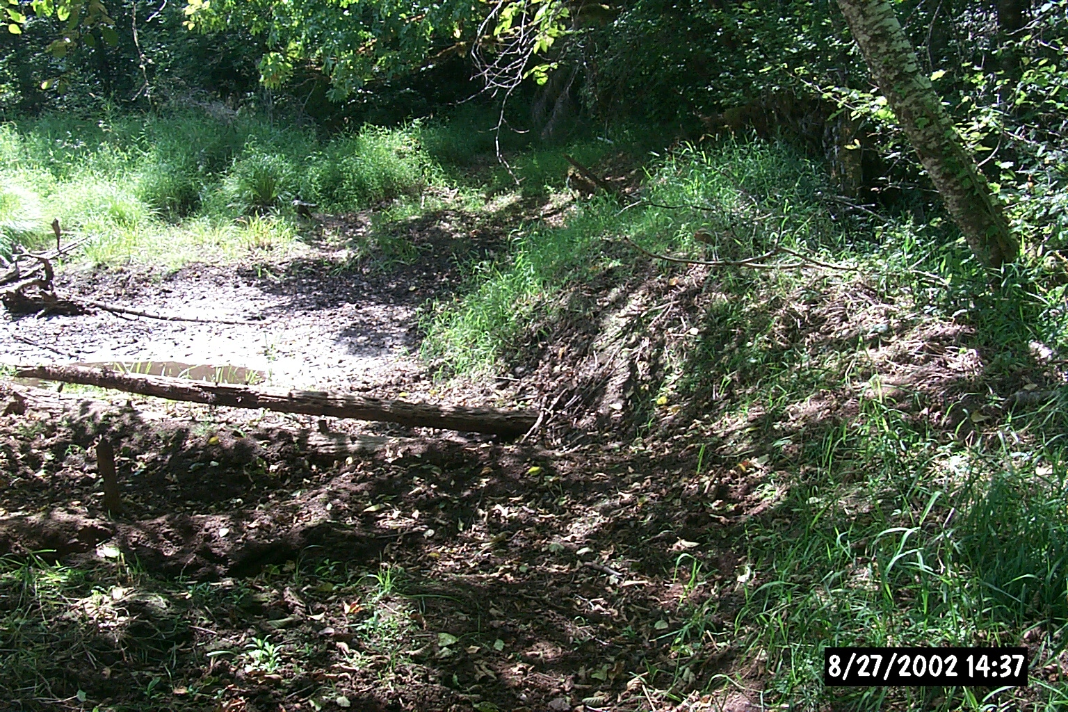
Beaver Dam

Slide 15
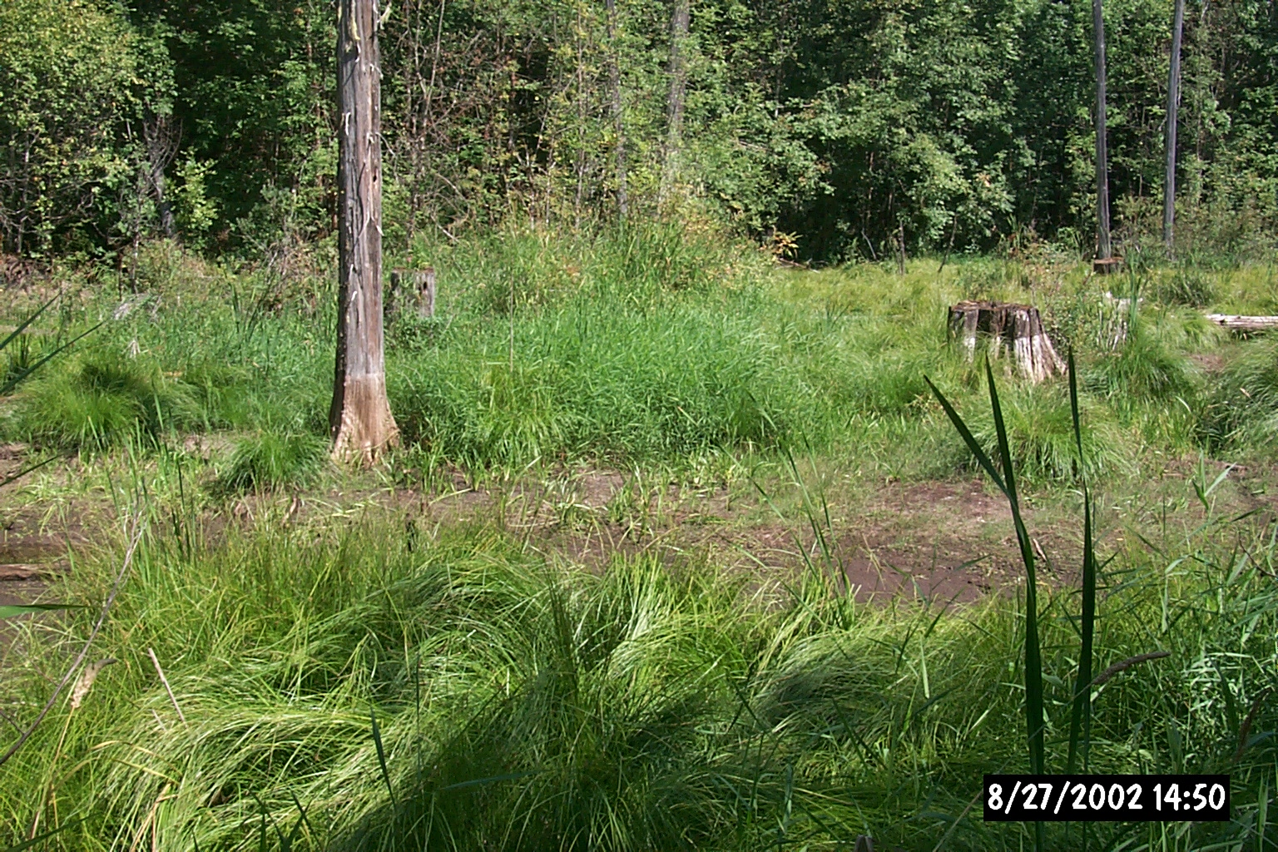
Drowned Cedars

Slide 16
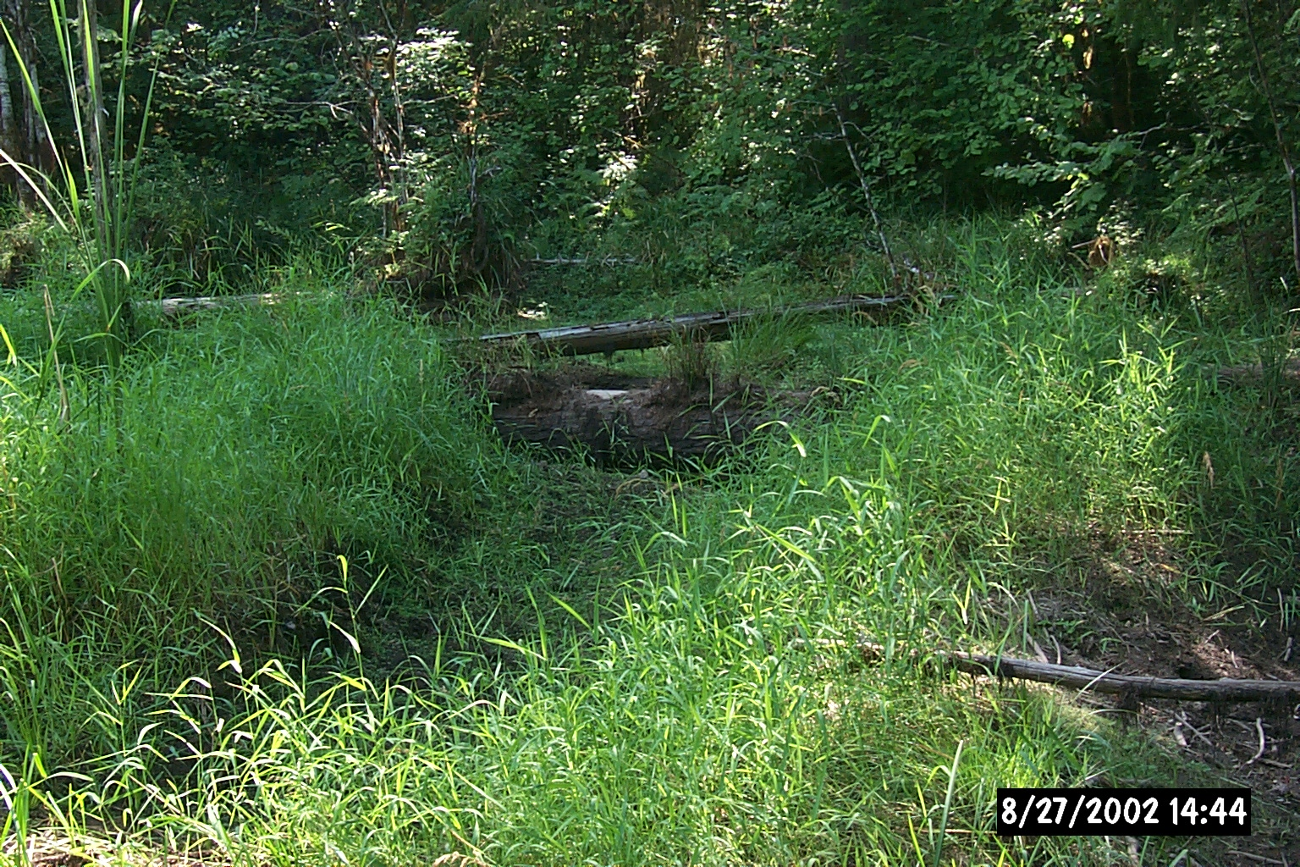
Exhumed Tree Bole

Slide 17
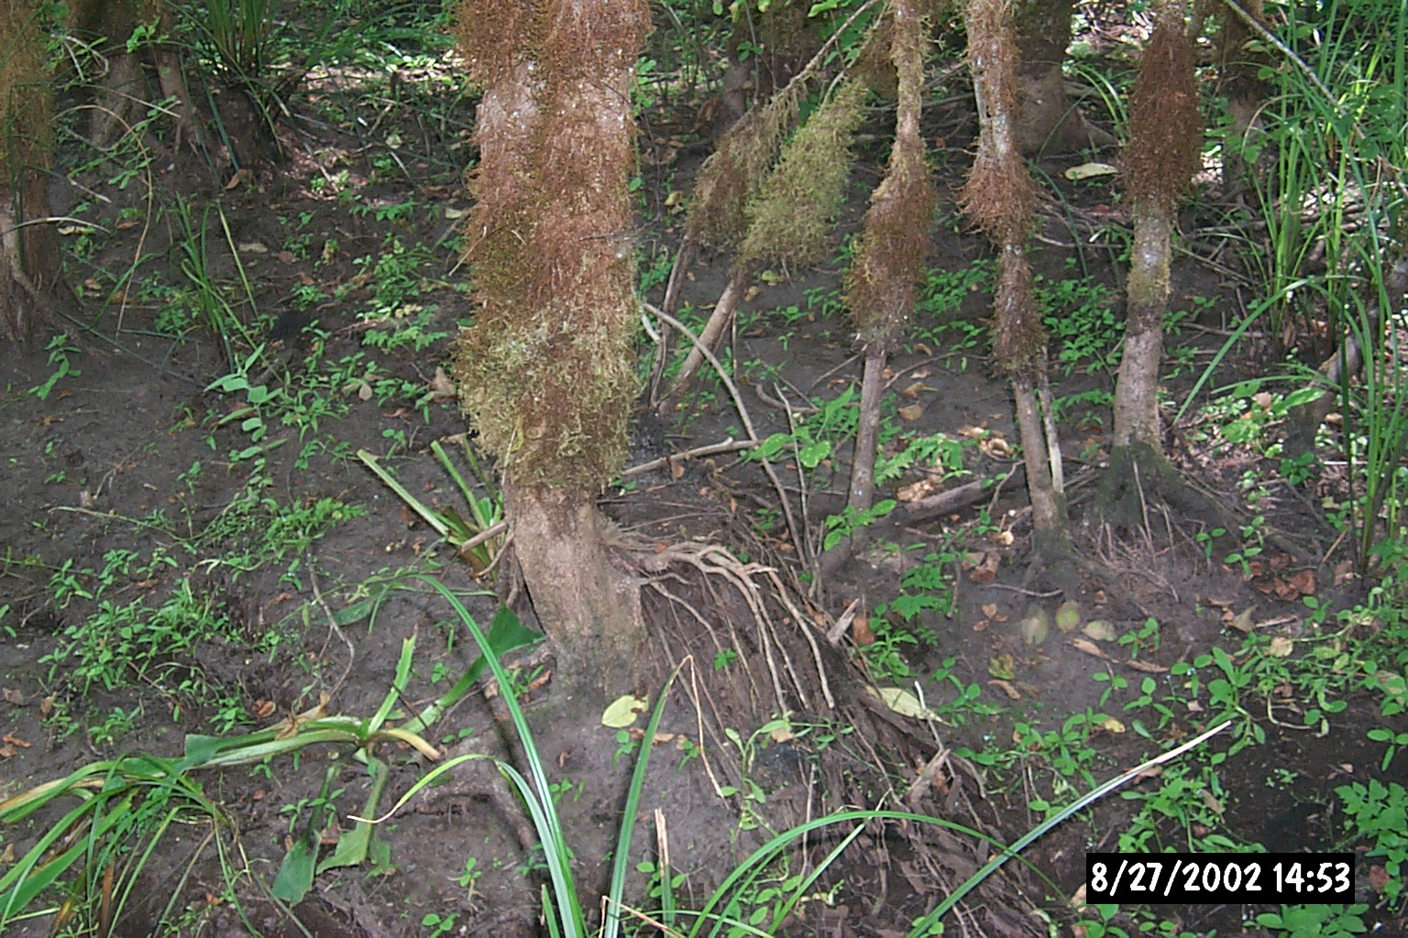
Fine Silts

Slide 18
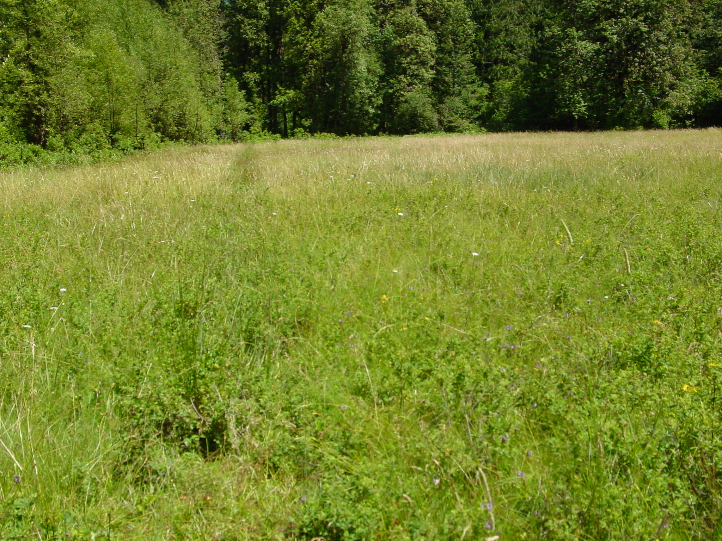
Water Spreading

Slide 19
Climate and the Future
Will potentially warmer climates impact these systems?

