Slide 1
Native American Use of West Cascade Montane Meadows
The View from the McKenzie River Watershed and HJ Andrews Experimental Forest

Slide 2
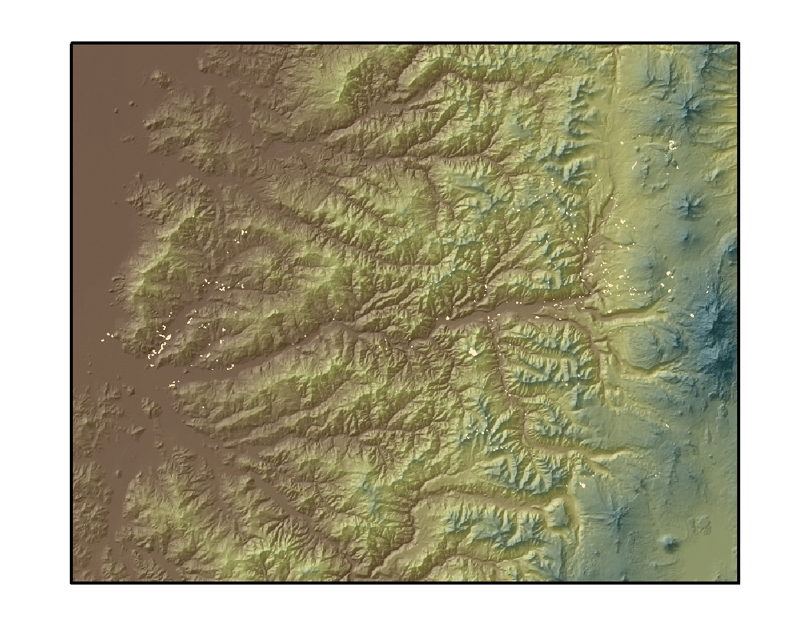
McKenzie River Watershed Archeological Sites

Slide 3
HJA Archeological Sites
Site Number | Site Type | Associated Artifacts
L1007 | Camp | 1 Obsidian Middle Archaic Projectile Point, Hammerstone, obsidian debitage/flakes
L1020 | Lithic Scatter | 2 Cores, debitage/flakes (all obsidian)
L1171 | Lithic Scatter | 2 Middle Archaic Projectile Point, utilized flake, debitage/flakes (all obsidian)
L130 | Camp | Middle Archaic Projectile Point, 2 bifaces, retouched flake, debitage/flakes (all obsidian)
L181 | Depression | Possible wickiup depression
L328 | Camp | 1 Biface, 1 scraper, 1 utilized flake, debitage/flakes (all obsidian)
L411 | Lithic Scatter | Utilized flake, debitage/flakes (all obsidian)
L474 | Cairns | 4 rock cairns
L614 | Lithic Scatter | Utilized flake, debitage/flakes (all obsidian)
L742 | Lithic Scatter | Obsidian debitage/flakes
L806 | Lithic Scatter | 1 Biface, debitage/flakes (all obsidian)
LI131 | Lithic Scatter | Retouched flake, debitage/flakes (all obsidian)
Unknown 1 | Lithic Scatter | Obsidian debitage/flakes
Unknown 2 | Lithic Scatter | Obsidian debitage/flakes
Unknown 3 | Camp | 2 Middle Archaic Projectile Point, debitage/flakes (all obsidian)
Unknown 4 | Camp | 3 Groundstone fragments, obsidian debitage/flakes
Unknown 5 | Lithic Scatter | Obsidian debitage/flakes

Slide 4
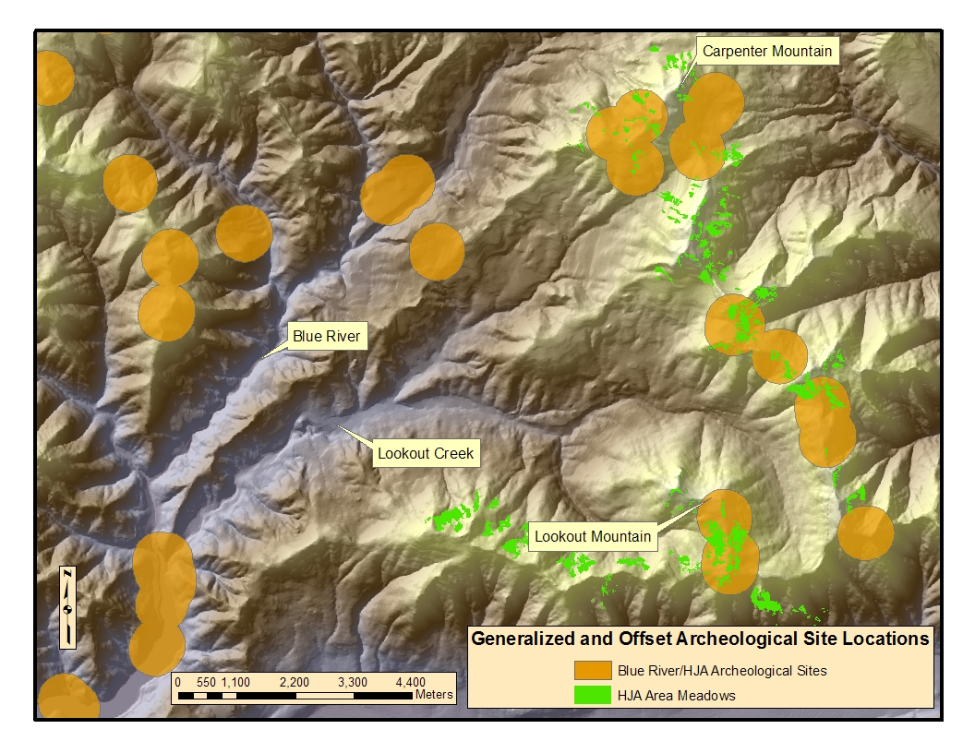
Archeological Sites in and Around HJ Andrews

Slide 5
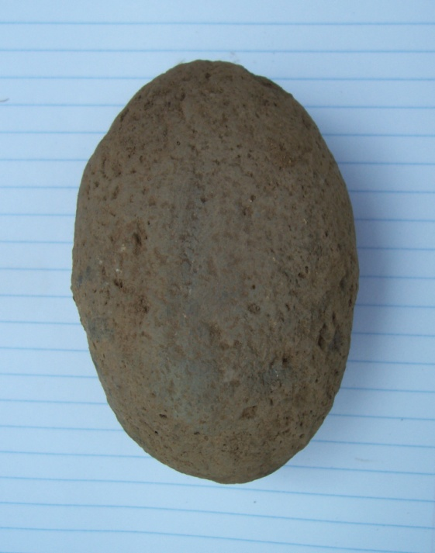
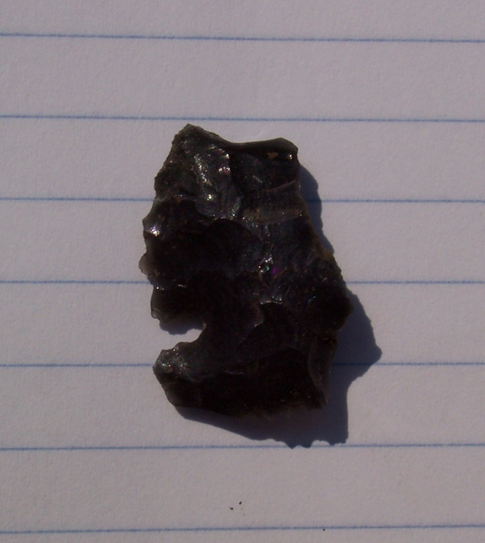
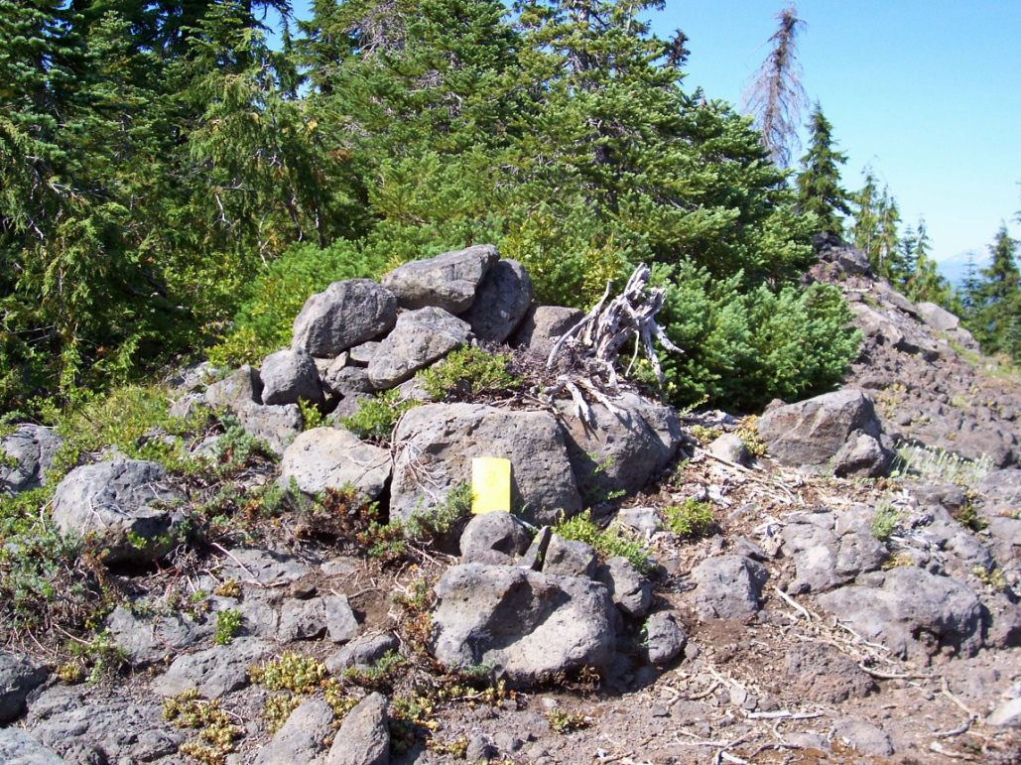
Select Artifacts from HJA Sites

Slide 6
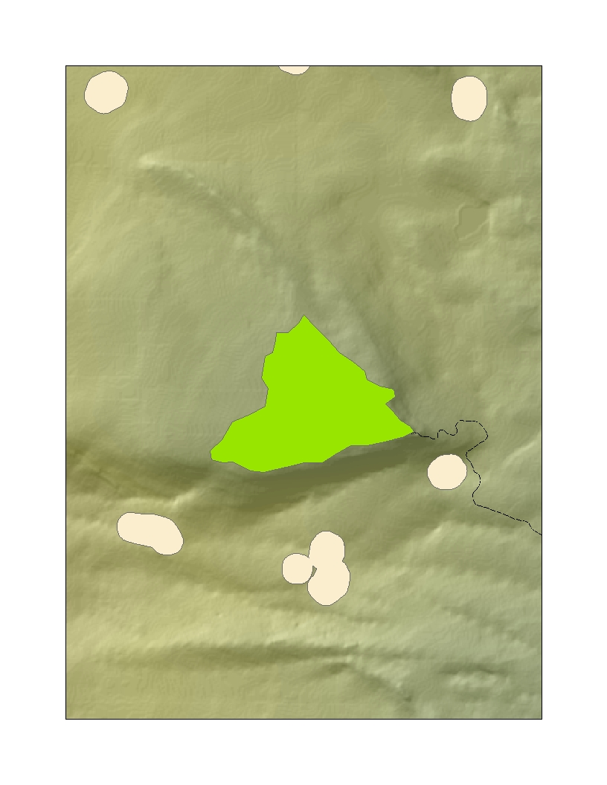
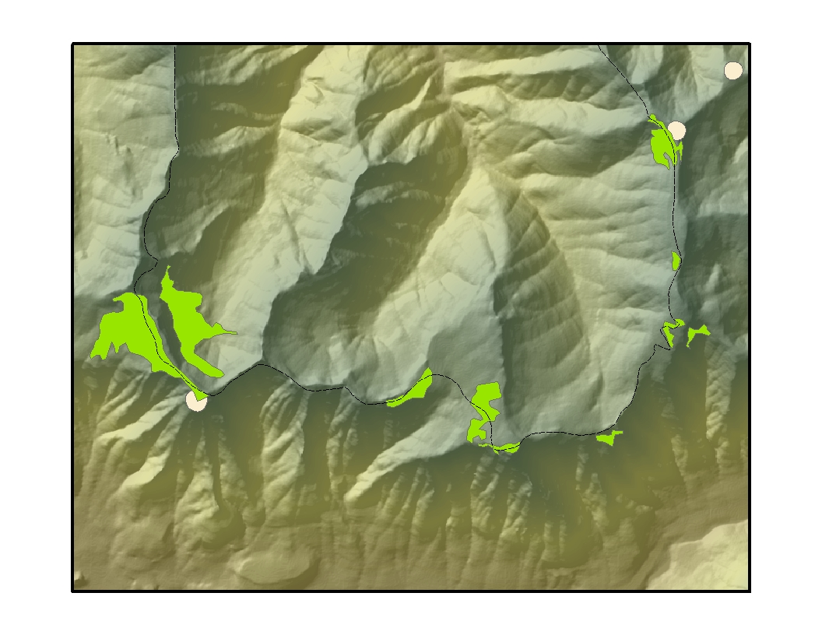
Other West Cascade Meadows
Bunchgrass Ridge Meadow
Chucksney-Grasshopper Meadow Complex

Slide 7
Prehistoric Foods and Meadows
Plant Name | Location | Notes
Vaccinium membranaceum | Openings, meadows, edges | Yields are improved if burned every 5 years
Vaccinium deliciosum | Openings, meadows, edges | Yields are improved if burned every 5 years
Pteridium aquilinum | Openings, meadows, edges | Colonizes burned areas
Lilium columbianum | Openings, meadows, edges
Perideridia gairdneri | Openings, meadows, edges
Erythronium grandiflorum | Openings, meadows, edges
Allium or Brodiaea spp. | Openings, meadows, edges
Lomatium spp. | Openings, meadows, edges
Animal Name | Location | Notes
Odocoileus hemionus | Openings, meadows, edges
Cervus elaphus | Openings, meadows, edges

Slide 8
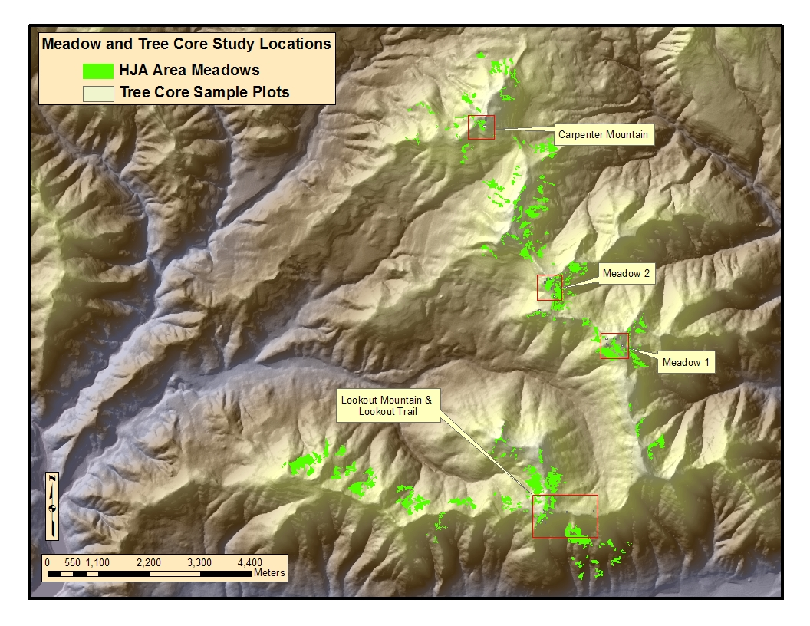
Mature Forest Plots

Slide 9
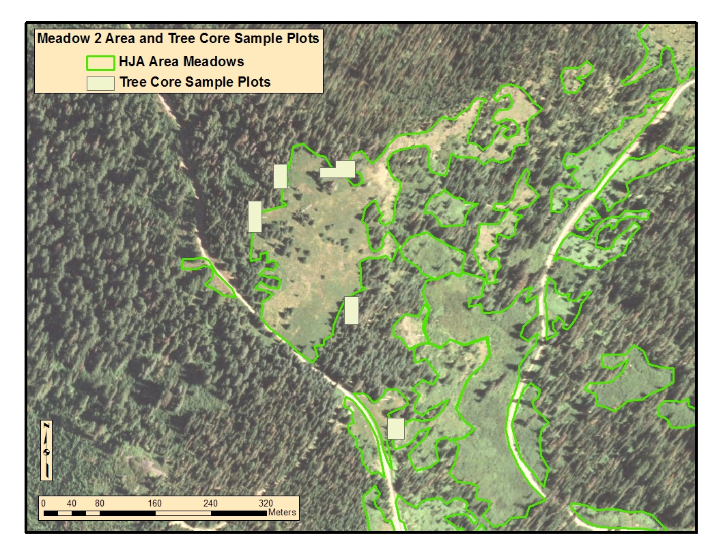
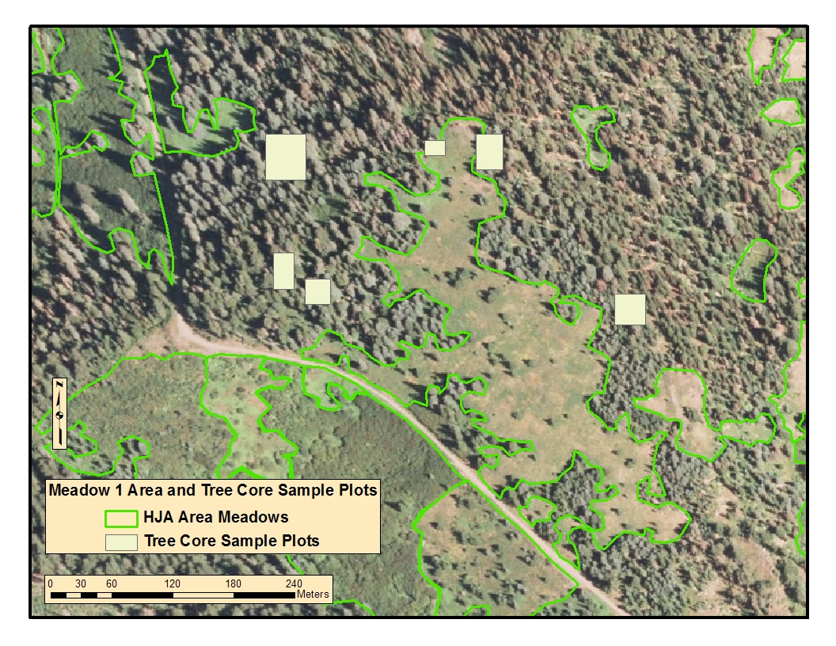
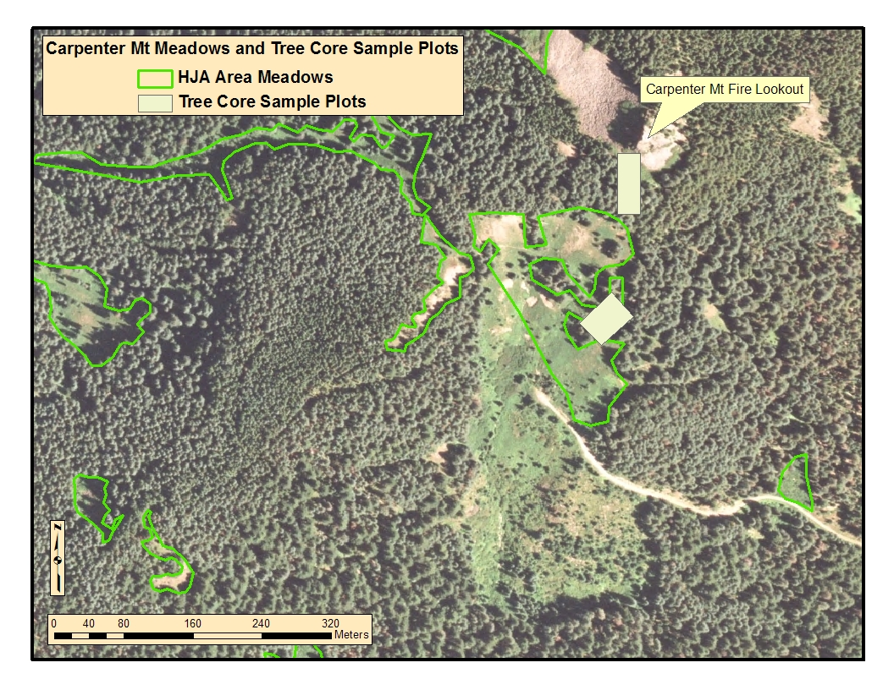
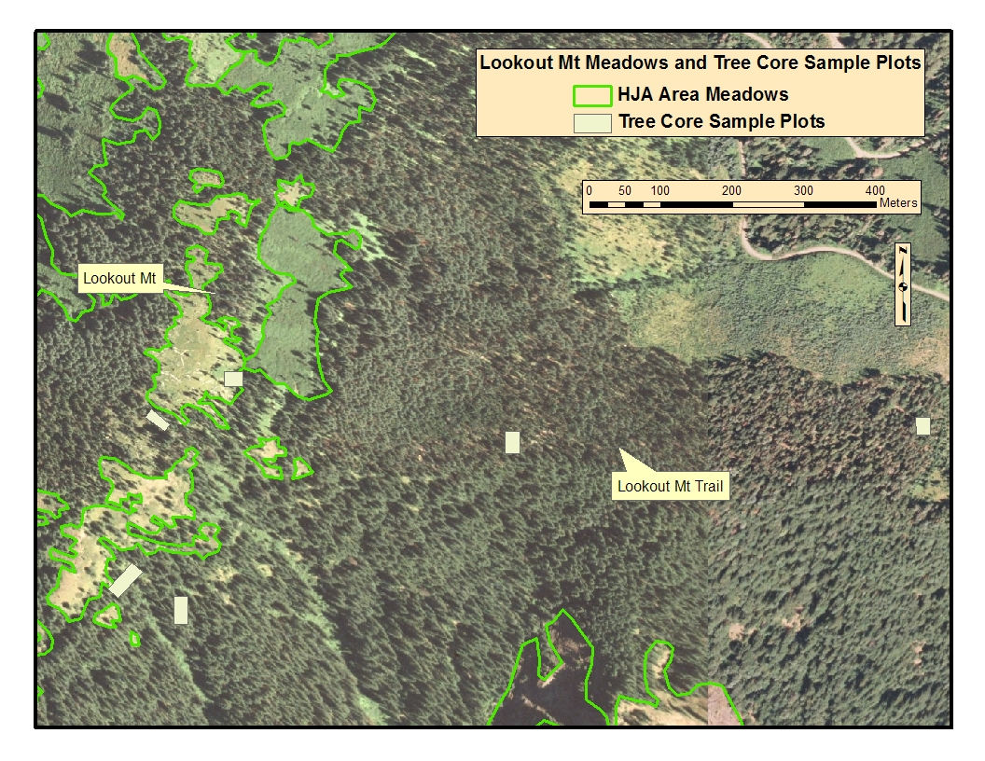
Aerial Photos of Mature Forest Plots

Slide 10
Old Growth Trees Surrounding Meadows in HJA
While many of these forests are dominated by Noble fir (Abies procera), most of these trees are less than 200 years old. The oldest trees in these forests are widely spaced Douglas fir (Pseudotsuga menzesii). Table 3 and Chart 1 (above) show the age class and species structure of trees sampled between and around various meadows, shown in detail below.
Age Categories | abam | abgr | abla | abpr | pimo | psme | tshe | tsme
0-50 | 4 | 3 | 2 | 9 | 0 | 1 | 1 | 1
51-100 | 15 | 0 | 0 | 54 | 0 | 6 | 3 | 6
101-150 | 11 | 0 | 0 | 29 | 5 | 10 | 0 | 18
151-200 | 4 | 0 | 0 | 8 | 2 | 7 | 0 | 2
201-250 | 0 | 0 | 0 | 1 | 0 | 4 | 0 | 4
251-300 | 0 | 0 | 0 | 0 | 0 | 1 | 0 | 0
301-350 | 0 | 0 | 0 | 0 | 0 | 2 | 0 | 0
351-400 | 0 | 0 | 0 | 0 | 0 | 1 | 0 | 0
401-450 |  | 0 | 0 | 0 | 0 | 1 | 0 | 0
Total | 34 | 3 | 2 | 101 | 7 | 33 | 4 | 31

Slide 11
Conclusions
Native Americans heavily utilized meadows for major plant and animal foods.
Use of these areas is at least 2200 years old and likely older.
Meadows were likely much more extensive 200+ years ago and managed by the indigenous population.

