Slide 1
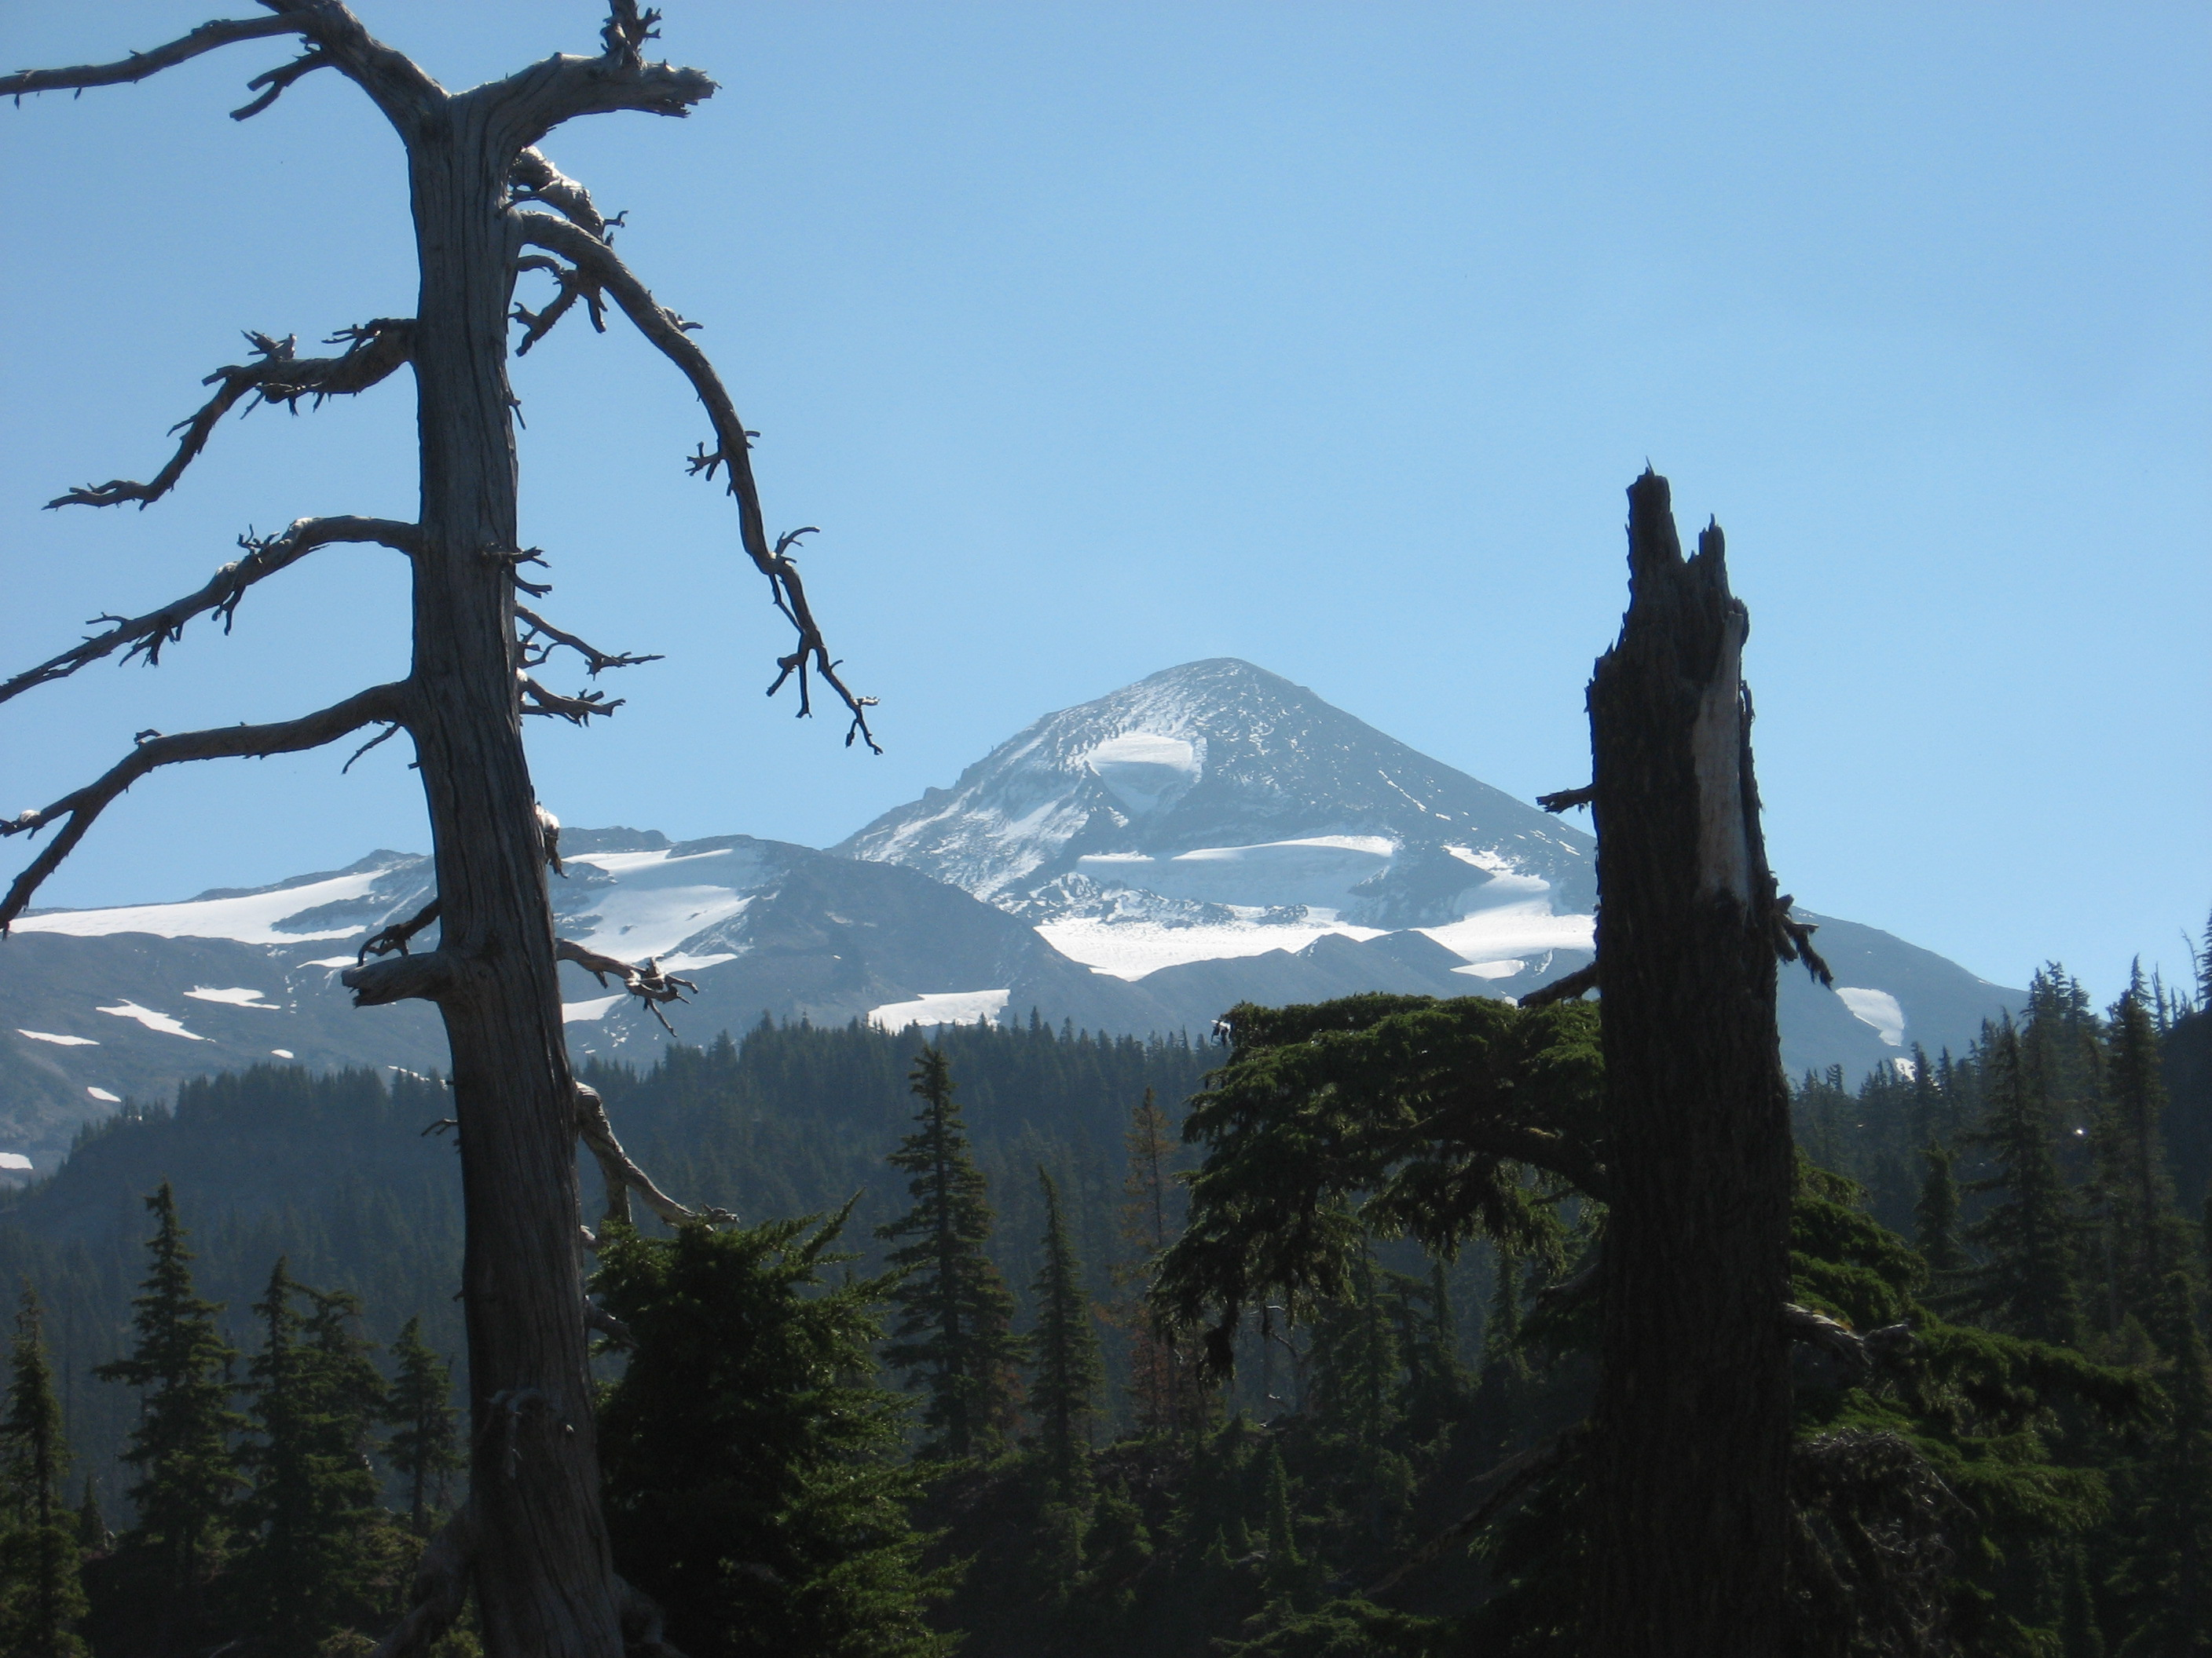
CAMPSITE RESTORATION
Three Sisters Wilderness

Slide 2
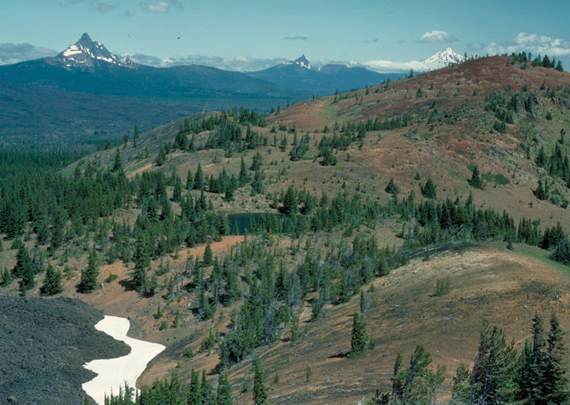

Slide 3
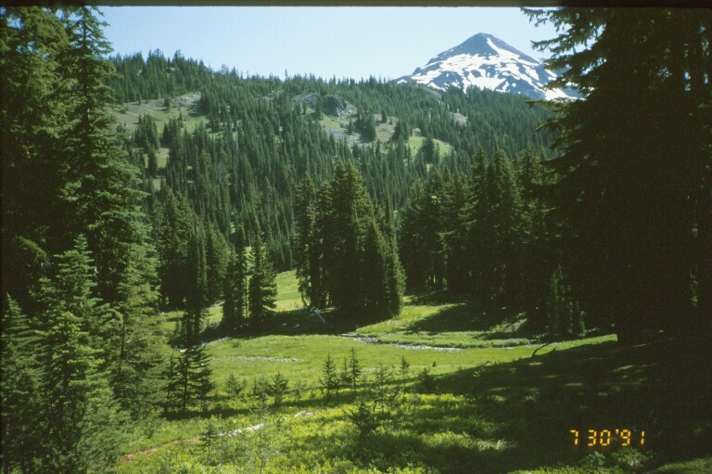

Slide 4
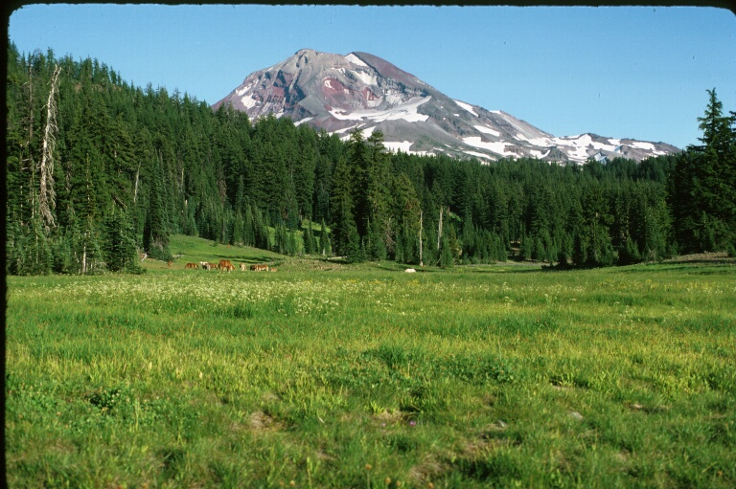

Slide 5
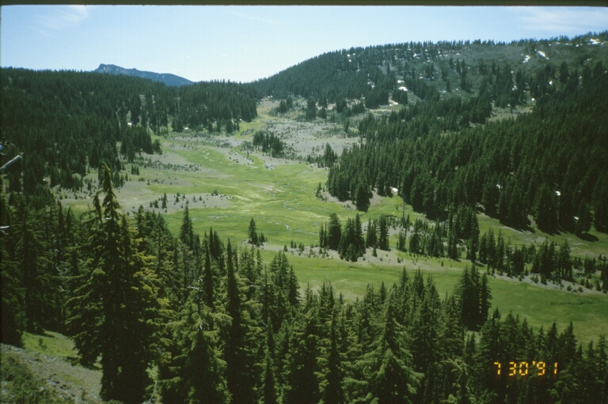

Slide 6
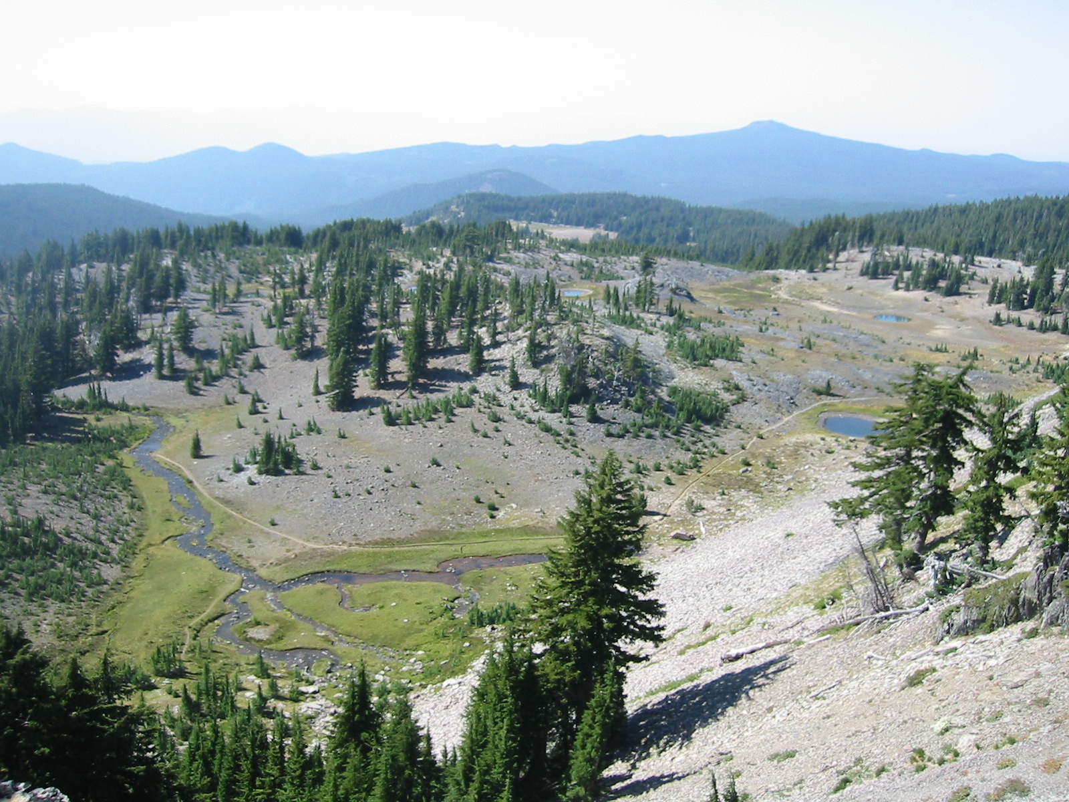

Slide 7
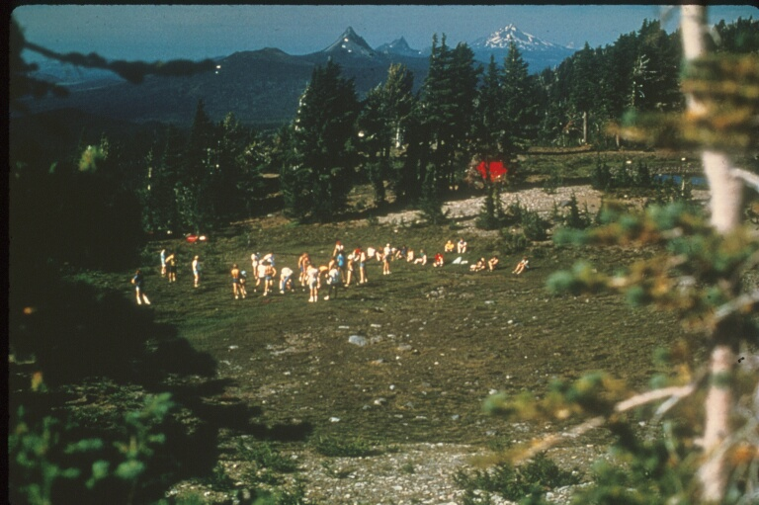

Slide 8
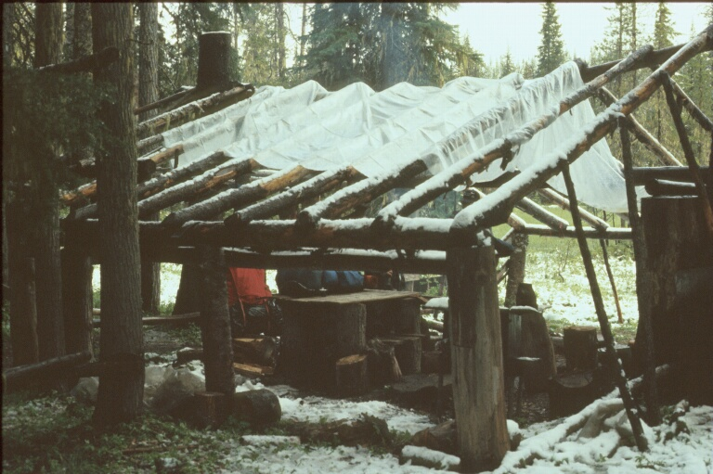

Slide 9
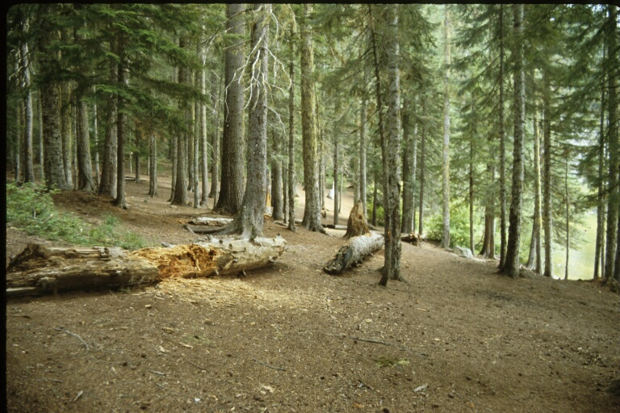

Slide 10
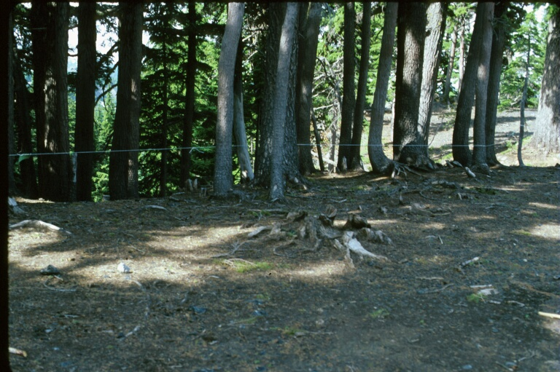

Slide 11
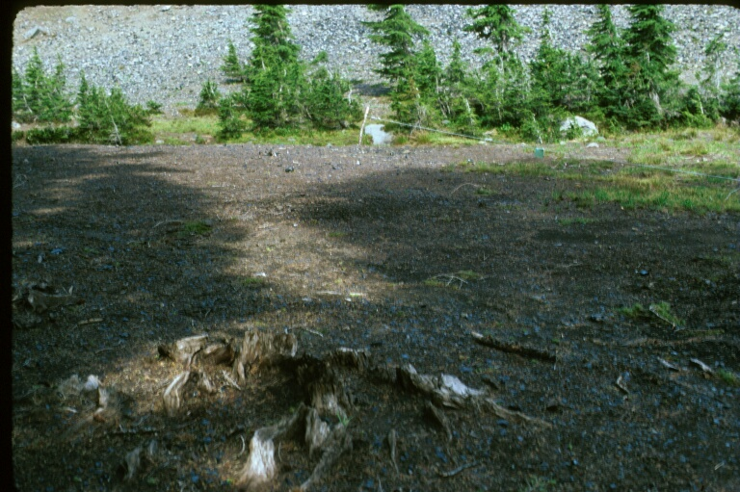

Slide 12
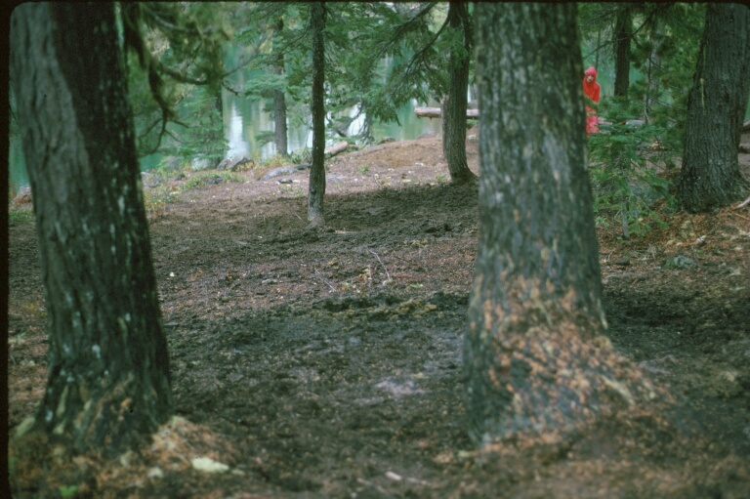

Slide 13
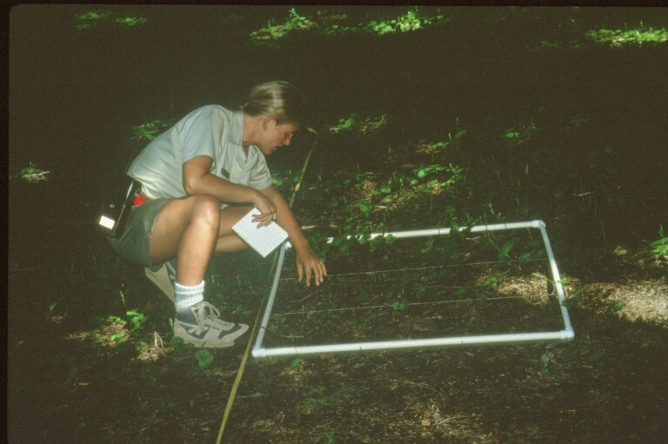

Slide 14
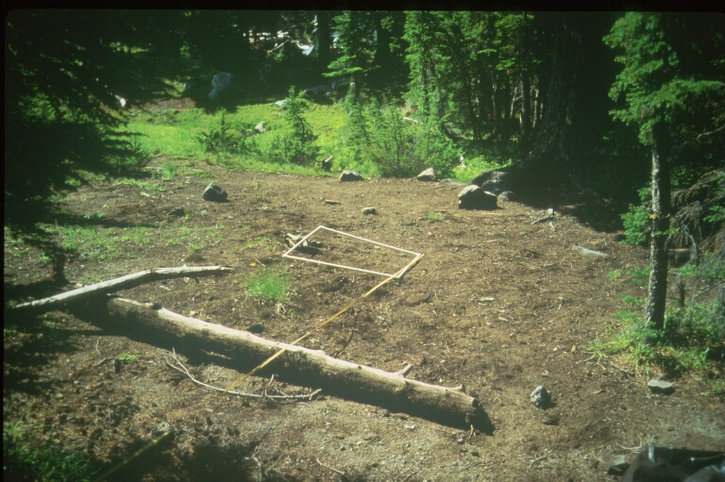

Slide 15
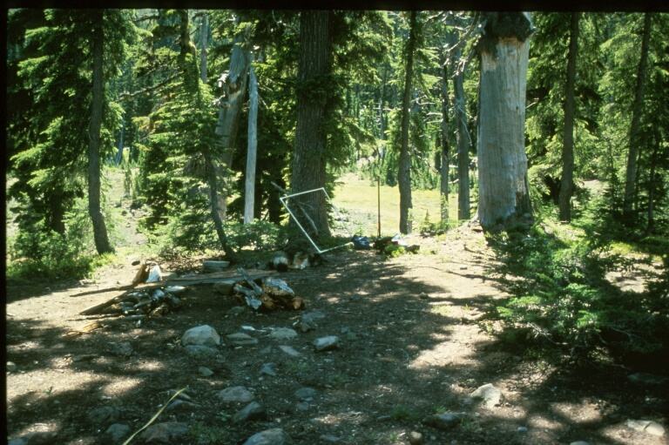

Slide 16
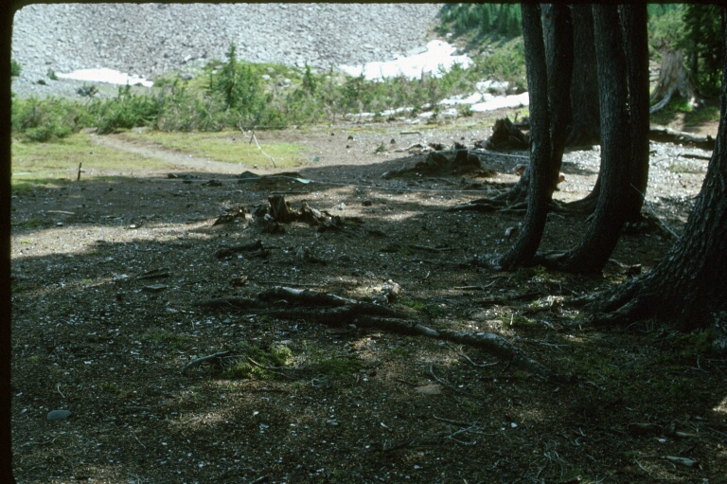

Slide 17
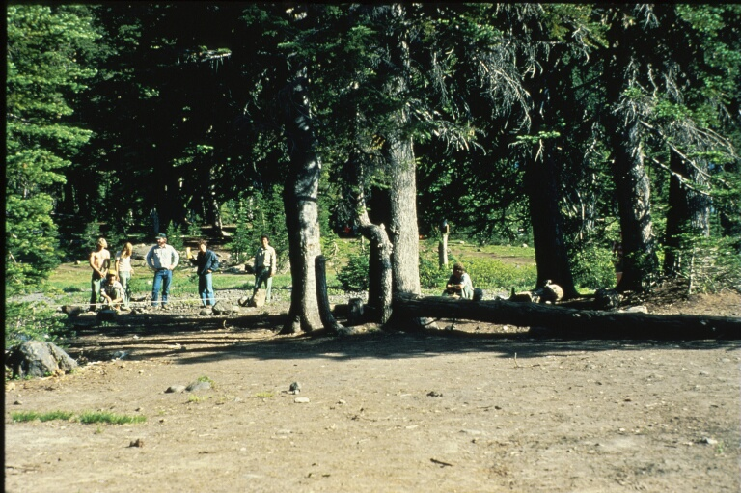

Slide 18
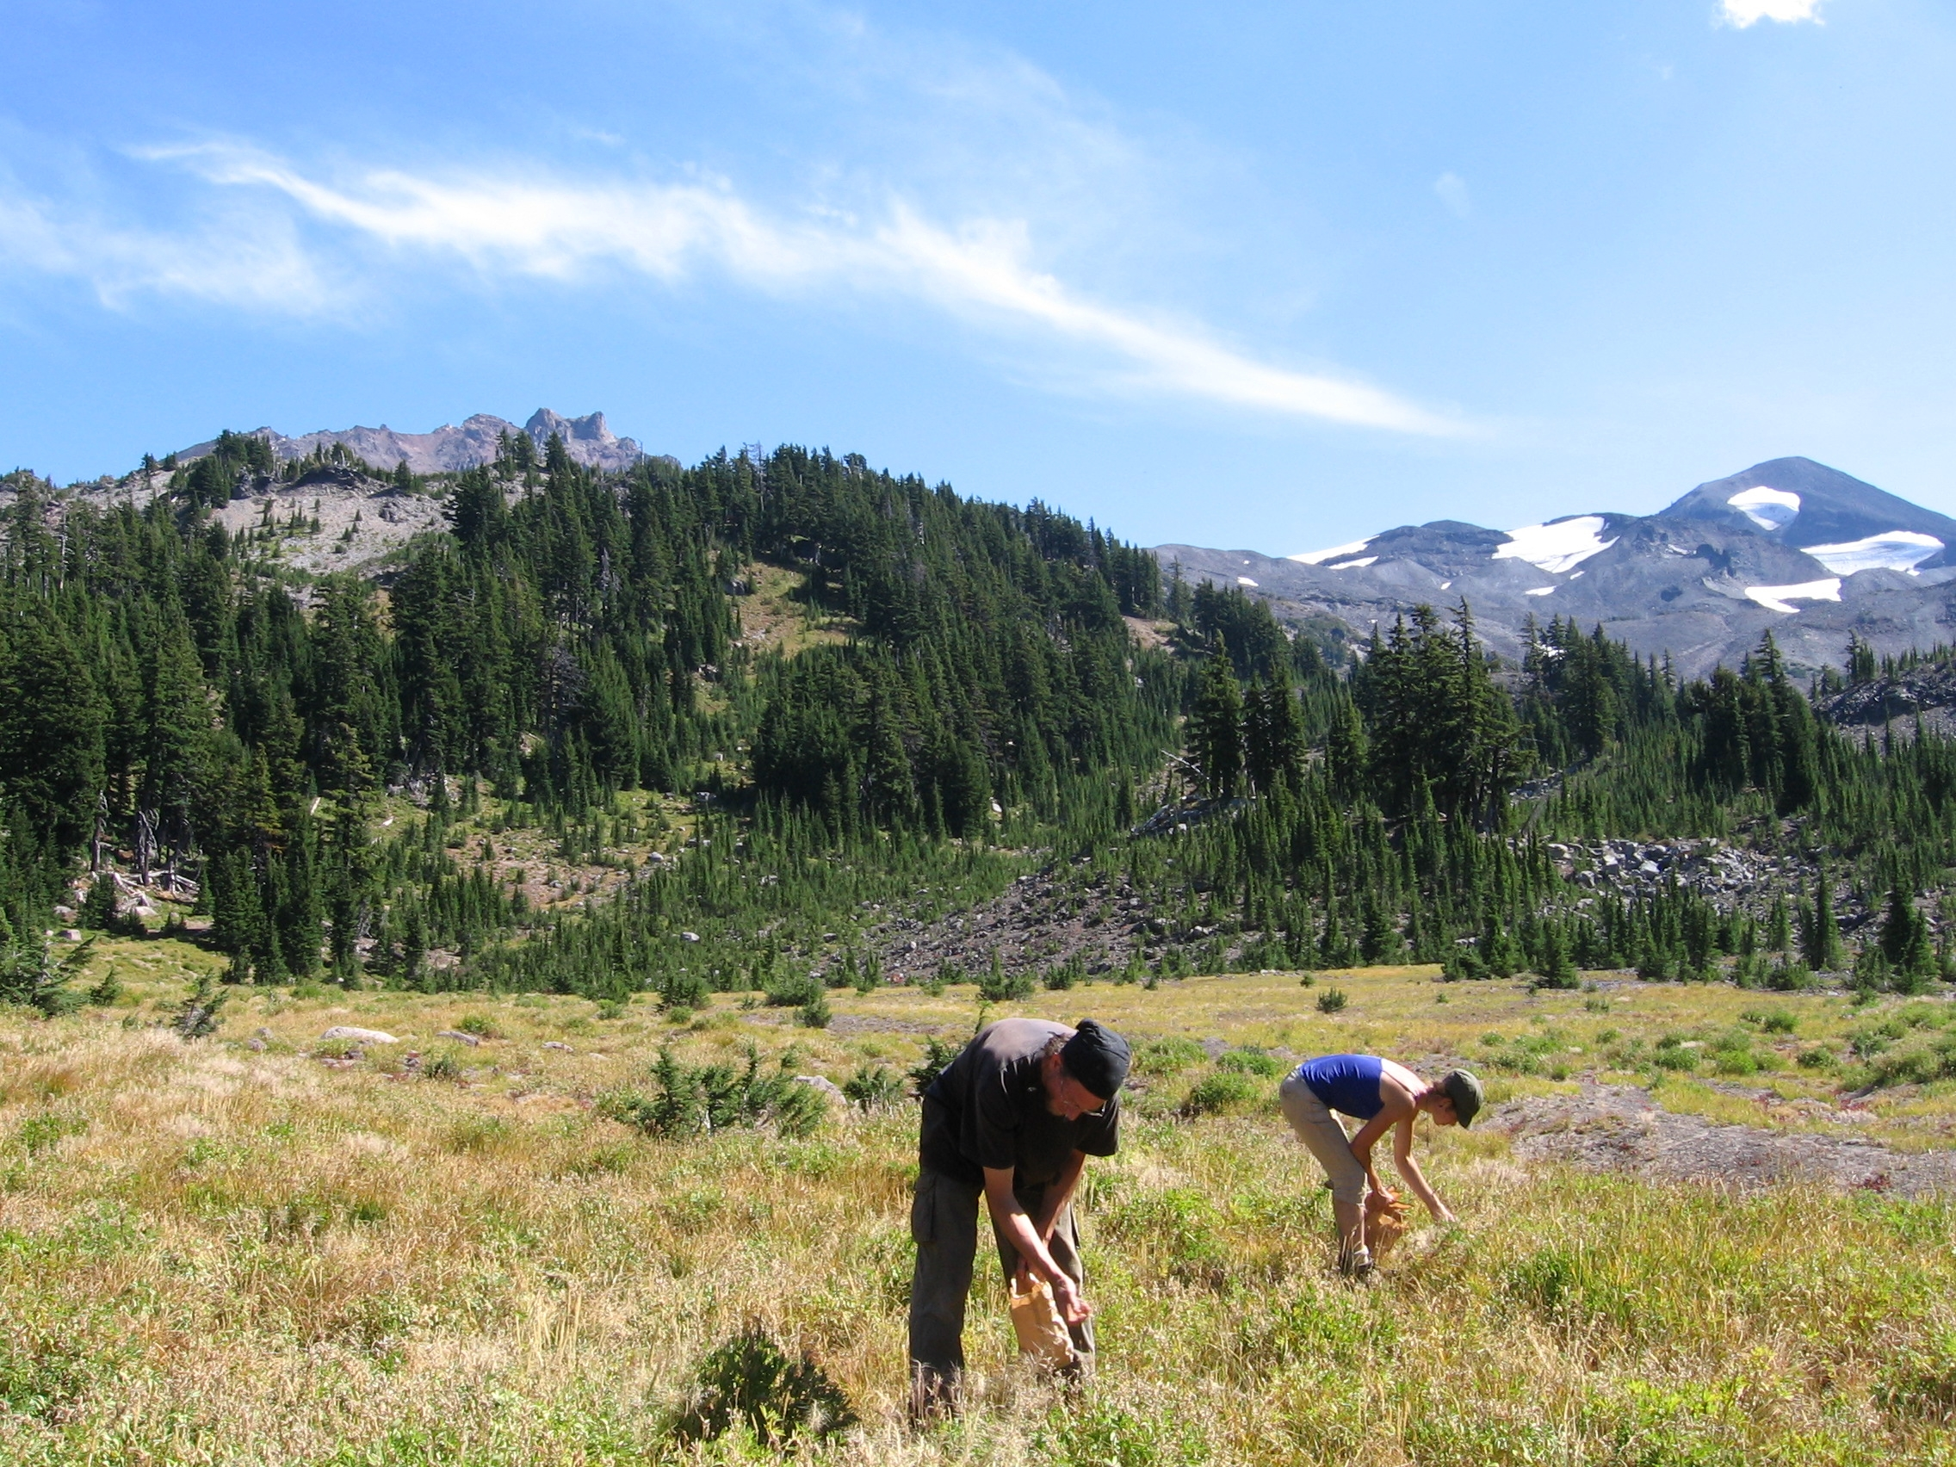

Slide 19
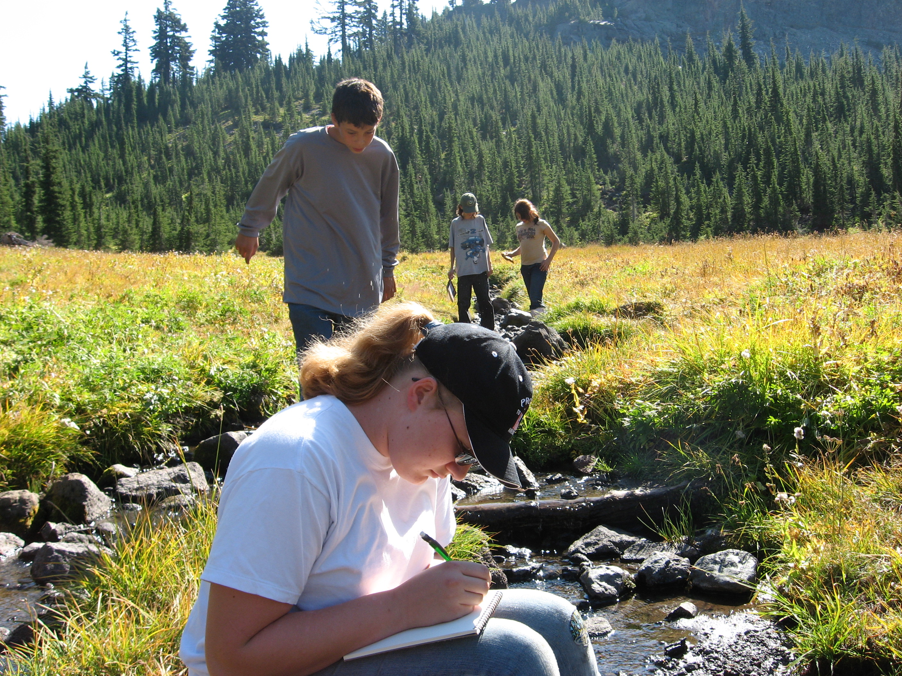

Slide 20
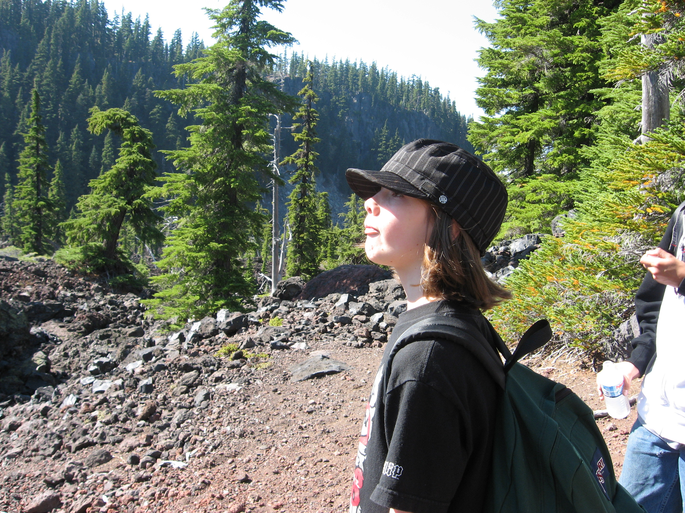

Slide 21
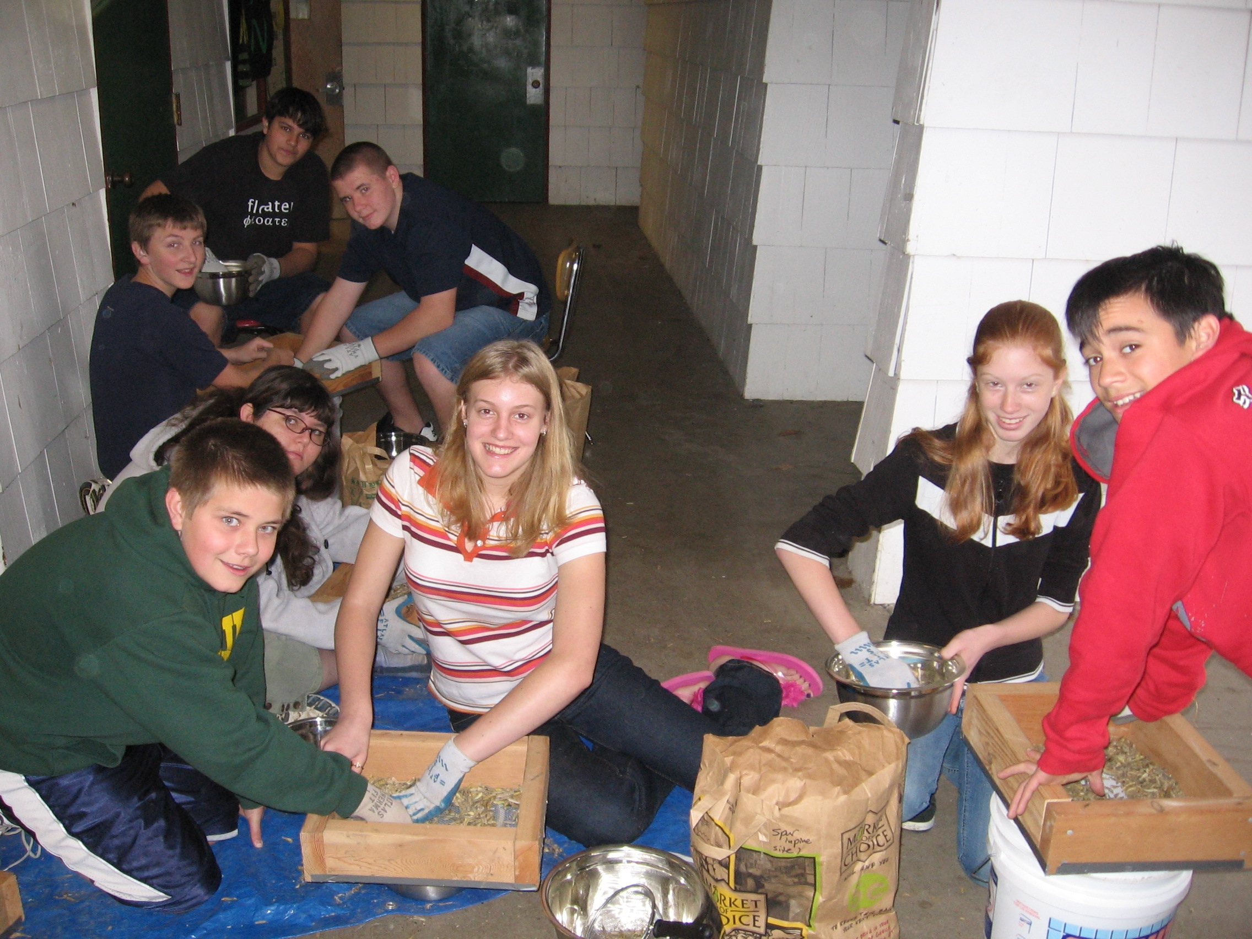

Slide 22
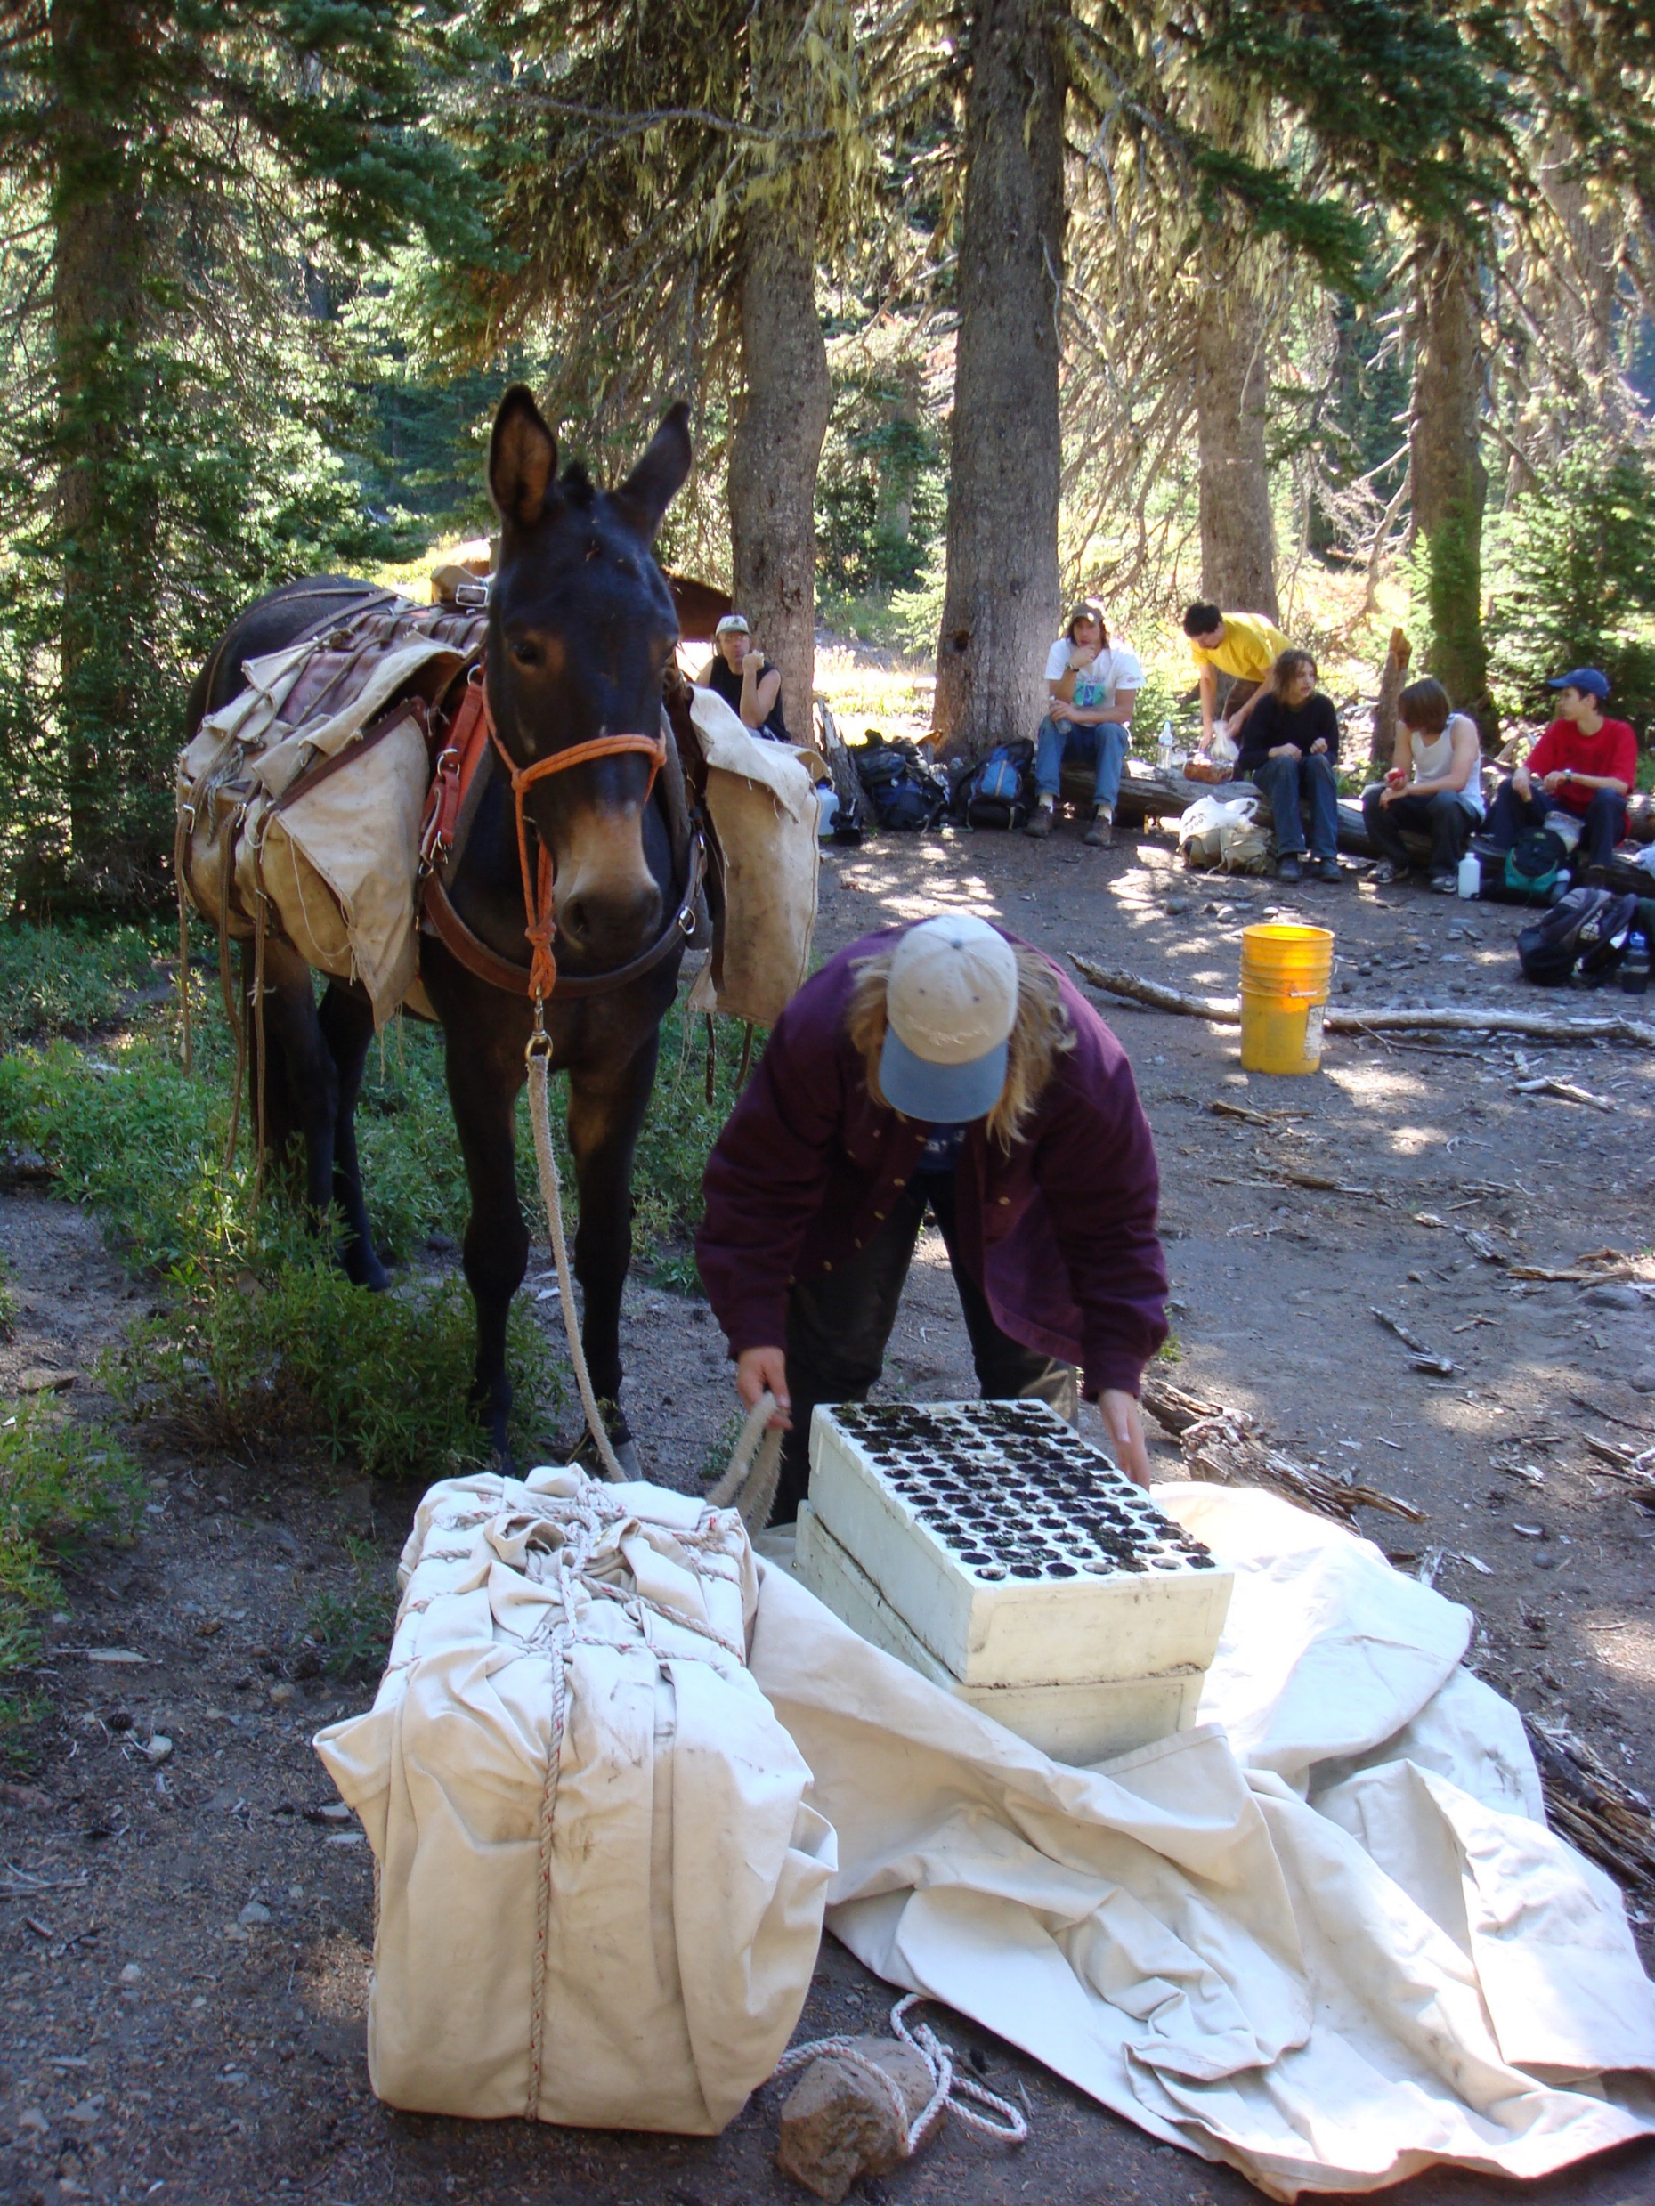

Slide 23
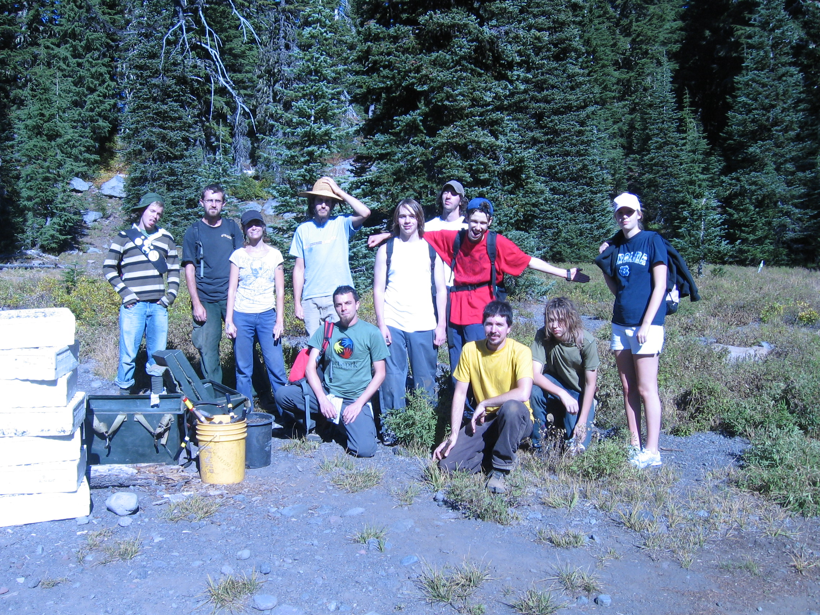

Slide 24
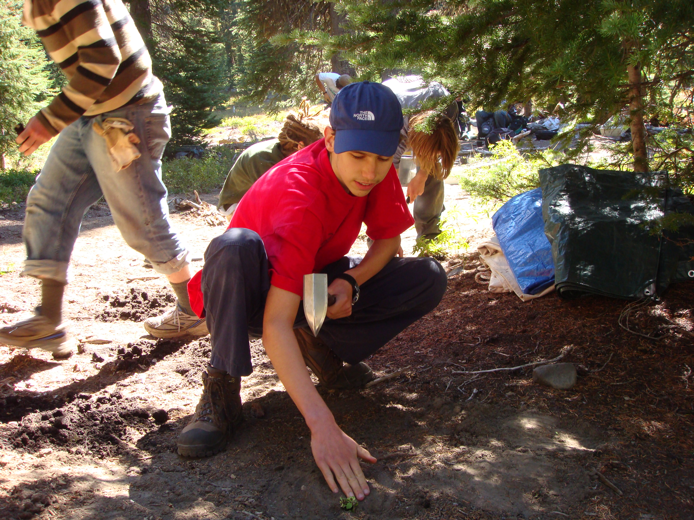

Slide 25
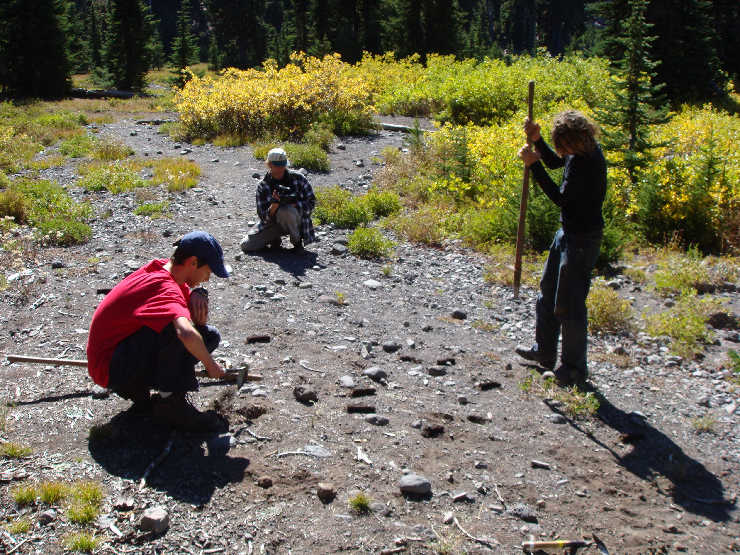

Slide 26
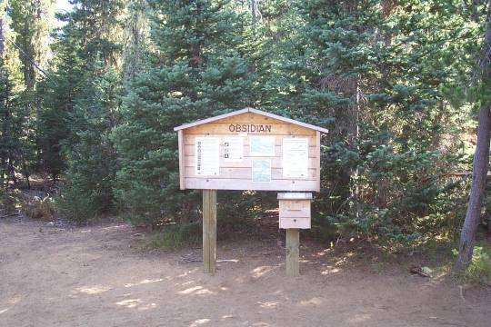

Slide 27
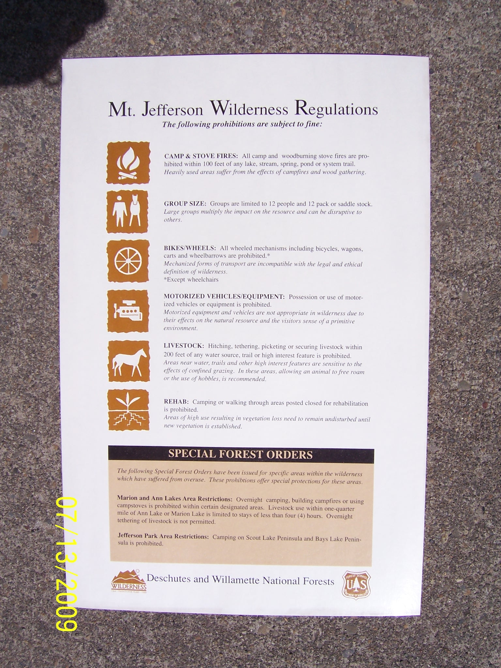

Slide 28
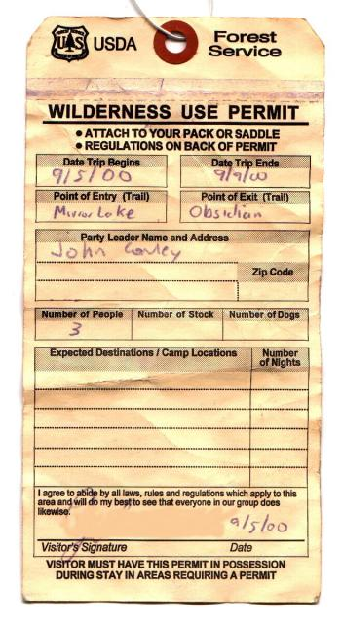

Slide 29

 | USDA |  | Forest Service
Three Sisters Wilderness Permit
Welcome to your National Wilderness Preservation System. Enjoy this Wilderness, but please abide by all regulations to protect and preserve the Wilderness. Help us keep the WILD in Wilderness by practicing Leave No Trace techniques.
Wilderness Regulations
Permits are required for entering all Wilderness areas on the Willamette and Deschutes National Forests.
Group size is limited to no more than 12 people and no more than 12 head of stock.
Campfires are prohibited within 100 feet of water, trail or shelters.
Do not cut trees, snags or boughs. Please use dead and down wood if you need to have a campfire.
Bury human and pet waste well away from camps and water sources. Dispose of wash water away from water sources.
Do not walk or camp in areas closed for restoration. These areas have been replanted to restore natural conditions.
Motorized and mechanized equipment is prohibited, including: motorbikes, bicycles, chainsaws, carts, hang gliders, rock drills, aircraft and other non-primitive modes of transportation.
Do not cut switchbacks. Stay on established trails.
Do not tether, hitch or picket stock within 200 feet of water or trail, except for loading and unloading.
Storing or caching equipment or supplies for more than 48 hours is prohibited.
WILLAMETTE / DESCHUTES NATIONAL FORESTS
Site Specific Regulations
Some areas of the wilderness have been affected by heavy use and require additional measures to restore Wilderness values. For site specific information, pick up a WILDERNESS REGULATION CARD at this trailhead.

Slide 31
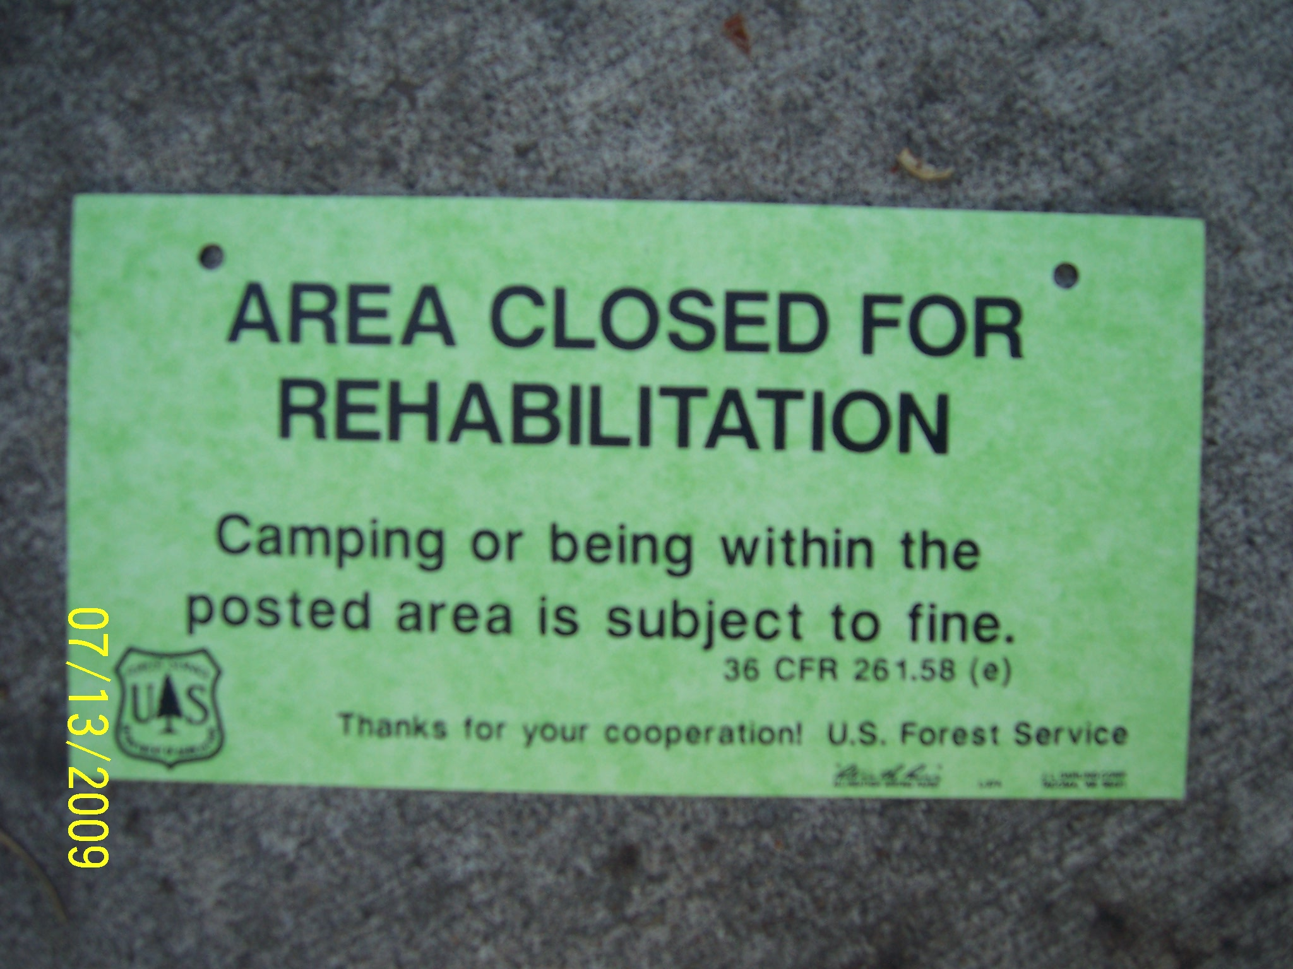

Slide 32
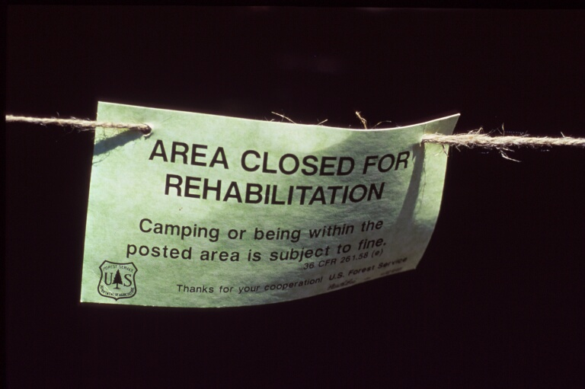

Slide 33
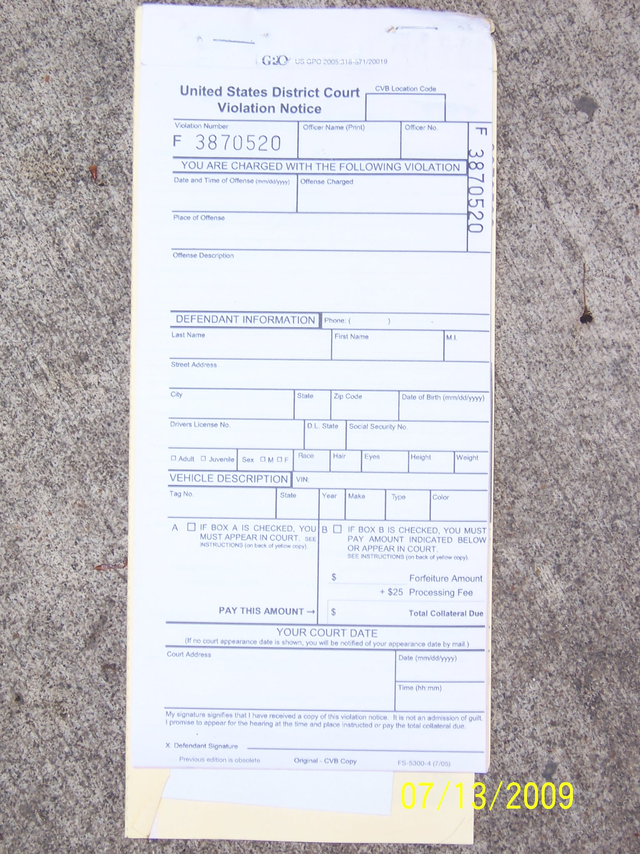

Slide 34
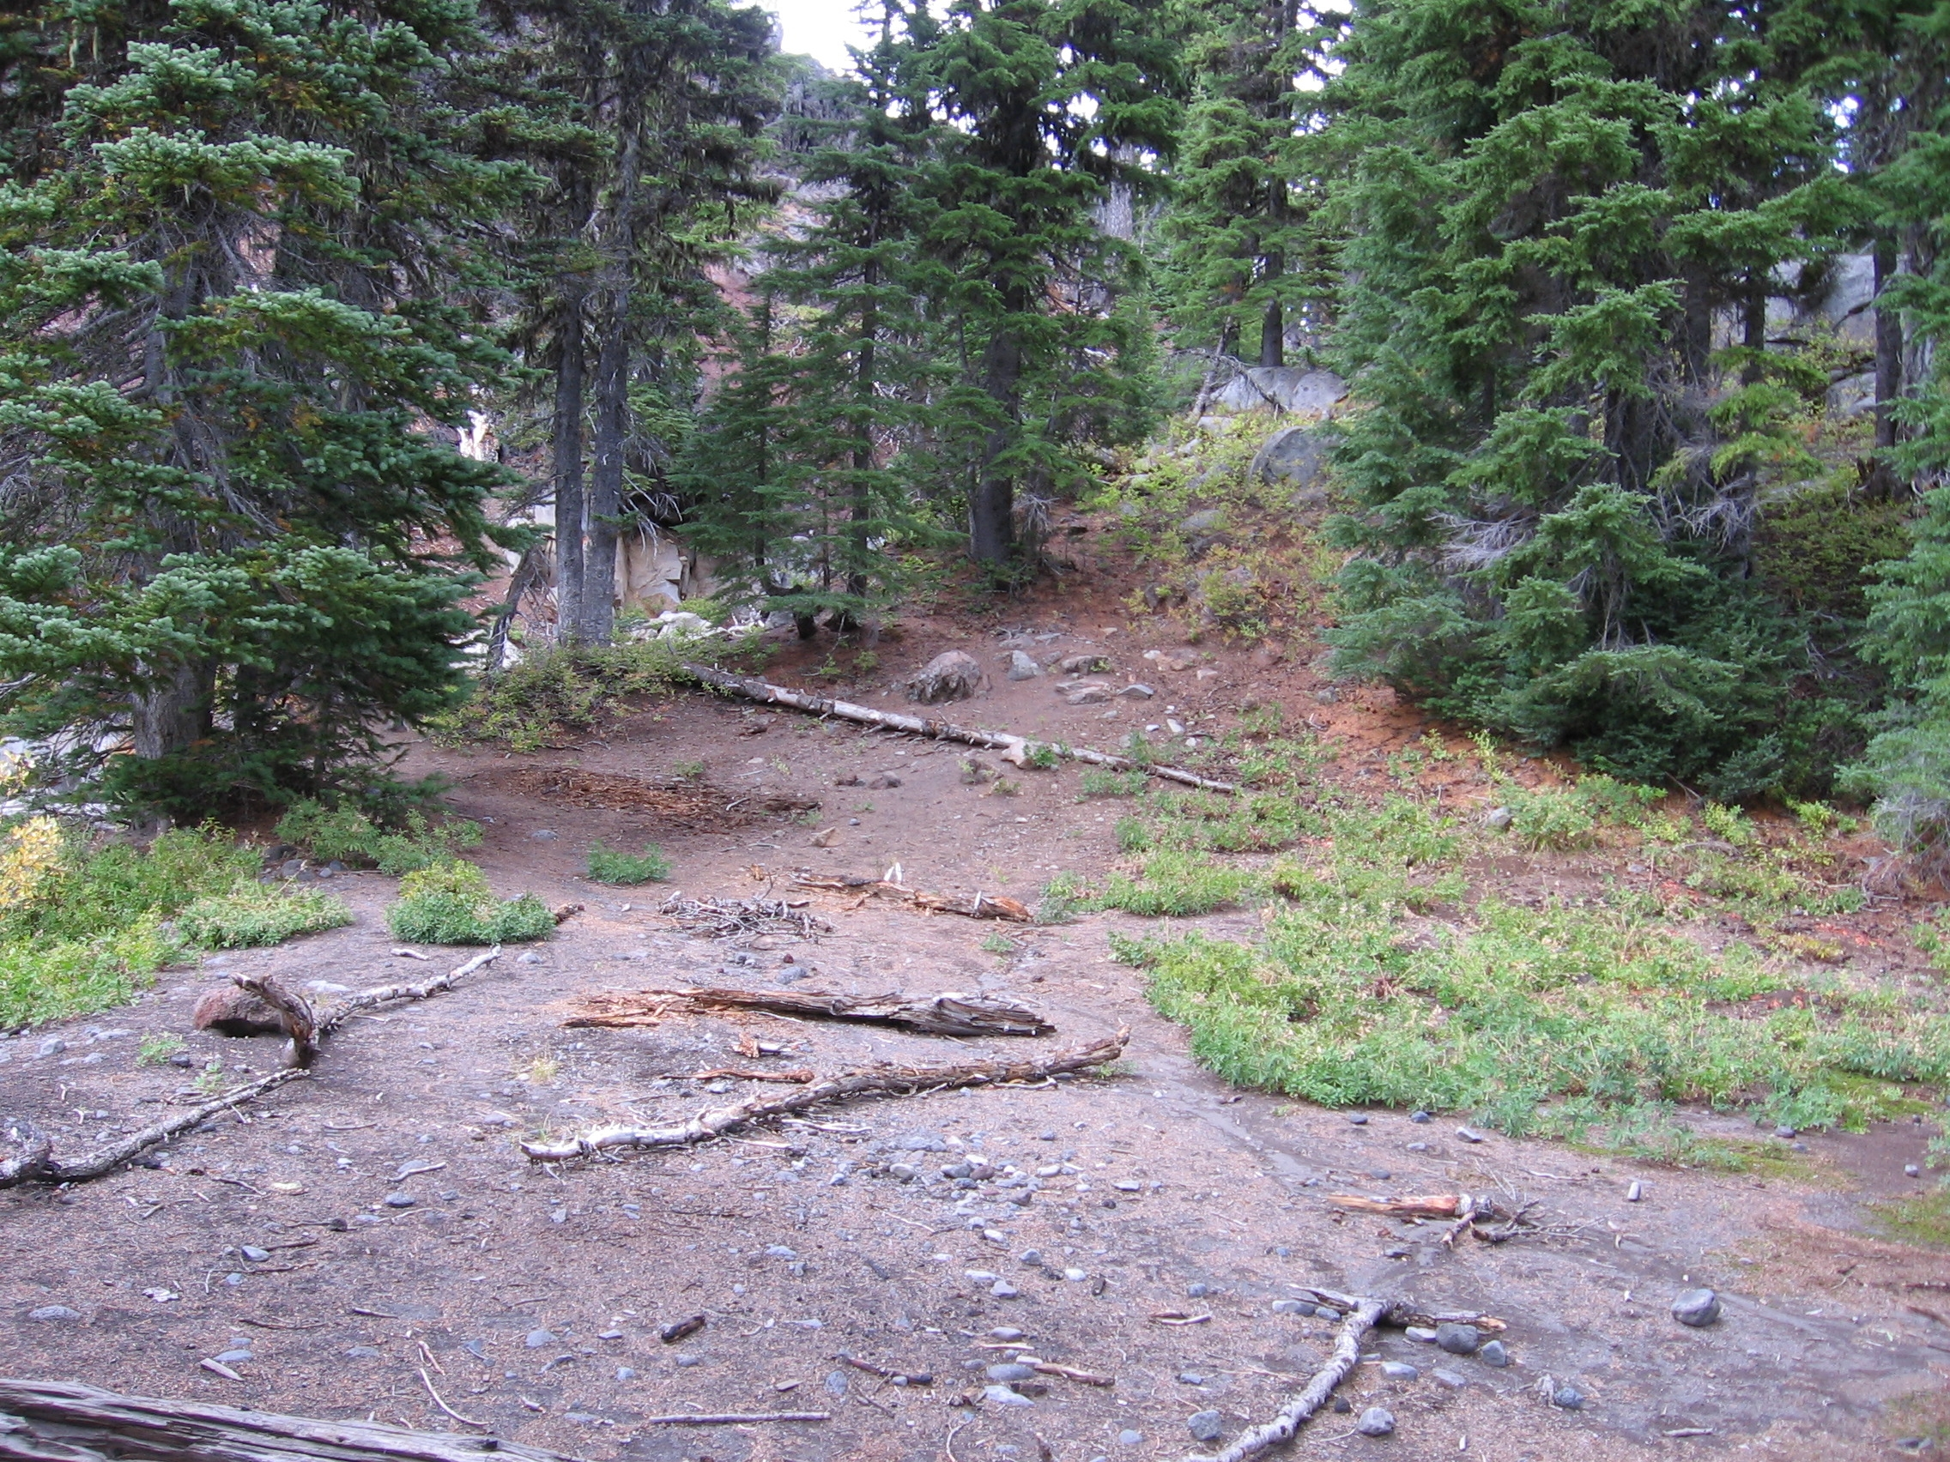

Slide 35
