Slide 1
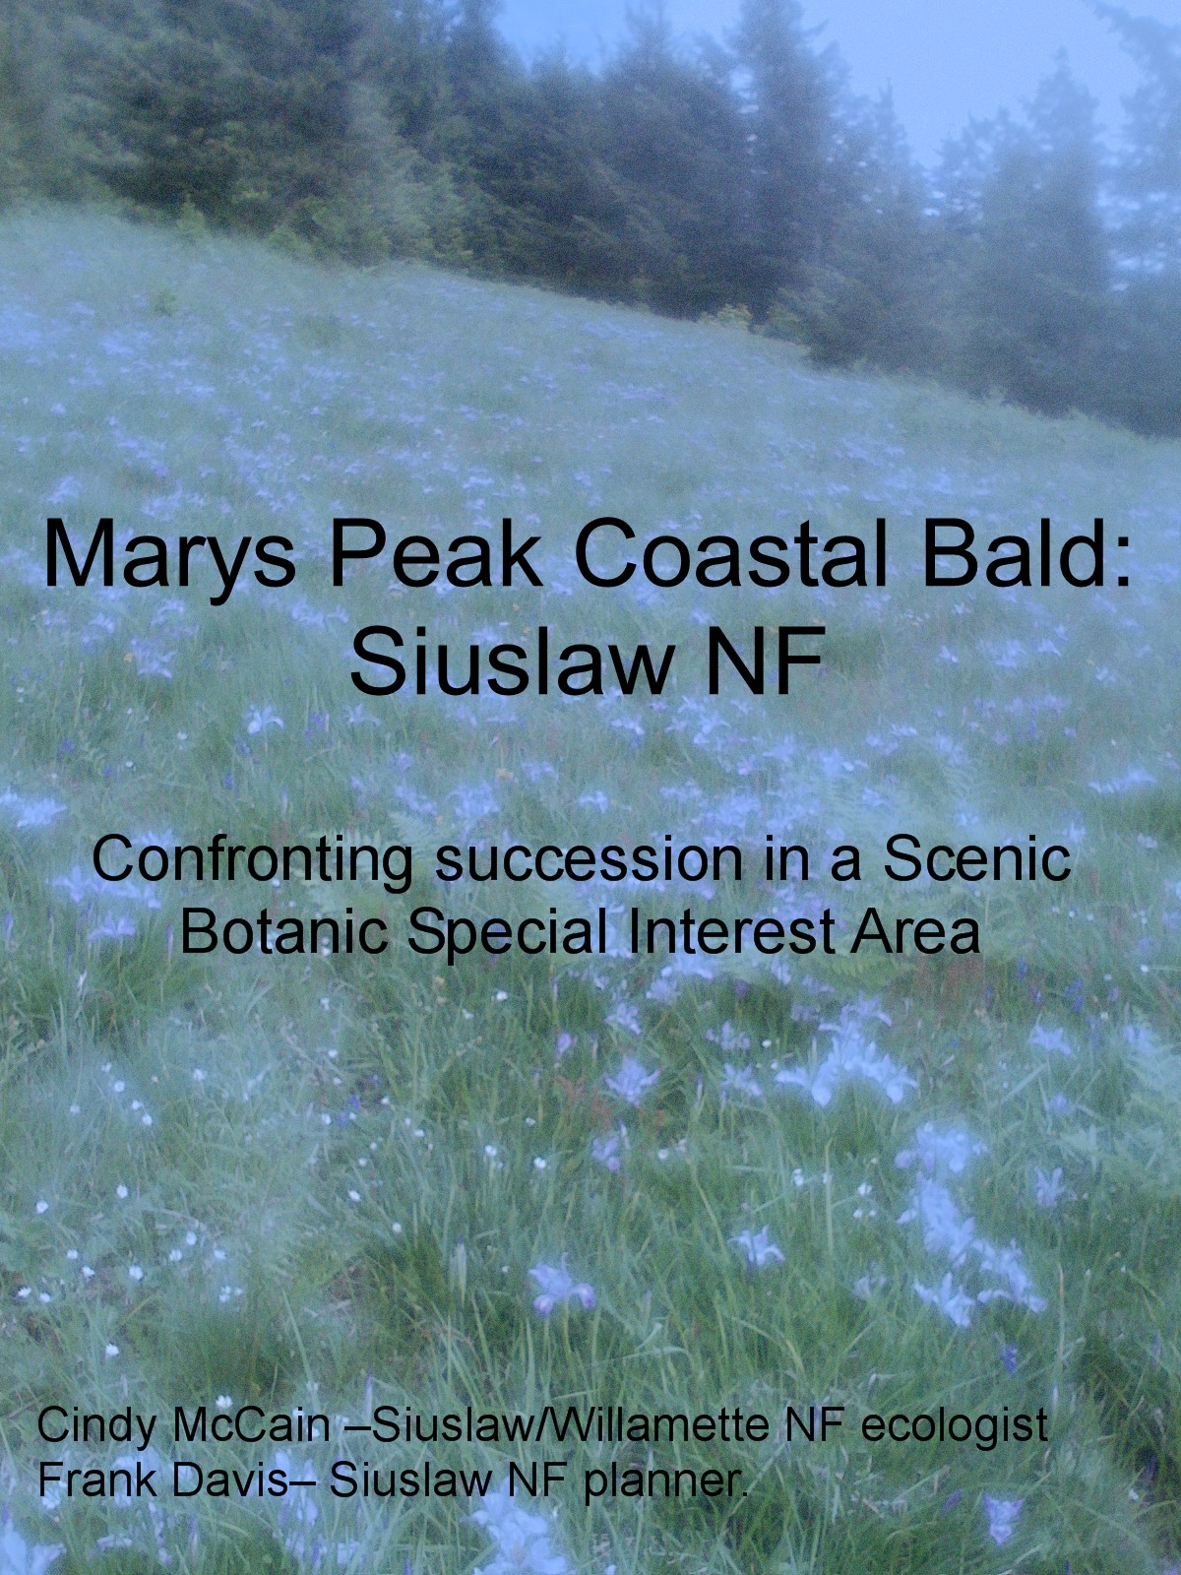
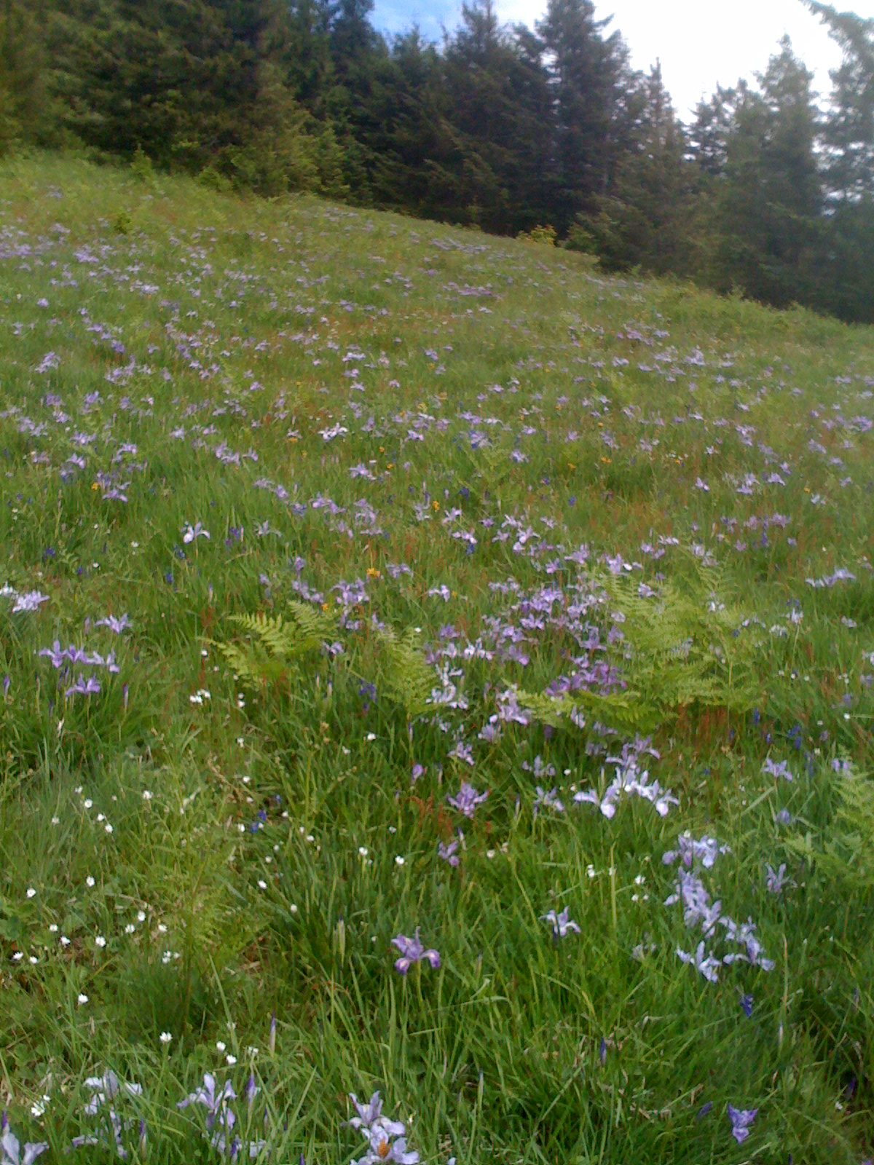

Slide 2
Marys Peak: Siuslaw NF, Salem BLM, City of Corvallis
Photo 2008

Slide 3
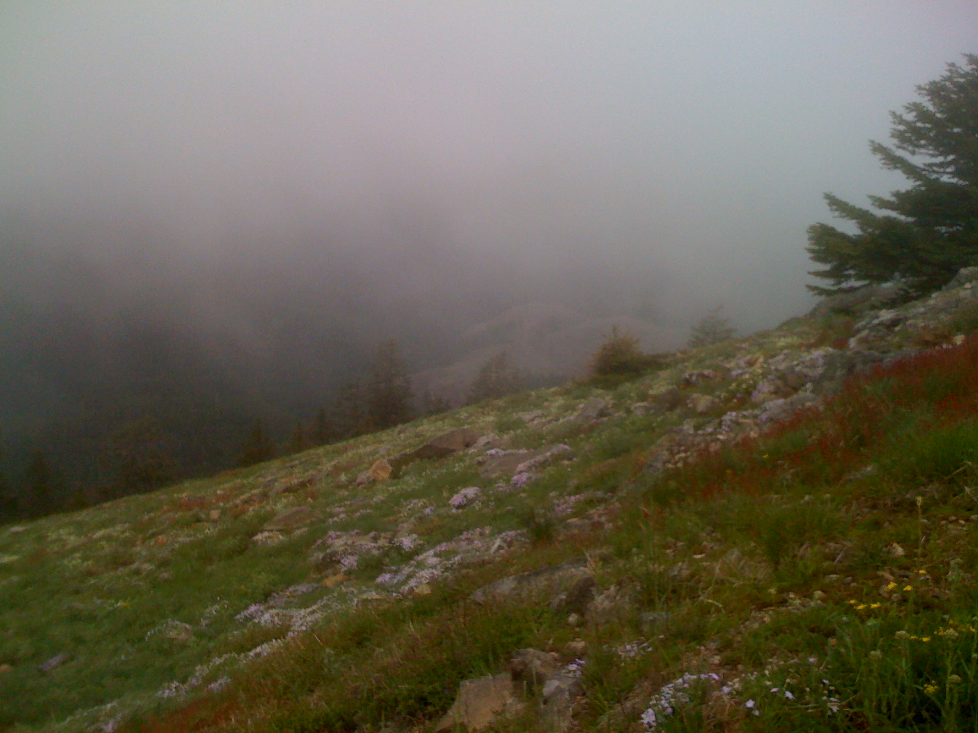

Slide 4
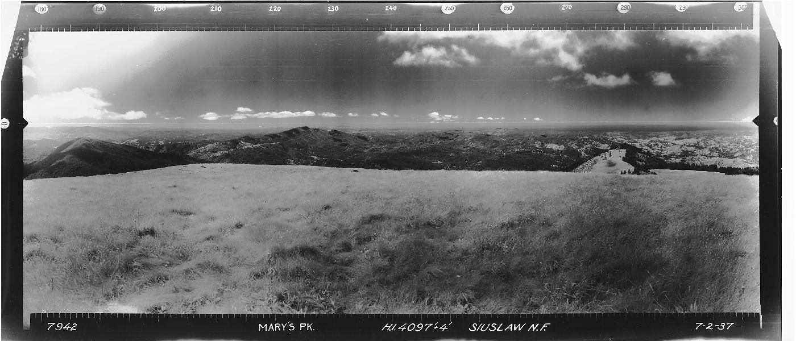
1937

Slide 5
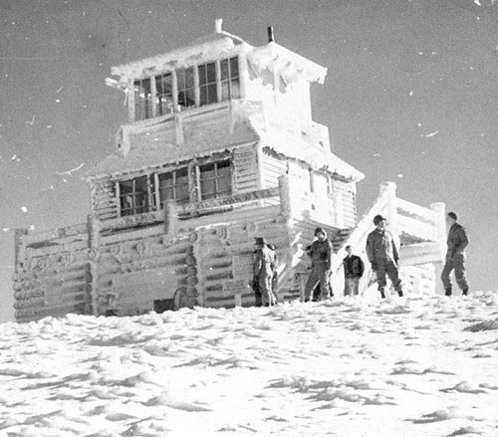
Fire lookout to cold war air defense installation
1941 Soldiers from Camp Adair visit the lookout on Marys Peak. The lookout was begun by the CCC, and completed in 1941—Benton County Historical Museum

Slide 6
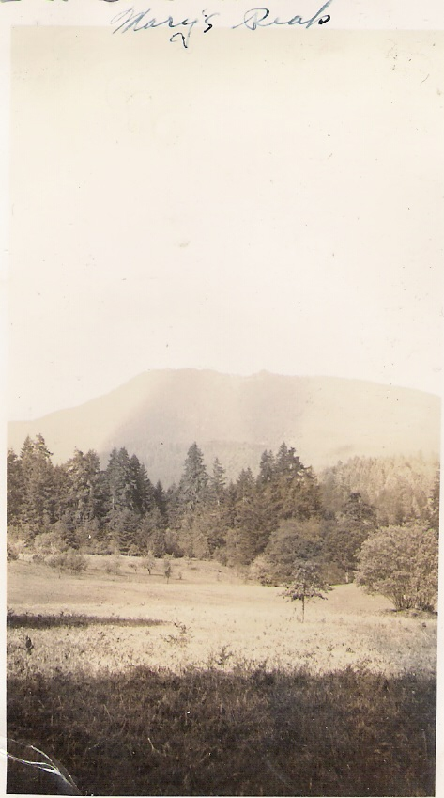
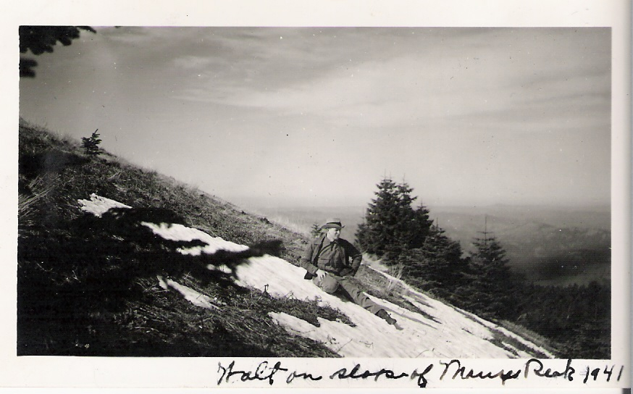
Marys Peak: recreation resource
Photos courtesy Jim Holroyd, Siuslaw NF dispatcher

Slide 7
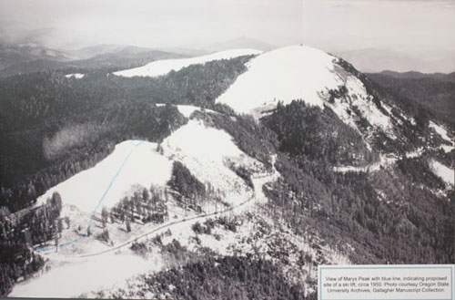
Marys Peak circa 1950: Benton County Historical Museum

Slide 8
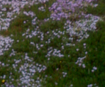
Useful facts
Highest point of the Coast Range (4097’)
Lower temperature, high precipitation (>120”/yr), high wind—snow pattern critical for invasion controls
Basaltic sill
Key research into meadow dynamics on Marys Peak from OSU graduate students Teresa Magee (1985 Invasion by Trees into a Grassy Bald on Marys Peak, Oregon Coast Range) and Billy Snow (1984 Plant communities of the Grassy Balds of Marys Peak, Oregon)
South and southwest slopes of the peak burned in 1932, did not reach the meadows
Four major meadow communities (Snow) Festuca/rubra/Agrostisdiegoensis/Carex californica;Senecio triangularis(S. triangulars, Lupinus albicaulis, grsses, sedges); Iris tenax (I. tenax, Fragaria virginiana, Maithemum stellata, Viola adunca, Festuca rubra, Carex californica); rock garden (Penstemon cardwellii, Phlos diffusa, Lomatiium martindali)
Other components: noble fir stand, Douglas fir coming up from below, vine maple on west and south sides of the Peak

Slide 9
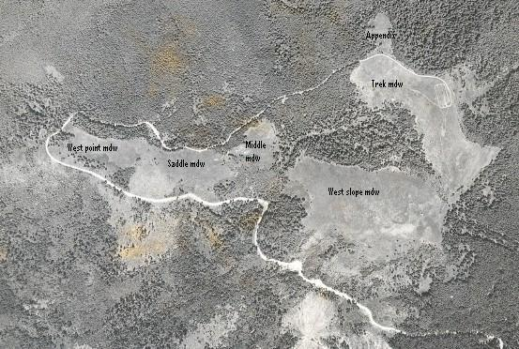
Marys Peak 1948

Slide 10
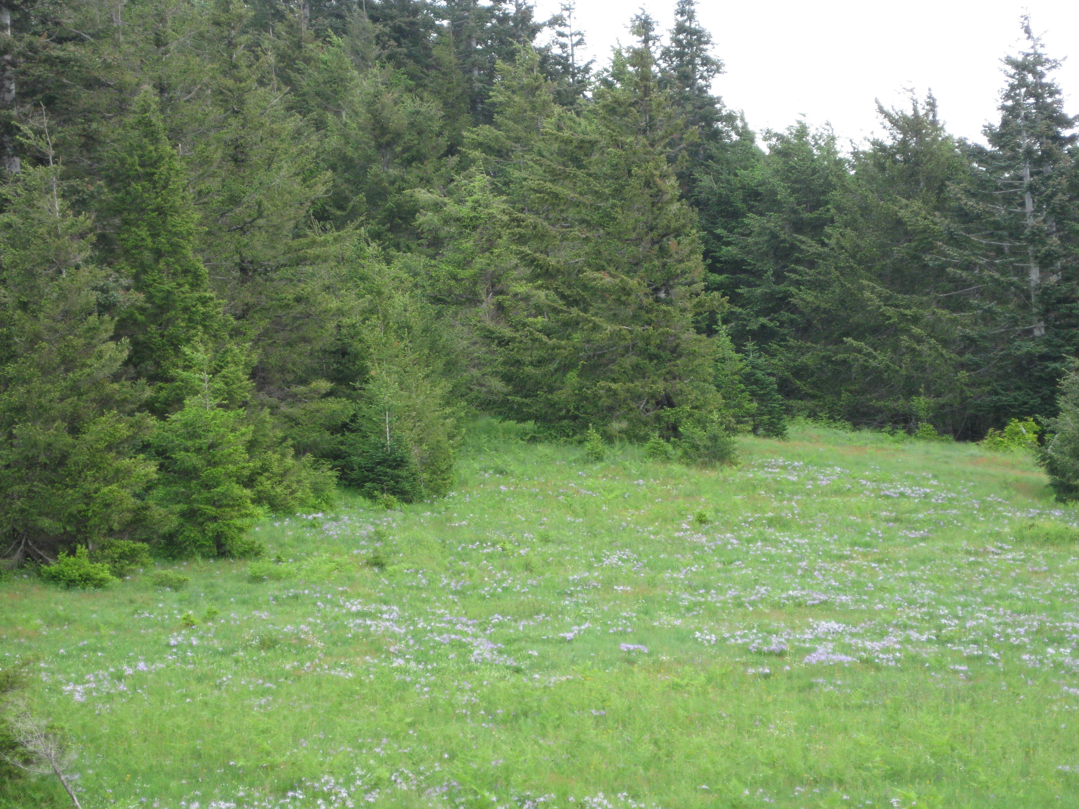
Forest meadow edge 2009

Slide 11
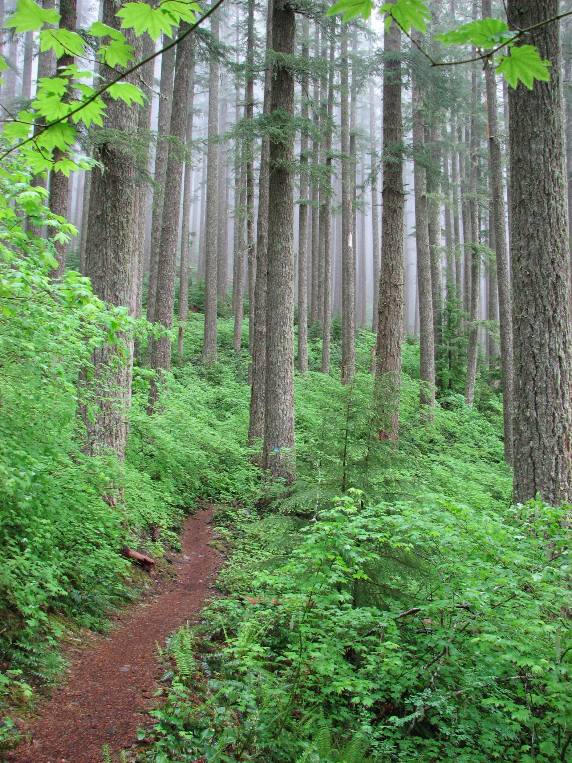
Noble fir stand: unique in the Coast Range. The Scenic Botanic Area designation recognized both forest and meadow for conservation
From groundspeak.com/waymarking

Slide 12
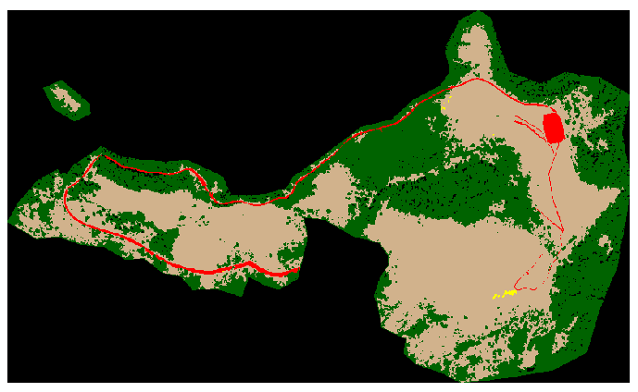
Meadow/forest 1948 (Zald)
(Harold Zald, Extent and spatial patterns of grass bald land cover change (1948-2000), Oregon Coast Range, USA—Plant Ecology 2008)

Slide 13
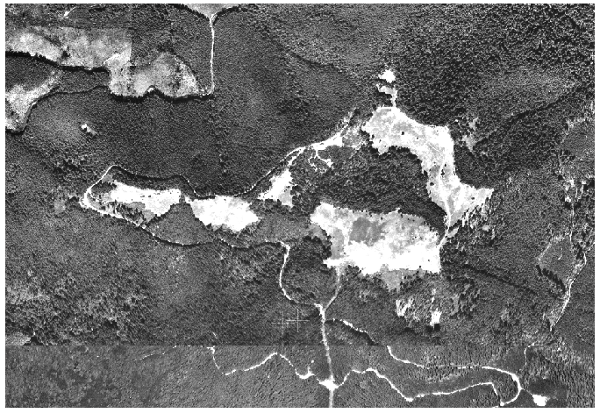
Marys Peak 1994

Slide 14
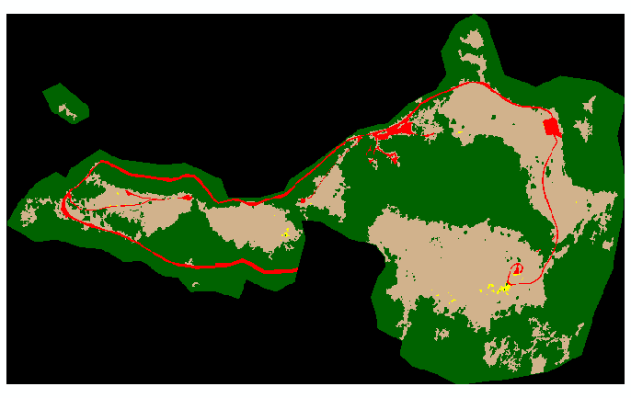
Marys Peak 1994 (Zald)

Slide 15
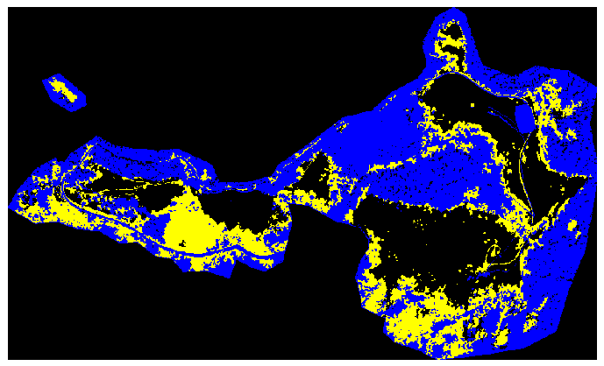
Marys Peak change 1948-1994 (Zald)
1948—293 acres 1994—191 acres; 94% of the change was bald to forest

Slide 16
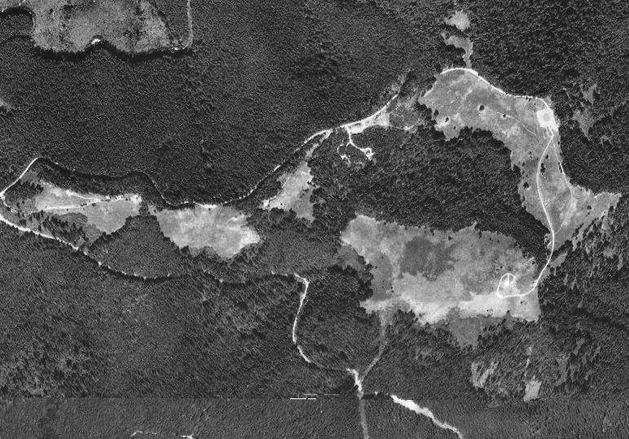
Peak NAIP imagery 2003

Slide 17
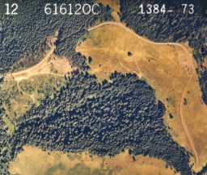
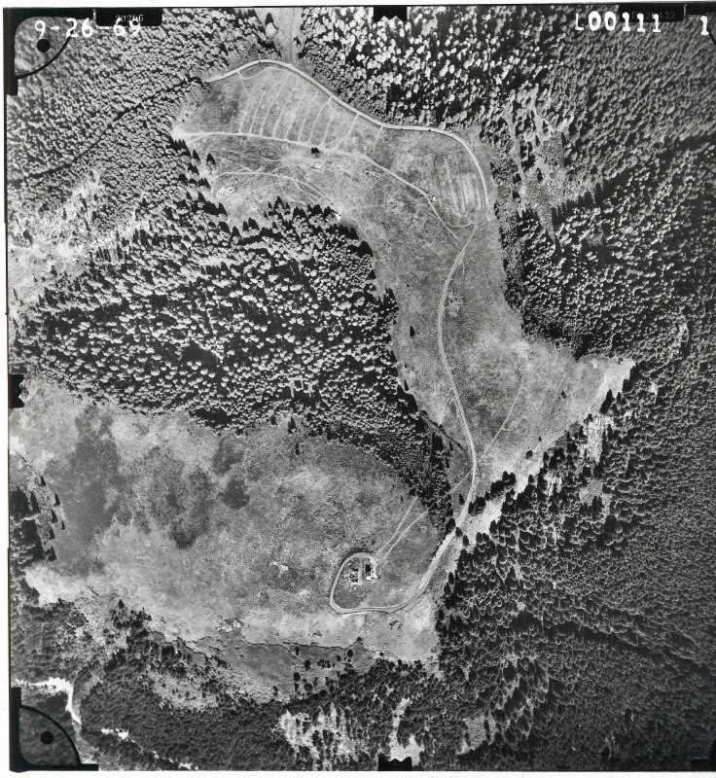
1969—Trek impact
1984-Trek meadow

Slide 18
Magee: controls on encroachment
Good establishment years: water content of spring snow pack, amount/distribution of summer precip; seed availability
Good survival: (depends on aspect, etc.)-late lying snow and/or late summer precip for dry types; moister cooler sites liked low spring snow water content
Hypotheses: 1) fir establishment enhanced on edges from decreased herbaceous competition due to shading and root competition; 2) deterioration of sod/herbaceous litter

Slide 19
But disturbance trumps?
Human influence affects encroachment rates
What would removing existing edge trees do?
How do we encourage reestablishment of the meadow vegetation in reclaimed edges?

Slide 20
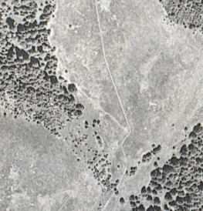
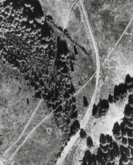
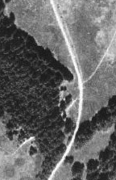
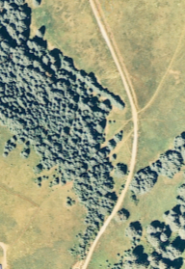
Mechanisms of invasion
1969
2003
The rope tow as pilot tree example
1948
1994

Slide 21
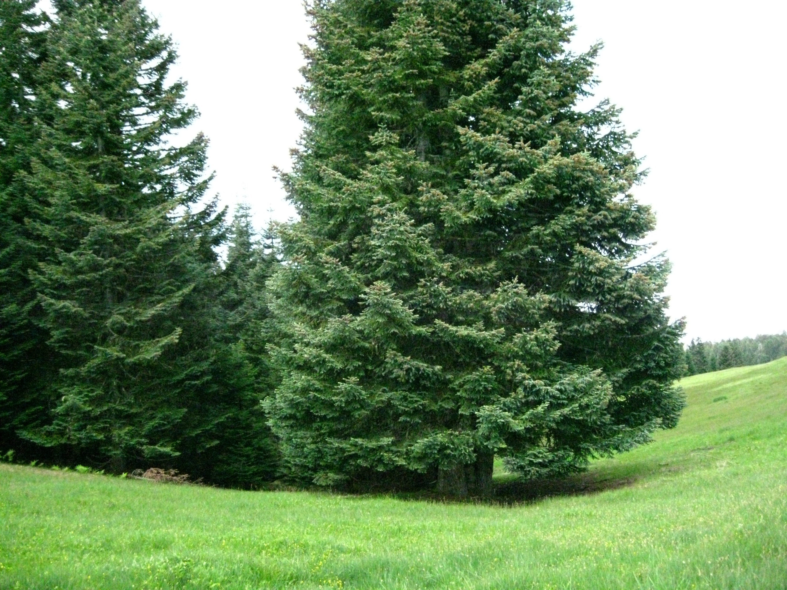
Upper end of “rope tow” noble line 2009

Slide 22
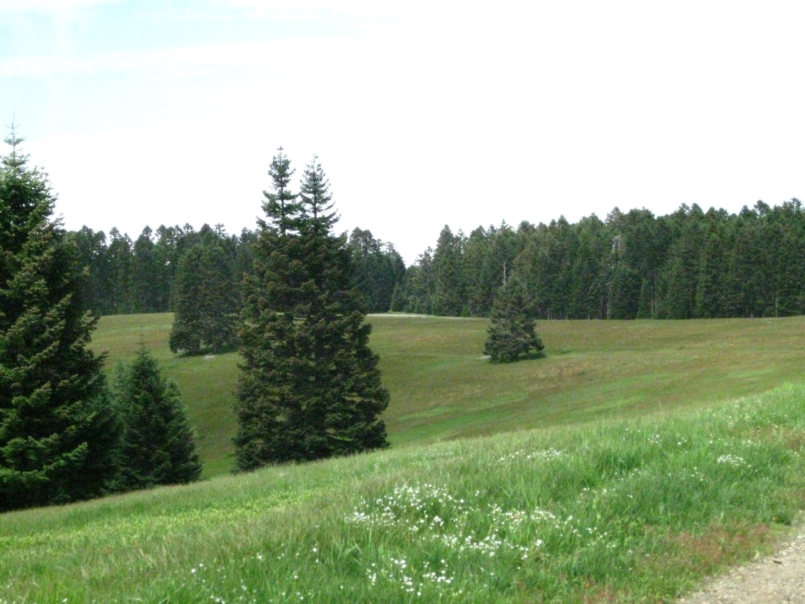
Tree islands—some pruning evident

Slide 23
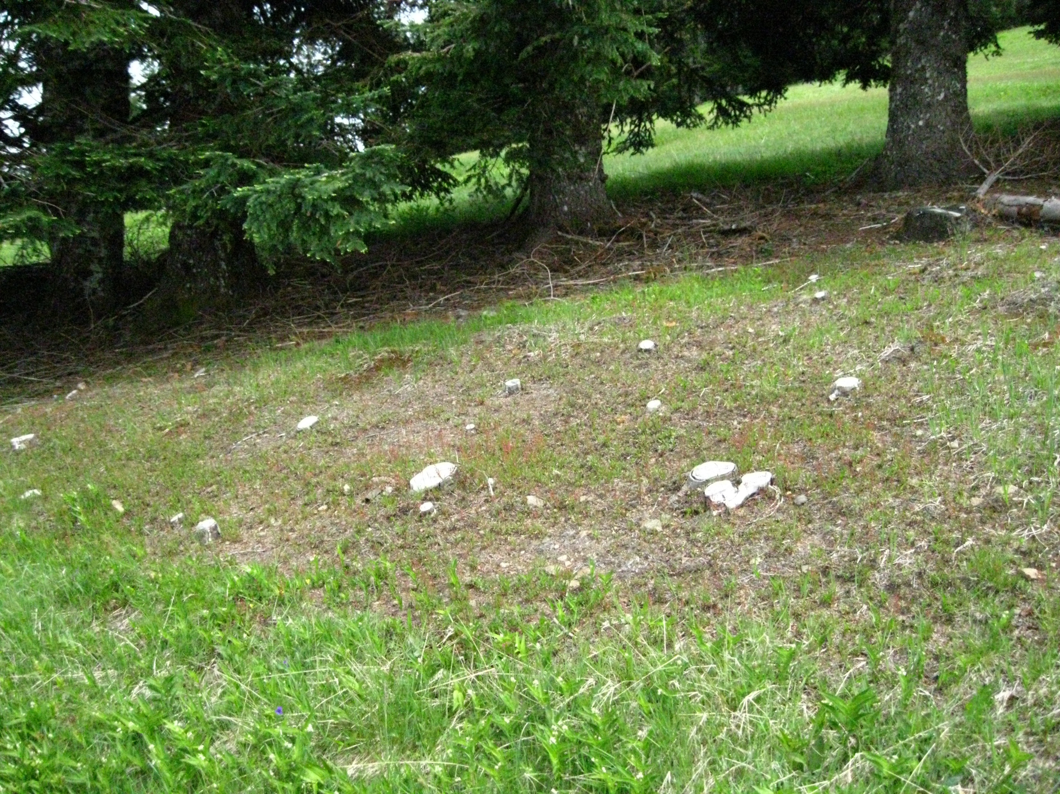
Tree island and evidence of island spread (removed 2006-7)

Slide 24
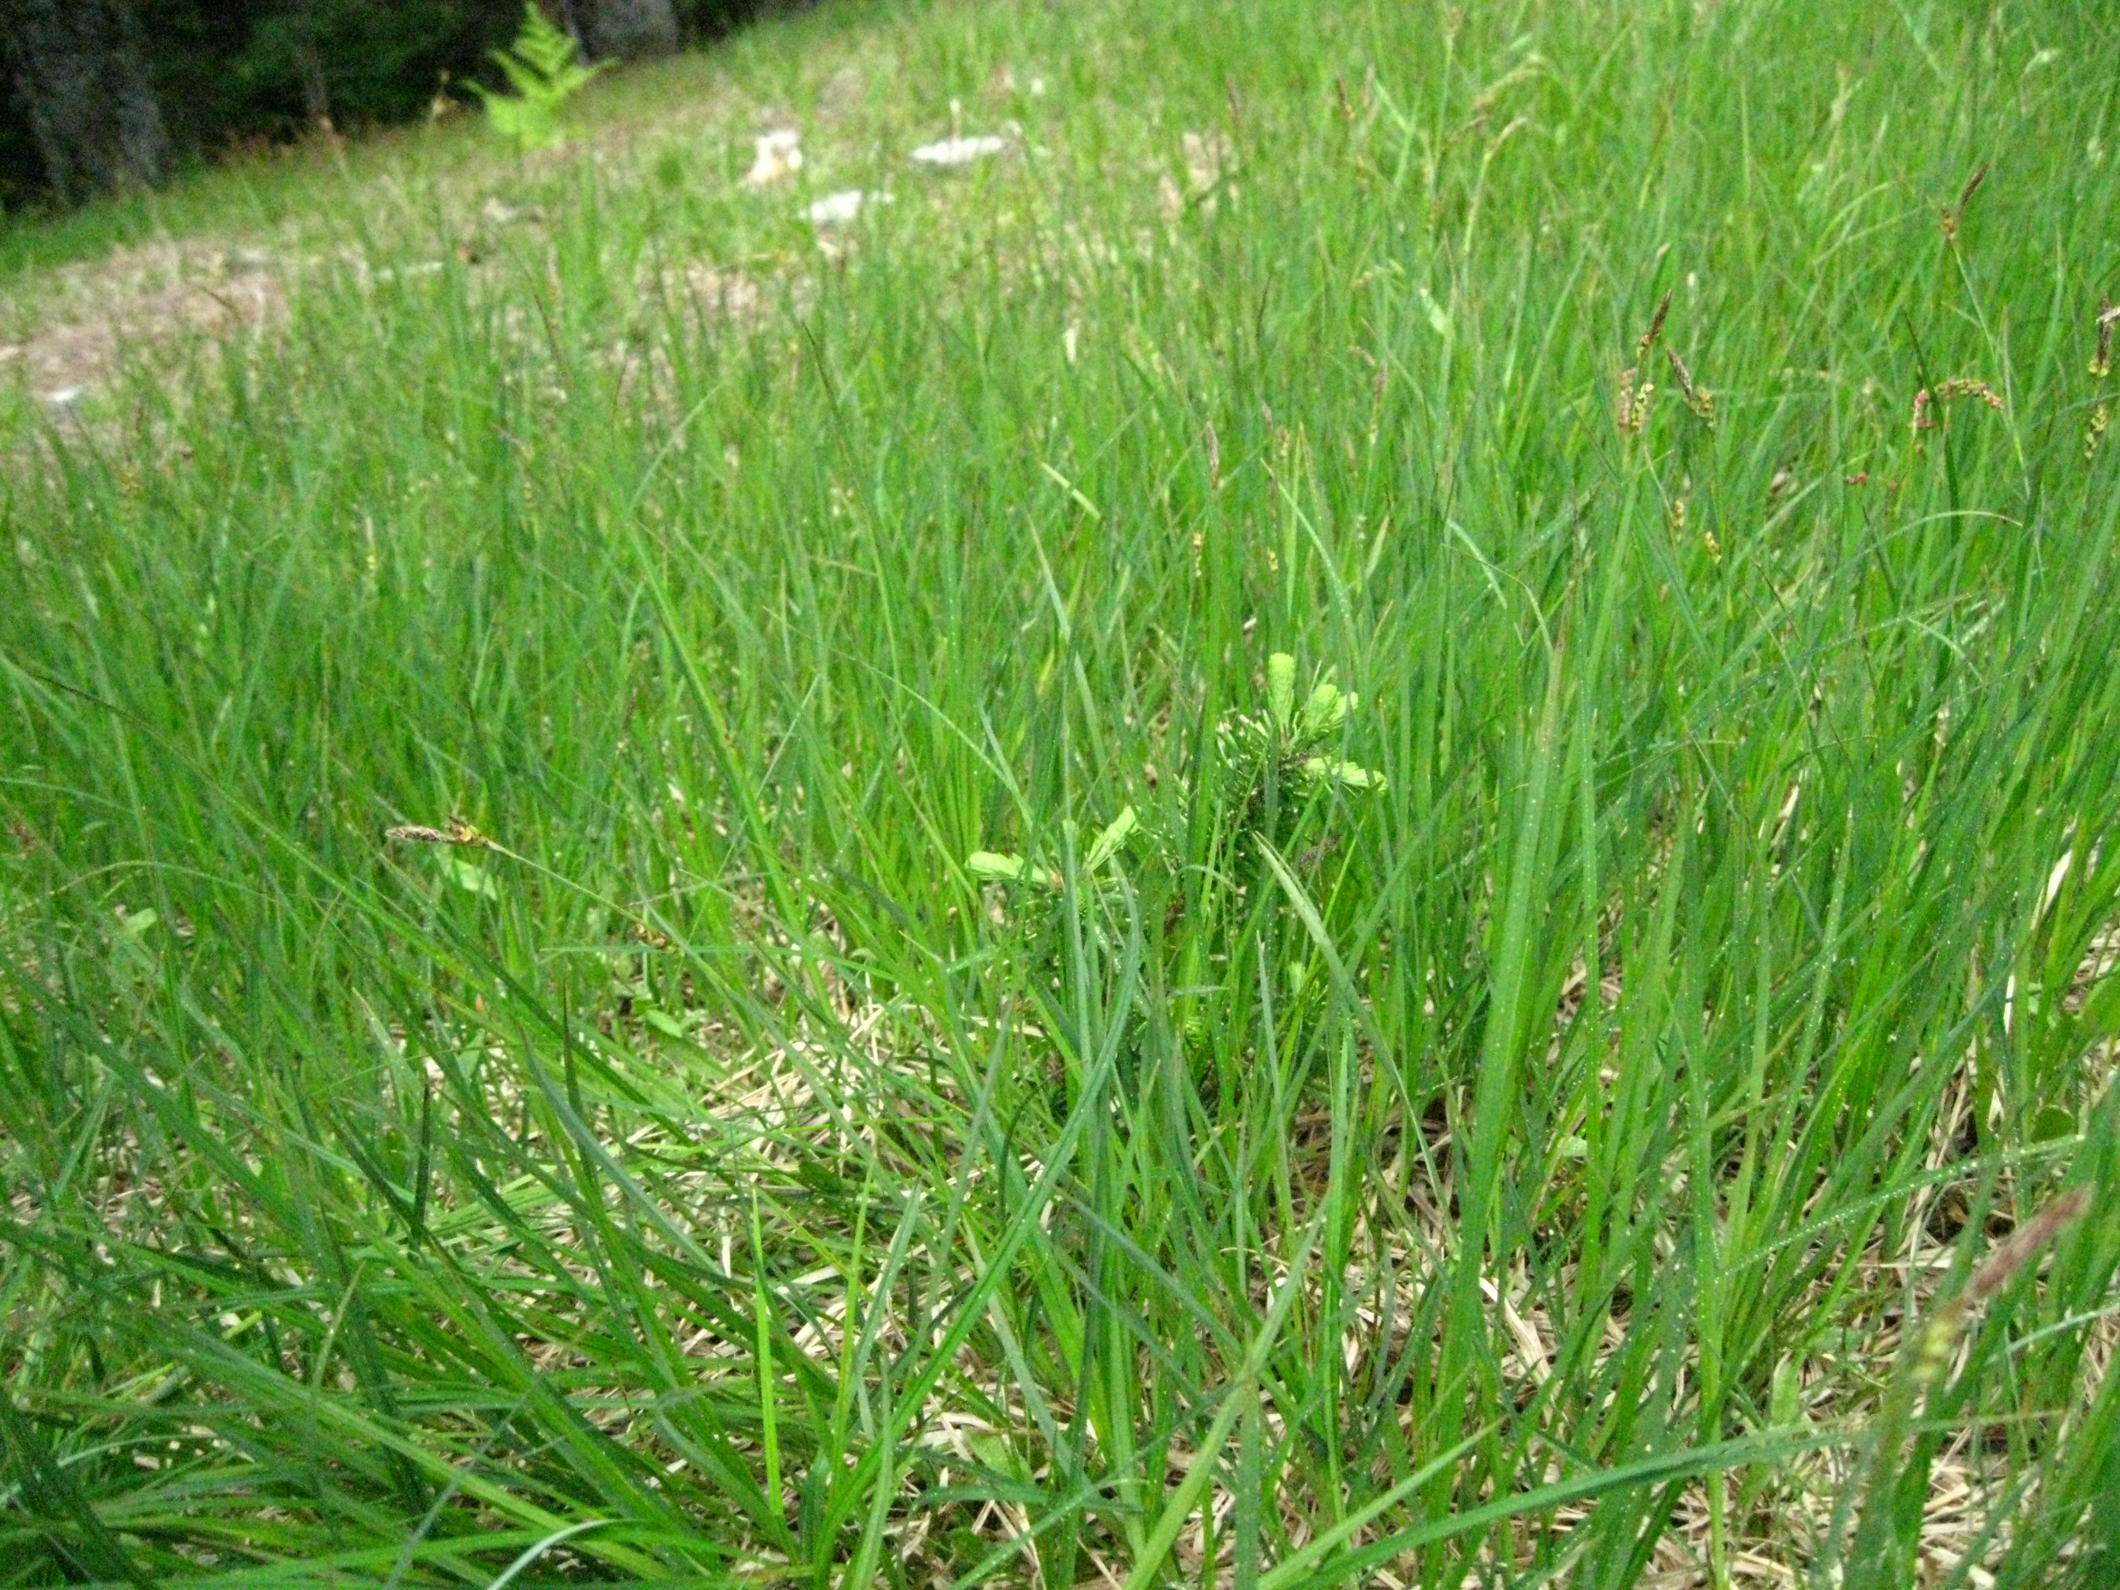
Young nobles at play

Slide 25
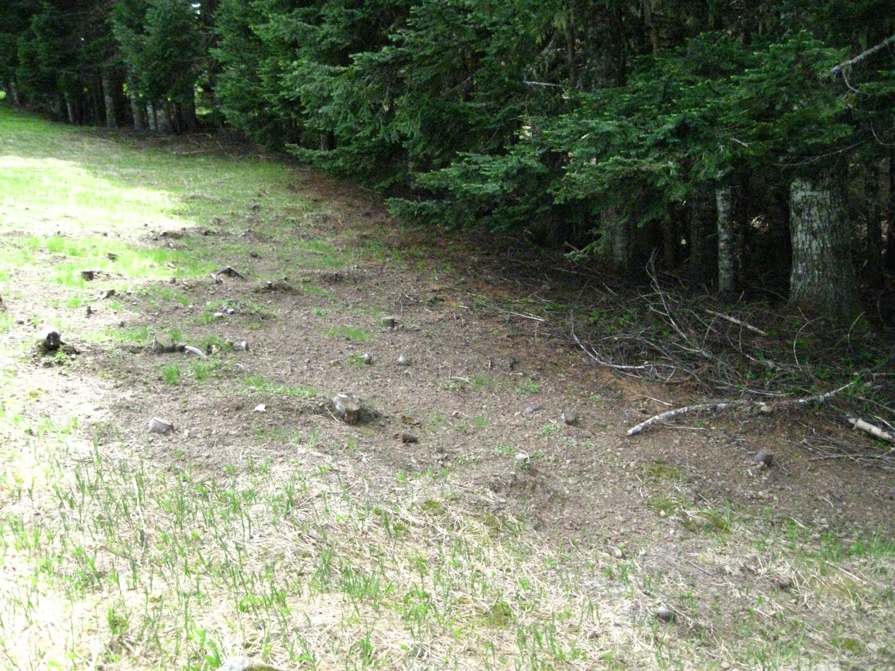
Forest edge pushed back

Slide 26
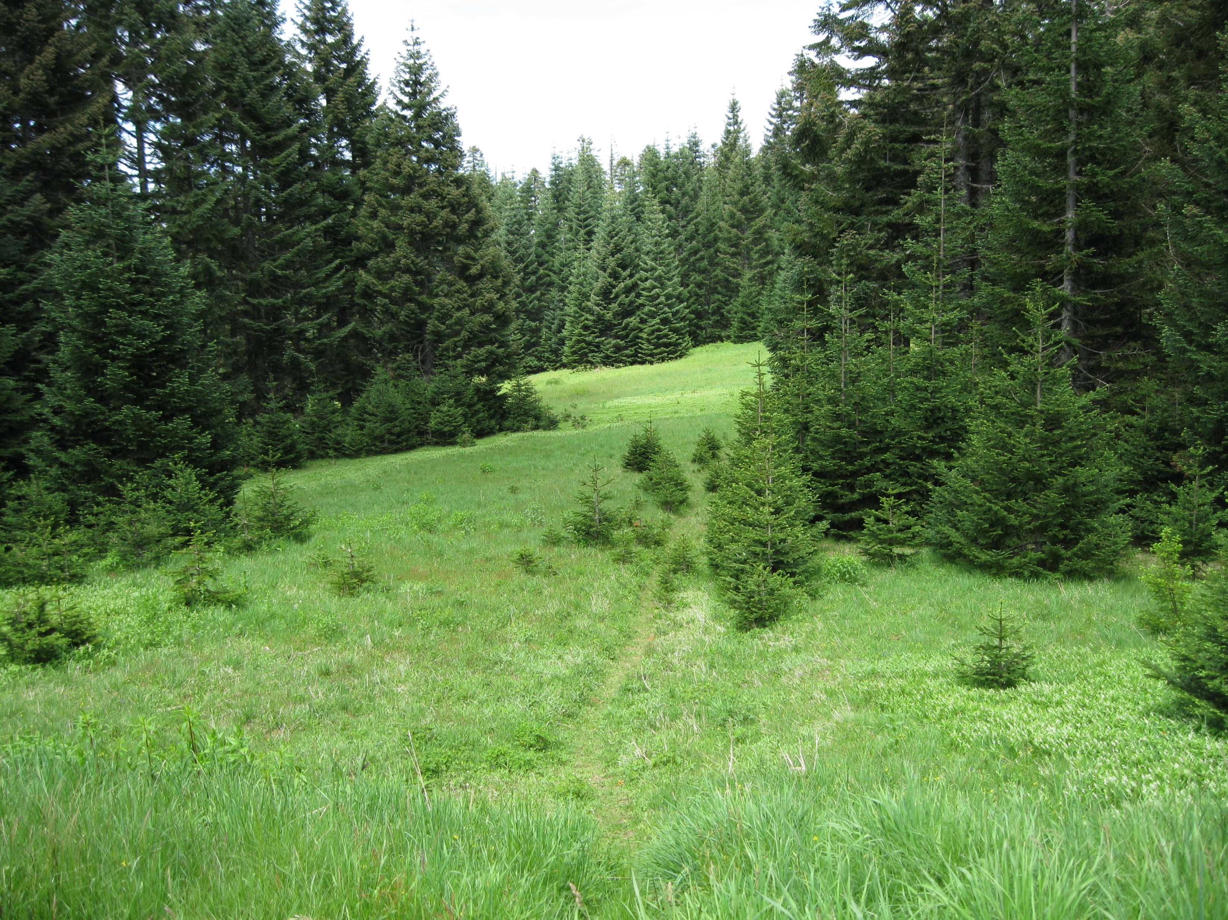
Appendix meadow tree encroachment

Slide 27
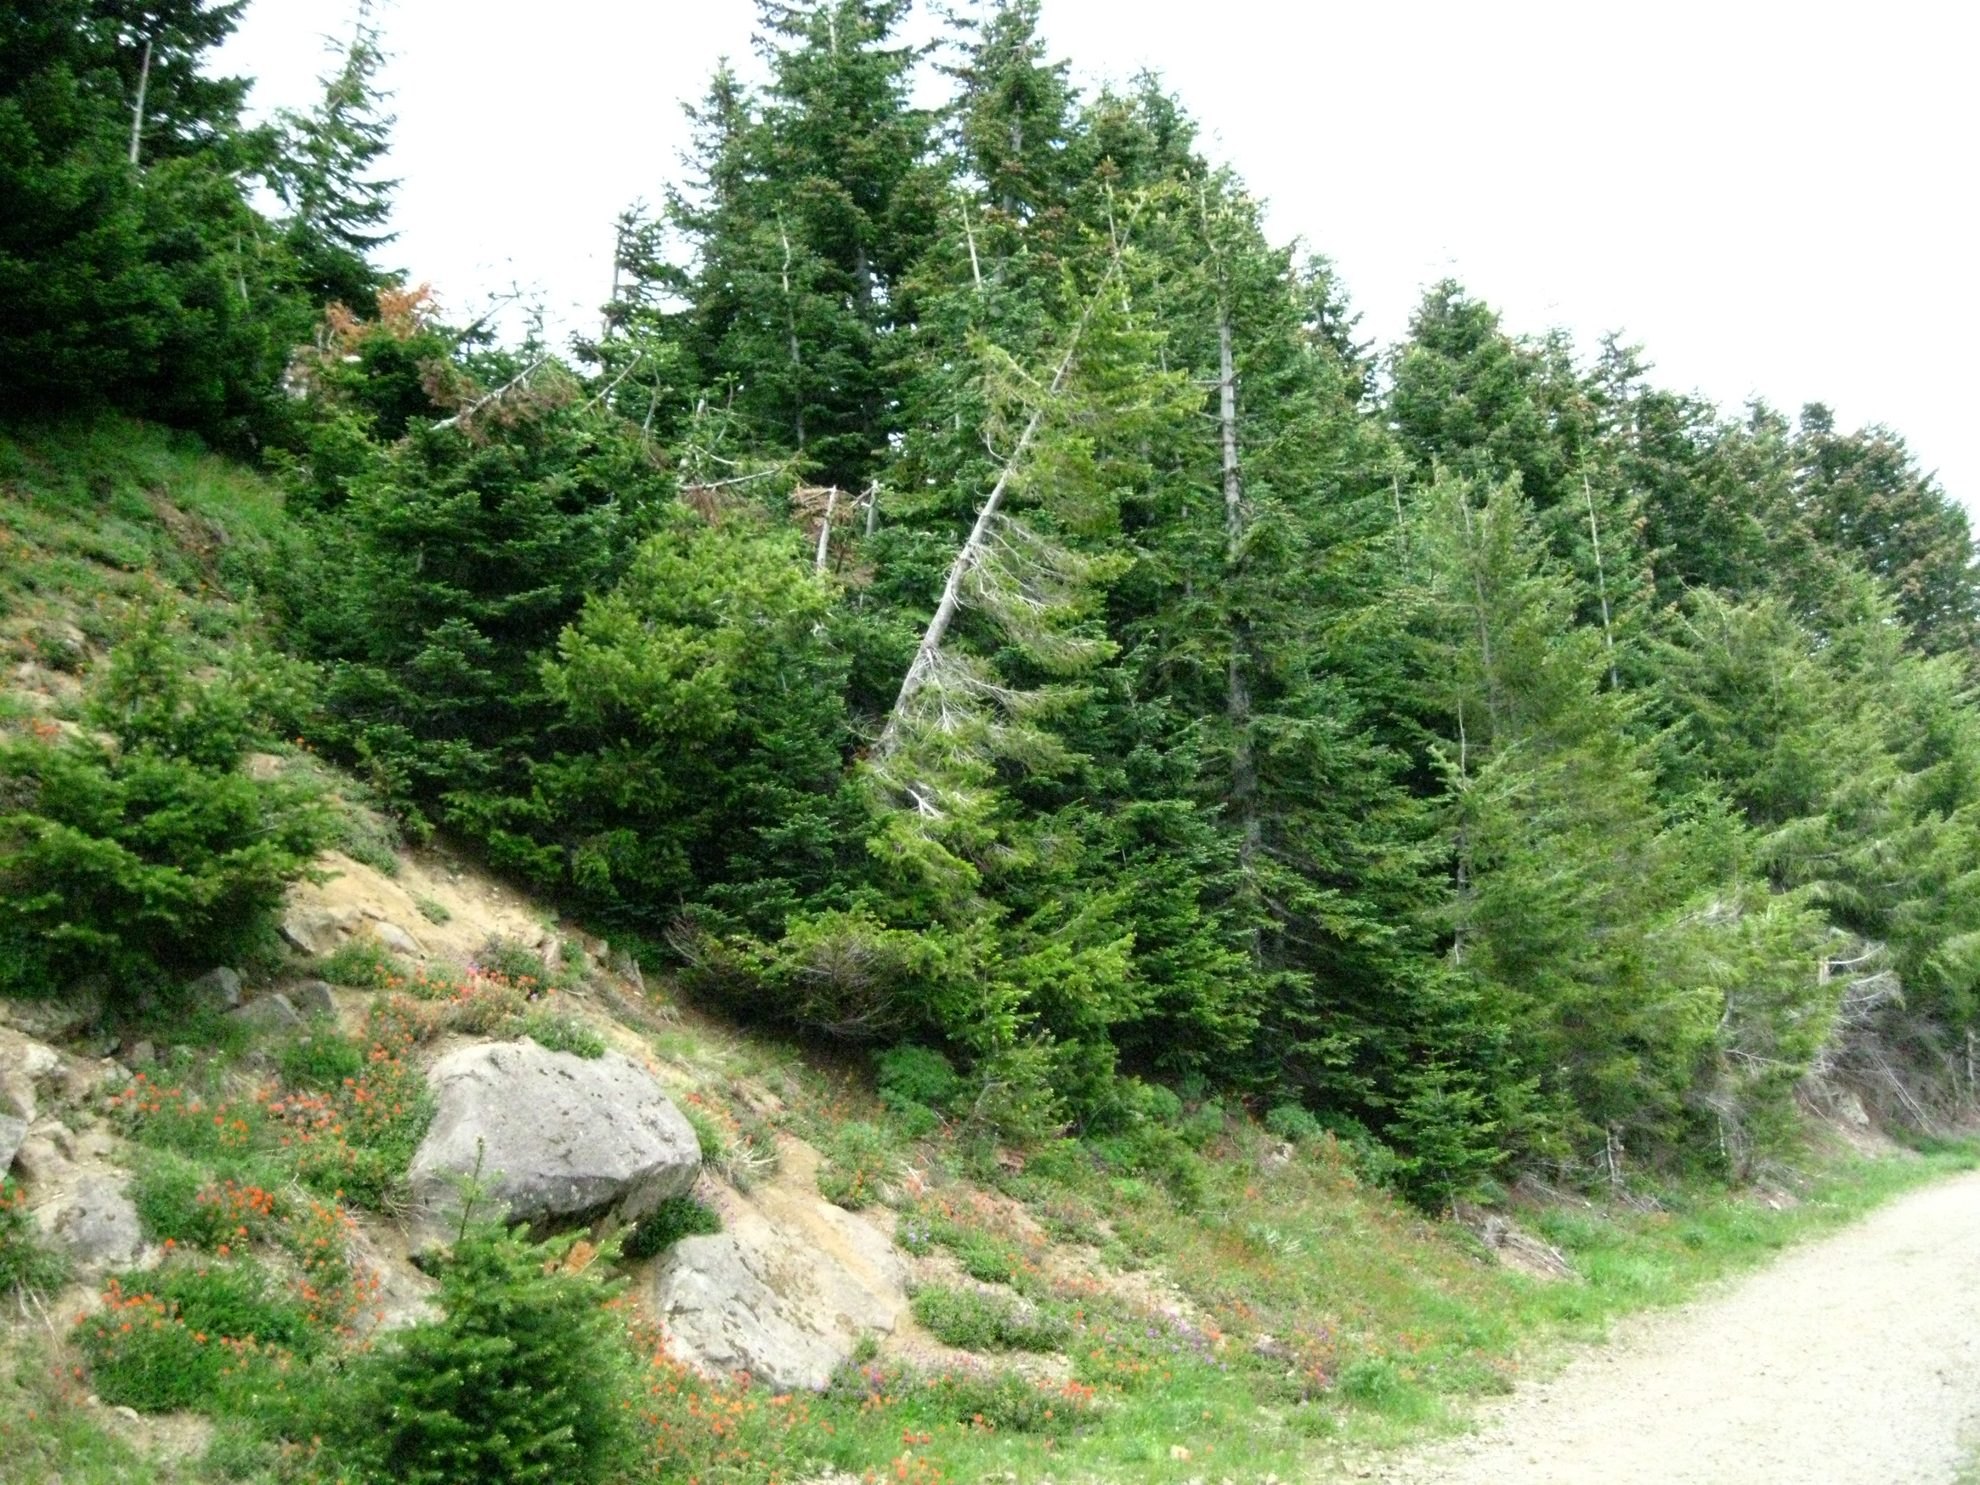
Road effects pinch Trek from West Slope meadows on BLM ownership

Slide 28
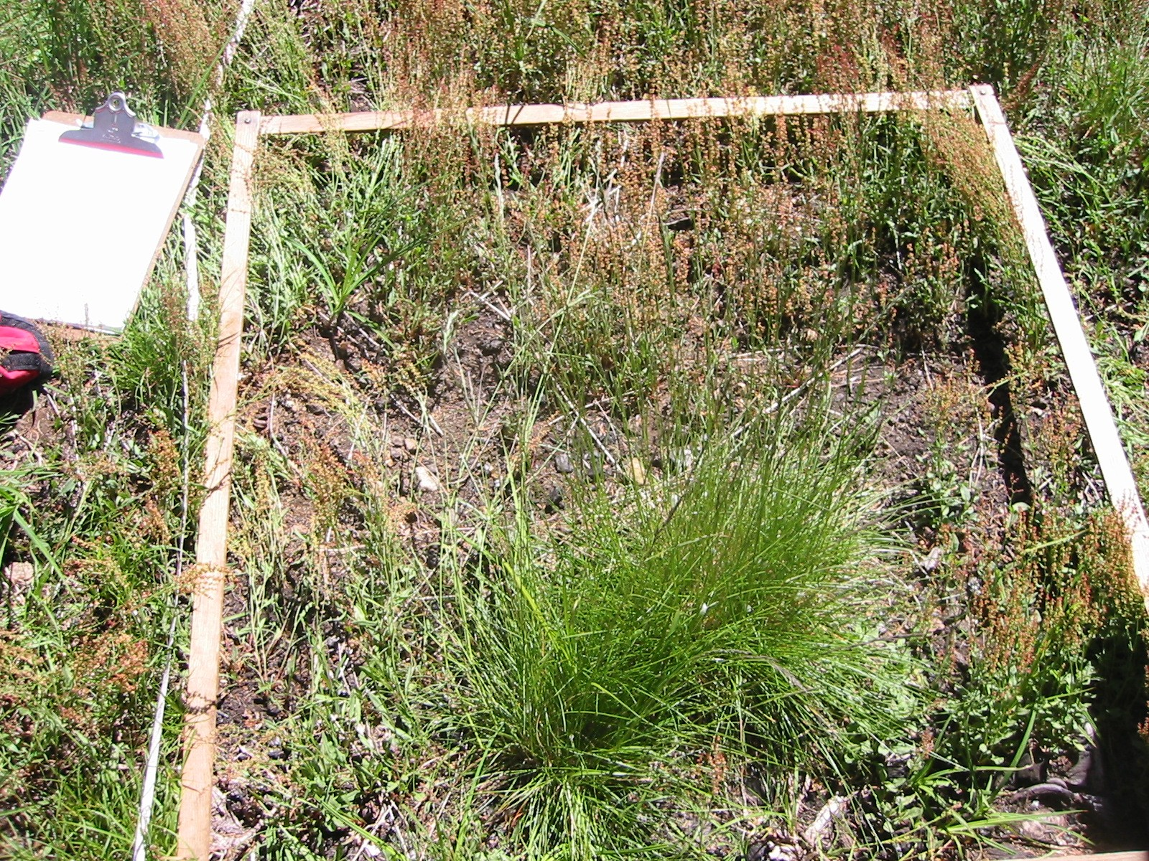
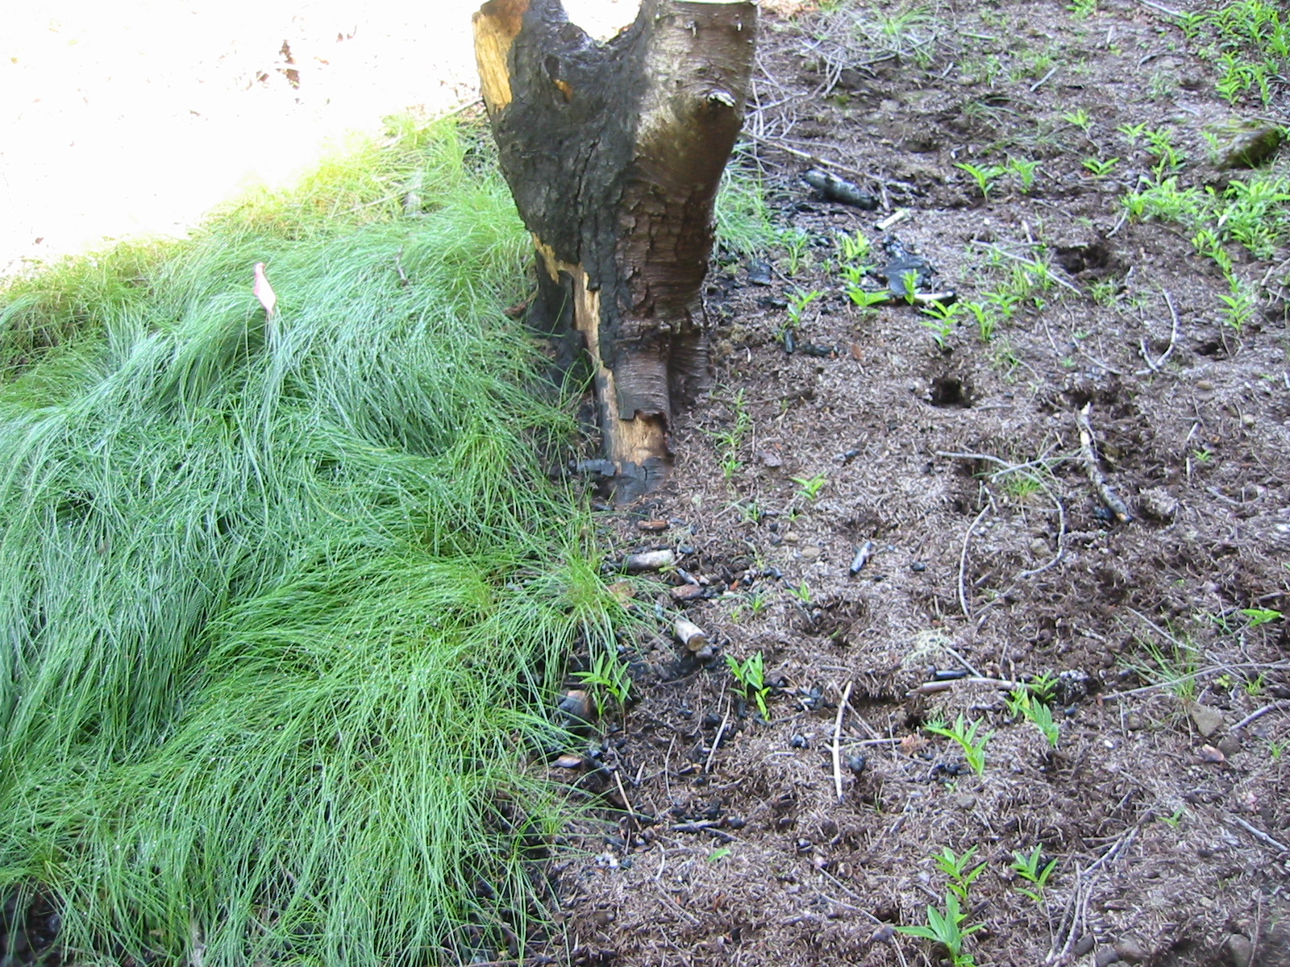
Push back
Burn piles from branches/small boles from encroaching noble firs
Seeded with native fescue collected at the Peak
Success variable

Slide 29

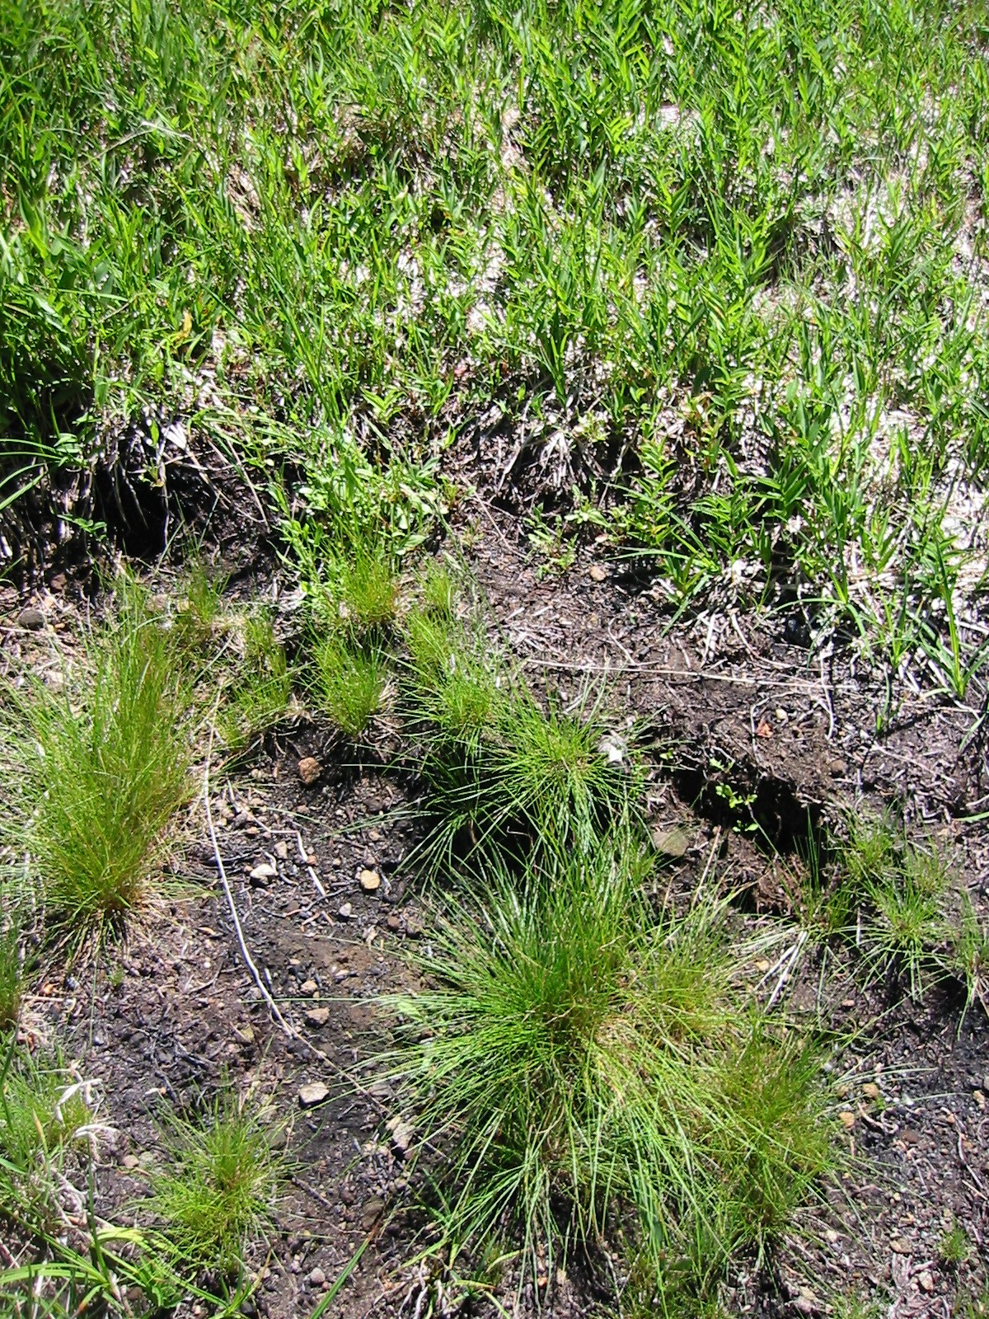
Monitoring
2007
2008
Other species begin to establish—faster in unburned plots—weedy rumex the clear winner, but natives edge in

Slide 30
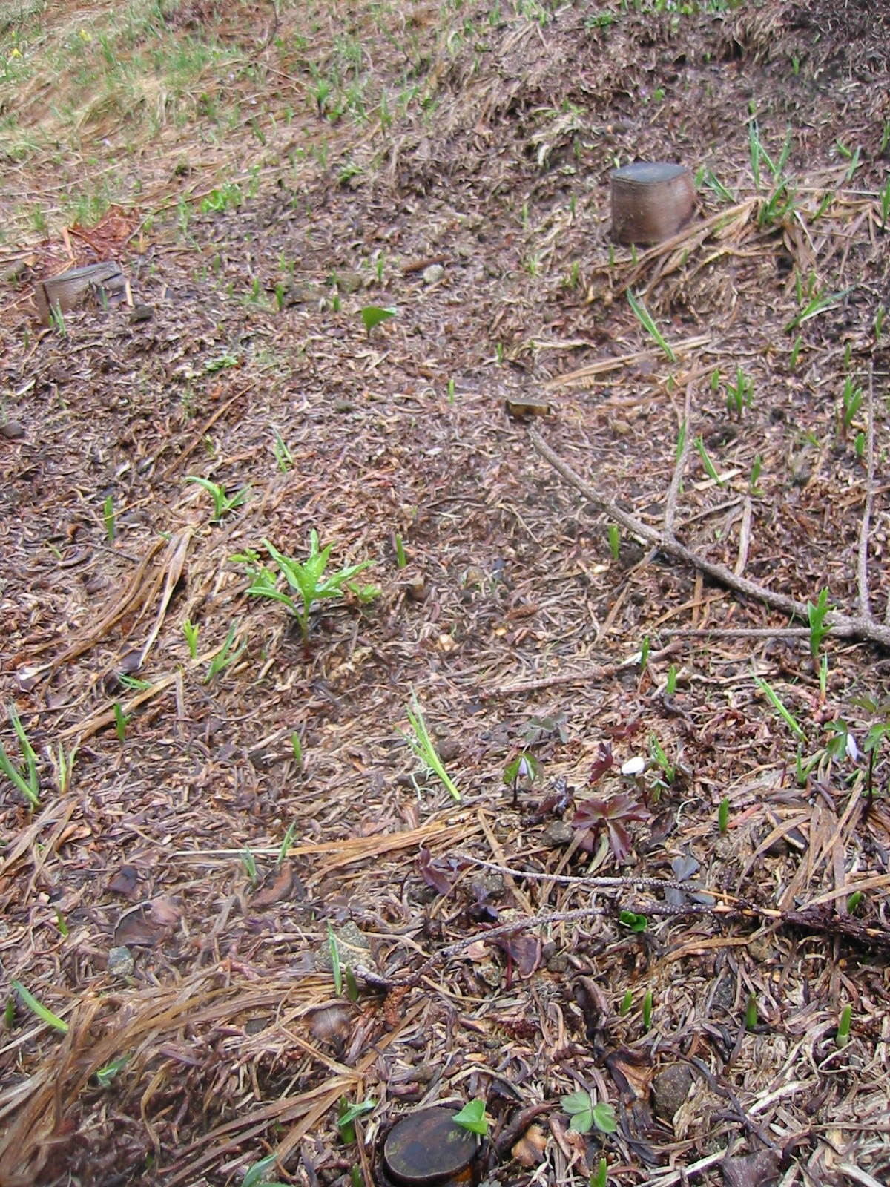
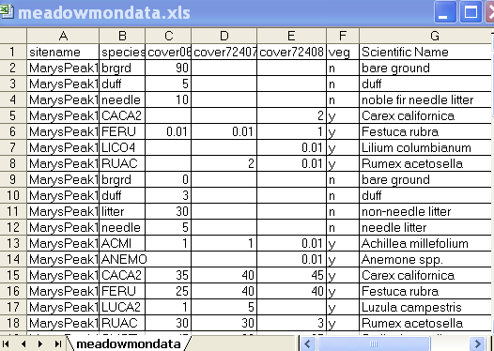
Monitoring ’06-’08

Slide 31
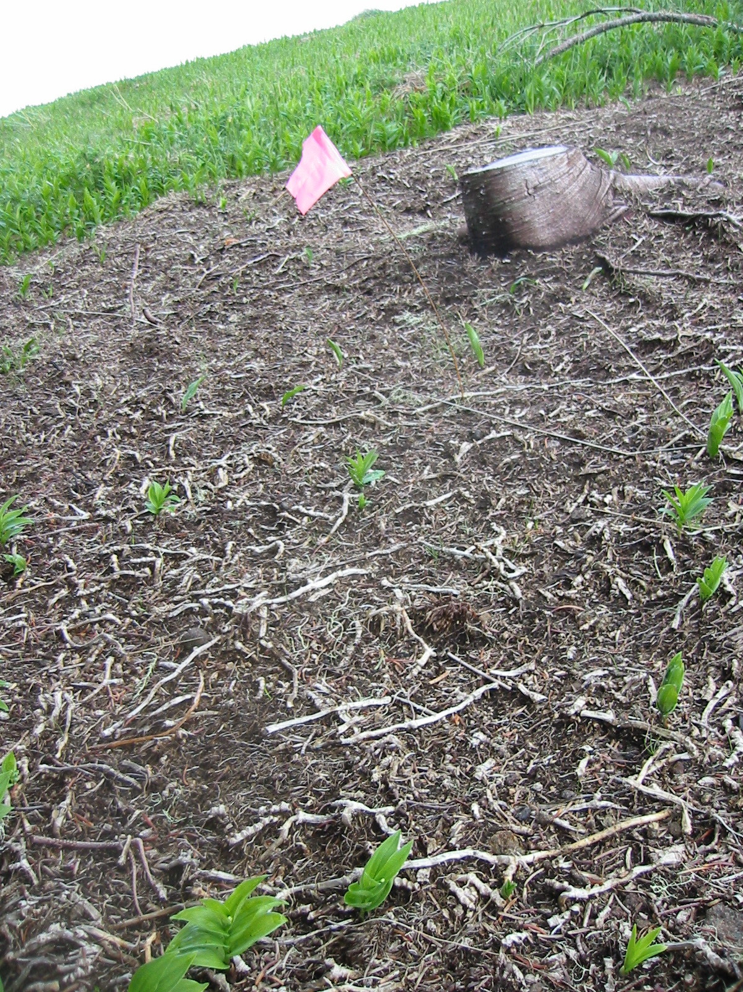
Uphill battle

Slide 32
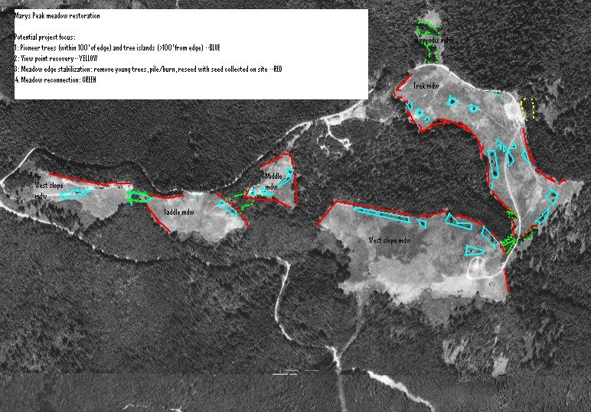
So much work

Slide 33
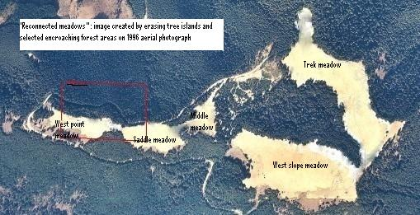
Marys Peak future? reconnected and stabilized

Slide 34
